Slide 1
NPFMC programs and actions on salmon bycatch
Diana Stram
NPFMC
April 15, 2019

Slide 2

Salmon Bycatch Programs
Management
EBS
GOA
Fisheries
EBS Pollock
Cooperative Structure
AFA
PSC limit
No limits for other trawl fisheries
Hard cap PSC limit annual level and performance standards contingent on estimate of Chinook status
  3-River index sum > and < 250,000 Chinook
Allocated by sector and season
Transferability provisions between entities
Flexibility to increase A season pollock catch to 45:55 to reduce Chinook catch
100% observer coverage
Incentive Plan Agreements designed for bycatch reduction of Chinook and chum
Fisheries
GOA pollock trawl
GOA non-pollock trawl
Cooperative Structure
Rockfish cooperative management; all other fisheries are limited access-no catch share programs
PSC limit
Hard cap PSC limits in CGOA and WGOA trawl fisheries
NMFS has authority to reallocate between fisheries based on need and availability. Limited to 50% of initial cap.
Observer coverage is partial
No measures for chum salmon
No mandatory excluder use
Pollock
CGOA 18,316
WGOA 6,683
Non-pollock
CV 2,700
CP 3,600
Rockfish 1,200

Slide 3
Salmon Bycatch Programs
EBS Pollock
GOA Pollock
GOA non-pollock trawl
Salmon enumeration and genetics sampling
Full retention
EM monitoring provisions to ensure full accountability
Census of salmon
Systematic genetics sampling
Full retention
Census shoreside when observed
Opportunistic genetic sampling
Full retention
Voluntary census
Systematic genetics sampling
Annual Reports to Council
AFA Coop Report
Monitoring
Salmon #s
CGOA rockfish coop report
Monitoring
Salmon by season
IPA reports
Measures to reduce Chinook bycatch at all levels of abundance
Measure to reduce chum
Genetics reports
GOA rockfish and ATF fishery chinook genetics
Chum genetics (what fisheries?)
Genetics reports
Chinook
Chum

Slide 4
Bering Sea pollock Incentive Plan Agreements (IPAs)
IPAs for each sector
Mothership SSIP
CV SSIP
CP IPA (includes CDQ)
Provisions for:
Reduce bycatch at all levels of abundance
Chum bycatch measures (hot spots)
Mandatory excluder usage
Additional constraints on high bycatch vessels

Slide 5
Industry efforts in bycatch management: SeaState

Slide 6
Salmon Incentive plan agreements as for 2019
All sectors are participating under different incentive plans (CDQ and C/Ps are in the same plan.
All plans include both chinook and chum
All plans operate at the individual vessel level or processing platform level. This means that there are allocations to vessels in the case of chinook and vessel (or mothership) level bycatch rate determine access to bycatch avoidance areas (new term for what used to be called “closures”).
All plans contain triggers to shift closure emphasis to chinook anytime chinook rates are higher than chums. CP/CDQ plan allows concurrent chinook and chum closures E/W of 168 W (e.g. a chinook closure E of 168 and a chum closure W).
Allocation of chum closure areas may be dependent on GSA results on WAK/Yukon likelihood; Sea State refers to cluster ratios from NOAA Technical memoranda.

Slide 7
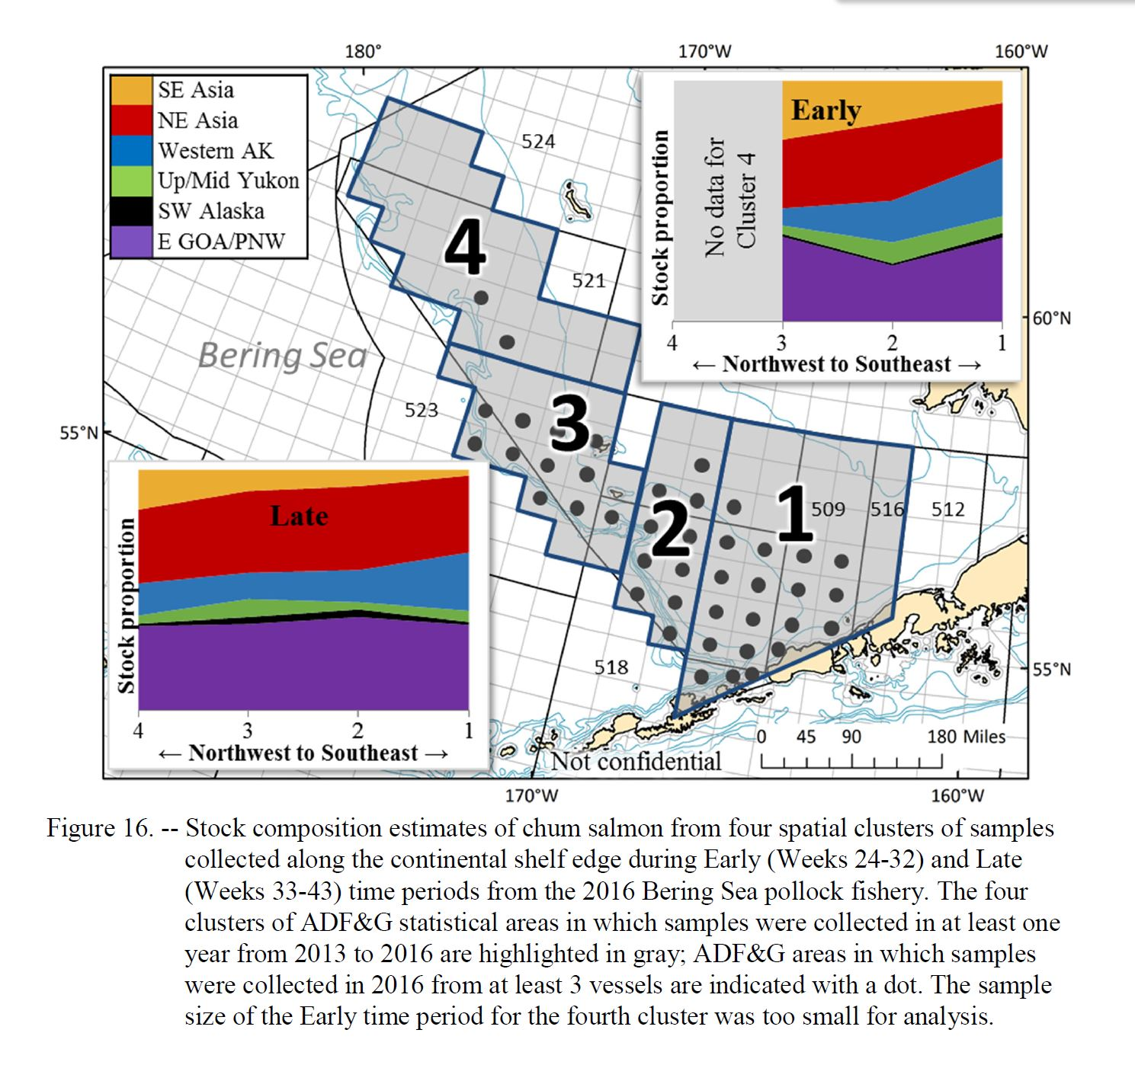
From: Genetic Stock Composition Analysis of Chum Salmon from the…2016 Bering Sea…Fisheries, Whittle, et al.

Slide 8
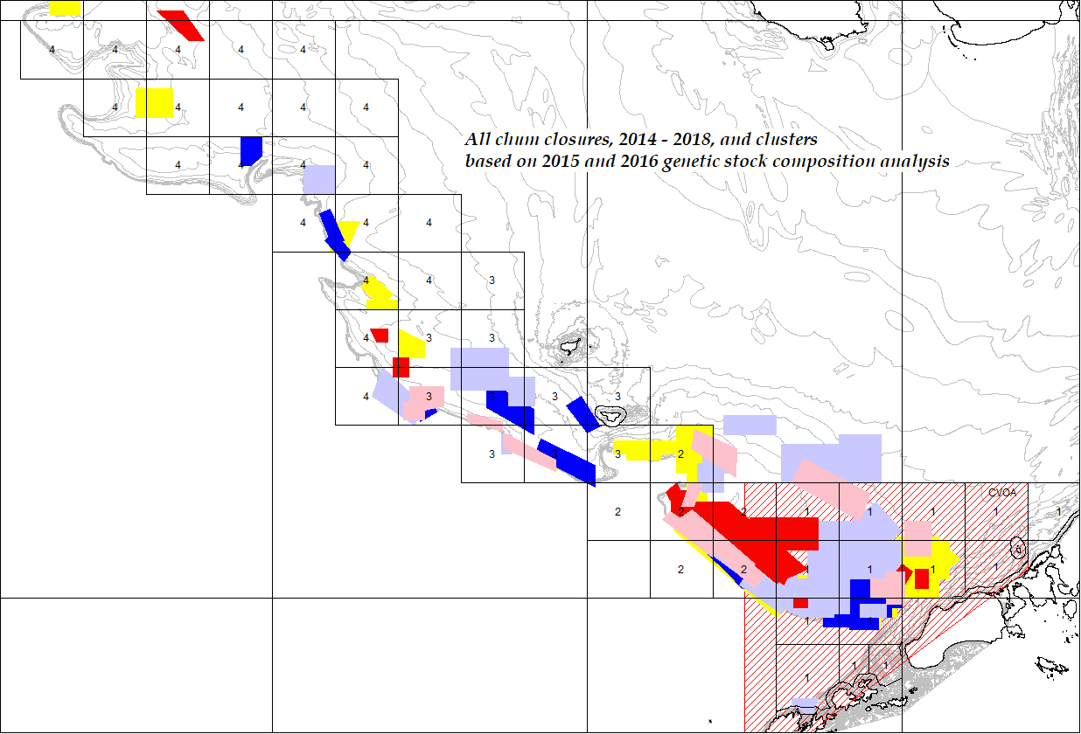
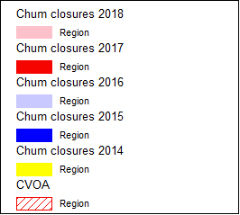
Chum closures, 2014 – 2018, relative to genetic clusters and CVOA

Slide 9
Proportions of WAK+Yukon chum stocks from 2015 and 2016 pollock fishery bycatch samples.
Most chum closures are in Clusters 1 or 2 and tend to be in the “early” designation (before mid-August).
Cluster | 1 | 2 | 3 | 4
Early 2015 | 0.32 | 0.17 | 0.24 | 0.11
Early 2016 | 0.31 | 0.26 | 0.10
Late 2015 | 0.21 | 0.06 | 0.18 | 0.03
Late 2016 | 0.29 | 0.16 | 0.18 | 0.17

Slide 10
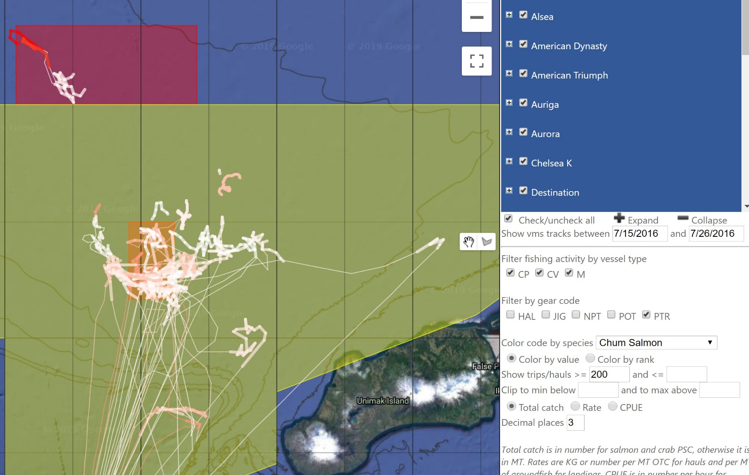
Closure analysis: VMS track data and subsequent closure for high bycatch (>200 chums) hauls or trips. Chum closures 7/26/16

Slide 11
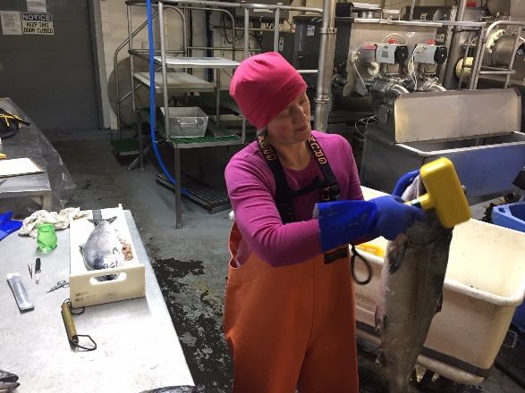
Salmon bycatch in Kodiak Trawl Fisheries
Industry Controls and Cooperative Research

Slide 12
Chinook bycatch: ROckfish
  Annual Chinook salmon cap for the shoreside rockfish program co-ops is 1,200 salmon (implemented in 2015) Season is May 1 – Nov 15.
  Rockfish Program (RP) is a cooperative catch share program which allows for more internal controls and vessel accountability. Vessels are 100% observed.
  Total fish ticket count across all deliveries assumed to be similar to NMFS CAS estimate even though FT counts are from plant personnel and CAS estimate from observer at-sea samples. Unlike in the pollock fisheries, there is no observer census count at the plants.

Slide 13
Chinook bycatch: ROckfish
Chinook salmon bycatch avoidance and hot spot reporting for Rockfish Co-ops:
  “Slow start” to test fishing grounds – each co-op sends 1 or 2 vessels to test the grounds at the start of the fishery.
  Mandatory Chinook salmon hotspot reporting (vessel is named in reports sent to fleet).
  Individual vessel Chinook salmon bycatch standards – monitored and enforced by fish ticket counts (red, yellow, green).
  Intercoop manager (AGDB) has the ability to stop the fishery if bycatch dangerously high (as in 2013 prior to implementation of co-op salmon avoidance measures).

Slide 14
NOAA Saltonstall-Kennedy Grant
$183,000 NOAA Grant. Field Seasons 2018 and 2019. Phase I took place May- June 2018; Phase II starts May 1, 2019
Partners: AGDB, Craig Rose (FishNext Research), NMFS AK Region and NP Observer Program
Title: Improving Chinook Salmon Bycatch Estimates for the Gulf of Alaska Trawl Fleet: Alternatives addressing accuracy, cost, and timeliness
Goal is to test alternative shore-based sampling methods to monitor and improve estimates of Chinook salmon bycatch in the non-Pollock fisheries.
Alternatives include monitoring large samples dockside (up to 50% of the landed catch); salmon census at the plant by observers and/or plant personnel; and sorting and sampling the entire offloaded catch by plant personnel with third party auditing via EM (electronic monitoring).
Phase I results: observers are effective at conducting censuses, but it is highly laborious, with logistical difficulties. The EM portion showed that a high percentage of salmon could be detected on video. For 3 of the 4 plants, video detected 83-90% of the salmon; at one plant, video detected only 25-50% (poor camera position and lighting). Sampling large portions of the delivery at the plants not feasible.
Phase II: Improve video performance (EM systems, video quality, camera placements, lighting). Test EM to assure plant compliance, allowing NMFS to use plant-reported salmon catches with confidence. Also, collect salmon images for computer automated detection.

Slide 15
Cooperative Research: Rockfish Genetics
Since 2013, the shoreside co-ops have partnered with the North Pacific Groundfish Observer Program, NMFS Alaska Region and NMFS Genetics Lab in Auke Bay to collect tissue samples and biological data from all Chinook landed in the shoreside rockfish fishery for Stock of Origin analysis.
All Chinook were also examined for the presence or absence of adipose fin clips and Coded Wire Tags (CWT). Snouts with positive signal sent to Auke Bay.
Otoliths were collected in 2017 and 2018 in an attempt to quantify the hatchery component (samples processed by Thermal Mark Lab, Alaska Department of Fish and Game). ~8% are thermal marked.
Project funded by the North Pacific Fisheries Research Foundation.
Project will continue in 2019.

Slide 16
Cooperative Research: Rockfish Genetics results 2013-2017
Area | 2013 Rockfish | 2014 Rockfish | 2015 Rockfish | 2016 Rockfish | 2017 Rockfish
No. Samples Processed | 2,070 | 398 | 635 | 493 | 480
Russia | 0.0% | 0.1% | 0.0% | 0.0% | 0.0%
Coast W AK | 0.0% | 0.3% | 0.1% | 0.5% | 0.1%
Mid Yukon | 0.0% | 0.0% | 0.0% | 0.0% | 0.0%
Up Yukon | 0.0% | 0.0% | 0.0% | 0.0% | 0.0%
N AK Pen | 0.0% | 0.0% | 0.0% | 0.0% | 0.0%
NW GOA | 2.2% | 3.2% | 2.7% | 3.7% | 2.7%
Copper | 0.3% | 0.1% | 0.8% | 0.3% | 2.4%
NE GOA | 0.0% | 0.1% | 0.0% | 0.3% | 0.0%
Coast SE AK | 6.4% | 7.1% | 4.8% | 6.9% | 10.9%
BC | 31.3% | 17.4% | 18.9% | 26.8% | 28.1%
West Coast US | 59.9% | 71.7% | 72.8% | 61.5% | 55.6%
SE, BC,WC combined | 97.6% | 96.2% | 96.5% | 95.1% | 94.7%
Total | 100.0% | 100.0% | 100.0% | 100.0% | 100.0%
4,076 samples processed since 2013 plus another 504 collected in 2018

Slide 17
Chinook Bycatch: pollock
For the Central Gulf, annual cap for pollock fishery is 18,316 Chinook.
Caps implemented in 2012.
Gulf pollock fisheries are NOT managed under catch share programs as in the Bering Sea but instead as limited access fisheries (race for fish).
Vessel observers conduct a salmon census at the plants for their deliveries. There are no plant observers.
Gulf pollock vessels are not 100% observed (they are in the partial coverage sector). Observed rate in the GOA in 2019 is about 24%.
PSC rates from observed vessels extrapolated out to unobserved catch by target, area and gear.

Slide 18
Chinook Bycatch: pollock
Chinook salmon hot spot reporting for pollock fisheries:
  Voluntary hotspot reporting and timely operator notification of Chinook catch by delivery. 25 Chinook is the trigger for an alert. Most operators agree to provide detailed information for the Chinook bycatch hotspot reports when asked: date/time, gear, lat/long, depth, excluder use. Alerts are sent to fleet and processors but vessel is not named. Plants assist in monitoring. Most boats avoid hotspots but not always. Some operators refuse to reveal location details.
  For voluntary pollock catch share plans, Chinook PSC is allocated to the vessels pro-rata and the different processor co-ops may implement and enforce their own vessel standards/penalties.
  No ability to stop the fishery if bycatch deemed too high except on voluntary basis which has never happened.

