Slide 1

Primer on
Genetic Mixed Stock Analysis
Chris Habicht
Alaska Department of Fish and Game, Gene Conservation Laboratory
NPFMC Salmon Bycatch Workshop
April 15, 2019

Slide 2
Outline
  How MSA works
  Review of sampling and genetic errors

Slide 3
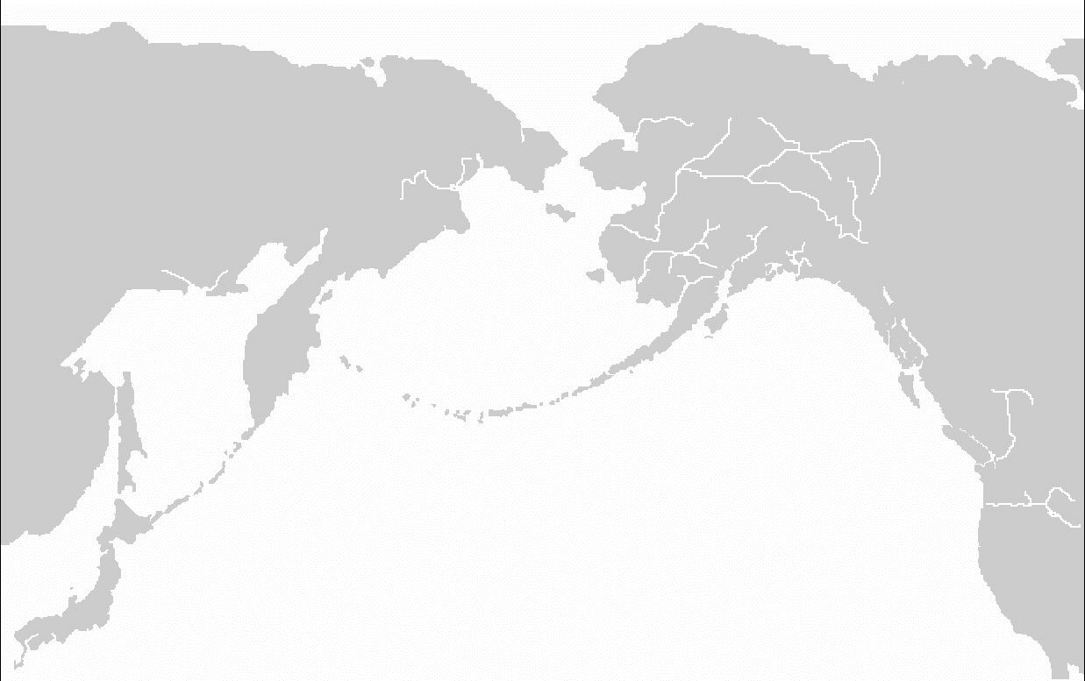
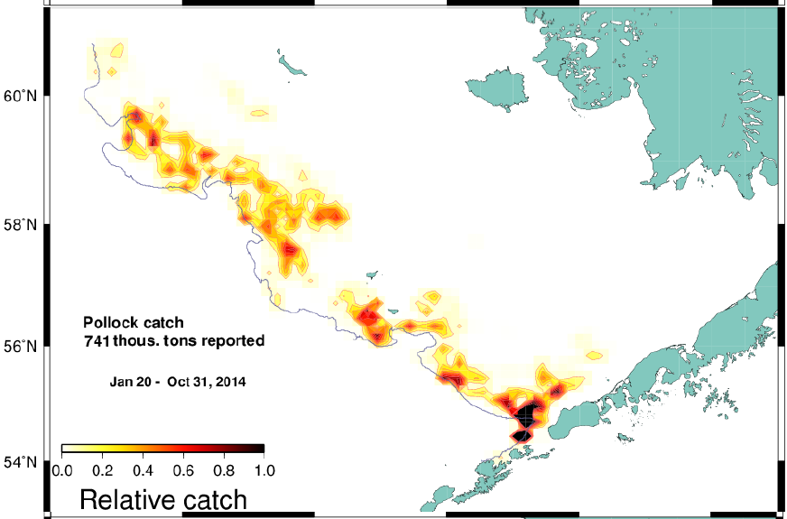
Primer on Genetic Mixed Stock Analysis:
How MSA works
  Baseline:
    Genetic characterization of populations (spawning aggregates)
    Populations grouped into Stock Groups (“Reporting Groups”)
  Mixture:
    Fishery sample of interest
    Genotypes of individuals
  Stock Composition Estimates:
    Best fit of combined mixture genotypes to populations
    Sum estimates by population into Stock Groups
      Individuals are NOT assigned to populations, and then summed
3

Slide 4
How MSA works
Mixture Models and Assignment tests
Baseline – 4 populations (A, B, C, D)
Likelihood
Population
From Manel et al. 2005
Notes:
Guthrie present?

Slide 5
How MSA works
Mixture Models and Assignment tests
Baseline – 4 populations (A, B, C, D)
Sample – 2 fish
Likelihood
Population
From Manel et al. 2005
Notes:
Guthrie present?

Slide 6
How MSA works
Mixture Models and Assignment tests
Baseline – 4 stocks (A, B, C, D)
Sample – 2 fish
Fish 1
Fish 2
Likelihood
Population
From Manel et al. 2005
Notes:
Guthrie present?

Slide 7
How MSA works
Mixture Models and Assignment tests
Assignment tests
Baseline – 4 stocks (A, B, C, D)
Sample – 2 fish
Fish 1 Fish 2
Population
Likelihood
GSI Mixture Model
Population
From Manel et al. 2005
Population
Notes:
Guthrie present?

Slide 8

Primer on Genetic Mixed Stock Analysis:
How MSA works
Sampling error:
  Chance that your sample contains the true proportions in the fishery mixture
    Toss of the dice
https://www.thoughtco.com/probabilities-of-rolling-two-dice-3126559

Slide 9

Primer on Genetic Mixed Stock Analysis:
How MSA works
Sampling error:
  If you roll a fair sets of dice, you should average 3.5 dots per die
  The fewer die you roll, the more likely you will not average 3.5 dots
https://www.thoughtco.com/probabilities-of-rolling-two-dice-3126559

Slide 10
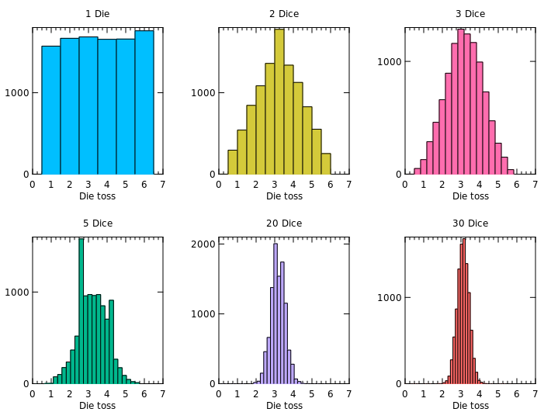
Primer on Genetic Mixed Stock Analysis:
How MSA works
Sampling error:
Toss only one die and do it 10,000 times, you will average anywhere from 1 – 6 dots per die, about equally.
Averaging 1 number!
1 die
The results of a simulated 10,000 tosses of fair dice: https://wildart.github.io/MISG1010/MIS_G1010_L5.html

Slide 11
Primer on Genetic Mixed Stock Analysis:
1 die 2 dice 3 dice
How MSA works
Sampling error:
Toss more dice, and you will more likely average closer to 3.5 dots per die – the correct value
5 die 20 dice 30 dice
The results of a simulated 10,000 tosses of fair dice: https://wildart.github.io/MISG1010/MIS_G1010_L5.html

Slide 12
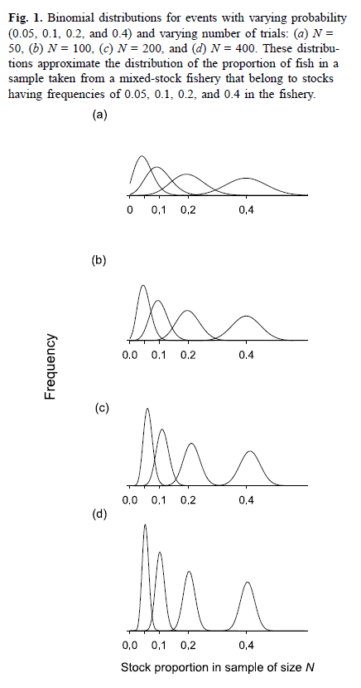
Primer on Genetic Mixed Stock Analysis:
N = 200
N = 50
+/- 7%
N = 400
N = 100
+/- 5%
+/- 10%
True proportions
Kalinowski, S.T., 2004. Genetic polymorphism and mixed-stock fisheries analysis. Canadian Journal of Fisheries and Aquatic Sciences, 61(7), pp.1075-1082.

Slide 13
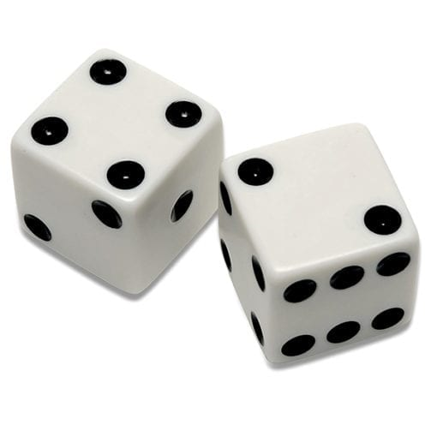

Primer on Genetic Mixed Stock Analysis:
How MSA works
Sampling error:
  Chance that you sample correct proportions
  Best Practices:
    Use larger sample sizes for the mixture
      100 fish: get within 10% of true, 90% of the time
      200 fish: +/- 7%
      400 fish: +/- 5% Gold standard for most projects
    Use fewer options (Stock Groups)
      The fewer the options, the lower the relative error
        Example: If we used a coin (heads/tails), we would need fewer tosses to accurately estimate 50% heads
      Pool all stock groups with anticipated estimates below 5%

Slide 14
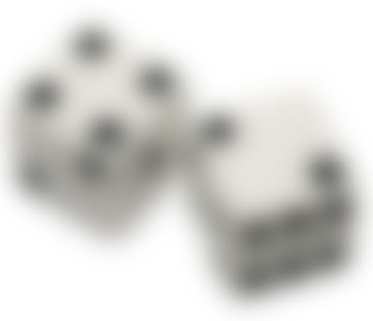
Primer on Genetic Mixed Stock Analysis:
How MSA works
Sampling error:
Genetic error:
  Misclassification of mixtures due to genetic similarity among Stock Groups
    Think of this as not wearing glasses when counting the die dots

Slide 15
Primer on Genetic Mixed Stock Analysis:
How MSA works
Sampling error:
Genetic error:
  Misclassification of mixtures due to genetic similarity among Stock Groups
  Best Practices:
    Use genetically distinguishable Stock Groups (add focus)
      Pool similar populations into Stock Groups
      Add markers to improve resolution
    Increase mixture sample sizes
      MSA methods incorporate information from all fish in the mixture

Slide 16
Best Practices for
Genetic Mixed Stock Analysis
Use proportional assignment – not individual assignment
  Individual assignment produces biases
  Every combination of mixture individuals requires new analysis
Use adequate sample sizes for each mixture
  100 fish: get within 10% of true, 90% of the time
  200 fish: +/- 7%
  400 fish: +/- 5% Gold standard for most projects
Use genetically distinguishable stock groups
  Aggregate similar populations together
  Develop baselines with more markers
Reduce the number of stock groups as low as possible
  Only use as many as needed
  Pool stock groups with anticipated estimates below 5%

