Slide 1
Chinook Salmon Bycatch Genetic Stock Composition: Current Capabilities and Analyses…with a word on Hatchery production
Chuck Guthrie, NOAA/AFSC/Auke Bay Laboratories
Dani Evenson, ADF&G (Hatchery Production)
NPFMC Salmon Bycatch Workshop
April 15-16, 2019, Seattle, WA
Notes:
Dani Evenson will speak about chinook and Hatchery production at the end

Slide 2
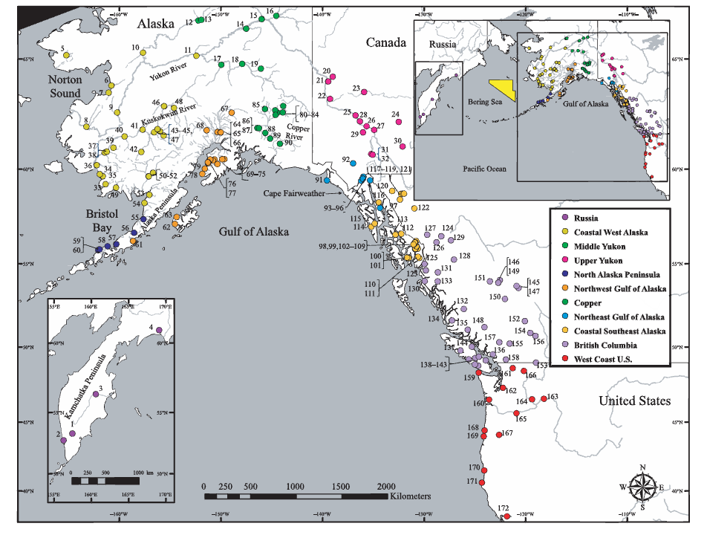
Templin et al., 2011
Notes:
This is a map of the 172 current baseline populations developed by the ADF&G gene conservation laboratory for 43 SNP markers. This baseline is used for both Bering Sea and GOA analyses

Slide 3
Templin et al., 2011
Notes:
This map highlights the eleven stock groups (also known as reporting groups) for which stock composition data is developed.

Slide 4
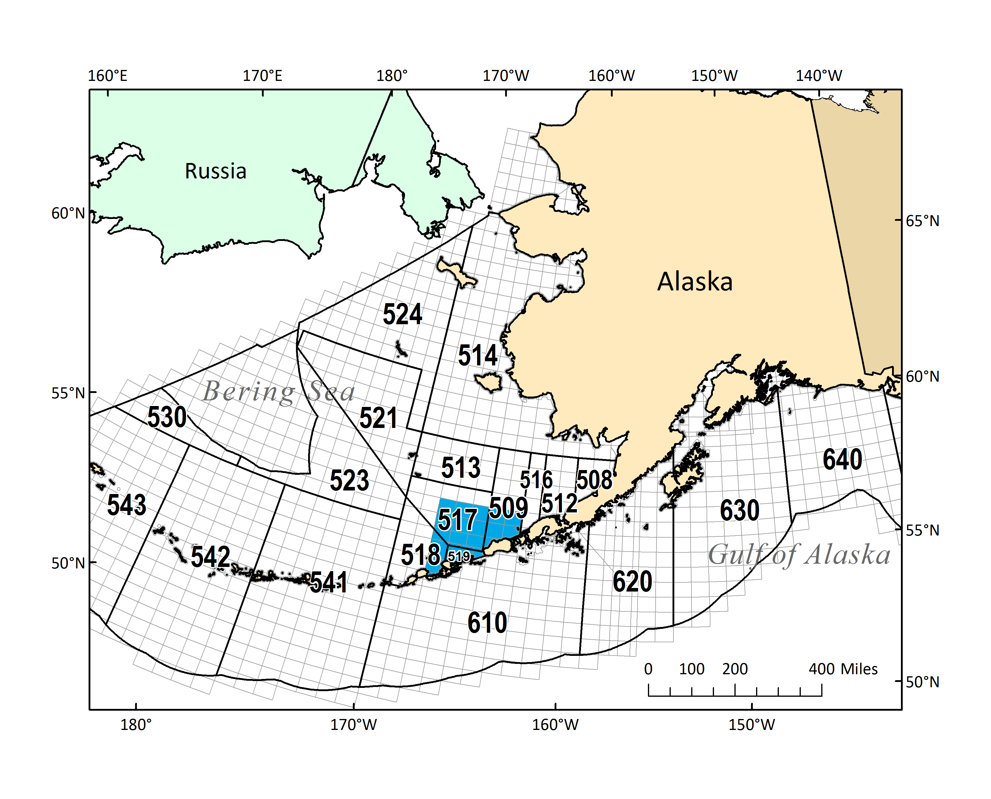
Notes:
This map show the statistical areas associated with the Bering Sea and Gulf of Alaska groundfish fisheries which are used in analyses -- NMFS (outlined in black) and ADF&G (outlined in light gray) The CVOA is highlighted in blue in blue

Slide 5
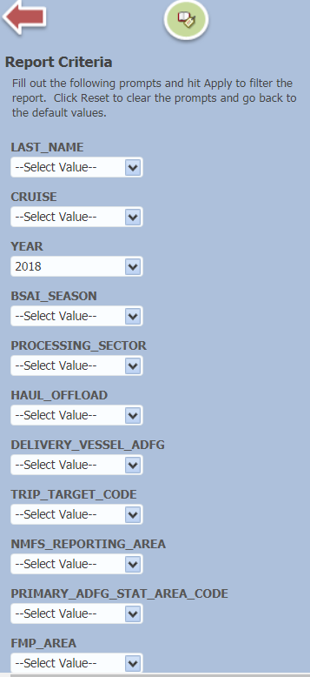
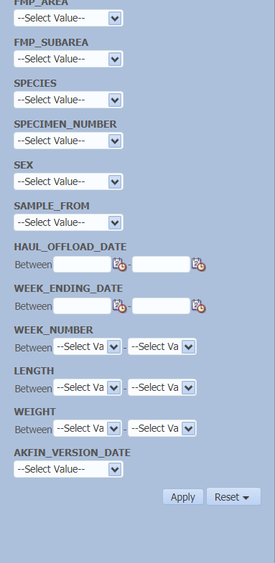
Notes:
We developed these strata using information from the ANSWERS tool provided by AKFIN (NMFS 2018), geographical (ADF&G statistical areas) aggregations were developed to provide stock compositions with greater spatial precision than the existing NMFS statistical areas. We developed this tool with AKFIN in late 2015. On the right are the sortable fields in AKFIN, on the left are the data fields for each sample. We can do a Bayes stock composition analysis on any of these fields for which there is an adequate sample size. Recently a field was added that includes SST which Jordan Watson will talk about later.

Slide 6
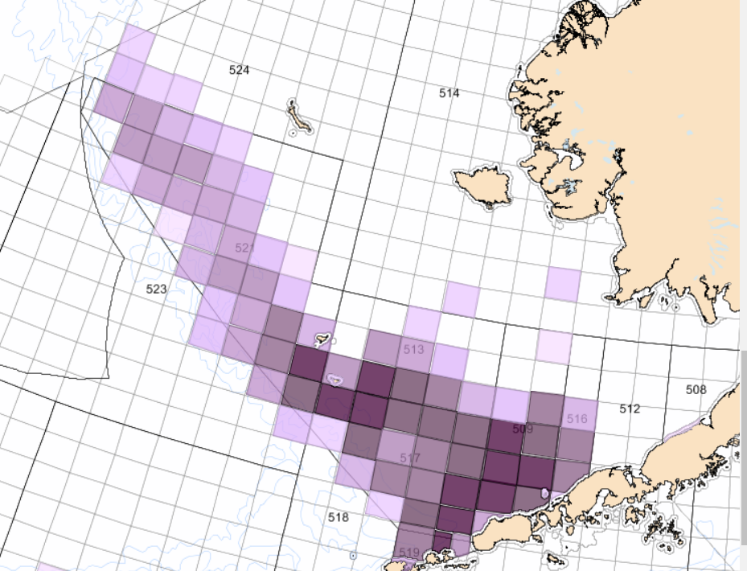
2011-18 Bering Sea
Genetic Samples
N=14,709
Notes:
This map which was pulled from answers shows where the Bering Seasamples were collected since the introduction of systematic sampling protocols in 2011, 1 in 10 for chinook. The samples from 2010 previous are excluded. The ADF&G statistical areas shaded depending on the number of samples collected, darker more samples.

Slide 7
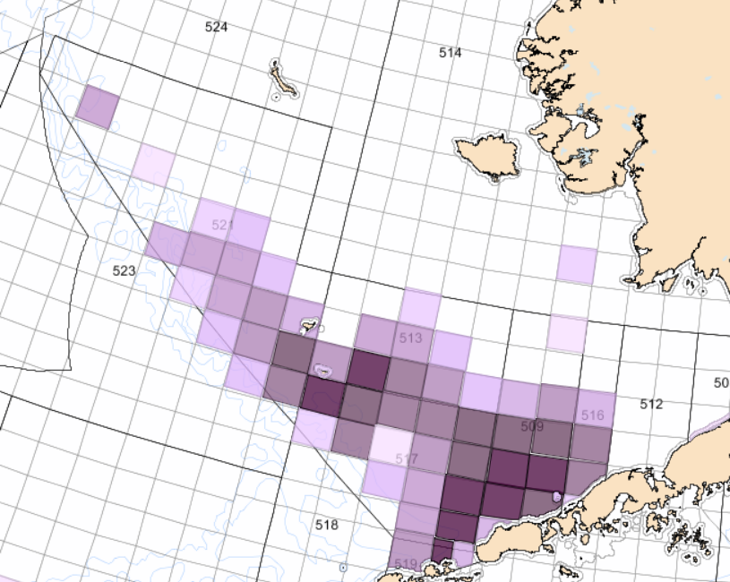
2011-18 Bering Sea
Genetic Samples
“A” season N=9,324
Notes:
This shows the samples collected in the “A” season

Slide 8
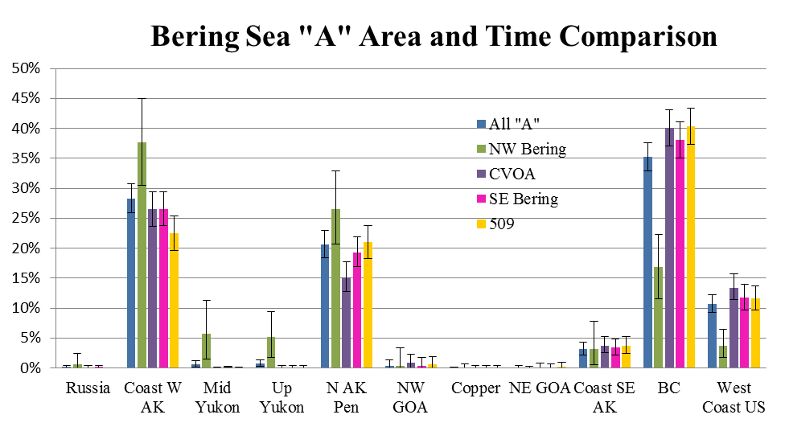
Notes:
This is an example of analyses performed on the samples from the 2017 “A” season, a bayes analysis was performed on each of these stratum. Notice that the Northwest Bering is different from the others

Slide 9
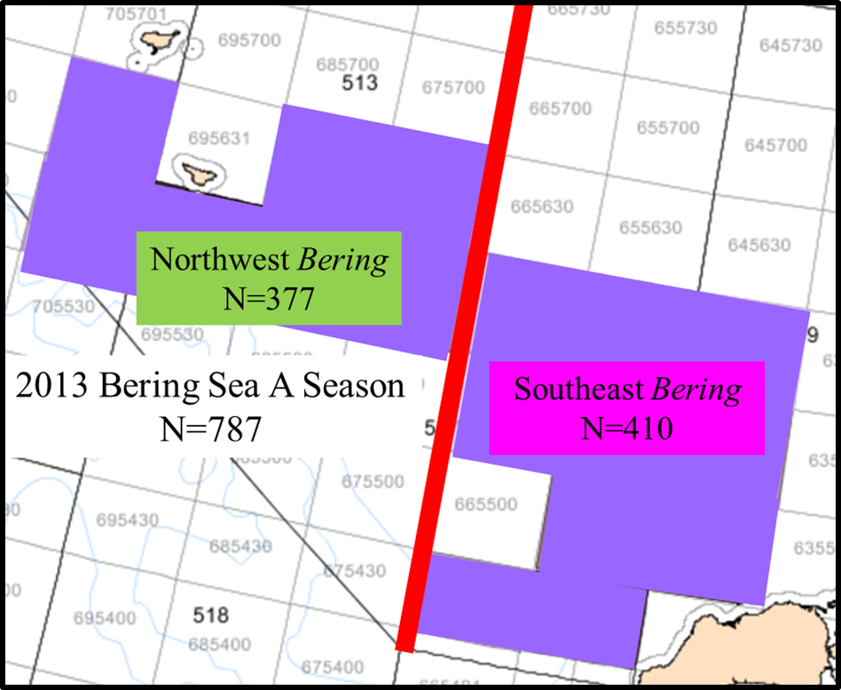
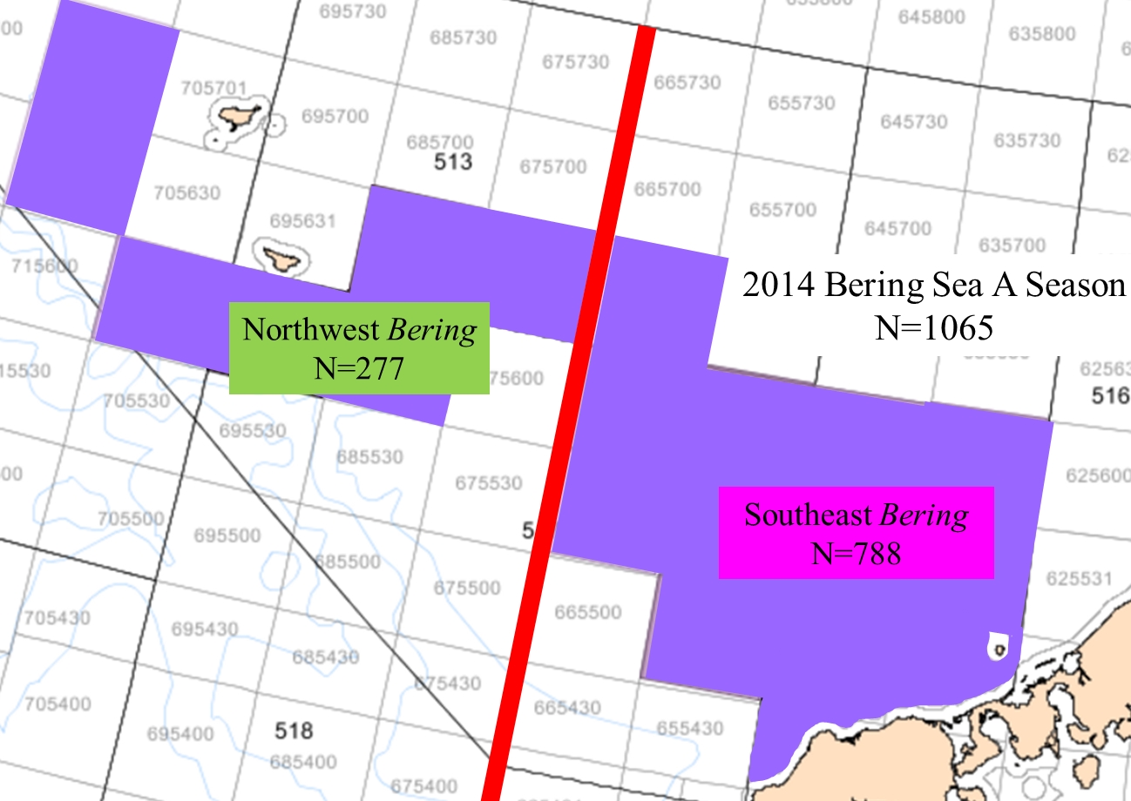
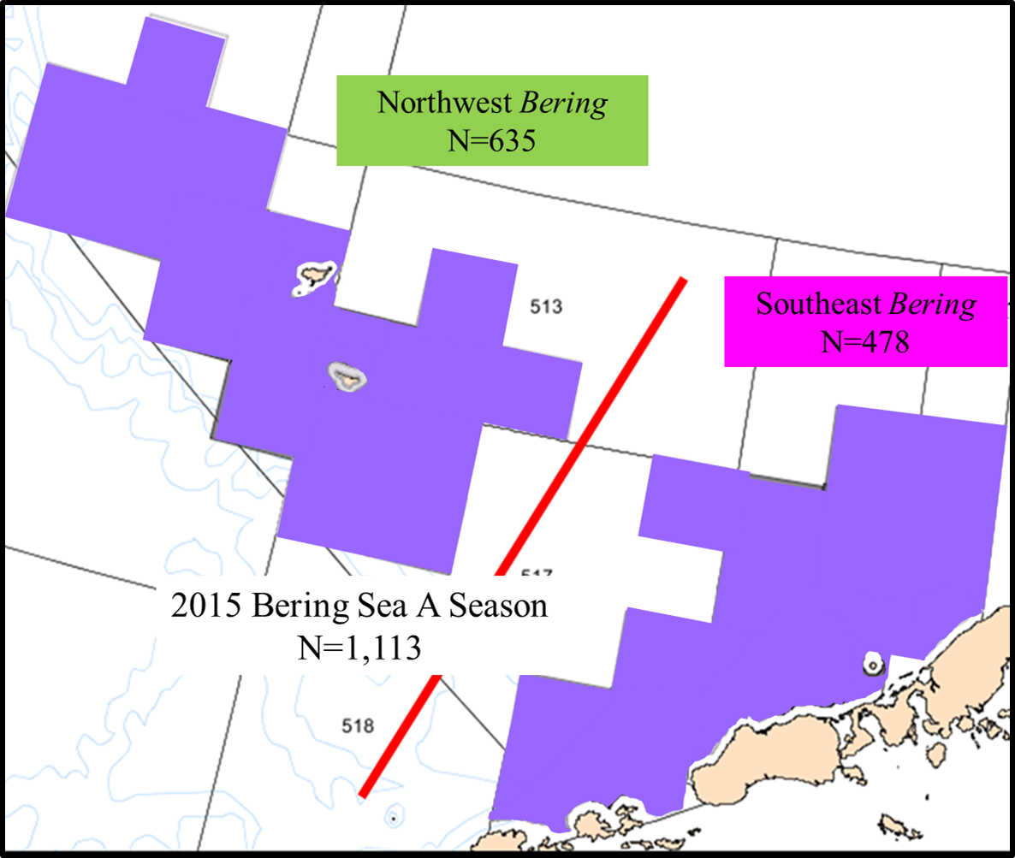
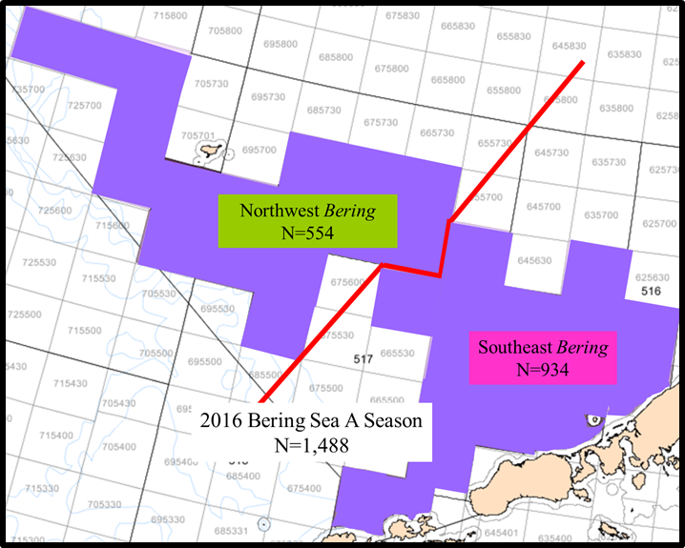
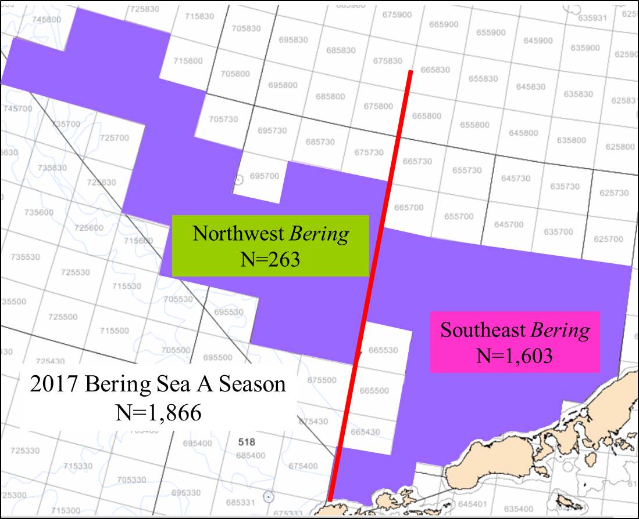
Locations of the Northwest Bering
and
Southeast Bering Chinook genetic samples 2013-2017
Notes:
Here are the locations of the Northwest Bering and Southeast Bering Chinook genetic samples 2013-2016. As you can see the locations between years is not indentical
This shows the locations of the 2 strata for which Bayes analyses was performed for multiple years; although data is available for 2011 and 2012, the sample sizes were not adequate.

Slide 10
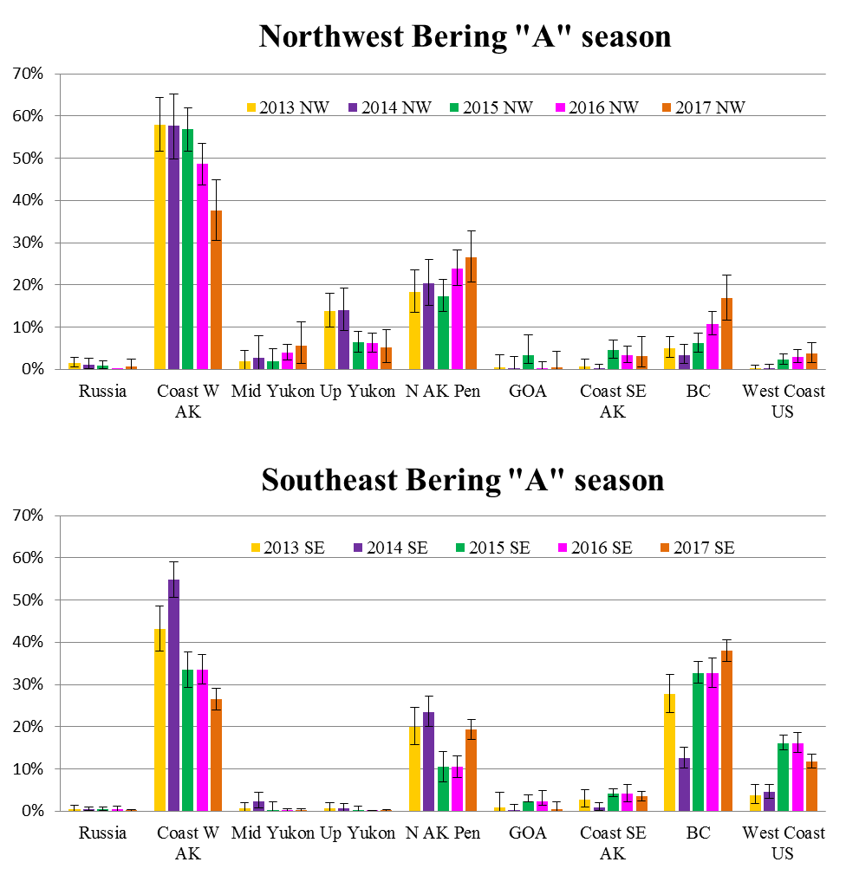
Notes:
This shows the stock compositions of the two strata, with error bars. The true stock compositions fall btw the upper and lower ends of the error bars.

Slide 11
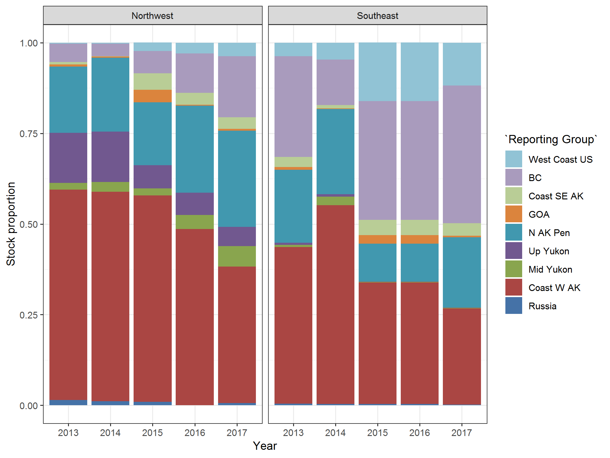
Stock Group
Notes:
This is a different way to visualize the same data, without error bars, which can make tends easier to see, for example the downward trend in coastal western ak region. Be mindful though if those differences aren’t greater than the standard error, it may not be real.

Slide 12
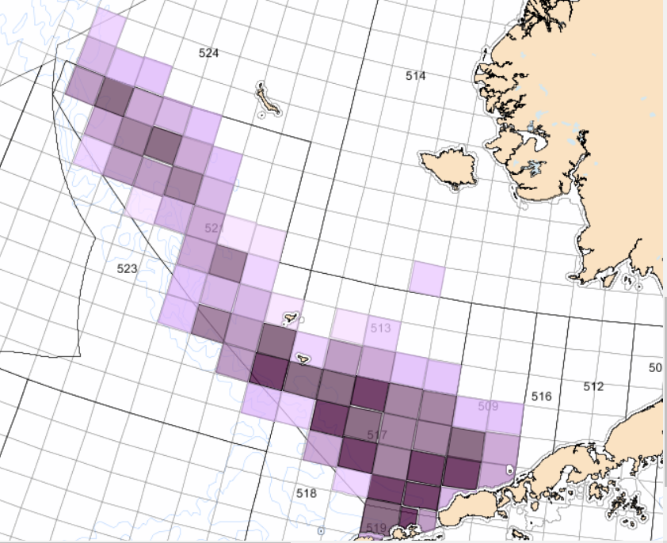
2011-18 Bering Sea
Genetic Samples
“B” season N=5,384
Notes:
This show the samples that were collected during the “B” season, which is typically a smaller number than the a, (except for 2012)

Slide 13
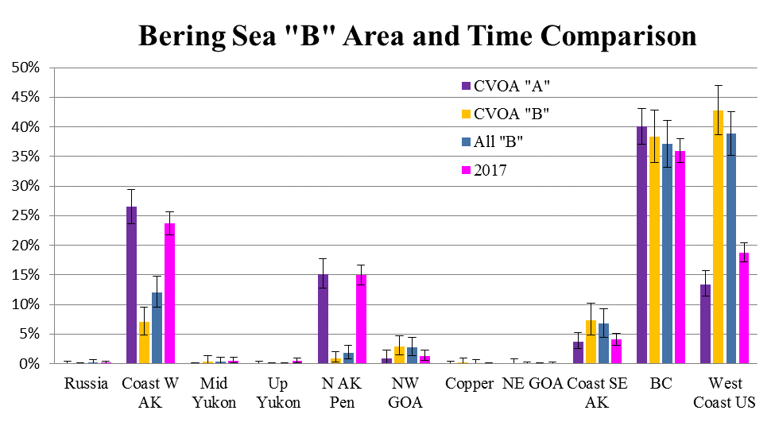
Notes:
This is analysis of the “B” season in 2017, notice that there were only 2 strata due to the absence of adequate samples.

Slide 14
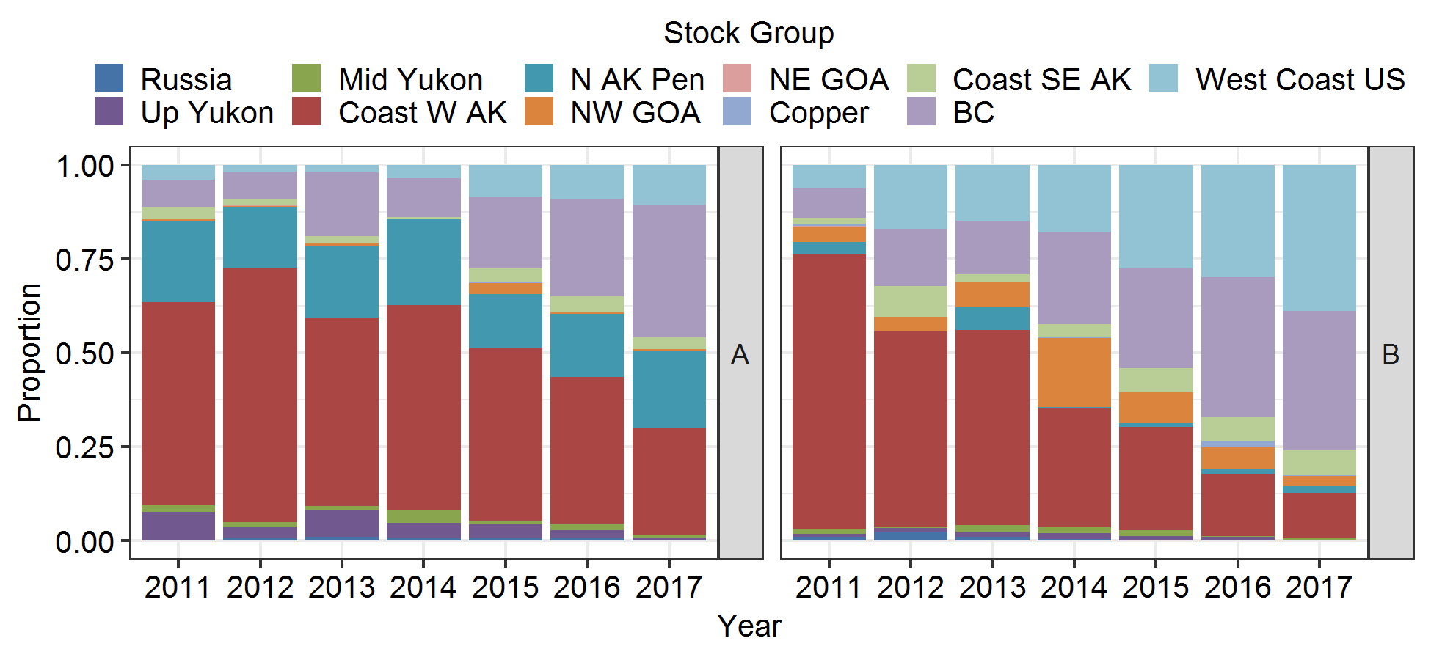
Notes:
This is a nice comparison of the “A” and “B” seasons which shows the downward trend of the regional stock groups which flow into the bering sea and the uptick of those from more southern regions

Slide 15
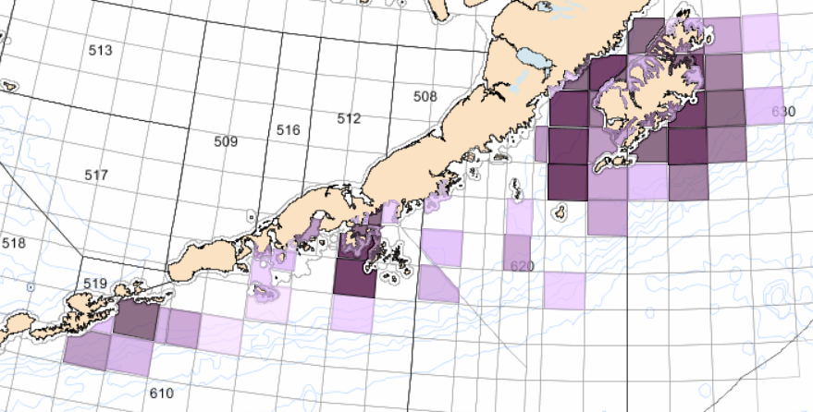
2011-18 GOA
Genetic Samples
N=18,155
Notes:
This is where the samples have been collected from in the GOA, the different strata I have looked at are circles in red. This does not include those collected by industry.

Slide 16
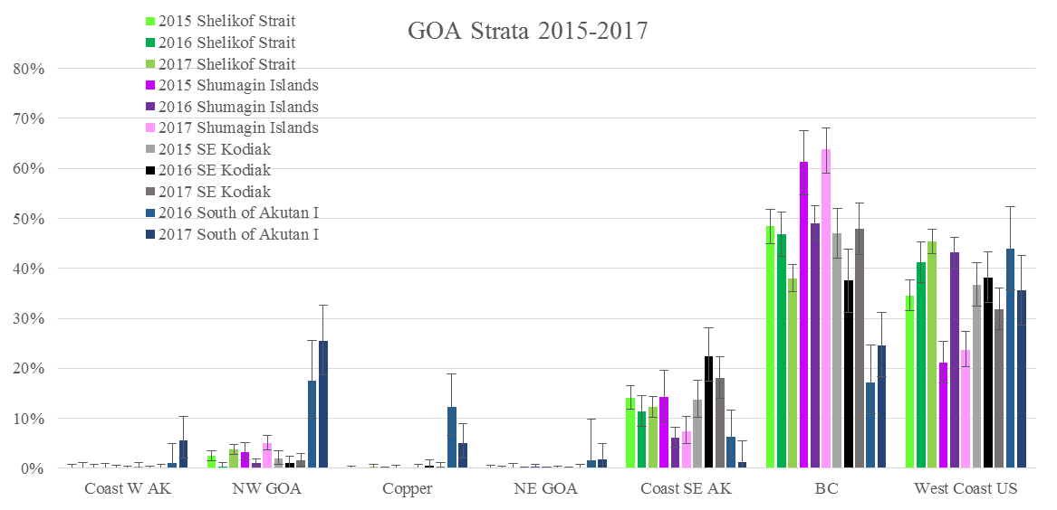
Notes:
This shows the Bayes analyses of the available samples form the strata shown on the previous map.

Slide 17
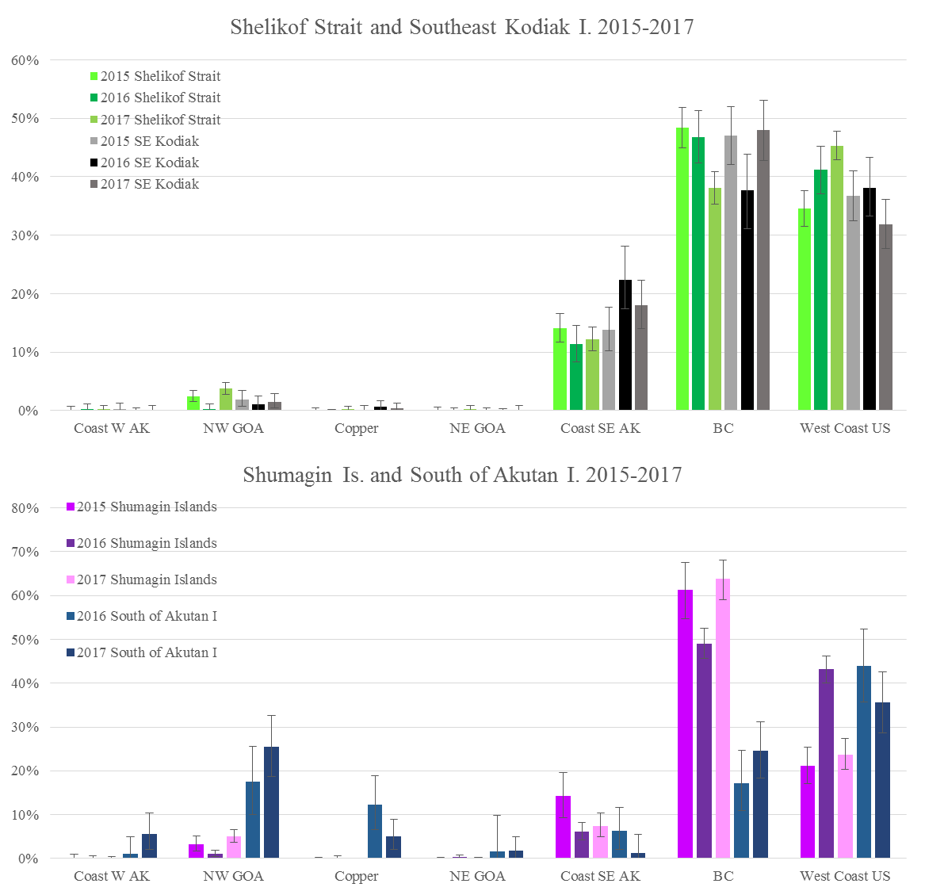
Notes:
These graphs show the previous data another way. Notice that most of the fish in the GOA are from the Southern stock groups, although fish from south of Akutan show some of the more Northern stock groups. However, Sample sizes were on the small size from there. 2016 (140), 2017(193)

Slide 18
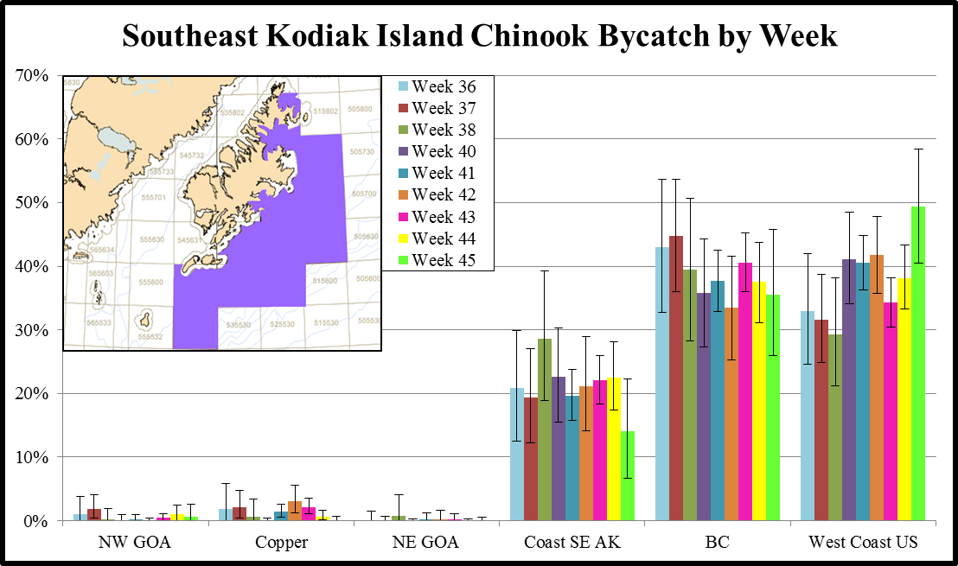
Notes:
This is an example of what can be done with a large amount of samples.
In 2016 we were able to develop weekly stock composition estimates for weeks 36-38 and 40-45. It doesn’t really show any big differences, and the error bars overlap for all weeks.
Across this series of weeks, the West Coast US stock composition estimates ranged from 49% in week 45 to 29% in week 38. The British Columbia contributions ranged from 45% in week 37 to 34% in week 42. Coastal Southeast Alaska ranged from 29% in week 38 to 14% in week 45

Slide 19
Notes:
This is a rough processing time line of chinook salmon samples from receipt to the time the tech memo is published. Sample processing begins with the first large shipment or when we get over 500 samples.
When the samples are received, an individual ID is developed for each fish which is associated with catch info from the observer database. Then in the lab the samples are inventoried checking for missing samples, and samples which are not in the database. Once the samples are verified the DNA is extracted, after which some were genotyped in house on the quantstudio (taqman assays, or shipped to the outside contractor for using maldi-tof assays. Genotype scoring involves rerunning poor samples or markers, after which the data goes through QC. The data is analyzed, and the report is written

Slide 20
Notes:
This is a similar the timeline for the GOA samples.

Slide 21
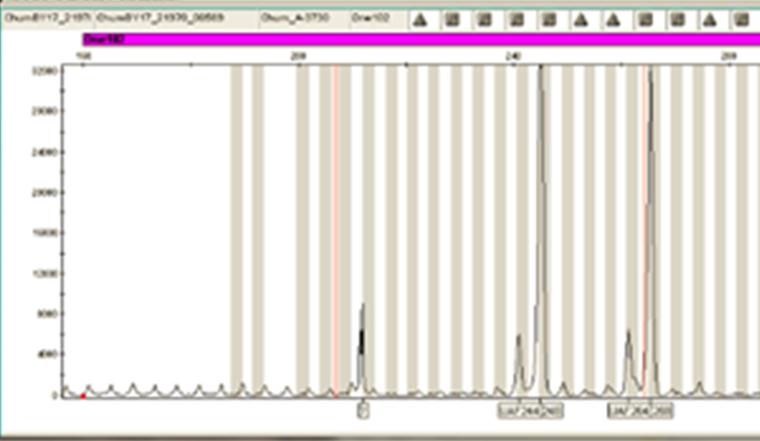
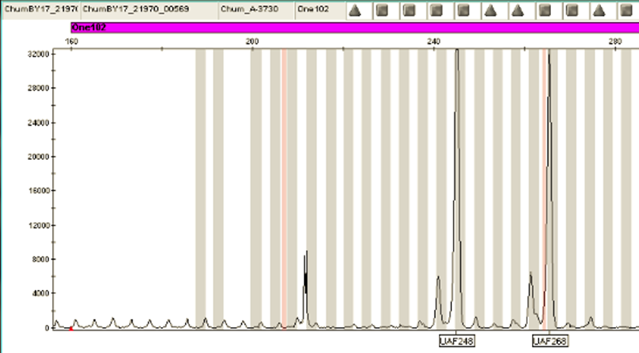
RAW
SCORED
Notes:
Comments Total numbers above are for all samples genotyped, and might not match tech memo numbers for samples successfully genotyped. "Genotypes scored" timeline involves initial scoring, doublescoring, and conflict resolution (a two to three person process). "Data analyses" timeline refers to running BAYES for spatial/temporal subsets. Cluster sample processing performed a month after all other sample processing, thus extending timeline (especially for "Data analyses".)
Scoring microsatellite genotypes (Applied Biosystems GeneMapper 5 software)
GeneMapper software automatically calls (scores) allele peaks, but often calls incorrect peaks.
Initial scorer visually looks at every sample for 13 microsatellite and makes corrections where necessary (selecting correct peaks and deselecting incorrectly-called peaks).
These corrected results are then reviewed by a second scorer. Second scorer reviews every sample for 13 microsatellites and corrects where necessary.
Scored genotypes by both scorers are copied into an Excel spreadsheet, where any conflicts are automatically highlighted. A third party reviews and resolves conflicts.
This process of “doublescoring” microsatellites in GeneMapper software is standard in many labs.
For the 2016 chum bycatch, 3,965 samples were individually reviewed for 13 microsatellite markers by two scorers (=51,545 individual sample records).
Note to Chuck: we only use results of 11 microsatellites (=43,615 individual sample records) for final analyses in Tech Memo, but 13 microsatellites are actually scored.

Slide 22

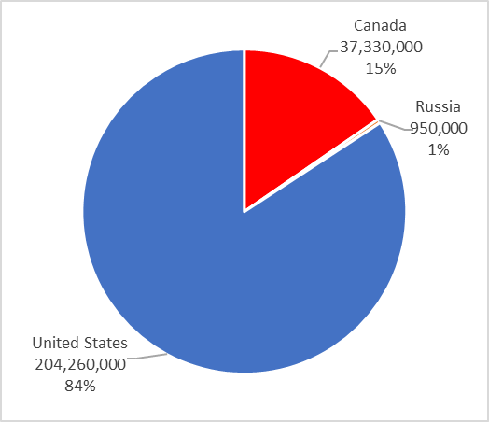
Chinook Hatchery Production
2014-2018 average = 242,540,000

Slide 23
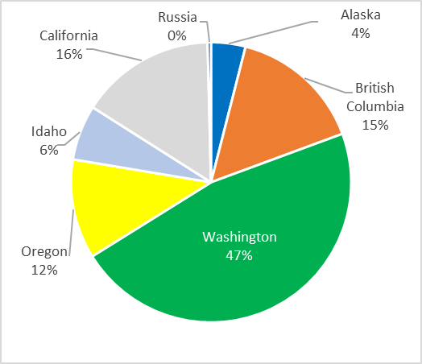
Chinook Hatchery Production
Notes:
WA is 47% or 113 M release annually
BC is 15% or 37M
CA (38M) and ID (15M) are rare occurrences in GOA

Slide 24
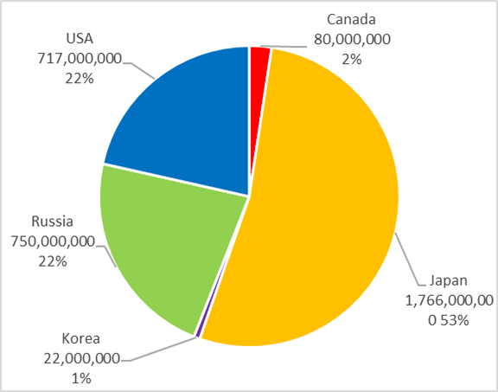
Chum Hatchery Production
2014-2018 average = 3,335,000,000

Slide 25
What Analyses would you like to see?
Thanks to those colleagues who helped to generate the data:
Hv. T. Nguyen, M. Marsh, J. Watson
and
J. R. Guyon

