Slide 1
Chum salmon bycatch genetic stock composition
Current capabilities and analyses
Chris Kondzela and Ellen Yasumiishi
NOAA/AFSC/Auke Bay Laboratories
NPFMC Salmon Bycatch Workshop
April 15-16, 2019, Seattle, WA

Slide 2
Overview
Background
Maps
Bycatch samples
Genetic baseline
Stock estimates – various strata
Age information
Subsampling
Reporting

Slide 3
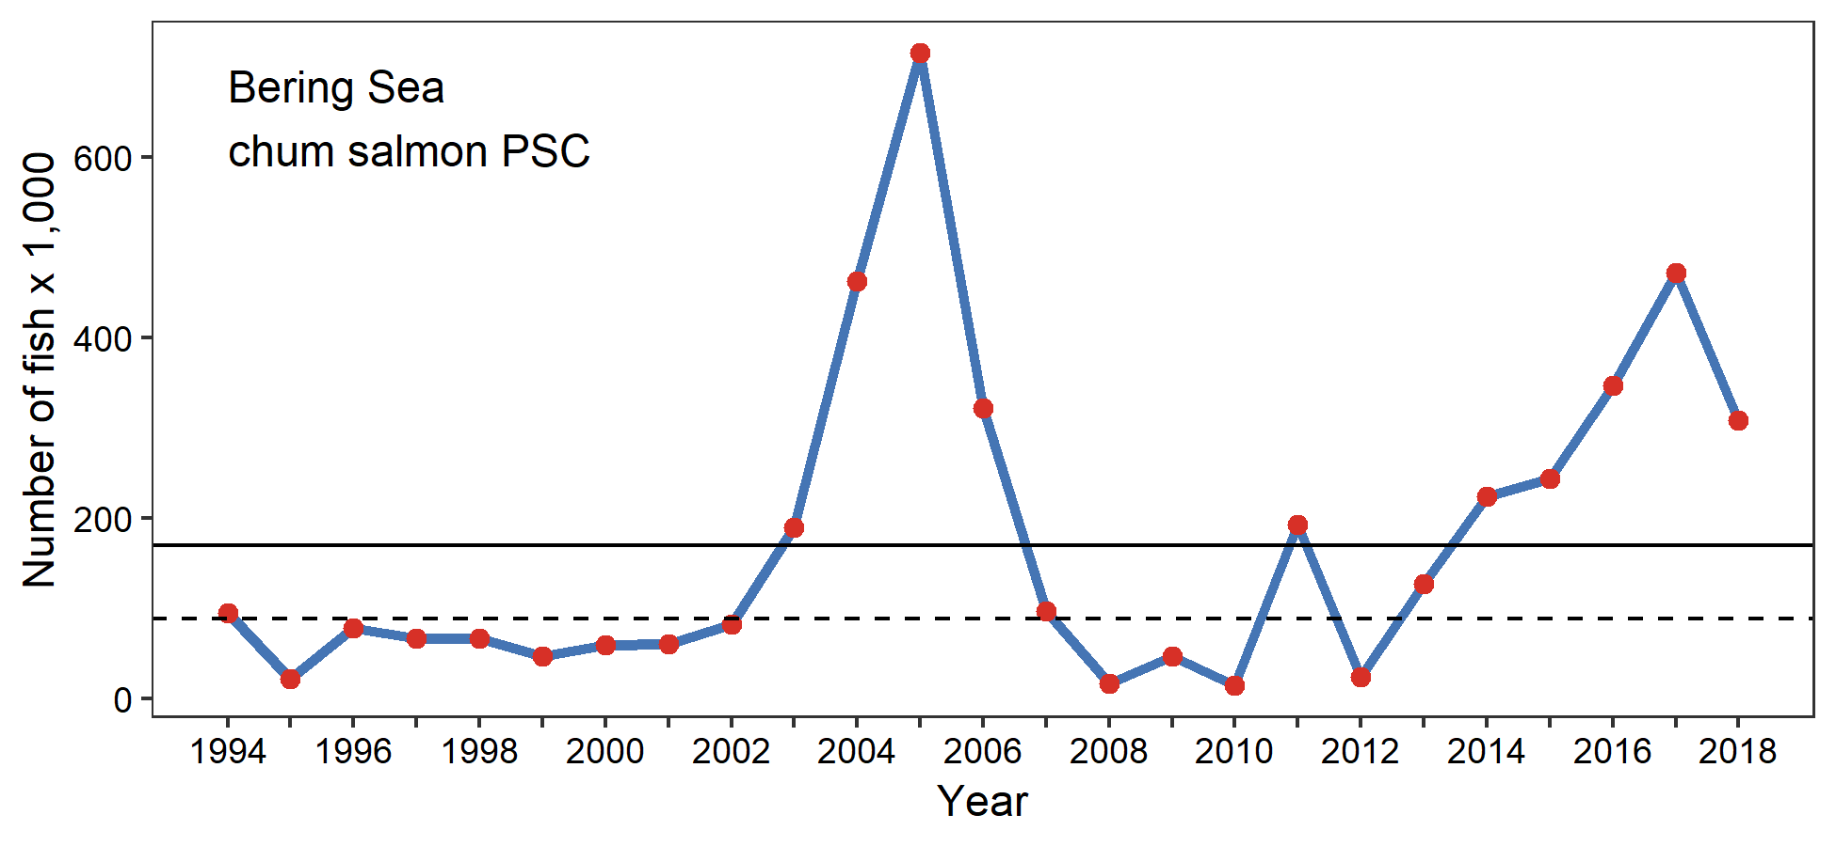
Background
Chum bycatch from Bering Sea pollock-directed trawl fisheries.
Early stock ID research used fish scale patterns and protein-based genetic markers (allozymes).
ABL restarted genetic stock identification of chum bycatch with DNA-based markers in 2009, after high bycatch in 2004-2006.
Notes:
2018 total chum bycatch in Bering Sea was 295,062 (172,616 fewer chum than in 2017).
Scale patterns (FRI at UW used to do).
Allozymes no longer used.
By 2009, a coastwide microsatellite baseline was available to identify what stocks were present in the bycatch.

Slide 4
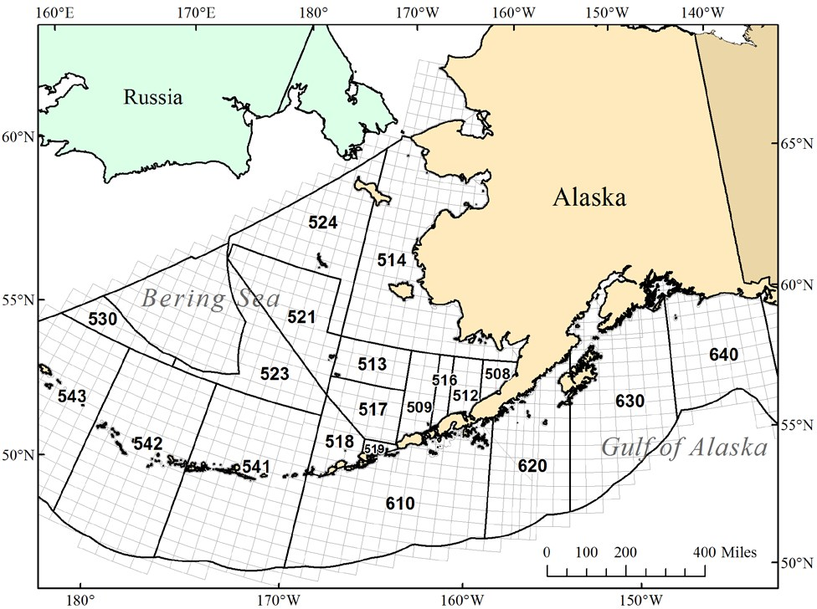
Statistical areas
Notes:
NMFS and ADFG groundfish statistical areas.
We use both types of stat areas in analyses of bycatch samples at various levels of spatial strata.

Slide 5
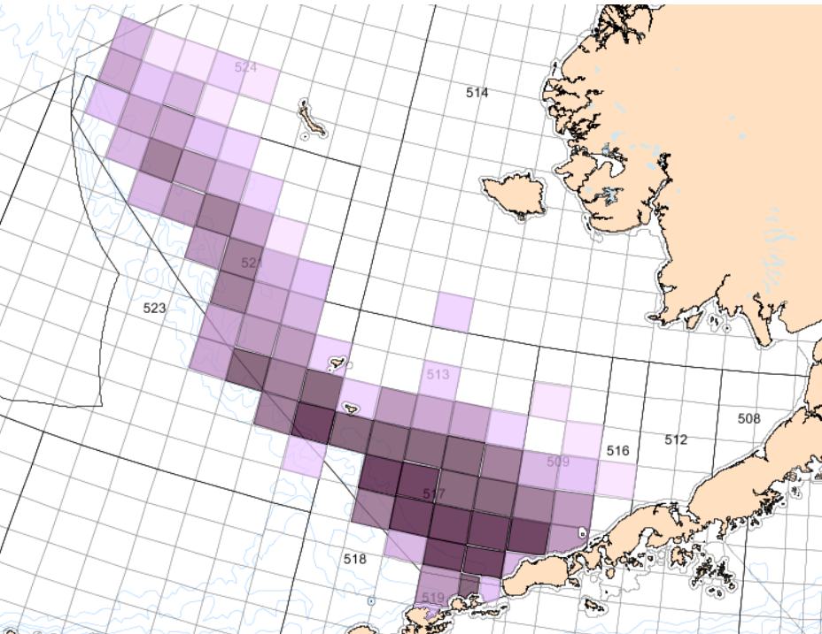
Chum bycatch location
Distribution of genetic samples, Bering Sea, B-season
2011-2018
55,351 received
17,230 genotyped
Not confidential
Notes:
Distribution of chum salmon bycatch genetic samples from Bering Sea B-season, 2011-2018. Copied from AKFIN report.
Darker purple represents higher number of fish.
N=55,351 received (58,872 total in AKFIN); a subset was run in high bycatch years. 17,230 genotyped, 14,367 analyzed.
Will come back to the subsampling later.
Areas where fewer than 3 vessels fished are not highlighted (map does not contain confidential information).
Chum bycatch sample counts.xlsx

Slide 6
Shift in temporal distribution
Bering Sea, B-season
Notes:
Total bycatch by week for 2018, 2017, 2016, 2011-2015.
Large shift to earlier catches in 2017 and 2018.
Total chum bycatch by year.xlsx

Slide 7
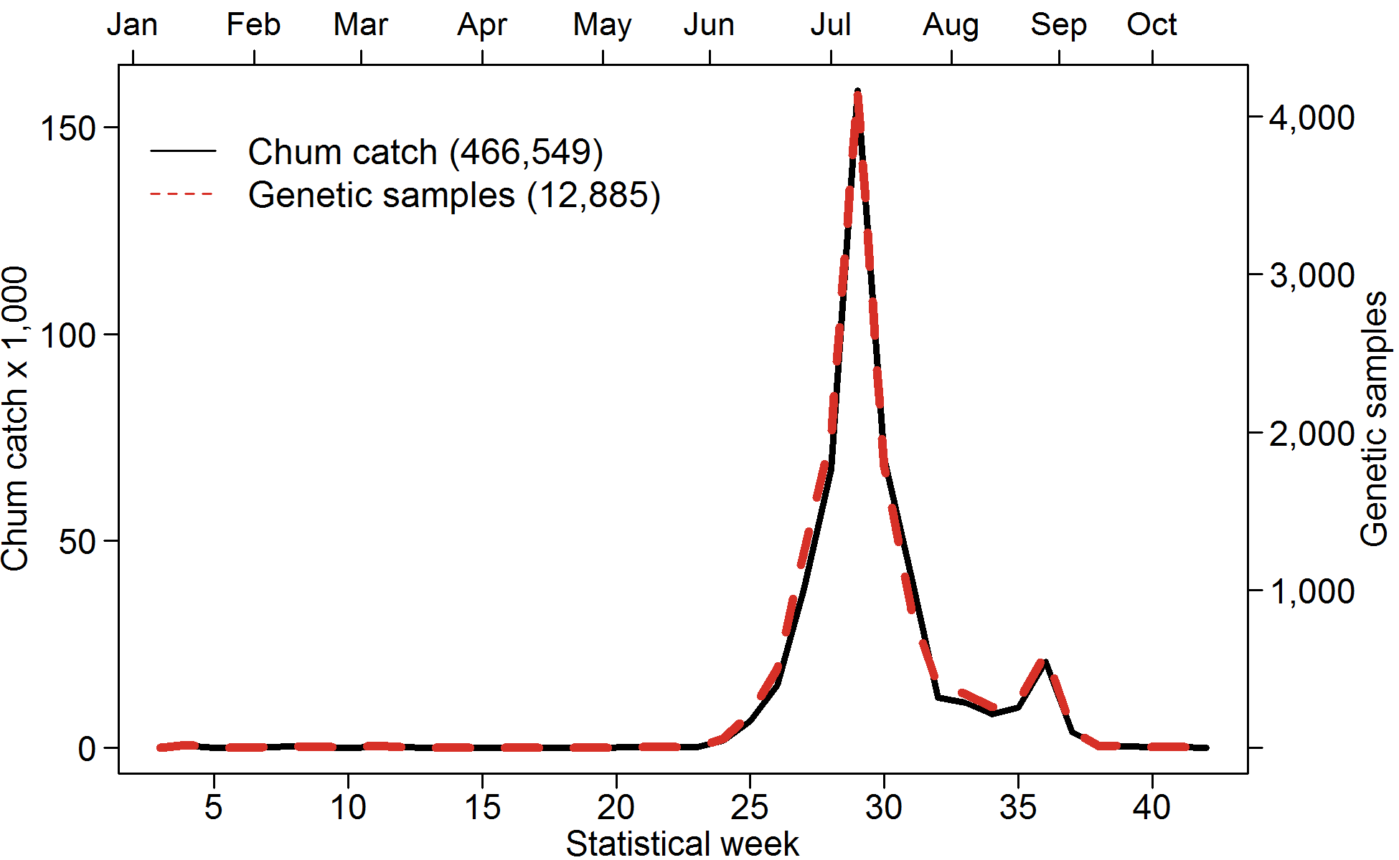
Chum bycatch & samples
2017 Bering Sea pollock-directed trawl fisheries by week.
Notes:
Catch vs. genetic sampling; 1 in 30 chum caught is sampled for scales and genetic tissue.
Close correspondence of number of samples to number of total bycatch by week.
Nearly all chum are caught in the B-season (starting June 10, ~week 24).

Slide 8
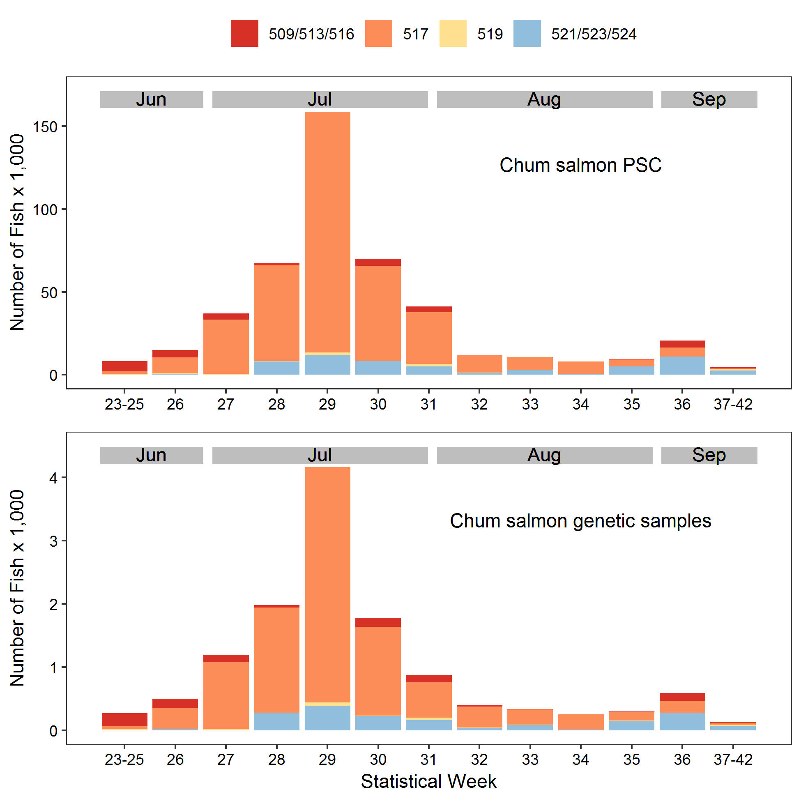
Chum bycatch & samples
2017 B-season
NMFS stat area and week
Notes:
Catch vs. genetic sampling; 1 in 30 chum caught is sampled for scales and genetic tissue.
Close correspondence of number of samples to number of total bycatch by area and week.

Slide 9
Chum bycatch & samples
Number of total bycatch and genetic samples per vessel
Notes:
2016 is typical pattern. Some loss of samples in 2017 due to sampling problems in field (observers on catcher-processors processing at sea).
2016 Figures & Tables for Tech Memo.xlsx
2017 Figs & Tables-CK1.xlsx

Slide 10
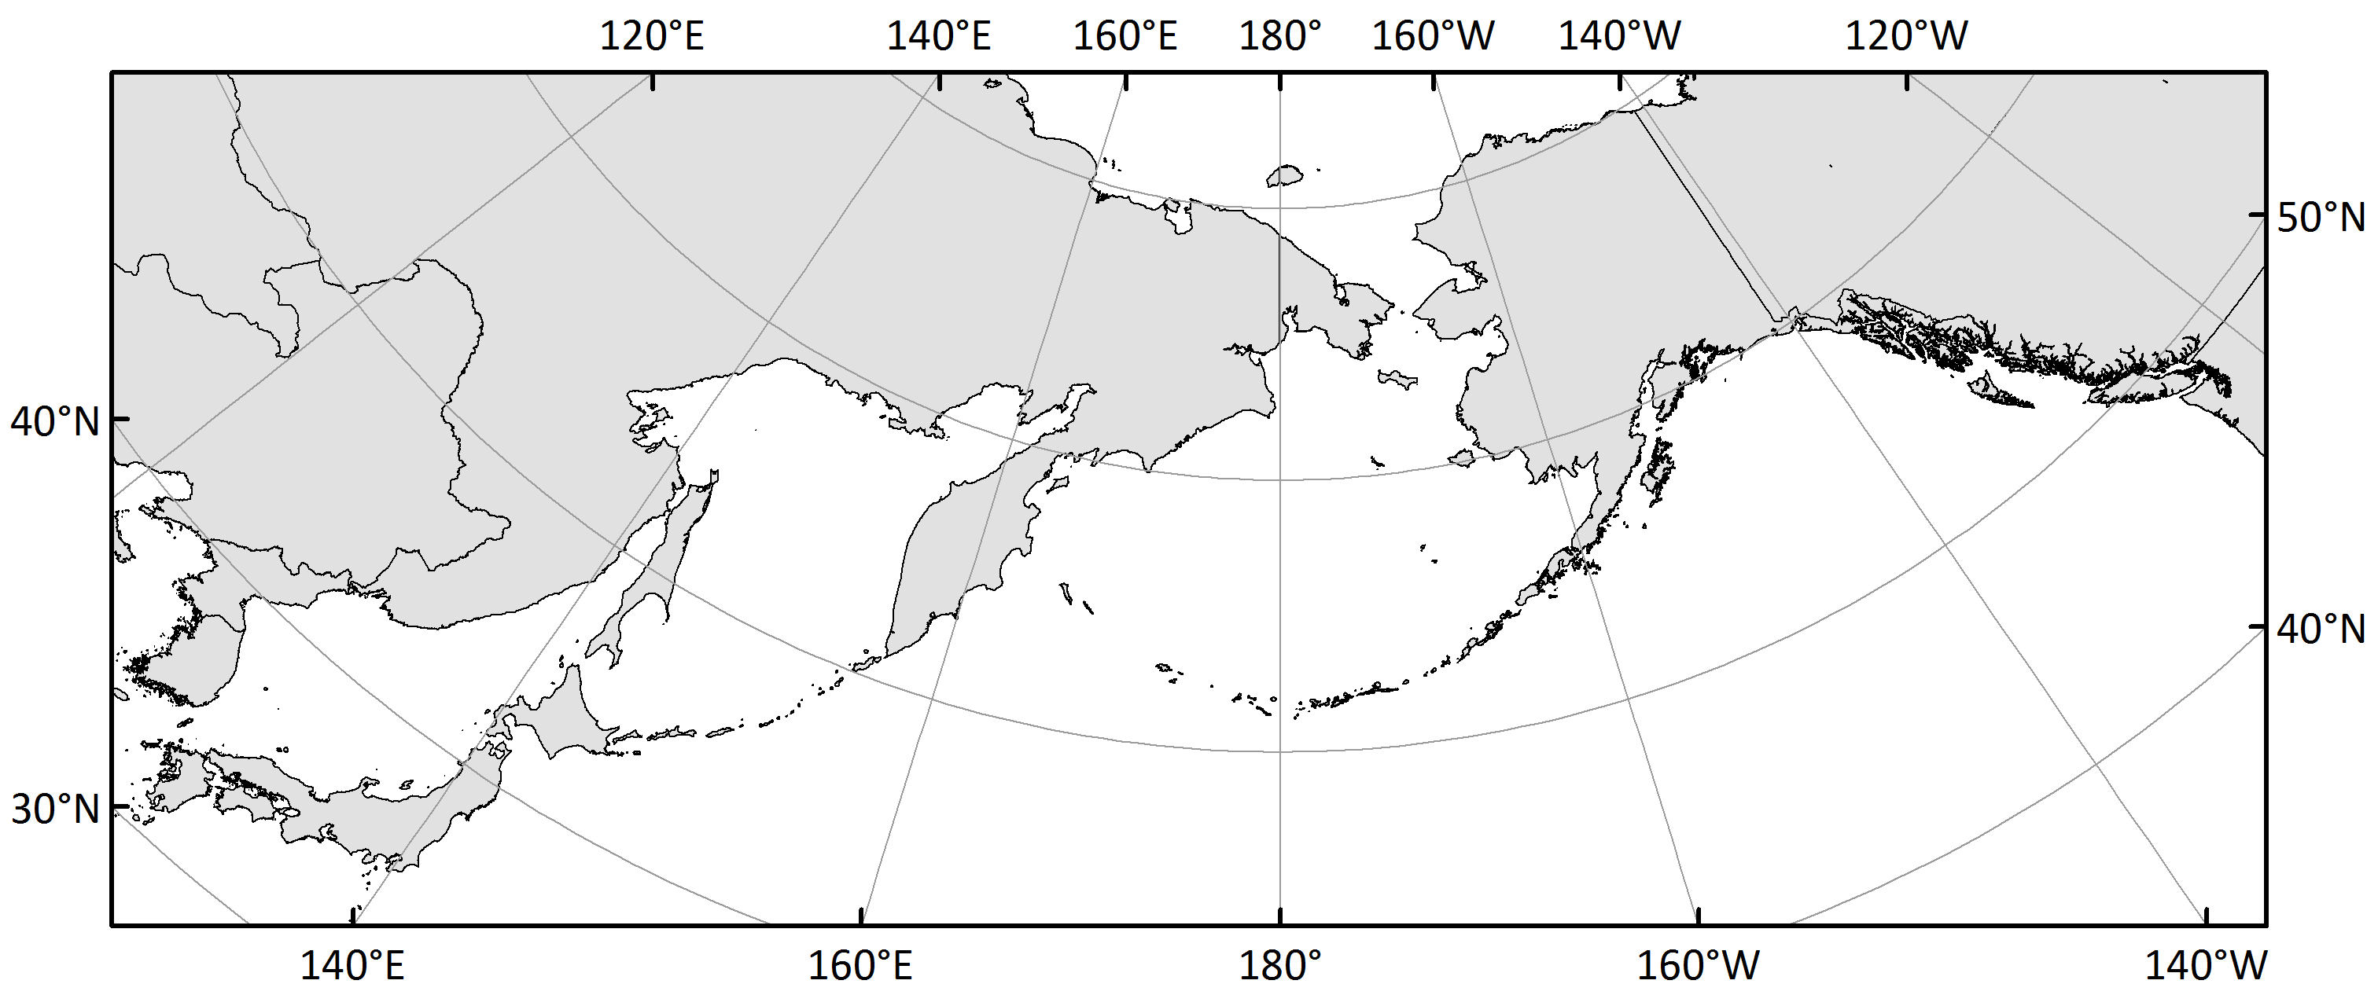
Genetic baseline
Current baseline in use for chum bycatch
11 microsatellites, 381 pops, 6 stock groups
Up/Mid Yukon
W AK
EGOA/PNW
NE Asia
SW AK
SE Asia
Notes:
Explain time-line of baseline development. The only coastwide baseline (other than allozymes) that was publically available when we started bycatch analysis in 2009 was the microsatellite baseline.
Beacham et al. 2009
DFO chum baseline.pptx
381-population microsatellite baseline
13 microsatellite markers (11 used for chum bycatch analyses)
6 stock groups for chum bycatch analyses: SE Asia (31), NE Asia (31), WAK (37), U/M Yuk (23), SWAK (17), EGOA/PNW (242)

Slide 11
Genetic baseline
Current baseline in use for chum bycatch
11 microsatellites
381 pops
6 stock groups
Notes:
DFO chum baseline.pptx
DFOChumSim2016-03-30.xlsx
381-population microsatellite baseline
6 stock groups for chum bycatch analyses, near or above 90% correct assignment of samples from each stock group (100% simulations).

Slide 12
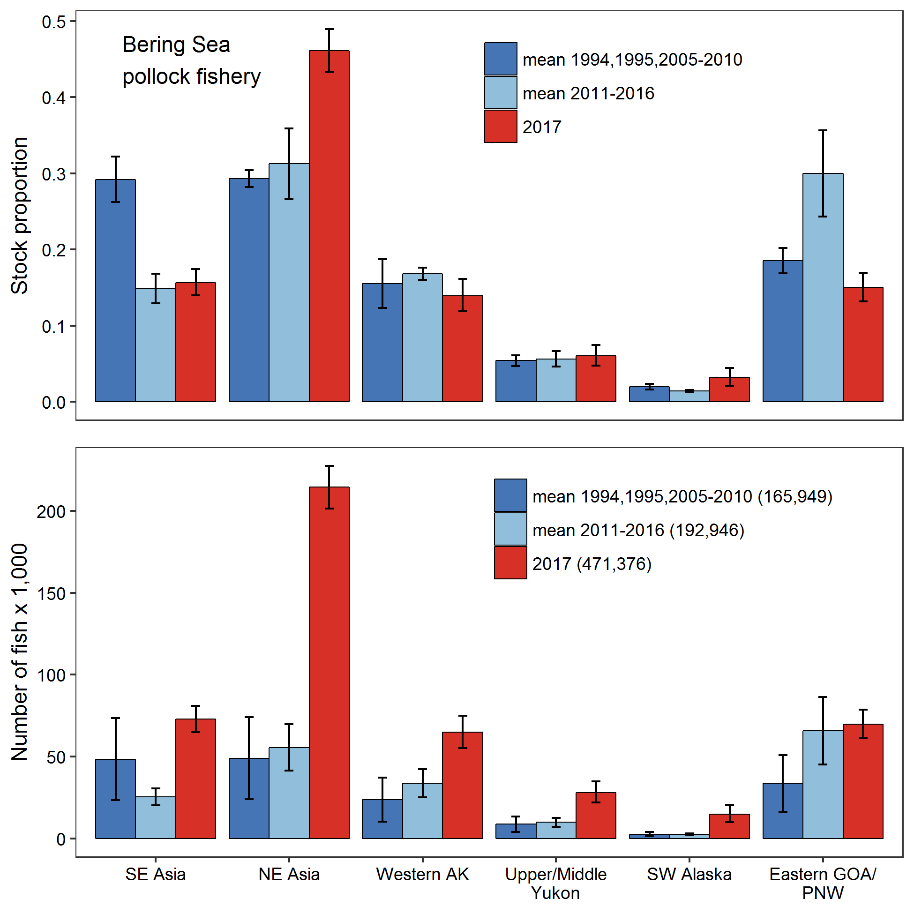
Stock estimates by year(s)
Bering Sea B-season
1994, 1995, 2005-2010
2011-2016
2017
Notes:
Stock estimates across years (proportions on top; numbers on bottom)
1994, 1995, 2005-2010 prior to representative sampling.
2011-2017 representative sampling.

Slide 13
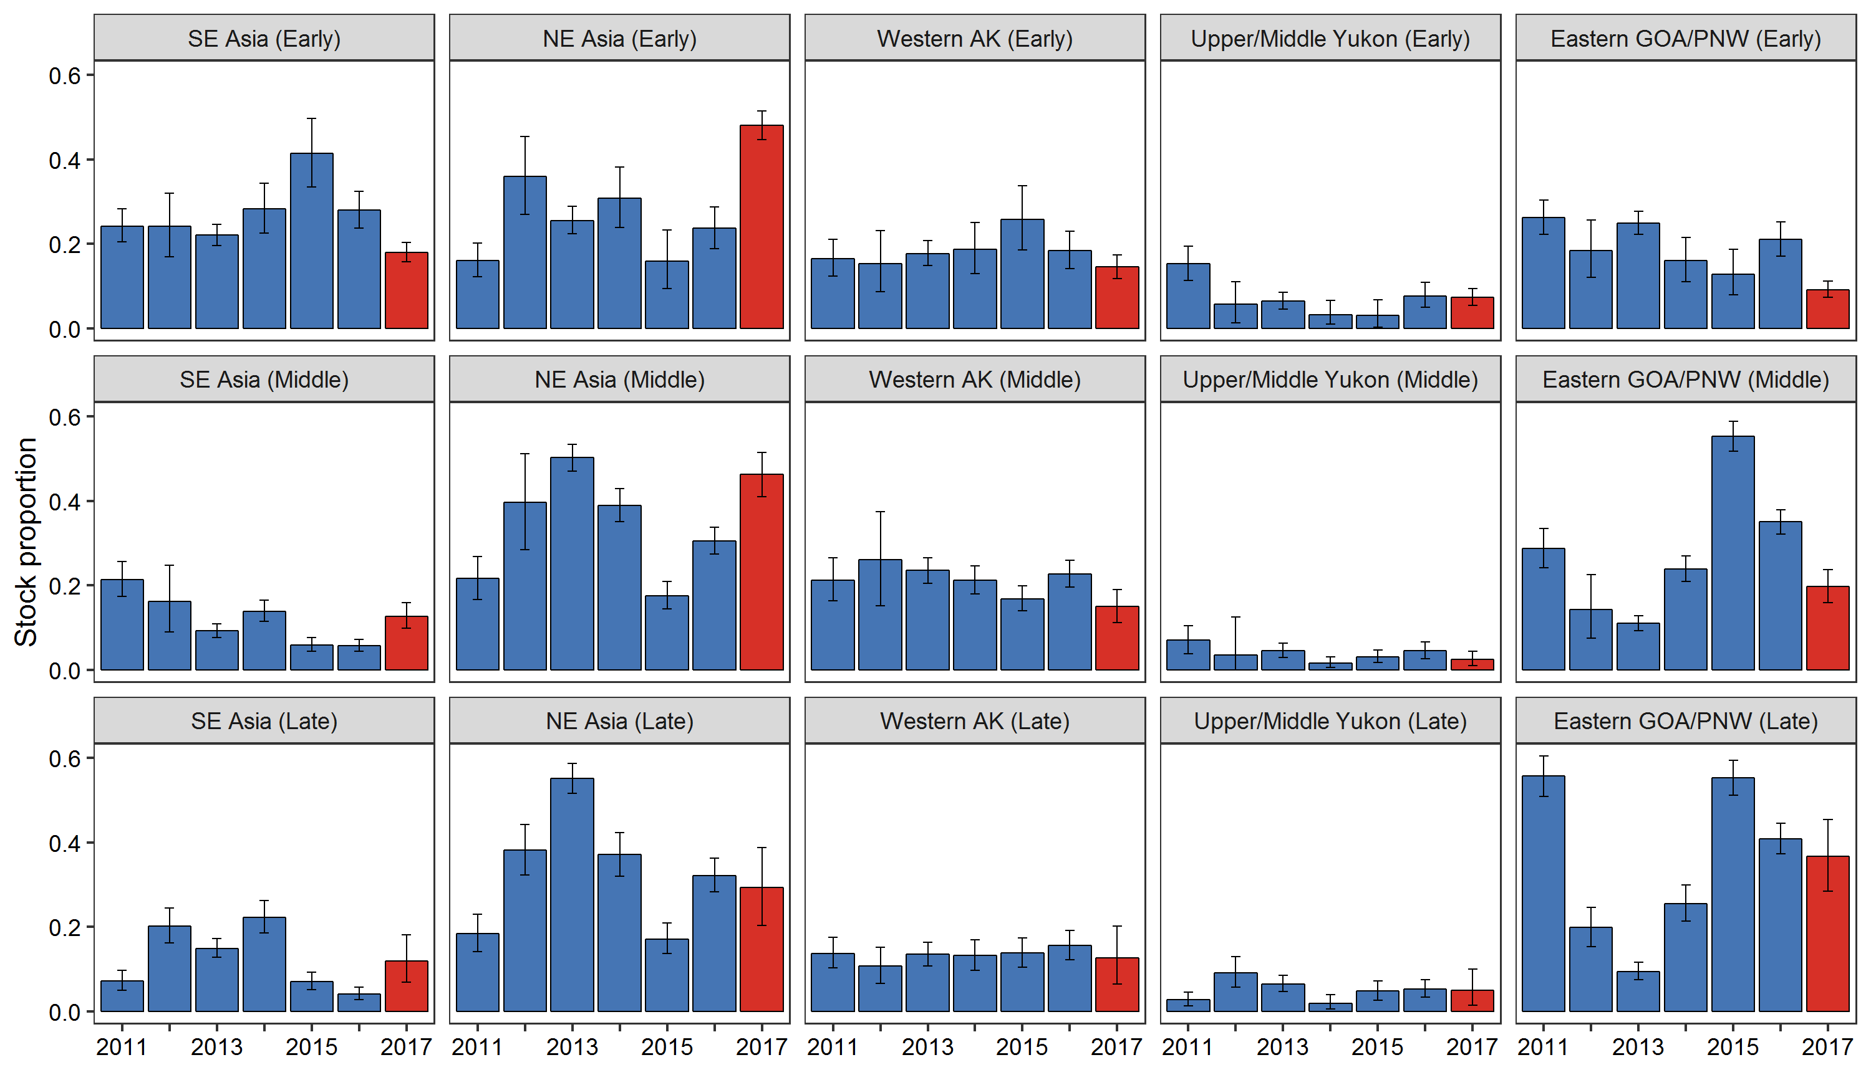
Stock estimates by year and season
2017 Bering Sea B-season, Early, Middle, Late
Notes:
Stock estimates for 2011-2017 by 3 time periods (Early, Middle, Late). 2017 in red.

Slide 14
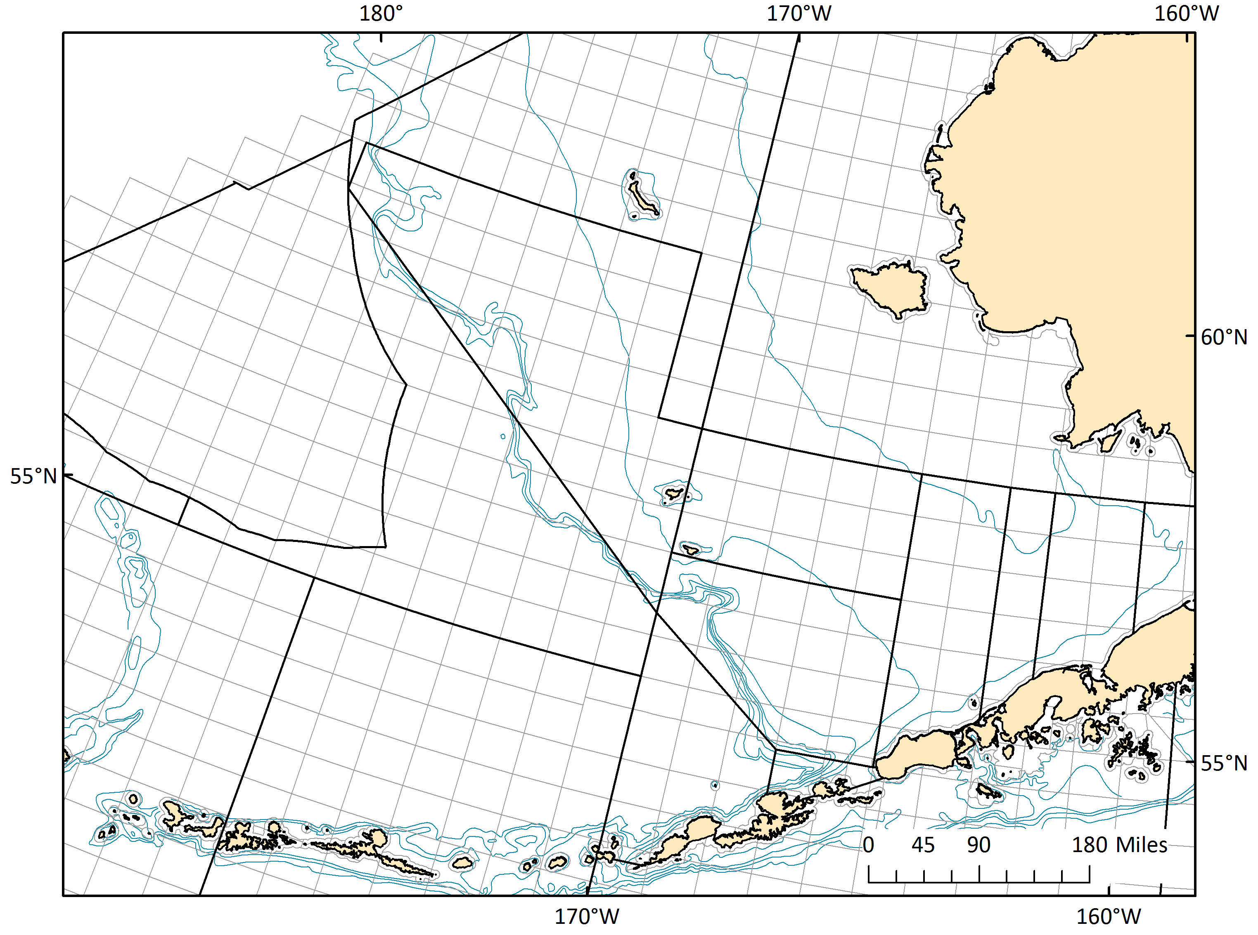
Stock estimates by area and season
2017 Bering Sea B-season, Early and Late for 4 spatial clusters
524
4
Sample size
too small
521
Bering Sea
3
523
2
1
509
516
512
518
Not confidential
Notes:
Stock estimates for 2017 by 4 spatial clusters and 2 time periods (week 24-32 and 33-42).
Sample size: Early 1,827 and Late 690
Samples were added to some strata to increase minimum sample size to ~200.
Stock estimates in these strata are not additive w/o weighting by total bycatch in each strata first!
2017 Figs & Tables-CK1.xlsx
2017 Chum bycatch map AKFIN not-confidential.PNG
2017 Figures Clusters.pptx

Slide 15
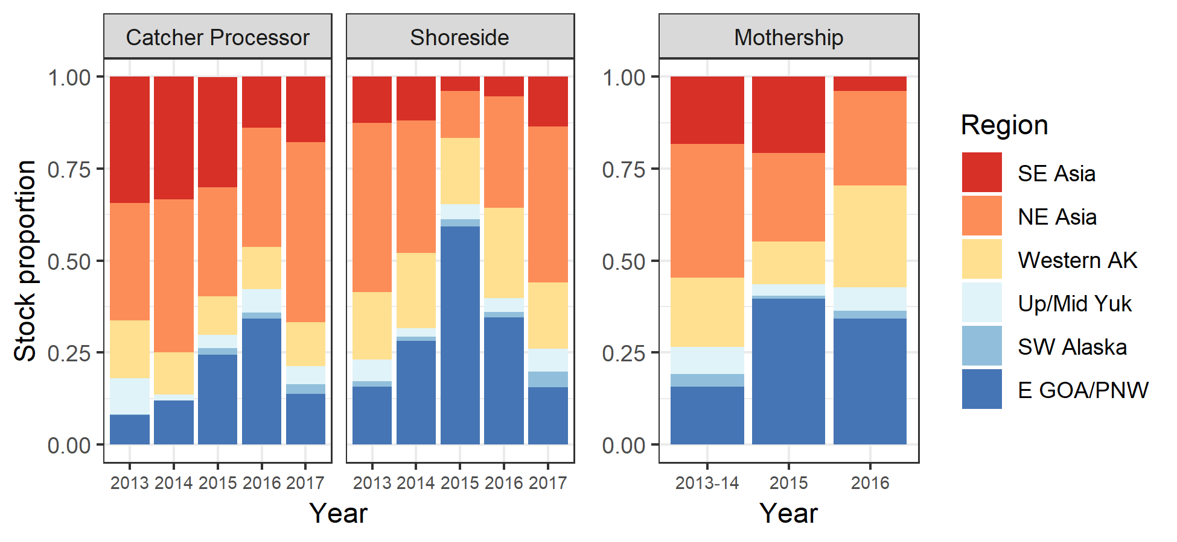
Stock estimates by fishing sector
Notes:
Stock estimates by fishing sectors, catcher-processor, shoreside, and mothership.
First time we have used this stratum.
John Gruver inquired about stock estimates by fishing sector.
Sector_stock_comp.png

Slide 16
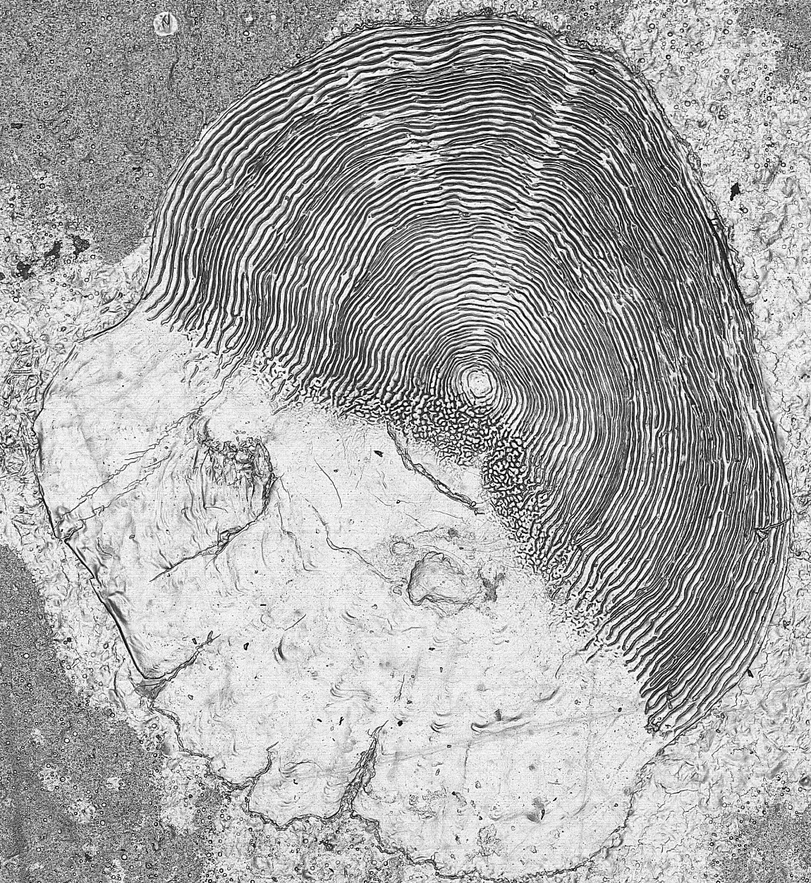
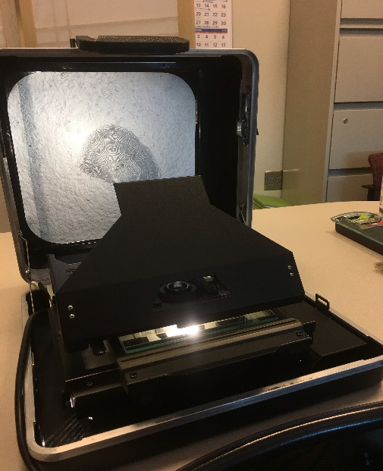
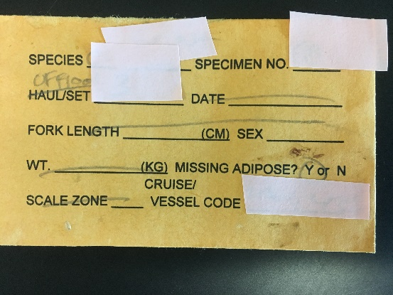
Age information
Observers collect scales for species ID and age
Value of age information (Dion Oxman)
Cannot accurately age chum salmon using body length
Today
  Length at age
  Inventory
  Trends
  Stock differences

Slide 17
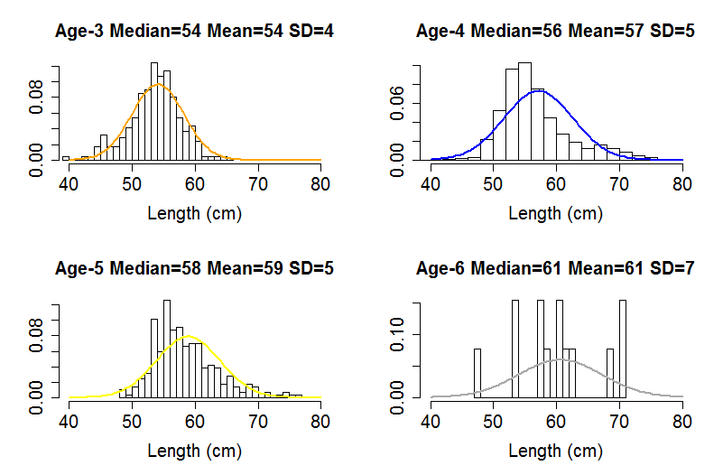
Length at age: lots of overlap
Notes:
Chum length at age distributions. Same x-axis, distributions overlap.

Slide 18
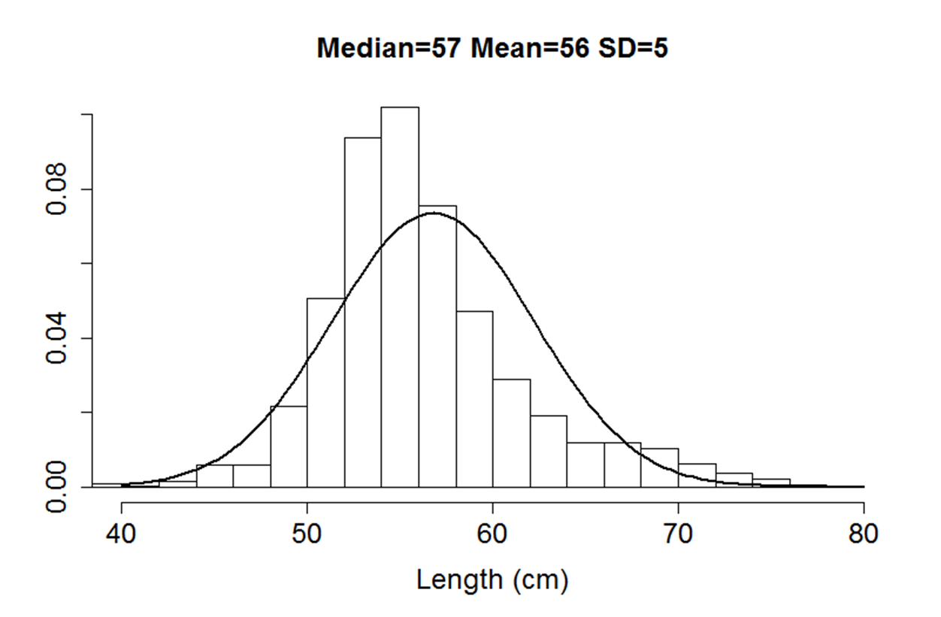
Length at age: lots of overlap
Notes:
Age 3-6 combined – one mode distribution!

Slide 19
Inventory of age data
Year | Aged | Hours | Sample
2005 | 3280 | 273 | genotyped
2006 | 1440 | 120 | genotyped
2007 | 1520 | 127 | genotyped
2008 | 720 | 60 | genotyped
2009 | 1800 | 150 | genotyped
2010 | 1360 | 113 | genotyped
2011 | 1920 | 160 | genotyped
2012 | 1440 | 120 | genotyped
2013 | 3920 | 327 | Full
2014 | 2200 | 183 | genotyped
2015 | 2400 | 200 | genotyped
2016 | 15240 | 1270 | Full
2017 | 2763 | 230 | genotyped
Total | 40,003 | 3333
Aged: Scales read for age 1997-2017.
Hours: Envelope to age takes 7 minutes/scale.
Sample:
Genotyped: Analyzed by geneticists
Full: Genotyped and non-genotyped. 2013 & 2016 to determine whether genotyped sample set has representative age.
Working on 2011 and 2012
Notes:
2013 cold year
2016 warm year

Slide 20
Trends in age composition
Preliminary results
Total age
Notes:
Preliminary age composition by year. Age 4 dominates, except in 2015, a warm “Blob” year with higher proportion of younger fish.

Slide 21
Stock estimates by age
2015-2017 Bering Sea B-season
Age-3
Age-4
Age-5
Notes:
Stock estimates by age for total bycatch in 2015-2017.
Annual differences in stock estimates for a given age.
There are differences between age within a year.

Slide 22
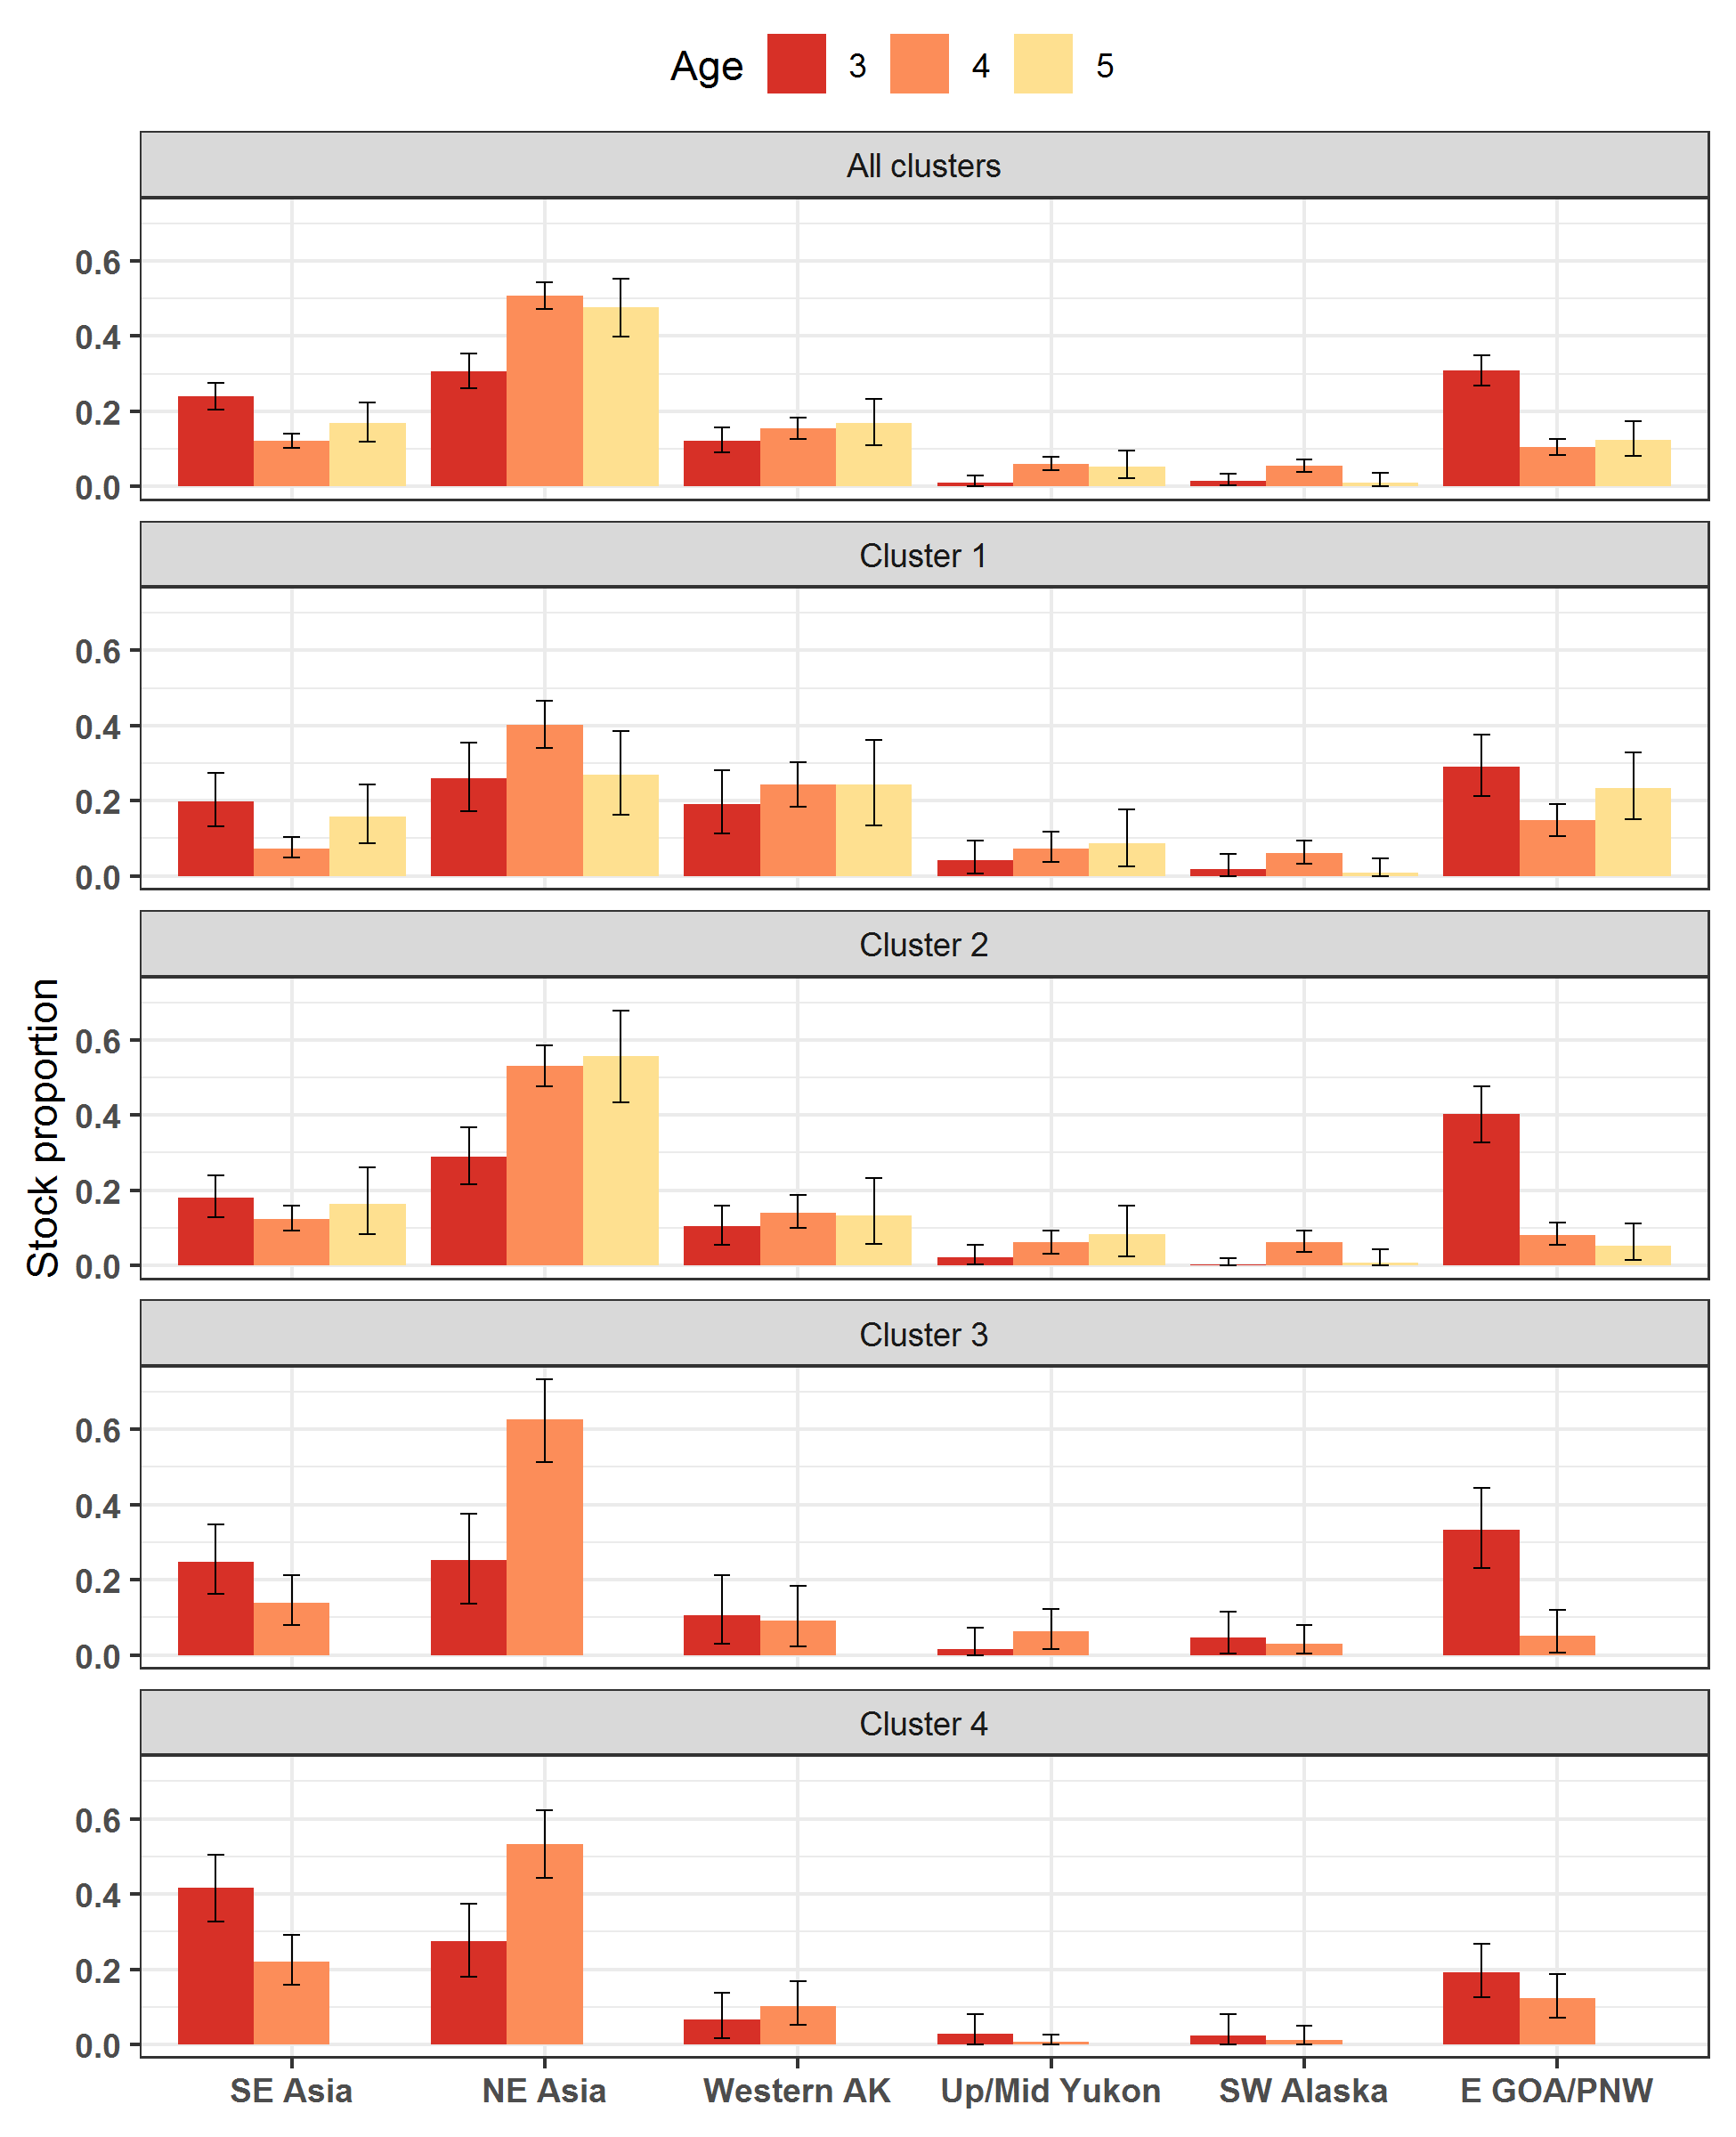
Stock estimates by age & area
2017 Bering Sea B-season
All clusters
Cluster 1-4
Notes:
Stock estimates by age for 2017 B-season samples, Total clusters, Clusters 1-4.
No 5-yr fish in Clusters 3-4 (northwest).
More 4-yr than 3-yr from Russia; reverse pattern from Japan and EGOA/PNW

Slide 23
Subsampling effects
Some years have high bycatch and we subsample the genetic samples received.
2013 stock estimates with different sample sizes.
Notes:
Large bycatches led us to explore effects of subsampling genetic samples Observers collected to balance good data and reasonable work load in the lab.
Stock estimates by sample size. Total was 3,880, ½ = 1940, ¼ = 970, 1/8 = 486. Every 30th, 60th, 120th, and 240th fish, respectively.
Gray crosses are the lowest and highest estimates of 2, 4, and 8 analyses.
All mean estimates fall within the 95% CI of the Total dataset, except WAK, for which the 1/8 estimate is just above the upper CI.
Often the minimum or maximum stock estimate of subsets lies outside of the total 95% CI.
In large bycatch years, we have been analyzing a subset of 1 in 4 genetic samples.
2013 ChumBY Subsampling comparisons.xlsx

Slide 24
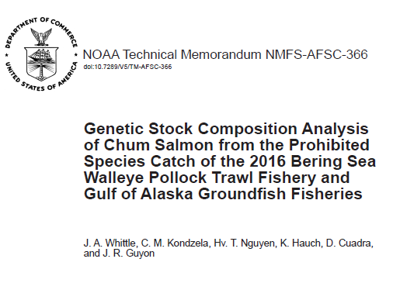
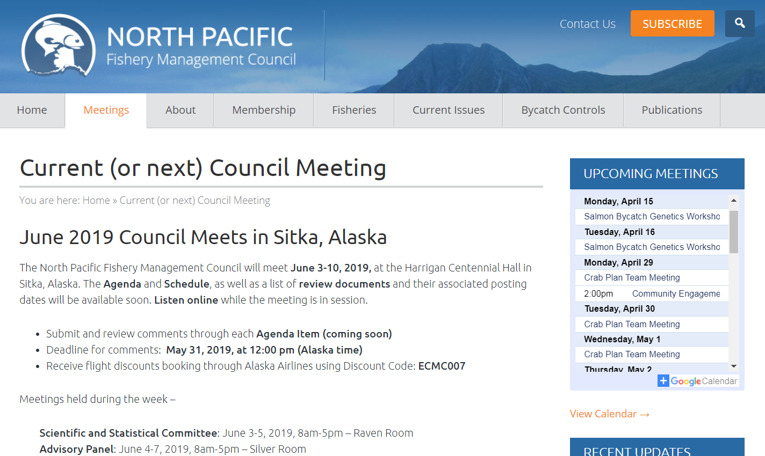
Bycatch reporting
Annual NOAA Tech Memoranda
Testimony at NPFMC, usually in April
Synthesis in progress
Rich dataset - multiple years of bycatch data.
Additional analyses to better understand the distribution of chum salmon stocks in the Bering Sea during the time and place groundfish fisheries occur.
Jordan will talk more about this.
Notes:
TMs usually out in January (2017 bycatch reported later than usual in 2019 due to the govt shutdown).
Moving toward standardizing reports to increase efficiency (Jordan Watson using R to make figures).
Testimony at NPFMC (usually in April, this year in June due to govt shutdown).
Looking to explore beyond annual reports.
There is quite a lot of distribution and stock information available about chum salmon from a fishery that intentionally avoids them!

Slide 25
Acknowledgements
ABL
Jeff Guyon
Jackie Whittle
Hanhvan Nguyen
Max Marsh
Dione Cuadra
Jordan Watson
Dave Nicholls
Kris Cieciel
Alaska Region
Jason Gasper
Jennifer Mondragon
Industry & NPFMC
ADFG
Dani Evenson
Chris Habicht
Andrew Munroe
Bill Templin
PSMFC
Rob Ames
Camille Kohler
Bob Ryznar
FMA
Observers
Julie Blair
Jennifer Cahalan
Glenn Campbell
Jennifer Ferdinand
Ren Narita
Lisa Thompson
Notes:
Many people over the years have contributed to processing and analyzing salmon bycatch.

Slide 26
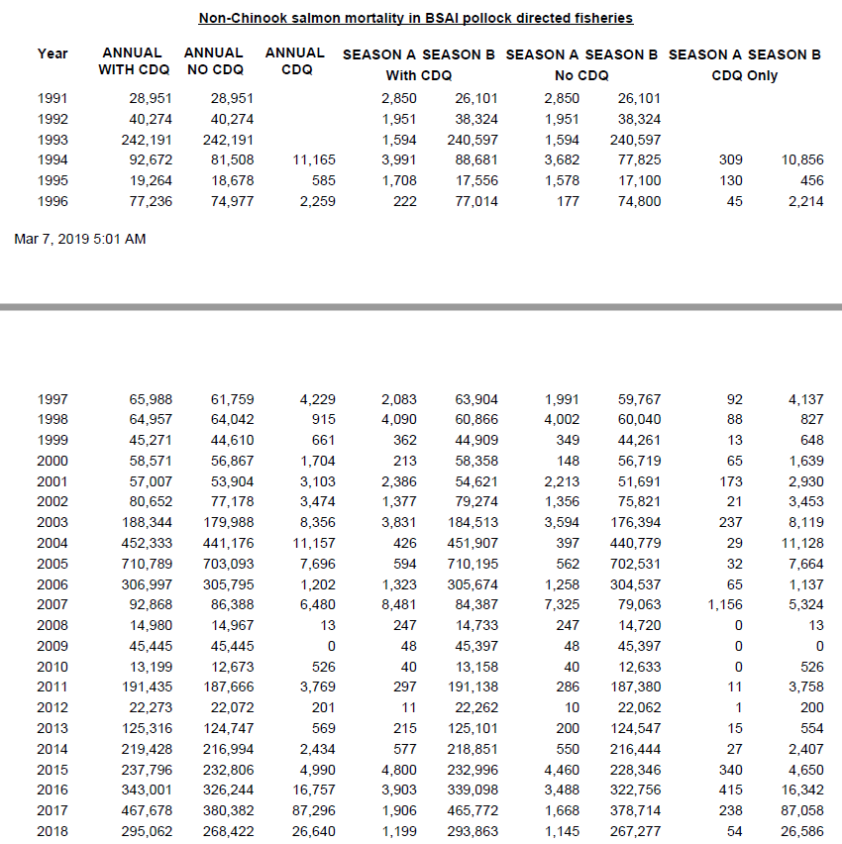
Chum mortality – AK Region Office
Notes:
Non-chinook (chum) bycatch by year from BSAI pollock-directed fisheries, from the Alaska Region website.
chum_salmon_mortality_2019-03-10.pdf

