Slide 1
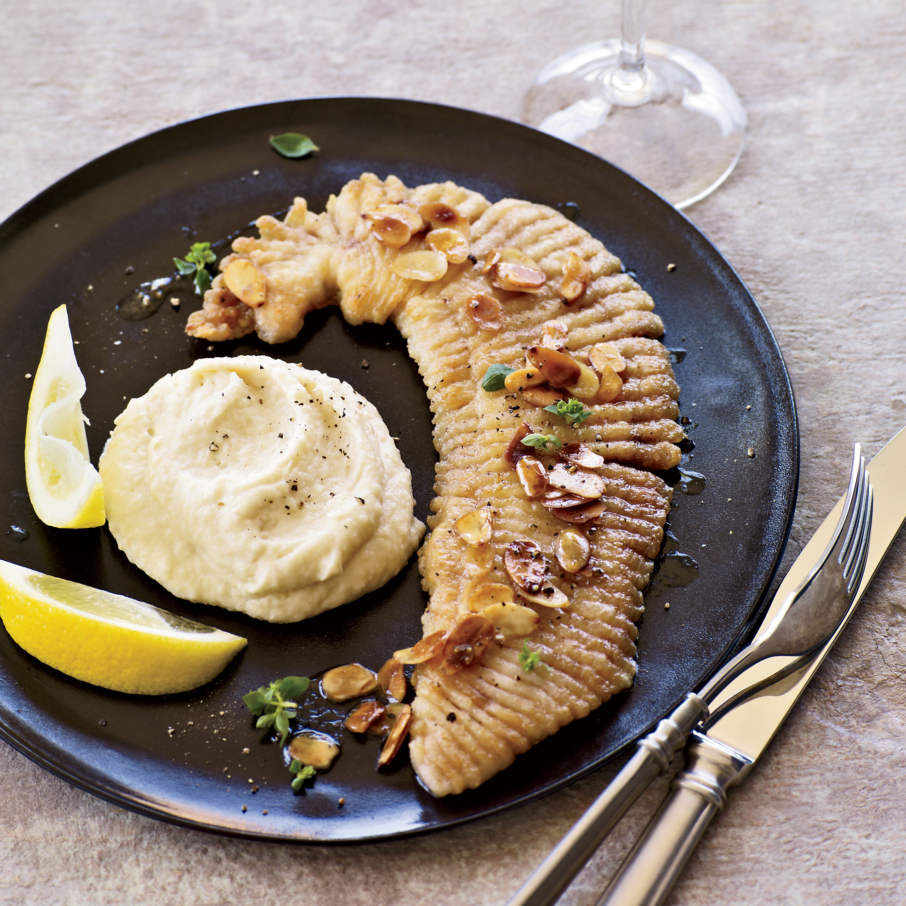
BSAI skate complex 2021 - partial
Olav A. Ormseth
Alaska Fisheries Science Center
NPFMC Groundfish Plan Team meeting, November 2021

Slide 2
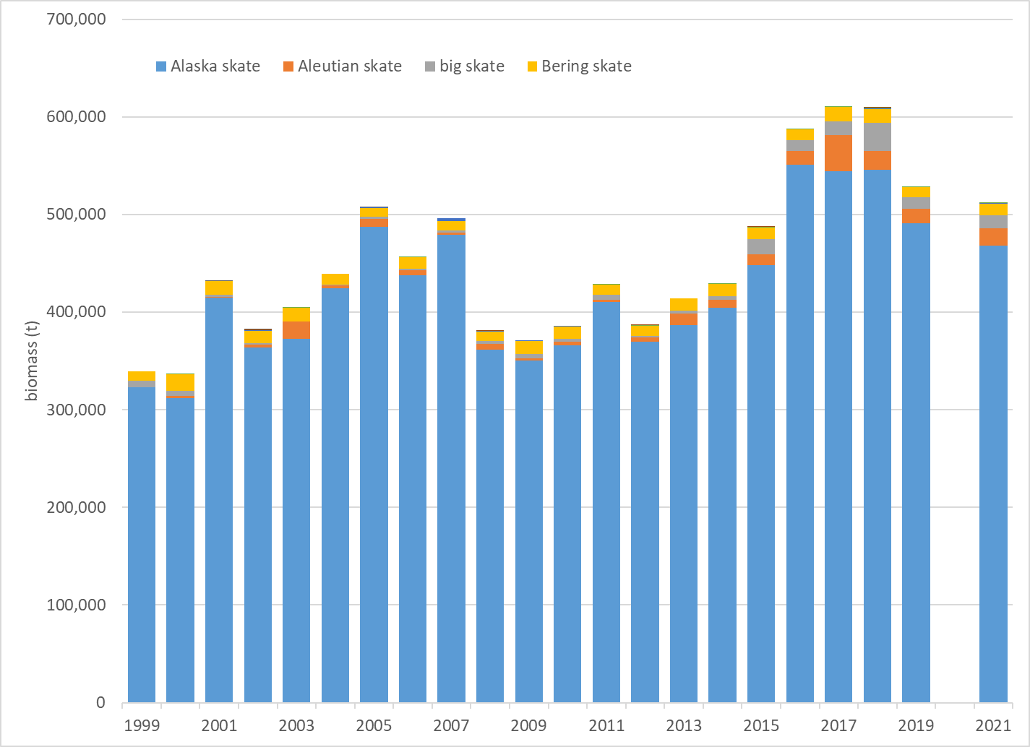
survey biomass – all skates

Slide 3
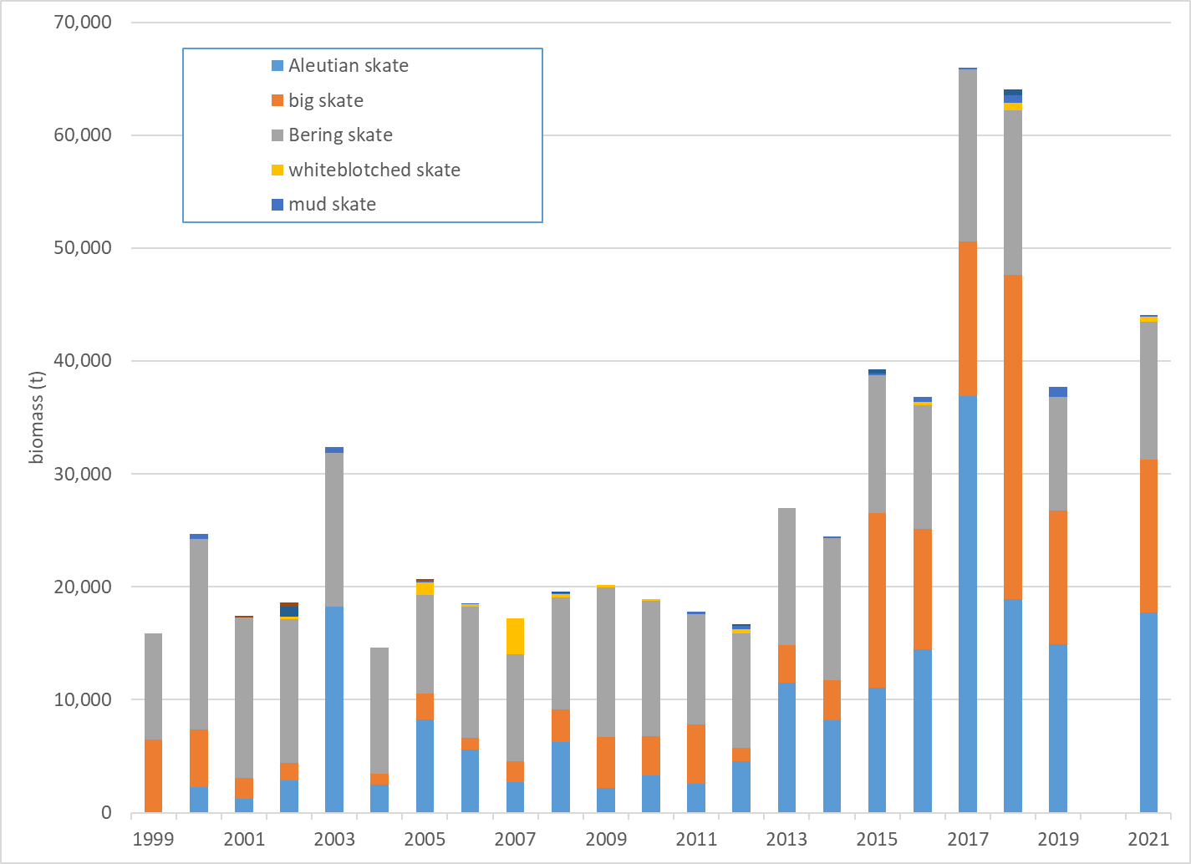
survey biomass – all except Alaska skate

Slide 4
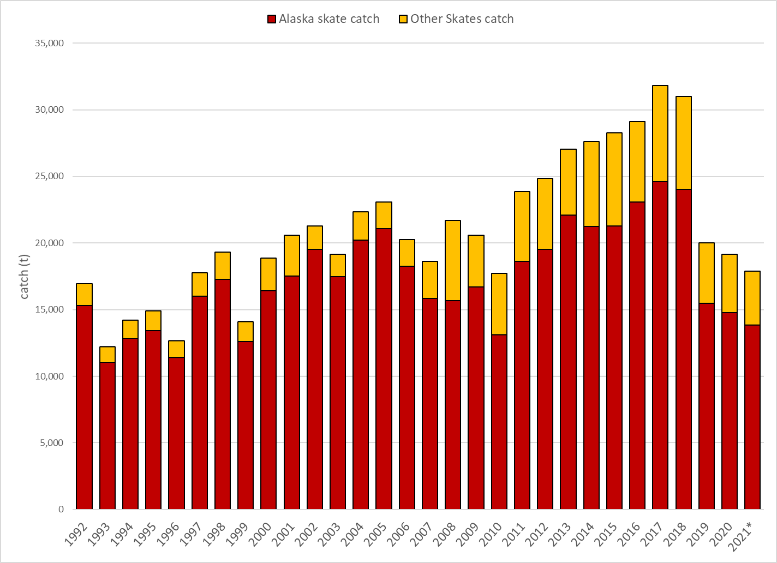
incidental catch

Slide 5
harvest recommendations

Slide 6
harvest recommendations

