Slide 1


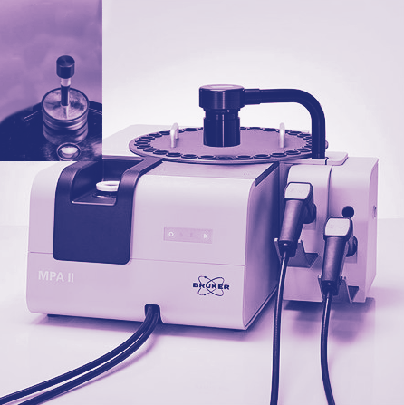

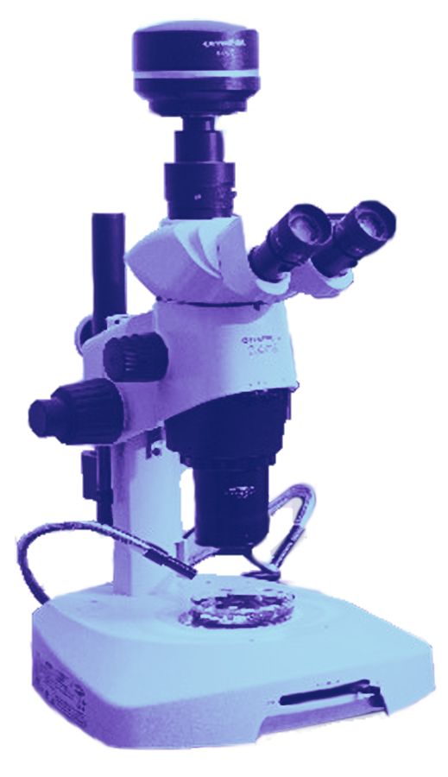
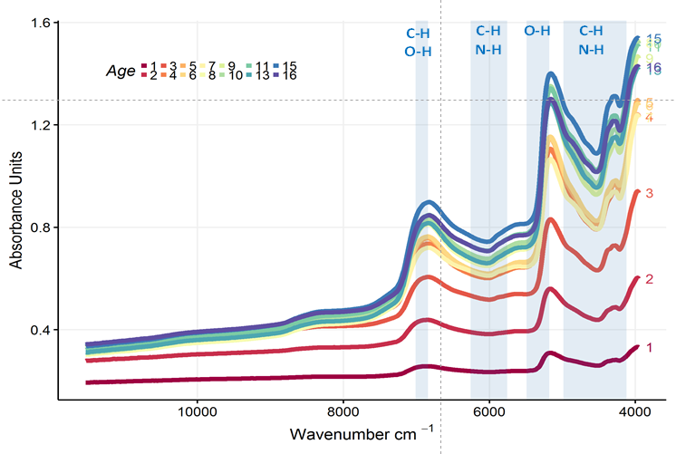
WORKSHOP: Rapid Estimation of
Fish Age Using Fourier-transform
Near Infrared Spectroscopy (FT-NIRS)
Virtual attendance
via Webex
is also be available
Monday, 3 April
1:00 PM – 1:30 PM | WELCOME AND INTRODUCTIONS
1:30 PM – 2:30 PM | NOAA Fisheries FT-NIRS Fish Ageing Strategic Initiative: Past, present & future (Thomas Helser, AFSC — Seattle Lab)
2:30 PM – 5:30 PM | Session 1: AFSC Spectroscopy Lab Tour & demonstration (Bruker Applications Scientist - Jason Erikson). AFSC, Building 4 Room 1111
5:00 | Informal social: Burke Gilman Brewing Company, 3626 NE 45th Street, Suite 102
Wednesday, 5 April
Presentations cont.
9:00 AM – 9:30 AM | Developing NIR sampling methodology for modeling species discrimination in live catfish for aquaculture (Carrie Vance – Mississippi State University)
9:30 AM – 10:00 AM | Fourier transform near infrared spectroscopy discriminates archived otoliths of newly detected cryptic species, Etelis carbunculus and Etelis boweni (Kristen Dahl, PIFSC)
 | FT-NIRS IMPLEMENTATION
10:00 AM – 10:30 AM | Trials and tribulations of using FT-NIRS on Pacific Sardine: Method development for scanning Pacific Sardine otoliths (Emma Saas, SWFSC – La Jolla Lab)
10:30 AM – 11:00 AM | Benefits and challenges of using FT-NIR spectroscopy for age estimation at the Northeast Fisheries Science Center (Eric Robillard, NEFSC – Woods Hole Lab)
Break
11:30 AM – 12:00 PM | FT-NIR spectroscopy of otoliths coupled with deep machine learning to improve age prediction (Irina Benson, AFSC – Seattle Lab)
12:00 PM – 12:30 PM | Automatic fish age prediction using deep machine learning: combining otolith image, NIR spectra and metadata features (Aotian Zheng – University of Washington)
12:30 PM – 1:00 PM | Calibration and variation of FT-NIRS otolith spectra among NIR spectrometers and species (Andy Ostrowski, SEFSC – Beaufort Lab)
Lunch
2:00 PM – 2:30 PM | A simulation study exploring best practices for model development and updating (Morgan Arrington, CICOES-AFSC)
2:30 PM – 3:00 PM | Database architecture and management envisioned for the FT-NIRS paradigm at Alaska Fisheries Science Center (Jon Short, AFSC – Seattle Lab)
3:00 PM – 3:30 PM | Group discussion: Likelihood of operational success, timeline for operational readiness and communication to stake holders (follow up on Friday, April 7 at 9:00 AM)
3:30 PM – 5:30 PM | Session 2: AFSC Spectroscopy Lab Tour & demonstration (Bruker Applications Scientist – Jason Erikson). AFSC, Building 4 Room 1111
6:00 PM – 10:00 PM | Organized social mixer and casual dinner – Elliot Bay Public House & Brewery 12537 Lake City Way, NE., Seattle WA 98125
Tuesday, 4 April
Presentations | FT-NIRS APPLICATION DEVELOPMENT
9:00 AM – 9:30 AM | FT-NIRS age prediction of eastern Bering Sea yellowfin sole: a case study of a moderately long-lived flatfish (Todd TenBrink, AFSC – Seattle Lab)
9:30 AM – 10:00 AM | A preliminary analysis and review of FT-NIR spectroscopy and DNA CpG site methylation for fish age prediction (Laurel Lam, NWFSC – Seattle Lab)
10:00 AM – 10:30 AM | Applying FT-NIRS predictive ageing to different genetic stocks of white grunt (Haemulon plumierii) within the U.S. South Atlantic (Jamie Clark, SEFSC – Beaufort Lab)
Break
11:00 AM – 11:30 AM | A novel approach for determining the spawning phenology of walleye pollock using Raman spectroscopy (Sandi Neidetcher, AFSC – Seattle Lab)
11:30 AM – 12:00 PM | FT-NIRS ageing of finfish and shark species in the northwest Atlantic (Alex Rubin, NEFSC – Narragansett Lab)
12:00 PM – 12:30 PM | Exploration of FT-NIRS for shortbelly rockfish (Sebastes jordani): an ecologically important forage fish off the coast of California (Jessica Choi, SWFSC – Santa Cruz Lab)
Lunch
2:00 PM – 2:30 PM | Investigating the use of FT-NIR spectroscopy to age gag (Mycteroperca microlepis), a protogynous hermaphroditic species (Beverly Barnett, SEFSC – Panama City Lab)
2:30 PM – 3:00 PM | Exploring the use of FT-NIRS for ageing sablefish (Anoplomona fimbria) and Pacific hake (Merluccius Productus) of the U.S. west coast (John Wallace, NWFSC – Seattle)
3:00 PM – 3:30 PM | Developing spectroscopy approaches to measure life history characteristics of fish throughout ontogeny (Esther Goldstein, AFSC – Seattle, Lab)
Break
4:00 PM – 4:30 PM | Rapid daily age estimation of juvenile walleye Pollock in the Gulf of Alaska using FT-NIR spectroscopy (Beth Matta, AFSC – Seattle Lab)
4:30 PM – 5:00 PM | Fish otolith proteomics and its relationship and impact on the use of FT-NIR spectroscopy for fish age prediction (Oliver Thomas, University of Melbourne)
Close
Thursday, 6 April
Presentations cont. | FT-NIRS STOCK ASSESSMENT INTEGRATION
9:00 AM – 10:00 AM | Envisioning the future of production fish ageing: end-to-end integration of the FT-NIRS age estimation enterprise (Thomas Helser, AFSC – Seattle Lab)
10:00 AM – 10:30 AM | A simulation framework to examine the effect of ageing error on model-based age predictions (Morgan Arrington, CICOES-AFSC)
Break
11:00 AM – 11:30 PM | Integration of FT-NIRS age data products into the eastern Bering Sea walleye pollock and Pacific cod stock assessments (Thomas Helser, AFSC – Seattle Lab)
Lunch
1:00 PM –1:30 PM | Efficacy of FT-NIRS predicted ages for use in the Gulf of Mexico gray snapper stock assessment (Steve Garner, SEFSC – Panama City Lab)
1:30 PM – 5:00 PM | Open discussion with national stock assessment forum
Friday, 7 April
 | FT-NIRS STRATEGIC INITIATIVE BUSINESS
9:00 AM – 10:30 AM | Wrap up - open discussion
Break
10:30 AM – 12:00 PM | FT-NIR strategic initiative business and budget meeting
Meeting Adjourn
April 3–7, 2023
NOAA Western Regional Campus, Alaska Fisheries Science Center
7600 Sand Point Way, NE, Building 9 Auditorium, Seattle, WA 98115

