Slide 1
North Pacific Groundfish Observer Program
Salmon Genetics Sampling Methods
NPFMC Salmon Bycatch Workshop
April 15 – 16, 2019
Alaska Fishery Science Center, Seattle
Presented by
Jennifer Cahalan
Pacific States Marine Fisheries Commission
Marlon Concepcion
Fisheries Monitoring and Analysis Division, AFSC, NMFS

Slide 2
Observer-Collected Data
Effort and Fishing Locations
Species Composition
Length Distributions
Age Structure Collections
Diet
Maturity
Marine Mammal Interactions
Seabird Interactions
Tissue Samples (Genetics)
Primary Recipients:
Alaska Regional Office
International Pacific Halibut Commission
Alaska Fisheries Science Center
North Pacific Fishery Management Council
Fishing Industry
PSMFC AKFIN Database
Secondary Recipients:
State and Federal Agencies:
  NOAA Fisheries HQ
  USFW, USGS,
  Sea Grant
Other Organizations
  Researchers, Universities

Slide 3
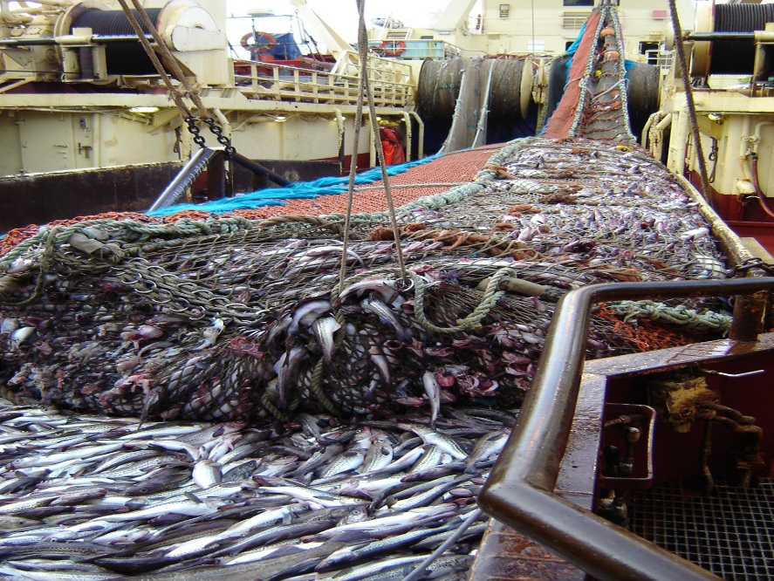
Stratified Sampling Design
Full Coverage: All trips observed (3,422 trips)
  29.5% of fishing trips
  CPs, Motherships, and Vessels in LAPs
Partial Coverage: Randomized deployments
  Selection rate - Annual Deployment Plan
  Catcher Vessels over 40ft (5,468 trips – 47%)
    Gear-based strata
  Catcher Vessels under 40ft (2,022 trips – 17.5%)
    0% trips monitored
  EM Catcher Vessels (683 trips – 6%)
    Regulated program in 2018 longline; 2019 pot gear
ALASKA FISHERIES SCIENCE CENTER and ALASKA REGIONAL OFFICE. 2018. North Pacific Observer Program 2017 Annual Report. AFSC Processed Rep. 2018-02, 136 p.

Slide 4
Annual Deployment Cycle
Review previous year deployment (2017)
  Representativeness of selected trips
  Spatial and temporal coverage (gaps)
    Departures from expectations
  Trip characteristics
    Differences observed and unobserved
Design for next year (2019)
  Strata definitions
  Sample allocation
    Base deployment rate – minimize gaps
    Additional allocation to meet Council priorities – if funding available

Slide 5
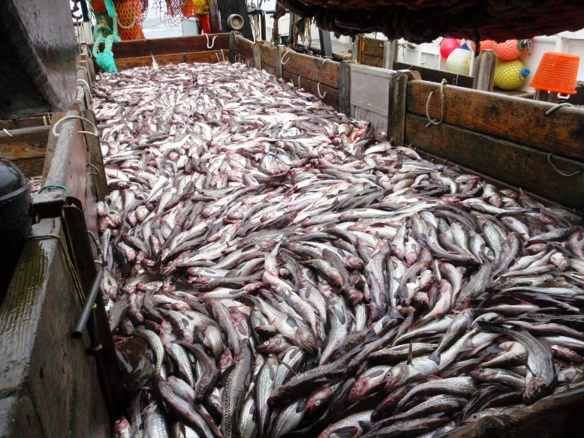
Hierarchical Sampling
Random selection of trips
Selection by Observer Program (ADP)
Fishing Effort and Location for all hauls
Research Projects
Special Data Collections
Random sample of hauls
Total catch
Protected & Prohibited Species Data
Random sample of the catch of each haul
Species Composition Data
Inclusive of protected & prohibited species in samples
Ecosystem components
Higher Resolution Species Identification (subsamples)
Random sample of individual fish
Length and Age distributions
Maturity data
Data for ecosystem modeling (diet)
Other Biological Specimens

Slide 6
Salmon Tissue (genetics) Collection Methods
Salmon genetics special project
  BSAI pollock B-season (June – November)
  Collect tissues from 25–30 Chinook & chum salmon per 90 day deployment
  Haphazard selection methods
2005
2005
2007
2009
2011
2013
2015
2017
Faunce, C. H. 2015. Evolution of observer methods to obtain genetic material from Chinook salmon bycatch in the Alaska pollock fishery. U.S. Dep. Commer., NOAA Tech. Memo. NMFS-AFSC-288, 28 p. doi:10.7289/V5MG7MFF. http://www.afsc.noaa.gov/Publications/AFSC-TM/NOAA-TM-AFSC-288.pdf

Slide 7
Salmon Tissue (genetics) Collection Methods
Salmon genetics special project
  BSAI pollock B-season (June – November)
  Collect tissues from 60 Chinook & chum salmon per 90 day deployment
  Haphazard selection methods
2006 - 2007
2005
2007
2009
2011
2013
2015
2017
Faunce, C. H. 2015. Evolution of observer methods to obtain genetic material from Chinook salmon bycatch in the Alaska pollock fishery. U.S. Dep. Commer., NOAA Tech. Memo. NMFS-AFSC-288, 28 p. doi:10.7289/V5MG7MFF. http://www.afsc.noaa.gov/Publications/AFSC-TM/NOAA-TM-AFSC-288.pdf

Slide 8
Salmon Tissue (genetics) Collection Methods
Salmon genetics special project
  BSAI & GOA pollock fisheries (full year)
  Collect tissues from 120 Chinook & chum salmon per 90 day deployment
  Haphazard selection methods
2008
2005
2007
2009
2011
2013
2015
2017
Faunce, C. H. 2015. Evolution of observer methods to obtain genetic material from Chinook salmon bycatch in the Alaska pollock fishery. U.S. Dep. Commer., NOAA Tech. Memo. NMFS-AFSC-288, 28 p. doi:10.7289/V5MG7MFF. http://www.afsc.noaa.gov/Publications/AFSC-TM/NOAA-TM-AFSC-288.pdf

Slide 9
Salmon Tissue (genetics) Collection Methods
Salmon genetics special project
  BSAI & GOA pollock fisheries (full year)
  Collect tissues from every Chinook and chum salmon
    At-sea: In all samples
    Shoreside: In 5min of every hour (up to 60 min)
2009 - 2010
2005
2007
2009
2011
2013
2015
2017
Faunce, C. H. 2015. Evolution of observer methods to obtain genetic material from Chinook salmon bycatch in the Alaska pollock fishery. U.S. Dep. Commer., NOAA Tech. Memo. NMFS-AFSC-288, 28 p. doi:10.7289/V5MG7MFF. http://www.afsc.noaa.gov/Publications/AFSC-TM/NOAA-TM-AFSC-288.pdf

Slide 10
Salmon Tissue (genetics) Collection Methods
Amendment 91 BSAI FMP
BSAI pollock fishery
  Collect tissues from
    1 of 10 Chinook salmon
    1 in 30 chum salmon
  Full coverage
  At-sea (CP/Ms) & shoreside (CVs)
GOA pollock fisheries
  Collect tissues from
    1 of 10 Chinook salmon
    1 of 30 chum salmon
  At-sea sampled Hauls
  Shoreside observed trips
    (partial coverage)
2011
2005
2007
2009
2011
2013
2015
2017
Faunce, C. H. 2015. Evolution of observer methods to obtain genetic material from Chinook salmon bycatch in the Alaska pollock fishery. U.S. Dep. Commer., NOAA Tech. Memo. NMFS-AFSC-288, 28 p. doi:10.7289/V5MG7MFF. http://www.afsc.noaa.gov/Publications/AFSC-TM/NOAA-TM-AFSC-288.pdf

Slide 11
Salmon Tissue (genetics) Collection Methods
BSAI pollock fishery (A91)
  Collect tissues from
    1 of 10 Chinook salmon
    1 in 30 chum salmon
  Full coverage
  At-sea (CP/Ms) & shoreside (CVs)
GOA pollock fisheries
  Collect tissues from
    1 of 10 Chinook salmon
    1 of 30 chum salmon
  Observed trips (partial coverage)
  Shoreside only
2012 - 2013
2005
2007
2009
2011
2013
2015
2017
Faunce, C. H. 2015. Evolution of observer methods to obtain genetic material from Chinook salmon bycatch in the Alaska pollock fishery. U.S. Dep. Commer., NOAA Tech. Memo. NMFS-AFSC-288, 28 p. doi:10.7289/V5MG7MFF. http://www.afsc.noaa.gov/Publications/AFSC-TM/NOAA-TM-AFSC-288.pdf

Slide 12
Salmon Tissue (genetics) Collection Methods
BSAI pollock fishery (A91)
  Collect tissues from
    1 of 10 Chinook salmon
    1 in 30 chum salmon
  Full coverage
  At-sea (CP/Ms) & shoreside (CVs)
Amendment 93 GOA FMP (2013)
GOA pollock fisheries
  Collect tissues from every Chinook and chum salmon
    At-sea samples
    Shoreside observed trips
    (partial coverage)
2014 - 2015
2005
2007
2009
2011
2013
2015
2017
Faunce, C. H. 2015. Evolution of observer methods to obtain genetic material from Chinook salmon bycatch in the Alaska pollock fishery. U.S. Dep. Commer., NOAA Tech. Memo. NMFS-AFSC-288, 28 p. doi:10.7289/V5MG7MFF. http://www.afsc.noaa.gov/Publications/AFSC-TM/NOAA-TM-AFSC-288.pdf

Slide 13
Salmon Tissue (genetics) Collection Methods
BSAI pollock fishery (A91)
  Collect tissues from
    1 of 10 Chinook salmon
    1 in 30 chum salmon
  Full coverage
  At-sea (CPs) & shoreside (CVs)
GOA pollock fisheries (A93)
  Collect tissues from every Chinook and chum salmon
    At-sea samples
    Shoreside observed trips
    (partial coverage)
2016 - 2019
2005
2007
2009
2011
2013
2015
2017
Faunce, C. H. 2015. Evolution of observer methods to obtain genetic material from Chinook salmon bycatch in the Alaska pollock fishery. U.S. Dep. Commer., NOAA Tech. Memo. NMFS-AFSC-288, 28 p. doi:10.7289/V5MG7MFF. http://www.afsc.noaa.gov/Publications/AFSC-TM/NOAA-TM-AFSC-288.pdf

Slide 14
Salmon Specific Data Collections
Amendment 91 Bering Sea pollock
Complete enumeration of all bycaught salmon
  Industry sorts and retains all salmon until counted by observer
Biological Data collected (designated salmon collection box)
  All species
    Sex, length, weight data
    FMA ID scale
    Snouts if adipose fin clipped
  King and Chum salmon
    Data from systematic random sample ONLY (Pella and Geiger, 2009)
    Every 10th Chinook salmon; Every 30th Chum salmon
    Tissue sample for genetic analysis (PAP + scales)

Slide 15
Salmon Specific Data Collections
Bering Sea non-pollock vessels
Salmon in samples
  Vessel observer identifies species, counts, weights, and determines sex
Biological Data collected
  All species
    Sex, length, weight data
    FMA ID scale
    Snouts if adipose fin clipped

Slide 16
Salmon Specific Data Collections
Amendment 93 Gulf of Alaska pollock
Complete enumeration of all bycaught salmon on observed trips
  All salmon counted by vessel observer shoreside
  At sea collect biological data from salmon in sample (only)
  At plant collect biological data from all Chinook and chum salmon
Biological data collections
  Chinook and chum salmon
    Tissue sample (PAP + scales)
    FMA ID scale every 20th salmon
    Sex, length, weight data, snout if adipose fin clipped
  Other salmon species
    FMA ID scale
    Sex, length, weight data, snouts if adipose fin clipped

Slide 17
BSAI
GOA
Pollock Fishery (A91)
Non-pollock fisheries
Pollock Fishery (A93-CV)
Non-pollock fisheries
CP/Ms (haul level) Plants (*offload level)
All vessels (sample level)
Sample level (@ sea) Offload level (@ plant
All vessels (sample level)
King /Chum
Other species
All species
King/Chum
Other species
King/Chum
Other species
Genetics(10th/30th)
-S/L/W
-FMA ID Scales (20 chum per vessel/cruise)
-Snout if no adipose fin
-S/L/W
-FMA ID Scales
-Snout if no adipose fin
-S/L/W
-FMA ID Scales
-Snout if no adipose fin
-Genetics
-S/L/W
-FMA ID Scales
(every 20th)
-Snout if no adipose fin
-S/L/W
-FMA ID Scales
-Snout if no adipose fin
-Genetics
-S/L/W
-FMA ID Scales
(every 20th)
-Snout if no adipose fin
-S/L/W
-FMA ID Scales
-Snout if no adipose fin
All species
CVs (@ sea, sample level)
-S/L/W
-FMA ID Scales
-Snout if no adipose fin
*Salmon delivered by BSAI pollock CVs

Slide 18
BSAI
BSAI
GOA
Pollock Fishery (A91)
Non-pollock fisheries
Pollock Fishery (A93-CV)
Non-pollock fisheries
Pollock Fishery (A91)
CP/Ms (haul level) Plants (*offload level)
Sample level (@ sea) Offload level (@ plant
CP/Ms (haul level) Plants (*offload level)
All vessels (sample level)
All vessels (sample level)
King /Chum
Other species
All species
King/Chum
Other species
King /Chum
King/Chum
Other species
Genetics(10th/30th)
-S/L/W
-FMA ID Scales (20 chum per vessel/cruise)
-Snout if no adipose fin
-S/L/W
-FMA ID Scales
-Snout if no adipose fin
-S/L/W
-FMA ID Scales
-Snout if no adipose fin
-Genetics
-S/L/W
-FMA ID Scales
(every 20th)
-Snout if no adipose fin
-S/L/W
-FMA ID Scales
-Snout if no adipose fin
-Genetics
-S/L/W
-FMA ID Scales
(every 20th)
-Snout if no adipose fin
-S/L/W
-FMA ID Scales
-Snout if no adipose fin
All species
CVs (@ sea, sample level)
-S/L/W
-FMA ID Scales
-Snout if no adipose fin
*Salmon delivered by BSAI pollock CVs

Slide 19
BSAI
GOA
Pollock Fishery (A91)
Non-pollock fisheries
Pollock Fishery (A93-CV)
Non-pollock fisheries
CP/Ms (haul level) Plants (*offload level)
All vessels (sample level)
Sample level (@ sea) Offload level (@ plant
All vessels (sample level)
King /Chum
Other species
All species
King/Chum
Other species
King/Chum
Other species
Genetics(10th/30th)
-S/L/W
-FMA ID Scales (20 chum per vessel/cruise)
-Snout if no adipose fin
-S/L/W
-FMA ID Scales
-Snout if no adipose fin
-S/L/W
-FMA ID Scales
-Snout if no adipose fin
-Genetics
-S/L/W
-FMA ID Scales
(every 20th)
-Snout if no adipose fin
-S/L/W
-FMA ID Scales
-Snout if no adipose fin
-Genetics
-S/L/W
-FMA ID Scales
(every 20th)
-Snout if no adipose fin
-S/L/W
-FMA ID Scales
-Snout if no adipose fin
All species
CVs (@ sea, sample level)
-S/L/W
-FMA ID Scales
-Snout if no adipose fin
*Salmon delivered by BSAI pollock CVs

Slide 20
Two Regions - Two Data Collection Methods
Bering Sea/Aleutian Island Pollock Fishery
Gulf of Alaska Pollock Fishery
Full coverage
  Observer has access to all salmon
Access to all salmon
  Bycatch estimate – complete enumeration
Observers in plants
  Plant observer collects data
  Enumerates retained salmon
Genetics sample directly from bycatch (SYS)
  1 of 10 Chinook salmon
  1 of 30 chum salmon
Partial coverage
  Access to salmon on observed trips
Access to salmon on observer trips
  Bycatch estimate – observed rate to landings
No Observers in plants
  Vessel observer collects data
  Enumerates of retained salmon
Genetics sample from portion of bycatch
  Hierarchical – all Chinook and Chum salmon encountered in at-sea samples and offload
  Sample weightings are important

Slide 21
Challenges & Trade-offs
Challenging sampling situation
  Limited access to salmon, no plant observers in the GOA
  Especially challenging in partial coverage (GOA, BSAI non-pollock)
Balancing data collections
  2008 refined sampling methods - fewer salmon lengths
  Add A91 collections – Discontinued monitoring prohibited species shoreside
  Add A93 collections – Series of refinements
Potential Electronic Monitoring (future)
  No at-sea collection of biological data

Slide 22
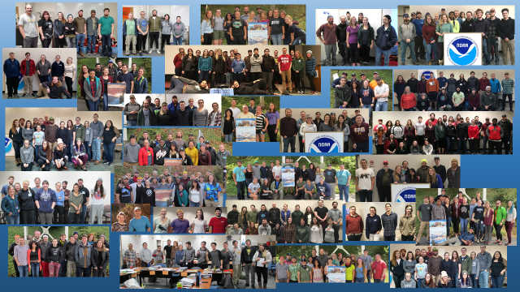
2018 North Pacific Groundfish Observers
Over 450 Years of at-sea experience
monitoring Alaskan Federal Groundfish Fisheries

Slide 23
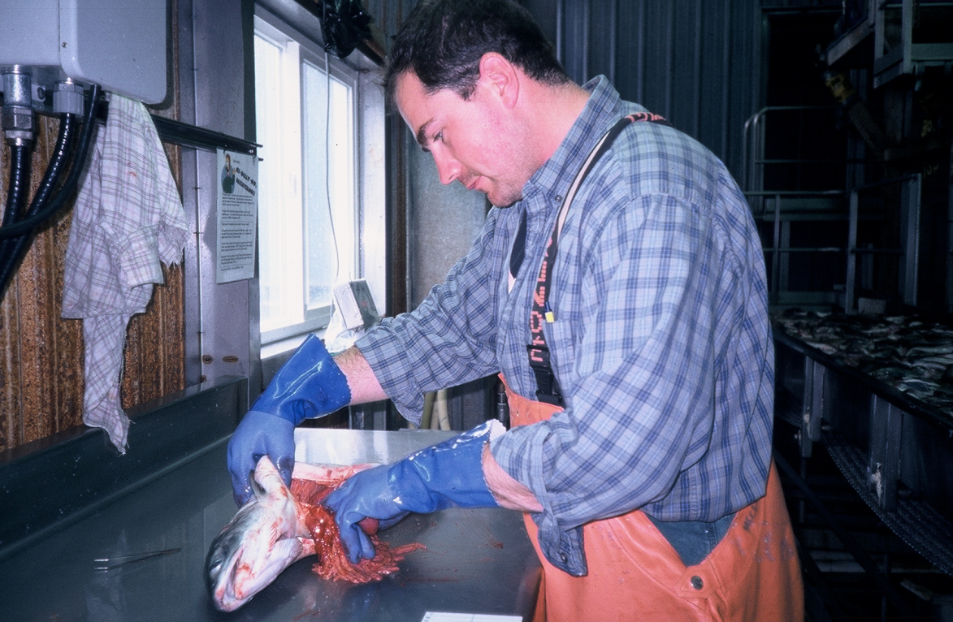
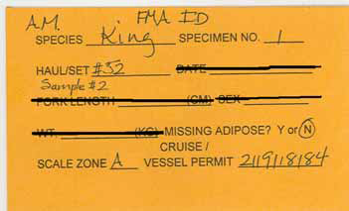
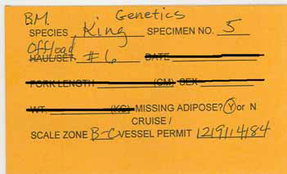
Salmon genetics
What happens when they are dropped off?

Slide 24
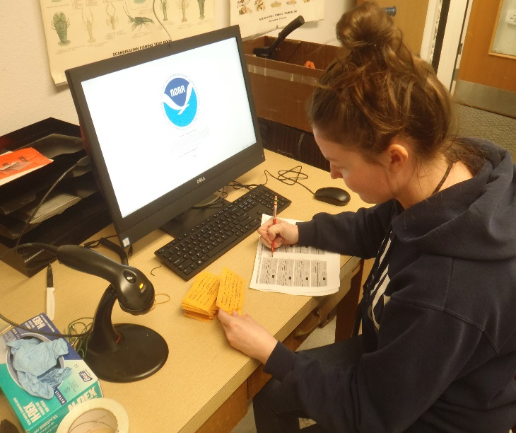
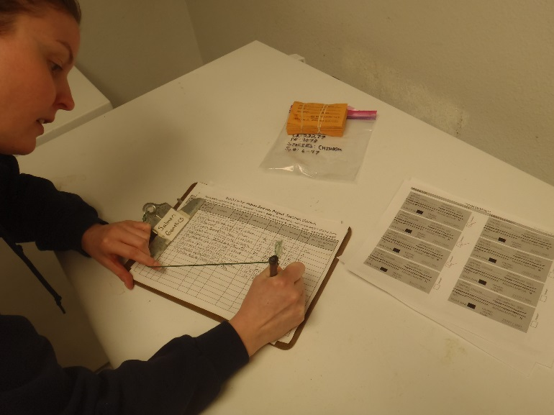
Drop off locations
Tissue samples for genetics only
Dutch Harbor
Kodiak field offices
All specimens
Seattle
Anchorage
Process of dropping off specimen:
  Printouts
  Check-in sheet (snouts vs. genetics)

Slide 25
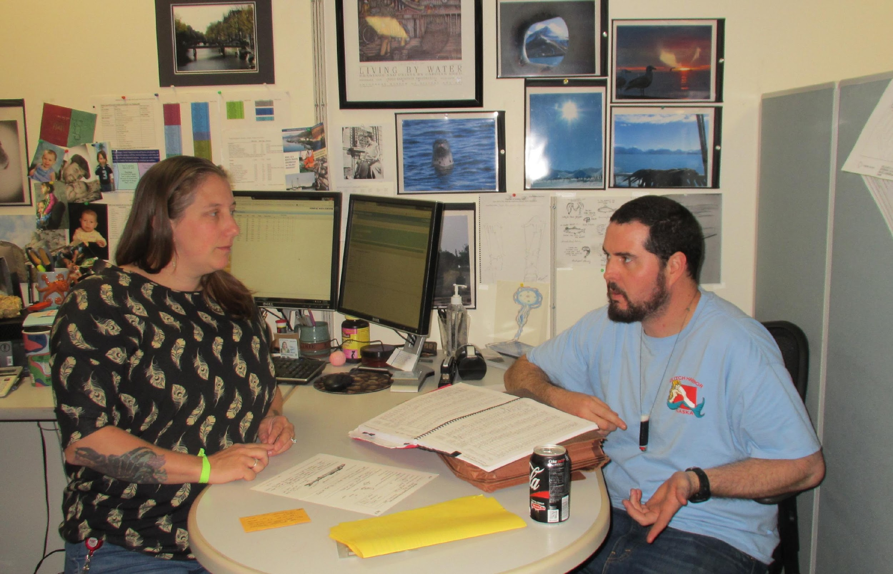
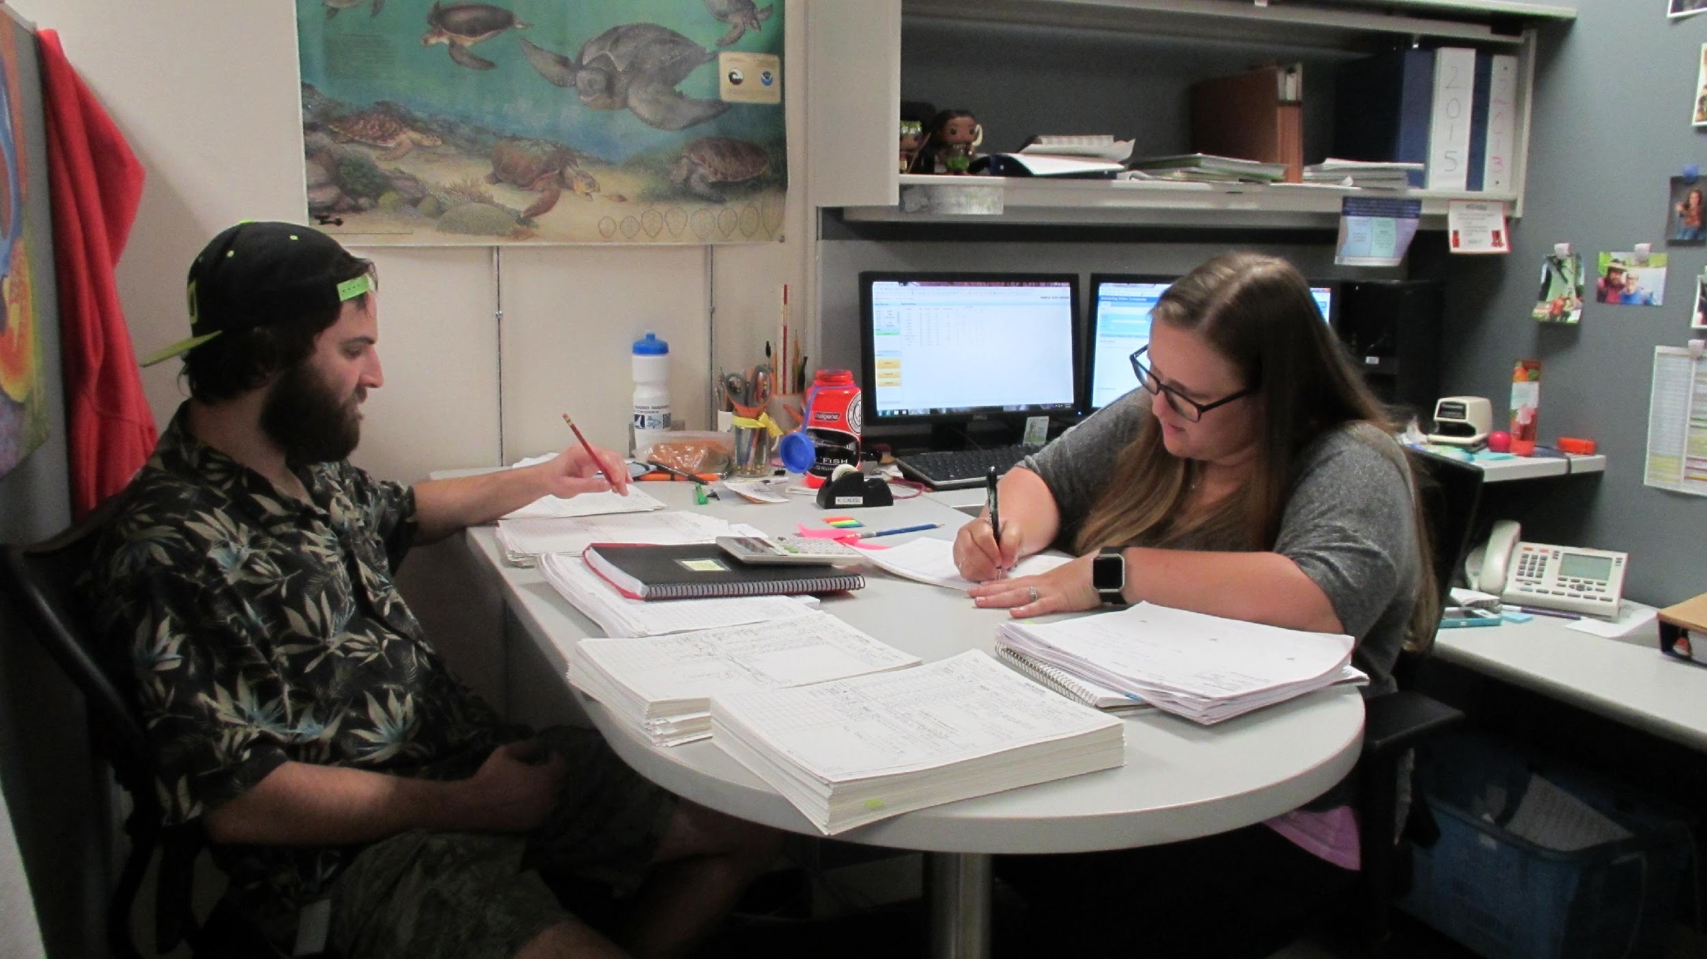
Debriefing Process
Interview
  Safety
  Sampling methods
  Enforcement issues
Data edits
  Raw data
  Specimens: Stay or go??
    Physically accounted for
    FMA ID scales verification
    ID forms
    Notification to field offices

Slide 26
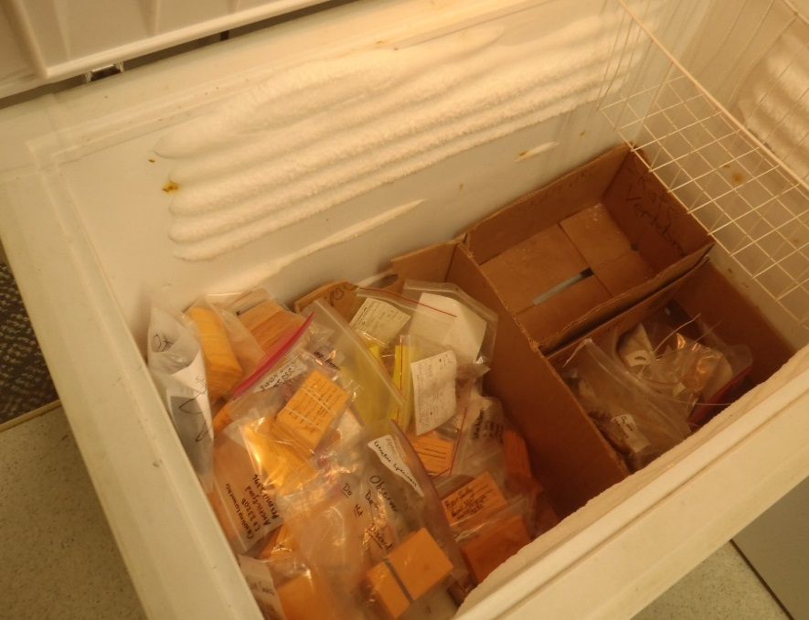
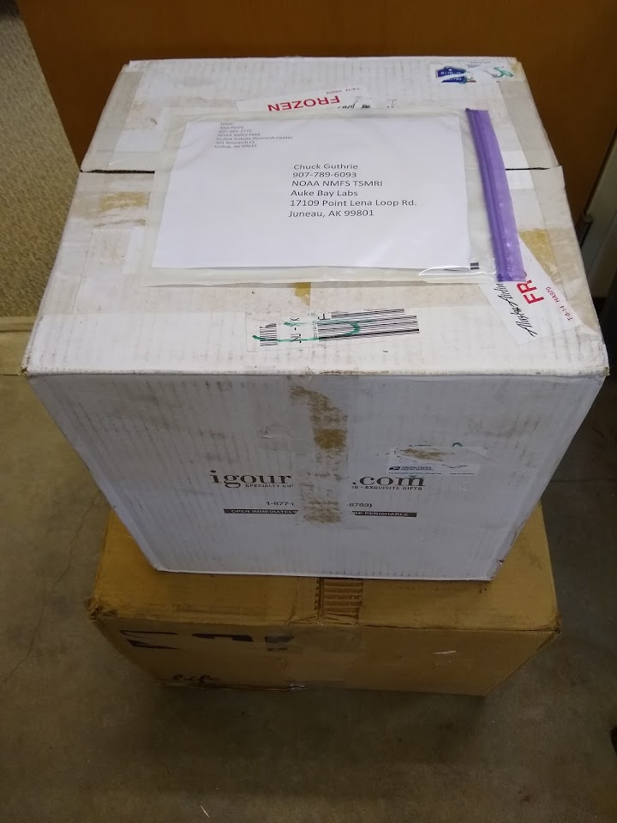
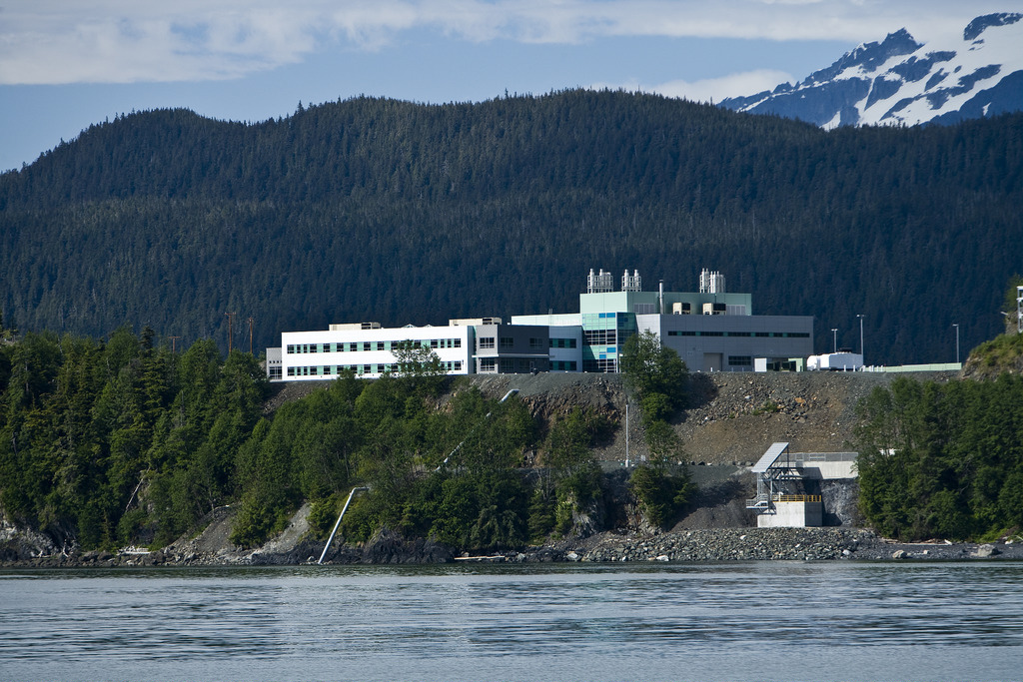
Specimens are shipped to Auke Bay
Twice a year (Genetics, Snouts)
Once a year (FMA ID scales)
Coordinate with Chuck Guthrie, Andy Gray, Michelle Masuda, Chris Kondzela
    Emailed copies of check-in sheets for inventory

Slide 27
Selected References
AFSC (Alaska Fisheries Science Center). 2019 Observer Sampling Manual. Fisheries Monitoring and Analysis Division, North Pacific Groundfish Observer Program. AFSC, 7600 Sand Point Way N.E., Seattle, Washington, 98115. https://www.fisheries.noaa.gov/resource/document/north-pacific-observer-sampling-manual
AFSC and ALASKA REGIONAL OFFICE. 2018. North Pacific Observer Program 2017 Annual Report. AFSC Processed Rep. 2018-02, 136 p. Alaska Fish. Sci. Cent., NOAA, Natl. Mar. Fish. Serv., 7600 Sand Point Way NE, Seattle WA 98115. https://www.afsc.noaa.gov/Publications/ProcRpt/PR2018-02.pdf
Cahalan, J.A., J. Mondragon, J. Gasper. 2014. Catch Sampling and Estimation in the Federal Groundfish Fisheries off Alaska: 2015 Edition. U.S. Dep. Commer., NOAA Tech. Memo. NMFS-AFSC-286, 41 p.
http://www.afsc.noaa.gov/Publications/AFSC-TM/NOAA-TM-AFSC-286.pdf
Faunce, C. H. 2015. Evolution of observer methods to obtain genetic material from Chinook salmon bycatch in the Alaska pollock fishery. U.S. Dep. Commer., NOAA Tech. Memo. NMFS-AFSC-288, 28 p. doi:10.7289/V5MG7MFF. http://www.afsc.noaa.gov/Publications/AFSC-TM/NOAA-TM-AFSC-288.pdf
Ganz, P., S. Barbeaux, J. Cahalan, J. Gasper, S. Lowe, R. Webster, and C. Faunce. 2018. Deployment performance review of the 2017 North Pacific Observer Program. U.S. Dep. Commer., NOAA Tech. Memo. NMFS-AFSC-379, 68 p. https://www.afsc.noaa.gov/Publications/AFSC-TM/NOAA-TM-AFSC-379.pdf
NMFS. 2018. 2019 Annual Deployment Plan for Observers in the Groundfish and Halibut Fisheries off Alaska. National Oceanic and Atmospheric Administration, 709 West 9th Street. Juneau, Alaska 99802. http://meetings.npfmc.org/CommentReview/DownloadFile?p=13252b3a-482b-4009-85ad-727d01384735.pdf&fileName=B2%202019%20ADP.pdf

Slide 28
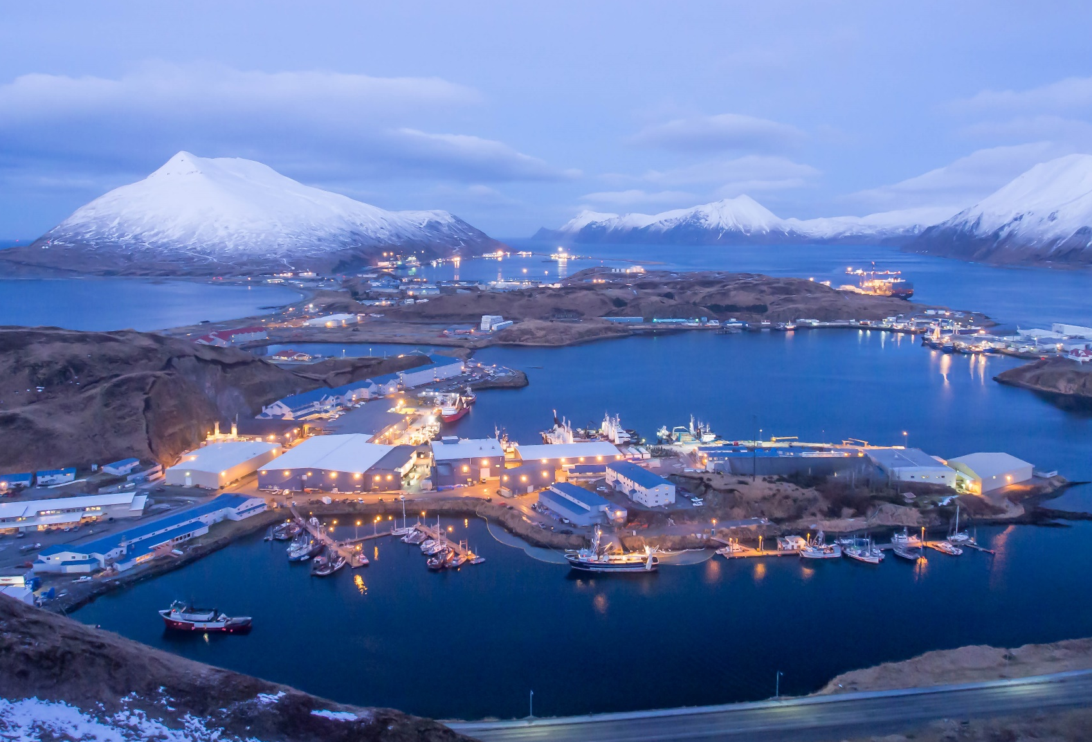
Questions?

