Slide 1
Looking for better ways to use genetic data to avoid critical chum stocks in groundfish fisheries
Update on current work and possibilities for future efforts
Chris Kondzela, NOAA/AFSC/Auke Bay Laboratories
Megan McPhee, University of Alaska Fairbanks
NPFMC Salmon Bycatch Workshop
April 15-16, 2019, Seattle, WA
Notes:
Collaboration with ADFG, NOAA, UAF, UW
Plus many contributions from other labs and countries (Canada, Japan, Korea, Russia) over decades.

Slide 2
30 years of baseline development
mid 1980s to today……..
Protein-based allozymes → DNA-based markers
Microsatellites → SNPs → Sequences
DNA more robust than proteins
  easier sampling logistics
  non-lethal sampling
  less toxic lab chemicals
  more samples in less time
  standardization easier across labs
Flip side
  lab equip more expensive to purchase & maintain
  larger datasets to process, analyze, and archive
Notes:
As technologies change, so too have genetic markers. Chum salmon baseline development really took off in the mid-1980s.
A lot of national and international collaboration across NOAA, WDFW, DFO, Russia, Japan, then later ADFG.
Earliest chum genetic papers I found: Seeb and Grant. 1976, and Utter et al. 1980.

Slide 3
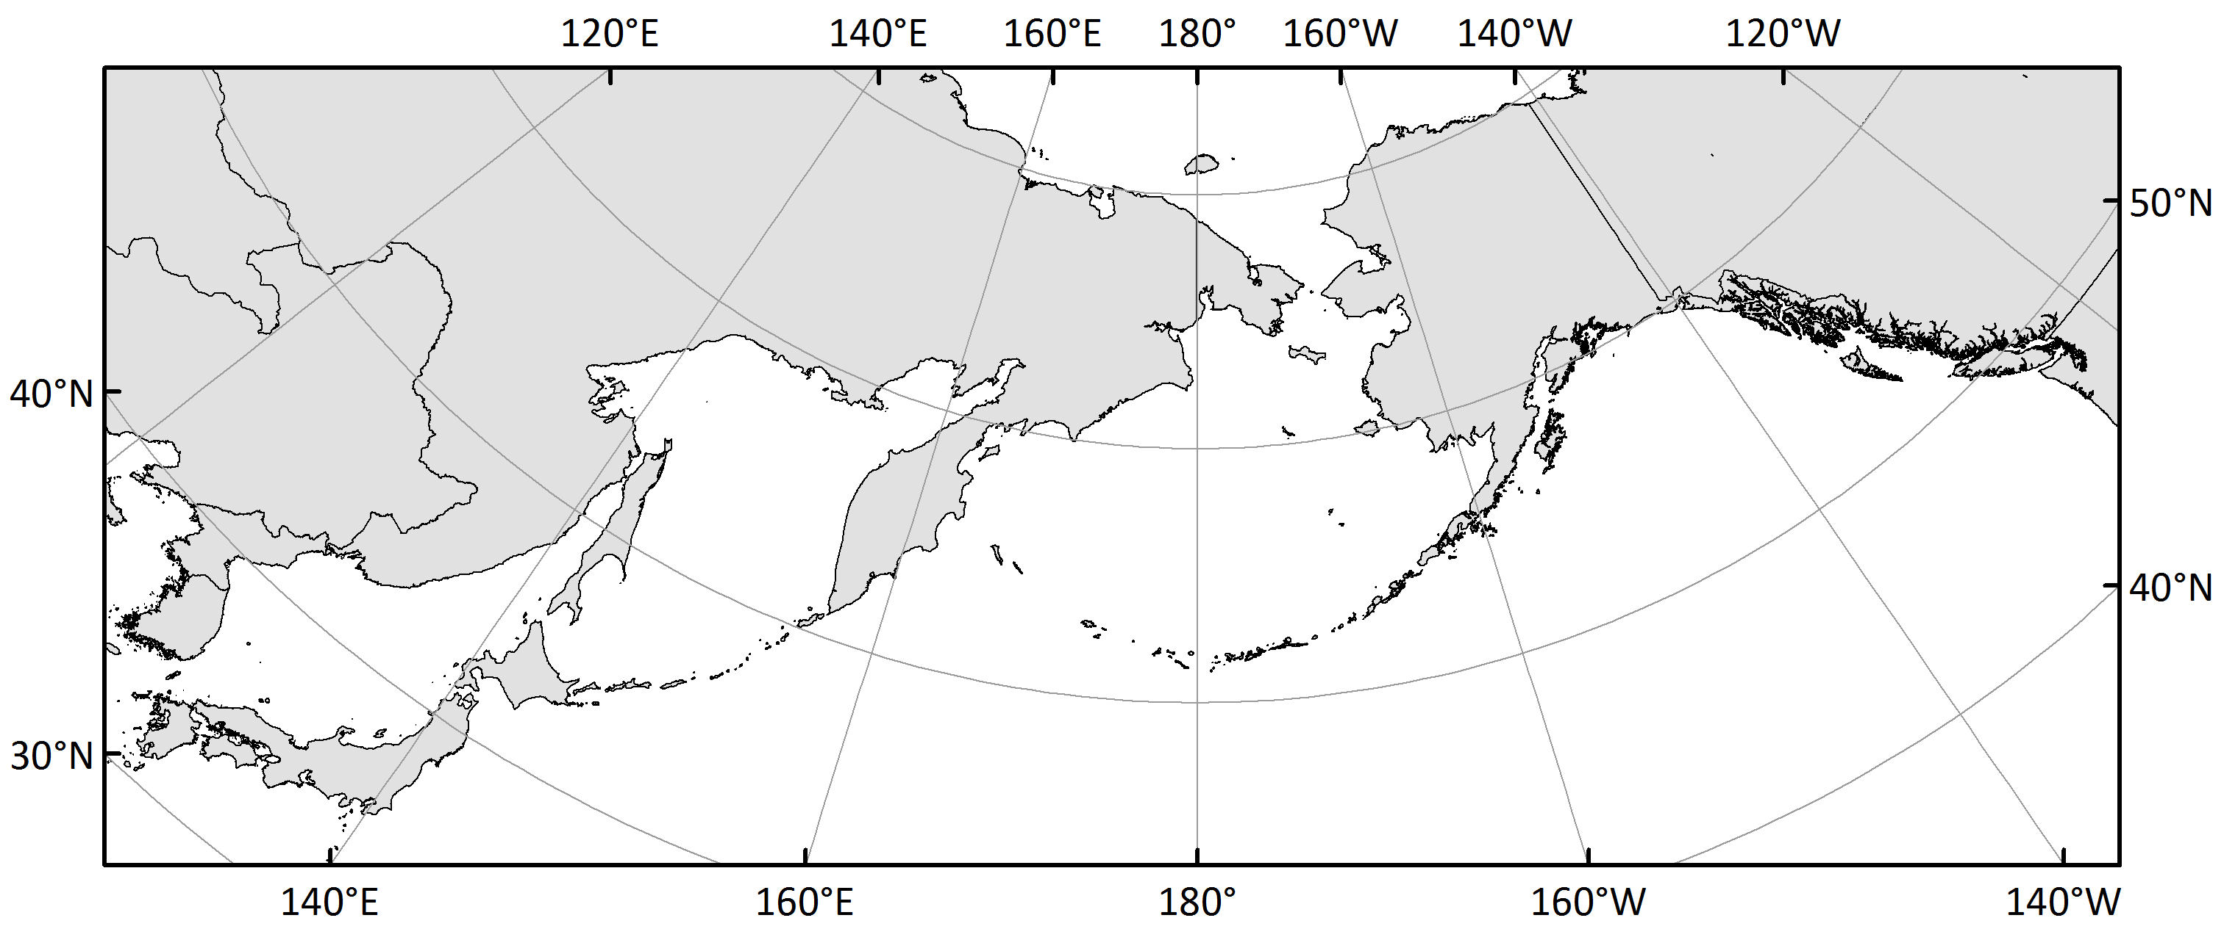
Microsatellite baseline
Current baseline in use for chum bycatch
11 microsatellites, 381 pops, 6 stock groups
Up/Mid Yukon
W AK
EGOA/PNW
NE Asia
SW AK
SE Asia
Notes:
Beacham et al. 2009
DFO chum baseline.pptx
381-population microsatellite baseline
13 microsatellite markers (11 used for chum bycatch analyses)
6 stock groups for chum bycatch analyses
This was the only DNA-based coastwide baseline available at the time we ramped back into bycatch analyses in 2009.
During the early years of bycatch analyses, efforts were underway to develop new markers to simplify standardization and improve stock resolution.

Slide 4
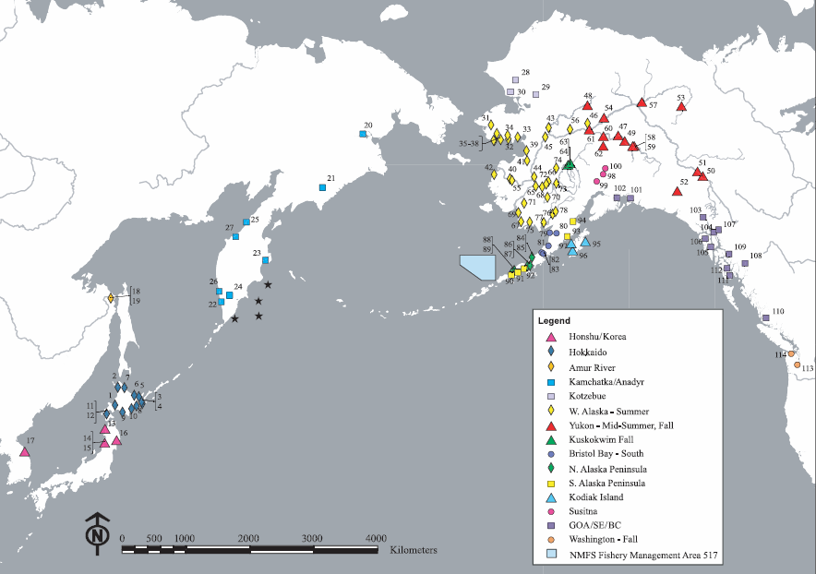
PacSNP baseline
Seeb et al. 2011
54 SNPs
114 pops
Notes:
Seeb et al. 2011 chum SNP map.PNG
Seeb et al 2011 Chum Salmon SNPs.pdf
Started at ADF&G and completed at Univ of Washington. A major effort to develop a coastwide SNP baseline.
54 SNPs, 114 pops, good coverage, but unable to break out coastal Western Alaska stocks, similar to Chinook populations.

Slide 5
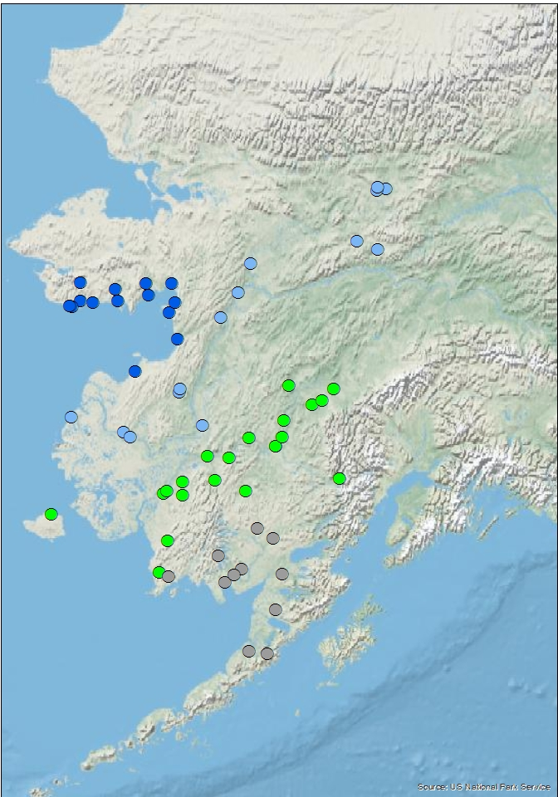
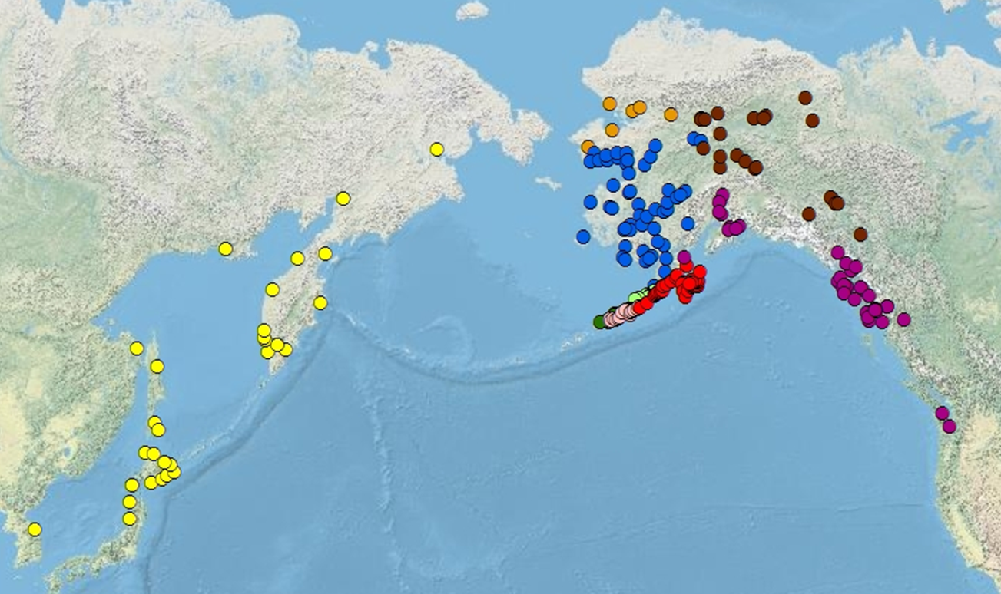
ADF&G - WASSIP SNP baseline
DeCovich et al. 2012
Effort to separate coastal western Alaska stocks 96 SNPs, 310 pops, 9 stock groups
Notes:
Western Alaska Salmon Stock Identification Program (WASSIP) – chum component
DeCovich et al WASSIP chum baseline SP12-26.pdf
ADFG slides for meeting 09182013.pptx
96 SNP markers, 310 pops
early evaluation with 12 stock groups (4 coastal western Alaska)
ended up with 9 stock groups (1 large coastal WAK)
Project time frame: MOU and first set of tissue samples collected in 2006 (sockeye and chum), last set of samples collected 2009, last analyses completed and reports finalized in 2012.

Slide 6
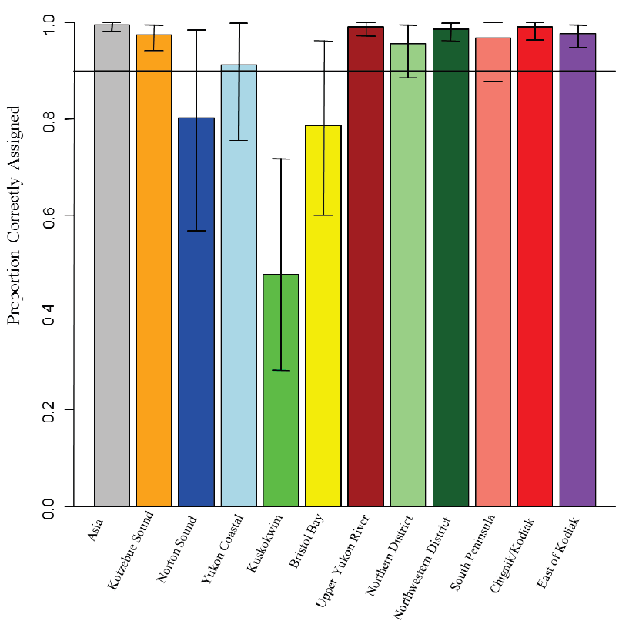
ADF&G - WASSIP SNP baseline
Evaluation
12 stock groups
Notes:
DeCovich et al WASSIP chum baseline SP12-26.pdf, Fig 10
Assignment tests, BAYES analysis, 90% credible intervals, the coastal western Alaska stocks do not correctly assign 90% of the time.

Slide 7
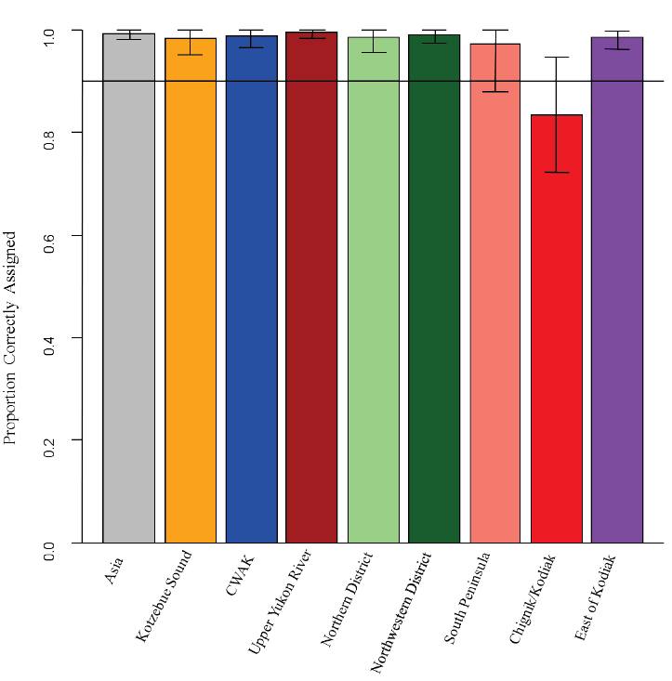
ADF&G - WASSIP SNP baseline
Evaluation
9 stock groups
Notes:
DeCovich et al WASSIP chum baseline SP12-26.pdf, Fig 11 (Fig. 19 shows that Chignik sample set in this case is an outlier).
Assignment tests, BAYES analysis, 90% credible intervals
The 4 coastal western Alaska sub-groups combined have high correct assignment.

Slide 8
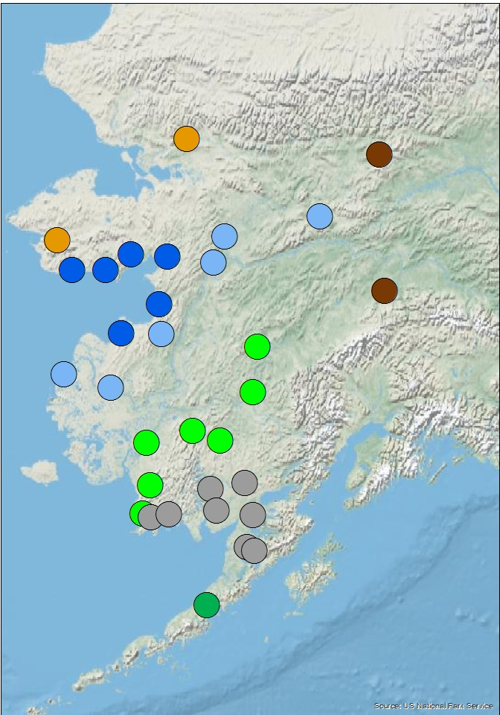
CIAP-WASC SNP-mSAT baseline
Goal: improve genetic stock identification in coastal western Alaska
31 pops
11 new SNPs discovered by UAF and evaluated by ADFG
11 new mSATs evaluated by NOAA
Still one CWAK stock group
Cost savings allowed additional round of SNP discovery
Notes:
WASC_Chum_pops2.png
ADFG slides for meeting 042215.pptx
31 pops, Kotzebue (2), Norton Sound (6), lower Yukon (6), middle Yukon (2), Kuskokwim (7), Bristol Bay (7), Alaska Peninsula (1)
This round of marker development still left us with 1 CWAK stock group.
But significant cost savings in the project led to another round of SNP discovery – that Megan McPhee coordinated with UW (Garrett McKinney in Seeb Lab).

Slide 9
WASC 2.0 SNP development
Objectives
To develop, test, and optimize a ‘GT-seq’ panel of 500 SNPs for Coastal Western Alaska chum salmon
Provide the optimized panel and protocols to resource managers throughout Alaska and adjacent areas
Notes:
McPhee_PCCRC_2019-02.pptx, Slide 7

Slide 10
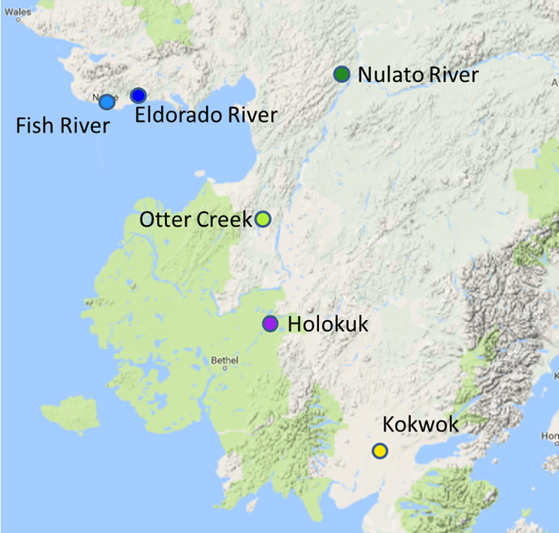
Samples for SNP discovery
48 individuals/site
Norton Sound (2)
Yukon (2)
Kuskokwim (1)
Bristol Bay (1)
Results – all 30,006 SNPs
Norton Sound emerges
Notes:
McPhee_PCCRC_2019-02.pptx, Slide 12

Slide 11
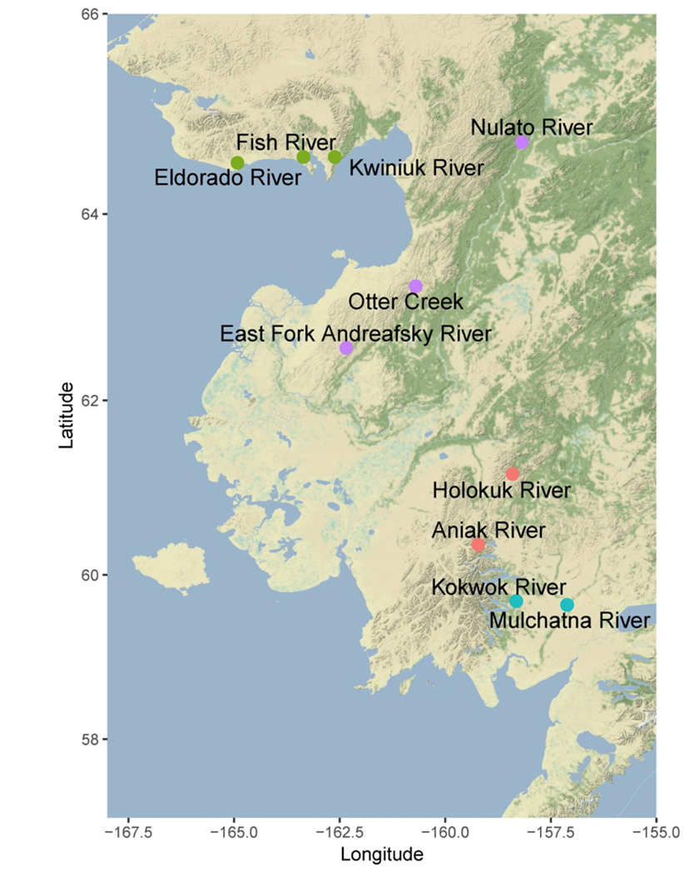
Panel evaluation
~80 individuals/site
Norton Sound (3)
Yukon (3)
Kuskokwim (2)
Bristol Bay (2)
Most informative 448 SNPs still pull out Norton Sound
Notes:
McPhee_PCCRC_2019-02.pptx, Slide 20
The Norton Sound stock group can still be separated with 448 SNPs (out of the 30,006 SNPs).

Slide 12
ADF&G - WASSIP SNP baseline
DeCovich et al. 2012
Effort to separate coastal western Alaska stocks 96 SNPs, 310 pops, 9 stock groups
Gap in baseline
Notes:
Western Alaska Salmon Stock Identification Program (WASSIP) – chum component
DeCovich et al WASSIP chum baseline SP12-26.pdf
ADFG slides for meeting 09182013.pptx
Gap in WASSIP baseline in British Columbia and Washington – has been filled in by WDFW and DFO.

Slide 13
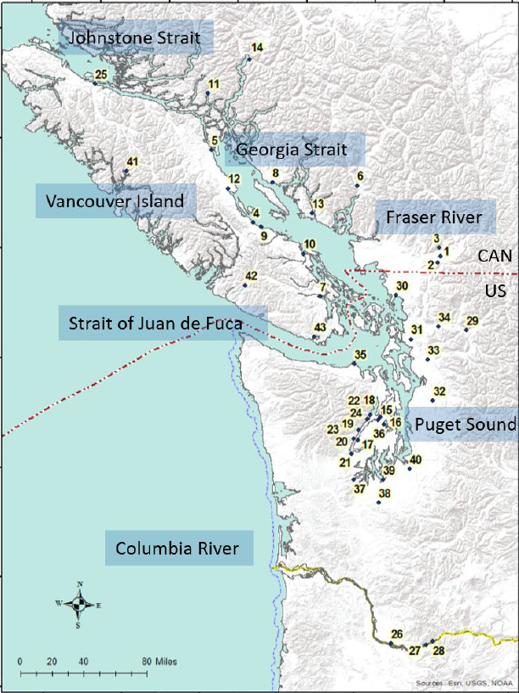
Southern boundary SNP baseline
Small et al. 2018
350 SNPs
43 pops from southern British Columbia and Washington.
11 stock groups
The 96 WASSIP SNPs are included.
Notes:
Small etal 2018 chum SNP southern boundary.pdf (downloaded from PSC website)
Canadians and WA have moved from mSATs to SNPs for chum.
One GT-seq panel (350 SNPs, 2000(?) samples), Illumina NextSeq, high resolution baseline in Southern Boundary Region.
How much overlap is there with Garrett’s panel? Only the 29 WASSIP SNPs.

Slide 14
Chum bycatch at a cross roads….
Continue with microsatellite baseline and 6 stock groups
Move to 96-SNP panel and possibly more stock groups
TaqMan
GT-seq
A cost-benefit analysis is in progress
Notes:
We have a choice to continue with microsatellite baseline and 6 stock groups or move to a SNP baseline with 6-9 or more stock groups.
Cost benefit analysis is in progress to evaluate each method in terms of labor, supplies, and equipment.
Move to 96-SNP panel is going to require some time to work out protocols and ABL personnel is stretched thin.
ADFG: SNPs are less expensive than microsatellites.
ADFG: the cost of 96-SNP panel on their Fluidigm system = 300 SNP panel on GT-seq (NextSeq).

Slide 15
Chum bycatch at a cross roads….
Future move to larger SNP panels:
Add more pops for a coastwide baseline with options for finer-scale stock resolution
Multiple marker sets (96-WASSIP, 448-WASC, 350-WA/CAN) – partial overlap
Stock grouping evaluation
Notes:
Currently do not have a coastwide baseline with a large SNP panel. That would require the addition of more populations.
Multiple marker sets of partial overlap: 29 WASSIP SNPs are in WASC panel, 96 WASSIP in 350 WA/CAN panel and other than the 29 WASSIP SNPs, there is no overlap between WASC and WA/CAN panels. Find optimal panel for coastwide.
Baseline evaluation to determine what stock groupings are possible.

Slide 16
Chum genetic data
Questions??

Slide 17

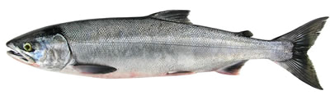
Marker: a place in the genome where we can assess genetic differences (sometimes also called ‘locus/loci’)
Microsatellite: differences are based on number of repeated motifs
    5’-CGTAGGTATTTATTTATTTATTGCTAGGTT
    5’-CGTAGGTATTTATTTATTGCTAGGTT
Genetics
Genetics
SNP (‘snip’): differences are based on a single base pair in the DNA sequence (single nucleotide polymorphism)
5’-CGTAGGGCTAGGTT vs. 5’-CGTAGAGCTAGGTT
Allele: a variant at a given marker (e.g., G & A above)
Genotype: what 2 alleles does an individual possess? (1 from ma, 1 from pa)
GG
GA
AA
Notes:
McPhee_PCCRC_2019-02.pptx, Slide 9

Slide 18
What is a GT-seq panel??
GT-seq: “genotyping in thousands” by DNA sequencing – Nate Campbell & colleagues at Columbia River Inter-Tribal Fish Commission
pool 1000s of individuals/100s of SNPs into single DNA sequencing run
use DNA “bar codes” to identify individual and marker
rapidly generate genotype data for 800-1000 individuals at 300-500 SNPs
now running at ADF&G Gene Conservation Lab
Notes:
McPhee_PCCRC_2019-02.pptx, Slide 10

Slide 19
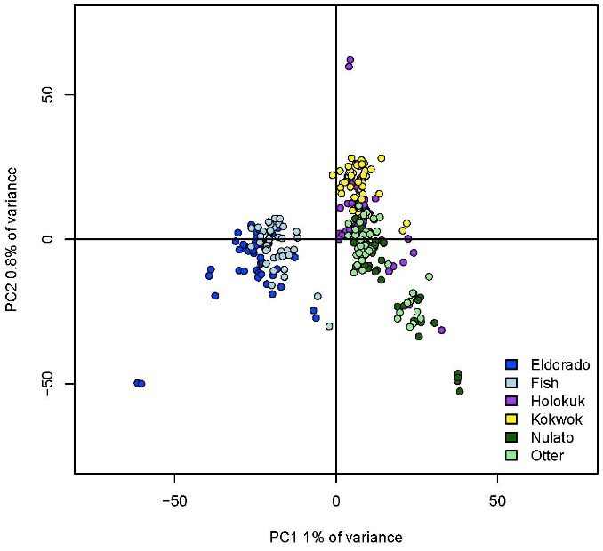
Results – all 30,006 SNPs
Norton Sound emerges as distinct
Norton Sound
Lower Yukon
Kuskokwim
Bristol Bay
Notes:
McPhee_PCCRC_2019-02.pptx, Slide 15

Slide 20
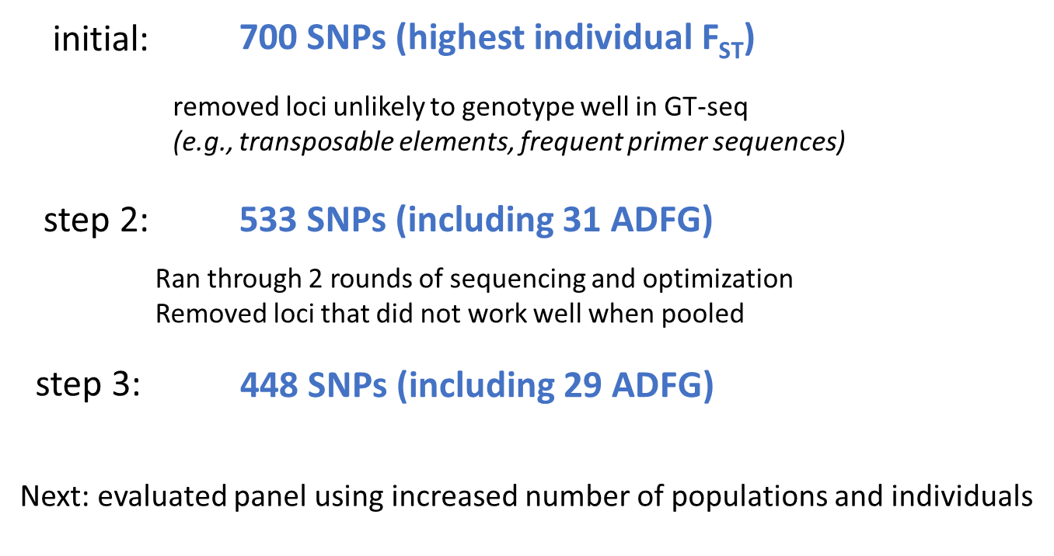
Panel selection
Notes:
McPhee_PCCRC_2019-02.pptx, Slide 19

Slide 21
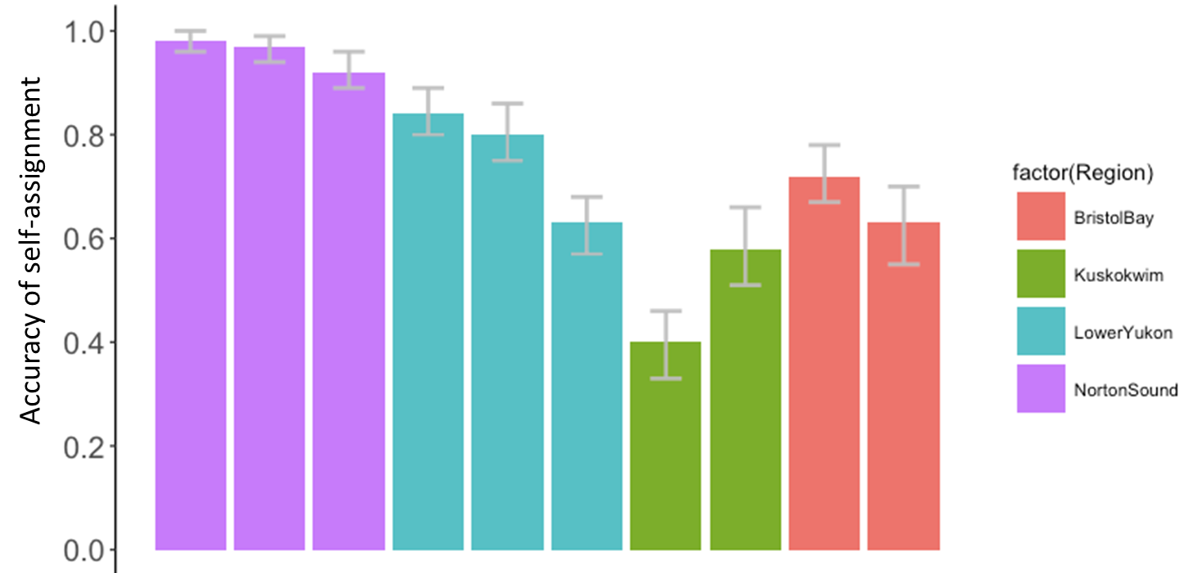
Results – 4 stock groups
Notes:
McPhee_PCCRC_2019-02.pptx, Slide 21

Slide 22
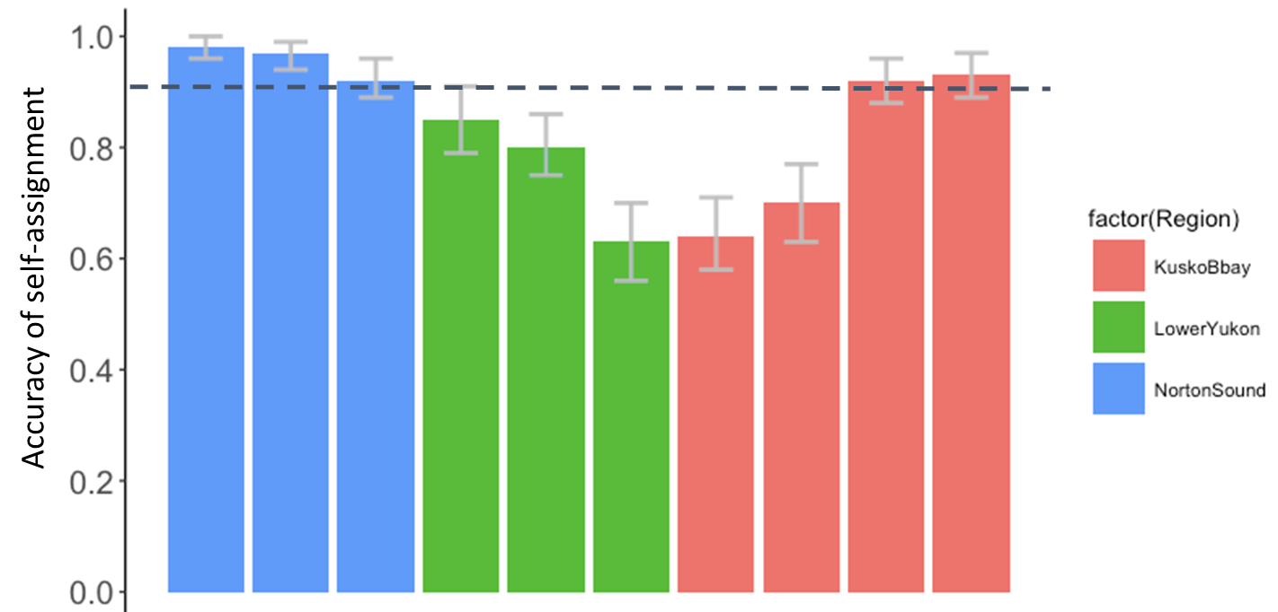
Results – 3 stock groups
Notes:
McPhee_PCCRC_2019-02.pptx, Slide 22

Slide 23
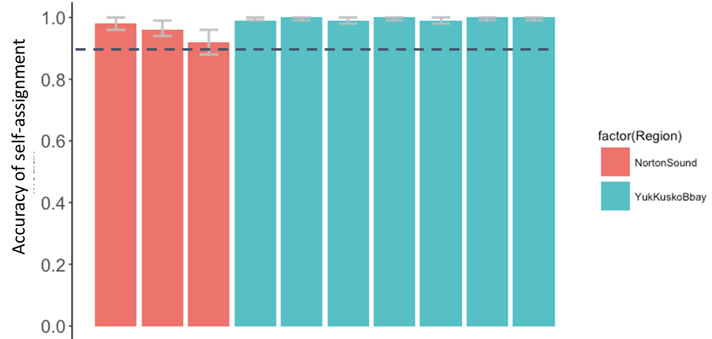
Results – 2 stock groups
Notes:
McPhee_PCCRC_2019-02.pptx, Slide 23

Slide 24
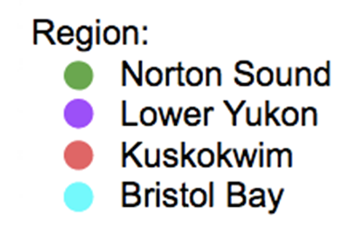
Panel evaluation
~80 individuals/site
Norton Sound (3)
Yukon (3)
Kuskokwim (2)
Bristol Bay (2)
448 SNPs most informative and still pull Norton Sound
Notes:
McPhee_PCCRC_2019-02.pptx, Slide 20

Slide 25

Conclusions
New panel allows for splitting Coastal Western Alaska summer chum into 2 stock groups:
  Norton Sound
  Yukon/Kusko/Bristol Bay
GT-seq panel of 448 SNPs is available now for future genetic stock identification work
Additional applications of panel – parentage-based tagging (e.g.)
Notes:
McPhee_PCCRC_2019-02.pptx, Slide 27

