Slide 1


Developing Capabilities: What else might be possible
Chris Habicht¹ and Jordan Watson²
¹Alaska Department of Fish and Game, Gene Conservation Laboratory
²Auke Bay Laboratories, AFSC/NMFS/NOAA/DOC, Ted Stevens Marine Research Institute
NPFMC Salmon Bycatch Workshop
April 15, 2019

Slide 2
Questions for industry:
What information, and when is it needed, to make a decision?
Prioritizing needs is key:
  Balancing priorities determines analytical design
  Often you have to give up one thing to get another
  Sometimes, it just takes more funding/logistics/coordination
Cost Efficiency
Stock Resolution

Slide 3
Questions for industry
What stocks do you need to identify?
  The fewer, the smaller the mixture sample size needed
    200 fish may be adequate for 3 stocks
    400 fish for 6 to 11 stocks (as is currently done)
    1,000 fish for 20 stocks
  The fewer, the smaller the relative error in the estimates
  Pool stock groups with anticipated estimates below 5%
  The less genetically differentiated the stock groups:
    The higher the costs:
      develop marker panels
      screen baselines
      screen mixtures
    The lower the precision of estimates
  Just because you can genetically separate stocks in a mixture, does not mean that you should
Precision
Stock Resolution
Cost and Time Efficiency
Fishery Resolution

Slide 4
Questions for industry
What stocks do you need to identify?
How precise do you need your estimates?
  Less precision needed, fewer samples needed
    100 fish: get within 10% of true, 90% of the time
    200 fish: +/- 7%
    400 fish: +/- 5%
Cost Efficiency
Processing Speed
Precision
Stock Resolution
Fishery Resolution

Slide 5
Questions for industry
What stocks do you need to identify?
How precise do you need your estimates?
What fishing area/time scales do you need analyzed?
  Bigger strata good enough:
    Fewer samples required, or
    Higher precision
  Smaller strata needed:
    More samples required, or
    Lower precision
Precision
Cost Efficiency
Fishery Resolution
Processing speed
Stock Resolution

Slide 6
Questions for industry
What stocks do you need to identify?
How precise do you need your estimates?
What fishing area/time scales do you need analyzed?
When do you need the results?
  Same day – shipside genotyping
Notes:
Currently takes over a year from the time the first fish is caught until stock composition estimates are available

Slide 7
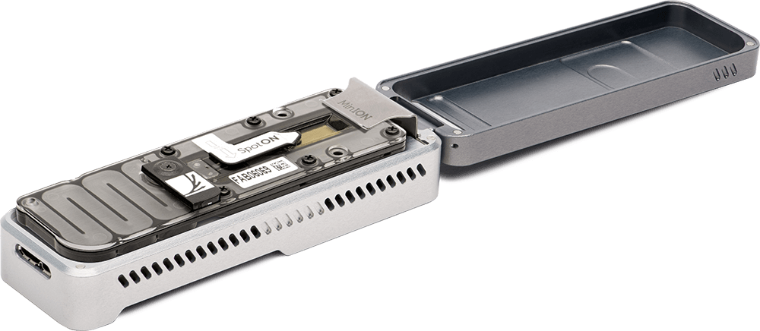
Toward Shipside Stock ID With Nanopore Sequencing
Megan McPhee & Pat Barry, UAF
Pollock Conservation Cooperative Research Center
(Oxford Nanopore Technologies)
(media.uaf.edu)
Objectives:
assess whether the MinION pocket sequencer is accurate enough for distinguishing Alaskan from Asian chum stocks;
develop laboratory & analytic work flows that would be feasible for onboard sample and data processing

Slide 8

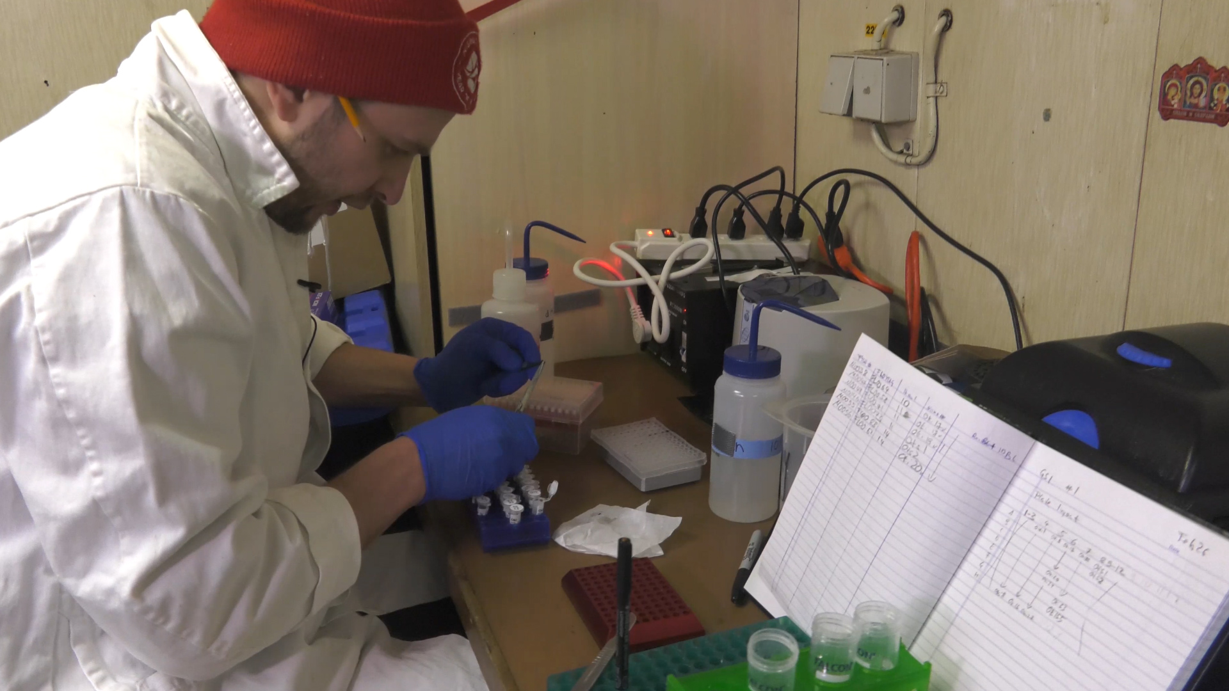
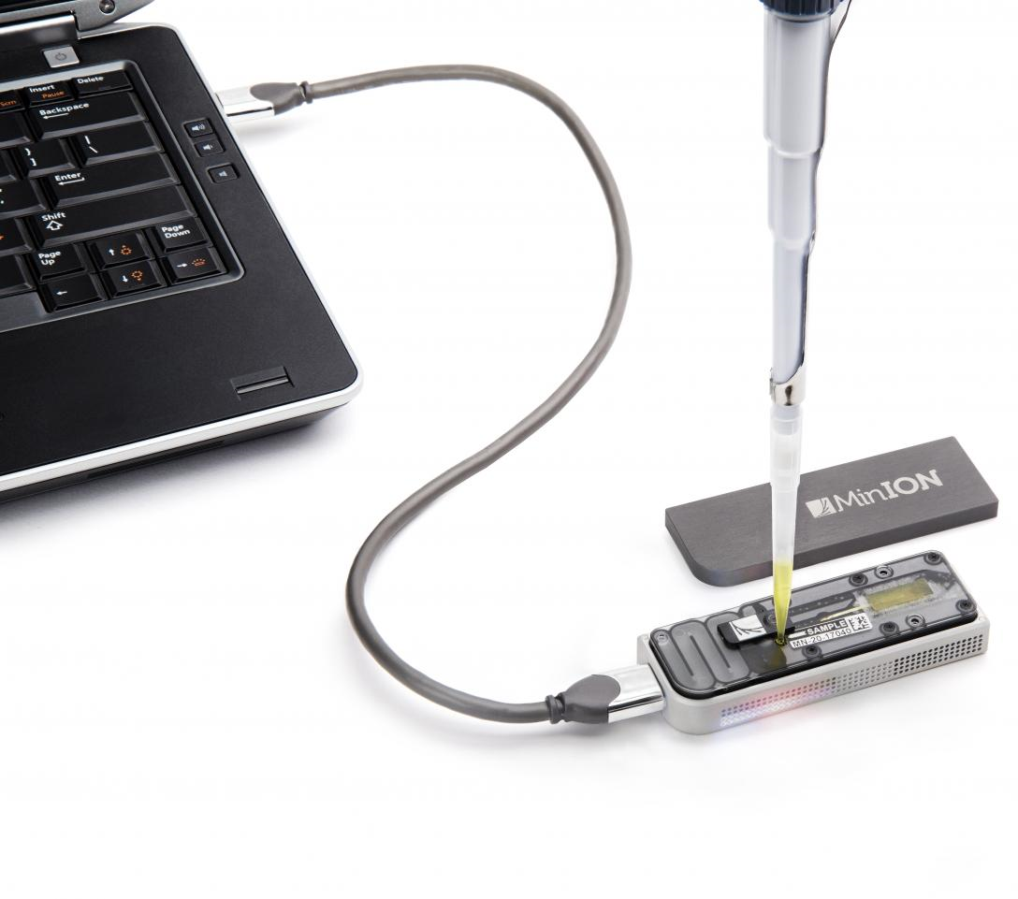
2019: MinION for Pacific salmon
Dr. Christoph Dee

Slide 9
Questions for industry
What stocks do you need to identify?
How precise do you need your estimates?
What fishing area/time scales do you need analyzed?
When do you need the results?
  Same day – shipside genotyping. Requires:
    Technical feasibility (in test phase by Megan McPhee)
    Logistics on vessel (trained personnel and space)
    Changes to the observer program
    Preliminary and final estimates (confusion? and adds staff costs)
    Limited stock group resolution with current technology (2-3 stock groups)
      Chum: Asia/America
      Chinook: North/South of Yakutat
Notes:
Currently takes over a year from the time the first fish is caught until stock composition estimates are available

Slide 10
Questions for industry
What stocks do you need to identify?
How precise do you need your estimates?
What fishing area/time scales do you need analyzed?
When do you need the results?
  Same day – shipside genotyping
  Same week – in season genotyping

Slide 11
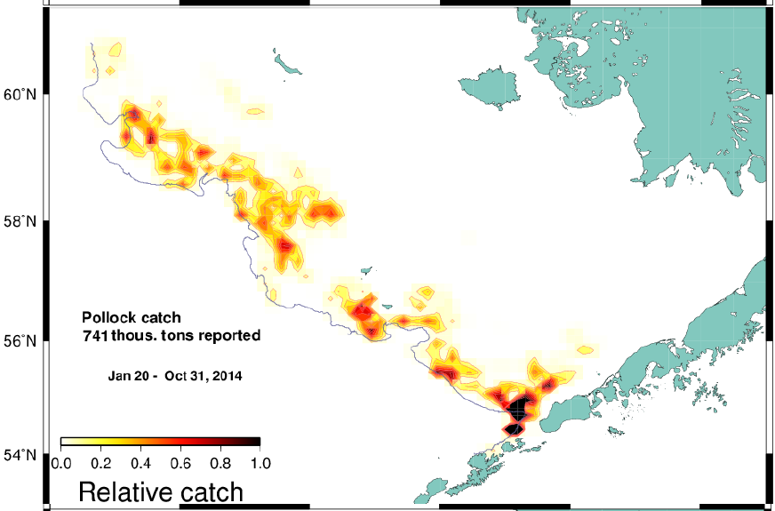
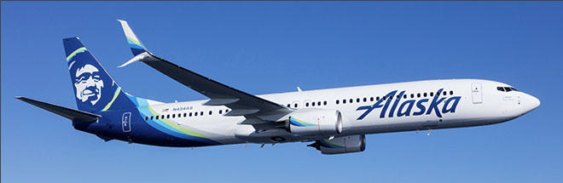

Same week – in season analyses
Map from: Ianelli, J.N., Honkalehto, T., Barbeaux, S.J., Fissel, B.E. and Kotwicki, S., 2016. Assessment of the walleye pollock stock in the Eastern Bering Sea.

Slide 12
Questions for industry
What stocks do you need to identify?
How precise do you need your estimates?
What fishing area/time scales do you need analyzed?
When do you need the results?
  Same day – shipside genotyping
  Same week – in season genotyping. Requires:
    Fast turnaround technology (SNPs; existing)
    Logistics to get samples from ship to lab
    Changes to the observer program
    Adequate lab staffing
    Preliminary and final estimates (adds confusion and staff costs)
    Delivers current stock group resolution

Slide 13
Questions for industry
What stocks do you need to identify?
How precise do you need your estimates?
What fishing area/time scales do you need?
When do you need the results?
  Same day – shipside genotyping
  Same week – in season genotyping
  Same year – expedited processing and shipping. Requires:
    Changes to the observer program
    Preliminary and final estimates (adds confusion and staff costs)
    Could use new marker panels with higher resolution

Slide 14
Questions for industry
What stocks do you need to identify?
How precise do you need your estimates?
What fishing area/time scales do you need?
When do you need the results?
Fishery Resolution
Vetted Results
Cost Efficiency
Processing Speed
Logistical Ease
Stock Resolution

Slide 15
Trade-offs between genotyping processing speed and stock group resolution
Processing Speed | # Markers | # Stock Groups | Methods
One day | 1 - 10 | 2 - 3 | MinION
One week | 24 - 96 | Current res. | Traditional
One year | 96 - 1,000's | Current or increased res. | Traditional or GT-seq

Slide 16
Questions for industry
What stocks do you need to identify?
How accurately do you need to estimate?
What fishing area/time scales do you need analyzed?
When do you need the results?
What result formats do you need?

Slide 17
GSI Software transition
From manual, slow, inefficient to faster more customizable and automatable
Easier to respond to custom requests
Industry standard (consistency across agencies)
Latest technology (virtual machines, remote access)

Slide 18
Reapportioning salmon PSC by stat area
Trip-level salmon PSC is spatially apportioned based on where pollock were caught (~40% of 2017 Chinook).
Using data from haul-level observations or from more certain locations of salmon catches, create probabilistic spatial reallocation.
Implications for spatial clustering and GSI

Slide 19
Environmental data integration
Linking satellite environmental data for each stat area to better understand patterns in catches
Implications for spatially-explicit GSI

Slide 20
Environmental data integration
Linking satellite environmental data for each stat area to better understand patterns in catches
Implications for spatially-explicit GSI

Slide 21
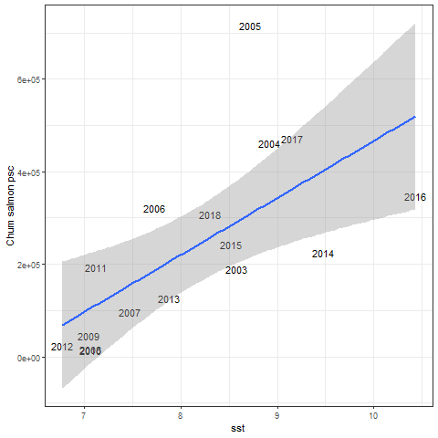
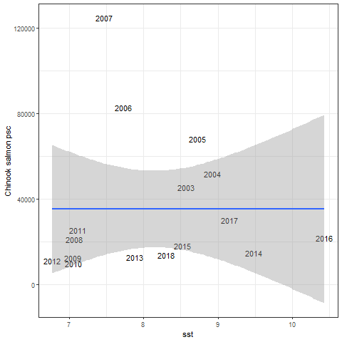

Slide 22
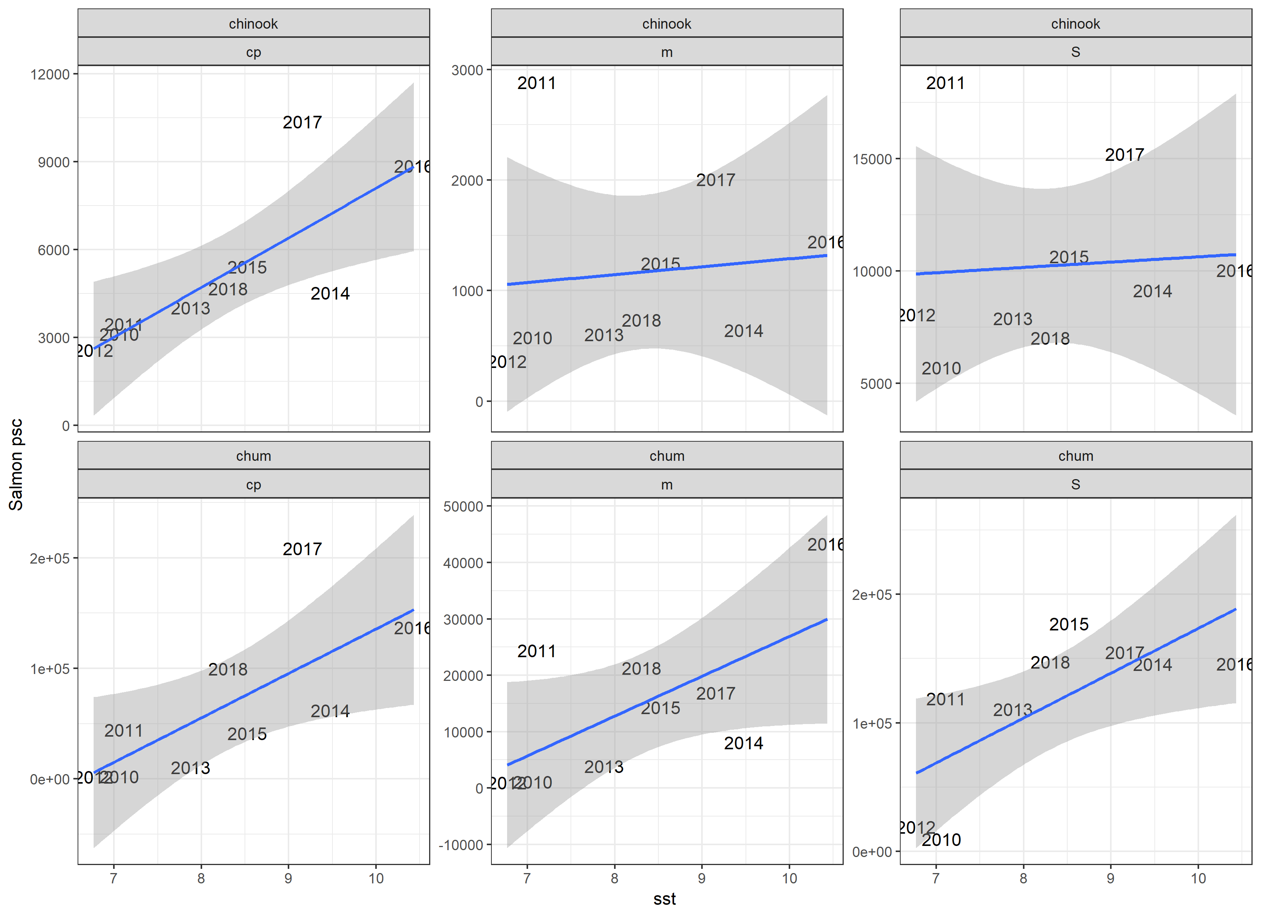

Slide 23
New visualizations of bycatch / genetics data

Slide 24
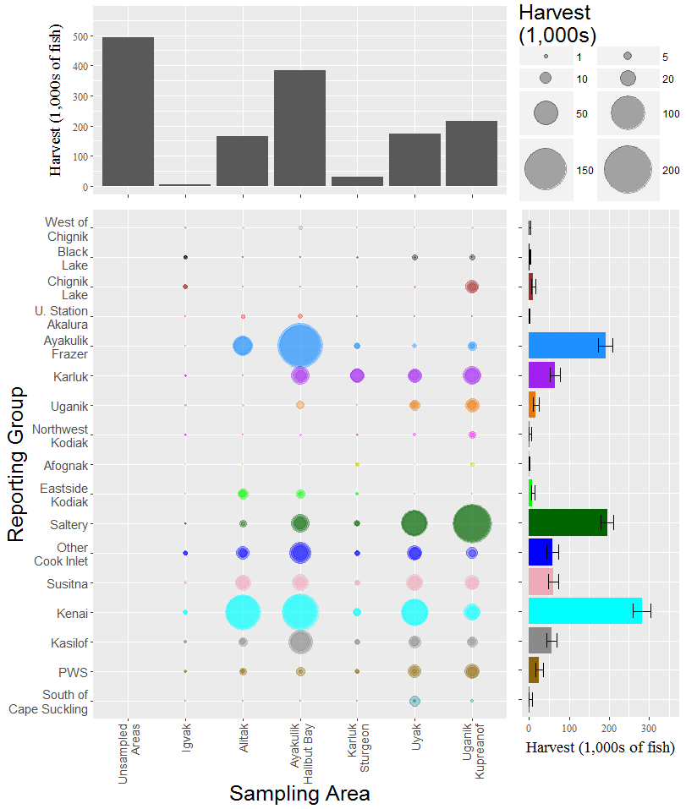
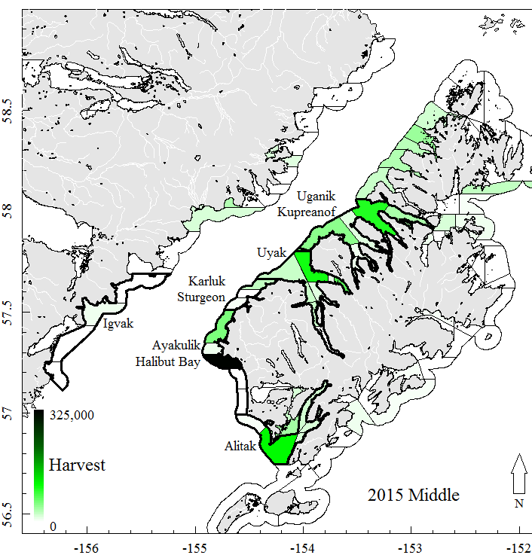
Courtesy: Kyle Shedd (ADF&G)

Slide 25
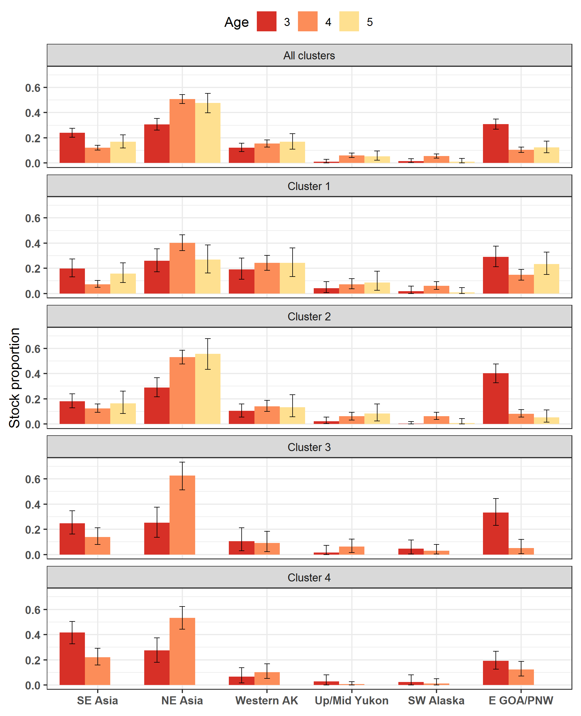
In a specific area, are fish of a particular stock group likely to be the same age?

Slide 26
In a specific area, are fish of a particular stock group likely to be the same age?
For a particular stock group (e.g., SE Asia), how does the stock proportion vary across age and space?

Slide 27
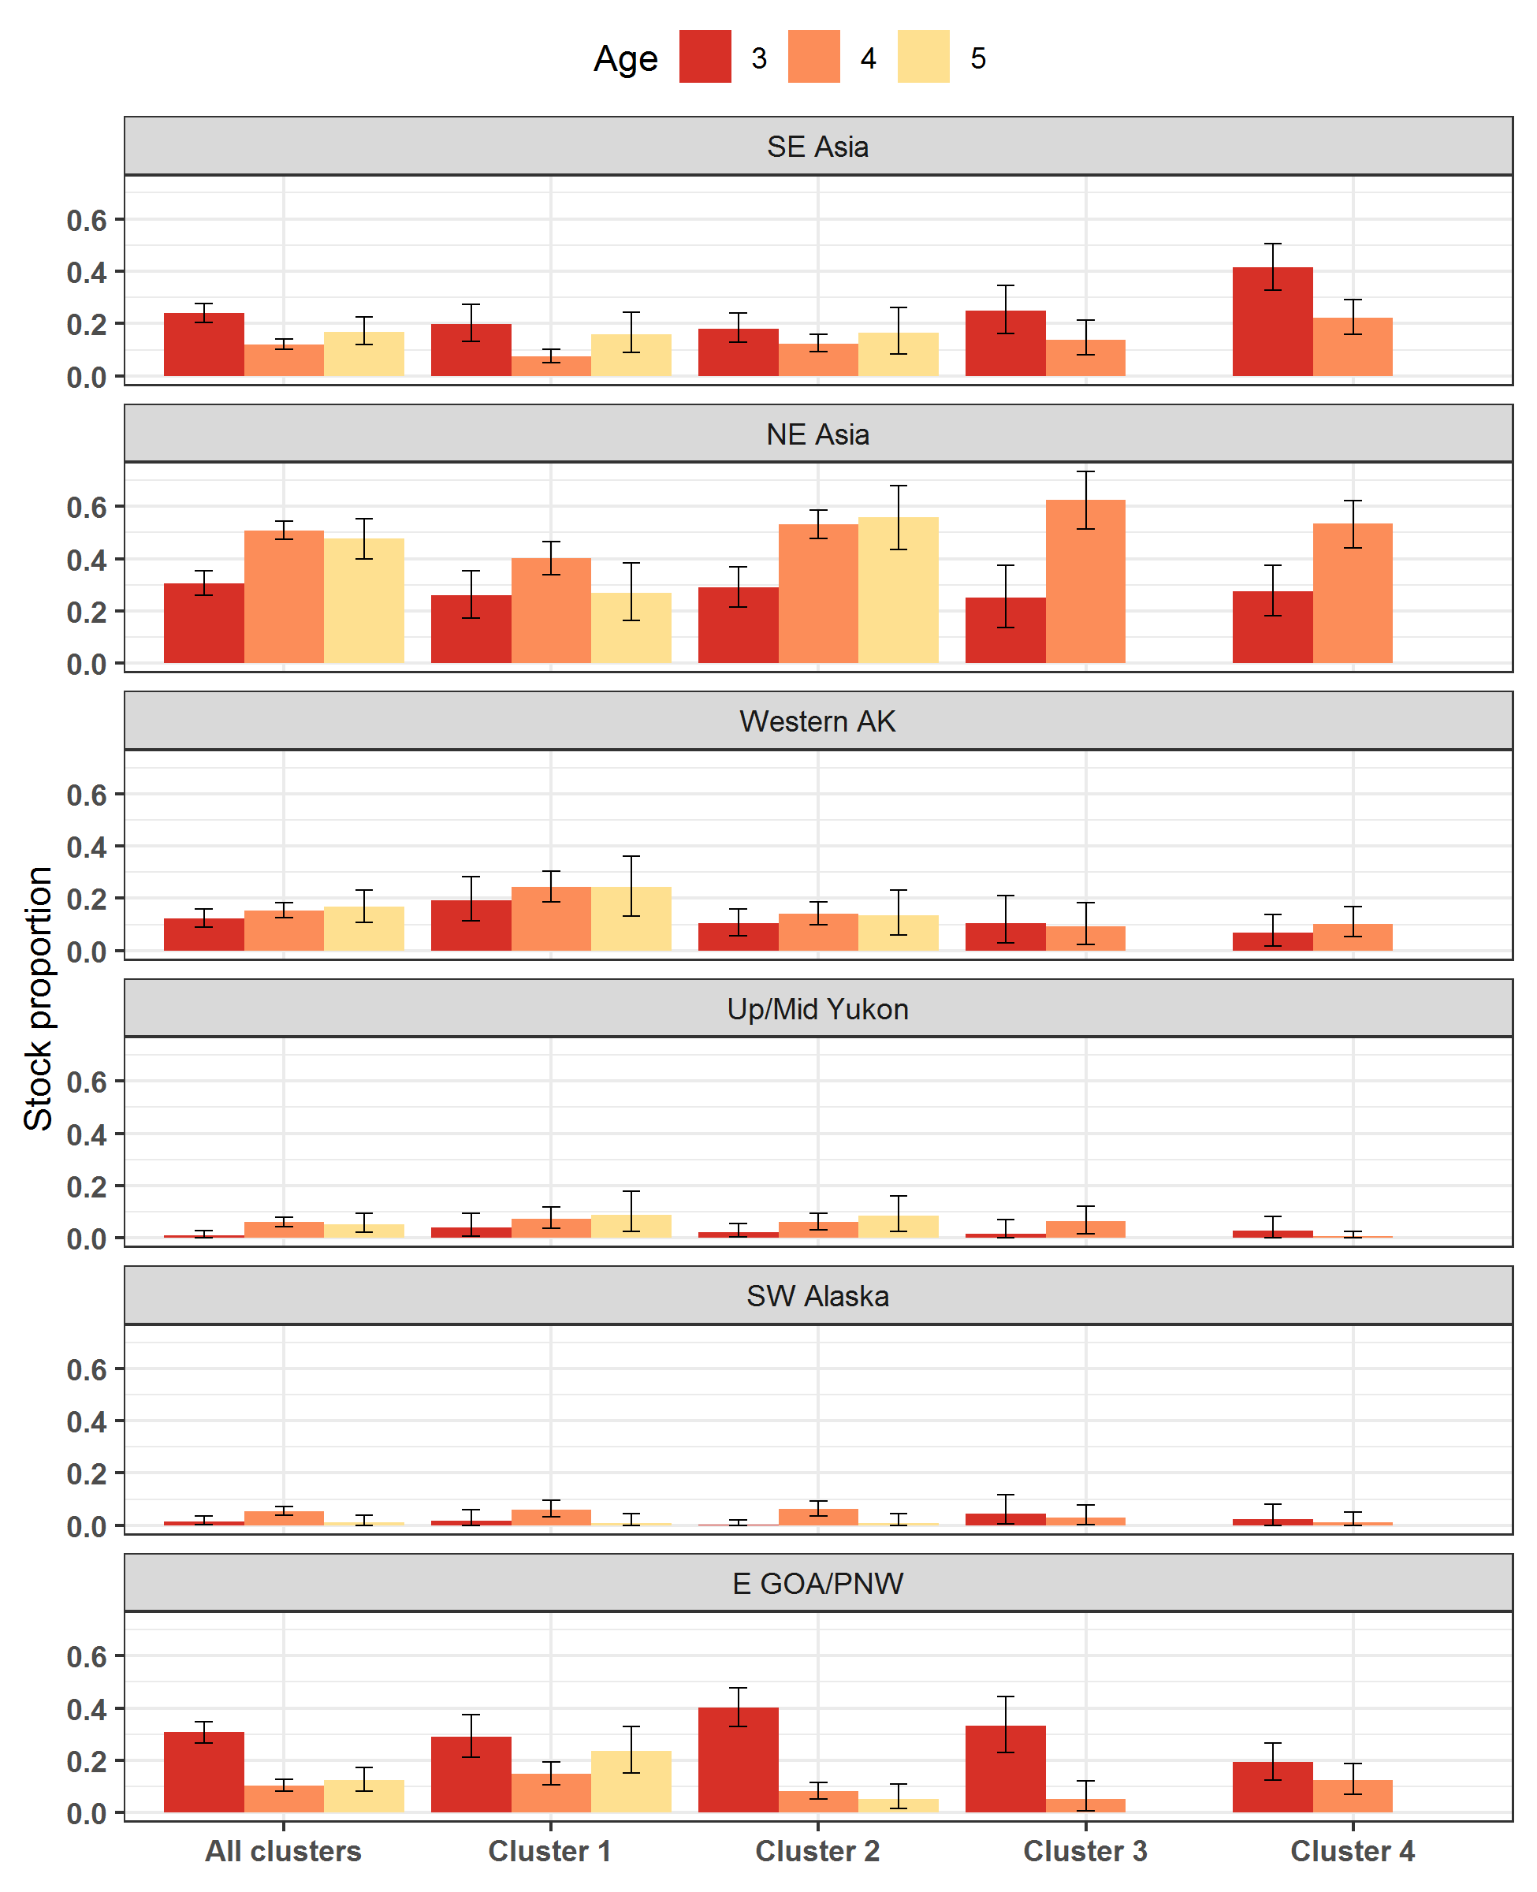
For a particular stock group (e.g., SE Asia), how does the stock proportion vary across age and space?

Slide 28
For a particular stock group (e.g., SE Asia), how does the stock proportion vary across age and space?
For a particular age fish (e.g., 3), how does stock origin vary across space?

Slide 29
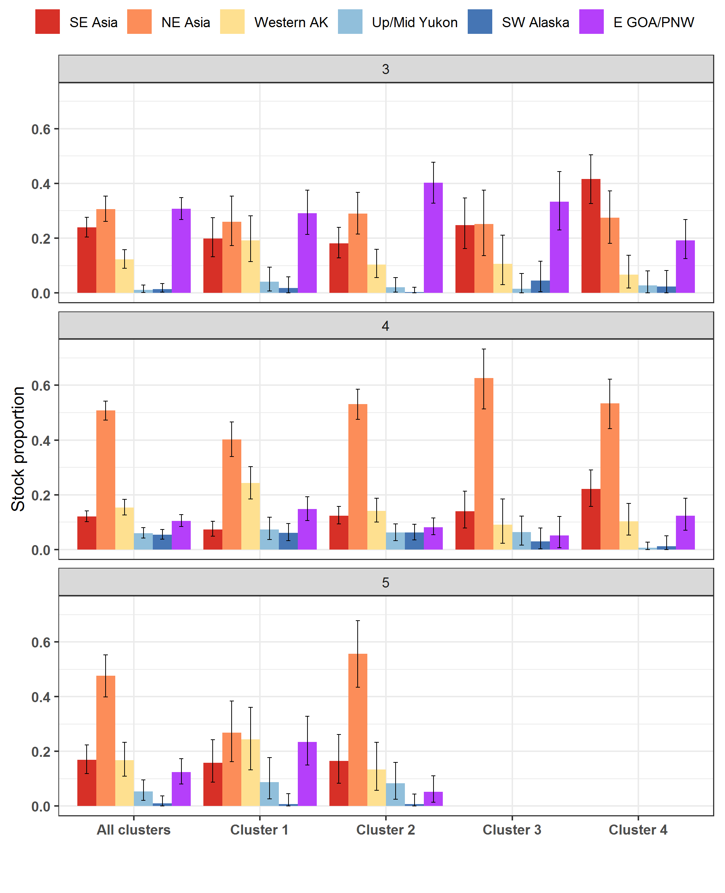
For a particular age fish (e.g., 5), how does stock origin vary across space?

Slide 30
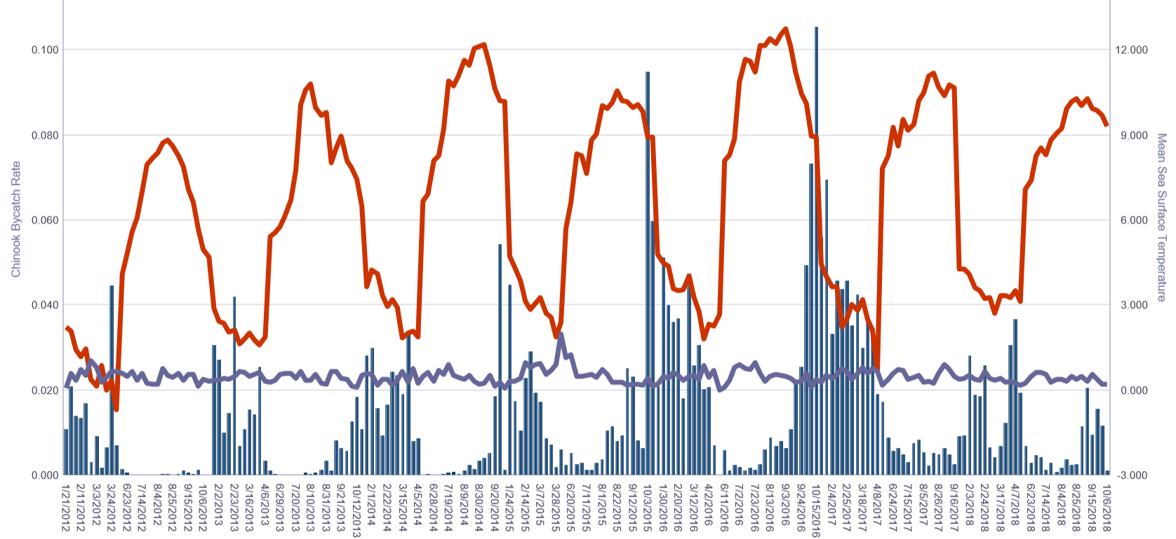

Slide 31
END

