Slide 1
Alternatives for updating AEQ analysis and prioritizing data needs

Slide 2
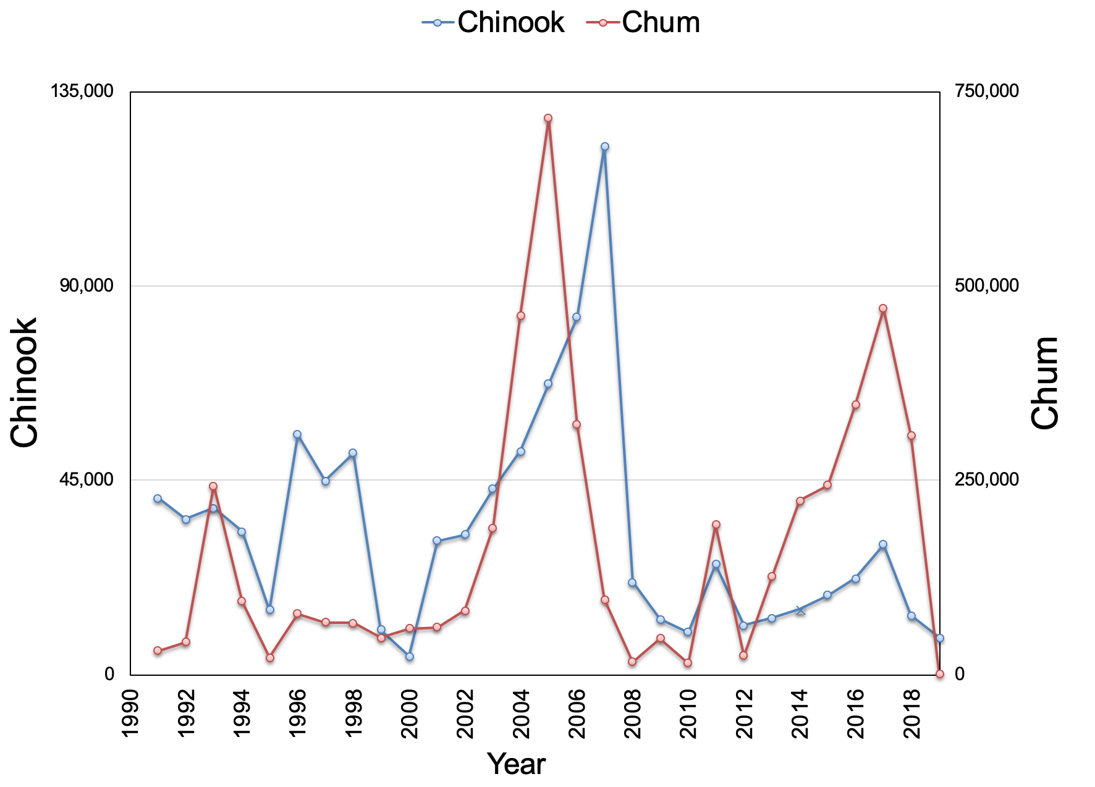
Bycatch history EBS pollock

Slide 3
General steps
Compile PSC statistics
  a. Total bycatch by season (Table 1)
  b. Length and sex composition of the bycatch
  c. Date and location
Convert seasonal length compositions to PSC by age
Apply oceanic survival and maturity-at-age
Use genetic stock ID information (Table 5)
Run the AEQ model (1994-2017) and summarize
Compare subset with available run-strength estimates
Modifications
Change effective growth assumption in recent period

Slide 4
Notes:
Table 1 in document Just PSC total

Slide 5
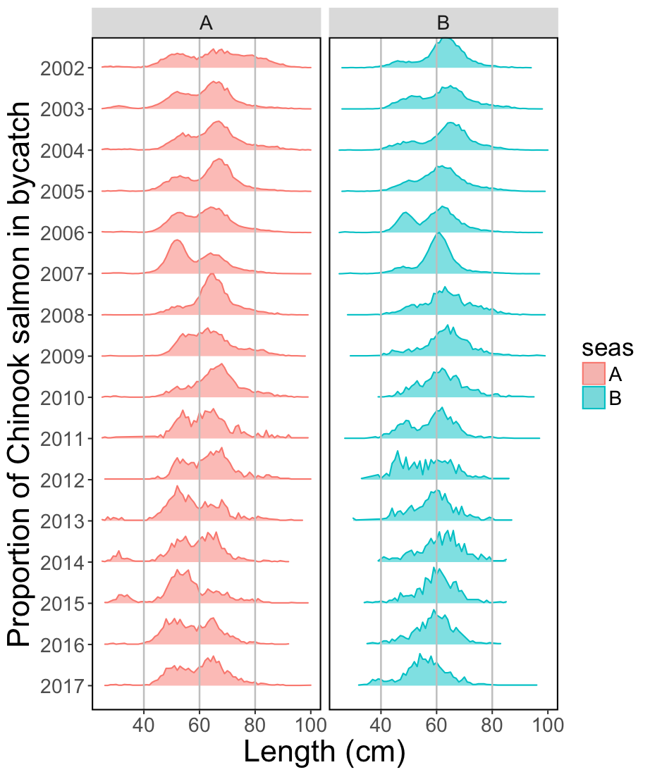
Chinook salmon proportions at length
Notes:
Season specific length frequencies sampled by observers

Slide 6
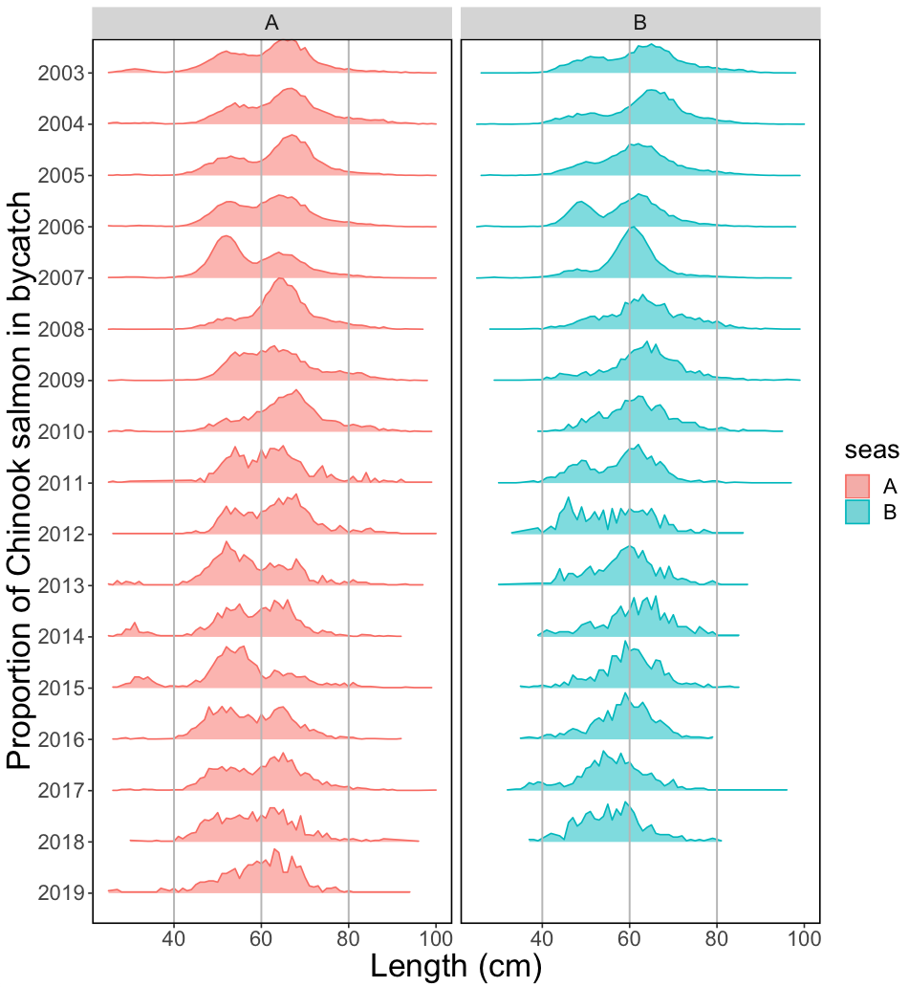
Chinook salmon proportions
at length

Slide 7
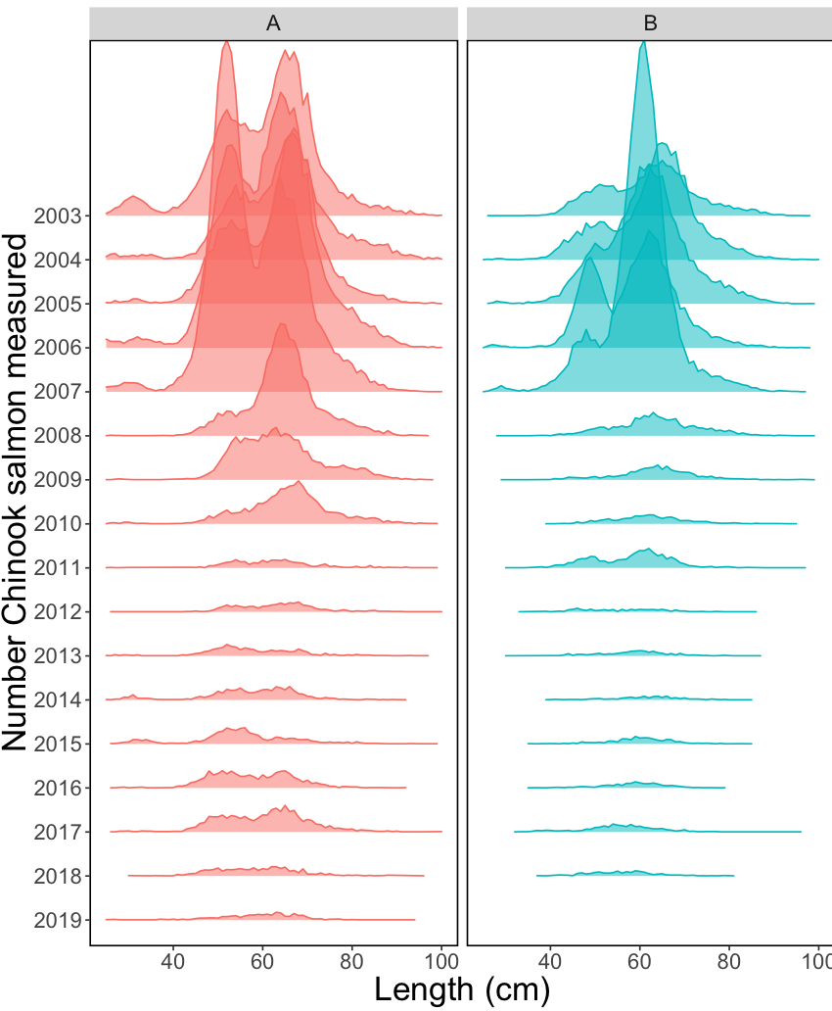
Chinook salmon measurements…
EBS A and B

Slide 8
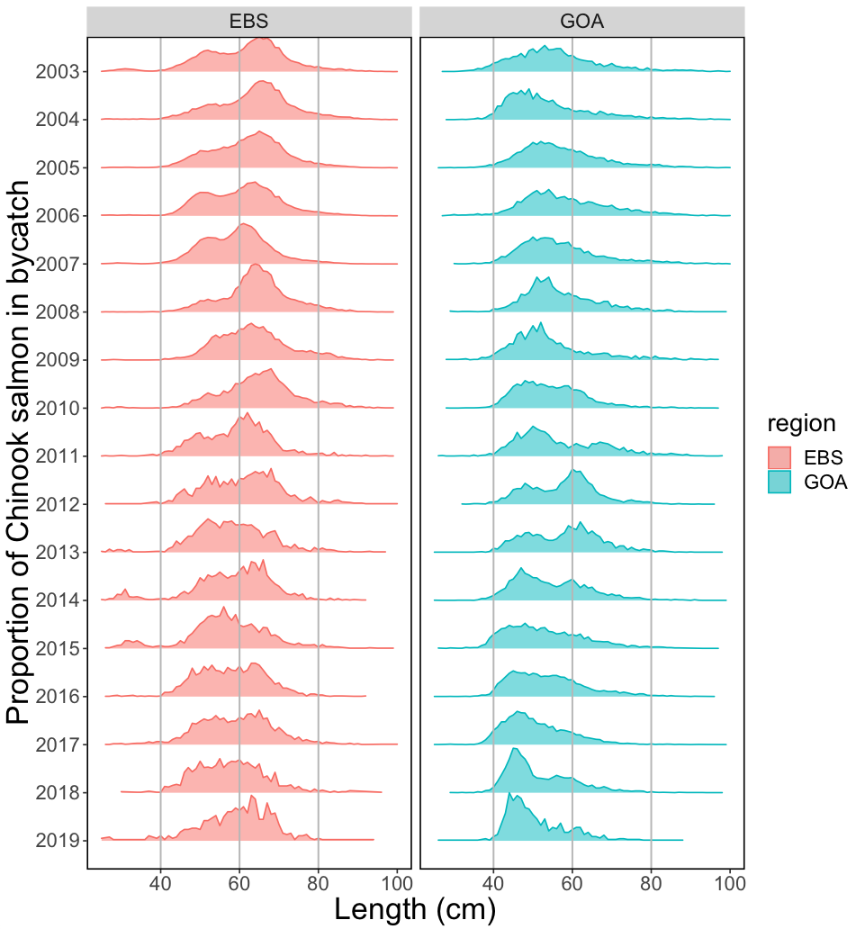
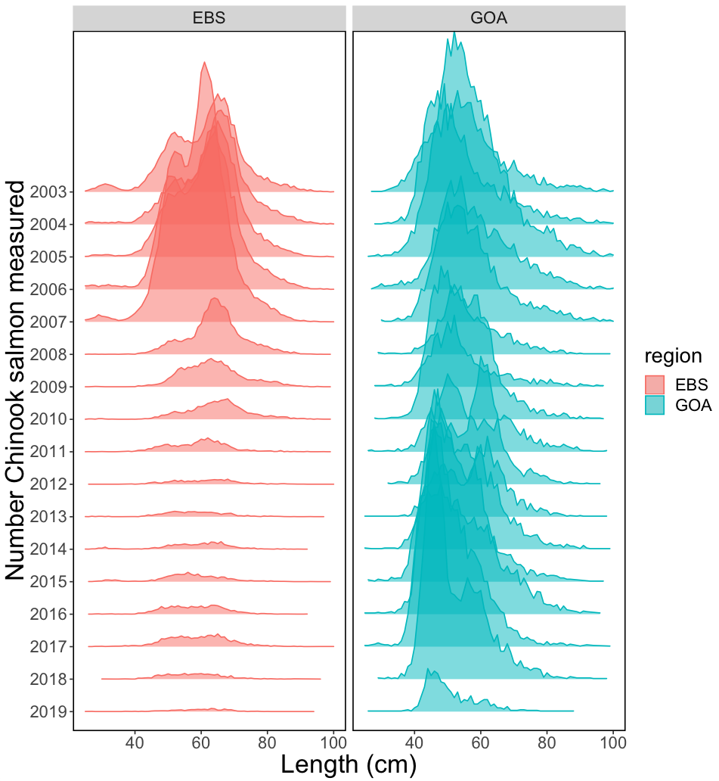
EBS vs GOA
Chinook salmon proportions…

Slide 9
EBS vs GOA
Chinook salmon measurements…

Slide 10
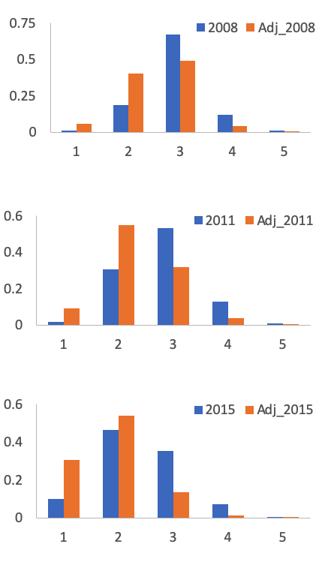
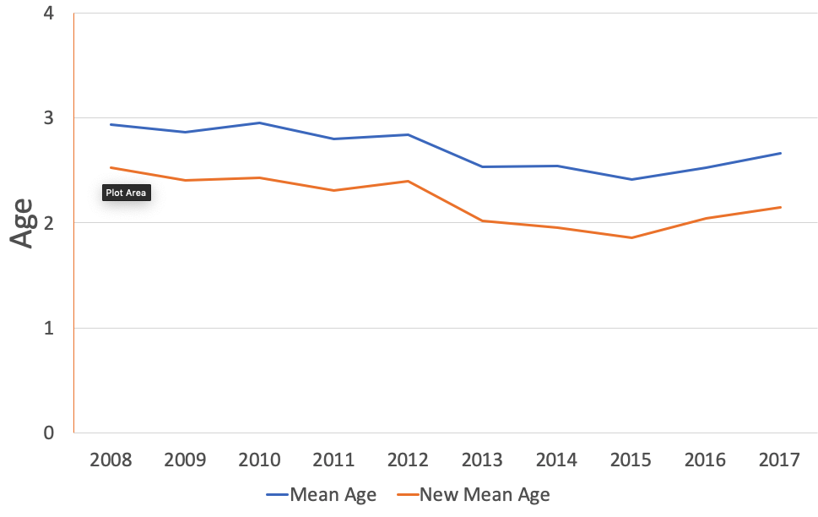
What-if ages wrong… younger at size
Ohlberger et al. 2018 suggest change over time
Modified 2008-2017 data to be on
average a half year younger…for
A-season
Notes:
Ohlberger et al. 2018 suggest some changes over time

Slide 11
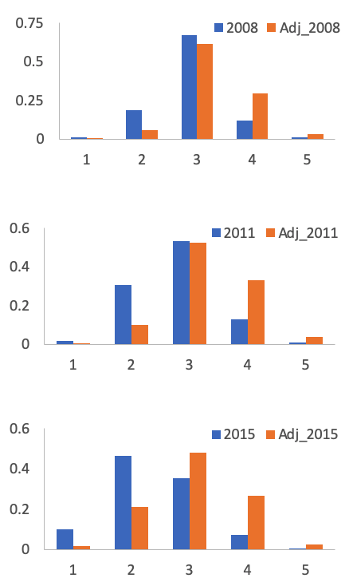
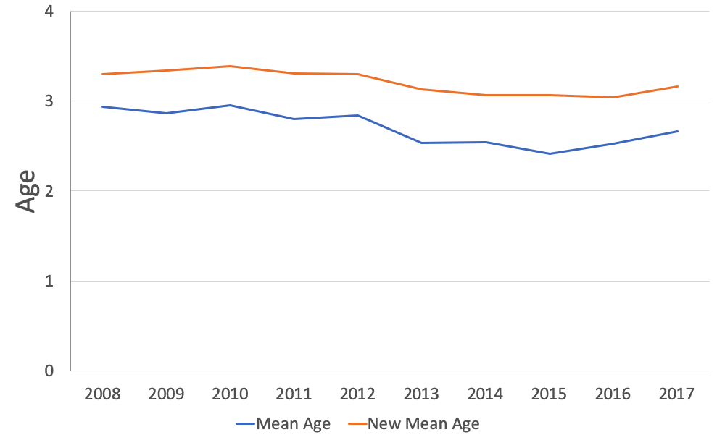
What-if ages wrong… older at size
Modified 2008-2017 data to be on
average a half year older…for
A-season

Slide 12
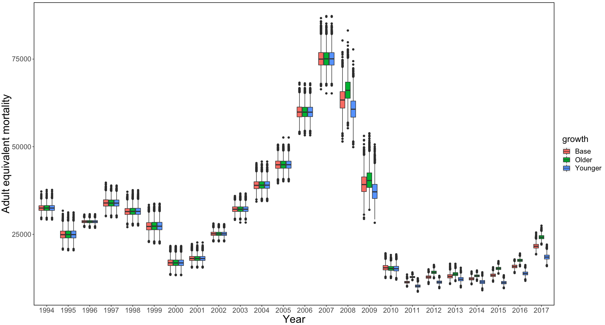
Time series of total Chinook salmon AEQ

Slide 13
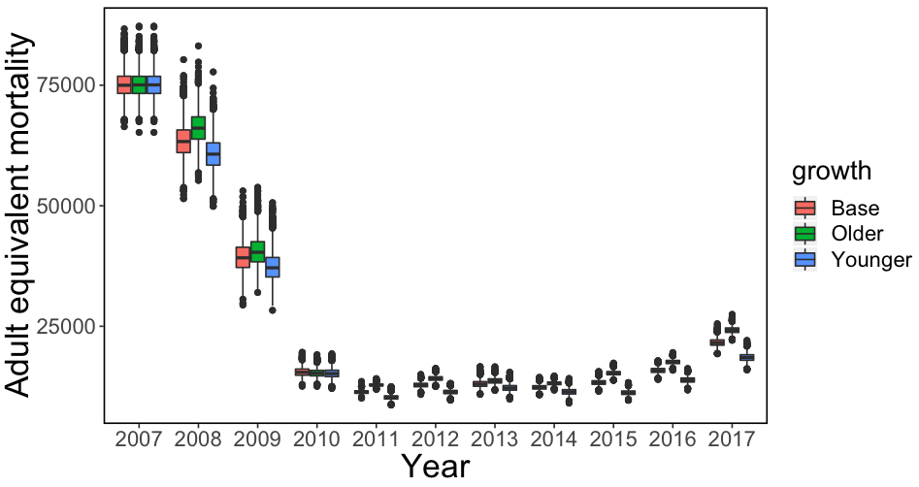
Time series of total Chinook salmon AEQ

Slide 14
Applying genetics stock ID estimates…

Slide 15
Notes:
From ABL, what Council has received

Slide 16
Chinook salmon AEQ estimates, 1994-2017
Notes:
This shows individual time trends on same scale, shows that Coastal West Alaska stocks were highest, NOTE that the time series extends from 1994 through 2017—the genetics data are only from 2011-2016, the years where the information was unavailable were based on the average stock composition estimates (from years where data exist) and the inter-annual variability

Slide 17
Chinook salmon AEQ estimates, 1994-2017 (rescaled)
Notes:
Scales vary here, to see how bycatch AEQ varies in patterns (instead of scale)

Slide 18
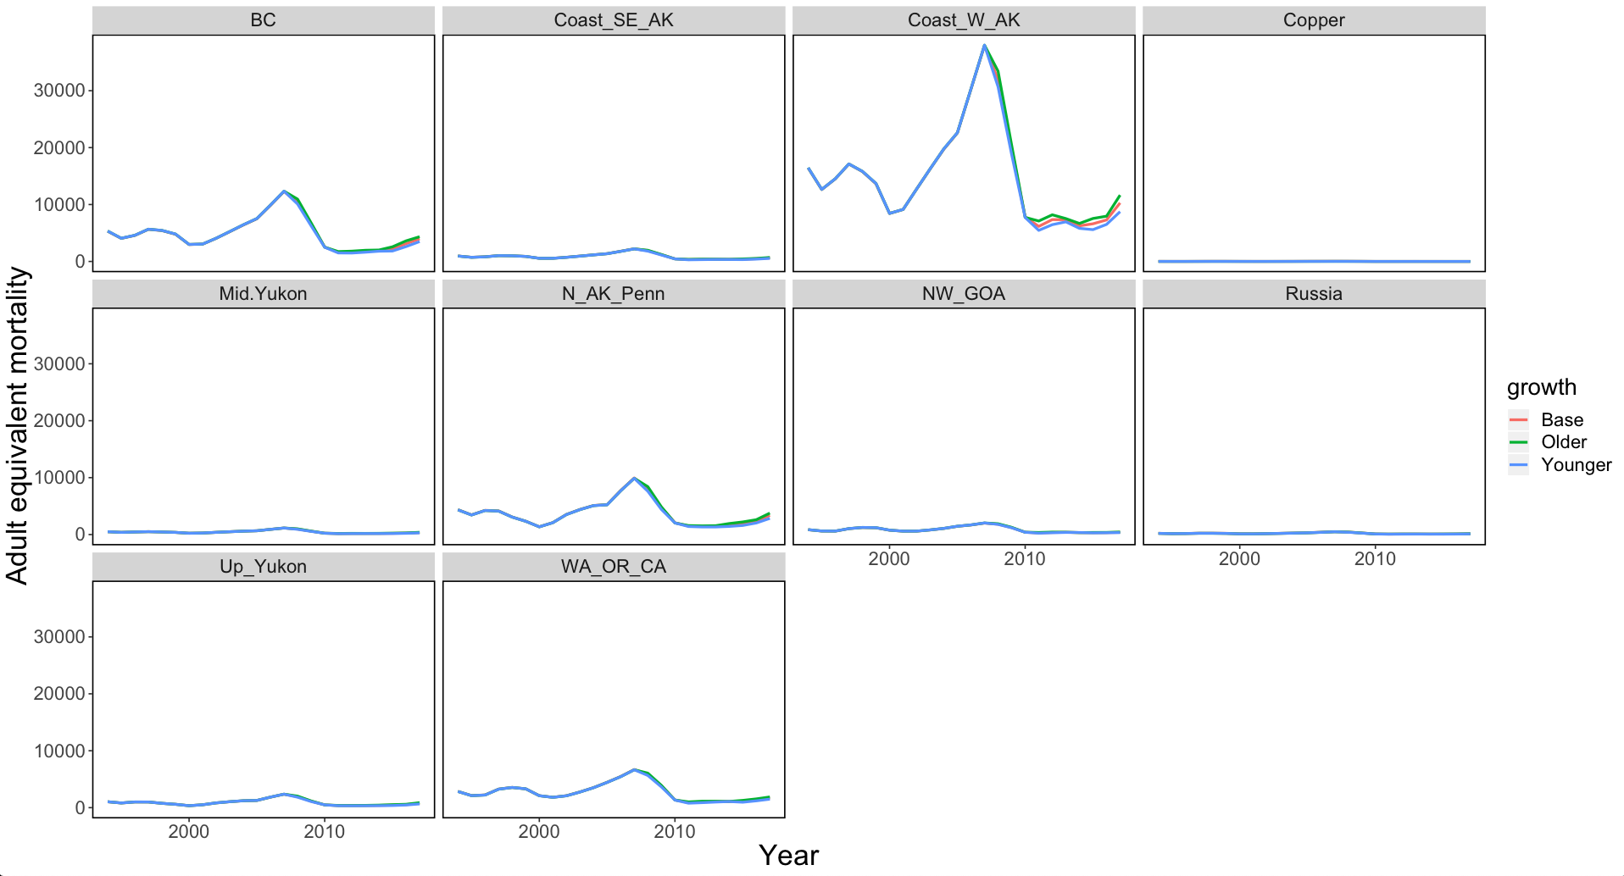
Chinook salmon AEQ estimates, 1994-2017, growth shifts…
Notes:
This shows individual time trends on same scale, shows that Coastal West Alaska stocks were highest, NOTE that the time series extends from 1994 through 2017—the genetics data are only from 2011-2016, the years where the information was unavailable were based on the average stock composition estimates (from years where data exist) and the inter-annual variability

Slide 19
Notes:
This is revised from previous version and is now posted to June 2018 council agenda

Slide 20
Chinook salmon run-strength estimates
(courtesy of ADFG)
2017
Notes:
2017

Slide 21
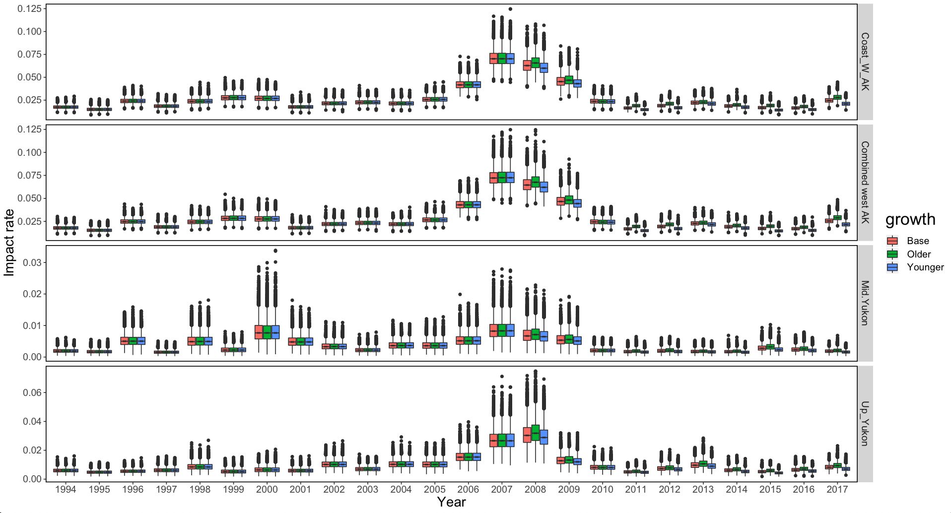
Regional impact estimates
(under different growth alternatives)

Slide 22
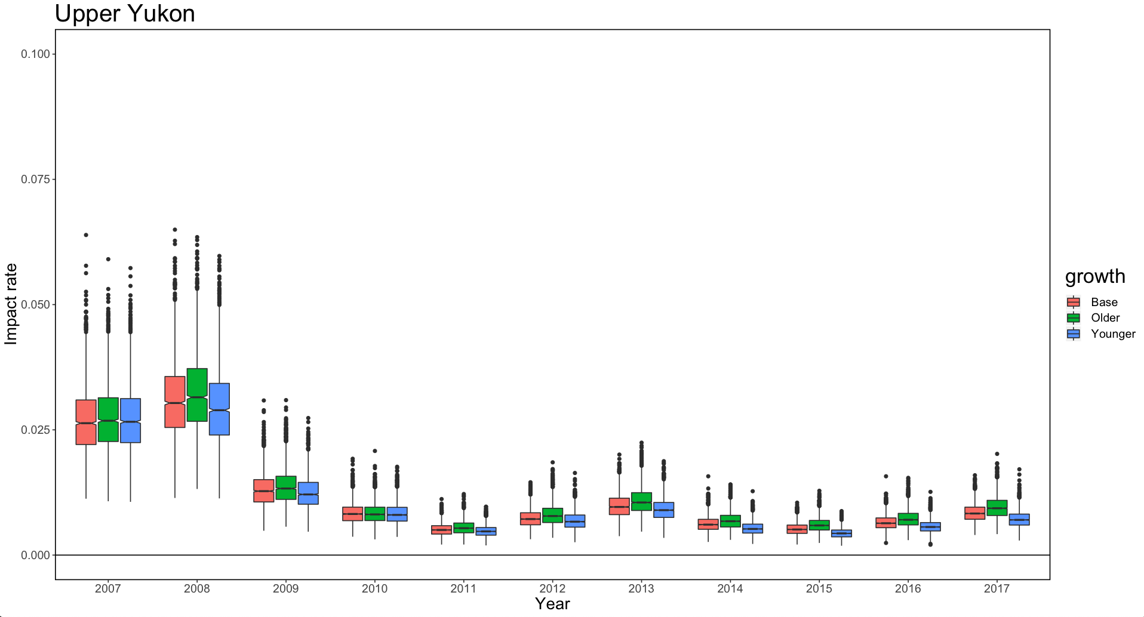
Chinook salmon AEQ / run strength

Slide 23
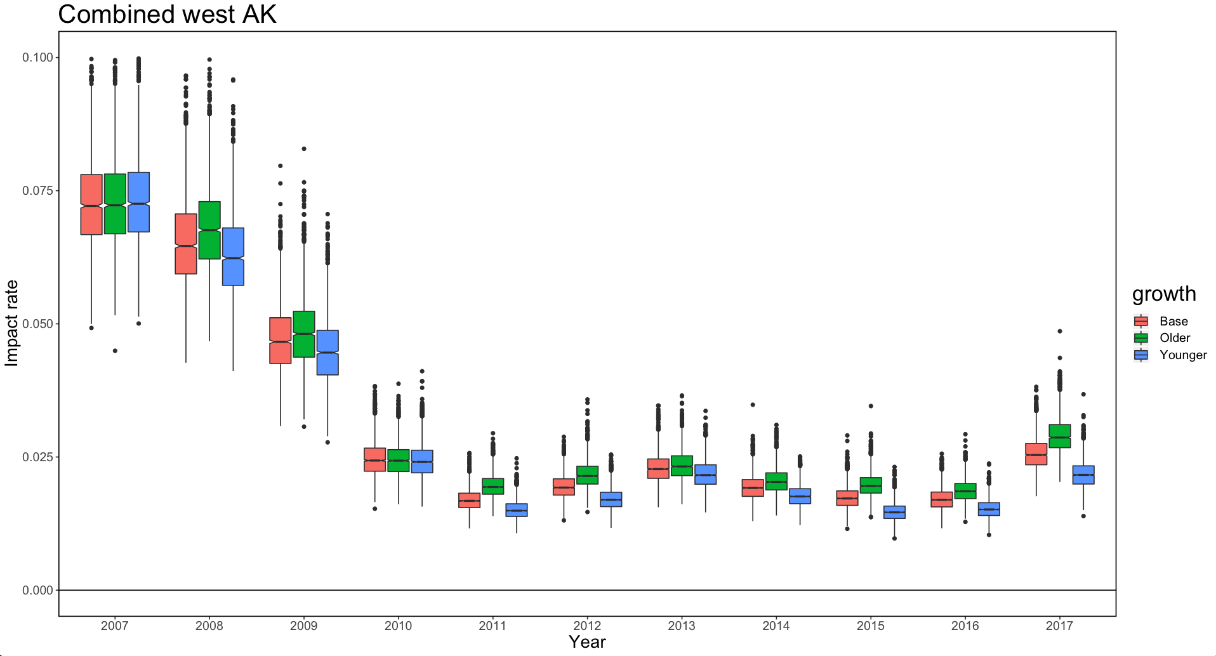
Chinook salmon AEQ / run strength

Slide 25
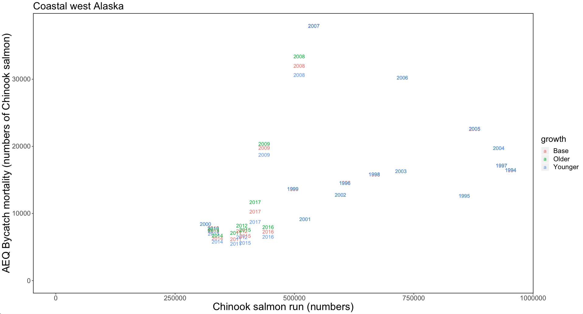
Coastal western Alaska stocks

Slide 26
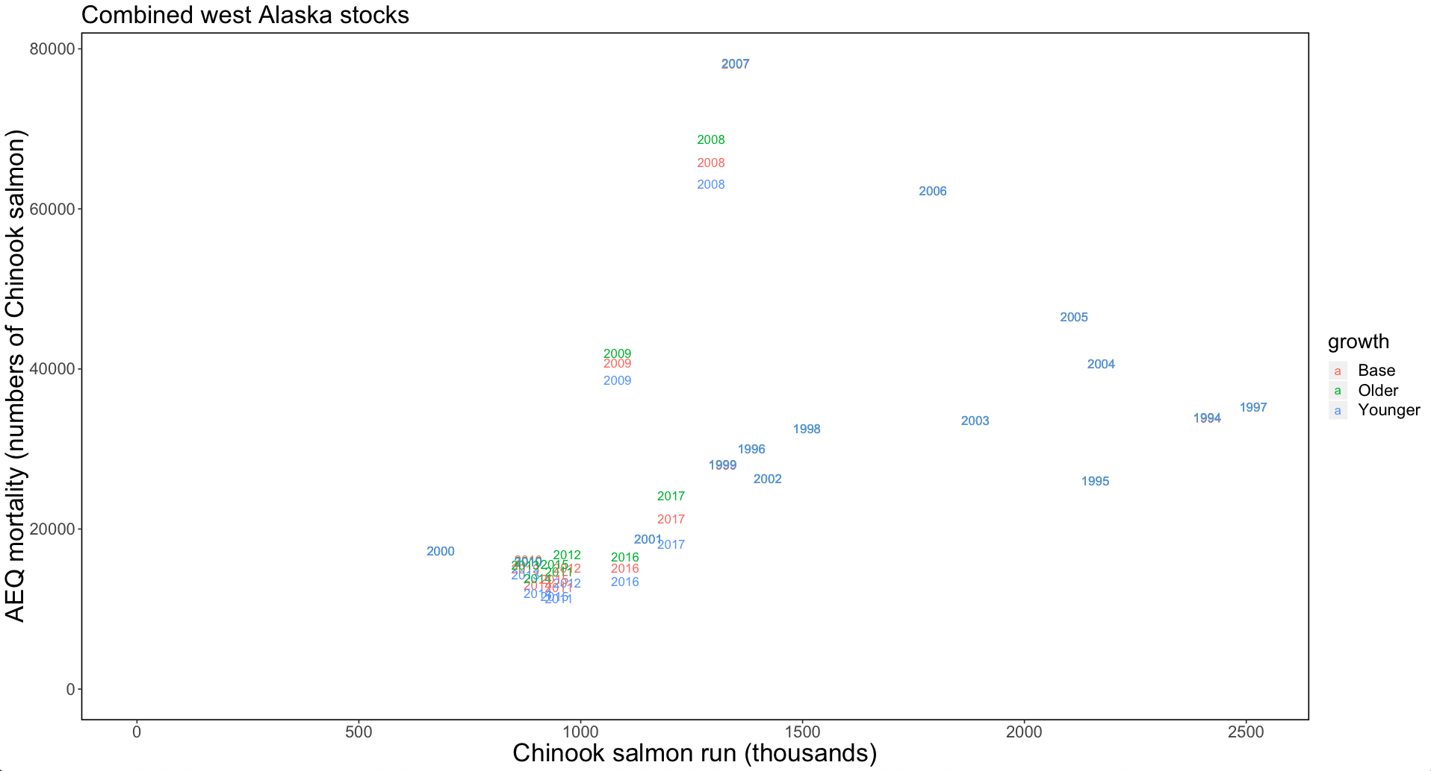
Combined western Alaska stocks

Slide 27
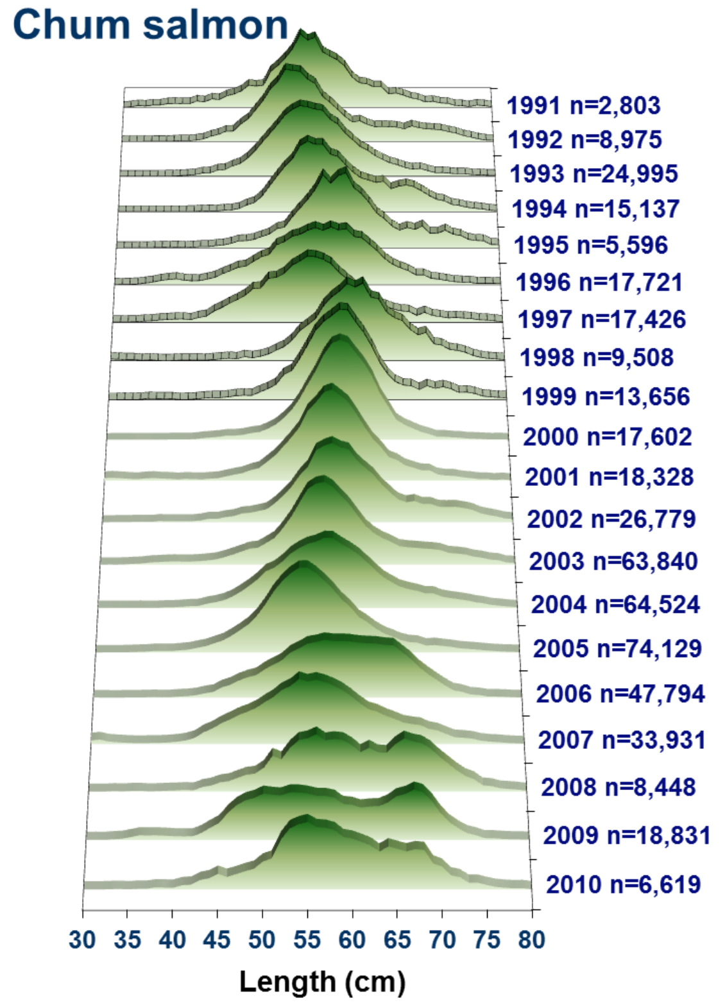
Chum salmon

Slide 28
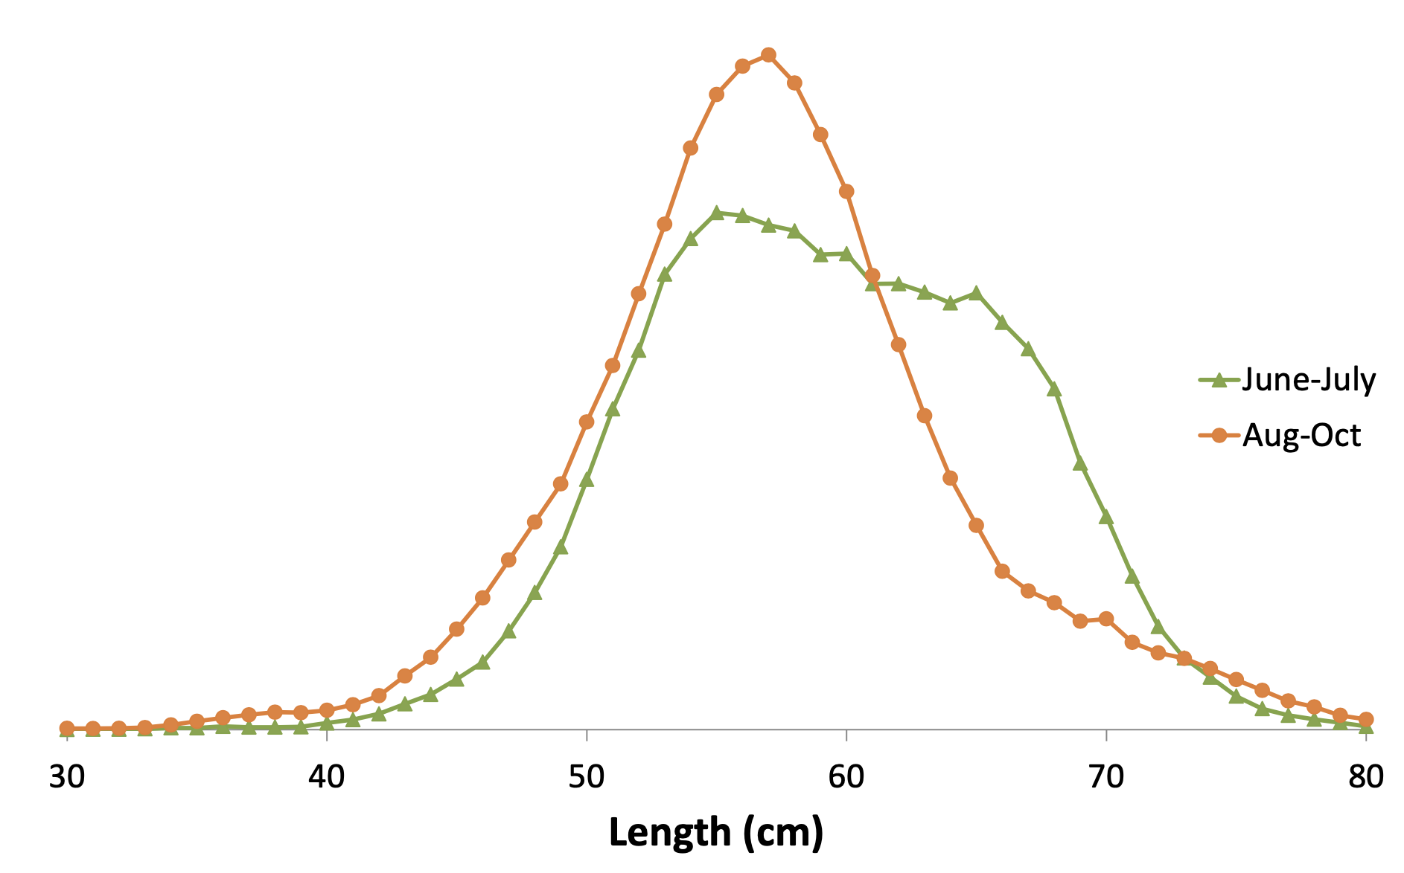
Chum salmon

Slide 29
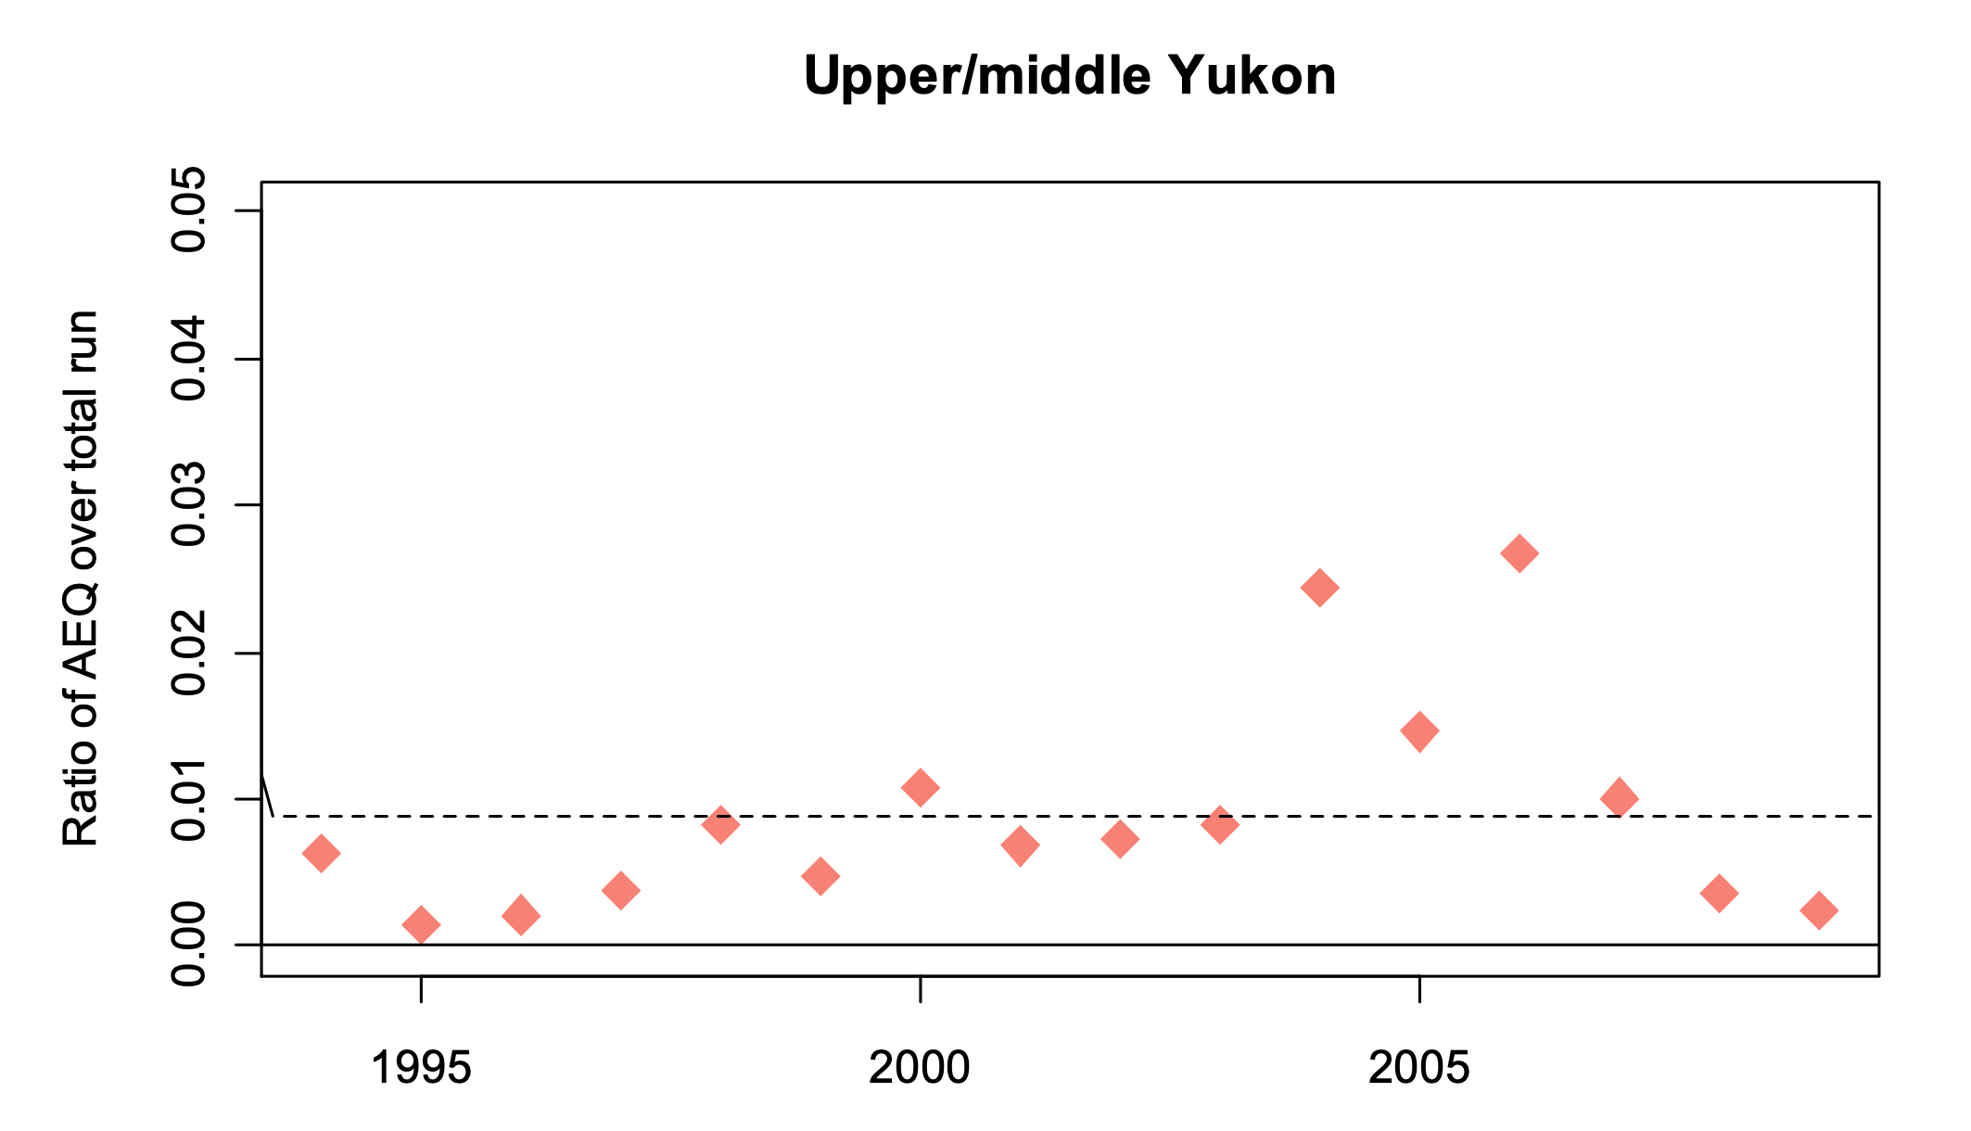
Chum salmon

Slide 30
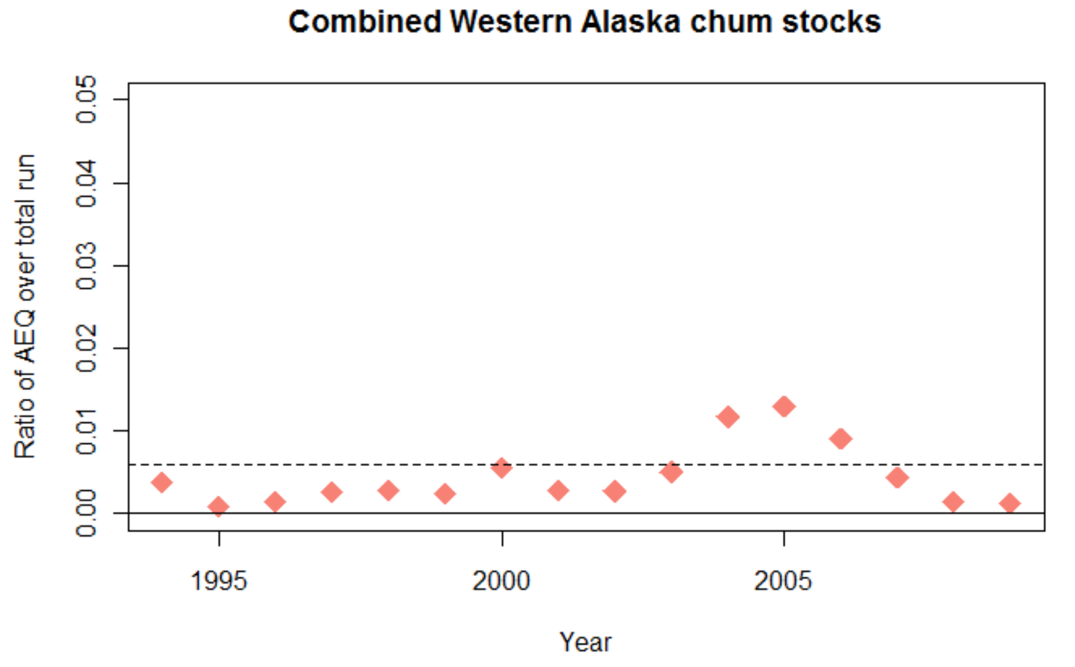
Chum salmon

Slide 31
Summary AEQ
Length frequency data:
  Seems to be smaller in recent years
  B-season generally smaller/younger Chinook salmon
  Sample sizes of length measures much lower in EBS since census period
  GOA sample sizes remain high (for length measurements)
Growth changes affect results slightly
  What-ifs based on aassumed growth changes
  (no basis for actual values chosen!!)
  The need to age samples would improve estimates

