Slide 1
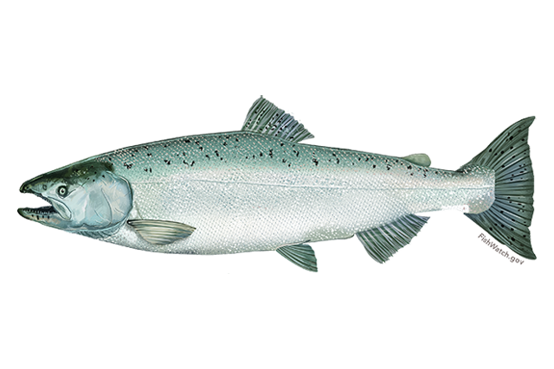


Looking for better ways to use genetic data to avoid critical Chinook stocks in groundfish fisheries
Update on current work and possibilities for future efforts
Sara Gilk-Baumer¹, Garrett McKinney², and Lisa W. Seeb²
¹Alaska Department of Fish and Game, Gene Conservation Laboratory
²University of Washington, School of Aquatic and Fishery Sciences
NPFMC Salmon Bycatch Workshop
April 15, 2019

Slide 2
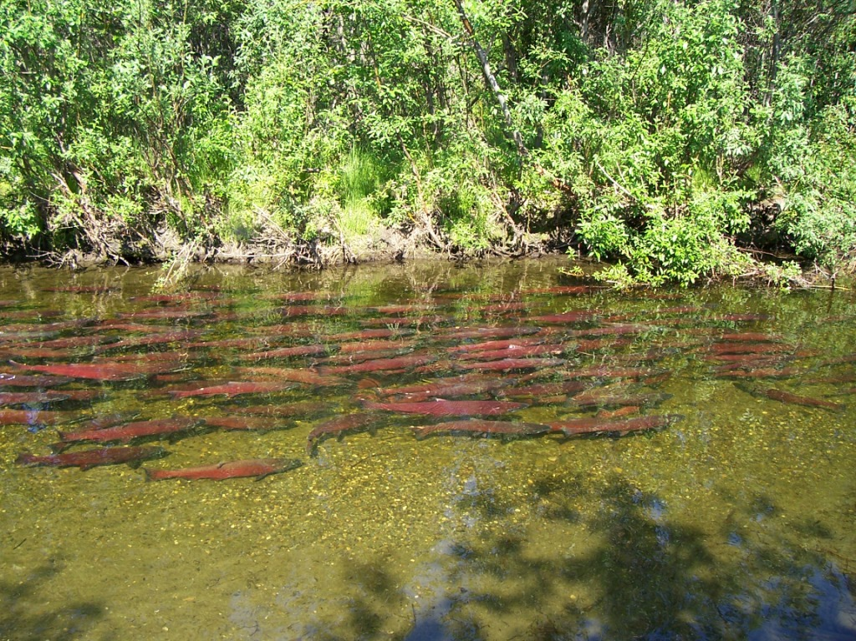
Outline
History of baseline development
Current baseline in use
Baseline updates
Working towards solutions in Western Alaska
Timelines and costs

Slide 3
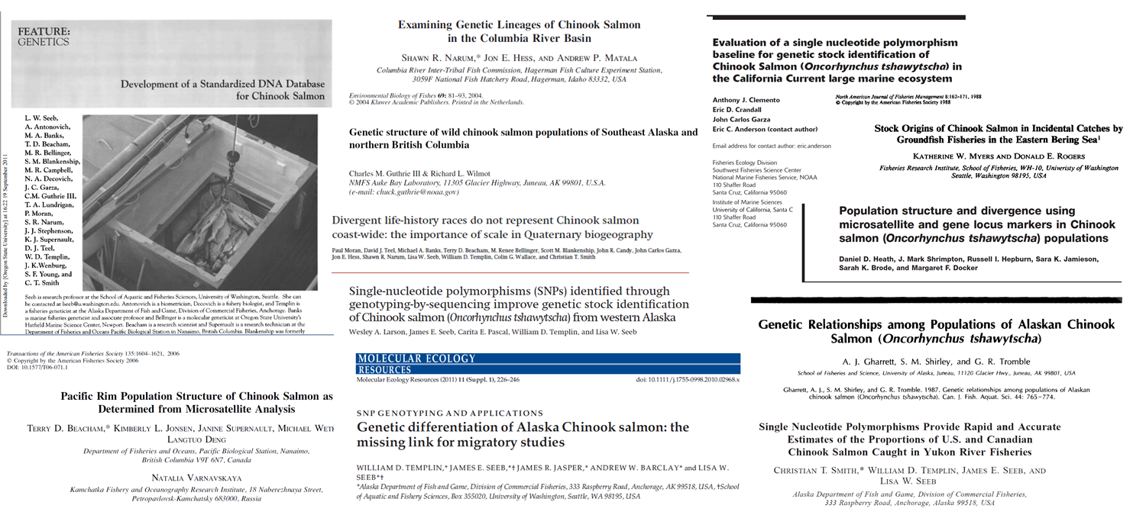
History of baseline development
Allozymes → Microsatellites → SNPs
Technology developments (e.g. GT-seq)
For Example…

Slide 4
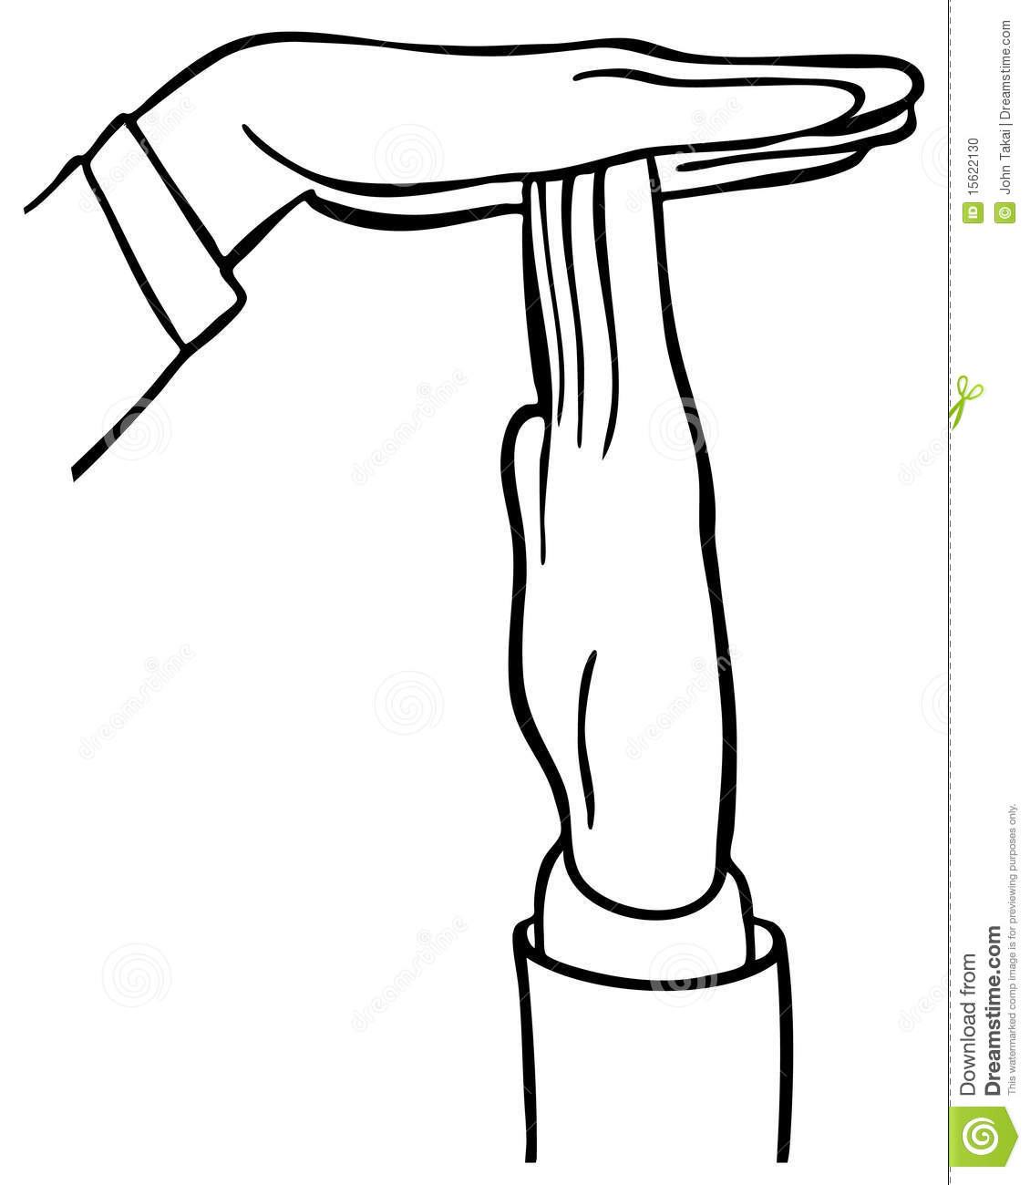
TIMEOUT!!! A few definitions…
Allozyme: protein-based marker
Microsatellite: DNA-based marker
SNP: DNA-based marker
  “single nucleotide polymorphism”, i.e. single base pair change
GT-seq: SNP chemistry
  “genotyping in thousands by sequencing”, i.e. SNPs but new lab chemistry
  Best for running 100s of SNPs in groups called panels
  Traditional chemistry is most efficient for ≤96 SNPs

Slide 5
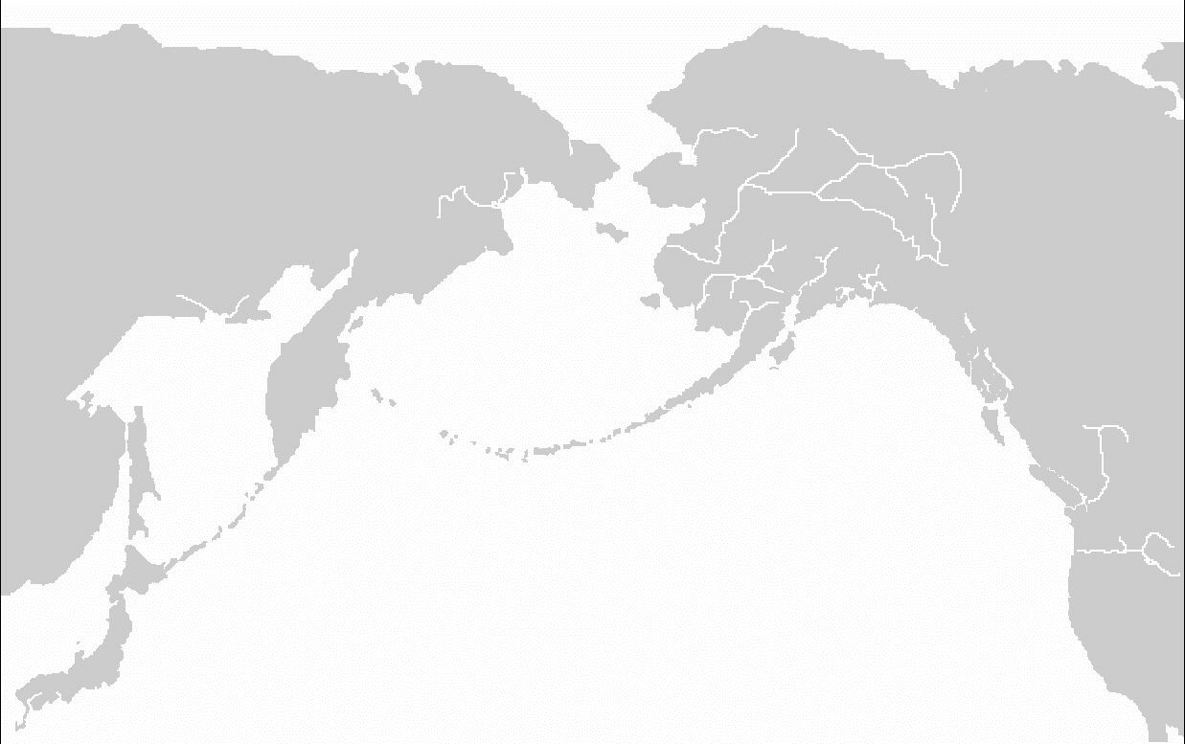
Current baseline
Middle Yukon
Upper Yukon
Coastal W. Alaska
Copper
NE Gulf of AK
NW Gulf of AK
Coastal SE Alaska
Russia
N AK Peninsula
British Columbia
Templin et al. 2011
43-45 SNPs
11 Stock Groups
W Coast U.S.

Slide 6
Regional baseline updates (e.g.)
California SNP parentage panels
Canada development of SNP baseline for parentage and MSA applications
Cook Inlet SNP panel
Lower 48 299-SNP panel
  Screening of Alaska populations in progress

Slide 7
Baseline updates
Additional resolution possible

Slide 8
Baseline updates
The bigger challenge

Slide 9
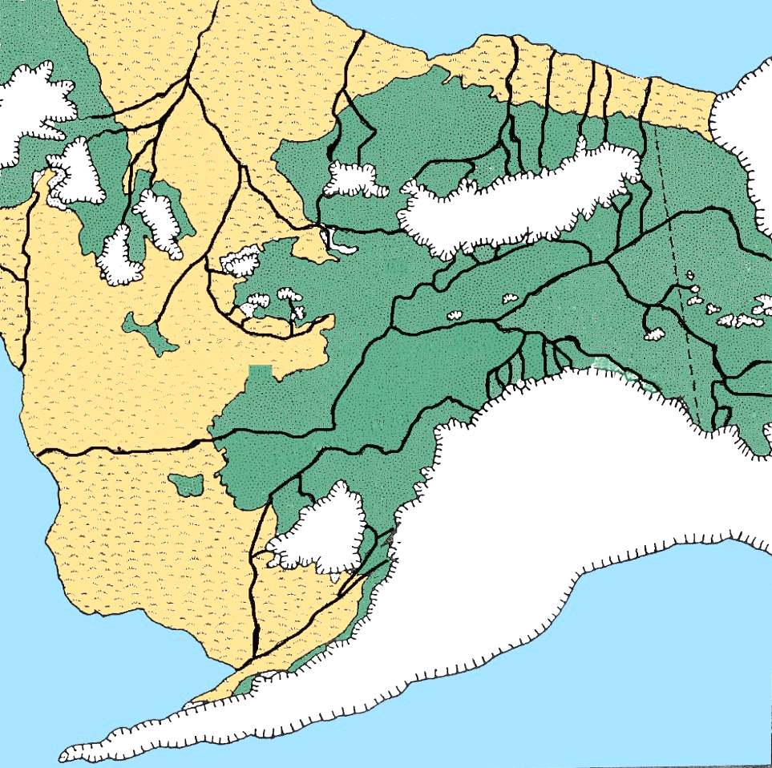
The Western Alaska Problem
Bering Land Bridge
Yukon River
Kuskokwim and Nushagak R.

Slide 10
Working towards solutions in W. Alaska
Templin et al. 2011 (current)
Mid Yukon
Upper Yukon
Coastal Western Alaska

Slide 11
Working towards solutions in W. Alaska
Larson et al. 2014
  Marker development
  96 high power SNPs
  Starting to break up group
    Still some misallocation
Mid Yukon
Norton Sound
Upper Yukon
Lower Yukon
Kuskokwim/Nushagak
Notes:
Coastal WAK little genetic differentiation with traditional panel of up to 96 SNPs; subdivide into only a few RGs for mixture analysis or assignment tests

Slide 12
Working towards solutions in W. Alaska
McKinney et al. (submitted)
  1,000+ existing and new SNPs
  4 GT-seq panels
  Focused specifically on Kuskokwim/Nushagak
  Some additional structure
Mid Yukon
Norton Sound
Upper Yukon
Lower Yukon
U. Kuskokwim
What if we could drastically increase the number of markers?
Kuskokwim/
Nushagak
Goodnews/
Togiak
Notes:
Also some within region scenarios tested for MSA (i.e. within Kuskokwim, within Togiak/Nushagak)—
The Kuskokwim and Nushagak problem
93% accuracy for Kuskokwim, 72% accuracy for Nushagak River using 847 loci
Large difference in sample sizes (fish from low sample RG may assign to higher sample RG)
Unable to utilize full panel in testing
Additional sampling of Nushagak pops: low resolution in that drainage due to unbalanced sampling or limitation of panel

Slide 13
Working towards solutions in W. Alaska
McKinney et al. (submitted)
  >15,000 RAD SNPs
  >95% accuracy
Mid Yukon
Norton Sound
Upper Yukon
Lower Yukon
U. Kuskokwim
Kuskokwim
Kusko Bay
Nushagak
Is this feasible?
Goodnews/
Togiak
Notes:
It may be possible to arrive at fewer panels and find higher resolution loci using haplotypes

Slide 14
Base cost comparison
(ADF&G)
 | # markers
 | 48 | 96 | 300 | 1,000 | 15,000
Relative cost | 1 | 1.5 | 1.5 | 3 | 45?
Ask yourself: What is my question? What is the best tool to answer it? How can I balance cost/benefits?
Cost
Timeline
Resolution

Slide 15
Future Work
UW working on a refined GTseq panel
Additional work with existing baseline
Approaches to unbalanced baselines
Technological advances

