Slide 1
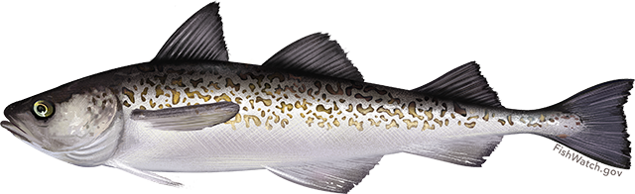
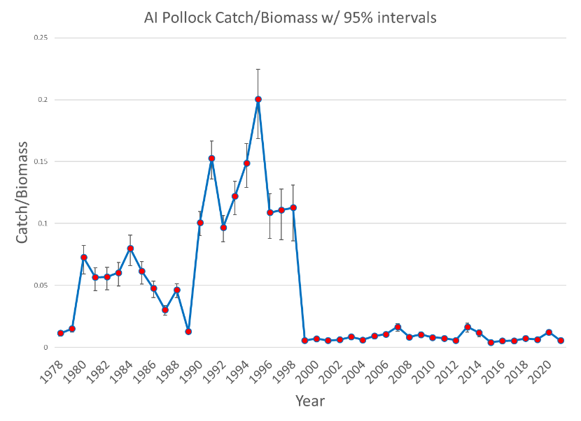
Aleutian Islands Walleye pollock (partial)
Steven J. Barbeaux, Jim Ianelli, and Wayne Palsson
19,000 t cap
2021 catch = 1,695 t
Catch has been less than 4,000 t since 1999
 | As estimated or specified last year for: |  |  | As estimated or recommended this year for:
Quantity | 2021 |  | 2022 | 2022 |  |  |  | 2023*
M (natural mortality rate) | 0.21 |  |  | 0.21
Tier | 3a |  |  | 3a
Total (age 1+) biomass (t) | 292,967 | 308,671 |  | 308,525 |  | 330,375
Female spawning biomass (t) Projected | 89,906 | 85,785 |  | 89,516 |  | 87,650
B_{100%} | 185,475 |  |  | 185,475
B_{40%} | 74,190 |  |  | 74,190
B_{35%} | 64,916 |  |  | 64,916
F_{OFL**} | 0.390 | 0.390 |  | 0.390 | 0.390
maxF_{ABC} | 0.313 | 0.313 |  | 0.313 | 0.313
F_{ABC} | 0.313 | 0.313 |  | 0.313 | 0.313
OFL (t) | 61,856 | 61,308 |  | 61,264 | 61,379
maxABC (t) | 51,241 | 50,789 |  | 50,752 | 50,825
ABC (t) | 51,241 | 50,789 |  | 50,752 | 50,825
Status | As determined this year for: |  |  | As determined this year for:
 | 2019 | 2020 |  | 2020 |  |  | 2021
Overfishing | no | no |  | no |  |  | n/a
Overfished | n/a | n/a |  | n/a |  |  | no
Approaching overfished | n/a | n/a |  | n/a |  |  | no
U.S. Department of Commerce | National Oceanic and Atmospheric Administration | NOAA Fisheries | Page 1
This information is distributed solely for the purpose of pre-dissemination peer review under applicable information quality guidelines.
It has not been formally disseminated by the National Marine Fisheries Service and should not be construed to represent any agency determination or policy.

