Slide 1
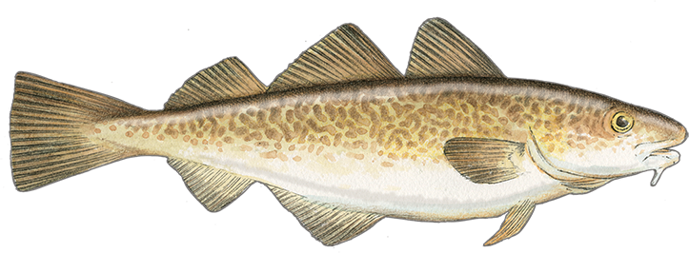
Assessment of the Pacific cod stock in the Aleutian Islands
Ingrid Spies, Steve Barbeaux, Pete Hulson,
Ned Laman, Ivonne Ortiz

Slide 2
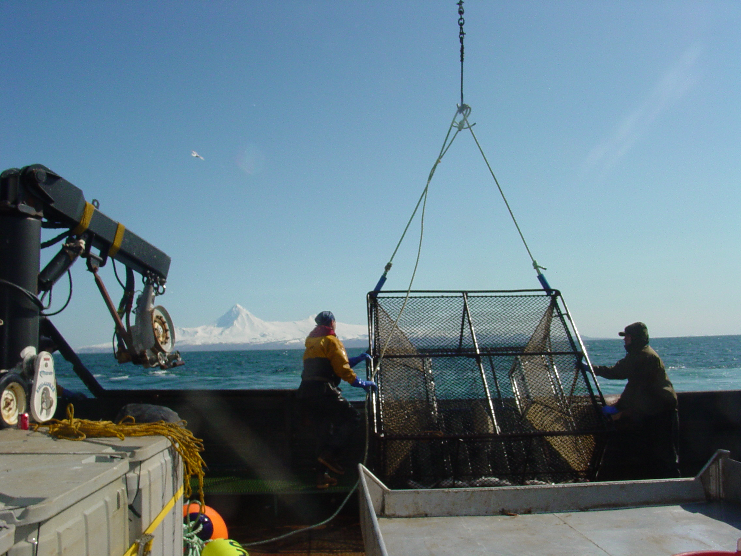
Aleutian Islands Pacific cod
2022 survey results
Catch and fishery
Models introduced this year.
Risk table components
Consideration of risk
Photo credit: Sandi Neidetcher

Slide 3
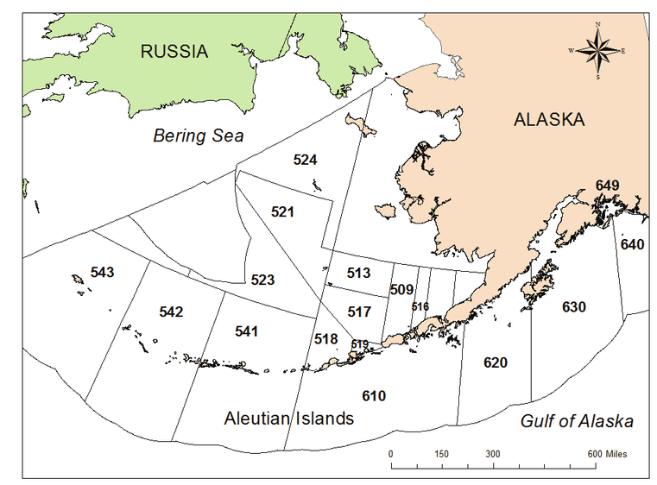
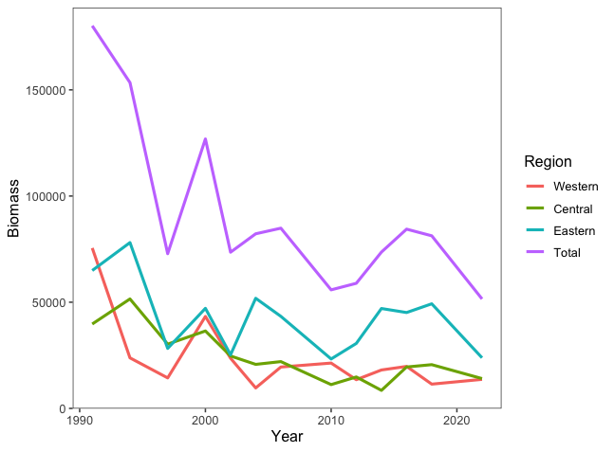
Aleutian Islands Pacific cod trawl survey estimates by NMFS area

Slide 4
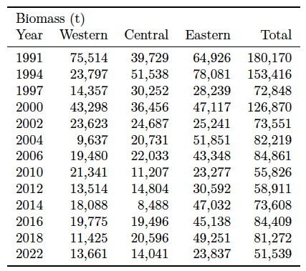
Aleutian Islands Pacific cod trawl survey estimates by NMFS area

Slide 5
Aleutian Islands cod fishery
The Adak processor was closed in 2020 through 2022, and is unlikely to open for the 2023 A season.
Sometimes tenders are hired to bring the fish to the Gulf of Alaska or the Bering Sea.

Slide 6
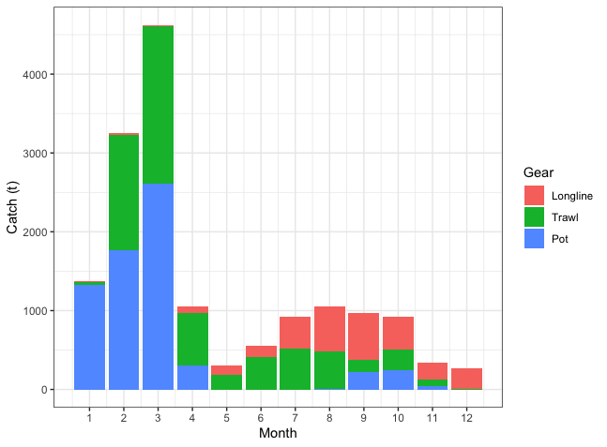
Aleutian Islands Pacific cod average catch (t) by month per year, for the past 5 years
66%
34%
Data from 2018 - October 31, 2022.

Slide 7
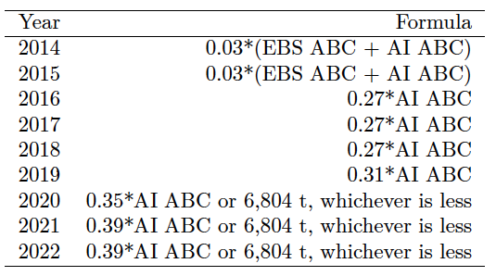
State guideline harvest levels for Aleutian Islands Pacific cod

Slide 8
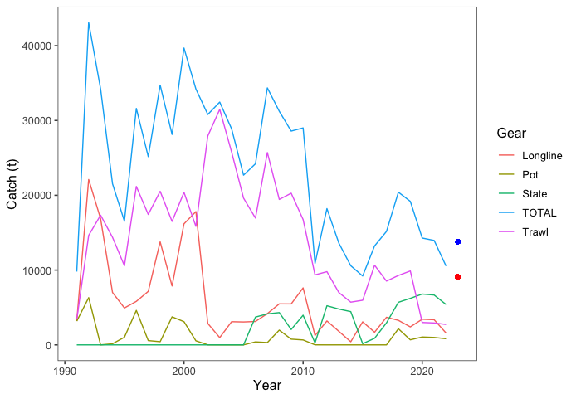
Aleutian Islands Pacific cod catch history, with federal catches by gear type
Tier 5 ABC
Model 22.0 ABC

Slide 9
Aleutian Islands Pacific cod catch by area
1993-2022 (October 31)

Slide 10
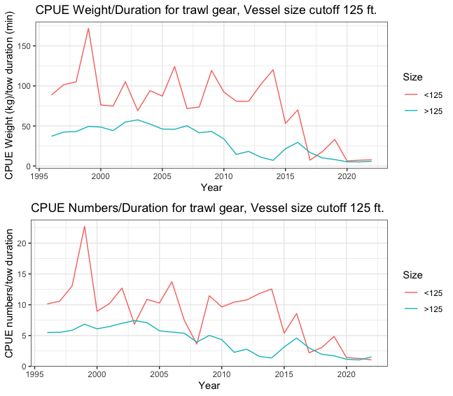
Notes:
Catch per unit effort for AI cod fisheries, 1996-2022. The upper plot represents CPUE weight (kg)/trawl duration (min) for vessels greater and less than 125 ft. The lower panel represents CPUE numbers/trawl duration for the same vessel sizes. Only tows with duration > 0 and < the 90th percentile of tow duration (909 minutes) are included. Estimates of relative CPUE are complete through October 31, 2022.

Slide 11
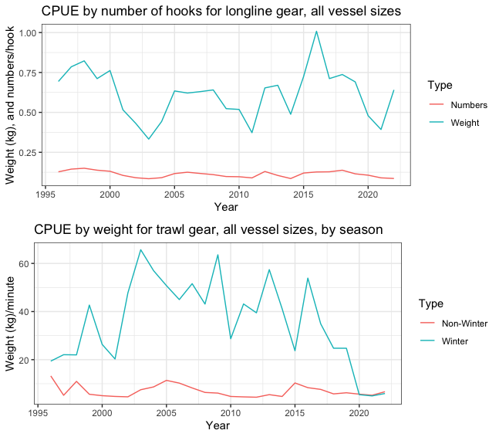

Slide 12
Assessment methodology
1. The Tier 5 methodology has not changed (Model 13.4).
2. Model 22.0 “Simple”
    1991-2022,
    fishery data considered a single fishery ,
    Aleutian Islands trawl survey.
3. Model 22.1 “Complex”
    1991-2022,
    fishery data for trawl, longline, and pot fisheries,
    Aleutian Islands longline and trawl survey.

Slide 13
In 2022 the age structured model methodology moved from ADMB to Stock Synthesis
Model formulations are known and well-documented.
Multiple options allow for additional analyses that can be done in a short time.
Consistency with other cod models.

Slide 14
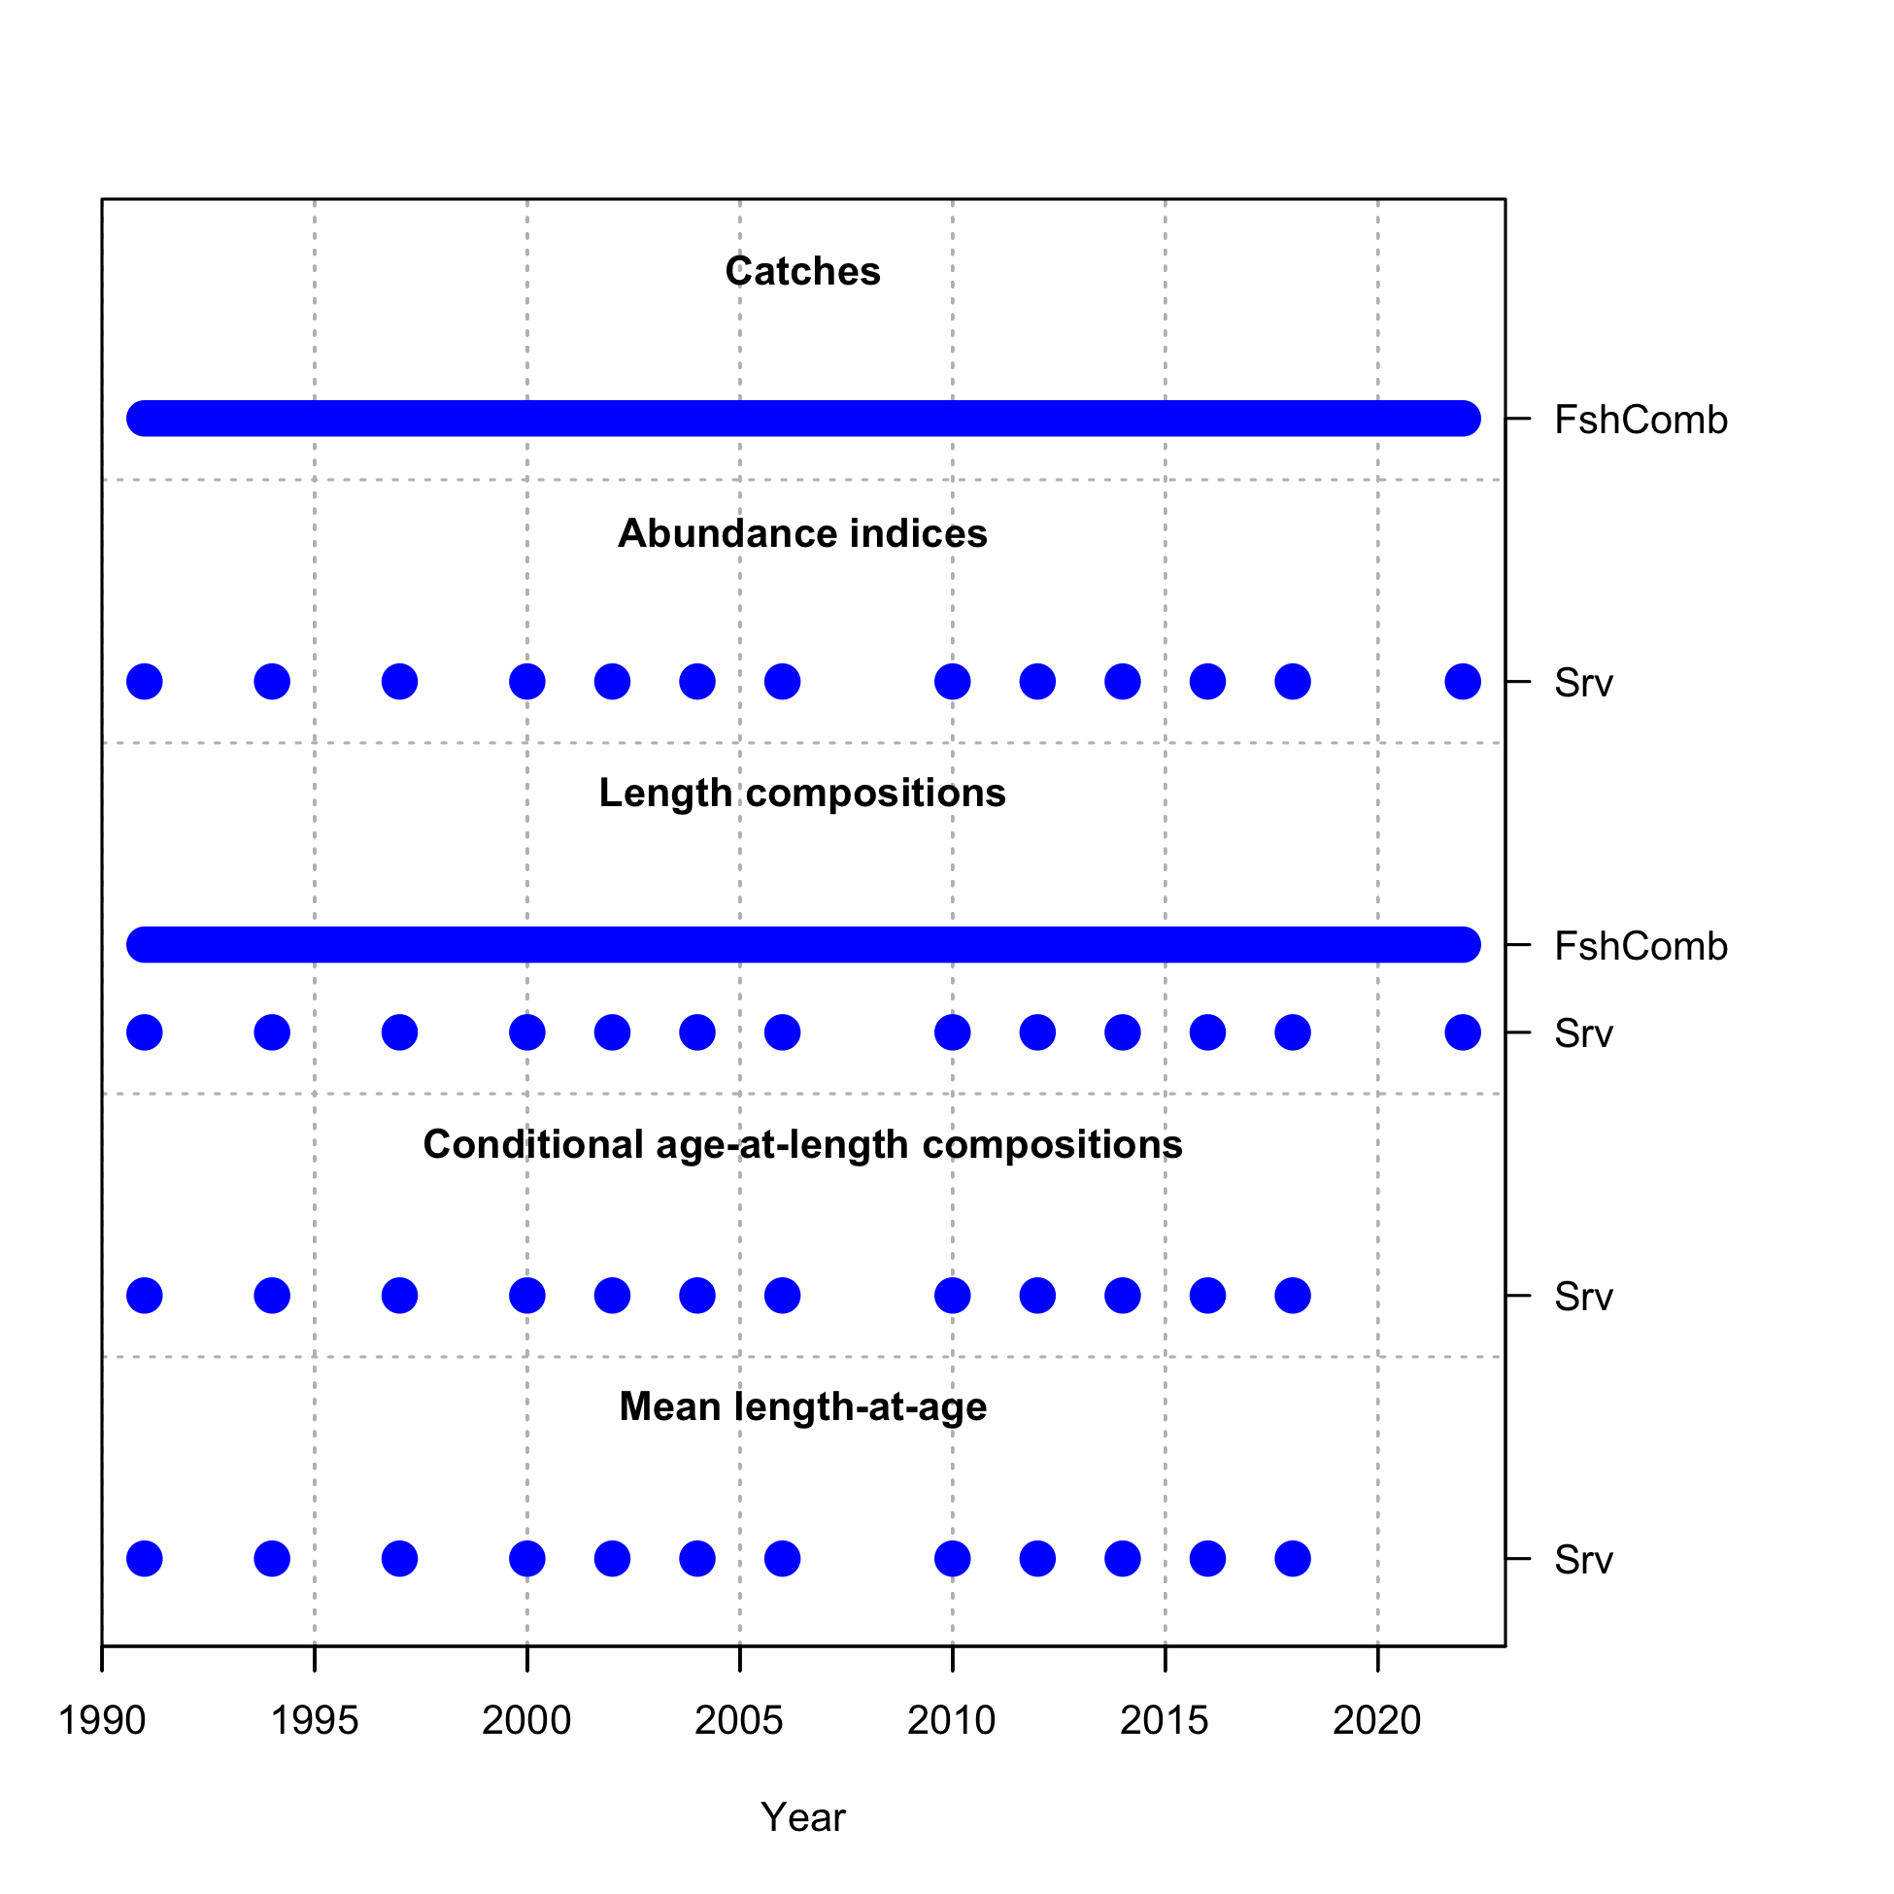
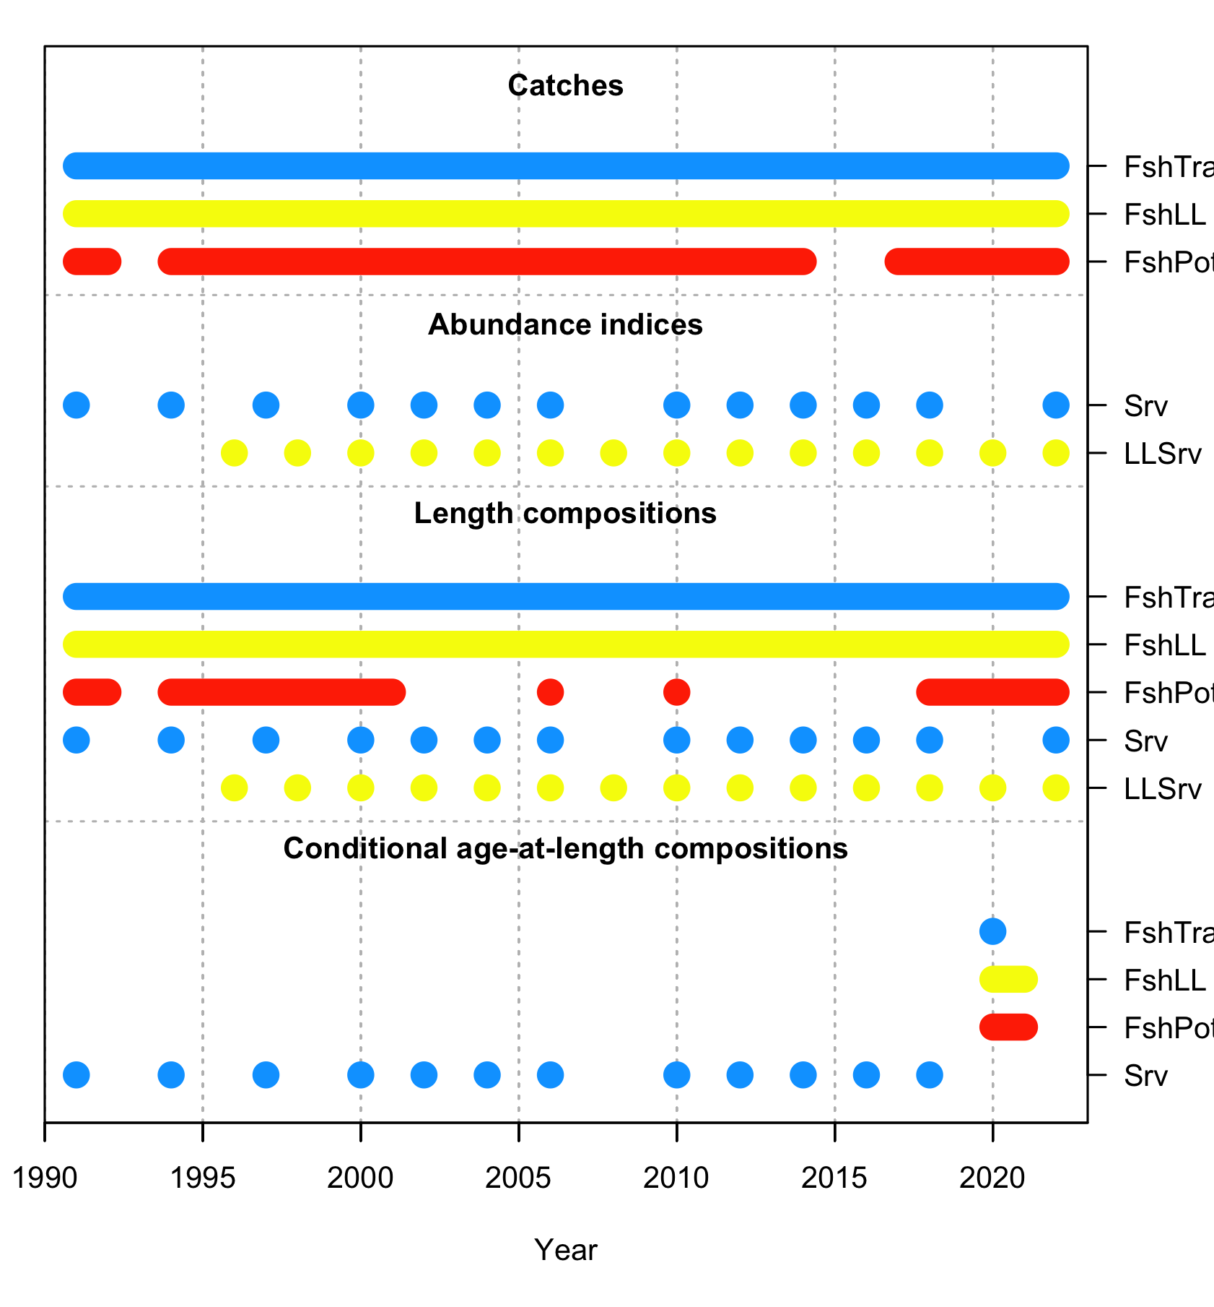
Model 22.0
Data sources
Model 22.1

Slide 15
Other model parameterizations
sigmaR is not estimated within the model but was tuned using the methodology of G. Thompson, which has been used for EBS P.cod (Sigma R = 0.636).
-log(Recruitment) is estimated within the model.
Natural mortality is estimated within the model.

Slide 16
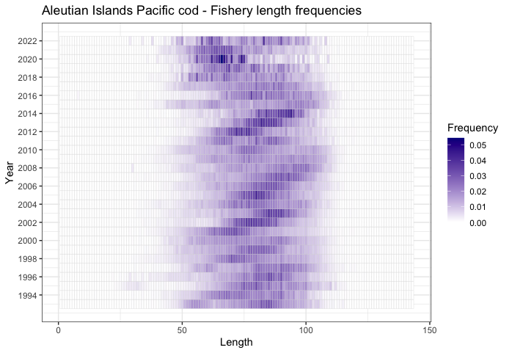

Slide 17
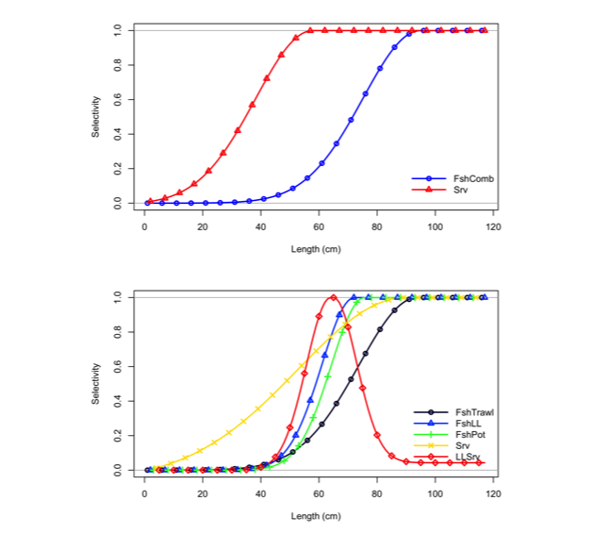
Selectivity
Model 22.0
Model 22.1

Slide 18
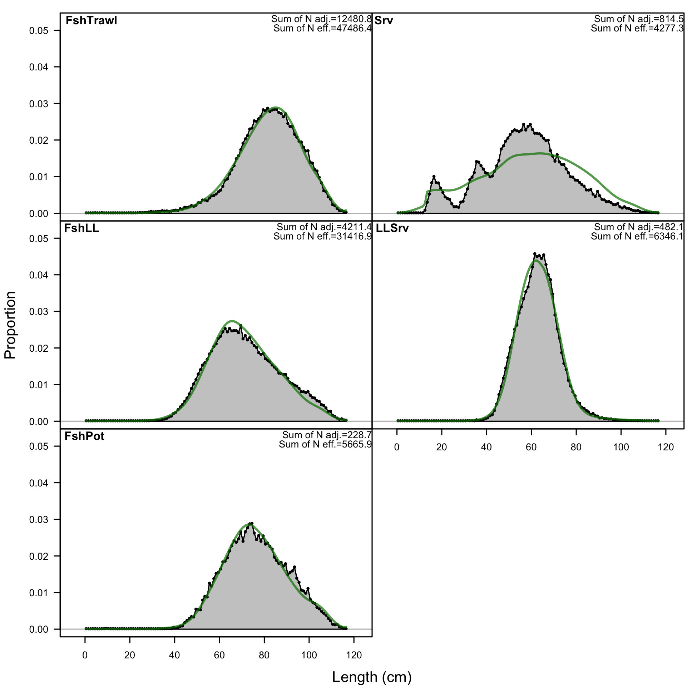
Survey length frequencies from fishery and surveys
Trawl fishery
Trawl survey
Pot fishery
LL fishery
LL survey
Larger fish do not seem to be caught in the longline survey.
Length (cm)

Slide 19
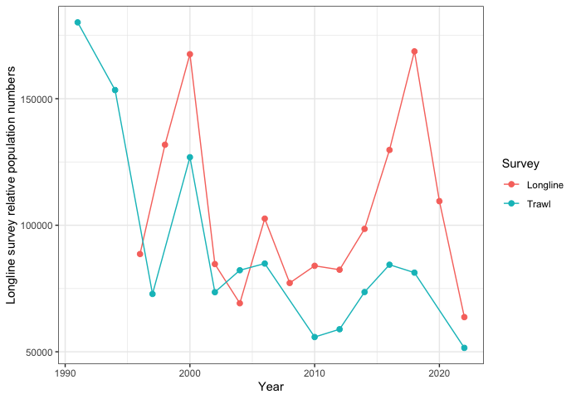
Aleutian Islands Pacific cod trawl and longline survey estimates 1991 - 2022

Slide 20
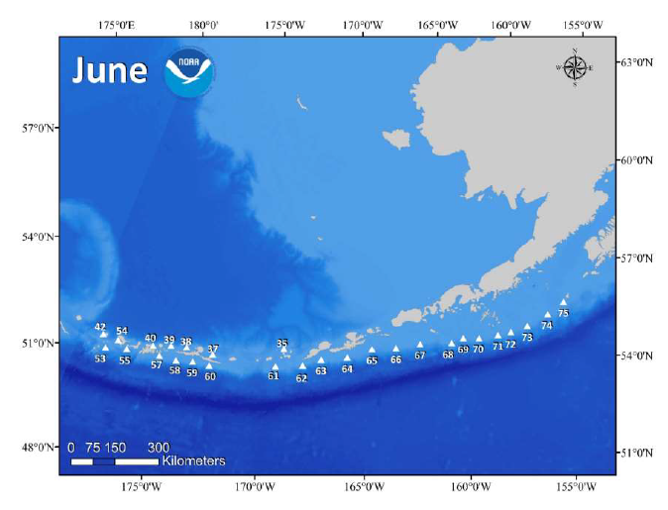
Aleutian Islands longline survey samples to Amchitka Pass (~half of the management unit)

Slide 21
Longline survey uses gear similar to that used in the fishery
The depth range of sablefish is deeper than cod, 150-2500 m, Pacific cod prefer 100-200 m.
The hook size used on the longline survey is 13/0, and the fishery generally uses 13/0, although it can range between 12/0 and 14/0.

Slide 22
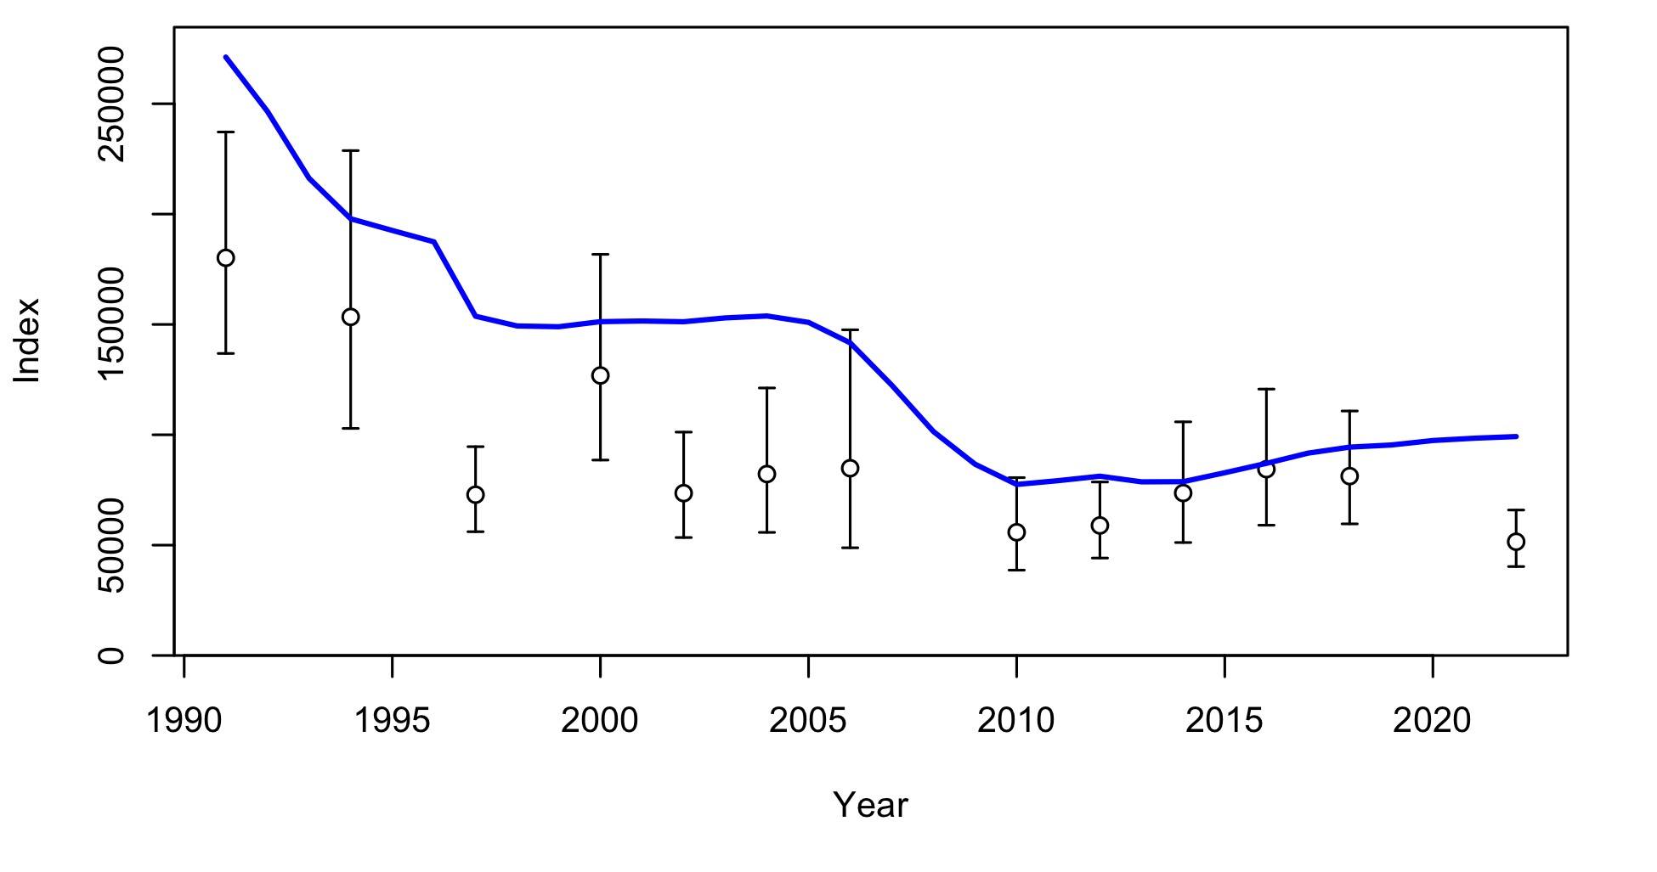
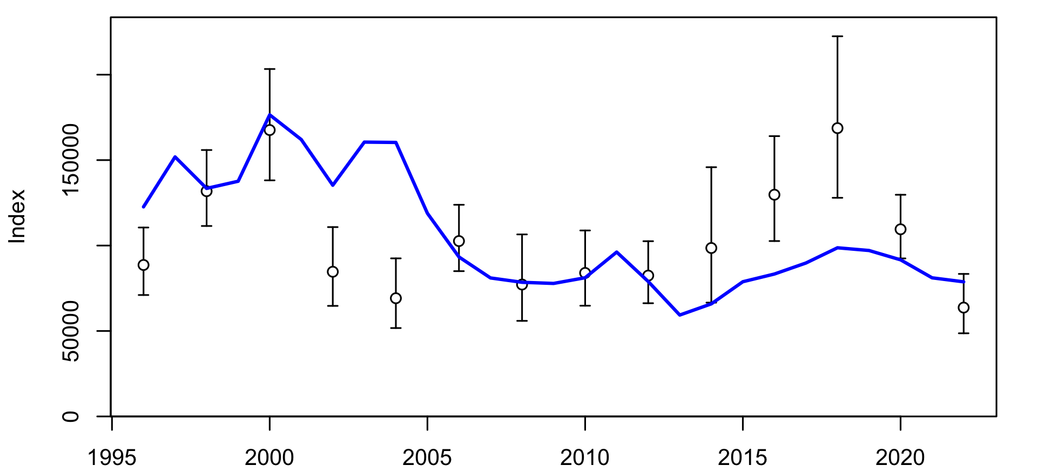
Model 22.1 fit to trawl and longline survey
Trawl Survey
Longline Survey

Slide 23
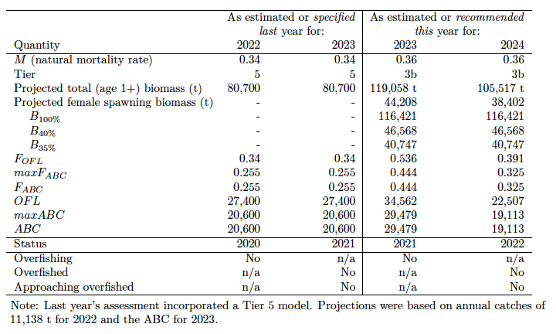
Reference points for Aleutian Islands Pacific cod based on Model 22.1
Trawl survey

Slide 24
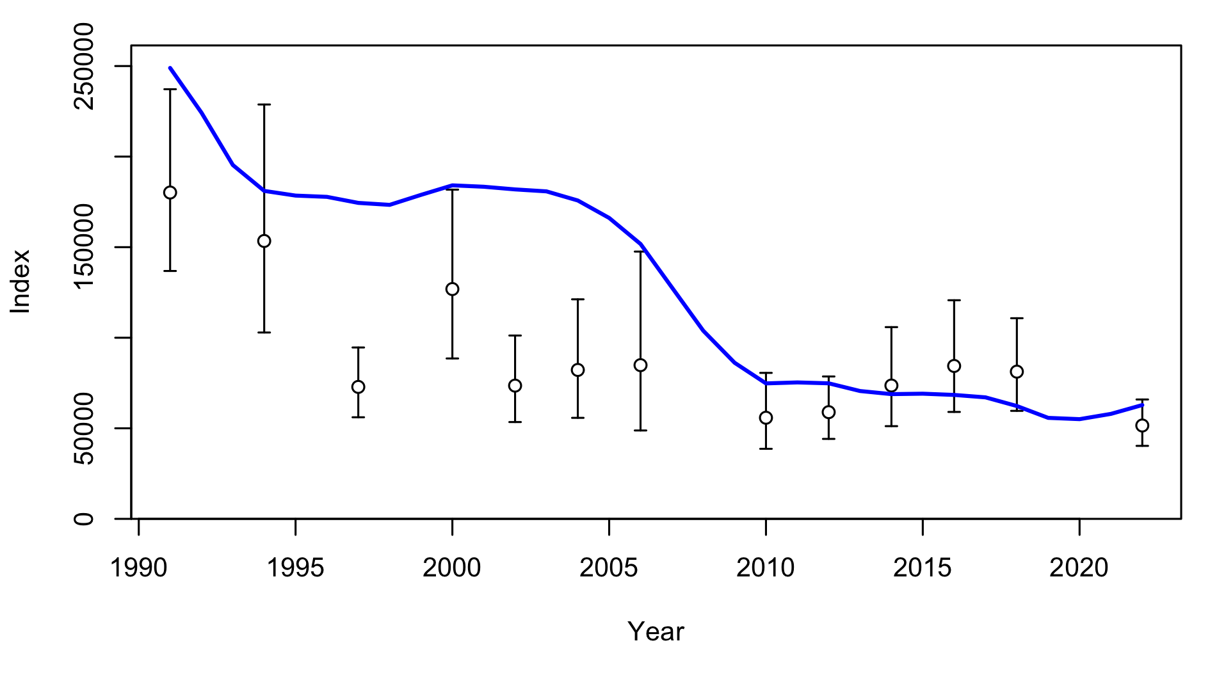
Model 22.0 fit to trawl survey

Slide 25
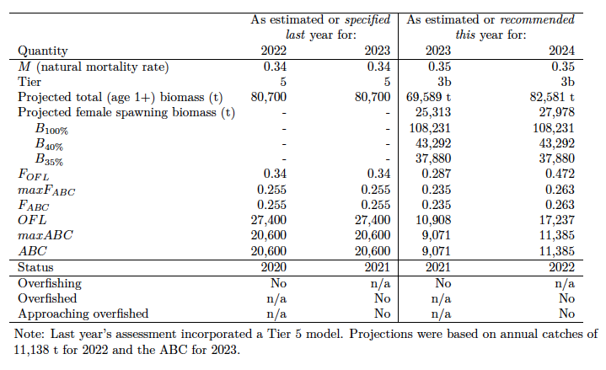
Reference points for Aleutian Islands Pacific cod based on Model 22.0

Slide 26
Model 22.0 likelihood profile over mean recruitment

Slide 27
Model 22.1 likelihood profile over mean recruitment

Slide 28
Spawning biomass estimate based on Model 22.1 (blue), 22.0 (red)

Slide 29
Recruitment based on Model 22.1 (blue), 22.0 (red)

Slide 30
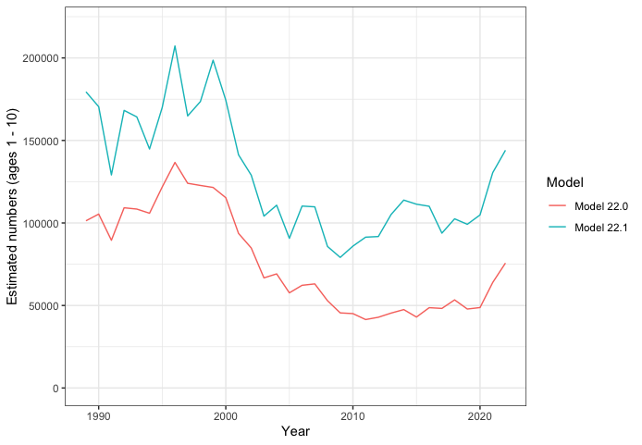
Numbers based on Model 22.1 (blue), 22.0 (red)

Slide 31
Model 22.0 numbers at age, 2010-2022
Year | Age0 | Age1 | Age2 | Age3 | Age4 | Age5 | Age6 | Age7 | Age8 | Age9 | Age10 | Total
2010 | 0 | 11,918 | 16,071 | 12,495 | 4,045 | 4,989 | 1,147 | 1,242 | 470 | 527 | 731 | 52,905
2011 | 0 | 11,725 | 8,381 | 11,196 | 8,266 | 2,363 | 2,461 | 484 | 470 | 167 | 429 | 45,514
2012 | 0 | 14,451 | 8,249 | 5,882 | 7,721 | 5,422 | 1,439 | 1,399 | 263 | 249 | 312 | 45,076
2013 | 0 | 12,259 | 10,166 | 5,778 | 3,982 | 4,765 | 2,981 | 730 | 686 | 128 | 272 | 41,475
2014 | 0 | 15,257 | 8,625 | 7,140 | 3,993 | 2,609 | 2,866 | 1,647 | 381 | 347 | 199 | 42,865
2015 | 0 | 16,490 | 10,734 | 6,062 | 4,967 | 2,679 | 1,643 | 1,683 | 916 | 205 | 287 | 45,380
2016 | 0 | 16,786 | 11,596 | 7,509 | 4,155 | 3,274 | 1,685 | 991 | 986 | 527 | 279 | 47,510
2017 | 0 | 11,224 | 11,810 | 8,140 | 5,176 | 2,713 | 1,967 | 935 | 521 | 504 | 406 | 42,990
2018 | 0 | 20,497 | 7,894 | 8,252 | 5,492 | 3,231 | 1,540 | 1,035 | 471 | 258 | 447 | 48,669
2019 | 0 | 16,982 | 14,409 | 5,462 | 5,296 | 3,074 | 1,597 | 715 | 472 | 214 | 320 | 48,219
2020 | 0 | 22,207 | 11,944 | 10,025 | 3,548 | 2,962 | 1,481 | 711 | 311 | 204 | 231 | 53,393
2021 | 0 | 12,739 | 15,619 | 8,297 | 6,424 | 1,978 | 1,525 | 750 | 360 | 157 | 220 | 47,848
2022 | 0 | 17,486 | 8,958 | 10,843 | 5,383 | 3,698 | 1,040 | 776 | 379 | 182 | 191 | 48,744

Slide 32
Relative spawning output (B/B₃₅%) with respect to fishing intensity (F/F₃₅%) for Model 22.0

Slide 33
Relative spawning output (B/B₃₅%) with respect to fishing intensity (F/F₃₅%) for Model 22.1

Slide 34
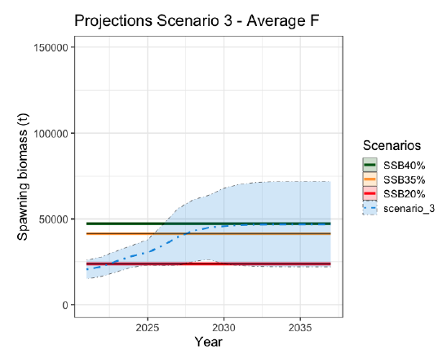
Model 22.0
Notes:
M22.1

Slide 35
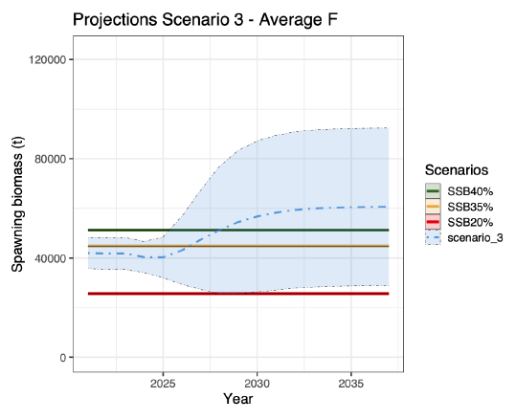
Model 22.1

Slide 36
Model 22.1 Retrospective plot of spawning biomass
Mohn’s rho = 0.252,
Range: -0.206 - 0.28

Slide 37
Model 22.0 Retrospective plot of spawning biomass
Mohn’s rho = 0.316
Range: -0.203-0.275.

Slide 38
Model 22.1 Retrospective plot of spawning biomass relative to unfished (B/B₀)
Mohn’s rho = 0.252,
Range: -0.206 - 0.28

Slide 39
Model 22.0 Retrospective plot of spawning biomass relative to unfished (B/B₀)
Mohn’s rho = 0.316
Range: -0.203-0.275.

Slide 40
Tier 5 random effects estimate of Aleutian Islands Pacific cod biomass from the NMFS Trawl Survey, 1991 - 2022
The Tier 5 random effects estimate from 2021 is included for comparison.

Slide 41
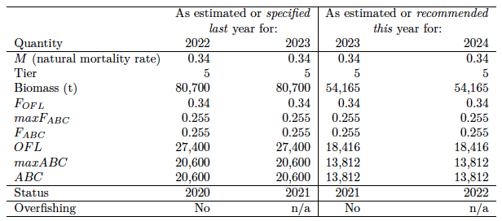
Tier 5 Reference point table

Slide 42
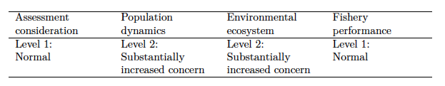
Risk Table* for Aleutian Islands Pacific cod
*SSC 2021: “risk” is the risk of the ABC exceeding the true (but unknown) OFL

Slide 43
Risk Table: Assessment Considerations
New data: A trawl survey was conducted in 2022 for the first time since 2018.
Age structured models provide a much more comprehensive picture of the state of the stock than the random effects model, which simply fits the survey biomass indices. The Tier 3 harvest control rule is designed for conservative harvest.
Assessment considerations were rated as level 1 due to recent survey data and a range of assessment models that provide relatively consistent results.

Slide 44
Risk Table: Population Dynamics Considerations
The long-term (1991-2022) trawl survey biomass trend is downward and the 2022 index is the lowest of the entire time series.
The AFSC longline survey index shows a strong decline since 2020, and the 2022 index is also the lowest of the entire time series.
Population Dynamics Considerations were rated as level 2 due to

Slide 45
Risk Table: Environmental/Ecosystem Considerations
Survey bottom temperatures have been above the long-term mean since 2014.
Sea surface temperatures have also been above the long-term mean since 2014.

Slide 46
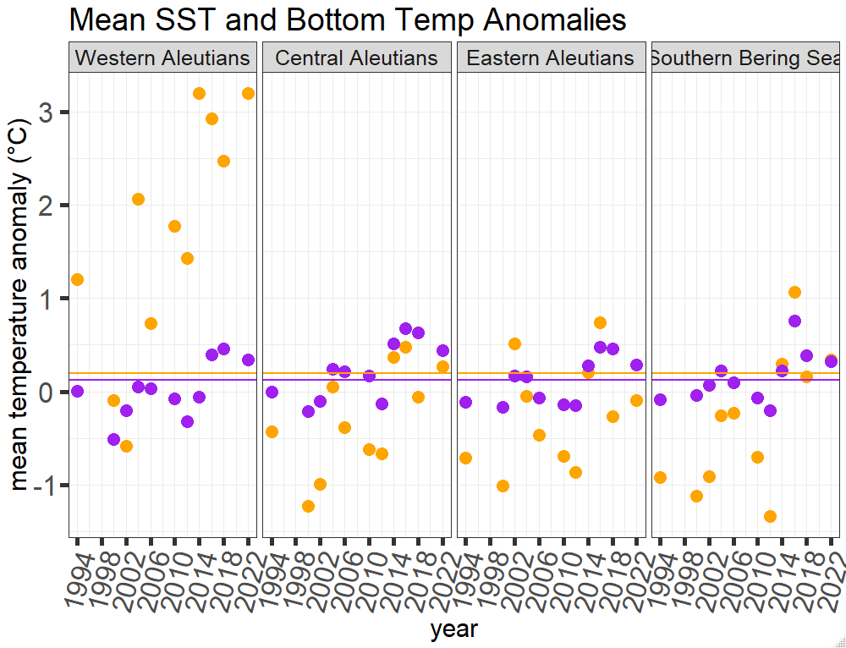
Water temperatures in the Aleutian Islands have been above the long term mean since at least 2014

Slide 47
Risk Table: Environmental/Ecosystem Considerations
In 2022 heatwave conditions have been observed in the Aleutians for most of the year.

Slide 48
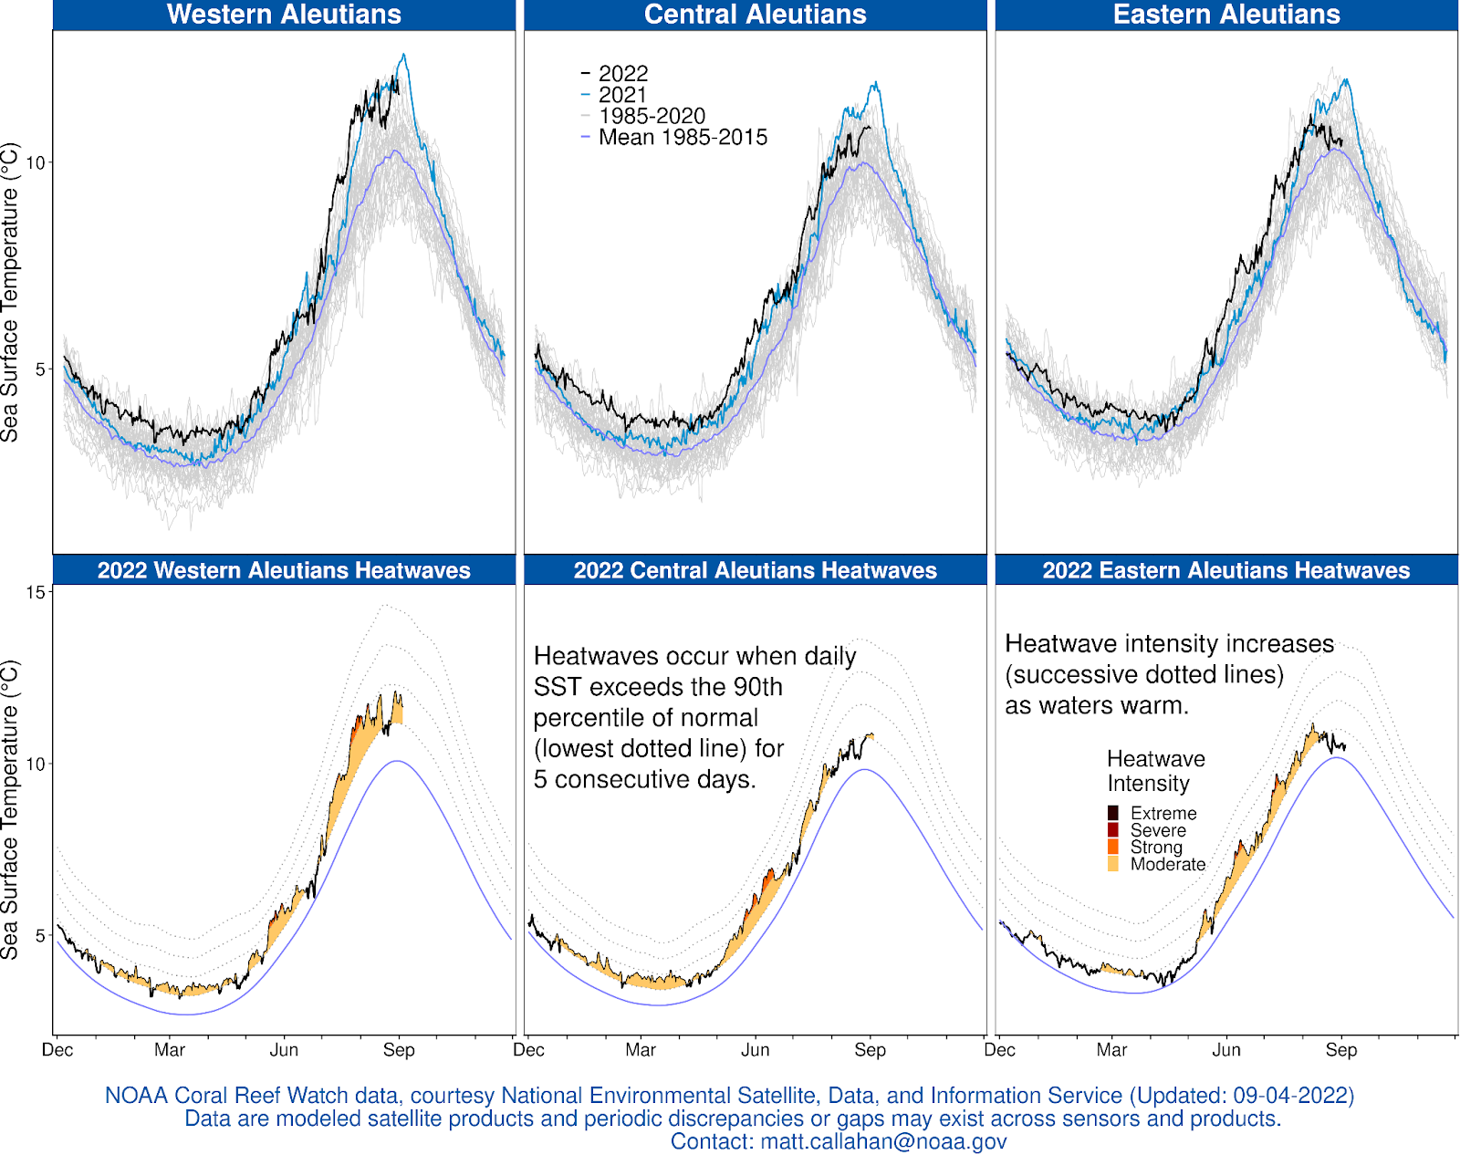

Slide 49
Risk Table: Environmental/Ecosystem Considerations
Aleutian Islands adult Pacific cod consumption increases up to 4°C and decreases past 5°C (Holsman and Aydin 2015).
Above long-term average temperatures throughout the water column and during both winter and summer is considered to have negative effect.

Slide 50
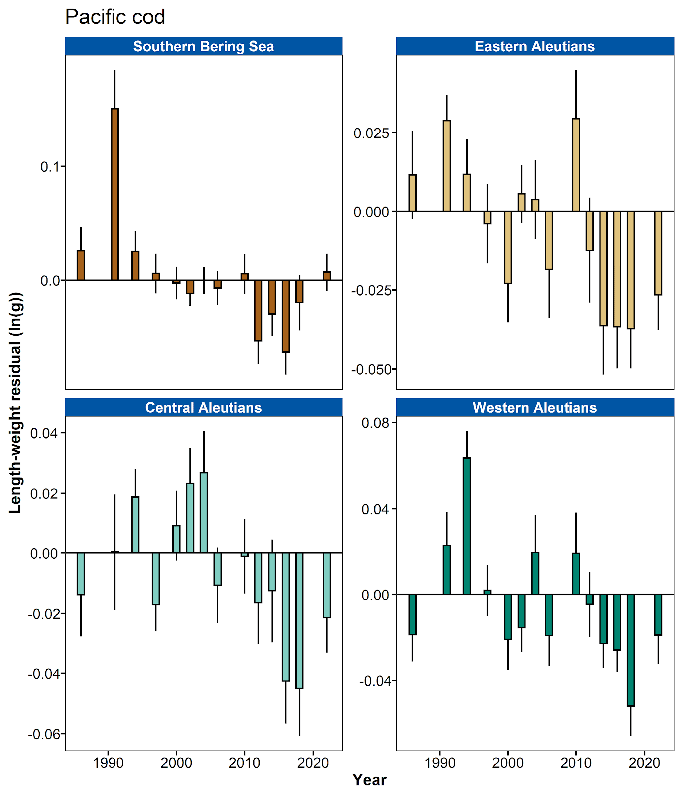
Fish condition of
Aleutian Islands
Pacific cod

Slide 51
Risk Table: Environmental/Ecosystem Considerations
Cod condition has now remained below average since 2012.
Environmental/Ecosystem Considerations were rated as level 2 due to increased temperature and low fish condition.

Slide 52
Risk Table: Fishery Performance Considerations
CPUE appears low but may be related to a number of factors.
Fishery Performance Considerations were rated as level 1

Slide 53
Future work:
Examine data conflicts
Seasonal model

Slide 54
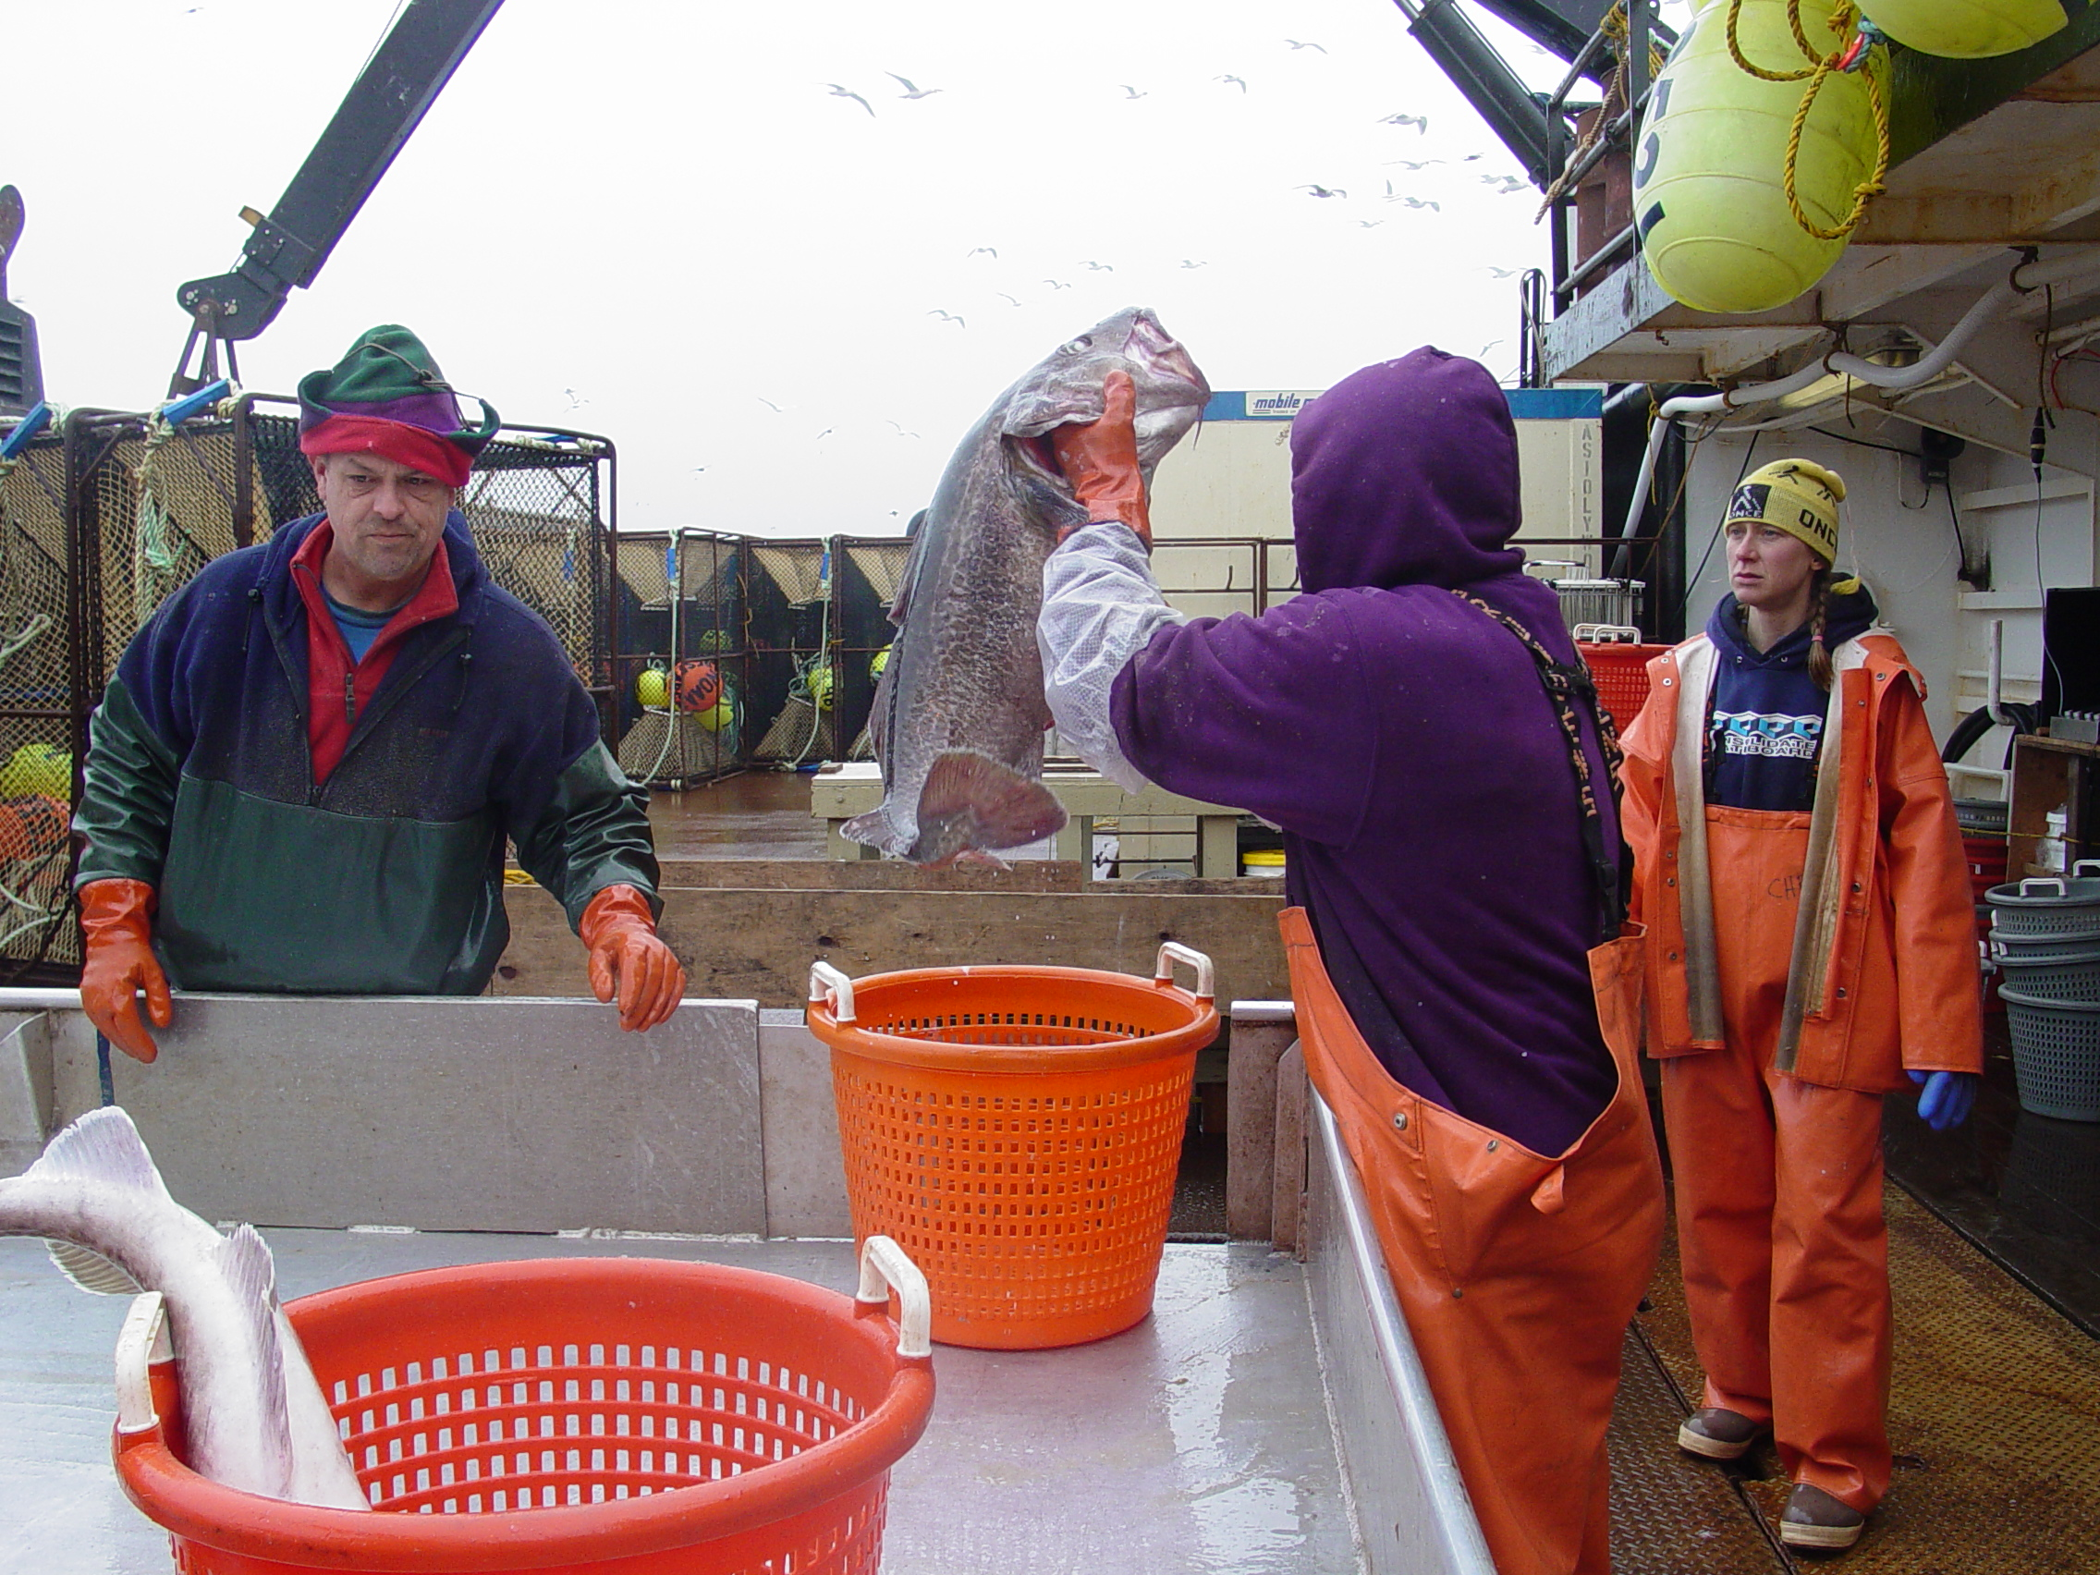
Questions?
Photo credit: Sandi Neidetcher

Slide 55
Bottom line
Aleutian Islands cod show a general decline since the last survey in 2018 (37%).
Unfished spawning biomass was estimated at a similar level for Model 22.0 B_{100%} 108,231 t and Model 22.1 B₁₀₀% 116,421 t.
Which means that spawning biomass relative to unfished B/B_{100%} is relatively consistent.
Trawl survey and age structured models indicate AI P.cod biomass is between B_{20%} and B_{40%} and likely closer to the lower end.

Slide 56
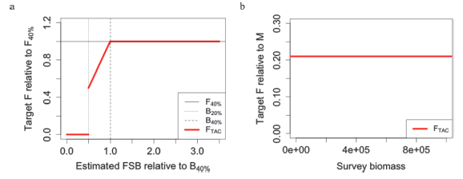
Tier 3 vs. Tier 5 Harvest Control Rule

Slide 57

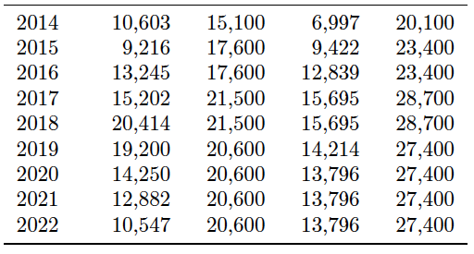
Should a lower ABC be recommended?
*SSC 2021: “risk” is the risk of the ABC exceeding the true (but unknown) OFL
Model 22.0 ABC:
9,071 t
Model 13.4 ABC:
13,812 t

Slide 58
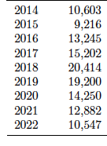
Potential reasons that the Tier 5 ABC exceeds the true (but unknown) OFL
Model 22.1 OFL = 10,908.
Model 13.4 (Tier 5) ABC = 13,812 t.
Retrospective pattern is likely due to no new trawl survey data between 2018 and 2022, which increased recruitment to the mean value.
Tier 3 model includes the precautionary sloping arm of the harvest control rule, Tier 5 does not.
AI cod catch

Slide 59
Questions?
Photo credit: Sandi Neidetcher

Slide 60
The Von Bertalanffy growth curve was selected as the most appropriate for Aleutian Islands Pacific cod

Slide 61
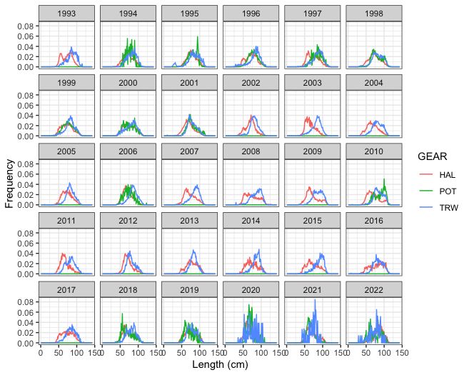
Notes:
Fishery length compositions for Aleutian Islands Pacific cod by longline (HAL), pot (POT), and trawl (TRW) gear, 1993-2022. Fishery length frequencies were weighted by the relative catch by year, area (NMFS areas 541, 542, and 543), gear, and quarter and only samples with a minimum of 70 observations were used. These fishery length compositions were used in Model 22.1.

Slide 62
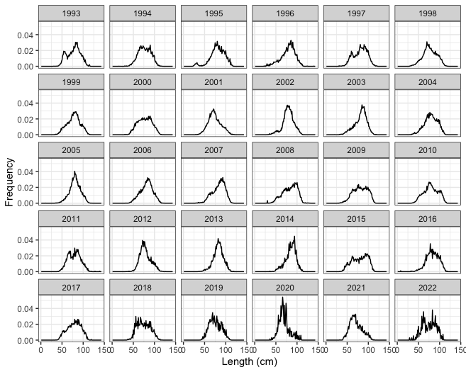
Notes:
Fishery length compositions over all fisheries combined. Fishery length frequencies were weighted by the relative catch by year, area (NMFS areas 541, 542, and 543), gear, and quarter and only samples with a minimum of 70 observations were used. The combined fishery length compositions were used in Model 22.0.

Slide 63
Model 22.1
Notes:
M22.1

Slide 64
Model 22.0
Notes:
M220

