Slide 1
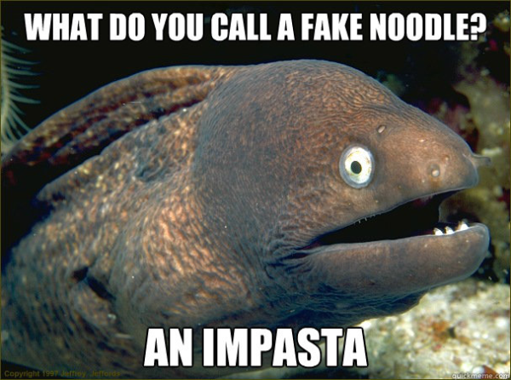
Aleutian Islands Pacific cod – preliminary model selection
Ingrid Spies, Steve Barbeaux,
Pete Hulson

Slide 2
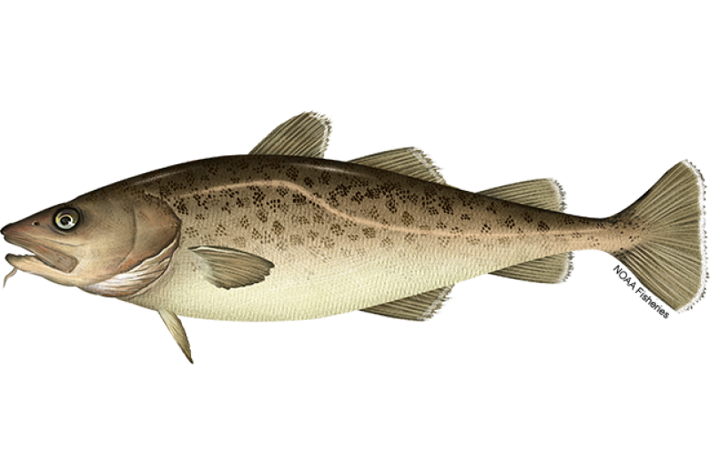
Aleutian Islands Pacific cod – preliminary model selection
Ingrid Spies, Steve Barbeaux,
Pete Hulson

Slide 3
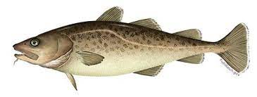
Sensitivity testing was applied to make improvements over Model 22.0
Parameters tested:
Survey conditional age-at-length
Mean survey length-at-age
Time varying survey and fishery selectivity
Input composition sample sizes
All models consider combined fisheries

Slide 4
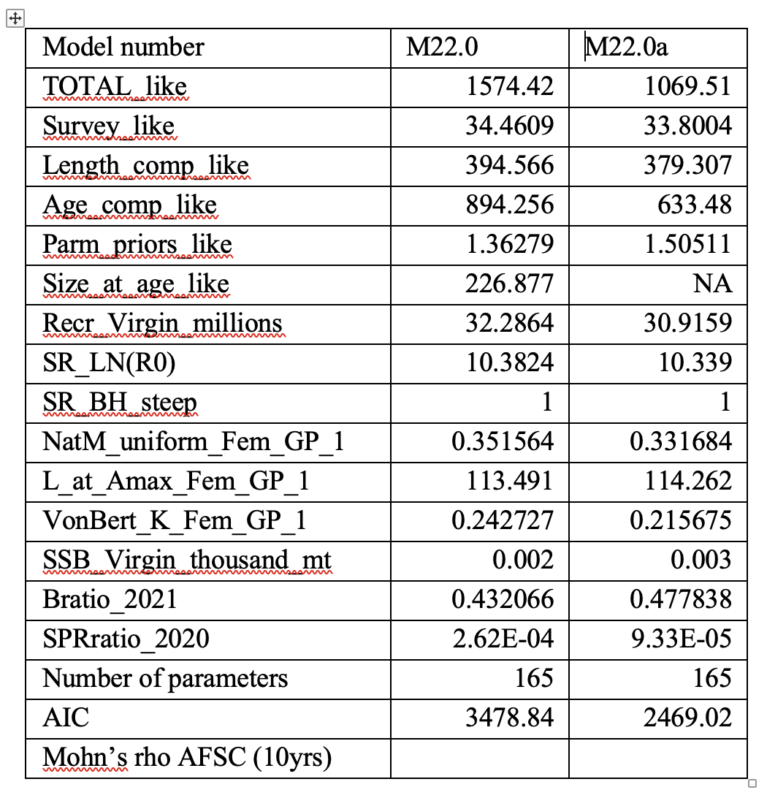
Sensitivity 1. Survey conditional age at length vs. mean survey length at age.
CAAL provided a better model.

Slide 5
Sensitivity 2. Improving the input sample sizes(ISS) for composition data
M22.0: Constant survey input sample size = 100, fishery = number of hauls.
M23.0:
Survey length and age input sample sizes generated by bootstrapping the number of hauls from which length and age data were taken (Hulson et al. 2023).
Fishery ISS: Generated from number of hauls, scaled to mean survey ISS
(→mean fishery length comp ISS = survey mean ISS).
No change in likelihood, but preferred over a constant sample size because considers the number of hauls in each year.

Slide 6
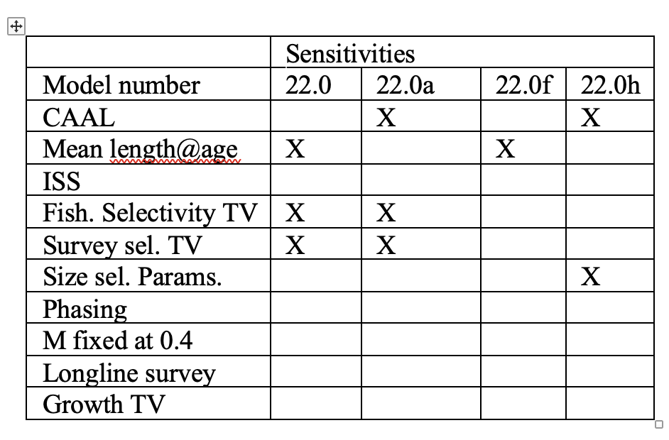
Sensitivities
CAAL = improvement
Mean Length at age - NO

Slide 7
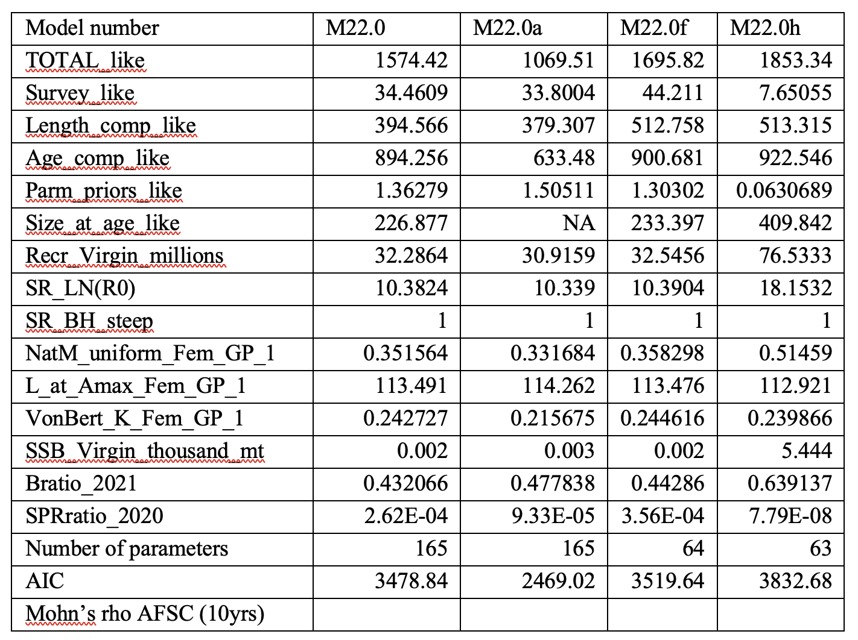
Sensitivity 3. Removing time varying survey and fishery selectivities.
Constant selectivity – Not a model improvement
Implemented in M23.0 as a base “simple” model.

Slide 8
Models explored
23.0 base model (no time varying parameters)
23.1 base model + time varying fishery selectivity
23.2 = 23.1+longline survey
23.3 = base model + time varying growth

Slide 9
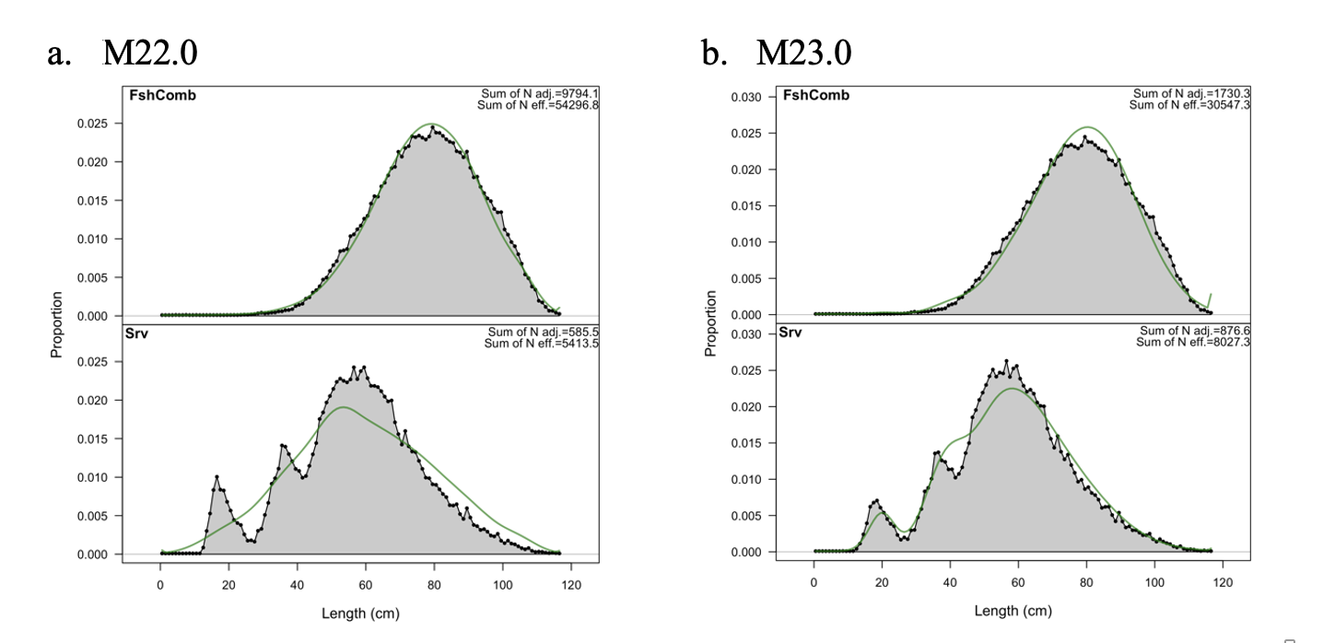
Model 23.0 improves the fit to the survey length composition index, due to input sample size adjustment, conditional aga at length, removing time varying selectivity.

Slide 10
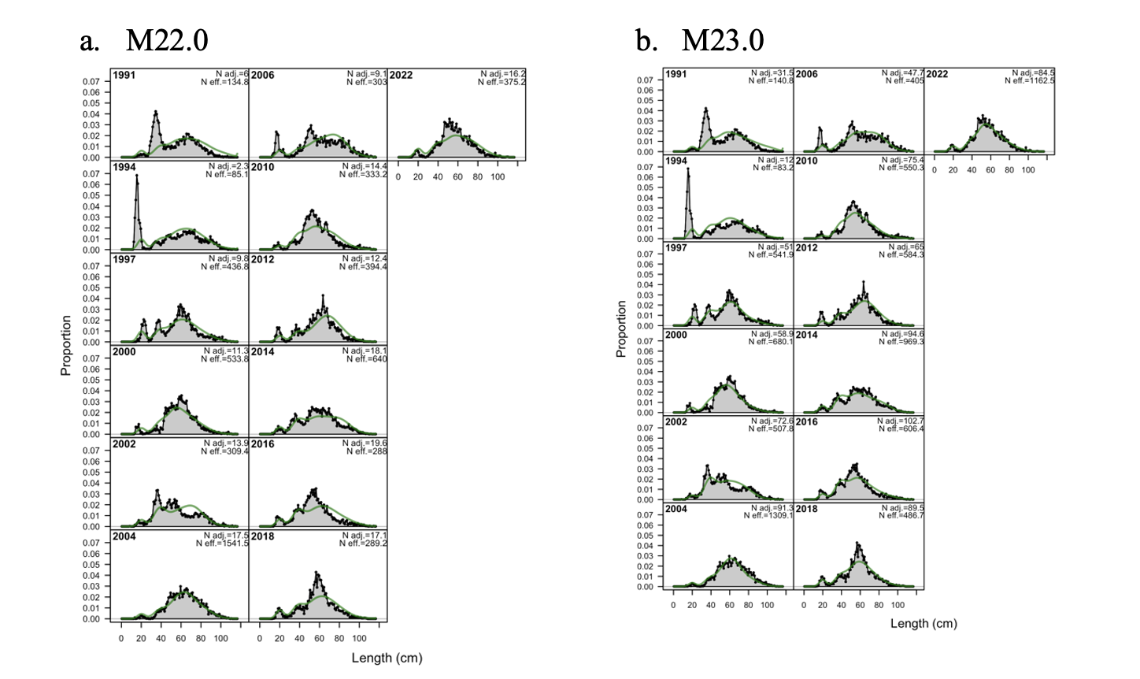
Improvement in fit to survey length compostions (input sample size, conditional age at length, removing time varying selectivity)

Slide 11
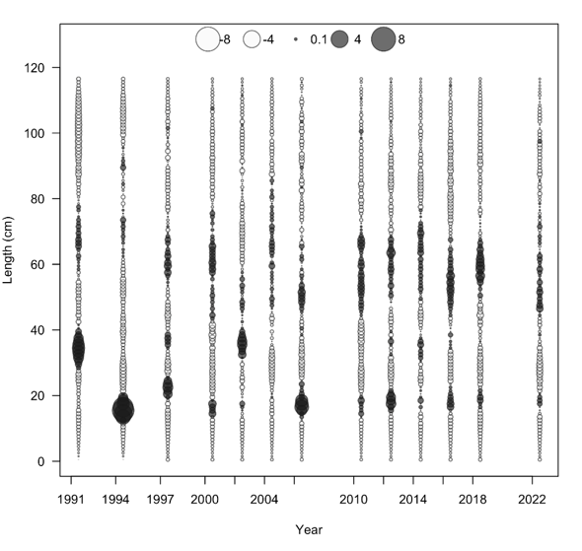
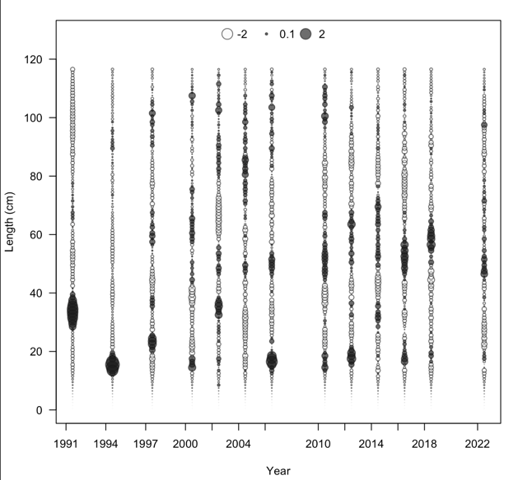
Pearson residuals
Closed bubbles are positive residuals (observed > expected) and open bubbles are negative residuals (observed < expected)]
M22.0
M23.0

Slide 12
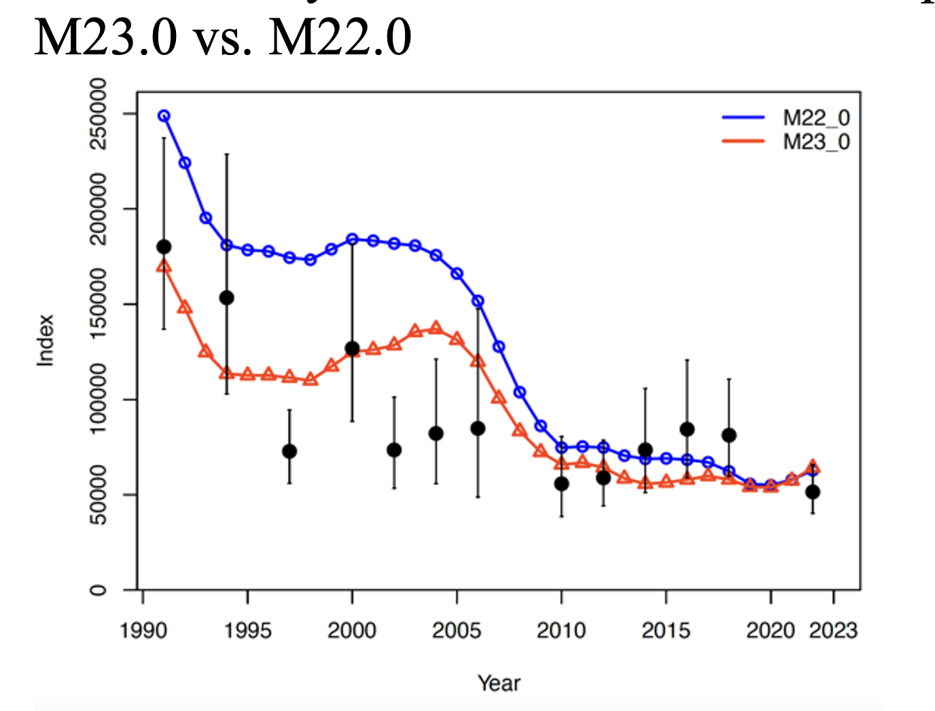
But 23.0 has a poor retrospective pattern.**

Slide 13
Model 23.1
Time varying fishery selectivity

Slide 14
Time-varying fishing selectivity is a reasonable assumption due to shifts in fishing patterns

Slide 15
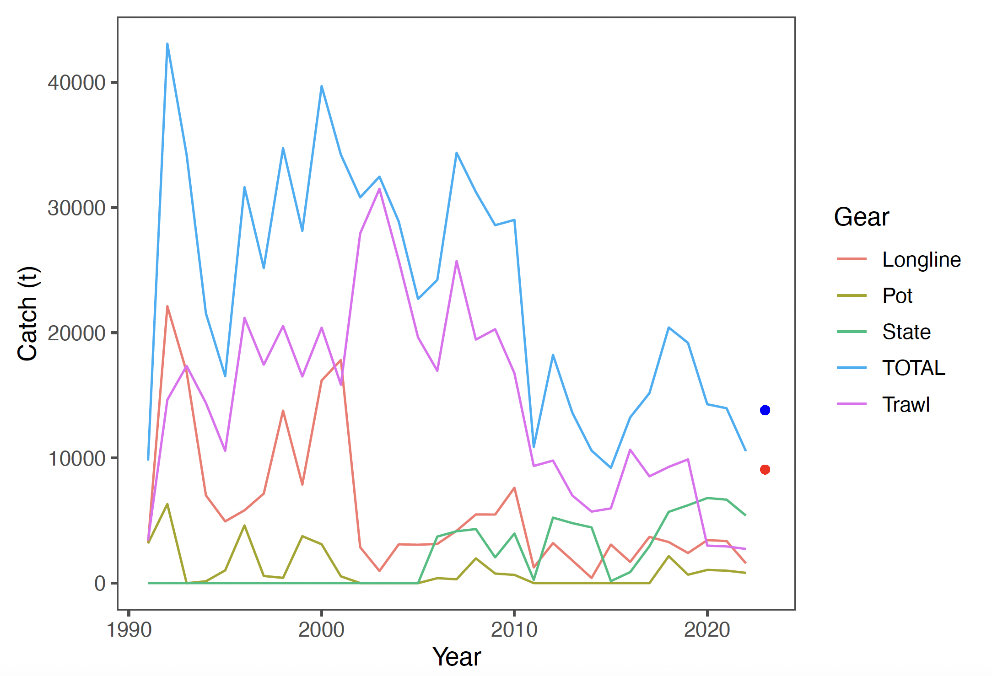
Fishing gear has changed over time in the Aleutian Islands cod fishery

Slide 16
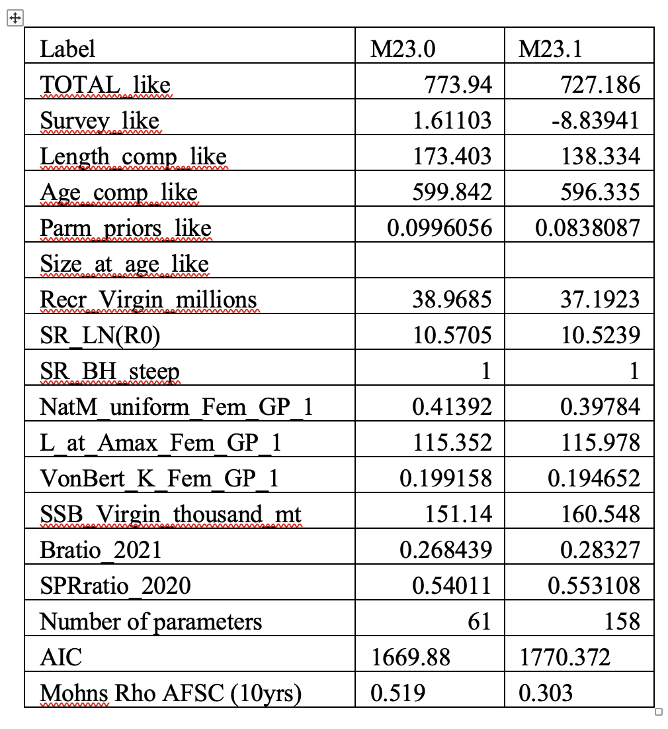
Incorporating annual time-varying fishery selectivity improves the overall likelihood but not AIC

Slide 17
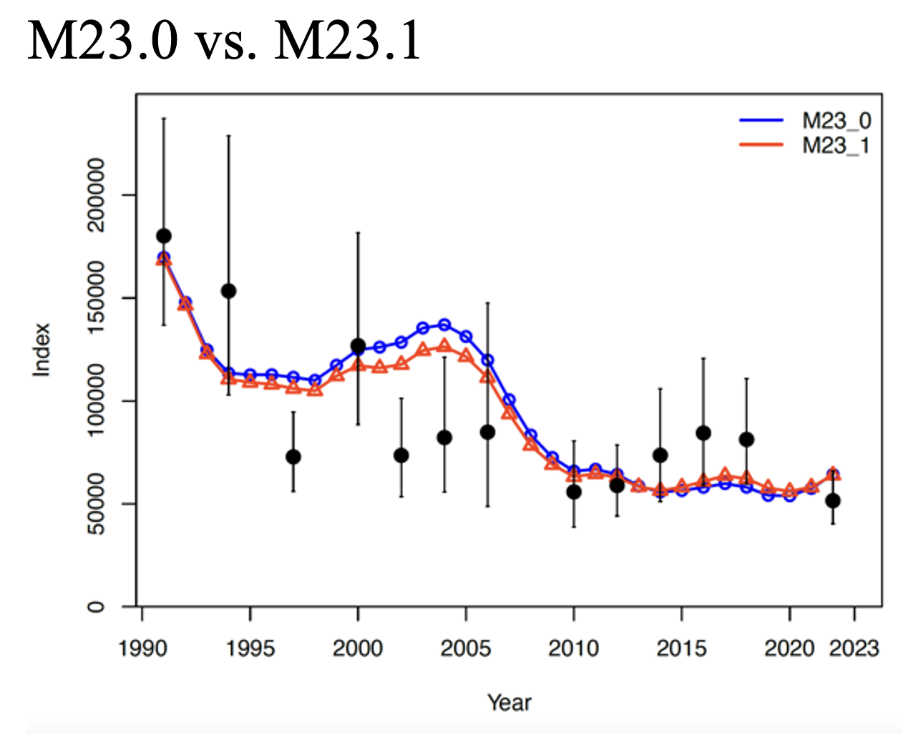

Slide 18
Time-varying fishery selectivity improves retrospective pattern somewhat.
Model 23.0 rho=0.5
Model 23.1 rho=0.3

Slide 19
Model 23.1
Next steps – consider alternatives to annually varying fishery selectivity
Time-varying fishery in time blocks

Slide 20
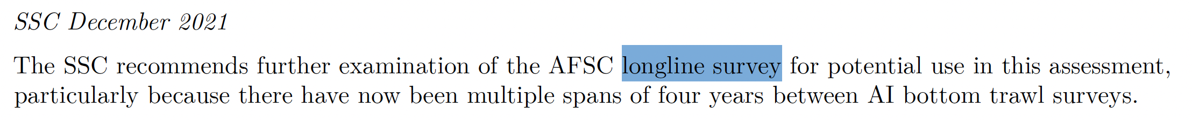
Model 23.2
Incorporating the longline survey

Slide 21
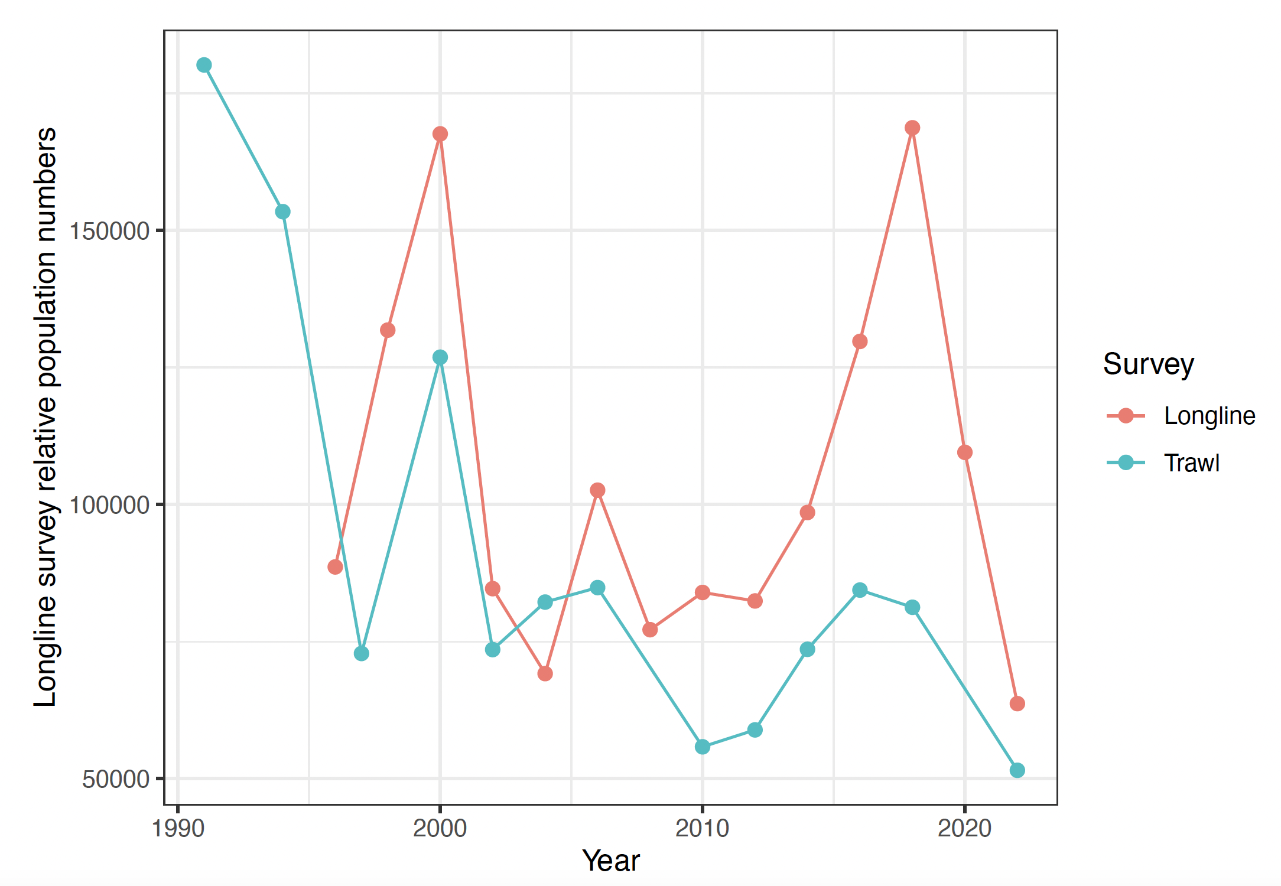
Trawl survey – indicates decline in biomass.
Longline survey – no overall change.

Slide 22
Longline survey may not accurately reflect abundance of Pacific cod in the Aleutian Islands
Longline gear - designed to target sablefish.
The depth range of sablefish is deeper than cod, 150-2500 m, whereas Pacific cod prefer 100-200 m.
The longline survey does fish in depths preferred by Pacific cod.
The hook size used on the longline survey is 13.0, and the fishery generally uses the same size, although it can range between 12/0 and 14/0.
The longline survey covers only roughly half of the Aleutian Islands area (eastern portion).

Slide 23
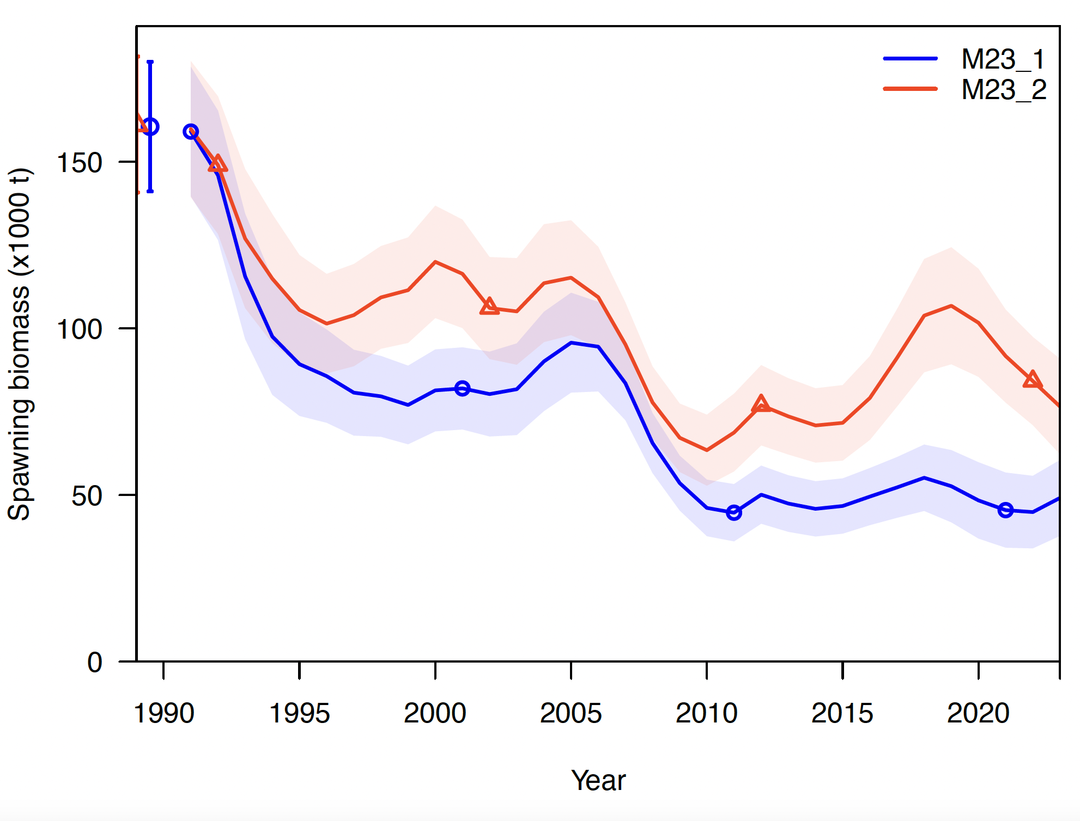
Addition of longline survey increases biomass estimates

Slide 24
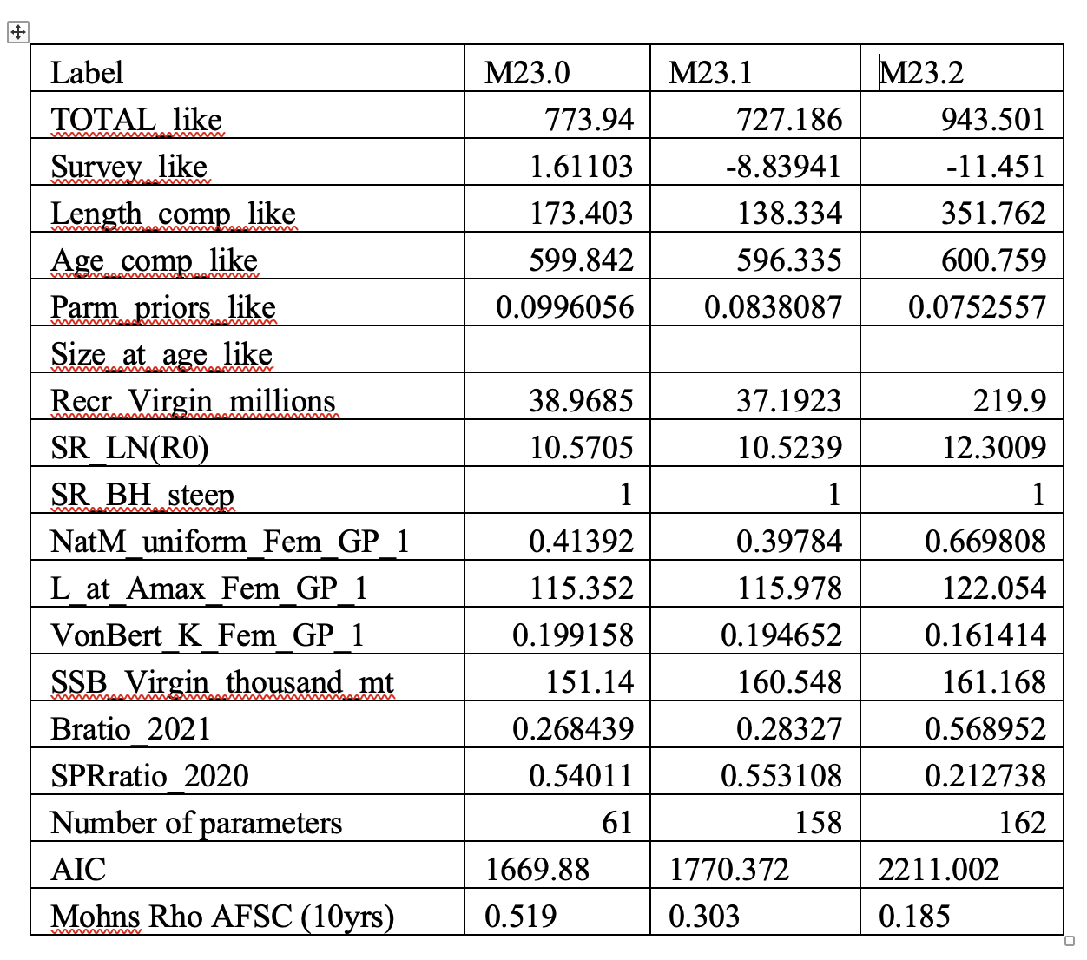
Addition of longline survey increases estimates of unfished recruitment, and therefore stock size

Slide 25
Model 23.3
Time-varying growth

Slide 26
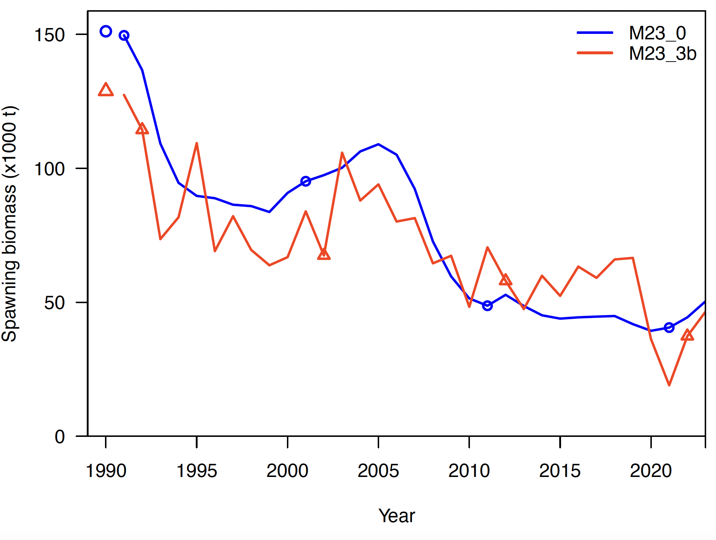
Standard error on time-varying parameters results in more year-to-year variability.

Slide 27
Annually-varying growth allows for a near-perfect retrospective pattern
Model 23.1 rho=0.3
Model 23.3 rho=0.01

Slide 28
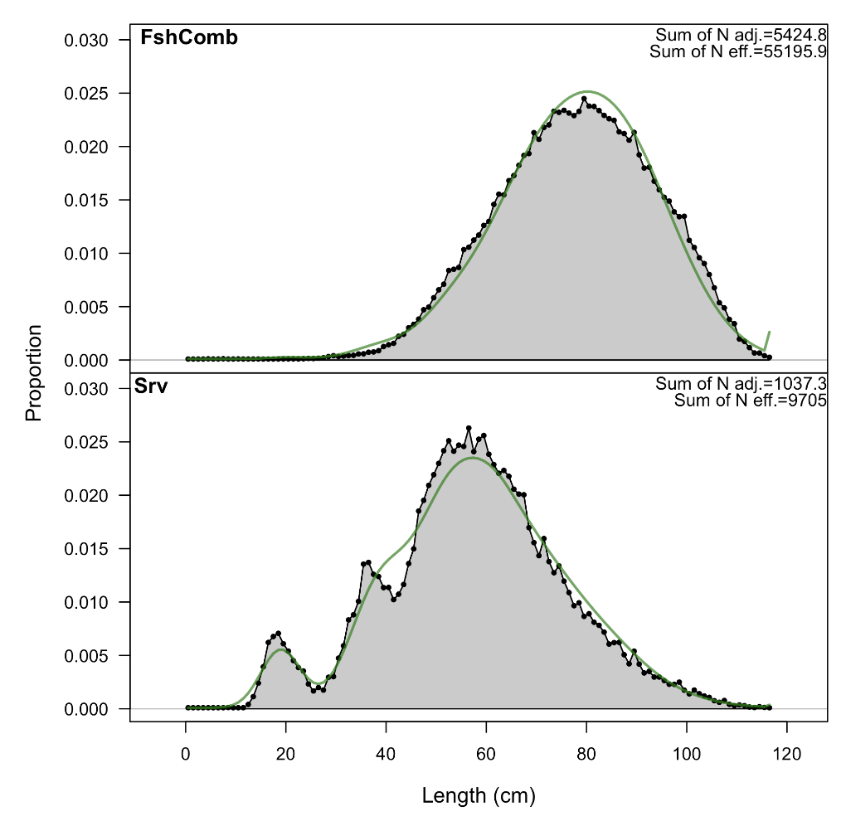
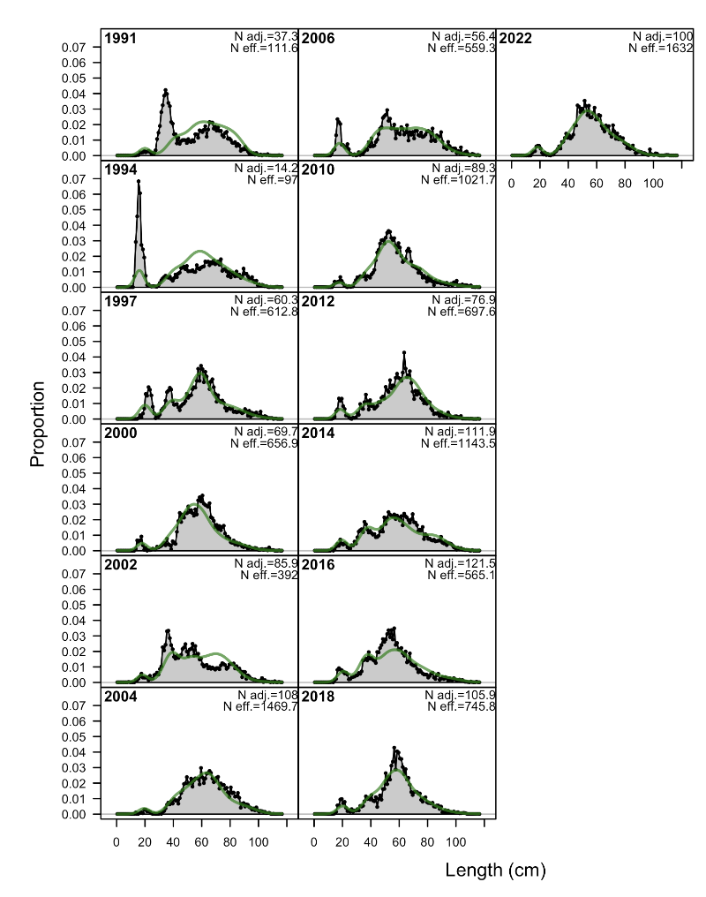
Fit to survey length comps retained with time-varying growth
M23.3a
***However, H=high time varying growth parameter variability results in a poor fit to length composition data.

Slide 29
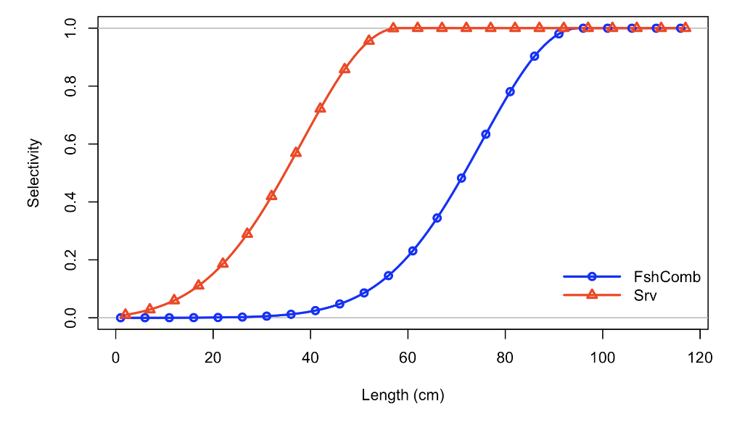
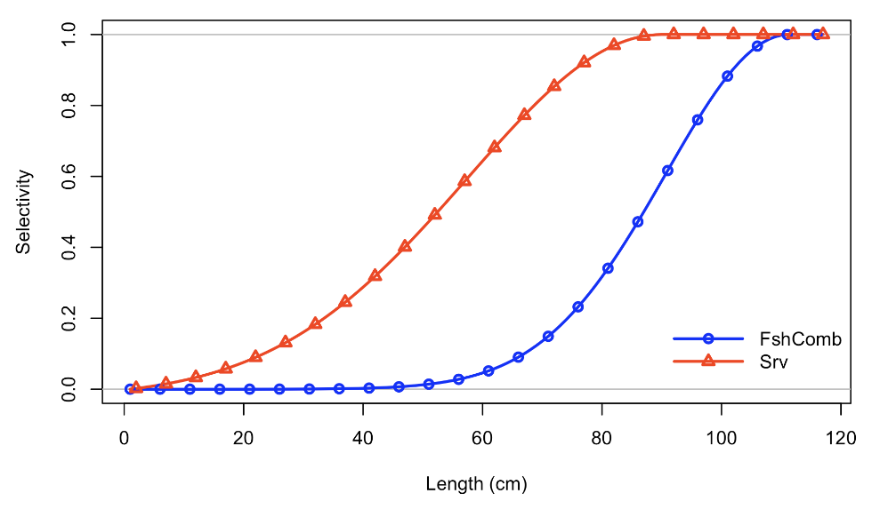
Annually varying growth also results in a shift in selectivity that is not realistic
Model 22.0
Model 23.3

Slide 30
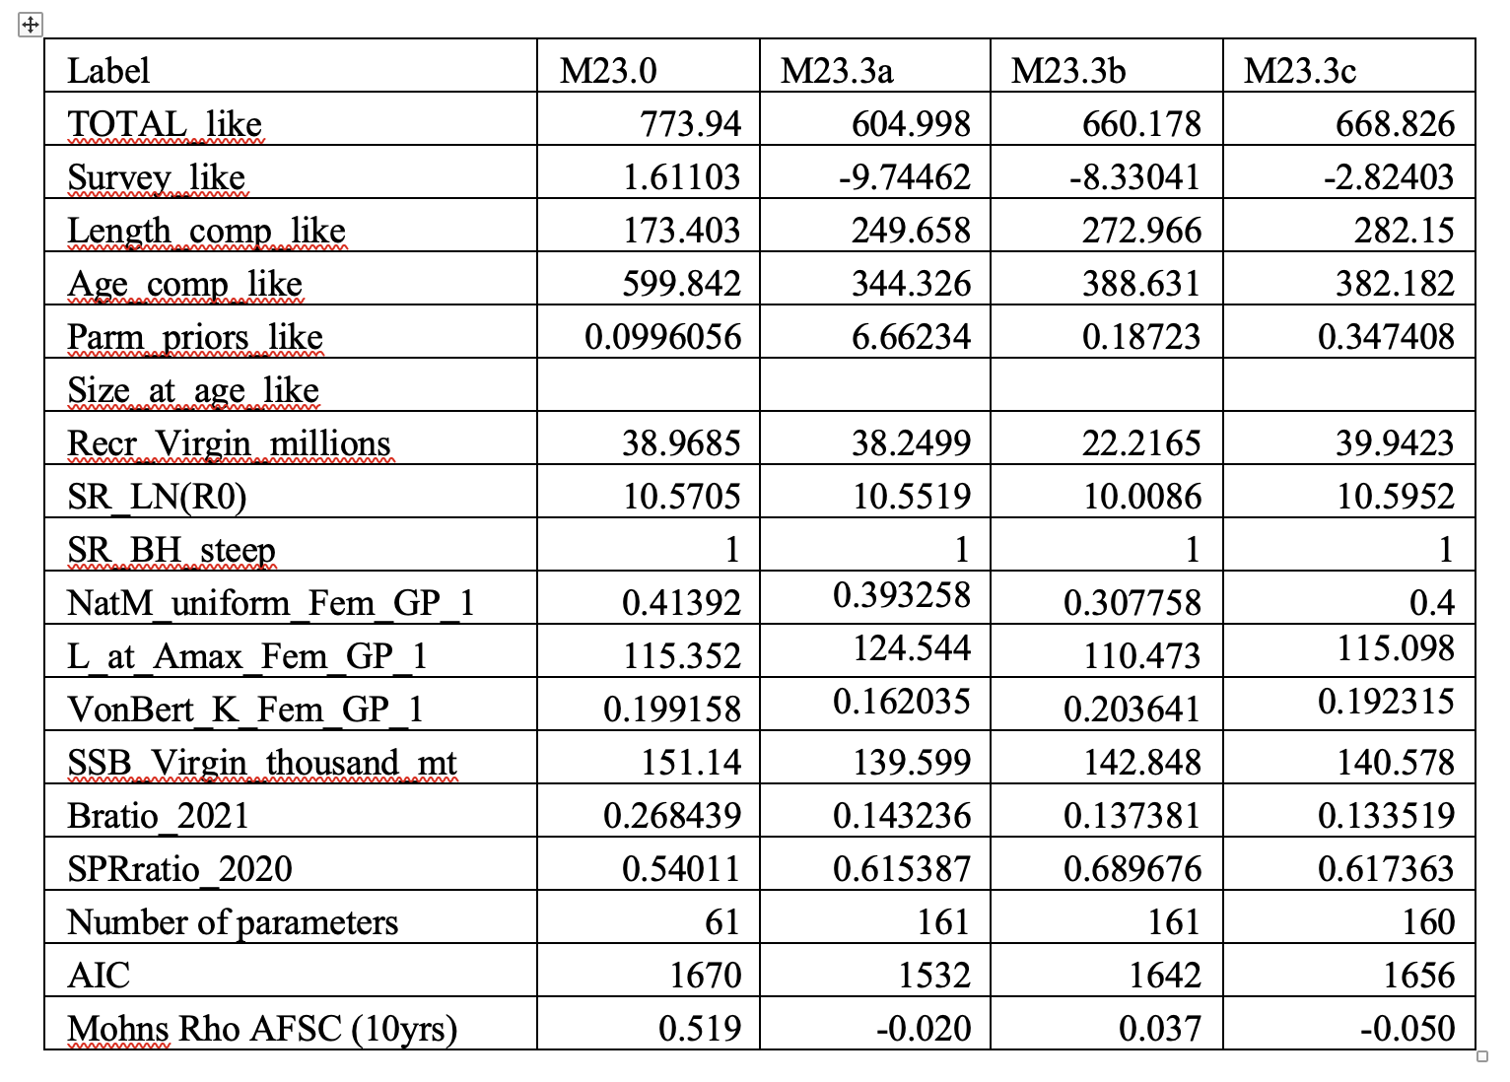
Time varying growth
Time-varying growth
Time varying parameter
Standard error
high
low
low

Slide 31
Time varying growth
Time-varying growth
Time varying growth
improves retrospective
bias.
Time varying parameter
Standard error
high
low
low

Slide 32
Time varying growth
Time-varying growth
Process error tuning
Time varying parameter
Standard error
high
low
low

Slide 33
Natural mortality
Notes:
Residuals match input variance.

Slide 34
Similar to EBS Pacific cod, fixing a key parameter may provide improved stability.
M, Q, Lmin, Lmax, K, etc. could be potential choices.
Natural mortality or growth may be the best candidate.

Slide 35
Time varying growth
Time-varying growth
Model 23.3c fixed natural
mortality.
Negatives: selectivity shifts
larger, natural
mortality declines.
Time varying parameter
Standard error
high
low
low

Slide 36
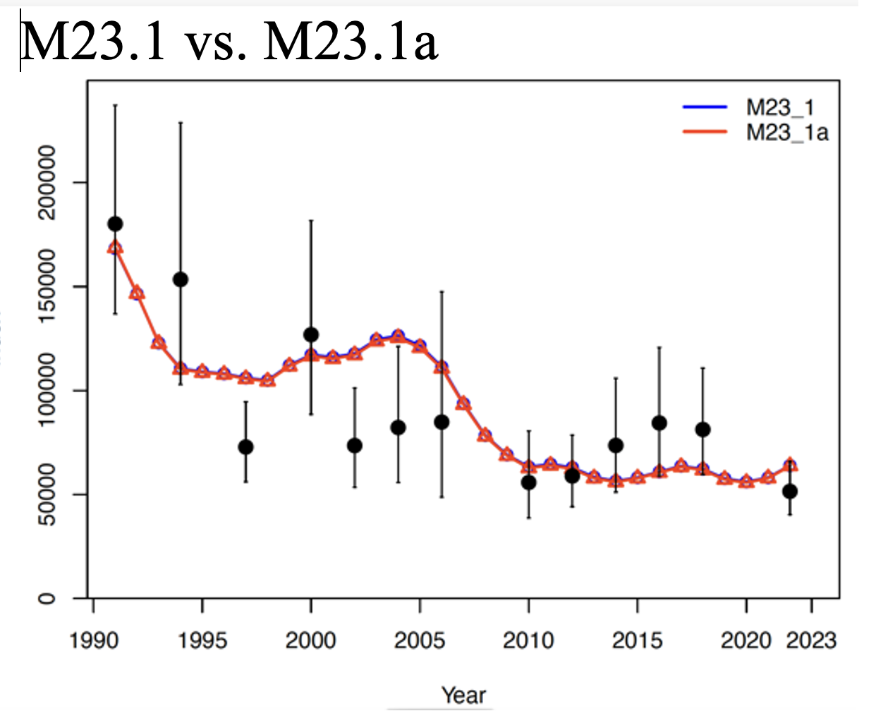
Fixing natural mortality does not change fit to survey index

Slide 37
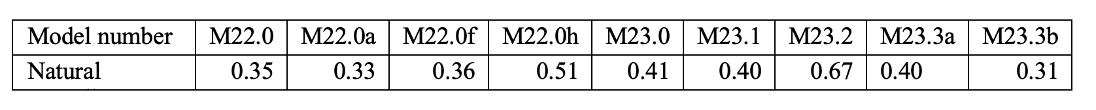
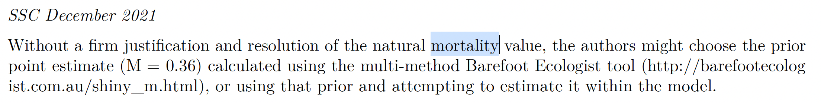
Natural mortality estimates are consistent across models.

Slide 38
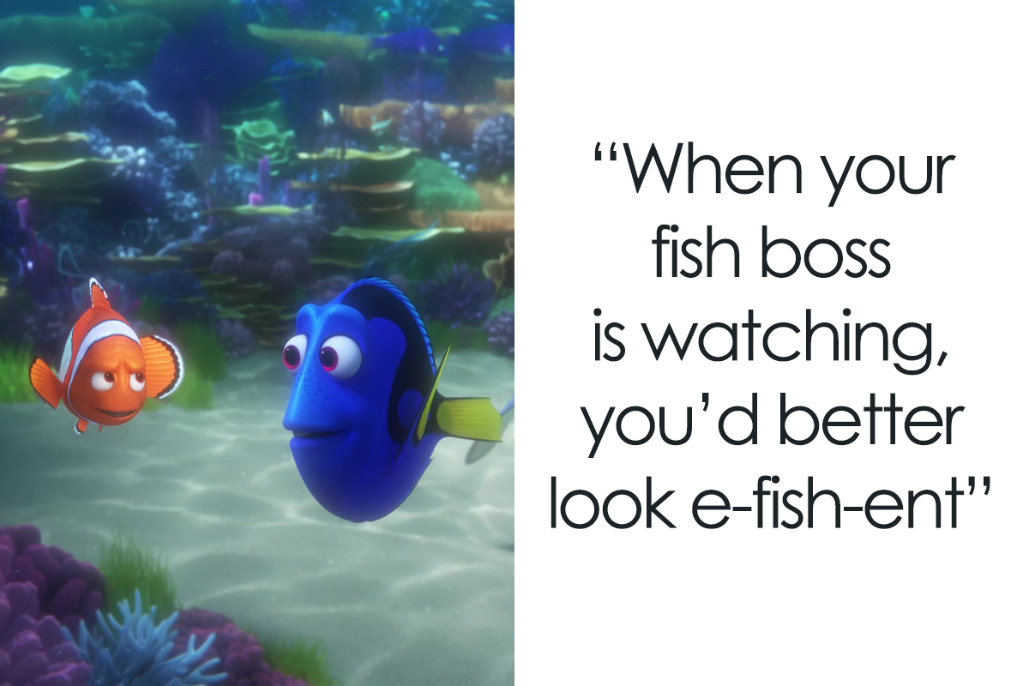
Conclusions

Slide 39
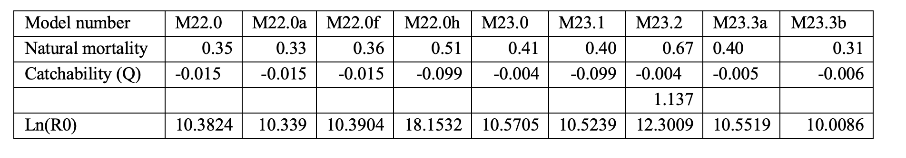
Conclusions
Overall, models are fairly consistent, as measured by key parameters M, Q, unfished recruitment (R0).
Most models indicate M=~0.4, SR_LN(R0) ~10, survey Q between 0.9 and 1.

Slide 40
November Models
Model 23.3: shows promise for reducing retrospective issues.
    Selectivity and natural mortality and growth appear constrained.
    Tune error parameters
    Consider fixing M or tight priors.
Model 23.0: Good base model, except for retrospective errors.
Model 23.1 with fishery selectivity time blocks – consider combining with time-varying growth.

Slide 41
Appendix

Slide 42
M23.3a

Slide 43
M23.3a

Slide 44
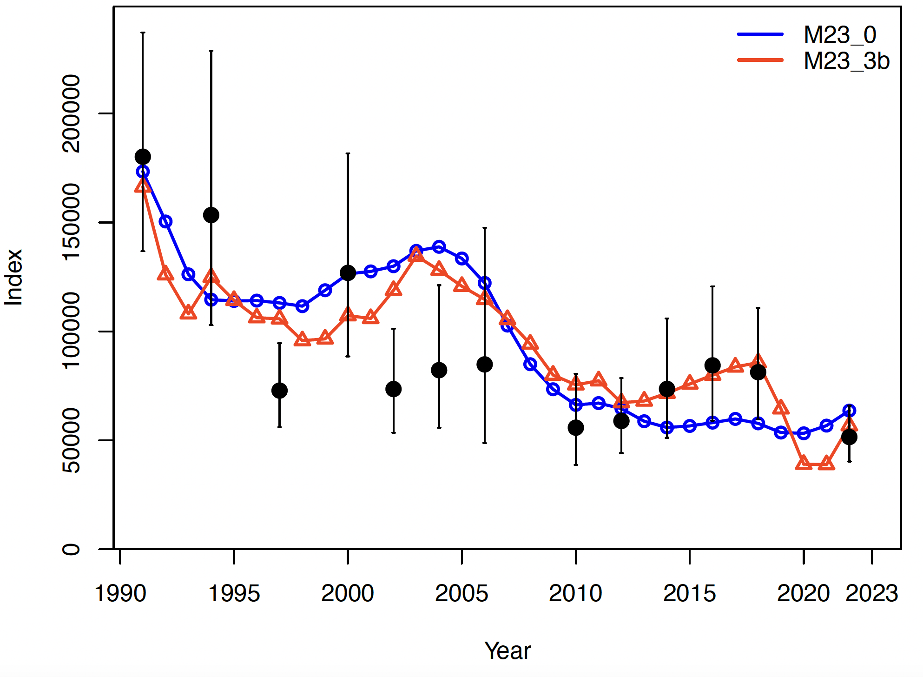
Time-varying parameters changes fit to the survey index slightly
Increases annual variability

Slide 45
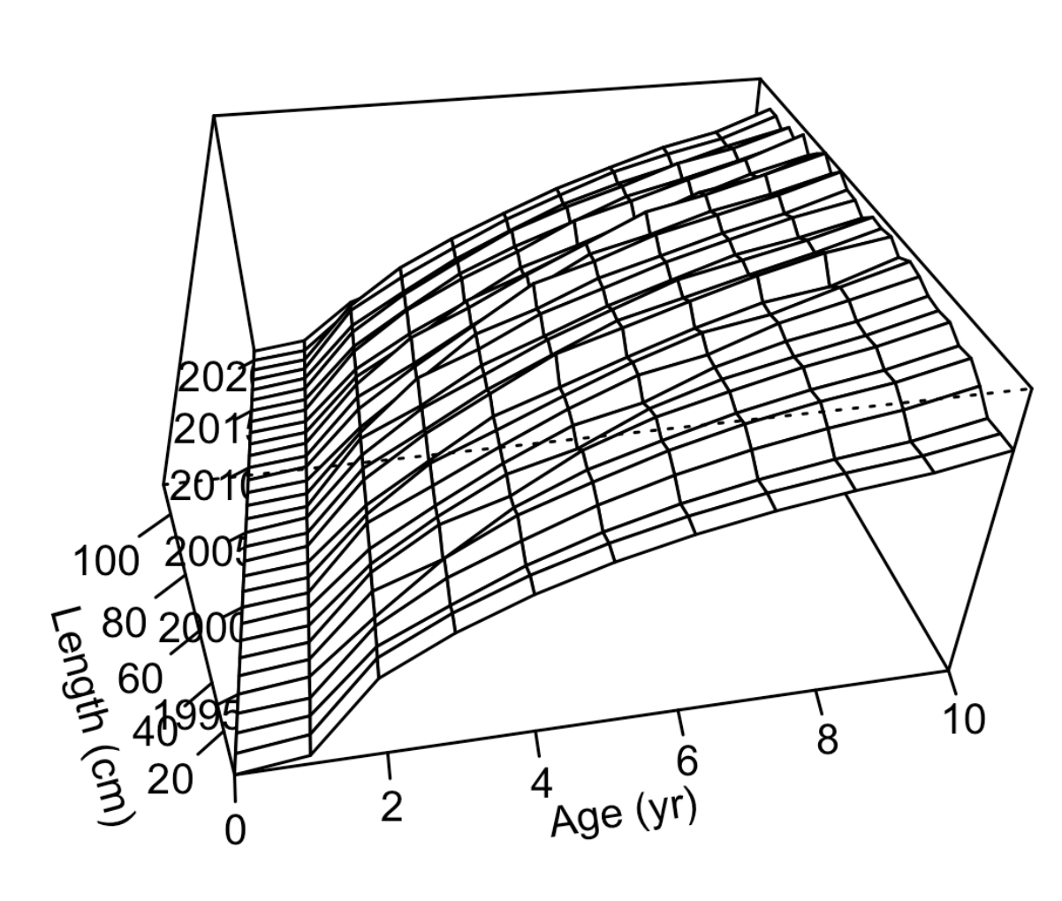
Time varying growth with constrained parameters Lmin, Lmax, K.
TV growth M23.3b
TV growth M23.3c

Slide 46
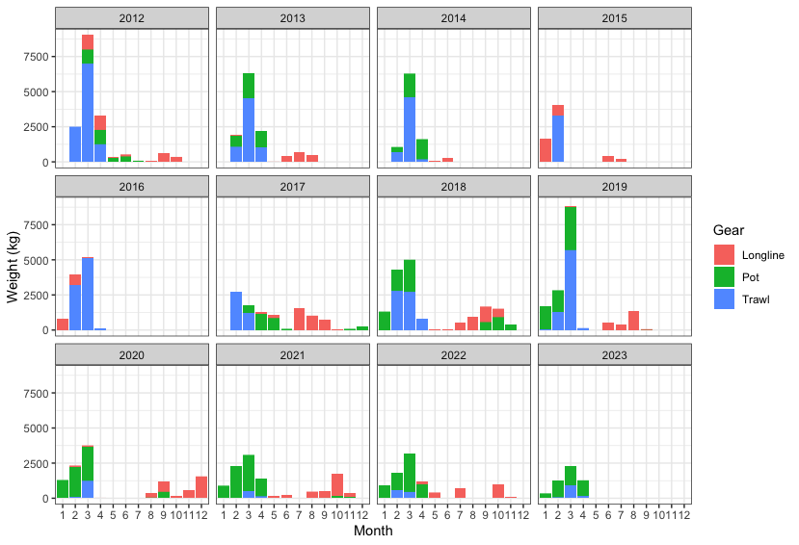
Aleutian Islands targeted cod fishery catch by gear, 2012-2023

Slide 47
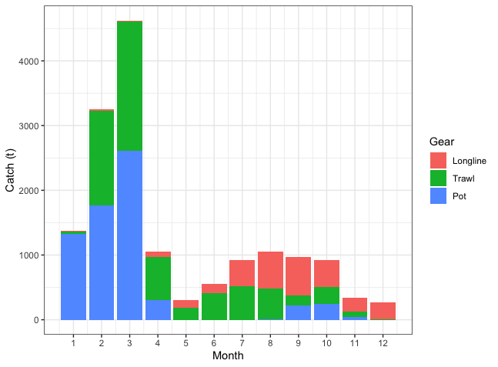
Aleutian Islands Pacific cod average catch (t) by month per year, for the past 5 years
66%
34%
Data from 2018 - October 31, 2022.

Slide 48
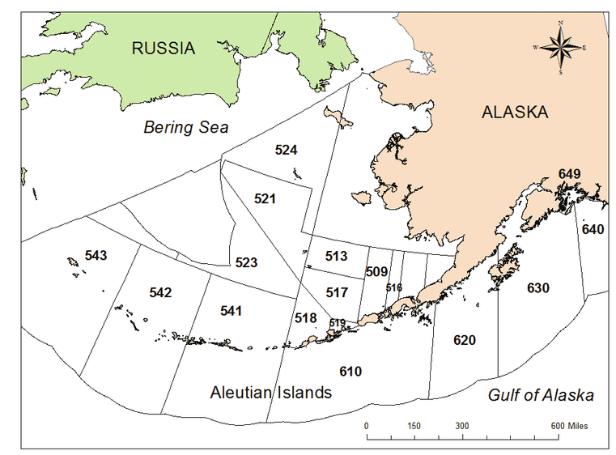
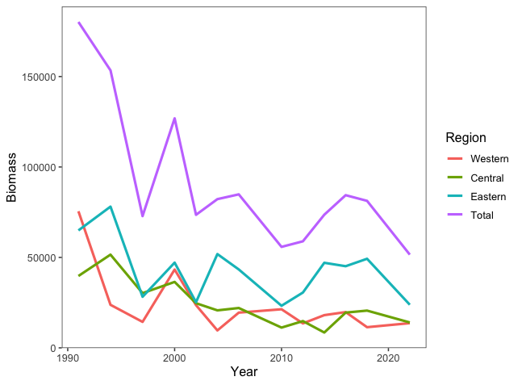
Aleutian Islands Pacific cod trawl survey estimates by NMFS area

Slide 49
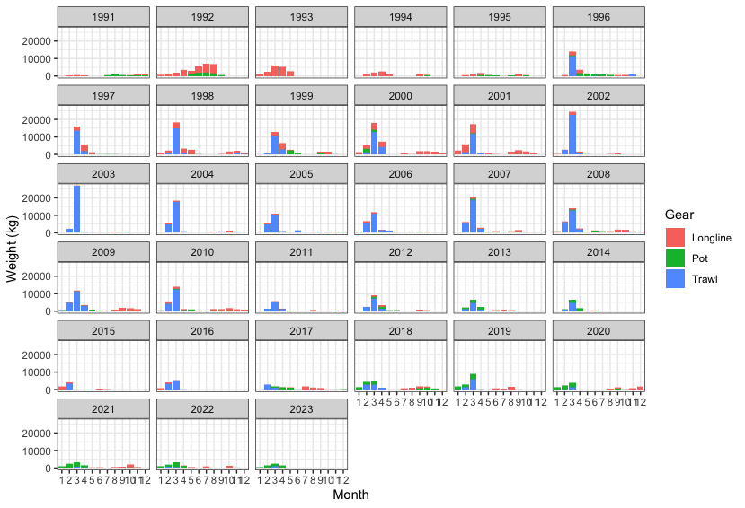
Aleutian Islands targeted cod fishery catch by gear, 1991-2023

