Slide 1
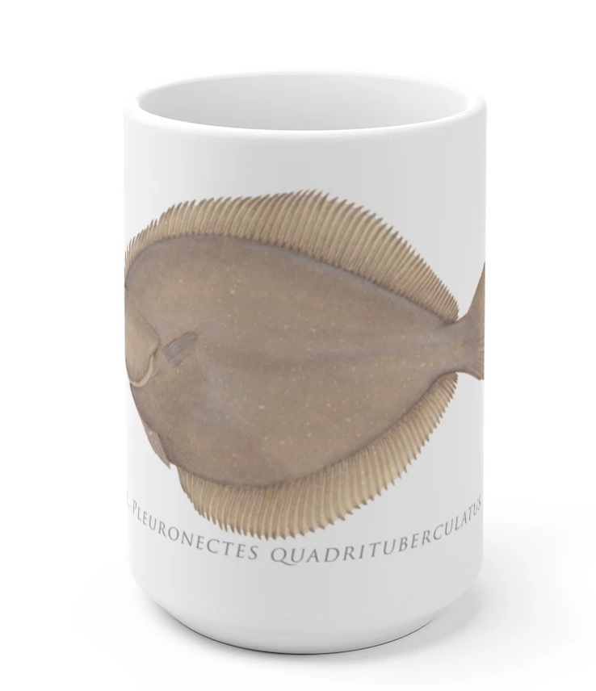
BSAI Alaska plaice 2021
Olav A. Ormseth
Alaska Fisheries Science Center
NPFMC Groundfish Plan Team meeting, November 2021

Slide 2
overview
summary of results
model overview & inputs
model evaluation & results
harvest recommendations

Slide 3
Summary of Results
2021 survey biomass estimate 9% lower than 2019; lowest value in time series
Model estimates of female spawning biomass continued their decline since 2013
Model estimates of total biomass increased relative to 2019
Model estimates relatively strong recruitment since 2017, a pattern which began to emerge in the 2019 assessment
Slightly higher reference fishing mortality rates and total biomass result in slightly increased OFL and ABC
Alaska plaice continue to be found in high abundance in the NBS; 2021 NBS estimate of exceeded EBS estimate for the first time

Slide 4
model overview
structure
same model that has been used since 2011 (2011.1)
2 sexes, 1 fishery
catchability fixed at 1.2 (herding experiments)
data
EBS shelf bottom trawl survey (no NBS data; catches are in EBS)
all available survey age comps
survey length comps when age not available
fishery length comps

Slide 5
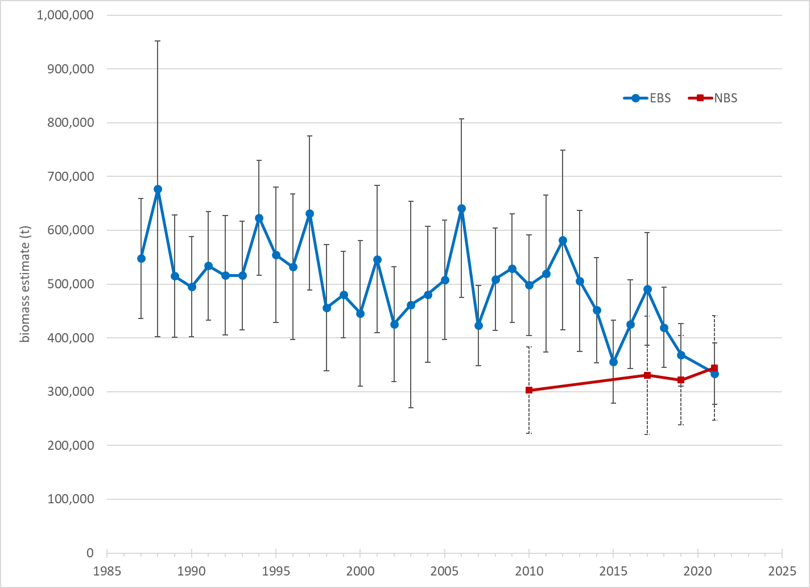
EBS & NBS survey biomass

Slide 6
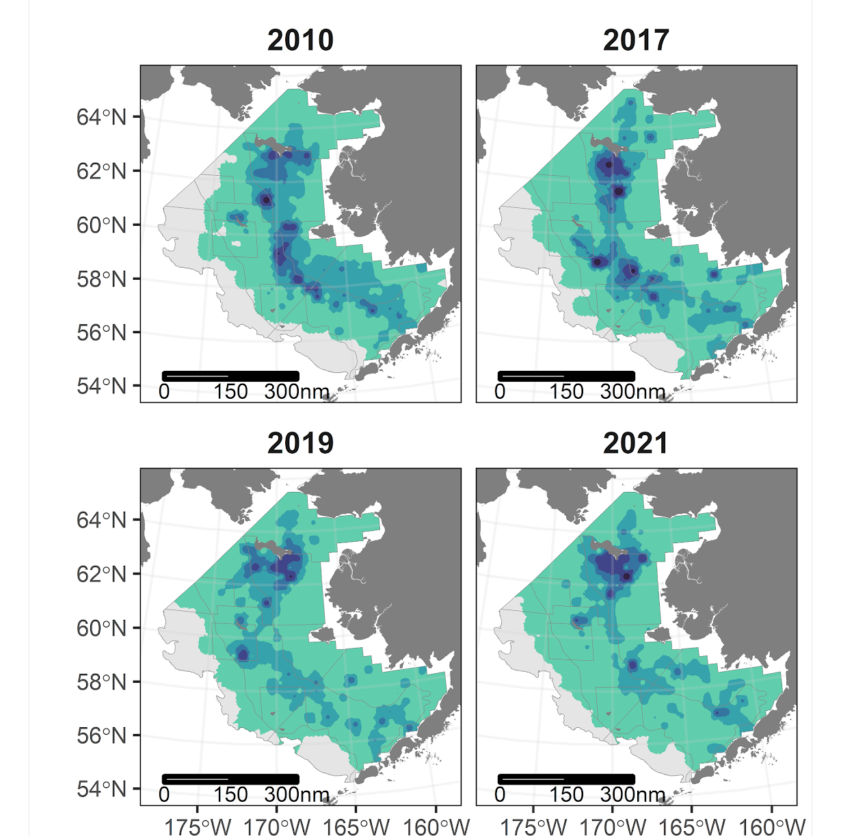

EBS & NBS spatial distribution

Slide 7
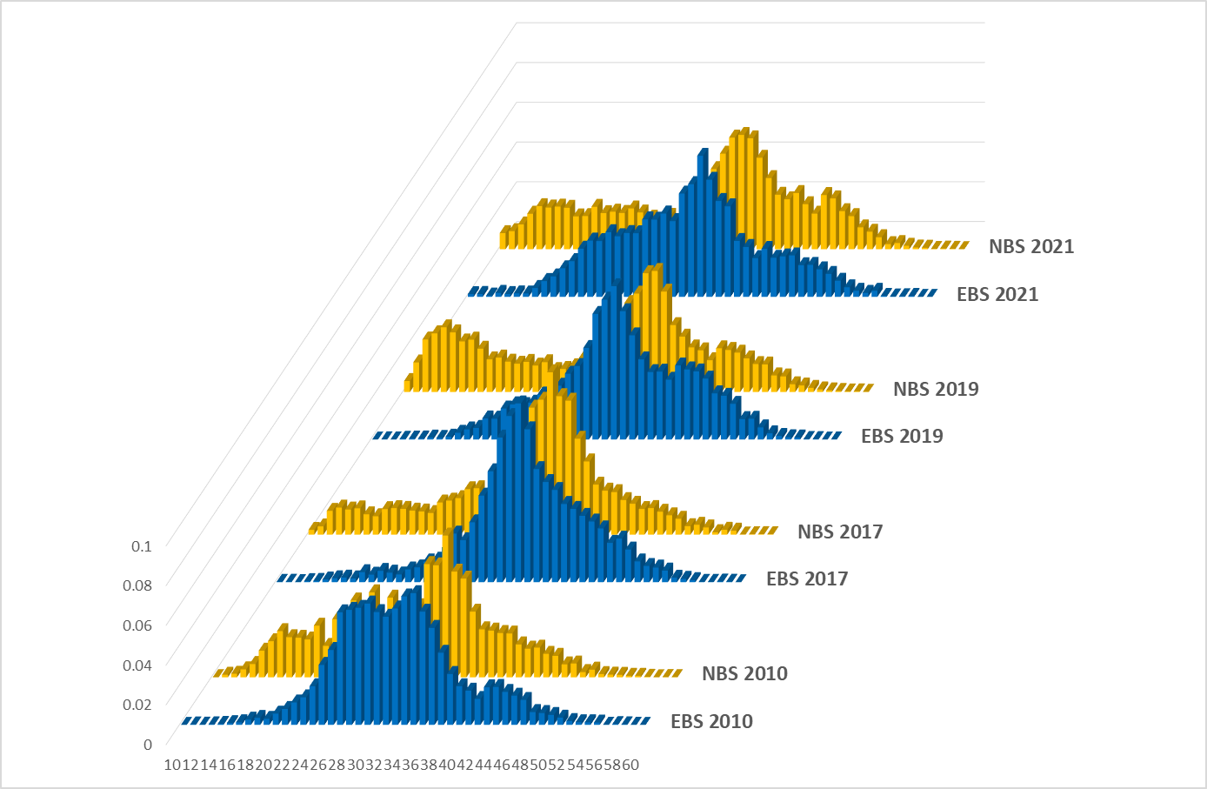
EBS vs NBS length composition

Slide 8
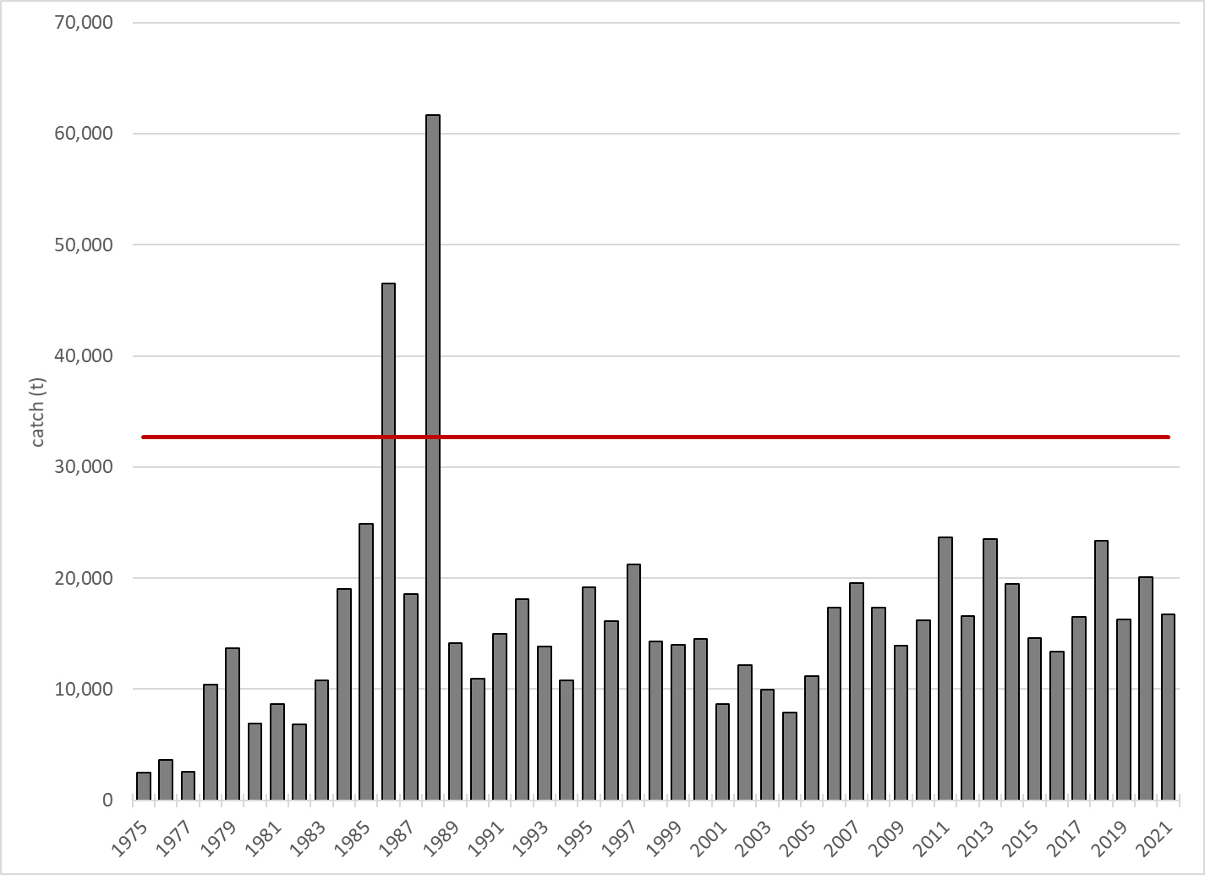
Alaska plaice catch (mainly in YFS fishery)
2022 ABC

Slide 9
model evaluation & results

Slide 10
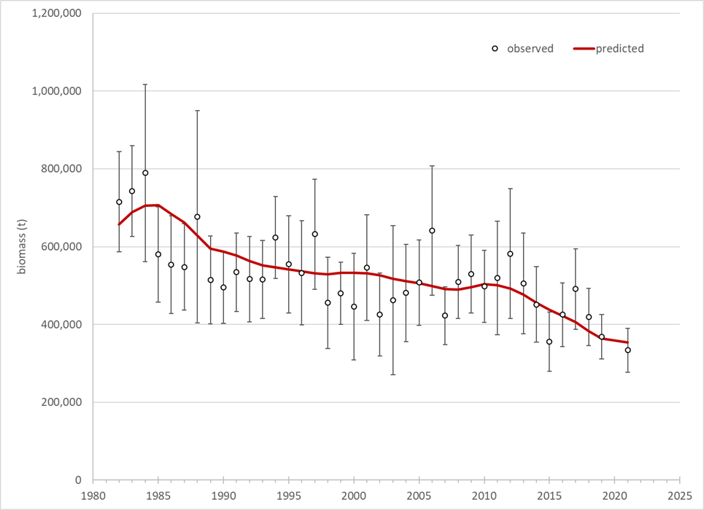
survey biomass fit

Slide 11
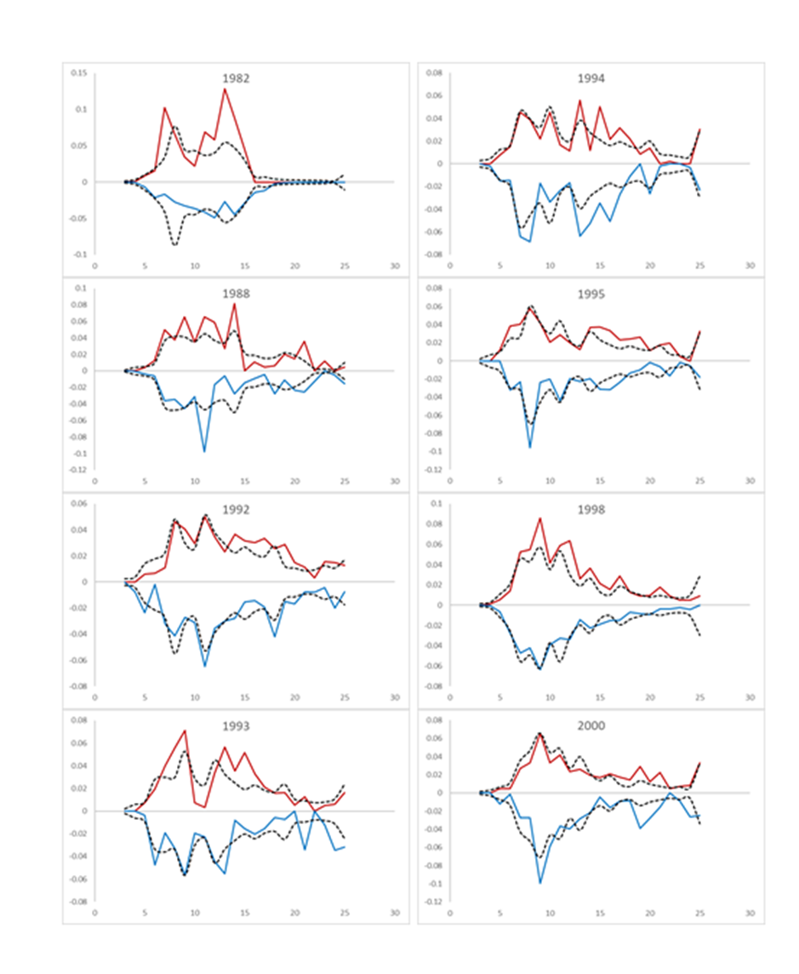
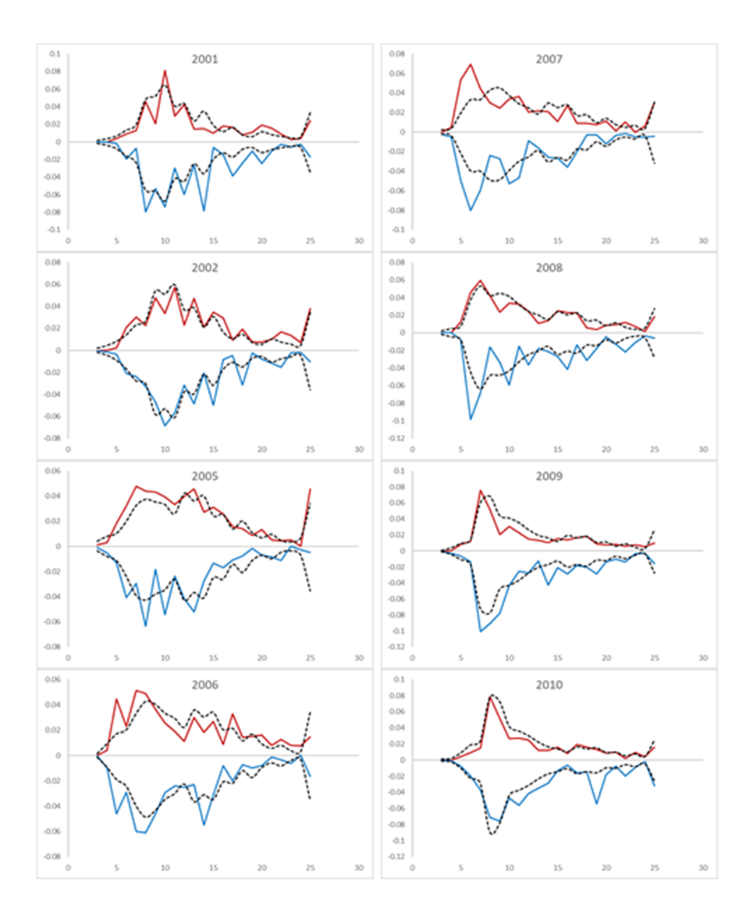
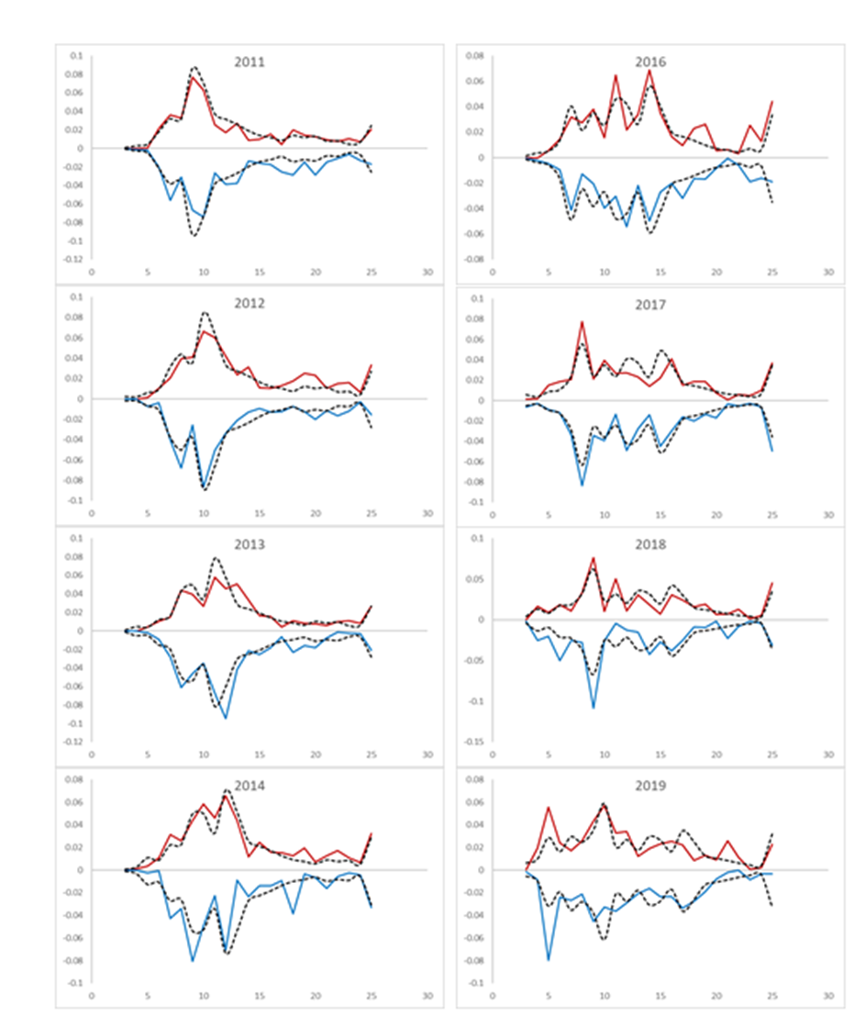
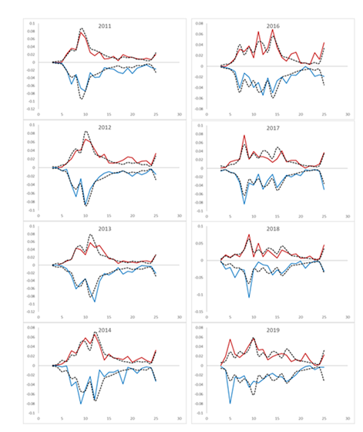
survey age composition

Slide 12
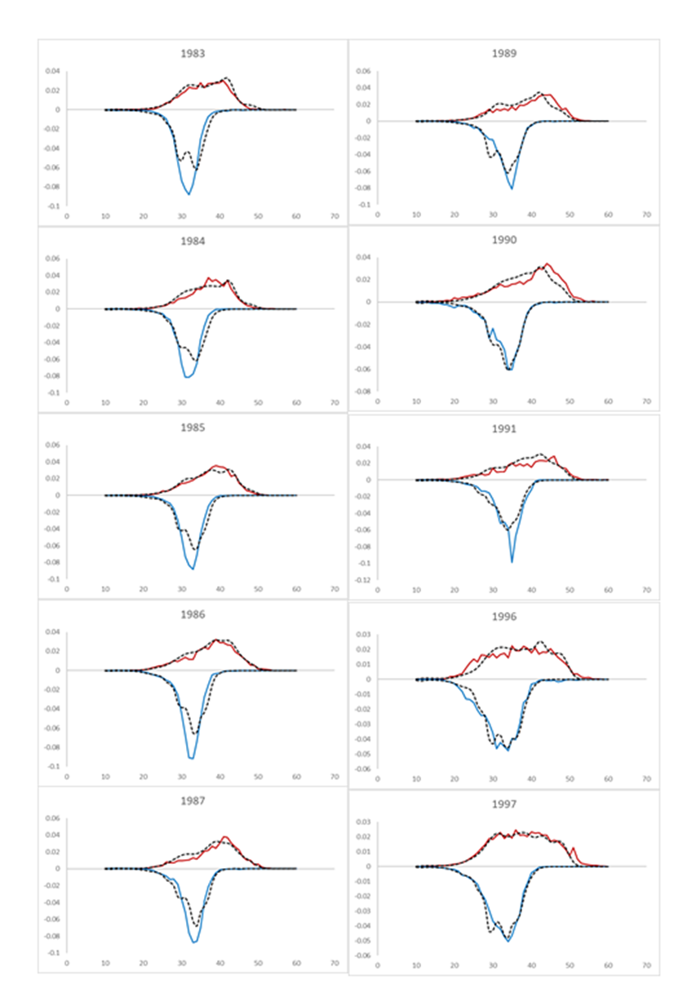
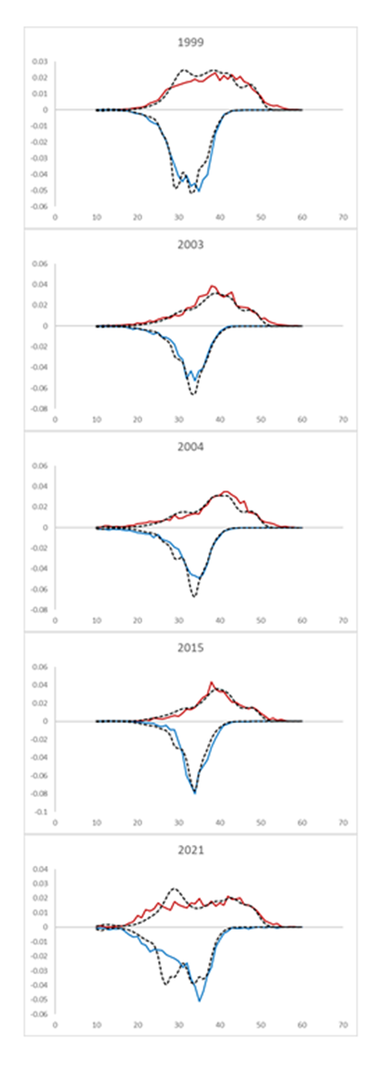
survey length composition

Slide 13
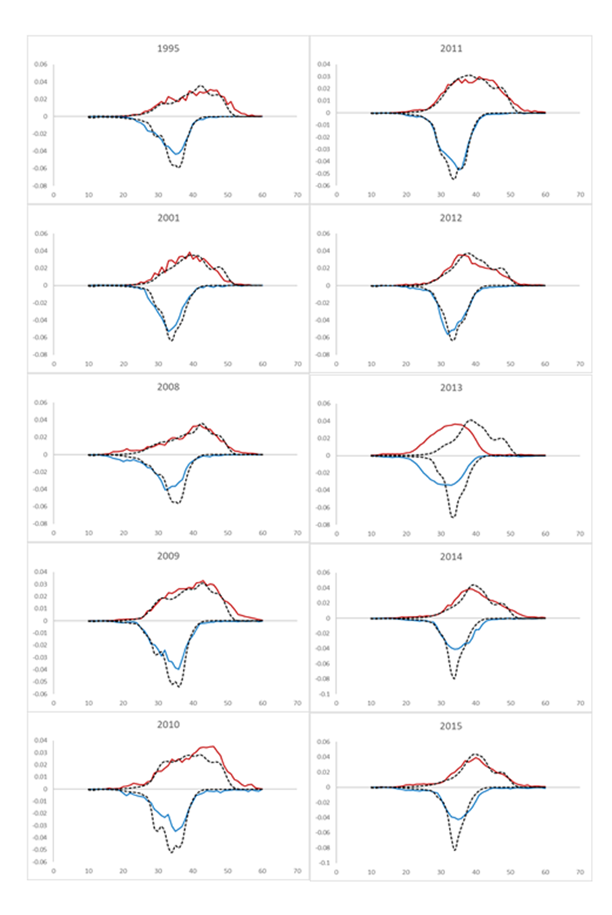
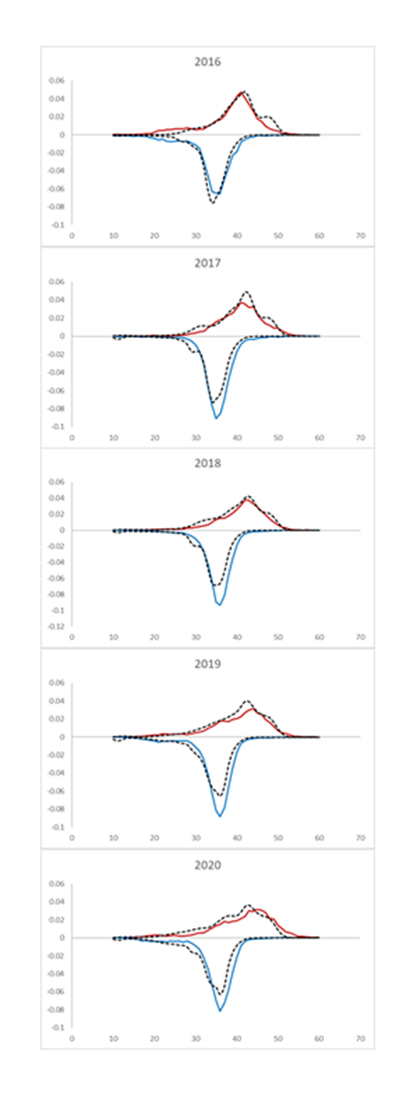
fishery length composition

Slide 14
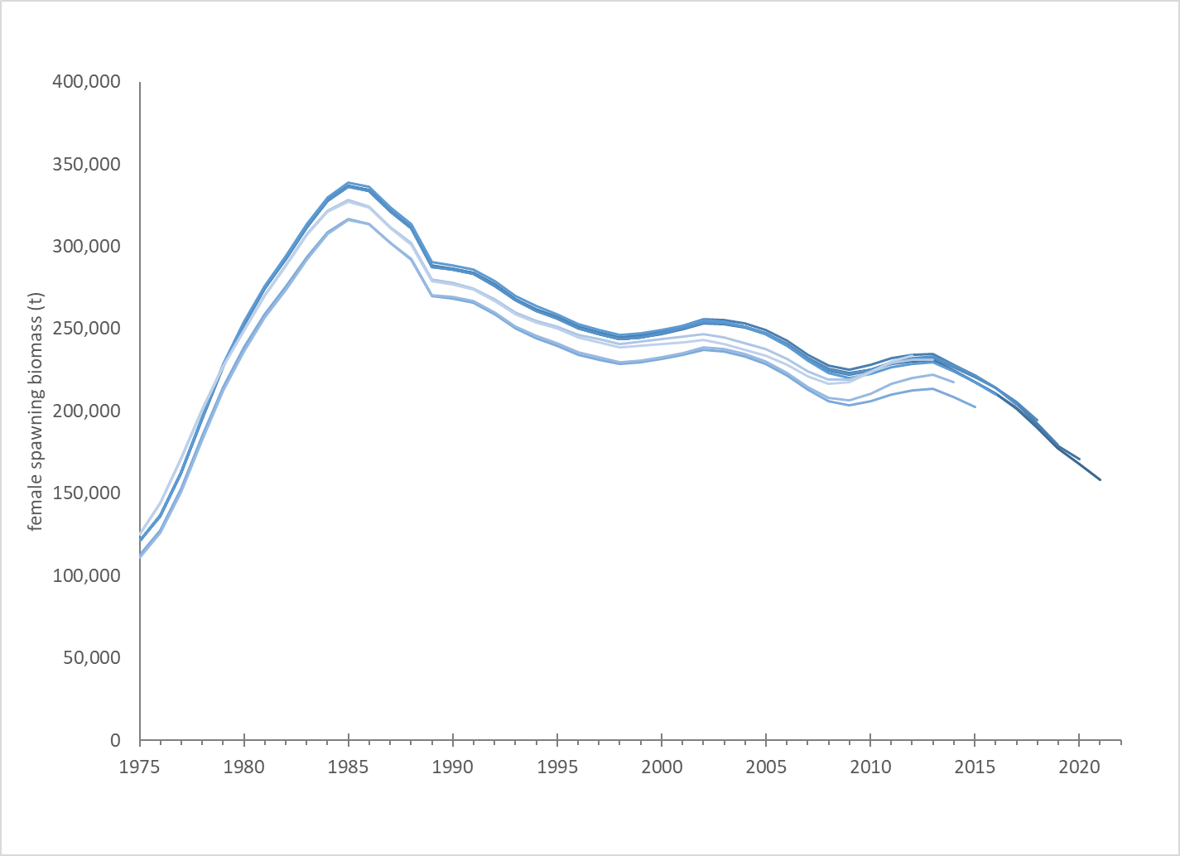
retrospective – female spawning biomass
Mohn’s ρ = -0.01.

Slide 15
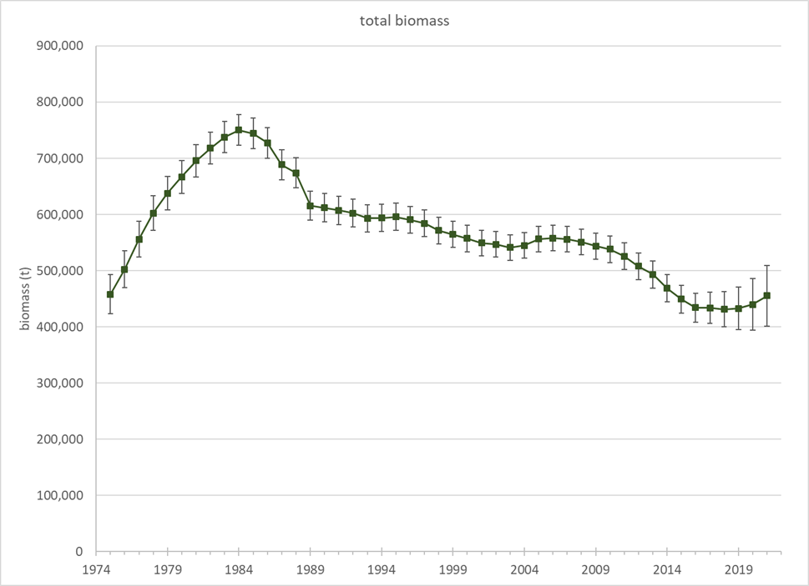
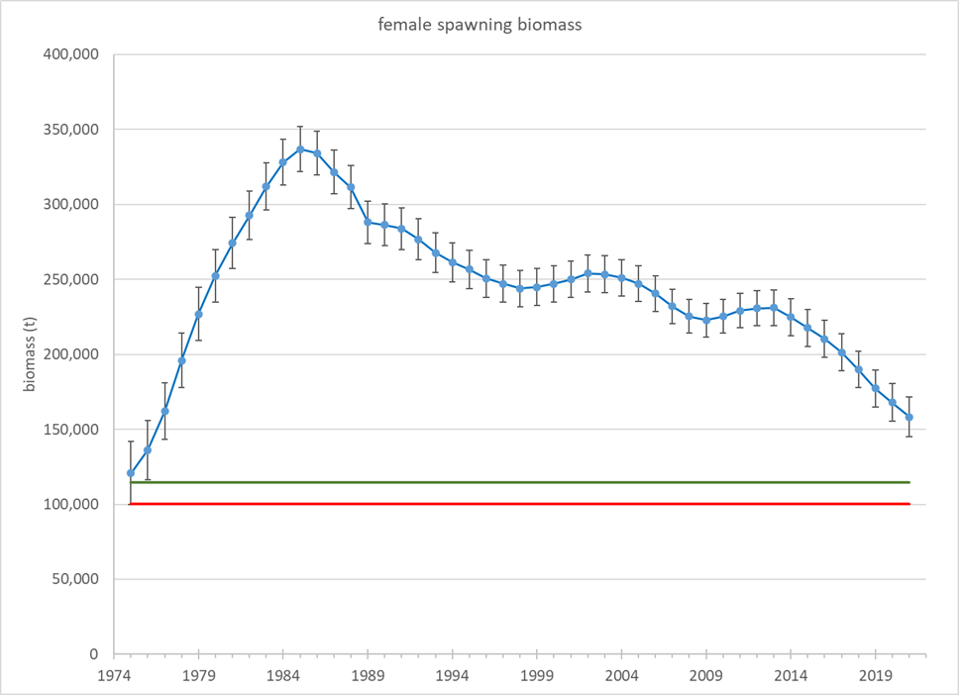
results - biomass

Slide 16
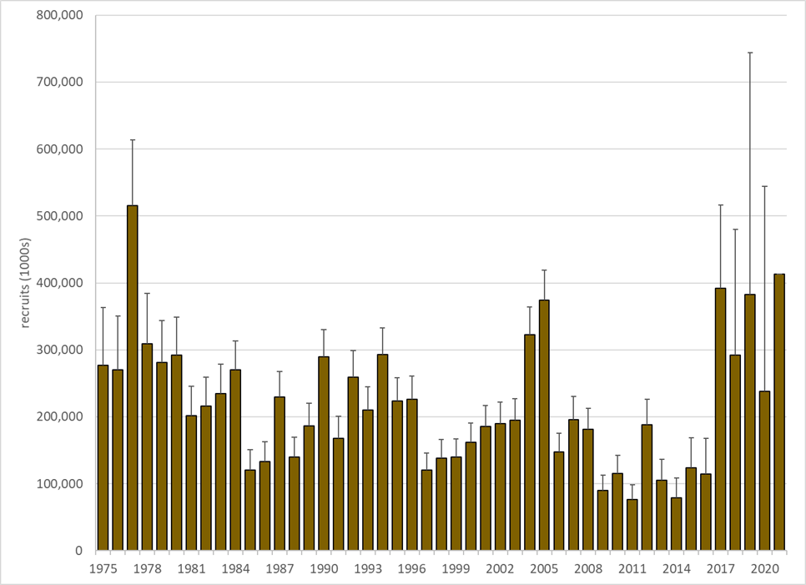
results - recruitment

Slide 17
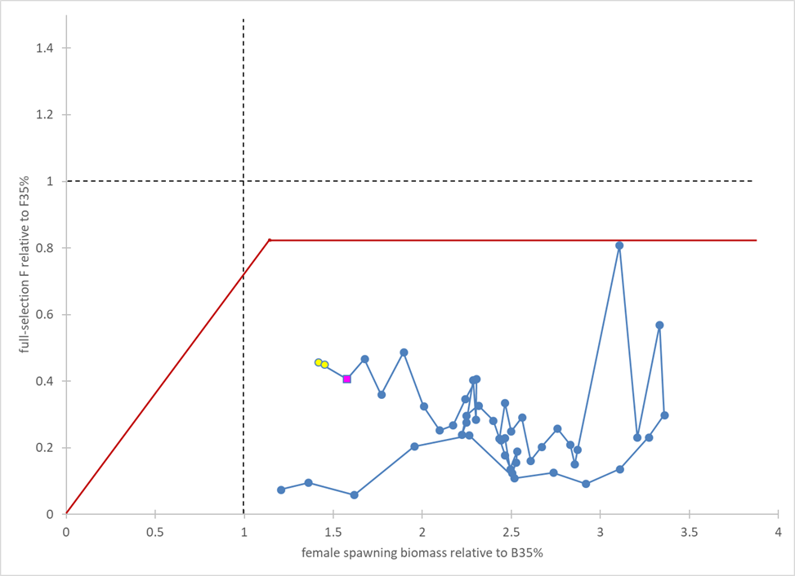
catch & biomass trajectory

Slide 18
harvest recommendations

Slide 19
risk table

Slide 20
end main AK plaice presentation
the following slides are for discussion purposes

Slide 21
the following slides are “as needed” Alaska plaice slides

Slide 22
Responses to SSC and Plan Team Comments Specific to this Assessment
From the December 2019 SSC minutes:
The SSC … recommends continuing to track survey biomass trends in the NBS. The assessment indicates that sampling in the NBS in 2017 by a NPRB project showed differential age-at-maturity and size-at-age compared to the EBS. For the next full assessment, the SSC requests that the authors investigate differences in length composition and sex ratios between the NBS and EBS surveys. In addition, the SSC recommends analysis of genetic information to inform whether there is evidence of stock structure between the survey regions.
Response: The assessment includes updated information on and discussion of Alaska plaice in the NBS. The assessment now also includes a comparison of EBS and NBS size compositions, which reveals the persistent presence of small Alaska plaice that are not present in the EBS. No progress has been made on developing genetic analysis of population structure.

Slide 23
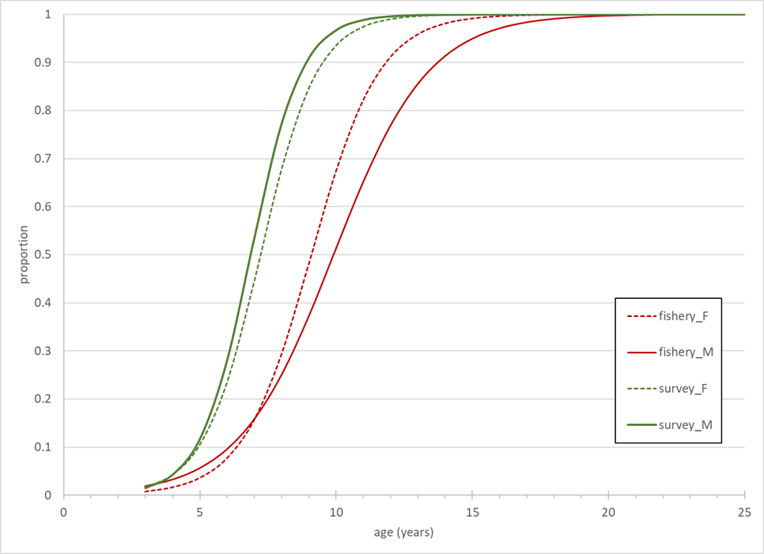
selectivity

Slide 24
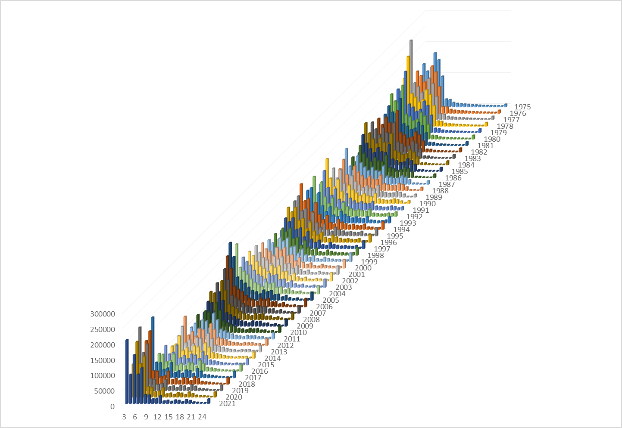
results – size at age
females

Slide 25
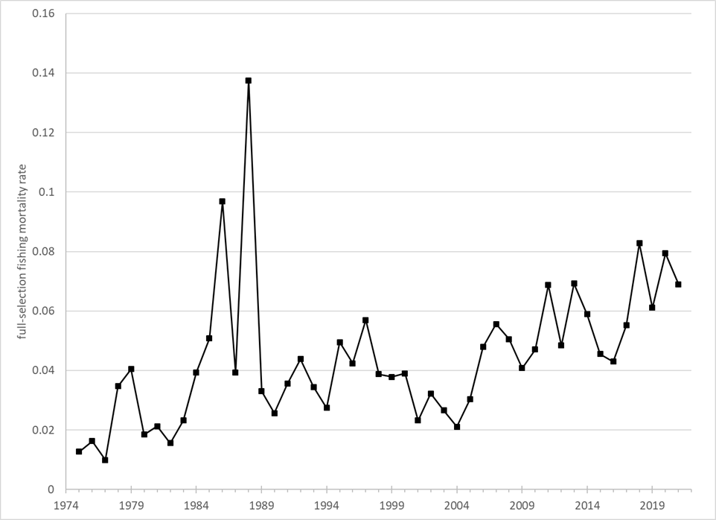
results - F

Slide 26
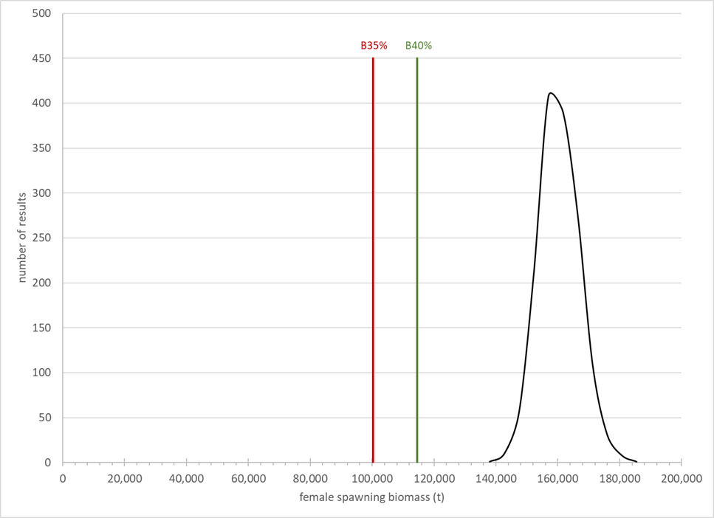
posterior distribution of FSB

