Slide 1
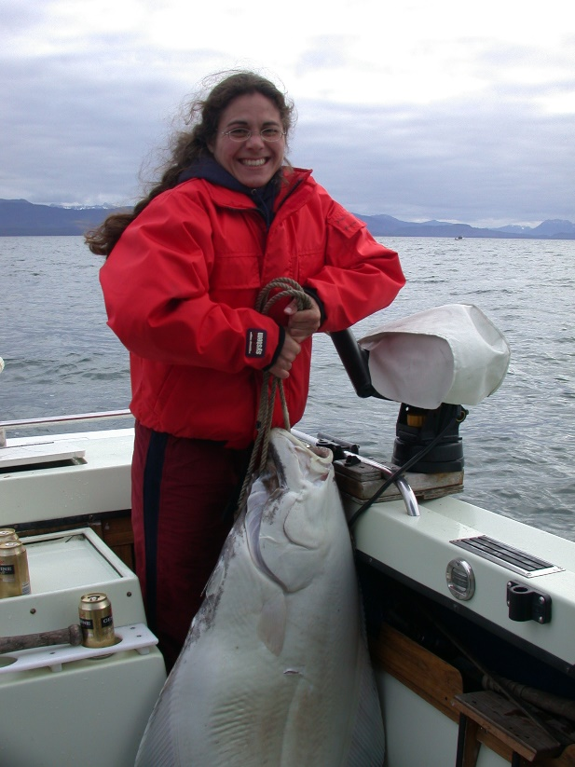
Arrowtooth Flounder
BSAI Groundfish plan Team, Nov 2021
Kalei Shotwell, Ingrid Spies, Lyle Britt, Meaghan Bryan, Dana Hanselman, Daniel Nichol, Jerry Hoff, Wayne Palsson, Kevin Siwicke, Jane Sullivan, Thomas Wilderbuer, Stephani Zador
Partial assessment (full in EVEN years)
Tier 3
  Projection model
  Recommendations for 2022:
    OFL 94,445 t
    ABC 80,389 t (4% increase from 2021)

Slide 2
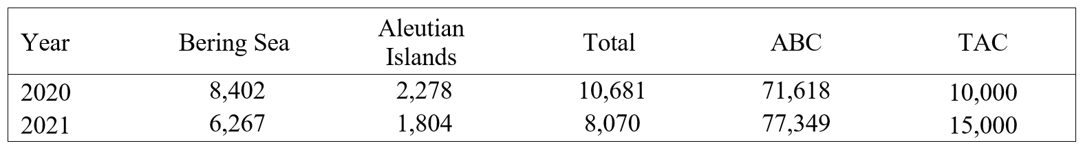
Fishery trends
Catch decreased in all areas in 2021 compared to 2020
  49% of catch in the Arrowtooth and Kamchatka flounder fishery
  32% in the Yellowfin sole and Flathead sole fisheries
  4% in the pollock fishery, 6% in rockfish fisheries
Low catch likely attributed to poor markets and COVID-19 related issues (e.g., increased downtime, loss of crew to illness, restaurant closures)
Notes:
Catch of Arrowtooth flounder decreased in all areas in 2021 compared to 2020 but remains within the range of the time series. About 49% of the catch was in the Arrowtooth and Kamchatka flounder fishery, with 4% in the pollock fishery, 6% in the rockfish fisheries, and the remainder mainly in the yellowfin sole and flathead sole fisheries.
The catch to biomass ratio for 1991-2021 has ranged from 0.008 in 2017 to 0.037 in 1991. The Arrowtooth flounder catch/biomass ratio has been steadily decreasing since 2012 (Figure 6.1). The catch to biomass ratio in 2021 was 0.009, and was 0.012 in 2020, decrease of 18%

Slide 3
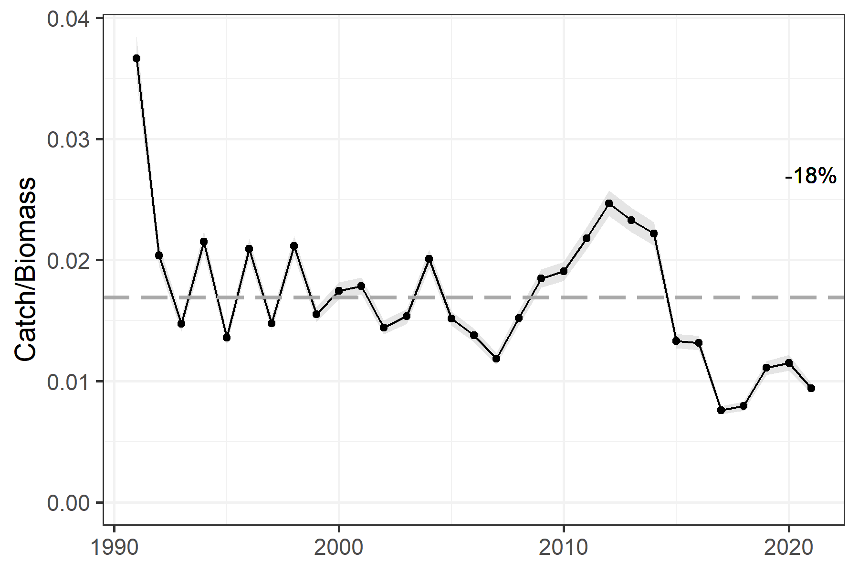
Catch/biomass
Notes:
The catch to biomass ratio for 1991-2021 has ranged from 0.008 in 2017 to 0.037 in 1991. The Arrowtooth flounder catch/biomass ratio has been steadily decreasing since 2012 (Figure 6.1). The catch to biomass ratio in 2021 was 0.009, and was 0.012 in 2020, decrease of 18%

Slide 4
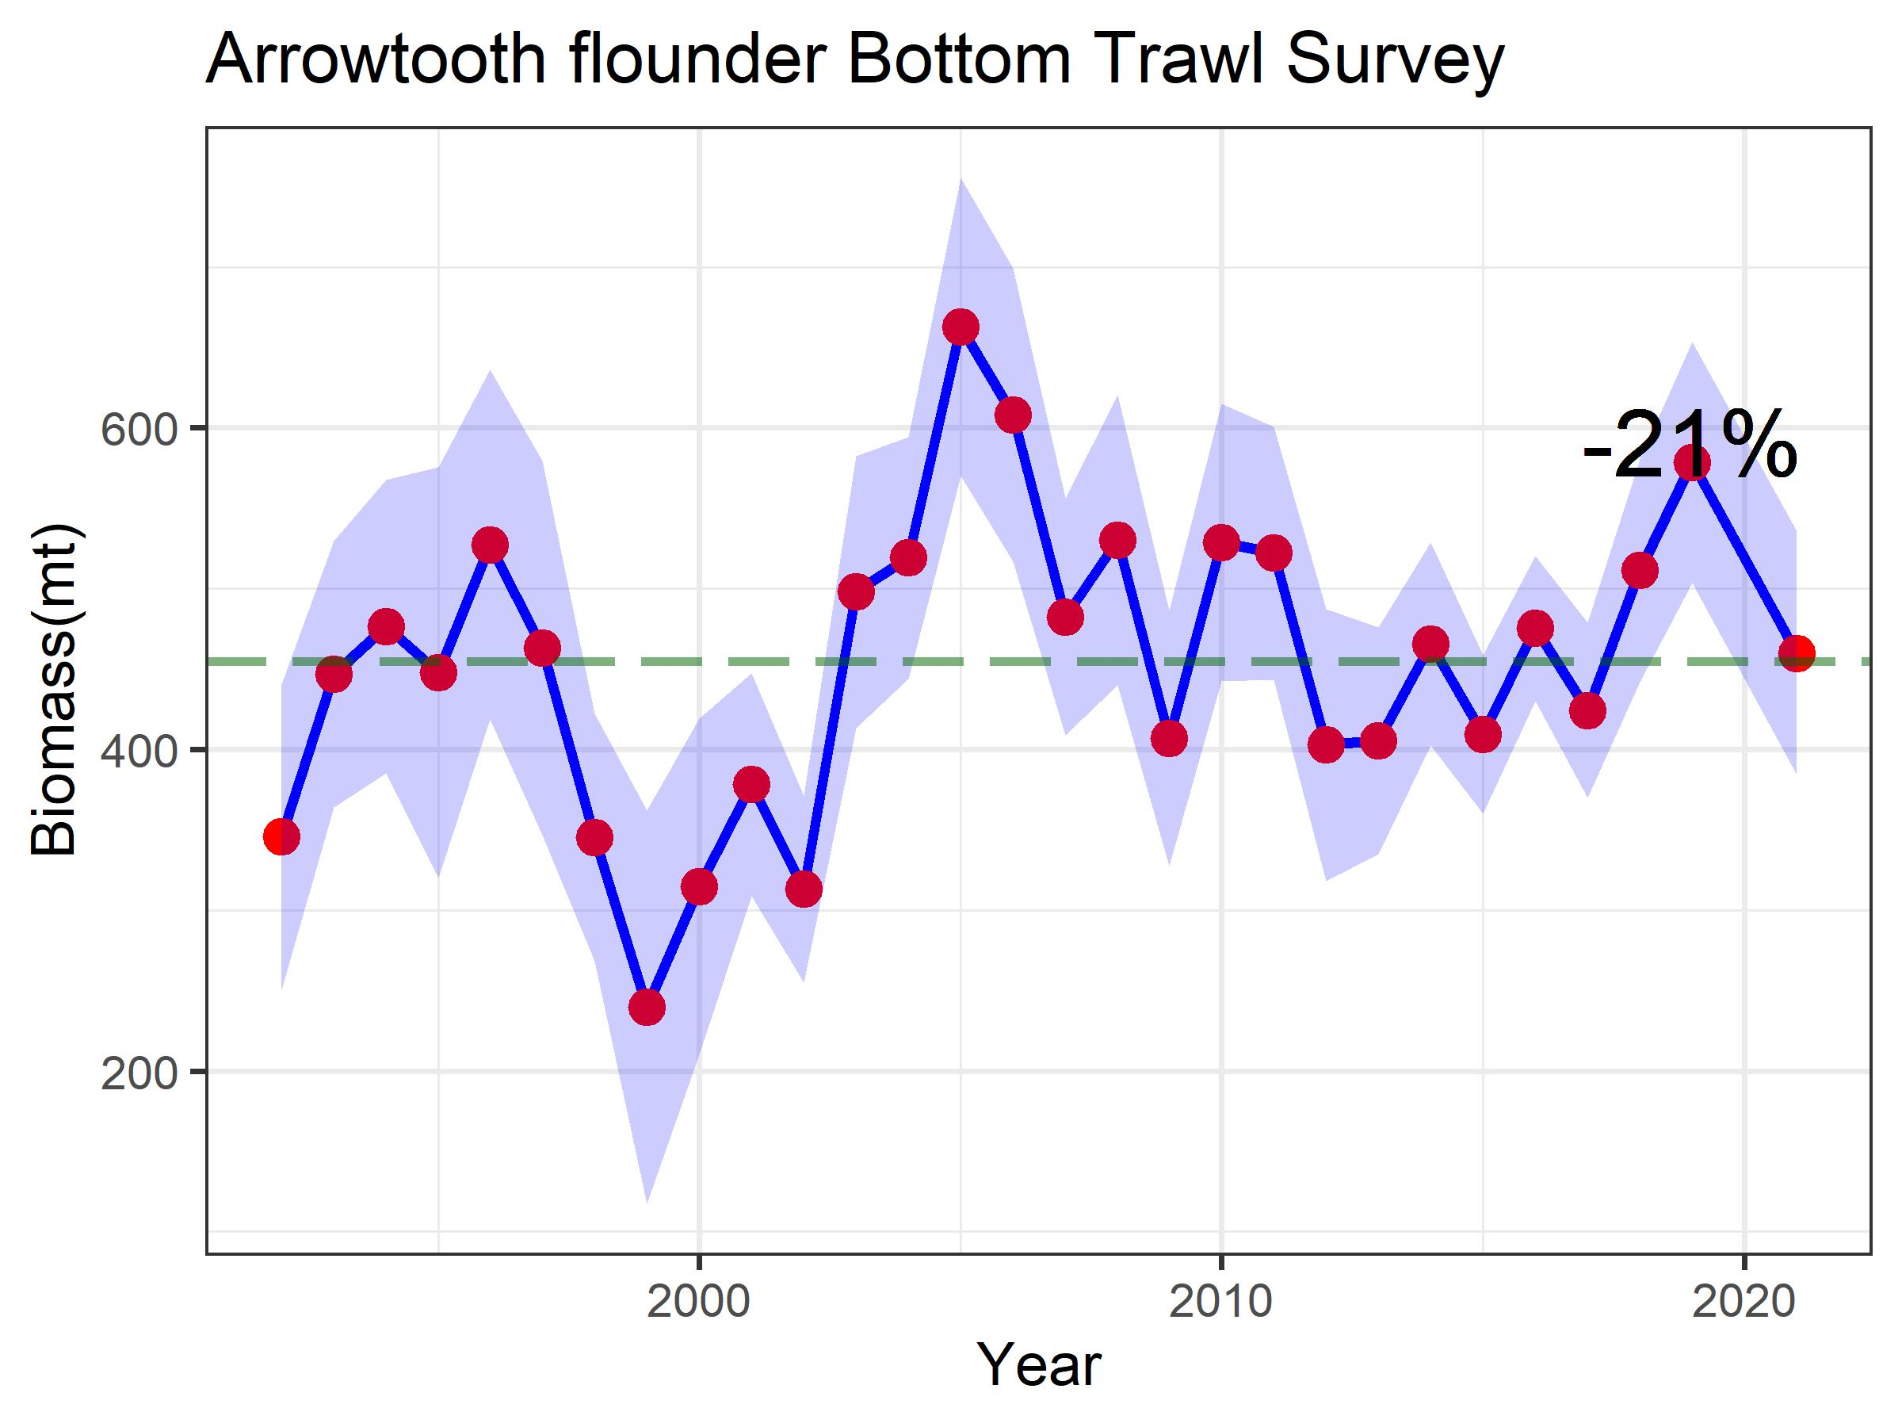
Survey trends –
EBS Shelf bottom trawl survey
Notes:
The EBS Arrowtooth flounder biomass estimate from the EBS shelf BTS was 459,660 (t) for 2021, which was 21% lower than the 2019 survey, but at the long term average for the time series

Slide 5
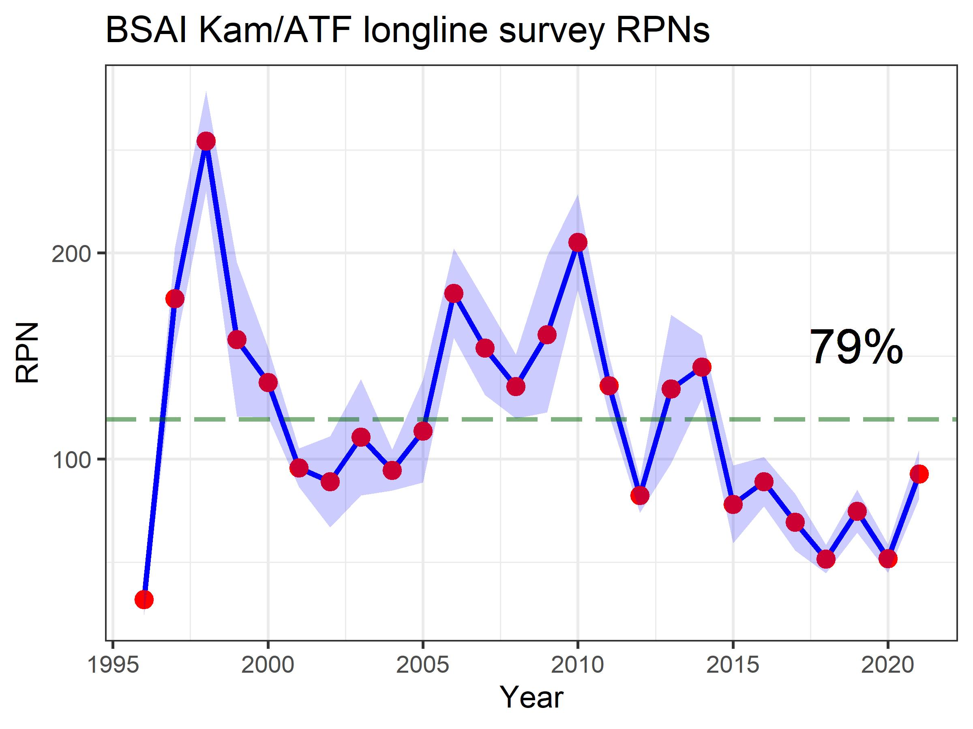
Survey trends – afsc longline survey
Notes:
Relative population number (RPN) estimates are available for Arrowtooth flounder and Kamchatka flounder combined in the Bering Sea and Aleutian Island areas from the AFSC longline survey. RPNs for Arrowtooth flounder increased by 79% since the 2020 survey and are now just below the long-term average for the time series

Slide 6
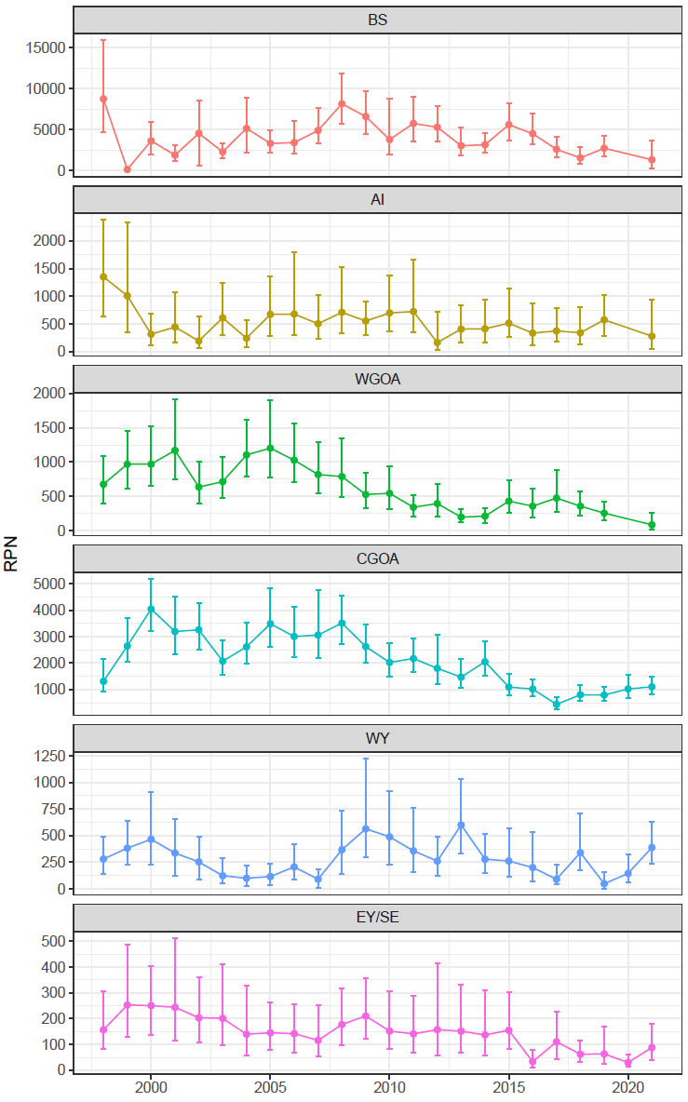
Survey trends – iphc longline survey
Notes:
RPN estimates are available for Arrowtooth flounder in the Bering Sea and Aleutian Island areas from the IPHC survey. RPNs for Arrowtooth flounder decreased by 52% from last year in the Aleutian Islands and by 51% in the Bering Sea. Both areas are well below the long-term average for the time series.

Slide 7
Partial assessment
Do not rerun the assessment model
Do update the projection model with new catch
  Updated 2020 catch = 10,681 t
  Estimated 2021 catch with expansion factor of 1.07 (based on average fraction of catch taken after Oct 30 in the last five complete catch years, 2016-2020) = 8,698 t
  Estimated 2022 and 2023 catch with yield ratio of 0.13 (based on average of the ration of catch to ABC for the last five complete catch years, 2016-2020)
    2022 = 9,272 t and 2023 = 8,806 t

Slide 8
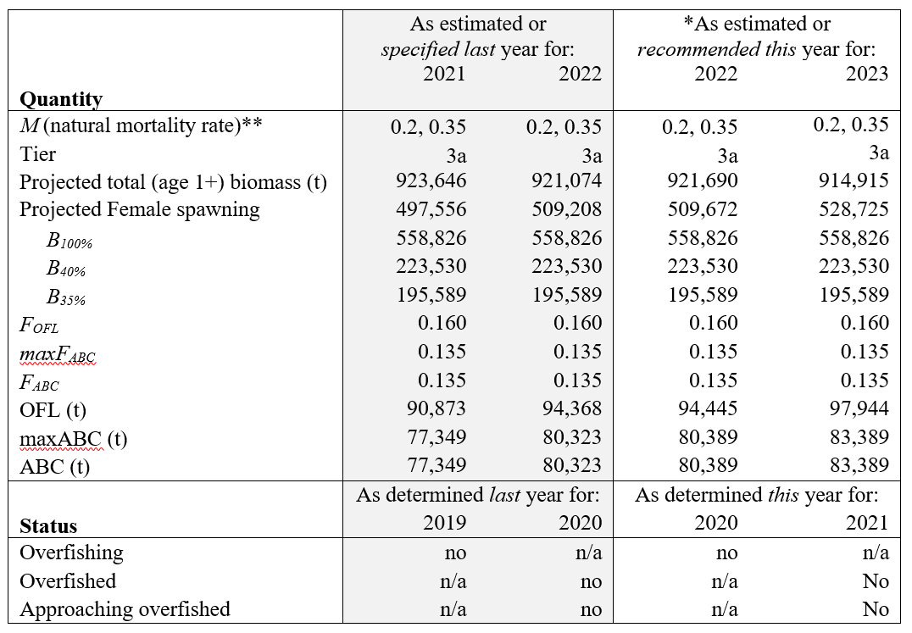
Summary table
Notes:
ABC for 2022 is 80, 389 t, which is a 4% increase from last year’s ABC and 0.1% increase from the 2022 projected ABC from last year’s assessment
Official total catch for 2020 was 10,681 t which is less than the 2020 OFL of 84,057 t, stock is not being subjected to overfishing
SSB for 2021 and 2023 from current projection model (497,740 t and 528,725 t) are well above B35% (195,589 t), stock is not currently overfished nor approaching an overfished condition

Slide 9
SSC/pt comments
The SSC recommends that the authors check the parameterization for selectivity and the estimated selectivity curves for the shelf survey to verify that the peaks of the domed shape failing to reach a value of 1.0 does not create any unexpected artifacts in the calculations or change the interpretation of catchability or other model results. The SSC requests the authors bring forward historical information on the rationale used for the selectivity parameterizations used in the assessment.
  We plan to bring forward historical information on the rationale used for the selectivity parameterizations in the next full assessment to the extent possible given multiple lead authors on this assessment.

Slide 10
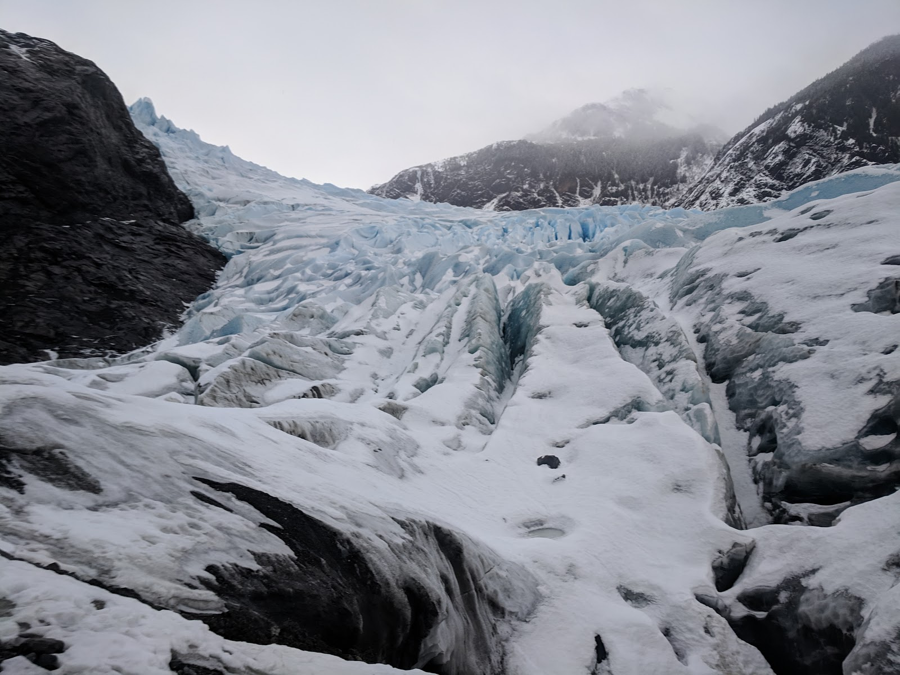
Questions
Kalei.Shotwell@noaa.gov

