Slide 1


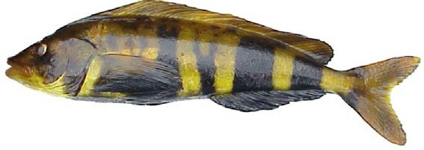

Atka mackerel
BSAI Groundfish Plan Team
Sandra Lowe and Jim Ianelli
November, 2022

Slide 2
Stock Overview
Tier: 3a 2023, 3b 2024
Areas: Southern Bering Sea (SBS) and Aleutian Islands (AI)
  541 (SBS, EAI),
  542 (CAI),
  543 (WAI)
Summary of changes to the current assessment data
Current year status and projections for 2023 and 2024

Slide 3
Data Summary
Source | Data component | Years of data
Fishery | Catch biomass | 1977-2022
 | Age composition | 1977-2021
NMFS Aleutian Islands bottom trawl survey | Survey biomass | 1991, 1994, 1997, 2000, 2002, 2004, 2006, 2010, 2012, 2014, 2016, 2018, 2022
 | Survey age composition | 1991, 1994, 1997, 2000, 2002, 2004, 2006, 2010, 2012, 2014, 2016, 2018
Notes:
Time series graph or table of data used in the model, specify years (try to avoid presenting data not used in the model unless presented to provide support for model evaluation)

Slide 4
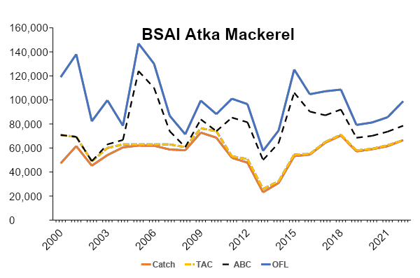
Catch, TAC, ABC, and OFL
Notes:
Time series with highlights of trends and any issues (e.g., overages, data issues, discards), provide regional breakdown time series or spatial distribution maps only if relevant to data interpretation or model evaluation

Slide 5
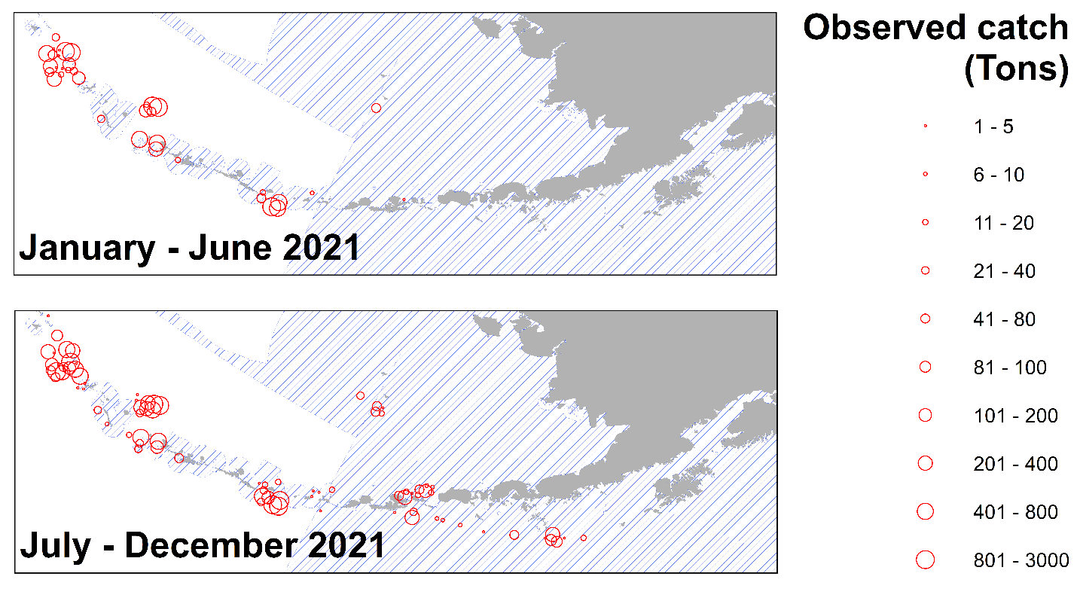
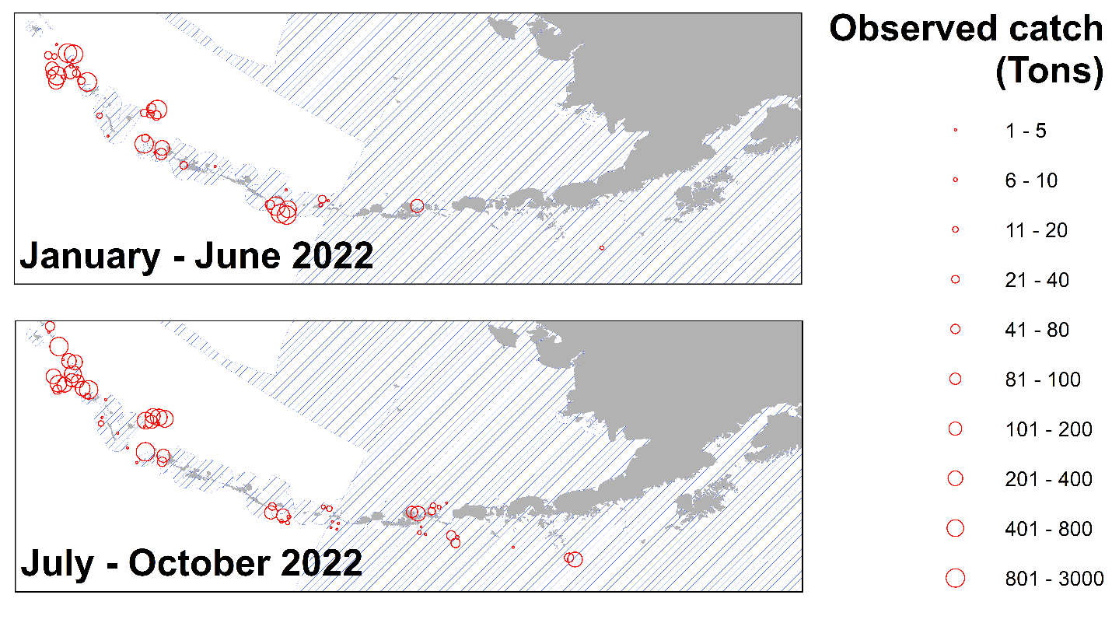
Observed Catches of Atka Mackerel

Slide 6
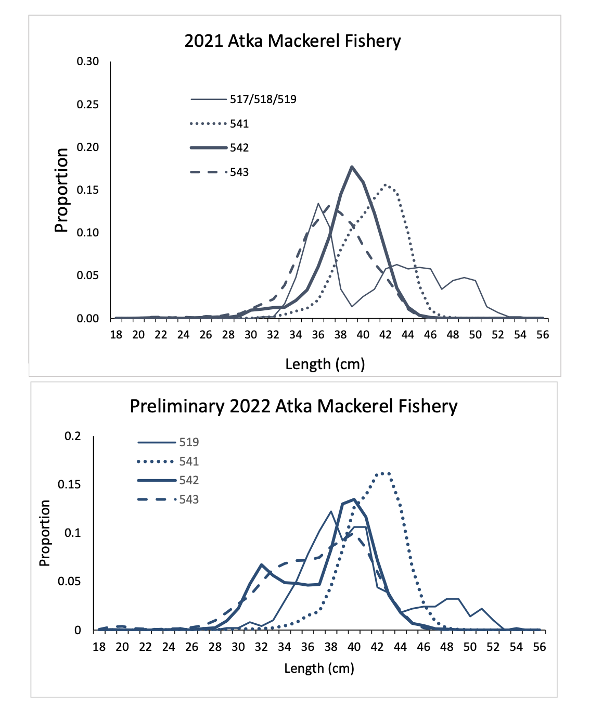
Fishery Length Compositions

Slide 7
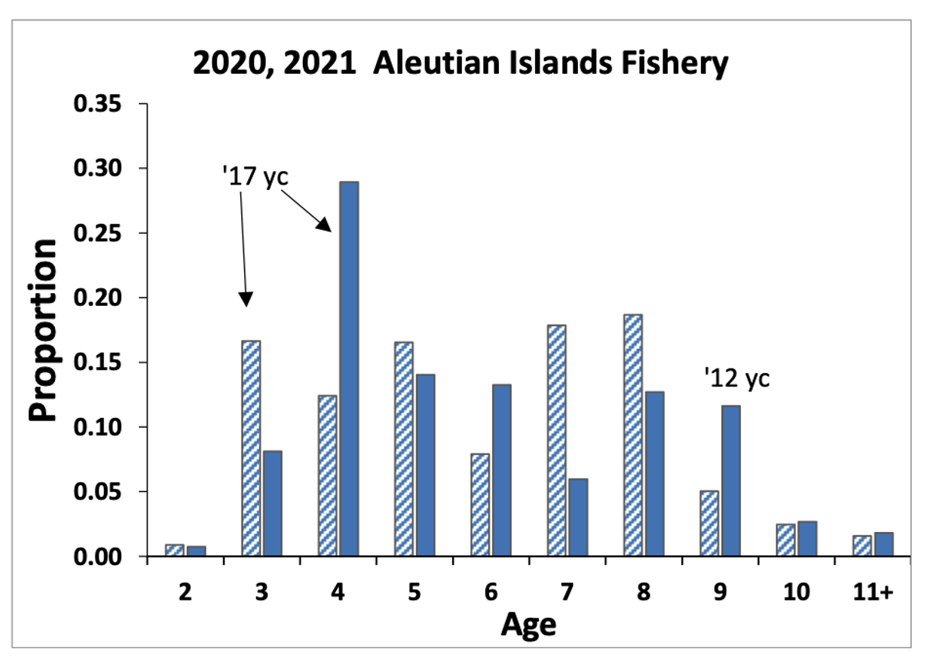
Fishery Age Composition
‘12-’13 yc
Notes:
Graphs of age compositions by sex (if relevant) over time followed by size compositions by sex (if relevant) over time with highlights of trends and any issues (e.g., tracking cohorts through time, shifts in size distributions, plus age group)

Slide 8
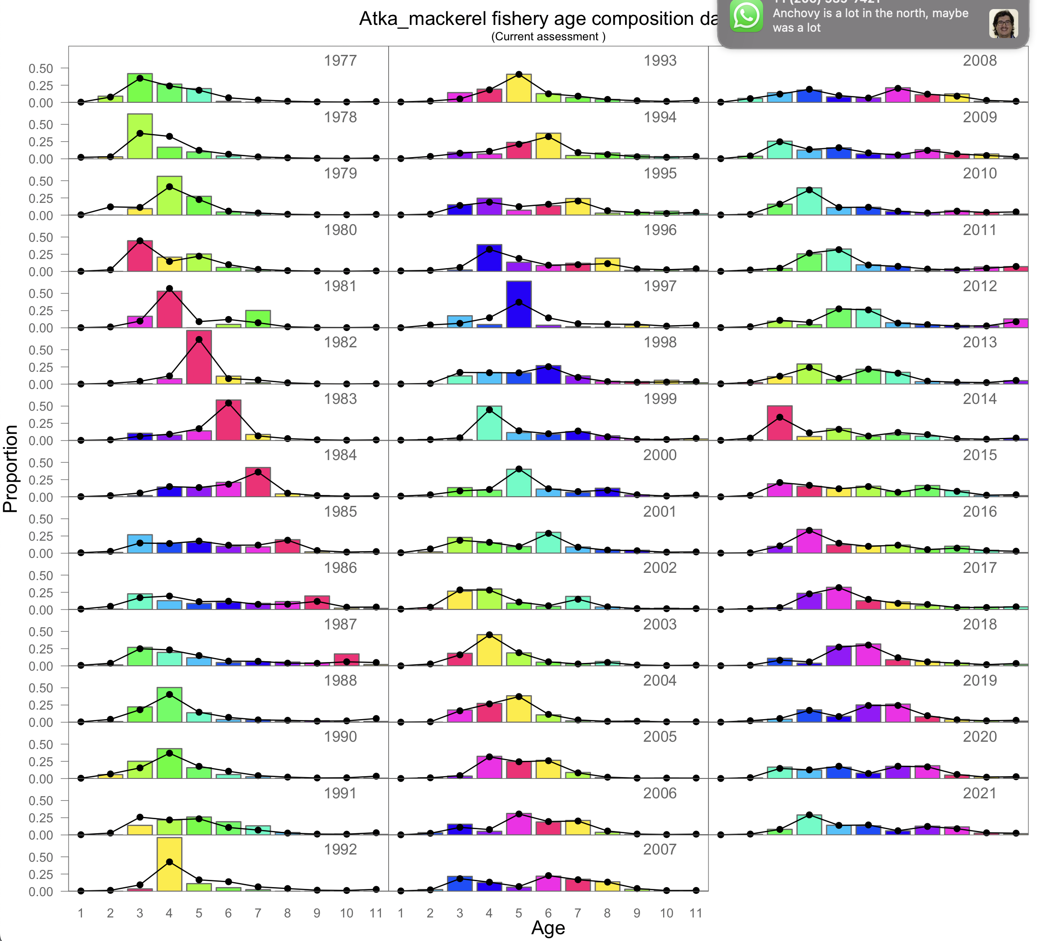
Fishery Age Composition
2012 yc
2013 yc
2017 yc
Notes:
Graphs of age compositions by sex (if relevant) over time followed by size compositions by sex (if relevant) over time with highlights of trends and any issues (e.g., tracking cohorts through time, shifts in size distributions, plus age group)

Slide 9
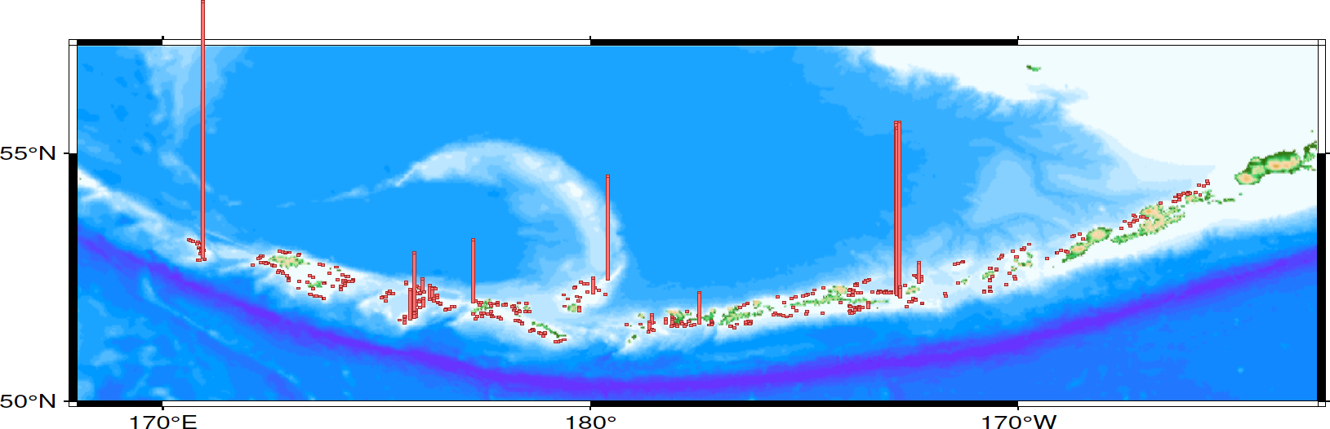
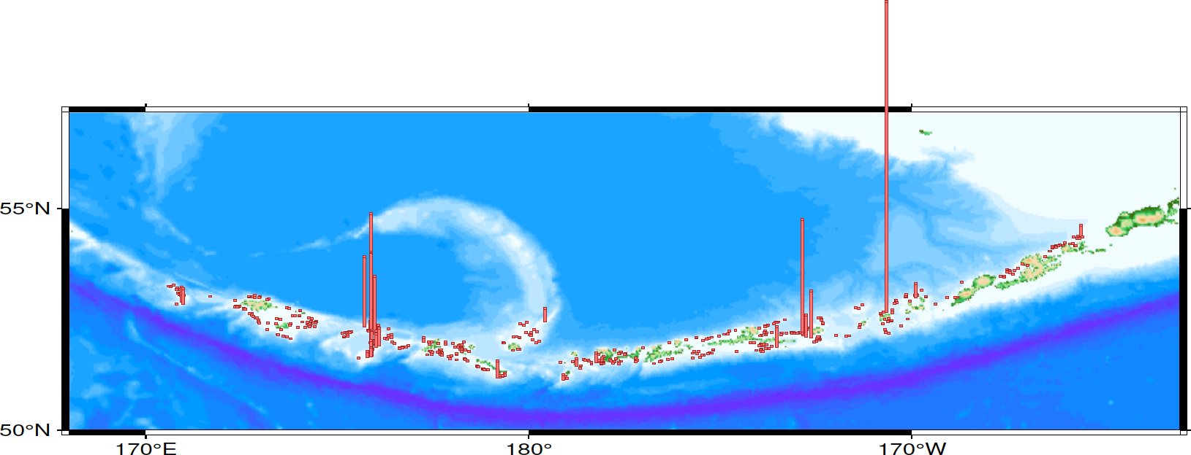
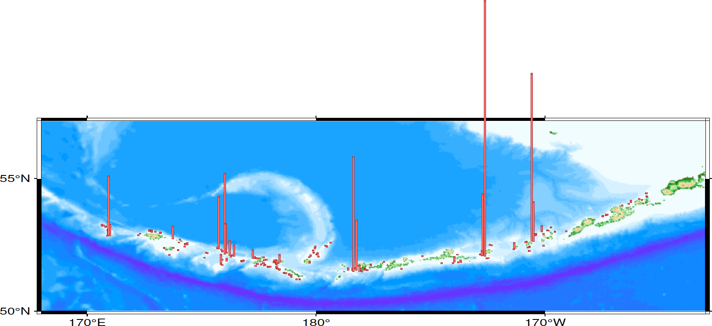
AI Bottom Trawl Survey CPUE
2016
2018
2022
Notes:
List or table with estimates with highlights of trends and any issues (e.g., different natural mortality estimates, changes in maturity)

Slide 10
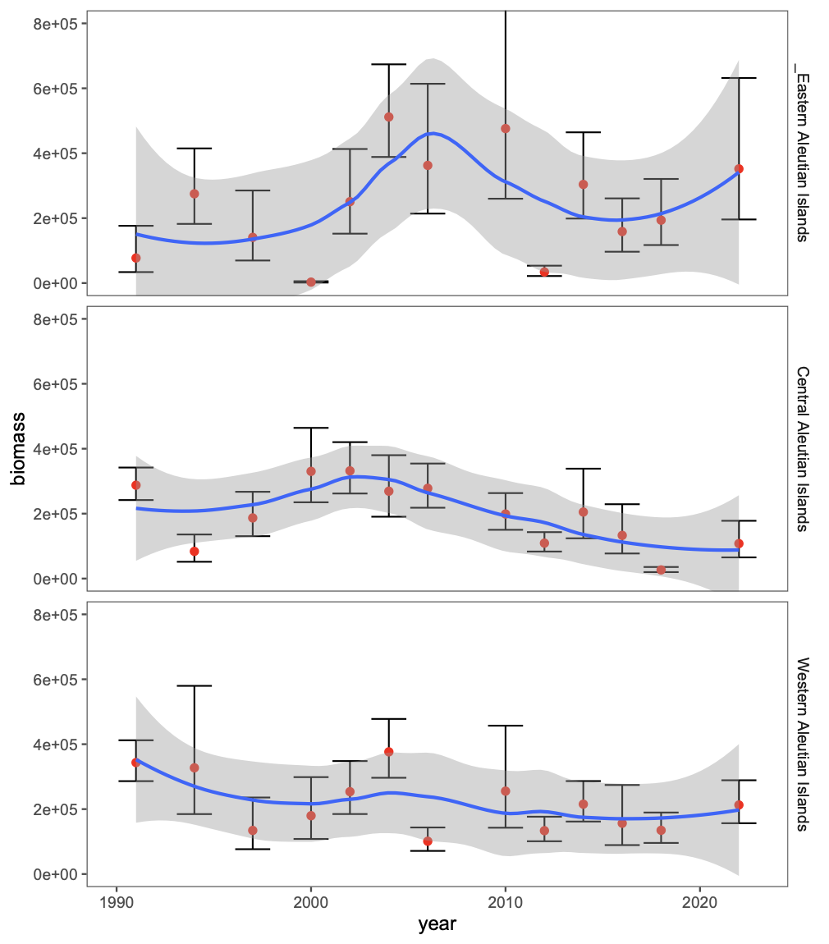
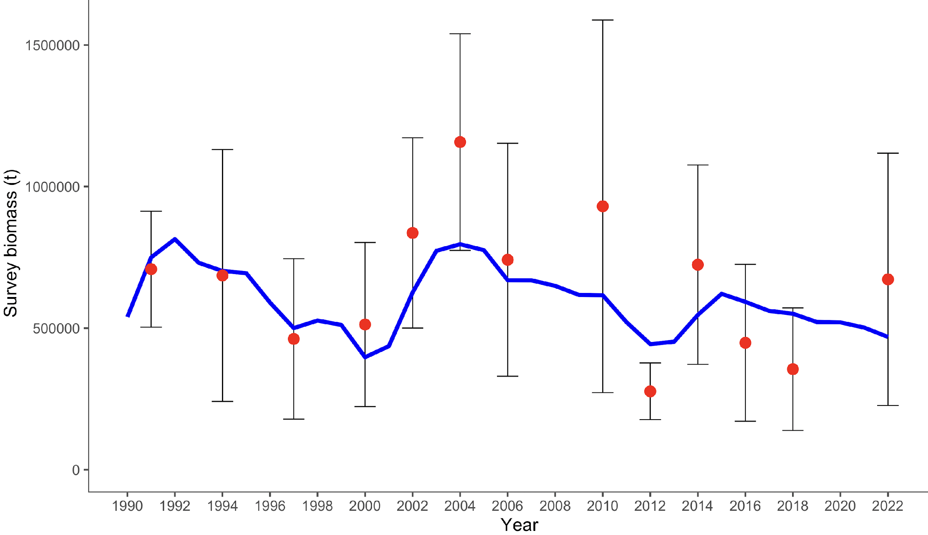
Survey - Aleutian Islands Bottom Trawl
200% Increase
in the 100-200 m depth strata
89% increase
Notes:
Time series with highlights of trends and any issues (e.g., survey method changes, data issues), use separate slides for different survey time series, provide regional breakdown time series or spatial distribution maps only if relevant to data interpretation or model evaluation, may include exploratory surveys if relevant to model interpretation, otherwise limit

Slide 11
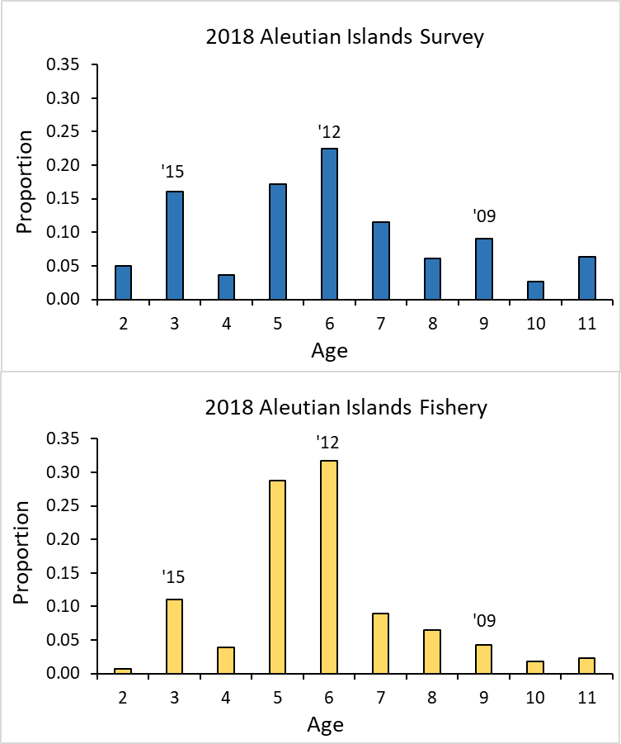
Survey Age Composition - AI Bottom Trawl
Notes:
Graphs of age compositions by sex (if relevant) over time followed by size compositions by sex (if relevant) over time with highlights of trends and any issues (e.g., tracking cohorts through time, shifts in size distributions, plus age group)

Slide 12
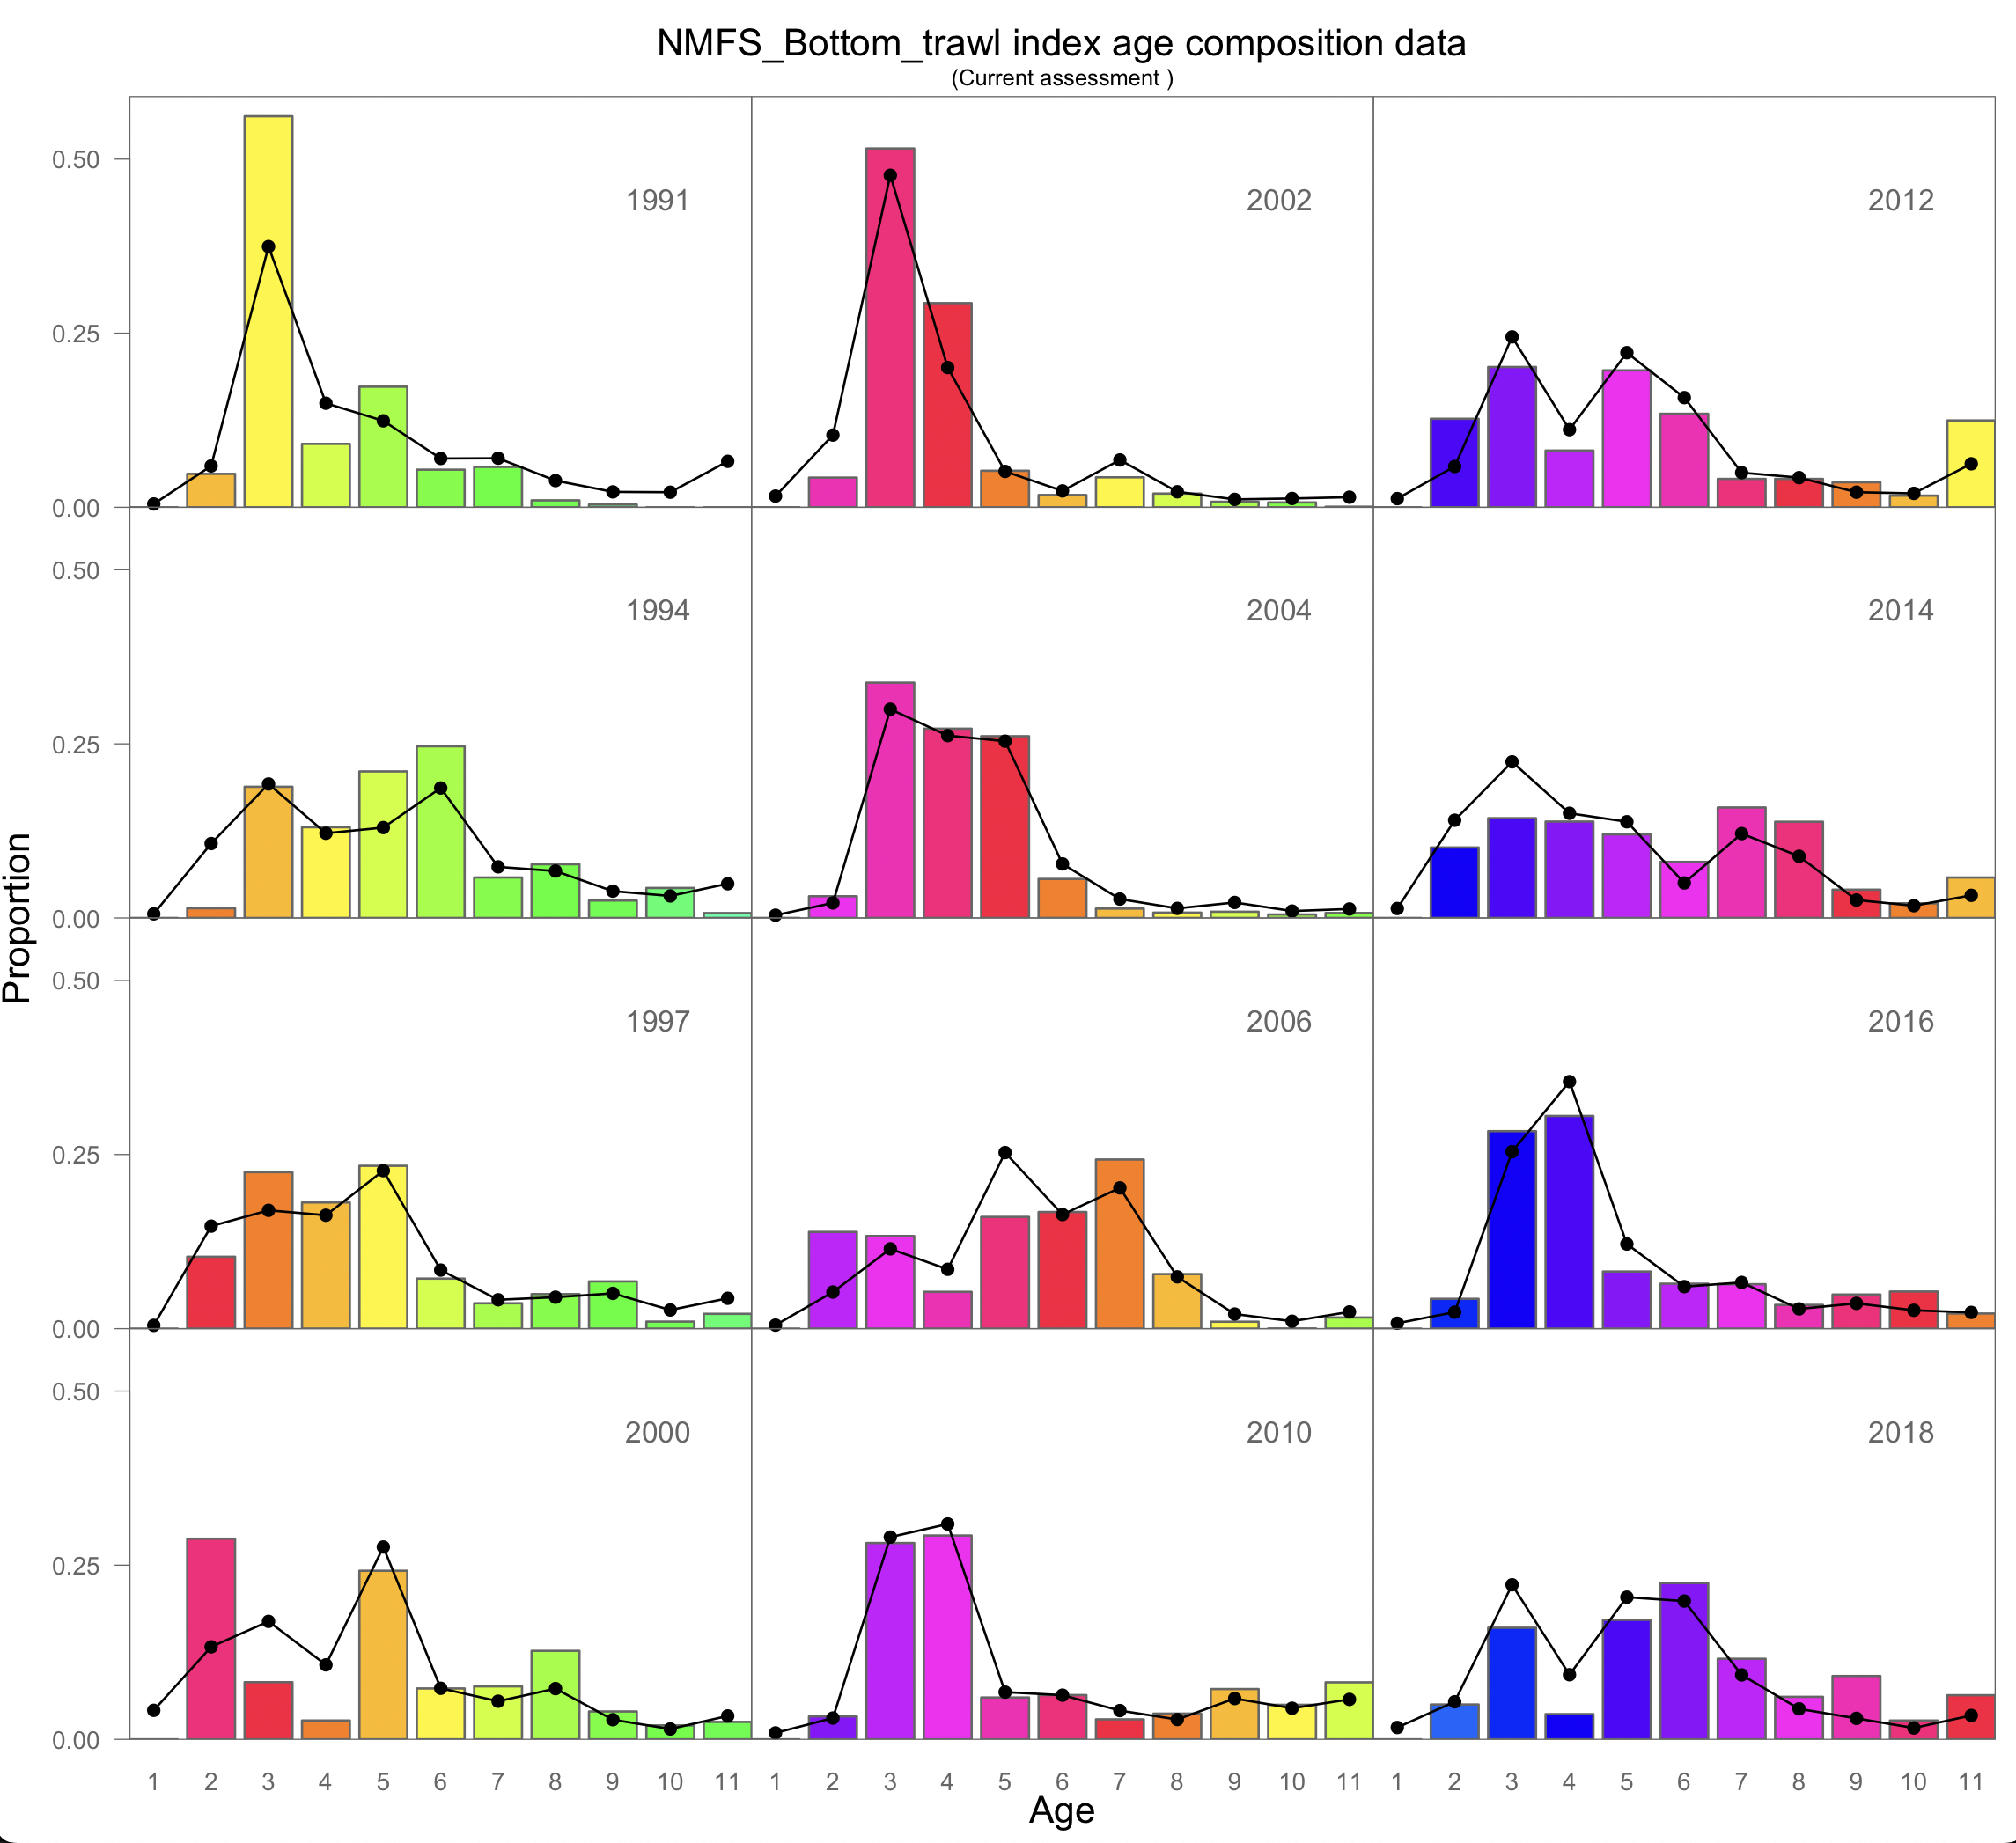
Survey Age Composition - AI Bottom Trawl
Notes:
Graphs of age compositions by sex (if relevant) over time followed by size compositions by sex (if relevant) over time with highlights of trends and any issues (e.g., tracking cohorts through time, shifts in size distributions, plus age group)

Slide 13
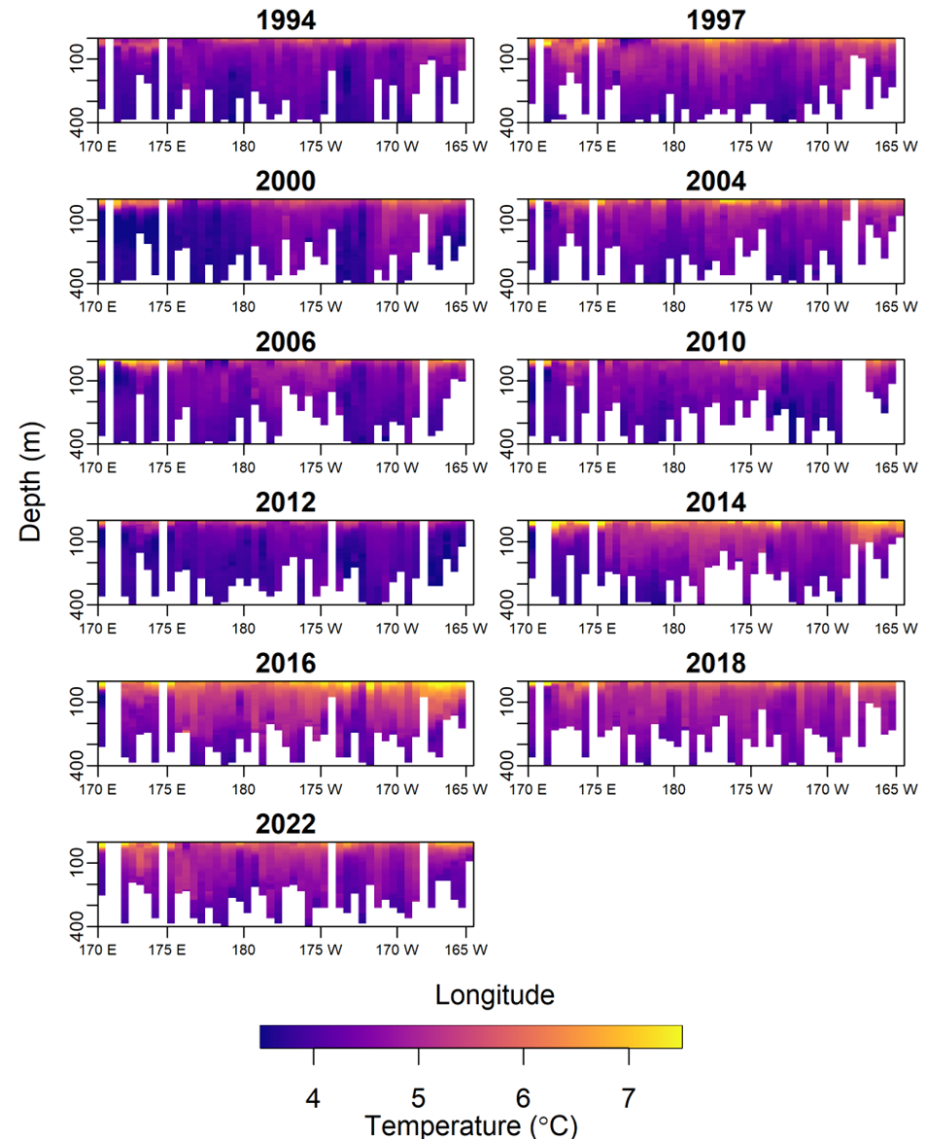
Bottom Temperature
Ave. bottom temp. 2022 ≈ 2018
2022 ave. bottom temp. above long term mean
Strong yc have been spawned in both temperature extremes
Notes:
Time series if used in the model with explanation of how used

Slide 14
Model Summary
No Model Changes
  Same model as last year (Mod16b)
  Updated catch, 2021 fishery ages, 2022 survey biomass
The est. ave. selectivity for 2017-2021 used for projections
We assume projected 2023 and 2024 catch < maxABC (SSL regulations)
Notes:
Table of base model with brief description of features and list of alternative models if relevant, NOTE: do not show models not being evaluated

Slide 15
Model Fit – Fishery Age Composition
Notes:
Should include graphs of model fit to time series and compositions shown in the Data Summary section, preferably in the same order (e.g., Model Fit - Catch, then Model Fit - Fishery Age Composition,...), may include convergence or goodness of fit statistics, if evaluating multiple models show fit of all models evaluated for time series and compositions, highlight any lack of fit, may provide likelihood comparison table

Slide 16
Model Fit – Survey Biomass
200% Increase
in the 100-200 m depth strata
89% increase
Notes:
Time series with highlights of trends and any issues (e.g., survey method changes, data issues), use separate slides for different survey time series, provide regional breakdown time series or spatial distribution maps only if relevant to data interpretation or model evaluation, may include exploratory surveys if relevant to model interpretation, otherwise limit

Slide 17
Model Fit - Survey Age Composition
Notes:
Should include graphs of model fit to time series and compositions shown in the Data Summary section, preferably in the same order (e.g., Model Fit - Catch, then Model Fit - Fishery Age Composition,...), may include convergence or goodness of fit statistics, if evaluating multiple models show fit of all models evaluated for time series and compositions, highlight any lack of fit, may provide likelihood comparison table

Slide 18
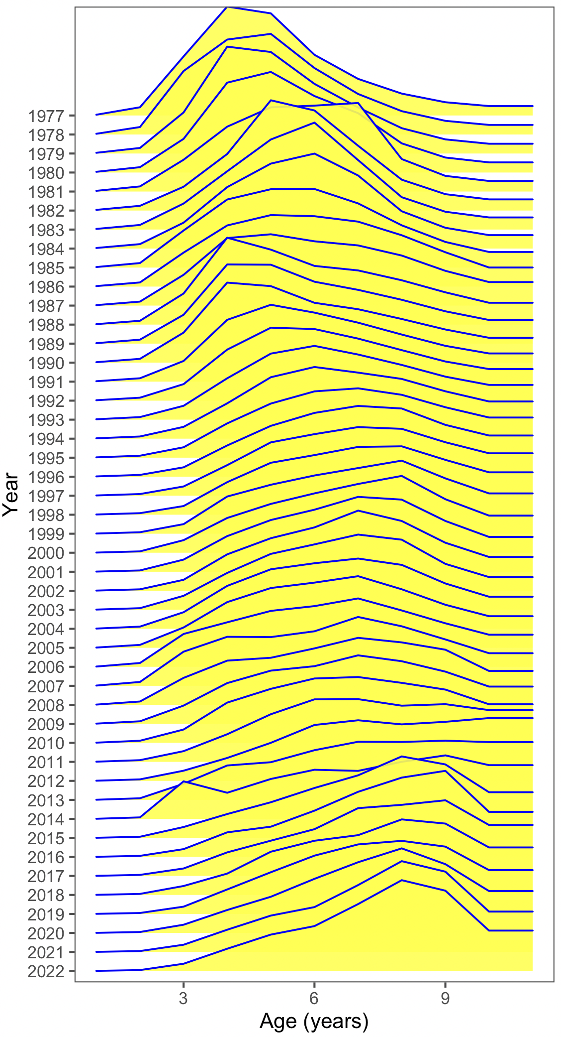
Fishery Selectivity
Notes:
Graphs of estimated selectivity curves (e.g., fishery, survey, maturity), if evaluating multiple models include selectivity curves for all models evaluated on same graph if possible, highlight author recommended model

Slide 19
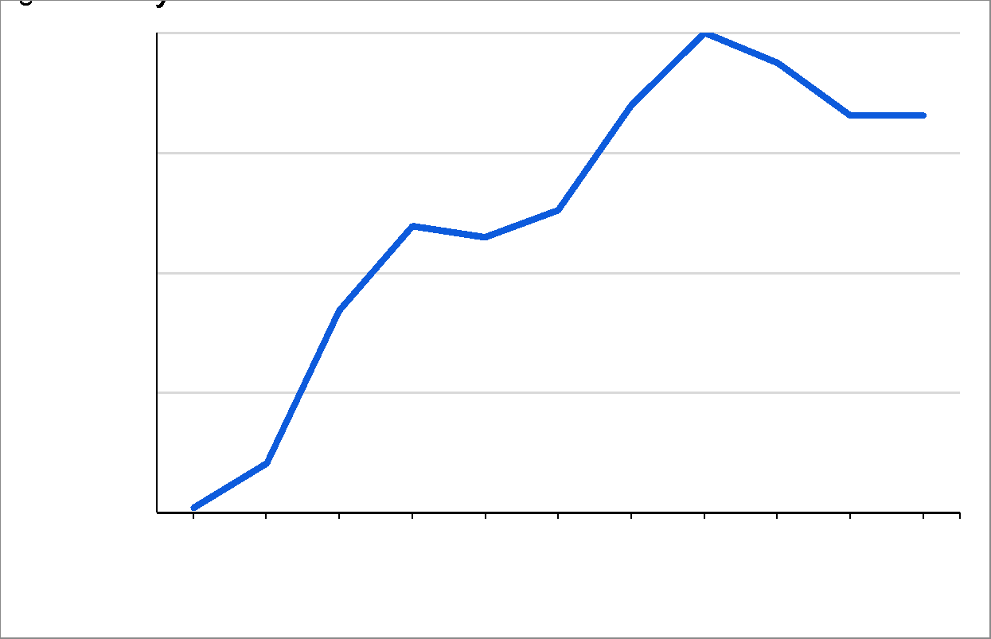
Survey Selectivity

Slide 20
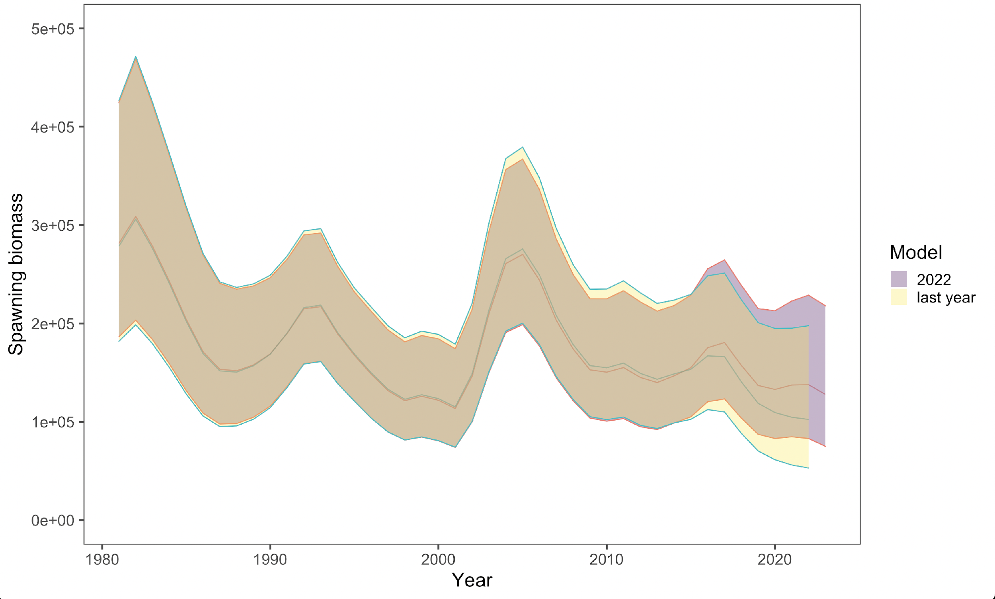
Time Series - Spawning Stock Biomass
Notes:
Graph to include at minimum estimates of Spawning Stock Biomass, Total Biomass, Recruitment, Fishing Mortality (e.g., Time Series - Spawning Stock Biomass), if evaluating multiple models include time series for all models evaluated on same graph, highlight author recommended model

Slide 21
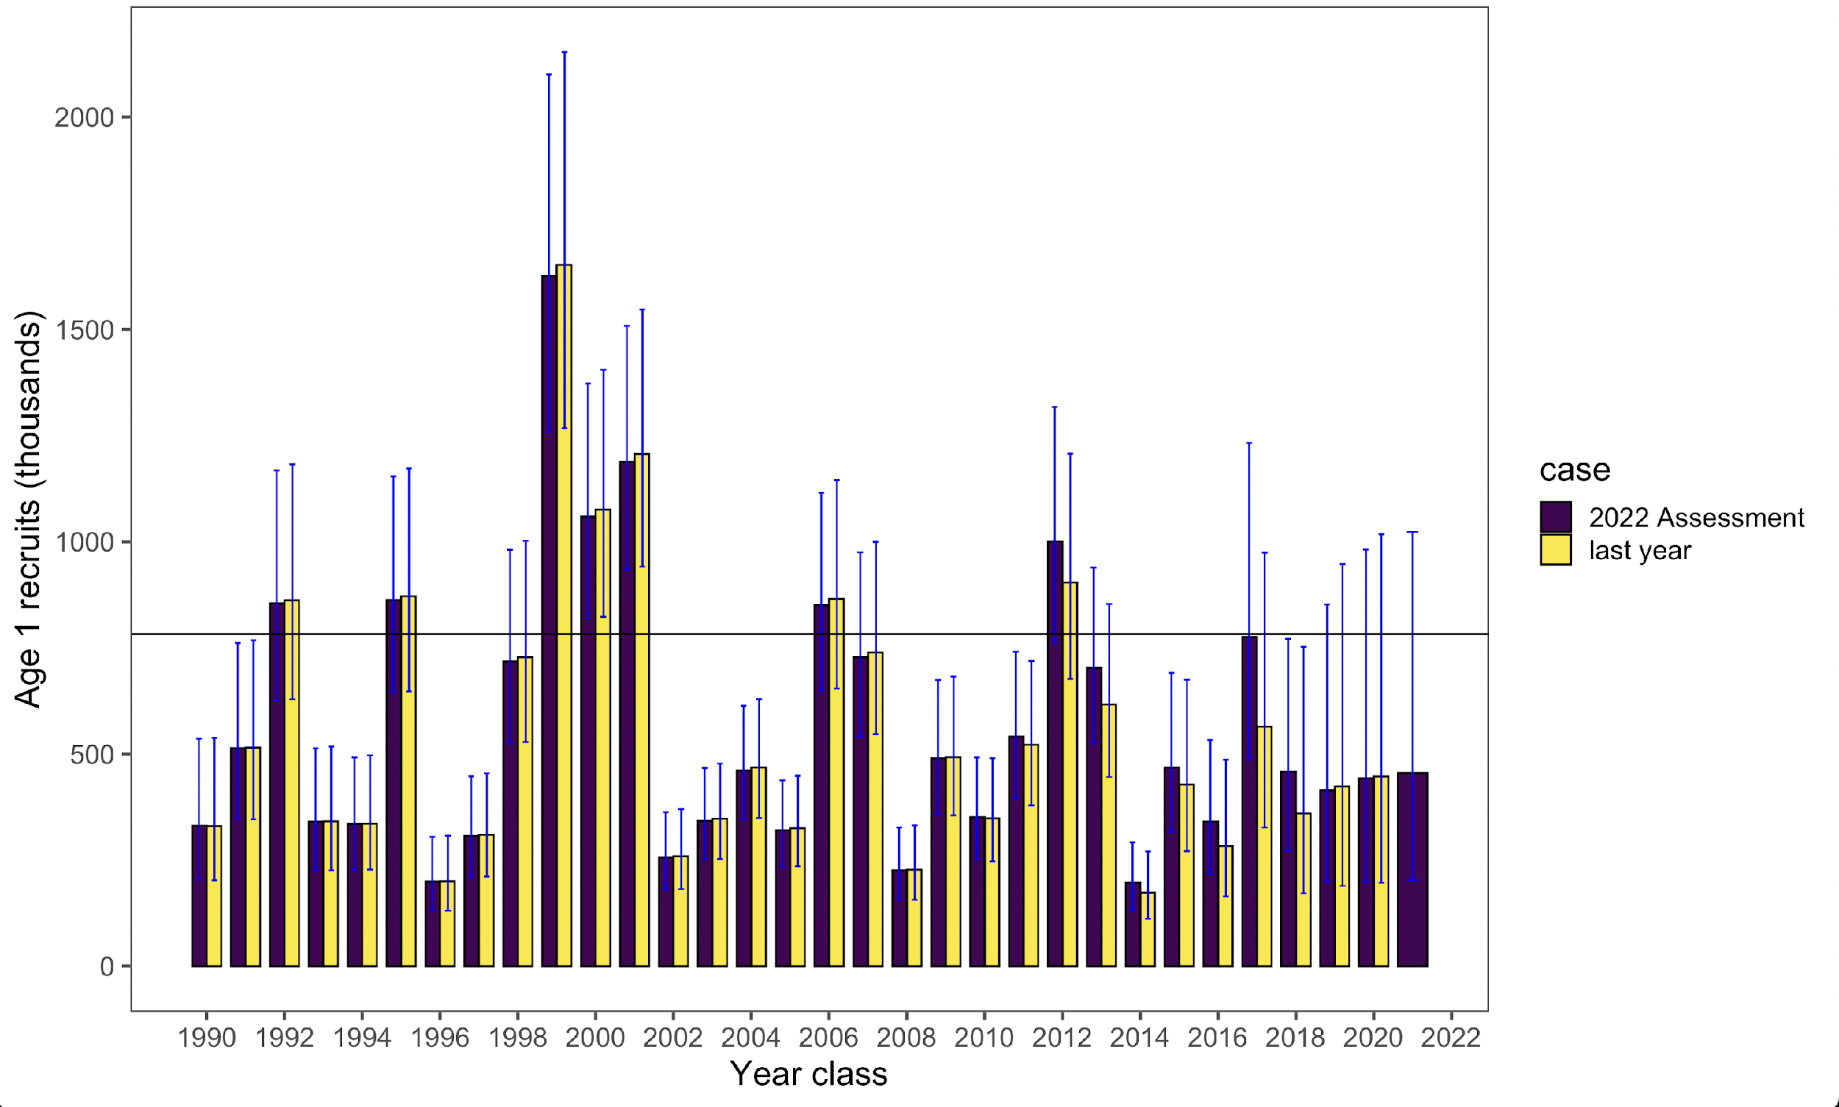
Time Series – Age 1 Recruitment
Notes:
Graph to include at minimum estimates of Spawning Stock Biomass, Total Biomass, Recruitment, Fishing Mortality (e.g., Time Series - Spawning Stock Biomass), if evaluating multiple models include time series for all models evaluated on same graph, highlight author recommended model

Slide 22
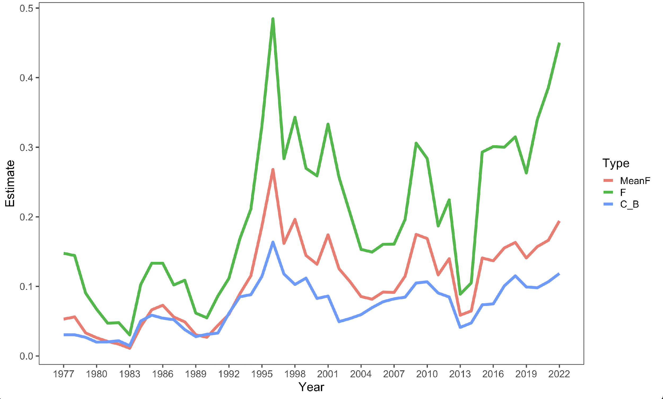
Time Series - Fishing Mortality
Notes:
Graph to include at minimum estimates of Spawning Stock Biomass, Total Biomass, Recruitment, Fishing Mortality (e.g., Time Series - Spawning Stock Biomass), if evaluating multiple models include time series for all models evaluated on same graph, highlight author recommended model

Slide 23
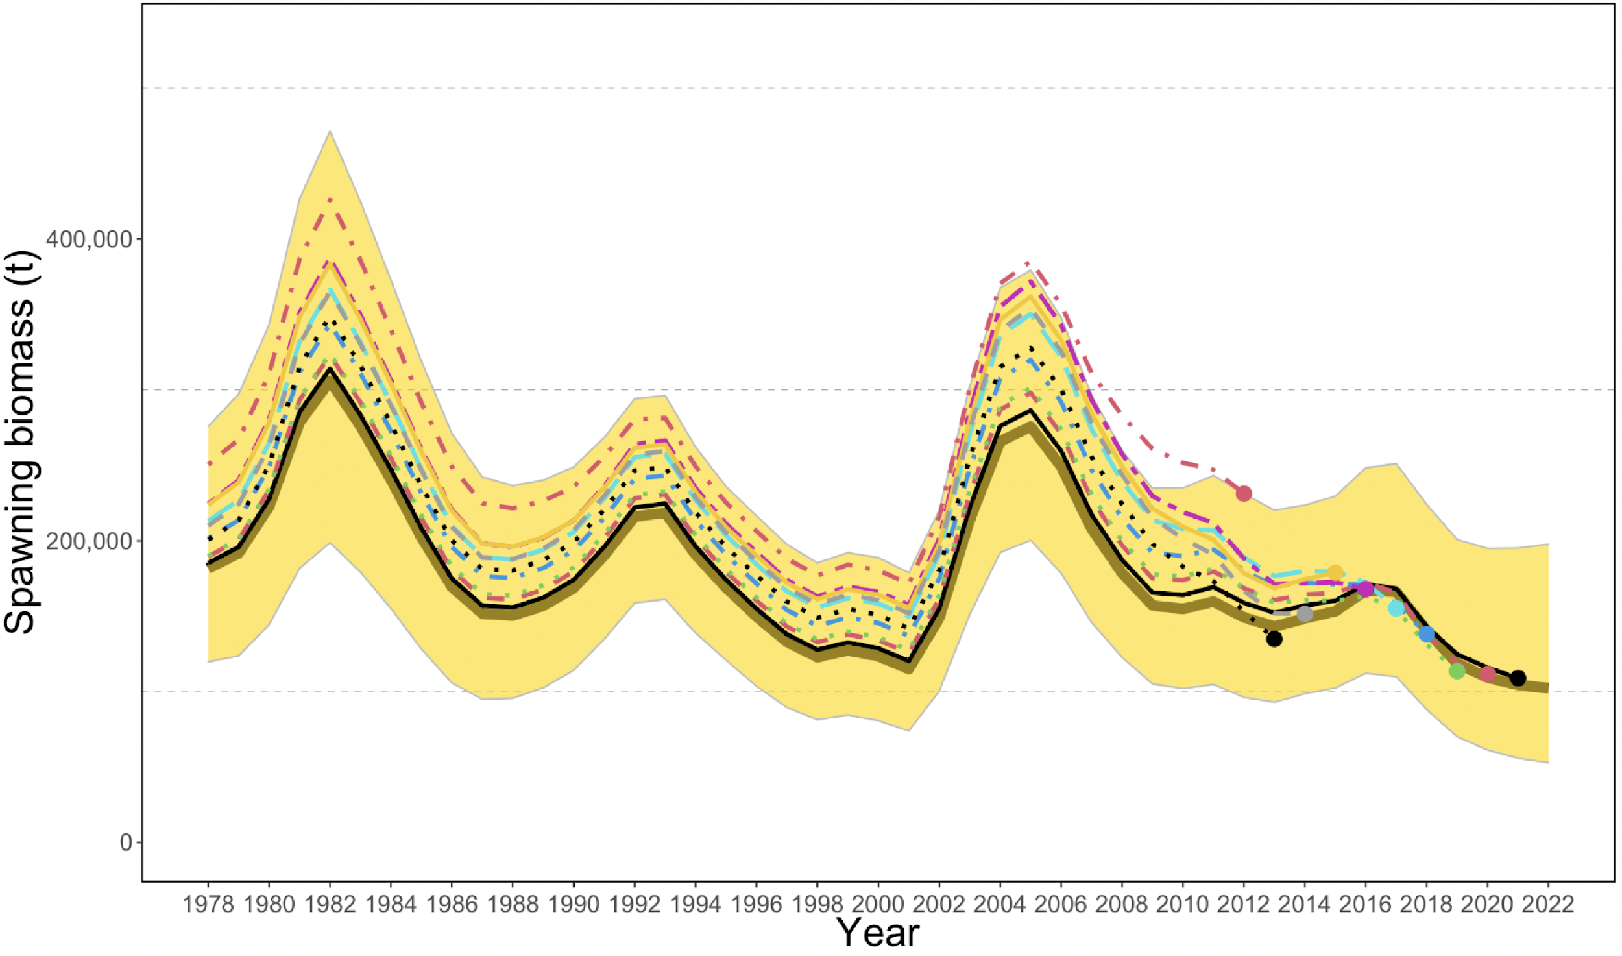
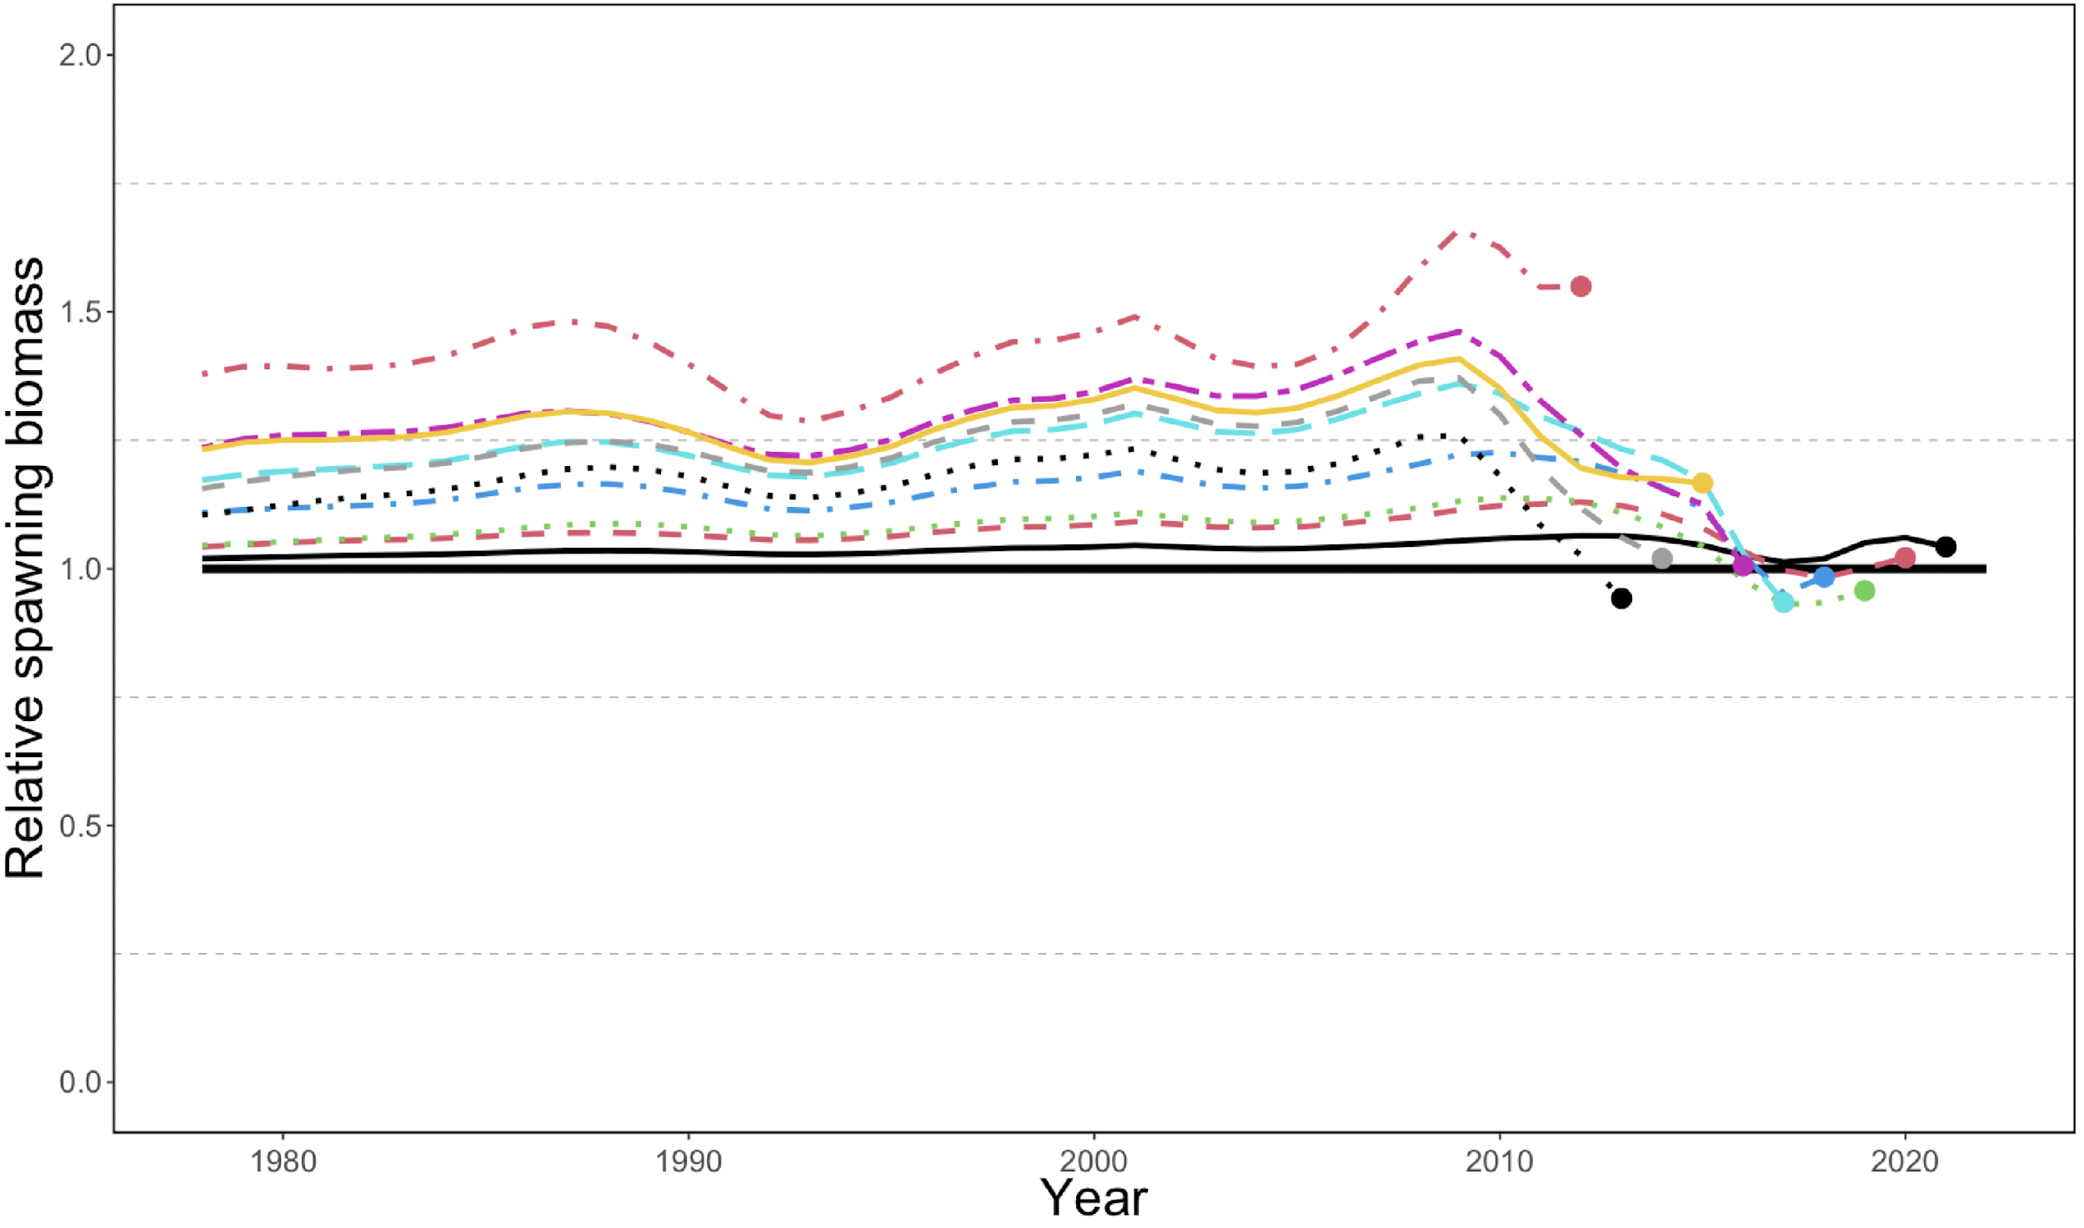
Retrospective
Mohn’s rho = 0.062
Notes:
Graph of 10 year peel with Mohns rho estimate, if evaluating multiple models include retrospective graph and Mohns rho estimate for base and author recommended model

Slide 24
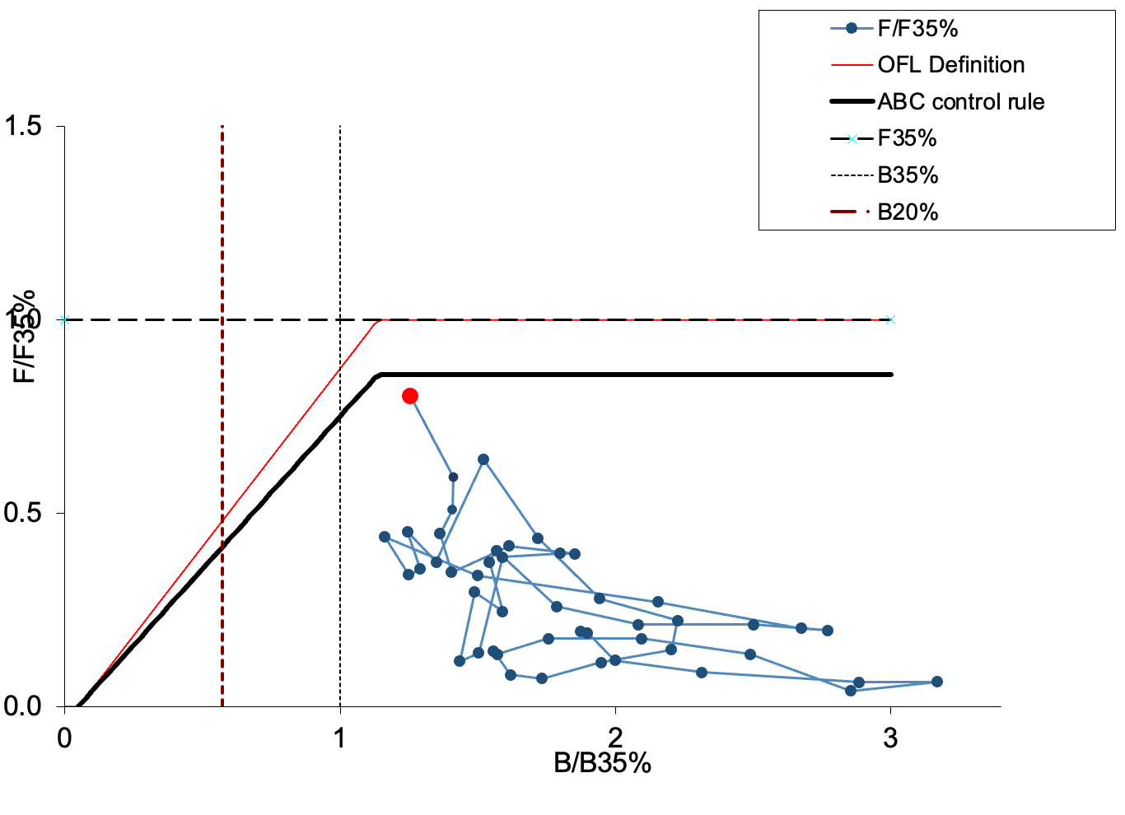
Phase Plane
Notes:
Plot of fishing mortality rate relative to F35% and female spawning biomass relative for B 35% for status

Slide 25
Projection Assumptions
The estimated average selectivity for 2017-2021 was used for projections.
We assume that approximately 85% of the BSAI-wide ABC is likely to be taken under the revised Steller Sea Lion Reasonable and Prudent Alternatives (SSL RPAs) implemented in 2015. This percentage was applied to the 2023 and 2024 maximum permissible ABCs, and those reduced amounts were assumed to be caught in order to estimate the 2023 and 2024 ABCs and OFL values.
Notes:
Model graph of Spawning Stock Biomass with B40% and B35% reference lines

Slide 26
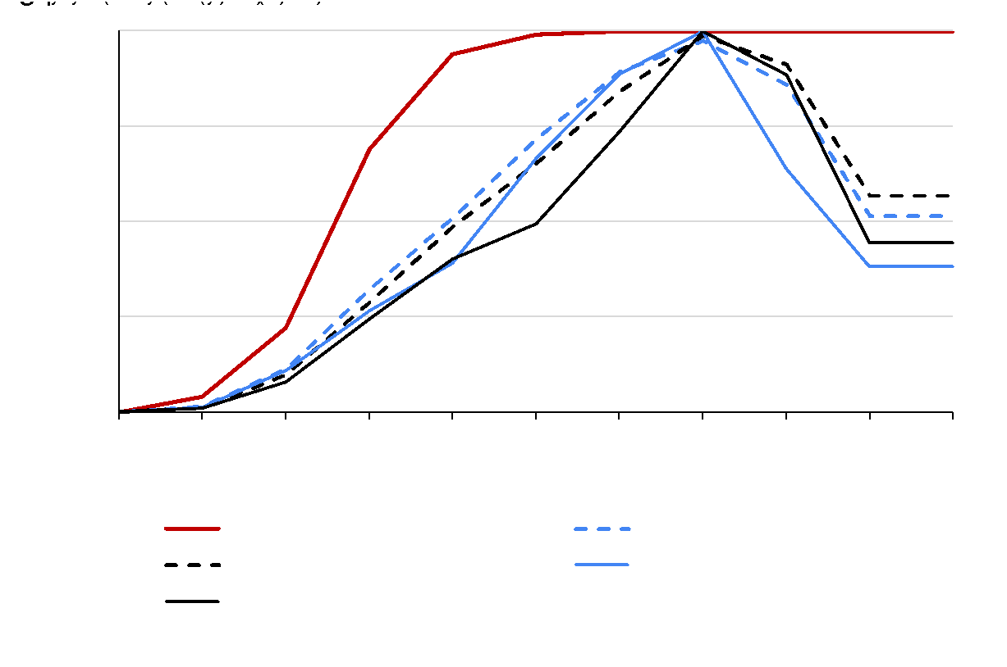
Projection Assumptions
Notes:
Model graph of Spawning Stock Biomass with B40% and B35% reference lines

Slide 27
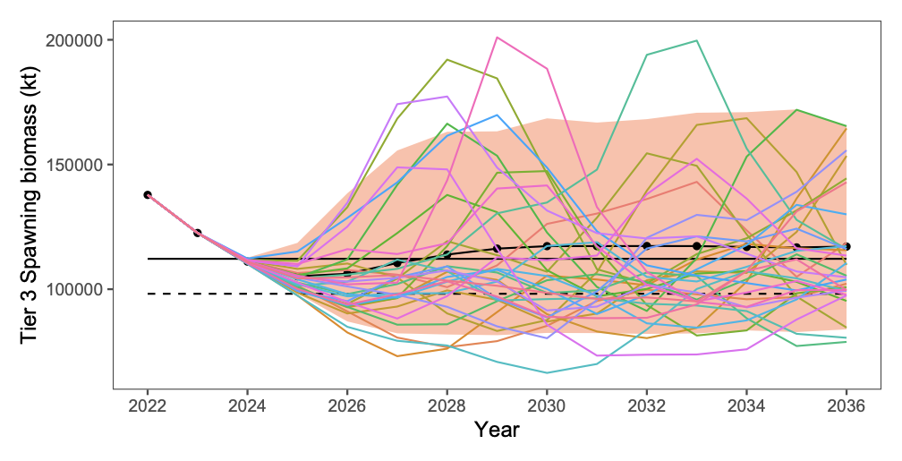
Projection
Notes:
Model graph of Spawning Stock Biomass with B40% and B35% reference lines

Slide 28
Risk Table
Assessment-related considerations | Population dynamics considerations | Environmental/ ecosystem considerations | Fishery Performance considerations
Level 2: Substantially increased assessment uncertainty/ unresolved issues. | Level 1: Stock trends are typical for the stock; recent recruitment is within normal range. | Level 2: Some indicators showing an adverse signals relevant to the stock but the pattern is not consistent across all indicators. | Level 1: No apparent fishery/resource-use performance and/or behavior concerns
The assessment-related concern rated as Level 2. Substantially increased assessment uncertainty/unresolved issues due to the loss of the 2008 and 2020 surveys, and variability in the survey biomass estimates, particularly for area specific estimates.
The population dynamics-related concern rated as Level 1. Stock trends are typical for the stock and expected given the stock dynamics; recent recruitment is within the lower end of the normal range and the magnitude of the 2012, 2013, 2015 and 2017 year classes has increased in recent assessments.
Notes:
Summary table with brief summary of justification text or plots for selected levels of risk, if have ESP for stock and presentation preceding then can simply reference ESP graphs

Slide 29
Risk Table
Assessment-related considerations | Population dynamics considerations | Environmental/ ecosystem considerations | Fishery Performance considerations
Level 2: Substantially increased assessment uncertainty/ unresolved issues. | Level 1: Stock trends are typical for the stock; recent recruitment is within normal range. | Level 2: Some indicators showing an adverse signals relevant to the stock but the pattern is not consistent across all indicators. | Level 1: No apparent fishery/resource-use performance and/or behavior concerns
Environmental/ecosystem considerations were rated as Level 2. Some indicators showing an adverse signal relevant to the stock but the pattern is not consistent across all indicators. This is an increase relative to last year due to sustained potentially adverse environmental conditions, but note that not all indicators show a consistent pattern.
Fishery performance-related concern rated as Level 1. There are no apparent fishery/resource-use performance and/or behavior concerns.
Notes:
Summary table with brief summary of justification text or plots for selected levels of risk, if have ESP for stock and presentation preceding then can simply reference ESP graphs

Slide 30
Risk Table
Assessment-related considerations | Population dynamics considerations | Environmental/ ecosystem considerations | Fishery Performance considerations
Level 2: Substantially increased assessment uncertainty/ unresolved issues. | Level 1: Stock trends are typical for the stock; recent recruitment is within normal range. | Level 2: Some indicators showing an adverse signals relevant to the stock but the pattern is not consistent across all indicators. | Level 1: No apparent fishery/resource-use performance and/or behavior concerns
The Level 2 scores for Assessment-related considerations and Environmental/ecosystem considerations indicates that continued monitoring of indicators is important, but there are no substantially increased concerns. Overall, we believe the scores and supporting information do not support setting the ABC below the maximum permissible.
Notes:
Summary table with brief summary of justification text or plots for selected levels of risk, if have ESP for stock and presentation preceding then can simply reference ESP graphs

Slide 31
Harvest Recommendation
Quantity | As estimated or specified last year for: |  | As estimated or recommended this year for:
 | 2022 | 2023 | 2023 | 2024
M (natural mortality rate) | 0.30 | 0.30 | 0.30 | 0.30
Tier | 3b | 3b | 3a | 3b
Projected total (age 1+) biomass (t) | 554,490 | 570,080 | 615,027 | 606,661
Projected Female spawning biomass | 109,360 | 103,330 | 122,541 | 111,122
B_{100%} | 278,670 | 278,670 | 280,456 | 280,456
B_{40%} | 111,470 | 111,470 | 112,182 | 112,182
B_{35%} | 97,540 | 97,540 | 98,160 | 98,160
F_{OFL} | 0.65 | 0.61 | 0.76 | 0.65
maxF_{ABC} | 0.54 | 0.51 | 0.61 | 0.56
F_{ABC} | 0.54 | 0.51 | 0.61 | 0.56
OFL (t) | 91,870 | 84,440 | 118,787 | 101,188
maxABC (t) | 78,510 | 71,990 | 98,588 | 86,464
ABC (t) | 78,510 | 71,990 | 98,588 | 86,464
Status | As determined this year for: |  | As determined this year for:
 | 2020 | 2021 | 2022 | 2023
Overfishing | No | n/a | No | n/a
Overfished | n/a | No | n/a | No
Approaching overfished | n/a | No | n/a | No
2023 ABC 26% higher
Notes:
Summary table with last year and recommendation for this year values, highlight ABC and OFL

Slide 32
Apportionment
 | 2022 Random Effects Model
541 | 56%
542 | 13%
543 | 31%
The current 2022 RE Central area apportionment represents a 63% decrease relative to the 2016 RE Central area apportionment.
Notes:
Table where applicable, including random effects model graphs and final apportionment table

Slide 33
Apportionment
 |  | Weighted Average (Recommended)
 | Survey Year |  |  |  |  | 2023 & 2024 Apportionment | 2023 | 2024
 | 2014 | 2016 | 2018 | 2022 |  |  | ABC | ABC
541 | 42% | 35% | 38% | 52% |  | 0.44 | 43,280 | 37,958
542 | 28% | 30% | 7% | 16% |  | 0.18 | 17,351 | 15,218
543 | 30% | 35% | 55% | 39% |  | 0.8 | 38,956 | 33,289
Weights | 8 | 12 | 18 | 27 |  | 1.00
Total ABC |  |  |  |  |  |  | 98,588 | 86,464
Notes:
Table where applicable, including random effects model graphs and final apportionment table

Slide 34

QUESTIONS?
CONTACTS:
SANDRA.LOWE@NOAA.GOV

