Slide 1
Update on BSAI Blackspotted –Rougheye Assessment
Paul Spencer and Jim Ianelli
Alaska Fisheries Science Center

Slide 2
Objectives
Discuss initial responses to Plan Team and SSC comments
Present modeling options for 2022 assessment

Slide 3
SSC Comments, Dec 2020
Depths of survey samples, trends by depth
Spatial overlap of fishery and survey effort
Explore “other” survey data (NMFS longline, IPHC longline, ADF&G survey)
Value of M are “very high”
Shifts of fishing effort to shallower depths
Have changes in fleet behavior affected fishery age/size compositions?

Slide 4
1a) Survey sample sizes
Survey sampling effort is relatively evenly distributed between the WAI, CAI, and EAI, with less effort in the SBS
The 100m – 200m depth zones receives the most sampling effort

Slide 5
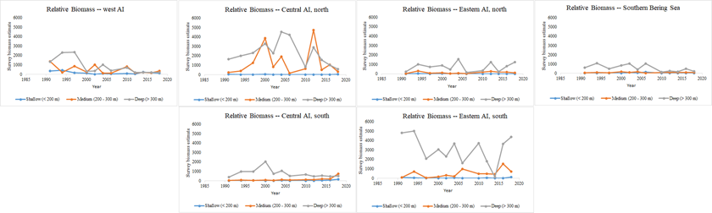
Survey biomass trends, by depth and area
In most areas, the 300m – 500m depth zone has the most biomass
Biomass is currently low in the WAI and northern part of the CAI

Slide 6
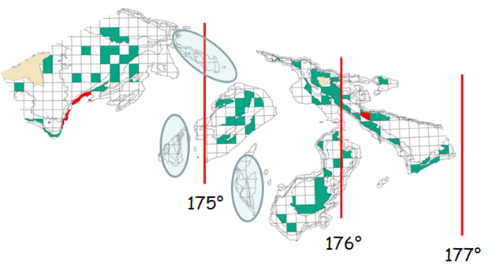
Spatial overlap of fishery and survey
Green = successfully trawled stations, red = untrawlable stations
The three ellipses are areas with fishing effort but no survey sampling

Slide 7
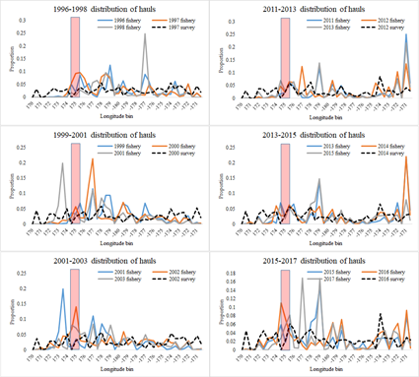
Proportion of fishery and survey hauls, by longitude
Observed fishery hauls which had positive catch of Blackspotted/rougheye rockfish

Slide 8
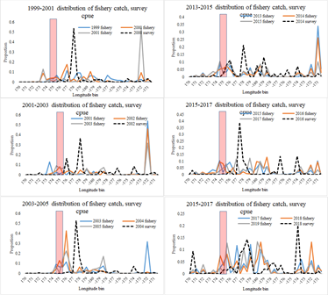
Proportion of fishery catch and survey CPUE, by longitude
Observed fishery hauls which had positive catch of Blackspotted/rougheye rockfish

Slide 9
Spatial overlap summary
We would not expect the spatial distribution of survey and fishery effort to match
Cara Hesselbach (Alaska Pacific University student) is studying spatial overlap of fishery and survey, and has recognized consistency in fishery and survey composition data.

Slide 10
Explore “other survey data” to augment abundance and size composition data
Multiple surveys in an assessment can be useful to fill in temporal gaps, or account for differential selectivity
An implicit assumption is made that each survey is an observation of a single underlying population, and that differences between survey estimates reflect sampling characteristics (catchability, selectivity) (Conn 2010)
Comparison of surveys that cover only a portion of the stock area is complicated, and could reflect different underlying population signals (Conn 2010, Peterson et al. 2021, Maunder and Piner 2017)

Slide 11
Explore “other survey data” to augment abundance and size composition data
None of the potential “other” surveys covers the entire stock area
There are substantial ecological and oceanographic differences between subareas of the Aleutian Islands
There is generally weak correlation between subarea indices of abundance (both within and between surveys)

Slide 12
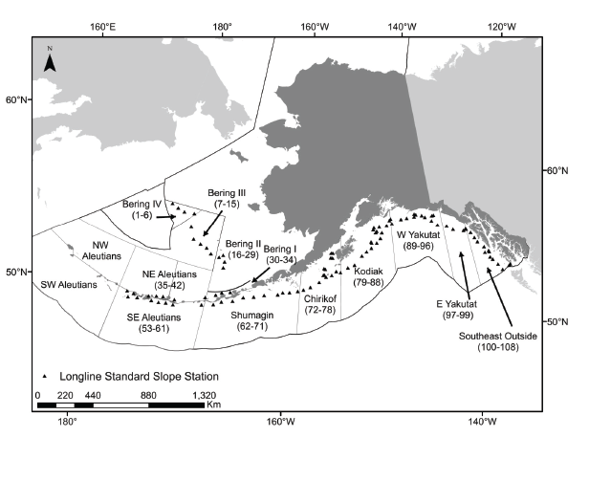
AFSC longline survey
Estimates of Relative Population Number are produced for the NW and SW areas, despite no observations
We can compare the correspondence in the areas where we do have observations
From Echave et al 2013

Slide 13
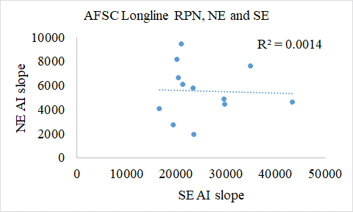
Correlation between RPNs in the NE and SE areas

Slide 14
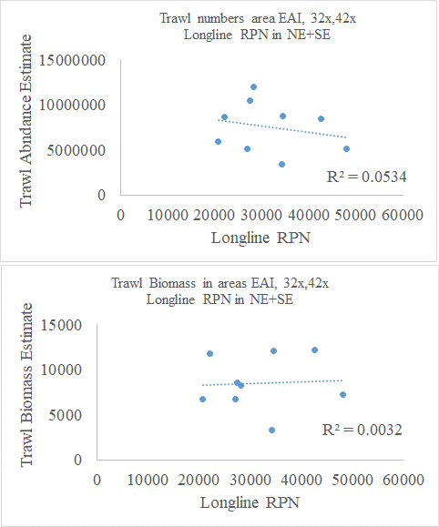
Correlation between longline RPNs (NE + SE) and AFSC trawl survey abundance (EAI and east part of CAI)

Slide 15
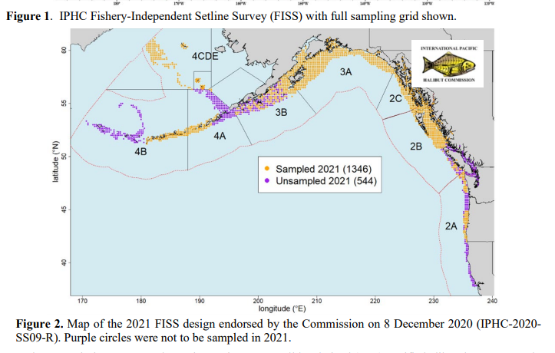
IPHC longline survey
Prior to 2020, good coverage throughout the AI
After 2020, much reduced coverage in the AI

Slide 16
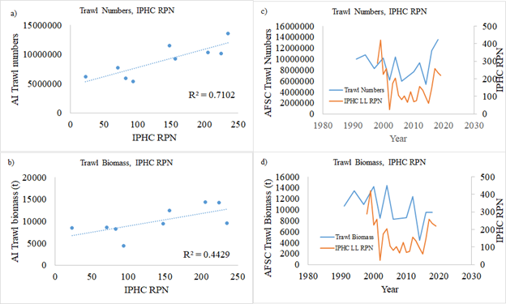
Correlation between IPHC survey and AFSC trawl survey

Slide 17
Spatial complexity in the AI
The AI Ecosystem Status Report recognizes 3 distinct ecoregions in the AI, which were developed by a team of ecosystem scientists
The west ecoregion is distinct from the central ecoregion with respect to northward flow through deep passes
The stock structure review also reviewed evidence for ecosystem structure, including spatial patterns in the biological and physical oceangraphy

Slide 18
Summary on inclusion of alternative surveys
Recommended not including the existing alternative surveys:
  Mismatch in spatial coverage relative to stock area (and existing AFSC trawl survey)
  Spatial complexity of the AI complicates interpretation of partial-area surveys
This conclusion is consistent with that for AI shortspine thornyhead

Slide 19
Natural Mortality
The M values were based on the relatively recent research of Then et al. (2015), a commonly used updated analysis
The SSC accepted this methodology in October, 2020
The M estimate of 0.049 is consistent with other north Pacific stocks
British Columbia: range of 0.035 – 0.055
US West coast: estimated at 0.042, with 95% CI of 0.035 – 0.049

Slide 20
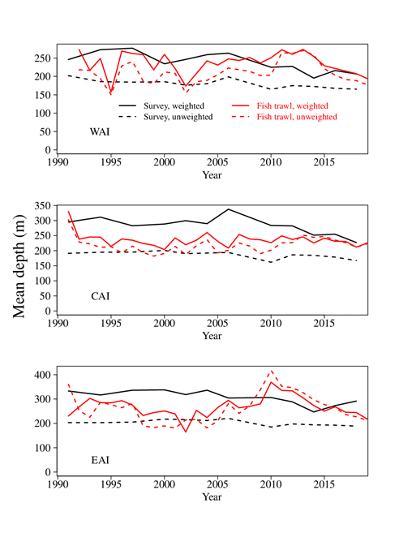
Shifts in fishery and survey depths
Mean depths of fishery effort have changed in the WAI and EAI, not so much in the CAI
Depths of capture have changed for both the fishery and survey

Slide 21
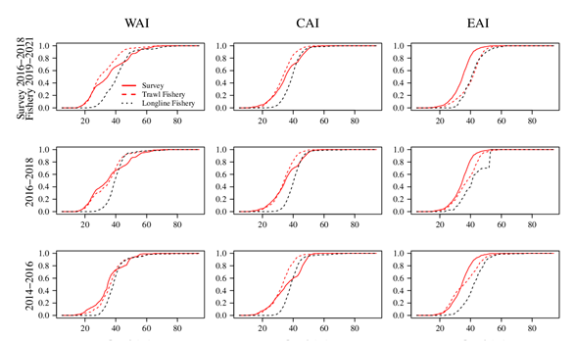
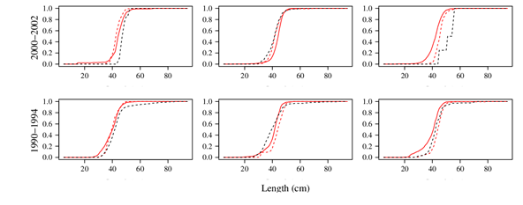
Shifts in size compositions?
The size compositions from the trawl fishery are similar to those in the trawl survey
Each has shown a decrease in size over time
WAI, 2016-2018: 34% and 29% of fishery and survey composition > 40 cm, respectively
WAI, 2002-2002: 82% and 86% of fishery and survey composition > 40 cm, respectively

Slide 22
Recommendations for 2022 assessment
We do not recommend including either the IPHC or AFSC longline surveys
Length compositions in the trawl fishery to those in the AFSC survey, indicating that increases in the proportion of small fish are not primarily a function of fishing effort
It is unclear what effort that modeling time-varying fishery effort would have on the model, although this could be explored in the 2022 assessment.

