Slide 1
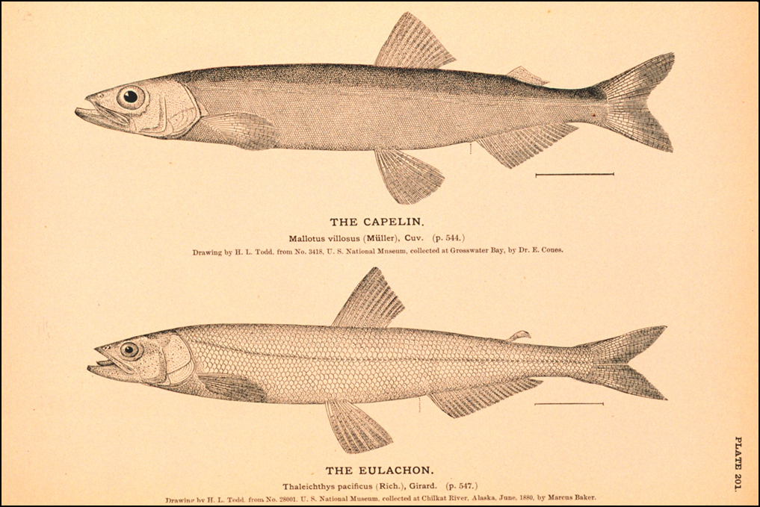

BSAI forage species report
Olav A. Ormseth, AFSC
BSAI Plan Team * September 2021

Slide 2
forage species report - overview
closer collaboration with ESR authors
aggregate forage index & synthesis statement in ESR
where to put forage-related information
timing: annual forage report?
overview
population trends
incidental catches

Slide 3
forage species overview
• members of the “forage fish group” listed in the BSAI Fishery Management Plan (FMP)
• Pacific herring Clupea pallasii
• juvenile groundfishes and salmon
• shrimps
• squids
• Arctic cod Boreogadus saida

Slide 4
EC squid management measures
Place squids in the Ecosystem Component category of the FMP
Prohibit directed fishing for squid
Establish a 20% maximum retention allowance (MRA)
Limits on processing removed in June 2021
Retain recordkeeping and recording requirements

Slide 5
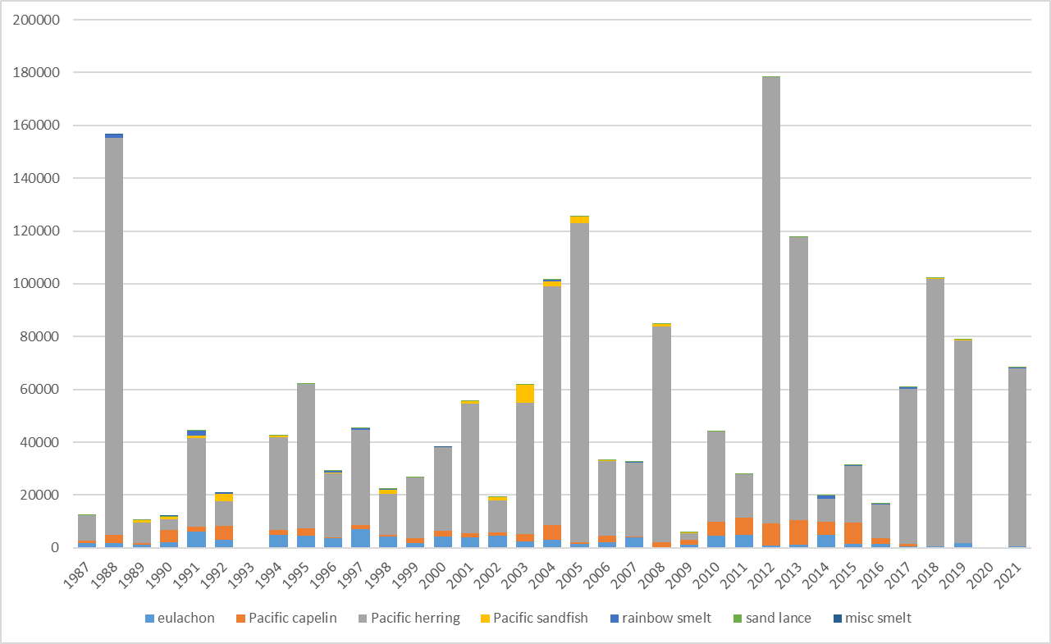
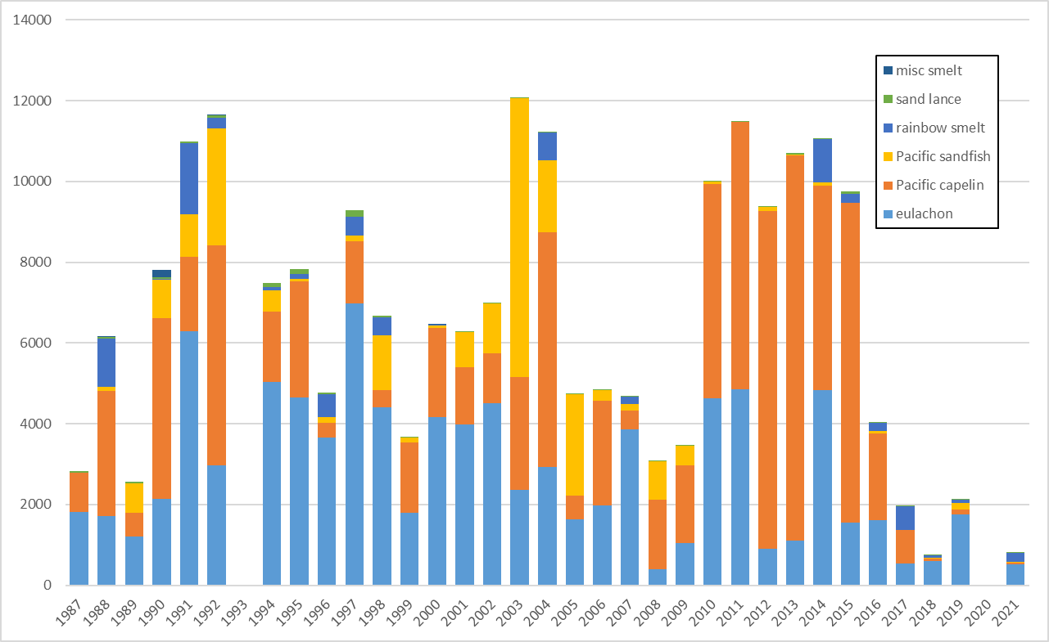
aggregate forage index in ESR
“FMP forage fish”: eulachon, capelin, other smelts, sand lances, sandfish
comprises EBS trawl survey biomass estimates
does not include herring, age-0 pollock, squids, etc.
with herring
“FMP forage” only

Slide 6
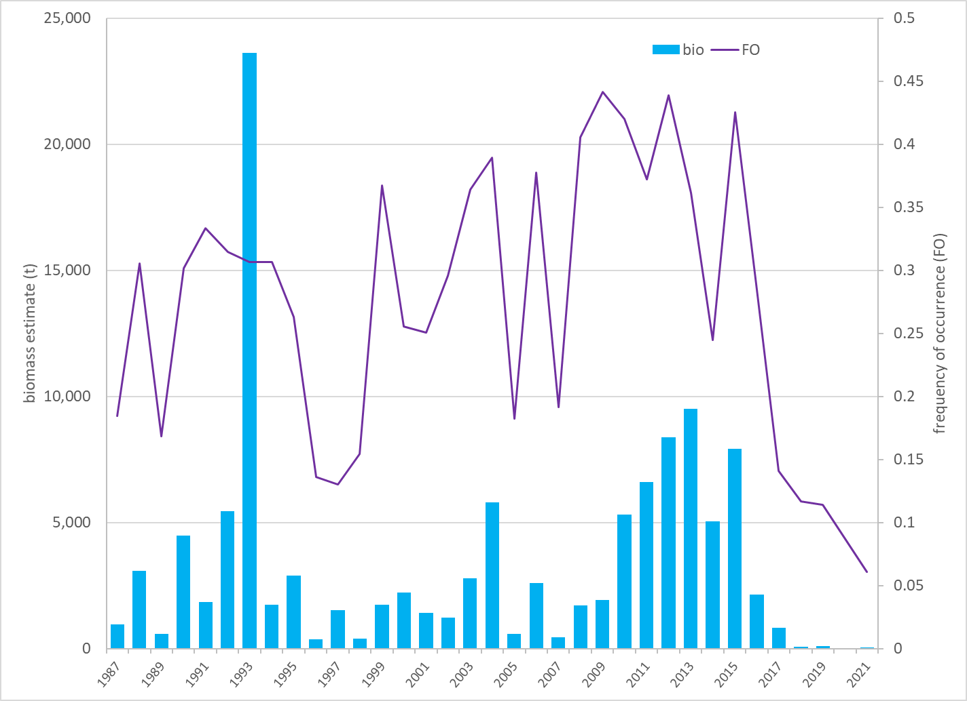
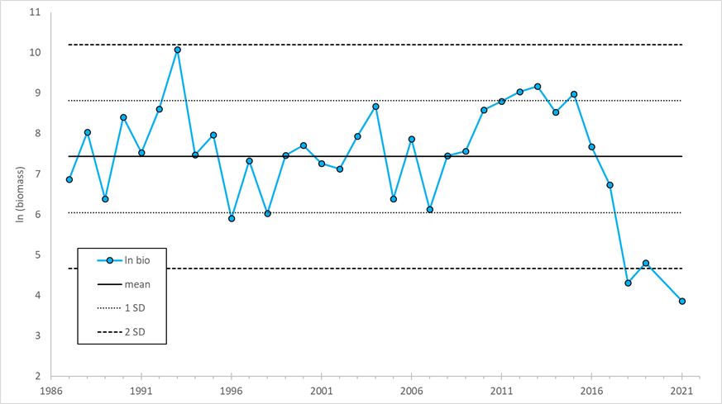
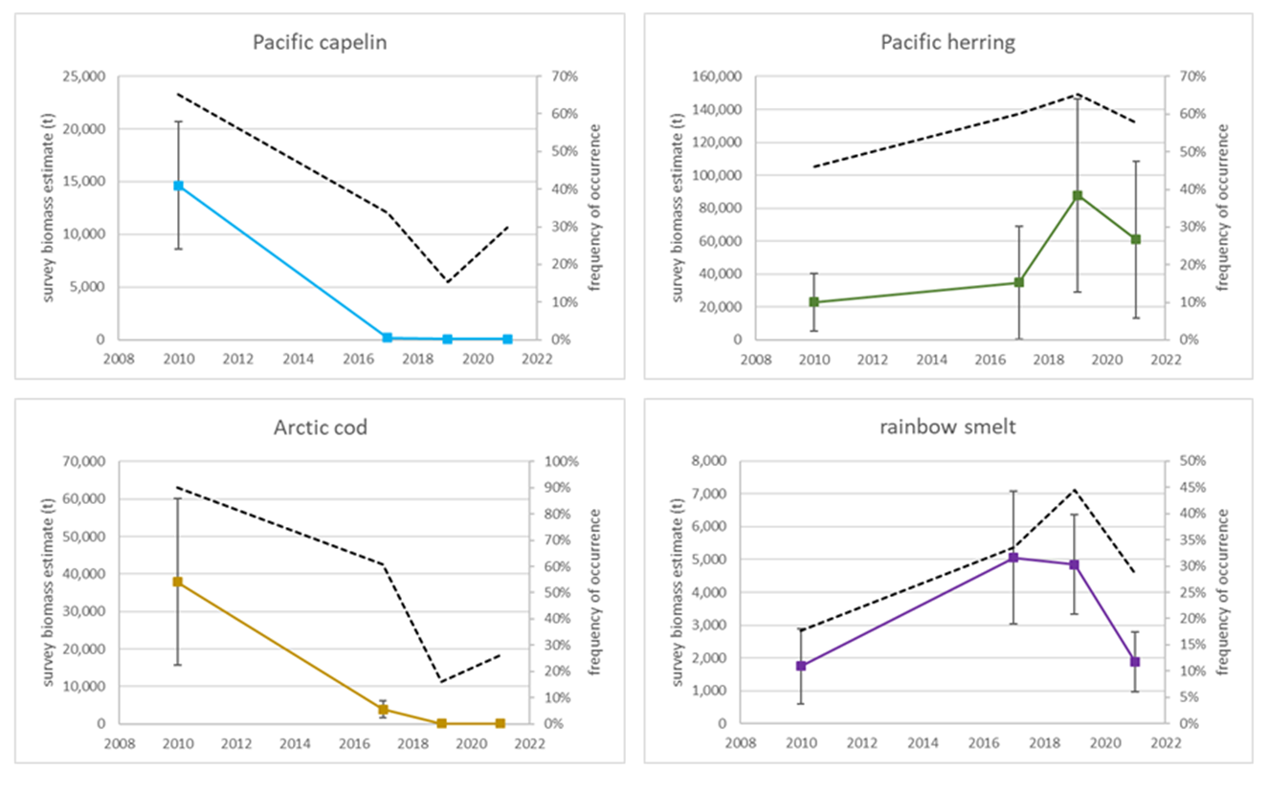
capelin trends
EBS shelf
EBS shelf
NBS bottom trawl
NBS surface trawl

Slide 7
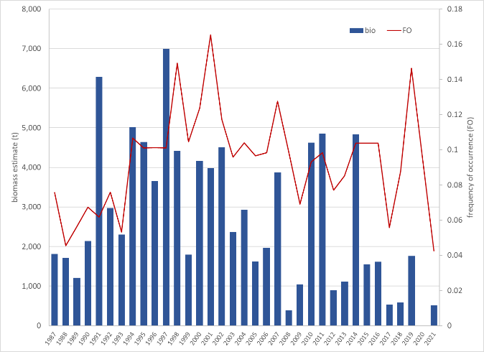
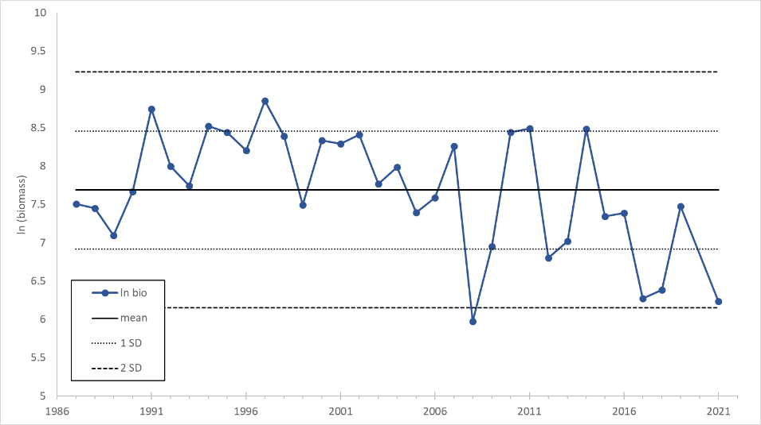
eulachon trends
EBS shelf
EBS shelf

Slide 8
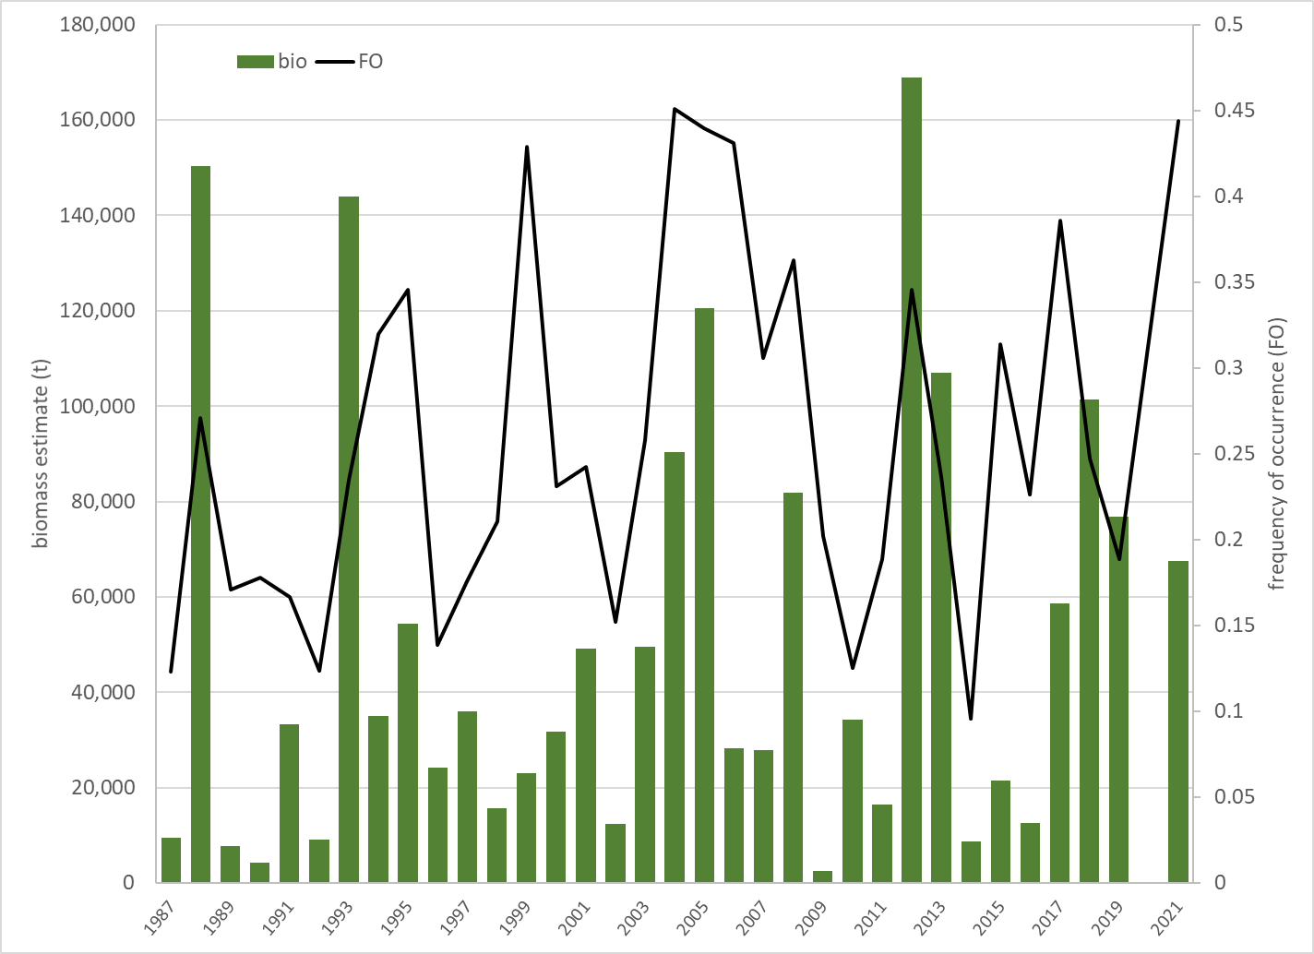
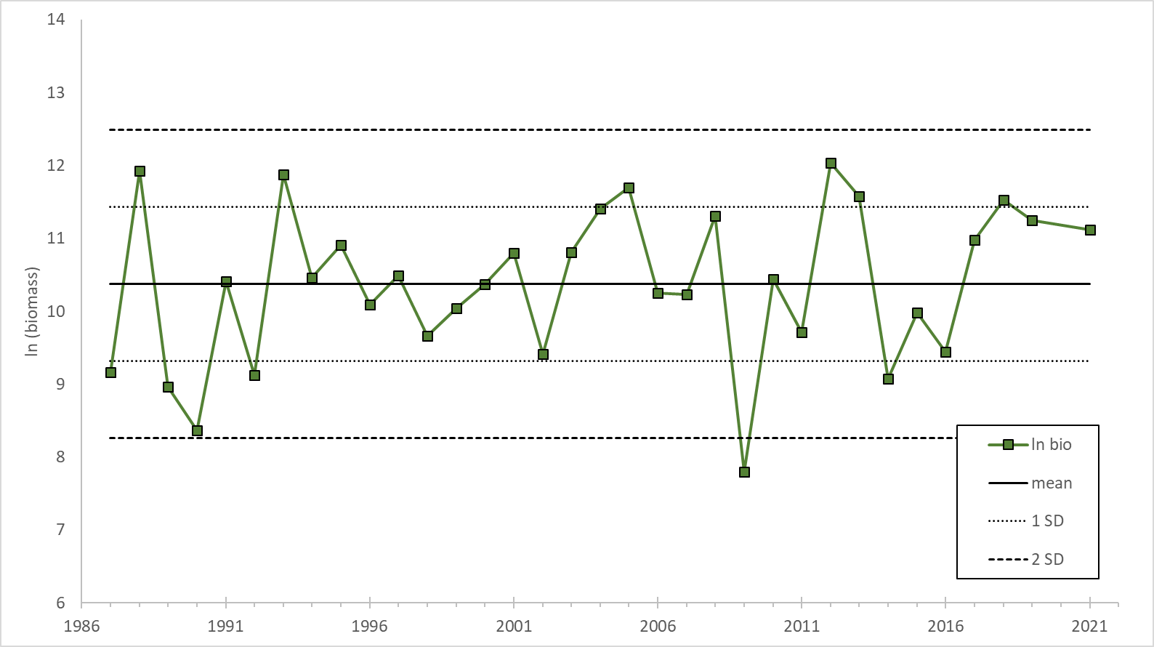
herring trends - NMFS
EBS shelf
EBS shelf
NBS surface trawl
NBS bottom trawl

Slide 9
herring trends (Buck et al ADFG data in ESR)
Togiak herring biomass
Circles are survey estimates
Black line is model estimate of mature fish
Togiak herring recruitment
Model estimates of age 4+

Slide 10
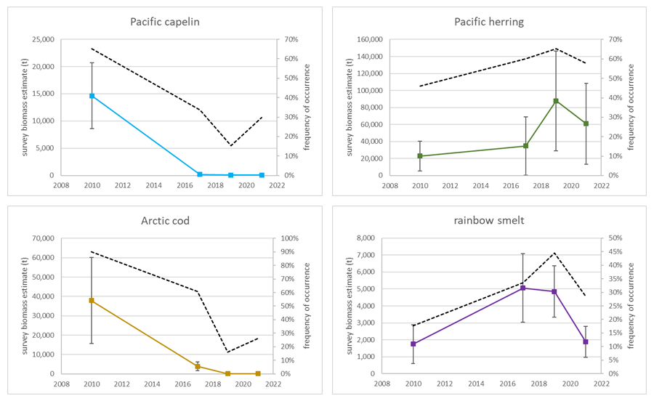
NBS bottom trawl

Slide 11
NBS surface trawl

Slide 12
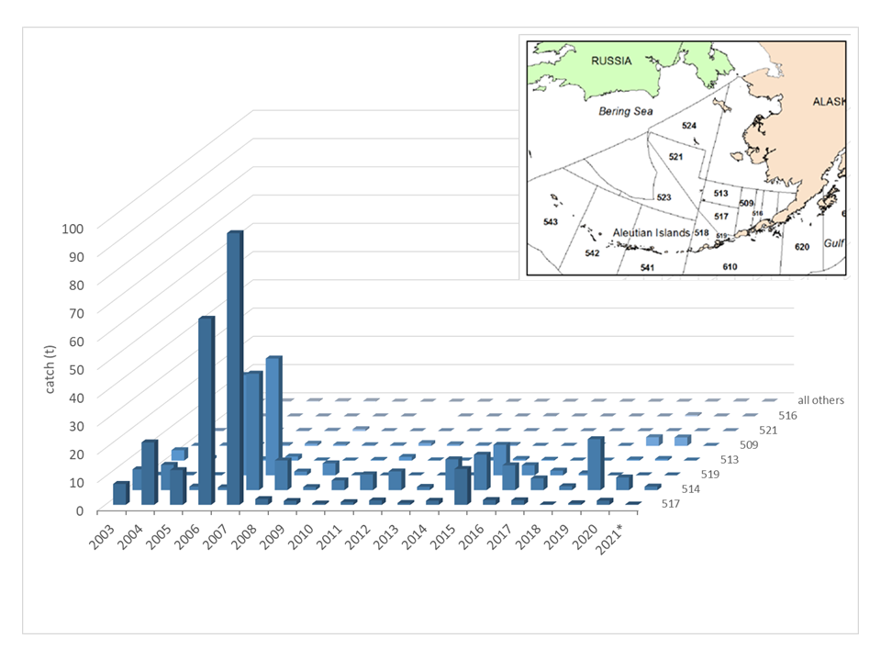
eulachon/osmerid bycatch
relatively low bycatch since large 2006-2007 catches in the pollock fishery
in recent years, catches occur mainly in yellowfin sole fishery

Slide 13
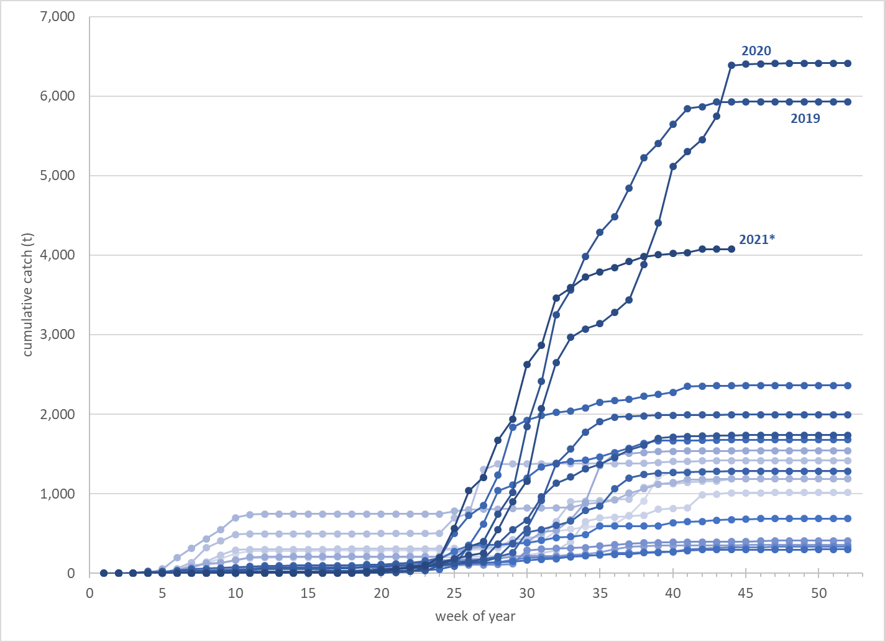
squid bycatch (by week)
high bycatch occurs in pollock fishery, especially in B season
catch no longer constrained

Slide 14
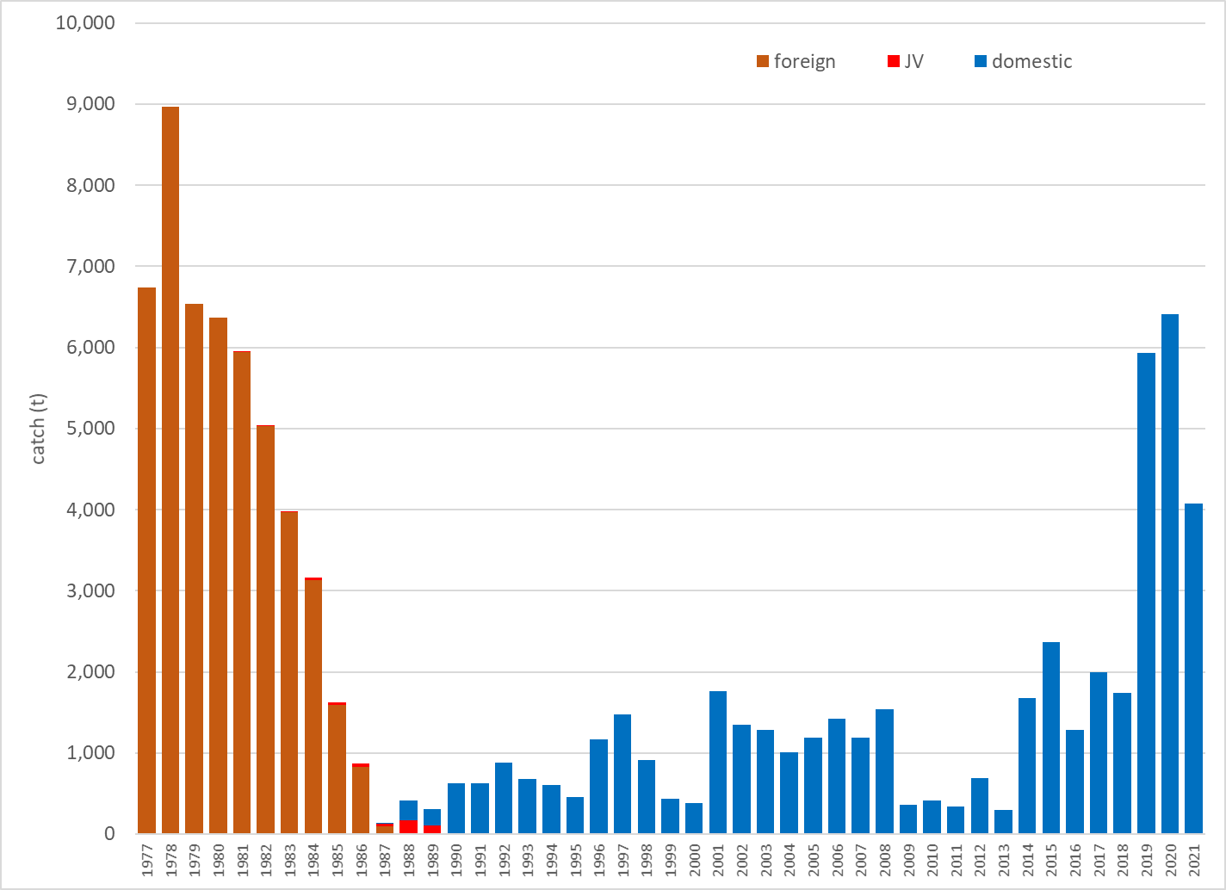
squid bycatch 1977-2021
recent catch similar to late 1970s foreign fishery

Slide 15
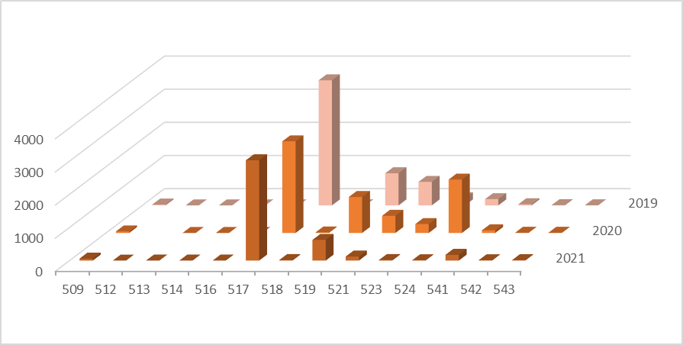
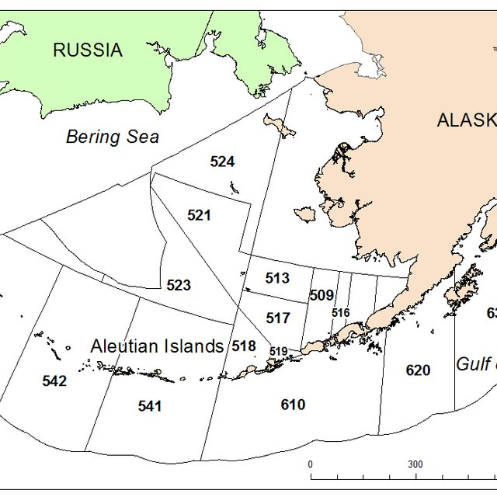
squid bycatch - area

Slide 16
herring bycatch - background
data are from Siddon et al 2020 ESR contribution
PSC is set at 1% of ADFG EBS biomass estimate (mostly Togiak)
exceeding PSC results in closure of Herring Savings Areas (HAS)
unclear which spawning stock affected
multiple hypotheses regarding high catch
need to re-evaluate HAS or other ways to reduce bycatch

Slide 17
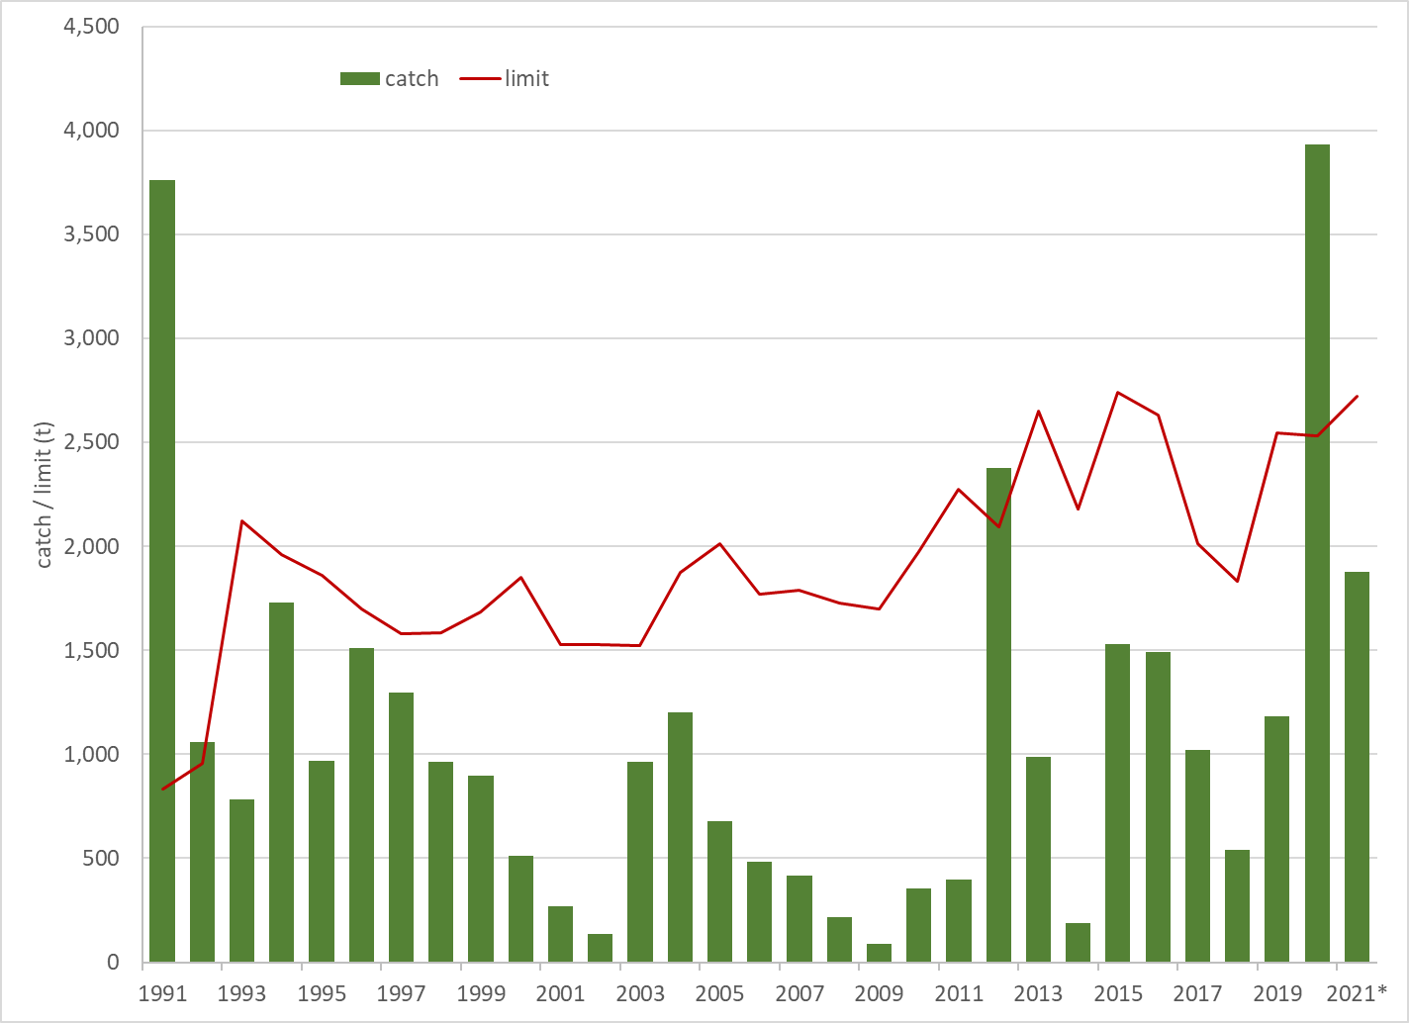
herring bycatch

Slide 18
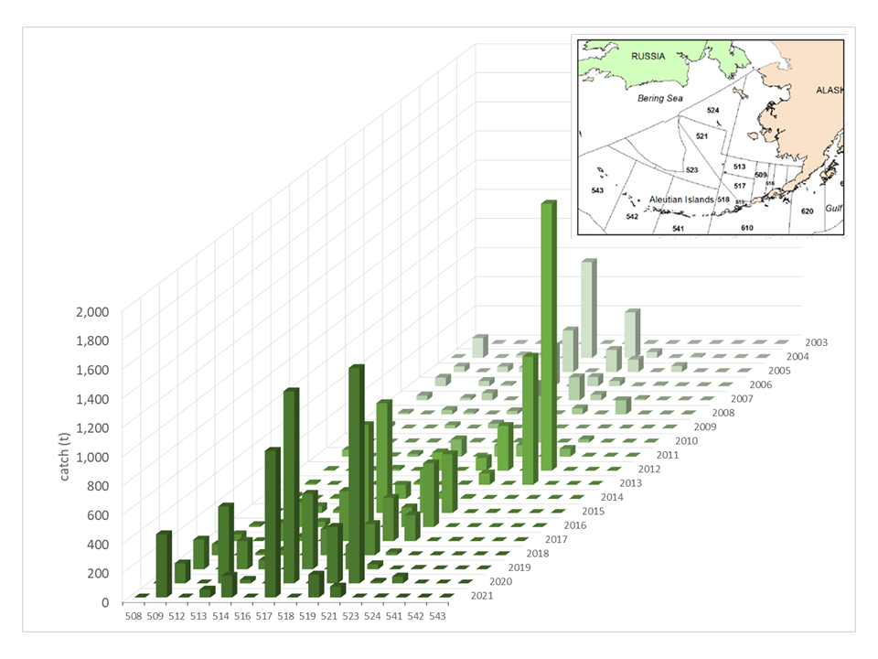
herring bycatch – spatial pattern

Slide 19
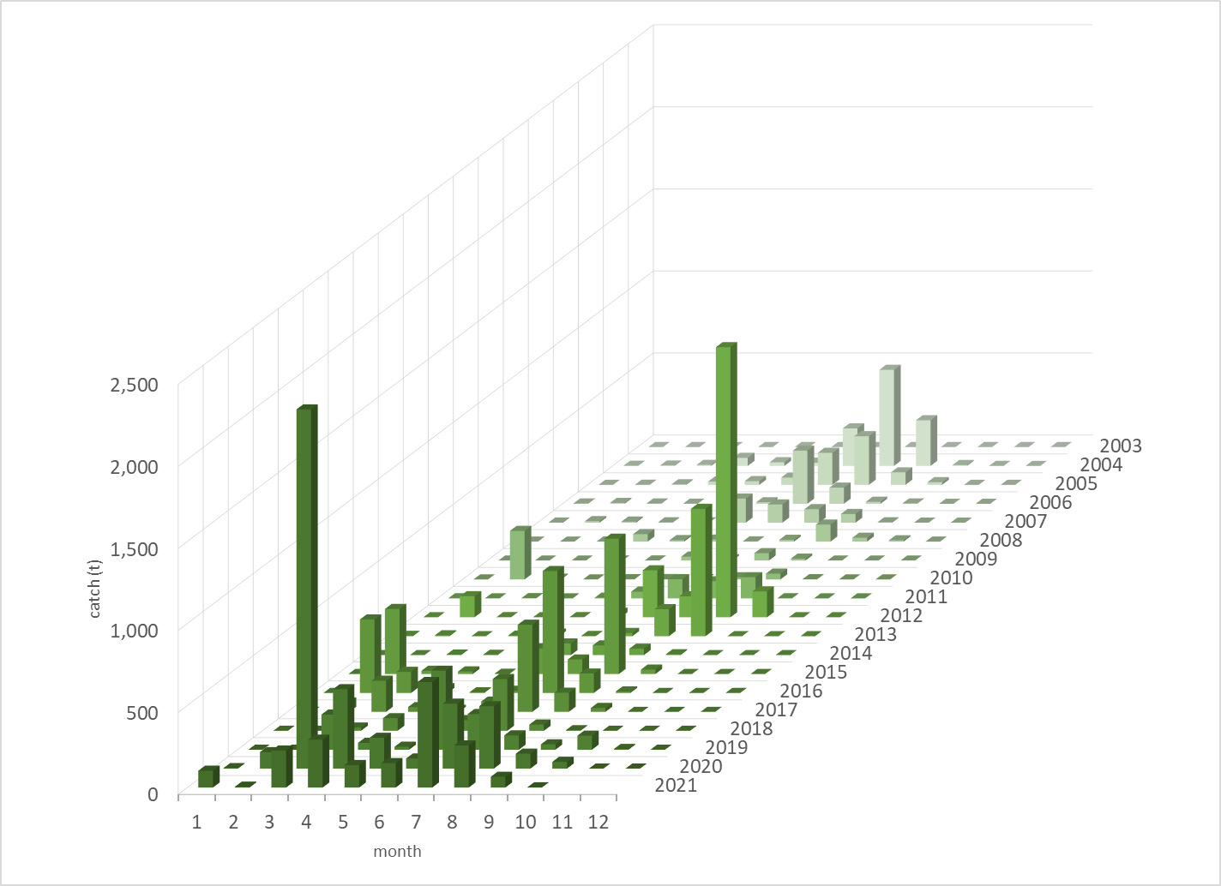
herring bycatch – seasonal pattern

Slide 20
summary
forage report still evolving, especially regarding the ESR
overall forage availability in the EBS/NBS has declined, except possibly for herring
decline has coincided with elevated temperatures and reduced sea ice extent
squid catches remain high since move to EC
herring bycatch below limit but still high

