Slide 1

2022 BSAI Blackspotted/Rougheye Rockfish Assessment
Paul Spencer, Jim Ianelli, and Ned Laman
Alaska Fisheries Science Center

Slide 2
Overall summary
Unusually large increase in 2010 year class (with high uncertainty), which affects the estimate of B_{40%}, perceived stock depletion, and F_{abc}
An alternative model with time-varying fishery selectivity was considered, and also showed a large estimate of the 2010 year class
We recommend setting the 2010 year class to the next largest value for the purpose of stabilizing B_{40%} and obtaining the maximum ABC
The recommended ABC is reduced from the maximum for several reasons, including not increasing the harvest based on an unusually large and uncertain 2010 year class.
Several concerns noted in risk table.
Spatially disproportionate harvesting has continued, and the SSC has noted that this is a concern.

Slide 3
Outline
SSC – Plan Team comments
Catch information
Fishery and survey data
Model description and evaluation
Monitoring of catch
Risk table
Management recommendations

Slide 4
SSC and Plan Team comments
Long list of recent SSC and Plan Team comments from recent years
Most comments directly related to the assessment were presented in a document to the Plan Team in September, which is included as an Appendix to the 2022 assessment.
(SSC, October 2022)The SSC recommends that assessment authors continue to highlight instances where the lack of these data [the EBS slope survey] may degrade stock assessment performance.
Because the EBS portion of the BSAI blackspotted-rougheye stock is assessed with Tier 5 methods, the lack of the EBS slope survey degrades the assessment.
(SSC, December 2020) . . . the SSC requests that the authors investigate the effects of fleet behavior on apparent size/ age compositions, and to what extent this may be influencing fishery selectivity.
Examination of depth of capture and size compositions in the fishery and survey was presented to the Plan Team in September. A model run with time-varying fishery selectivity was considered in this assessment.

Slide 5
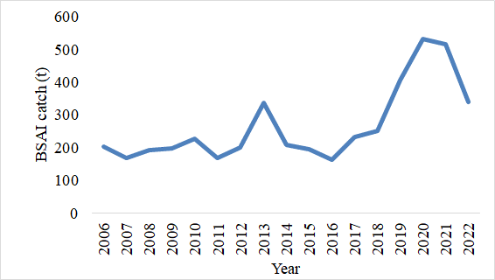
BSAI catch has increased since 2016
Peaked in 2020 – 2021, and declined in 2022 (through September 25)

Slide 6
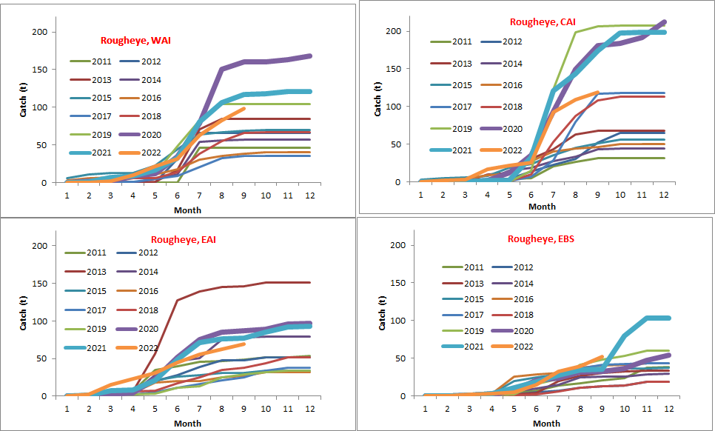
BSAI Blackspotted/Rougheye catch by month and area, 2011-2022

Slide 7
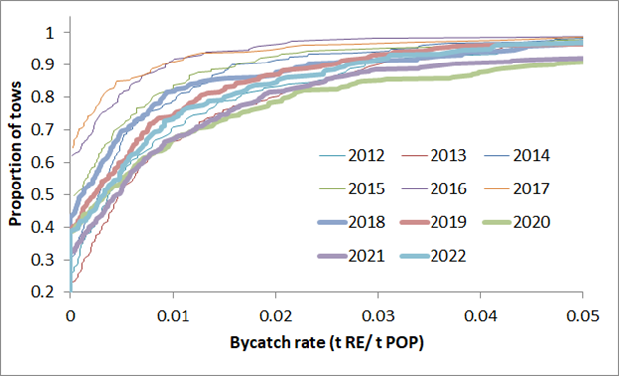
Distribution of bycatch rates
(WAI, POP target, A80 vessels)

Slide 8
Data in assessment model
Component | Years
Fishery catch | 1977-2022
Fishery age composition | 2004-2005, 2007-2009, 2011, 2013, 2015, 2017, 2019-2021
Fishery size composition | 1979, 1990, 1992-1993, 2003, 2010, 2012, 2014, 2016, 2018
AI Survey age composition | 1991, 1994, 1997, 2000, 2002, 2004, 2006, 2010, 2012, 2014, 2016, 2018
AI Survey length composition | 2022
AI Survey biomass estimates | 1991, 1994, 1997, 2000, 2002, 2004, 2006, 2010, 2012, 2014, 2018, 2022

Slide 9
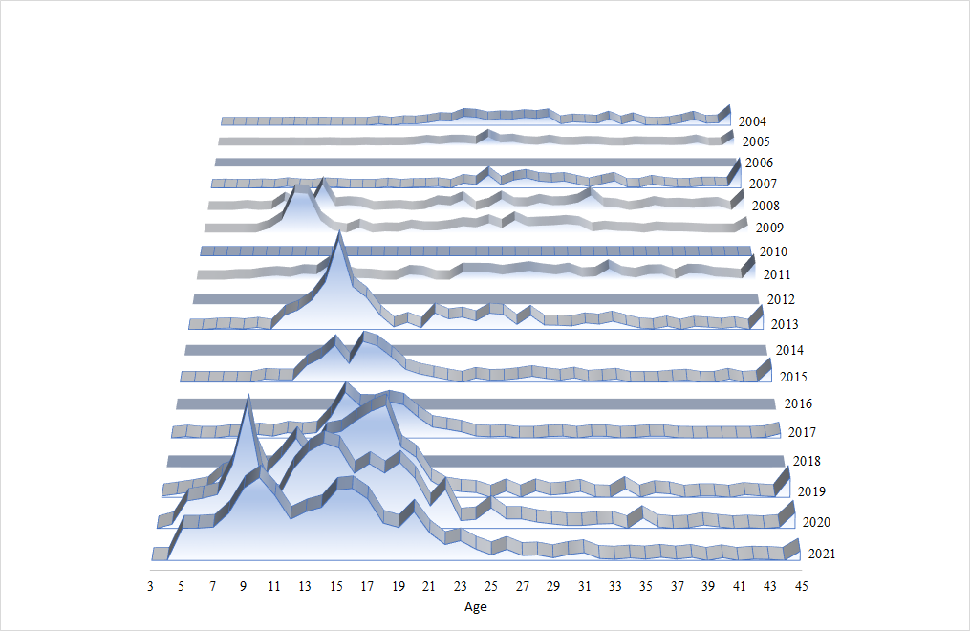
AI blackspotted/rougheye fishery age composition data

Slide 10
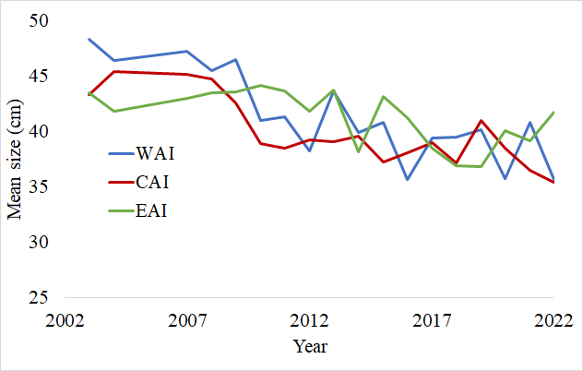
Decline in mean size caught in the fishery

Slide 11
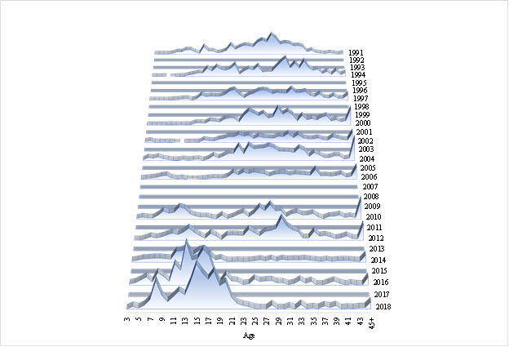
Absence of older fish in recent AI surveys

Slide 12
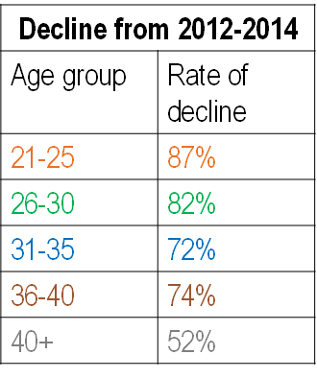
Decline of older fish, and increase of younger fish

Slide 13
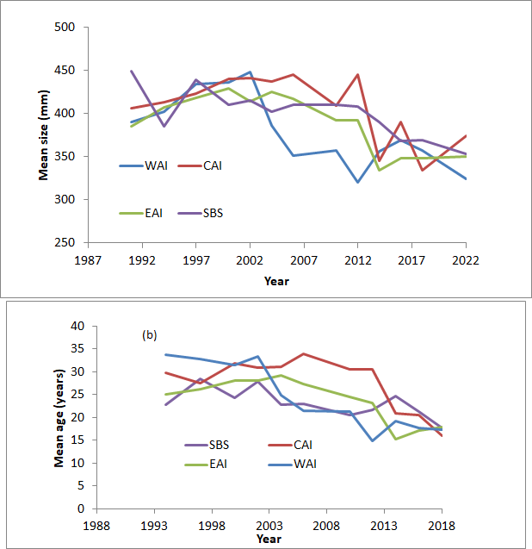
Reductions in fish size and age in AI survey

Slide 14
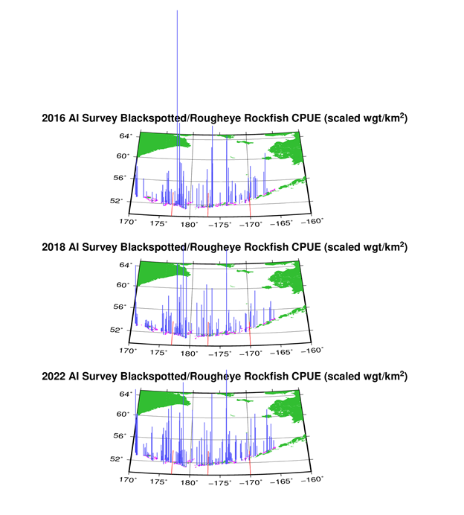
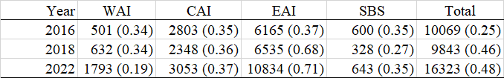
AI survey CPUE, 2014 – 2022 AI surveys
Survey biomass estimates and CVs

Slide 15
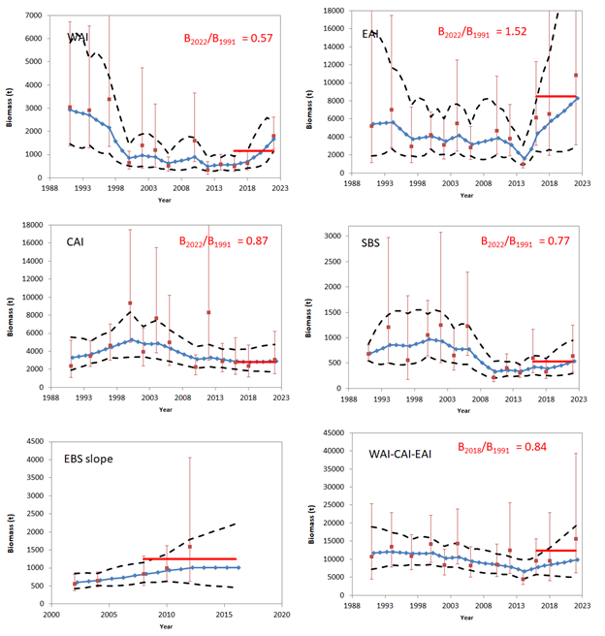
Smoothed survey biomass estimates

Slide 16
Models considered
Model 20 (2022) run, has updated data
Model 22 has time-varying fishery selectivity
Model | Differences from 2020 model
Model 20 (2022) | No modeling differences, model fishery selectivity with time-invariant selectivity curve
Model 22 | Model fishery selectivity with a cubic spline, using 5 age nodes and 5 year nodes and setting the parameters controlling variability for temporal variability and smoothness to 100.

Slide 17
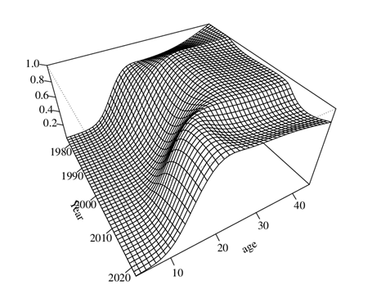
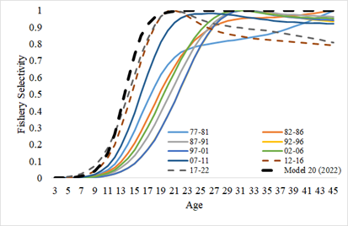
Fishery Selectivity Curves
Model 22
Selectivity in Model 22 averaged within shorter time periods
Recent years have higher number of observations and are weighted more heavily in the time-invariant model 20 (2022)
The two models have similar selectivity at the younger age in recent years

Slide 18
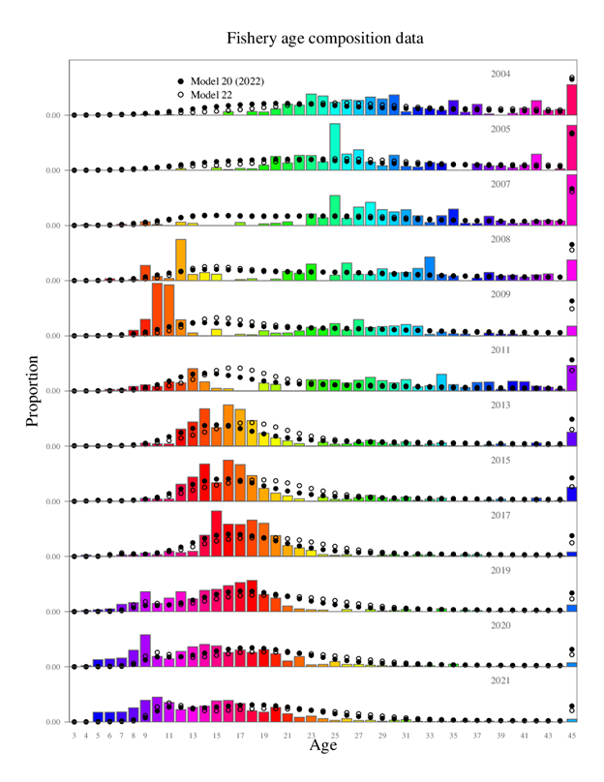
Fits to fishery age compositions across the two models

Slide 19
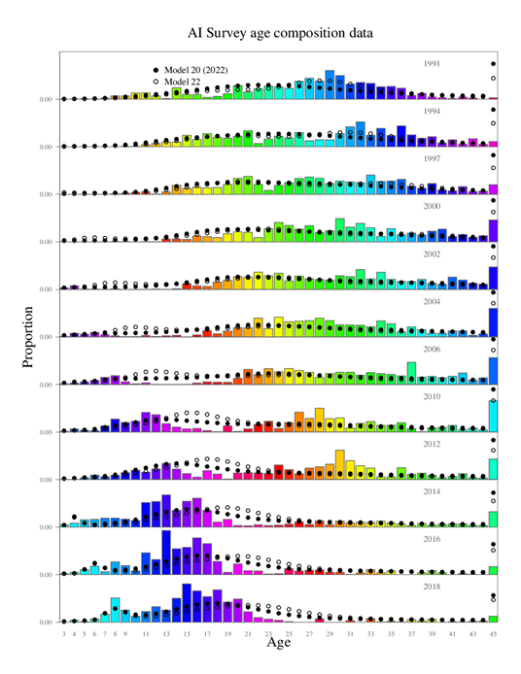
Fits to survey age compositions across the two models

Slide 20
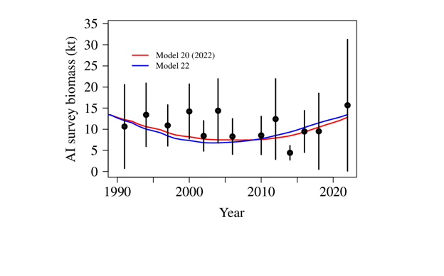
Fits to the AI survey biomass

Slide 21
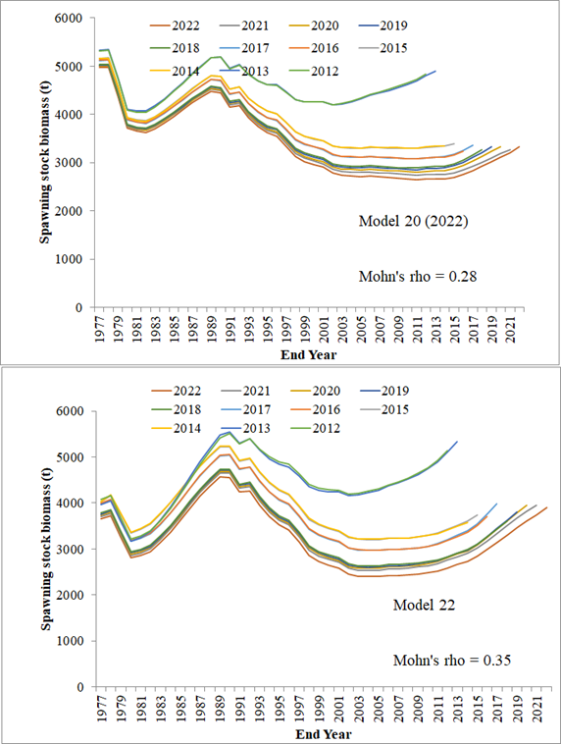
Retrospective pattern in SSB

Slide 22
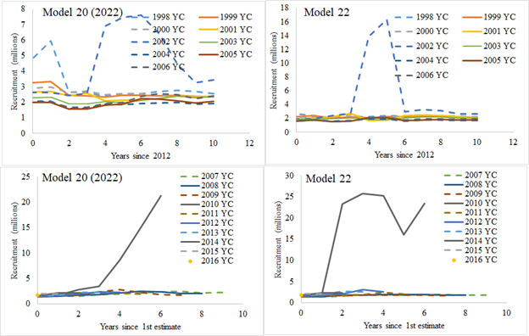
Retrospective pattern in estimated recruitments

Slide 23
Model Selection
Modeling of time-varying selectivity did not account for the increased number of small/young fish seen in the fishery, and did not improve the model.

Slide 24
Risk table considerations
Assessment considerations: “data-inputs: biased ages, skipped surveys, lack of fishery-independent trend data; model fits: poor fits to fits to fishery or survey data, inability to simultaneously fit multiple data inputs; model performance: poor model convergence, multiple minima in the likelihood surface, parameters hitting bounds; estimation uncertainty: poorly-estimated but influential year classes; retrospective bias in biomass estimates.
Level 3: Major Concern. Very poor fits to data; high level of uncertainty; strong retrospective bias.

Slide 25
Risk table considerations
Population dynamics considerations: “decreasing biomass trend, poor recent recruitment, inability of the stock to rebuild, abrupt increase or decrease in stock abundance.
Level 2: Substantially increased concerns. Stock trends are unusual; abundance increasing or decreasing faster than has been seen recently, or recruitment pattern is atypical.
Also, existing spatial management measures are generally inconsistent with the relatively smaller spatial structure of Pacific rockfish

Slide 26
Risk table considerations
Environmental/ecosystem considerations: “adverse trends in environmental/ecosystem indicators, ecosystem model results, decreases in ecosystem productivity, decreases in prey abundance or availability, increases or increases in predator abundance or productivity.”
Level 1: Normal. “We rank the environmental/ecosystem considerations as a 1 (Normal; No apparent environmental/ecosystem concerns) aside from the recent stretch of increased temperatures.

Slide 27
Risk table considerations
Fishery performance considerations: “fishery CPUE is showing a contrasting pattern from the stock biomass trend, unusual spatial pattern of fishing, changes in the percent of TAC taken, changes in the duration of fishery openings.”
For a bycatch stock, fishery performance can be evaluated with respect to how well the target fishery can avoid bycatch.
Level 2: Substantially increased concerns. Fishery CPUE in the WAI subarea are larger than would be expected based on the spatial distribution of survey biomass estimates. Also, the WAI catches have consistently exceeded the MSSC, and these overages have increased over time. The catches in the WAI/CAI subarea have also exceeded the subarea ABC from 2019 – 2022, and the BSAI ABC in 2021.

Slide 28
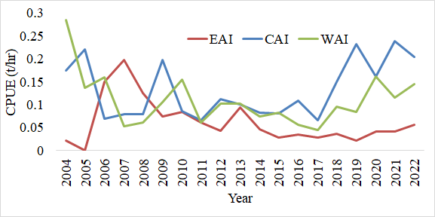
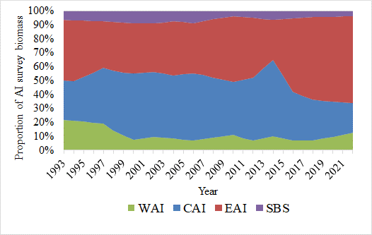
Fishery CPUE by subarea
Tons/hr, from tows targeting POP based on haul species composition. Source: North Pacific Groundfish Observer Program.
Fishery CPUEs are higher in the WAI than one would expect from the distribution of survey biomass

Slide 29
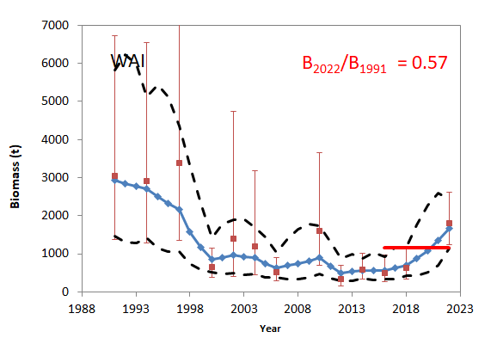
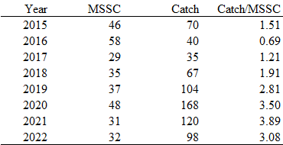
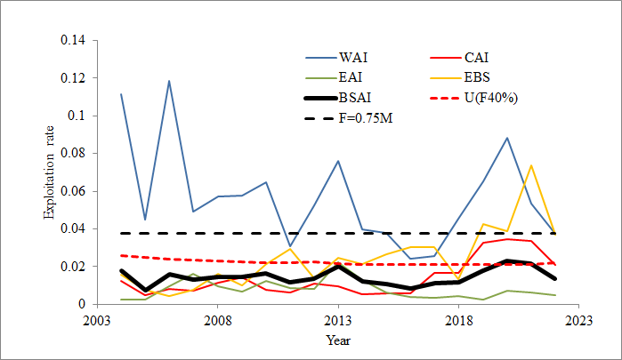
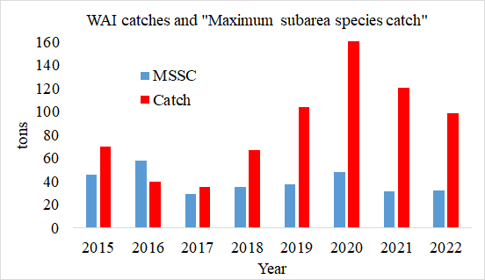
Monitoring of WAI catch relative to MSSC
Requested by SSC (Oct 2016, Dec 2016)

Slide 30
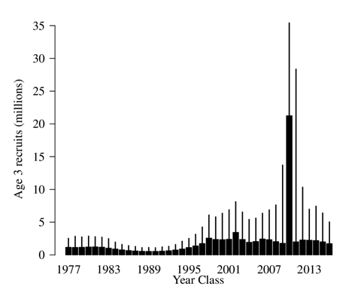
Estimation of recruitment
The 2010 year class is 21.25 million (CV of 0.58), which is > 6 times the next largest year class
This year class contributes 25% of the beginning year 2022 total biomass

Slide 31
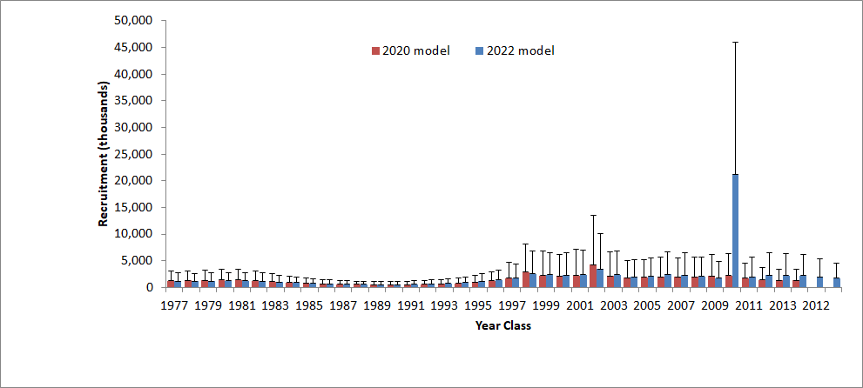
Estimation of recruitment – comparison with 2020 model

Slide 32
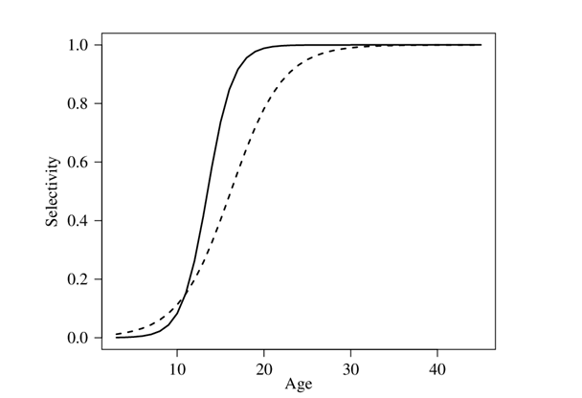
Estimated AI survey selectivity curve
AI survey – dashed line
Fishery – solid line
Selection at age 12:
Fishery 0.26
AI survey 0.20

Slide 33
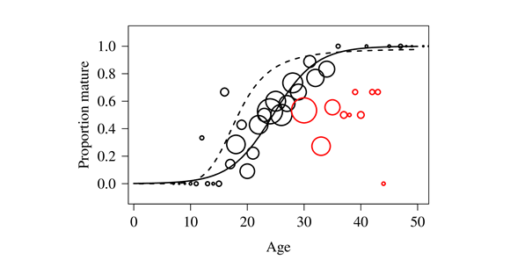
Estimated maturity
Estimated age at 50% mature = 24.5 years
Estimate proportion mature at 12 years old = 0.035

Slide 34
The effect of this year class on B40% and ABC
If we apply our standard procedures, B40% increases sharply, and Fabc decreases sharply, despite little change in estimated SSB
If we adjust the 2010 year class when computing mean recruitment to a more likely value, the B40% is stabilized, but the ABC would increase sharply (based on fishing a stock in which a large portion of the biomass is composed of a large and uncertain year class).
We propose a middle ground—set the value of the 2010 year class to the next largest (3.43 million, 2002 year class) for the purpose of stabilizing B40% and computing max ABC, low recommend a lower ABC so as to not substantially raise the ABC until more certainty in this year class and overall stock size can be obtained.

Slide 35
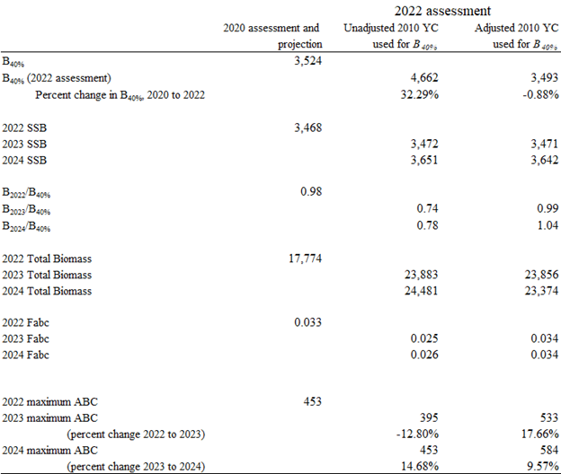
The effect of this year class on B40% and ABC

Slide 36
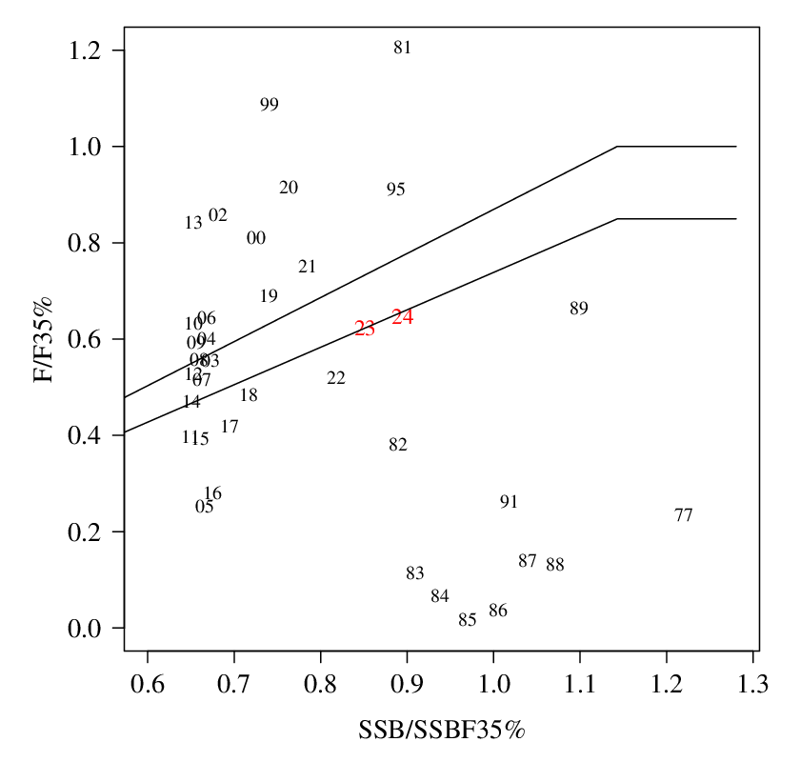
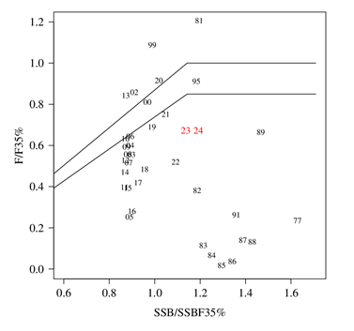
Phase plane
Unadjusted estimate of 2010 year class
Adjust estimate of 2010 year class to next largest estimated recruitment (2002 Year class; 3.43 million)

Slide 37
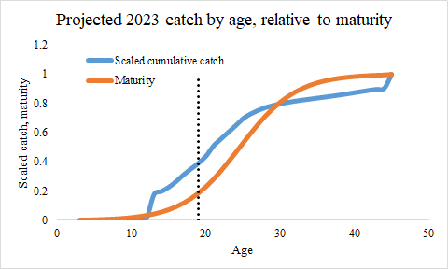
How much of the 2023 catch would come from recent cohorts?
About 40% of the catch biomass would come from cohorts less than 20% mature

Slide 38
Rationale for the reduction from max ABC
Strong retrospective pattern recruitment estimation – estimates of the 2002 year class were reduced as more data became available.
High level of uncertainty in the estimate of the 2010 year class (and other recent recruitments)
The 2010 year class has not been observed too often in our fishery and survey data.
The survey biomass estimates do not provide strong and clear evidence that the stock is increasing
Consistency with how recent and uncertain strong recruitments were addressed in the sablefish model.
History of being judicious in choosing which years of recruitment estimates to include when calculating average recruitment.
Consistency with SSC concerns regarding spatially disproportionate harvesting, and an interest in increasing stock biomass in the western AI.

Slide 39
Harvest spec table, AI subarea
Recommended 2023 BSAI ABCs and OFLs
BSAI ABC: 467 t (increase from 2022 ABC of 453 t)
BSAI OFL: 626 t (increase from 2022 OFL of 531 t)

Slide 40
EBS portion table

Slide 41
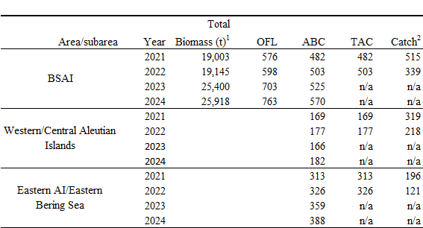
Plan Team table

Slide 42

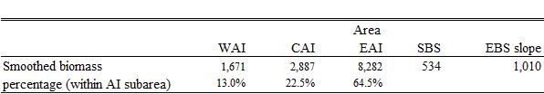
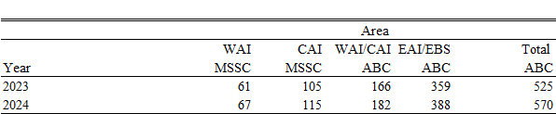
MSSC calculations
Spatial apportionment from (2020 assessment)
Spatial apportionment (from 2022 assessment)
MSSCs (from 2022 assessment)

Slide 43
Conclusions
Sablefish déjà vu (all over again)
A consistent way of dealing with the management implications of these recruitment events would be good
Some aspects to consider:
  Lag time between when fish begin to be observed, and when they are mature
  B40% is an equilibrium concept, but recruitment spikes are not equilibrium conditions
  Projections to not take into account the uncertainty in the initial numbers at age. Even if we had this information on uncertainty, how would we use it?
Some previous work by PT working group on calculation of mean recruitment that we should refer to.

