Slide 1
BSAI Greenland turbot
Meaghan D. Bryan., Steven J. Barbeaux, James Ianelli, Stephanie Zador, Rebecca Haehn and Jerry Hoff
Alaska Fisheries Science Center
November 18, 2021

Slide 2
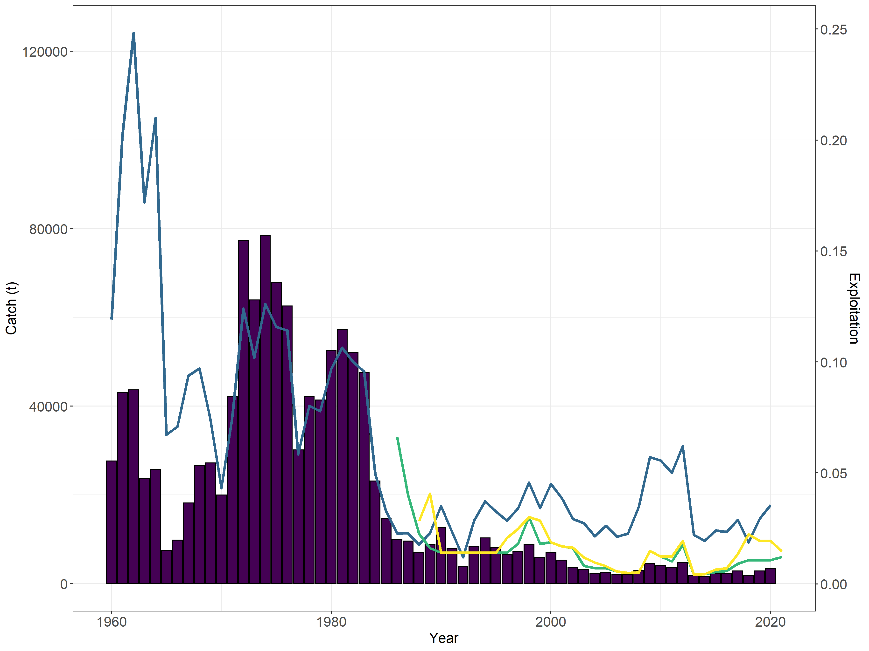
BSAI Greenland turbot catch and exploitation
Catch
0.25
120
Exploitation
ABC
TAC
0.20
~ 55% of TAC caught (2016-2020)
80
0.15
Catch (1000s t)
Exploitation
0.10
40
0.05
0
0.00
1960
1980
2000
2020
Year
Notes:
Over the past 5 years, on average, ~55% of the TAC has been caught, ~35% of ABC.

Slide 3
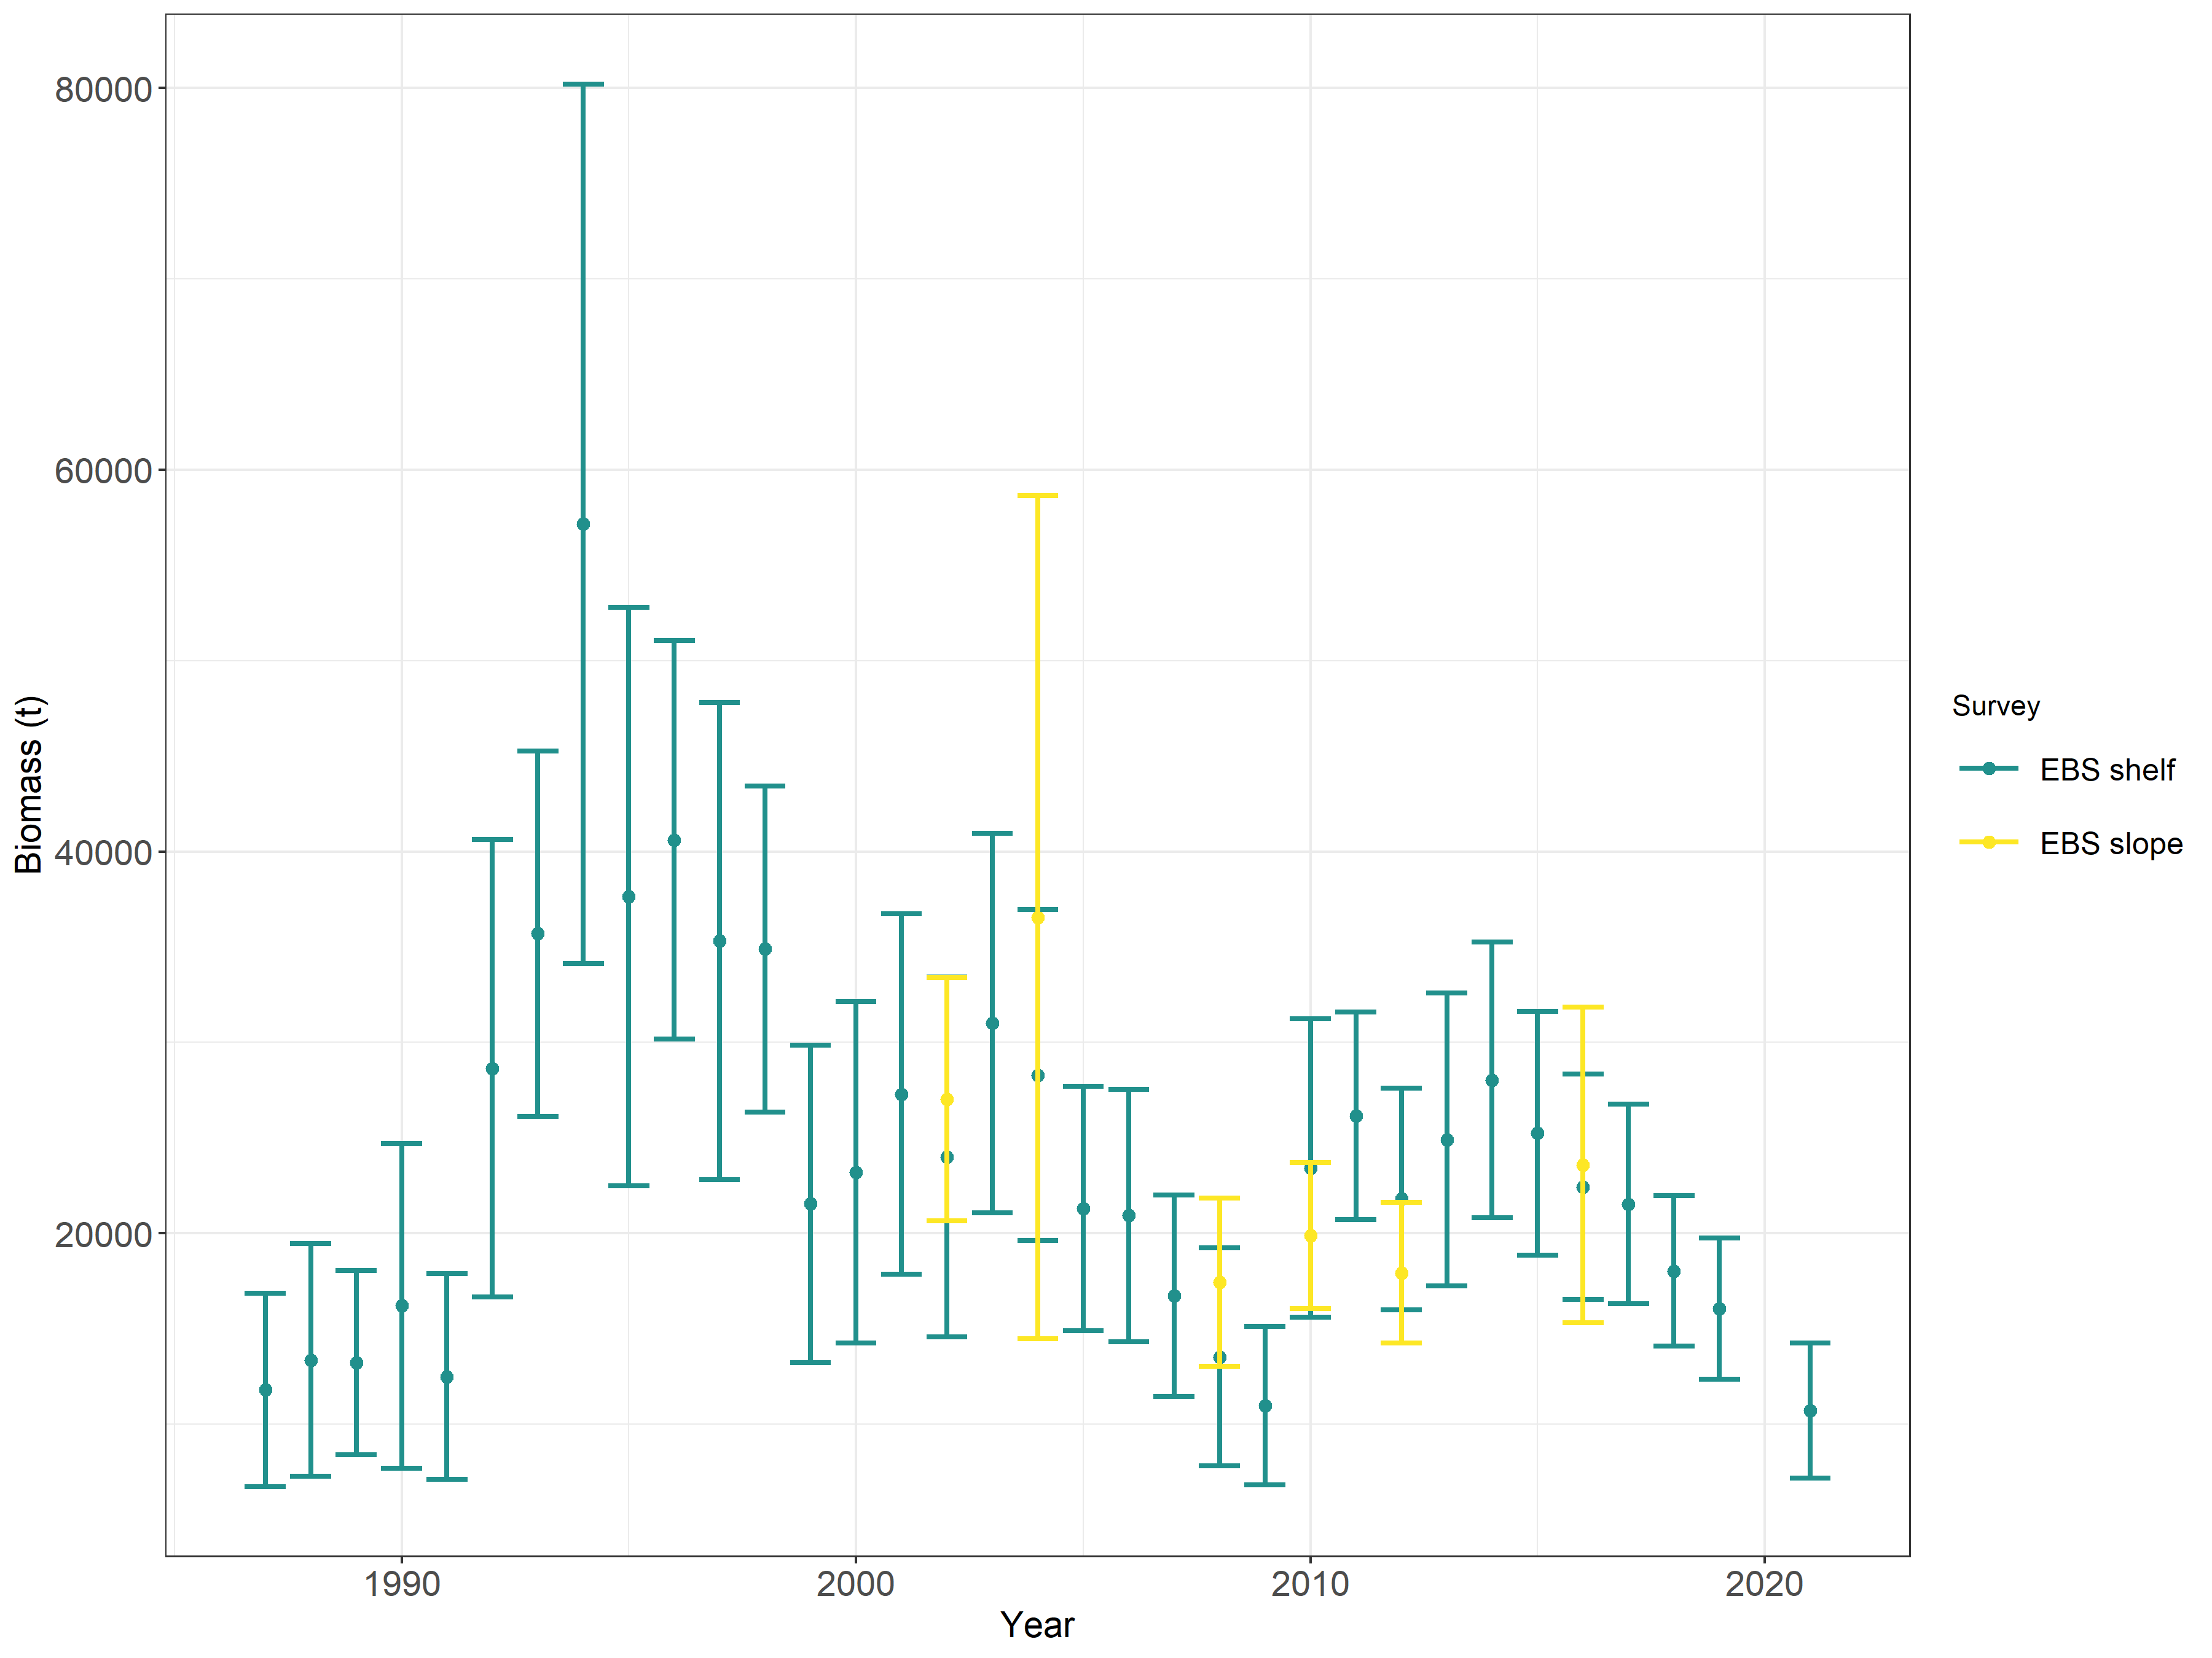
Survey biomass
80
0.25
ABC
TAC
0.20
60
0.15
Biomass (1000s t)
Exploitation
40
0.10
-33%
0.05
20
0.00
1990
2000
2010
2020
Year

Slide 4
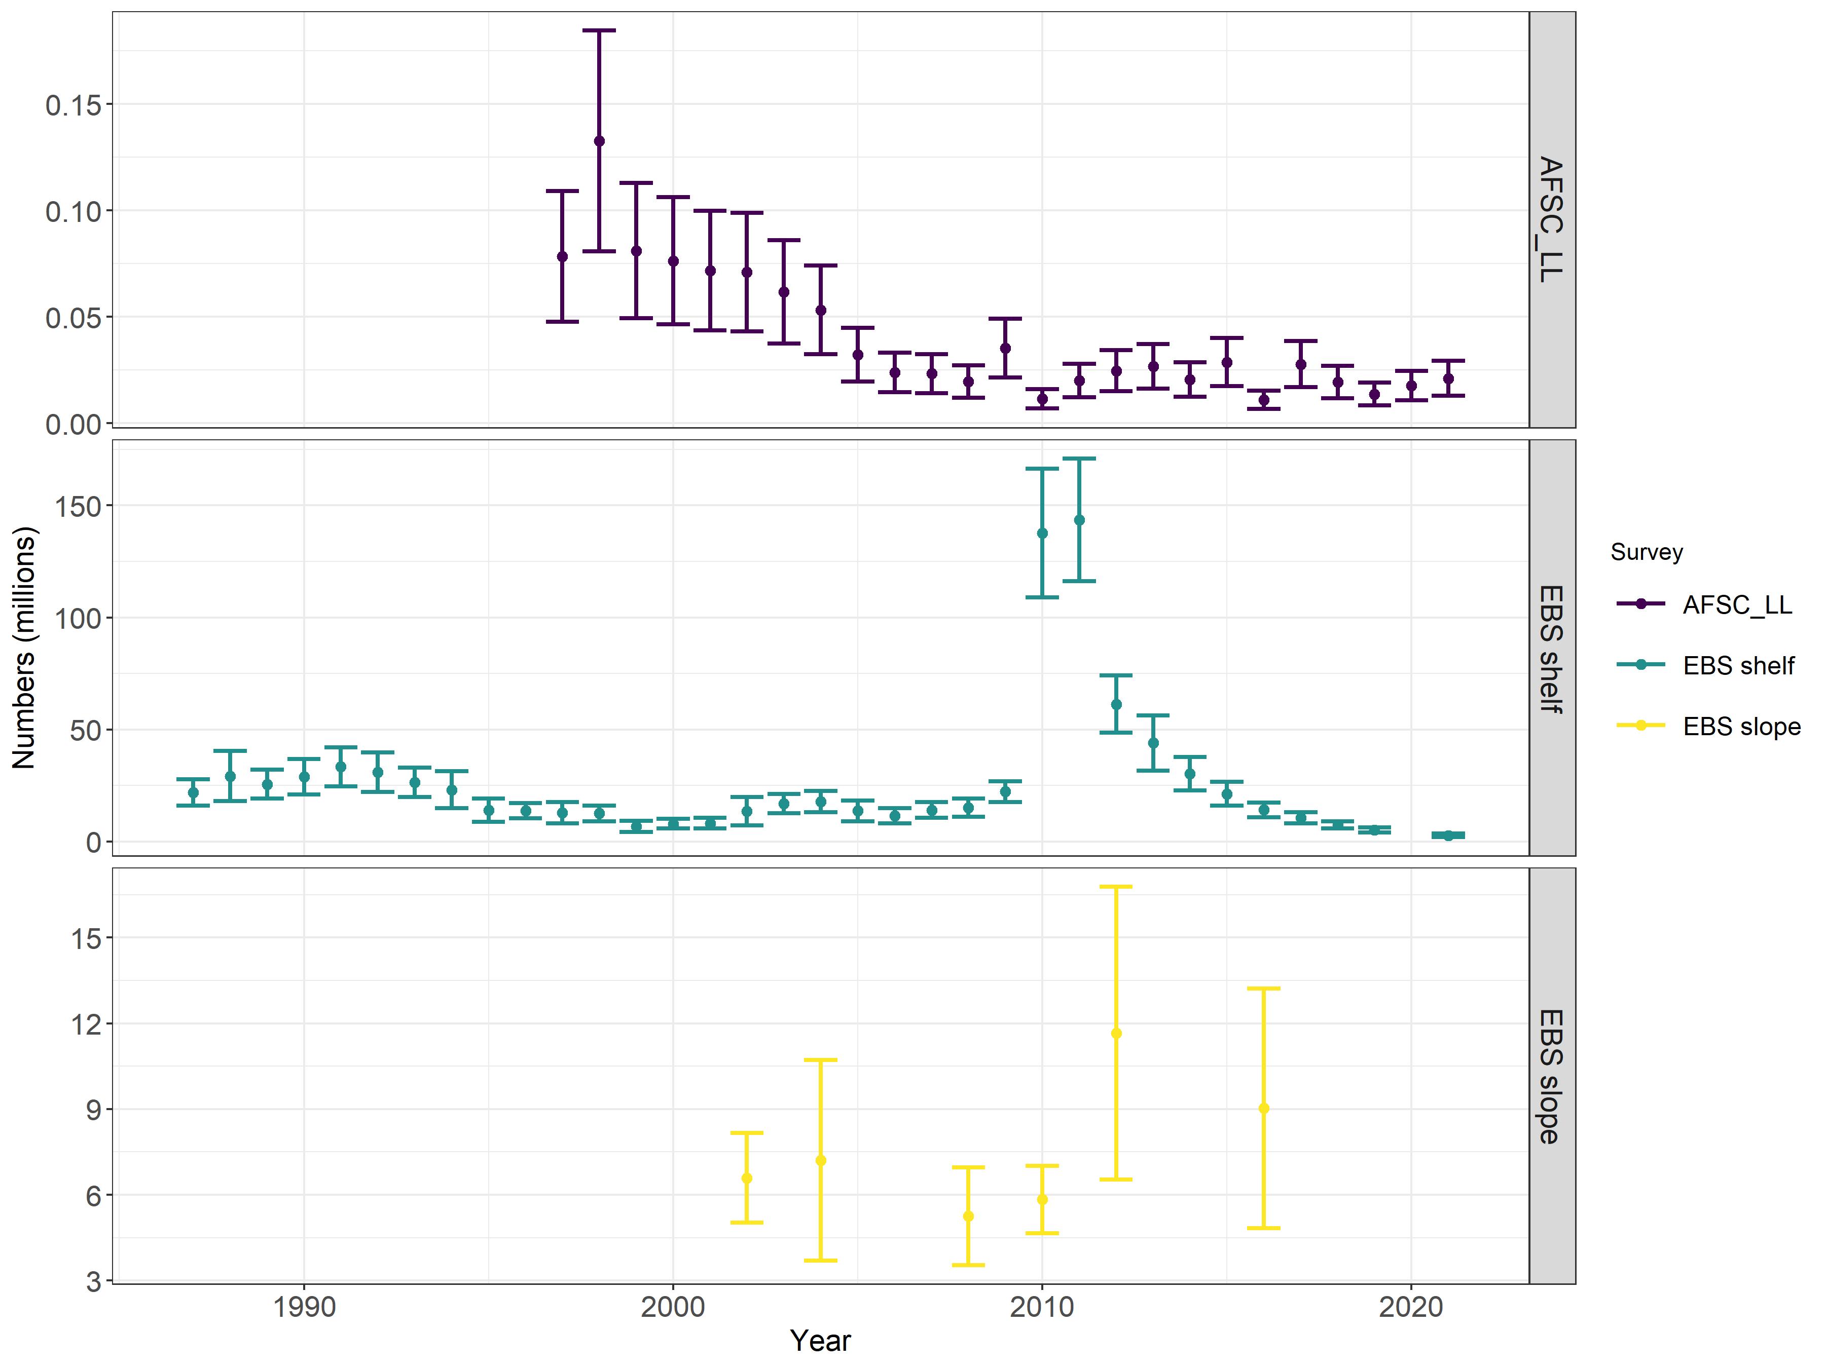
Survey numbers
RPNs
+19%
-46%

Slide 5
Partial assessment
Assessment model was not updated
Catch was updated
  Final 2020 – 2,326 t
    Reduced from 3,321 t
  Preliminary 2021: 3,309 t
    Average proportion TAC (2016-2020) * 2021 TAC
Preliminary catch used a catch input for 2021, 2022, and 2023
    Rather than maximum ABC for 2022 and 2023

Slide 6
Quantity | As estimated or specified last year for: |  | As estimated or recommended this year* for:
 | 2021 | 2022 | 2022 | 2023
M (natural mortality rate) | 0.112 | 0.112 | 0.112 | 0.112
Tier | 3a | 3a | 3a | 3a
Projected total (age 1+) biomass (t) | 87,849 | 79,382 | 84,341 | 80,404
Female spawning biomass (t) | 51,914 | 47,197 | 50,361 | 47,376
Projected
B_{100%} | 89,054 | 89,054 | 89,054 | 89,054
B_{40%} | 35,622 | 35,622 | 35,622 | 35,622
B_{35%} | 31,169 | 31,169 | 31,169 | 31,169
F_{OFL} | 0.22 | 0.22 | 0.22 | 0.22
maxF_{ABC} | 0.18 | 0.18 | 0.18 | 0.18
F_{ABC} | 0.18 | 0.18 | 0.18 | 0.18
OFL (t) | 8,568 | 7,181 | 7,687 | 6,698
maxABC (t) | 7,326 | 6,139 | 6,572 | 5,724
ABC (t) | 7,326 | 6,139 | 6,572 | 5,724
Status | As determined last year for: |  | As determined this year for:
 | 2019 | 2020 | 2020 | 2021
Overfishing | No | n/a | No | n/a
Overfished | n/a | No | n/a | No
Approaching overfished | n/a | No | n/a | No
Notes:
ABC for 2022 from the updated projection model is 6,572 t. This is 10.3% lower than the 2021 ABC and 7.1% higher than the 2022 ABC projected from last year’s assessment.
The official Greenland turbot total catch for 2020 (2,326 t) is less than the 2020 OFL (11,319 t) indicating overfishing is not occurring.
Spawning biomass is projected to be above B_{35%} for 2021-2023; hence, the stock is not overfished and it is not approaching an overfished condition.

Slide 7
Apportionment
Average ratio of survey biomass on the EBS slope and Aleutian Islands
  Since 2010 (2010, 2012, and 2016 surveys)
84.3% in EBS
15.7% in the Aleutian Islands
Region | 2022 ABC (t) | 2023 ABC (t)
Bering Sea | 5,540 | 4,825
Aleutian Islands | 1,032 | 899

