Slide 1
BSAI Kamchatka flounder
Meaghan D. Bryan, Kalei Shotwell, Stephani Zador, James Ianelli
Alaska Fisheries Science Center
November 18, 2021
Notes:
Previous identity has proved to be overly complex to apply, reducing buy-in. The old brand guide did not perform well in the difficult balancing act between consistency and sameness.
This presentation introduces branding goals and outlines proposed changes to the brand standards guide.

Slide 2
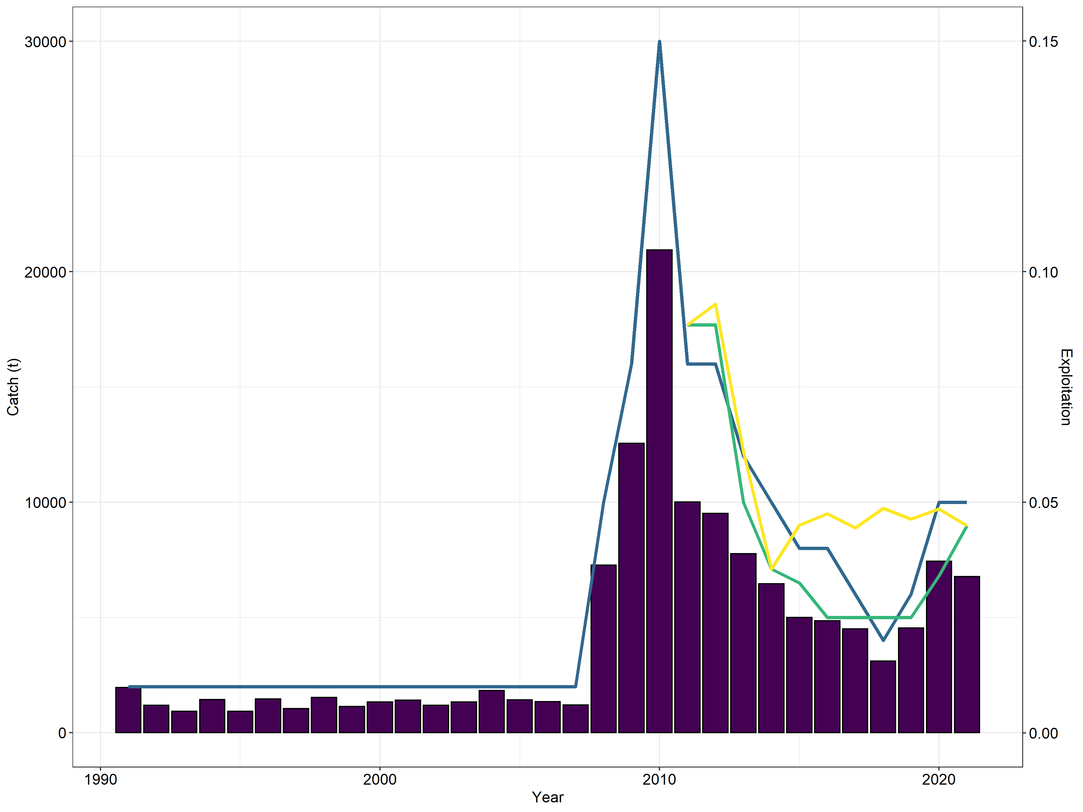
BSAI Greenland turbot catch and exploitation
30
Catch
0.15
Exploitation
ABC
TAC
20
0.10
Exploitation
Catch (1000s t)
10
0.05
0
0.00
1990
2000
2010
2020
Year

Slide 3
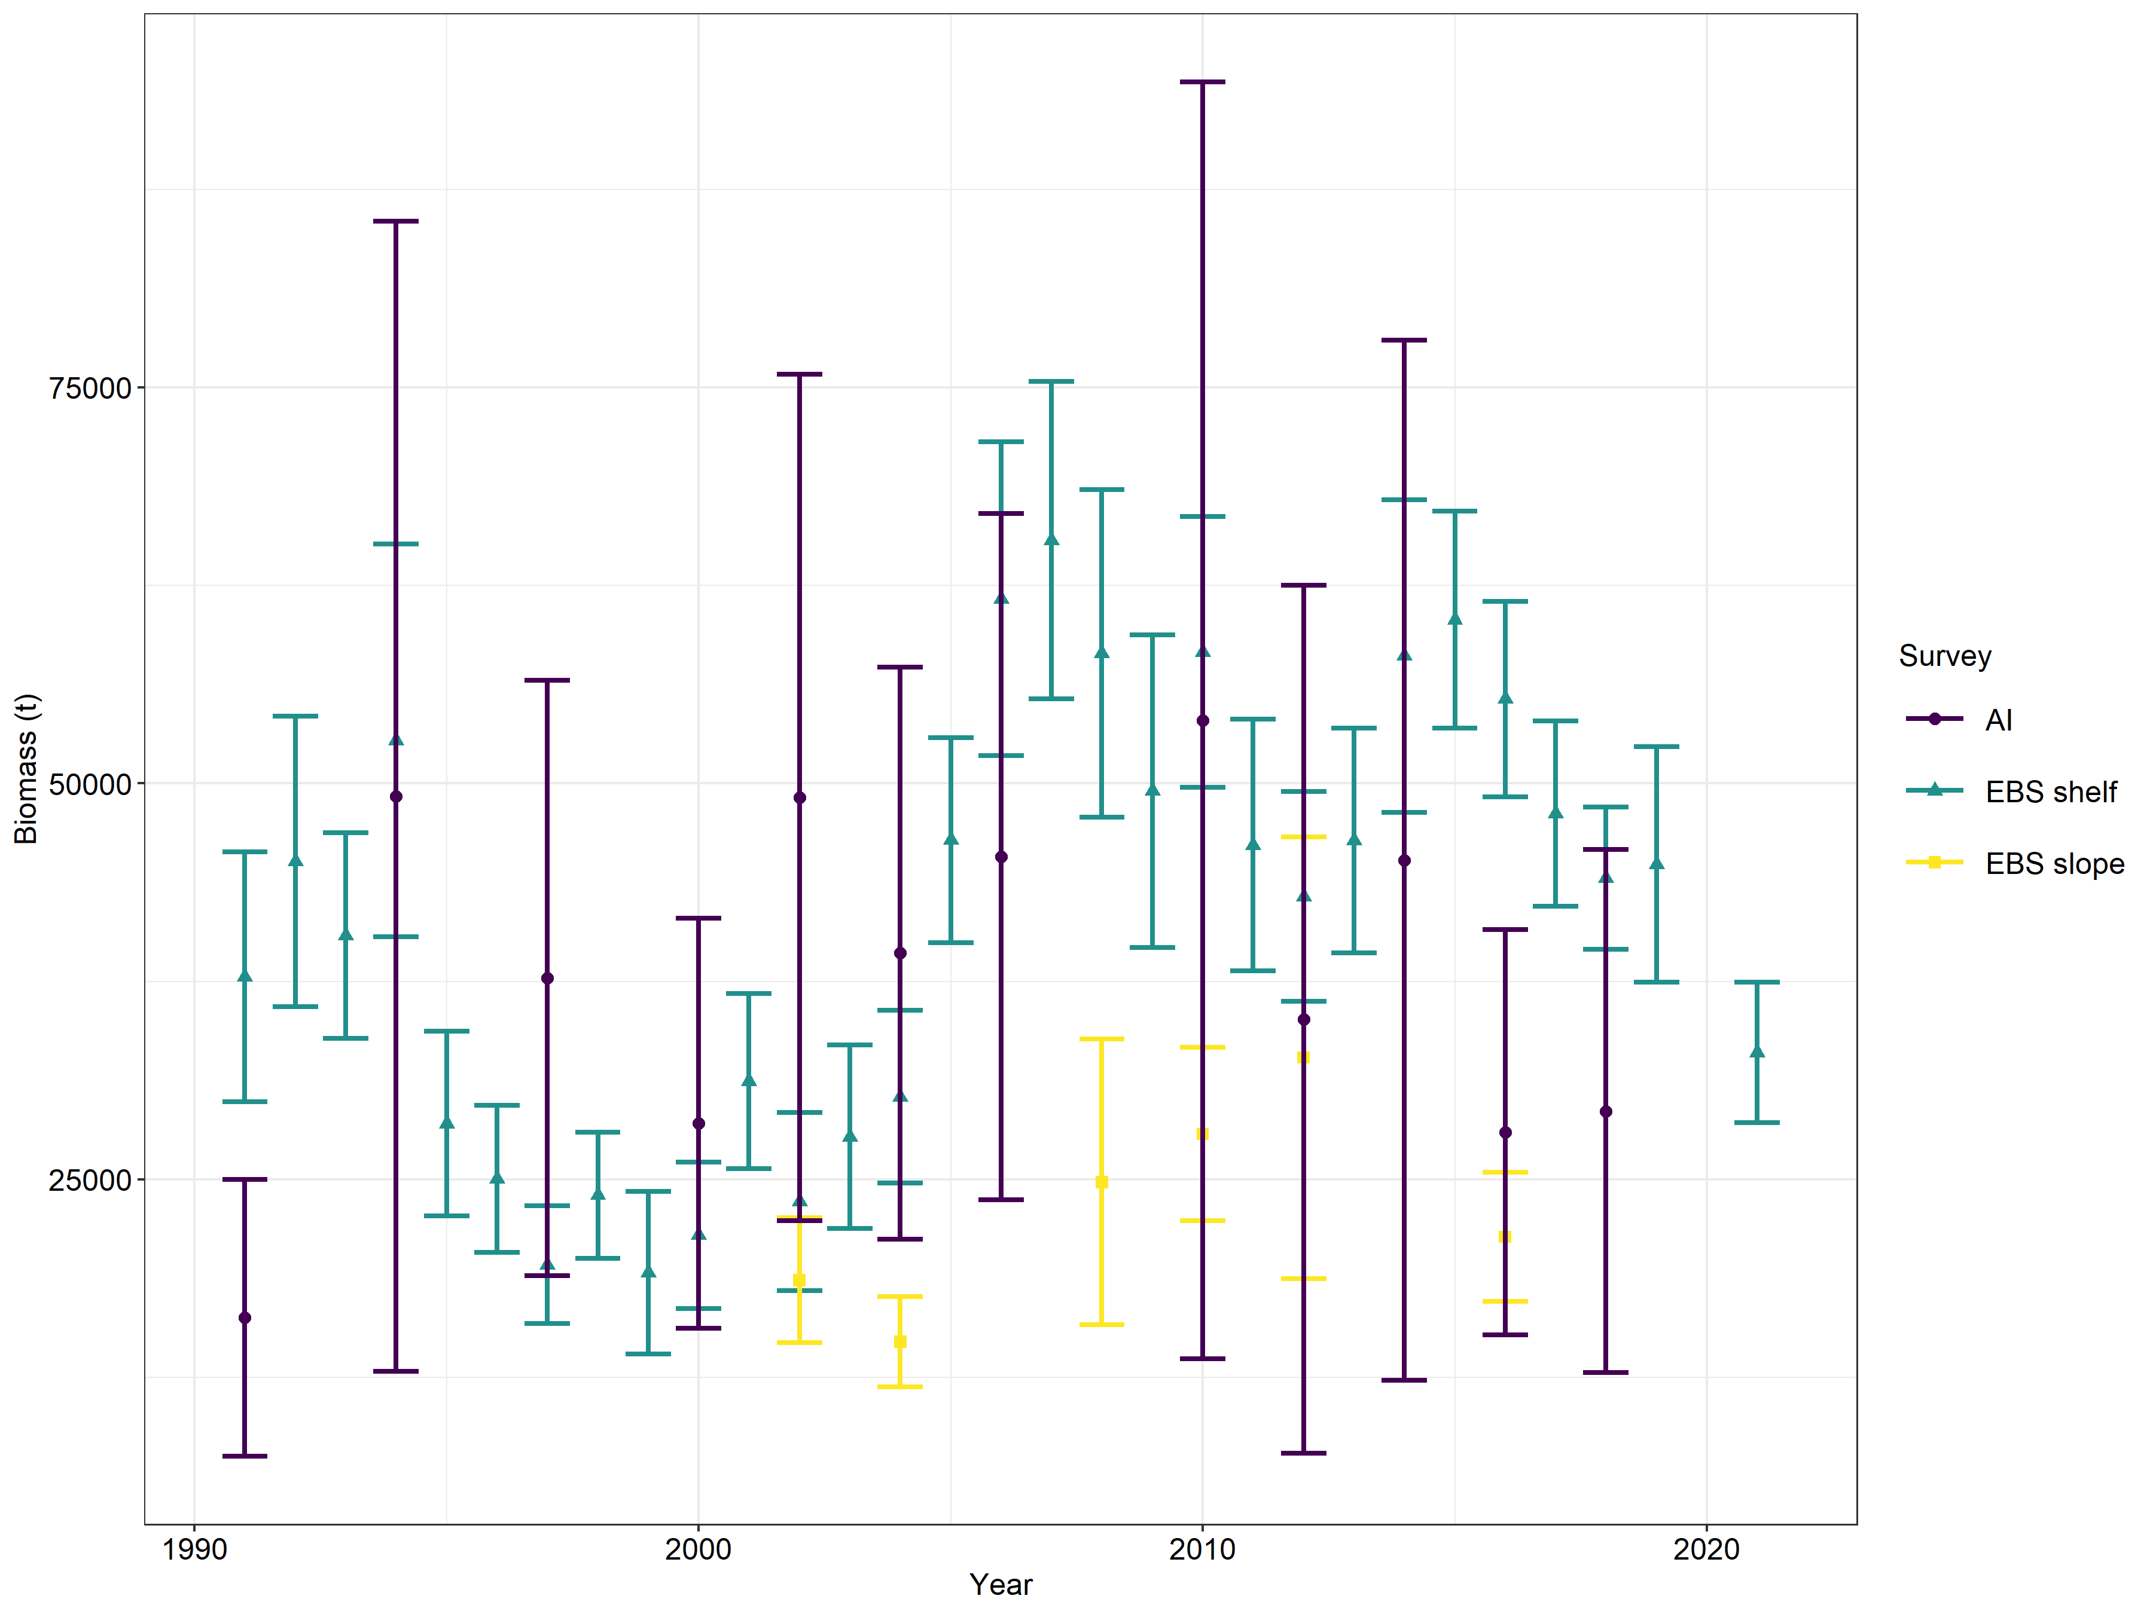
Survey biomass
AI
EBS Shelf
EBS Slope
ABC
TAC
75
-26%
50
Biomass (1000s t)
-33%
25
1990
2000
2010
2020
Year

Slide 4
Partial assessment
Assessment model was not updated
Catch was updated
  Final 2020 – 7,422 t
    Reduced from 7,427 t
  Preliminary 2021: 6,770 t
    Catch as of October 8th was expanded by a factor of 1.0493
Preliminary catch used a catch input for 2021, 2022, and 2023
Notes:
This expansion factor represents the average proportion of catch after October 8th between 2016 and 2020.

Slide 5
Quantity | As estimated or specified last year for: |  | As estimated or recommended this year* for:
 | 2021 | 2022 | 2022 | 2023
M (natural mortality rate) | 0.11 | 0.11 | 0.11 | 0.11
Tier | 3a | 3a | 3a | 3a
Projected total (age 2+) biomass (t) | 144,671 | 143,248 | 143,983 | 142,762
Female spawning biomass (t) | 54,341 | 55,256 | 55,701 | 57,082
Projected
B_{100%} | 101,376 | 101,376 | 101,376 | 101,376
B_{40%} | 40,550 | 40,550 | 40,550 | 40,550
B_{35%} | 35,482 | 35,482 | 35,482 | 35,482
F_{OFL} | 0.108 | 0.108 | 0.108 | 0.108
maxF_{ABC} | 0.090 | 0.090 | 0.090 | 0.090
F_{ABC} | 0.090 | 0.090 | 0.090 | 0.090
OFL (t) | 10,630 | 10,843 | 10,903 | 11,115
maxABC (t) | 8,982 | 9,163 | 9,214 | 9,393
ABC (t) | 8,982 | 9,163 | 9,214 | 9,393
Status | As determined last year for: |  | As determined this year for:
 | 2019 | 2020 | 2020 | 2021
Overfishing | No | n/a | No | n/a
Overfished | n/a | No | n/a | No
Approaching overfished | n/a | No | n/a | No
Notes:
2022 ABC is 2.6% higher than 2021 ABC
2022 ABC is less than 1% higher than the 2022 ABC projected last year.

