Slide 1

2022 BSAI Pacific ocean perch Assessment
Paul Spencer and Jim Ianelli
Alaska Fisheries Science Center

Slide 2
Overall summary
Straightforward assessment
No changes to recommended model (although a model fit to survey abundances was considered)
Recent high survey biomass estimates have been keeping model-estimated biomass high.
2023 ABC of 42,038 t (18% increase from 2022 ABC).
Assessment-related concerns noted in risk table.

Slide 3
BSAI POP Outline
SSC, Plan Team comments
Catch information
Survey and fishery data
Model description, fits to data
Retrospective analysis
Risk table
Management recommendations

Slide 4
SSC and Plan Team comments
(SSC, October 2022)The SSC recommends that assessment authors continue to highlight instances where the lack of these data [the EBS slope survey] may degrade stock assessment performance.
The EBS slope survey is used in the model, and is the only fishery-independent data for this portion of the stock. The lack of the EBS slope survey degrades the assessment.

Slide 5
SSC and Plan Team comments
(BSAI Plan Team, November 2020) The Team recommended investigating Francis weighting and trying different time blocks of natural mortality to help improve the fit to the Aleutian Islands survey index.
(SSC, December 2020) The lack of fit in recent years is concerning and the SSC suggests that this should continue to be a focus of future work.
(SSC, December 2020) The SSC supports continued work on evaluating M, including examining the impact of loosening the prior on M and considering time blocks in M, as suggested by the BSAI GPT, if an appropriate rationale can be developed. The SSC also supports the BSAI GPT recommendation to investigate Francis weighting.
These comments formed the Terms of the Reference for the CIE review in spring, 2022, and were evaluated with modifications to the 2020 accepted model

Slide 6
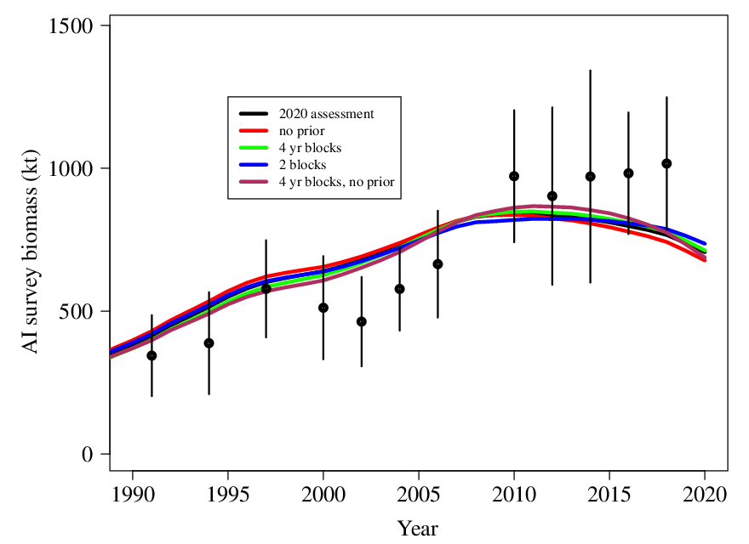
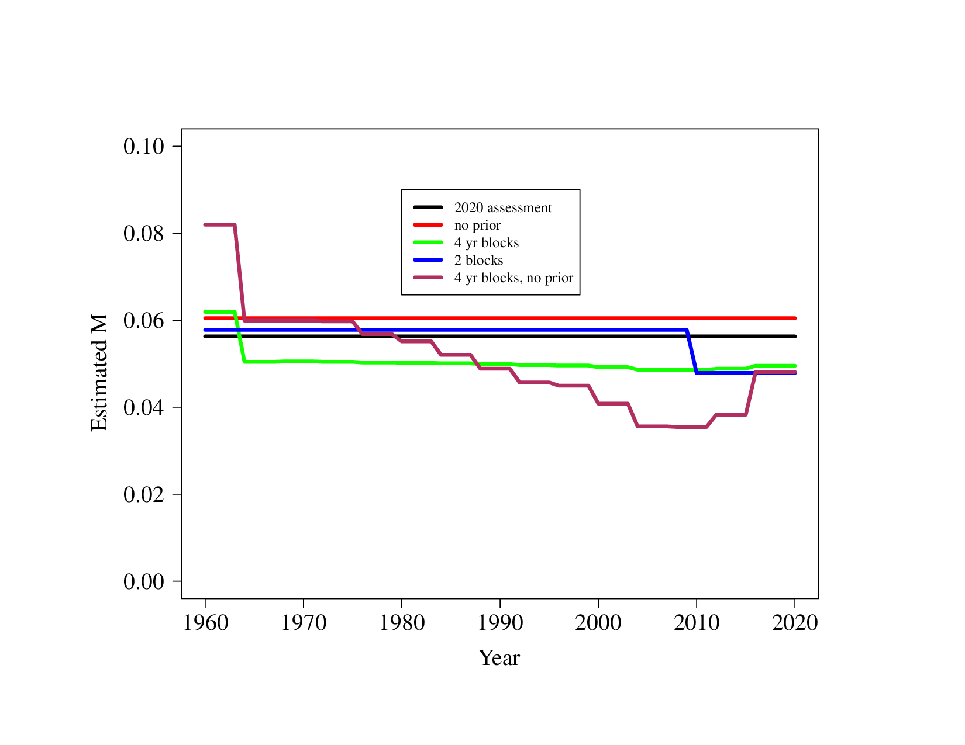
SSC and Plan Team comments
Estimation of natural mortality in the model
Various options for estimating natural mortality did not improve the fit to the AI survey index
The CIE panel also considered that implementing time-varying dynamics in processes such as natural mortality, when used to improve retrospective patterns, can cause misspecification in reference points if the “wrong” process is modeled (Szuwalski et al. 2018)
The CIE panel was split regarding the utility of further exploring time-varying natural mortality

Slide 7
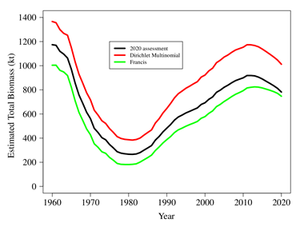
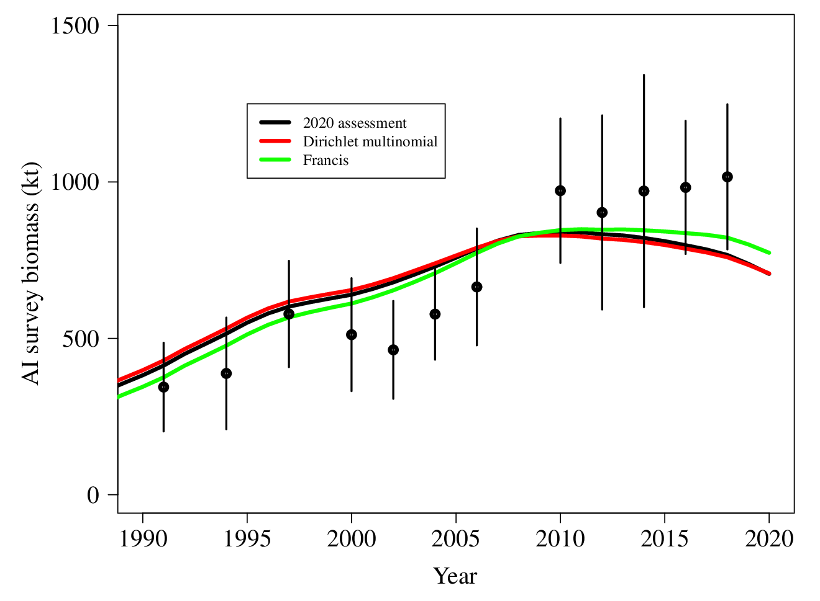
SSC and Plan Team comments
Data weighting
Several data-weighting procedures were evaluated, including McAlllister-Ianelli, Francis, and the Dirichlet-multinomial.
The data-weighting procedures affected the scale of estimated biomass (via estimation of survey catchability), but did not substantially improve the fit to the AI survey biomass time series
The CIE reviewers did not find that alternative data-weighting procedures improved to model sufficiently to warrant departure from the McAllister-Iannelli weighting.

Slide 8
BSAI catch has increased
Peaked in 2019 – 2020, declined last couple years
(2022 through September 25)

Slide 9
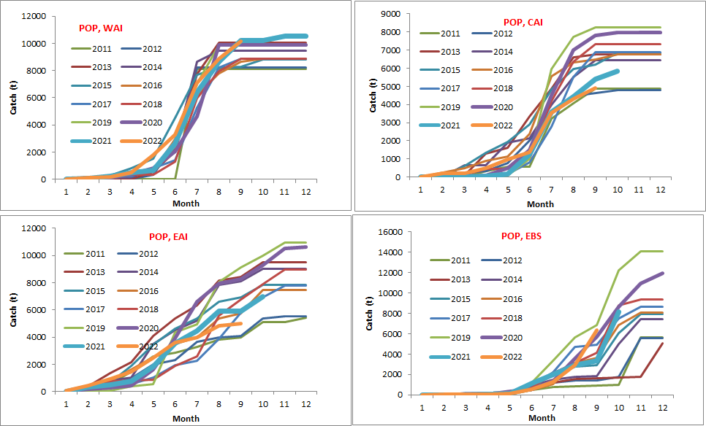
BSAI POP catch by month and area, 2011-2022

Slide 10
Data in assessment model
Component | BSAI
Fishery catch | 1960-2022
Fishery age composition | 1981-82, 1990, 1998, 2000-2009, 2011, 2013, 2015, 2017, 2019, 2020, 2021
Fishery size composition | 1964-72, 1983-1984, 1987-1989, 1991-1997, 1999, 2010, 2012, 2014, 2016, 2018
AI Survey age composition | 1991, 1994, 1997, 2000, 2002, 2004, 2006,2010,2012,2014,2016, 2018
AI Survey length composition | 2022
AI Survey biomass estimates | 1991, 1994, 1997, 2000, 2002, 2004, 2006, 2010, 2012, 2014, 2016, 2018, 2022
EBS Survey age composition | 2002,2004,2008,2010,2012,2016
EBS Survey biomass estimates | 2002,2004,2008,2010,2012,2016

Slide 11
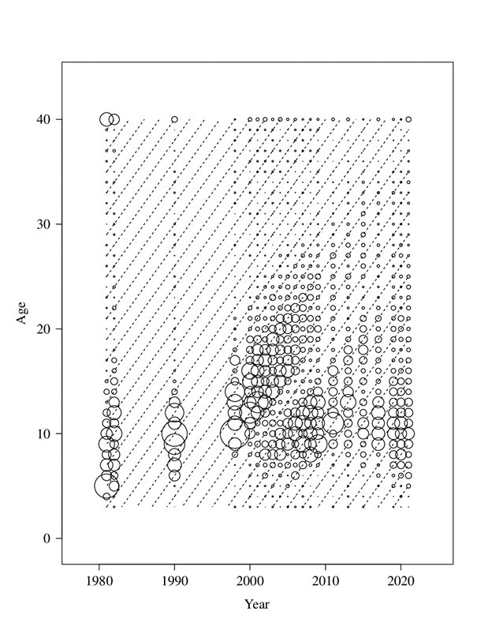
POP fishery age composition data

Slide 12
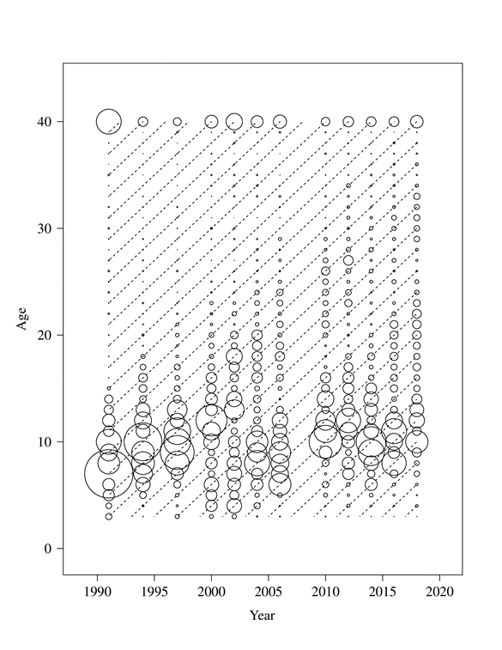
POP AI survey age composition data

Slide 13
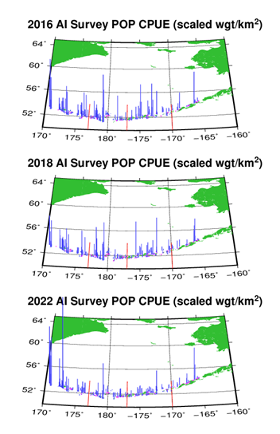
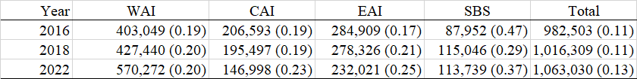
Survey CPUE, 2014 – 2022 AI surveys

Slide 14
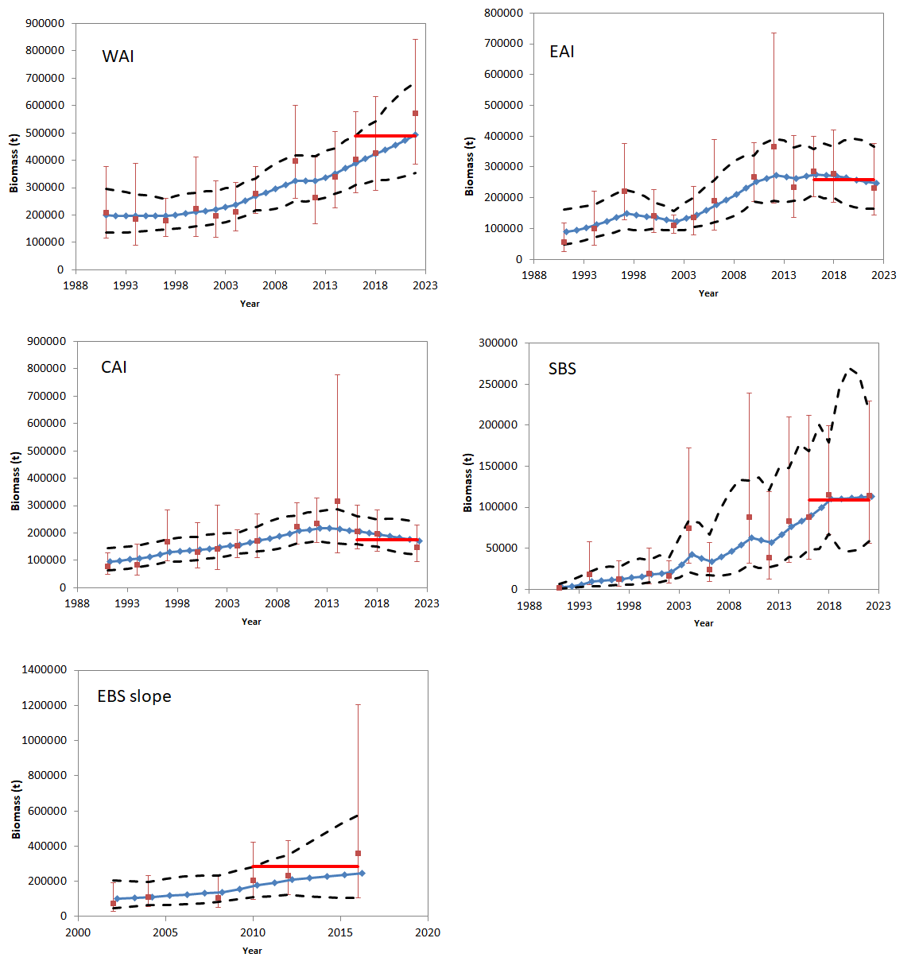
Smoothed survey time series by subarea

Slide 15
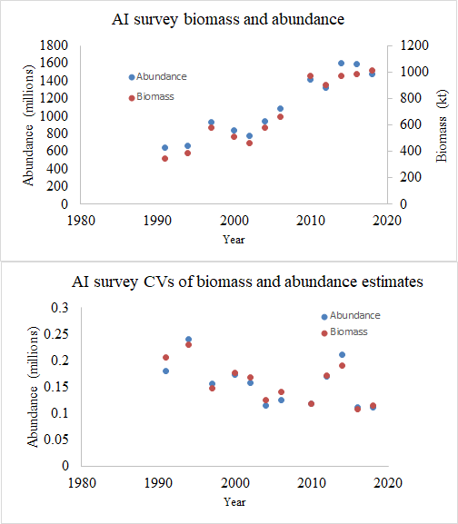
AI survey biomass and abundance
CIE panel recommended evaluatnjg a model with fit to survey abundance rather than survey biomass

Slide 16
Model description
Model | Differences from 2020 model
Model 16.3 (2022) | No modeling differences
Model 22 | Fit the model to the survey abundance indices instead of the survey abundance indices.

Slide 17
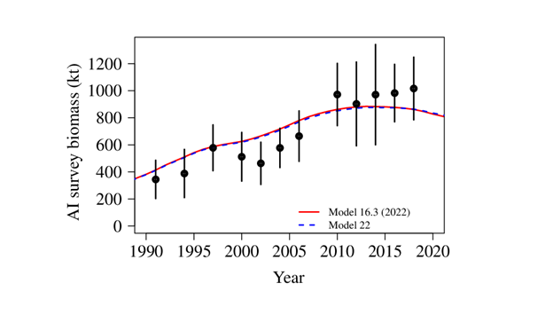
Fit to the AI survey

Slide 18
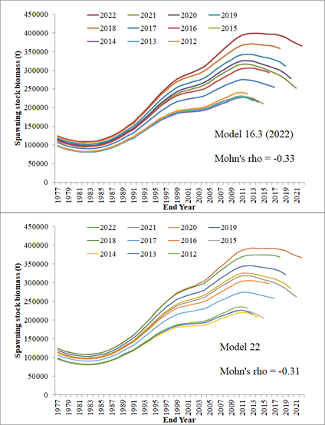
Retrospective pattern in SSB

Slide 19
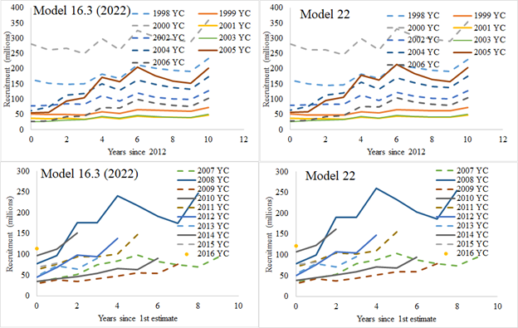
Retrospective pattern in estimated recruitments

Slide 20
Model Selection
Fitting the survey abundance indices, rather than the survey biomass indices, did not improve the assessment model.

Slide 21
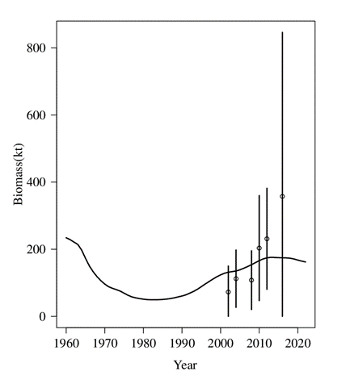
Fit to the EBS survey index

Slide 22
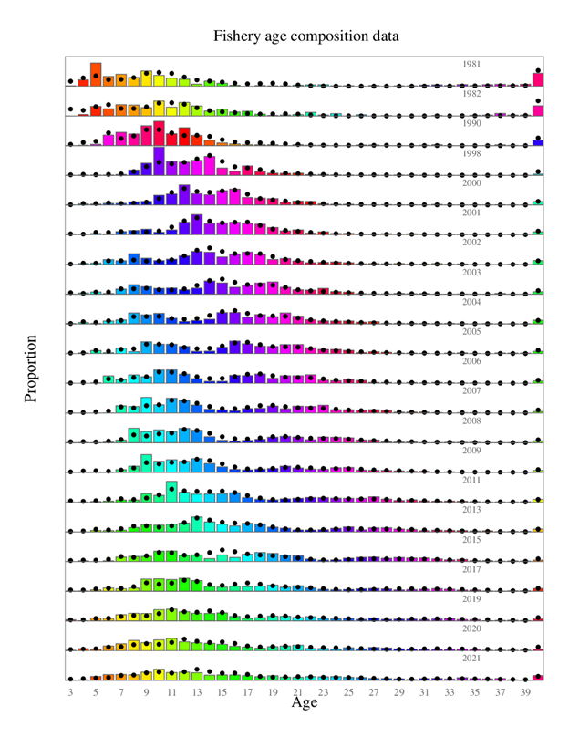
BSAI fishery age composition

Slide 23
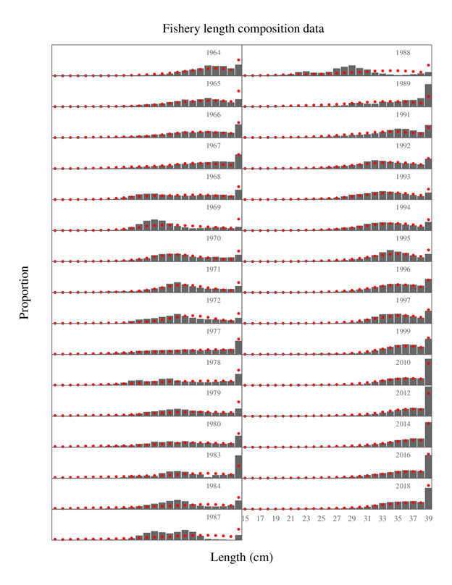
Fishery length composition

Slide 24
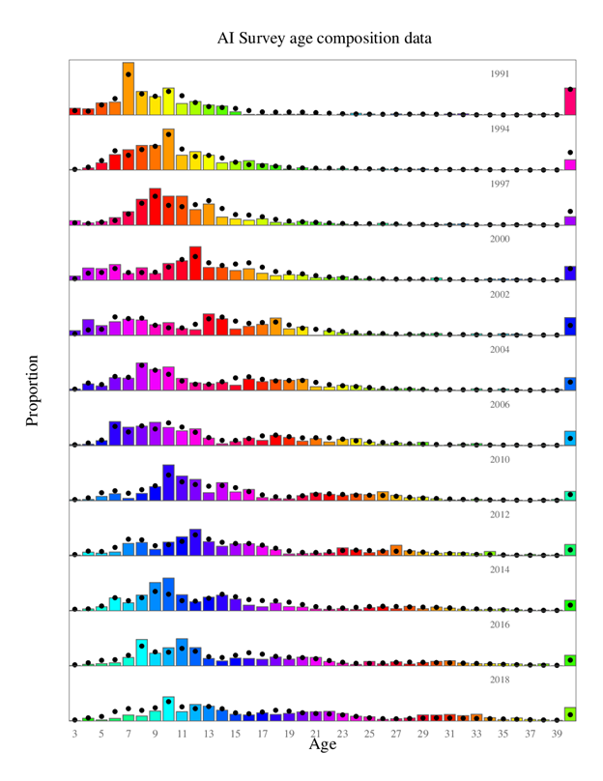
AI survey age composition

Slide 25
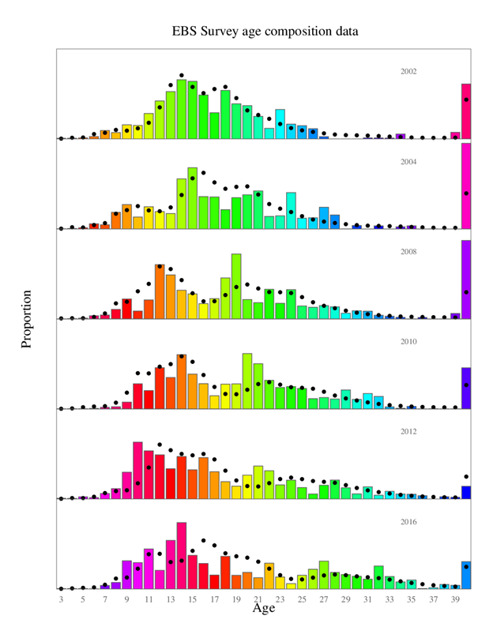
EBS survey age composition
Not a great fit to the EBS survey age compositions
2000 year class is strong in the AI age data, not so much in the EBS data

Slide 26
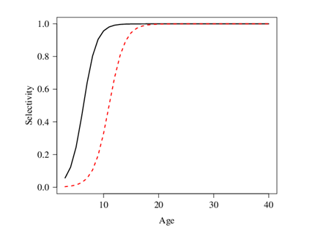
EBS and AI survey selectivity
AI survey
EBS survey

Slide 27
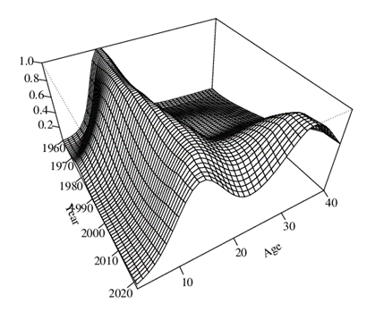
Fishery selectivity

Slide 28
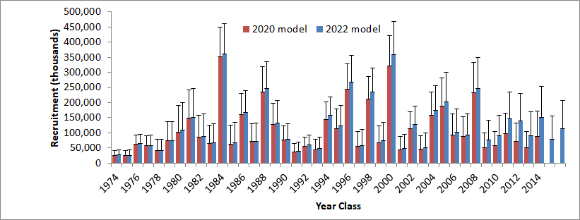
BSAI POP recruitment

Slide 29
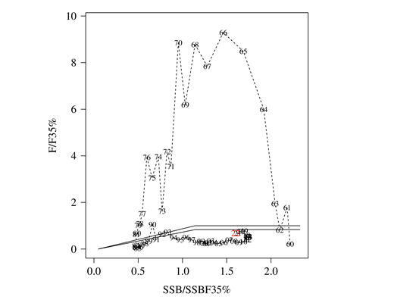
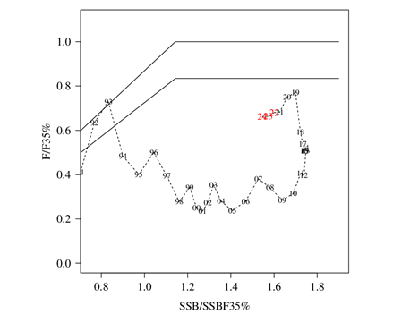
Phase plane plot

Slide 30
Risk table considerations
Assessment considerations: “data-inputs: biased ages, skipped surveys, lack of fishery-independent trend data; model fits: poor fits to fits to fishery or survey data, inability to simultaneously fit multiple data inputs; model performance: poor model convergence, multiple minima in the likelihood surface, parameters hitting bounds; estimation uncertainty: poorly-estimated but influential year classes; retrospective bias in biomass estimates.
Level 2: Substantially increased uncertainty/unresolved issues. Strong retrospective bias that could represent model misspecification, but population dynamics and/or observational processes have not been identified. Poor residual pattern in fitting recent AI survey biomass estimates.

Slide 31
Risk table considerations
Population dynamics considerations: “decreasing biomass trend, poor recent recruitment, inability of the stock to rebuild, abrupt increase or decrease in stock abundance.
Level 1: Stock trends are typical for the stock; recent recruitment is in the normal range.
Rapid increase in the stock between 2006-2010 is somewhat unusual, although there is precedence for the stock rebuilding quickly from periods with strong recruitments. Recent recruitments have been lower.

Slide 32
Risk table considerations
Environmental/ecosystem considerations: “adverse trends in environmental/ecosystem indicators, ecosystem model results, decreases in ecosystem productivity, decreases in prey abundance or availability, increases or increases in predator abundance or productivity.”
Level 1: Normal. “Taken together, these indicators suggest no clear concerns for the POP stock aside from the recent stretch of increased temperatures. That being said, the recent increasing trend in the POP stock suggests that the temperature impacts have not been limiting. However, the lack of data in 2020 limits our assessment of potential recent ecosystem impacts on this stock. Overall, we rank the assessment considerations as a 1”

Slide 33
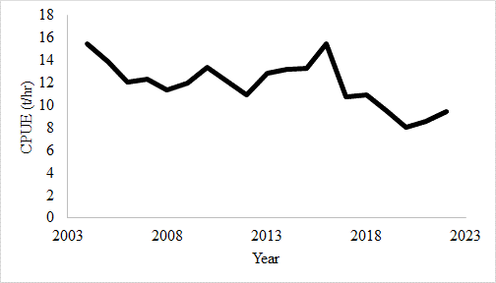
Fishery CPUE
Tons/hr, from tows targeting POP based on haul species composition. Source: North Pacific Groundfish Observer Program.

Slide 34
Risk table considerations
Fishery performance considerations: “fishery CPUE is showing a contrasting pattern from the stock biomass trend, unusual spatial pattern of fishing, changes in the percent of TAC taken, changes in the duration of fishery openings.”
Level 1: No apparent fishery/resource-use performance and/or behavior concerns.
Fishery CPUE was relatively stable from 2004-2016. A decline in CPUE has occurred since 2017, which might be related to change in fishing practices in order to better avoid bycatch stocks.

Slide 35
Reference points and ABCs
Recommended 2023 BSAI ABCs and OFLs
BSAI ABC: 42,038 t (increase from 2022 ABC of 35,688 t)
BSAI OFL: 50,133 t (increase from 2020 OFL of 42,605 t)

Slide 36
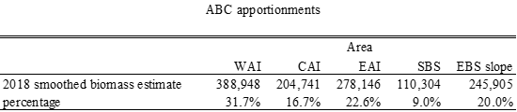
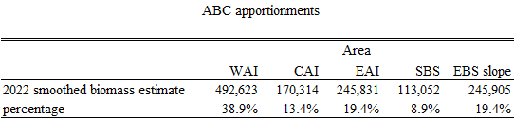
Spatial apportionments
Spatial apportionment from 2020 assessment)
Spatial apportionment from 2022 assessment)

Slide 37
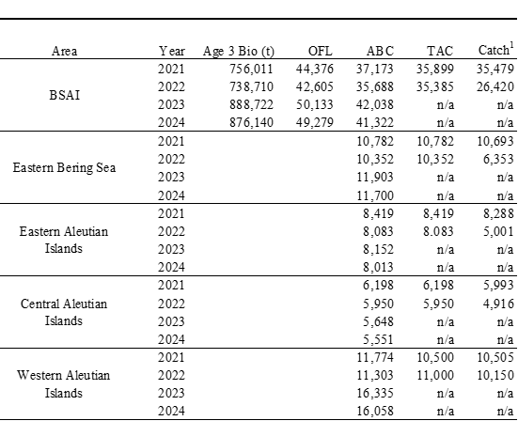
Subarea ABCs
.

Slide 38
Conclusions
Continued high abundance of POP
High survey biomass estimates have been keeping the estimated biomass in the assessment at a high level.
Statistical estimation of ageing error (i.e., Punt method) would be useful
Further exploration of smoothing in bicubic fishery selectivity should be explored
Further CIE comments – numbers at age in initial model year

Slide 40
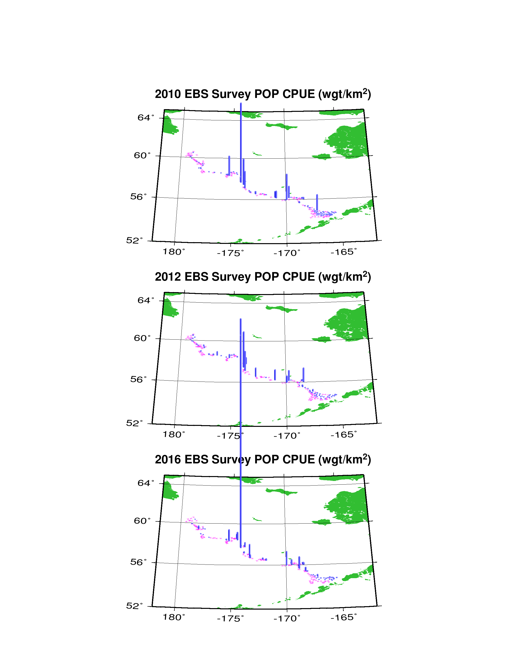
Survey CPUE, 2010 – 2016 EBS surveys

Slide 41
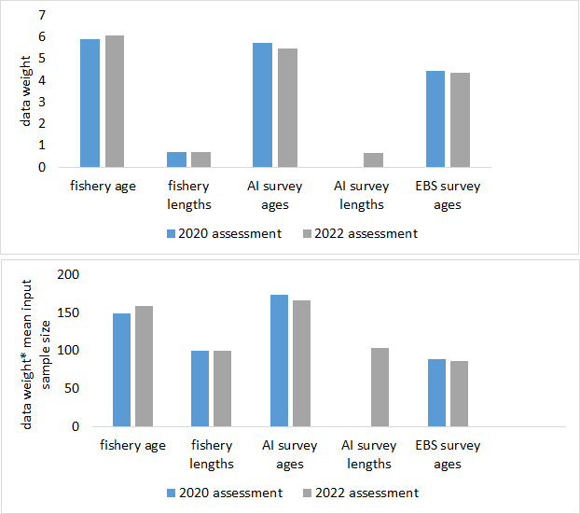
Age/length composition weights
Data weights
(Data weights) *
(mean input sample size)

