Slide 1



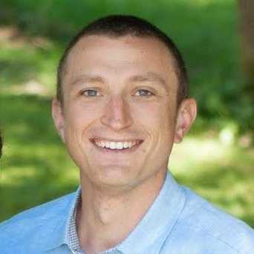
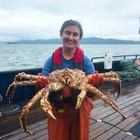

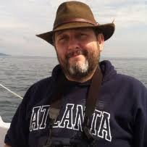
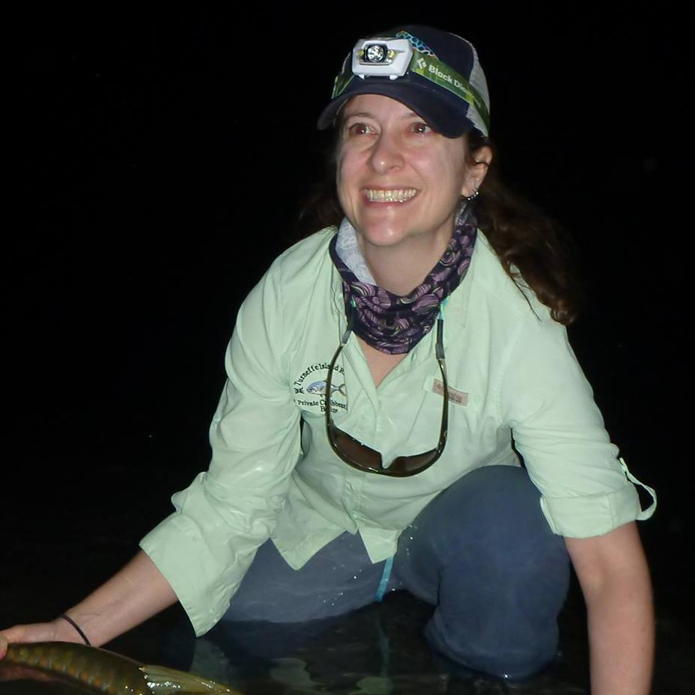
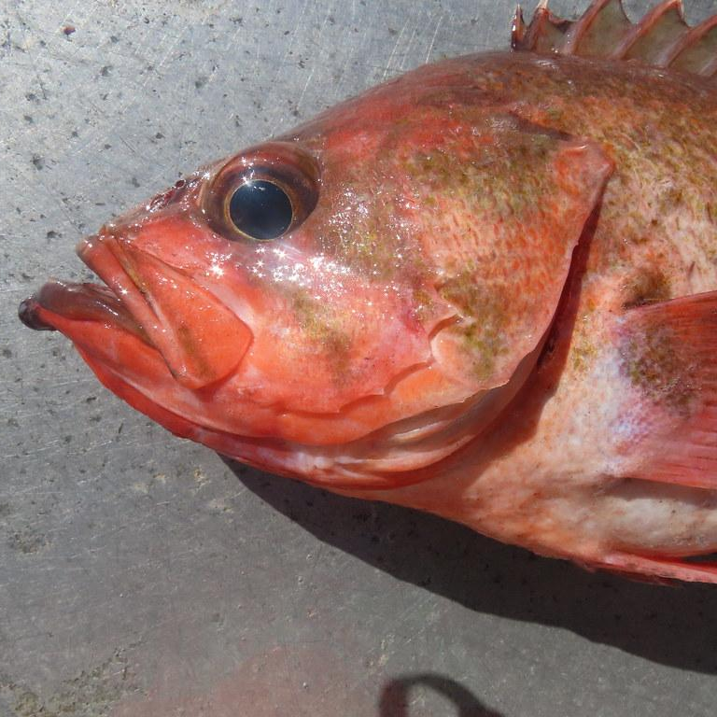
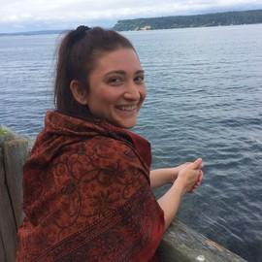
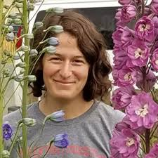
Partial Assessments
BSAI Groundfish Plan Team
Cole Monnahan, Jane Sullivan, Jim Ianelli, Steve Barbeaux, Cindy Tribuzio, Paul Spencer, Maia Kapur, Cara Rodgveller
November, 2022

Slide 2
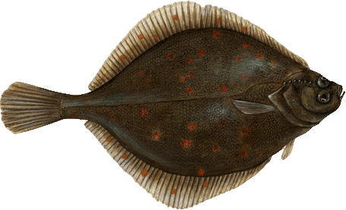
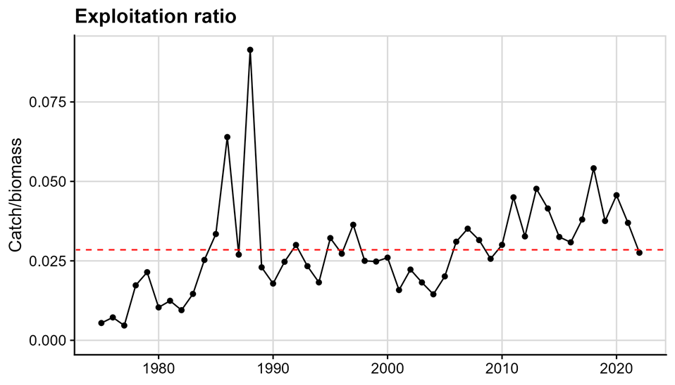
Alaska Plaice (Tier 3a)
Not overfishing, overfished or approaching overfished
Fishery Trends: Catches stable since 2010, slight decrease in 2022
Survey Trends: Slight increase in 2022 but still well below long-term mean
Update Projection Catch:
  2021: 15,862 t, 2022 and 2023: 12,226 t
  Catch/Biomass decreased in 2022, estimated to be near long-term mean
ABC: 33,946 t, OFL: 40,823 t
Thanks to Jane Sullivan and Cole Monnahan

Slide 3
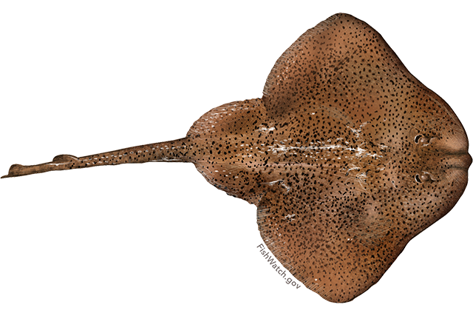
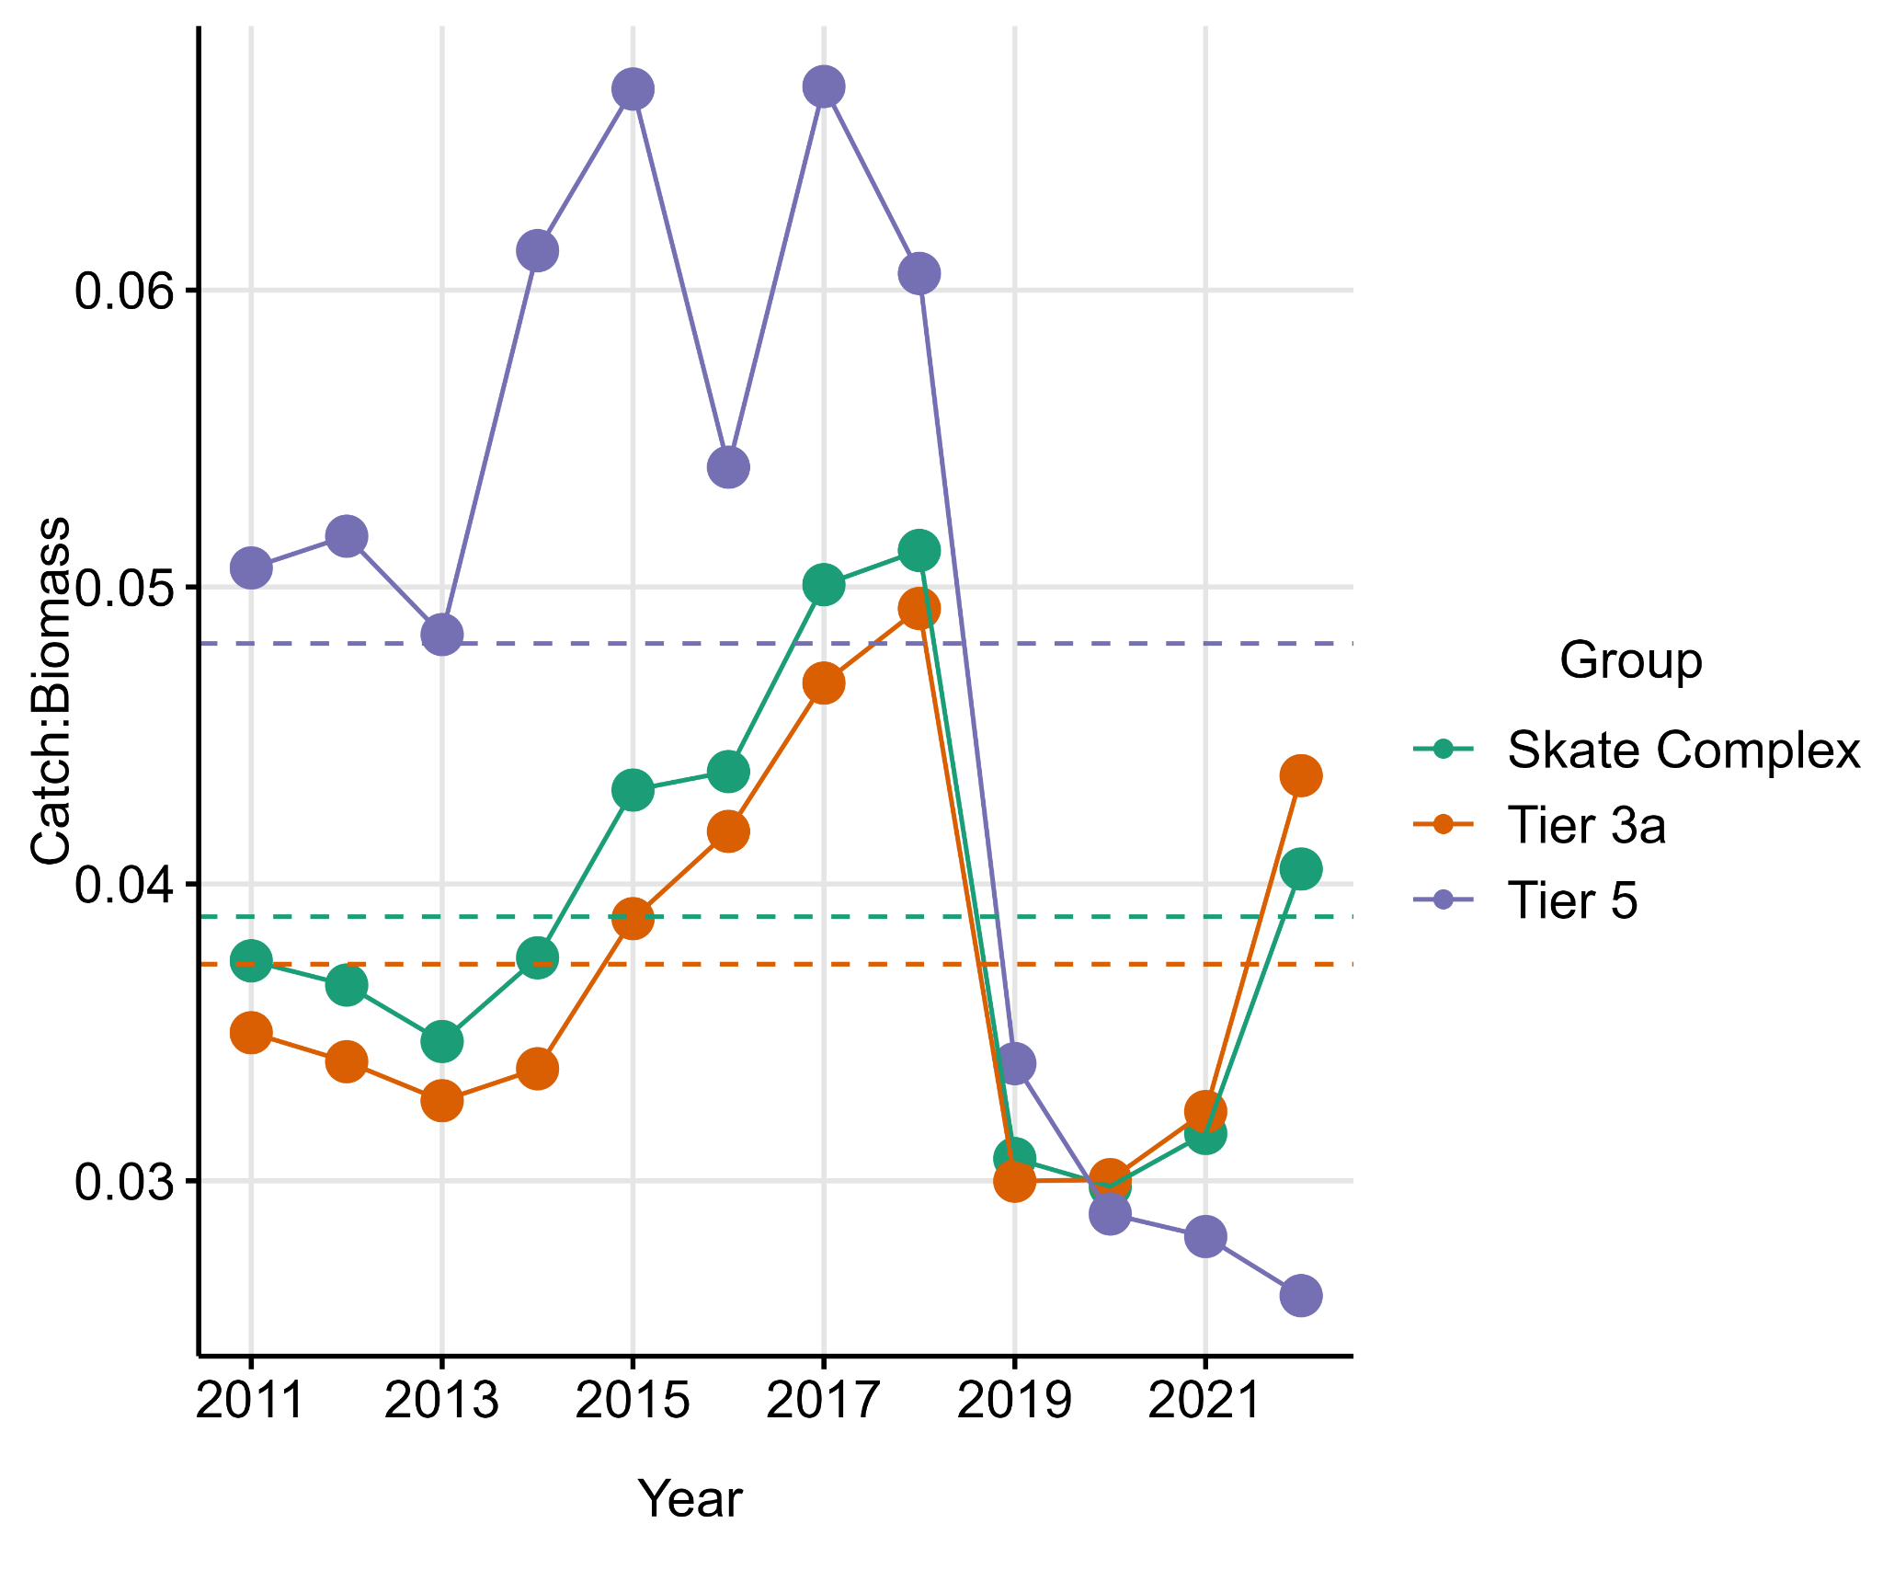
Skates (Tier 3a/5)
Not overfishing
Fishery Trends: catch of Alaska skate up in 2022, other skates stable
Survey Trends: slight decrease in Alaska skate in 2022, trending down from 2016. Other skates up slightly, continuing trend since 2019
Catch/Biomass - Tier 3a: increasing, above long term mean
Catch/Biomass - Tier 5: decreasing, well below long term mean
Harvest Recommendations
  Tier 3a: ABC: 30,567 t, OFL: 35,503 t
  Tier 5: ABC: 8,038 t, OFL: 10,717 t
  Complex: ABC: 38,605 t, OFL: 46,220 t
Thanks to Cindy Tribuzio, Jim Ianelli, and Steve Barbeaux

Slide 4
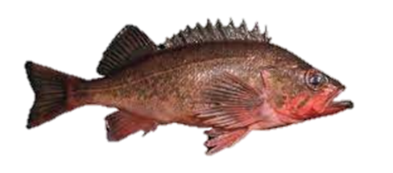
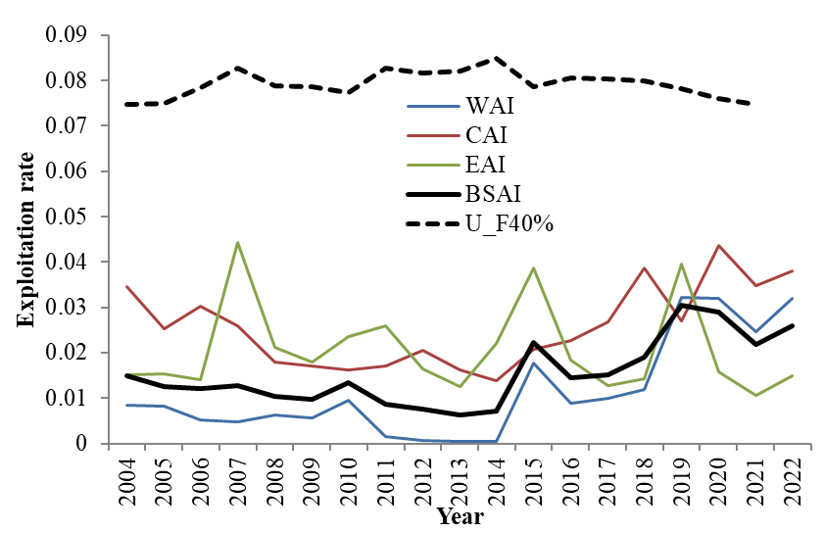
Northern Rockfish (Tier 3a)
Not overfishing, overfished or approaching overfished
Fishery Trends: Catches peaked in 2019- 2020, declined in 2021, and increased in 2022.
Survey Trends: AI survey biomass increased in 2022, and are above long-term mean
Update Projection Catch:
  2021: 6,212 t, 2022: 8,434 t, 2023: 8,129 t
  Catch/Biomass: Increased since 2014, but below U_{F40%} reference exploitation rate.
ABC: 18,687 t, OFL: 22,776 t
Thanks to Paul Spencer

Slide 5
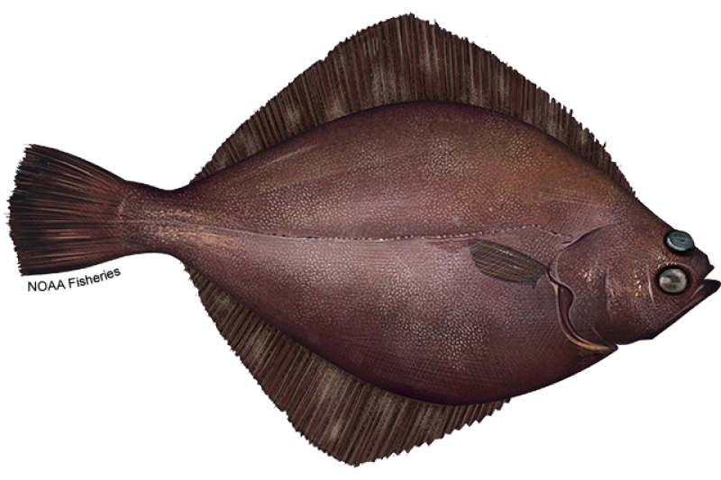
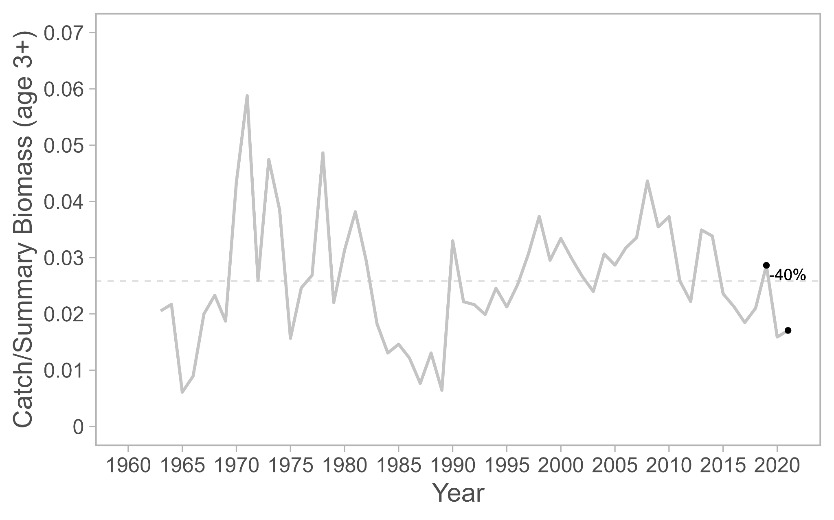
Flathead Sole (Tier 3a)
Not overfishing, overfished or approaching overfished
Fishery Trends: Catches down 2020/2021 (as for GOA Flathead sole)
Survey Trends: Up 6% over 2021
Update Projection Catch:
    2021: 10,259 t
    2022: 14,659 t
    2023: 11,130 t
  Catch/Biomass down 40% 2019-2021
ABC: 65,344 t OFL: 79,256 t
Thanks to Maia Kapur
Notes:
as of data pull, 2022 catches were at 14,075.
Note that 2023-2024 catches are higher than recent observations due to pandemic dropoff in catches (projection uses 5y average)

Slide 6
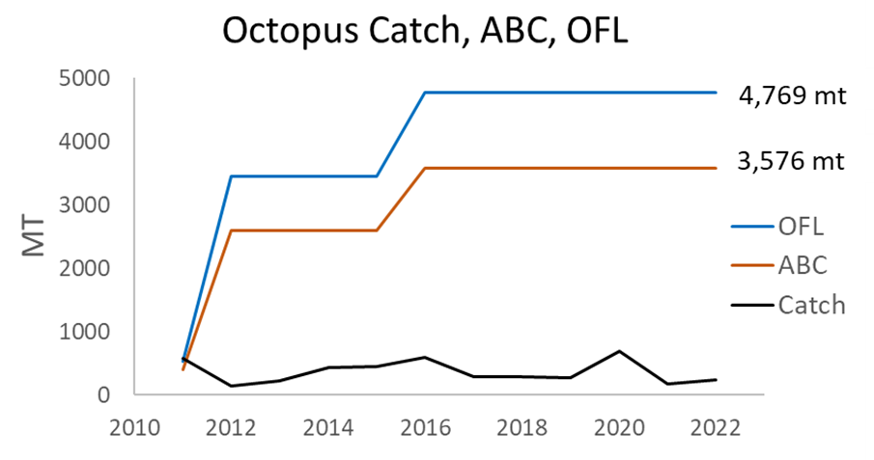
Octopus (Tier 6)
Alt. Tier 6 - conservative est. of total mortality = octopus consumed by P. cod (AFSC food habits data)
Created for 2012; updated for 2016
ABC: 3,576 t, OFL: 4,769 t
Thanks to Cara Rodgveller

Slide 7
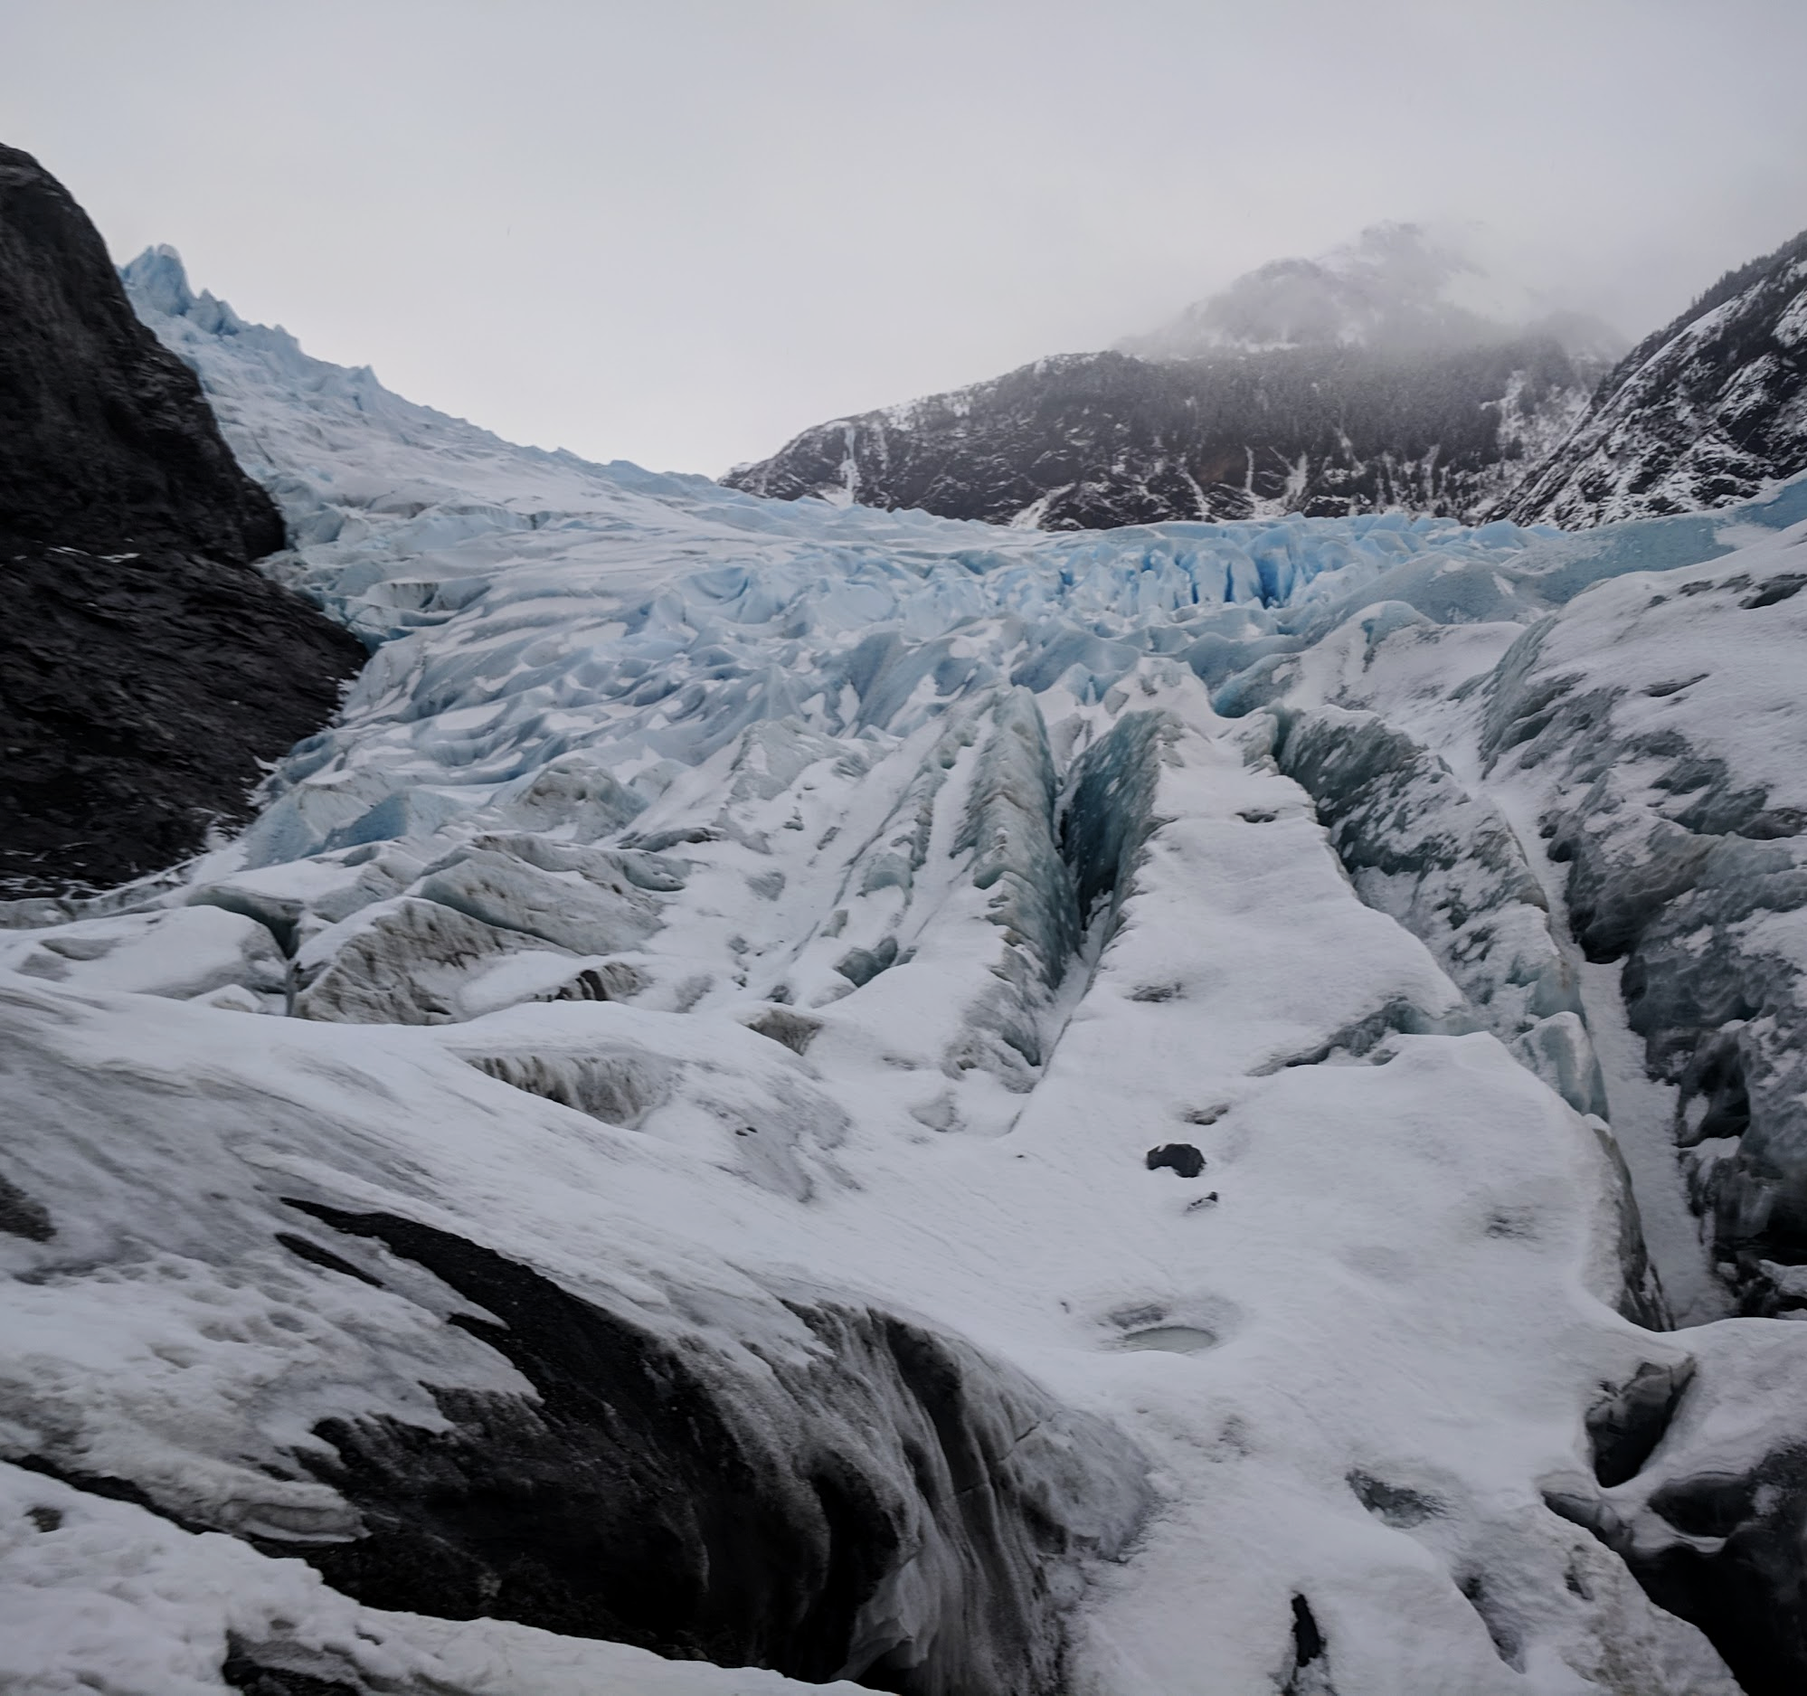
QUESTIONS?
PARTIAL ASSESSMENT CONTACTS:
COLE.MONNAHAN@NOAA.GOV
JANE.SULLIVAN@NOAA.GOV
JIM.IANELLI@NOAA.GOV
STEVE .BARBEAUX@NOAA.GOV
CINDY.TRIBUZIO@NOAA.GOV
PAUL.SPENCER@NOAA.GOV
MAIA.KAPUR@NOAA.GOV
CARA.RODGVELLER@NOAA.GOV

