Slide 1


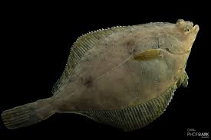
Assessment of the Yellowfin sole stock in the bering sea and aleutian islands
Ingrid Spies, November 16, 2021

Slide 2
Responses to SSC and Plan Team Comments Specific to this Assessment
SSC November 2020
We also agree that no adjustment to the maximum ABC is necessary at this time, based on the risk table. However, the SSC suggests that the authors and BSAI GPT consider a level 2 designation for the assessment category in the risk table, given the strong retrospective bias in the model.
Authors’ response:
Retrospective bias, measured by Mohn's Rho for model 18.2 (2020) was -0.185 and Rho for model 18.1 (2020) was -0.184. The Mohn's Rho for Model 18.2 (2021) was closer to zero than past assessments, -0.118.
Another consideration is the fit to the Ricker stock recruitment curve – is it sufficient to predict recruitment? Therefore, a reference table for Tier 3a is provided for comparison, and we propose a level 2 designation for the assessment category in the risk table.

Slide 3
Responses to SSC and Plan Team Comments Specific to this Assessment
SSC November 2020
The SSC remains concerned about the large retrospective pattern and supports the PT recommendation to investigate decreased female natural mortality and weight at age.
Authors’ response:
In the current assessment, Mohn's rho shifted closer to zero. Further investigation into decreased female natural mortality should be a point of future study.

Slide 4
Responses to SSC and Plan Team Comments Specific to this Assessment
SSC November 2020
The SSC commends the authors for including temperature-dependent growth, validated by otolith chronologies, into the model as noted on p. 8 of the assessment. However, details of the implementation are not documented and the list of parameters does not show any parameters related to temperature-dependent growth. The SSC requests a clarification and, as appropriate, additional documentation of how temperature-dependent growth is implemented in the model.
Authors’ response
There is some evidence of temperature-dependent growth by Yellowfin sole (YFS) and thermal sensitivity. Temperature and start date are included in the calculation for survey catchability.

Slide 5
Responses to SSC and Plan Team Comments Specific to this Assessment
SSC November 2020
The SSC appreciates the discussion of YFS biomass trends in the NBS, including trends in the ADF&G survey in Norton Sound, as well as the inclusion of a model that uses VAST estimates of the combined EBS + NBS survey biomass time series (Model 18.4). Both models 18.3 and 18.4 provided good fits to the survey biomass estimates and reasonable estimates of total and spawning biomass. We note that the biomass in the NBS increased from 311,000 t in 2010 to 520,000 t in 2019 based on the NBS bottom trawl survey. Similarly, YFS catch per unit effort in the ADF&G trawl survey in Norton Sound has shown an increasing trend over time since the late 1970s with peak catches in 2019. …Therefore, and in anticipation of annual surveys in the NBS and potential further increases in YFS biomass in the NBS, the SSC encourages the authors to bring forward a model in the next assessment cycle, such as Model 18.4, that includes the NBS survey biomass estimates.
Authors’ response:
The VAST NBS+EBS survey estimates are used in Model 18.2b.

Slide 6
Responses to SSC and Plan Team Comments Specific to this Assessment
SSC November 2020
The SSC was concerned about some of the posterior distributions from the MCMC analysis, specifically the bimodality in log(Recruitment) for Model 18.2. The SSC requests that the authors provide standard diagnostics for assessing MCMC convergence and parameter correlations. If the bimodality in log(Recruitment) is a feature of Model 18.2, the SSC recommends that the authors examine if the issue is related to the separation of sexes in the model.
Authors' response:
With the reanalysis of survey weight at age, MCMC distributions no longer appear bimodal, and have improved over MCMC posteriors from the 2020 assessment.

Slide 7
Responses to SSC and Plan Team Comments Specific to this Assessment
SSC November 2020
The SSC recommends further investigation of previously noted issues as time allows, including possible further adjustments to estimating separate natural mortality for males and females, explorations of the sex ratio relative to the timing of annual spawning migrations as an alternative explanation for a high proportion of females, a potential link between wave height and catchability, and a single selectivity curve for both sexes. We note that the latter is supported by survey selectivity estimates that are virtually indistinguishable in Model 18.2 (Fig. 4.17) and by time-varying fishery selectivities that are very similar between males and females since the early 1980s, but diverge widely and inconsistently in some earlier years (Fig. 4.18).
Authors’ response:
Noted.

Slide 8
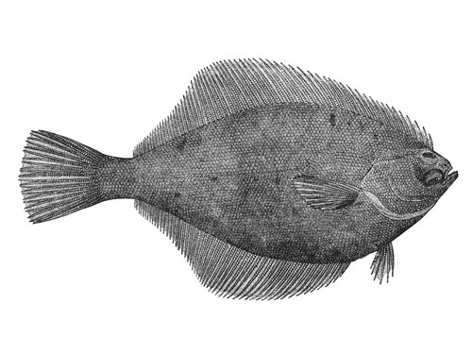
How are Yellowfin Sole sensitive to temperature?

Slide 9
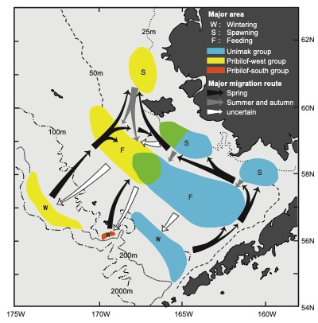
Distribution of wintering, spawning, and feeding areas for YFS in the Bering Sea
Distribution of wintering, spawning, and feeding areas for Yellowfin Sole in the Bering Sea, and observed regional grouping. Migration routes from wintering to feeding take place in spring.

Slide 10
Yellowfin sole early life history
It appears that YFS remain in the shallow nearshore nursery areas through at least their first 2 years post-settlement.
They begin to disperse offshore age 3-5 and by 5-8 years they follow adult migratory patterns.

Slide 11
Yfs settlement timing may reduce susceptibility to temperature
YFS may be less sensitive to temperature due to their settlement timing, relative to Northern Rock Sole, which seems to be sensitive to temperature.
YFS settle later in summer, when the influence of the cold pool is weaker and nearshore bottom temperature is relatively stable and high (Yeung and Yang, 2018).
YFS migrate across the shelf to spawn near their nursery habitat, rather than relying on currents for larval transport to nursery habitat (Nichol and Acuna, 2001).
Therefore, their larvae may be less susceptible to variable currents (Yeung and Cooper 2019).

Slide 12
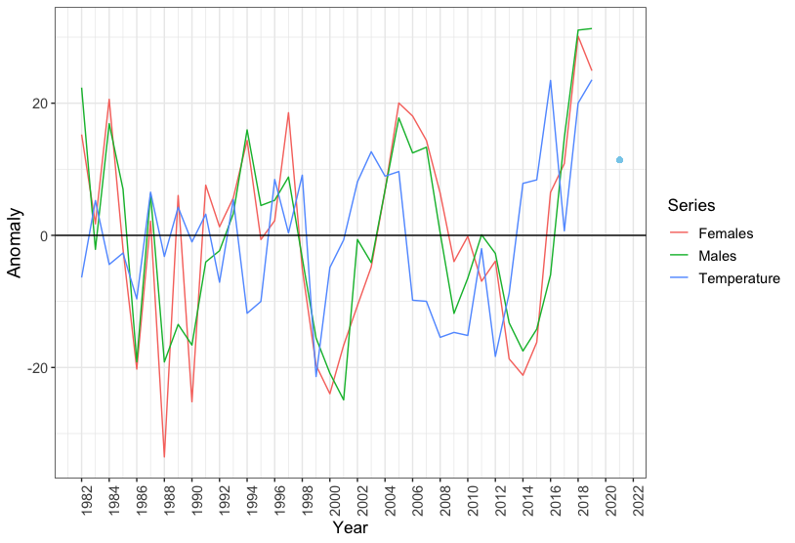
Yellowfin Sole length-at-age anomalies, for 5-year olds, and bottom temp. anomalies
Bottom temperature anomalies were scaled up by a factor of 10 to demonstrate the pattern and match length anomalies.
Late 1980s and early 1990s pattern may be a density-dependent response in growth from the large 1981 and 1983 year-classes.

Slide 13
Distribution of yfs in the e. and N. Bering Sea based on surveys in 2010, 2017, 2019, and 2021
There is inconclusive evidence that Yellowfin sole have shifted distribution in response to climate changes.

Slide 14
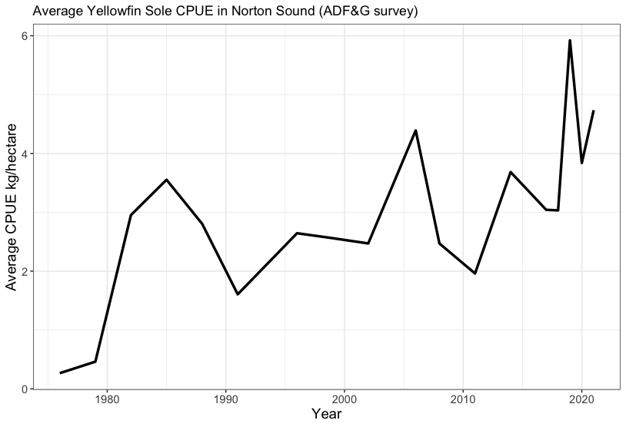
Average catch per unit effort (CPUE) of YFS in Norton Sound, ADF&G survey 1976 - 2021.

Slide 15
Weight at age (as a result of length at age) appears to be increasing with time.

Slide 16
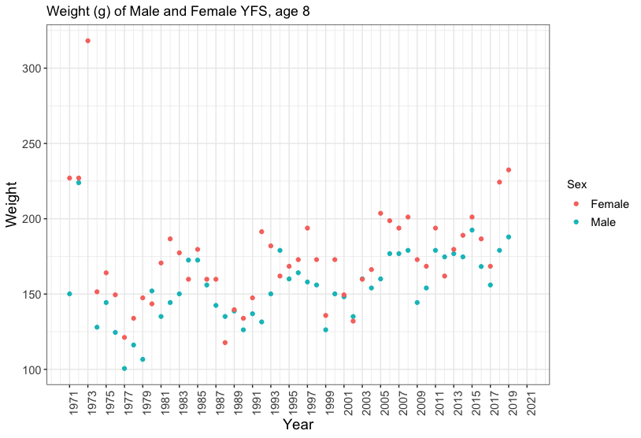
Mean weight at age (g) for Yellowfin Sole Age-8 females and males from the EBS survey
High values early in the time series are likely outliers.
1971-2019
Not associated with
obvious ageing error.

Slide 17
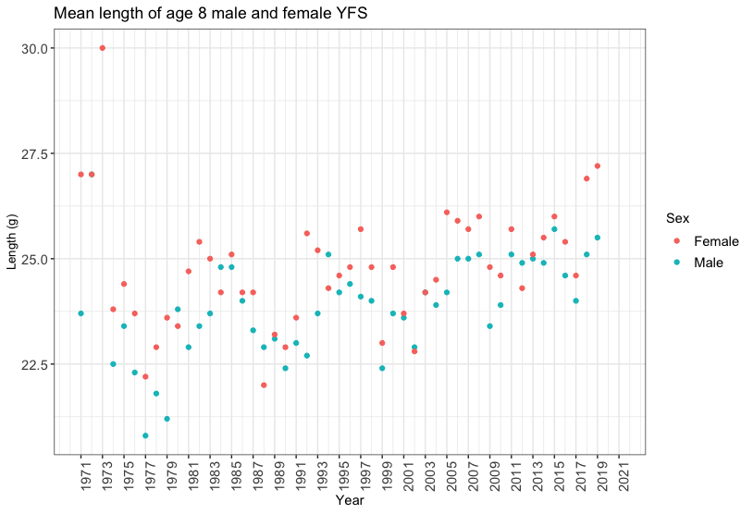
Mean length at age (cm) for Yellowfin Sole Age-8 females and males from the EBS survey
High values early in the time series are likely outliers.
1971-2019
Not associated with
obvious ageing error

Slide 18
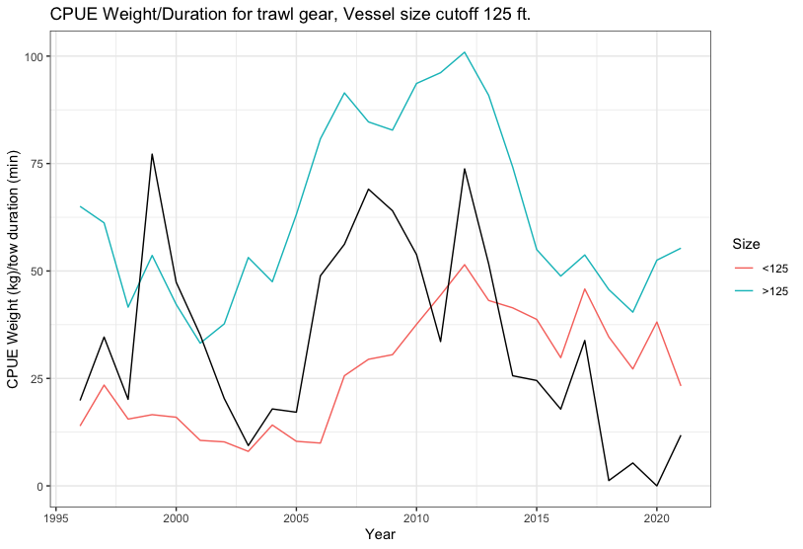
CPUE appears to be correlated with EBS survey cold pool index
Cold pool index: defined as the area of the EBS shelf with bottom temperatures less than or equal to 2 degrees C).
NMFS survey
Cold pool index

Slide 19
How are Yellowfin Sole sensitive to temperature?
Larvae are likely less sensitive to temperature due to spawn timing and location (spawned in rearing habitat in the fall).
Growth rate appears to be increasing over time (greater length at age), likely correlated with increasing water temperatures.
Do not appear to be shifting northward, roughly 16% in the NBS vs. 20% observed in 2019. Although they are increasing in Norton Sound.
Fishery CPUE appears to be correlated with the cold pool index.

Slide 20

How does the model incorporate temperature?
Survey catchability is proportional to temperature through the equation
EBS bottom
temperature
anomaly
EBS survey
catchability
Parameters estimated within the model
Currently, weight at age is incorporated in the model based on empirical weight at age data (updated in current year’s assessment).

Slide 21
How could the model incorporate more information on temperature?
An investigation of temperature-mediated growth is warranted.
The model already includes annual growth via empirical estimates from the fishery and the survey.
The trend in increasing length at age may not continue if metabolic needs exceed prey availability as ocean temperatures continue to increase, as climate models predict.

Slide 22
Catch and stock trends

Slide 23
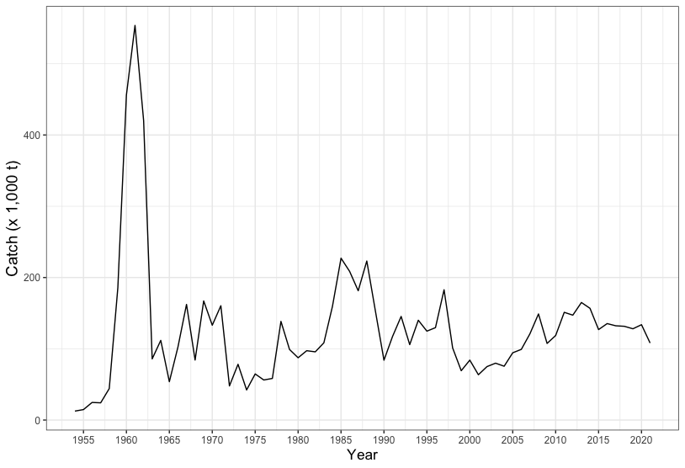
Yellowfin Sole annual total catch (1,000 t) in the Eastern Bering Sea from 1954-2021
In 2021 25% tariffs were imposed on Yellowfin Sole exports to China, which likely played a role in the decreased catch in 2021.

Slide 24
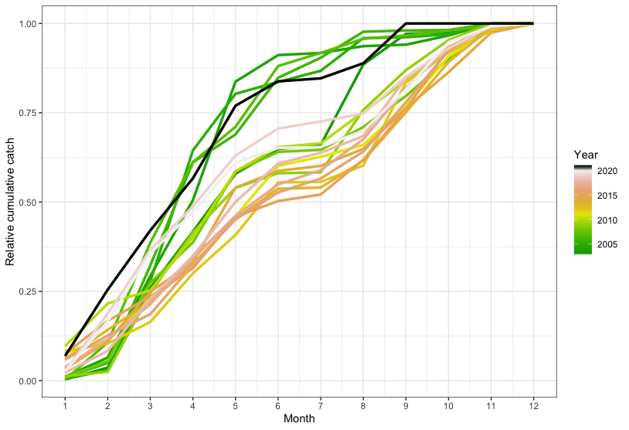
Yellowfin Sole annual cumulative catch by month and year (non CDQ) 2003-October 1, 2021

Slide 25
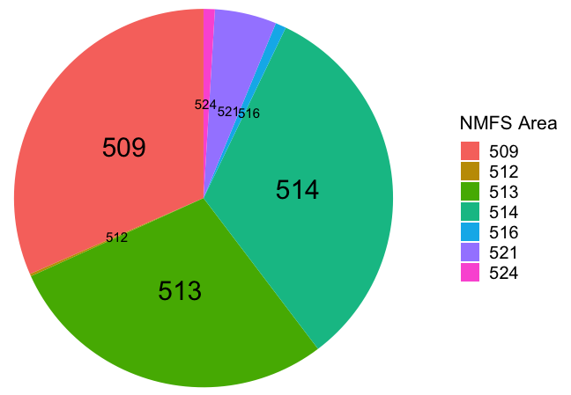
Yellowfin Sole catch proportion by area in which catch through October, 2021 was >100 t

Slide 26
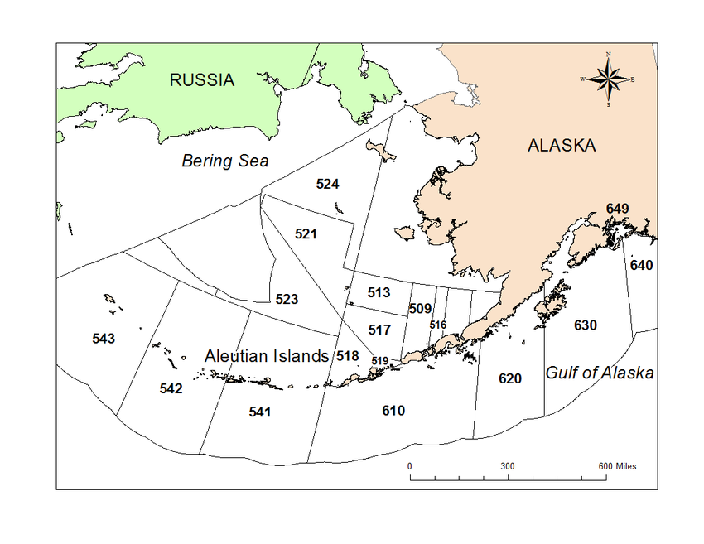
Areas of primary YFS catch
Yellowfin Sole primarily caught in: 509, 513, 514, 516, 521, and 524.
514

Slide 27
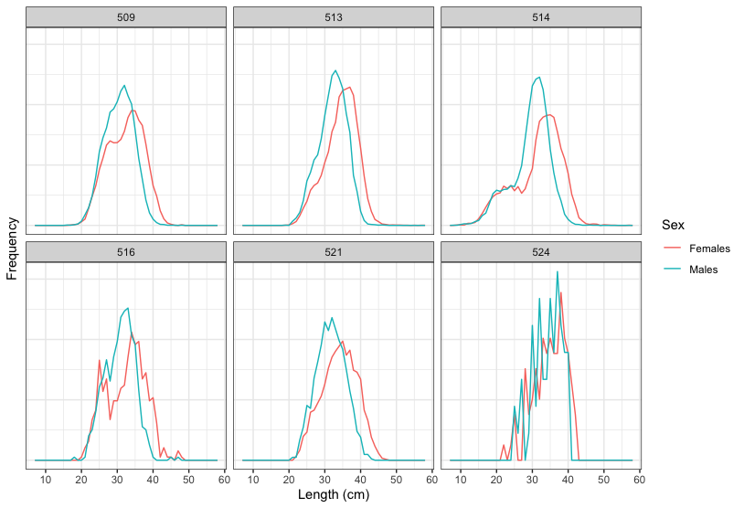
Size composition of the Yellowfin Sole catch in 2021 in highest AREAS of yfs catch

Slide 28
Catch of Yellowfin Sole in the BSAI in 2021 by month (through October)
Highest catches near Bristol Bay
in May and June.

Slide 29
Catch of Yellowfin Sole by trawl gear in the BSAI, 2002-2021reported by observers.

Slide 30
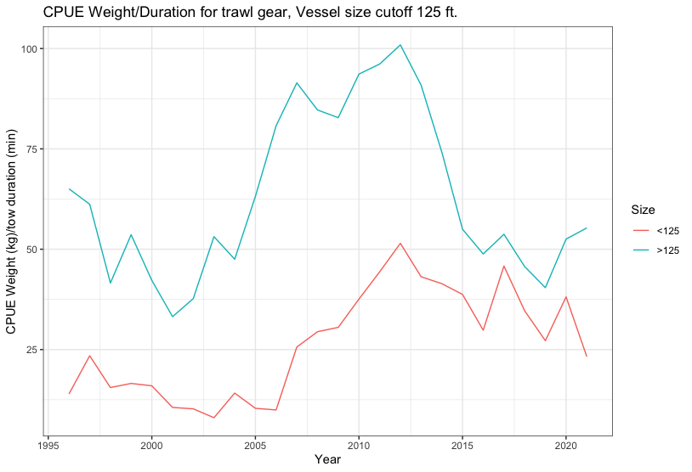
Catch per unit effort based on Yellowfin Sole fishery data, 1996-2021 through Oct 31
CPUE weight (kg)/trawl duration (min) for vessels cutoff 125 ft, and only including self-made tows.
Results are limited to Catcher/Processor and Catcher vessels.

Slide 31
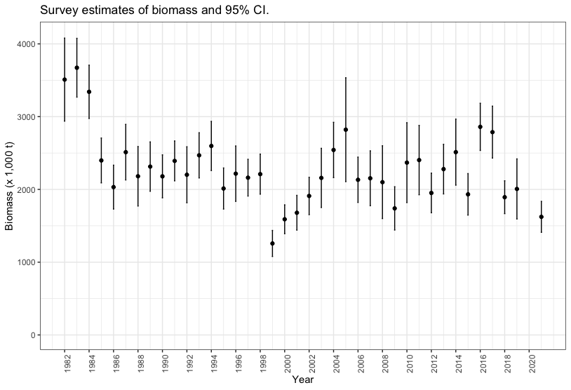
EBS trawl survey biomass point estimates and 95% confidence intervals for YFS, 1982-2021
Third lowest
in survey history.

Slide 32
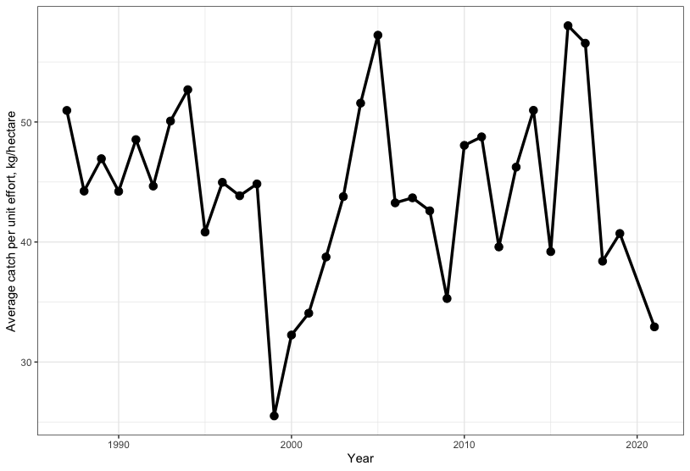
Average catch per unit effort on NMFS eastern Bering Sea surveys, 1982-2021
CPUE is in
kg/hectare.
Third lowest
in survey history.

Slide 33
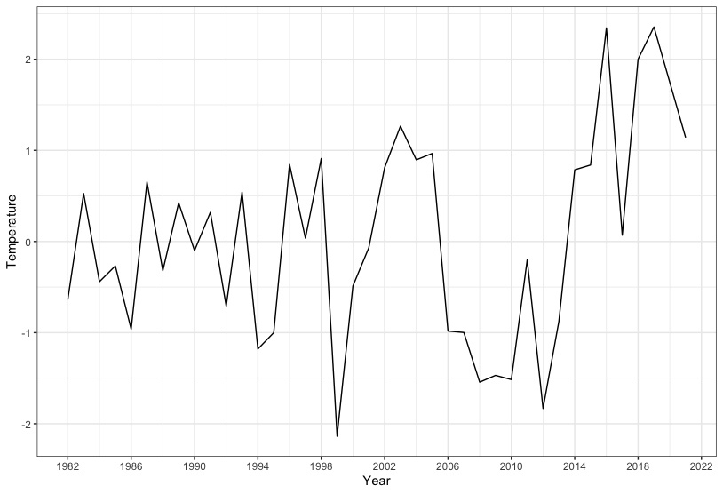
Bottom temperature anomalies from the NMFS survey, 1982-2021.

Slide 34
Population dynamics
trends

Slide 35
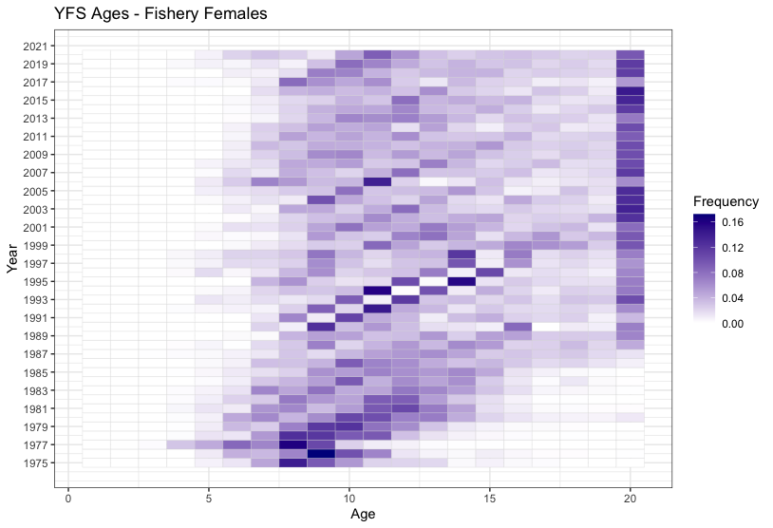
Age frequency of females from the Yellowfin Sole fishery, 1975 - 2020.
Age 11 (2010 year class)
Also some 7-8
year olds 2013-2014
year classes.

Slide 36
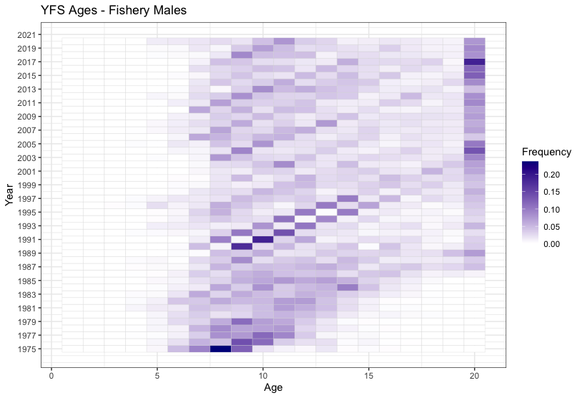
Age frequency of males from the Yellowfin Sole fishery, 1975 - 2020.
Age 11 (2010 year class)

Slide 37
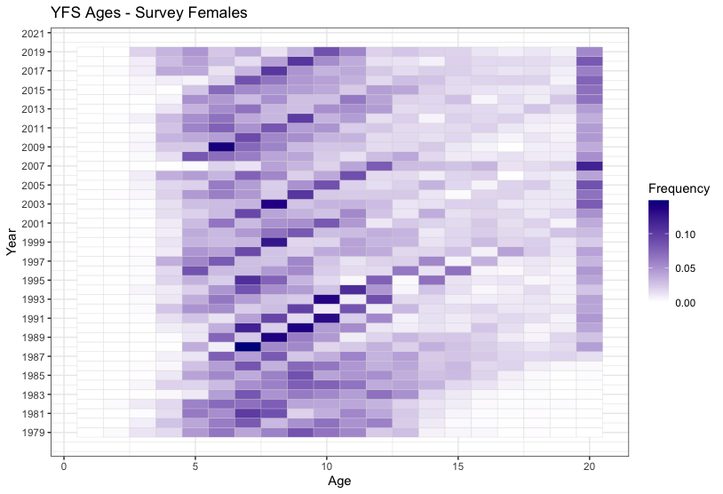
Age frequency of female Yellowfin Sole females from surveys, 1977-2020.
Age 10 (2009 year class)
Also age 5, 7
(2015, 2013 year classes)

Slide 38

Age frequency of Male Yellowfin Sole from surveys, 1977-2020.
Age 10 (2009 year class)

Slide 39
Models used in this assessment:
Model 18.2* uses a fixed value for female natural mortality (M=0.12) and allows male natural mortality to be estimated within the model.
Model 18.2a: same as Model 18.2 except VAST biomass estimates and standard error for the Eastern Bering Sea, 1982-2021.
Model 18.2c: same as Model 18.2 except it incorporates VAST biomass estimates and standard error for the EBS and NBS,combined, 1982-2021 [used 1985, 1988, 1991, 2010, 2017, 2018, 2019, and 2021 and all EBS survey data estimates 1982-2021, except 2020.]
*preferred, accepted 2020.

Slide 40
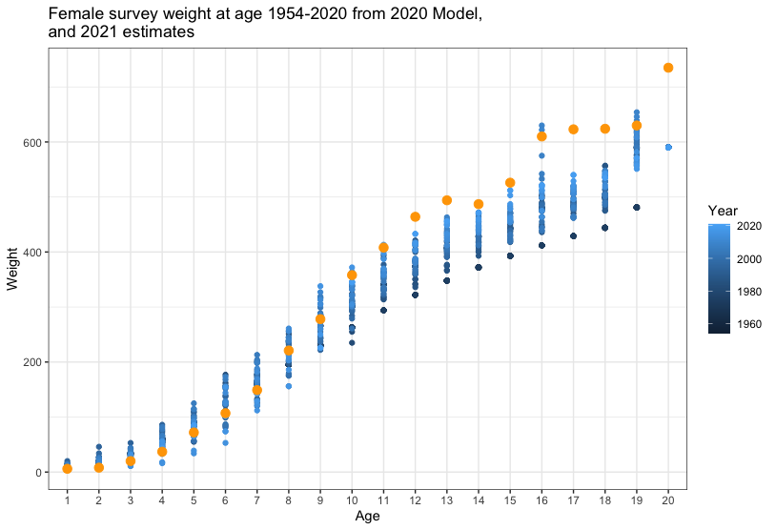
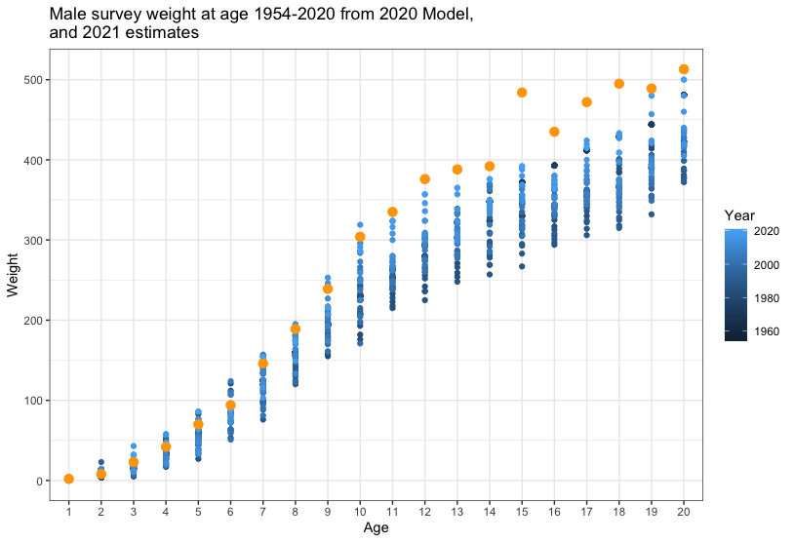
Mean weight at age (g) for Yellowfin Sole from the EBS survey, 1954-2019 Model 18.2 (2020)

Slide 41

For 2021, weight at age from the entire time series were evaluated as follows.
Survey weights at age were available from 1984 through 2019 (19,074 records). Weight-at-age was calculated for all ages 1-19 as well as the age 20 plus group (all ages 20 and over).
There were some gaps due to years in which no fish of a particular age had been collected.
Where possible, gaps filled with survey length at age data converted to weight at age.
The relationship between weight and length was calculated using the power function.

Slide 42
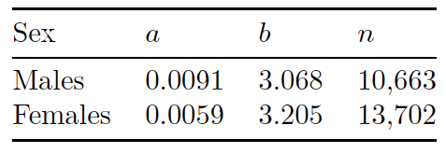
For 2021, weight at age from the entire time series were evaluated as follows.
Between 1971 through 2019, more lengths were associated with ages than weights.
Lengths at age were converted to weights at age and used to fill gaps using a sex-specific length-weight relationship based on all available current data.
The parameter estimates and the number of individual data points are shown below.

Slide 43
For 2021, weight at age from the entire time series were evaluated as follows.
Finally, annual age categories for which no length-at-age or weight-at-age were available were filled by calculating weight at age (using the power relationship described above) from a mean overall length at age for males and females from 1971-2019 data.
The mean weight at age from from first 10 years (1971-1980) was used to fill in years 1954-1970. It was important to select years from the beginning of the time series, as it appears that length at age appears to be increasing.
The mean weight at age from 2015-2019 was used as an estimate for weight at age in 2020 and 2021, as there was no survey in 2020 and the 2021 ages have not yet been processed. The five most recent years of age data were used for 2020 and 2021 in consideration of the increase in average size at age.

Slide 44
Results, model fits to data

Slide 45
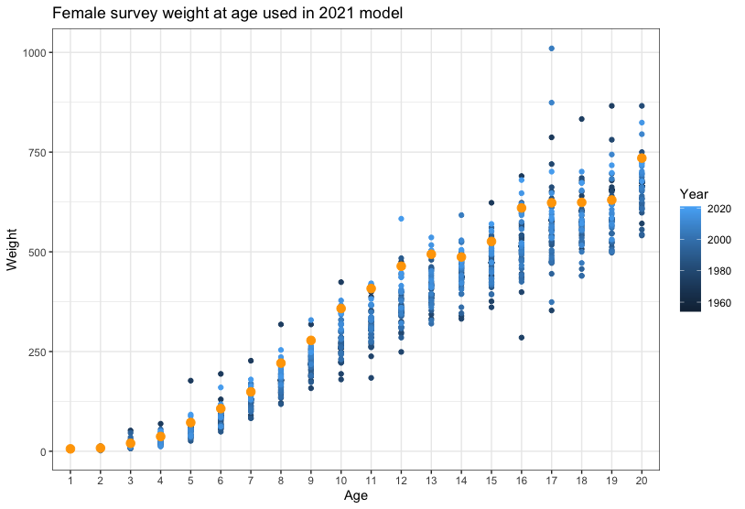
Mean weight at age (g) for Yellowfin Sole from the EBS survey, 1954-2019 Model 18.2 (2021)

Slide 46
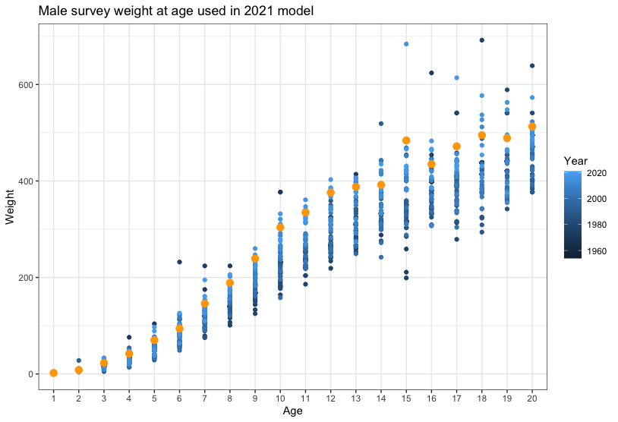
Mean weight at age (g) for Yellowfin Sole from the EBS survey, 1954-2019 Model 18.2 (2021)

Slide 47
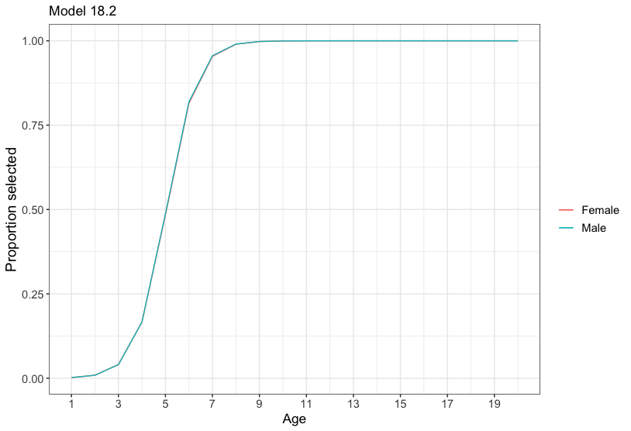
Estimate of survey selectivity for males and females

Slide 48
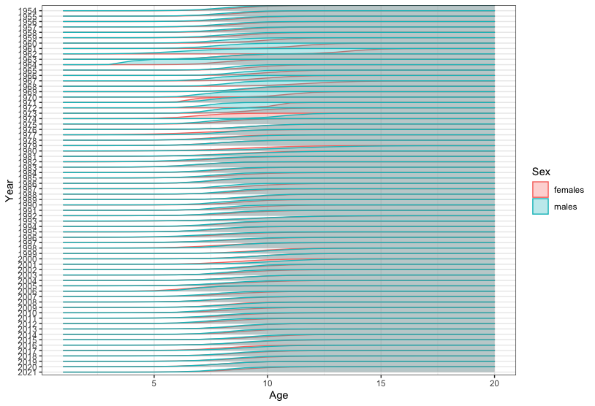

Slide 49
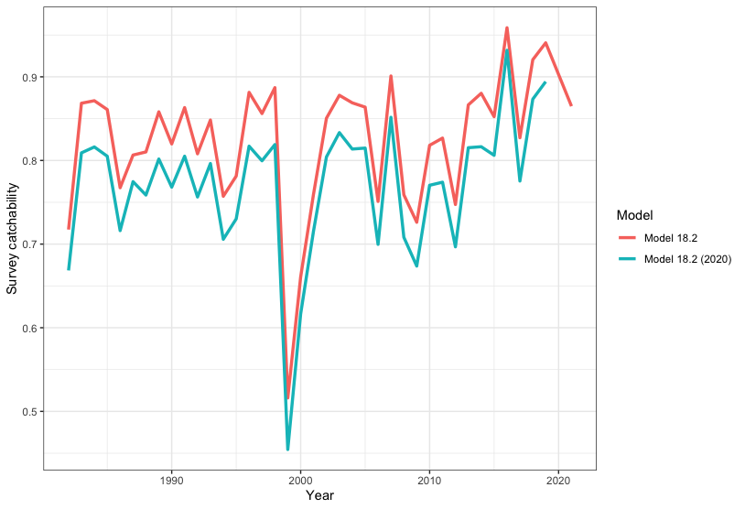
Survey catchability for Model 18.2 (2020) and 18.2 (2021), 1982-2021.

Slide 50
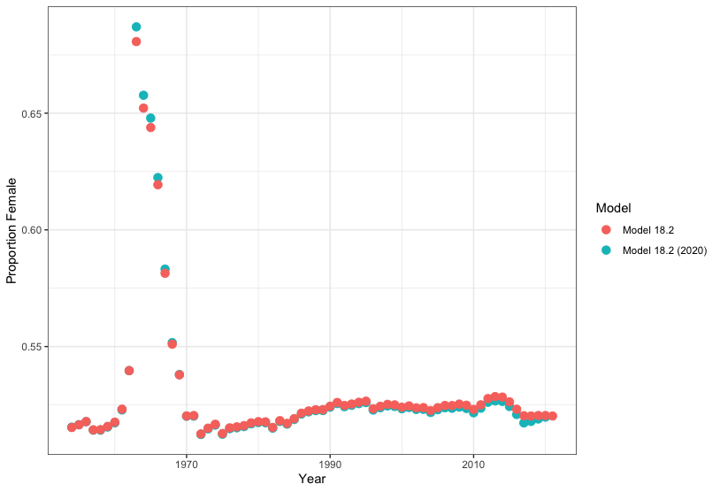
Model estimates of the proportion of female Yellowfin Sole in the population, 1982-2021

Slide 51
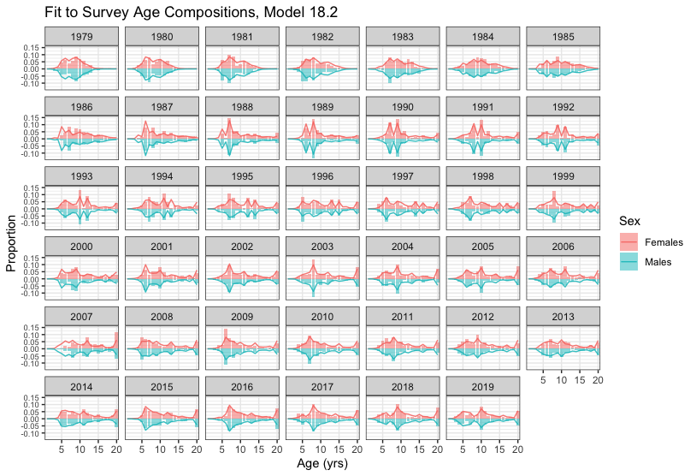
Model 18.2 fit to the time-series of survey age composition, by sex, 1979-2021

Slide 52
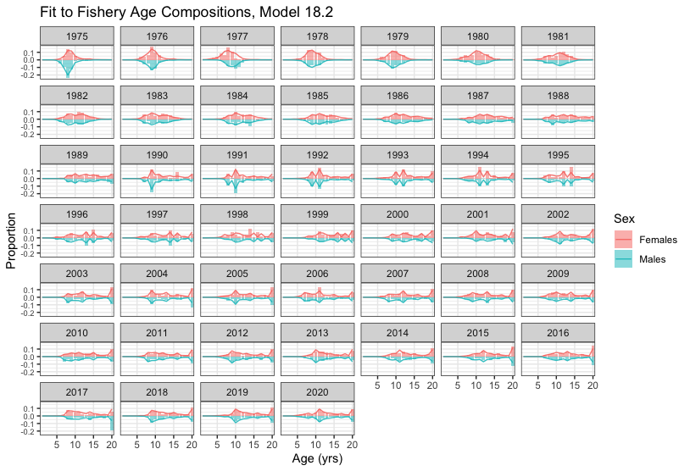
Model 18.2 fit to the time-series of fishery age composition, by sex, 1975-2021

Slide 53
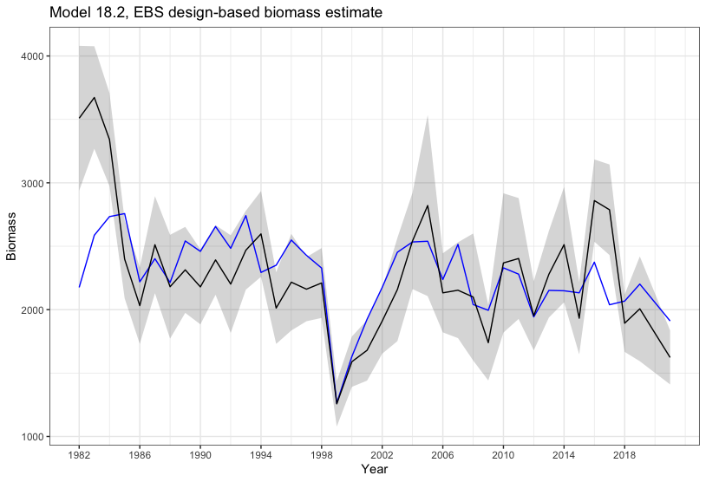
Model 18.2 fit to NMFS eastern Bering Sea survey biomass estimates, from 1982-2021

Slide 54
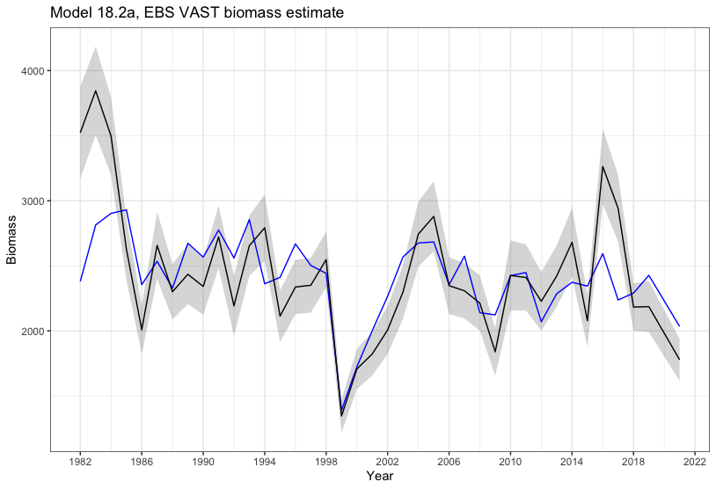
Model 18.2a fit to NMFS eastern Bering Sea survey biomass estimates, from 1982-2021

Slide 55
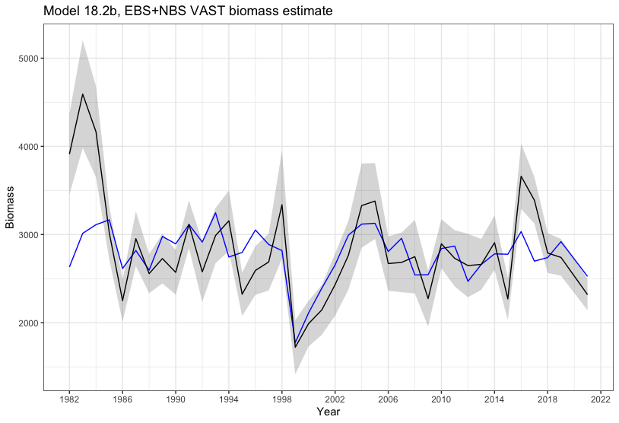
Model 18.2b fit to NMFS eastern Bering Sea survey biomass estimates, from 1982-2021

Slide 56
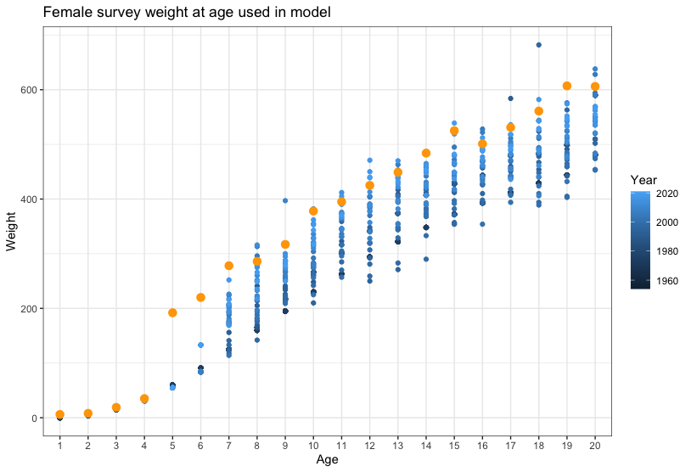
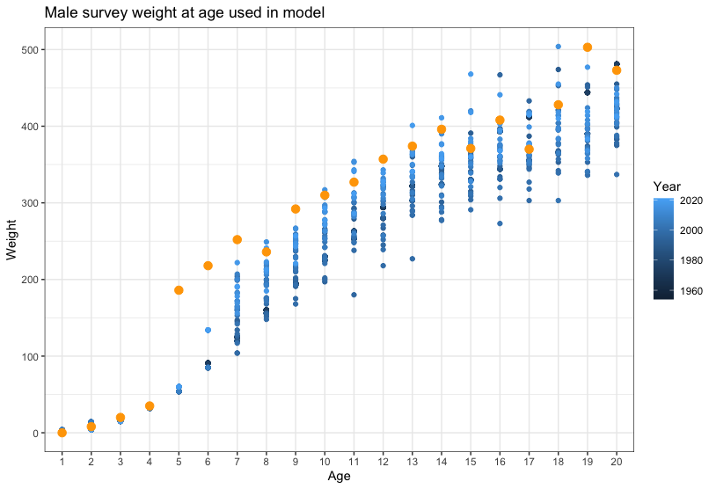
Empirical estimates of weight (g) at age, based on fishery data 1954-2021 used in 2021
Yellow dots are based on 2020, the most recent set of aged data.
Estimates were based on catch-at-age methodology used in the Walleye Pollock assessment.

Slide 57
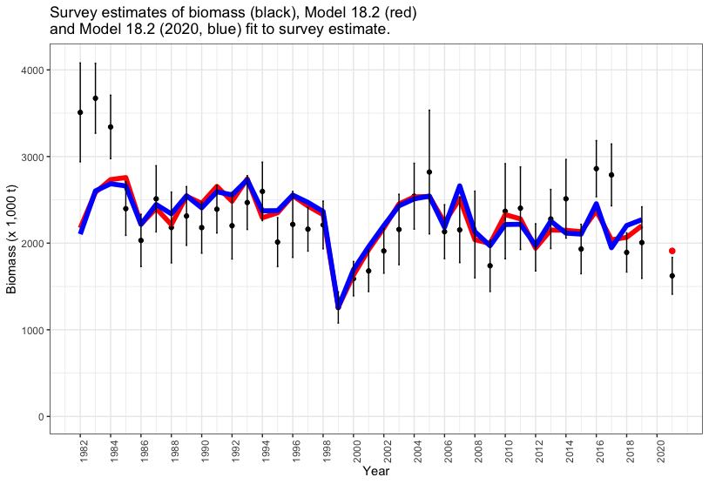

Slide 58
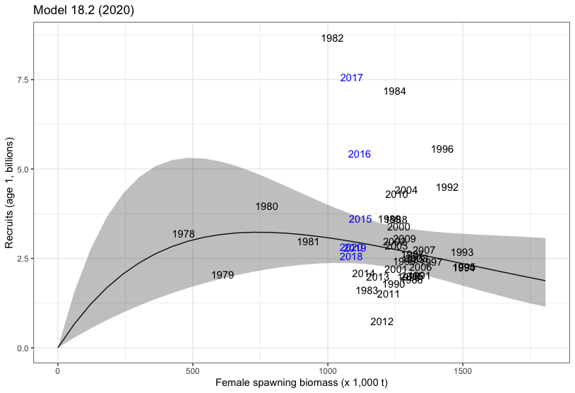
Last year’s Model 18.2 ricker stock recruitment relationship
Years in black indicate data used to fit the model, years in blue were not used to fit the model.

Slide 59
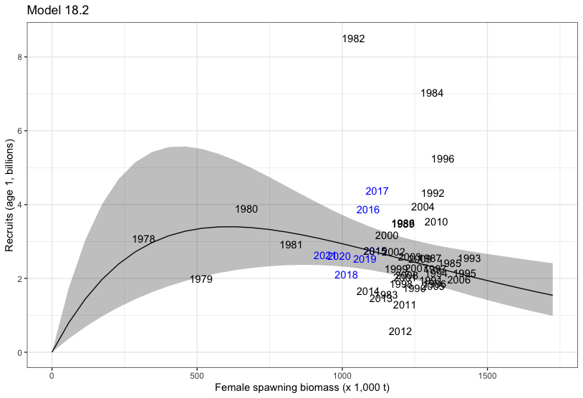
Current year Model 18.2 ricker stock recruitment relationship
Years in black indicate data used to fit the model, years in blue were not used to fit the model.

Slide 60
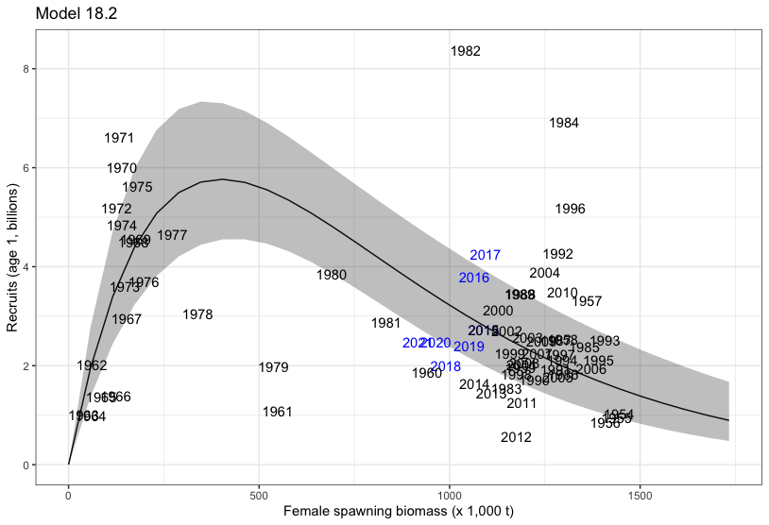
Recruitment fit with all years of data (for comparison)

Slide 61
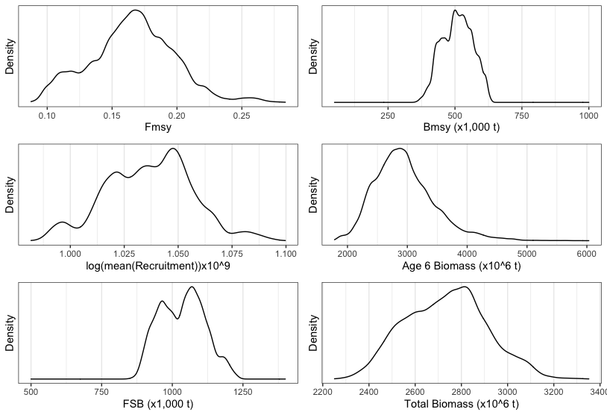
MCMC posterior distributions from Model 18.2
Female spawning biomass for 2021
Total biomass for 2021

Slide 62
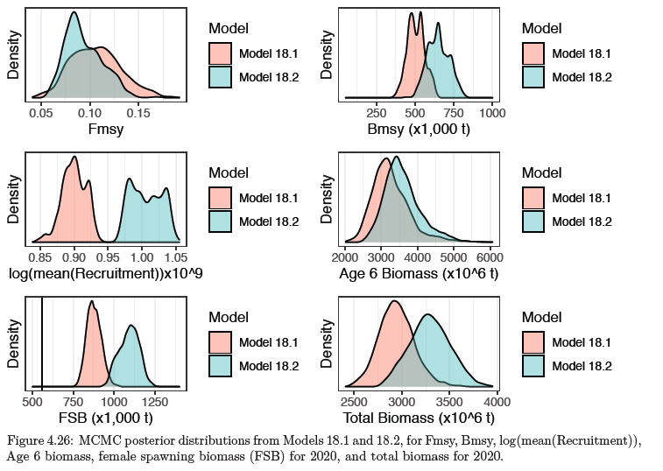
MCMC posterior distributions from 2020

Slide 63
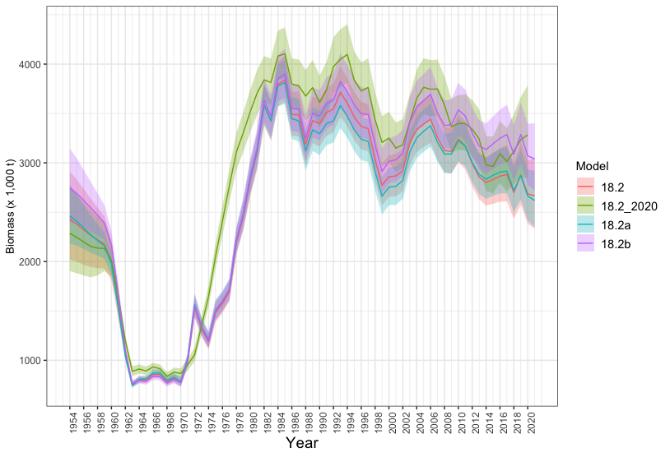
Total (age 2+) Biomass for YFS based on Models 18.2 (2020), 18.2, 18.2a, and 18.2b, 1954-2021.

Slide 64
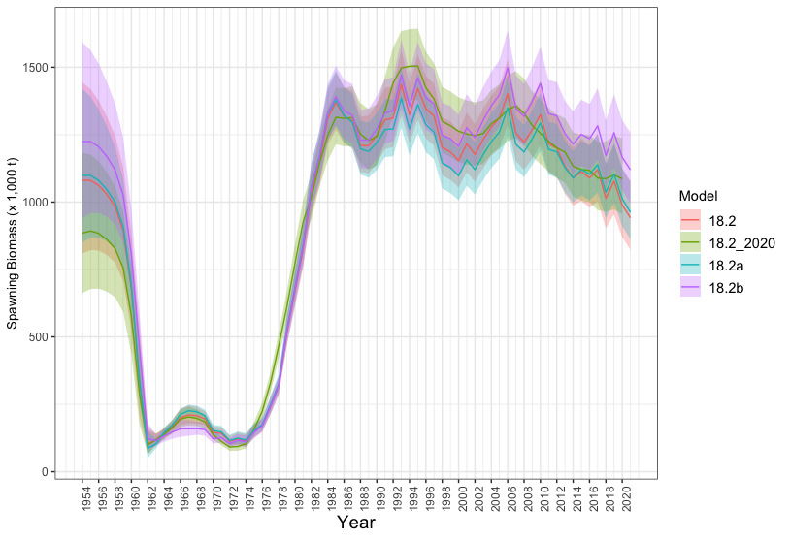
Spawning Biomass for YFS based on Models 18.2 (2020), 18.2, 18.2a, and 18.2b, 1954-2021.

Slide 65
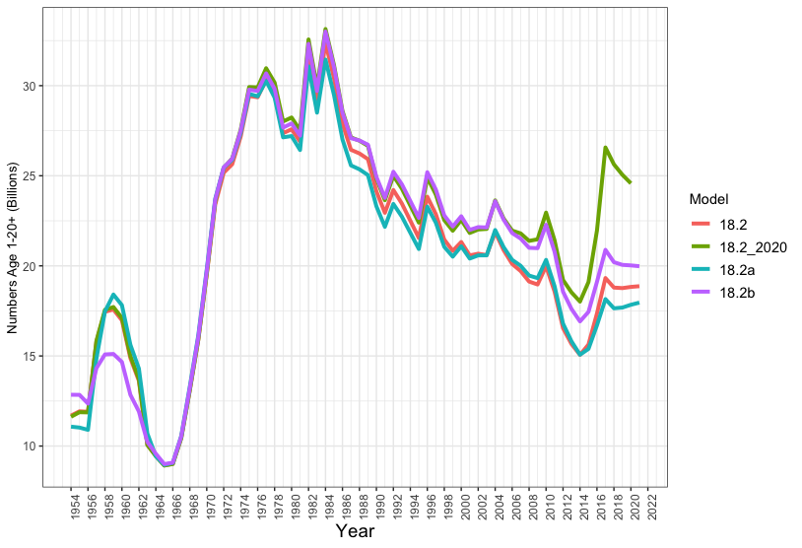
Total number of YFS based on Models 18.2 (2020), 18.2, 18.2a, and 18.2b, 1954-2021.

Slide 66
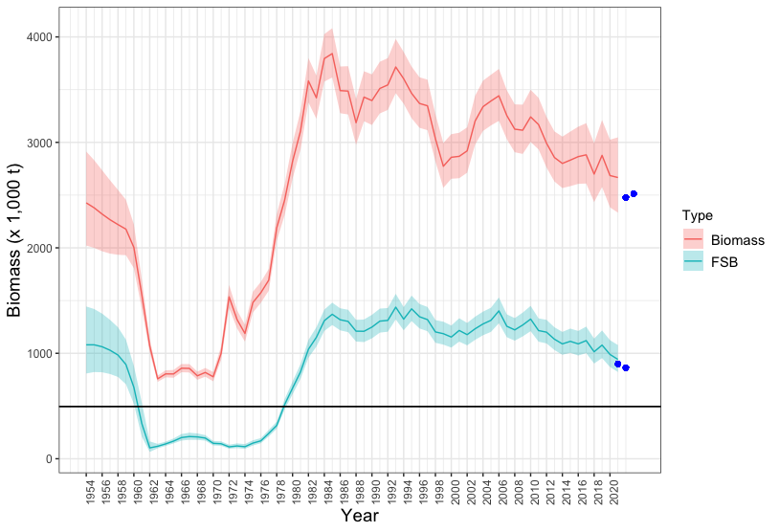
Model estimates of total (age 2+) and female spawning biomass with 95% CI’s, 1954-2021
Dots indicate projections for 2022 and 2023

Slide 67
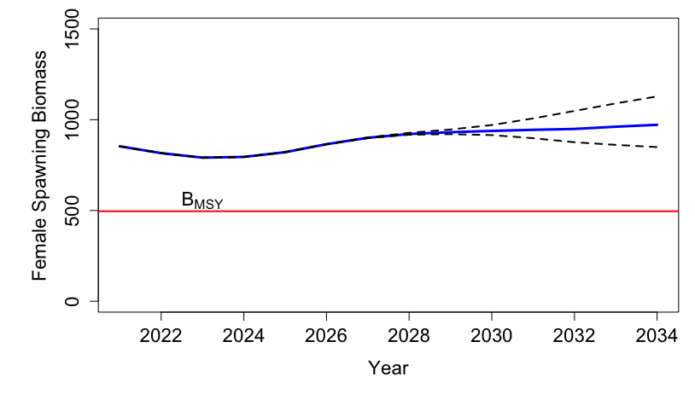
Projected female spawning biomass for 2021-2034 fishing at the 5-year (2016-2020) avg f
F=0.0769

Slide 68
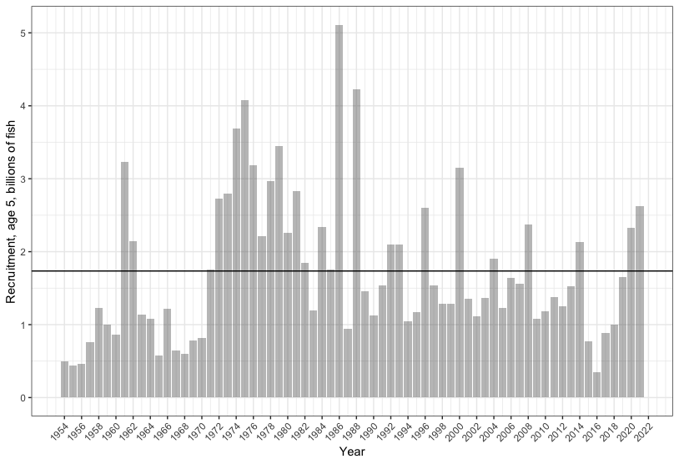
Year-class strength of age 5 Yellowfin Sole estimated by Model 18.2
The horizontal line represents the average recruitment 1954-2016, 1.78 billion,

Slide 69
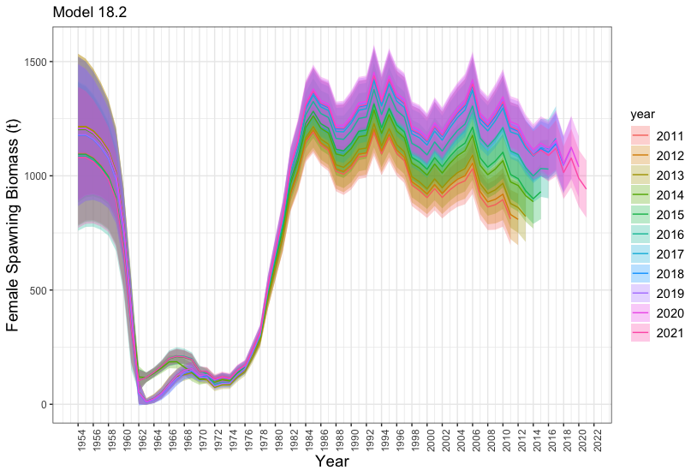
Retrospective plot of female spawning biomass for Model 18.2
Mohn’s Rho18.2=-0.118

Slide 70
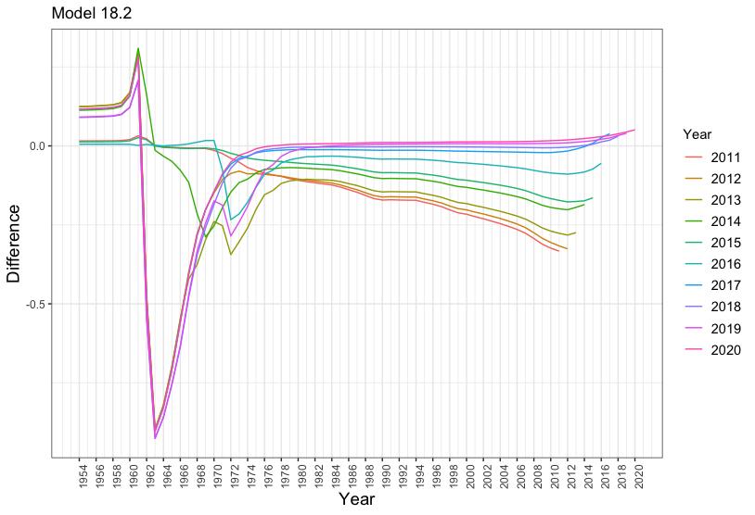
Relative differences spawning biomass between the 2021 model and retrospectives

Slide 71

Fishing mortality rate and FSB 1975-2021 compared to the F35% and F40% control rules
2021
2023
2022

Slide 72

Tier 1a reference points for yellowfin sole

Slide 73

Tier 3a reference points for yellowfin sole

Slide 74

Likelihood values comparing model 18.2 (design based) and 18.2a (VAST estimate)
(Negative log likelihoods)

Slide 75


Slide 76

data

Slide 77

Distributional assumptions

Slide 78
Risk table – assessment related concerns
Pros:
Cons:
Annual surveys 1982-2021 (not 2020).
Fishery and survey ages are available and have been validated.
The model exhibits good fits to compositional and abundance data.
Retrospective pattern.
Fit to stock recruitment relationship.
Assessment considerations were rated as level 2 due to lack of survey data the relatively recent development of age-structured models (substantially increased concern).

Slide 79
Risk table – population dynamics considerations
Projections indicate that the female spawning biomass will remain well-above the B_{MSY} level through 2033.
Stock is declining.
2021 NMFS survey biomass estimate was the third lowest in the survey history.
Population dynamics considerations were rated as level 2.

Slide 80
Risk table - Environmental/ecosystem considerations
Near-average bottom temperatures were present over the SEBS in 2021.
In 2021, fish condition was neutral in the SEBS and negative in the NBS, with both regions showing declines from positive residuals observed in 2019.
Concerns about the food web dynamics and carrying capacity in the NBS have existed since 2018.
Sufficient prey may have been available for YFS over the southern shelf based on trends in motile epifauna.
Predation pressure may be mixed; a decrease in Pacific cod biomass and potential refuge from predation in the inner domain may be countered by the spatial overlap with Pacific halibut in the inner domain of the SEBS.
Trends in benthic forager biomass over the SEBS suggest a reduction in prey competition.
Environmental/ecosystem considerations were rated as level 2.

Slide 81
Risk table – Fishery performance considerations
CPUE – is it truly a decline in the stock or an environmental factor resulting in less aggregating?
Fishery performance considerations were rated as level 1.

Slide 82

Risk table
Overall risk level: 2.

Slide 83
Questions?

Slide 84

CPUE with EBS survey bottom temperature anomalies

