Slide 1
2021 BSAI Northern rockfish
Paul Spencer and Jim Ianelli
Alaska Fisheries Science Center

Slide 2
BSAI Northern Rockfish Outline
Catch information
Size at age patterns, fishery and survey
New data (2019 and 2020 fishery age comps)
Responses to comments (part 1)
Model evaluation
Model fits to data
Retrospective analysis
Exploitation rates
Risk Table
Responses to comments (part 2)
Management recommendations

Slide 3
Northern rockfish, catch by month and area

Slide 4
Hauls identified as targeting northern rockfish
(from Observer data)
Number of tows that in which northern rockfish is the target species declined in 2020 and 2021, after increasing from 2016-2019.

Slide 5
Proportion of catch by target fishery
(for observed hauls)
Northern rockfish targeted hauls account for a large portion of the catch

Slide 6
Percent of northern rockfish in haul catch, by target
Within northern rockfish targeted tows, >= 50% of the catch is northern rockfish

Slide 7
Distribution of the percent of northern rockfish in haul catch, for northern rockfish target hauls

Slide 8
CPUE has declined slightly in 2021

Slide 9
Catches have been increasing since 2013, but declined in 2021 (*through Sept. 25)

Slide 10
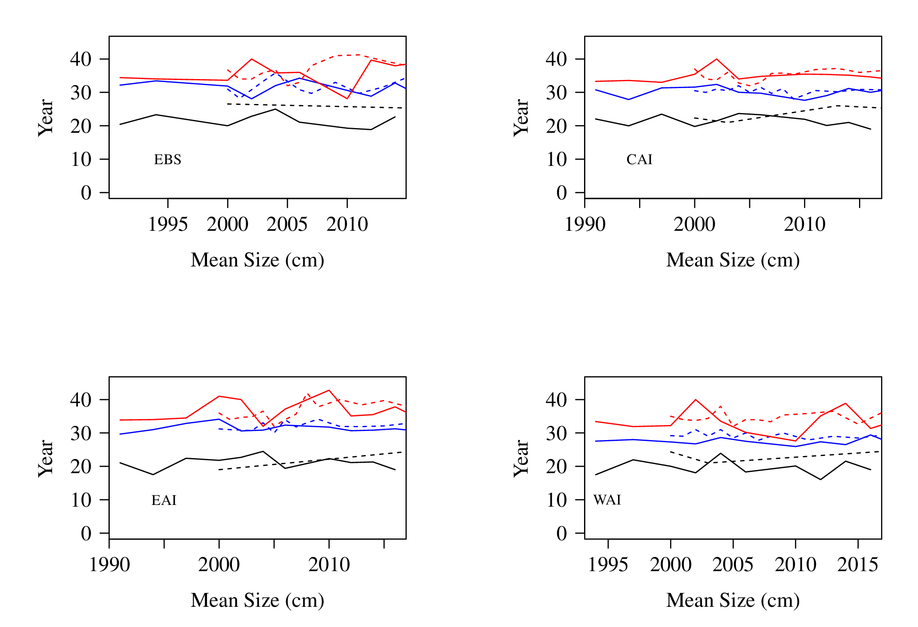
Size at age patterns
Mean size over time, ages 5,10,30

Slide 11
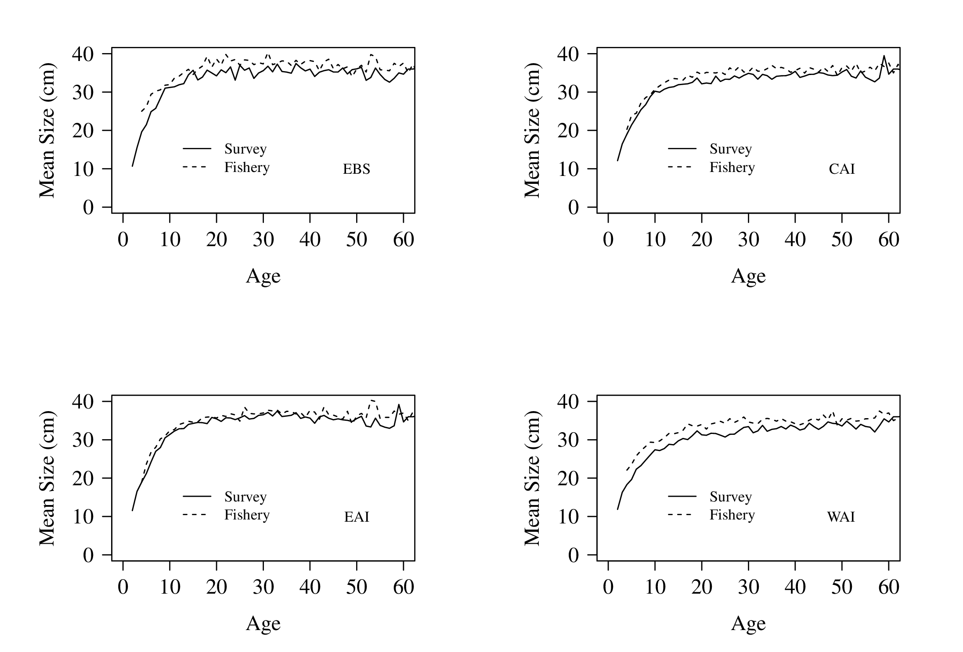
Mean size by age, averaged over years

Slide 12
Computation of fishery and survey size at age
Spatial gradient of size at age, for both fishery and survey
Within an area, fishery size at age is larger than survey size at age
The model averages over the spatial areas. However, the spatial distribution of catch is different from the spatial distribution of survey biomass

Slide 13
Fishery catch and survey abundance by area
Subarea growth patterns and age compositions are calculated, and global growth patterns (and age compositions) are produced by weighting by either estimated survey abundance or fishery catch.

Slide 14
Historical pattern of otolith sampling disproportionate to survey abundance
The fishery otoliths have been randomly sampled for many years. This results in the spatial distribution of otoliths being relatively similar to the spatial distribution of the catch
The survey otoliths have been randomly sampled only since 2016. In earlier years, the spatial distribution of otoliths was not similar to the spatial distribution of the catch

Slide 15
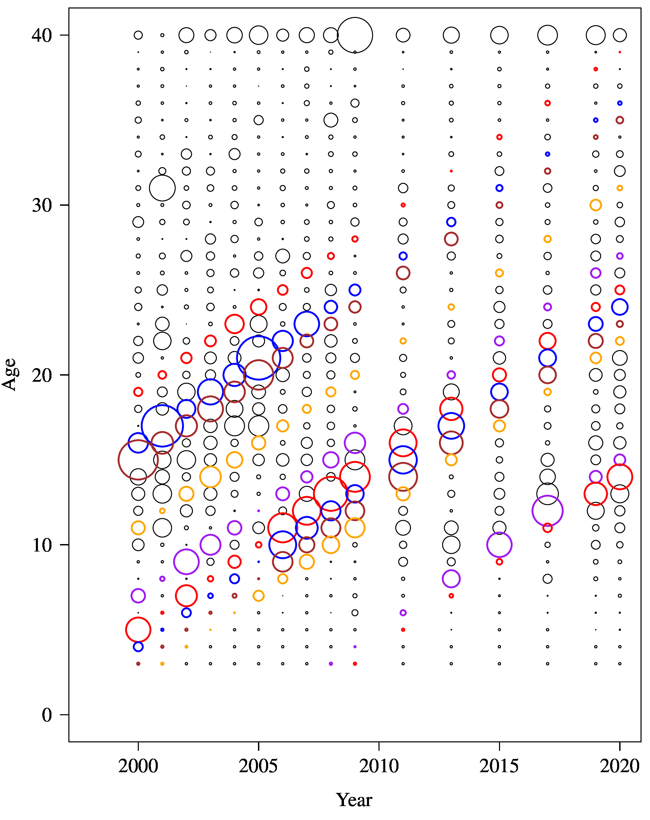
New fishery age comp data
1981
1984
1985
1989
1993
1995
1996
1997
1998
2005
2006

Slide 16
Responses to comments (part 1)
(BSAI Plan Team, November 2019) The Team recommended exploring global age-length keys that weight by population size between areas.
This is mathematically equivalent to the current method of computing subarea age compositions, and then averaging (see Appendix).

Slide 17
Responses to comments (part 1)
(BSAI Plan Team, November 2019) The Team recommended addressing the issues concerning the restrictive priors on key parameters in the model and exploring alternatives for estimating survey selectivity
I focused on the selectivity constraint

Slide 18
Exploratory models
(all have same data weighting as 2019 model)
Model | Description
Model 0 | The 2019 model and results
Model 16_1a(2021) | The 2019 model, with data updated through 2021
Model 21a | Data updated through 2021, logistic survey selectivity with no constraint
Model 21b | Data updated through 2021, double logistic survey selectivity with no constraint
Model 21c | Data updated through 2021, logistic survey selectivity with no constraint, and a prior place on the average of survey catchability * selectivity over ages 30 to 40.
Model 21 | Data updated through 2021, logistic survey selectivity estimated to age 30 and fixed for ages > 30. A prior is placed on selectivity at age 30 to ensure that it is close to 1.

Slide 19
Selectivity and total biomass across exploratory models
Models without a selectivity constraint estimate selectivity as < 1 for all ages, with increased biomass
For the assessment, I considered the current model (16.1a) and a model with the relaxed selectivity constraint (Model 21).

Slide 20

Models evaluated
Model 0 The 2019 model results
Model 16.1a(2021) The 2019 model, with data updated through 2021.
Model 21 Logistic survey selectivity estimated to age 30 and fixed for ages > 30. A prior is placed on selectivity at age 30 to ensure that it is close to 1.
Selectivity constraint
$$S_{30}\sim N(1, 0.003)$$

Slide 21
Model evaluation
(iterative data weighting applied for each model)

Slide 22
Weights for age/length composition data

Slide 23
Fits of the two models to the survey age comps

Slide 24
Fits of the models to the survey biomass

Slide 25
Catch, and fit to the AI survey

Slide 26
Fishery age composition

Slide 27
Updated survey selectivity curve

Slide 28
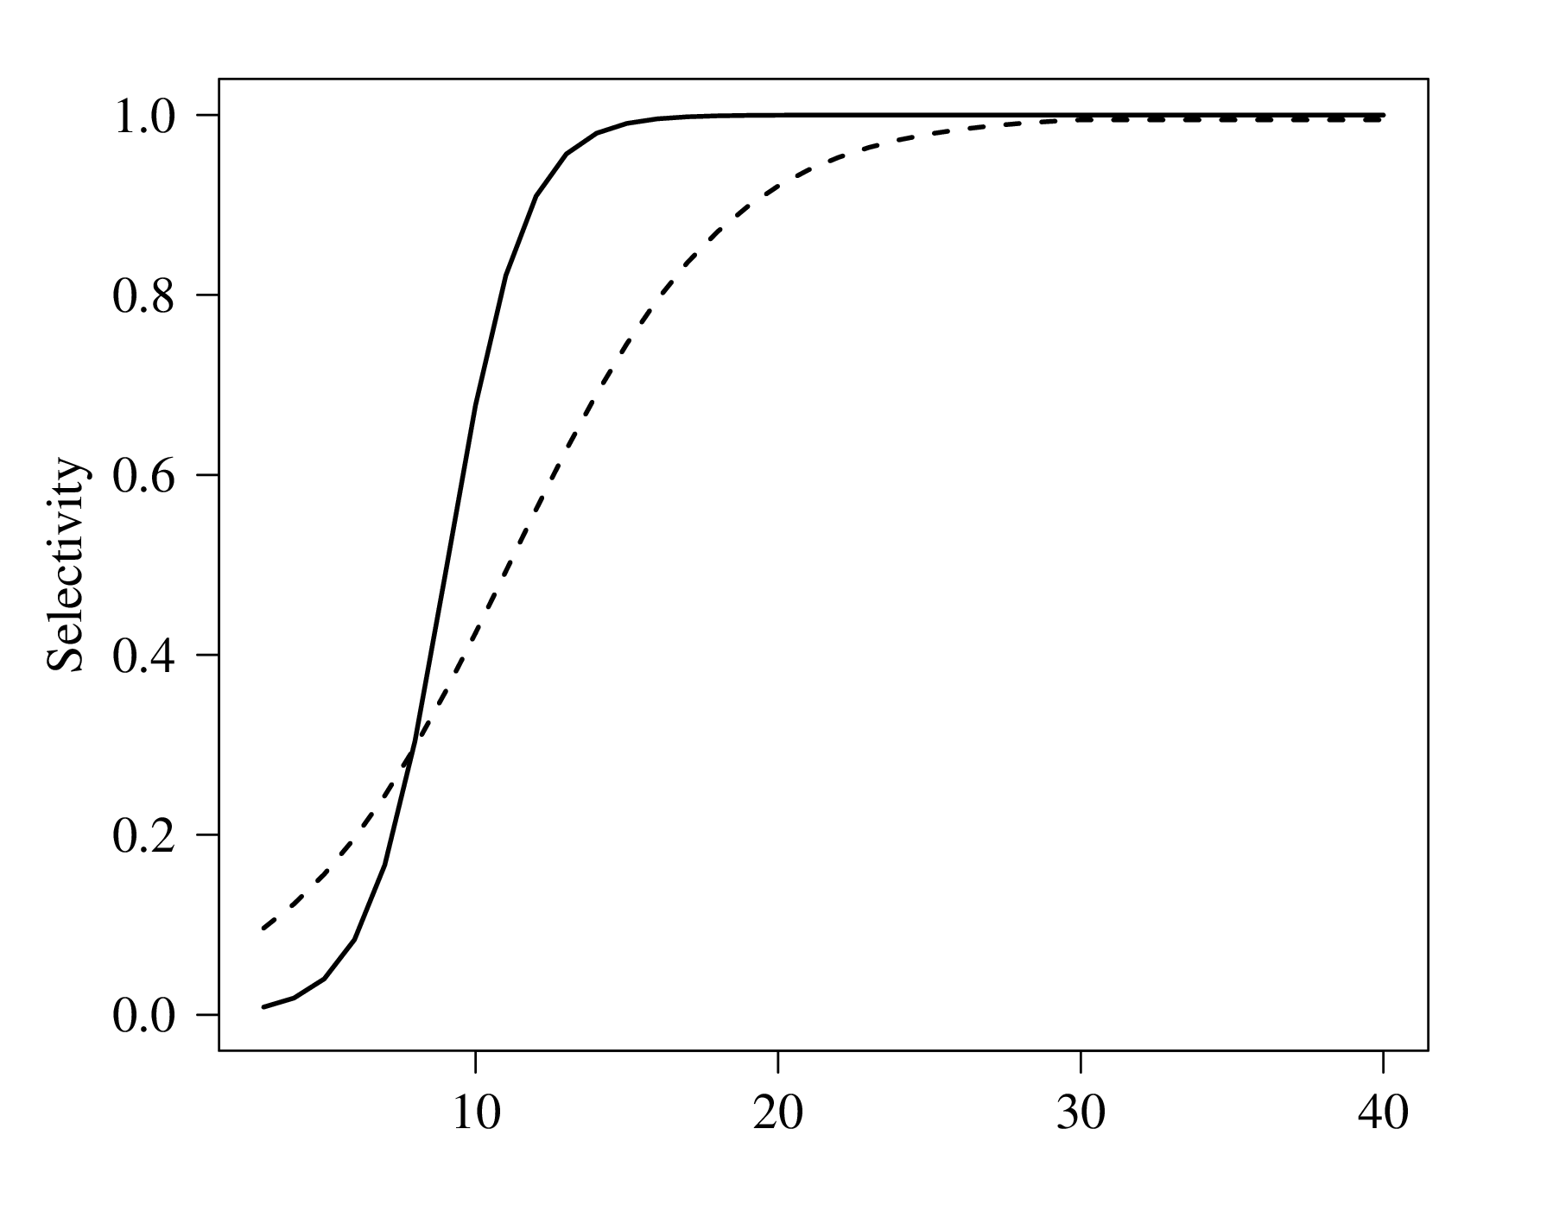
Fishery and survey selectivity curves
Fishery
AI survey

Slide 29
Recruitment

Slide 30
Retrospective pattern
Mohn’s rho = -0.18
(2019 assessment: -0.14)

Slide 31
Phase plane plot

Slide 32
Risk Table
We do not recommend a reduction from the max ABC
Assessment related considerations: Several key parameters strongly constrained by prior distributions; retrospective bias.

Slide 33
Exploitation rates

Slide 34
Responses to comments (Part 2)
SSC (December, 2019). The SSC also notes that the aging error matrix is currently based on GOA northern rockfish information and requests that it be updated using BSAI information, if possible.
Time did not allow for a full evaluation; however, some sensitivity runs were conducted in which the standard deviation of read ages given a true age was either:
1) doubled from currently used values
2) half of currently used values
3) set to zero

Slide 35
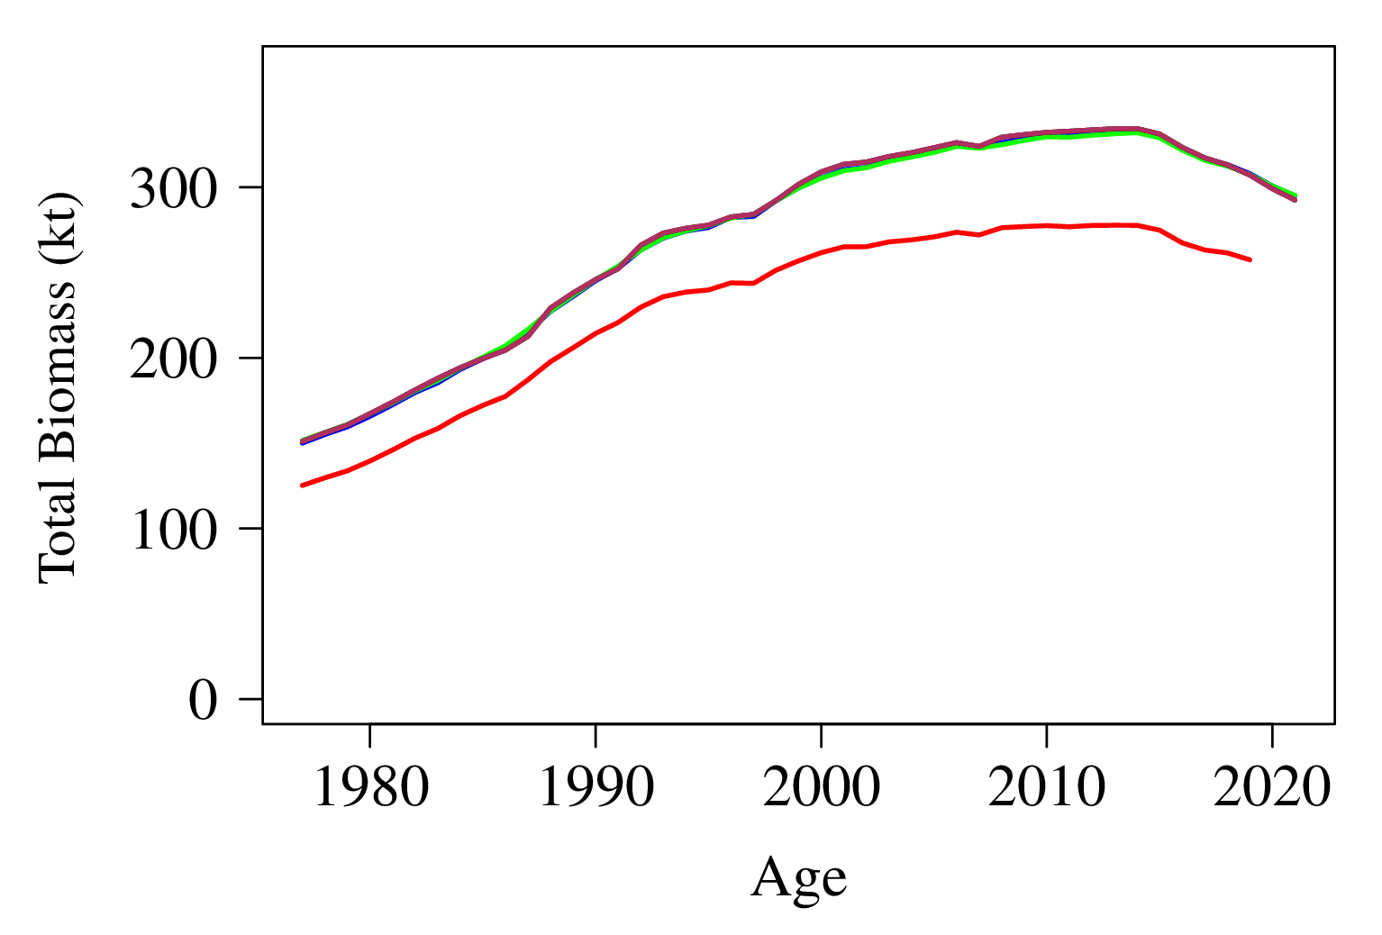
Responses to comments (Part 2)
Red line is 2019 model
The three ageing error sensitivity runs are very similar to each other

Slide 36
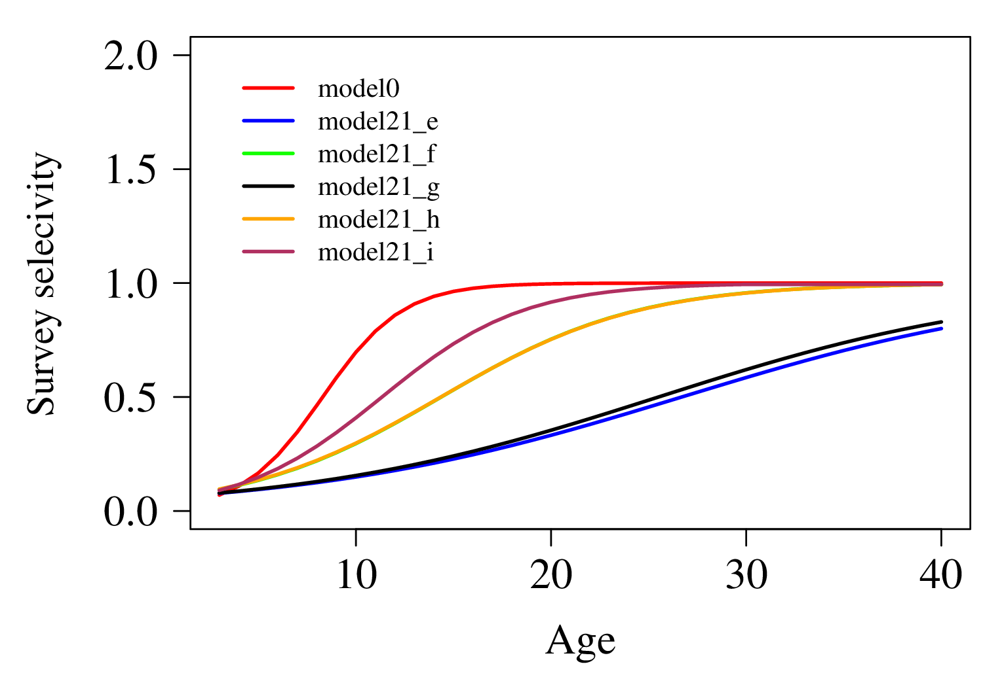
Additional model runs exploring constraints

Slide 37
Reference points and ABCs

Slide 39
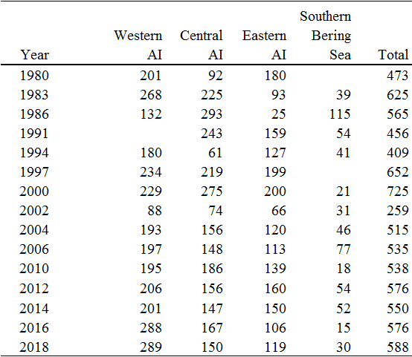
Otoliths sample sizes in AI trawl survey, by area

Slide 40
Square root of survey CPUE, 2014 – 2018 AI surveys

Slide 41
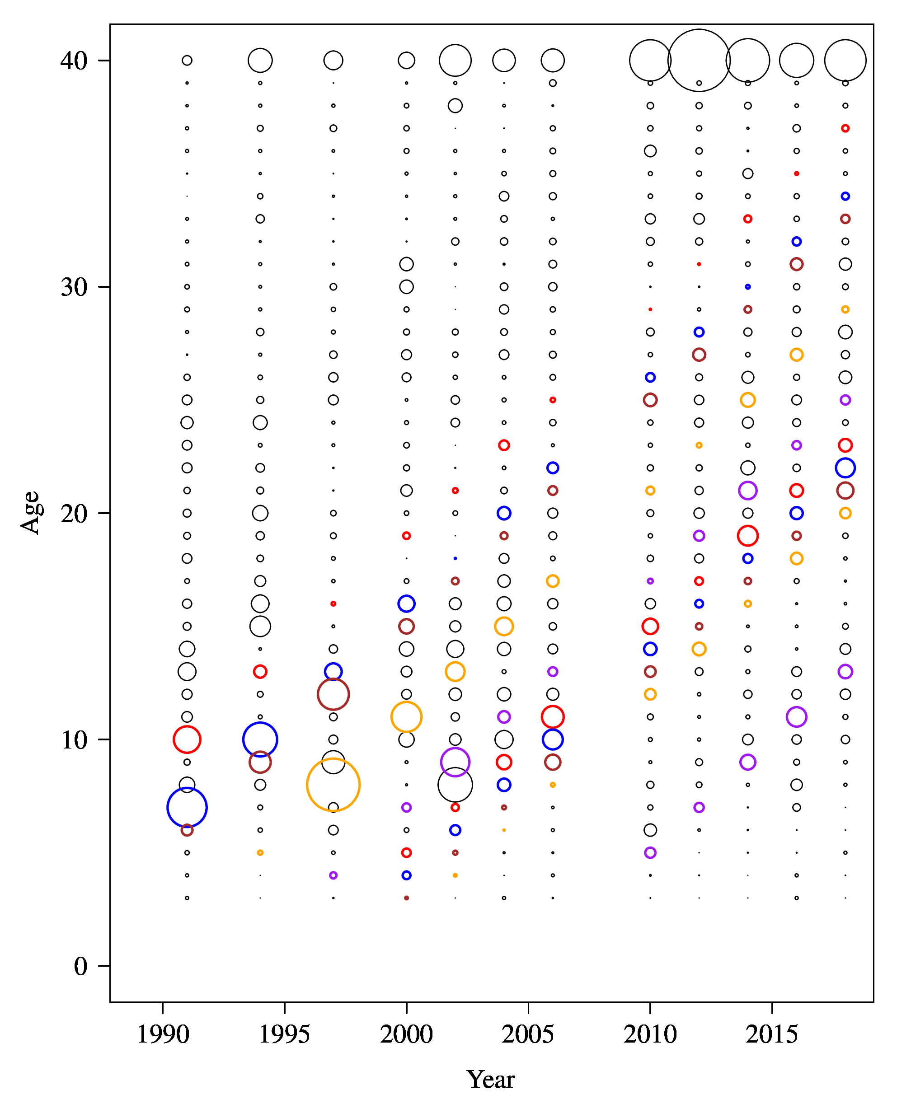
BSAI northern rockfish survey age compositions
1981
1984
1985
1989
1993
1995
1996
1997
1998
2005

Slide 42
Future research plans
Explore alternatives for estimating survey selectivity
Explore global age-length keys that weight by the population size between areas

