Slide 1



Bogoslof pollock
Jim Ianelli, Denise McKelvey
November, 2022

Slide 2
Stock Overview
Tier: 5
Age—structured evaluation (from 2015 SSC request)

Slide 3
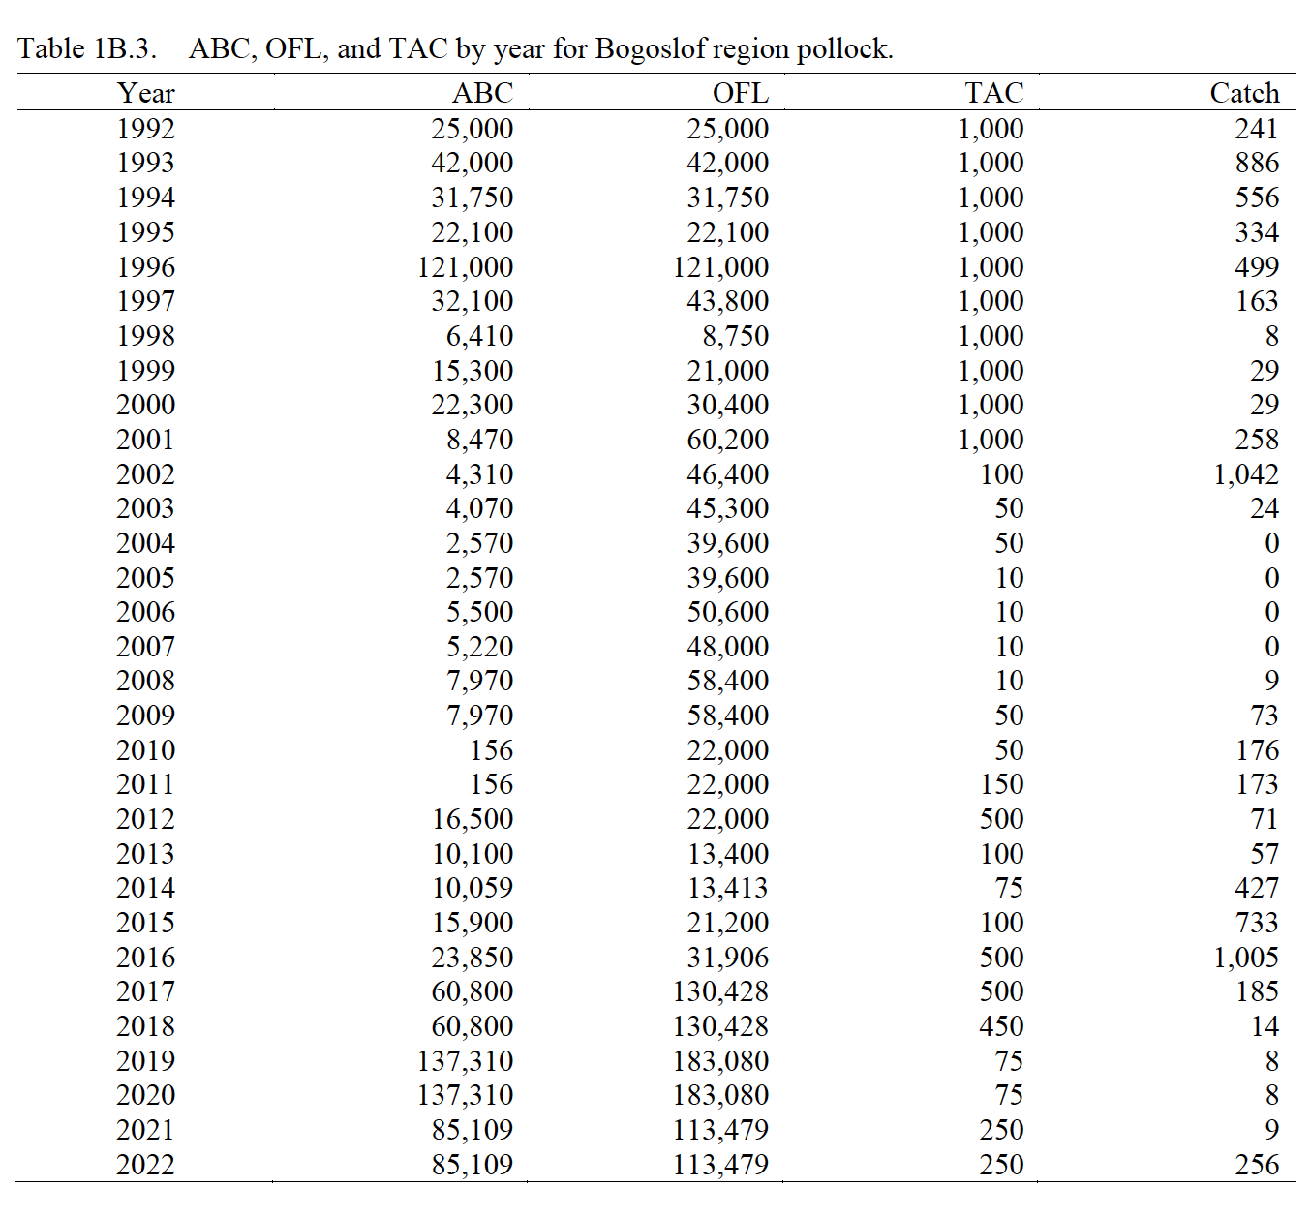
Catch Bogoslof pollock
Notes:
Time series with highlights of trends and any issues (e.g., overages, data issues, discards), provide regional breakdown time series or spatial distribution maps only if relevant to data interpretation or model evaluation

Slide 4
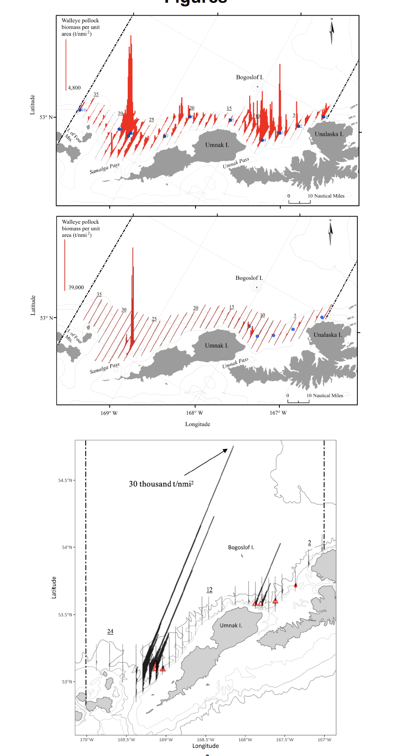
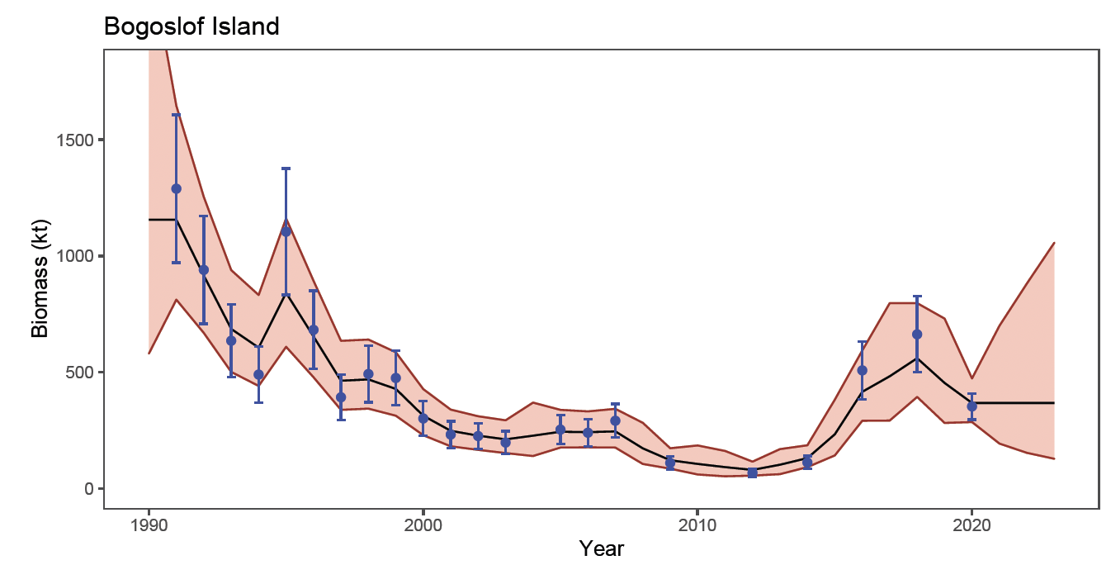
Survey Bogoslof pollock
2016
2018
2020
Notes:
Time series with highlights of trends and any issues (e.g., survey method changes, data issues), use separate slides for different survey time series, provide regional breakdown time series or spatial distribution maps only if relevant to data interpretation or model evaluation, may include exploratory surveys if relevant to model interpretation, otherwise limit

Slide 5
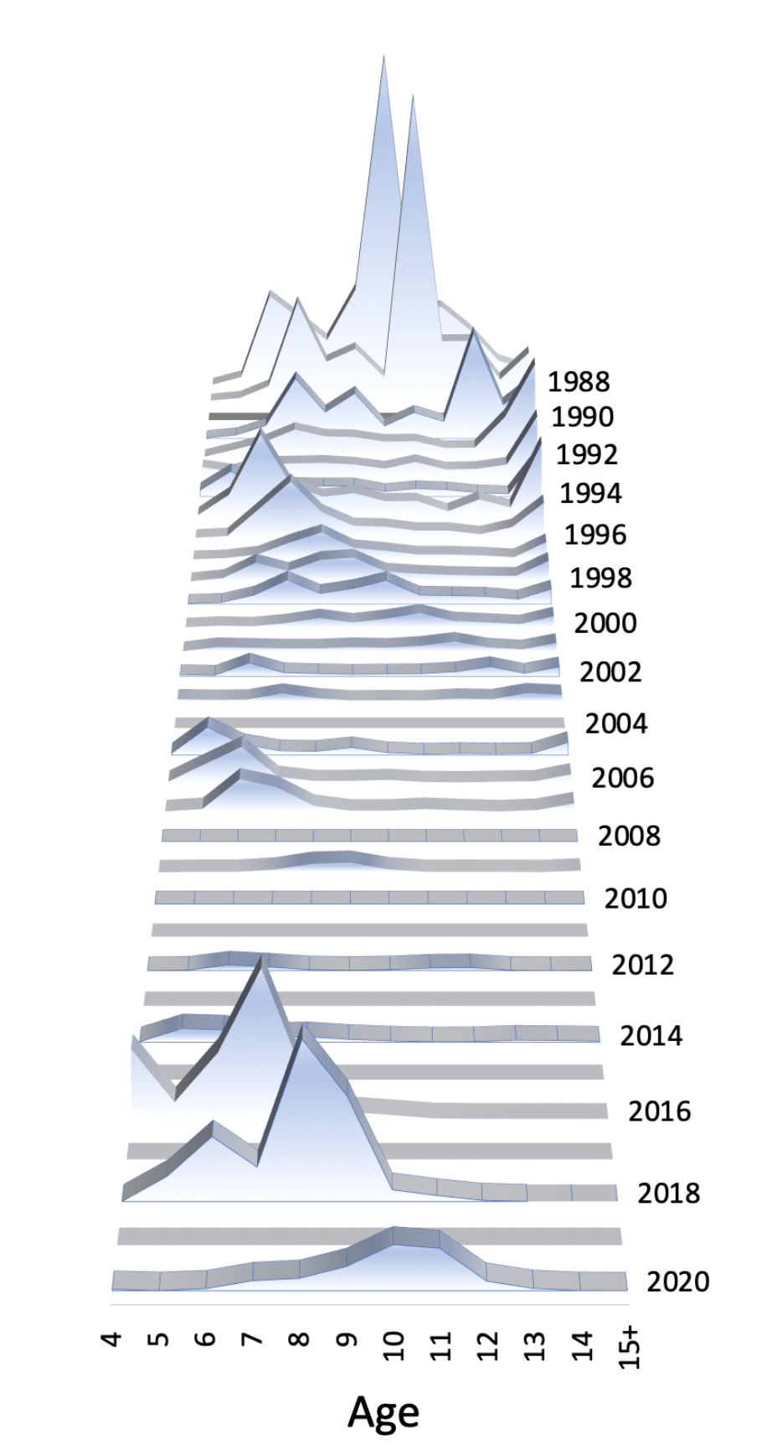
Survey Age Composition
Bogoslof pollock
Notes:
Graphs of age compositions by sex (if relevant) over time followed by size compositions by sex (if relevant) over time with highlights of trends and any issues (e.g., tracking cohorts through time, shifts in size distributions, plus age group)

Slide 6
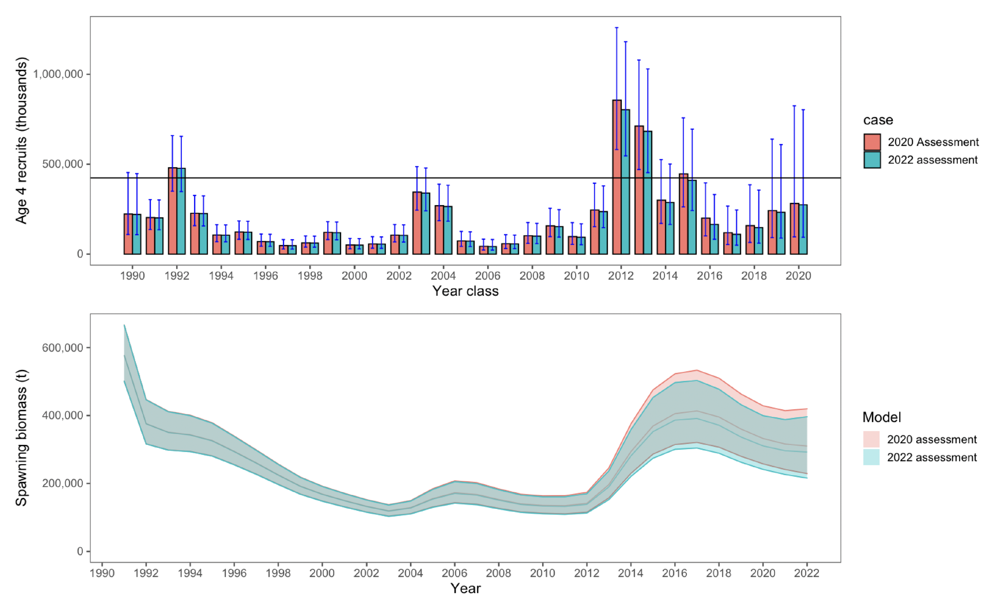
Model Summary
No Model Changes
  Same model as 2018
Notes:
Table of base model with brief description of features and list of alternative models if relevant, NOTE: do not show models not being evaluated

Slide 7
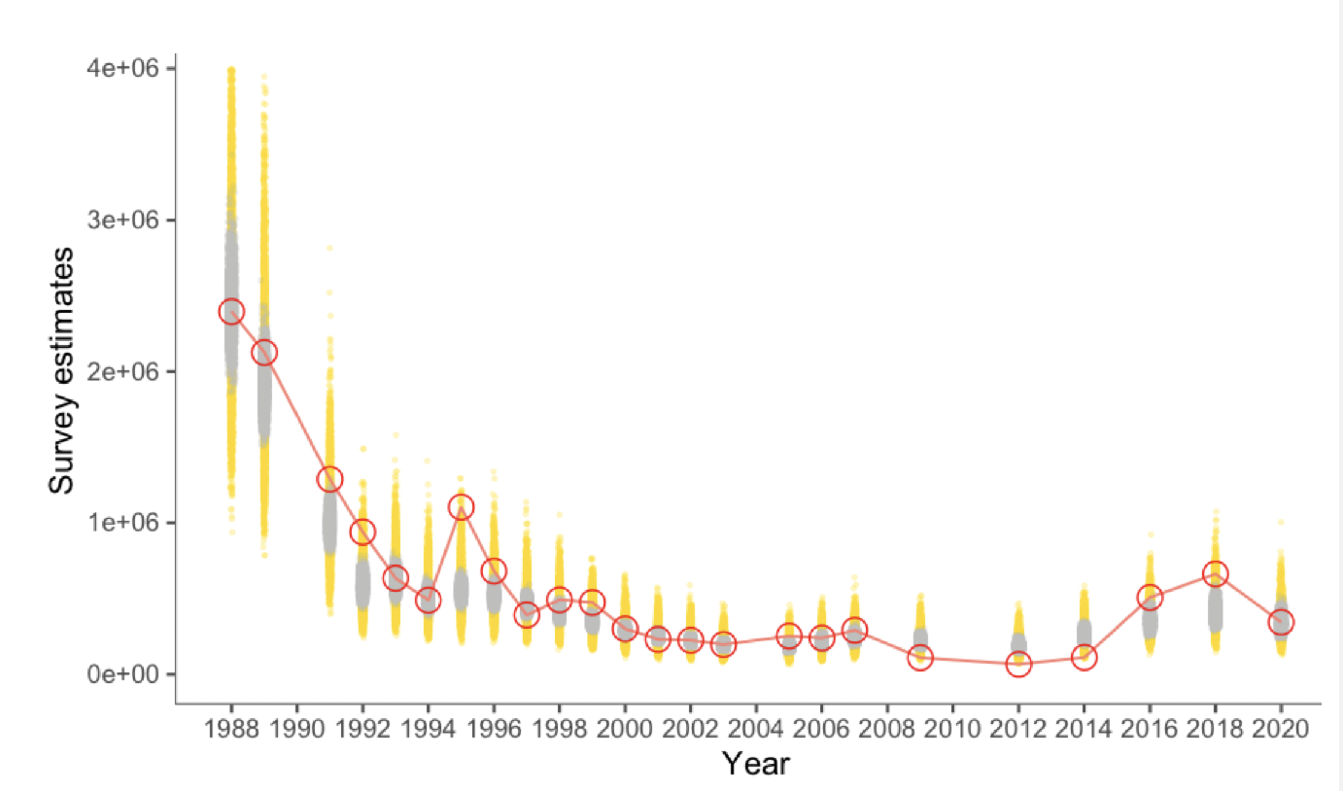
Model Fit - Survey Biomass, Bogoslof pollock
Notes:
Should include graphs of model fit to time series and compositions shown in the Data Summary section, preferably in the same order (e.g., Model Fit - Catch, then Model Fit - Fishery Age Composition,...), may include convergence or goodness of fit statistics, if evaluating multiple models show fit of all models evaluated for time series and compositions, highlight any lack of fit, may provide likelihood comparison table

Slide 8
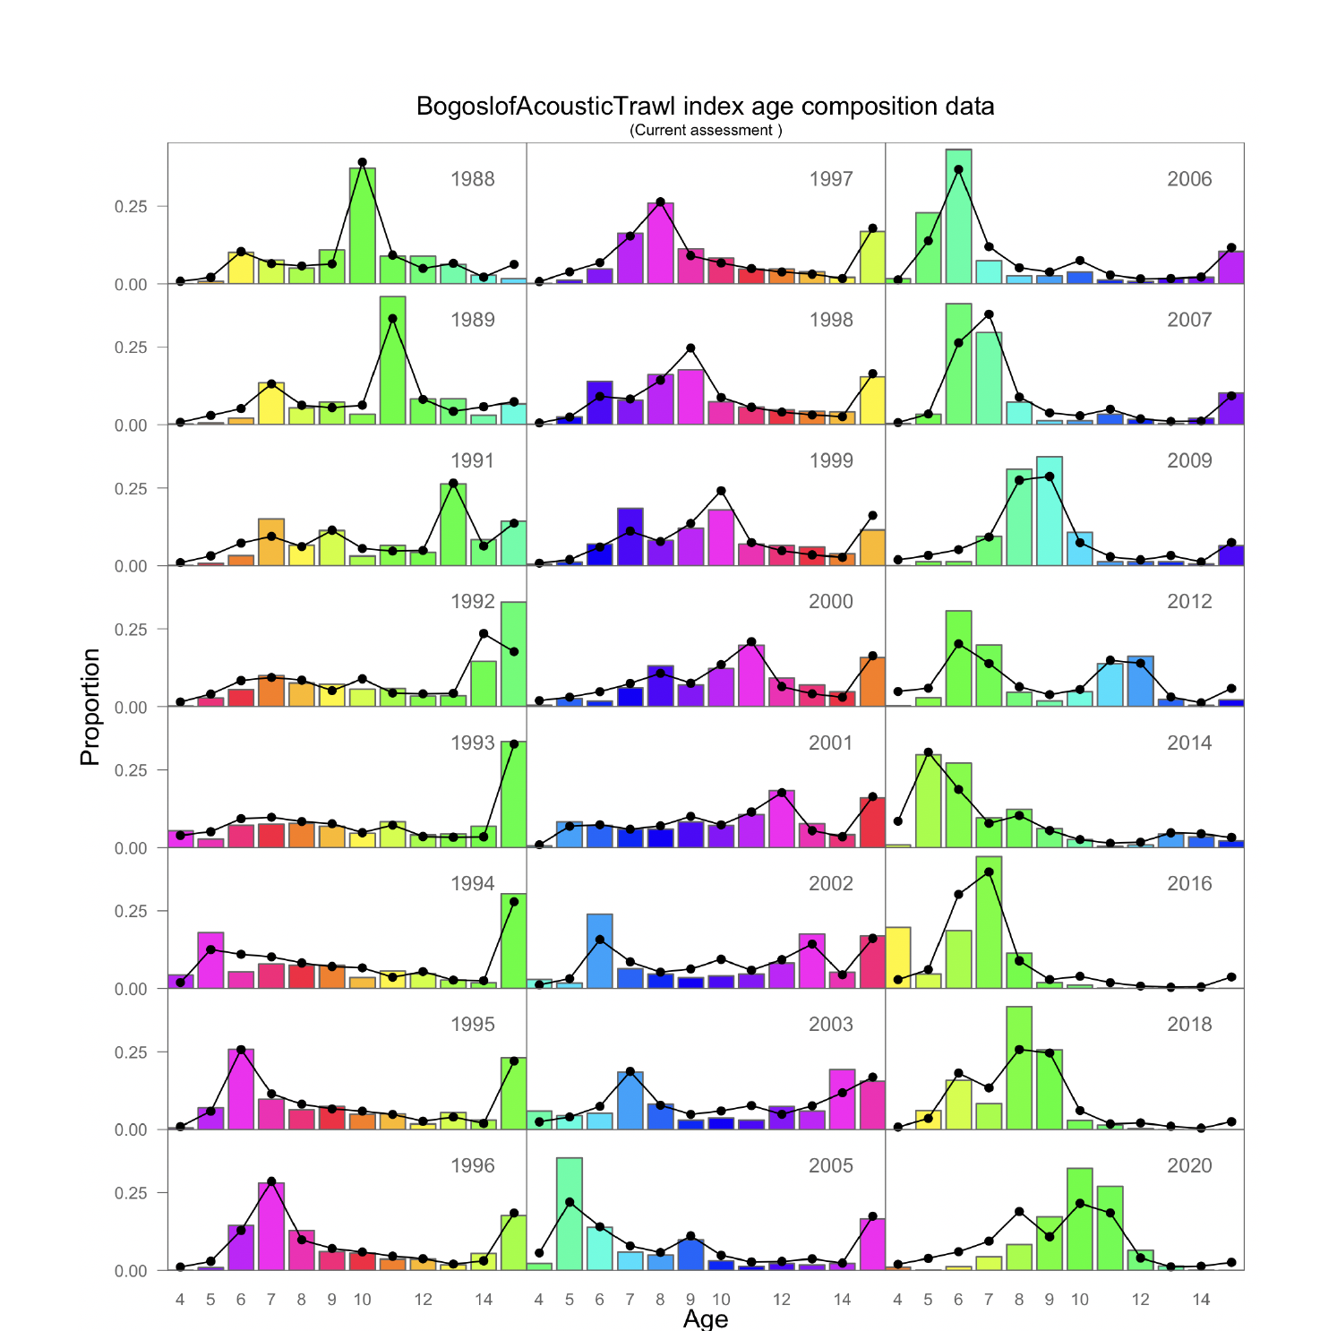
Model Fit - Survey Age
Notes:
Should include graphs of model fit to time series and compositions shown in the Data Summary section, preferably in the same order (e.g., Model Fit - Catch, then Model Fit - Fishery Age Composition,...), may include convergence or goodness of fit statistics, if evaluating multiple models show fit of all models evaluated for time series and compositions, highlight any lack of fit, may provide likelihood comparison table

Slide 9
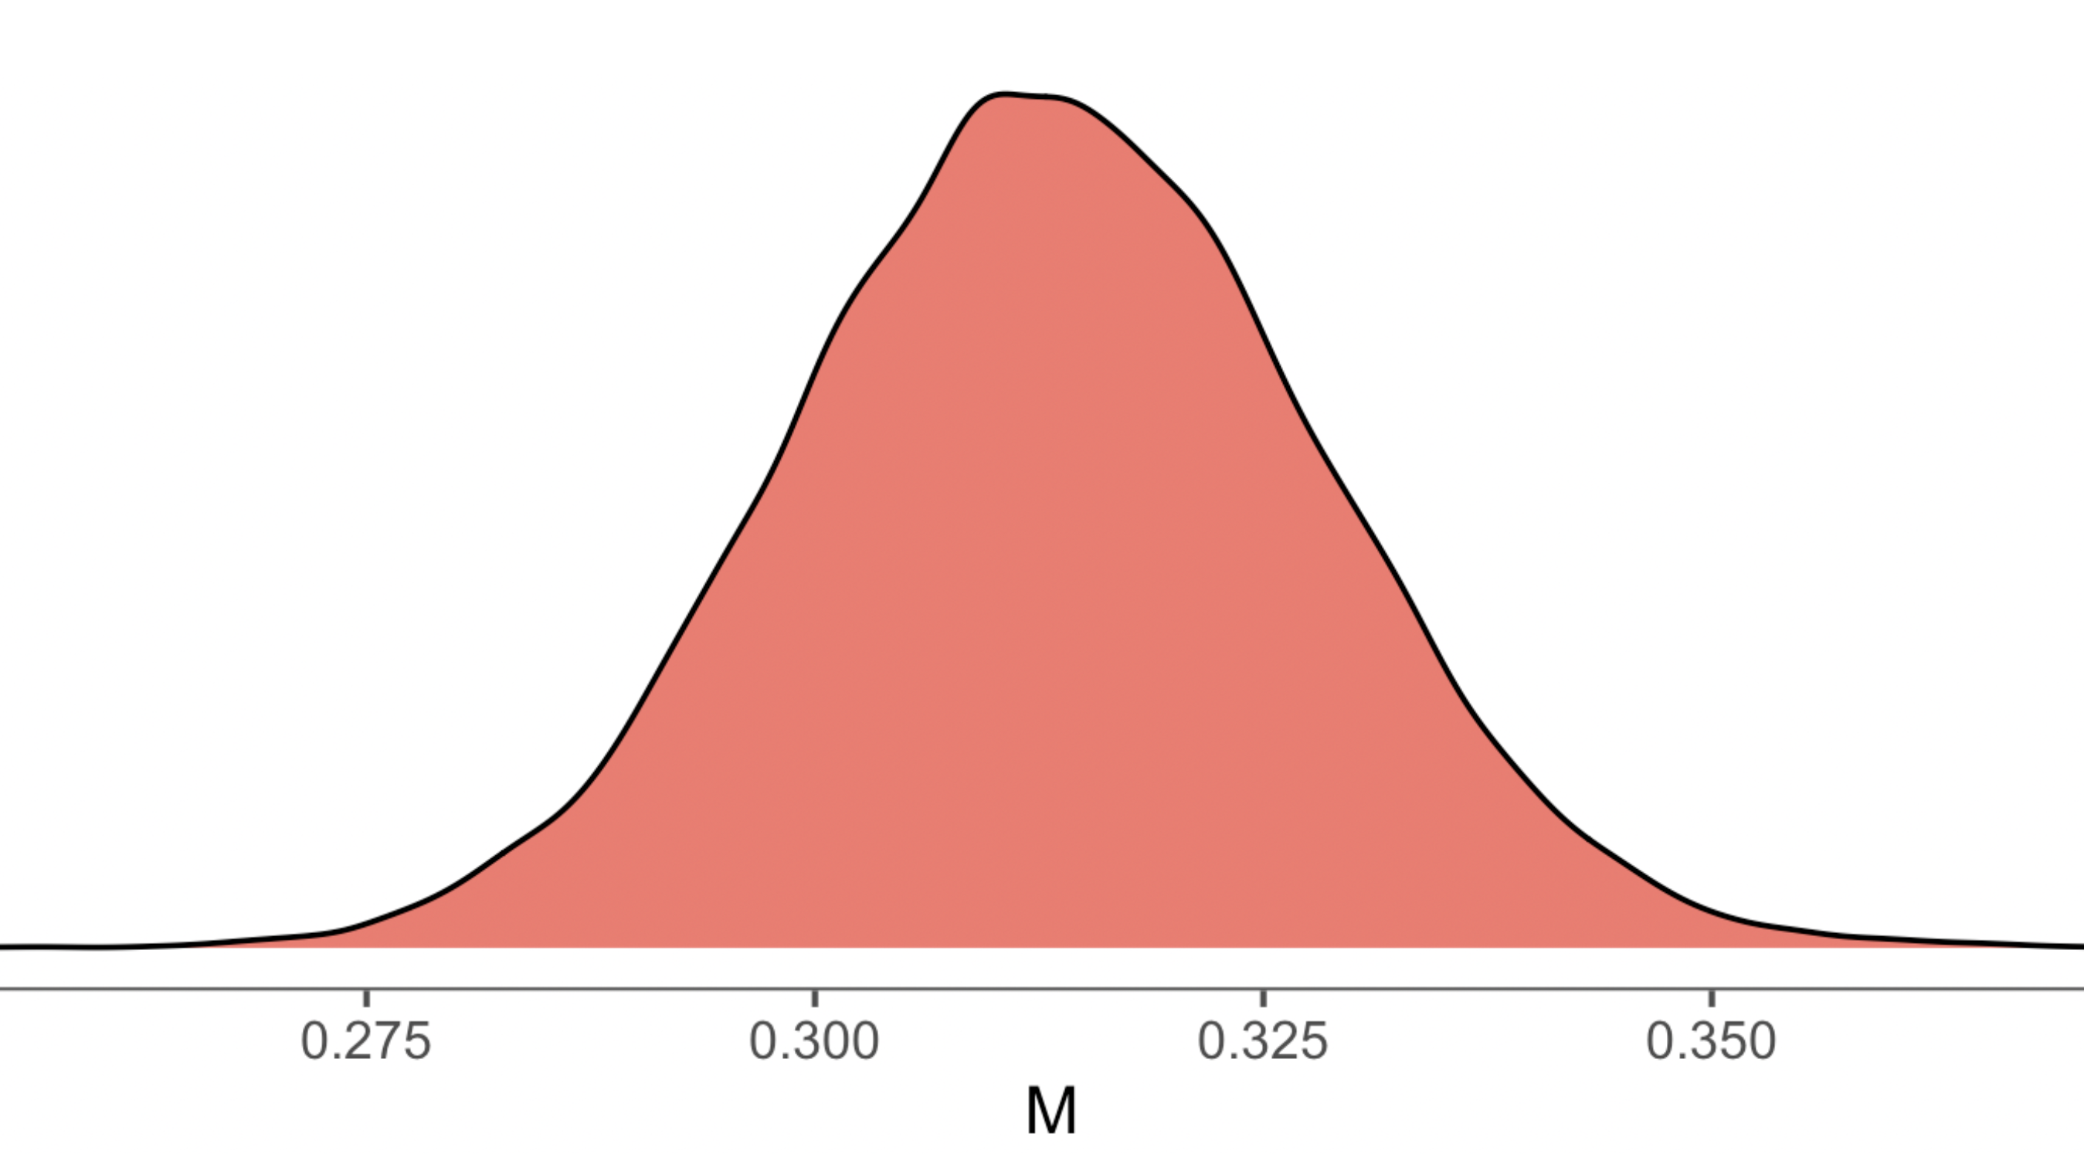
Parameters Bogoslof pollock
Notes:
Comparison table of main estimated parameters with uncertainty estimates, if evaluating multiple models provide parameter estimates for all models evaluated, highlight author recommended model

Slide 10
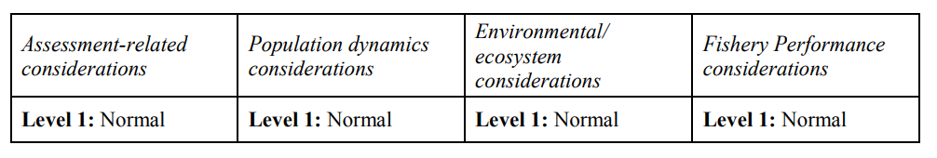
Risk Table
Notes:
Summary table with brief summary of justification text or plots for selected levels of risk, if have ESP for stock and presentation preceding then can simply reference ESP graphs

Slide 11
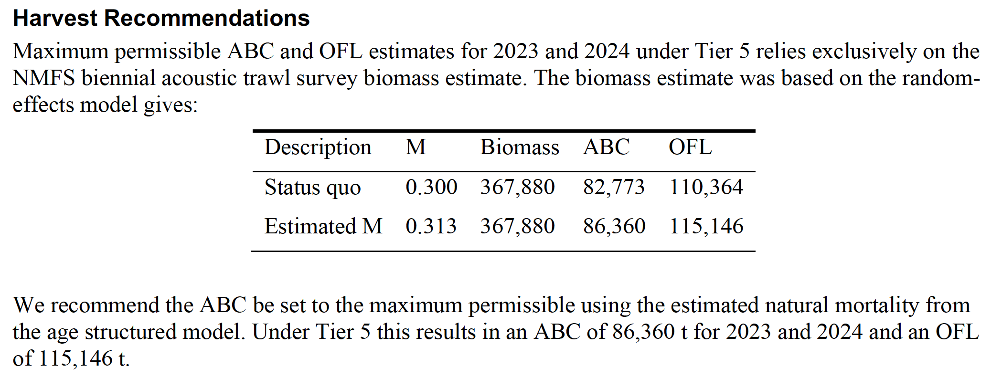
Model evaluation
Notes:
List with brief description, if relevant to decision of model provide highlights

Slide 12
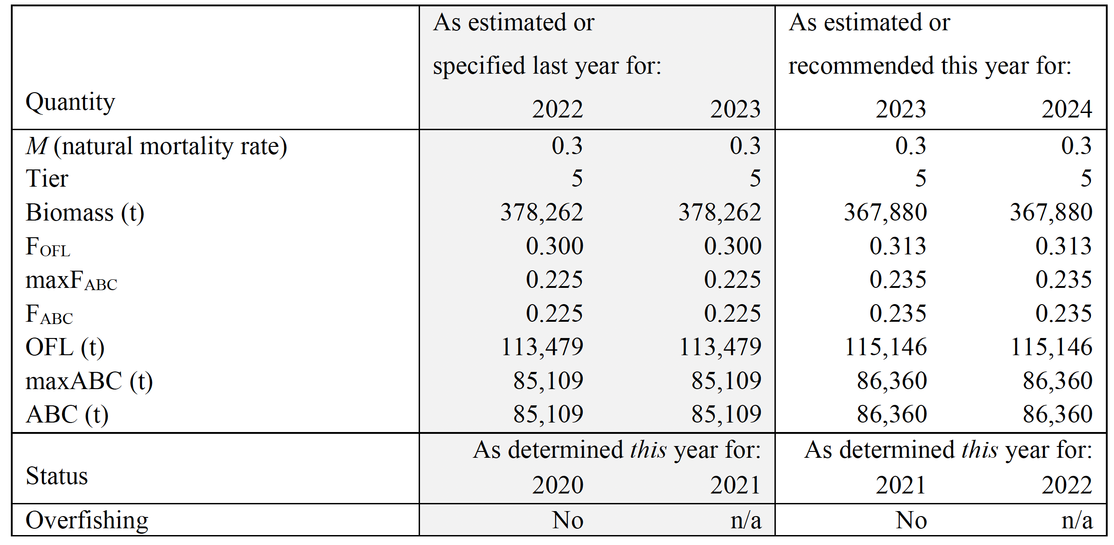
ABC / OFL recommendation, Bogoslof pollock
Notes:
Summary table with last year and recommendation for this year values, highlight ABC and OFL

