Slide 1

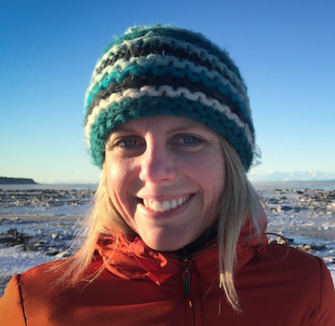
CLIMATE CHANGE TASK FORCE
Meeting 5 (part 1)
January 18-20
January 2021
CCTF Members:
Co-chair: Diana Stram (NPMFC): diana.stram@noaa.gov
Co-chair: Kirstin Holsman (NMFS- AFSC) : kirstin.holsman@noaa.gov
Lauren Divine (Aleut Community of Saint Paul Island)
Scott Goodman (Natural Resources Consultants/BS Fisheries Res. Foundation)
Jason Gasper(NMFS-Regional Office)
Mike LeVine (Ocean Conservancy)
Steve Martell (SeaState)
Brenden Raymond-Yakoubian (Sandhill Culture Craft)
Jeremy Sterling (AFSC Marine Mammal Lab)
Todd Loomis (Ocean Peace, Inc.)

Slide 2
  The goal of the Climate Change Module is to facilitate the Council’s work towards climate-ready fisheries management that helps ensure both short- and long-term resilience for the Bering Sea.
Notes:
The goal of the climate change module is to facilitate and support equitable climate change adaptation pathways and long-term resilience for the coupled social-ecological system of the Eastern Bering Sea (see geographic description in the FEP [ add link] ) . This module will support the capacity to i) evaluate management tools to develop incremental (normative) adaptation measures to preserve livelihoods, health and wellbeing across fisheries and dependent coastal communities, and, ii) enable transformative adaptation needed to ensure the productivity and sustainability of the coupled social-ecological Bering Sea system. To achieve this, the climate change module will be used to synthesize current knowledge regarding climate change effects on the EBS system, identify potential climate-resilient management measures that can improve adaptive capacity and avoid maladaptation (Figure 1), evaluate the risks, timescales, and probability of success of various climate-resilient management policies under future scenarios of change; and provide prioritized recommendations for actions that could be taken to advance the goals and minimize the risks identified.

Slide 3
CCTF MEETINGS TO DATE
  January 2020: spin up meeting and update to Council bodies (Ecosystem Committee, SSC/AP/Council)
  February 2020 CCTF meeting 2:
    Initial development of framework and proposed process
    Initial draft of work plan
    Update to FEP (March meeting)
  December 2020 CCTF meeting 3
  May 2021 CCTF meeting 4
    Work plan approved

Slide 4
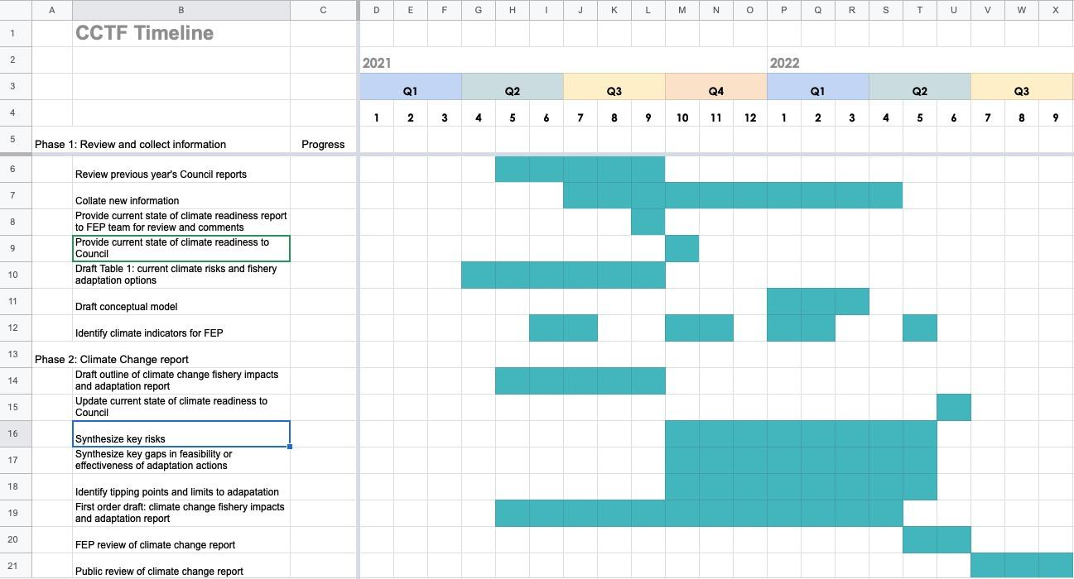
CCTF Meeting 4 recap
Workplan finalized, all further revisions will go through linked ‘live’ deliverables document
“live” glossary of terms added
plain language added to overview section
Identified activities for now through 2021
  Update table 1 (annual exercise)
  FEP Climate Indicators short list
  Synthesis of current climate readiness
  Outline of Climate change report

Slide 5
Timeline
CCTF will continue work through 2025
Meetings in Winter 2022 (January 18-20 and March (TBD?)) work sessions):
  move forward with Climate Readiness synthesis
  draft of the Climate Briefing Report to present for feedback to FEP and SSC/AP/Council in March/April
    Case study for report on snow crab
  Continued work on indicators
Discuss schedule of 2022-23 meetings
  Previously identified 2-3 meetings per year and two Council meeting updates
    April update in conjunction with FEP

Slide 6
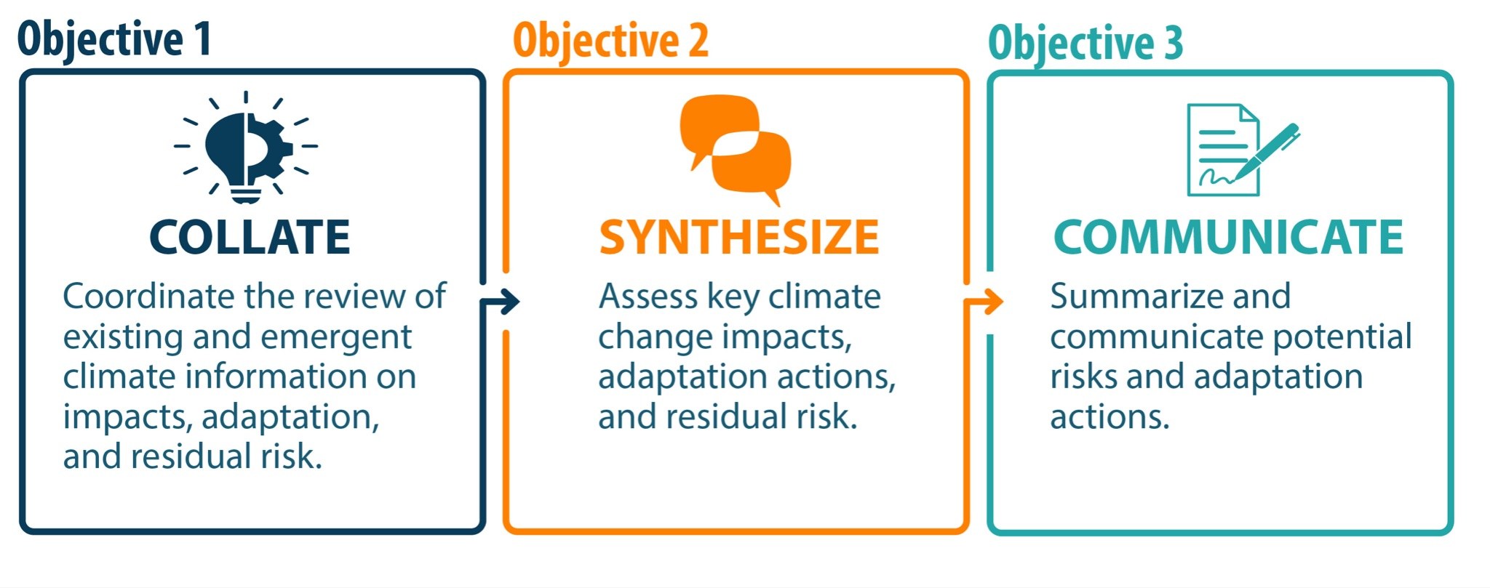
Overall CCTF objectives
Objective 1. Collate:
Evaluate the mechanisms and processes through which climate change information is currently included in the fishery management process, identify gaps, and help create opportunities to increase the inclusion of available information
Objective 2. Synthesize:
Synthesize information about long-term climate change impacts and scenarios and help create pathways for inclusion of that information in the fishery management process.
Objective 3. Communicate:
Identify potential management tools and actions for consideration by the Council that could help increase resilience and adaptation to climate change impacts

Slide 7
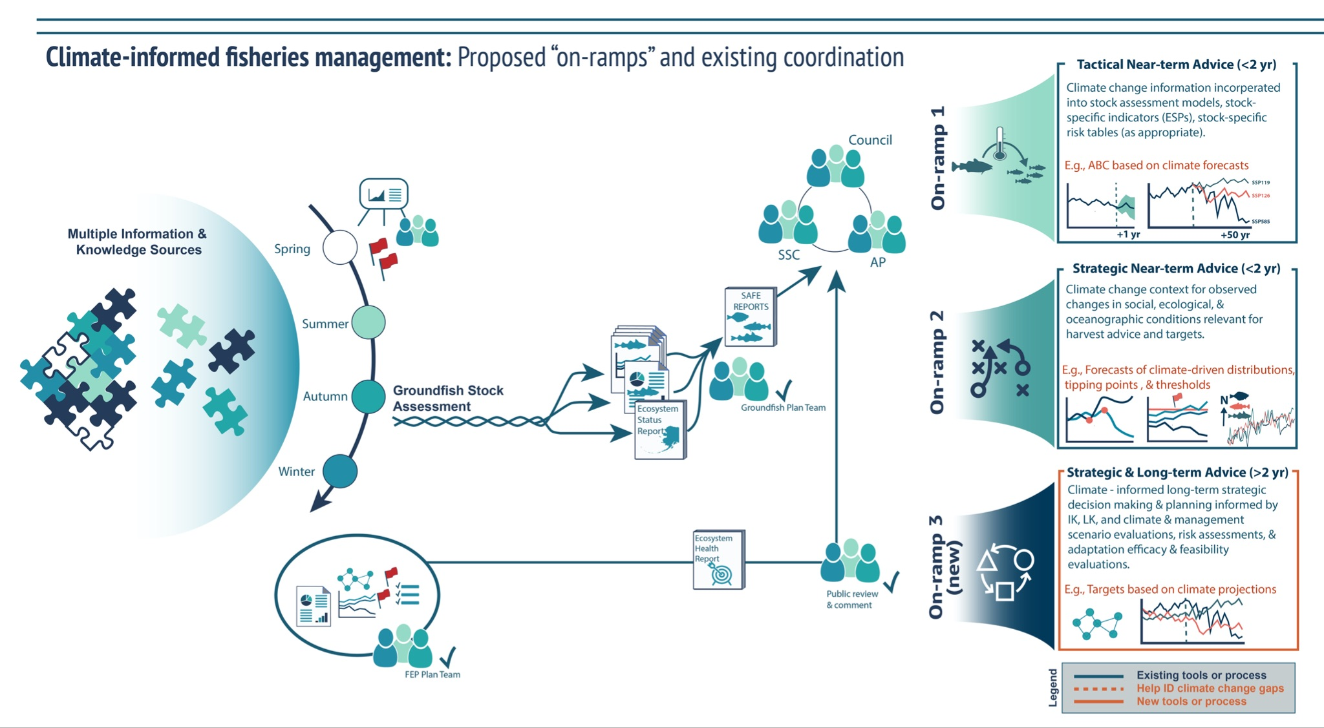
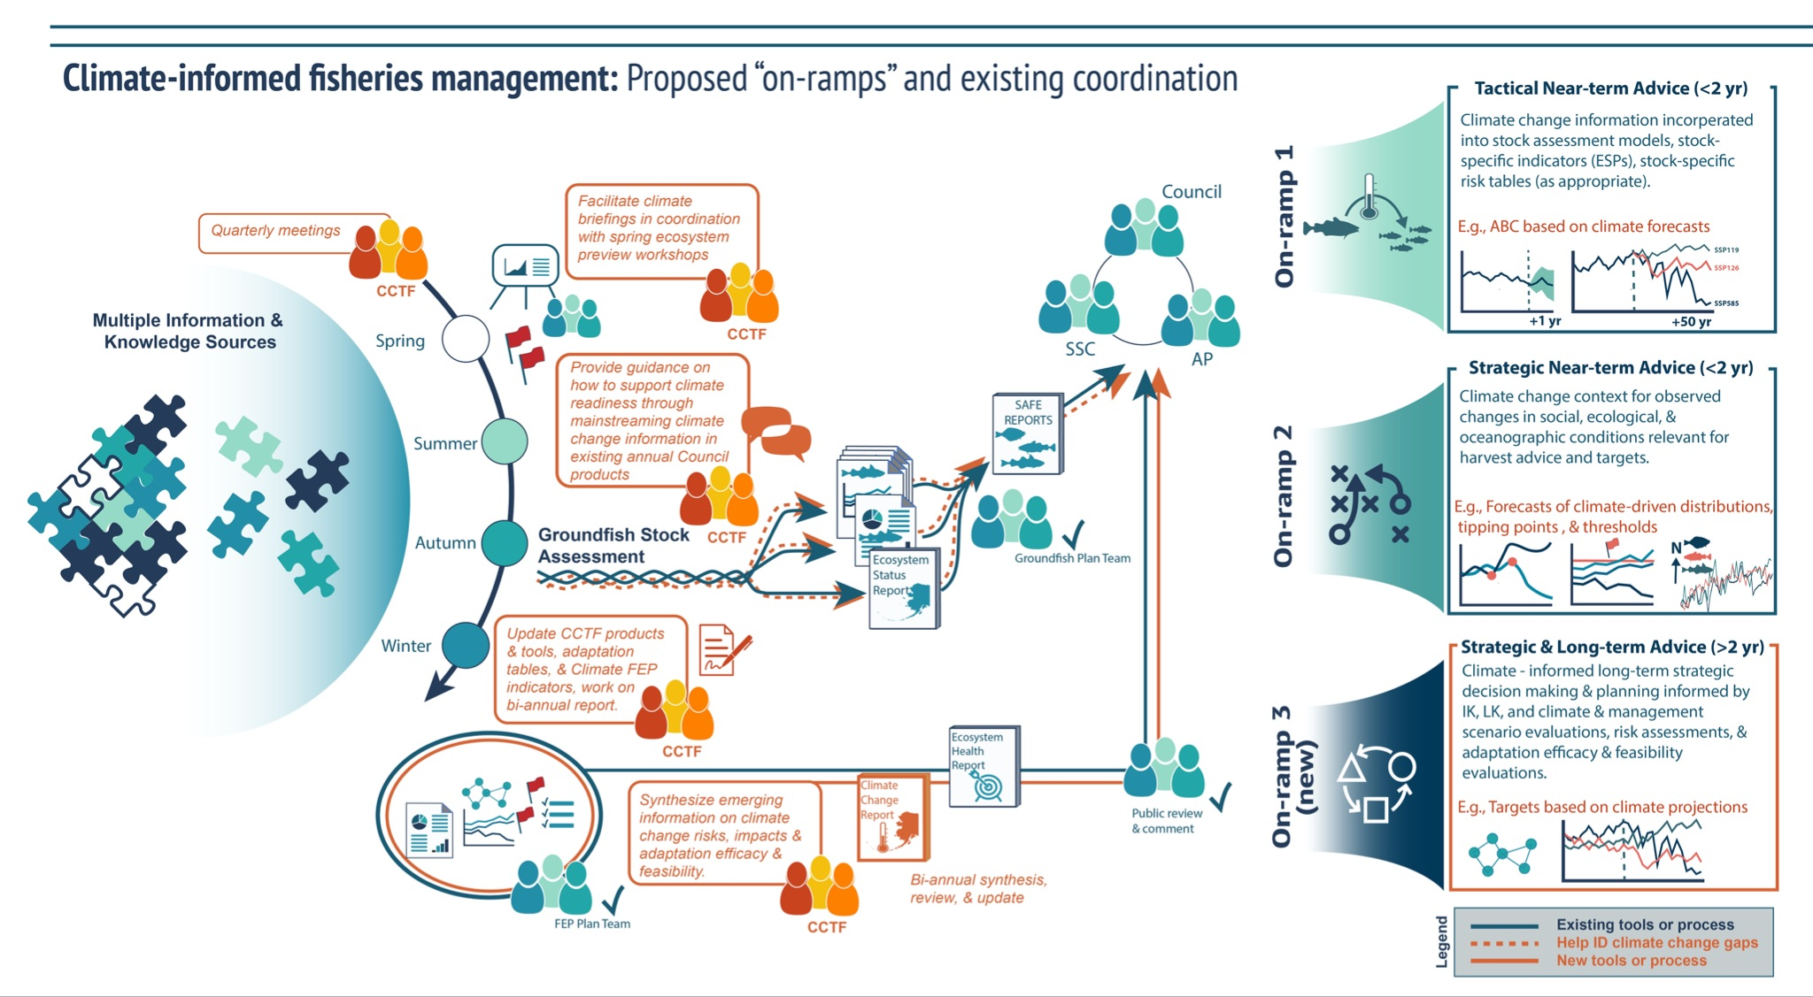

Slide 8
Issues to address in these two meetings (January and March)
Update on Task Force and FEP Coordination
    Monthly meeting between FEP, CCTF, and LKTKS co-chairs
    Include FEP Team on email updates of progress/etc as reported out to Council when FEP does not meet prior
What will the climate briefing look like?
  Review of current state of climate readiness [goal for starting at this meeting]
  How to incorporate case study for snow crab, YFS, others as examples of issues and our resilience in management or ideas for improvement
  Synthesis of risk and adaptation efficacy/feasibility
  Draft of climate briefing as goal out of March meeting
Process by which new on ramps developed under CCTF process will be taken up moving forward from 2025 - i.e., who will be responsible for these tasks post 2025
Indicator development:
  Sub-group across TF and FEP for indicators

Slide 9
Current Climate readiness synthesis
  Summarize management system
    Management framework
    Stock assessment
    Knowledge base
      Is this the tie-in to indicators?
  Use case studies to help develop examples of different BSAI management issues and their relative vulnerability to climate change
    Could include but not be limits to:
      Snow crab
      YFS
      Sablefish
      Pollock
      Squid
      herring

Slide 10
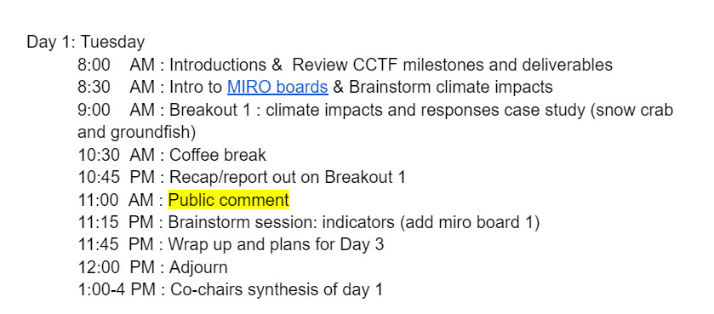
Day 1

Slide 11
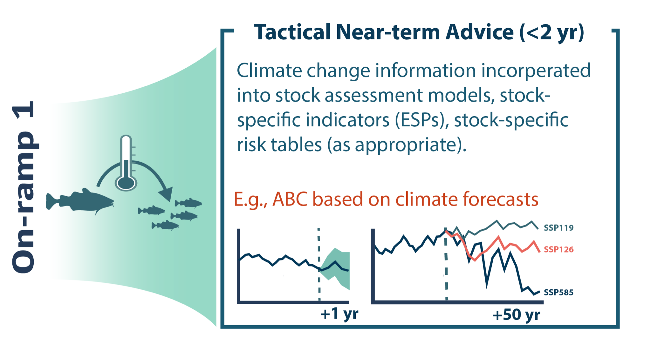

Slide 12
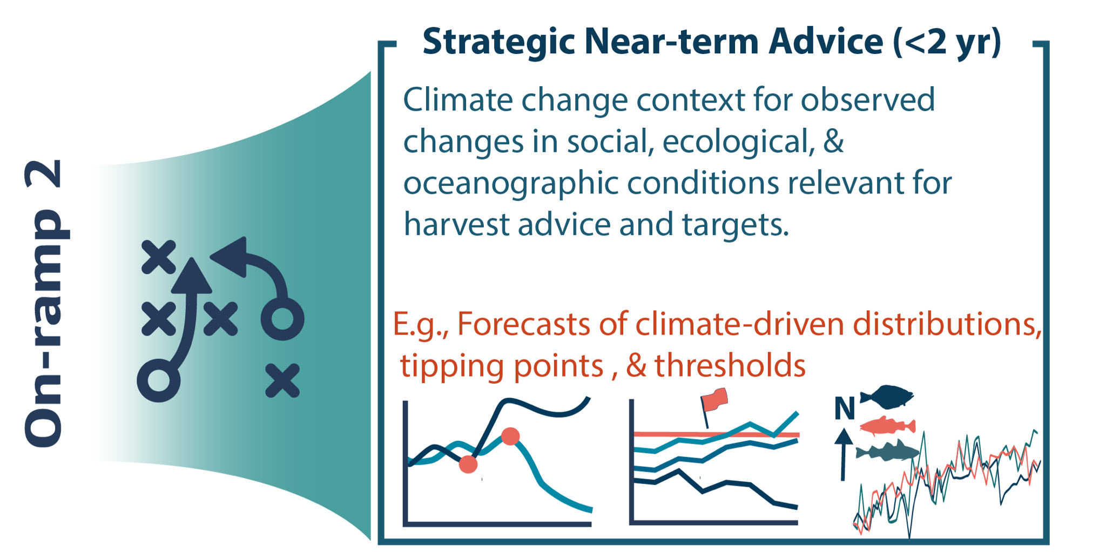

Slide 13
