Slide 1
Local Knowledge, Traditional Knowledge, and Subsistence Taskforce Meeting
January 17th, 2020
Anchorage, Alaska

Slide 2
Today’s Agenda
Welcome back
  Update from Climate Change Taskforce
Review L&TK Objectives
Establish Subsistence Objectives
Taskforce Ground rules and meeting structure
Public engagement
Next steps

Slide 3
Taskforce Objectives Identified in the Workplan
1. Local knowledge and traditional knowledge: Create a clear set of directions for the Council regarding best practices for solicitation and consideration of these types of knowledge and information.
  Strengthen relationships with local and traditional knowledge holders.
2. Subsistence:
Create clear direction(s) for the Council regarding how impacts to subsistence are understood and incorporated into analyses as well as how to mitigate potential impacts to subsistence resources or use of those resources by Alaska Natives.
3. The Task at this Meeting: identify 3-5 overarching objectives that will help achieve the overarching objectives described above.
    These could form the background for what the Taskforce will attempt to achieve and how they will get there.

Slide 4
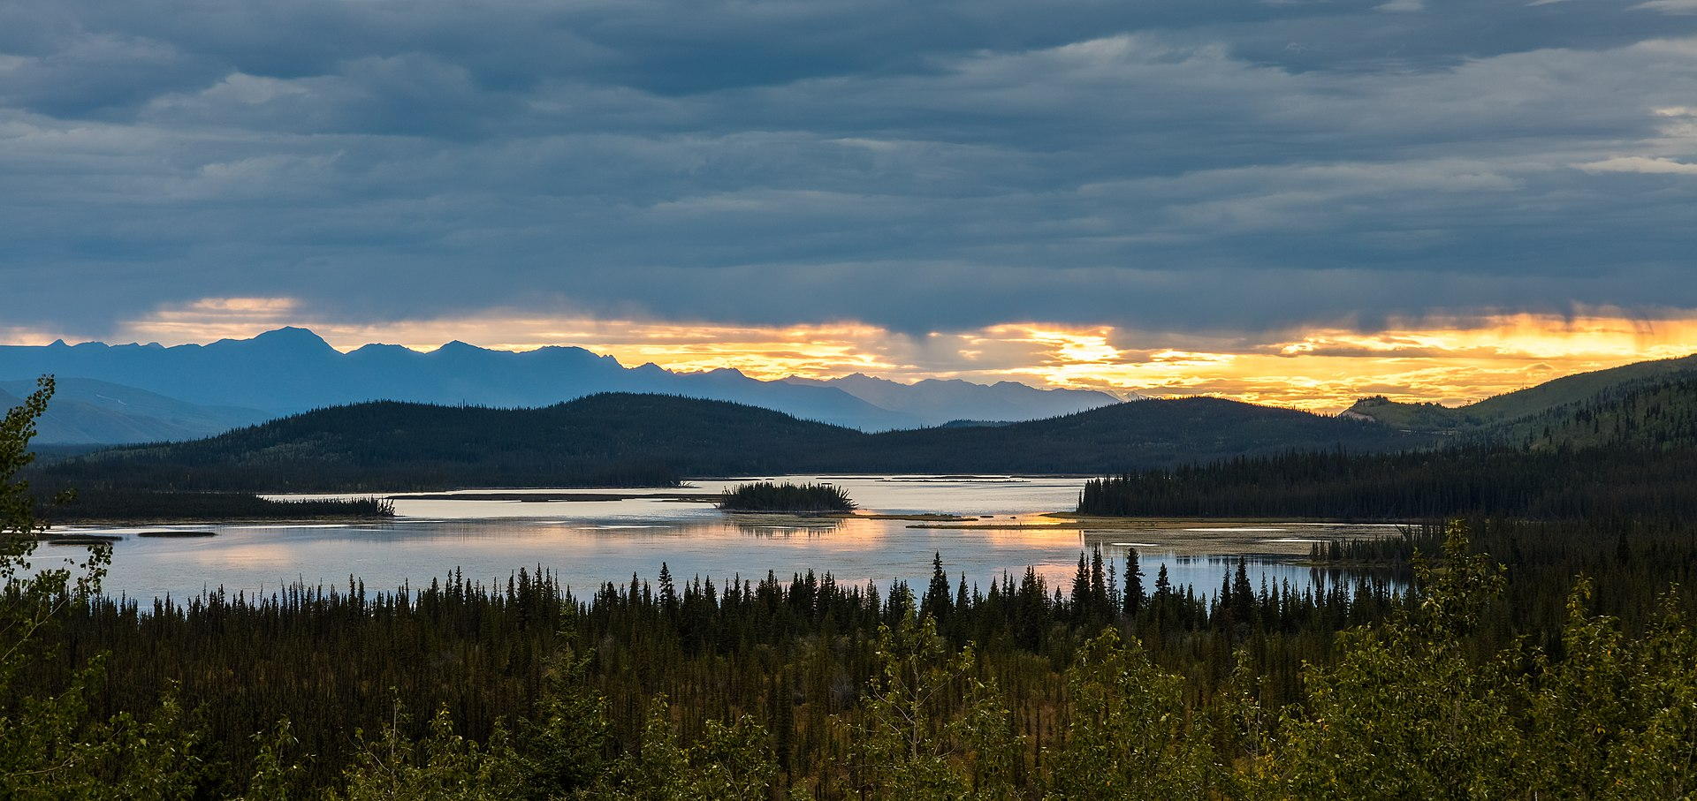
  Group Discussion
  Establish Subsistence Objectives

Slide 5
  Group Discussion
  Come to Consensus:
  TF objectives
  Priorities for actions needed to meet objectives

Slide 6
Prioritized Steps/Methods to Meet Objectives- Guiding Questions
The task is to identify and prioritize these action steps or methods.
  What do we need to accomplish our objectives?
  What are the specific needs to meet each objective?
  What is the timing of these steps over the next two to three years?
  Appendix 2 of the Action Module’s Workplan contains an extensive list of potential bounded actions adopted by the Council in December 2018.

Slide 7
Establish Meeting Structure and Ground Rules for Task Force (Task III)
Kate H.

Slide 8
Purpose of Section
The purpose of this section is to come to a consensus on the timing and format of the Taskforce.
It provides a space for discussion related to when meetings will occur, the scope of work that is reasonable, etc.

Slide 9
Review of Action Module Timelines
All Action Modules are temporary groups with members working to achieve the objectives of each Action Module within its scope as defined by the Council.
This Action Modules works across multiple timescales, although with a finite timeline of two to three years.
This section provides a space for the Taskforce to be specific about the prioritization for timing of work related to the Action Module.

Slide 10
Meeting Structure and Ground Rules
When, where, and how should Taskforce meetings take place?
  6 meetings over 2-3 years
  Stakeholders have requested that efforts be made to maximize all possibilities for access and examine the possibility of diversity in meeting site choices, where funding allows
  Stakeholders have recommended that most meetings take place in-person when possible, with an inaugural meeting in-person in Anchorage, AK

Slide 11
  Group Discussion
  Establish ground rules for Task Force (Task III cont.)
  What is the scope of work that is feasible?
  Define details: When, where, how often to meet?

Slide 12
  Come to consensus
  on timing and format

Slide 13
Structure of Public Involvement (Task III cont.)
Kate H.

Slide 14
Purpose of Section
The purpose of this section is to provide a space for the Taskforce to discuss the nature and scope of public involvement within the Taskforce process.
The outcome of this section should be a structure or plan for public involvement in the Taskforce process with potential applications to the Council process more broadly.

Slide 15
Public Involvement and Engagement- Potential Considerations
It is anticipated that LK, TK, and subsistence experts will need to be actively involved on the development team for this Action Module.
Outreach to partner agencies and their constituents as well as ongoing collaboration with Tribes, Alaska Native Organizations, and communities throughout the Bering Sea region will be important in verifying the data, products, and methods to use in management.

Slide 16
Public Engagement – Guiding Questions
How does the Taskforce envision public engagement?
How does the Taskforce envision stakeholder involvement and engagement, particularly as it relates verifying data, outputs, and methods to use in management processes?

Slide 17
  Group Discussion
  Public Engagement (Task III cont.)
  How does the TF envision public and stakeholder engagement?
  particularly as it relates verifying data, outputs, and methods to use in management processes?

Slide 18
Next Steps (Task IV)
Kate H.

Slide 19
Identify Action steps and leads

Slide 20

Next Steps (Task IV):
Group Task
- Identify action steps
- Prioritize next steps
- Establish leads

Slide 21


Slide 22
Taskforce Work Products (Task III cont.)
Kate H.

Slide 23
Purpose of Section
The purpose of this section is for the Taskforce to come to a consensus on a set of potential work products for the Taskforce.
This Action Module is expected to result in multiple sets of directions, processes, or best practices for the Council related to local knowledge, traditional knowledge, and subsistence in Council analyses or processes.
  Potential Examples: Appendix 2 of the Action Module’s Workplan contains an extensive list of potential bounded actions adopted by the Council in December 2018.

Slide 24
  Group Discussion
  Work Products (Task III cont.)
  - What kinds of work products will be helpful to the Council?
  - What kinds of products would be helpful to Taskforce?
  - What kinds of products would be helpful to communities?

Slide 25
  Group Discussion
  Identify work products (Task III cont.)
  Come to consensus

Slide 26
Taskforce-determined Next Steps
(To be updated live at meeting)

Slide 27
EXTRAS

Slide 28
References
Martin, K. S., McCay, B. J., Murray, G. D., Johnson, T. R., & Oles, B. (2007). Communities, knowledge and fisheries of the future. International Journal of Global Environmental Issues, 7(2-3), 221-239.
Raymond-Yakoubian, J., B. Raymond-Yakoubian, and C. Moncrieff (2017) “The incorporation of traditional knowledge into Alaska Federal fisheries management” in Marine Policy 78 (2017): 132–142.

