Slide 1
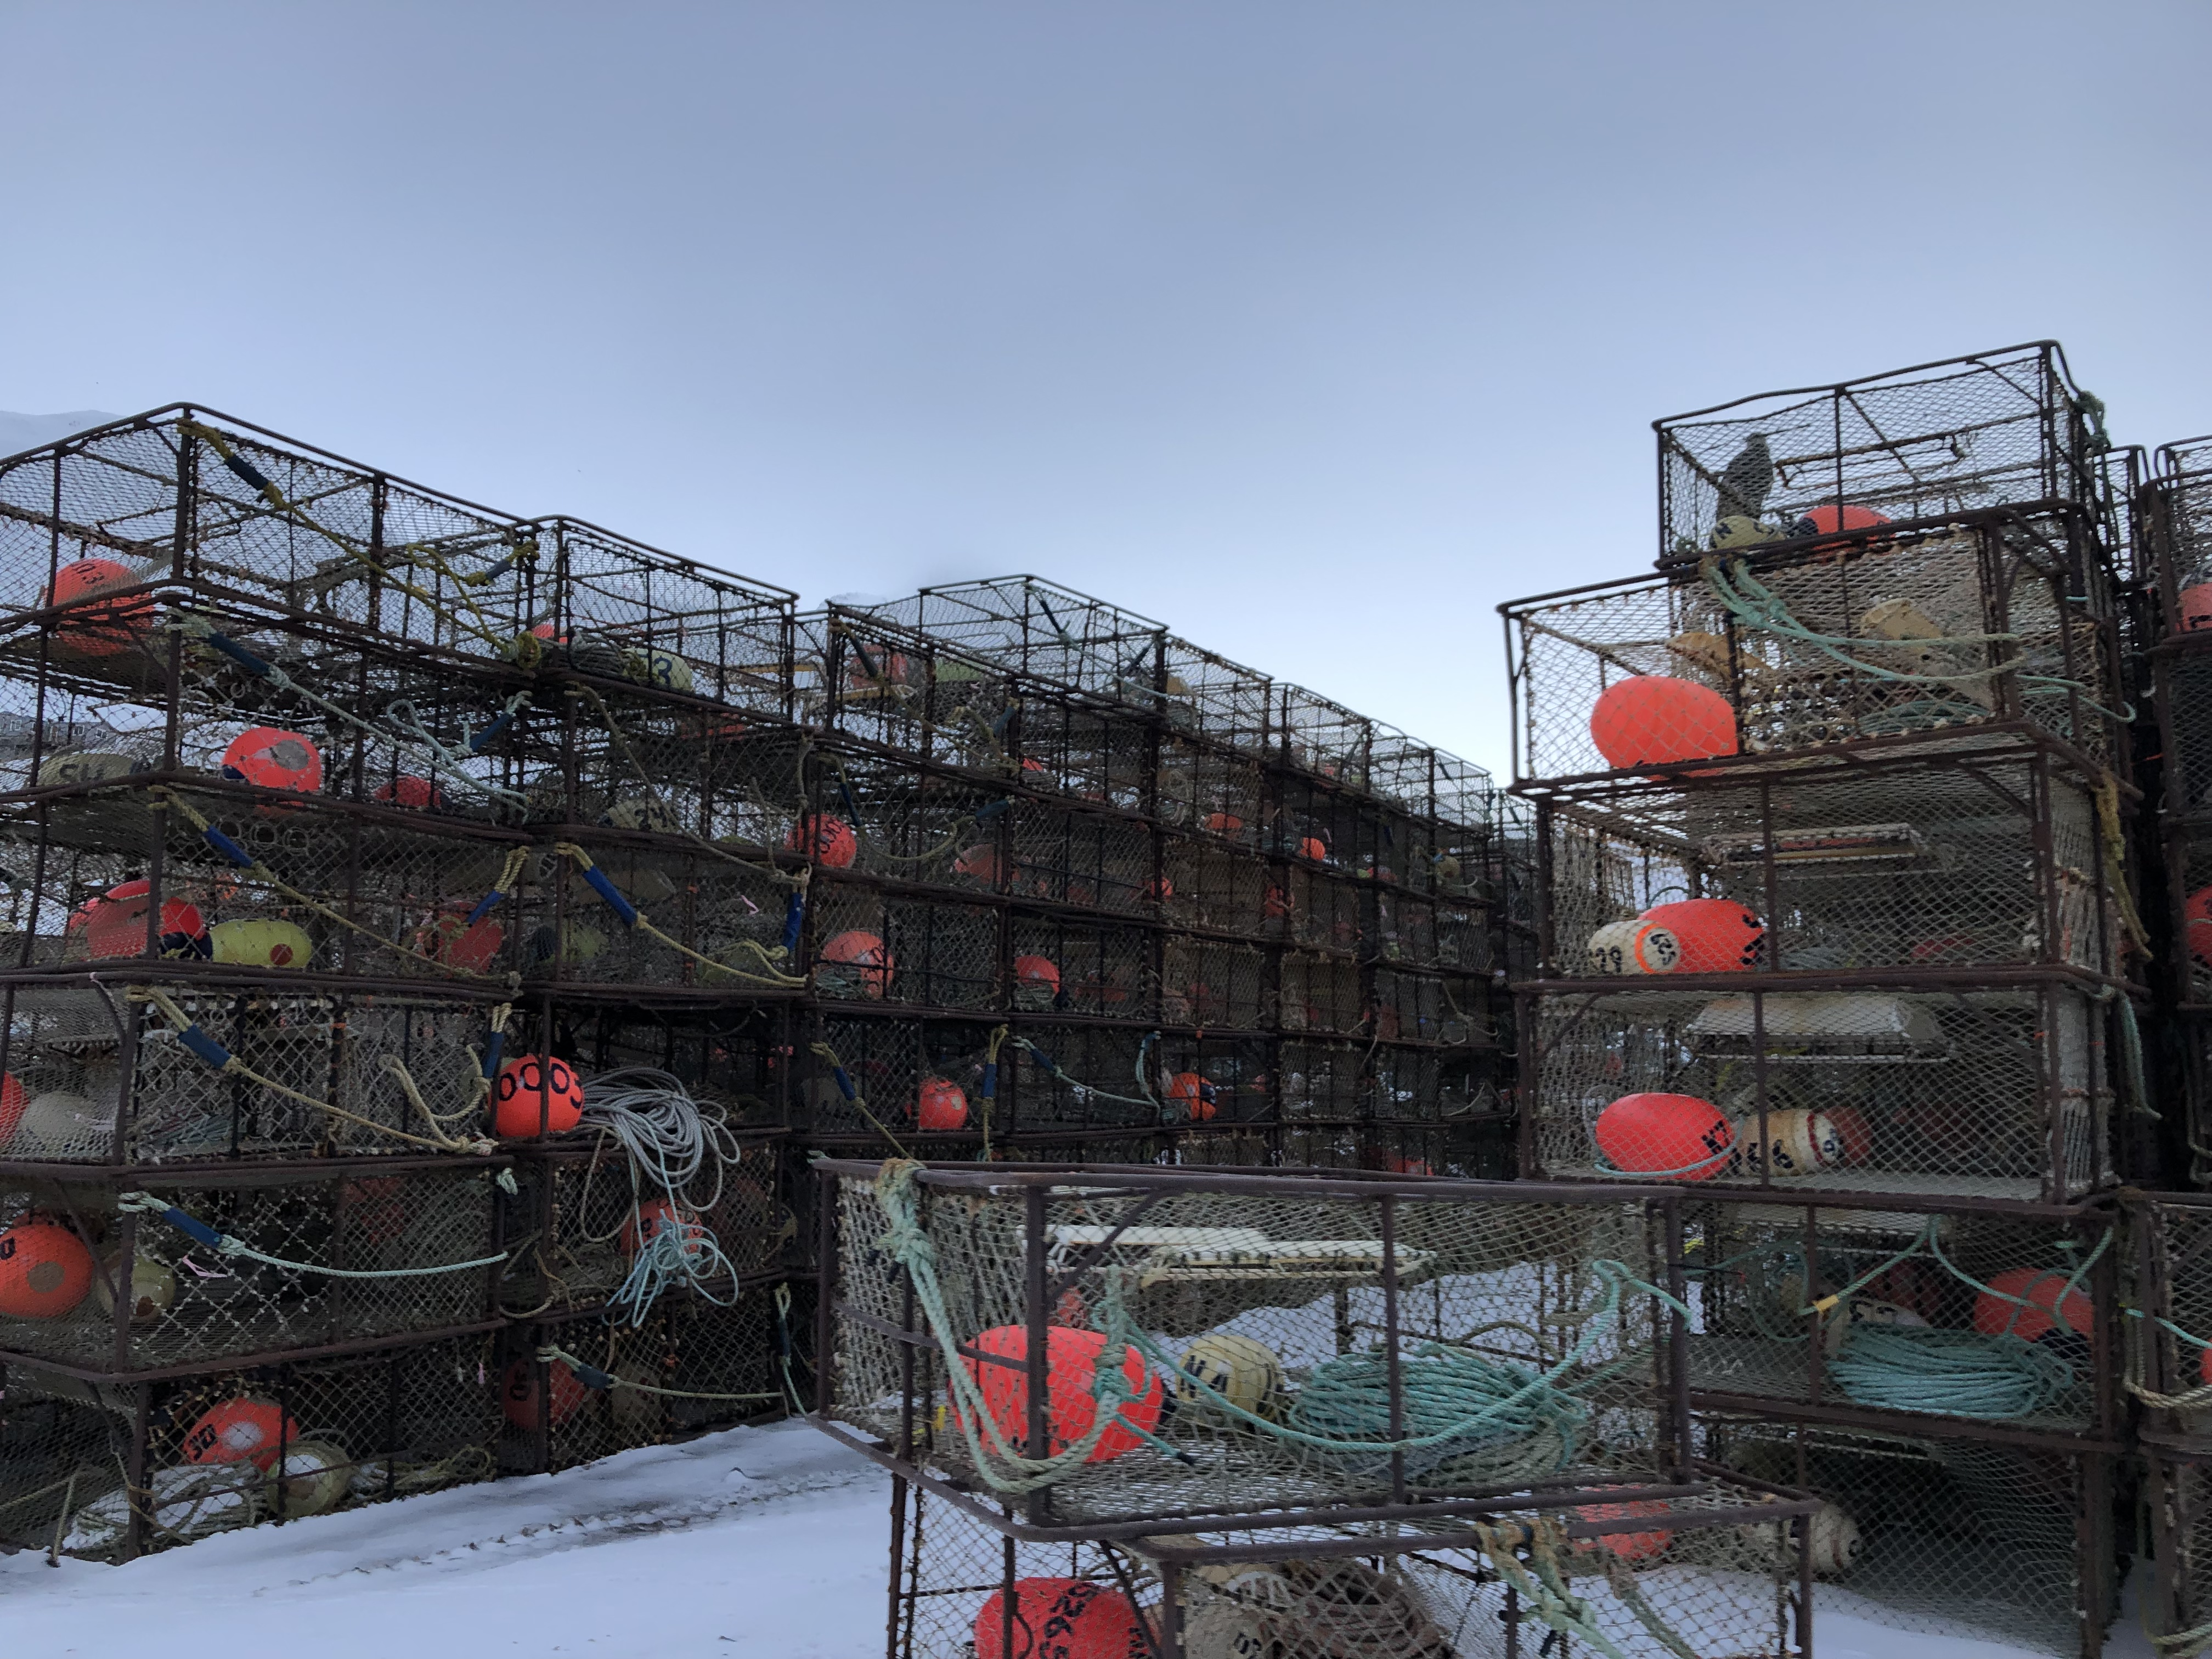
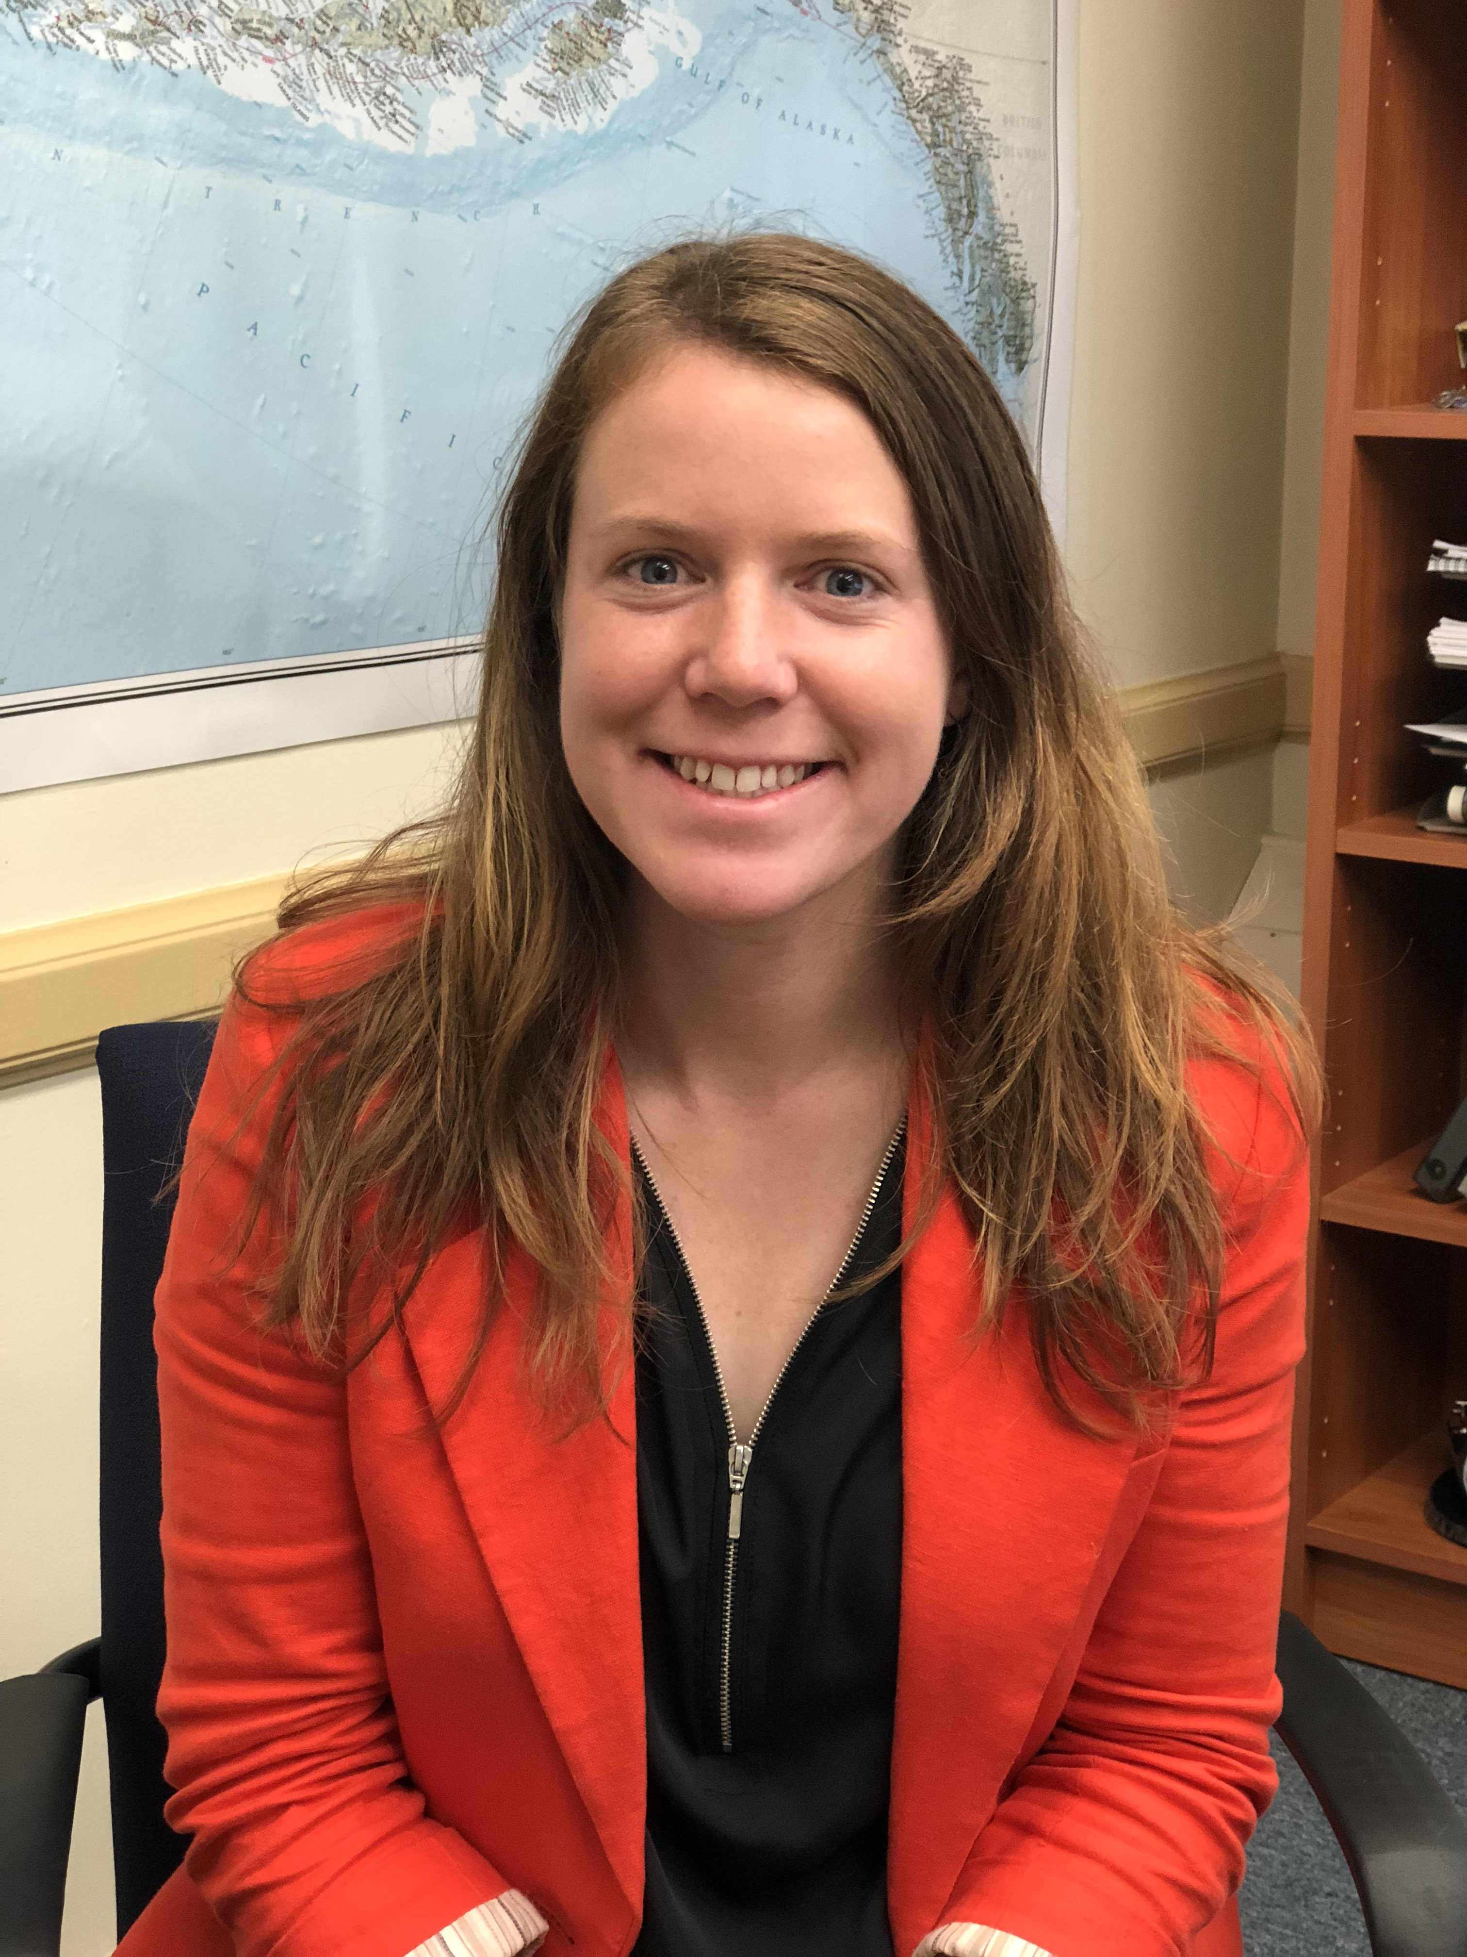
Clarification on Crab Crew Share Active Participation Action
An initial review analysis is scheduled for June: considers temporary changes to Crab Crew share (“C share”) requirements
A memo was produced for this meeting (attached under agenda E)
Highlighting challenges with the timeline
Staff are seeking clarification on the Council’s focus for its purpose and need statement

Slide 2
C Share Active Participation Requirements
In order to receive an annual allocation of C share IFQ:
Participate as crew in at least 1 delivery in a CR Program fishery in the 3 years preceding, or
the individual was an initial recipient of C shares, they could also participate as crew in at least 30 days of fishing in a commercial fishery managed by the State of AK or a US commercial fishery in federal waters off Alaska in the 3 years preceding

Slide 3
C Share Active Participation Requirements
In order to retain C share QS:
Participate as crew in at least 1 delivery in a CR Program fishery in the 4 years preceding, or
the individual was an initial recipient of C shares, they could also participate as crew in at least 30 days of fishing in a commercial fishery managed by the State of AK or a US commercial fishery in federal waters off Alaska in the 4 years preceding
There are narrow exemptions for closed fisheries – only if a C share holder has QS in a single closed fishery
E.g., if the C share holder held C. bairdi CVC, in additional to BBRKC CVC, they are still expected to be active and could lose QS in both

Slide 4
 |  |  |  | Beginning July 1, 2018 RAM may withhold IFQ | "COVID year" | "COVID year" | "COVID year" | Emergency rule- no IFQ withheld no QS revoked
 |  |  |  |  | Beginning July 1, 2019 RAM may revoke QS |  | no BBRKC | no BBRKC
 |  |  |  |  |  |  |  | no opilio
Seasons from July 1 - June 30: | 2015/2016 | 2016/17 | 2017/18 | 2018/19 | 2019/20 | 2020/21 | 2021/22 | 2022/23 | 2023/24 | 2024/25 | 2025/26
Example 1 | 0 | 0 | 0 | IFQ withheld; 0 | QS revoked
Example 2 | A | A | A | A | 0 | 0 | 0 | 0 | QS revoked
Example 3 | A | A | 0 | A | A | 0 | 0 | 0 | IFQ withheld; 0 | QS revoked
Example situations
A = active participation requirement met, 0 = active participation requirement not met

Slide 5
In June 2022, the Council requested an emergency rule to temporarily suspend C share active participation requirements for the 2022/23 season.
  The Secretary agreed and no C shares were withheld or revoked during that application period. C share holders had another year to make up participation if possible or divest QS.

Slide 6
 |  |  |  | Beginning July 1, 2018 RAM may withhold IFQ | "COVID year" | "COVID year" | "COVID year" | Emergency rule- no IFQ withheld no QS revoked
 |  |  |  |  | Beginning July 1, 2019 RAM may revoke QS |  | no BBRKC | no BBRKC
 |  |  |  |  |  |  |  | no opilio
Seasons from July 1 - June 30: | 2015/2016 | 2016/17 | 2017/18 | 2018/19 | 2019/20 | 2020/21 | 2021/22 | 2022/23 | 2023/24 | 2024/25 | 2025/26
Example 1 | 0 | 0 | 0 | IFQ withheld; 0 | QS revoked
Example 2 | A | A | A | A | 0 | 0 | 0 | 0 | QS revoked
Example 3 | A | A | 0 | A | A | 0 | 0 | 0 | IFQ withheld; 0 | QS revoked
Example situations
A = active participation requirement met, 0 = active participation requirement not met

Slide 7
Also in June 2022, the Council took action to initiate an analysis:
The CVC and CPC shares have a participation requirement of one delivery during the previous 4 consecutive years. With the ongoing impacts of the COVID-19 pandemic, now in its third year, many some crew members have not been able to comply with the participation requirement. With the unforeseen circumstance of the decline of the BSS stock and potential fishery closures, there will be less opportunity for crew to participate in crab fisheries.
Alternative 1: No action
Alternative 2: Modify the CVC QS and CPC QS recency requirements
  Option 1: Restart the recent participation requirement beginning in 2023/24 fishing year. Do not count 2019/20, 2020/21, 2021/22 towards the recent participation requirement.
  Option 2: Give the Regional Administer the authority to suspend the CVC QS and CPC QS recent participation requirements.

Slide 8
Notification: It is too late for a full amendment package to be implemented prior to when this issue may affect some stakeholders
June 5 – 13, 2023 – Initial Review (T)
June 15, 2023 IFQ application deadline for 23/24 year
July 1, 2023 IFQ issuance for 23/24 year
October 2 – 10, 2023 – Council Final Action (T)
June 15, 2024 IFQ application deadline for 24/25 year
July 1, 2024 IFQ issuance for 24/25 year
October 2024 – Soonest possible implementation of reg changes
June 15, 2025 IFQ application deadline for 25/26 year
July 1, 2025 IFQ issuance for 25/26 year
First set of years where new regs may apply

Slide 9
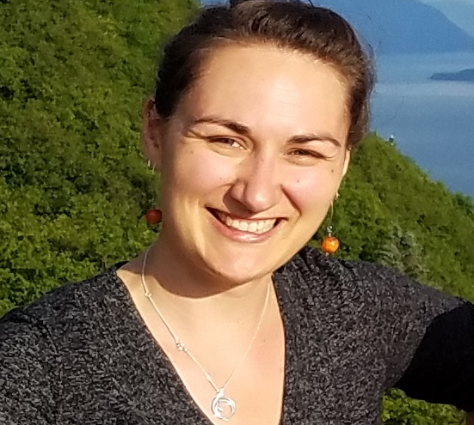
NMFS Administration of Current C Share Participation Requirements
Documentation of participation is not submitted each year
Inconsistencies in administrative procedures from 2018 through 2022
In that time period, IFQ was correctly withheld on specific occasions, however NMFS has not revoked C share QS
Few CR Program participants should have had their crew shares annual IFQ withheld or QS revoked in a past crab fishing year
We have revised our procedures and are conducting a thorough review for 23/24 crab fishing year
REQUEST: All C share holders submit documentation of recent participation for the upcoming 2023/24 crab fishing year due June 15, 2023.

Slide 10
Clarification: Does the Council still perceive a need for action?
Is the need focused on exempting active participation during the convergence of “covid years” and closed fisheries (i.e., the last 3 years?) or shifted to include other future situations?
  Is the Council intending to include those who have had QS revoked in the action? (e.g., re-issuing QS?)
While the Council can’t change alternatives at this meeting, answers to these questions could help inform future changes to a purpose and need and set of alternatives

Slide 11
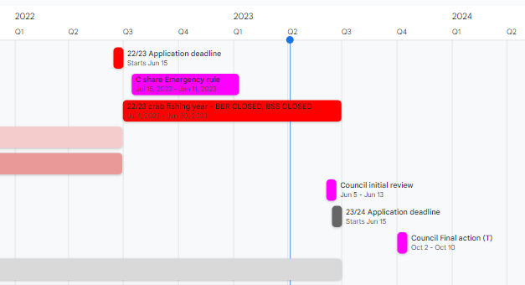
Timeline

Slide 12
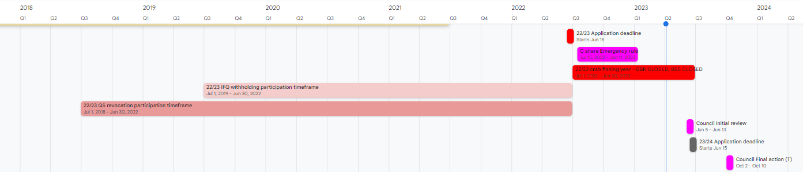
Timeline

Slide 13
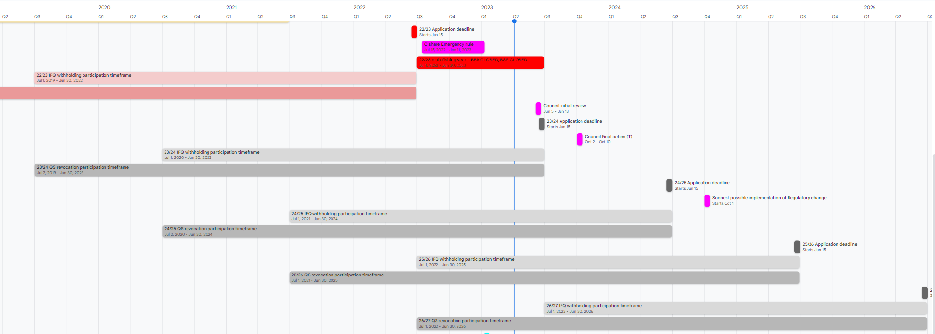
Timeline
25/26

Slide 14
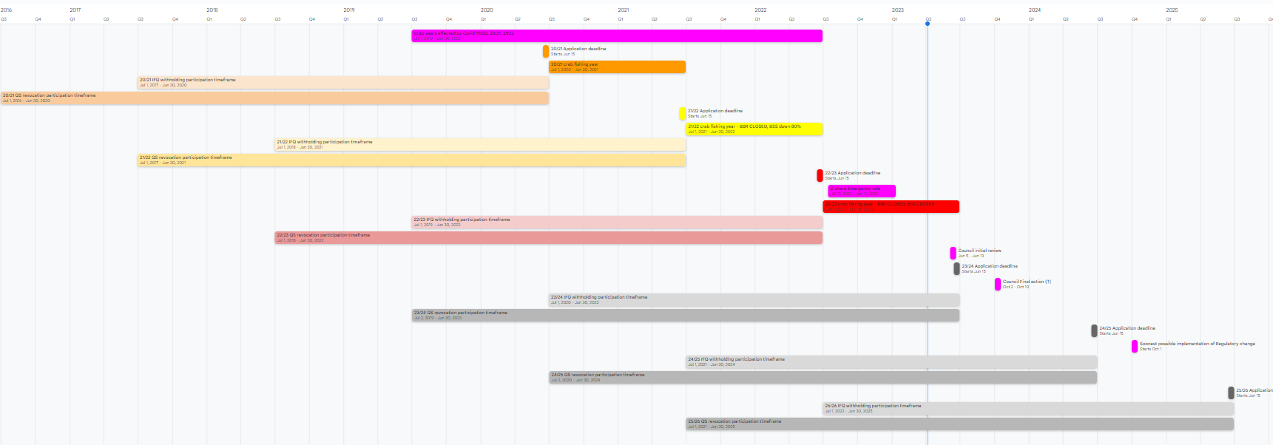
Timeline
Emergency Rule
22/23
Potential impl. mid 24/25 fishing year
25/26

