Slide 1
EDR Program review:
Conceptual framework (Proposed)
Social Science Planning Team Conference Call
November 6, 2019
Presented by:
Brian Garber-Yonts & Steve Kaspersky

Slide 2
Overview of Working paper
Review Motion and SSPT Workplan
Decision Framework for Data collection design
Key decision/design elements
  Information Utility/Purpose & Needs
  Data Quality
  Cost & Burden
Best Practices
SE Management Information Tier framework

Slide 3
Intro comments
Background: EDR Program Discussion paper (April, 2019)
  Details of edr system, scope/content of individual surveys, data limitations
Scope of working paper
  process and criteria
  no edr revisions yet
Outline correction – sect 5.1 > Sect 6

Slide 4
Council Motion
Develop a process for revising EDR programs
Review Purpose and needs
Improve utility and consistency
Reduce burden & content x3
SSPT Plan
Short-term
  Review duplication
  Review best practices
  B/C of standardizing EDRs
  SSC directions
Long Term
  Framework

Slide 5
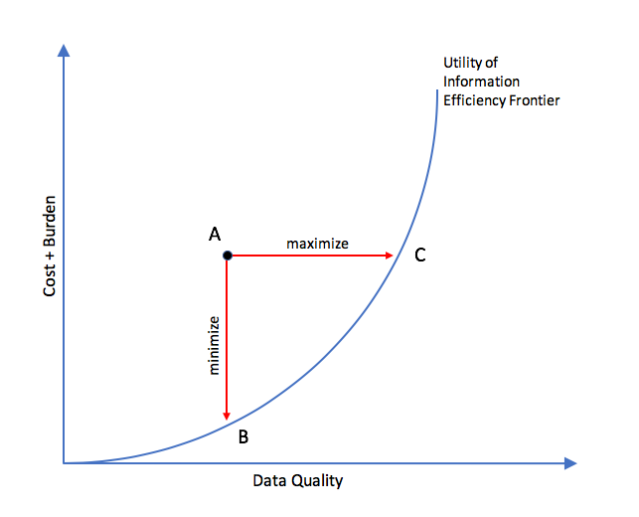
Decision framework for data collection design
Tradeoffs:
Cost + burden
Data quality
Information utility
Methods: Best practices
Optimization (?)
Analysis of previous decisions

Slide 6
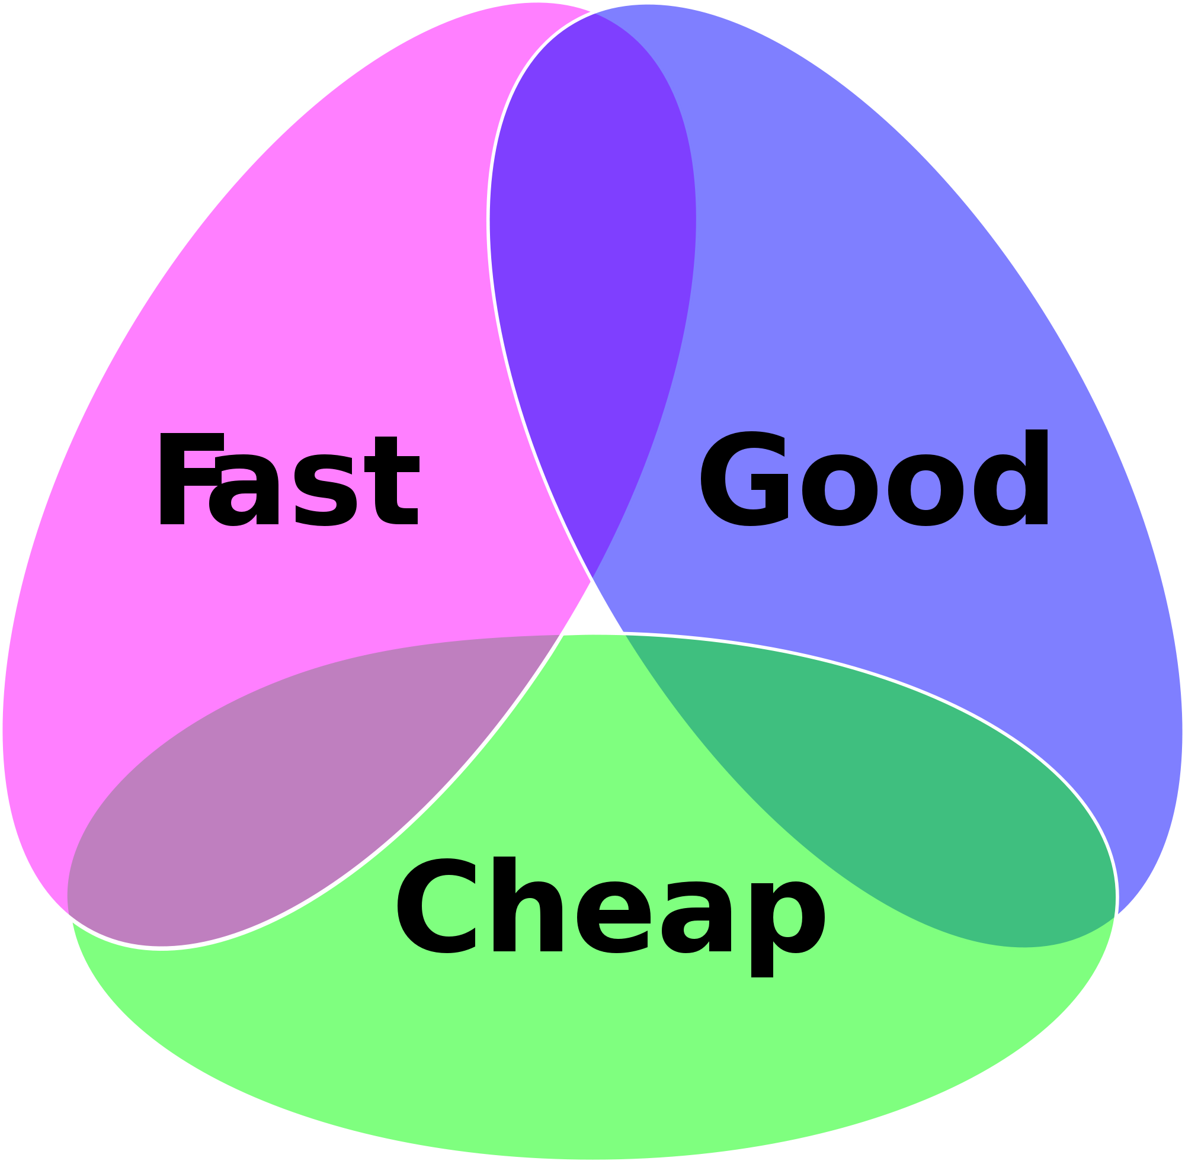
Decision framework V2
PICK 2:
(CHEAP) Cost + burden
(GOOD) Data quality
(FAST) Information utility
Risk & expectations

Slide 7
Information utility
S-E Management objectives
Efficiency, equity, stability
Analytical Functions
Description, explanation, prediction
Data Applications
General Purpose Statistics
Inferential Analyses

Slide 8
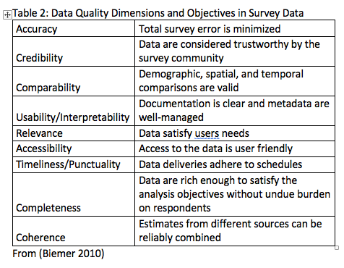
Data Quality
Utility = minimum requirements in all dimensions
Not just accuracy
Accuracy of Estimates, not data

Slide 9
Cost & Burden
Dimensions of reporting burden
  Distribution
  Disclosure
Administrative cost
Potential for Cost + Burden Redux
Reduce content
Improve practices

Slide 10
Draft Tier Framework
SSC Quote
Not just a data problem
Too many choices
Structure and prioritize

Slide 11
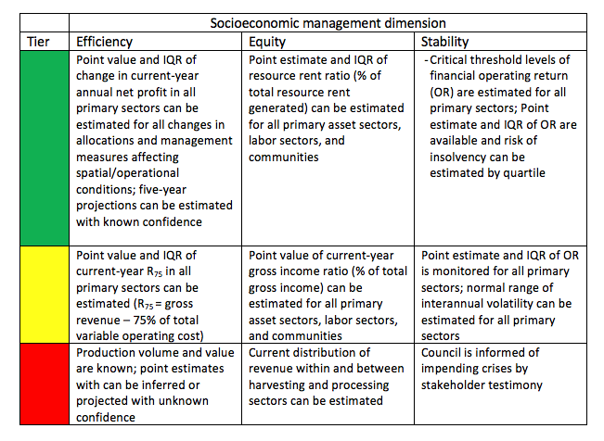

Slide 12
Discussion
Best practices
Framework development

