Slide 1

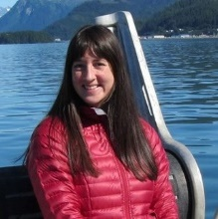
2022 Essential Fish Habitat (EFH) 5-Year Review
Component 1 Descriptions and Identification
NMFS Alaska Region (AKRO) and Alaska Fisheries Science Center (AFSC)
Jodi Pirtle, AKRO, Habitat Conservation Division
Ned Laman, AFSC, Groundfish Assessment Program
Jeremy Harris, AFSC, Groundfish Assessment Program, Lynker
Margaret Siple, AFSC, Groundfish Assessment Program
Molly Zaleski, AKRO, Habitat Conservation Division
Gretchen Harrington, AKRO, Habitat Conservation Division
Jim Thorson, AFSC, Habitat and Ecological Processes Research Program

Slide 2
EFH Components of Fishery Management Plans
NMFS has prioritized the seven EFH components in bold for the 2022 EFH 5-year Review and will present components 1 and 2 today:
EFH descriptions and identification (maps)
Fishing activities that may adversely affect EFH
Non-MSA fishing activities that may adversely affect EFH
Non-fishing activities that may adversely affect EFH
Cumulative impacts analysis
EFH conservation and enhancement recommendations
Prey species list and locations
Habitat Areas of Particular Concern (HAPC) identification
Research and information needs
Review EFH every 5 years
An EFH 5-Year Review Summary Report will be presented to the Council in October 2022 (T).

Slide 3
Timeline – Progress to Date
2022 EFH 5-year Review Plan to Crab Plan Team
Proposed Approach for Component 1 (C1) Species Distribution Models (SDMs) to SSC
2022 EFH 5-year Review Proposed Approach to EC
C1 Stock Author Review Meeting
Launch C1 Stock Author Review
April 2019
June 2020
January 2021
May 2021
April 2020
September 2020
April 2021
September 2021
2022 EFH 5-year Review Proposed Approach Update to Council
Progress on C1 SDMs to Groundfish Plan Teams
2022 EFH 5-year Review Plan to SSC
C1 Stock Author Review Completed

Slide 4
Timeline – Progress and Next Steps
Stock Assessment Authors Conduct C2 Fishing Effects Analysis
Groundfish Plan Teams Review of C1 Progress and C2 Plan
Council Review of EFH 5-year Review Summary Report
Groundfish Plan Teams Review of C1 Progress
September 2021
November 2021
Spring 2022
October (T) 2022
October 2021
January and February 2022
June (T) 2022
TBD
SSC Review of C1
SSC Review of C2 Analysis and C1 Additional Contributions
Complete FMP Amendment process
CPT, EC, and SSC Review of C1 New SDMs and EFH maps and C2 Fishing Effects Analysis Updates and Plans
Complete C1 Analyst Follow-up with Reviewing Stock Authors and Experts

Slide 5
EFH Descriptions and Identification
“Essential fish habitat (EFH) means those waters and substrate necessary to fish for spawning, feeding, or growth to maturity.” (50 CFR 600.10)
Component 1: EFH descriptions and identification (maps)
  Fishery Management Plan (FMP) text and tables
  FMP maps based on species distribution models (SDMs) established in the 2017 Review and refined for 2022 Review.
EFH information levels
  Level 1: Distribution data are available for some or all portions of the geographic range of the species.
  Level 2: Habitat-related densities or relative abundance of the species are available.
  Level 3: Growth, reproduction, or survival rates within habitats are available.
  Level 4: Production rates by habitat are available. [Not available at this time]
New and revised EFH descriptions and maps for the 2022 Review
  EFH Levels 1 and 2 Expanded for GOA and BSAI Groundfish, BSAI Crab, and Arctic FMPs.
  EFH Level 3 New for GOA and BSAI Groundfish, and Arctic FMPs.

Slide 6
EFH Requirements
EFH Regulations:
600.815(a) “Mandatory contents—(1) Description and identification of EFH—(i) Overview. FMPs must describe and identify EFH in text that clearly states the habitats or habitat types determined to be EFH for each life stage of the managed species. FMPs should explain the physical, biological, and chemical characteristics of EFH and, if known, how these characteristics influence the use of EFH by the species/life stage. FMPs must identify the specific geographic location or extent of habitats described as EFH. FMPs must include maps of the geographic locations of EFH or the geographic boundaries within which EFH for each species and life stage is found.”
Alaska EFH EIS (2005):
EFH is the area inhabited by 95% of a species’ population.
SSC Guidance (2017 5-year Review):
Map EFH areas from species distribution models (SDMs) using an area percentiles approach and use the “core EFH area” (upper 50% of EFH area) in the EFH Component 2 Fishing Effects Analysis.
SDM EFH mapping approach for the 2022 5-year Review characterizes EFH for a species’ life stage as the spatial domain containing 95% of occupied habitat conditioned by encounter probability.

Slide 7
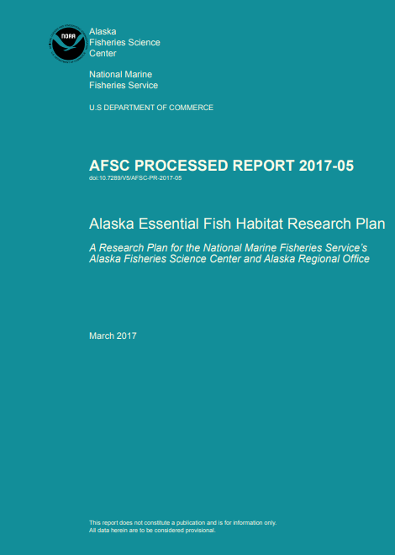
EFH Research Progress
Alaska EFH Research Plan objectives for progress by the 2022 EFH 5-year Review:
Develop EFH Level 1 information (distribution) for life stages and areas where missing.
Raise EFH level from Level 1 or 2 (habitat-related density or abundance) to Level 3 (habitat-related growth, reproduction, or survival rates).

Slide 8
Contributing Habitat Science
New Species Distribution Models (SDMs) and EFH Maps
Available for the February 2022 Meeting:
Advancing Model-based EFH Descriptions and Maps for Groundfishes and Crabs (Laman et al. study)
Available for the June 2022 Meeting:
First Model-based Arctic EFH (Marsh et al. study)
Juvenile Walleye Pollock Thermal Habitat (Laurel et al. study)
Individual-based Models to Advance EFH for Groundfish Pelagic Early Life History Stages (Shotwell et al. study)
All projects will provide new and revised EFH Level 1, 2, or 3 information, representing exciting progress on the Alaska EFH Research Plan objectives for the 2022 EFH 5-year Review.

Slide 9
Orientation to EFH Component 1 Documents
We have provided the Discussion Paper on Advancing Model-based EFH Descriptions and Maps for the 2022 EFH 5-year Review for this meeting.
The Discussion Paper is an overview document with five supporting attachments that provide additional details on the new and revised model-based EFH descriptions and maps available for the 2022 EFH 5-year Review by the Laman et al. study:
Stock Assessment Author Review Report of EFH Components 1 and 7
EFH Area Comparison Maps (image files comparing 2017 and 2022 EFH areas)
EFH Descriptions and Maps for the Bering Sea (Tech Memo)
EFH Descriptions and Maps for the Aleutian Islands (Tech Memo)
EFH Descriptions and Maps for the Gulf of Alaska (Tech Memo)

Slide 10
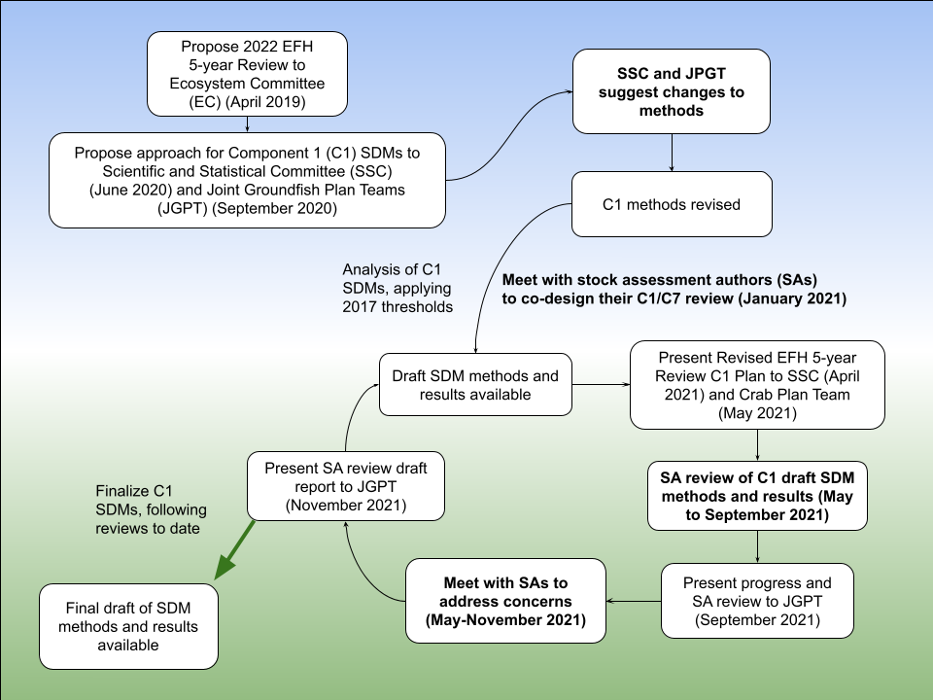
Iterative Review Process

Slide 11
Iterative Review Process to Develop Methods
SSC in June 2020 and Groundfish Plan Teams in September 2020 provided input on proposed methods and plan for new and revised EFH component 1 descriptions and maps for the 2022 5-year Review (EFH June 2020 Discussion Paper)
  Laman et al. study modified our approach, which led to improvements (e.g., introduce SDM ensembles, negative binomial SDM, and uncertainty map), and produced the first draft of SDM ensemble EFH methods and results for review.
SSC in April 2021 and Crab Plan Team (CPT) in May 2021 provided input on the 2022 EFH 5-year Review Plan.
  Laman et al. study responded to the SSC and Plan Team input received in 2020 with an update on methods and draft results examples. SSC provided guidance for analysts to prepare for SSC review in October 2021 (now February 2022). CPT provided recommendations for the stock assessment author review process.
Stock Assessment Author Review occurred May – September 2021.
  See the Discussion Paper Appendix 1 and Attachment 1 for the Laman et al. study’s responses to input by the SSC, Plan Teams, and Stock Assessment Author Review.

Slide 12
Stock Assessment Author Review
Iterative review by stock assessment authors (SA) and other experts is a critical element of an EFH 5-year Review for our region. SA Review Process of EFH component 1 for the 2022 EFH 5-year Review Attachment 1 Chapter 2.
Innovations of our approach to the SA review of EFH component 1 strengthened the research products, process, and collaboration.
  We collaborated with senior stock assessment scientists to hold an SA Summit in January 2021, to co-develop the process for the SA review of EFH component 1.
  We included additional crab species expert reviewers; recommended by CPT.
  SAs reviewed the complete draft SDM ensemble EFH methods and results.
  We implemented the SA review of EFH component 1 with timing that allowed incorporation of reviewer feedback in the outcomes of this work.
Launched the SA review in May 2021.
  SAs reviewed the FMP EFH descriptions and maps from the 2017 5-year Review.
  SAs reviewed draft SDM ensemble EFH methods and species results chapters with new and revised EFH descriptions and maps for the 2022 5-year Review.
Completed September 1, 2021 with 100% engagement by 32 reviewers, THANK YOU!!

Slide 13
Stock Assessment Author Review
SA Review Results and Communication Summary Attachment 1 Chapter 3.
Presented SA review response plan to the Groundfish Plan Teams September 2021.
32 SAs reviewed and provided input on 3 regional draft methods sections and 125 SDM ensemble EFH draft species results chapters with 1-3 life stages each, and the current FMP EFH descriptions and maps.
27 species (out of 60 species) received model re-runs as determined by our internal evaluation or by SA review (e.g., revise life stage breaks = 22 species; reevaluate ensemble constituents = 1 species; hold and revisit in the future = 3 species without an EFH description and map from 2017).
Followed up with all reviewers who provided input as comments, questions, and concerns, and worked with (8) individual reviewers more closely, largely completed by November 1. Revisions were made available for reviewers upon request.
Co-developed research recommendations for a future EFH 5-year Review.
Presented the draft SA Review Report to the Groundfish Plan Teams November 2021. Final SA Review Report is Attachment 1.
NMFS Technical Memoranda for the Bering Sea, Aleutian Islands, and Gulf of Alaska are in the publication process and available as Attachments 3, 4, and 5.

Slide 14
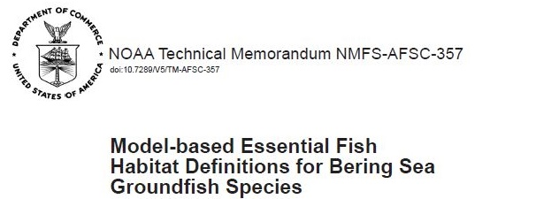
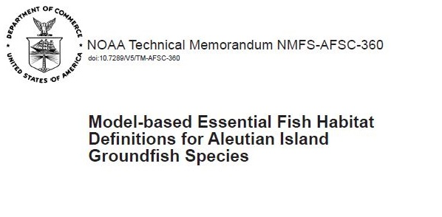
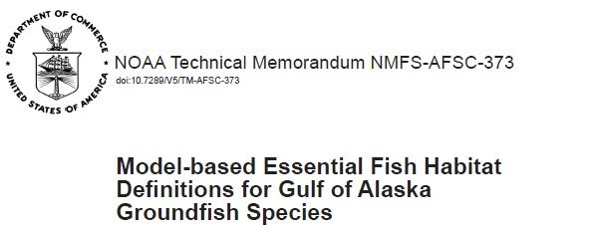

Advancing Model-based EFH for the 2022 5-year Review
(Laman, Pirtle, Harris, Siple, Rooper, Hurst, Conrath)
Purpose:
Describe and map EFH for federally managed North Pacific groundfish and crab species in the Bering Sea, Aleutian Islands, and Gulf of Alaska, using RACE GAP summer bottom trawl survey data and regional habitat covariates.
Built on the species distribution modeling (SDM) approach introduced and accepted in the 2017 EFH 5-year Review.
Guided by the Alaska EFH Research Plan.
    Characterize habitat utilization and productivity.
    Advance EFH information levels from none to Level 1 and from Levels 1 or 2 to Level 3.
2017 NMFS Tech Memos:

Slide 15
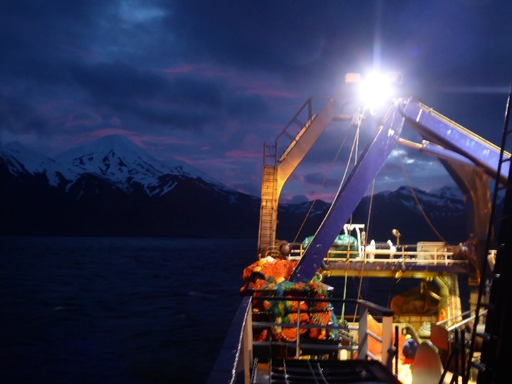

Advancing Model-based EFH for the 2022 5-year Review
(Laman, Pirtle, Harris, Siple, Rooper, Hurst, Conrath)
Results by the Numbers:
EFH for North Pacific groundfish species, including up to three life stages:
  32 species in the Bering Sea
  25 species in the Aleutian Islands
  42 species in the Gulf of Alaska
  7 stock complexes (a first)
EFH for invertebrates; all life stages combined:
  5 crab species in the Bering Sea
  2 crab species in the Aleutian Islands
  1 octopus species in all three regions
Advanced EFH information levels for 211 species’ life stages resulting in 229 new and revised EFH descriptions and maps:
  None to Level 1
  Level 1 to Level 2
  Level 3 (another first)

Slide 16
SDM EFH Methods Overview and Comparison
2022 SDM Ensemble
Response Variable:
Fish numerical abundance (1982-2019 catches)
Models:
MaxEnt, paGAM, hGAM, Poisson GAM, Negative Binomial GAM
All SDMs considered for the ensemble
Skill testing with RMSE
Ensemble:
Best performing SDMs retained
Performance Metrics: (applied to all)
k-fold cross validation to generate RMSE and other fit metrics
Spearman’s correlation (ρ), AUC, Poisson Deviance Explained (PDE)
2017 SDM
Response Variable:
4th root transformed CPUE (1982-2014 catches)
Models:
MaxEnt, hGAM, GAM
One SDM selected a priori
New for 2022
Ensemble:
New for 2022
Performance Metrics:
Applied based on SDM
MaxEnt (AUC); GAMs (Deviance Explained)
80/20 training/testing, fit metrics examined for out of sample comparison

Slide 17
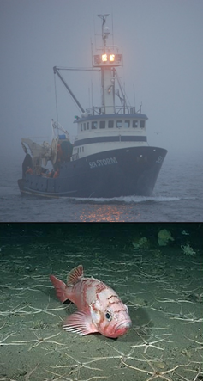
Advancing Model-based EFH for the 2022 5-year Review
(Laman, Pirtle, Harris, Siple, Rooper, Hurst, Conrath)
SDM Performance Metrics:
Spearman’s rank correlation coefficient (ρ)
    distinguish between high and low abundance
Area under the receiver operator characteristic curve (AUC)
    discriminate presence absence
Poisson Deviance Explained (PDE)
    deviance explained by the ensemble assuming a Poisson distribution
Mapping EFH from SDM ensembles:
EFH is the spatial domain containing 95% of occupied habitat for a species’ life stage conditioned by encounter probability
Additional EFH area percentiles: Upper 75% of occupied habitat; Upper 50% “Core EFH area” was applied to Fishing Effects Analysis in 2017 EFH 5-year Review; Upper 25% “EFH hot spots”

Slide 18
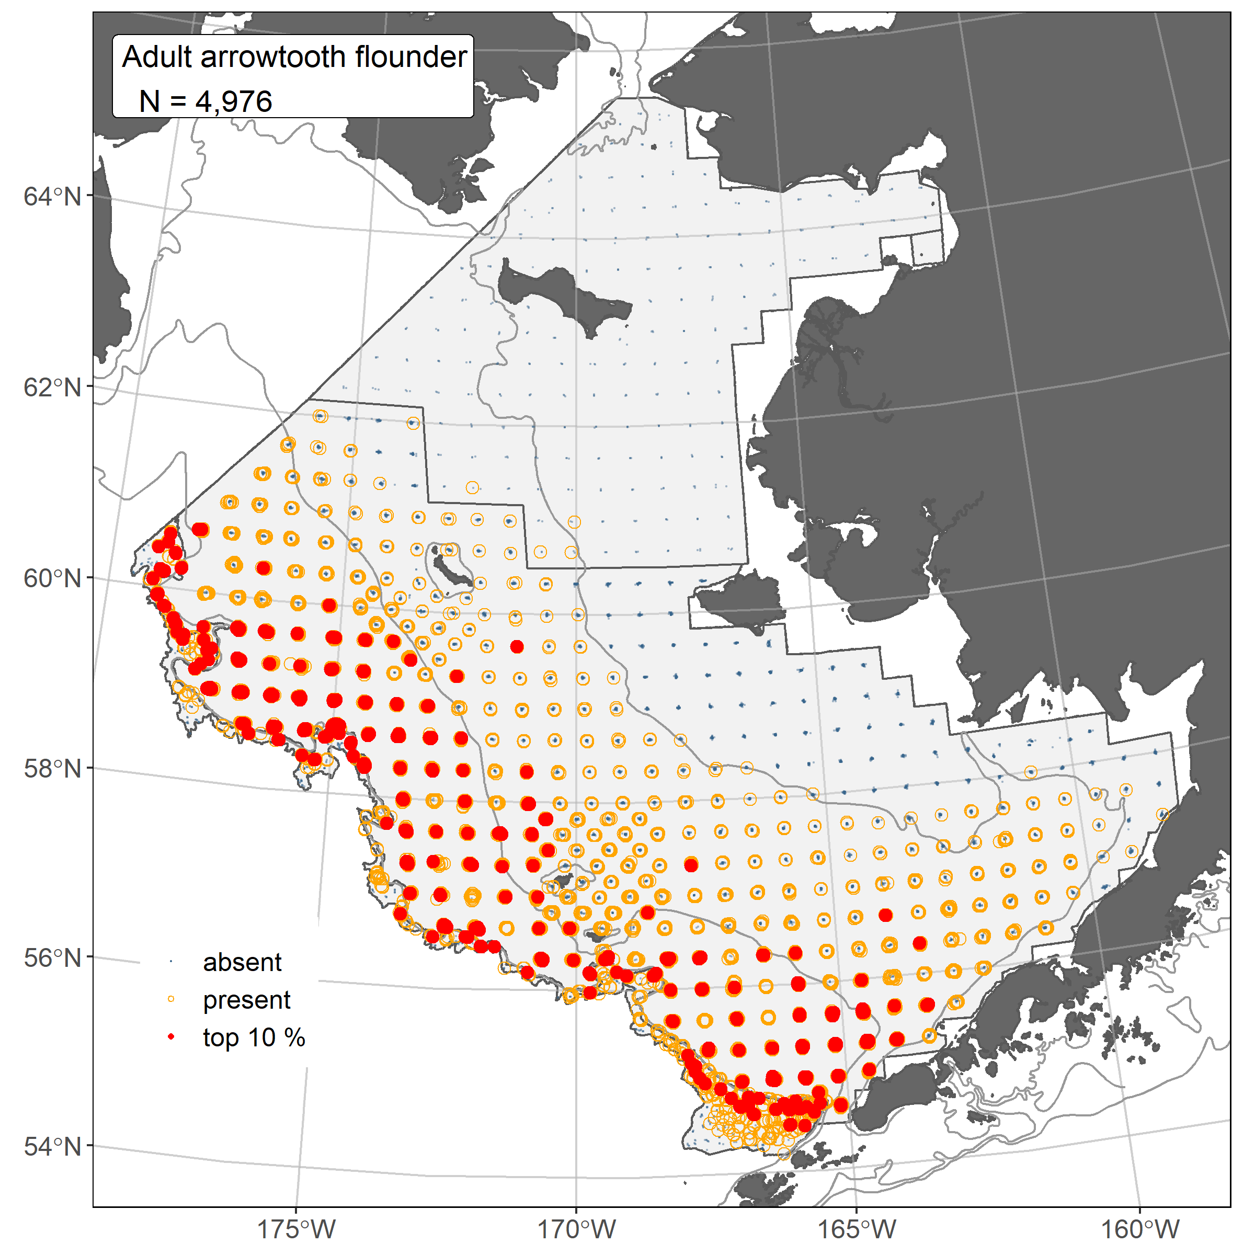
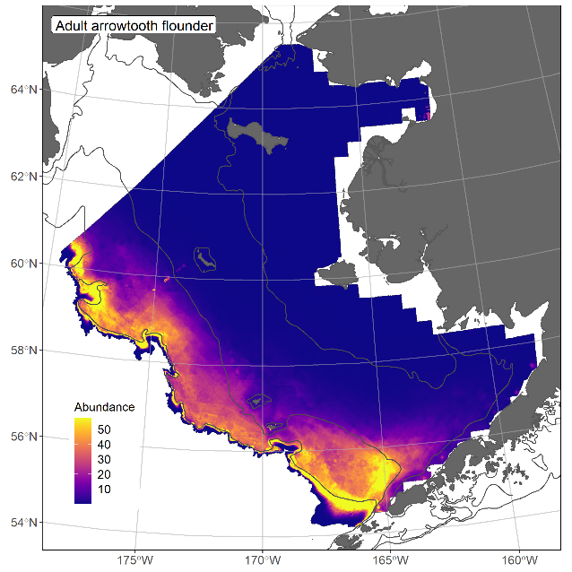
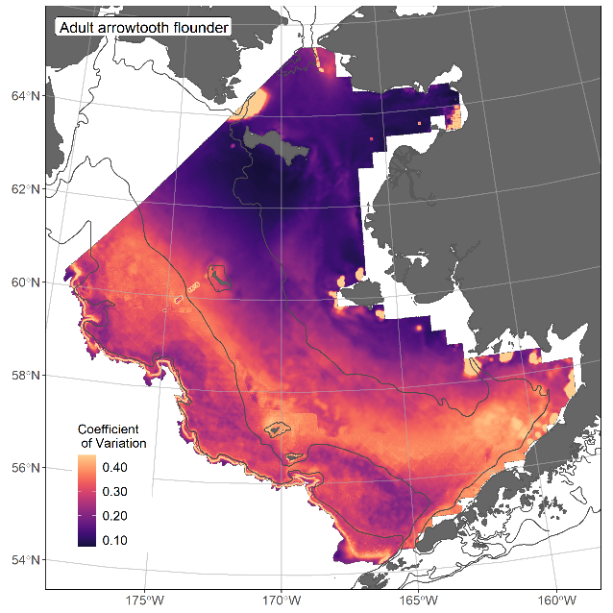
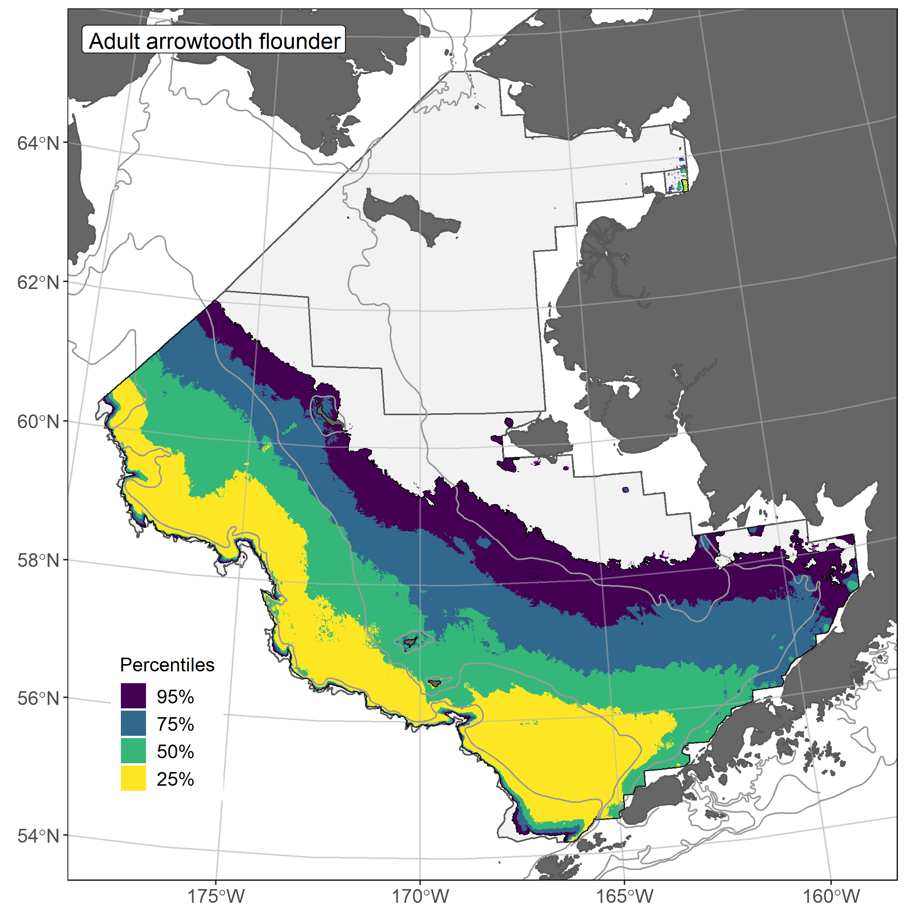
Arrowtooth Flounder Adults
𝝆 = 0.81
AUC = 0.96
PDE = 0.63

Slide 19
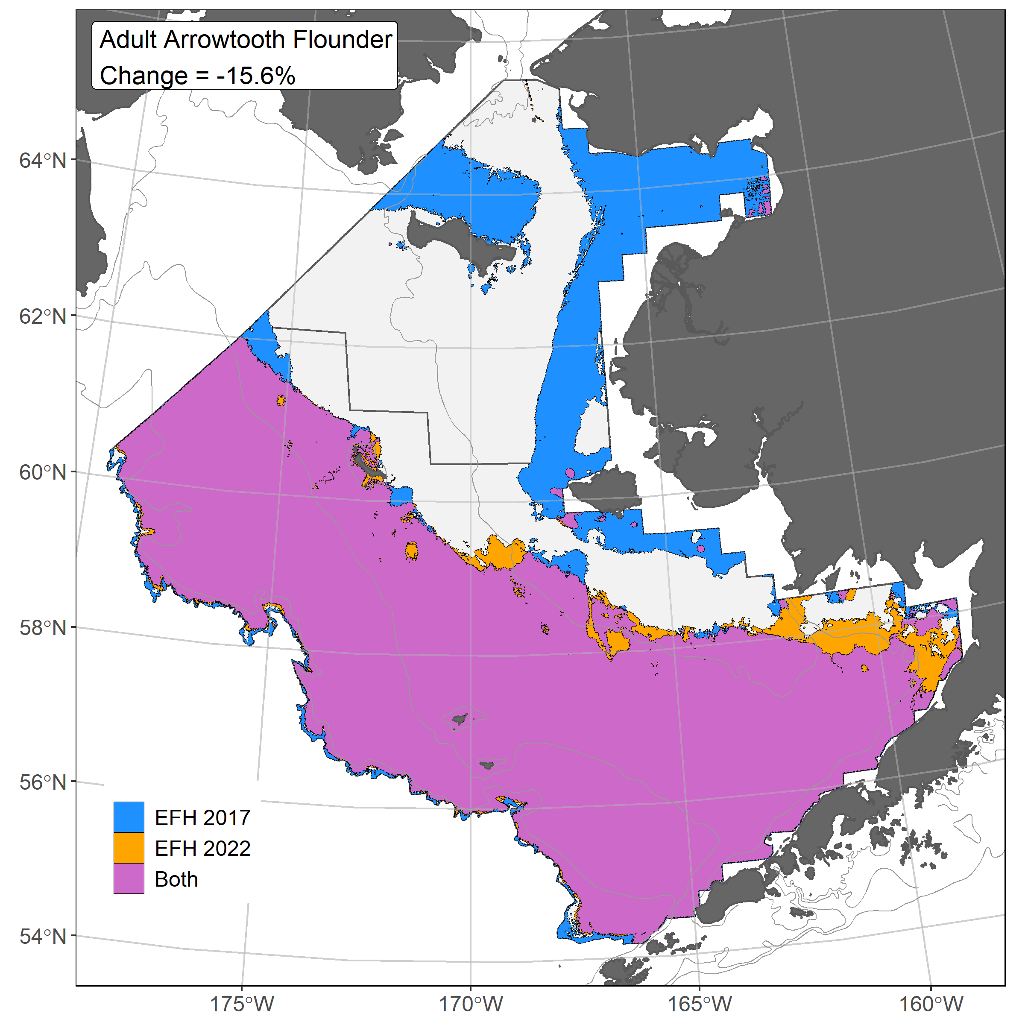
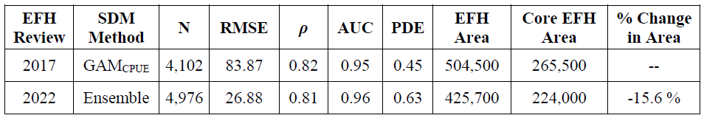
SDM EFH Comparison 2017 and 2022

Slide 20
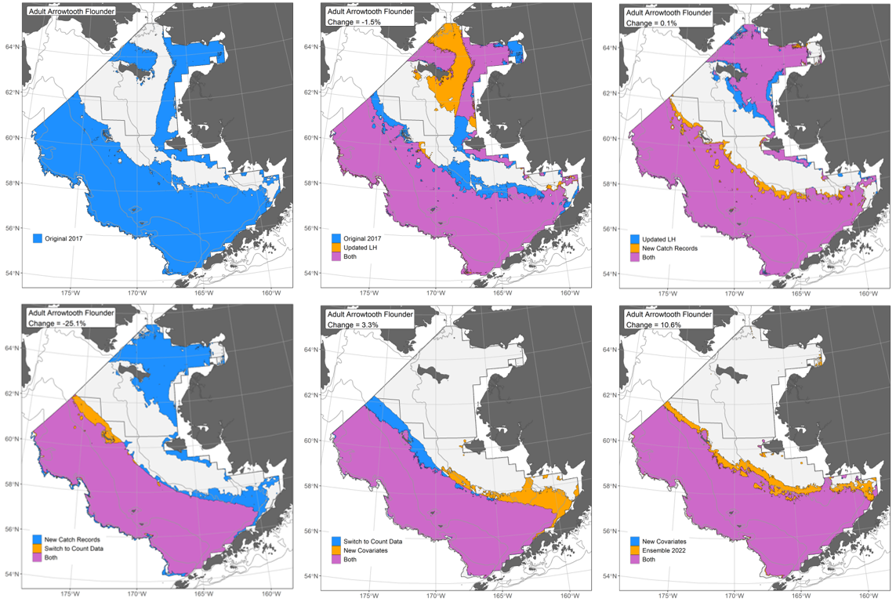
EFH Area Bridging Sequence 2017 and 2022

Slide 21
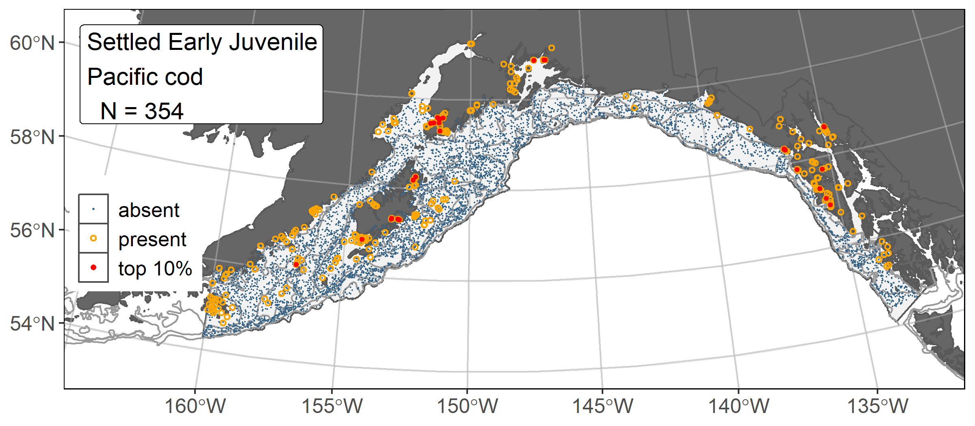
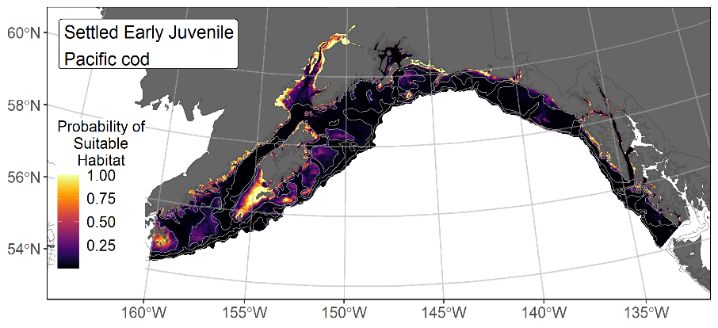
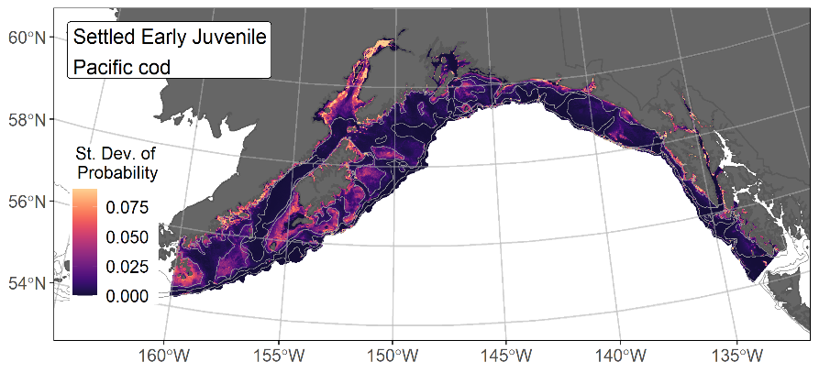
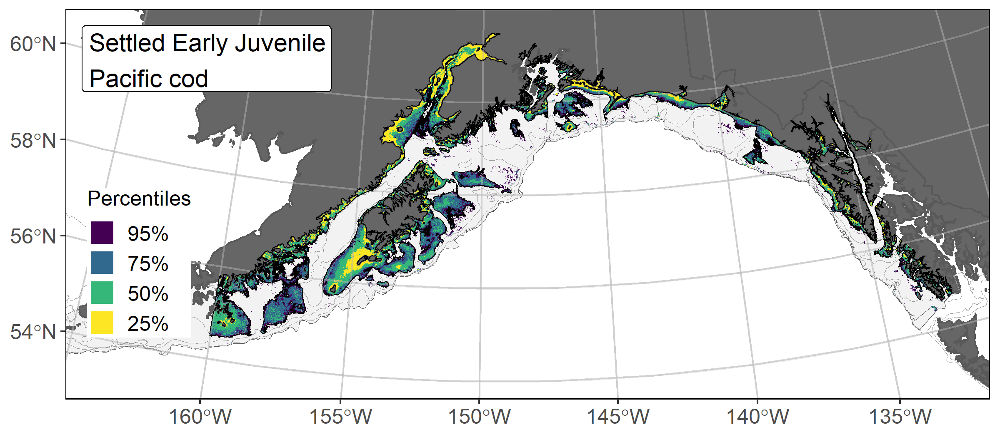
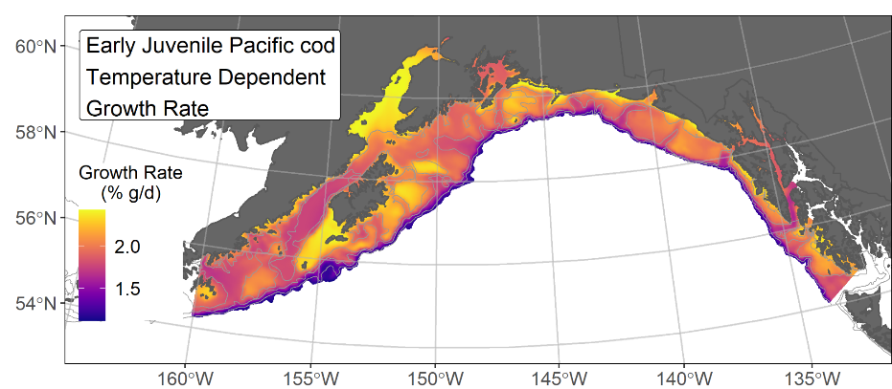
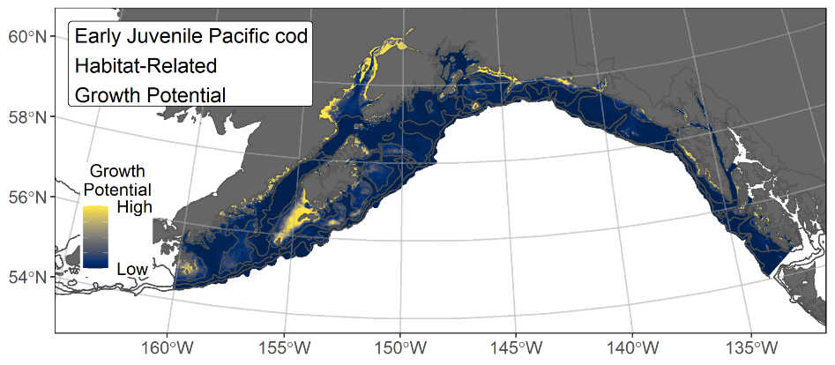
Pacific Cod Settled Early Juveniles
AUC = 0.95
EFH Level 1 Map
EFH Level 3 Map
21

Slide 22
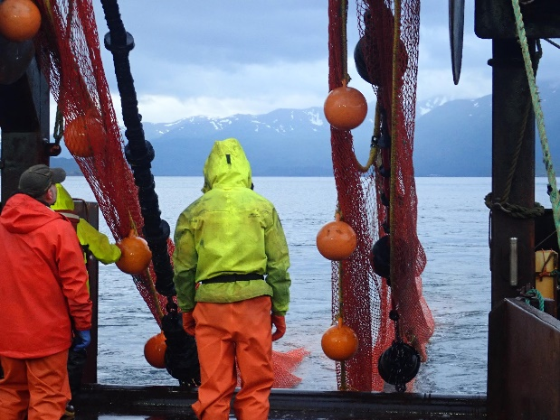
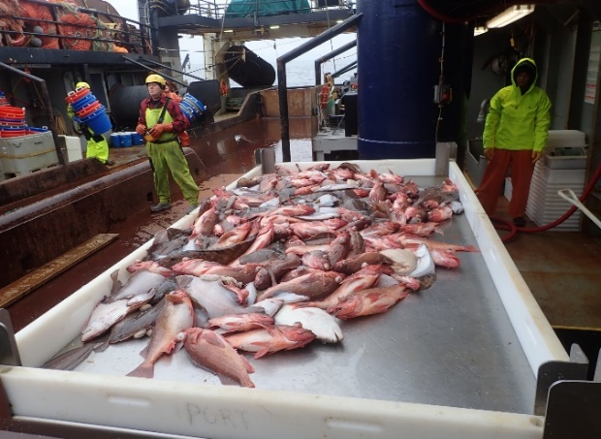
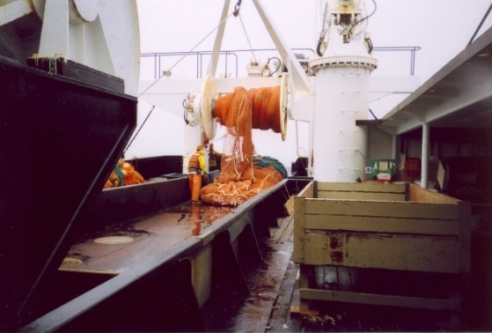
Conclusions
Accomplished Alaska EFH Research Plan objectives.
Incorporated reviews and guidance from SSC, Plan Teams, stock authors, species experts, and other stakeholders.
SDM ensemble was an improvement over single SDM approach of 2017 EFH 5-year Review.
                Reduced model-dependent prediction bias
                Performance metrics were improved overall
                Robust modeling framework
A total of 229 new or revised EFH Level 1, 2, or 3 descriptions and maps are available for 211 individual species’ life stages and 7 stock complexes in 3 FMPs.
Extend to stock assessment and other EBFM
  ESPs (e.g., Shotwell et al. in review), groundfish recruitment processes (e.g., Goldstein et al. 2020), future distribution changes related to climate (e.g., Rooper et al. 2021).

Slide 23
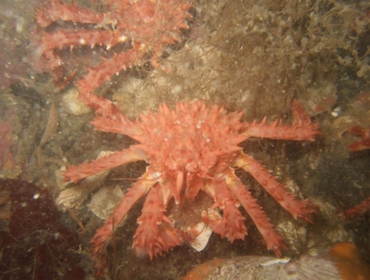
Future Research Directions
Future Research Directions:
  Data
    Model crab life stages (immature/mature)
    Incorporate other data sets (e.g., longline surveys, fisheries data, or optical surveys)
    Explore additional or new environmental variables
  Modeling
    Explore classes of SDMs
    Focus on data-limited species
    Execute SDMs on reduced temporal scales
Future EFH Process Recommendations:
    Timely review
    Automation
      Reproducible code
        Automated reports
    Working Group

Slide 24
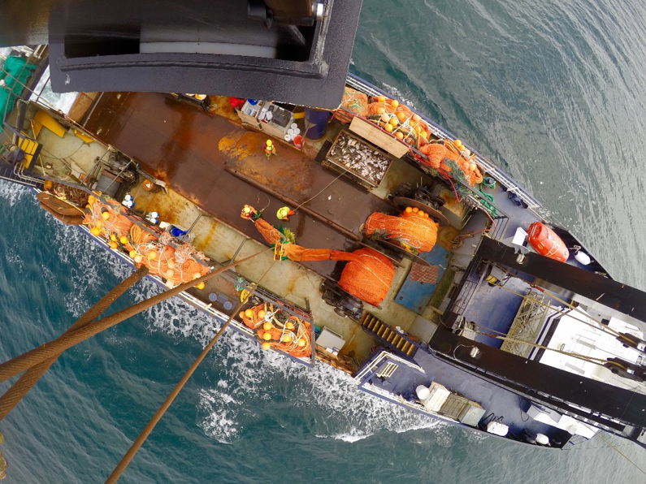
THANK YOU
JODI PIRTLE
JODI.PIRTLE@NOAA.GOV
NED LAMAN
NED.LAMAN@NOAA.GOV

Slide 25
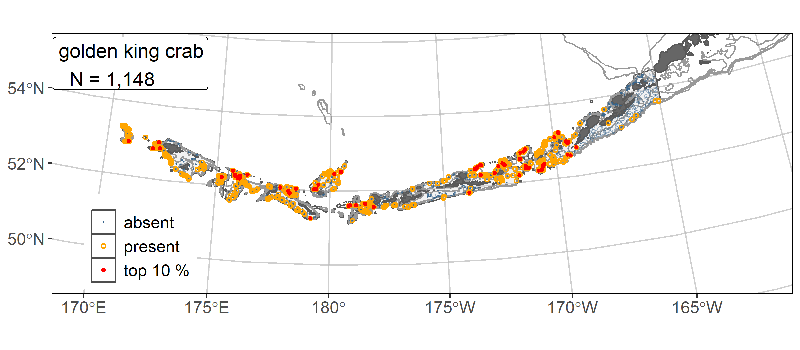
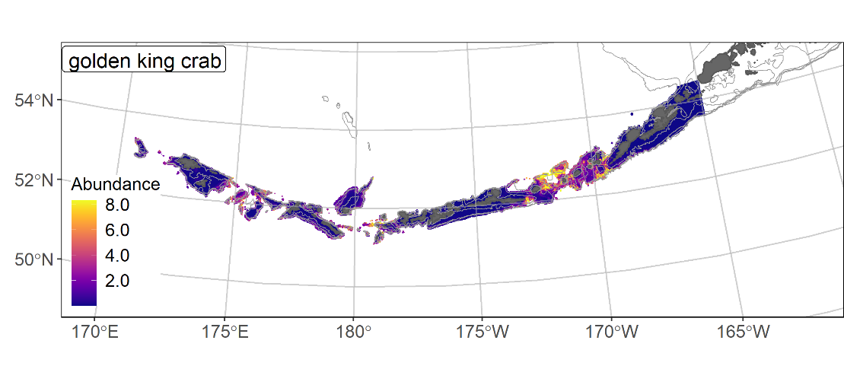
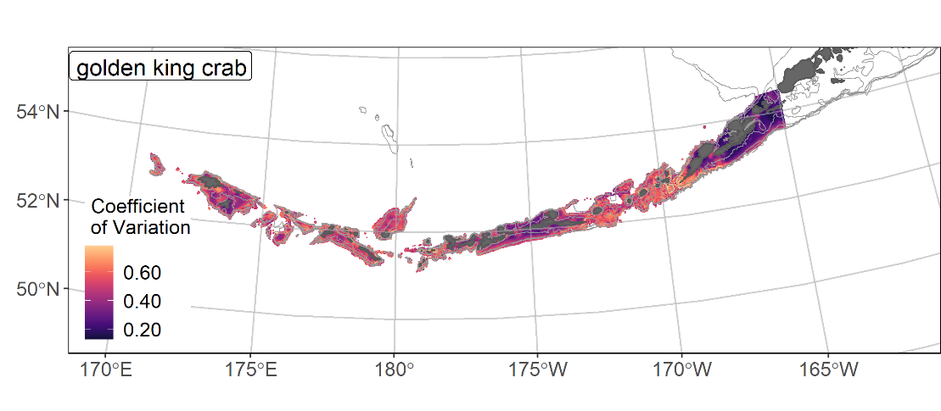
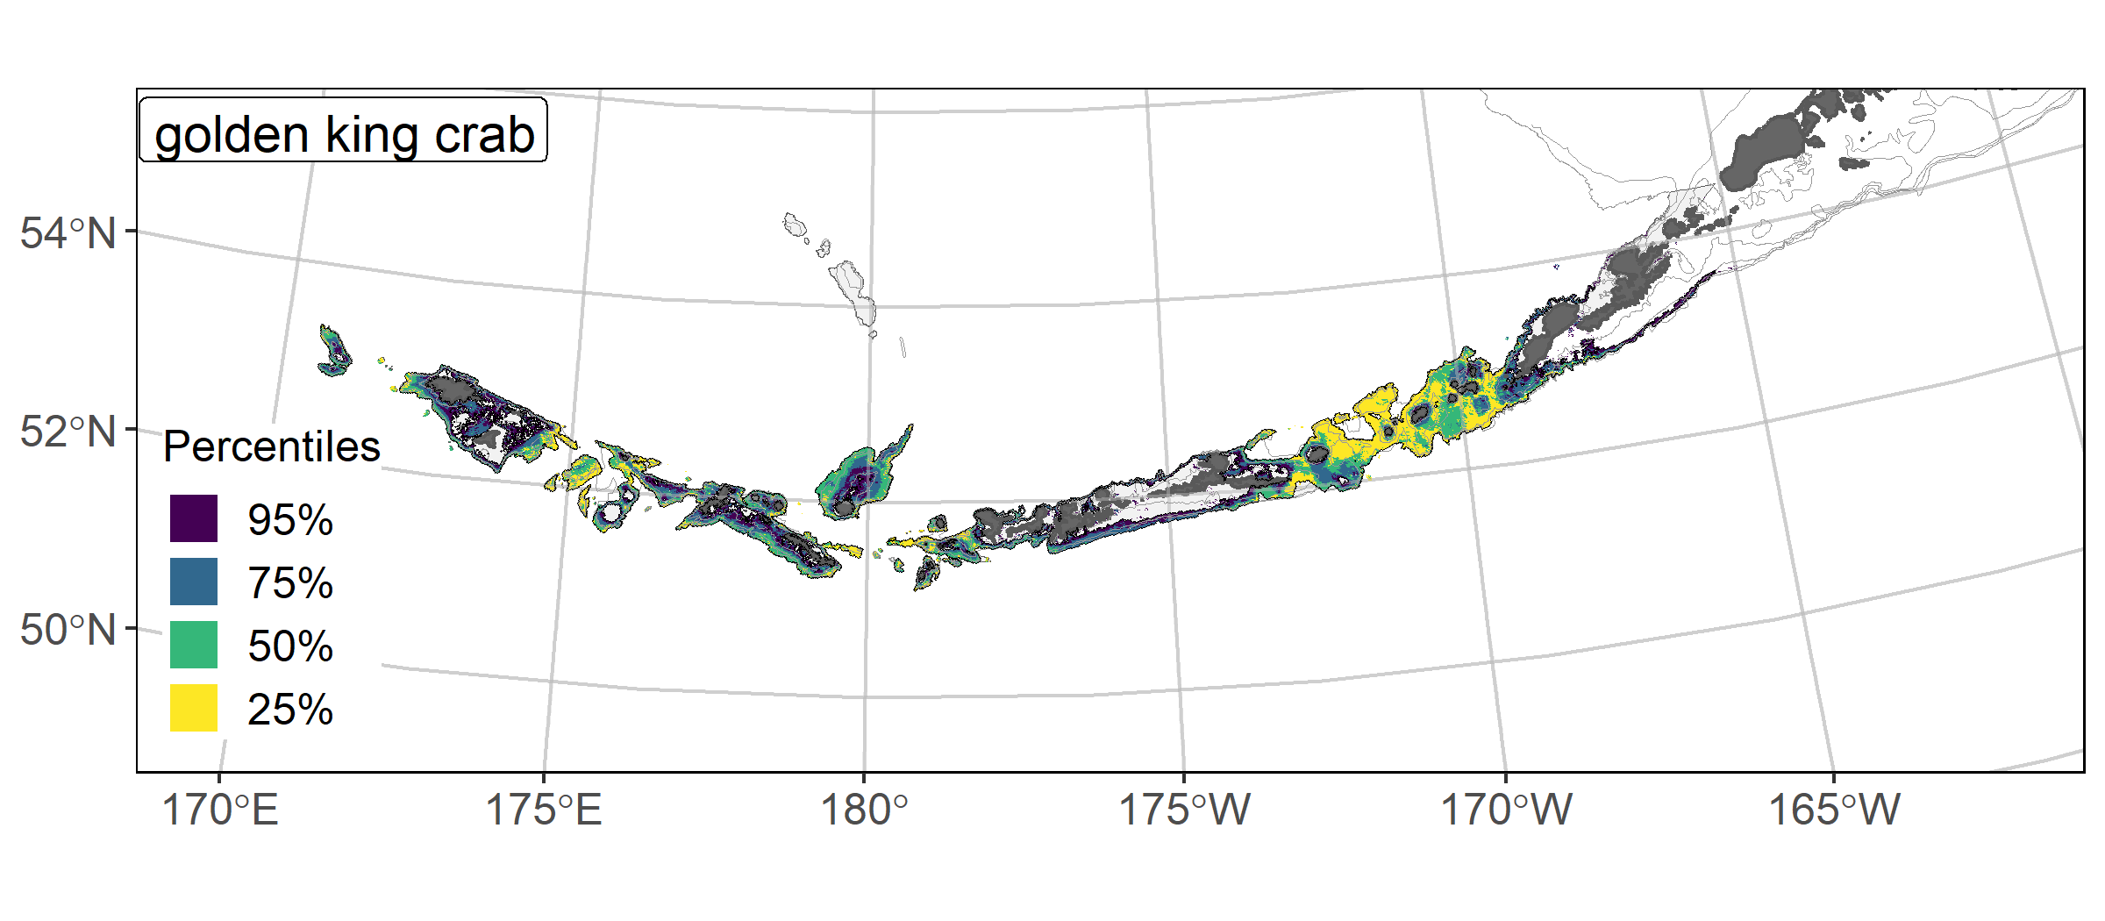
Golden King Crab
𝝆 = 0.56
AUC = 0.89
PDE = 0.48
EFH Level 2 Map
See the Discussion Paper on EFH Descriptions and Maps for the Golden King Crab results example and the Aleutian Islands Tech Memo (Discussion Paper Attachment 4).

Slide 26
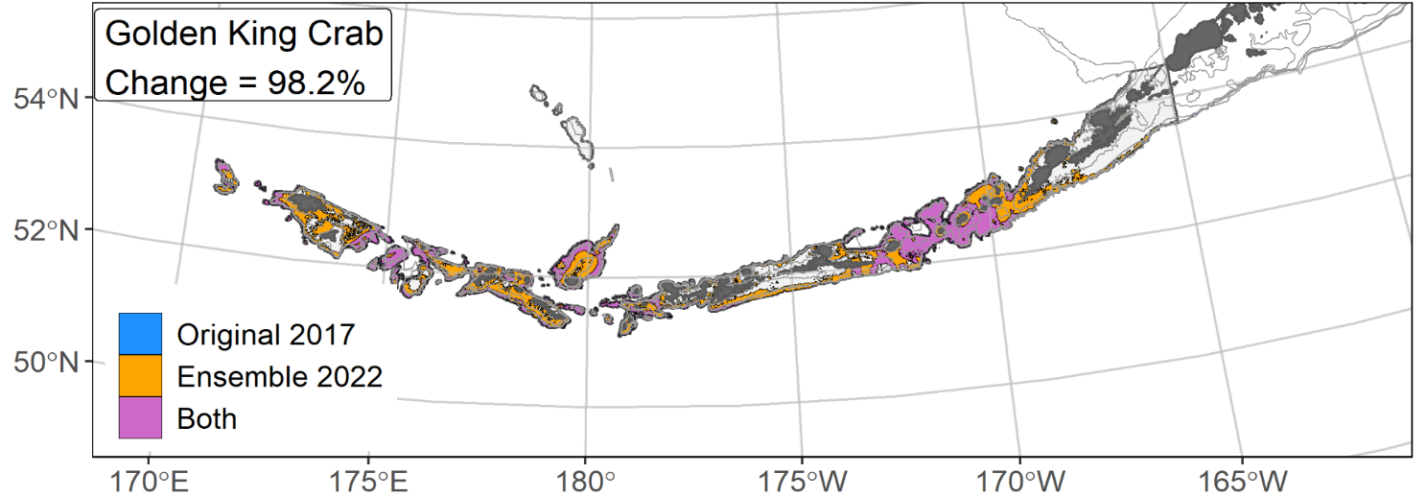
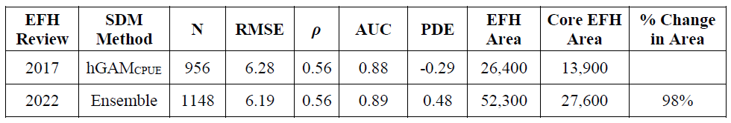
EFH Comparison 2017 versus 2022

Slide 27
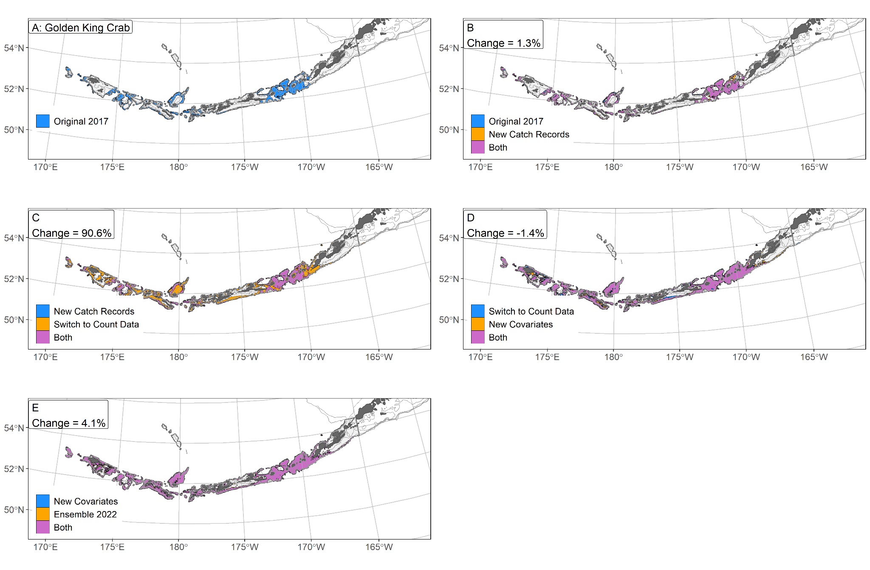
Golden King Crab Bridging Sequence

Slide 28
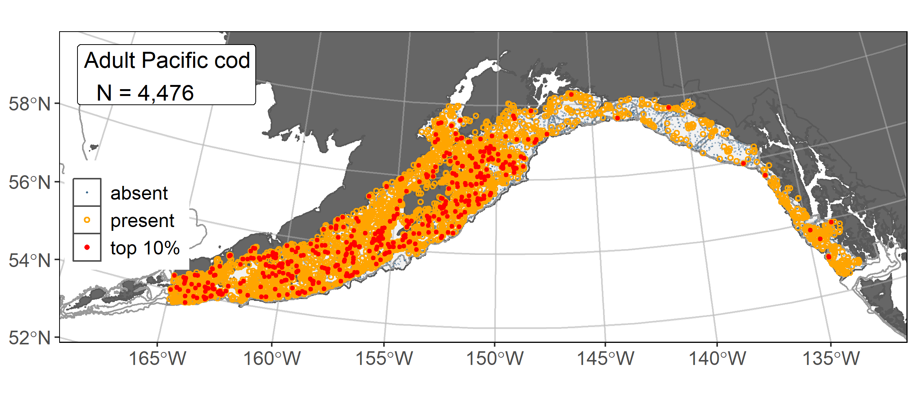
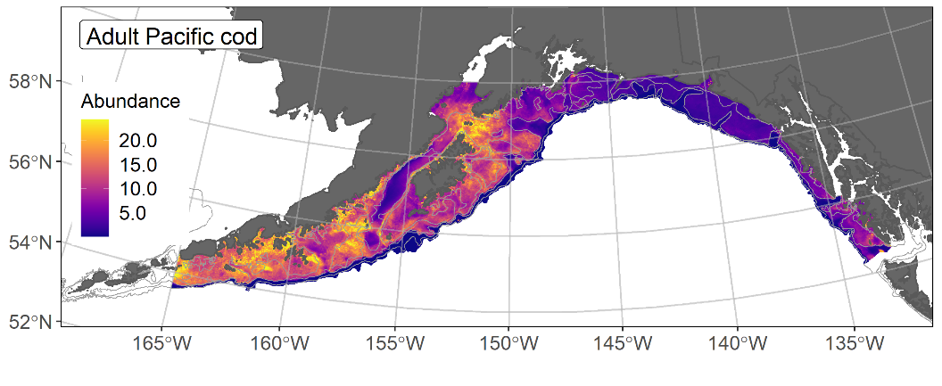
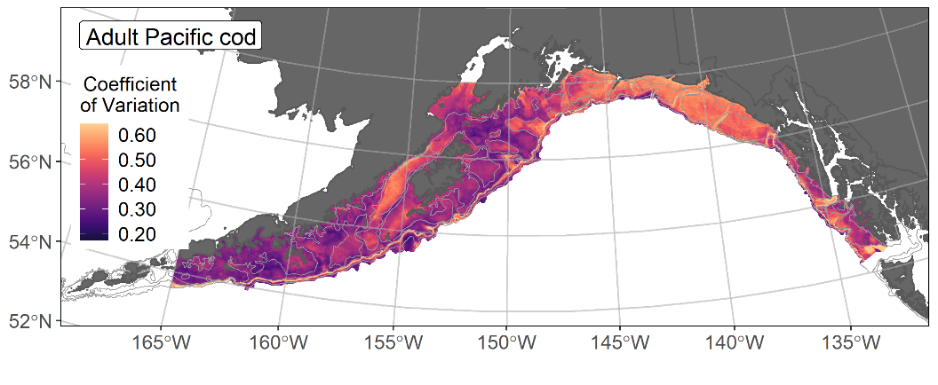
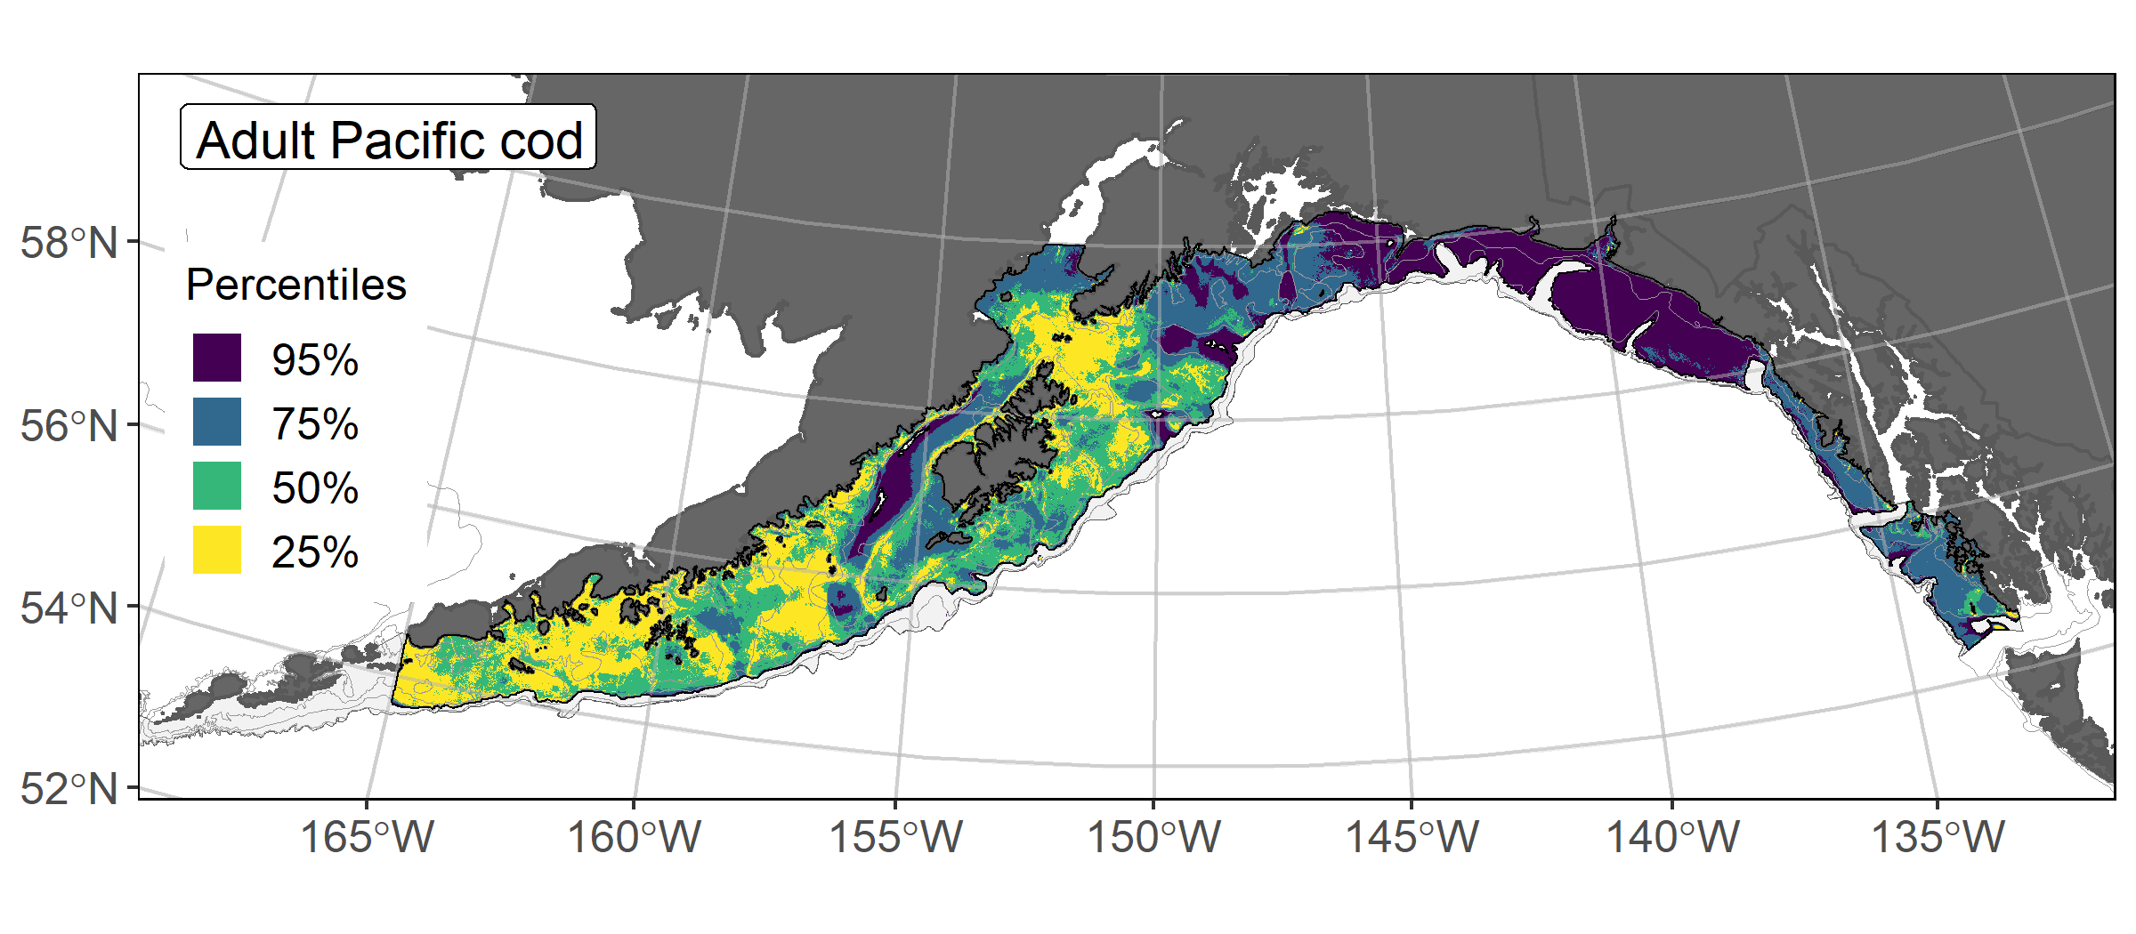
Pacific Cod Adults
𝝆 = 0.49
AUC = 0.77
PDE = 0.16
EFH Level 2 Map
See the Discussion Paper on EFH Descriptions and Maps for the Pacific cod results example and the Gulf of Alaska Tech Memo (Discussion Paper Attachment 5).
Notes:
Adult Pacific cod example from the Gulf of Alaska, including catches in RACE GAP summer bottom trawl surveys (upper left), SDM ensemble (upper right), CV of ensemble predictions (lower left), and EFH map with area percentiles (lower right).
Adult Pacific cod were predicted to be more abundant in waters shallower than 175 m on bathymetric rises west of the Kenai Peninsula.

Slide 29
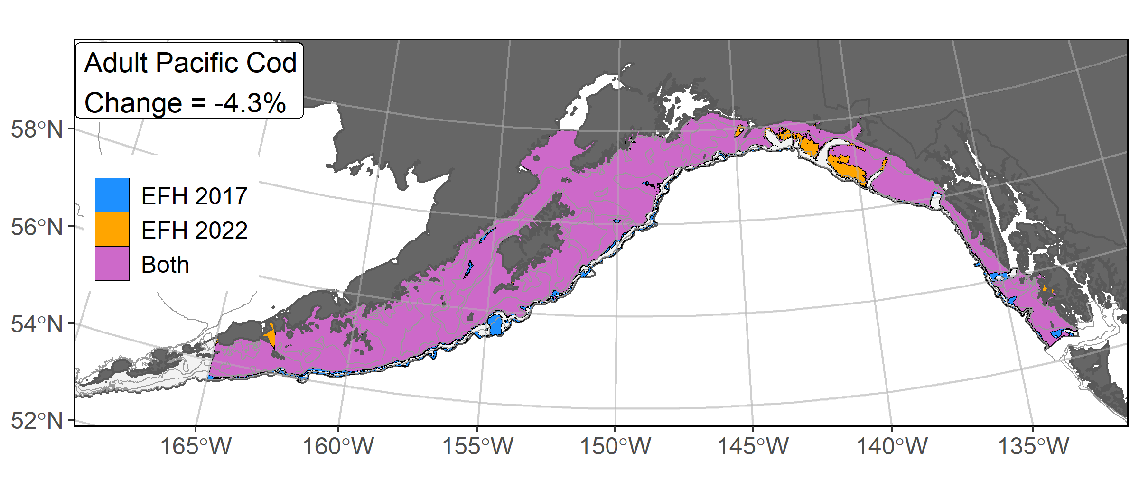
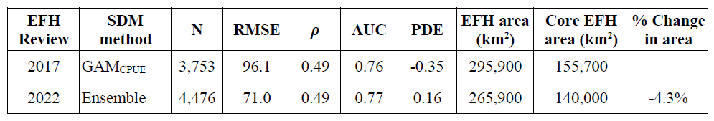
SDM EFH Comparison 2017 and 2022

Slide 30
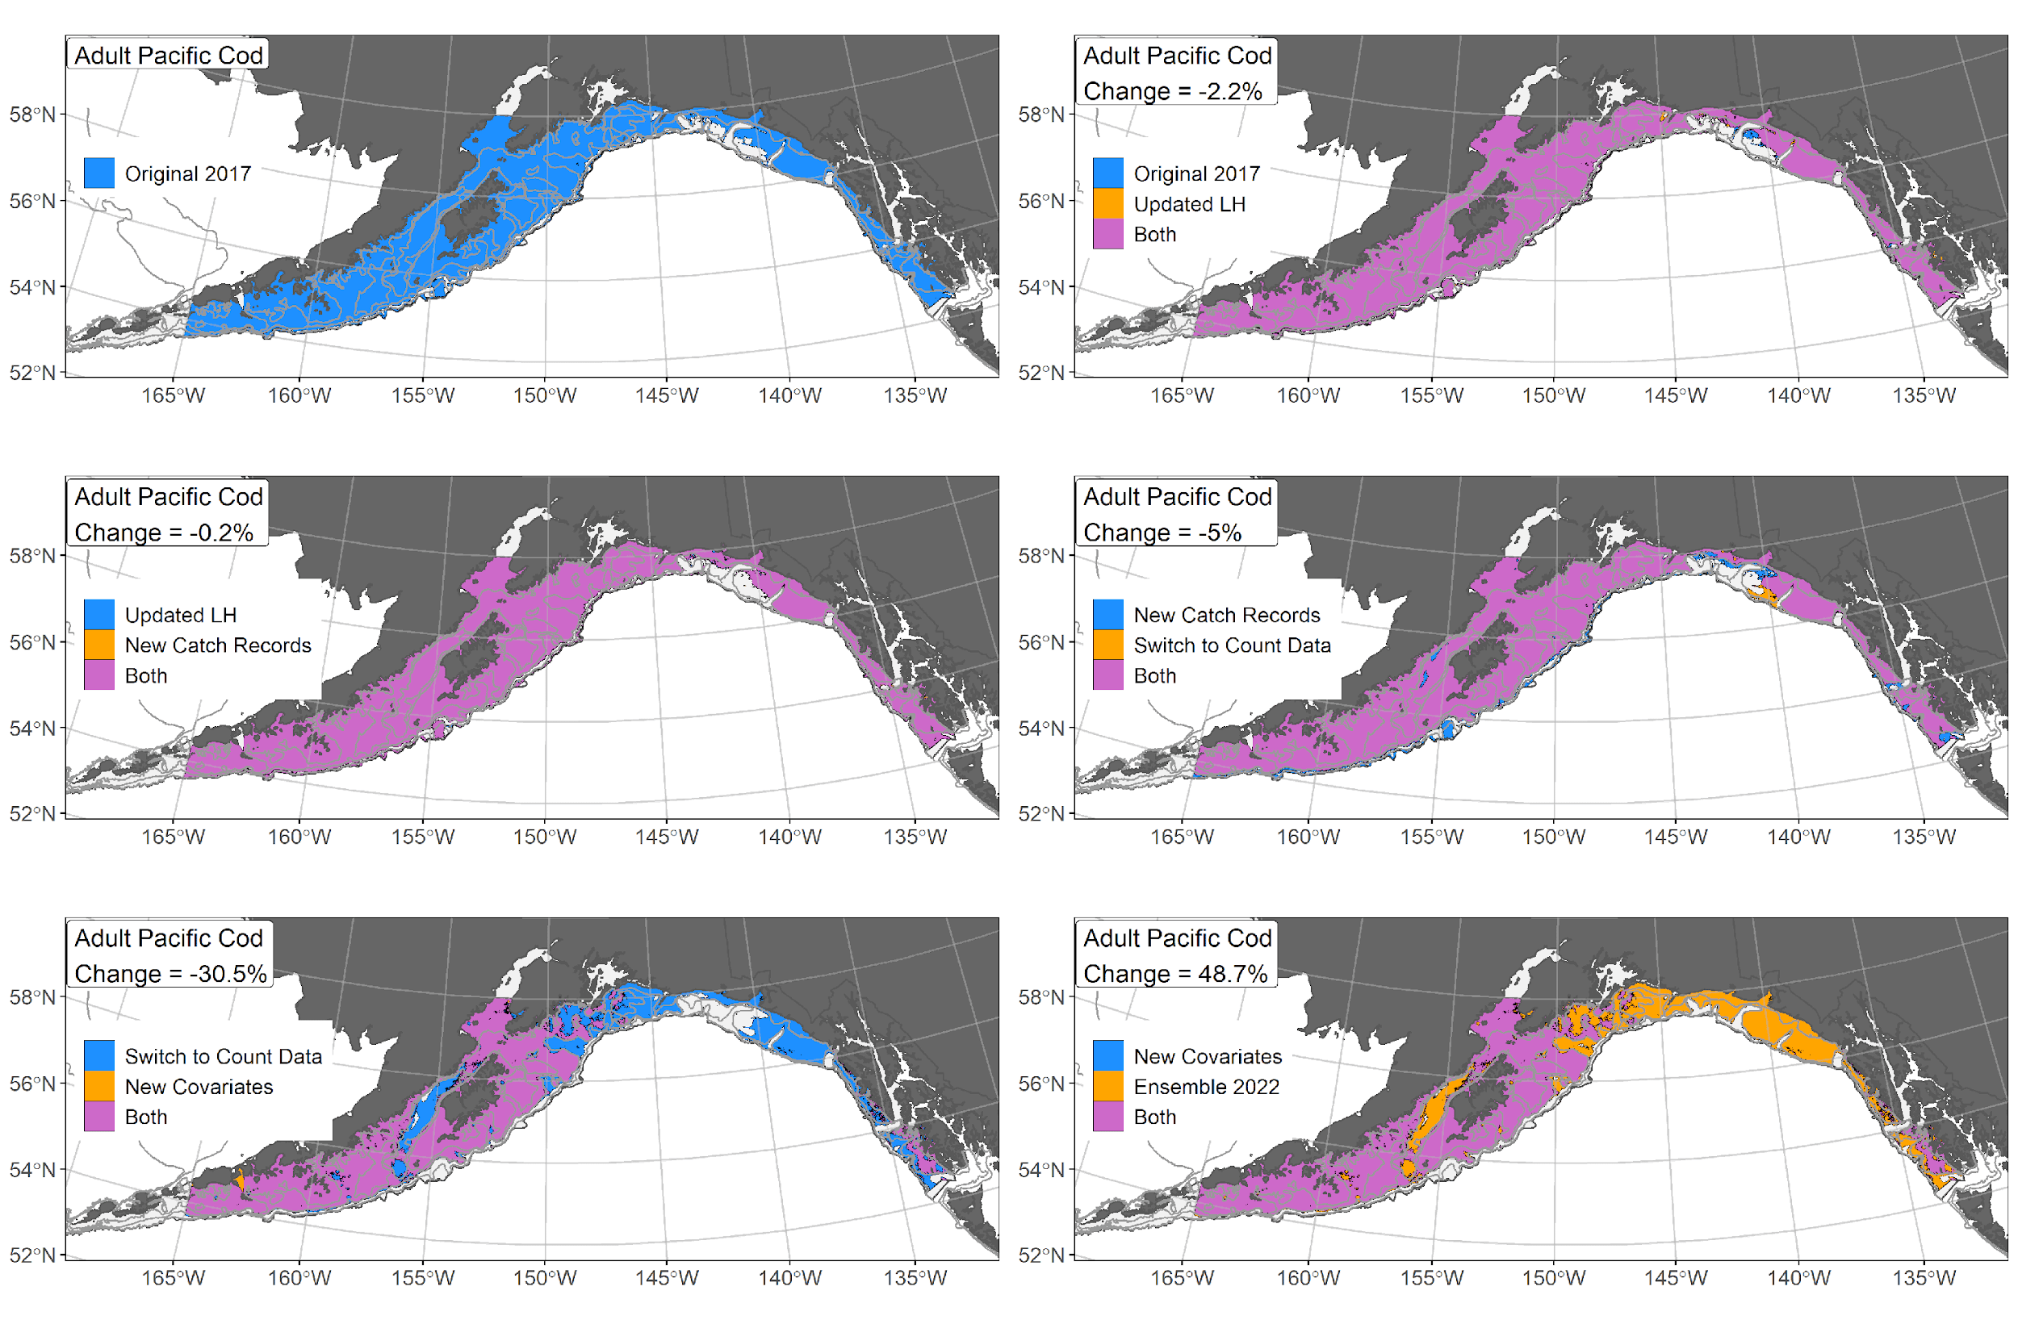
EFH Area Bridging Sequence 2017 and 2022

