Slide 1
Economic Status of the Groundfish Fisheries off Alaska, 2021
Alaska Fisheries Science Center
Presented by:
Ben Fissel
AFSC Economics and Social Sciences Research Program (ESSRP)
Sept. 20, 2022

Slide 2

Passing the Torch
New Program Manager: Michael Smith michael.d.smith@noaa.gov
AKFIN SAFE production lead: Anna Ableman anna.abelman@noaa.gov
Notes:
A new ESSR FTE economist lead has not yet been identified for the SAFE

Slide 3
Economic Status Report, 2021: Content of the Sept. Draft
Executive Summary:
  High level summary of economic data in 2021.
Economic Data Tables
    Breakdowns of AK, BSAI, and GOA ex-vessel and wholesale volume, value, and price by species, gear, and product.
Economic Indices – figures and tables only
  Summary indices of value, catch/production, and price by region, at-sea/shoreside, species, gear, product type.

Slide 4
Economic Status Report, 2021:
Additional Final Draft Content (Nov.)
Report Card Metrics
Plan Team Reports
Wholesale and ex-vessel price projections
Market Profiles (update planned)
Amendment 80 Economic Data Report
Gulf Trawl Economic Data Report
Year-to-date catches and value estimates.
Economic Performance Reports and ESPs
Discussion.

Slide 5
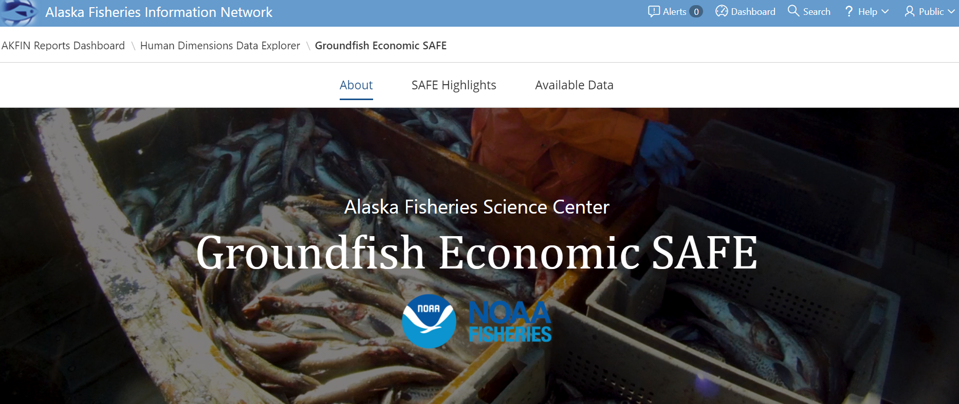
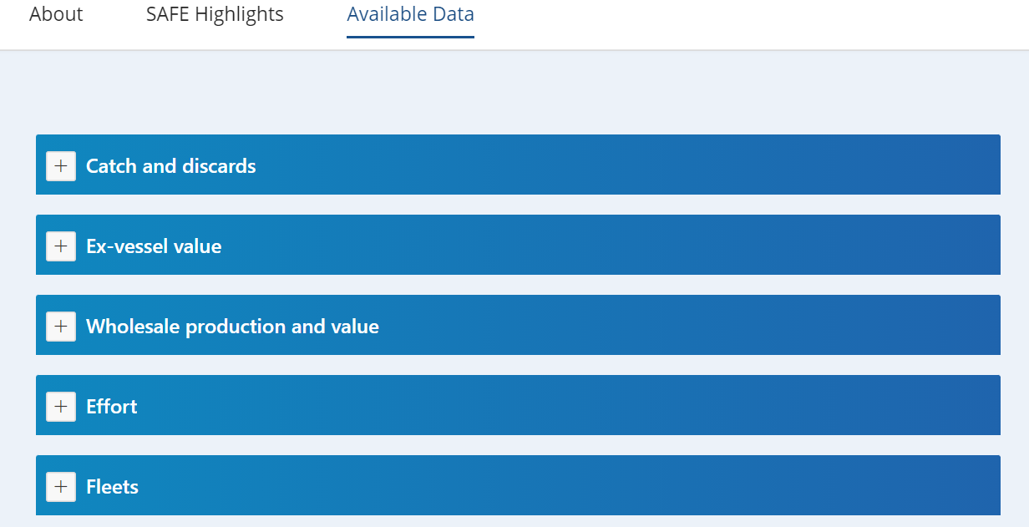
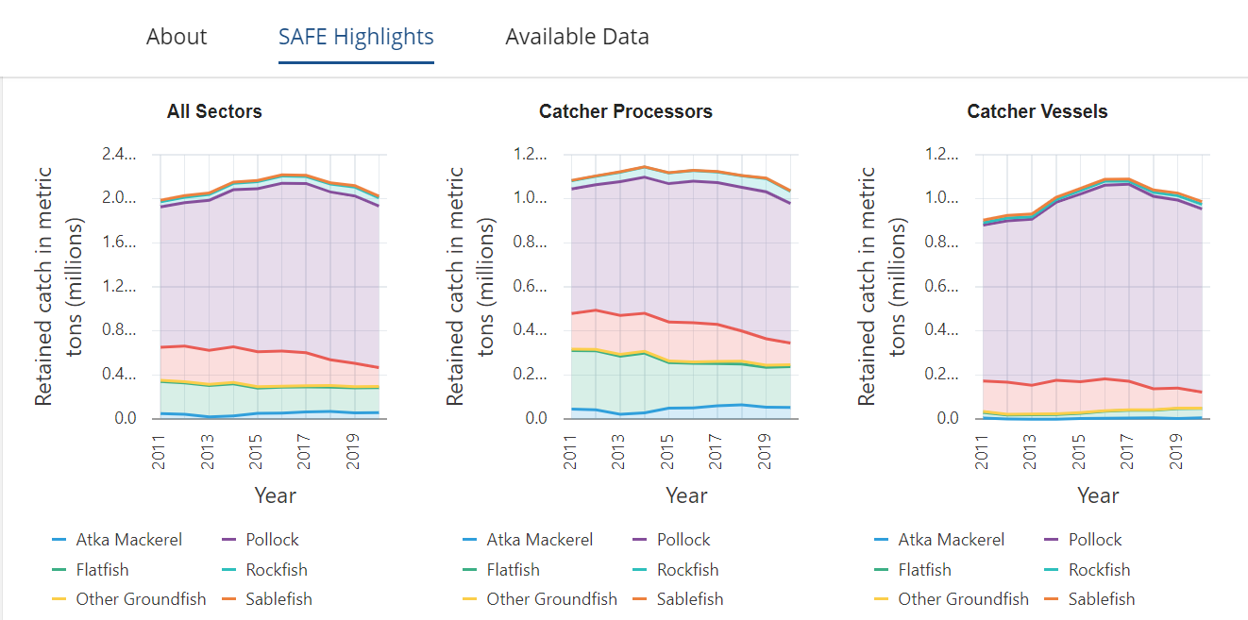
Where to find the data I need?
https://reports.psmfc.org/akfin/f?p=501:2001

Slide 6
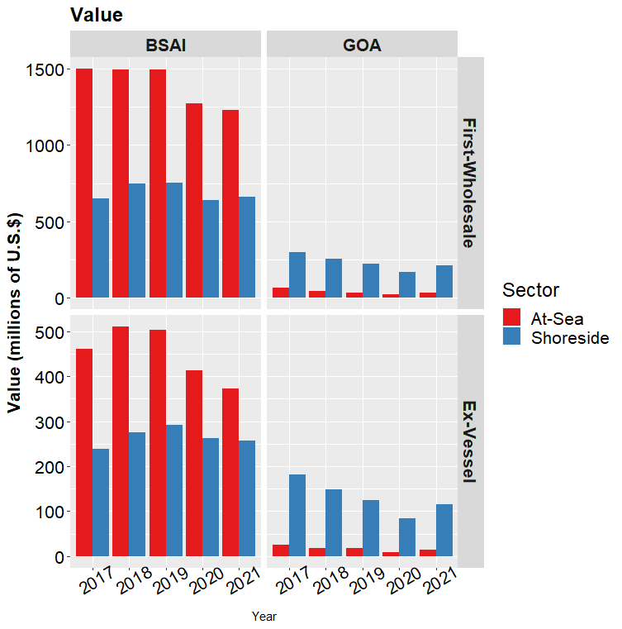
Alaska’s Groundfish Fisheries in 2021
Total catch: 2.01 million t
(decreased 4%)
Aggregate ex-vessel value decreased in the BSAI and increased in the GOA.
Wholesale value:
$2.12 billion (down 2.5%)
Ex-vessel value:
$759.6 million (down 5.3%)
Percent change adjusted for inflation.
Values in figure nominal (not adjusted for inflation)

Slide 7
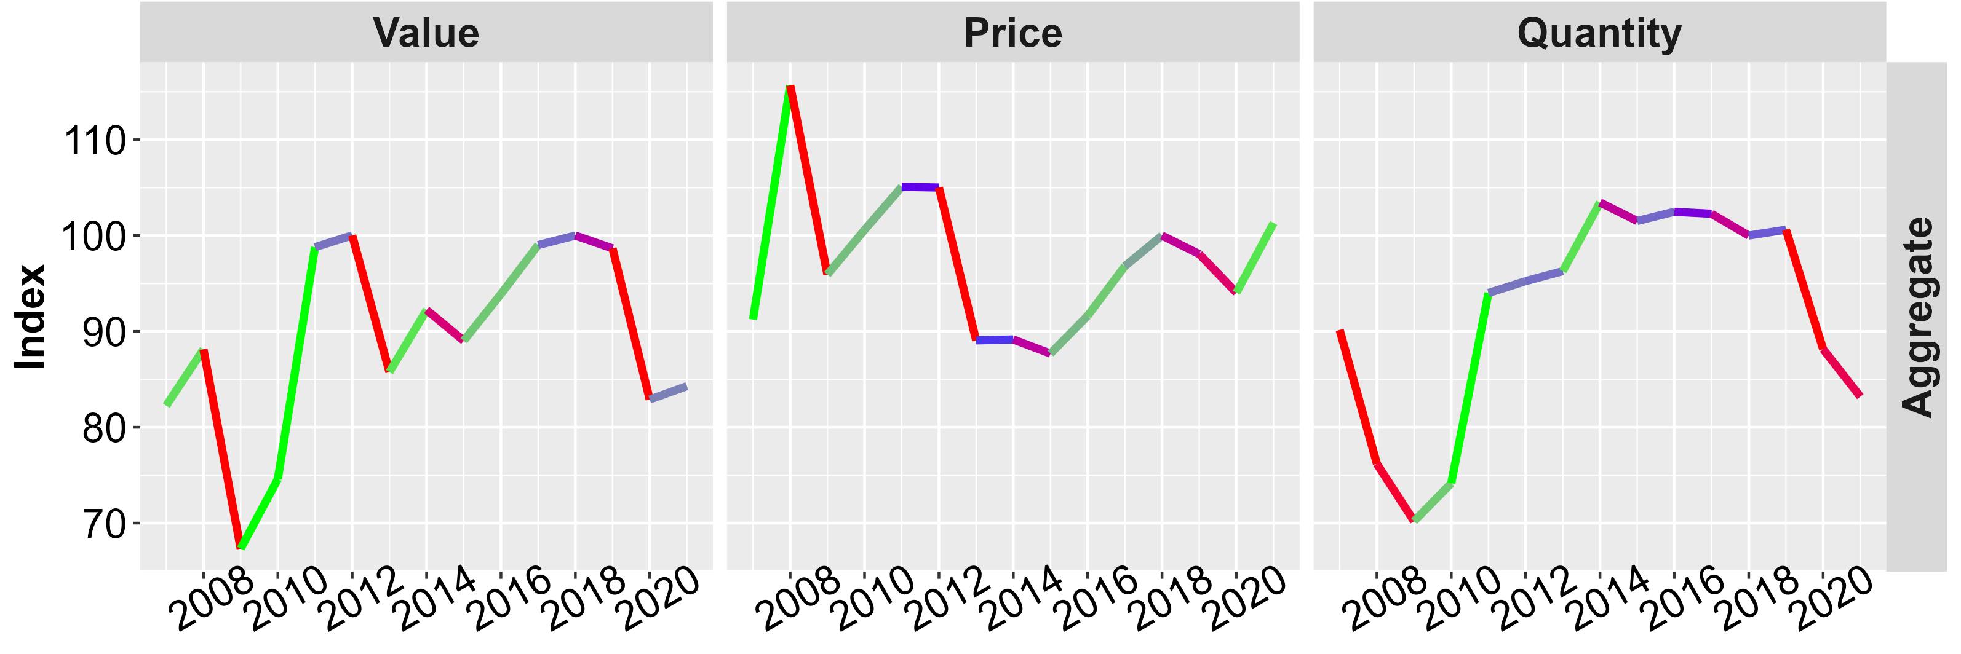
Alaska’s Groundfish Fisheries in 2021
Alaska First Wholesale Economic Indices
In the aggregate:
The change in value was the result of increasing prices which offset decreases in volume

Slide 8
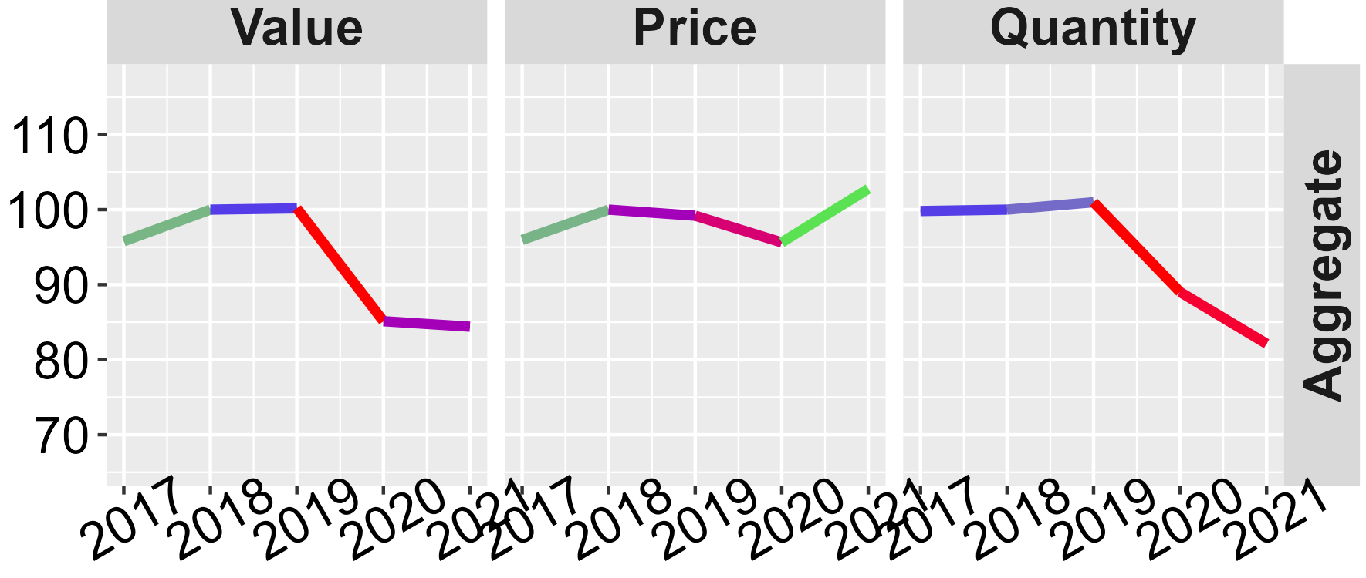
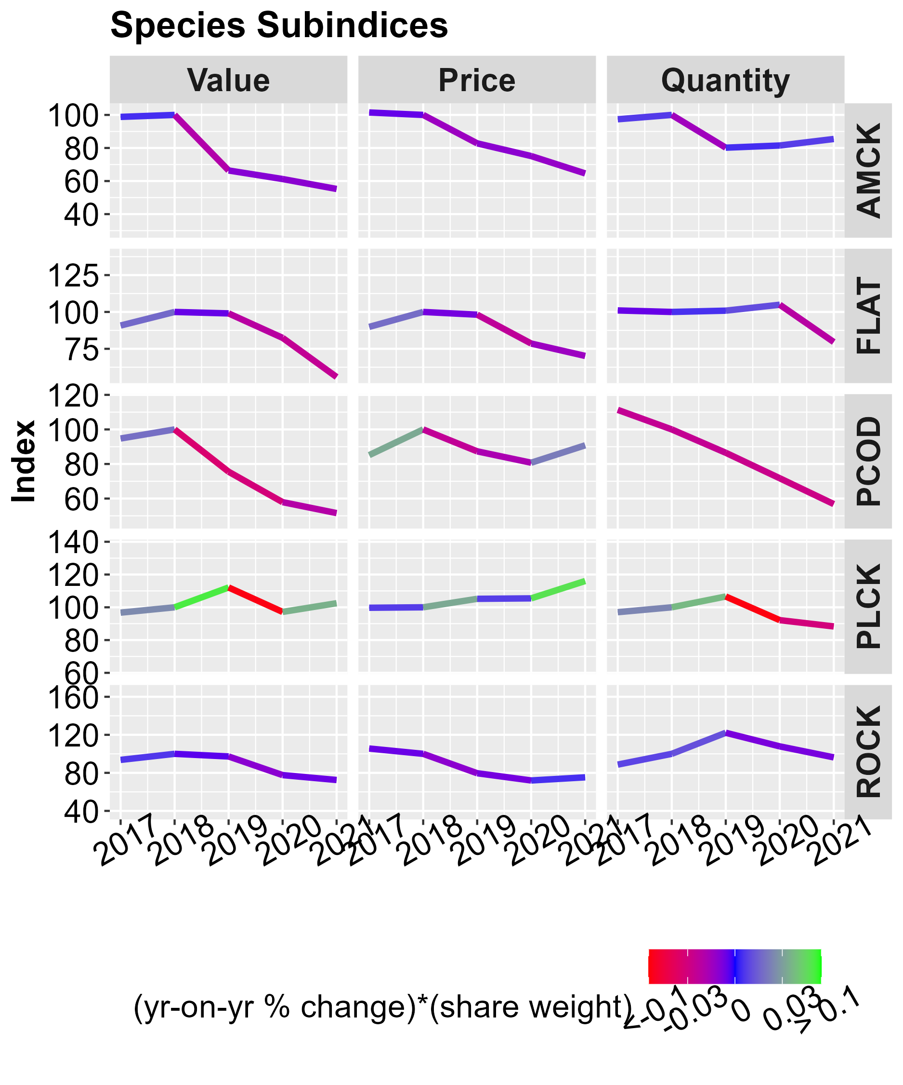
Species
BSAI First Wholesale
Economic Indices
Value increased:
  Pollock
  Sablefish
Value stable or decreasing
  Atka
  Flatfish
  Pacific cod
  Rockfish
Indices are nominal (not adjusted for inflation)

Slide 9
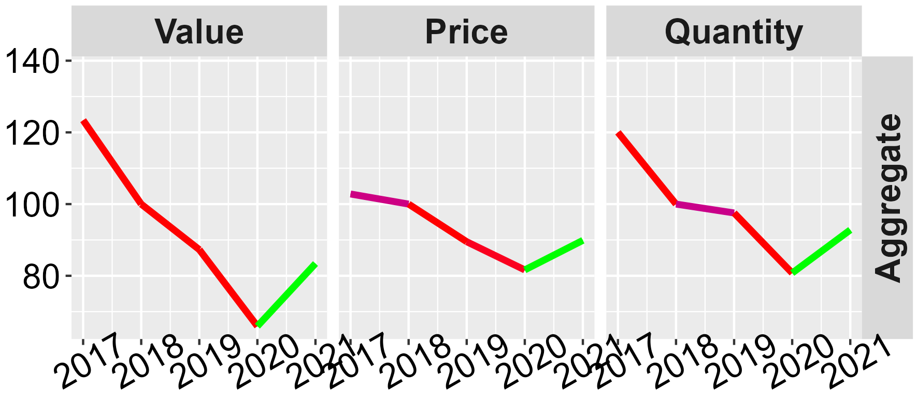
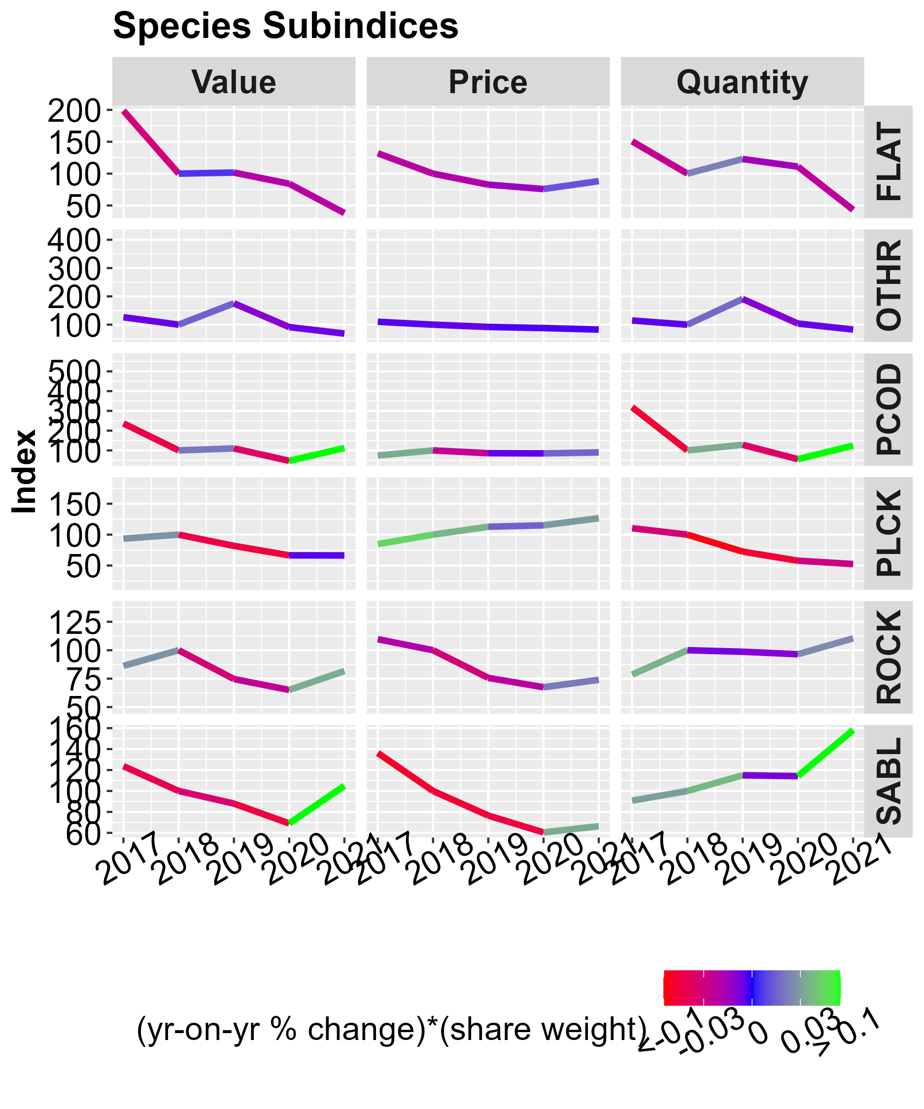
Species
GOA First Wholesale
Economic Indices
Value increased:
  Sablefish
  Pacific cod
  Rockfish
Value stable or decreased:
  Flatfish
  Pollock
  Other species
Indices are nominal (not adjusted for inflation)

Slide 10
Economic Status Report, 2021
The Economic Status Report serves many purposes. Among them is to provide information to the Plan Team.
Economic data for 2021 are still being finalized and validated (typically price and value).
We invite feedback -- michael.d.smith@noaa.gov@noaa.gov

