Slide 1
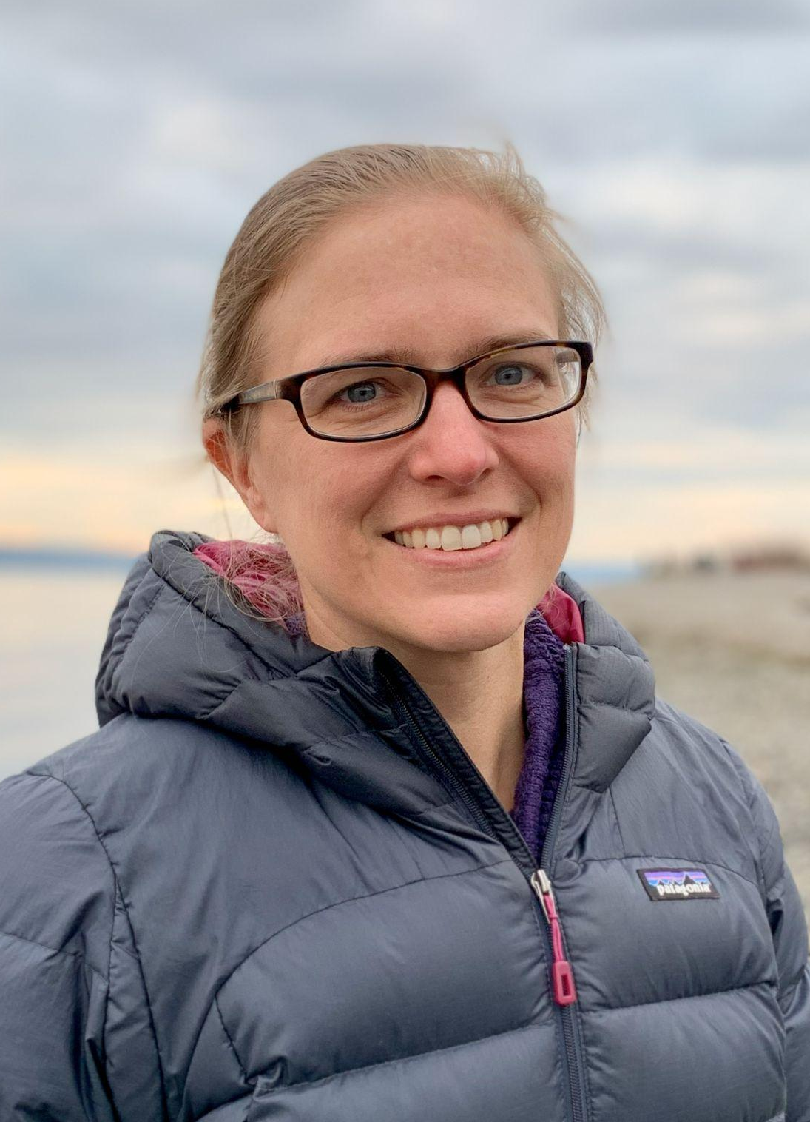
2023 Ecosystem Surveys
Bering Sea & Gulf of Alaska
Alaska Fisheries Science Center
Cross division/agency collaboration focused on ecosystem research to support ecosystem based fisheries management
Ecosystems and Fisheries-Oceanography Coordinated Investigations (EcoFOCI: PMEL and Recruitment Processes Program), Seattle
Ecosystem Monitoring and Assessment, Juneau/Seattle
Recruitment, Energetics & Coastal Assessment, Juneau
Fisheries Behavioral Ecology, Newport
Shellfish Assessment Program, Kodiak
Presenters: Lauren Rogers, Rob Suryan, Ellen Yasumiishi
September 20, 2023
Notes:
Alternate Ellen, Lauren, Rob or others

Slide 2
Goal & Objectives
Goal: Provide the most recent information on ecosystem conditions affecting fish recruitment processes.
Objectives:
Provide an update on 2023 ecosystem surveys.
Provide an update on recruitment indicators.
Encourage discussions of data/indicators most useful to the Groundfish Plan Teams.

Slide 3
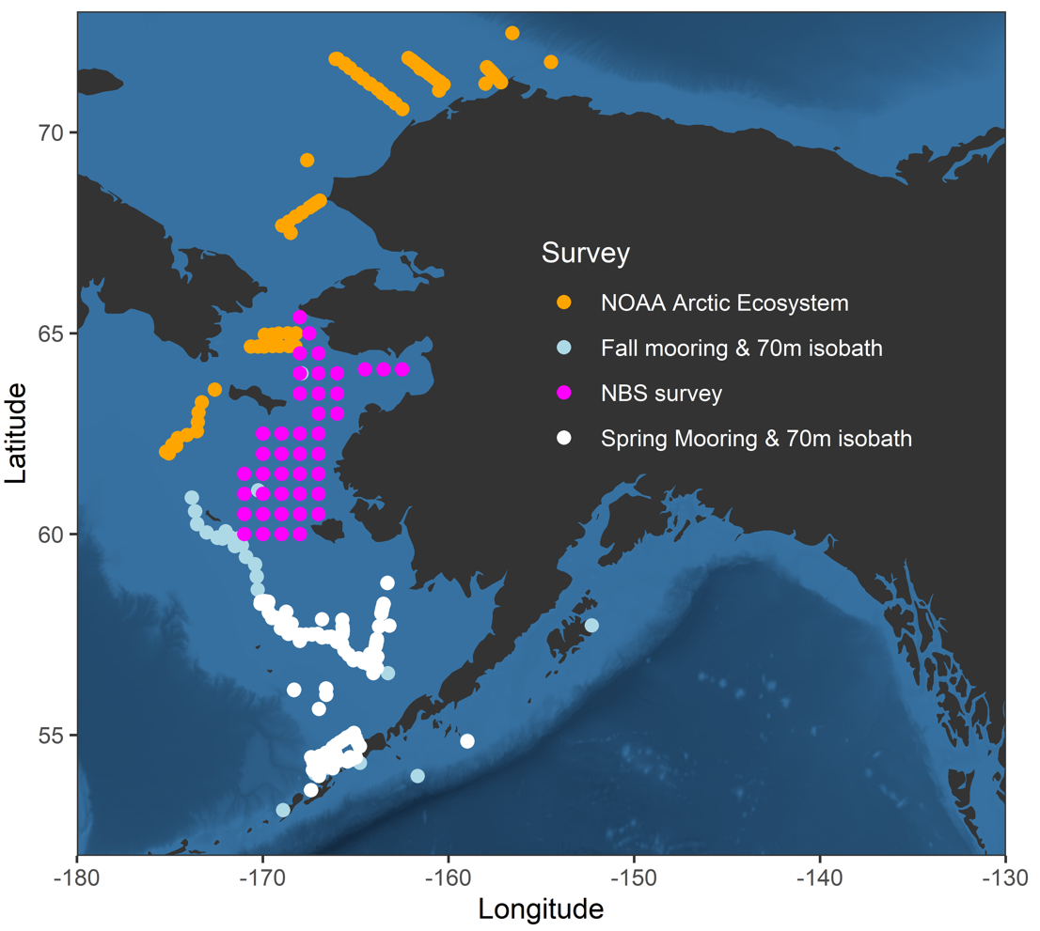
Bering Sea
Notes:
“Odd year” means more of our survey effort was focused in the GOA, but we did have a number of surveys in the BS and Arctic.

Slide 4
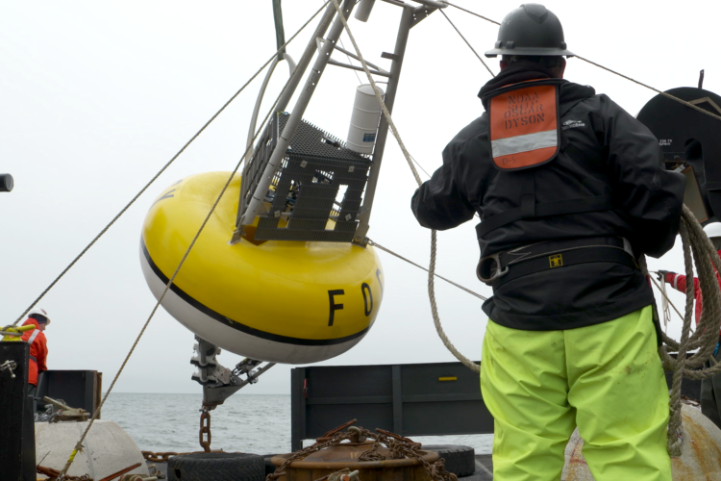
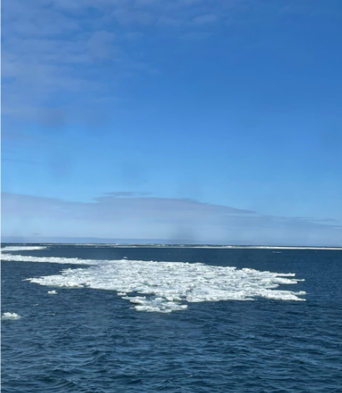
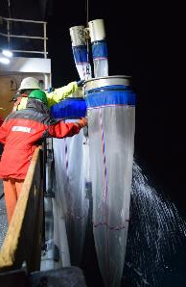
2023 Moorings & 70m Isobath
Focus: Deploy moorings and sample lower trophic levels.
When: Spring and Fall
Operations: Surface, subsurface moorings and instrumentation (incl Prawler),
CTDs, Bongos, Pop-up floats.
Indicators: Integrated chlorophyll; temperature, salinity, oxygen, zooplankton.
Contact : Julie Keister
Notes:
This survey is a collaboration with PMEL. We will focus on the Rapid Zooplankton Assessment for today’s talk since zooplankton are important prey for fish

Slide 5
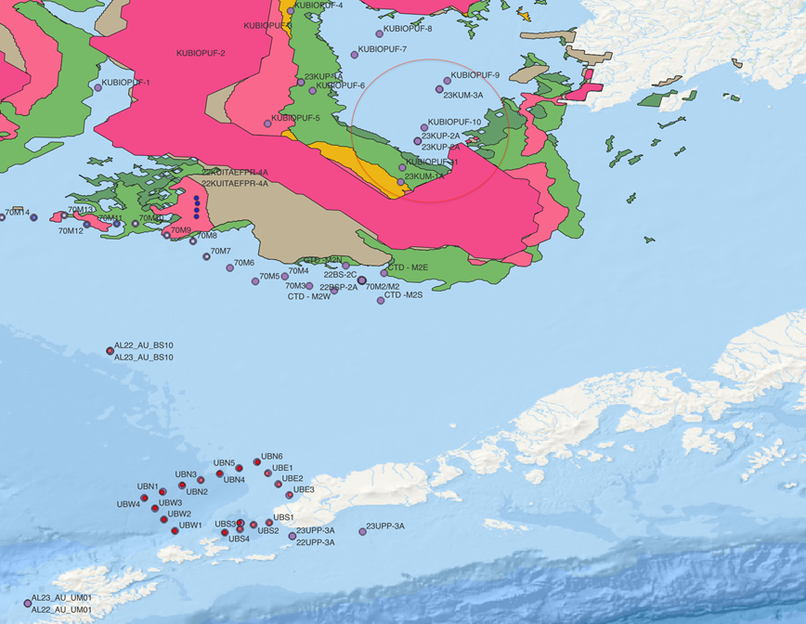
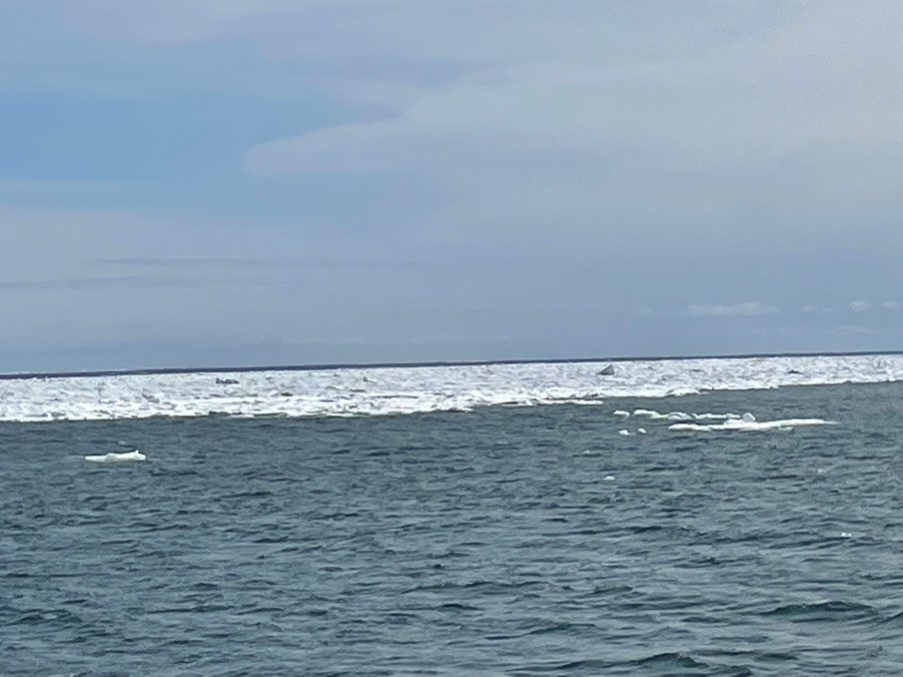
Ice during Spring mooring survey
Notes:
Ice was encountered during the spring mooring survey for the first time in a long time.
Left panel: ice concentration, showing ice north of the 70 m sampling line.

Slide 6
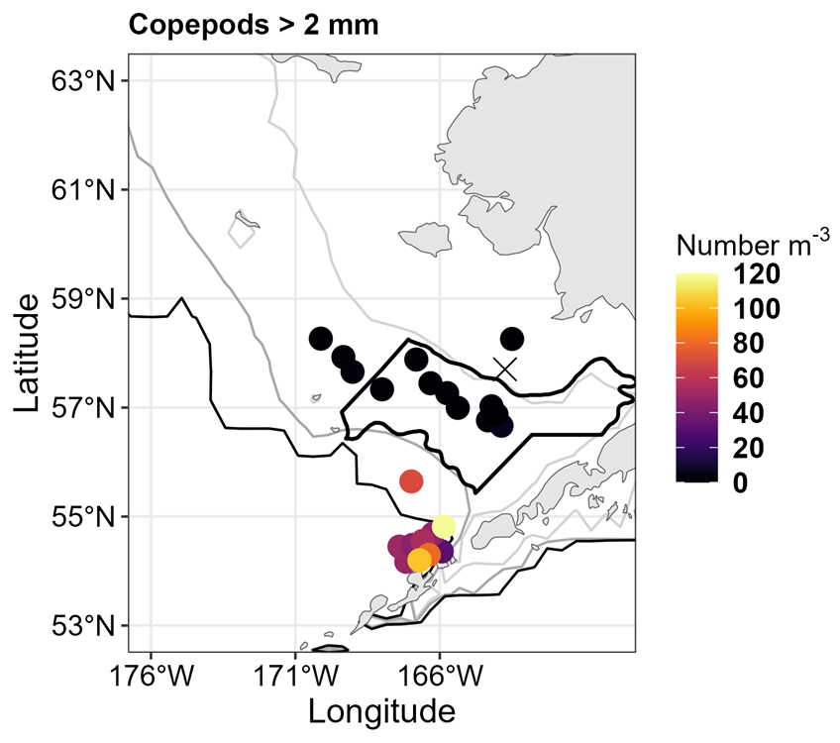
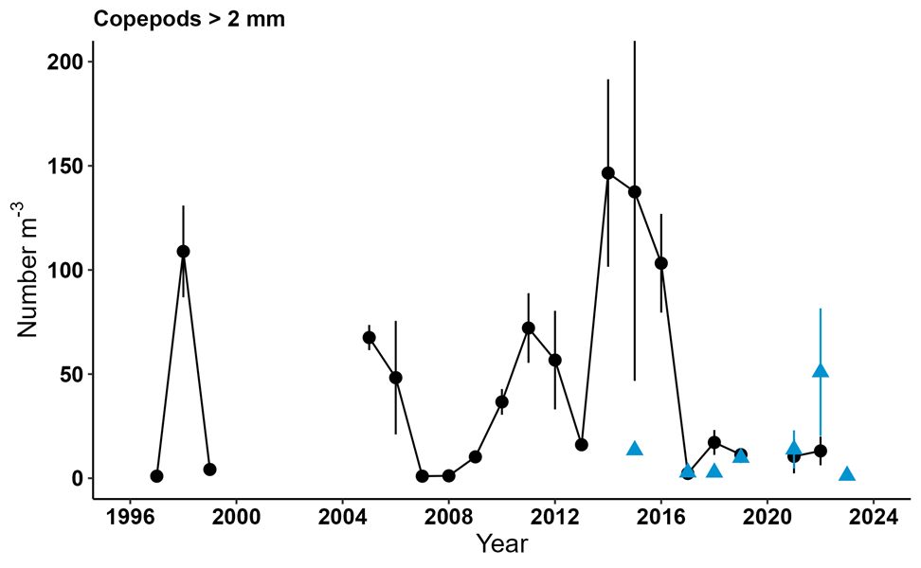
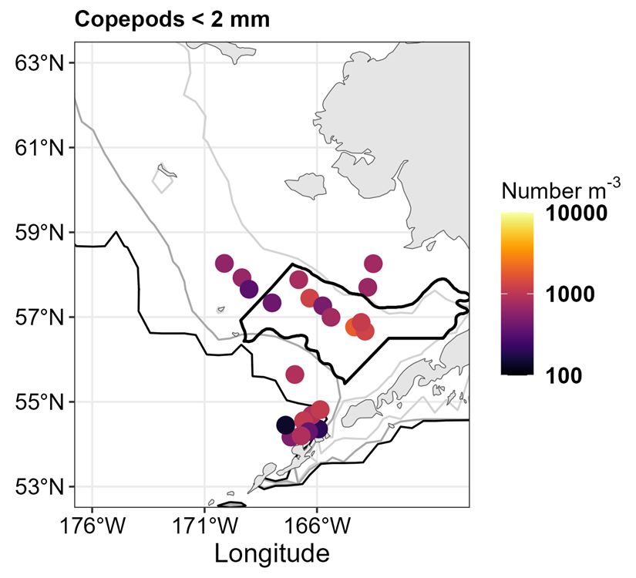
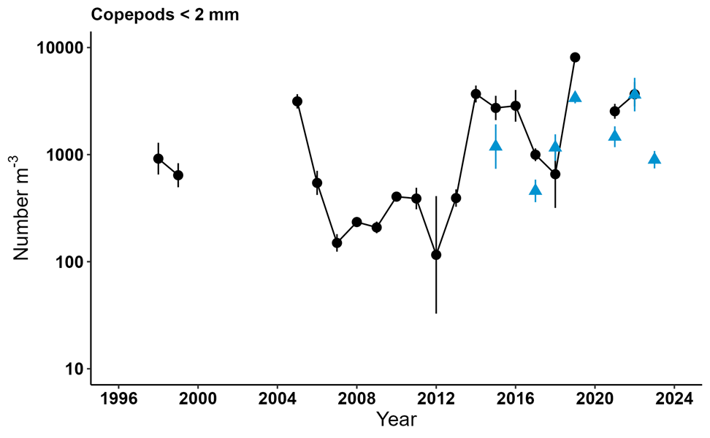
Spring - Rapid Zooplankton Assessment
Large copepods
Large copepod abundance was low, as is typical in cold springs.
Small copepods
Small copepod abundance was moderate: higher than cold years but lower than recent warm years.
Rapid Zoop Assessment
Take home: While small copepod numbers were lower than in recent years, they were still abundant suggesting adequate forage for larval fish.
Contact : Dave Kimmel
Notes:
Orient to these figures: For maps, colors show relative abundance. For time-series, showing average abundance for South Middle Shelf: black circles are average abundance ± SE estimated by sorters back in the lab. The blue triangles are estimates conducted onboard - RZA.

Slide 7
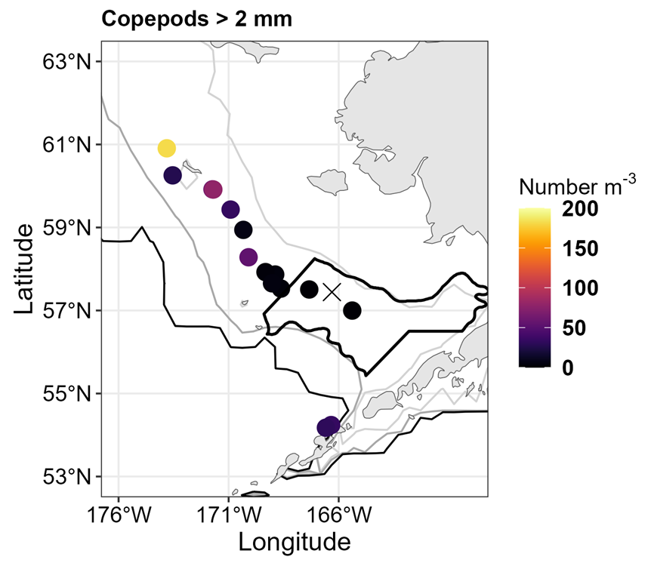
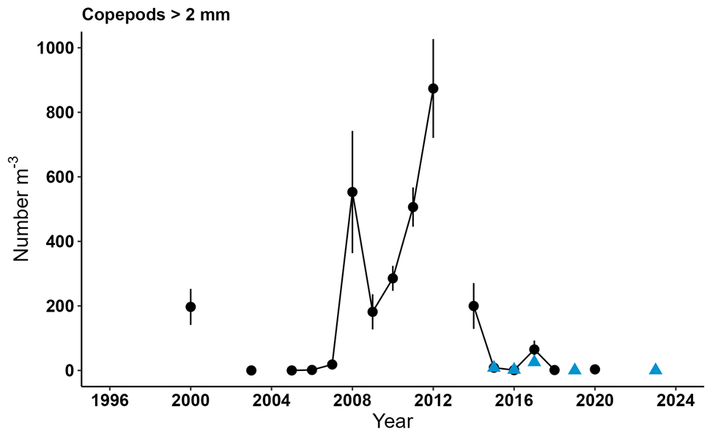
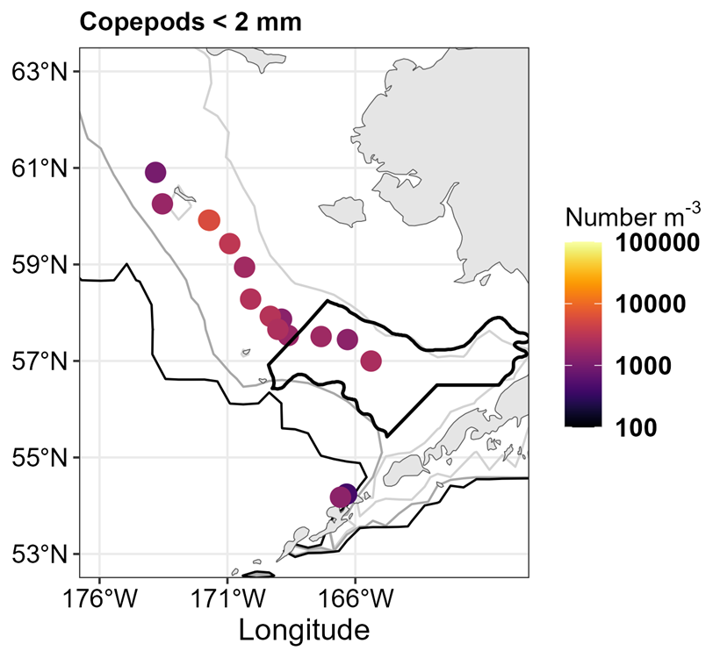
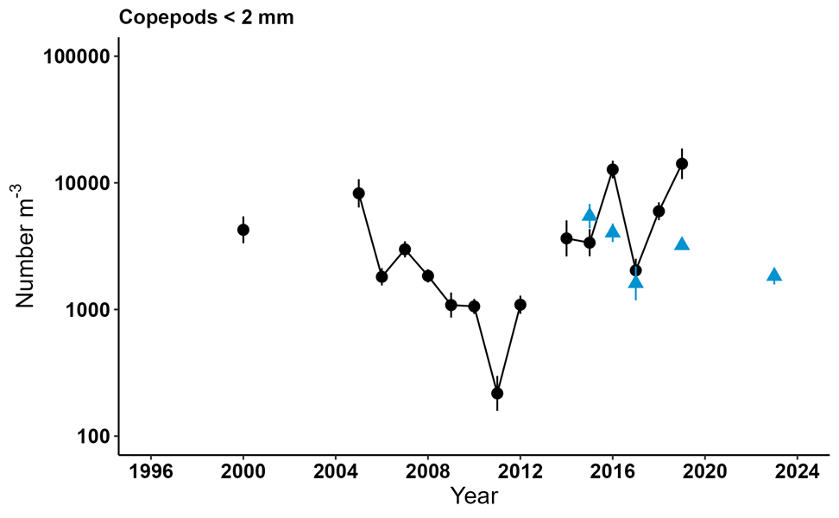
Fall - Rapid Zooplankton Assessment
Large copepods
Large copepod numbers were low in the SE Bering shelf where bottom temps > 3 C. Numbers increased north of 60N and were more abundant where bottom temps were < 0 C.
Small copepods
Small copepods were moderate in abundance and similar to colder years. Reduced in comparison to more recent warm years.
Take home: Lipid-rich large copepods (Calanus) were associated with cooler temperatures to the North. There was less high-quality food for age-0 pollock on the SE Shelf.
Contact : Dave Kimmel
Notes:
The typical pattern in cool years is that by end of summer there should be an accumulation of lipid-rich copepods on the shelf, and that’s what we expected, but it’s not what we saw. INstead large copepod numbers were very low on the SE shelf, and only increased north of 60 degrees when sampling encountered the cold pool.

Slide 8
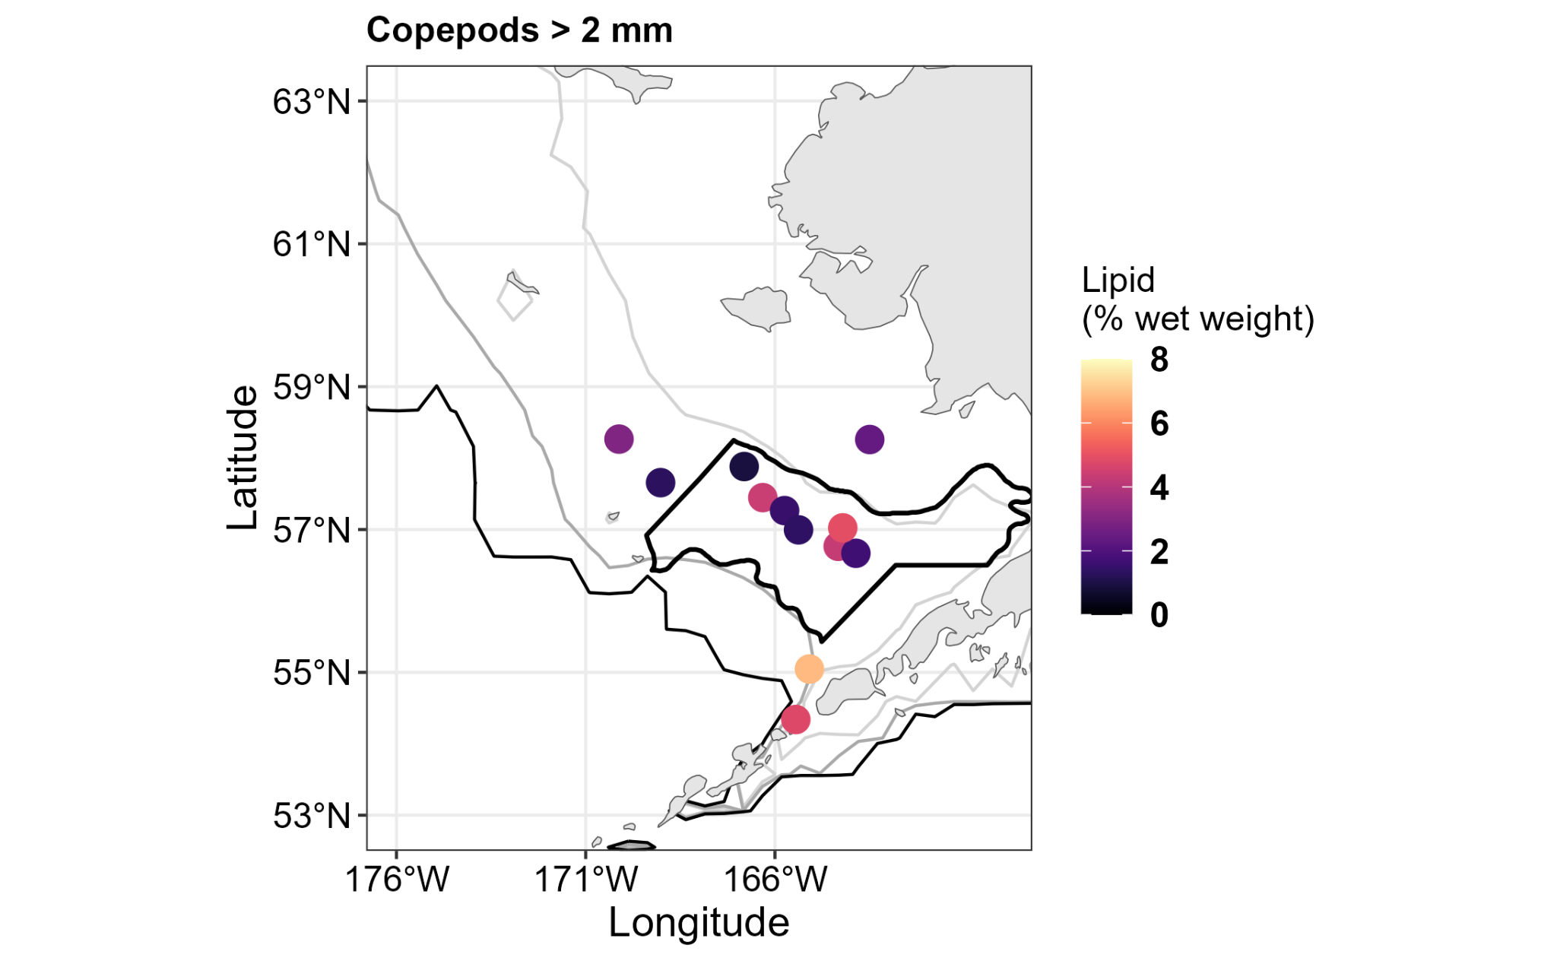
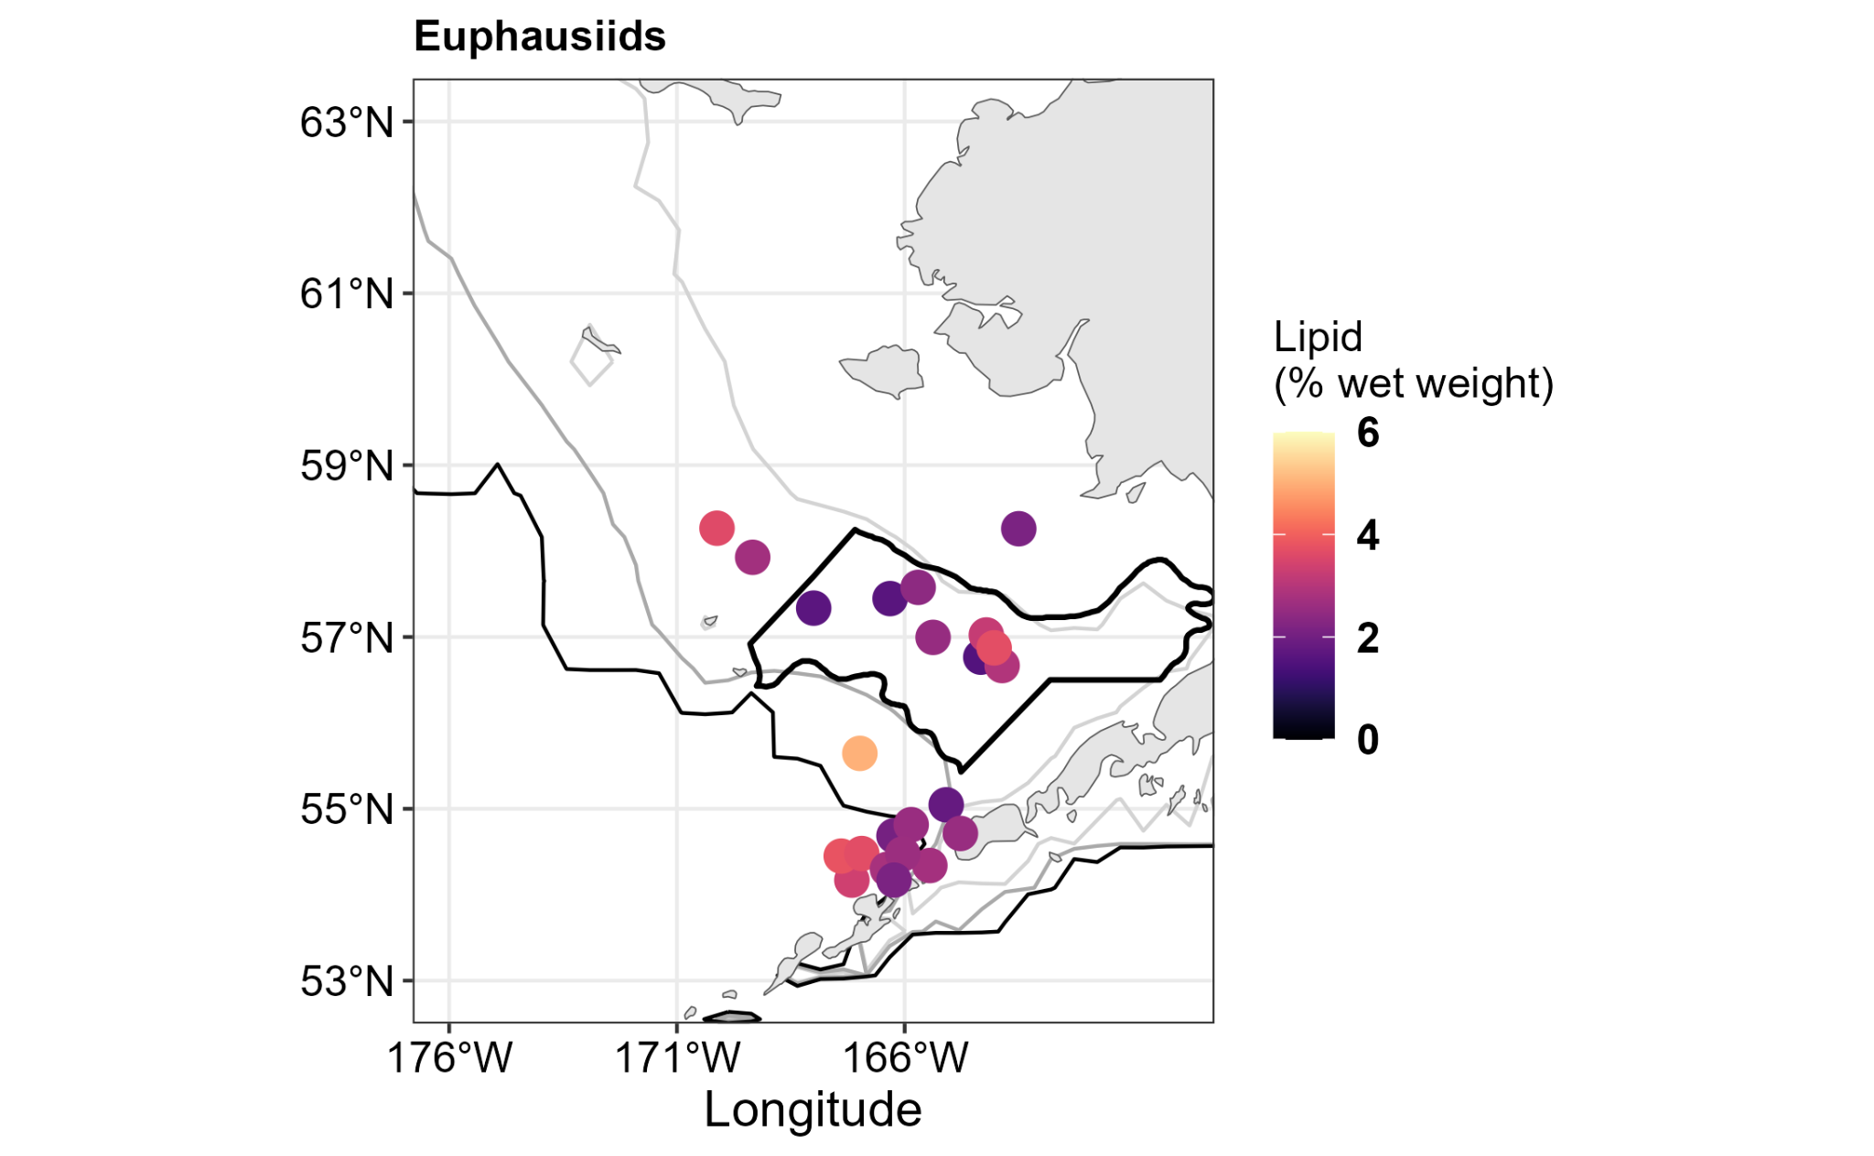
Zooplankton Lipids
Spring Mooring Survey
2023: Spring copepod and euphausiid lipid levels were generally low, with slight increases in the south.
Overall: Low values and less variable in spring. More variable in fall with higher lipid values in cool years.
Large copepods
Region/Survey | Year | Phase | %lipid (SD)
Spring | 2022 | Cool | 4.8 (3.5)
Mooring | 2021 | Neutral | 3.5 (2.3)
 | 2018 | Warm | 4.2 (4.8)
Fall | 2022 | Cool | 16.7 (2.4)
SEBS | 2018 | Warm | 10.3 (5.1)
 | 2022 | Cool | 15.3 (6.2)
NBS | 2021 | Neutral | 8.7 (4.7)
 | 2018 | Warm | 5.2 (3.7)
Euphausiids
Contact : Cody Pinger, Todd Miller, Dave Kimmel, and the RZA team

Slide 9
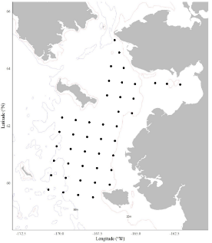
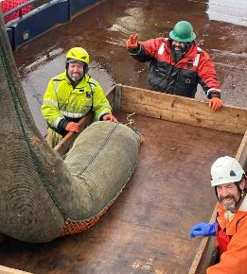
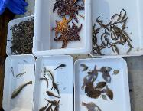
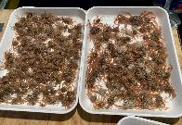
2023 North Bering Sea Ecosystem Survey
Focus: YOY Pacific cod, Arctic cod, saffron cod, pollock, juvenile salmon, capelin, herring, ATF sablefish, sand lance, crab, zooplankton, phytoplankton
When: August 27- September 28, 2003-2023, excluding 2008, spans 21 years
Operations: CTD, bongo tows, benthic grabs, surface trawl, beam trawl
Indicators: Growth and consumption model output. Fish abundance, conditions, diets. Salmon forecasting. Crab EFH. HABs. eDNA
Contact : Ed Farley

Slide 10
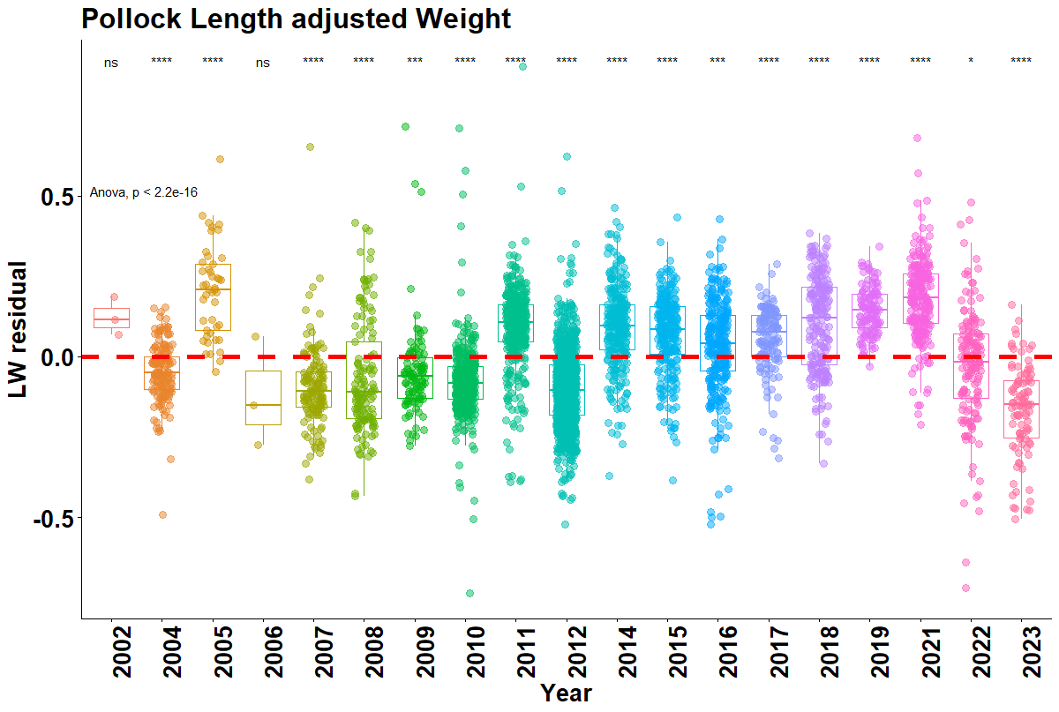
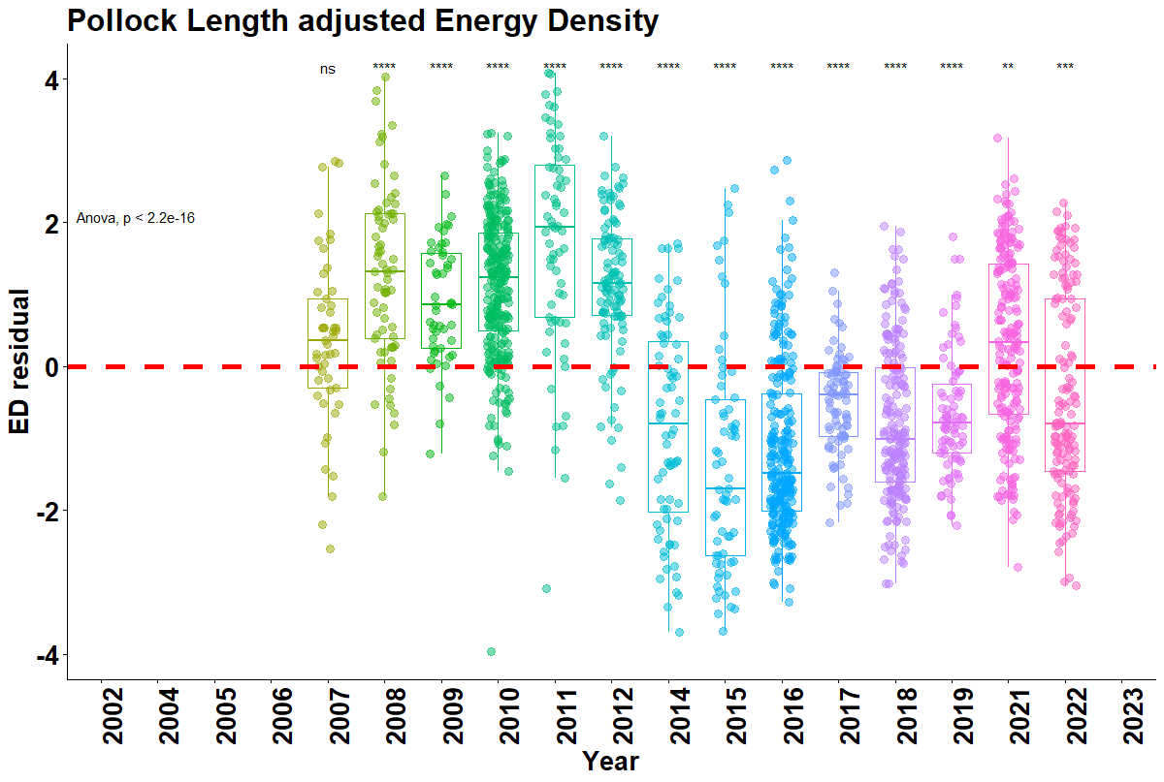
Fall - Age-0 Pollock Condition
2014-2019: Above avg weight for a given size during recent warm years, but below average lipid stores and energy density.
Since 2021: Trending back toward mean, but variable
Take home: 2023* below avg weight for size typical of cooler years.
*
*Preliminary subsample
Contact : Johanna Page, Jacek Maselko, Rob Suryan

Slide 11
2023 NBS survey observations
Qualitative Assessment - cruise just completed
Prey abundance looked positive
  Capelin catches were up for a second year in a row, but still below average.
  Rainbow smelt and age-0 saffron cod were atypically abundant
  Catches of age-0 pollock were relatively low
Salmon catches atypical
  Chinook salmon well below average again this year
  Coho salmon exceptionally low
Contact : Jim Murphy

Slide 12
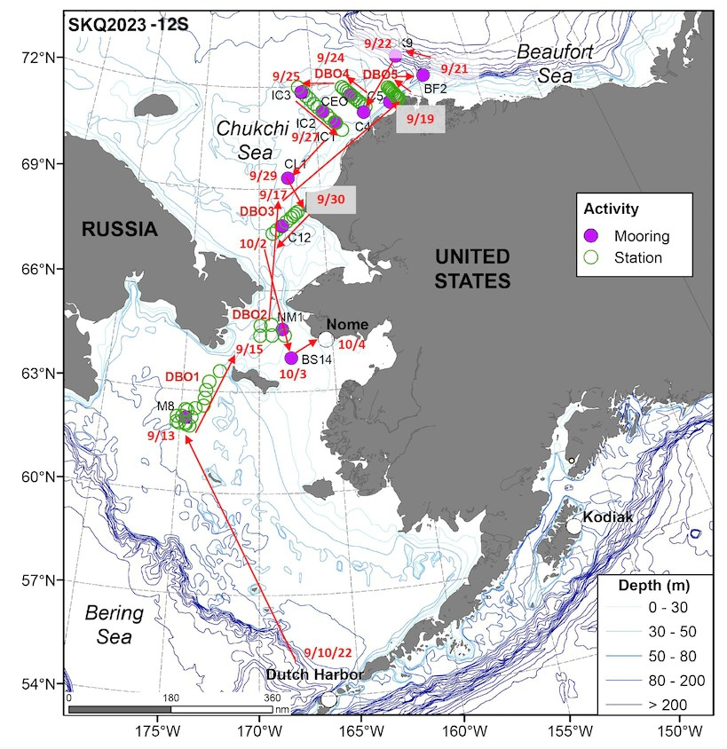
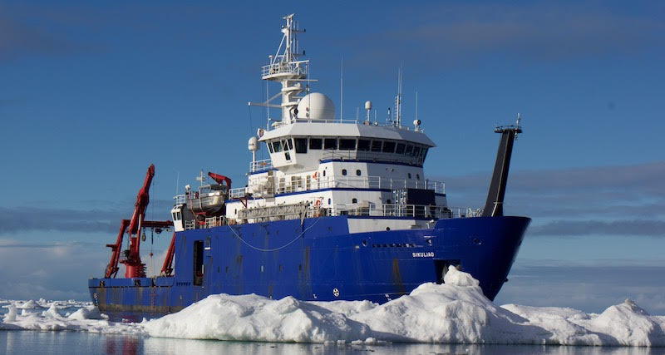
2023 NOAA Arctic & Ecosystem Research
Focus: Evaluate ecosystem status and change in the N. Bering and Chukchi Seas
When: Summer/Fall 10 Sept - 4 Oct 2023. (Similar surveys conducted since mid-2000s)
Operations: Subsurface moorings, benthic grabs, bongos (plankton), beam trawl, mammal and bird obs, process studies
Indicators: Nutrients, sediment, pH, OA, HABs, plankton, fish, birds, mammals.
Contact : Libby Logerwell
Notes:
We do have scientists participating right now in a survey in the Arctic, focused on evaluating ecosystem status and change in the N Bering and Chukchi seas. Some version of this has been conducted most years for the last two decades, with various partners and funding sources. This ongoing engagement in the Arctic is providing us with a baseline understanding of these ecosystems. I won’t present any of those data today.

Slide 13
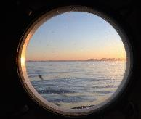
2023 Bering Sea summary
SE Bering Sea Zooplankton
Cold spring followed by warmer summer: relatively low large copepod abundance, reduced prey for juvenile fish. Conditions better to the North.
SE Bering Sea Juvenile Fish
Even years only
Northern Bering Sea Juvenile Fish
Up from last year but below average.
Fish Condition
Preliminary results from NBS age-0 pollock suggest fish condition is typical of cool ocean conditions

Slide 14
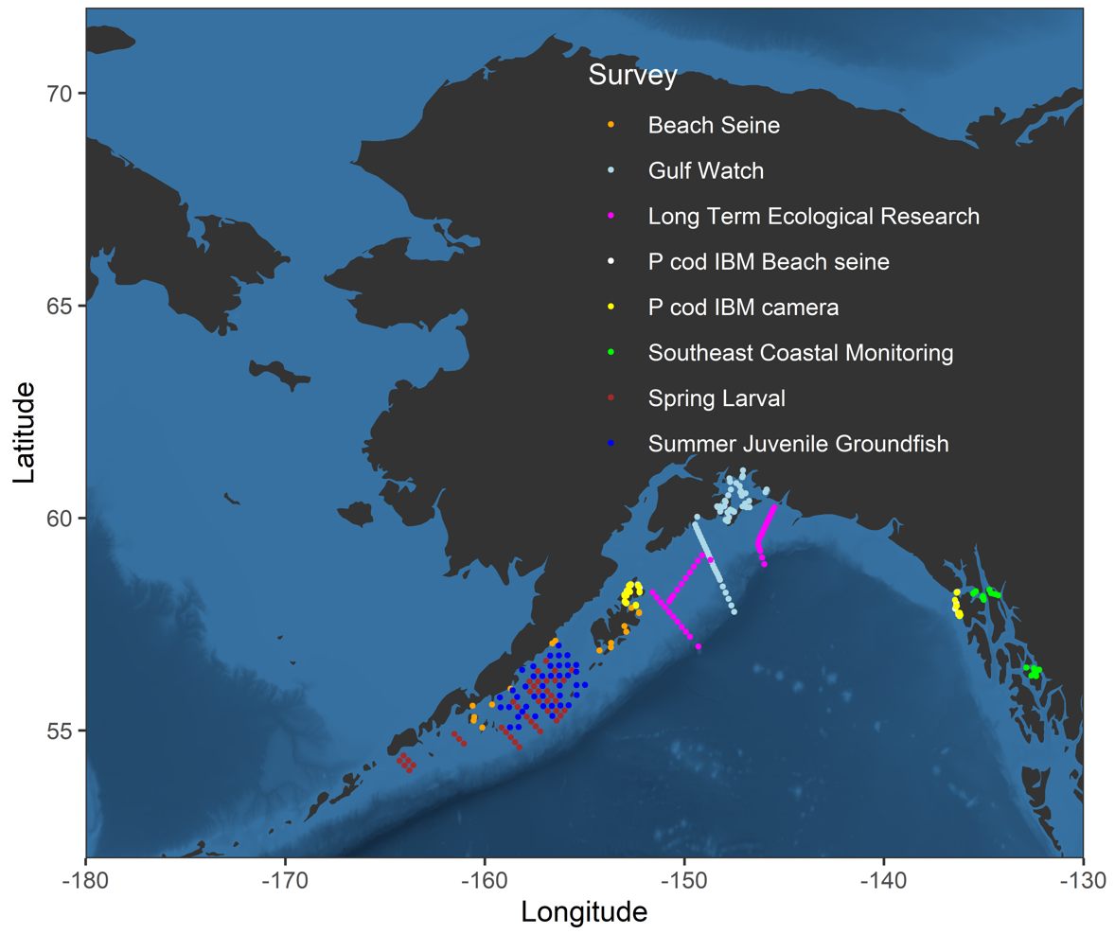
Gulf of Alaska
Notes:
Most of our survey coverage was in the WGOA. But I’ll start over here in the East with the SECM survey

Slide 15
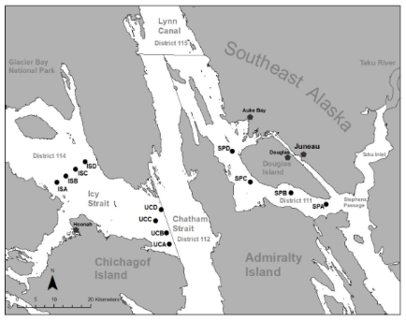
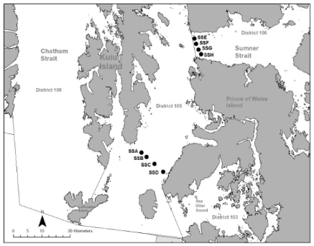
EGOA Southeast Coastal Monitoring
Focus: Juvenile salmon, YOY gadids (Pacific cod, saffron cod, pollock), sablefish
When: 3 cruises annually: May, June, July, 1997-2023 (27 years total)
Where: Northern and central SEAK
Operations: Surface trawl, CTD, zooplankton/phytoplankton
Indicators: Onshore-offshore gradient of juvenile gadid growth and
energetics. Feeding ecology of southern coastal age-0 groundfish, HABs
Contact: Andrew Gray, Wess Strasburger, Emily Fergusson

Slide 16
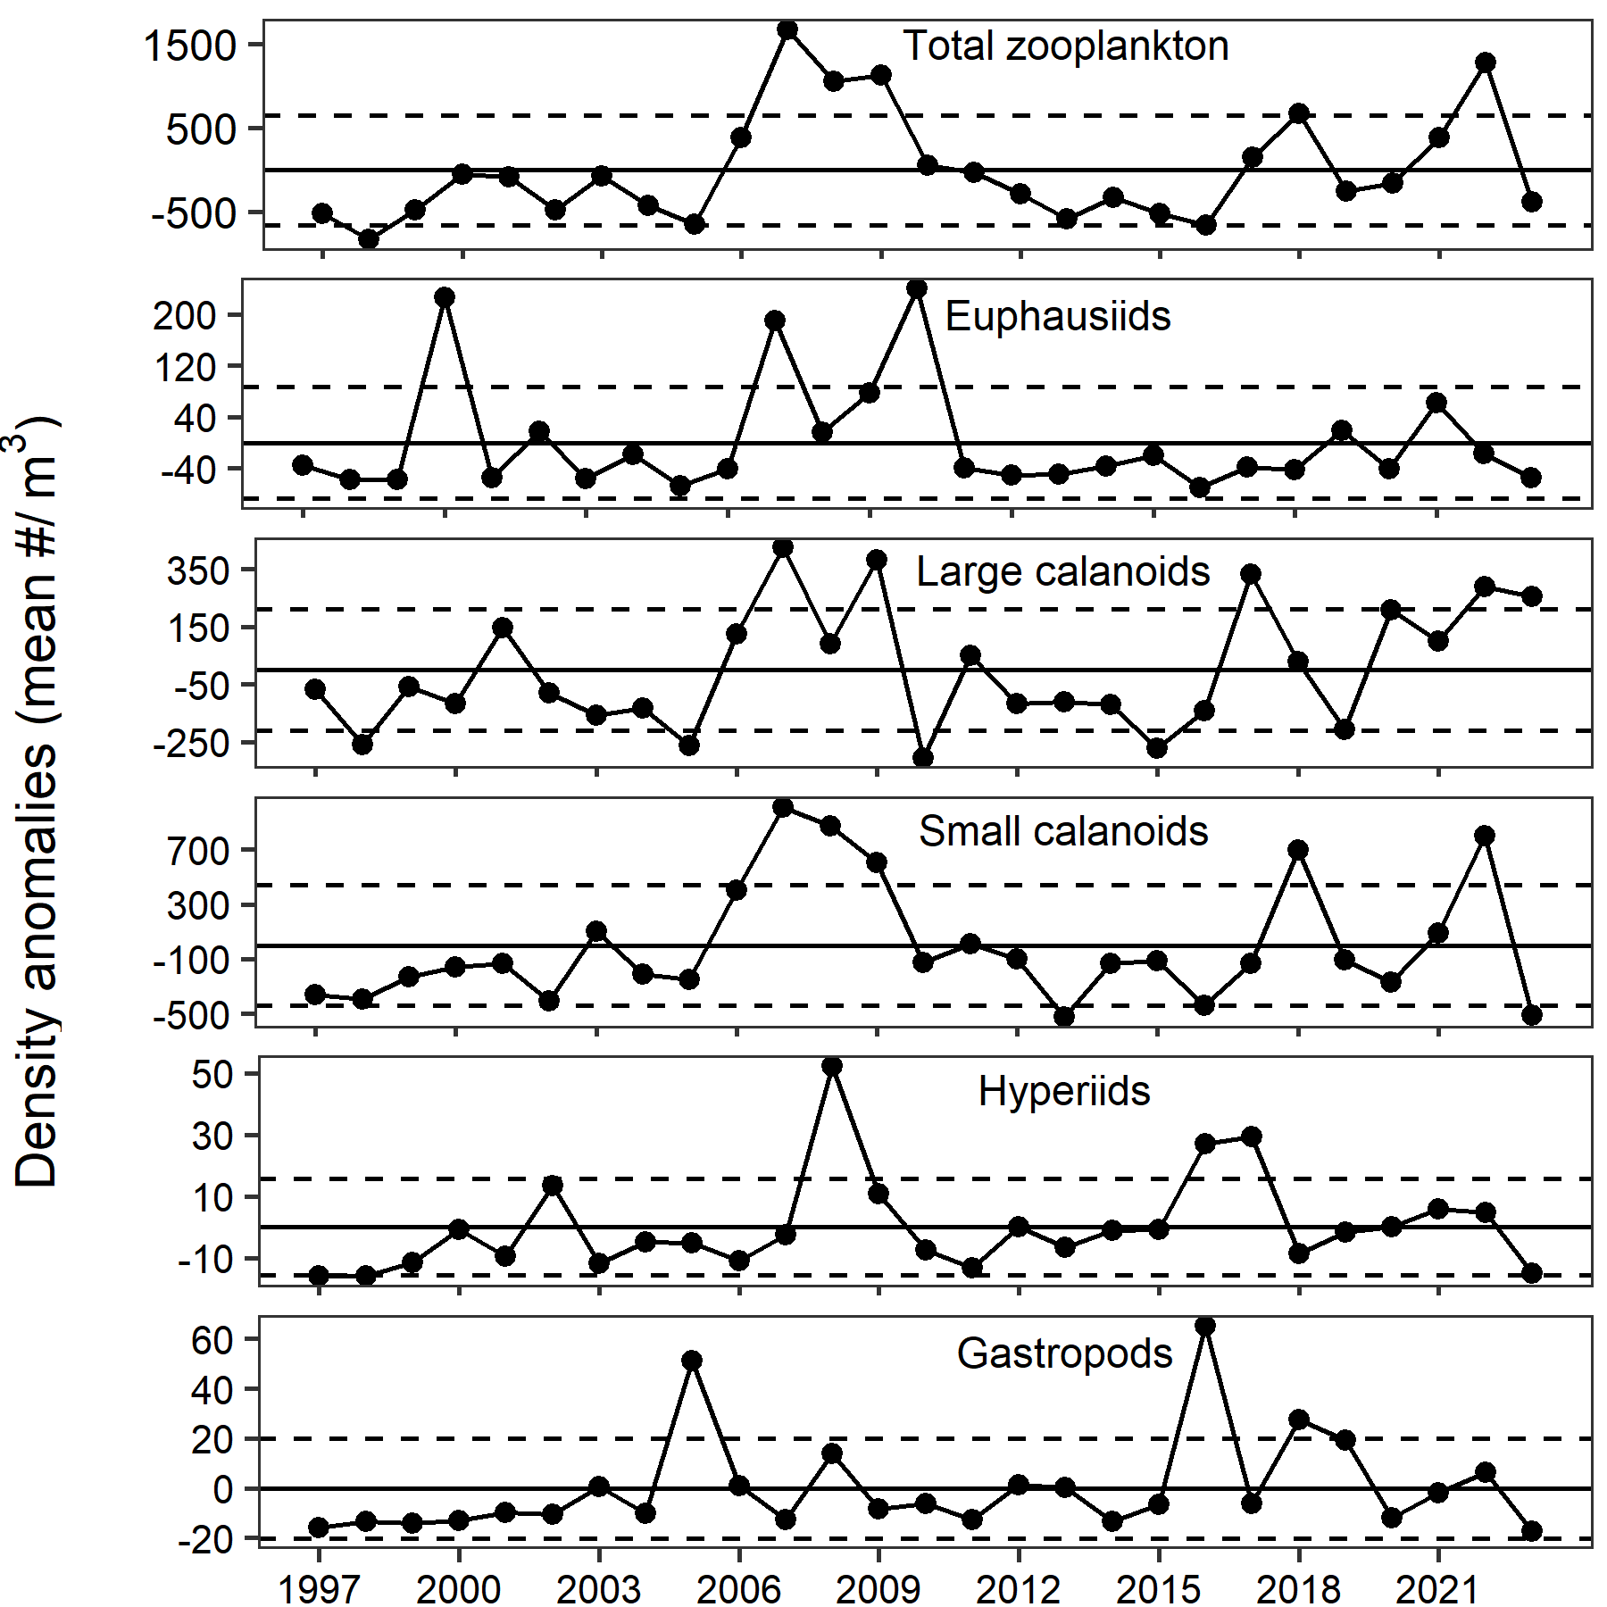
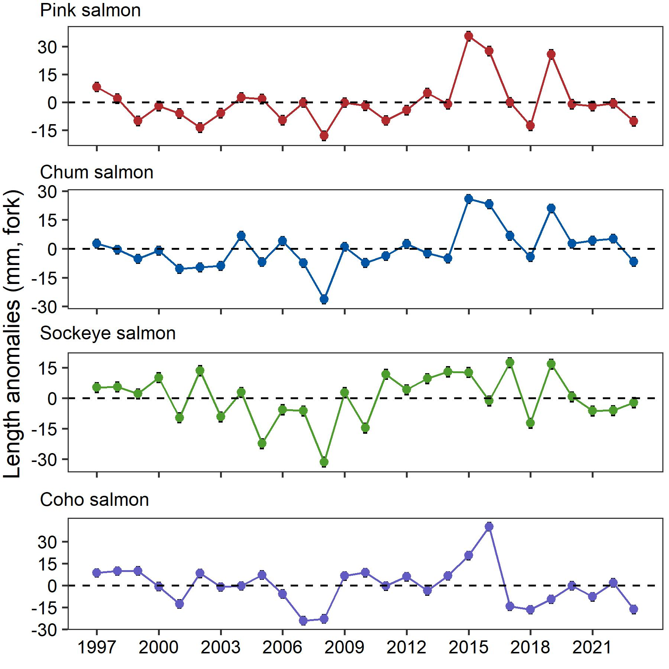
SECM 2023 observations
Large copepod density above average, euphausiids and other zooplankton below average
Juvenile salmon size below average.
Contacts: Wess Strasburger, Emily Fergusson, Andrew Gray

Slide 17

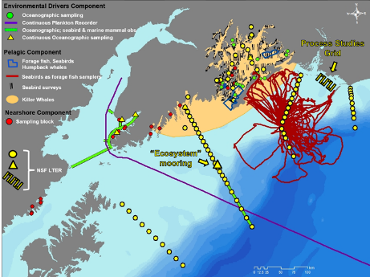

GAK1
Gulf Watch & LTER surveys
Gulf Watch Alaska is the long-term ecosystem research and monitoring program of the Exxon Valdez Oil Spill Trustee Council to understand factors affecting recovery of resources affected by the 1989 oil spill.
The Northern Gulf of Alaska Long-term Ecosystem Research site is funded by the National Science Foundation to understand processes that drive GOA ecosystem production and foster its resilience
Seward Line
Contact: Rob Suryan
Notes:
We usually present some observations from Gulf Watch and from LTER surveys conducted by partners, but in the interest of time I won’t cover those today - although do look for many indicators that go to ESRs and ESPs from these surveys. The one indicator I will present is the sablefish growth indicator.

Slide 18
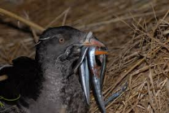
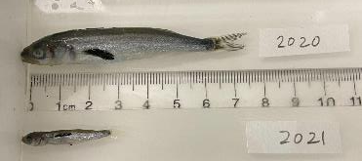
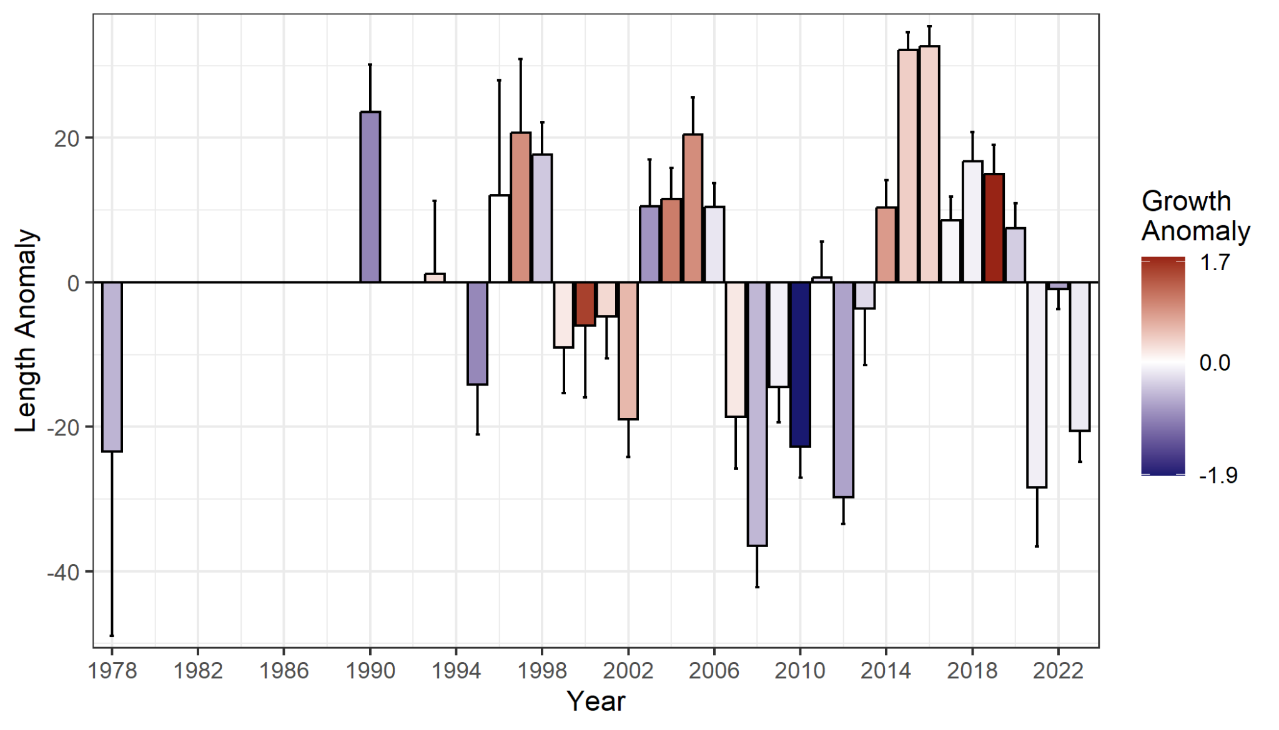
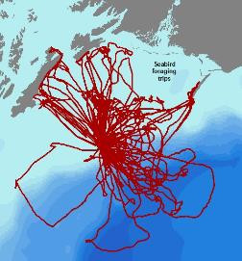
Sablefish Indicator
age-0 sablefish growth in warm years
Age-0 sablefish
Sablefish:
2023: Average growth, but below average size.
Seabird Foraging Trips
Contact: Yumi Arimitsu, Scott Hatch, Shannon Whelan
Notes:
Fish are collected from Rhinoceros Auklets and Tufted Puffins bringing fish in to feed chicks on Middleton island (Fig shows that auklet and kittiwake foraging trips cover the entire shelf and off shelf region surrounding Middleton Island). Fish are collected June through August. Growth is change in size of fish brought in over those months.
Detailed methods: an index of age-0 sablefish growth rate is calculated using the relationship between mean fish length and Julian day for each year. From this model, growth (in mm per day) is the slope, and length is the predicted length on the median Julian day = 205 (July 24). Annual anomalies of growth and length are calculated for each variable by subtracting the mean of all years.

Slide 19
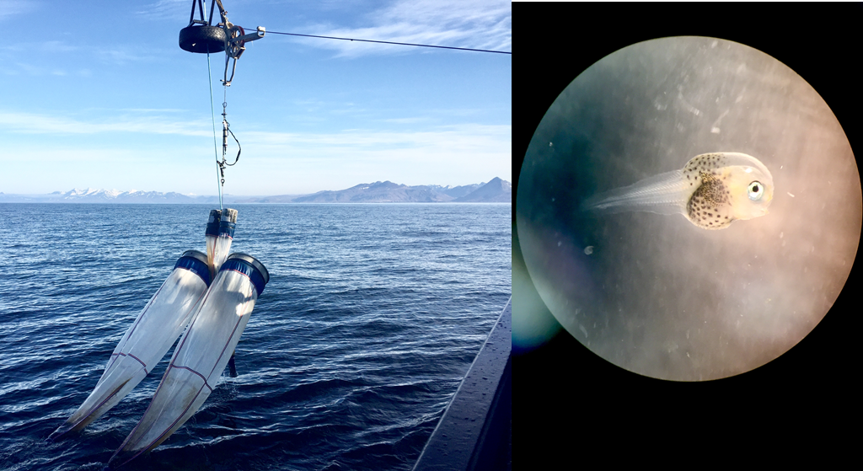
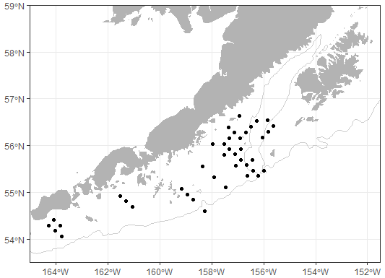
Western GOA Spring Larval Survey
Focus: Larval fishes (e.g. pollock, cod, rockfish, flatfishes) and zooplankton
When: May/June (1979 - present, biennial since 2011). Note: Survey truncated to only 5 days in 2023 due to ship staffing.
Operations: Bongos, CTDs.
Indicators: Larval fish abundance, distribution, spawn timing, zooplankton abundance
Contact : Julie Keister

Slide 20
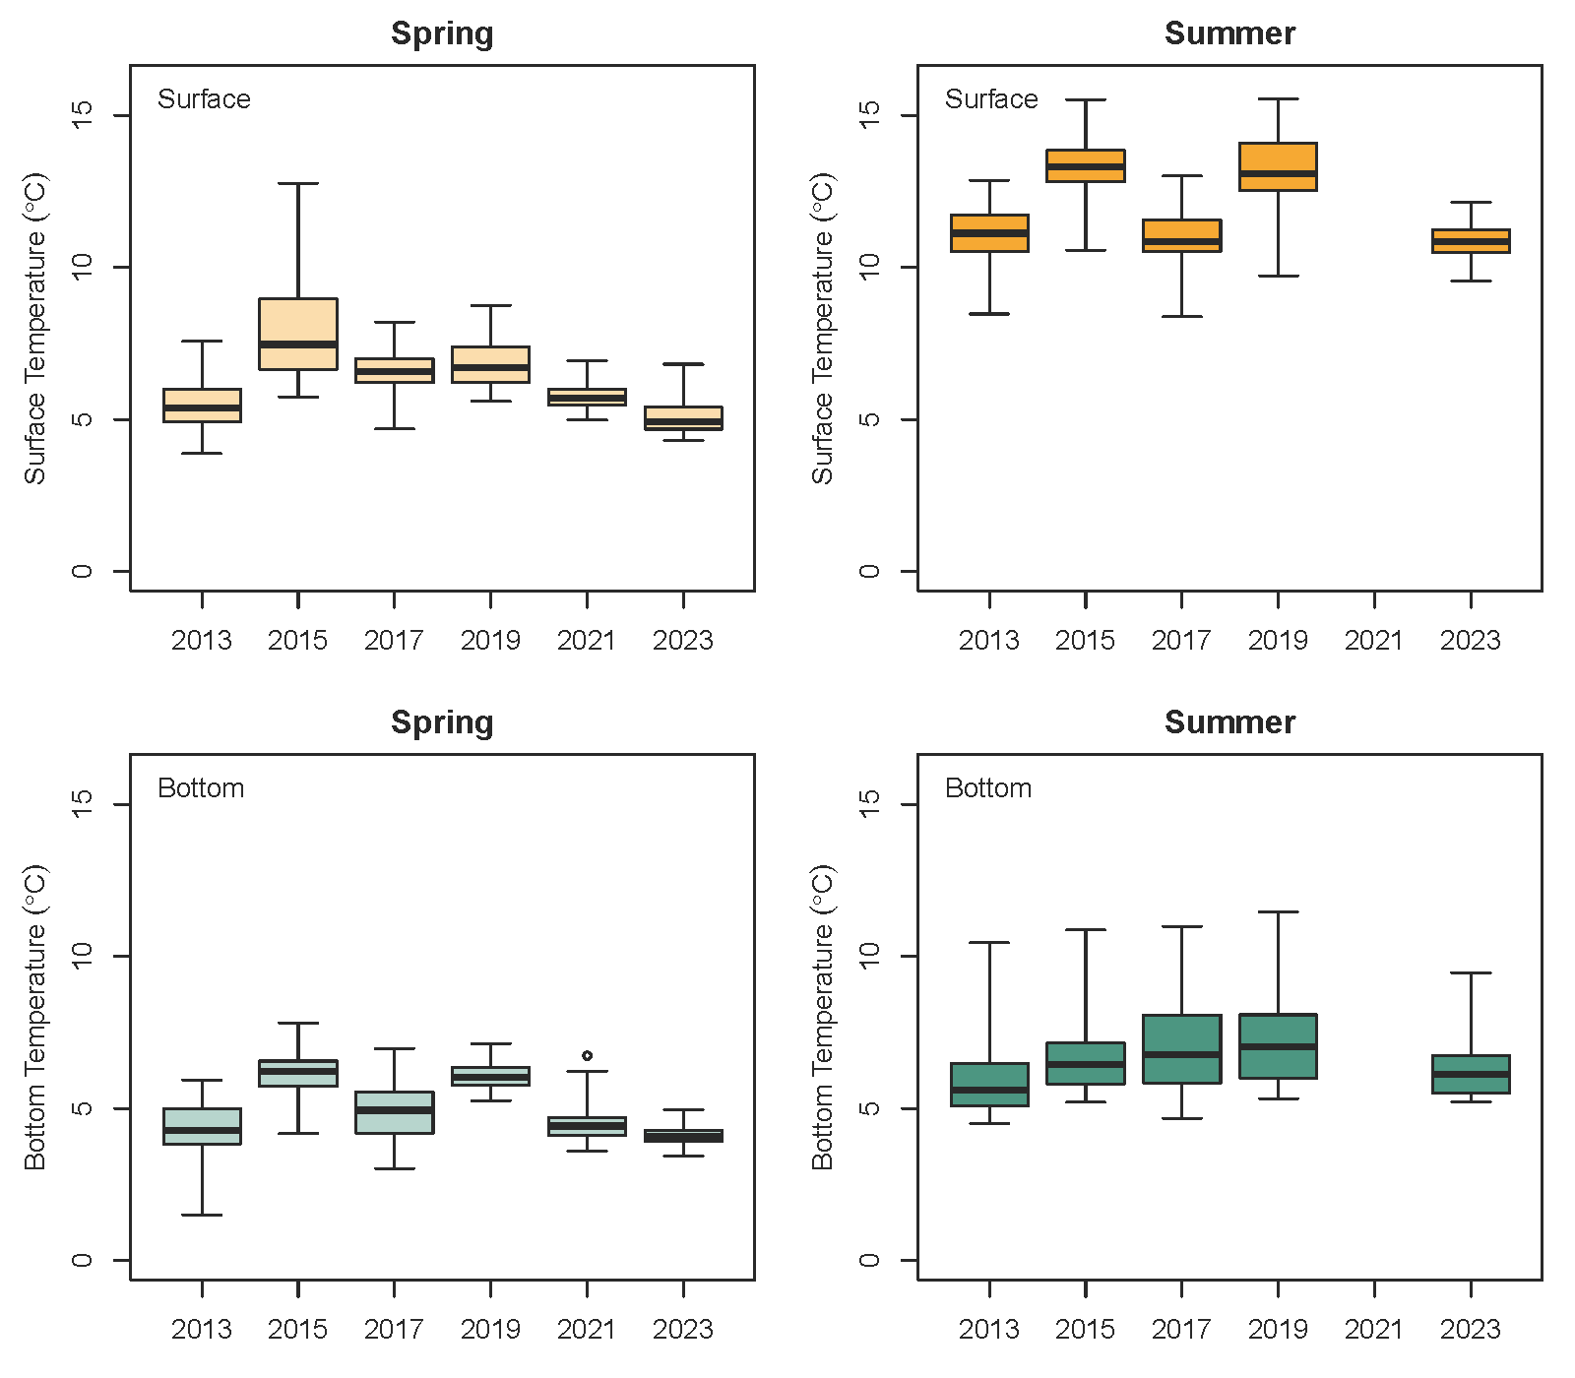
W GOA Temperatures
Spring (May) conditions cool at surface and at depth.
Surface
Bottom
Average of temperature profiles (surface: 0-5 m, bottom: 100-150 m) from each bongo station.
Contact: Kelia Axler, Lauren Rogers, Julie Keister

Slide 21
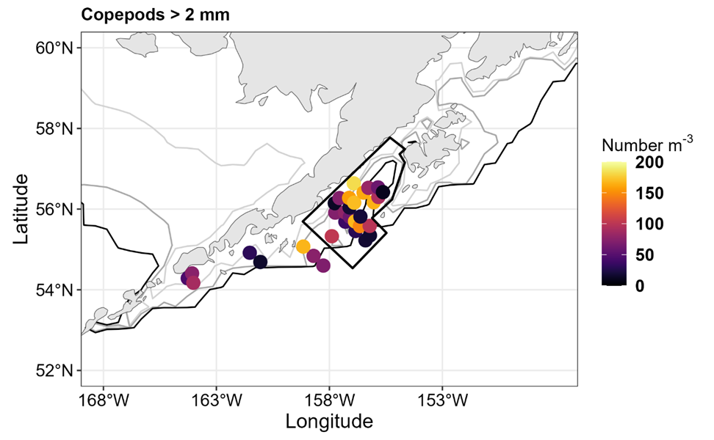
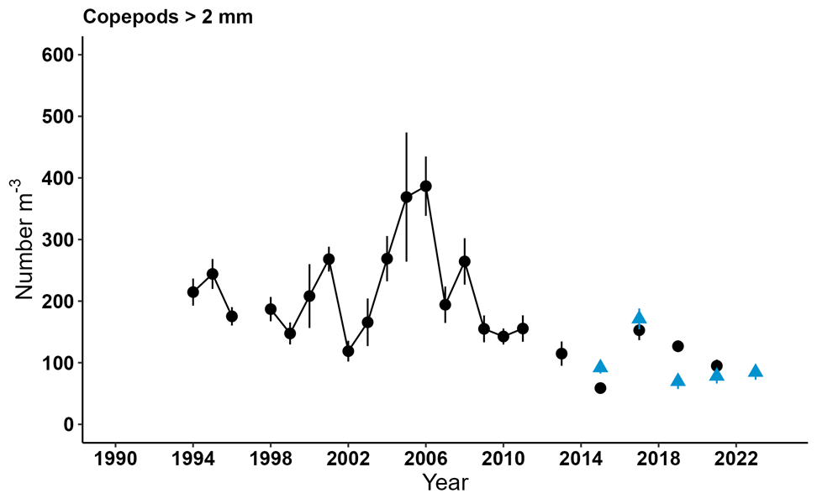
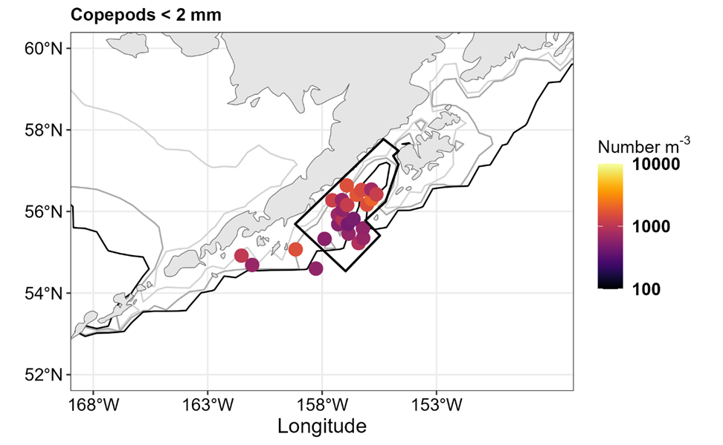
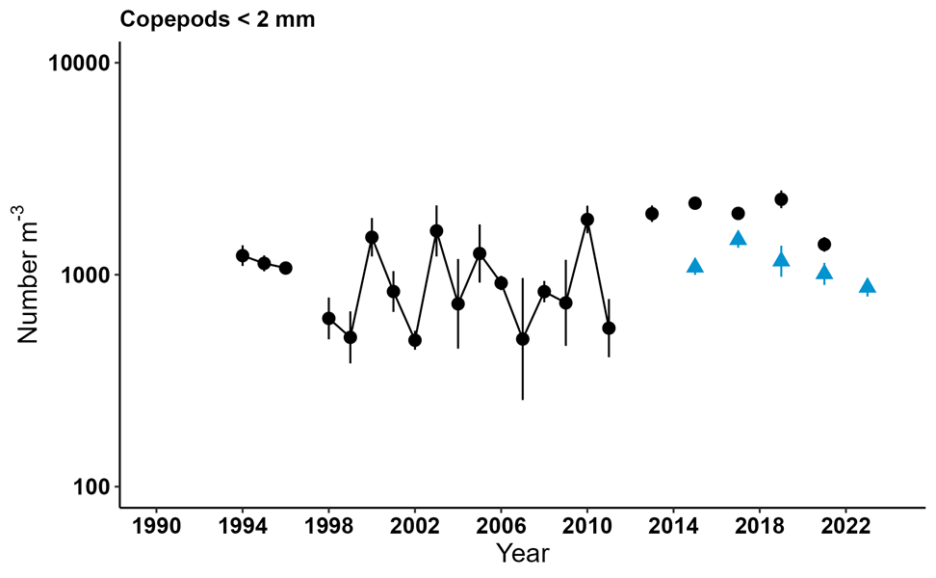
Spring - Rapid Zooplankton Assessment
Large copepods
Large copepod numbers were low, similar to recent years including the marine heat wave years.
Small copepods
Small copepod abundance was moderate and lower than the marine heat wave years.
Take home: Spring conditions appeared average in terms of forage for larval & early juvenile fish as indicated by small copepod abundances.
Contact : Dave Kimmel

Slide 22
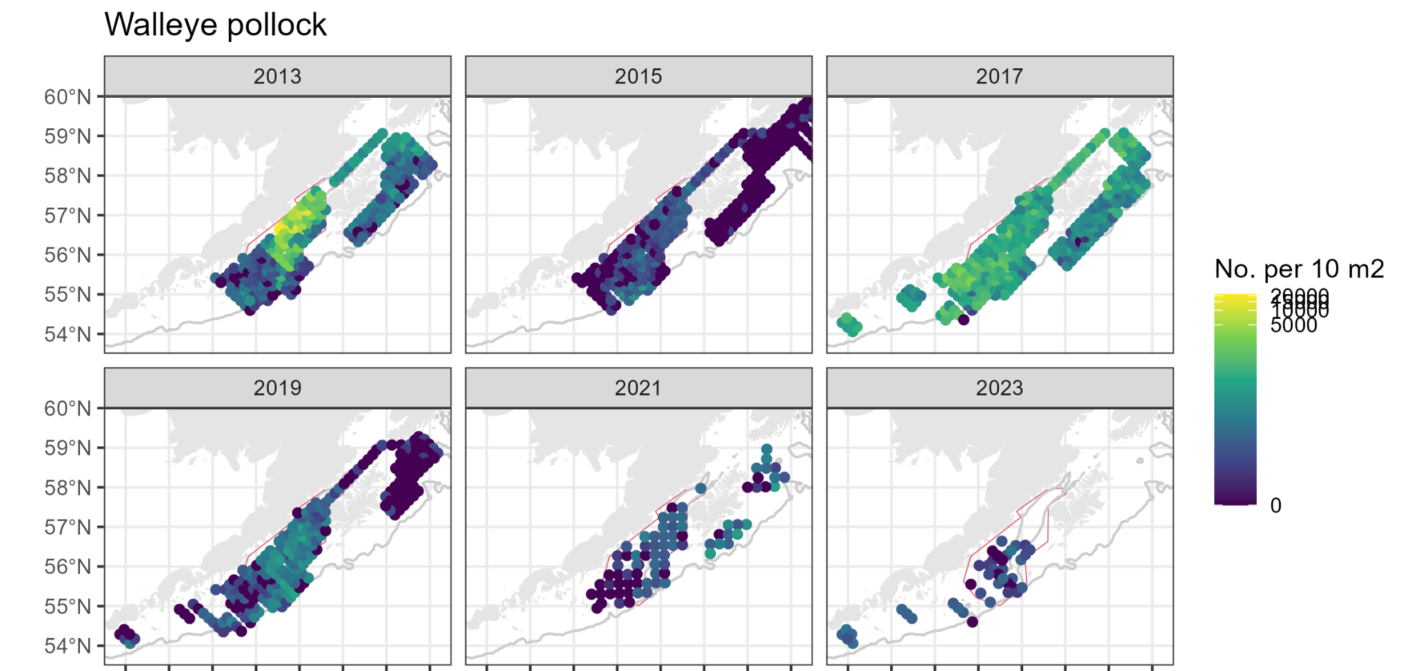
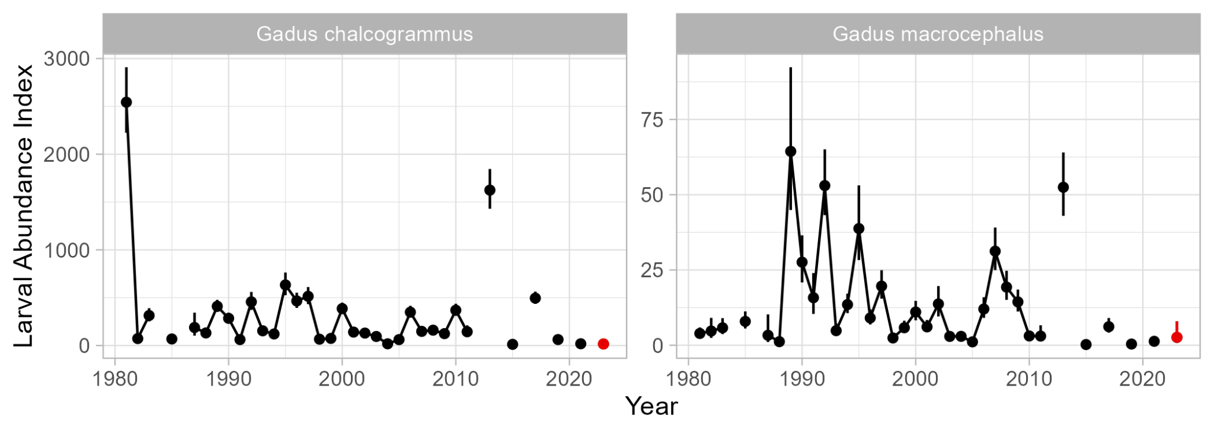
Spring - Rapid Larval Assessment
Pollock larvae were sparse across the sampling grid in 2023.
Overall abundance was low, similar to 2015, 2019, 2021.
*2023 numbers preliminary. Note reduced survey coverage in 2023.
Contact: Lauren Rogers, Kelia Axler, Julie Keister

Slide 23
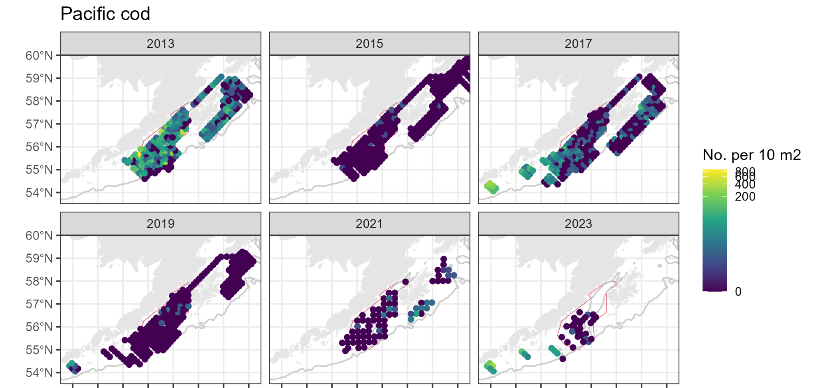
Spring - Rapid Larval Assessment
Pacific cod larvae were most abundant to the SW.
Overall, abundance was low, but higher than 2015, 2019.
*2023 numbers preliminary. Note reduced survey coverage in 2023.
Contact: Lauren Rogers, Kelia Axler, Julie Keister

Slide 24
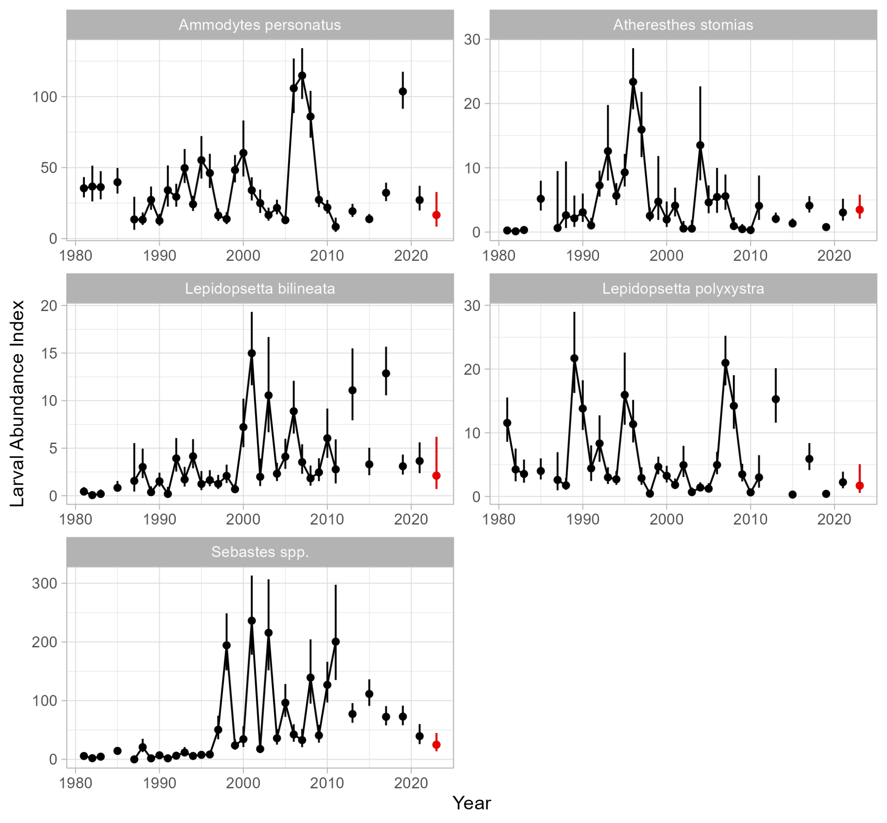
Spring - Rapid Larval Assessment
Sand lance
Arrowtooth flounder
All spp: Larval abundances similar to/lower than 2021.
Rockfishes continue trending down from recent high.
S. rock sole
N. rock sole
Rockfishes
(mostly POP)
Contact: Lauren Rogers, Kelia Axler, Julie Keister

Slide 25
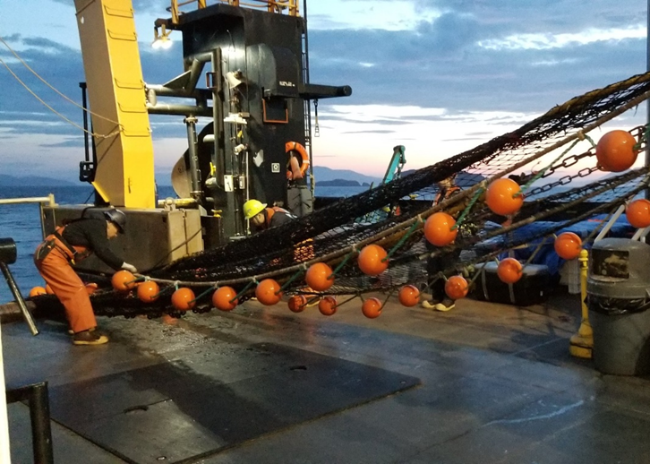
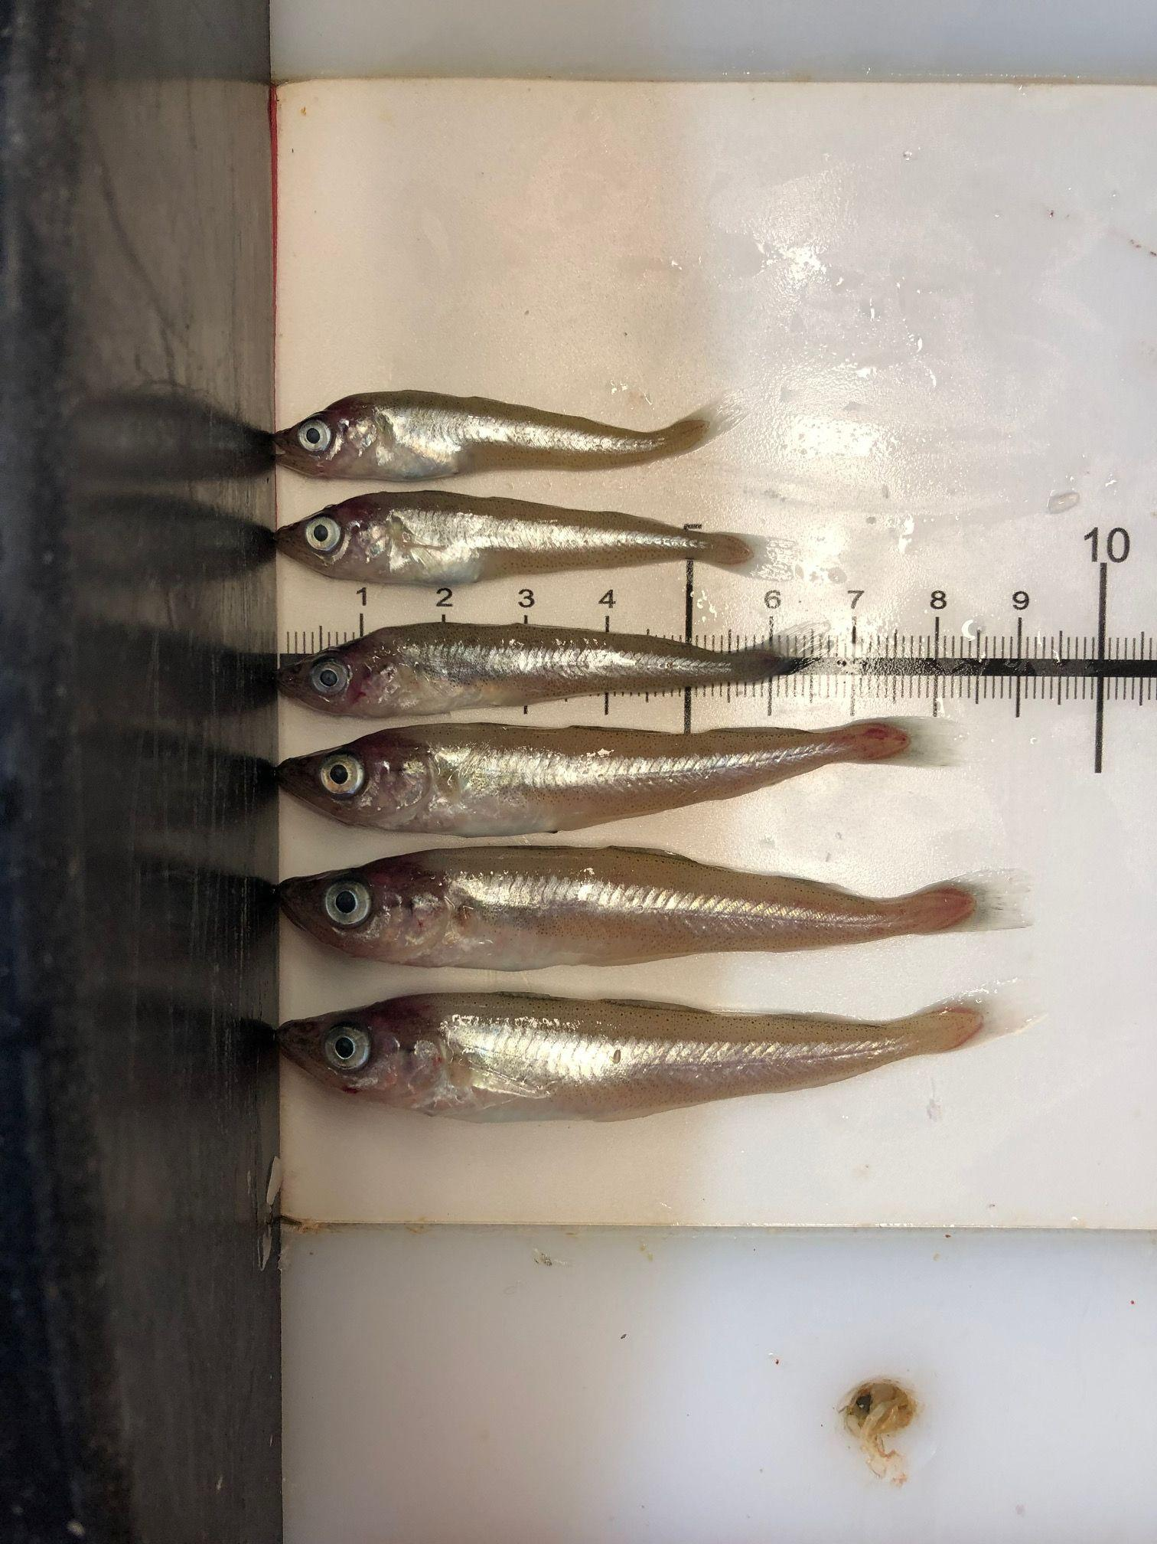
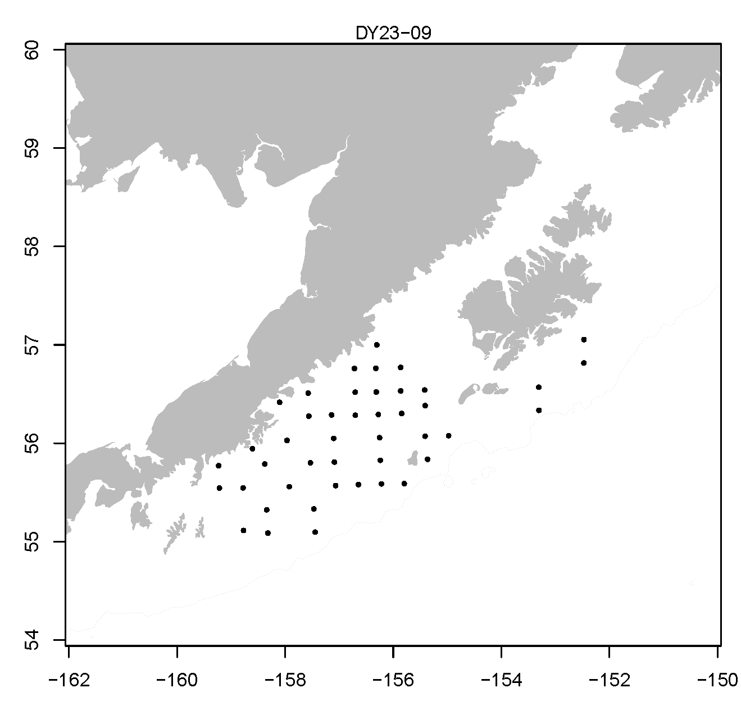
Western GOA Late-Summer Juvenile Groundfish and Ecosystem Survey
Focus: Juvenile pollock, cod, and other forage fish (capelin, eulachon, sand lance, herring, etc)
When: August/September (2000 - present, biennial). Note: Survey truncated to only 9 days in 2023 due to ship staffing and maintenance schedule).
Operations: Stauffer trawl (midwater, small-mesh). Bongos. CTDs.
Indicators: Juvenile fish abundance, distribution, condition, diets. HABs. OA. Zooplankton. Lipids.
Contact : Julie Keister

Slide 26
W GOA Temperatures
Cool conditions persisted through the summer on the W GOA shelf.
Surface
Bottom
Average of temperature profiles (surface: 0-5 m, bottom: 100-150 m) from each station.
Contact: Kelia Axler, Lauren Rogers, Julie Keister

Slide 27




Late Summer - Rapid Zooplankton Assessment
Large copepods
Large copepod numbers were similar to recent years and slightly higher than the marine heat wave years.
Small copepods
Small copepod abundance was low in relation to the entire data record and lower than the marine heat wave years
Take home: Average numbers of large copepods, and lower numbers of small copepods. Large copepods are important prey for age-0 groundfish in late summer.
Contact : Dave Kimmel

Slide 28

Late Summer - Age-0 Pollock
No Survey
Small-mesh, midwater trawls
Contact : Lauren Rogers

Slide 29

Late Summer - Age-0 Pollock
Take home: Low age-0 pollock abundance in 2023 suggests a weak year-class, only slightly larger than 2019.
Low abundance in this survey historically corresponds to weak recruitment.
Contact : Lauren Rogers

Slide 30


Late Summer - forage fishes
Take home: Forage fish abundance remains low in the W GOA.
Small-mesh, midwater trawls
Contact : Lauren Rogers

Slide 31



Long-term stns
Kodiak long-term
WGOA
Western GOA Summer Beach Seine
Focus: YOY gadids (Pacific cod, saffron cod, pollock)
When: Kodiak: July/Aug (4 surveys, 16 sites across 2 bays) 2006-2023
Expanded WGOA: July/Aug (75 sites across 14 bays) 2018-2023
Operations: Beach seine, CTD, baited cameras
Indicators: abundance & size, genetics, diets, temperature, salinity, oxygen
Contact : Ben Laurel, Mike Litzow, Alisa Abookire

Slide 32



Beach Seine: Age-0 Pacific cod
n = 14 bays
n = 126 sets
Take home: 2023 Age-0 Pacific cod abundance near long-term log mean.
Relationship with estimated recruitment:
Posterior means with 95% credible intervals from zero-inflated negative binomial model controlling for spatial and seasonal sampling variability among years.
Bayes R² = 0.28
github.com/mikelitzow/seine-data
Contact: Ben Laurel, Mike Litzow, Alisa Abookire

Slide 33



n = 6 bays with high pollock abundance
n = 87 sets
Beach Seine: Age-0 Pollock
Survey has captured strong year-classes of pollock.
Greater uncertainty than cod seine results
Take home: 2023 Age-0 pollock abundance below long-term log mean, but higher than heat-wave years.
Posterior means with 95% credible intervals from zero-inflated negative binomial model controlling for spatial and seasonal sampling variability among years.
github.com/mikelitzow/seine-data
Contact: Ben Laurel, Mike Litzow, Alisa Abookire

Slide 34
Gulf of Alaska summary
Zooplankton
Large copepods moderately abundant at end of summer. Small copepod abundance low in both EGOA and WGOA.
Juvenile Fish
Gadids: Few larval and age-0 pollock suggest weak 2023 year class. Pacific cod slightly more abundant, but unlikely to be a strong year class.
Forage fish: Relatively few capelin, eulachon, larval sand lance.
Fish Size and Condition
Sablefish: Age-0 size and growth typical of cold years
Additional metrics forthcoming. Studies underway to assess if larger fish have greater survival potential.

Slide 35
Highlighted projects
Contact : Ed Farley, Julie Keister, Rob Suryan, Tom Hurst

Slide 36






Developing rapid phytoplankton assessment
Indicator
Phytoplankton composition as indicators for juvenile fish (prey of their prey).
Phytoplankton lipid content varies with taxa & environment.
Rapid assessment tool IFCB
IFCB plugs into flow through water system, takes photos of water, and analyses the phytoplankton community.
Developing artificial intelligence/machine learning to ID phytoplankton for batch processing of survey results.
Imaging Flow Cytobot
Contact: Jeanette.Gann@noaa.gov Phd Dissertation
Notes:
Young of the year fish eat Zooplankton like large lipid-rich copepods (Calanus) found to be important for fisheries like Pollock.
Calanus eat phytoplankton and prefer large celled taxa: They need Essential Fatty Acids (like DHA, EPA) made by phytoplankton
Phytoplankton are linked to environmental conditions and their nutritional products (fats) change with taxa and environment,.
Therefore phytoplankton are an important link between the environment, and the nutritional value of prey.
Identifying phytoplankton is really time consuming, and so Jeanette and others are starting to use IFCB.
Due to the time consuming nature of microscopy (2+ hours per sample) for analysis of phytoplankton taxa, new technology is needed for more efficient means of analysis. IFCB is a microscope with a camera, and the ability to trigger particles based on fluorescence and take images (upper right compilation is an example of the photos it takes). Continuous flow through sampling is possible so that you can leave this out on a ship and have it running samples with minimal supervision (after initial settings are calibrated properly). AI/ML can be developed based on a large phytoplankton library of classified images, so that an entire survey’s worth of images can be processed very quickly. Other options for deployment include moorings (within reasonable access), sail drones, and bench top operation for discrete samples. We had this out on the Dyson last summer in the SEBS for its’ maiden voyage (EMA), and have recently hired a post-doc that will start this winter to help develop the imaging library and AI/ML algorithms. We will continue to deploy this out on the Dyson and on other ships of opportunity. It is currently out on the Sikuliaq sampling the EBS, NBS, and Chukchi sea on the DBO survey where it will help to ground-truth remote sensing information for satellite images and hyperspectral camera images. The aim is to develop remote sensing algorithms to help identify variations in large phytoplankton groups (diatoms vs dinoflagellates, e.g.) and potentially ID harmful algal blooms for improved monitoring throughout Alaska.

Slide 37


Changes in phytoplankton taxonomic composition with environmental regimes may reveal changes in available nutrition for young fish
Southern Bering Sea
Three environmental regimes differ in temperature, salinity, nutrients (DIN), and large phytoplankton biomass
Phytoplankton community varies among three regimes.
Next step: Link phytoplankton taxa to copepod abundance.
Contact: Jeanette.Gann@noaa.gov Phd Dissertation
Notes:
Results from analyses (manuscript in prep) that reveal nuances in environmental regimes that help separate old and new warm periods. **Note that the large chla, surface salinity, and Dissolved inorganic nitrogen (proxy for nutrient availability) all create a separation between old and new warm periods, while mean temp (water column average based on CTD casts during BASIS surveys in the SEBS) largely separates the warm/cold. A subset of years (2005, 2010, 2011, and 2018) where taxa were investigated via microscopy (time consuming!) also show significant separation between each of the 3 regimes, with the 2 cold years having similar community composition. Warrants further investigation of phytoplankton that could reveal changes in food quality for zooplankton at the base of the food web based on environmental variations.

Slide 38





PlanktonScope deployment – Bering Sea
Deployed PlanktonScope, a shadowgraph imager, in the Bering Sea with the goal of enumerating plankton in general and euphausiids in particular.
Collected images every 10 s over 5 hour tows. 500,000 images, ~500 GB of data
Ran a rapid identification algorithm on board and were able to classify small and large copepods, euphausiids, appendicularians, small jellyfish, and invertebrate larvae as well as generate size estimates for copepods
Next steps: compare to net tows and historical data
Vision: rapid characterization of the zooplankton community across broader spatial scales & effective enumeration of euphausiids.
Developed by Hongsheng Bi, University of Maryland
Contact: Dave Kimmel
dave.kimmel@noaa.gov

Slide 39




Underwater Baited Cameras
(Age 1+)
2023 Focused Sampling
Seines
Cameras
Beach Seines
(Age 0)
EFH Habitat Evaluation
2023 GOA Juvenile Pacific Cod IBM Validation
Focus: YOY and juvenile Pacific cod (Walleye pollock, saffron cod)
When: July 2021 (GOA-wide), 2023 (Afognak), 2024-2025 (GOA-wide)
Operations: Beach seines, baited underwater cameras
Indicators: Predictive modeling of juvenile Pacific cod distributions. Essential fish habitat. Abundance, growth, condition, genetics.
2023: 10-day focal survey around Afognak Island used to evaluate the effect of habitat selection on juvenile cod abundance and condition.
Contact : Katharine Miller, Johanna Page
Notes:
The objective of this broad study is to groundtruth the Juvenile Pacific Individual Based Model developed by Sarah Hinkley & others in 2019, which predicts areas of juvenile Pacific cod settlement in the Gulf of Alaska based on adult spawning locations, ocean currents, and juvenile cod ecology. In 2021 they conducted month-long survey of juvenile cod abundance underwater in the nearshore using baited cameras and beach seines across the GOA from Southeast Alaska to the Shumagins. In 2023, a 10-day focal survey around Afognak Island will be used to evaluate habitat preferences on juvenile cod abundance and condition. Gulf-wide surveys are planned for 2024 & 2025.

Slide 40


Acknowledgements
Thank to everyone who helped collect these data (too many to list)!
NOAA Contacts:
Ed Farley
Rob Suryan
Julie Keister
Mike Litzow
Tom Hurst
lauren.rogers@noaa.gov

Slide 41
Recruitment Processes Alliance
Conduct long-term monitoring and use a holistic ecosystem approach to address emerging questions and provide critical baseline information to stakeholders
NOAA RESEARCH
Pacific Marine Environmental Lab
Seattle, WA
CONTRIBUTIONS//SKILLS: Physical oceanography, nutrients, models, advanced technologies, atmospheric, and phytoplankton.
NOAA FISHERIES
AFSC Juneau, AK
CONTRIBUTIONS//SKILLS: Bioenergetics, diets, nutritional and trophic ecology, nearshore studies, Gulf Watch Alaska
PMEL FOCI
RECA
TEAM EFFORT
Shiptime
Cruise Staffing
Lab Research
Data collection
Data processing
QA/QC
Research Syntheses
Products
NOAA FISHERIES
AFSC Seattle, WA
CONTRIBUTIONS//SKILLS: Zooplankton, eggs & larvae, GOA young of the year gadids & forage fish, beam trawl, diets, Arctic
NOAA FISHERIES
AFSC Juneau, AK
CONTRIBUTIONS//SKILLS: Bering Sea young of the year gadids & forage fish, jellies, phytoplankton, salmon, surface trawl, Arctic, ESR’s, GOA/BS/Arctic RAPs
AFSC
FOCI
EMA
Scientific Research Collaborations & Partnerships
NOAA MML, WHOI & NWFSC HABs, UAF & NOAA OA, NOAA eDNA, EFH, USFW seabird, ADFG salmon
Non-base funds to the RPA include North Pacific Research Board IERP’s, NPRB single projects, NOAA NOPP, NOAA RAP, ADFG, NOAA Arctic Research Program

