Slide 1
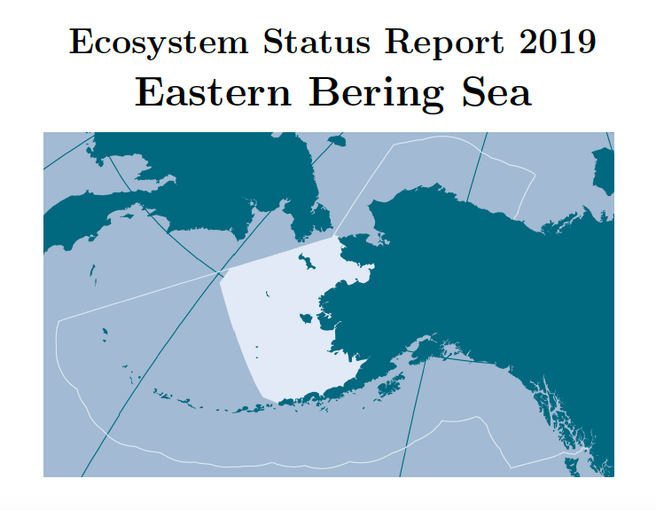
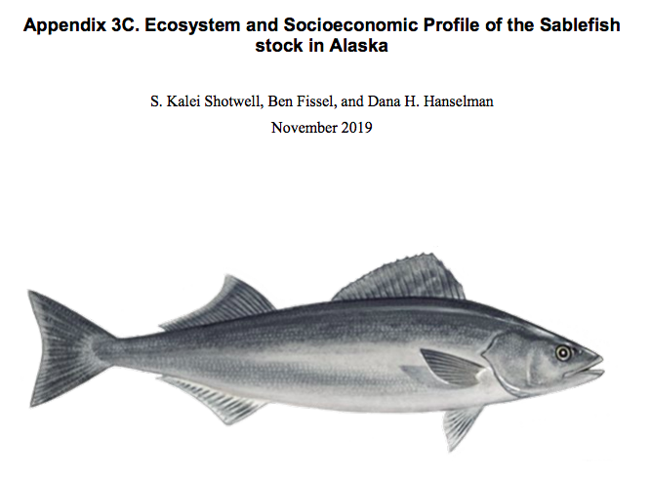







Distinguishing ESR, ESP, BSEHR
Bering Sea Ecosystem Health Report
 | Ecosystem Status Report | Ecosystem and Socio-economic Profile | Bering Sea Ecosystem Health Report
Purpose | Tactical - harvest specs* * in past, this was the single catch-all report for all ecosystem considerations data | Tactical - harvest specs | Strategic – is Council achieving ecosystem goals
When issued | Oct-Dec | Oct-Dec (partial or full) | April (bi- or triennially)
Scope | Aggregated - Indicators that pertain to many stocks at once | Species/Stock-specific – indicators that have an impact on this specific stock | Aggregated - Synthesizing across ecosystem area /activities
Spatial | Large Marine Ecosystem (EBS, GOA, AI) | Large Marine Ecosystem/ FMP (EBS, GOA, AI) | LME -- Basin-scale
Temporal | Annual trend updates | Mixed | Longer term trends

Slide 2
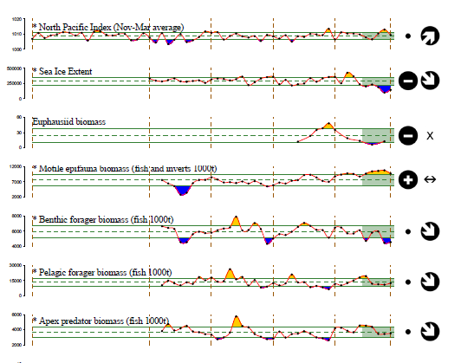
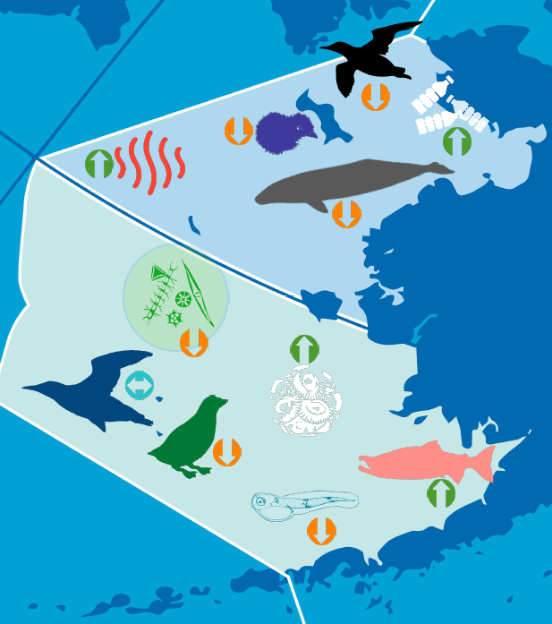
Bering Sea Ecosystem Health Report
Cumulative, multi-species effects
Informs management strategy, not tactical management decisions
Diversity of audiences
Monitors success of EBFM management actions (progress towards goals and objectives)
Progress: Currently initial scoping of indicators under FEP objectives
Draft developed Jan-Mar 2022

Slide 3
So where is our report starting point?
Focus of FEP is strategic
  Strategic versus Tactical advice led to development of this new product to deliver longer-term strategic advice rather than the near-term tactical advice contained in the ESRs.
  Purpose in FEP: to allow fishery management to more explicitly take into account and be responsive to changes in the ecosystem
Six ecosystem goals are overarching; FEP associates them with one or more strategic Ecosystem Objectives
May 3 workshop recommendation: Organize report by six goals, and objectives under those goals. Subteams at workshop brainstormed initial data sources/resources.

Slide 4
Council’s Ecosystem Goals
Maintain, rebuild, and restore fish stocks at levels sufficient to protect, maintain, and restore food web structure and function
Protect, restore, and maintain the ecological processes, trophic levels, diversity, and overall productive capacity of the system
Conserve habitats for fish and other wildlife
Provide for subsistence, commercial, recreational, and non-consumptive uses of the marine environment
Avoid irreversible or long-term adverse effects on fishery resources and the marine environment
Provide a legacy of healthy ecosystems for future generations

Slide 5
FEP Ecosystem Objectives
Ecosystem Goal 1: Maintain, rebuild, and restore fish stocks at levels sufficient to protect, maintain, and restore food web structure and function
Maintain target biomass levels for target species, consistent with optimum yield, using available tools.
Maintain healthy populations and function of non-target and forage species.
Adjust fishing-related mortality from the system to be commensurate with total productivity and continue to limit optimum yield to 2 million metric tons for the BSAI groundfish fisheries.
Progress:
Primarily "traditional" aggregate fisheries indicators - e.g. "Fisheries Stock Sustainability Index" (number of overfished/experiencing overfishing stocks)
Bering Sea simulation studies ongoing as part of ACLIM project

Slide 6
FEP Ecosystem Objectives
Ecosystem Goal 2: Protect, restore, and maintain the ecological processes, trophic levels, diversity, and overall productive capacity of the system
4. Maintain key predator/prey relationships.
5. Conserve structure and function of ecosystem components.
Progress:
Longest history of use in EBFM literature and Bering Sea EBFM (e.g. EPAP 1999, PSIES 2004) and theoretical work (Link et al.)
Bering Sea simulation studies ongoing as part of ACLIM project

Slide 7
FEP Ecosystem Objectives
Ecosystem Goal 3: Conserve habitats for fish and other wildlife
6. Minimize adverse impacts to essential fish habitat, to the extent practicable.
7. Minimize and/or avoid impacts to ecologically-sensitive habitat, including habitat areas of particular concern.
8. Minimize and/or avoid impacts to seabirds, marine mammals, and protected species.
Progress:
Initial data/indicator scoping

Slide 8
FEP Ecosystem Objectives
Ecosystem Goal 4: Provide for subsistence, commercial, recreational, and non-consumptive uses of the marine environment
9. Support benefits in the Bering Sea fishery and fishery-related industries.
10. Provide opportunities for new entrants in federal fisheries.
11. Promote economic and community stability to all commercial harvesting and processing sectors.
12. Promote sustainable opportunities and community resilience for subsistence users and Alaska Native communities.
13. Provide for directed fisheries including subsistence fisheries by minimizing bycatch mortality, to the extent practicable.
14. Preserve the ability for stakeholders to derive non-consumptive and cultural value from the Bering Sea ecosystem.
Progress:
Initial data/indicator scoping

Slide 9
FEP Ecosystem Objectives
Ecosystem Goal 5: Avoid irreversible or long-term adverse effects on fishery resources and the marine environment
Ecosystem Goal 6: Provide a legacy of healthy ecosystems for future generations
15. Establish appropriate thresholds to minimize risk of crossing ecosystem tipping points caused by fishery or other human activity.
16. Encourage responsible parties to minimize adverse impacts to fish and other wildlife associated with changes in shipping activity, tourism, energy, and other types of development.
17. Ensure that fishery management is sufficiently adaptive to account for the effects of climate change or other ecosystem changes, including loss of sea ice and ocean acidification.
Progress:
Consult with CCTF? (particularly objective 17)

Slide 10
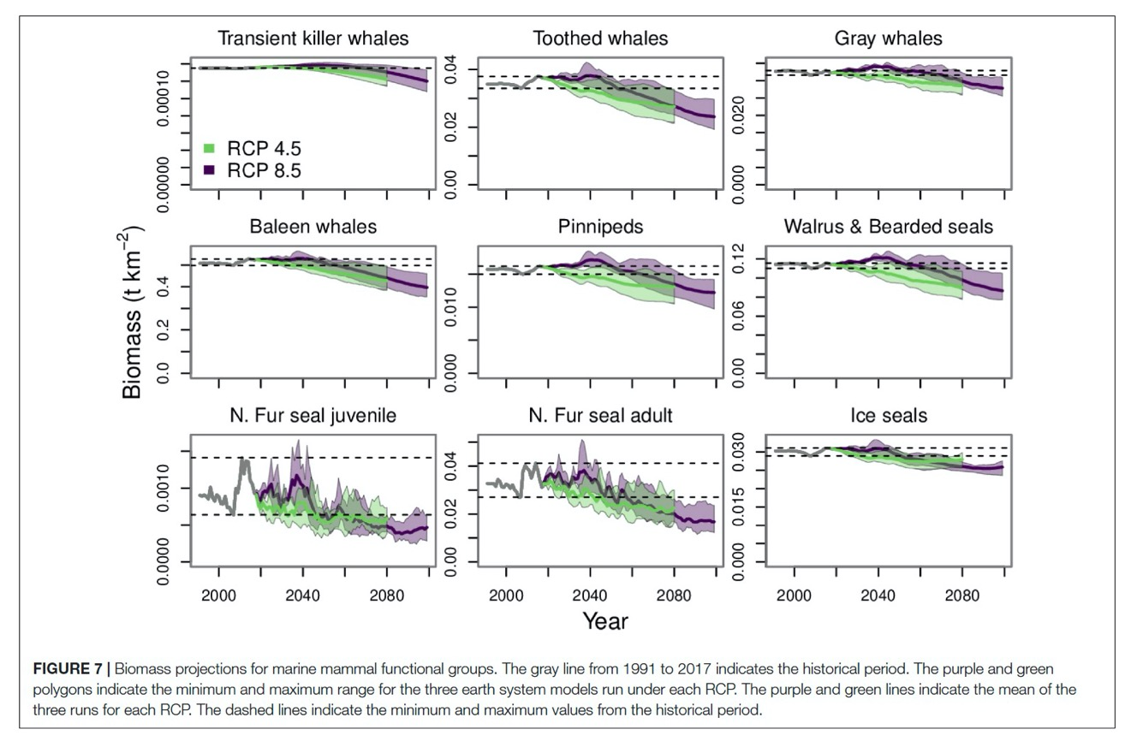
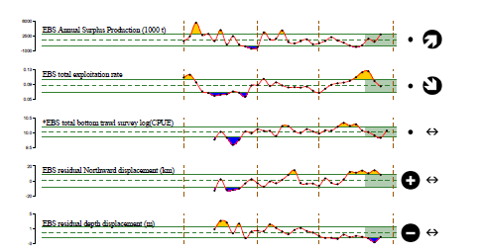
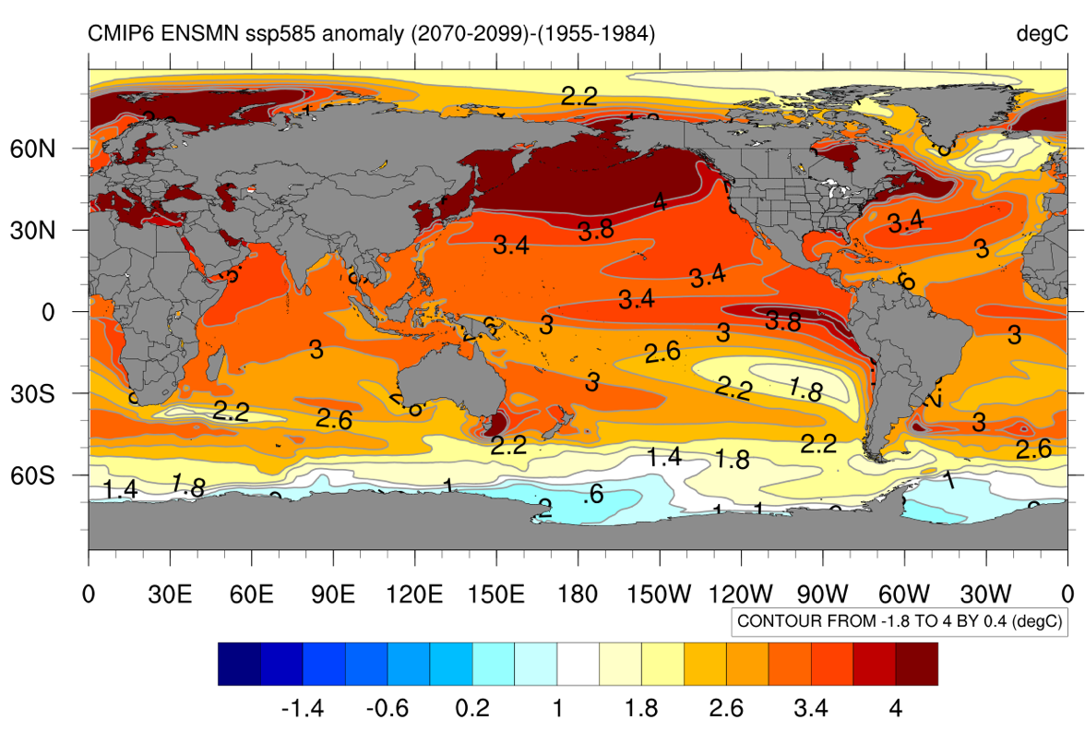
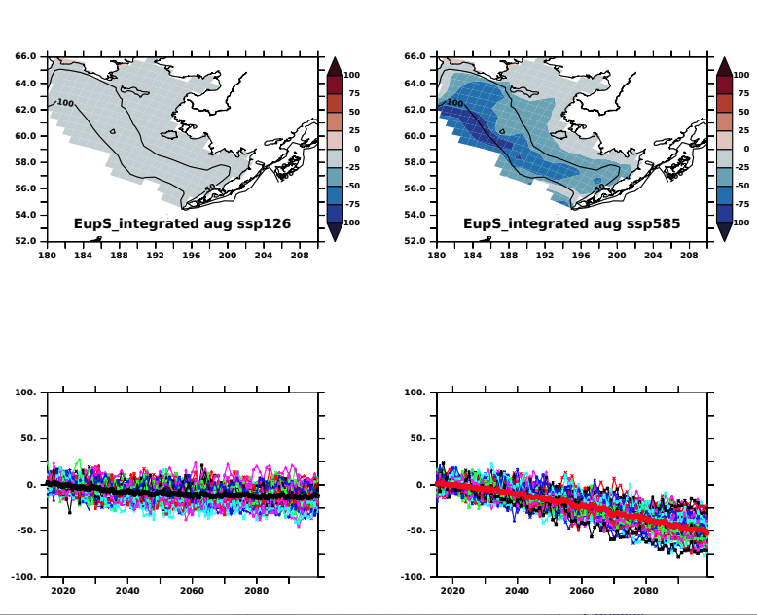
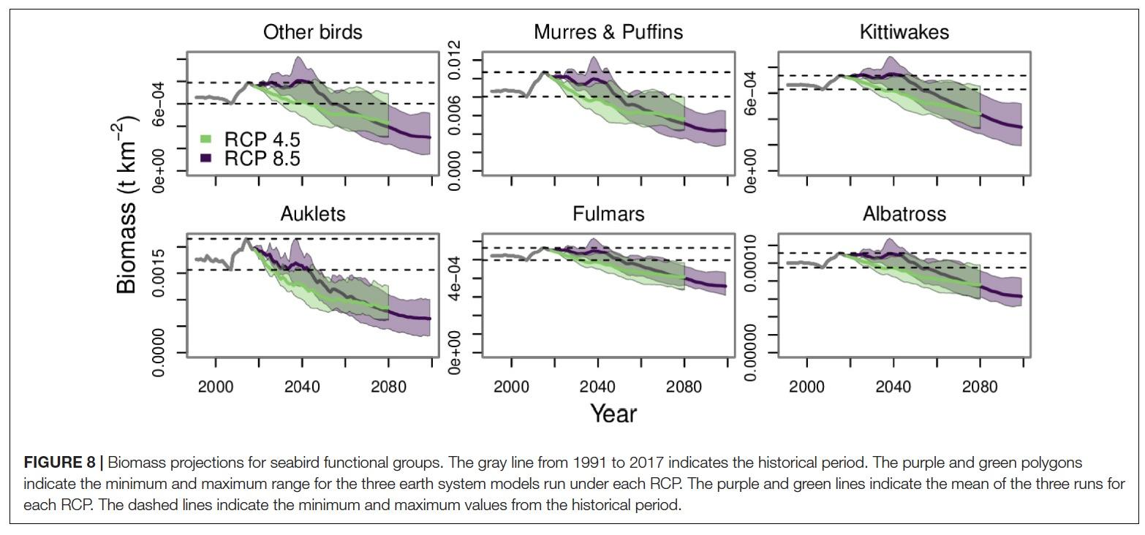
Two parallel approaches with respect to climate
Determine expected/projected pathways for all relevant indicators (all categories) with respect to future climate pathways.
E.g. ACLIM simulations of ecological properties for Goals 1-2 (ongoing for upcoming FEP meeting)
Specific measures of resilience/adaptation capacity of current management system (Goals 5-6)
  17. Ensure that fishery management is sufficiently adaptive to account for the effects of climate change or other ecosystem changes, including loss of sea ice and ocean acidification.
Are resulting indicators sensitive to SSPs (social/carbon emission scenarios), different simulated management strategies, etc.

