Slide 1




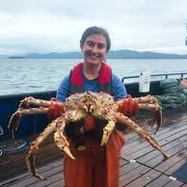
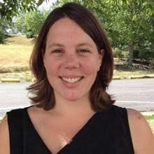
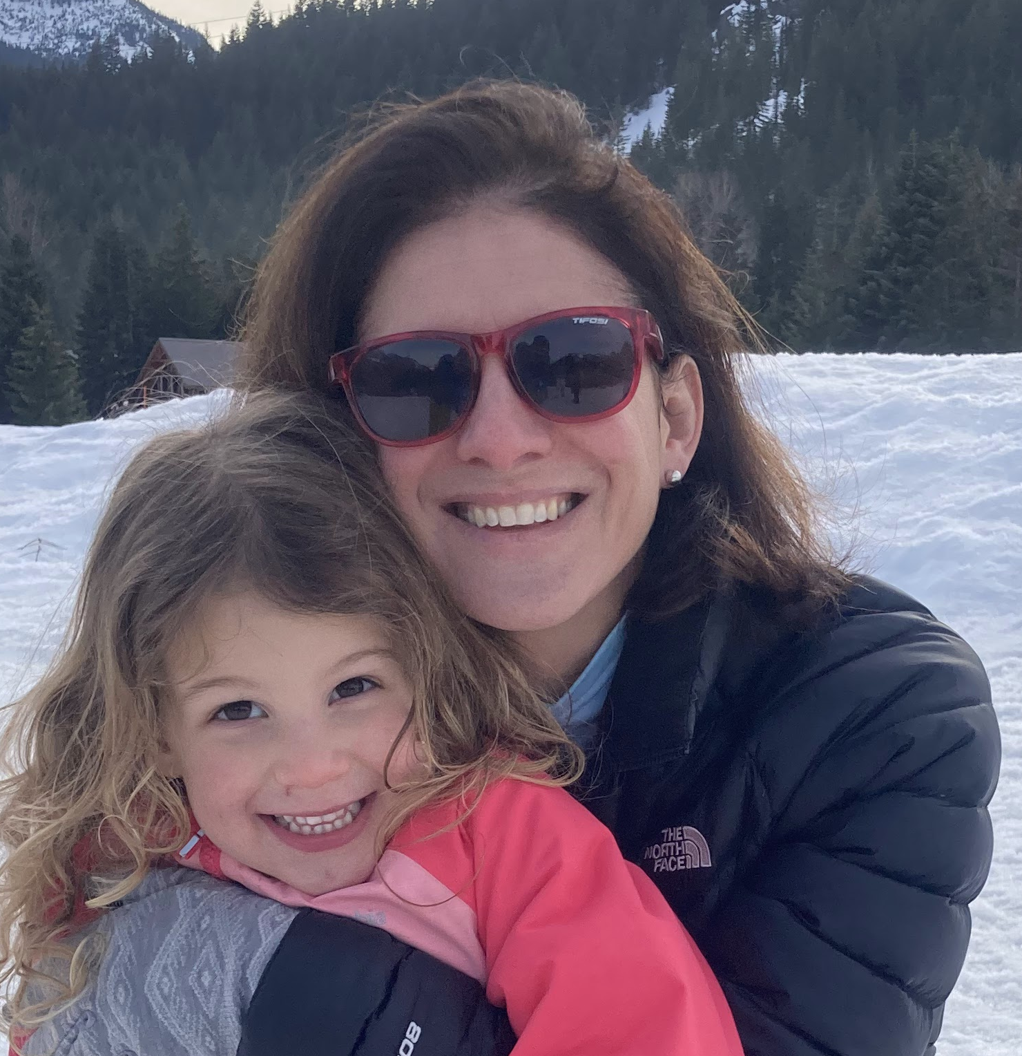
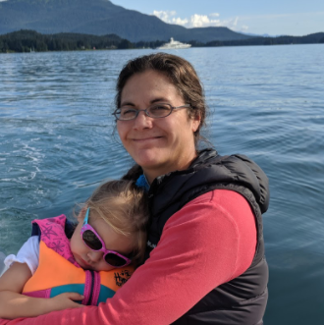
Partial Assessments
GOA Groundfish Plan Team
Pete Hulson, Jane Sullivan, Carey McGilliard, Meaghan Bryan, Kalei Shotwell
November, 2022

Slide 2
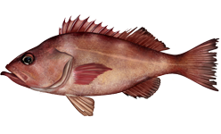
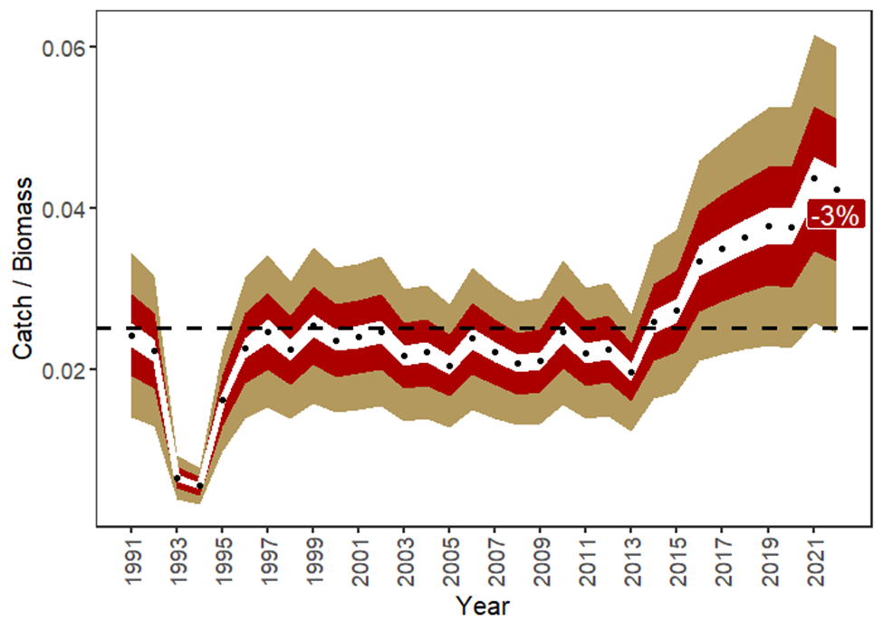
Pacific Ocean Perch (Tier 3a)
Not overfishing, overfished or approaching overfished
Fishery Trends: catch increasing following increases in ABC
Survey Trends: Persistent large biomass, no new survey information since full assessment
Update Projection Catch:
  2021: 27,501 t, 2022: 30,556 t, 2023: 30,960 t
  Catch/Biomass decreased 3%
ABC: 37,193 t, OFL: 44,302 t
Thanks to Pete Hulson

Slide 3
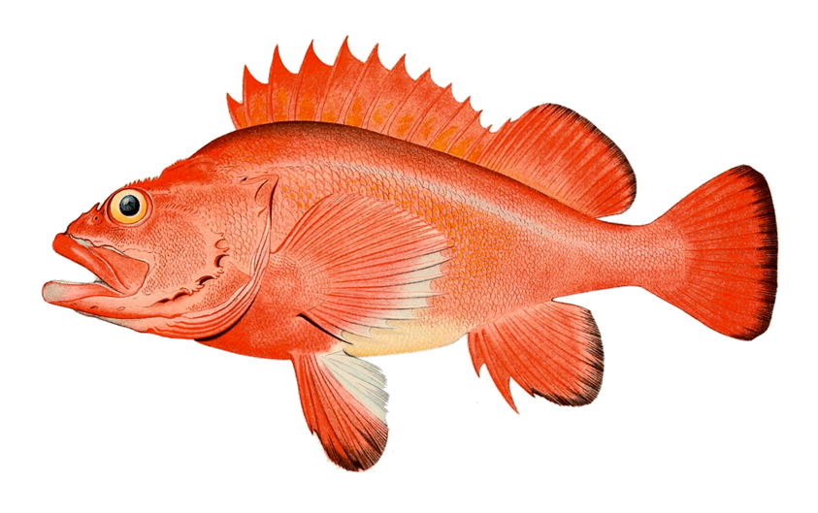
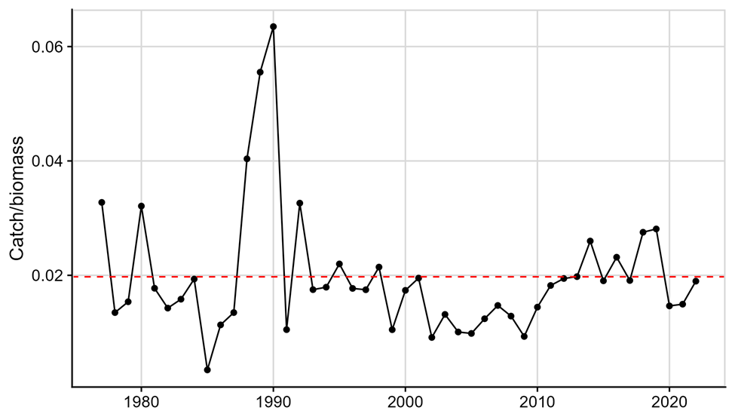
Rougheye/Blackspotted Rockfish (Tier 3a)
Not overfishing, overfished or approaching overfished
Fishery Trends: Increase in bycatch in trawl fisheries, decrease in hook-and-line
Survey Trends: Increase in longline survey RPW in 2022, still below long-term mean
Update Projection Catch:
  2021: 407 t, 2022: 494 t, 2023: 387 t
  Catch/Biomass: Slight increase in 2022, near long-term mean
ABC: 775 t, OFL: 930 t
Thanks to Jane Sullivan
Notes:
There was no new GOA bottom trawl survey biomass estimate in 2022. The 2021 biomass estimate was a 56% decrease from 2019 and 43% below the long-term mean (1990-2021). The 2022 longline survey abundance estimate (relative population number, RPN) increased 12% from the 2021 estimate but is 16% below the long-term mean (Figure 13.2). The new longline survey RPN was not used for updating the 2022 projection model for RE/BS rockfish as this was an off-cycle year.

Slide 4
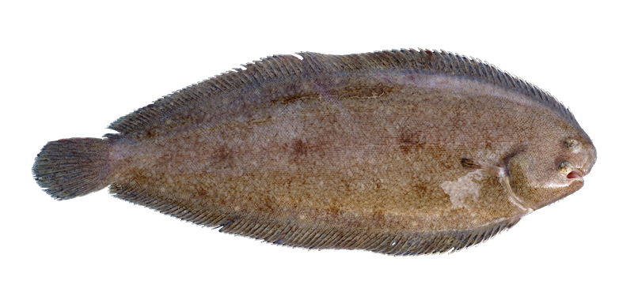
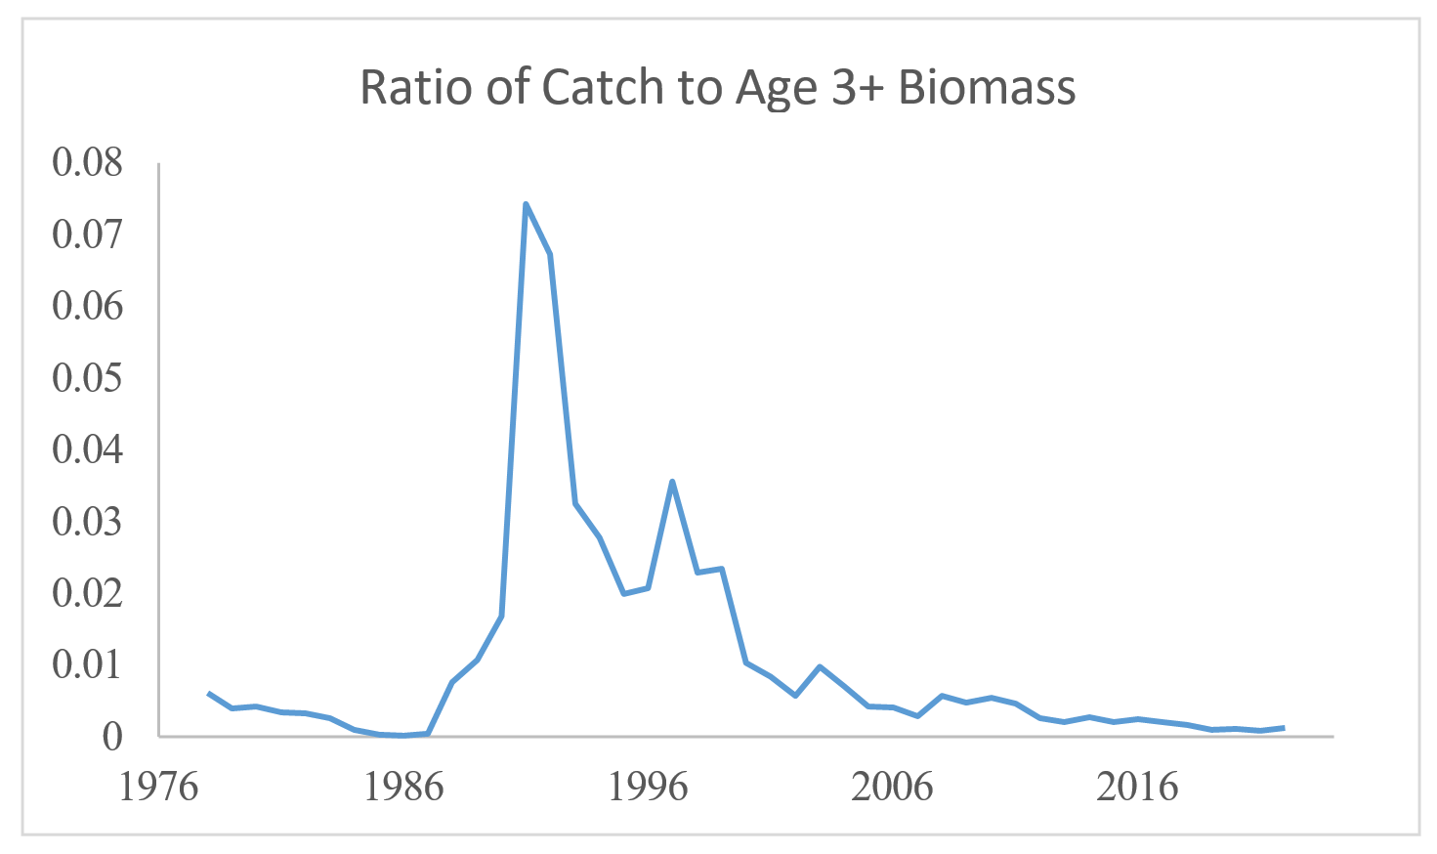
Deep-water Flatfish (Tier 3a/6)
Not overfishing
Fishery Trends: Most catch in central GOA, in arrowtooth flounder and rockfish fisheries, slight increase in dover catch in 2022
Survey Trends: No new survey info
Catch/Biomass - Tier 3: declining trend since 1998, rates <0.01
Catch - Tier 6: very little catch, <200 t since 2015
Harvest Recommendations
  Tier 3a: ABC: 5,581 t, OFL: 6,605 t
  Tier 6: ABC: 235 t, OFL: 313 t
  Complex: ABC: 5,816 t, OFL: 6,918 t
Thanks to Carey McGilliard

Slide 5
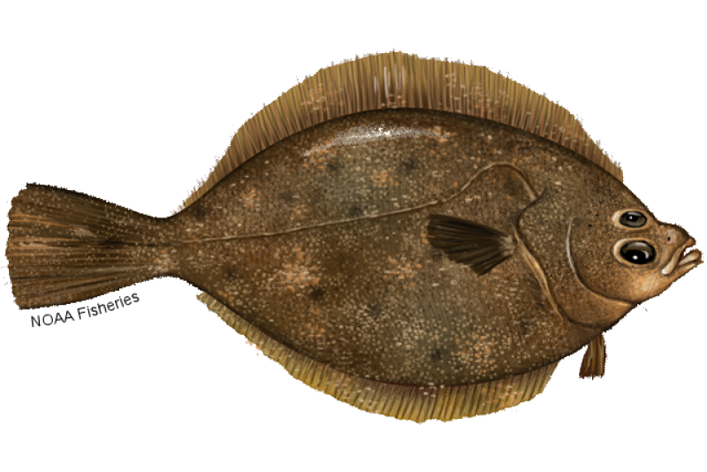
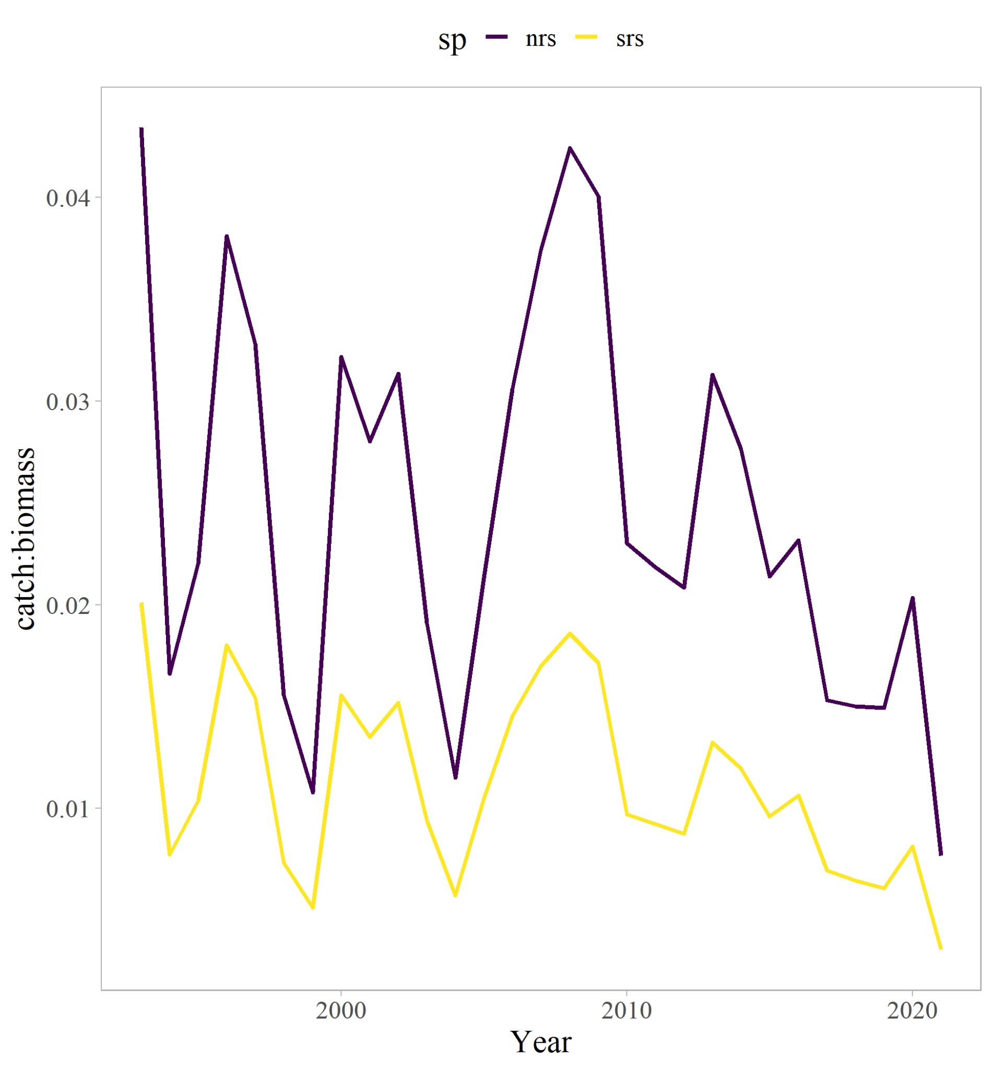
Northern and Southern Rock Sole (Tier 3a)
Not overfishing, overfished or approaching overfished
Fishery Trends: Catch has been declining since 2008, majority of catch is from central GOA
Survey Trends: No new survey information
Update Projection Catch:
  Central - 2021: 634 t, 2022: 551 t, 2023: 13 t
  Western - 2021: 10 t, 2022: 551 t, 2023: 13 t
  Catch/Biomass has been declining
NRS Central: ABC: 4,214 t, OFL: 4,934 t
NRS Western: ABC: 8,508 t, OFL: 10,259 t
SRS Central: ABC: 14,246 t, OFL: 16,874 t
SRS Western: ABC: 11,840 t, OFL: 14,029 t
Thanks to Meaghan Bryan

Slide 6
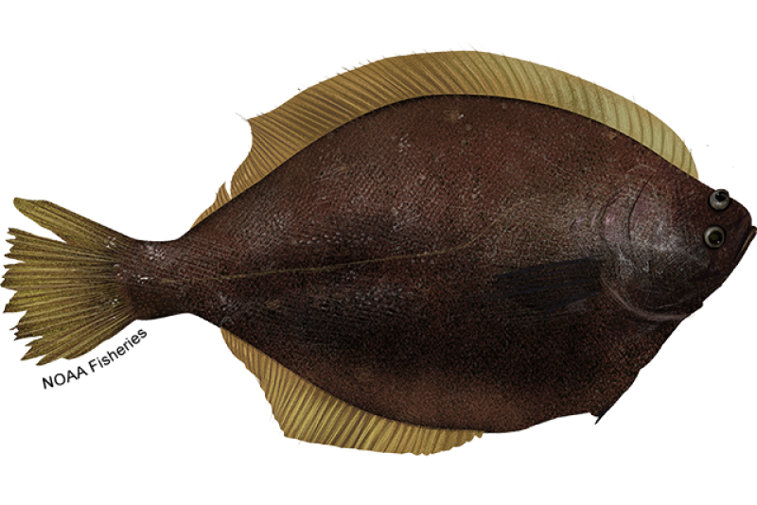
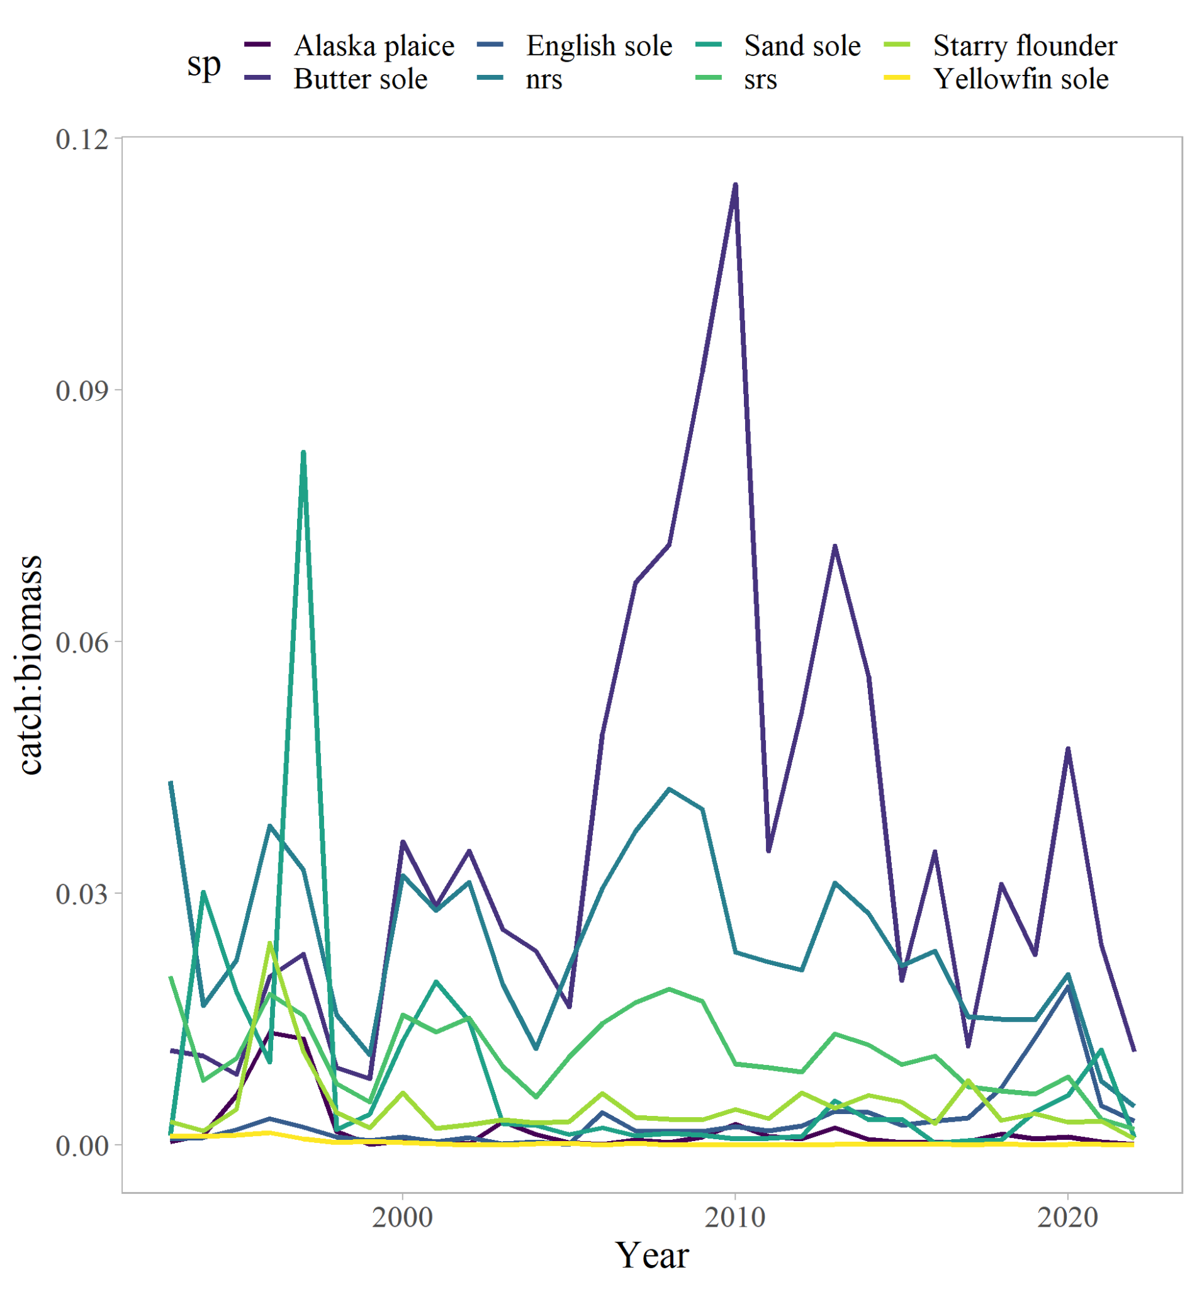
Shallow-water Flatfish (Tier 3a/5)
Not overfishing
Fishery Trends: Overall catch has been declining since 2008
Survey Trends: No new survey information
Catch/Biomass - Tier 3 and 5: Declining trend
Harvest Recommendations
  Tier 3a: ABC: 38,808 t, OFL: 46,096 t
  Tier 5: ABC: 14,279 t, OFL: 19,640 t
  Complex: ABC: 53,537t, OFL: 65,736 t
Thanks to Meaghan Bryan

Slide 7
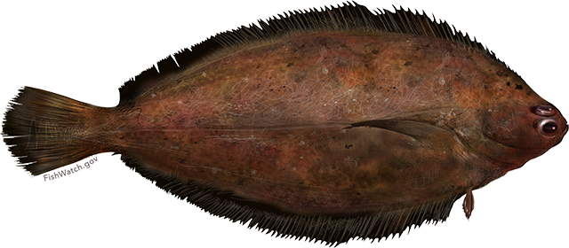
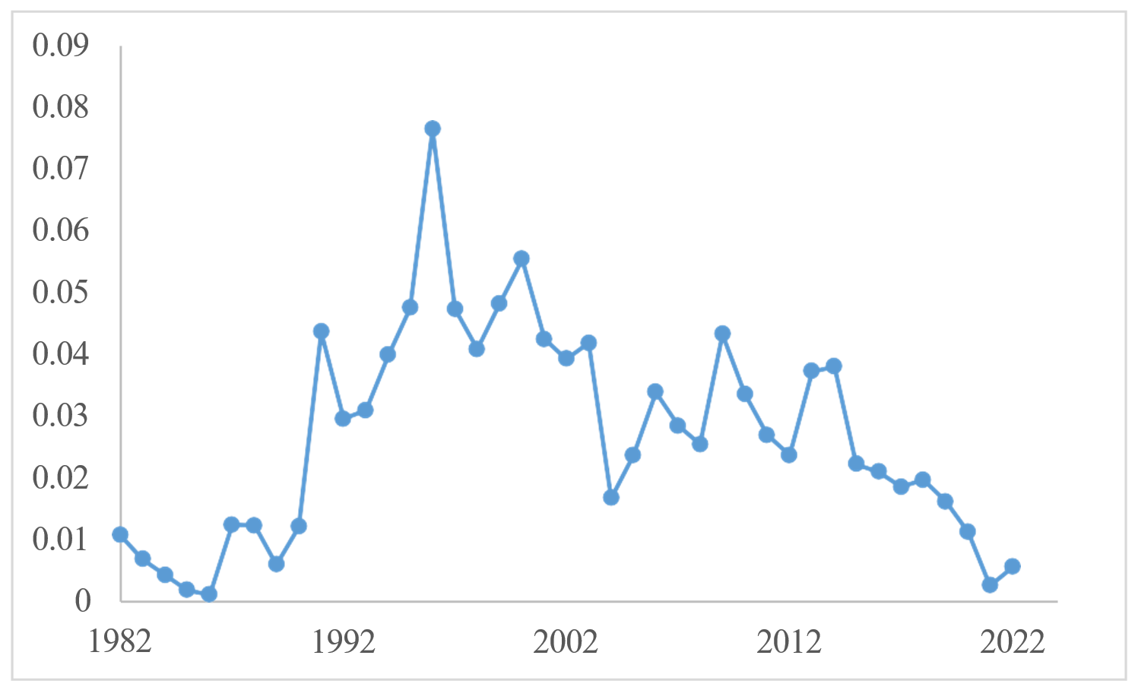
Rex Sole (Tier 3a)
Not overfishing, overfished or approaching overfished
Fishery Trends: declining trend, slightly higher in 2022, most catch in central GOA in arrowtooth, rex, & rockfish fisheries
Survey Trends: no new survey info
Update Projection Catch:
  2021: 301 t, 2022: 1,277 t, 2023: 1,277 t
  Catch/Biomass: declining trend since 2014, slight increase in 2022
ABC: 20,664 t, OFL: 25,135 t
Thanks to Carey McGilliard

Slide 8
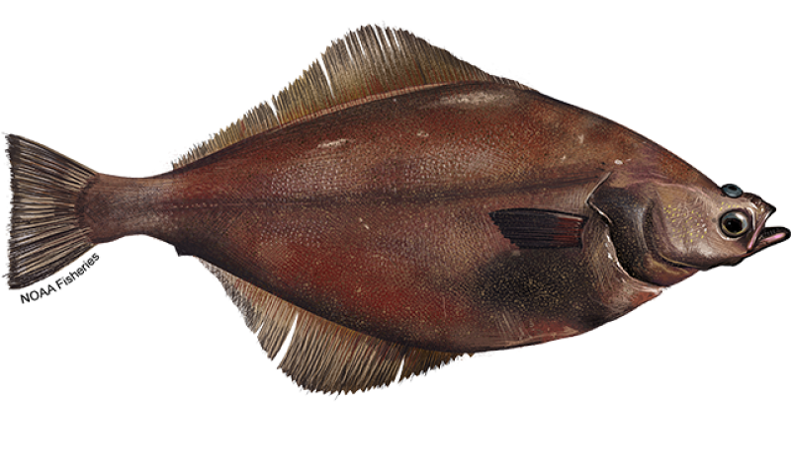
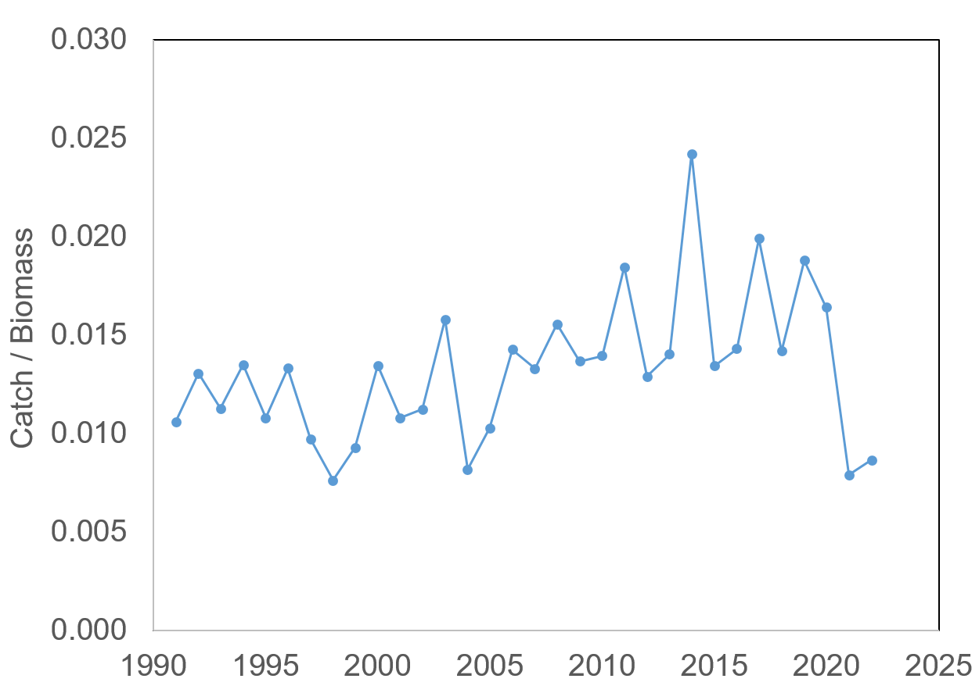
Arrowtooth Flounder (Tier 3a)
Not overfishing, overfished or approaching overfished
Fishery Trends: catch remains low as in 2021, majority in ATF fishery but less than in 2020, increase in rockfish fishery
Survey Trends: 16% decrease in longline survey, below long term average
Update Projection Catch:
  2021: 9,988 t, 2022: 12,233 t, 2023: 16,382 t
  Catch/Biomass increased by 22%
ABC: 119,485 t, OFL: 142,749 t
Thanks to Kalei Shotwell
Notes:
Majority of the catch is in the arrowtooth trawl fishery, but 24% in the rockfish fishery 2022 similar to 2021
But in 2020, 78% in arrowtooth fishery, only 4% catch in rockfish fishery and 10% was in the pollock bottom trawl fishery, shift in fisheries might have something to do with the drop in catch
2022 ABC similar to 2021 ABC, decreased by 0.2%

Slide 9
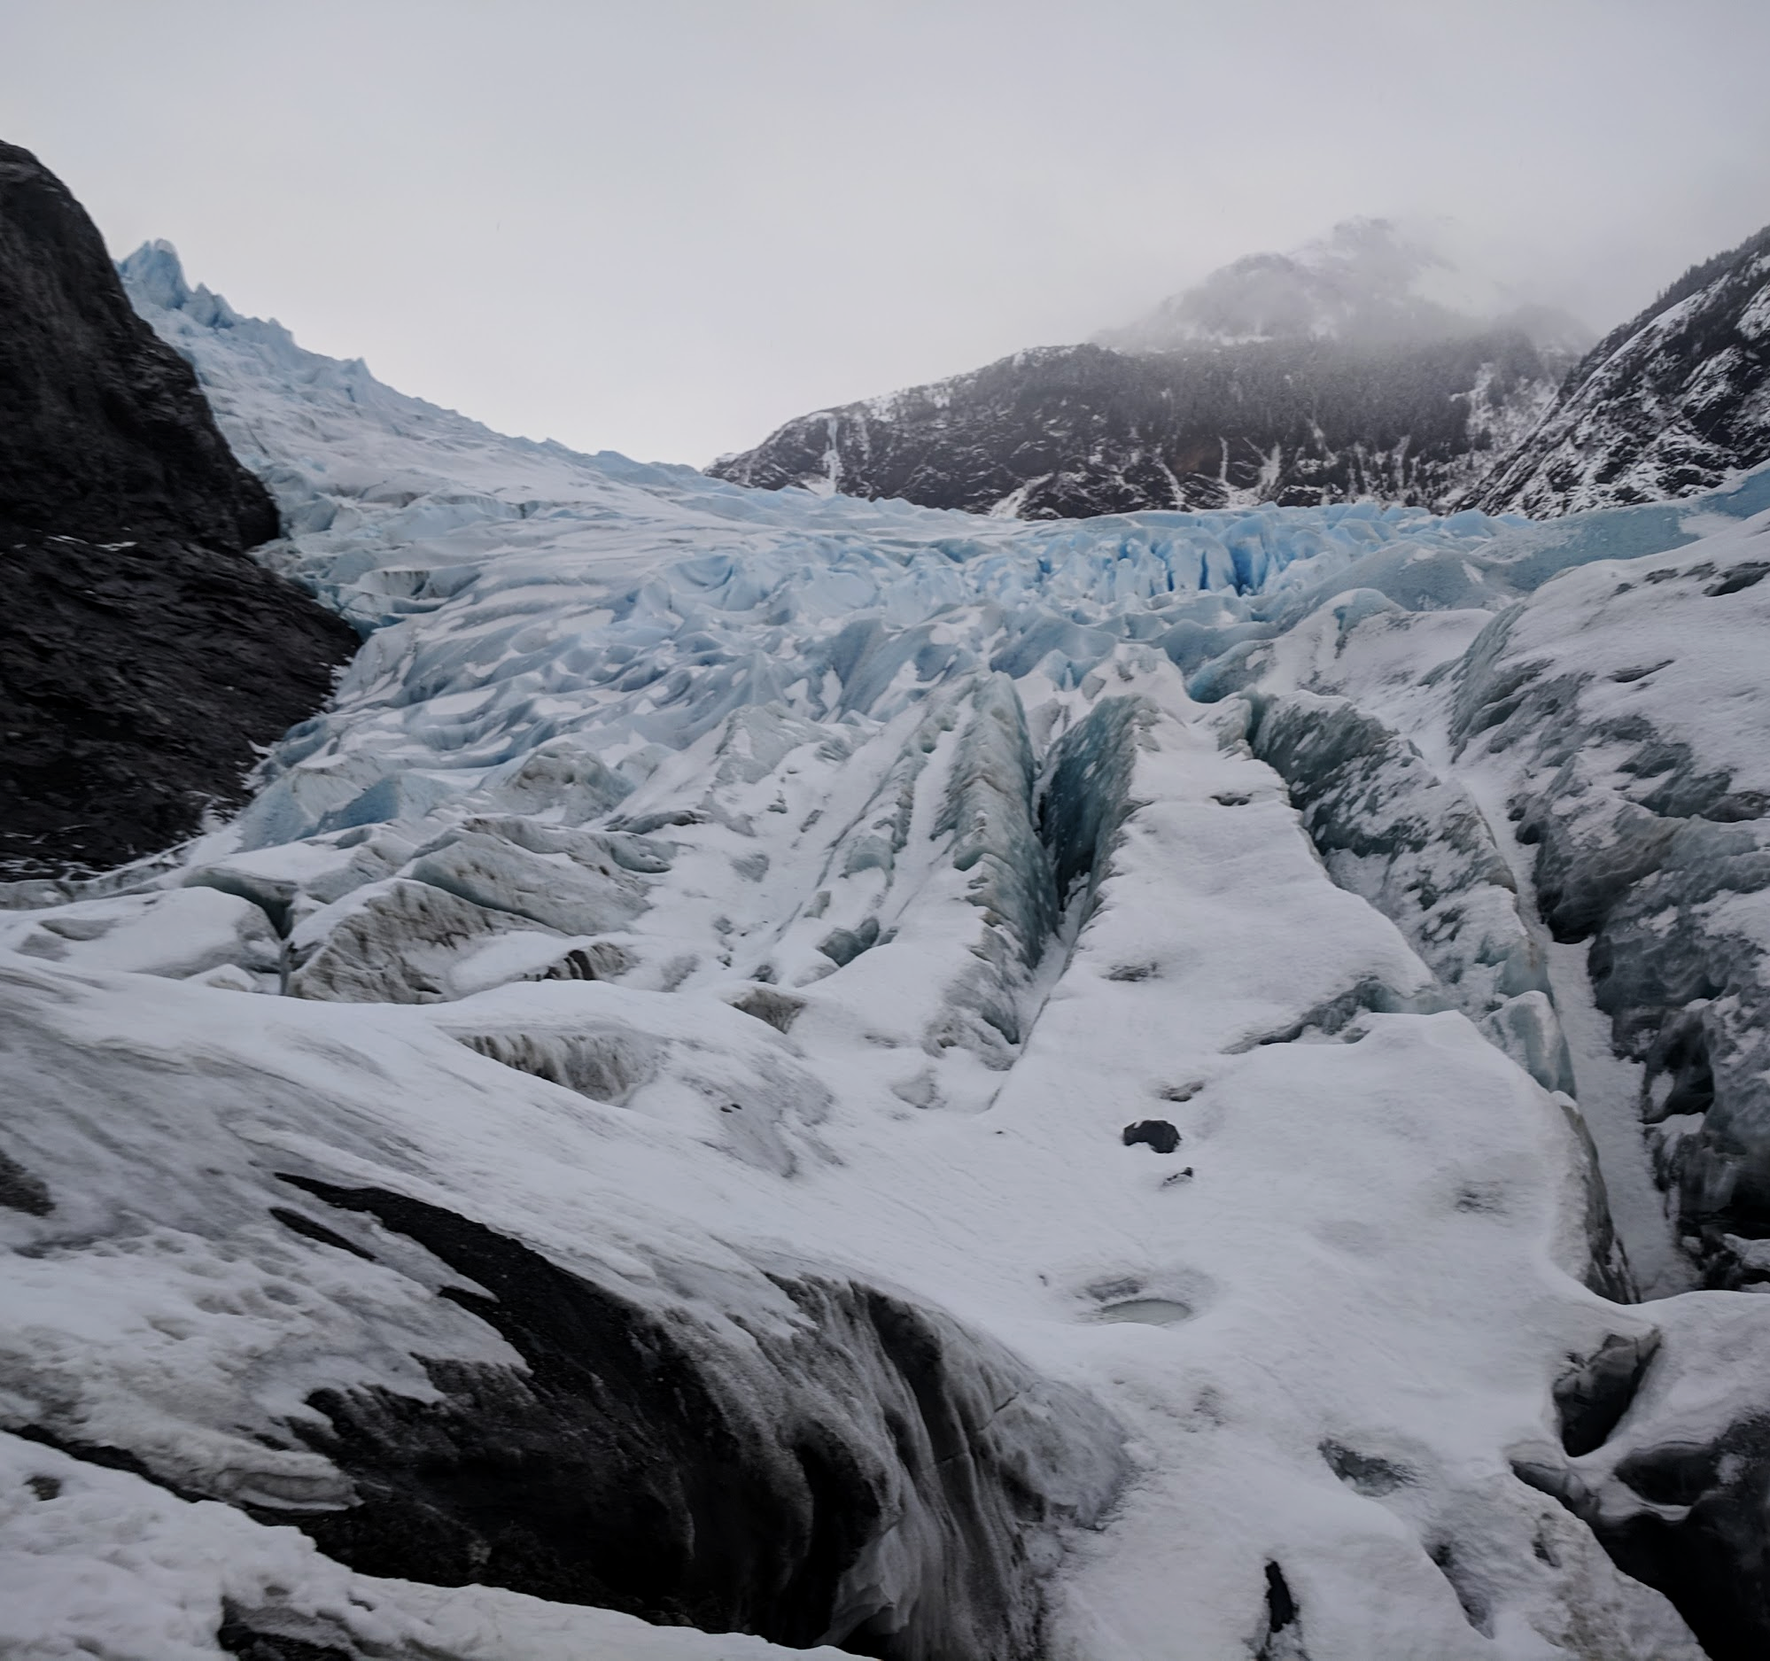
QUESTIONS?
PARTIAL ASSESSMENT CONTACTS:
PETE.HULSON@NOAA.GOV
JANE.SULLIVAN@NOAA.GOV
CAREY.MCGILLIARD@NOAA.GOV
MEAGHAN.BRYAN@NOAA.GOV
KALEI.SHOTWELL@NOAA.GOV

