Slide 1
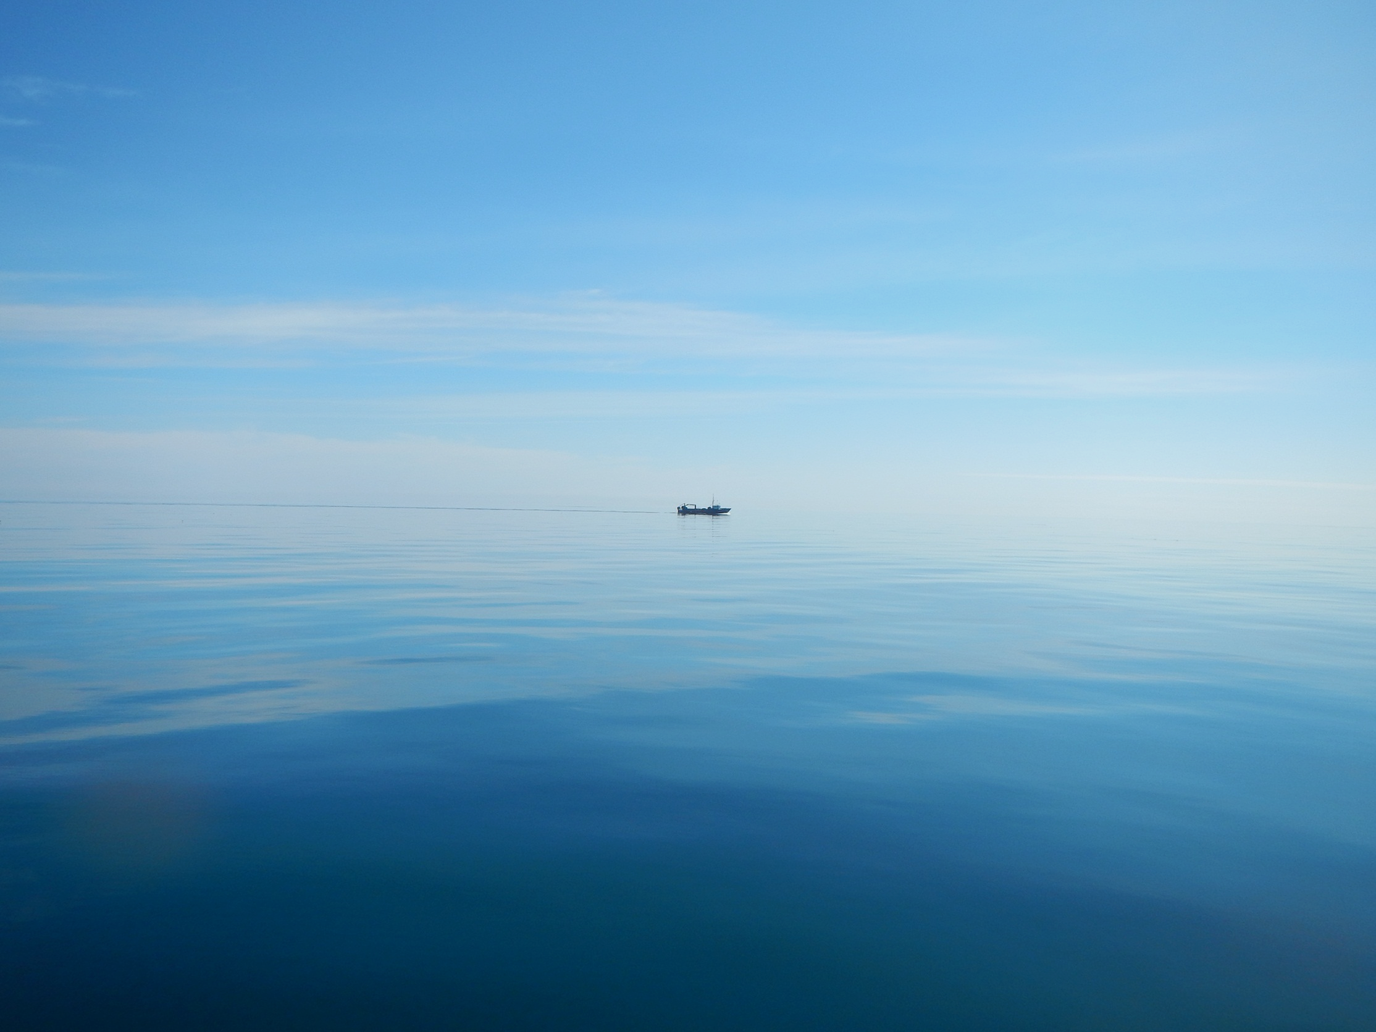
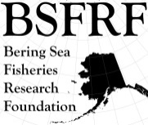


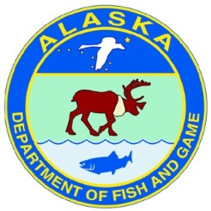
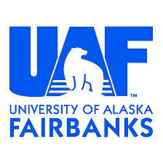



BSFRF Research
Why we are meeting
SNOW CRAB WORKSHOP
Post-Doc
Research/Support
Develop New
Co-op Partners
Snow Crab Cooperative
Workshop (JAN – MAY)
Pre-recruit
Surveys
Ocean Acifification
Research
Life History
Research
Trawl Selectivity
Research
Stock Assessment
Support
BSFRF Survey Data
Standardize - Share
Movement Research
Tagging & Monitoring
Crab Aging
Research
Growth Project
Sampling OPI/BRD
Discard - Handling
Mortality
Natural
Mortality
2021 Contingency Planning
Bycatch Research
BREP Projects
Harvesters - Processors
Cooperative Research Partners

Slide 2

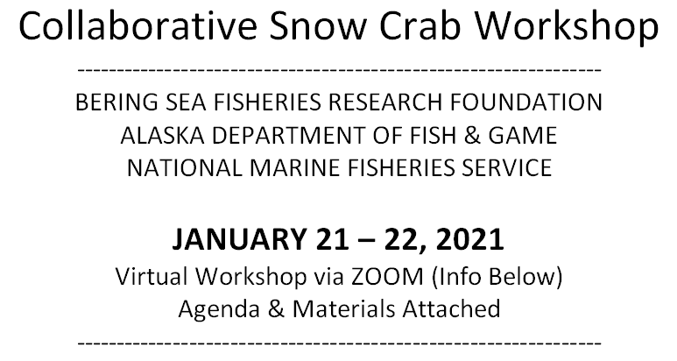

Welcome – Workshop will start soon…

Slide 3
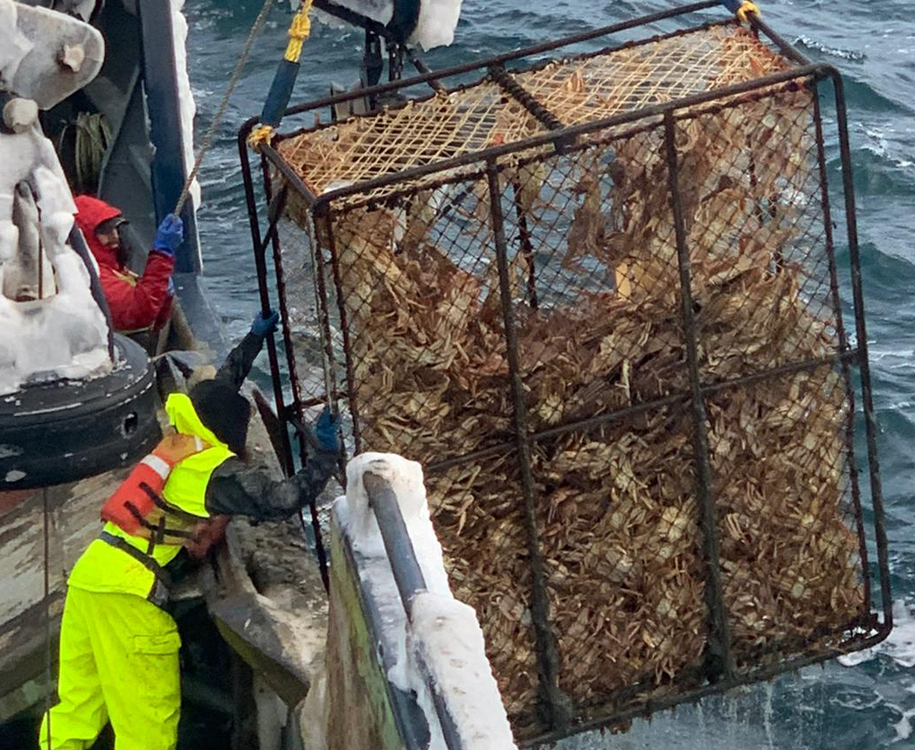
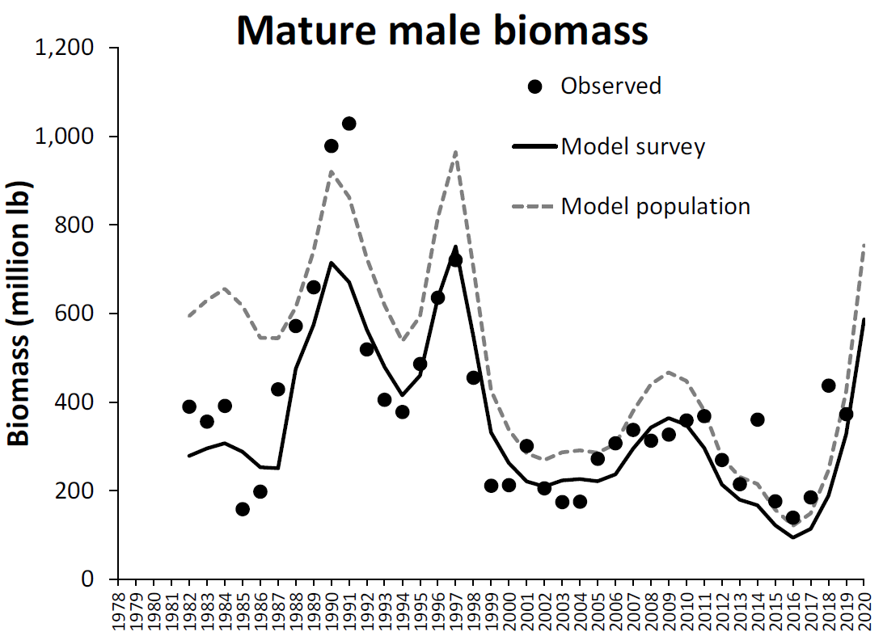
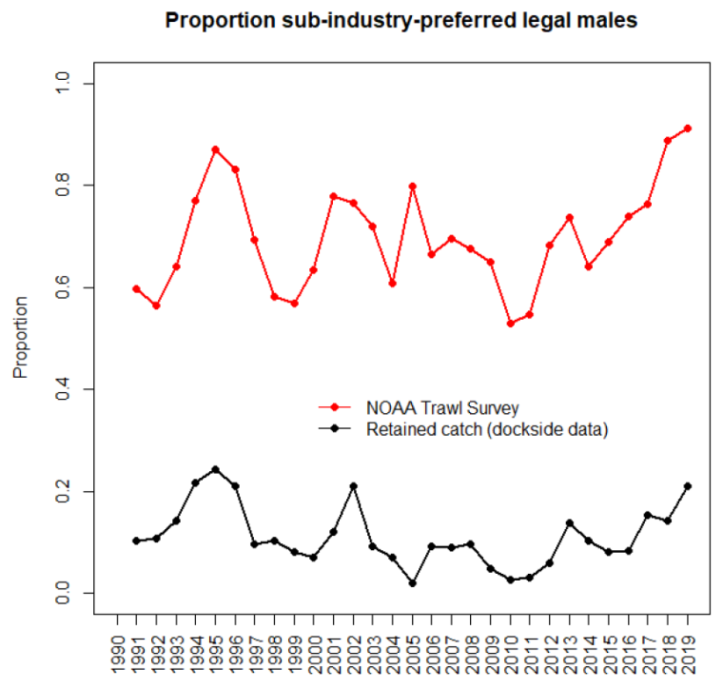
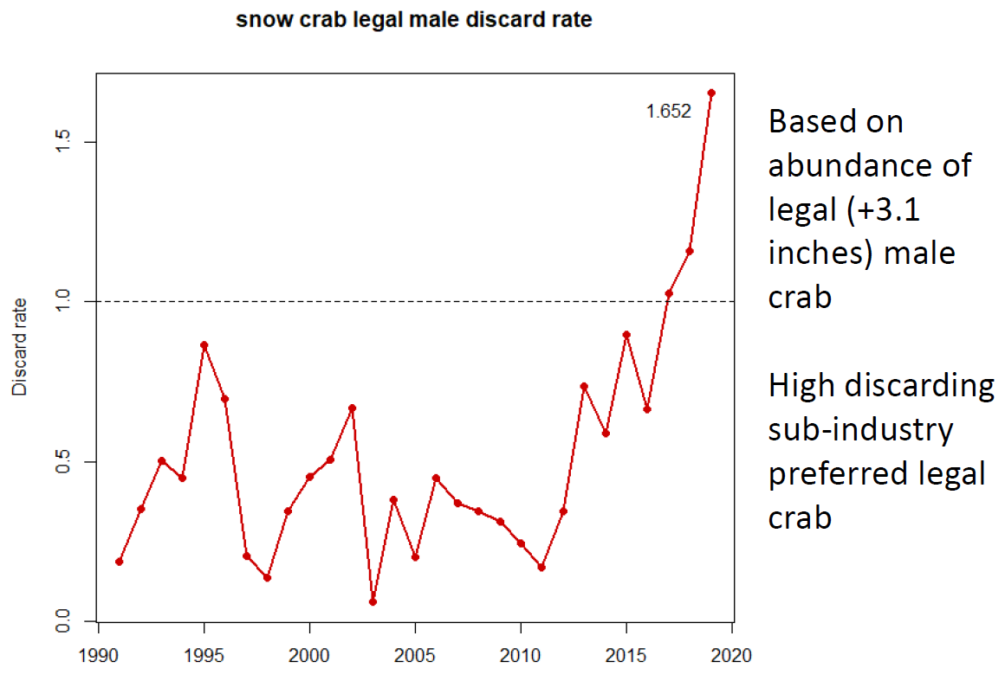
Why do we care?
What’s going on?

Slide 4
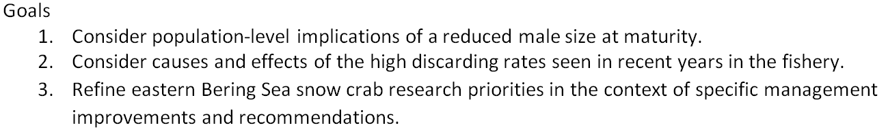
What we are trying to accomplish
Research
Management
Biology
Workshop #1
January
Workshop #2
May
Economic Implications
-- not part of workshop --

Slide 5
What we are trying to accomplish
Research
Management
Biology
Workshop #1
January
Workshop #2
tbd OCTOBER
Economic Implications
-- not part of workshop --

Slide 6
Steering Committee; BSFRF, ADFG, and NOAA
chaired by BSFRF w/ co-hosts – some ZOOM rules
Open to snow crab researchers and managers
Stakeholder input is planned – research focused
Plans include 4 presenters; 2 from AK (Cody & Ben) and 2 from Canada (St.-Marie & Mullowney)
Workshop results are intended to be shared and build into further steps
There are some sensitive parts of this workshop – we’ll stay focused on biological research

Slide 7
Won’t try to answer too much (planning smaller steps first, can’t address or answer all questions – 2 workshop approach)
Review available information from research & biology perspective (maturity, growth, etc., available data)
Intended to build on Bairdi Workshop methods and outcomes as a pattern for successful collaboration -> this began in DEC 2017, led to MSE (UW Masters) project, extensive sharing w/ stakeholders, and was adopted into management MAR 2020

Slide 8
Preliminary Summary of Workshop
ZOOM 66 attendees day 1, 56 attendees day 2
BSFRF, NMFS, ADFG, 10 industry groups, other researchers/academics, 7 DFO (2 presented)
Limited presentation time to 4 topics
Focused on dialog between researchers with some input from crab stakeholders
Canadian v. US perspectives on snow crab
Notable differences in scale, magnitude, and diversity in CA opilio v. BS opilio
Effort to set the stage for further research and considerations for management

Slide 9
Preliminary Summary of Workshop
Entire workshop both days was recorded on ZOOM
Presentations are available for sharing
Comprehensive summary notes taken to review and inform next steps
“Low hanging fruit” approach first:
A few summary takeaways from draft materials and post workshop notes…

Slide 10
A few summary takeaways from draft materials and post workshop notes…
Chela height measurements taken during survey and/or fishery
Analysis of climate drivers may be an intermediate time line
Have the terminal molt schedules changed? How is it affected by the leading edge of a cohort approaching legal size? This could be done to examine the increase in discards observed in the past two years even absent a 2020 survey.
Erin – Some experimental studies at the Kodiak Laboratory may be useful to examine shifts in size of terminal molt to maturity. This could follow up laboratory work conducted by Bernard. Also, can new data be collected during the upcoming 2021 survey.
Mike Litzow: are we getting the data on chela and maturity that we need during the EBS trawl survey? Also, Mike encourages the comparative analysis between EBS and NL and climate drivers.

Slide 11
A few summary takeaways from draft materials and post workshop notes…
Gordon: Suggest Y/R analysis to examine tradeoffs in size limit and exploitation rate. Also consider examining Darrell’s magic ratio to inform considerations of residual biomass.
Scott: Do we have enough information to undertake lagged analyses of the effect of temperature in early life? Bernard: Understands we have very little information on the early crab stages. Where are the young concentrated and what is the thermal regime? This is known for the Gulf of St. Lawrence, but Bernard is not aware of refined studies in the EBS. Darrell cautions that it is not all about temperature either. He used to have a habitat index lagged 7 years. But, he has found that the explanatory power is stronger with climate indices. Bernard agrees for abundance, but the relationship between temperature and SoM is more related to temperature or density-dependent effects, including mating effects.
Buck: He is incorporating temperature dependence on intermolt duration in a IBM model that he is working on. This will allow us to have some idea about coupling temperatures from ROMs. This might help focus on areas known to contain small crab.

Slide 12
What’s next? Steering Committee Planning
Final workshop #1 materials including recommendations available soon, this will be intended to provide guidance on activity to prep for next steps
Steering Committee met last week and will meet on June 24-25
Current fishery information and upcoming survey data are key, some fishery data available soon, and survey data available late AUG-SEP
OCTOBER 2021 tentative plans for Workshop 2:
  Allows for stakeholder availability (crabbers are getting ready)
  NMFS survey is complete and crab researchers are more available
  CPT cycle and Council activity will be done or underway
  TAC setting may be complete
  Stay Tuned for More Info Soon !
  Please direct questions to Scott Goodman [sgoodman@nrccorp.com], Madison Heller-Shipley [mshipley@nrccorp.com]

Slide 13
BSFRF Research
Why we are meeting
Post-Doc
Research/Support
Develop New
Co-op Partners
Snow Crab Cooperative
Workshop (JAN – MAY)
Pre-recruit
Surveys
SNOW CRAB WORKSHOP
Ocean Acifification
Research
Life History
Research
Trawl Selectivity
Research
Stock Assessment
Support
BSFRF Survey Data
Standardize - Share
Movement Research
Tagging & Monitoring
Crab Aging
Research
Growth Project
Sampling OPI/BRD
Discard - Handling
Mortality
Natural
Mortality
2021 Contingency Planning
Bycatch Research
BREP Projects
Harvesters - Processors
Cooperative Research Partners

Slide 14
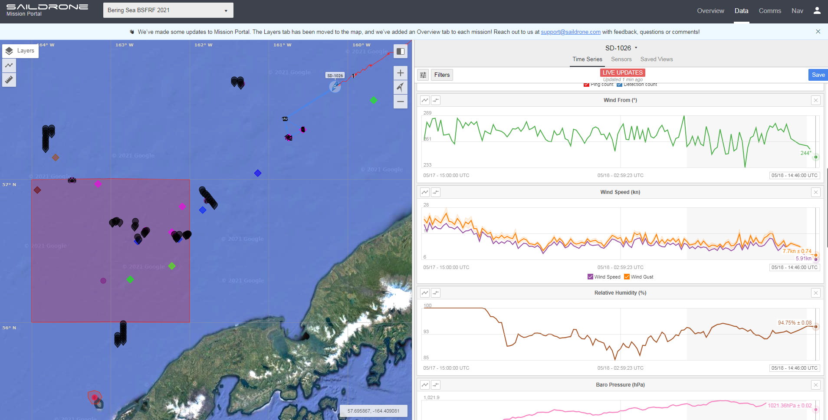
Current research highlights/updates

Slide 15
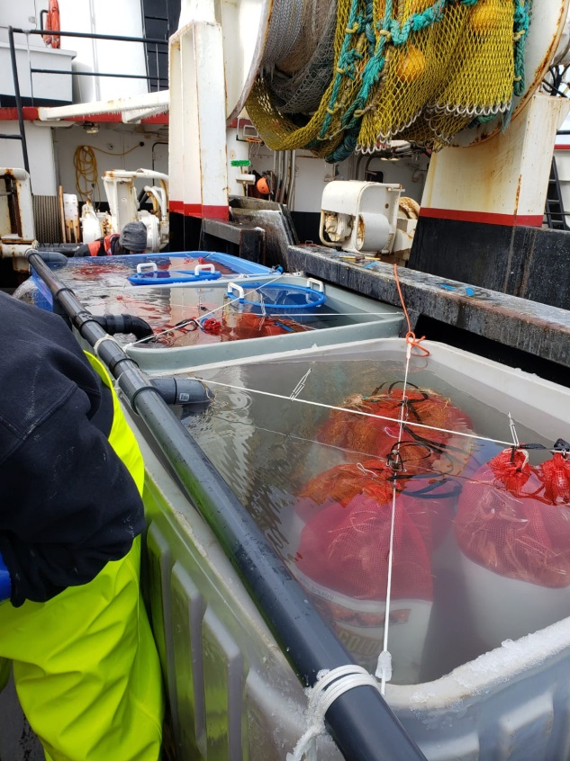
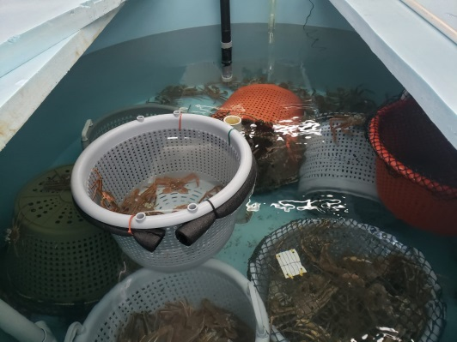
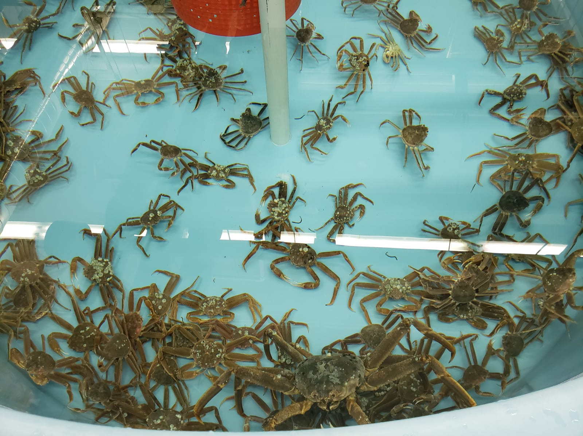
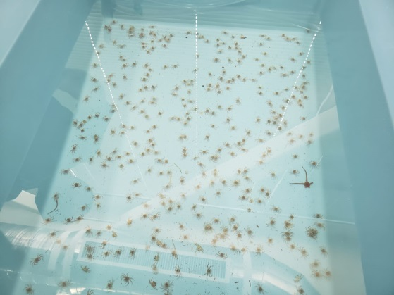
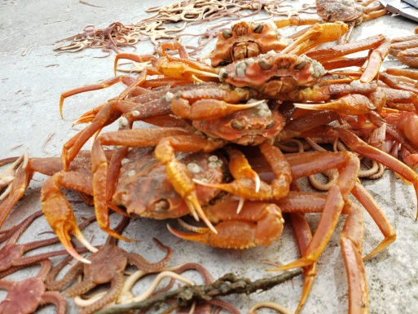
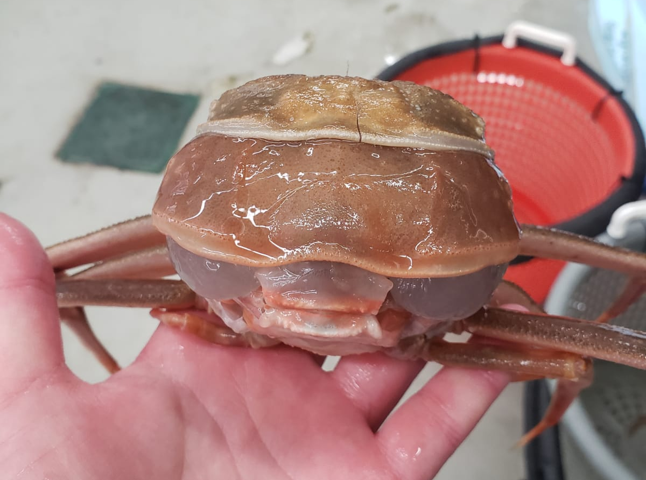
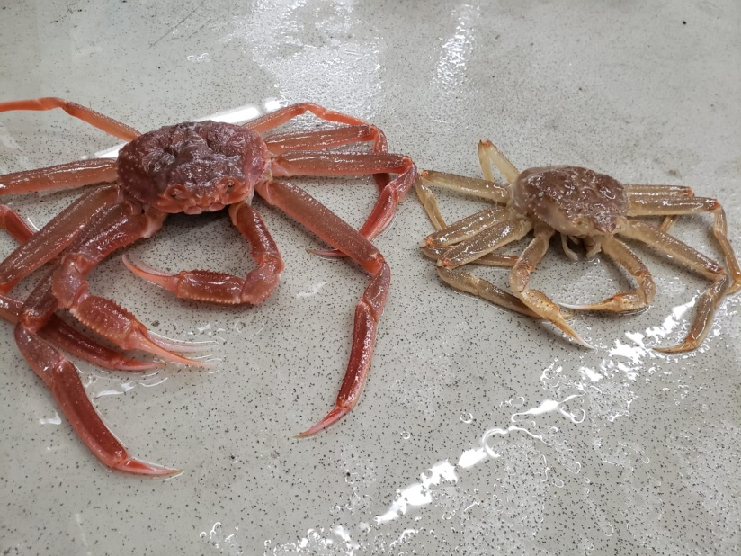
Current research highlights/updates
Recent update from NOAA Kodiak…
“(We) cleaned up the growth experiment today (30 days holding) and of the 184 male snow crab we held at the lab, we've got post-molt growth data on 170 males, and only 6 crab didn't molt of the 184. I haven't run the maturity cutline script yet but I'd guess at least a quarter of the molts were terminal.”

Slide 16
Current research highlights/updates
Priority on data compiling and sharing – getting BSFRF database accessible
October cooperative charter focused on BBRKC tagging is planned
BREP bycatch research is continuing in Kodiak and in the field
Direct support of the NMFS survey science parties – legs 2 and 3
Crab and Climate Mini-Symposium planned (coming up fast, next Wednesday May 26, 1:00-3:00 pm AK time
Opportunistic video footage taken from snow crab pots this season…

