Slide 1
Assessment of BSAI Greenland turbot
Meaghan D. Bryan, Steven J. Barbeaux,
Jim Ianelli, Elizabeth Siddon, Stephani Zador, Jerry Hoff
November 19, 2020

Slide 2
Model
In September 4 models were presented:
    2020 assessment: SS3 version 3.30.12
    Model 16.4a: base model, same as 2020 assessment but used new version of SS3
    Model 16.4b: includes ABL longline survey length data and estimates selectivity
    Model 16.4c: Same as 16.4b and includes EBS slope

Slide 3
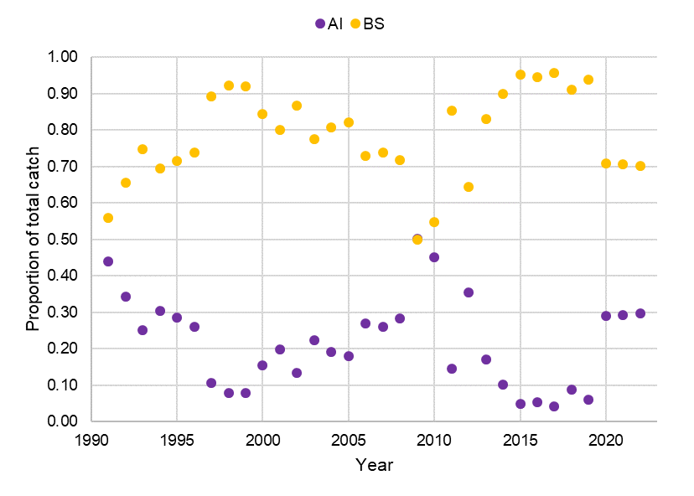
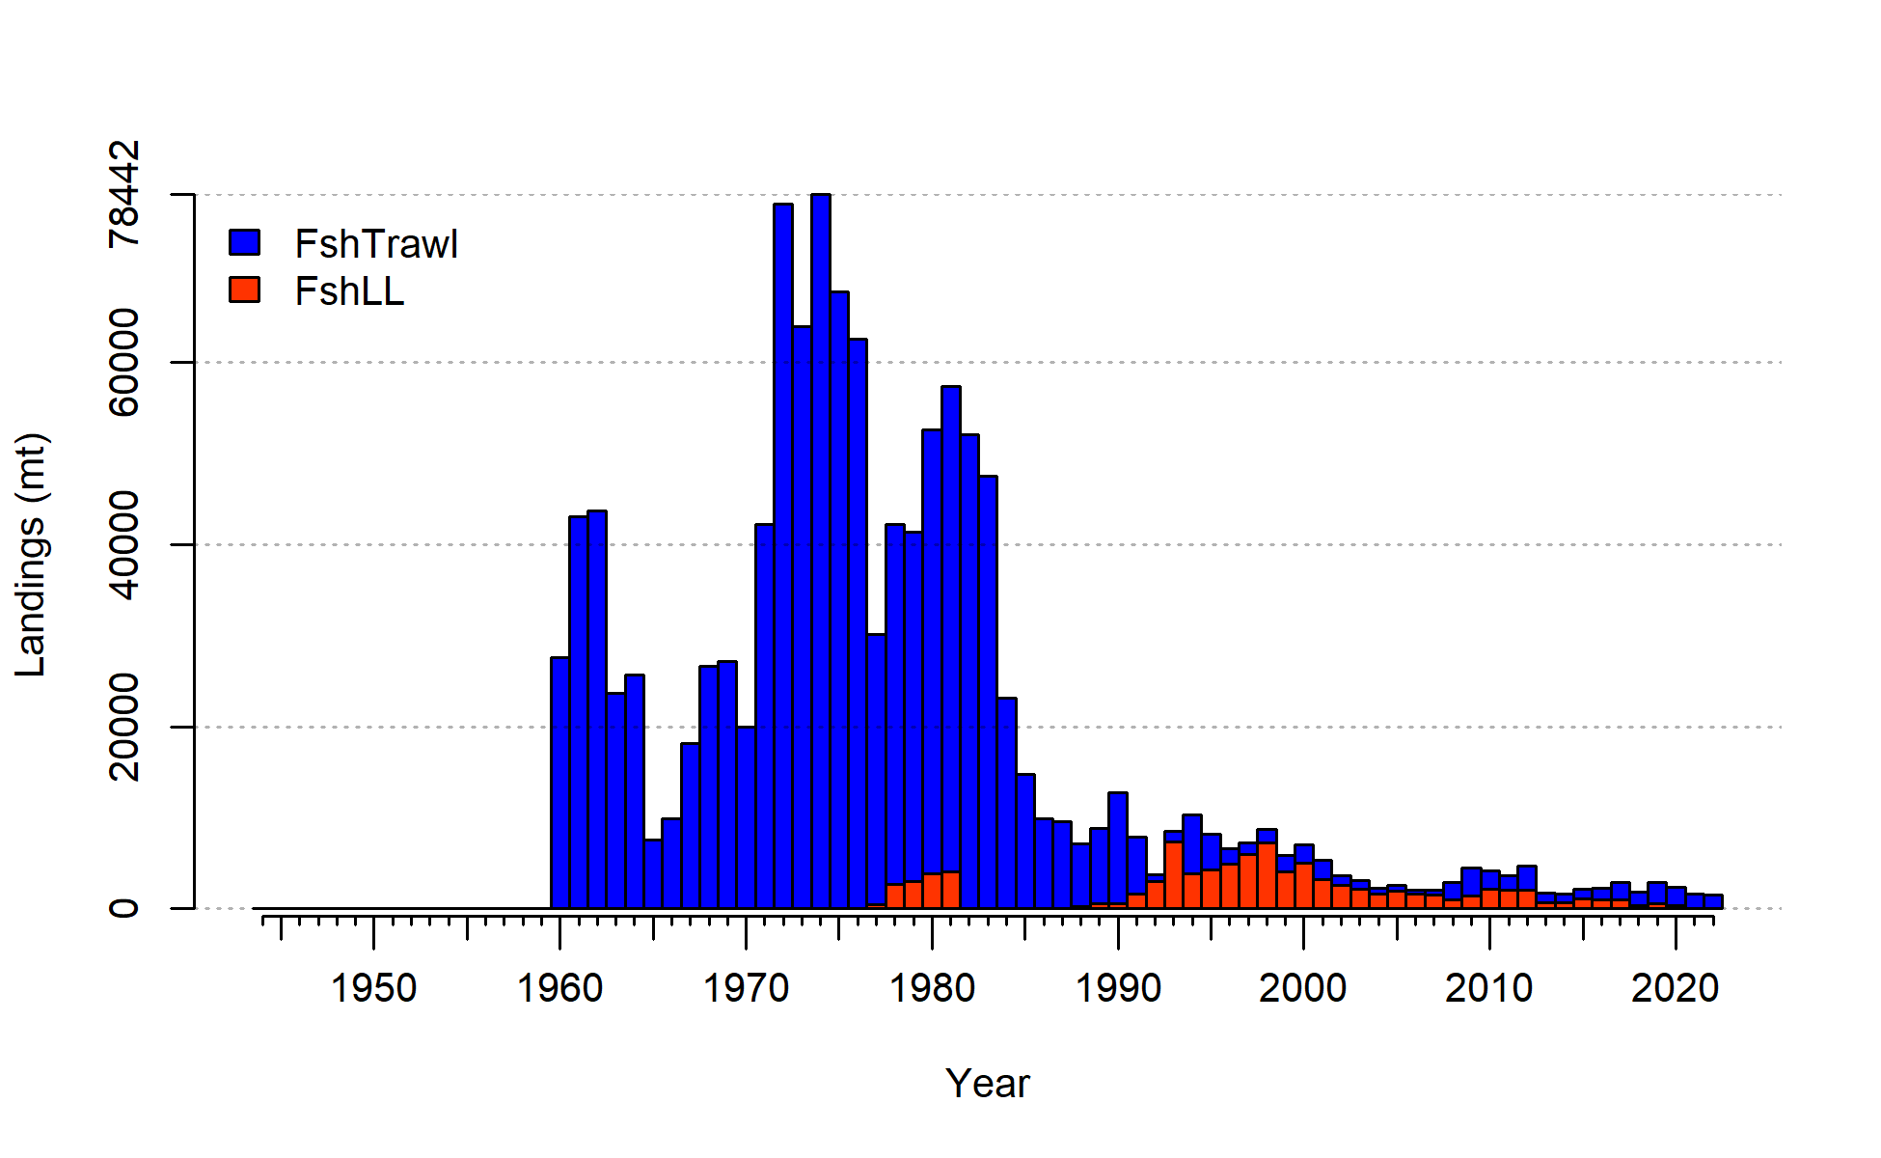
Fishery catch
MFCMA
Notes:
This slide shows the catch history of the fishery on the left and the proportion of catch in the Bering Sea separate from the Aleutian Islands.

Slide 4
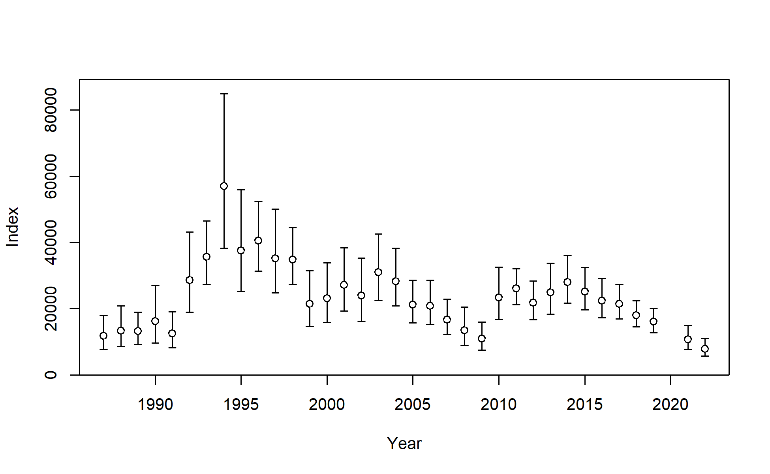
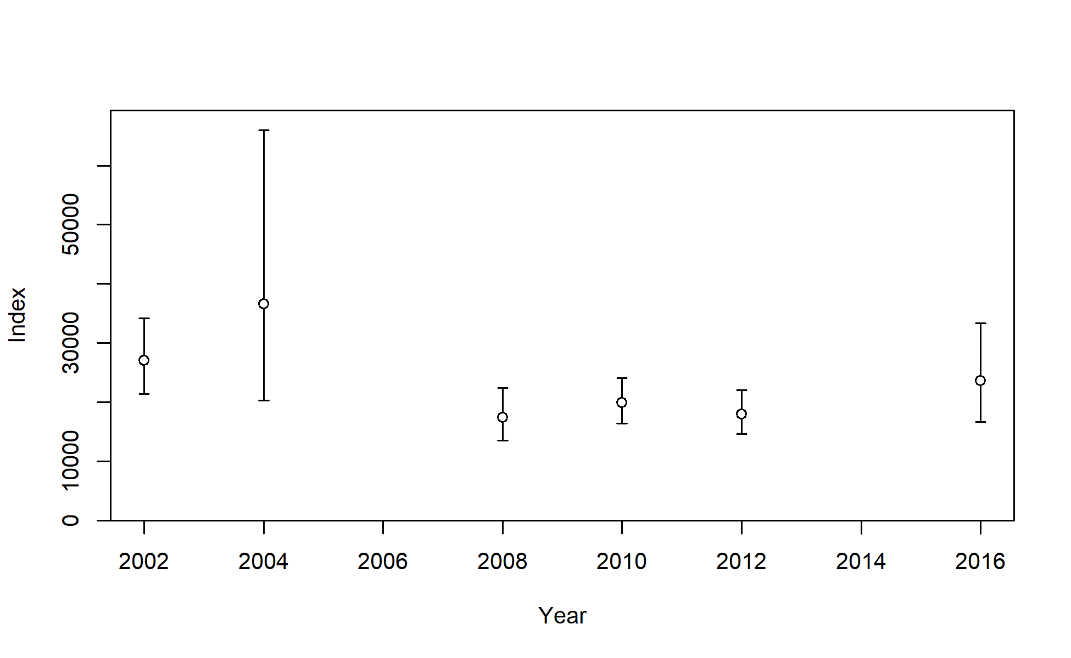
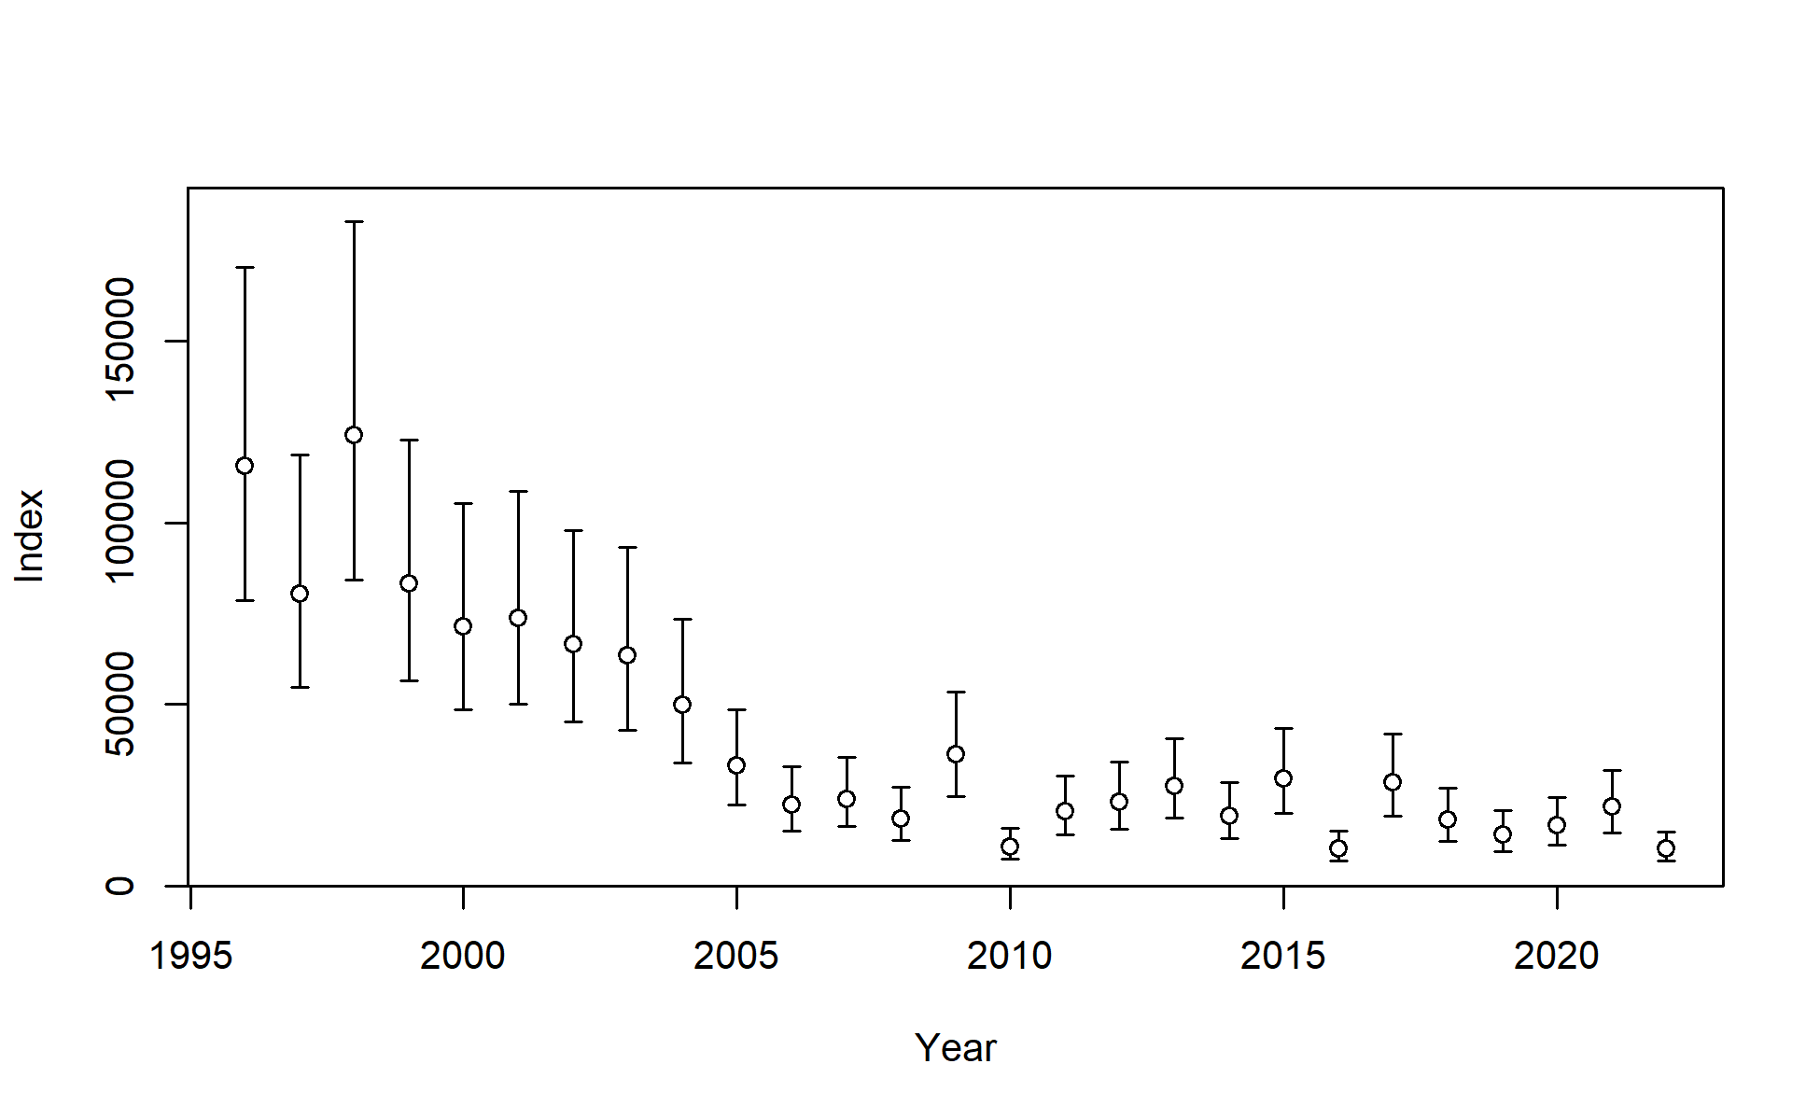
Survey estimates
Shelf
Slope
AFSC longline
Shelf
  Declined by 33% in 2021
  Declined by 26% in 2022
AFSC longline - RPN
  Increased by 30% in 2019 (Bering Sea surveyed)
  Declined by 53% in 2022 (Aleutian Islands surveyed)
Notes:
RPN – relative population numbers

Slide 5
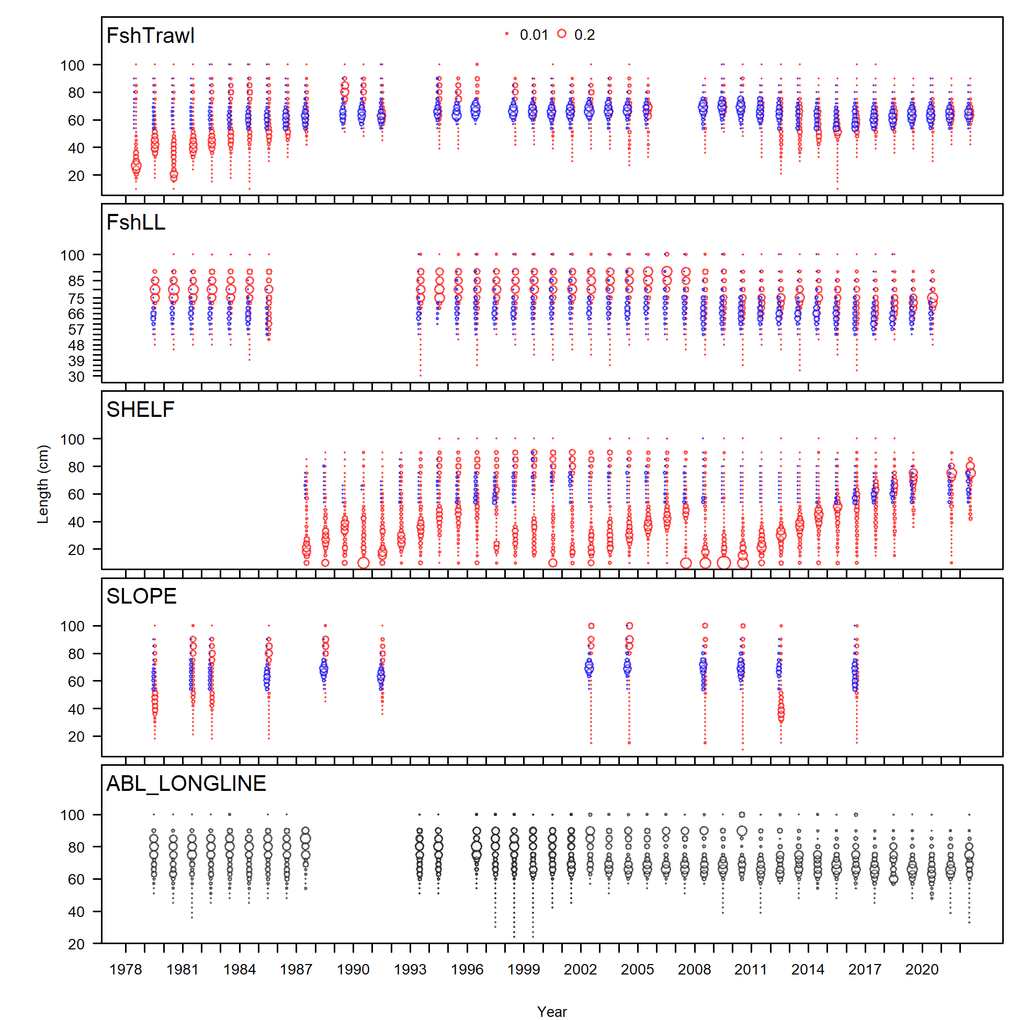
Length composition data
Models 16.4b and 16.4c

Slide 6
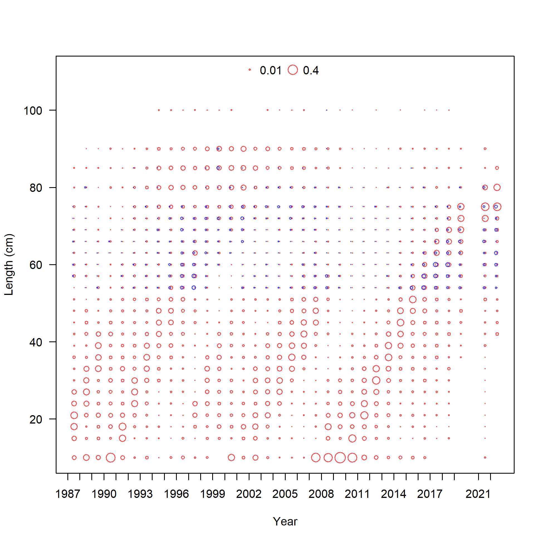
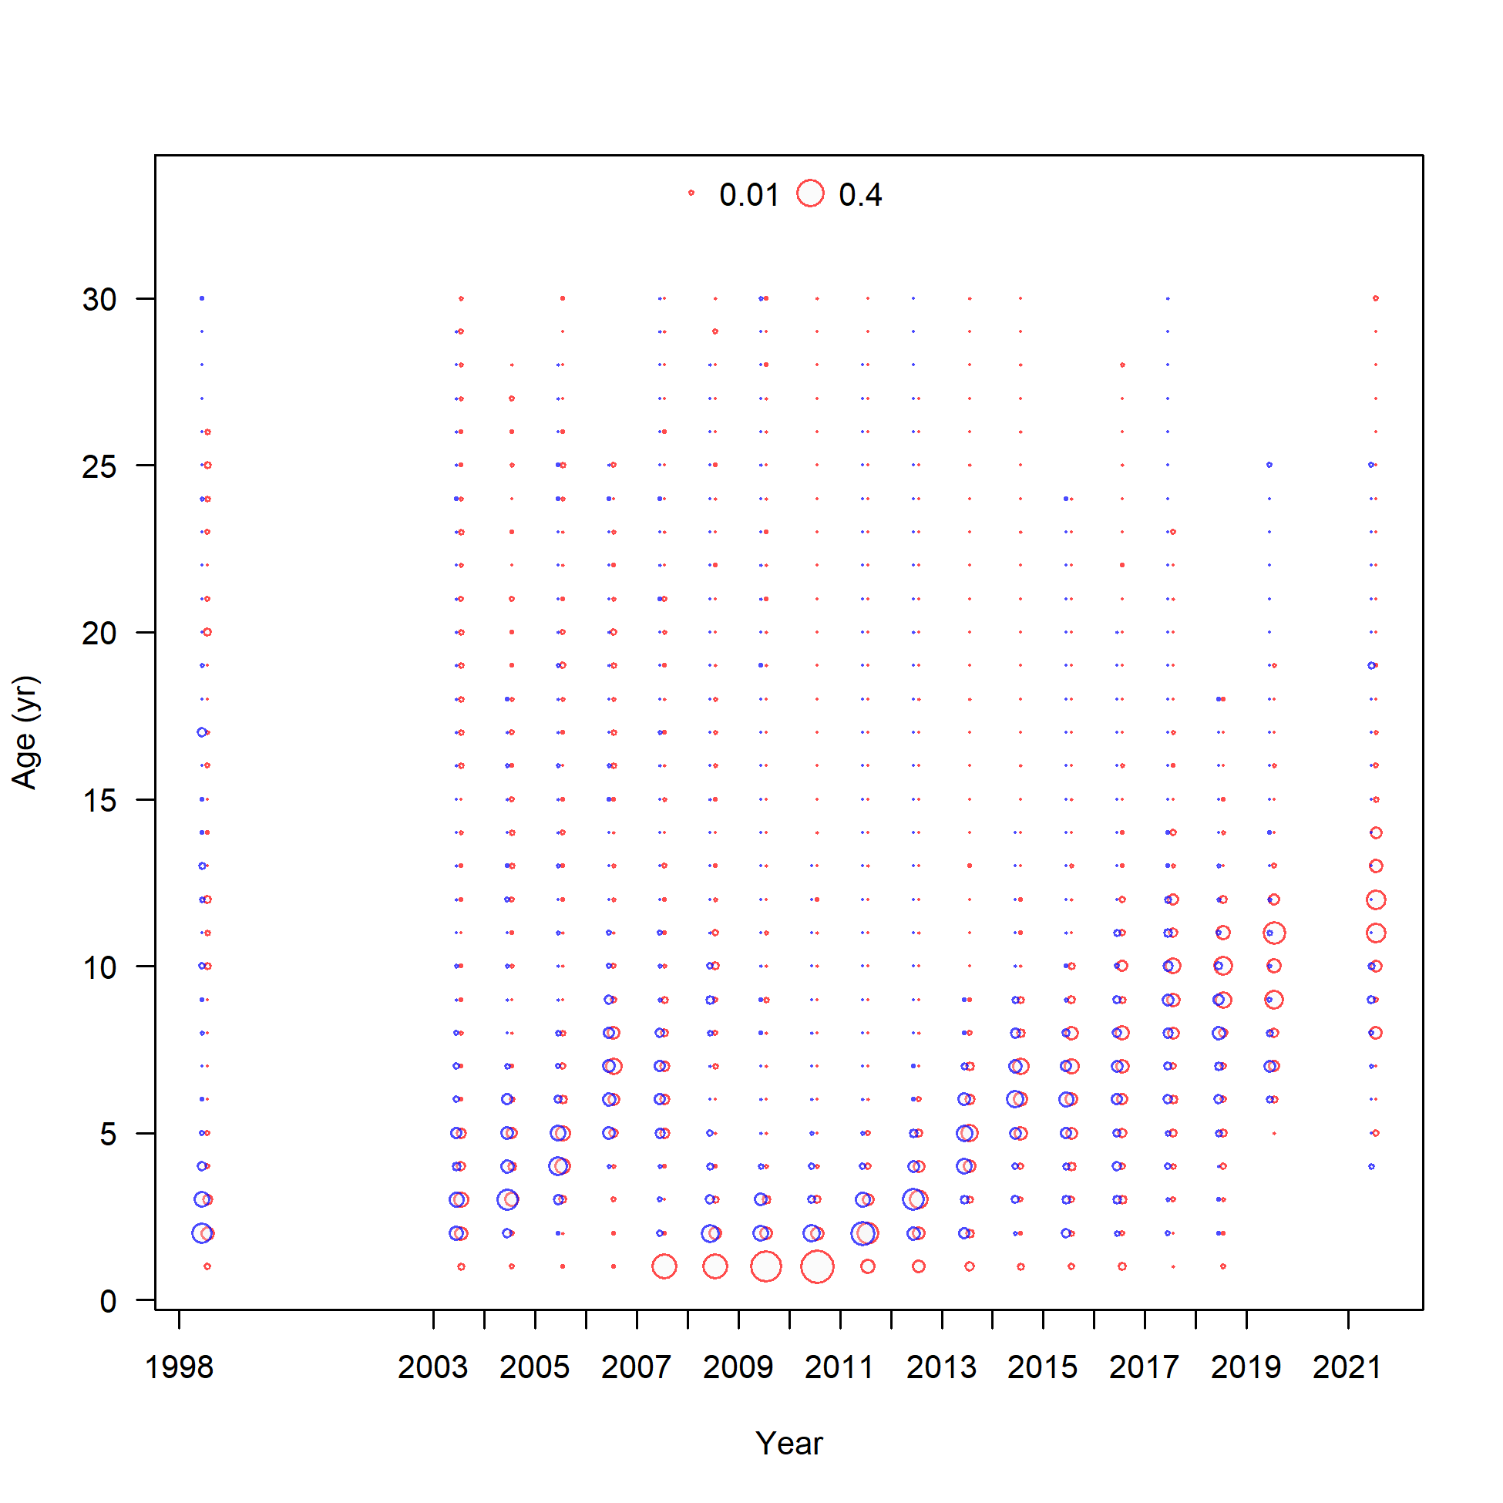
EBS shelf survey length and age composition
Notes:
I do want to focus on the data from the shelf survey quickly. This slide shows the length data on the left and the age data on the right.
Direct age data not included in the model.
You can see the presence of the 2007-2010 year classes in both data sources.
Length and age truncation at smaller sizes and younger ages. Not seeing smaller/younger GT on the shelf showing a lack of recruitment, which has been a consistent concern over the last several years.

Slide 7
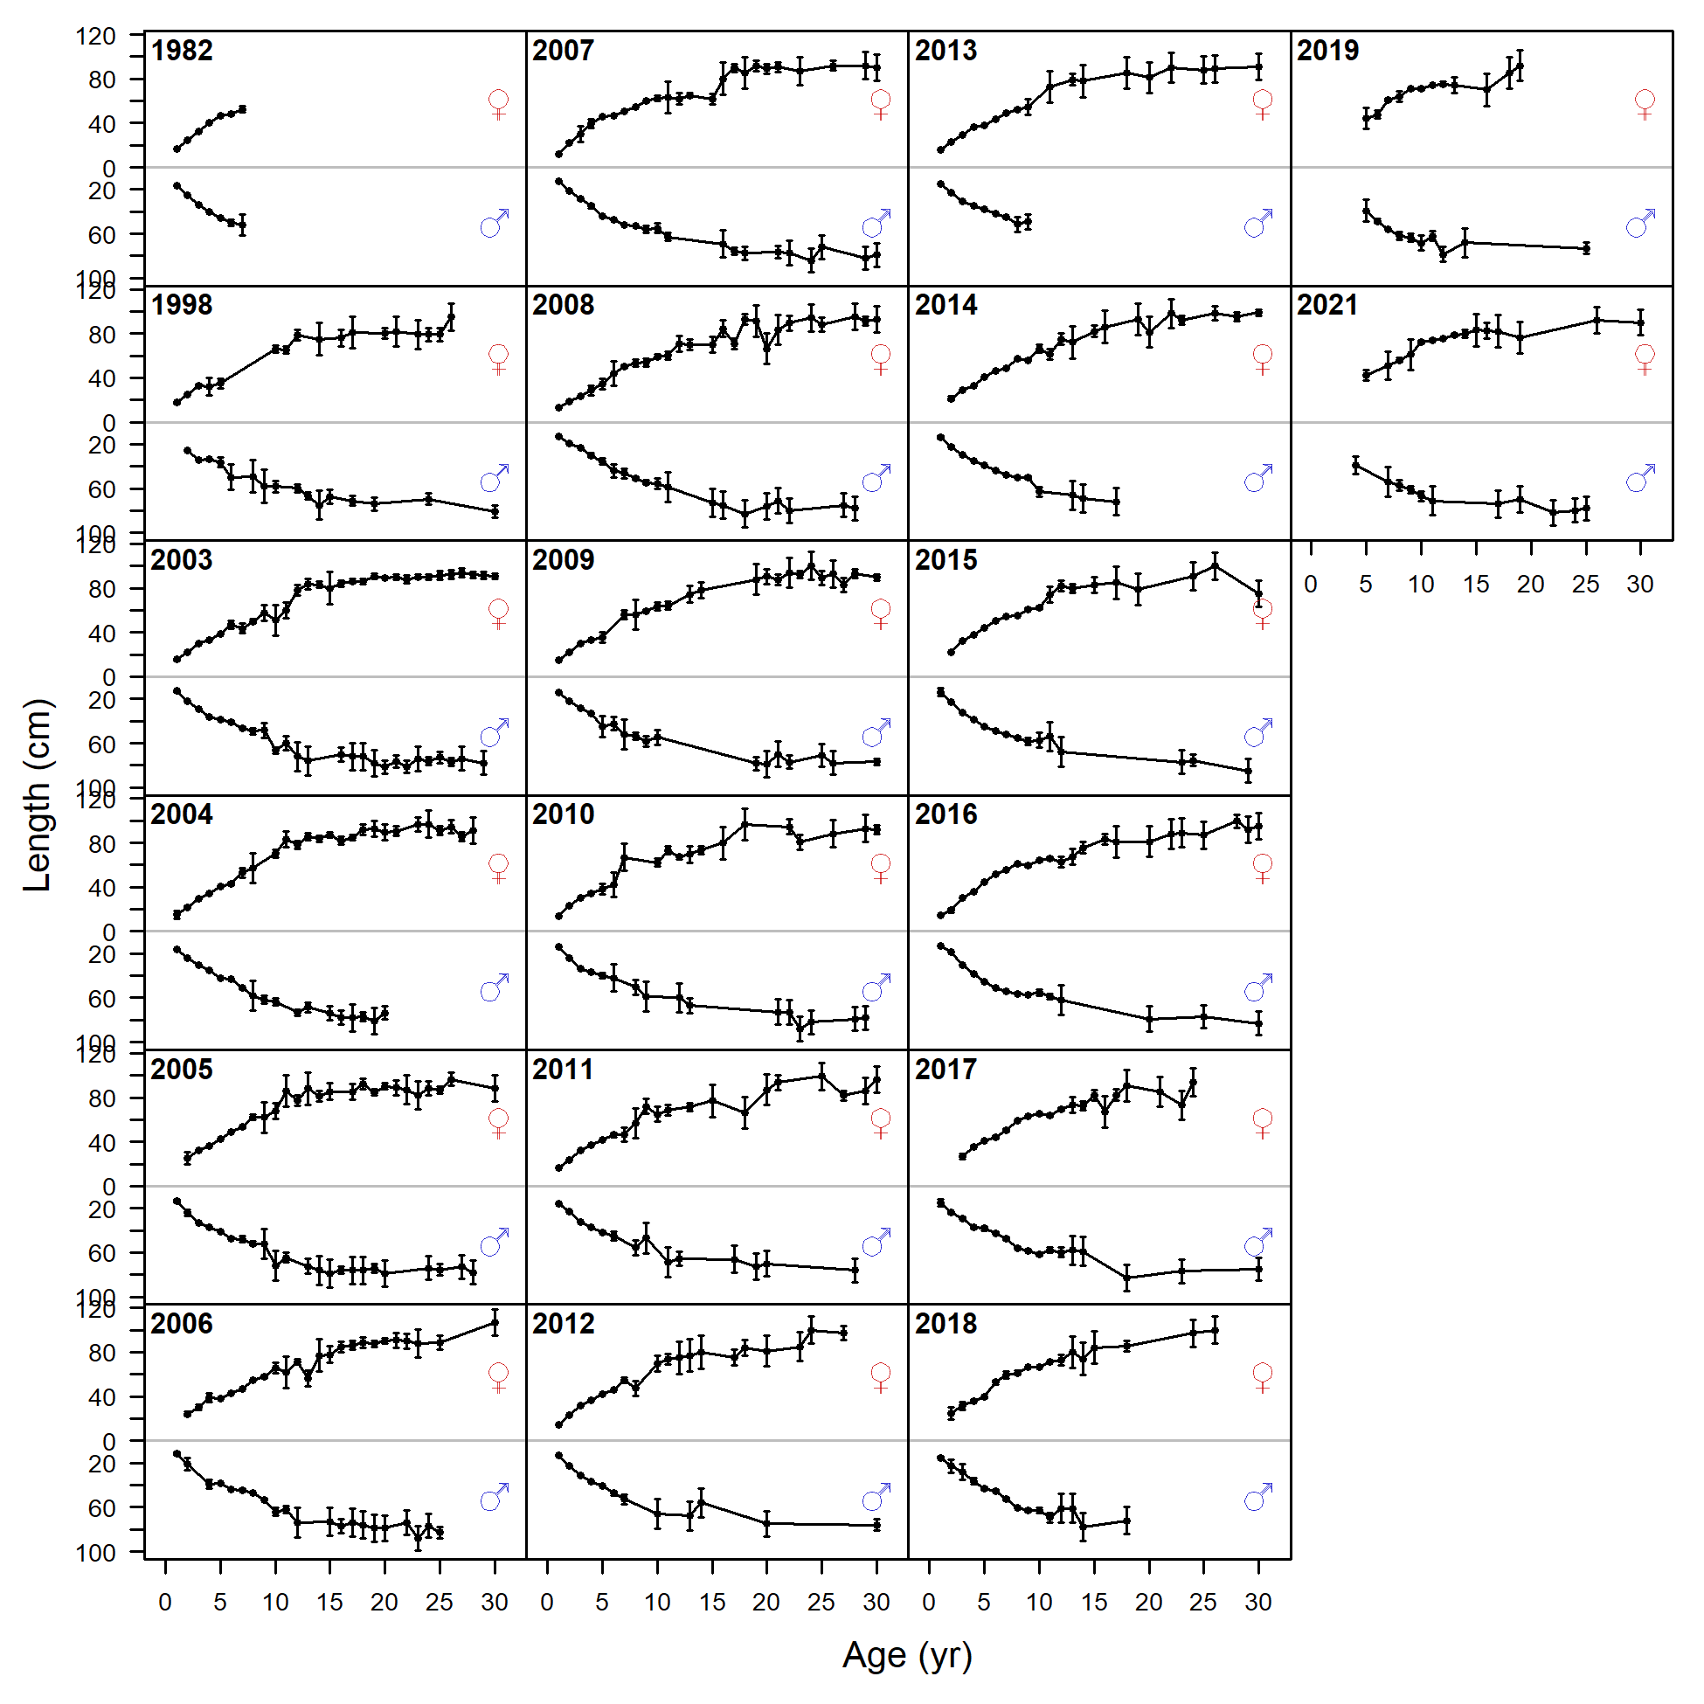
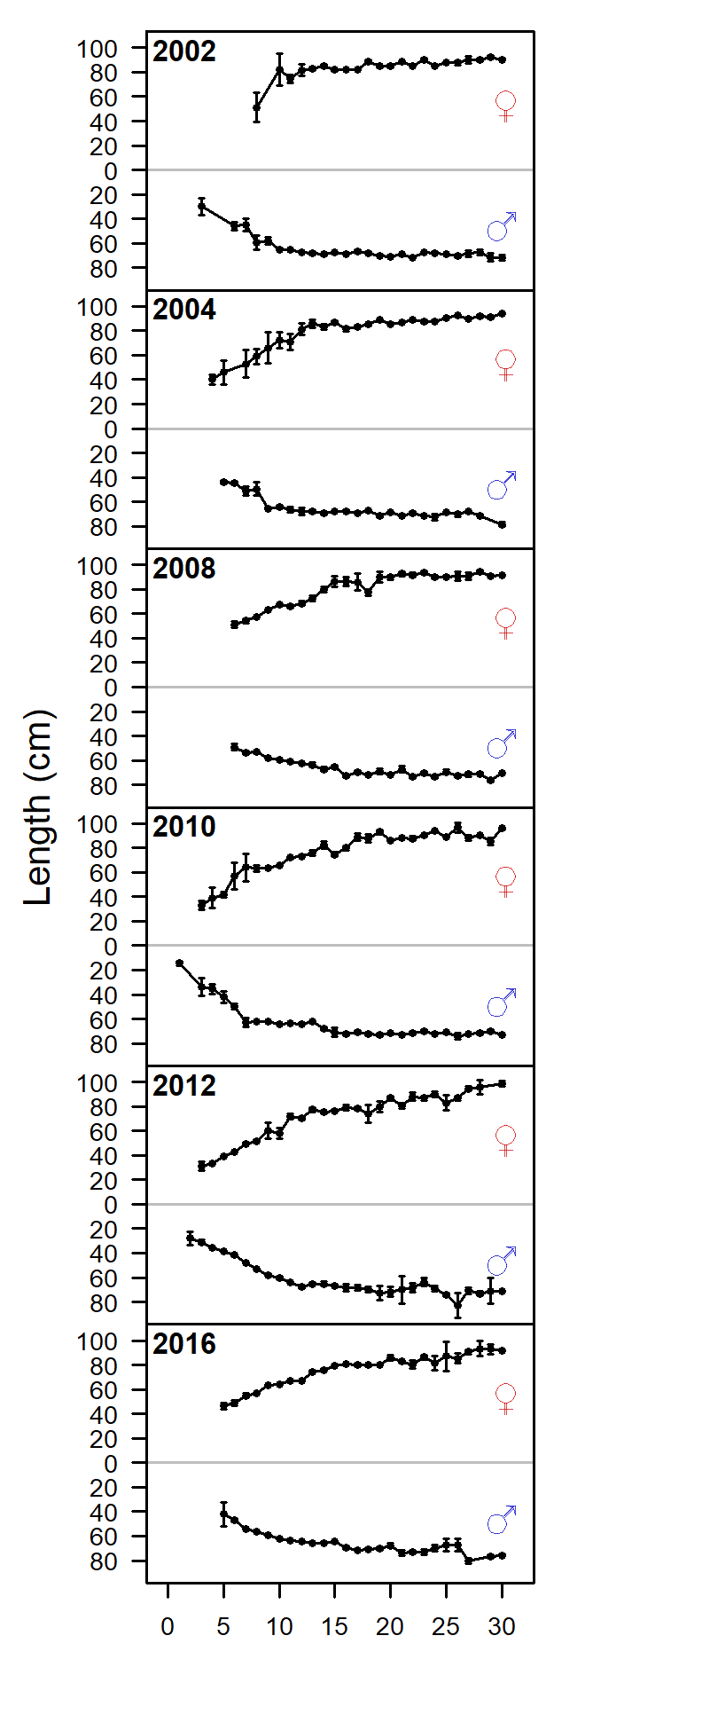
Mean length-at-age
Shelf
Slope (M16.4b and M16.4c)

Slide 8
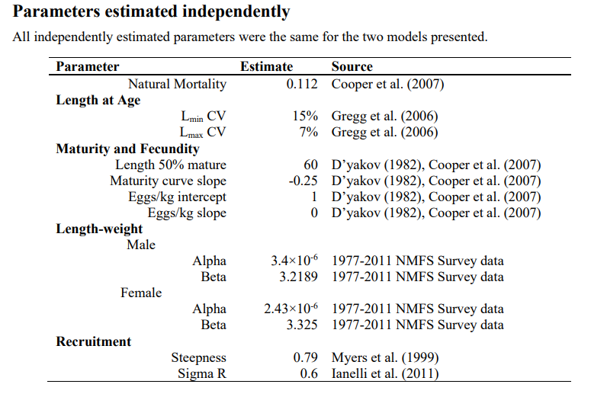
Model structure
Notes:
Will talk more about maturity when we get to the risk table

Slide 9
Model structure

Slide 10
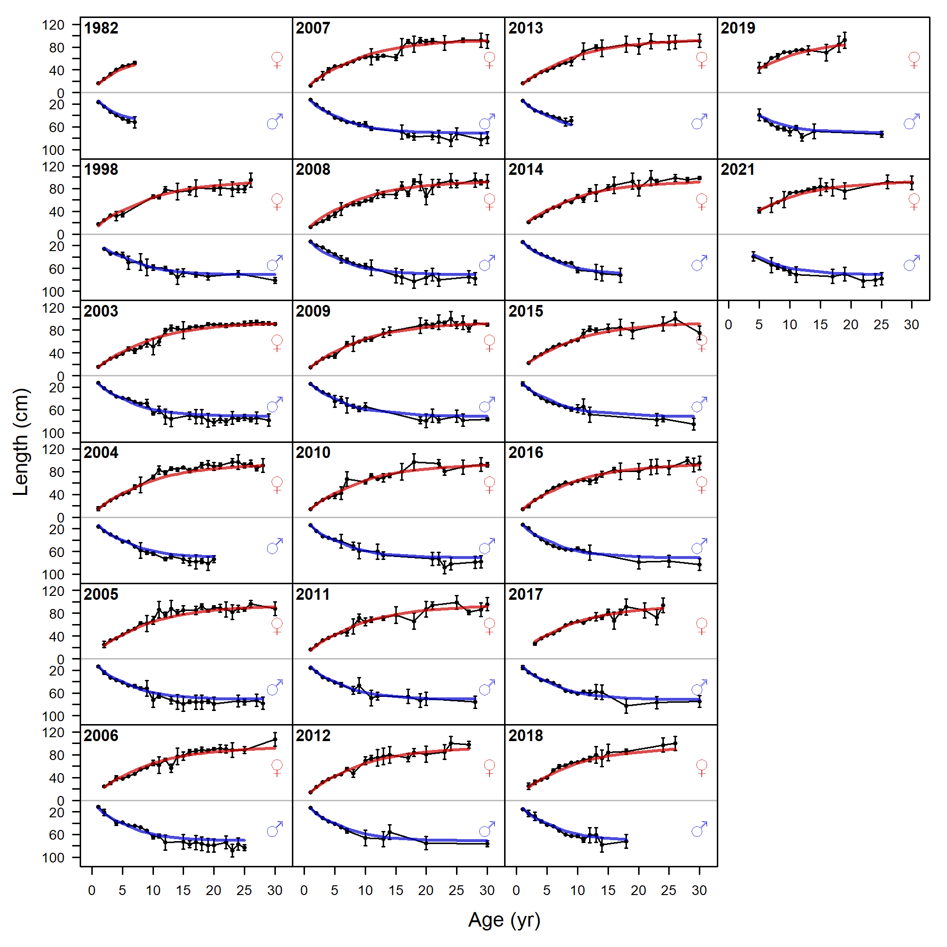
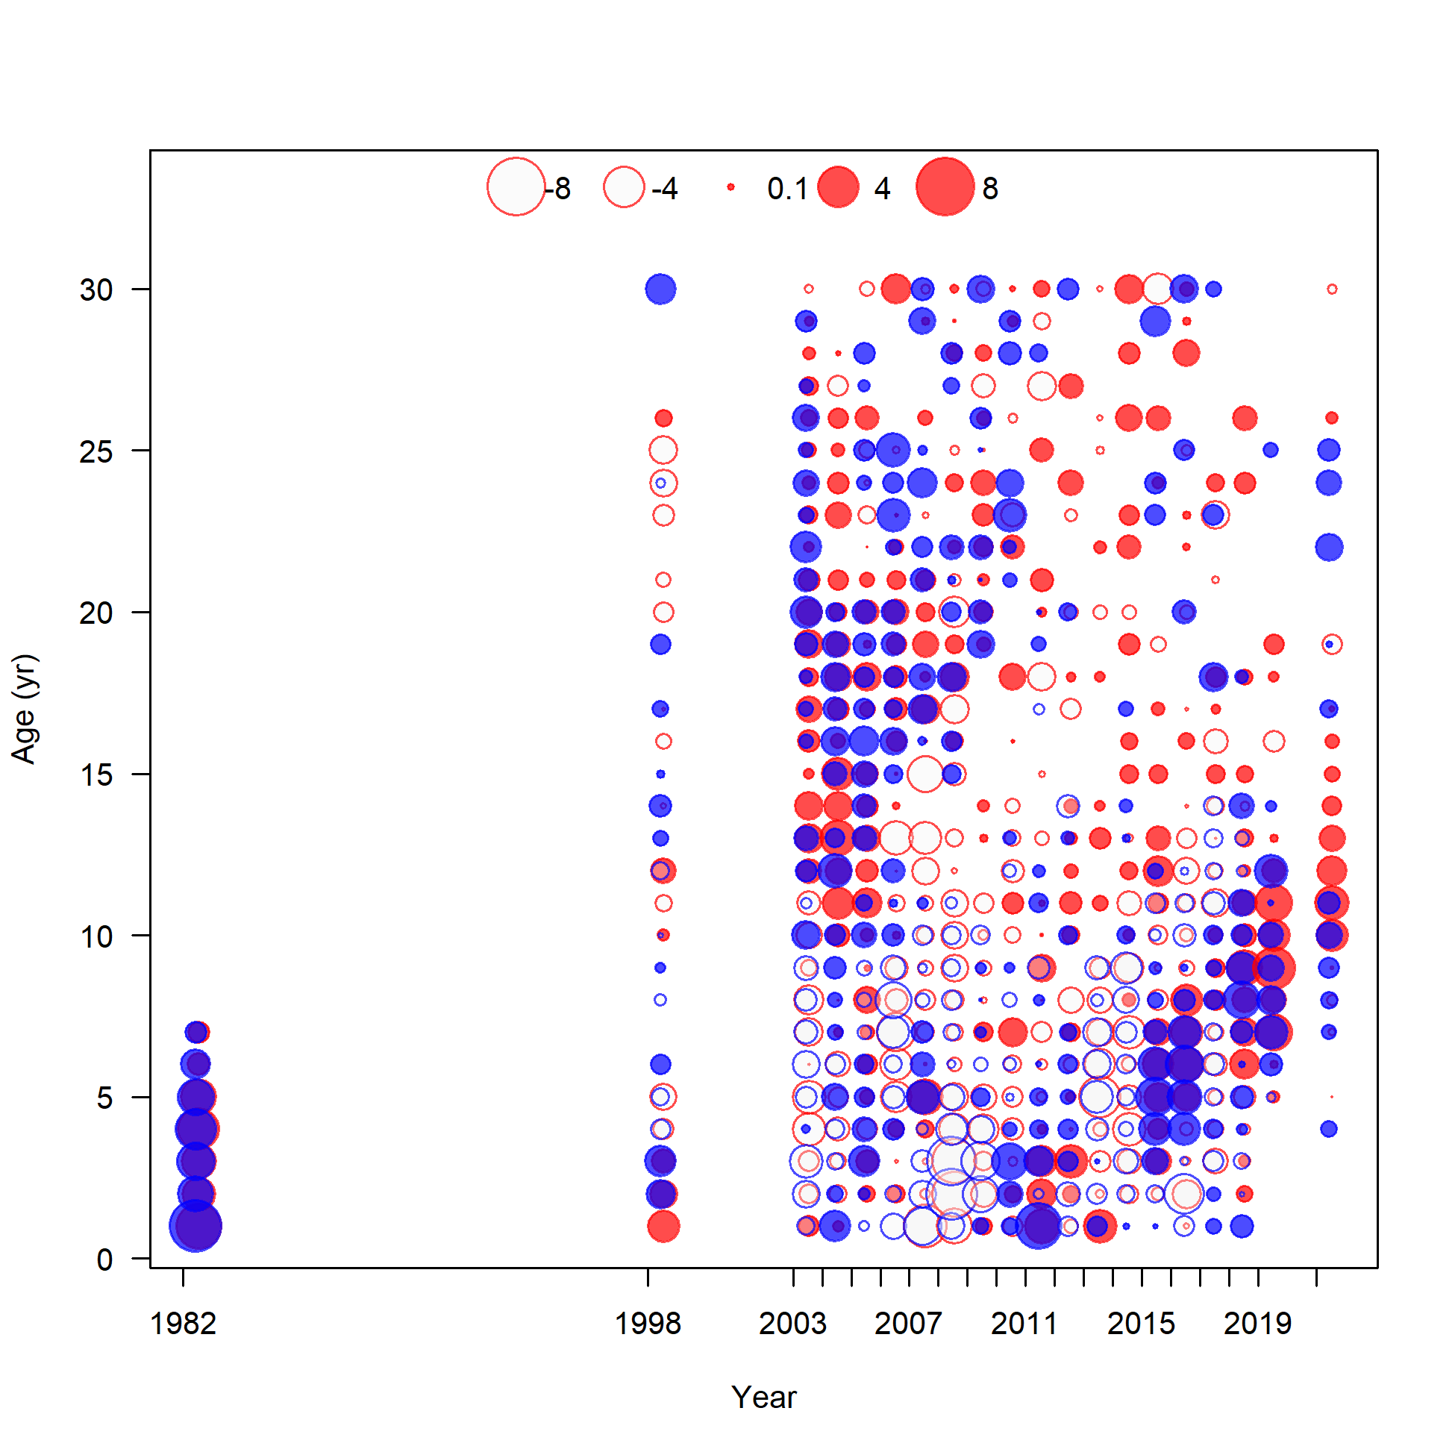
Model fit to EBS shelf survey mean size-at-age

Slide 11
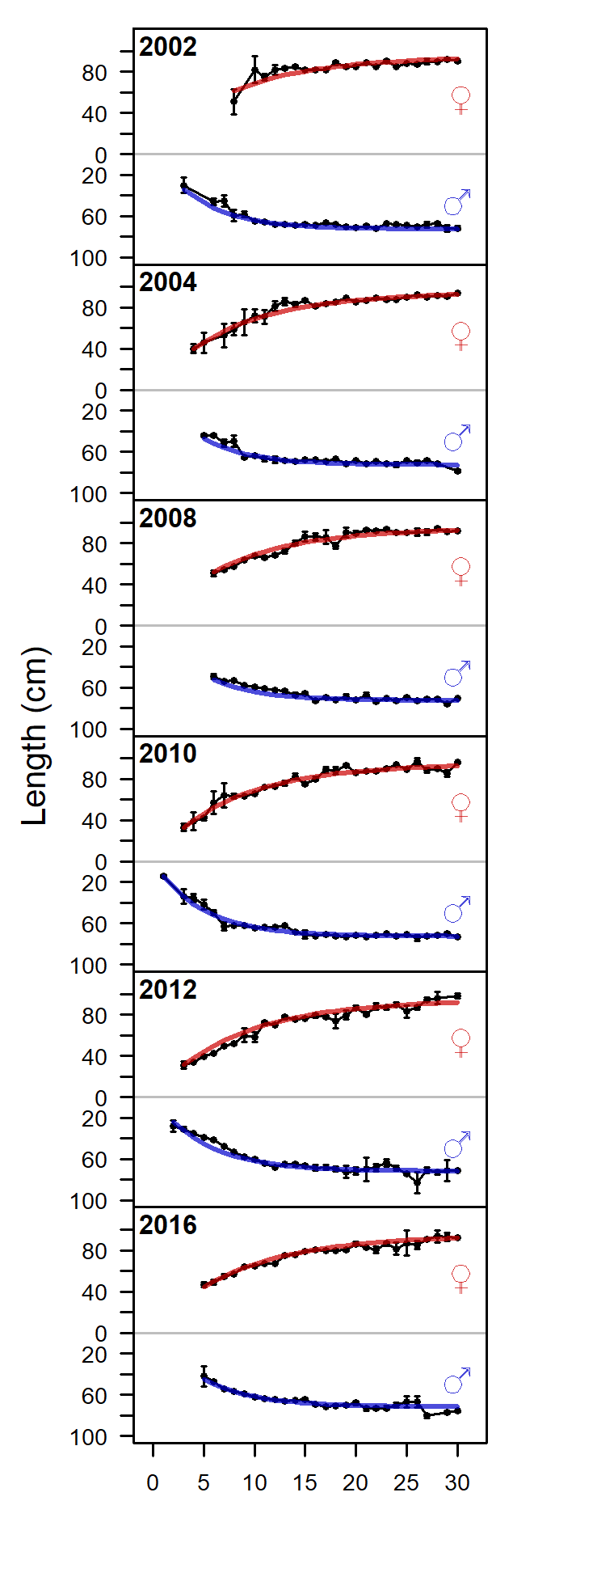
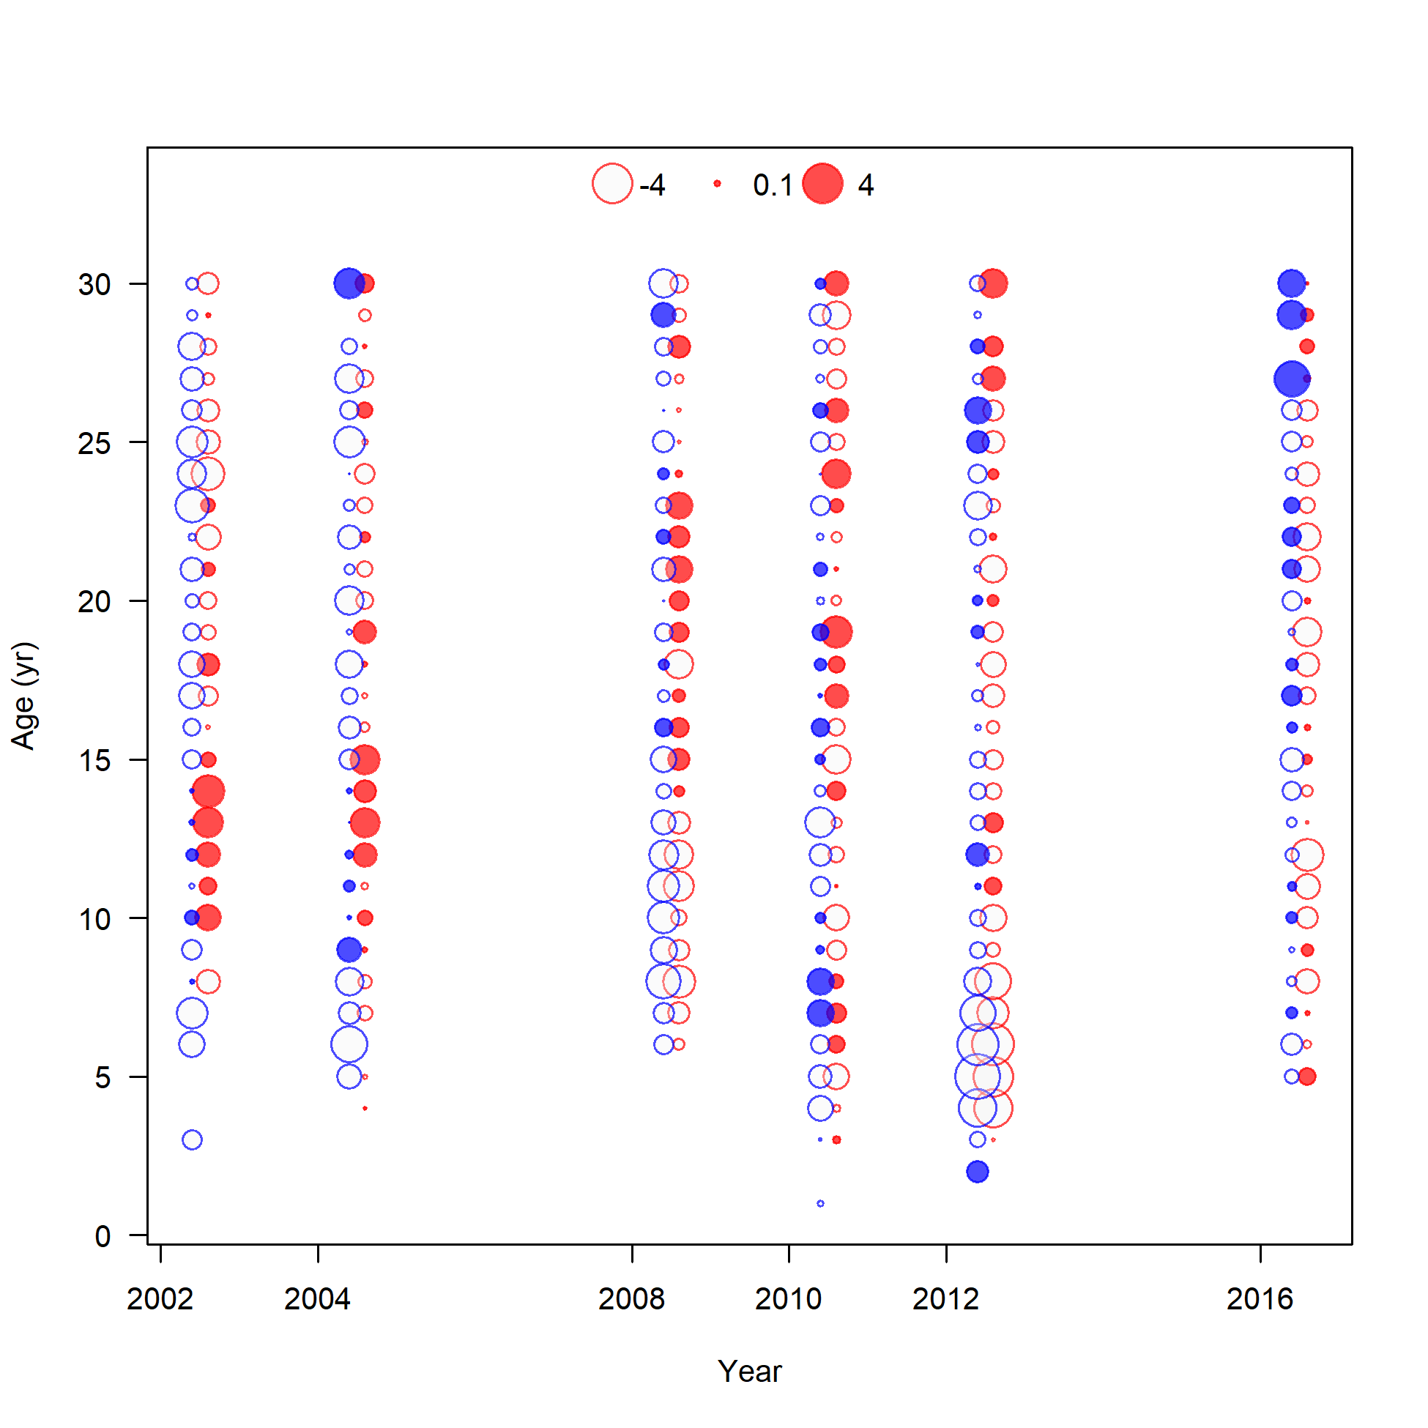
Model fit to EBS slope survey mean size-at-age
Model 16.4c only

Slide 12
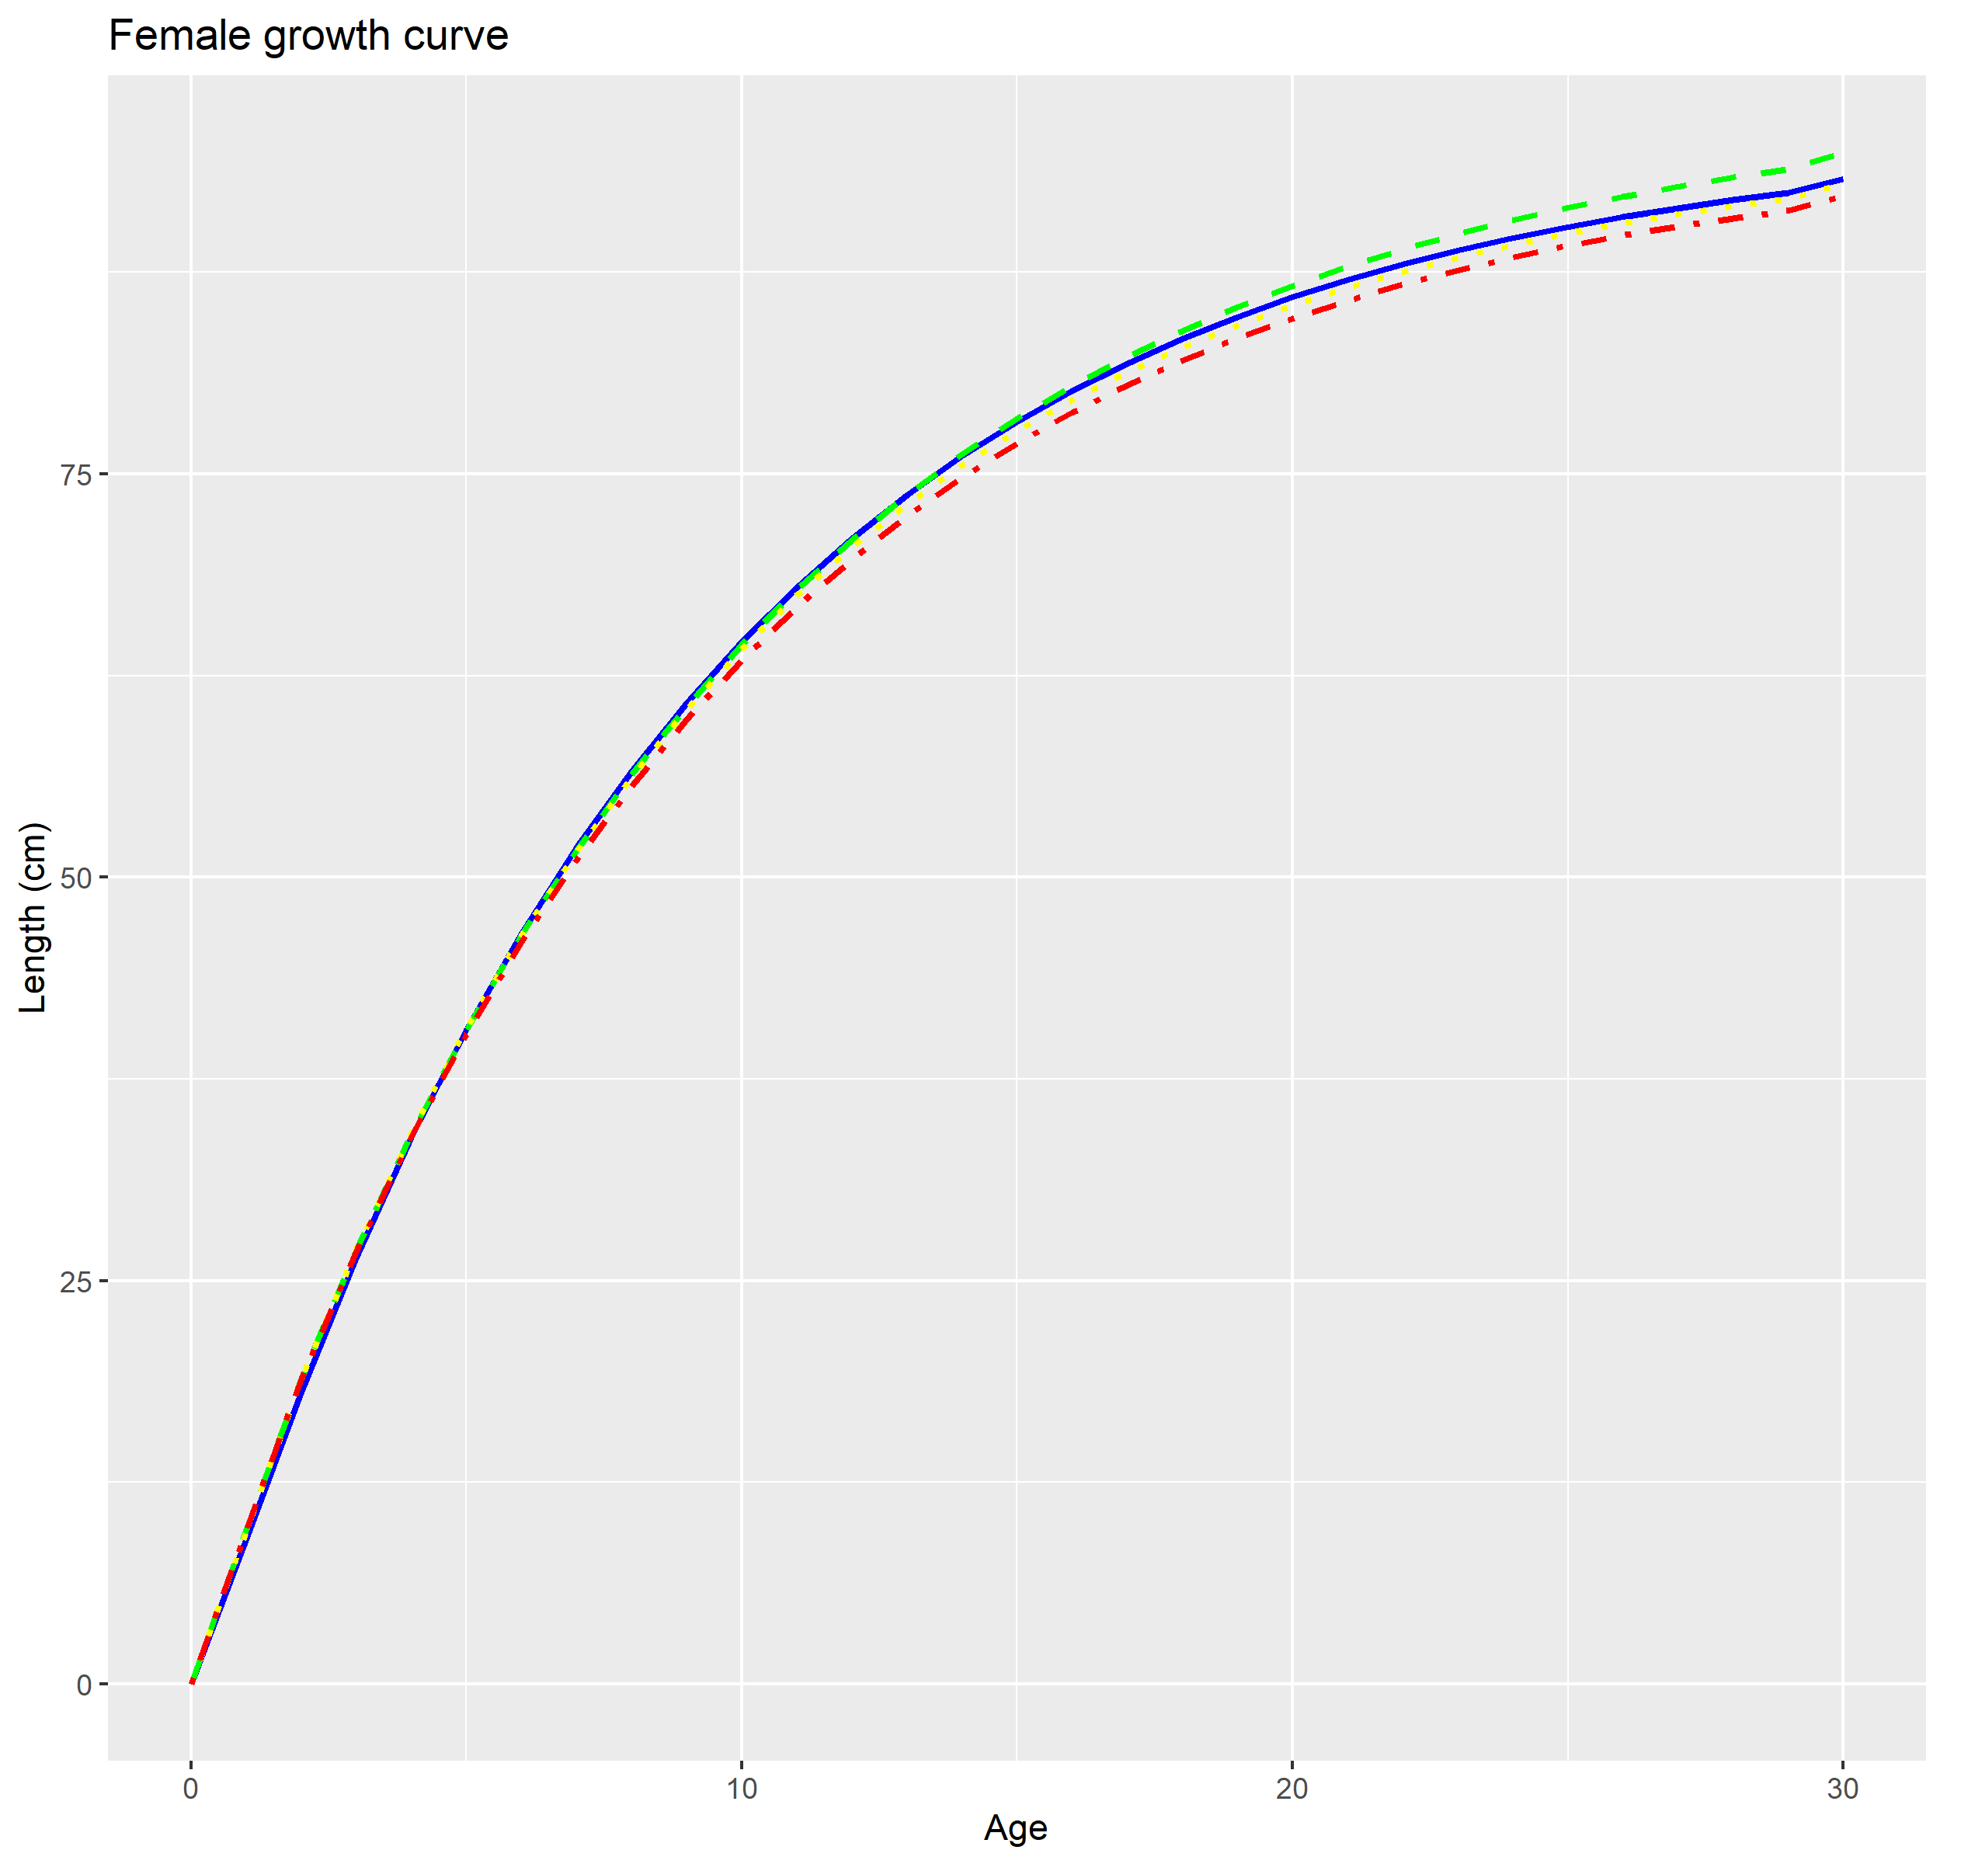
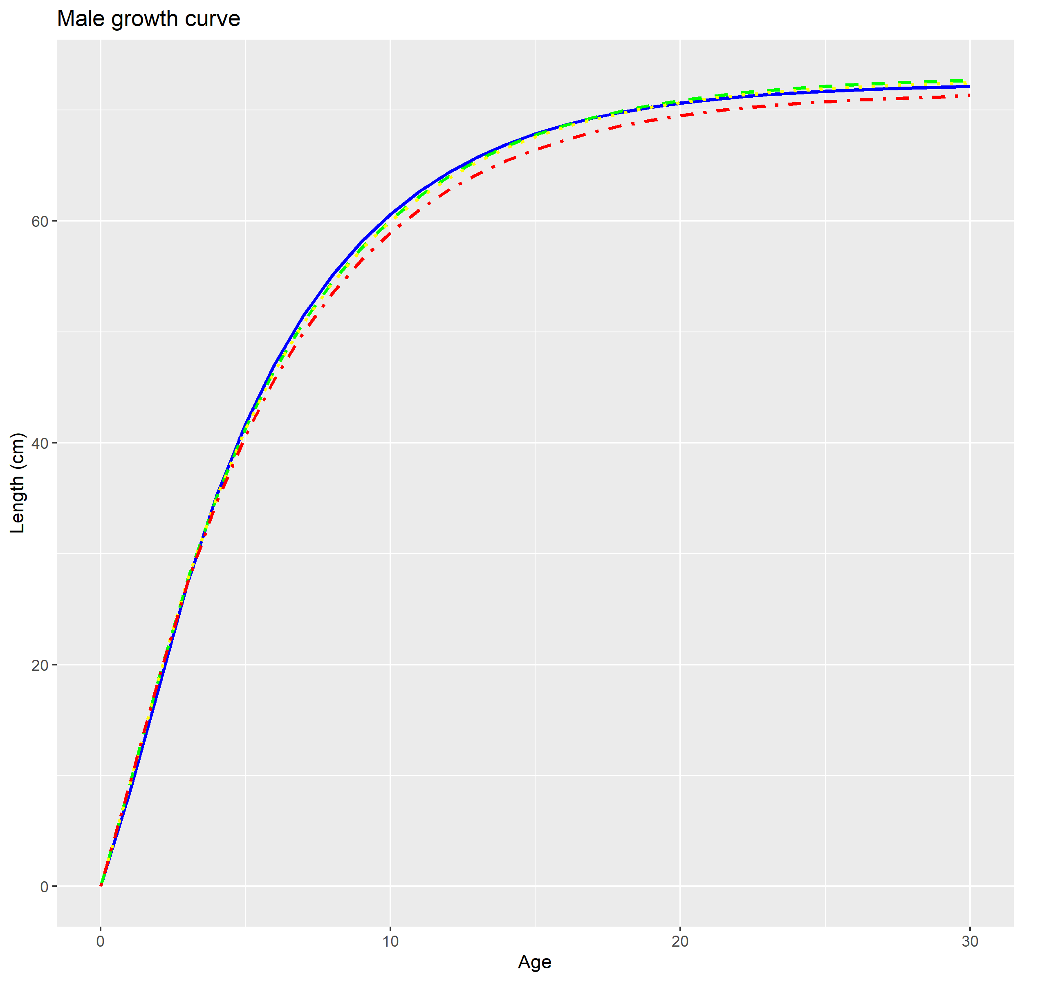
Growth estimates
 | 16.4a (2020) |  | 16.4a (2022) |  | 16.4b |  | 16.4c
Label | Value | Stdev | Value | Stdev | Value | Stdev | Value | Stdev
Biology
L Amin female | 14.92 |  | 15.88 | 0.147 | 15.85 | 0.15 | 15.92 | 0.142
L Amax female | 90.34 |  | 91.50 | 0.390 | 89.90 | 0.334 | 89.13 | 0.274
von Bert k female | 0.11 |  | 0.11 | 0.002 | 0.11 | 0.002 | 0.110 | 0.002
L Amin male | 14.06 |  | 15.21 | 0.135 | 15.21 | 0.130 | 15.31 | 0.128
L Amax male | 71.70 |  | 72.13 | 0.33 | 71.92 | 0.320 | 70.75 | 0.263
von Bert k male | 0.19 |  | 0.18 | 0.003 | 0.18 | 0.003 | 0.179 | 0.003
Females Males
Model 16.4a (2020)
Model 16.4a (2022)
Model 16.4b
Model 16.4c
Notes:
Estimated growth similar to previous assessment

Slide 13
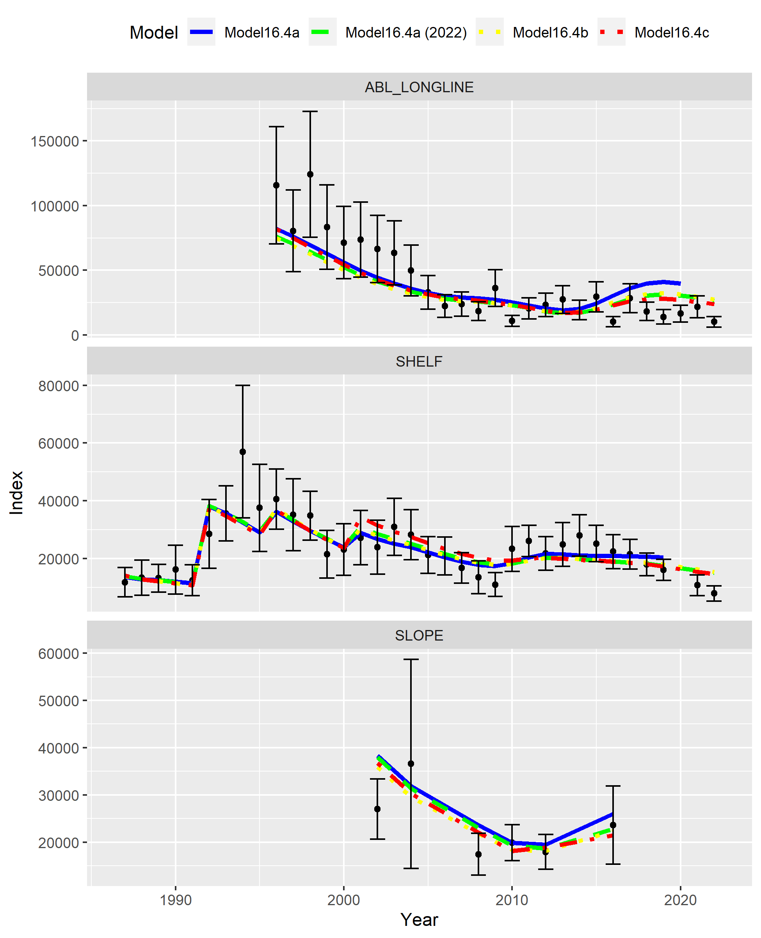
Model fit to indices
Model 16.4a (2020)
Model 16.4a (2022)
Model 16.4b
Model 16.4c
LN(q) | 16.4a (2020) | 16.4a (2022) | 16.4b | 16.4c
Shelf | -0.49 | -0.49 | -0.49 | -0.49
Slope | -0.56 | -0.56 | -0.56 | -0.56
ABL Longline | 0.79 | 0.74 | 0.73 | 0.75
RMSE | 16.4a (2020) | 16.4a (2022) | 16.4b | 16.4c
Shelf | 0.207 | 0.250 | 0.254 | 0.264
Slope | 0.204 | 0.192 | 0.175 | 0.185
ABL Longline | 0.474 | 0.477 | 0.497 | 0.438

Slide 14
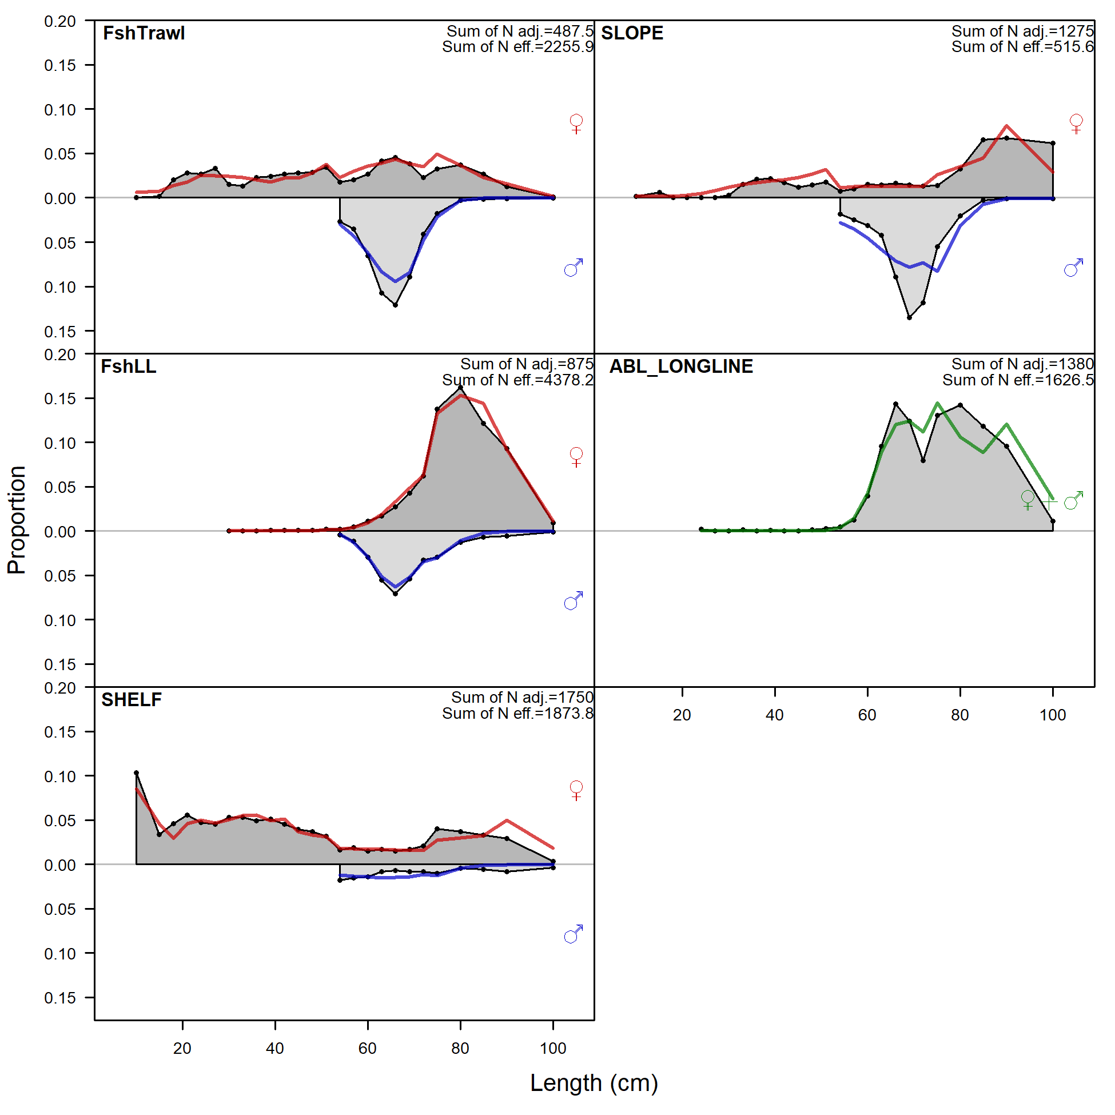
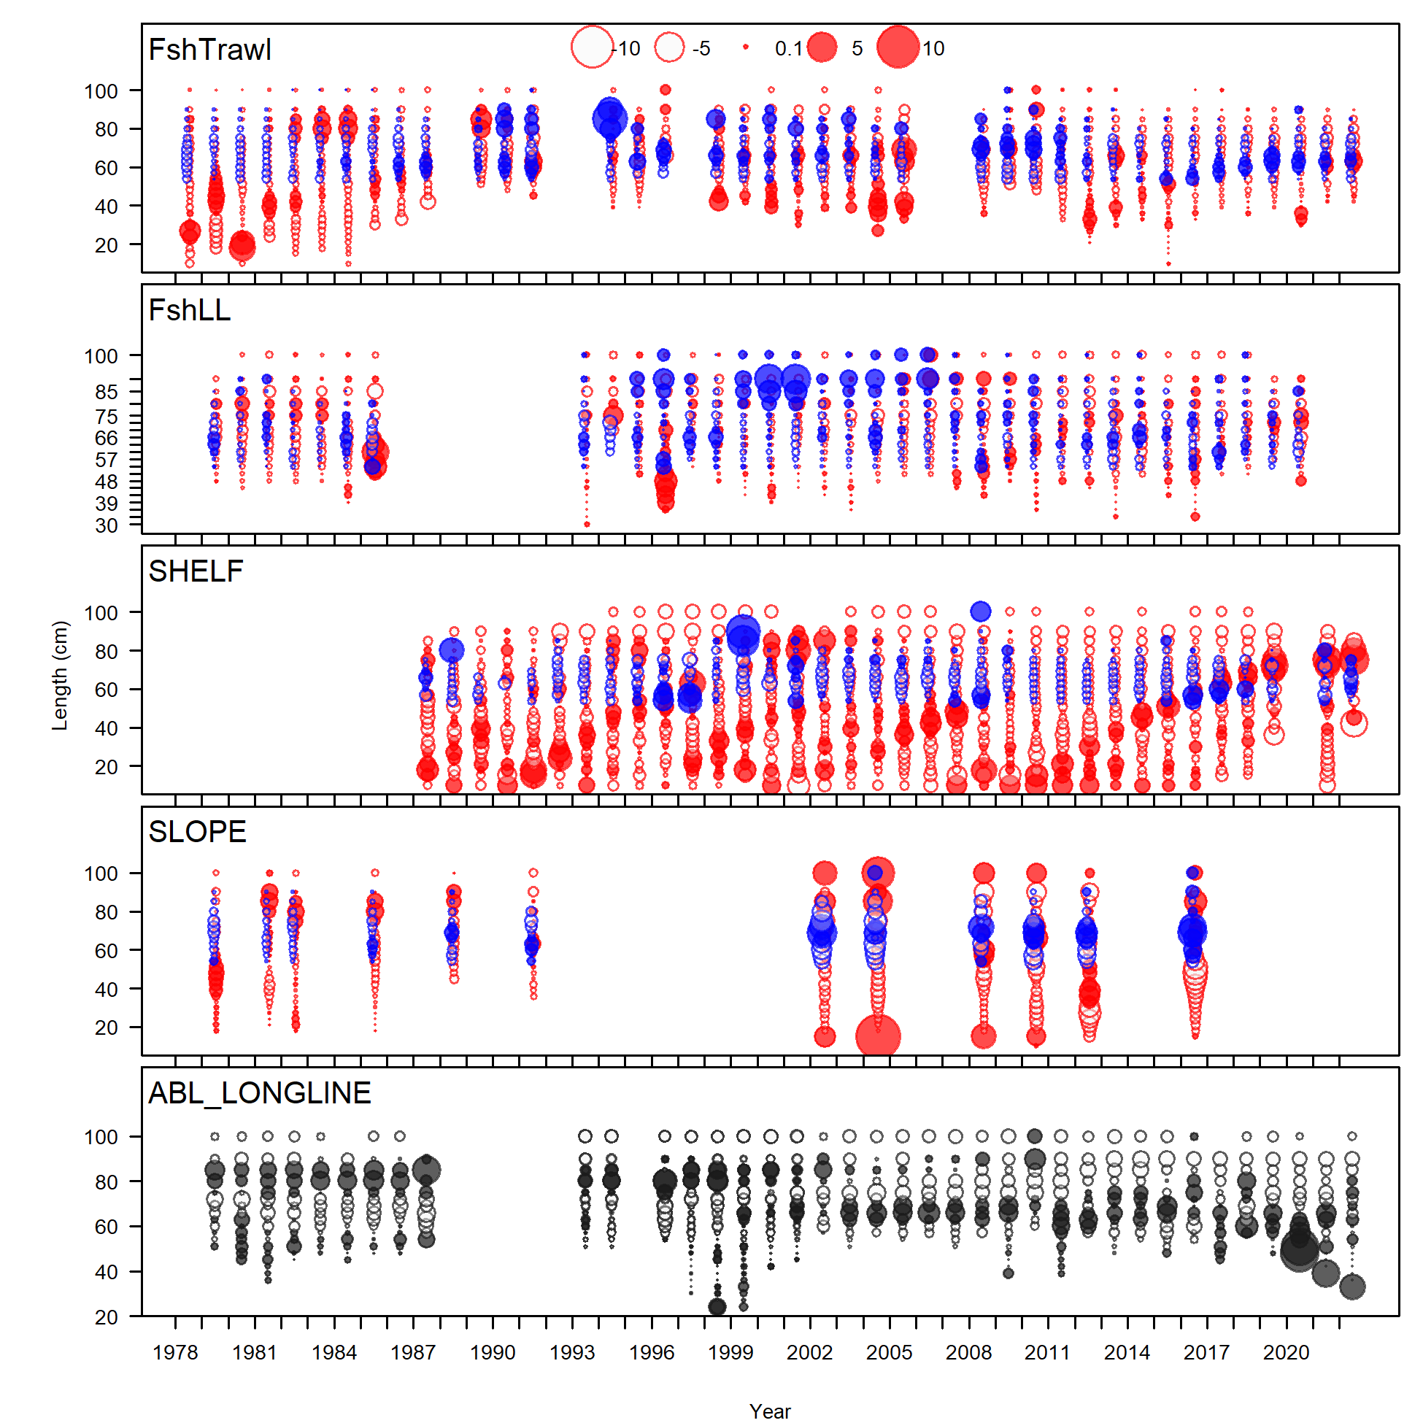
Fit to length composition estimates
Notes:
Model best fits the LL fishery length data (especially the male data).

Slide 15
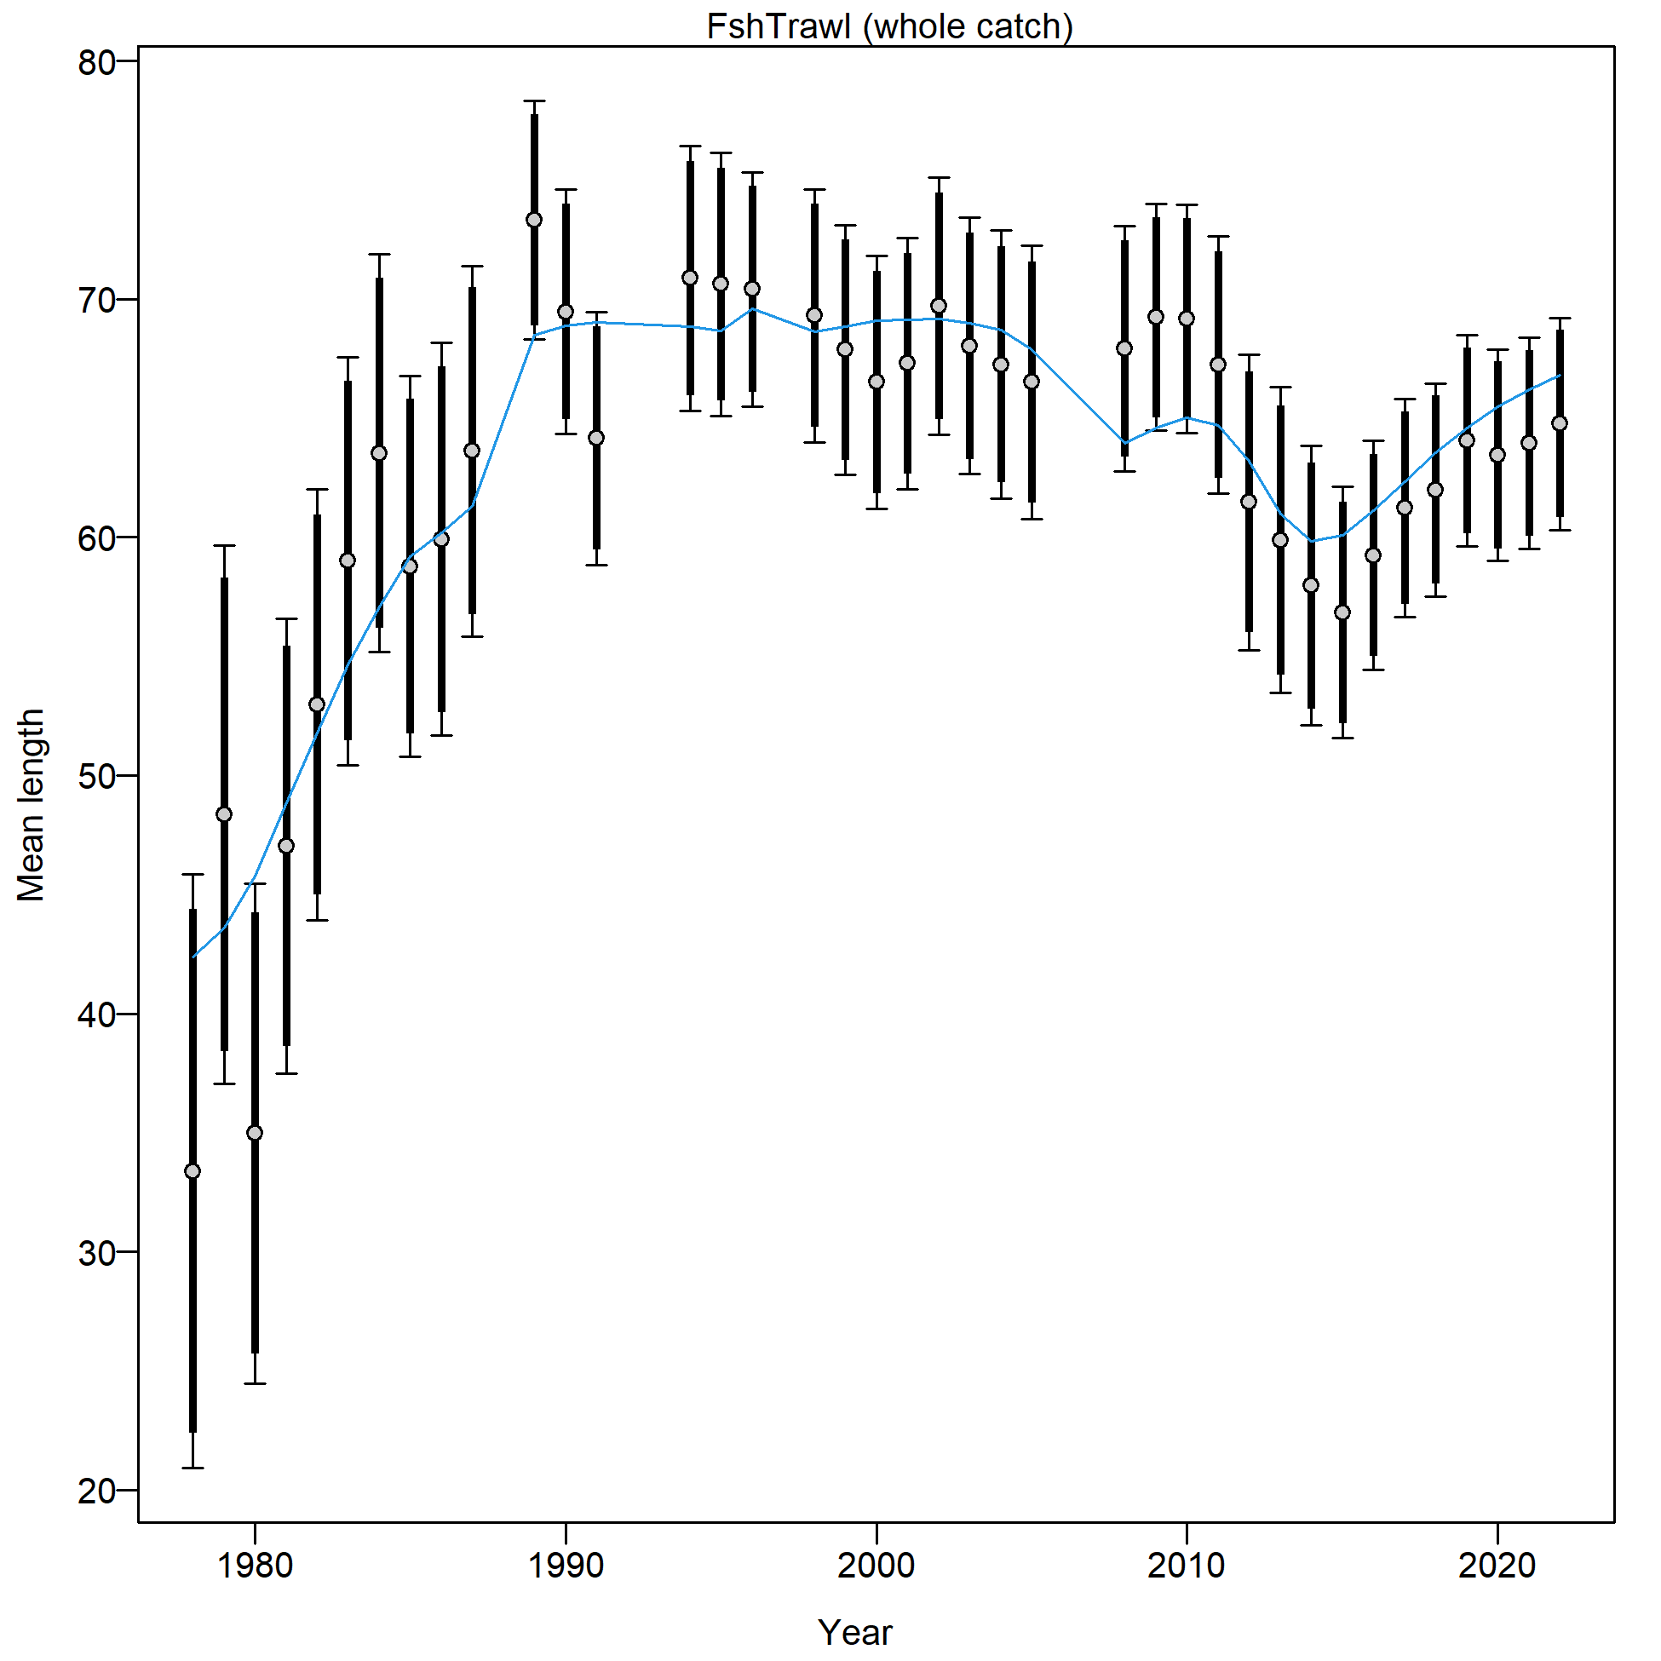
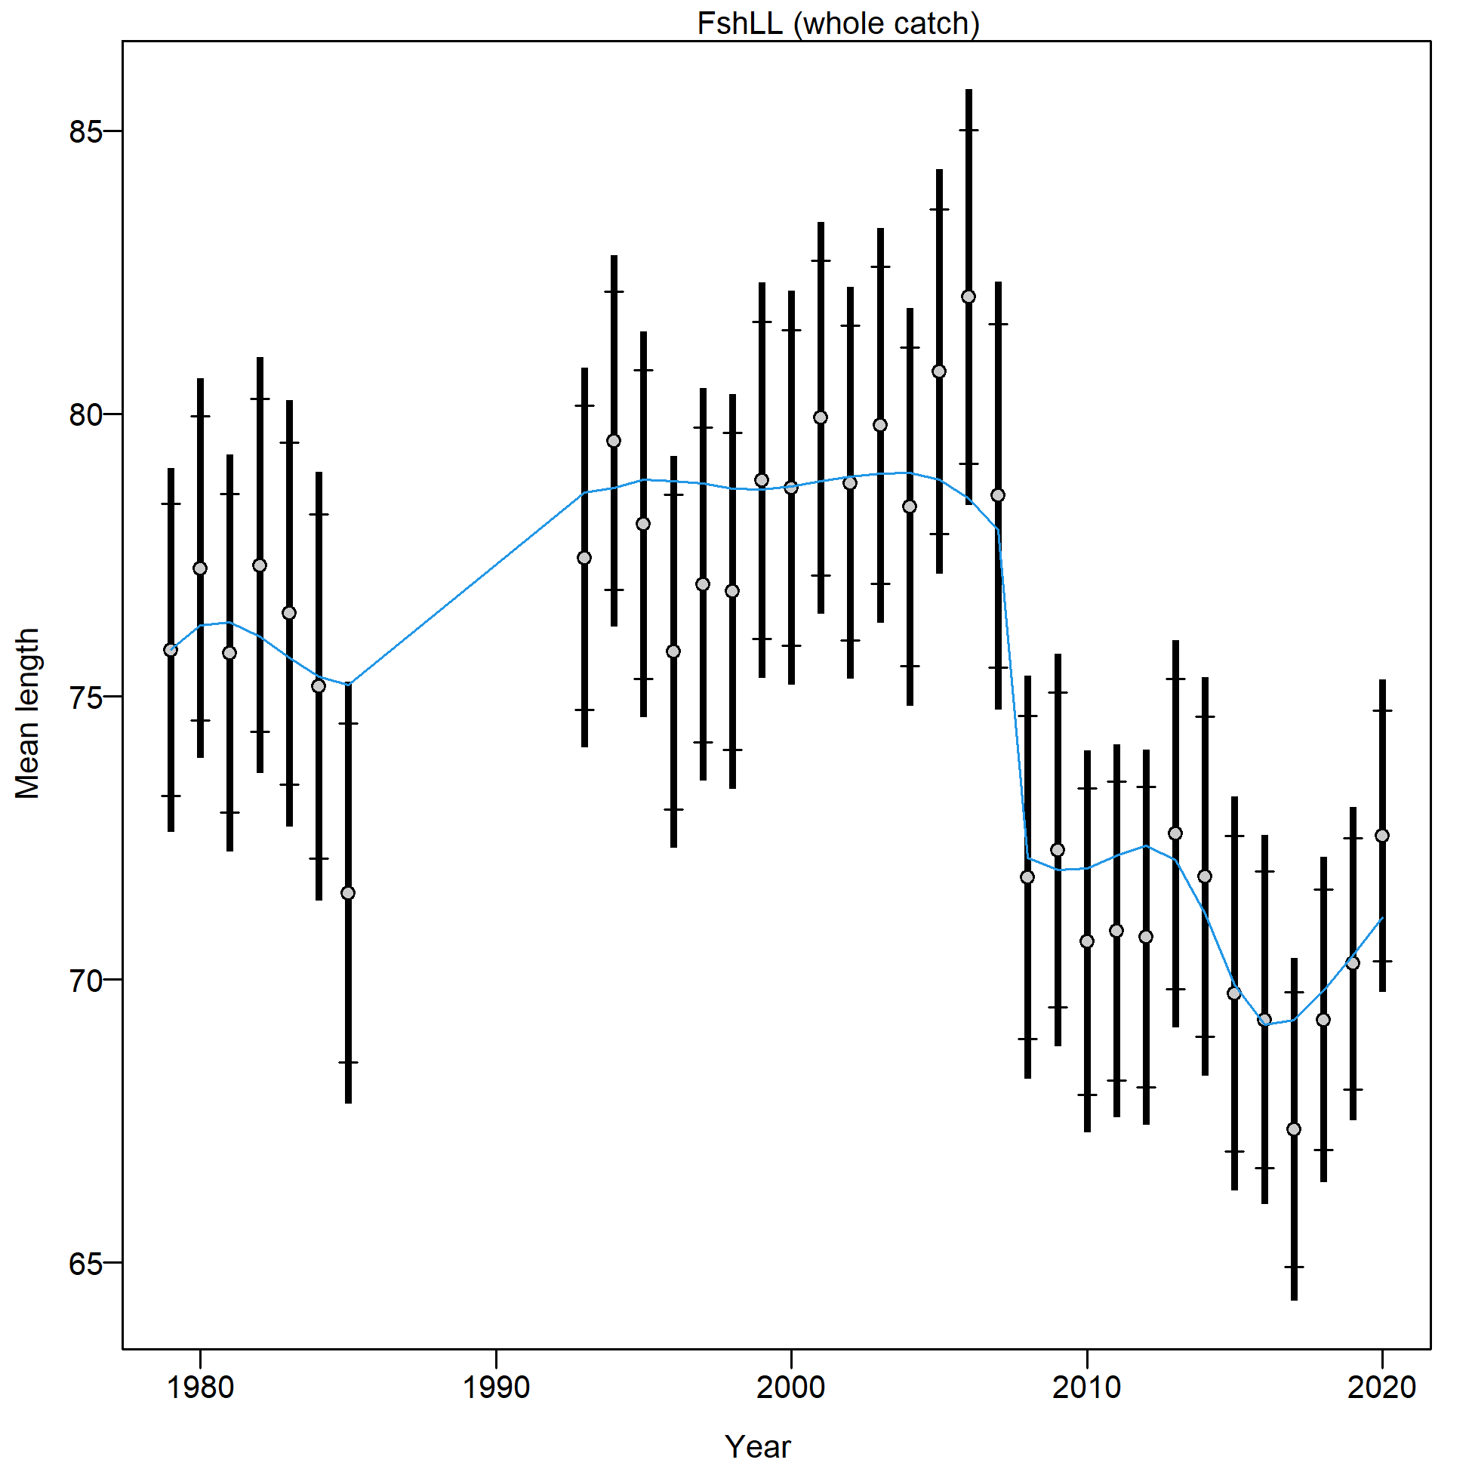
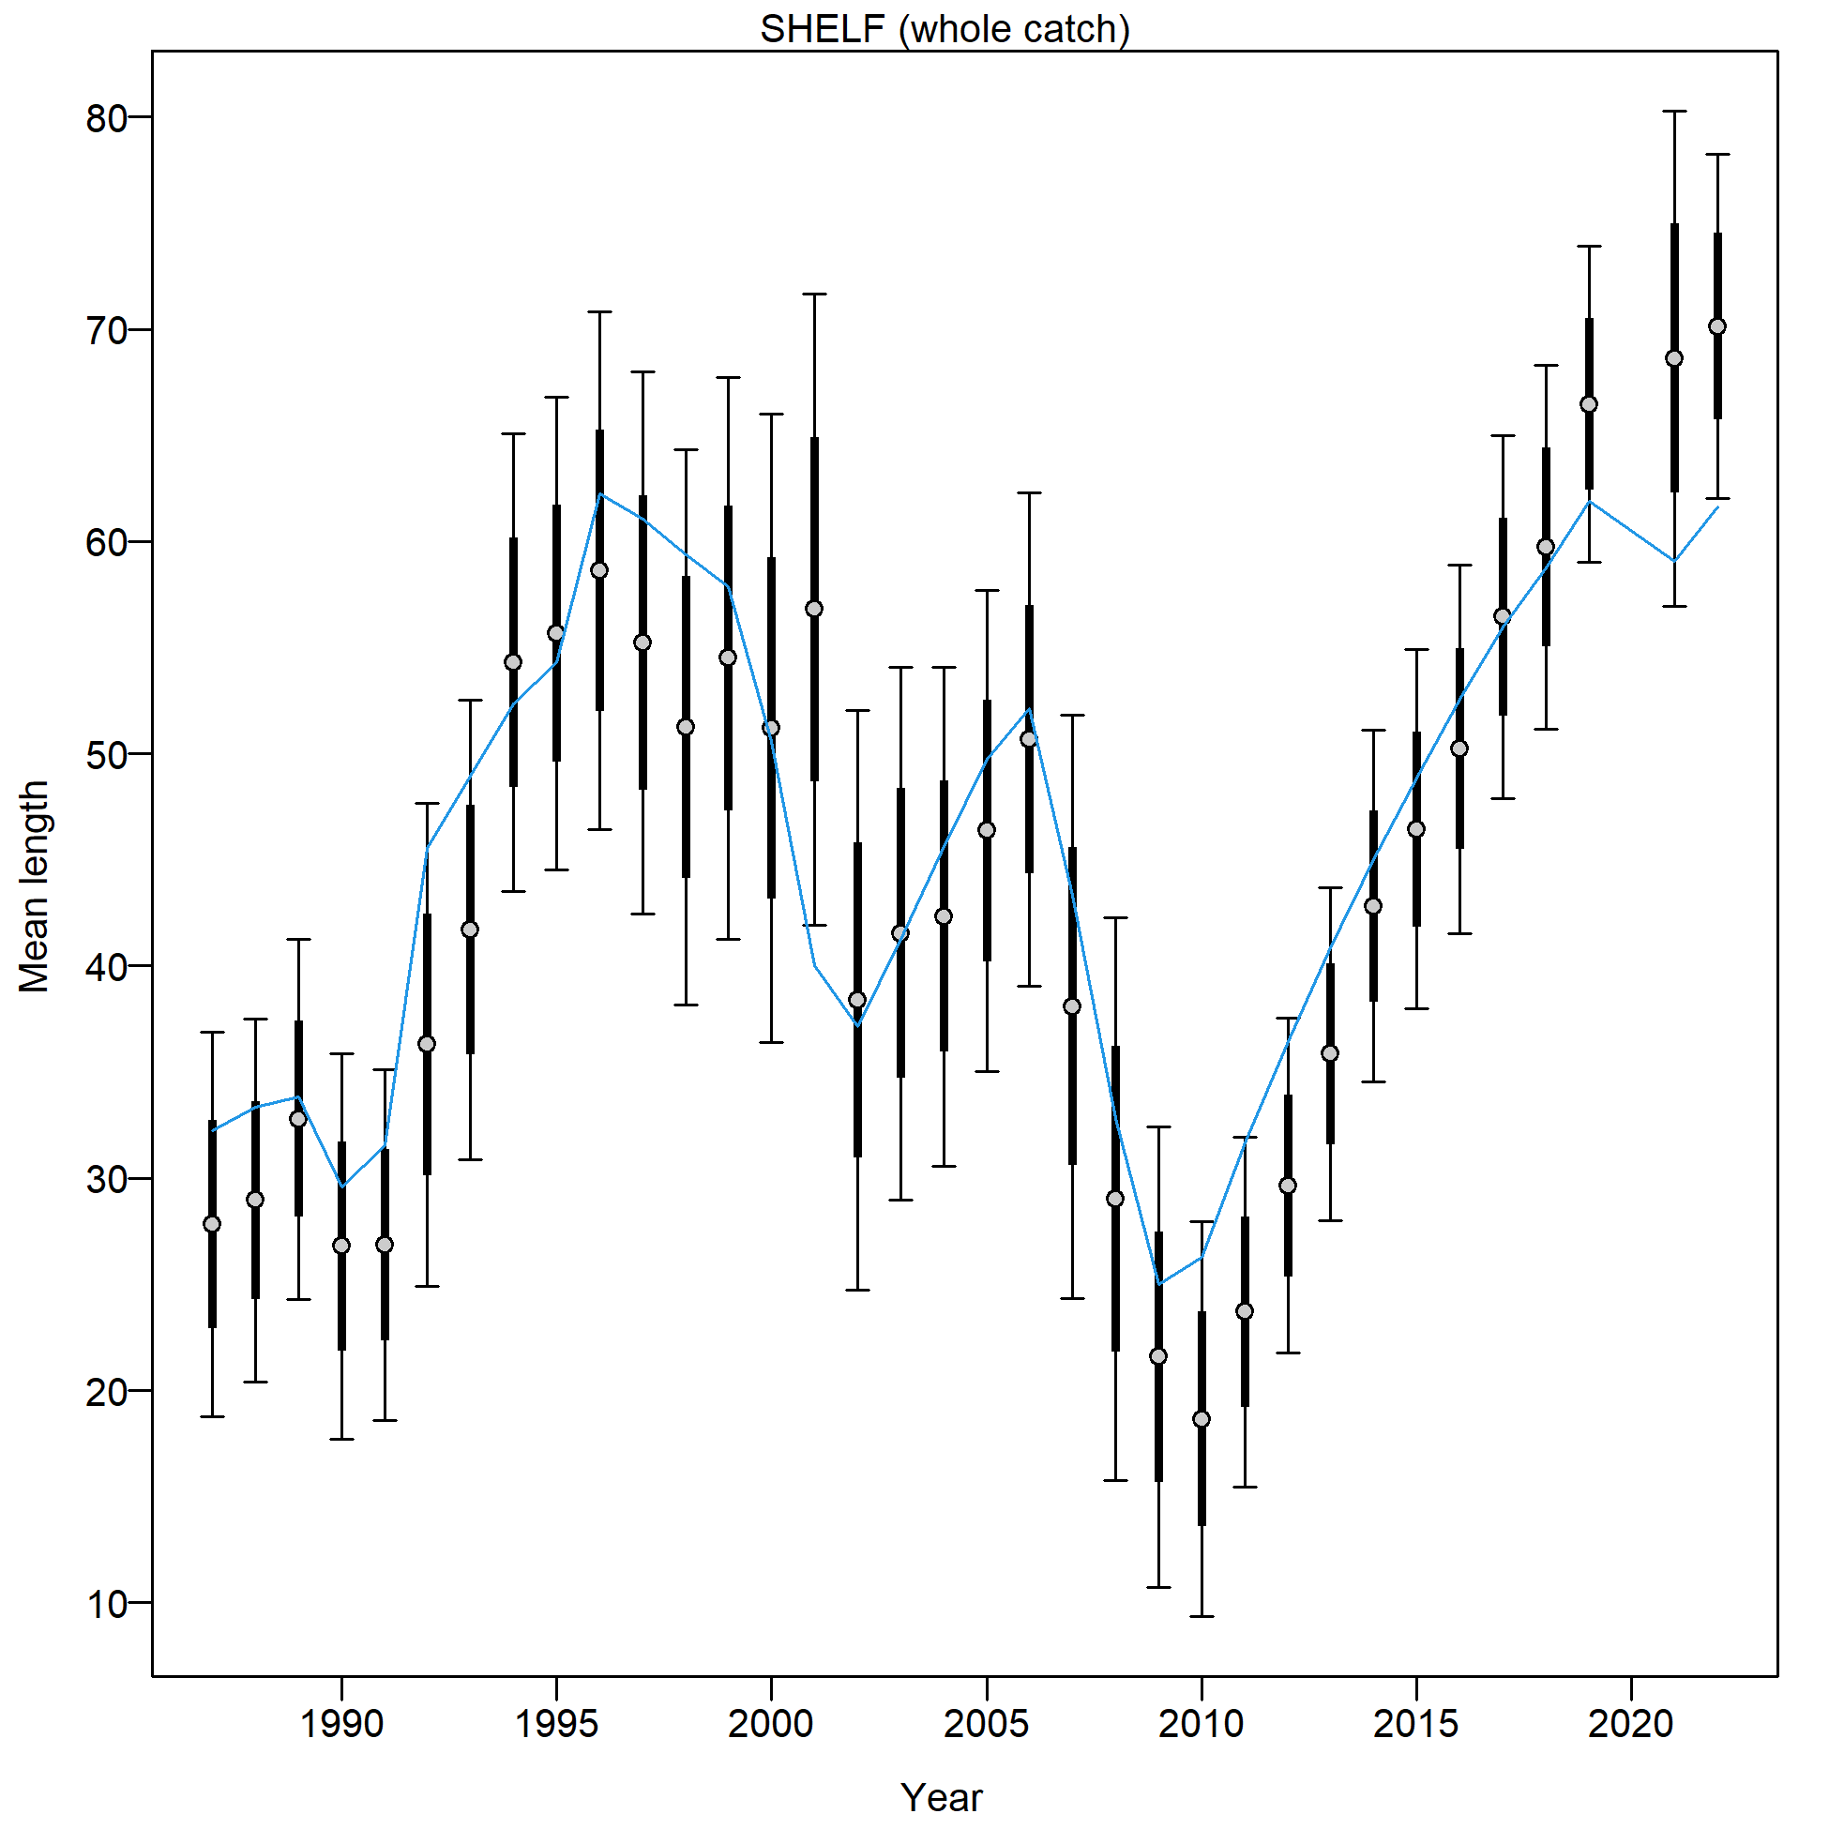
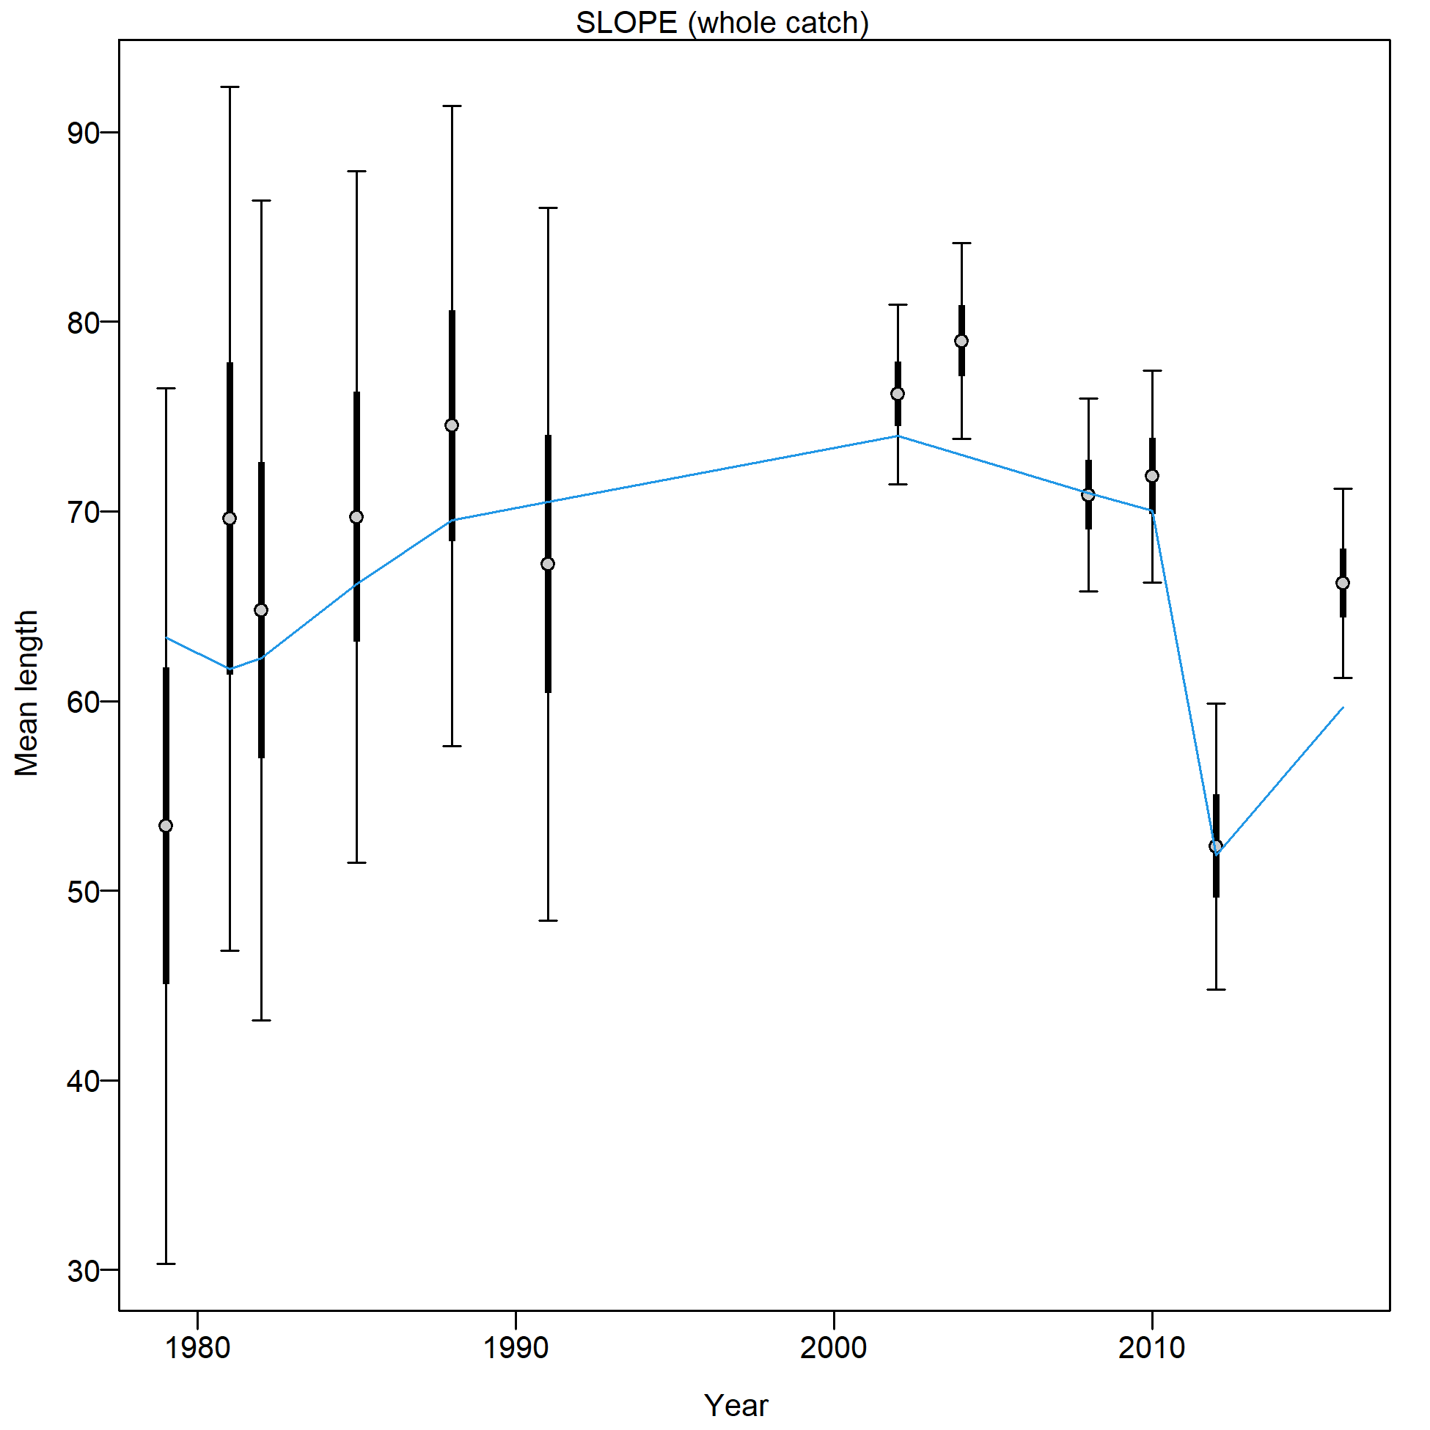
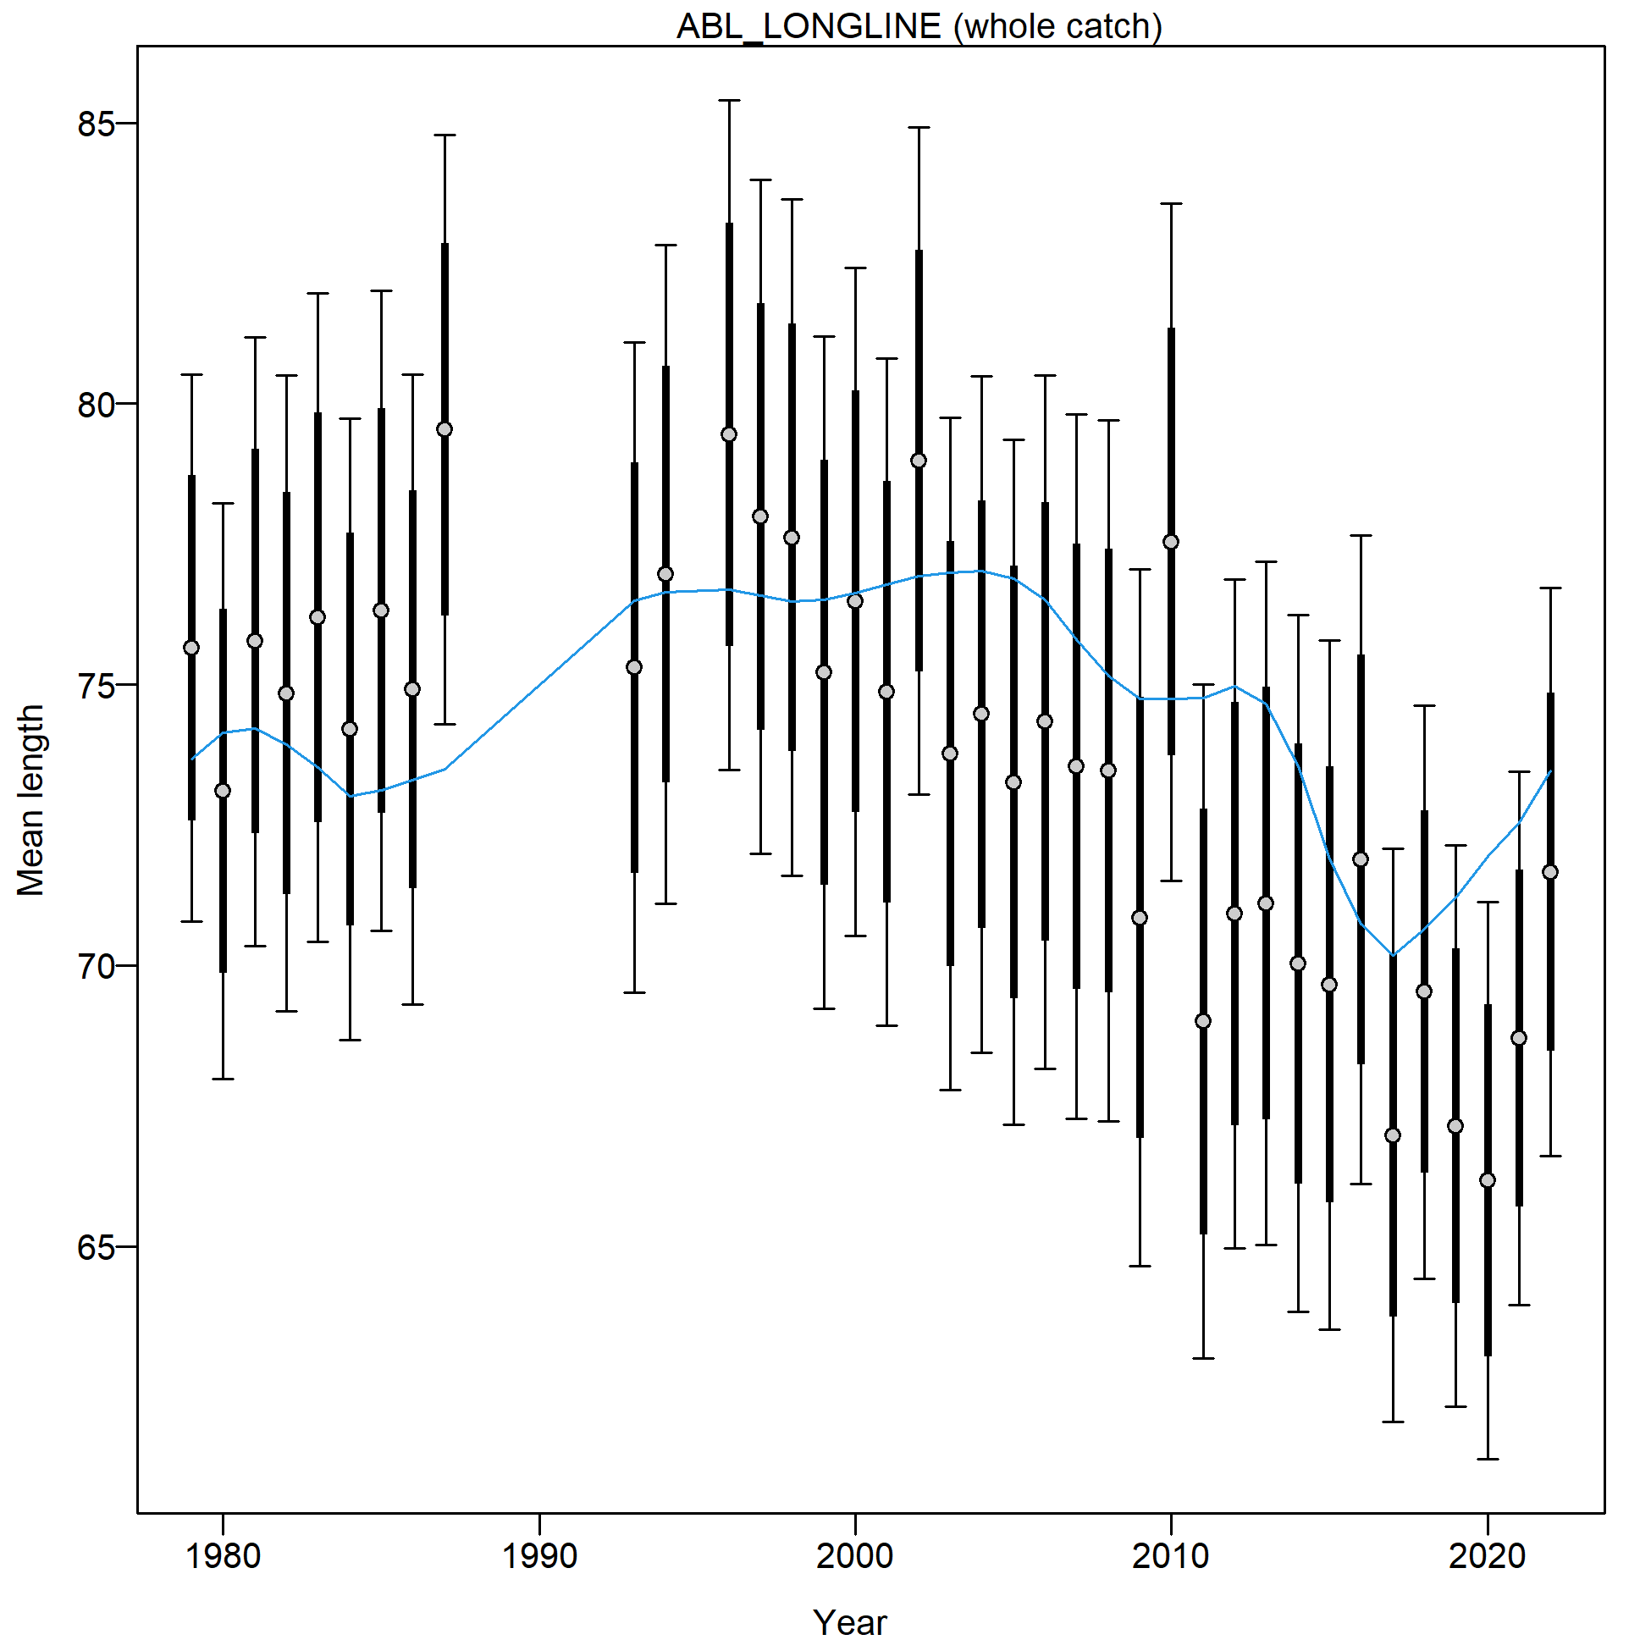
Mean length estimates
Notes:
Model best fits the LL fishery length data (especially the male data).

Slide 16
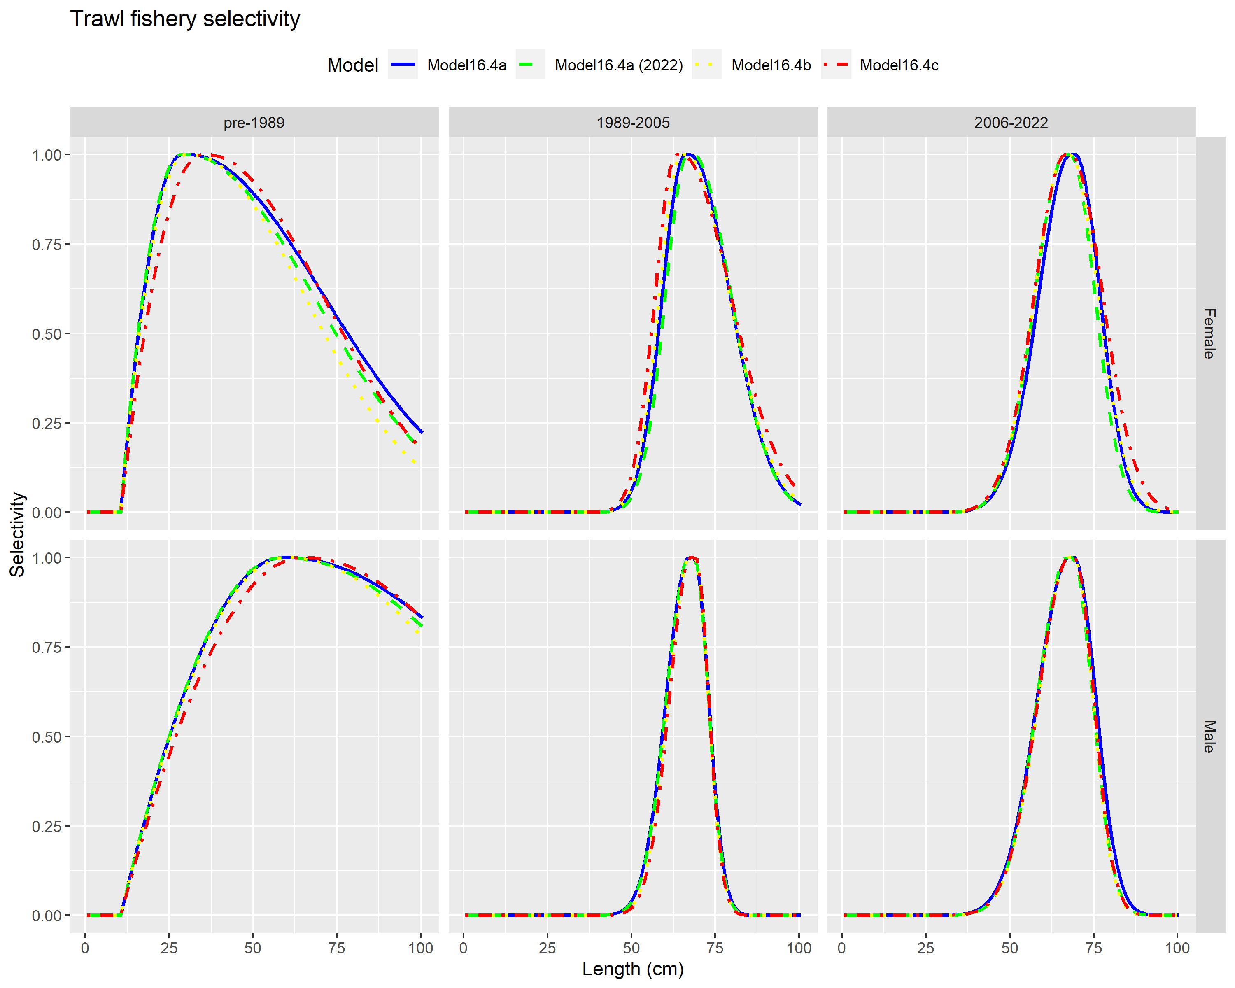

Slide 17
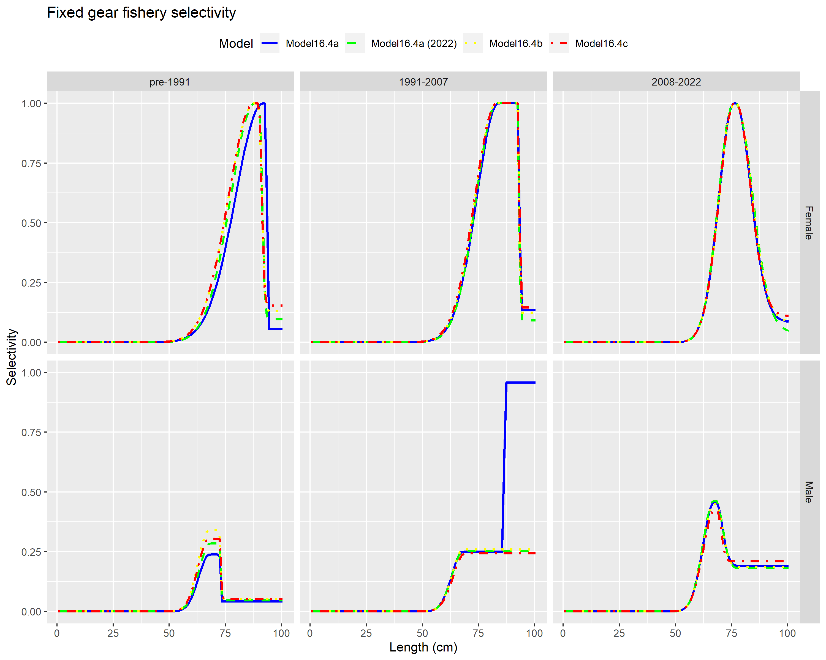

Slide 18
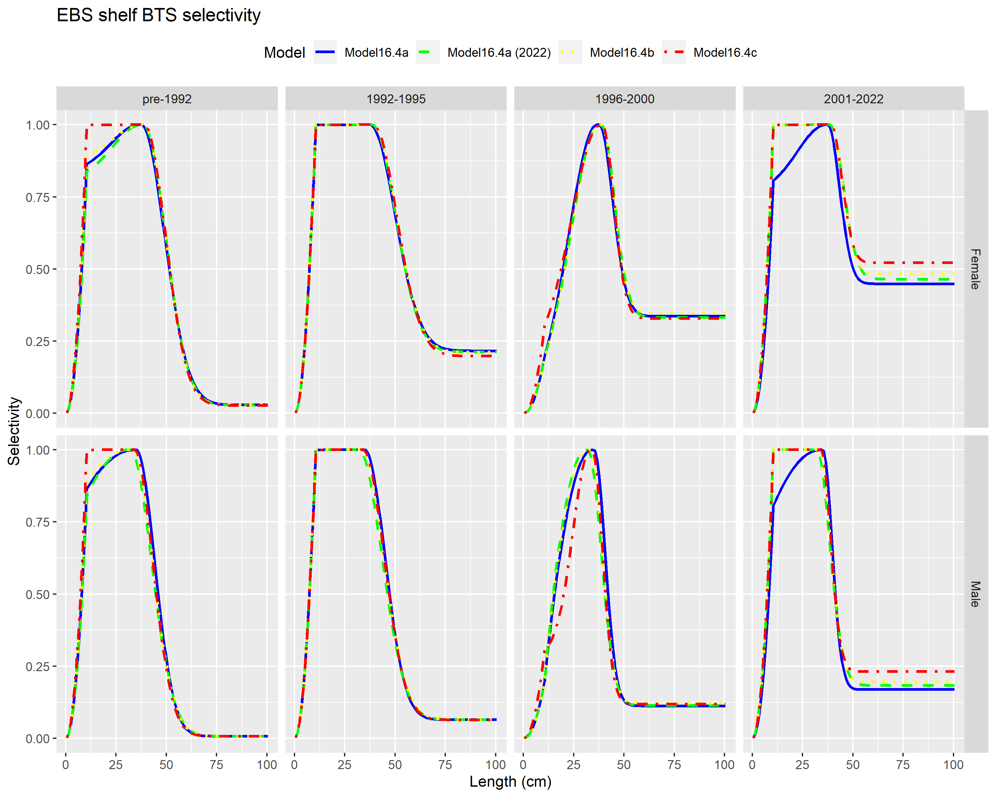

Slide 19
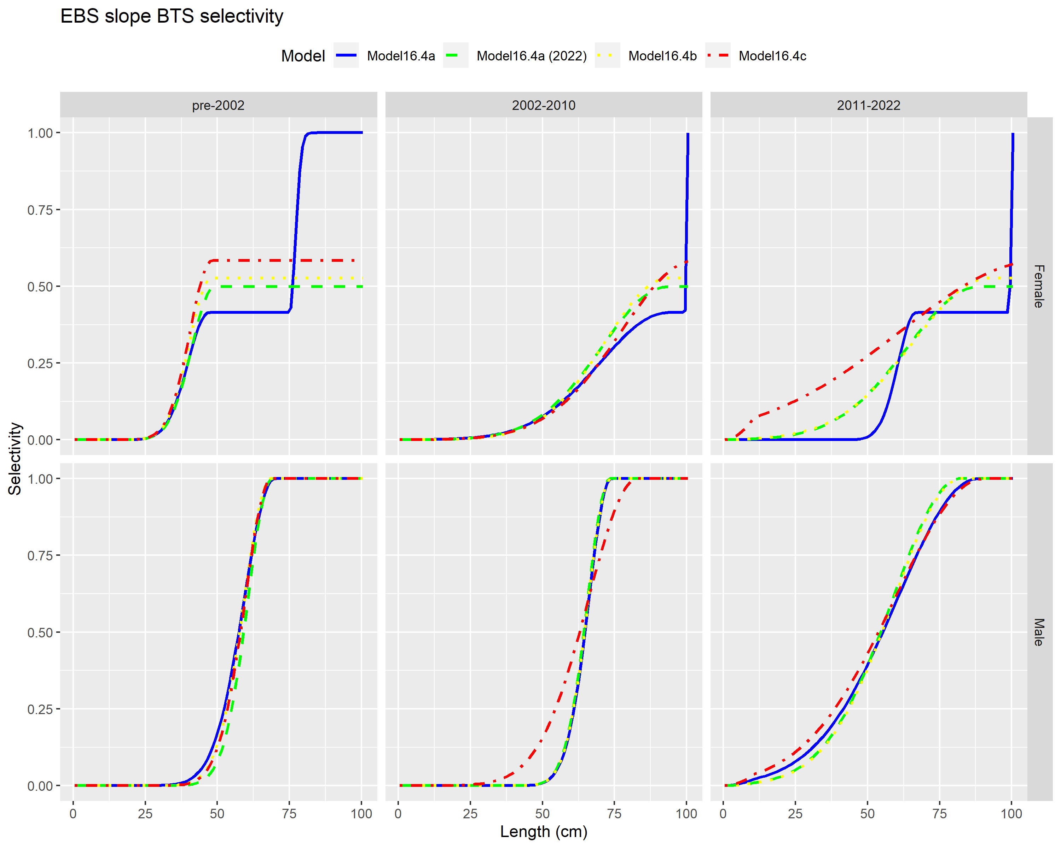

Slide 20
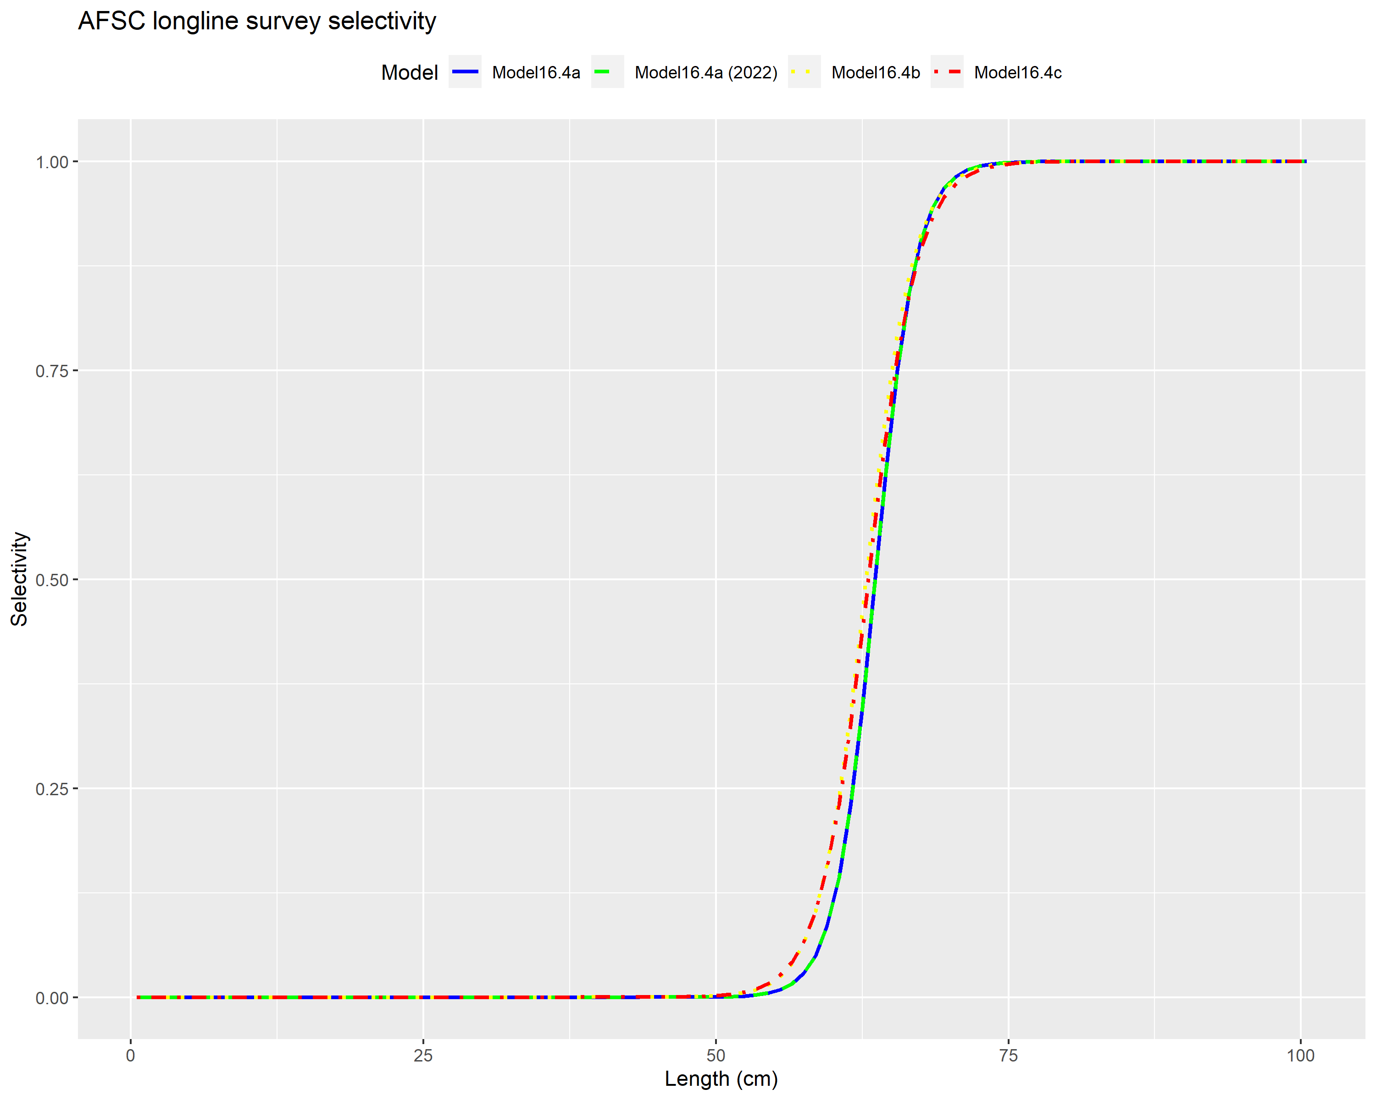

Slide 21
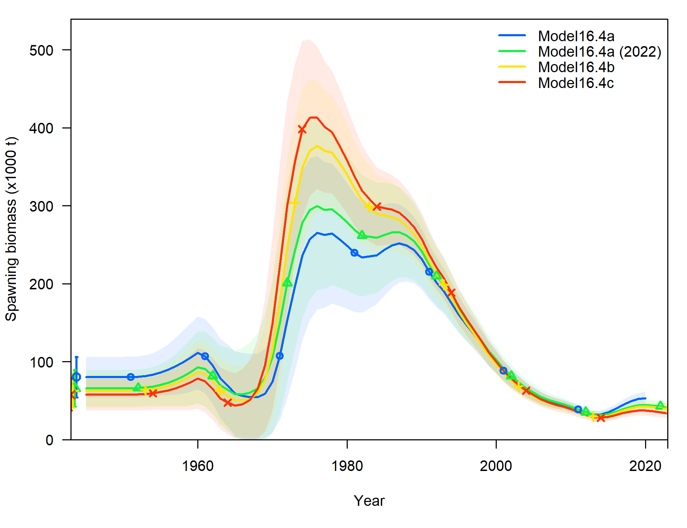
Time series

Slide 22
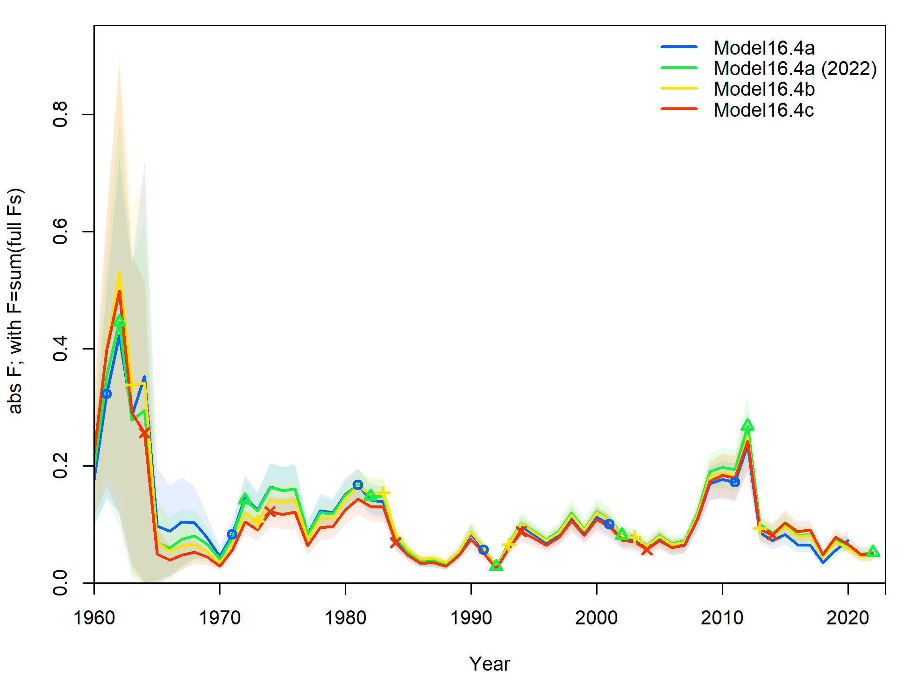
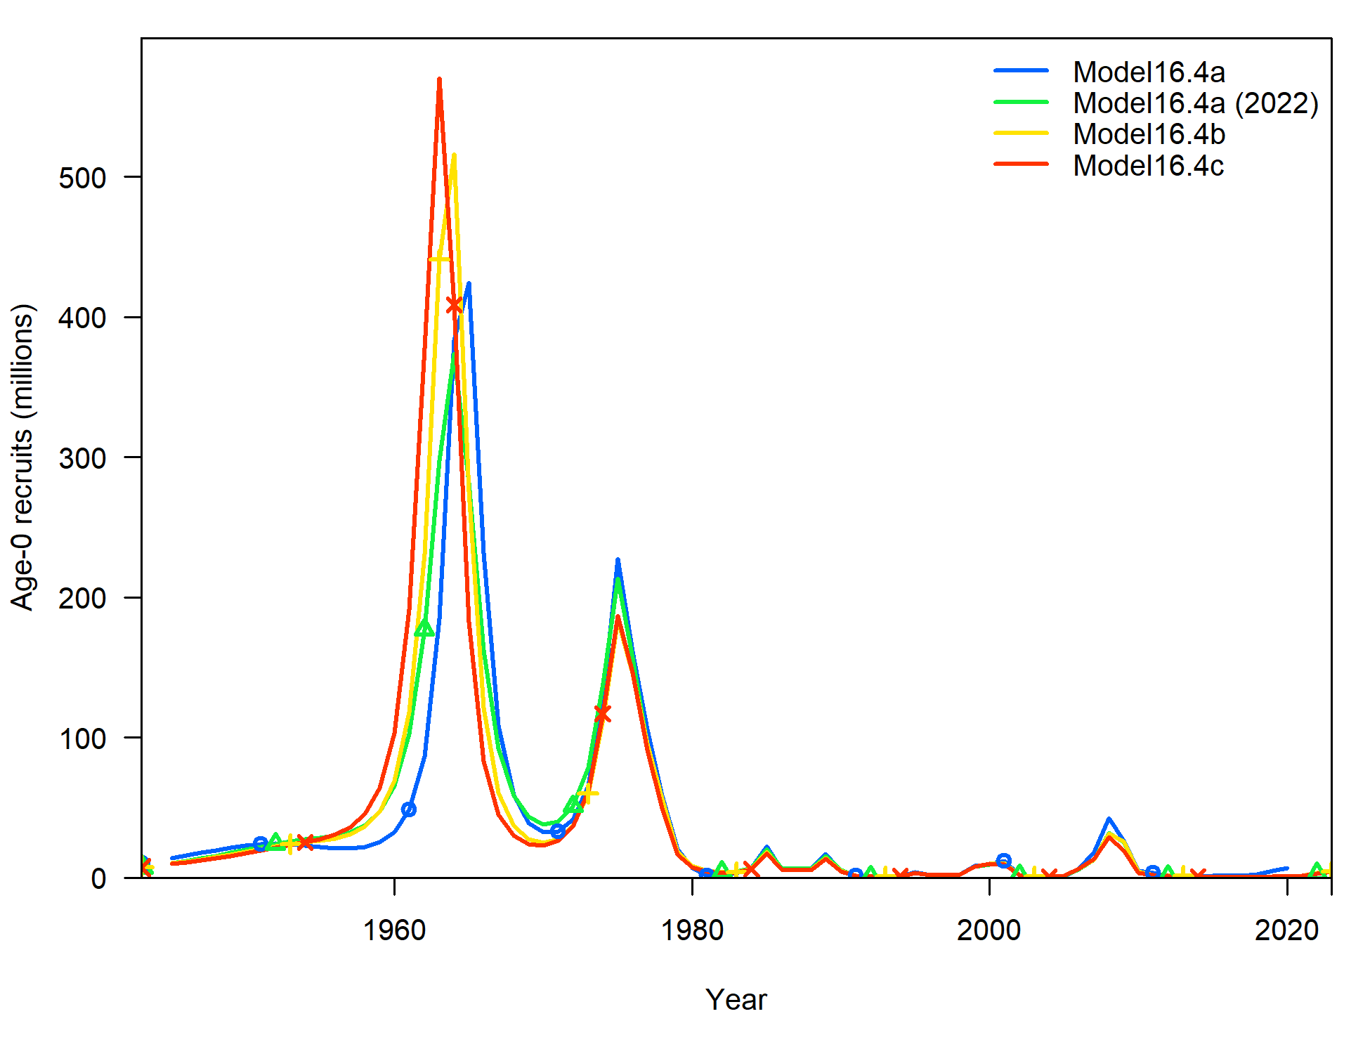
Time series

Slide 23
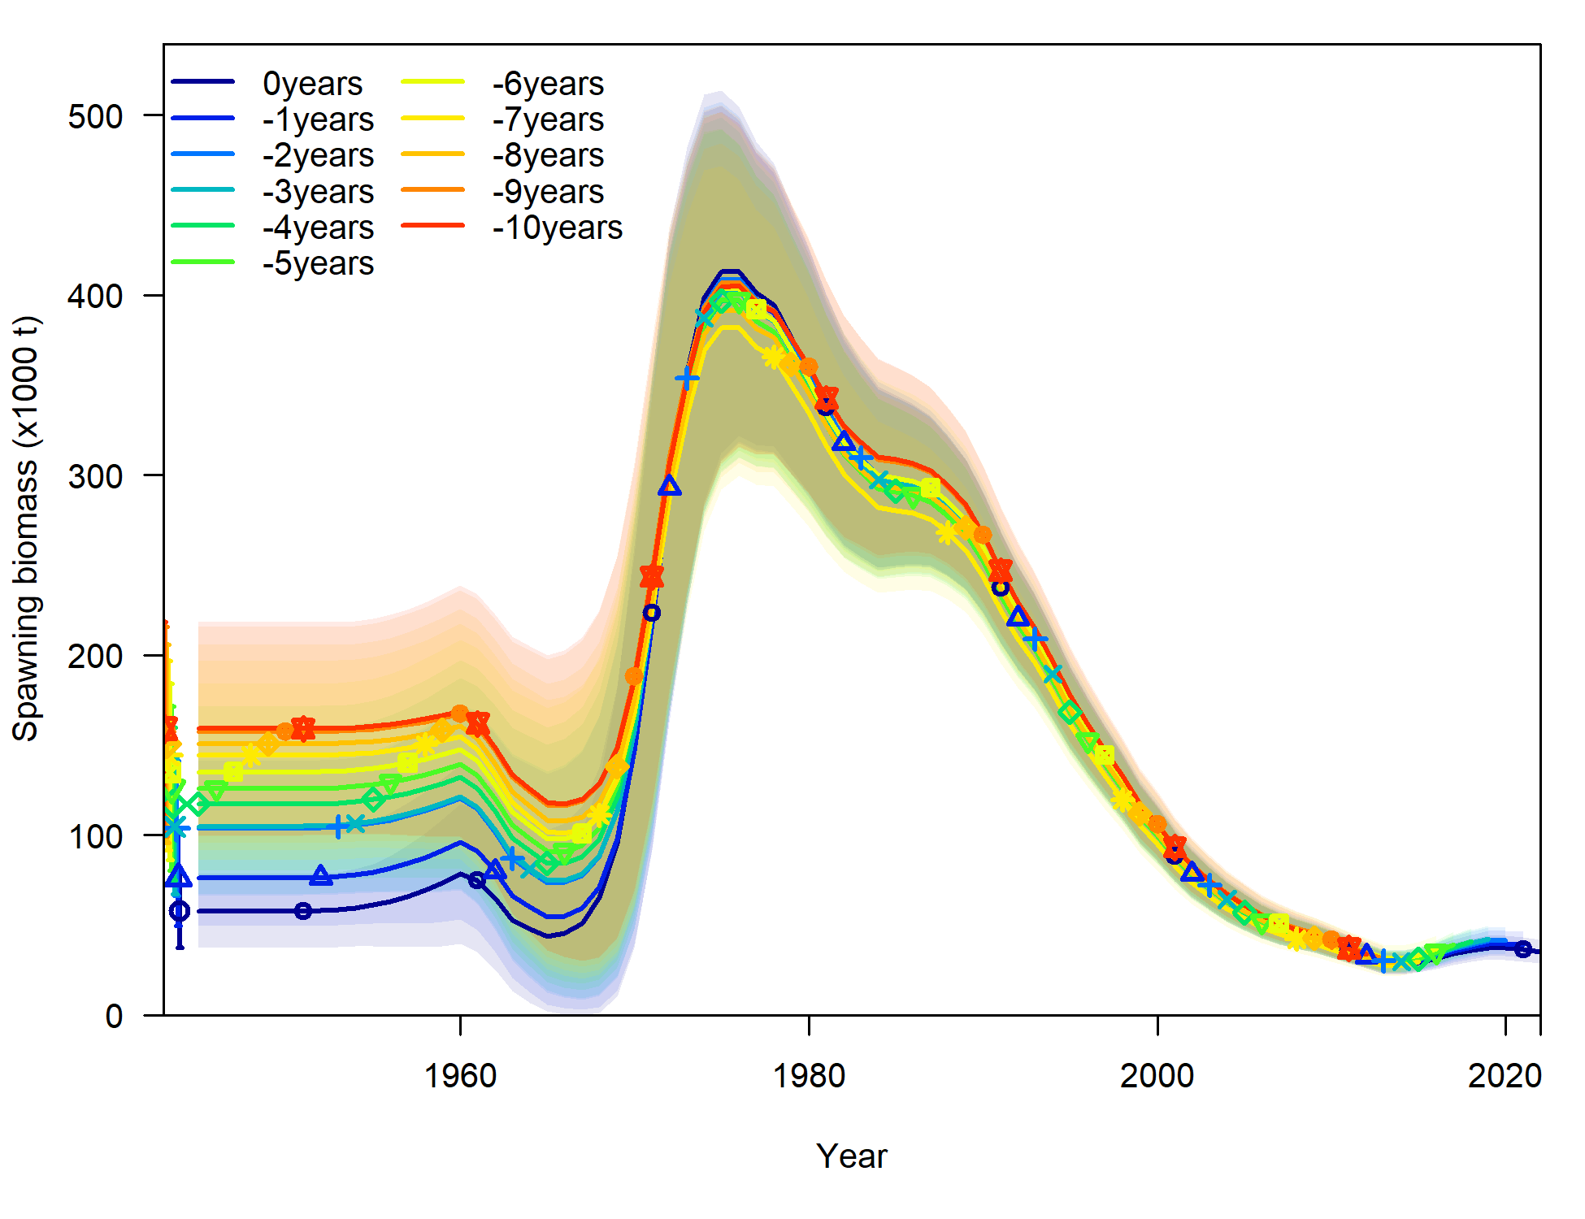
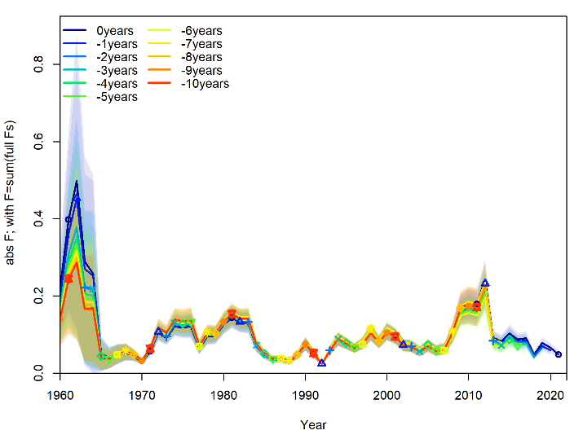
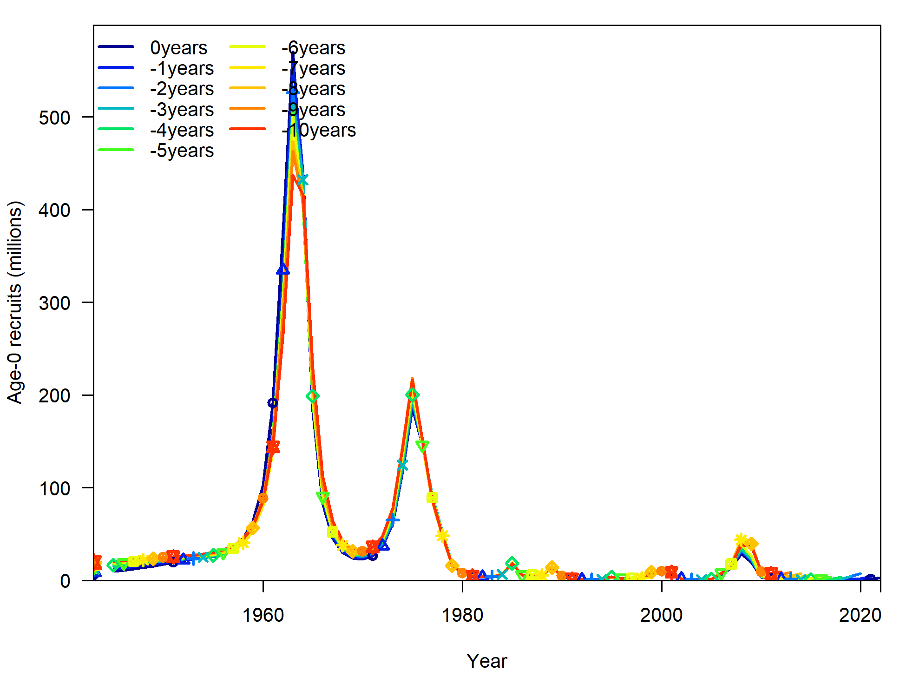
Retrospective analysis
ρ = 0.10
ρ = -0.13
ρ = 8.97
Notes:
Results form Model 16.4c

Slide 24
Risk table
Environment/Ecosystem considerations – Level 1
  The extended warm phase experienced by the eastern Bering Sea (EBS) that began in approximately 2014 has largely relaxed to normal conditions over the past year (August 2021 - August 2022).
  Recruitment: The 2022 cold pool extent indicates average conditions for juvenile recruitment based on a previously established positive correlation between the cold pool and juvenile recruitment.
  Prey: Indicators of prey availability suggest few clear concerns about prey abundance for Greenland turbot.
  Trends in potential competitors do not indicate substantially increased competition for habitat or prey resources.
  Trends in predator abundances would indicate no increased predation concern for turbot.

Slide 25
Risk table
Population dynamics – Level 2
  “The BSAI Greenland turbot stock is characterized by infrequent recruitment events. The last relatively strong cohorts in the population are from 2007-2009. As they have grown and matured, we saw an increase in total biomass and spawning biomass, which is now starting to decline. Given the frequency of past recruitment events, we would have expected another in recent years. However, recruitment has been below average since 2012 and fish younger than 4 years old have not been observed in the EBS shelf bottom trawl survey data since 2018. We score this category as Level 2 given the uncertainty in future recruitment levels.”

Slide 26
Risk table
Assessment considerations – Level 2
  The EBS slope survey has not been conducted since 2016
    Was the main biomass index of the adult population, some uncertainty about the portion of the adult population on the slope
  Uncertainty about the length at 50% maturity is unresolved
    Greenland turbot develop 2 cohorts of oocytes (Rideout et al. 2012)
      Developing cohort: Used for spawning the next year
      Leading cohort: Larger, advanced cohort used for within year spawning
    Kennedy et al. (2014) revised estimates of length at 50% maturity for east Greenland Greenland halibut
      Assumed individuals with only developing cohorts were “functionally immature”
      Estimate of length at 50% maturity increased

Slide 27
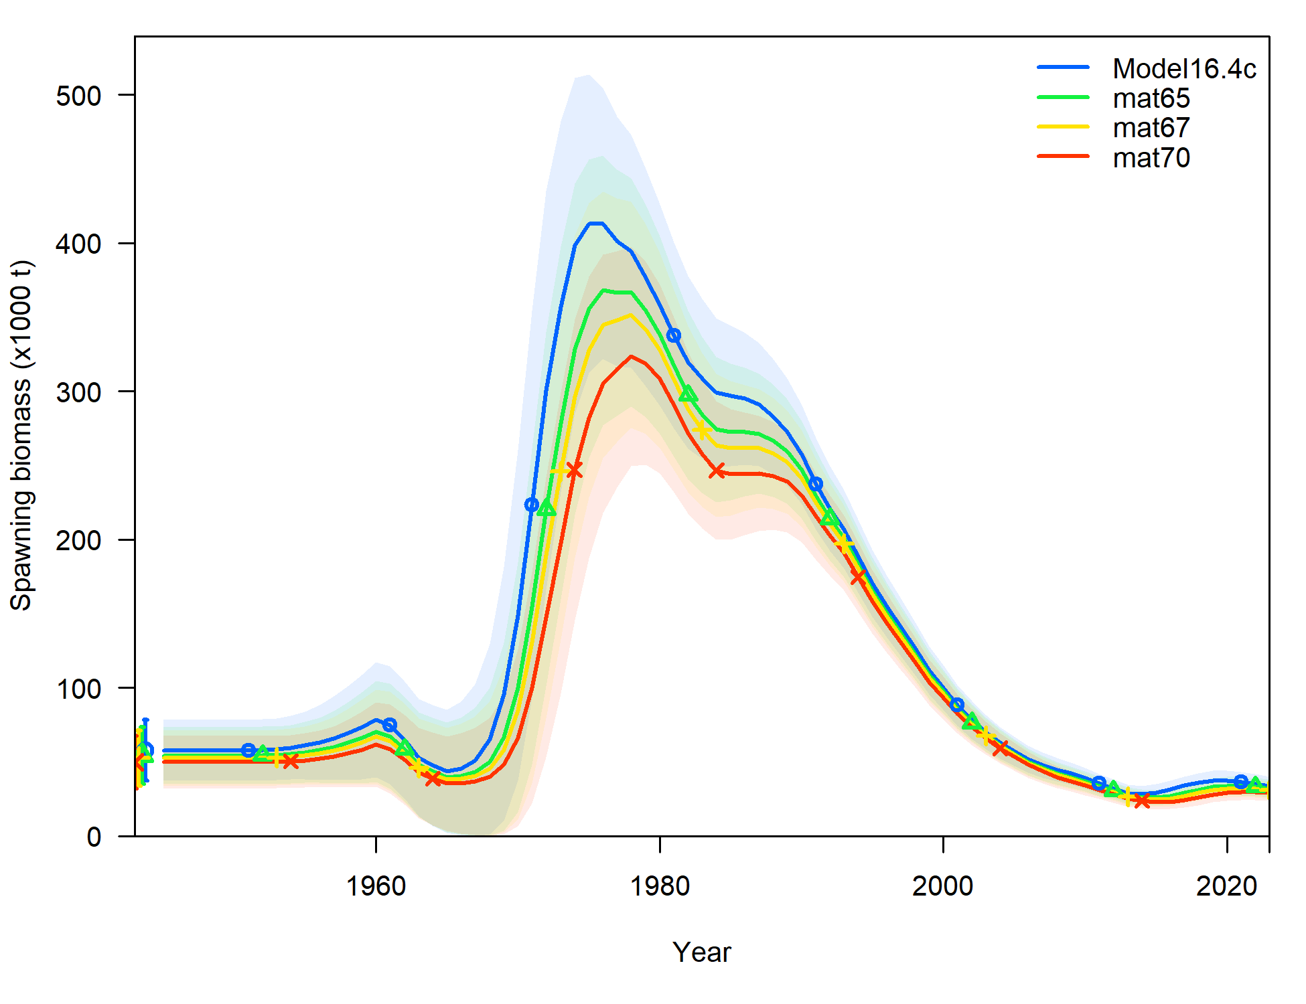
Risk table
Assessment considerations – Level 2
  Uncertainty about the length at 50% maturity is unresolved
    Conducted a maturity sensitivity analysis
      Used estimates from Cooper et al. (2007): 65cm, 67cm, and 70cm
    Results:
      SSB reduced by 6% - 13% on average
Reduction in max ABC may be warranted

Slide 28
Harvest recommendations
Notes:
Without a reduction in maxABC

Slide 29
Apportionment
Determined from the proportion of adult biomass observed in the EBS slope survey estimates and the Aleutian Islands survey since 2010 (when they overlapped)
  15.7%

Slide 30
Future directions
Updating the maturity ogives is a priority for this stock. Funding to conduct an updated maturity study was secured in 2020, but was cancelled due to the pandemic. The lead author and Todd TenBrink (AFSC, REFM, Age and Growth Program) are submitting a research proposal in 2022 to fund this study.
Inclusion of a combined EBS slope bottom trawl survey and AFSC longline survey abundance index in the assessment model will be evaluated during the next full assessment.
Evaluate/Re-evaluate
  Simplified selectivity time blocks
  Sex-specific natural mortality
  Catchability estimates for the EBS shelf and slope bottom trawl surveys
    Currently fixed in the assessment model

Slide 31
Divider Title
Additional Divider Information

Slide 32
Model structure
Natural mortality – Fixed
  M = 0.112 (Cooper et al. 2007)
  Same for females and males
Maturity at length – fixed parameters
  L50: 60 cm (D’yakov 1982)
  Slope: -0.25 (D’yakov 1982)
Weight-length relationship – fixed parameters
  Males: W = 3.4 x10⁻⁶L^{3.2189}
  Females: W = 2.43x10⁻⁶L^{3.325}
  Barbeaux et al. (2012)
von Bertalanffy growth
  Length at minimum age (estimated)
  Length at maximum age (estimated)
  Growth coefficient (estimated)
  CVs at young and old age (fixed)
    15% young and 9% old

Slide 33
Model structure
Stock-recruitment (Beverton-Holt)
  R0 – Estimated
  Steepness - Fixed = 0.79 (Myers et al. 1999)
  Sigma R - Fixed = 0.6
  Autocorrelation – Estimated
    Normal prior
    Mean = 0.473 and Stdev = 0.265 (Thorson et al. 2014)
  Recruitment deviations - Estimated
    Early: 1945 - 1970
    Main: 1970 - 2013
    Forecast: 2014 - 2019

Slide 34
Model structure
Selectivity
  Sex-specific, size-based
  ABL longline survey: Fixed logistic
  Double normal pattern
    Trawl fishery, longline fishery, EBS shelf and slope surveys
    Slope selectivity is constrained to be logistic
    Female selectivity offset from males for longline fishery and slope survey
    Male selectivity were offset from female for trawl fishery and shelf survey
  Time-varying selectivity using time blocks
    Trawl fishery: pre-1989 (10), 1989-2005 (14), 2006 -2018 (11)
    Longline fishery: pre-1991 (7), 1991-2007 (15), 2008-2018 (11)
    EBS shelf survey: pre-1992(5), 1992-1995 (4), 1996-2000 (5), 2001-2018 (18)
    EBS slope survey: pre-2002 (6), 2002-2010 (4), 2011-2018 (2)

