Slide 1
Ocean and ice dynamics of the Bering 10K model: structure, performance, and uncertainties
Albert J Hermann
University of Washington/JISAO
Seattle, WA

Slide 2
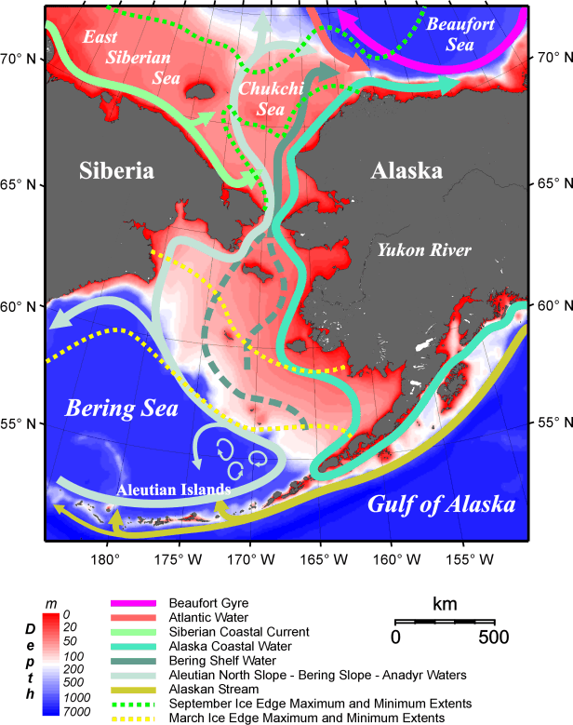
What is unique about the Bering Sea?
  Physical
    Seasonal ice with advection to the south
    Tidal mixing sets up distinct biophysical regimes
  Biological
    Ice plankton may be a major food source to higher trophic levels
    Benthic food chain is a major player

Slide 3
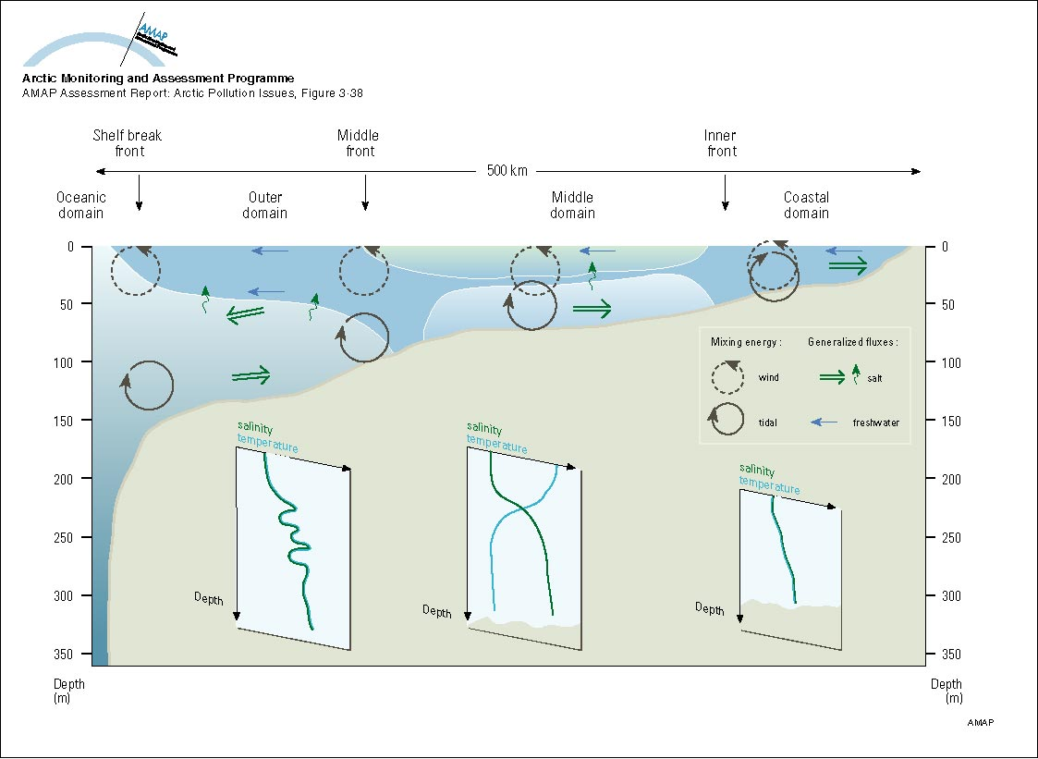
Biophysical domains of the
Bering Sea shelf

Slide 4
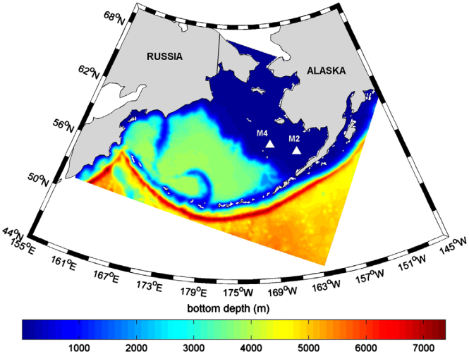
Bering10K model
Regional Ocean Modeling System (ROMS)
Descendent of NEP5 (Danielson et al. 2012)
10/30 layers, 10-km grid
Includes ice and tides
CCSM bulk flux
Details in Hermann et al. (DSR2, 2013, 2016)

Slide 5
Model-based downscaling
Hindcasts
  generate past regional ocean states using global atmospheric and oceanic reanalyses (here, primarily use NOAA Climate Forecast System Reanalysis [CFSR])
Seasonal forecasts
  generate future (9-month) regional ocean states using global seasonal forecasts (here primarily from NOAA CFS)
Multidecadal projections
  generate future (multi-decadal) regional ocean states using IPCC models as forcing and boundary conditions

Slide 6
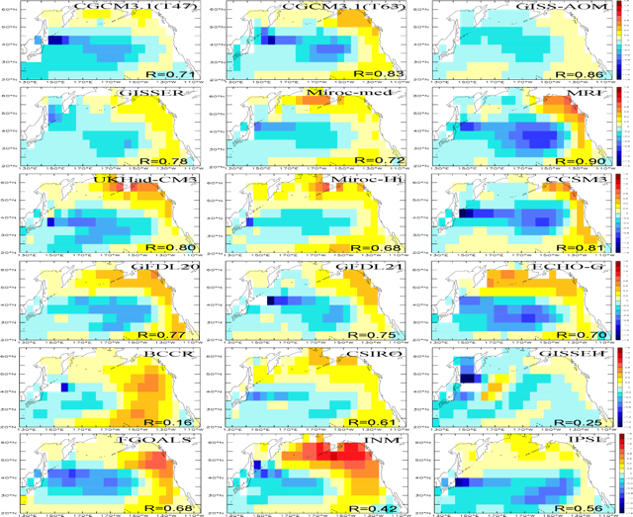

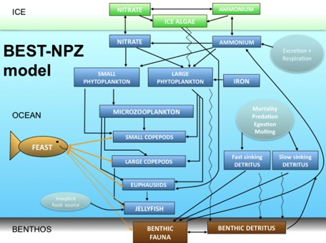
Climate models
provide BCs/ICs to
regional coupled models
Bering10K
ensemble of runs
NPZ
Statistical methods
GOAL: seasonal and mutidecadal projections of physics and biology in the Bering Sea
ensemble of projected futures
MSE
D. Pilcher now adding carbonate!

Slide 7
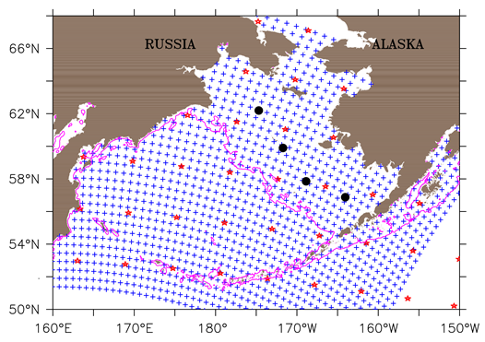
Bering10K grid density
(every 5th gridpoint shown)
+ : Bering Sea 10 km
✩: Global model
⚫ : PMEL moorings

Slide 8
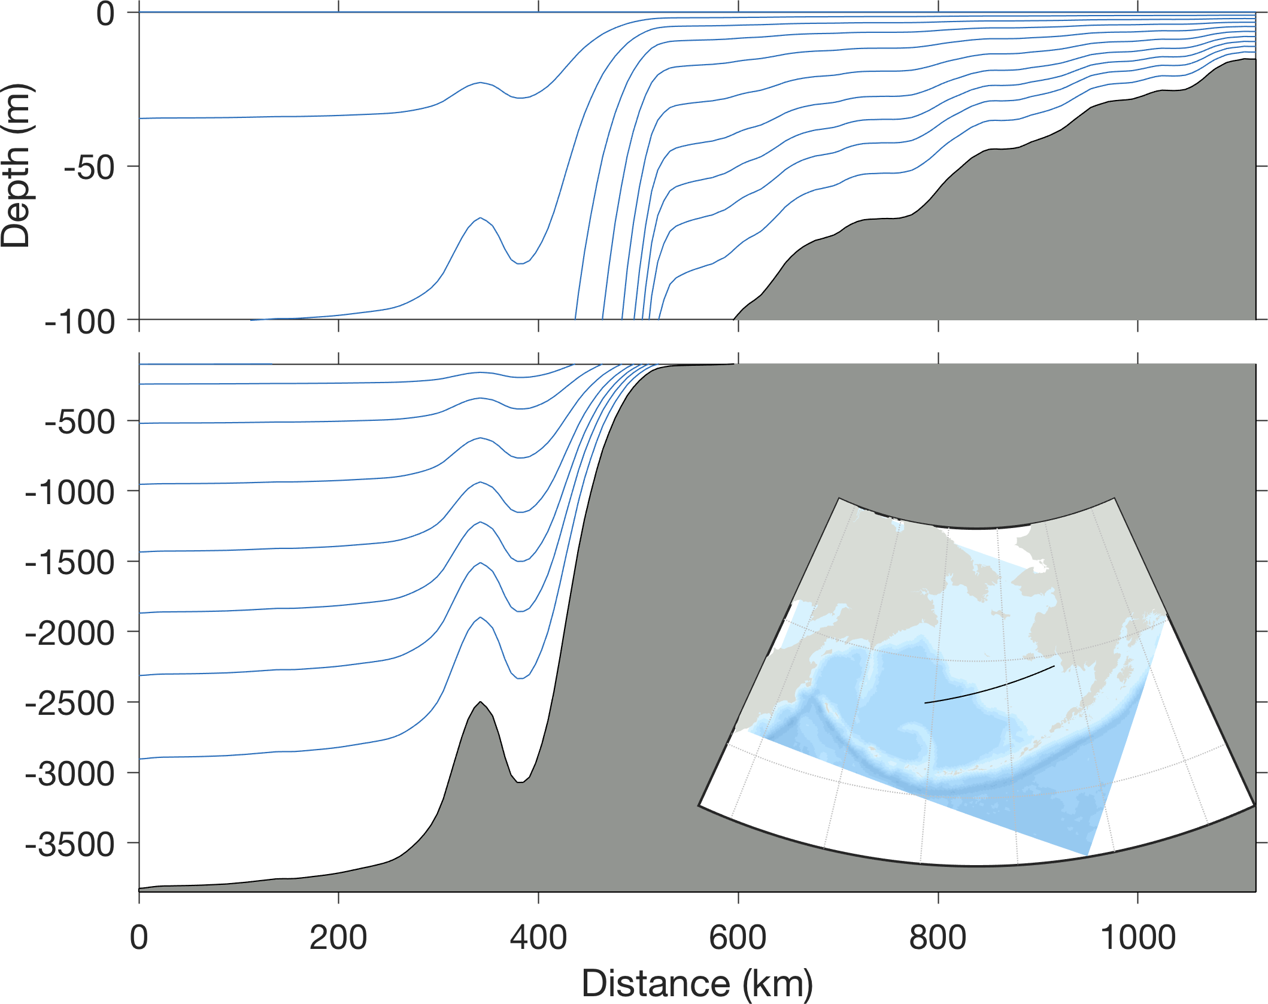
Terrain-following coordinate detail

Slide 9
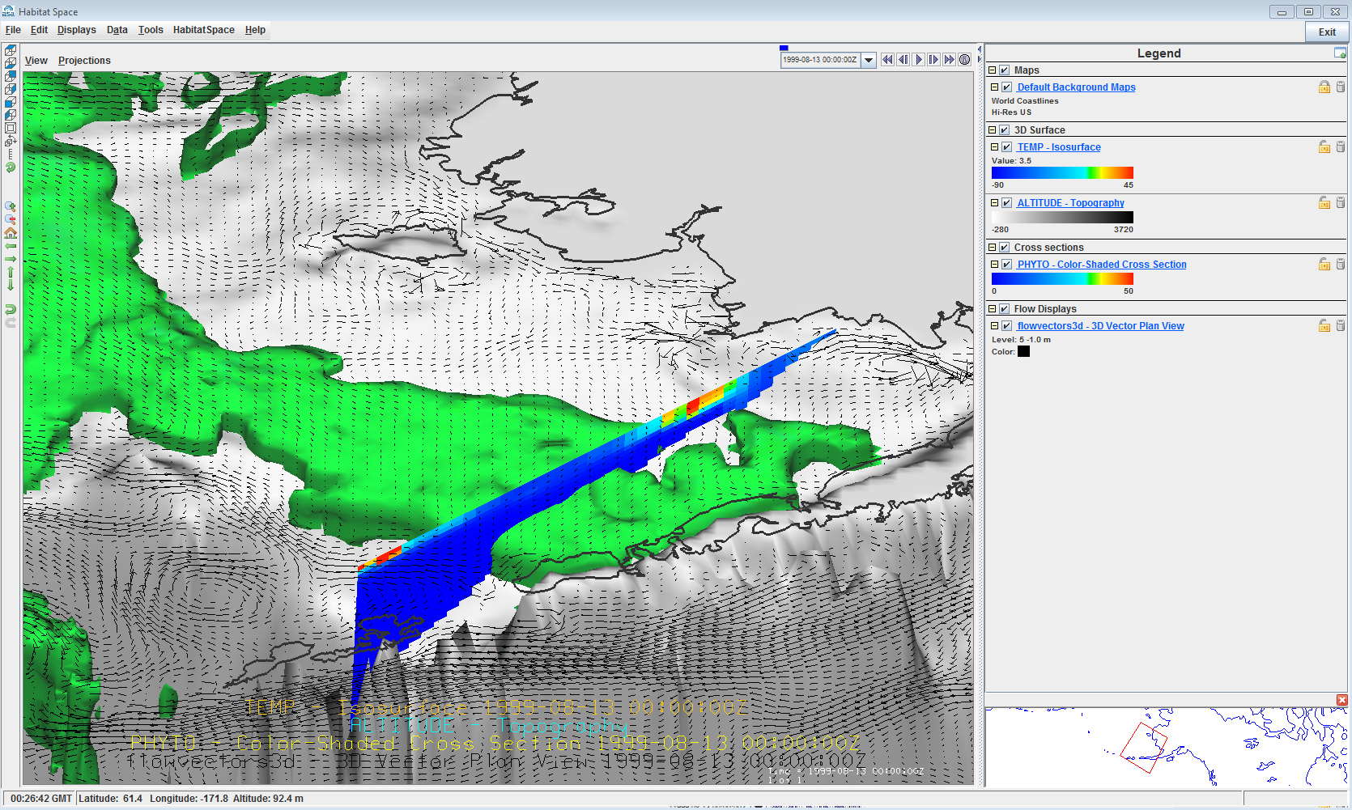
BEST/BSIERP modeling results: cold pool, phytoplankton and velocity

Slide 10
Primary physical ocean variables
Variable | Symbol | Units
Temperature | T | Deg C
Salinty | S | ppt
Sea Surface Height | SSH | m
Horizontal Velocity | U,V | m/s
Vertical velocity Vertical diffusion | W AKT | m/s m2/s
Ice area Ice thickness | AICE HICE | (fraction) m

Slide 11

Initial and Boundary conditions
Interpolate large-scale T,S, SSH fields from the global model to the regional model. Note global ocean hindcasts assimilate data, so regional model is guided by that data.
Allow signals from the regional/global models to propagate through the boundaries

Slide 12
Atmospheric forcing variables used (from global, data-assimilating models)
Variable | Symbol | Units
Air Temperature | TAIR | Deg C
SLP | PAIR | mbar
Absolute Humidity | QAIR | kg/kg
Wind velocity | UWIND, VWIND | m/s
Downward longwave radiation | LWRAD_DOWN | W/m^2
Shortwave radiation Precipitation | SWRAD | W/m^2
These are used to calculate surface momentum flux (wind stress) and surface heat flux

Slide 13
Four types of surface heat flux
Shortwave radiation – i.e. “sunlight” – what you see and feel on a nice day at the beach
Longwave radiation – also felt but not seen – e.g. the radiation from hot coals
Sensible heat flux – warm air molecules collide with and heat up a cold ocean
Latent heat flux – evaporation at the sea surface cools the ocean

Slide 14
Coastal runoff
Can directly input freshwater and momentum at the coast but in coarse models this causes trouble (the runaway estuary problem).
A useful fix is to add runoff at the surface within a near-coastal band.
Kearney updated runoff forcing with USGS data
Salinity is usually more challenging to capture than temperature.

Slide 15
Ice
Changes the surface fluxes of heat, momentum
Has different dynamics than the fluid; deformation

Slide 16
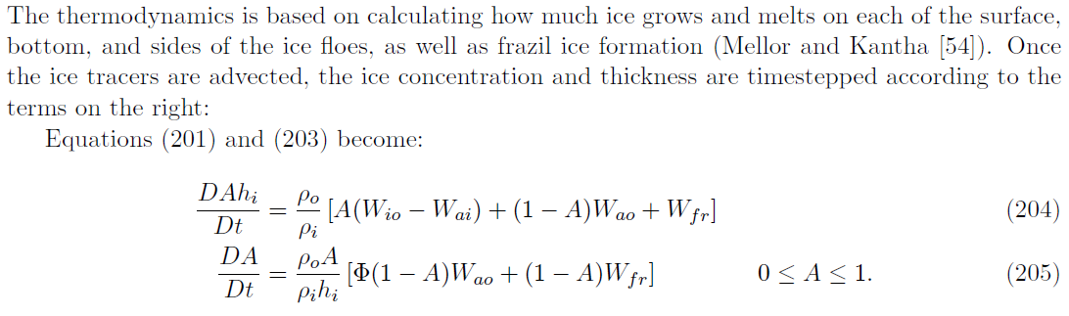
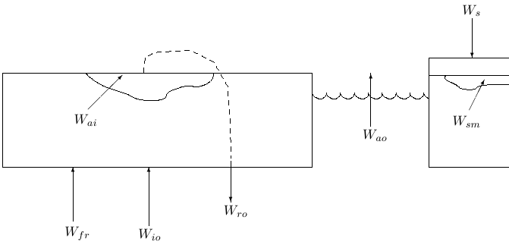
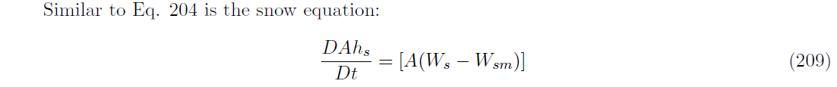
ICE thermodynamics

Slide 17
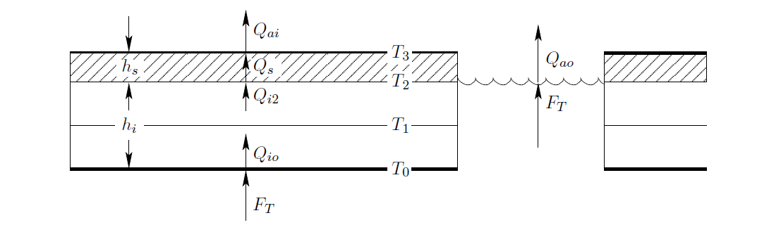
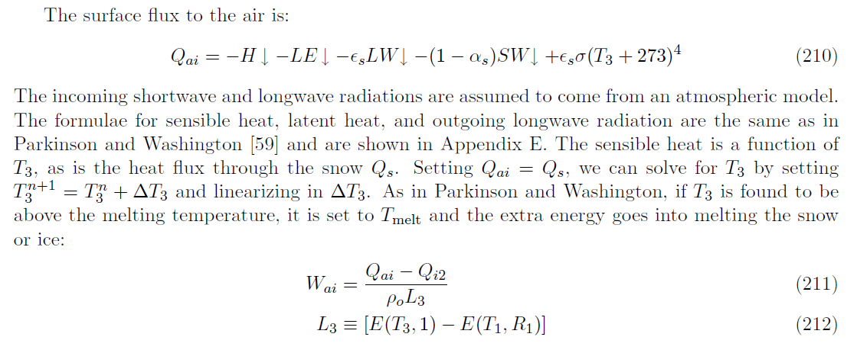
ICE thermodynamics

Slide 18
Regional model (Bering10K) uncertainty: a few tuned (or tunable) physical parameters
Bulk flux algorithms (heat/stress flux at surface, based on atmospheric forcing)
Vertical mixing algorithms (based on shear and density gradients in the ocean interior)
Bottom friction
Surface albedo of open water (whitecap effects)
Surface albedo of ice (carbon black, sediment effects)
Horizontal vs vertical ice growth
Plasticity of ice (resistance to ridging)

Slide 19
Forcing uncertainty
Global forecasts have finite skill, limited by observations and model structure
Nature is chaotic so details always elusive
All forecasts have bias. Reforecasting experiments help establish mean bias, which can be subtracted from the forcing

Slide 20
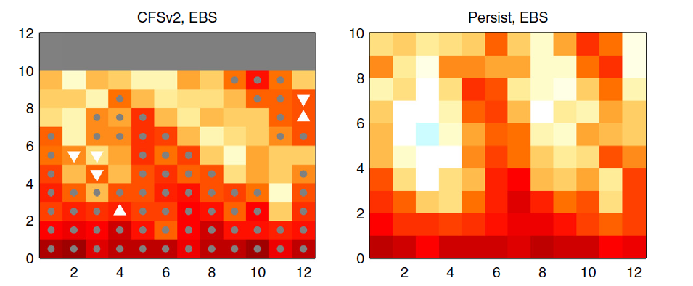

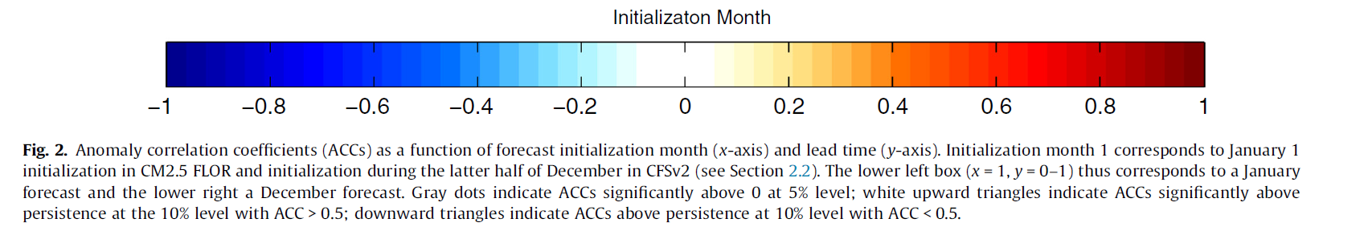
Stock et al (2015) looked at large-scale predictive skill for SST from CFS model vs. from persistence in the Eastern Bering Sea
(red = more skill)

Slide 21
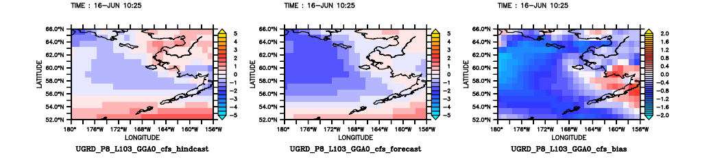
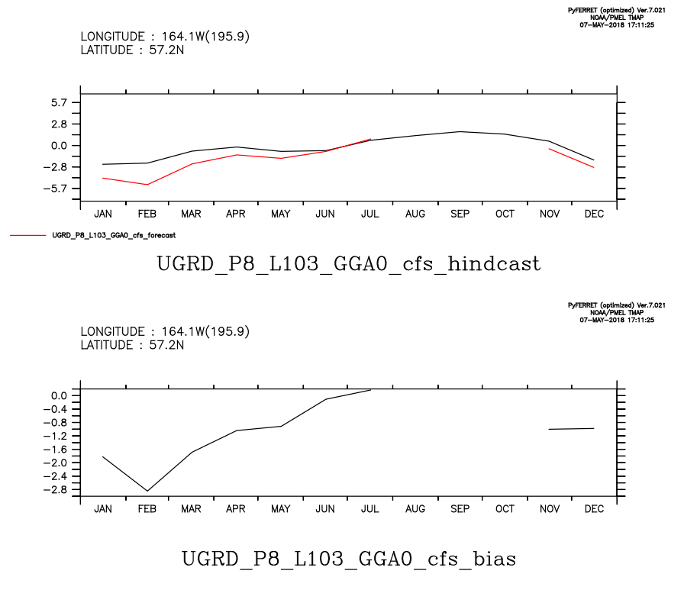
CFSv2 forecast bias: zonal winds (m/s)
CFS hindcast
CFS forecast
CFS bias
CFS hindcast
CFS forecast
CFS bias

Slide 22
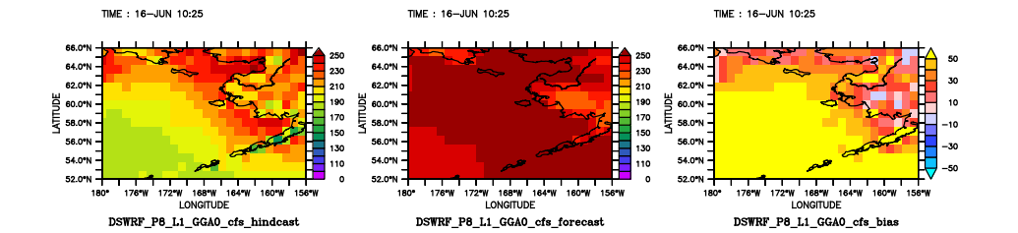
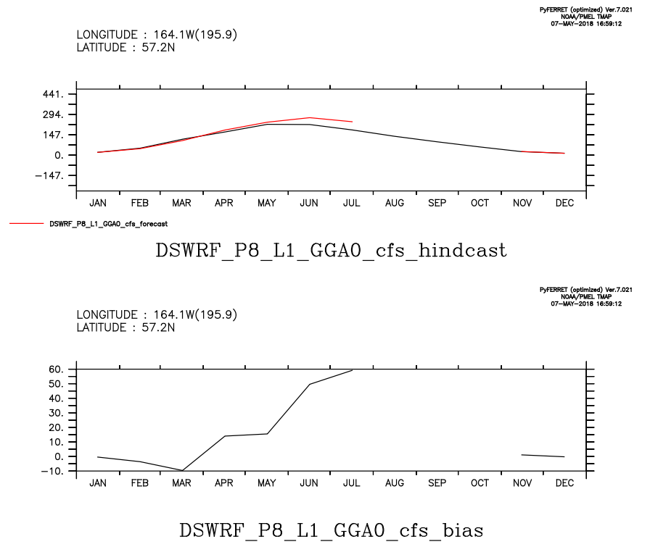
CFSv2 forecast bias: shortwave radiation (W/m^2)
CFS hindcast
CFS forecast
CFS bias
CFS hindcast
CFS forecast
CFS bias

Slide 23
Comparisons with data
Here use moorings, CTD surveys to compare with 10-layer (“Bumble”) version of model
Kelly’s talk includes comparisons of 30-layer (“Migo”) version of model with satellite data

Slide 24
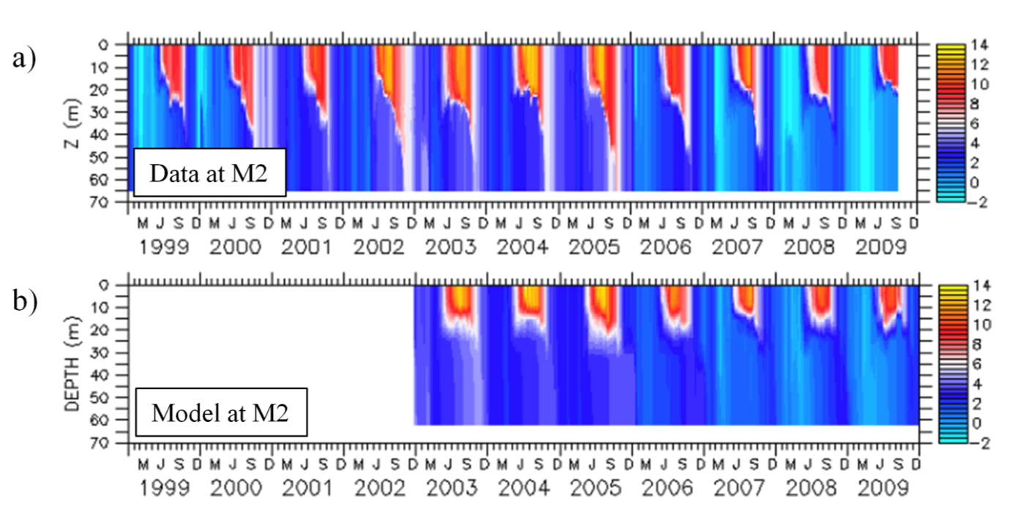
Bering10K validation:
Modeled/Observed mid-shelf temperatures (deg C)
Note “stanzas” of warm/cold years

Slide 25
Temperature comparison at biophysical moorings
M2
(a)
M4
(b)
M2
(c)
M4
(d)

Slide 26
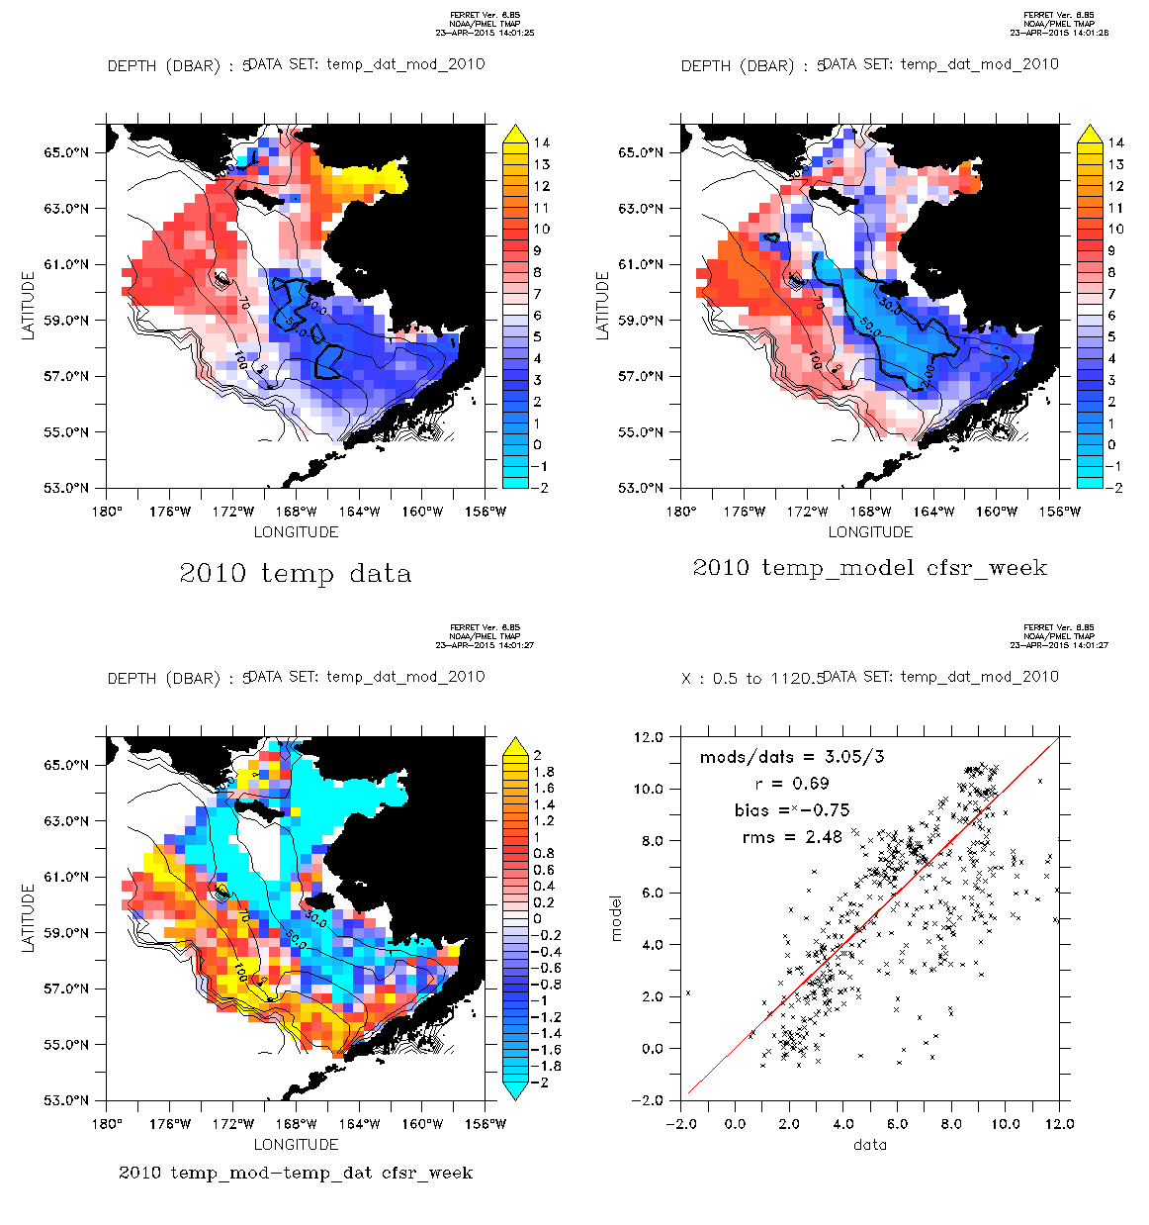
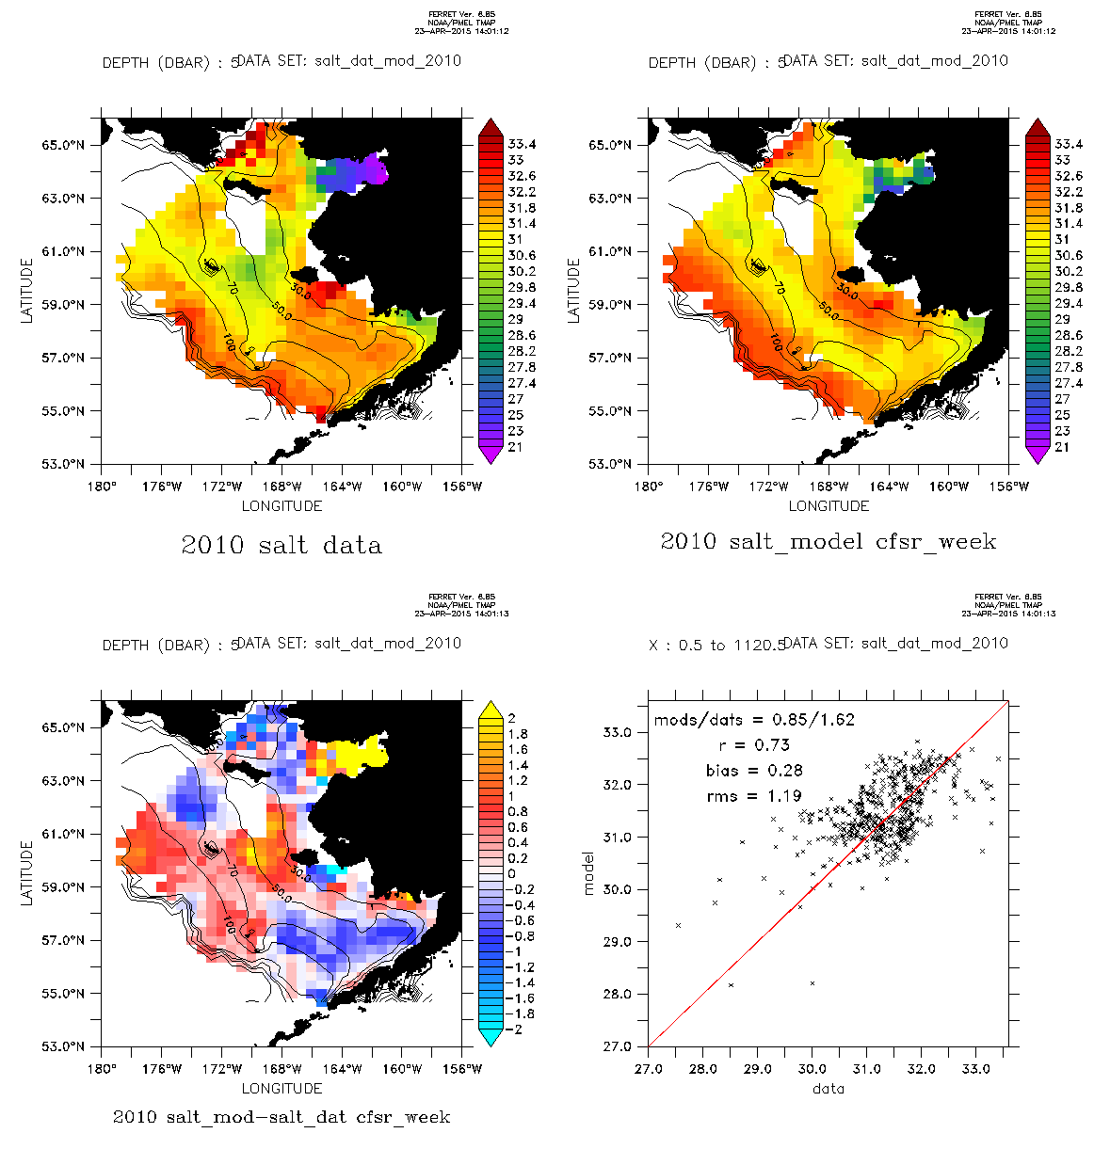
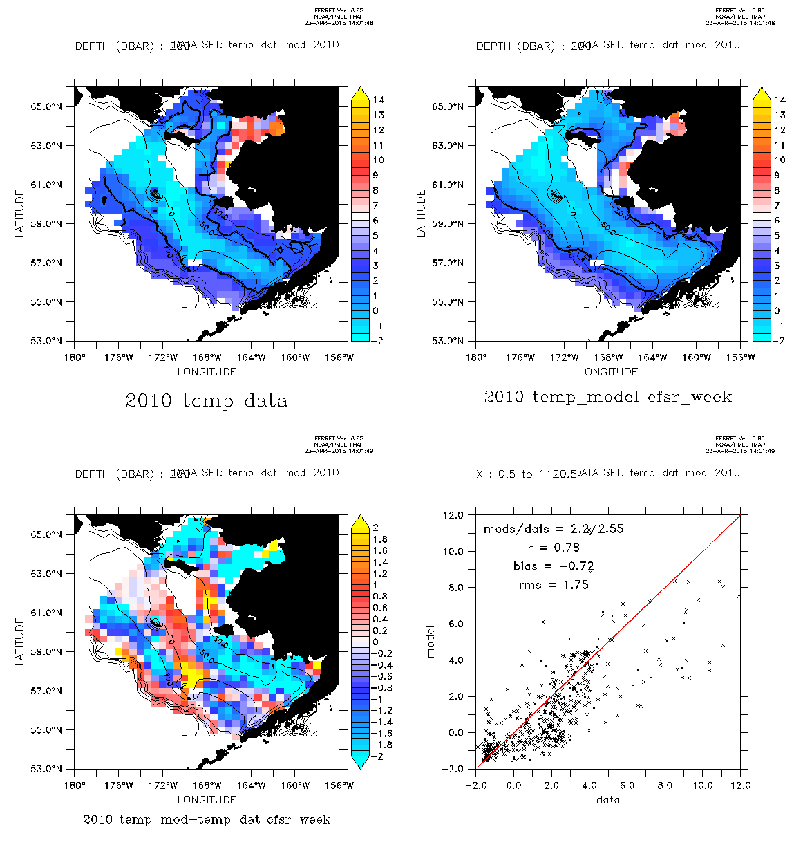
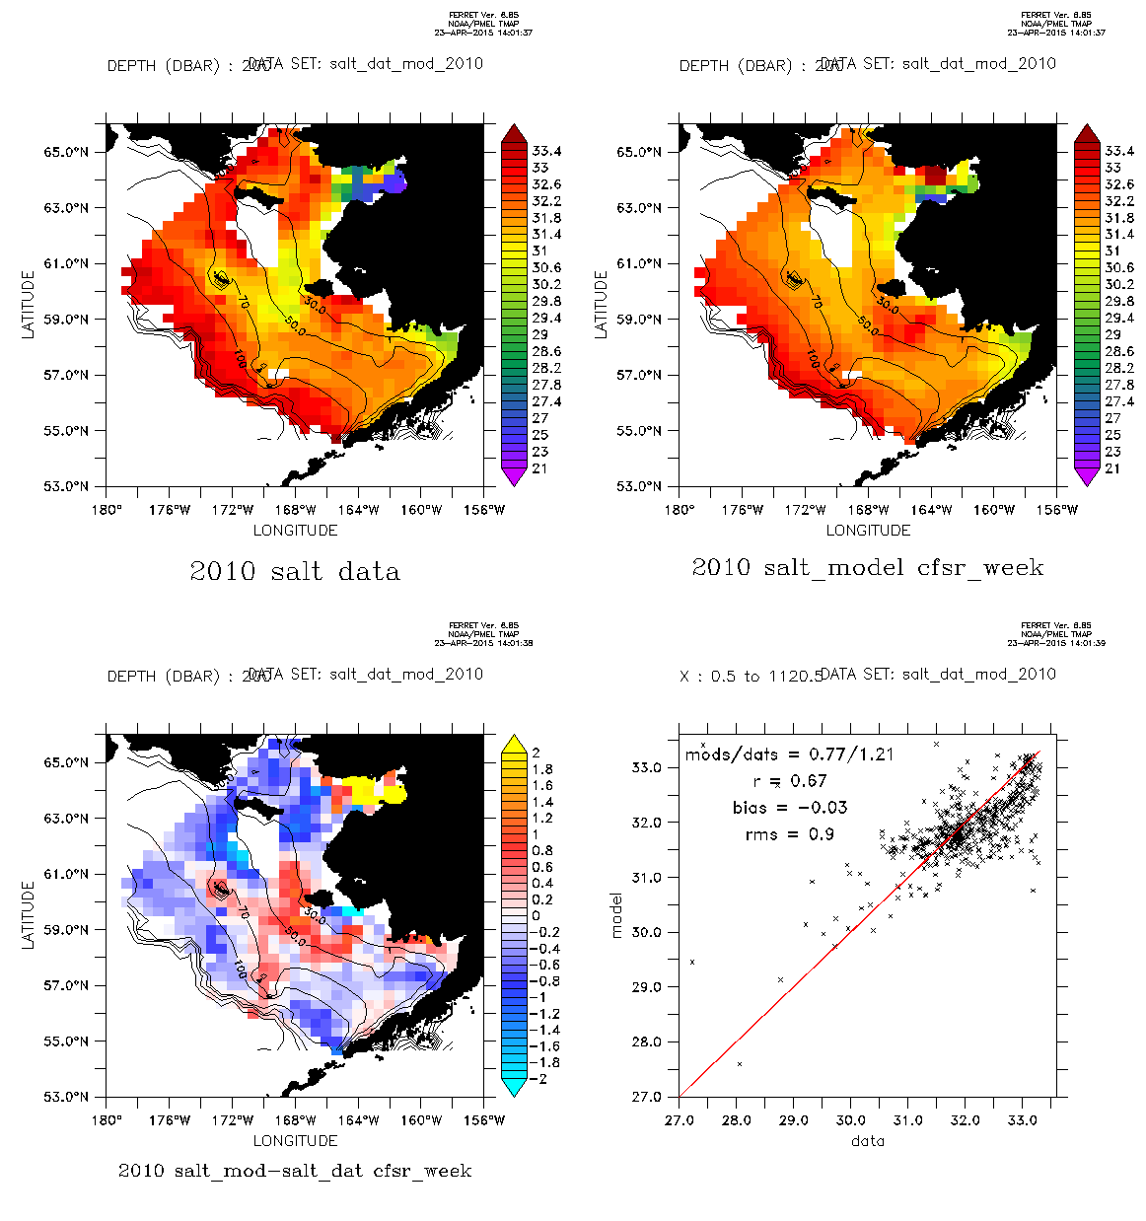
Comparison with 3D data (collected during bottom trawl survey)
(bumble version, old runoff)
DATA
MODEL
MODEL - DATA
DATA VS. MODEL
SURFACE T
(a)
surface T
surface T
surface T
SURFACE S
(b)
surface S
surface S
surface S
BOTTOM T
(c)
bottom T
bottom T
bottom T
BOTTOM S
(d)
bottom S
bottom S
bottom S

Slide 27
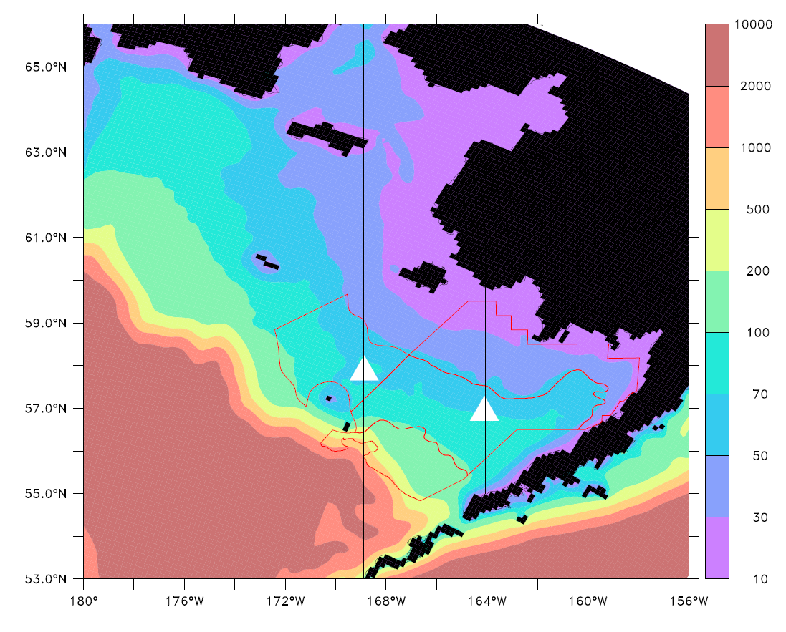
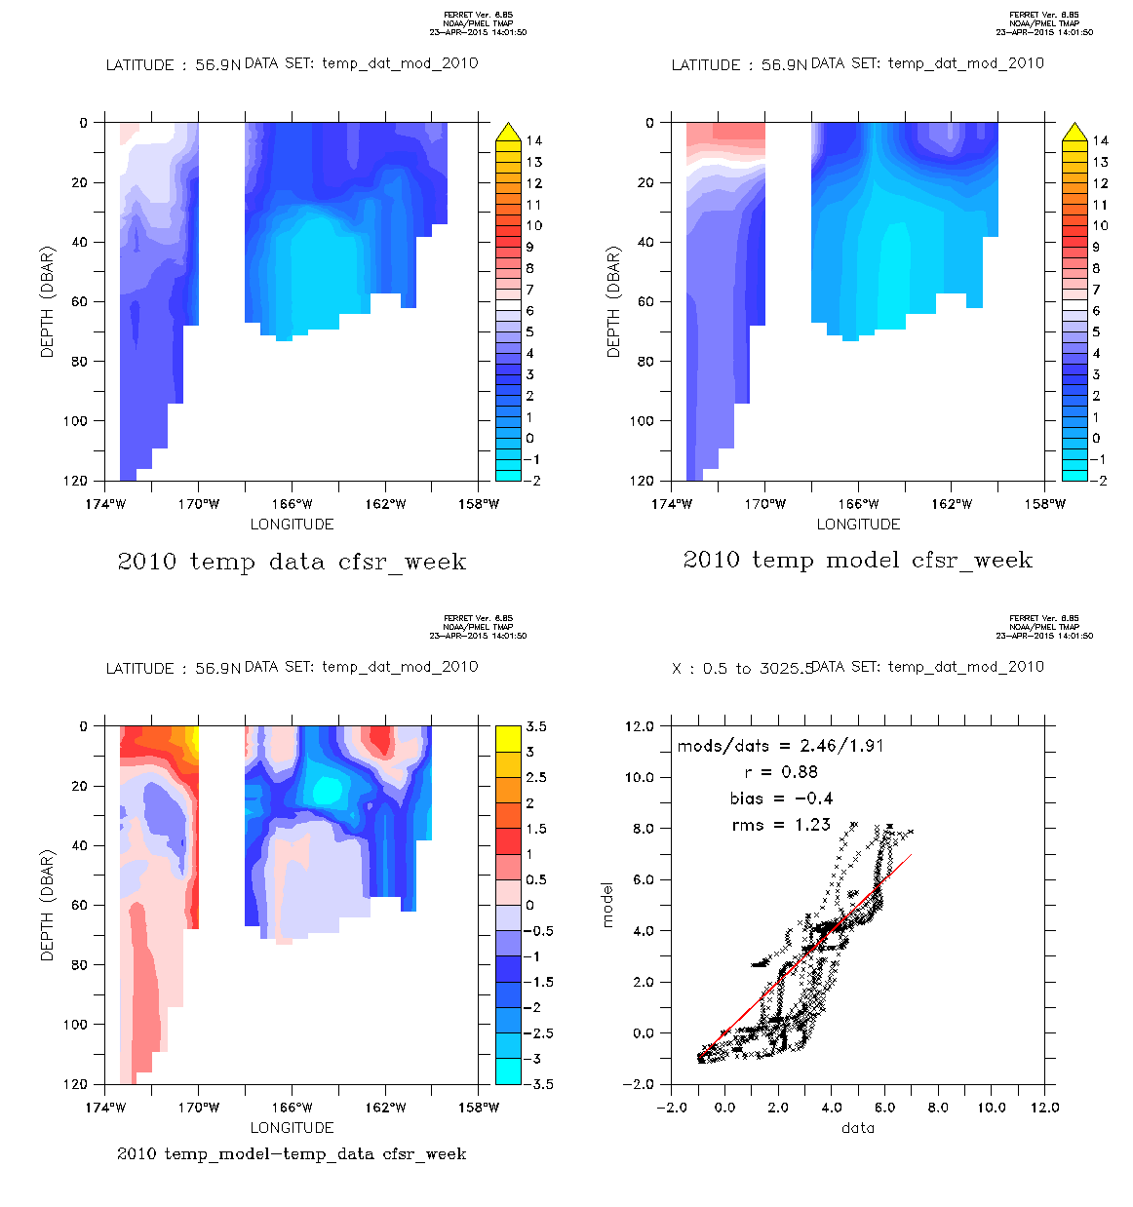
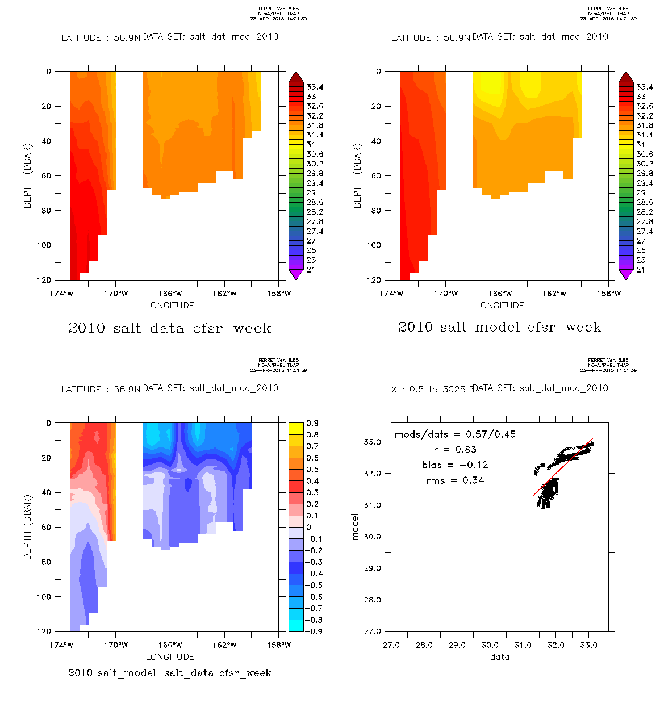
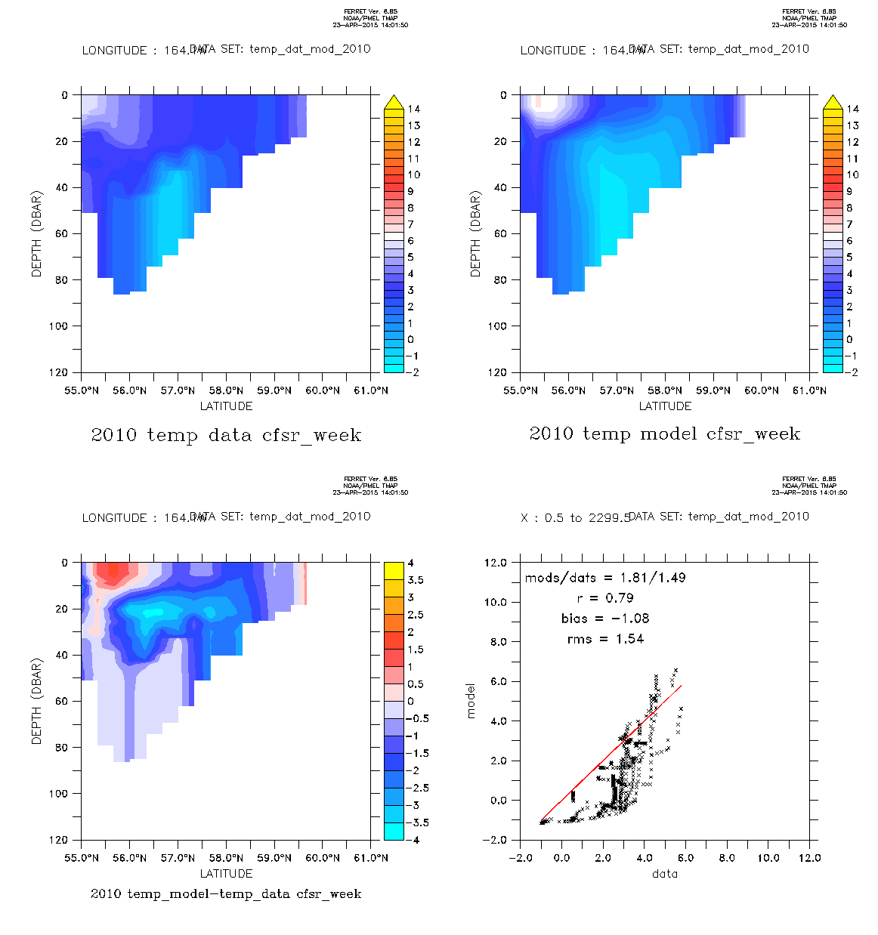
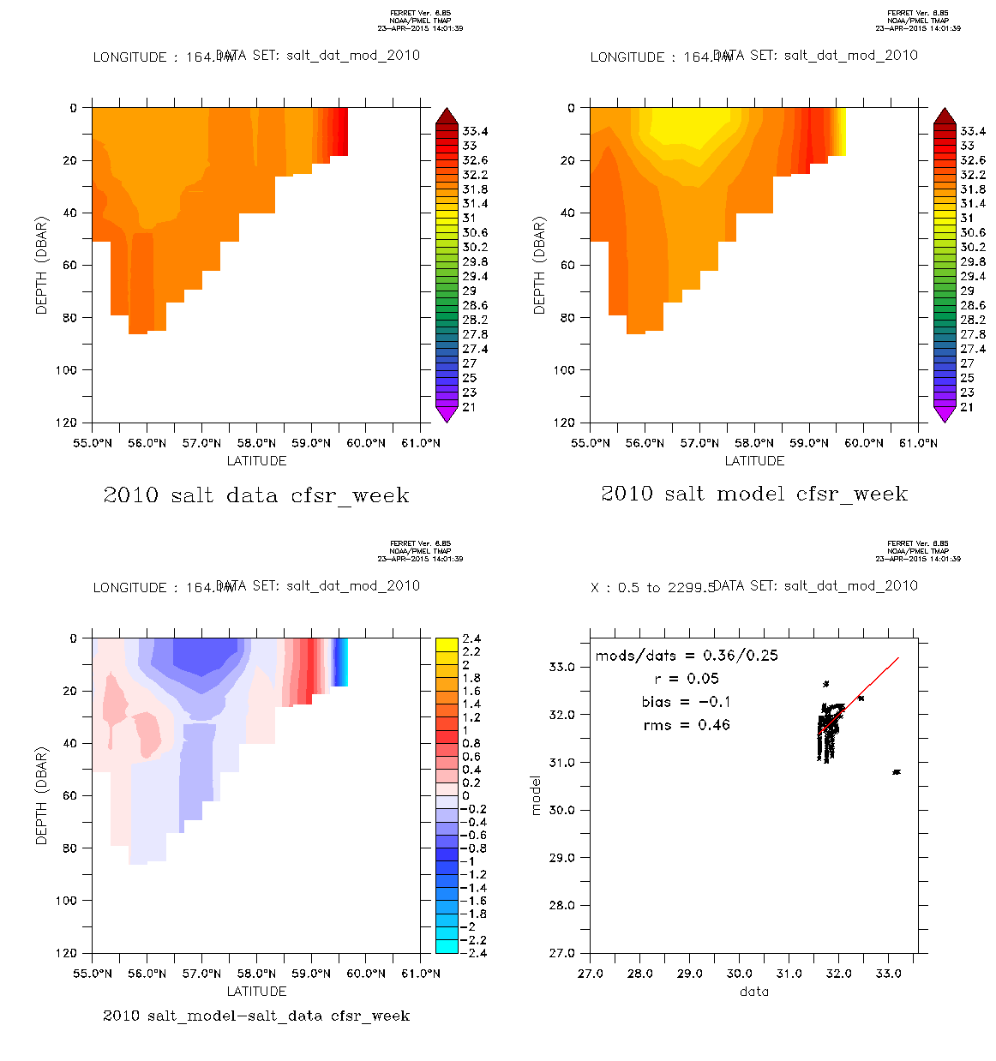
Comparison with 3D data (collected during bottom trawl survey)
DATA
MODEL
MODEL - DATA
DATA VS. MODEL
(a)
E/W section T
E/W section T
E/W section T
(b)
E/W section S
E/W section S
E/W section S
(c)
N/S section T
N/S section T
N/S section T
(d)
N/S section S
N/S section S
N/S section S

Slide 28
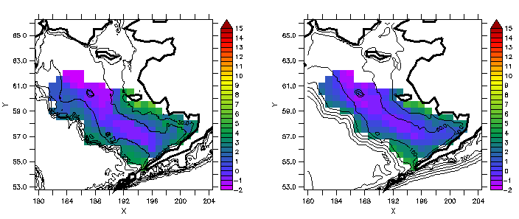
Comparison with the “Cold Pool”
DATA
MODEL
Bottom Temp in deg C, summer 2009

Slide 29
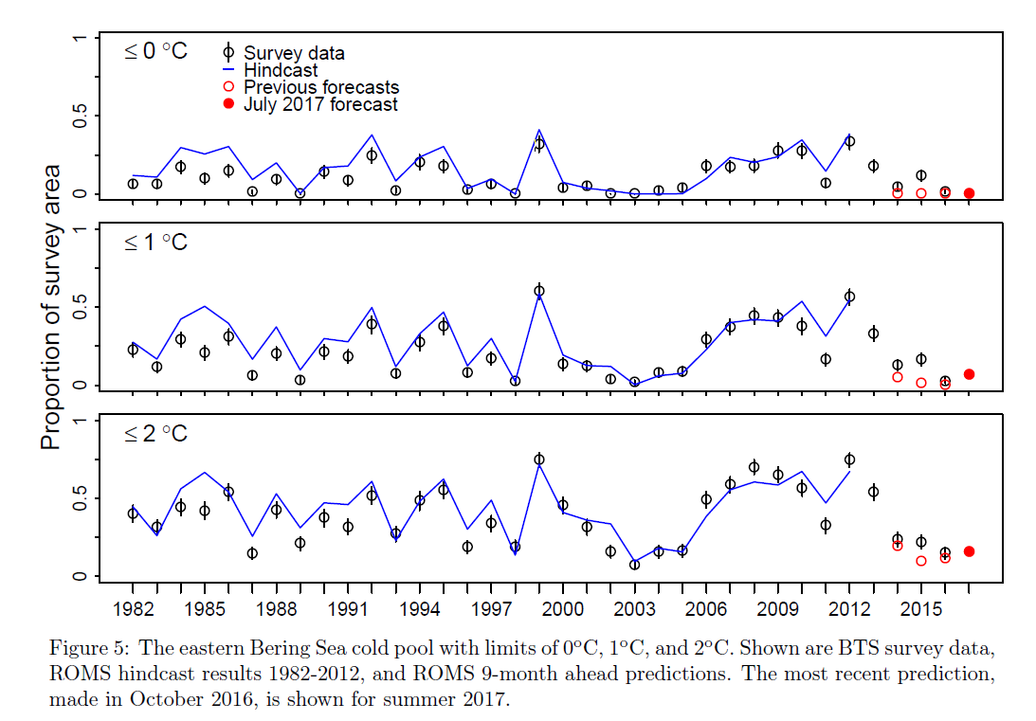
Replication of the Bering Sea cold pool
Zador et al., 2016

Slide 30
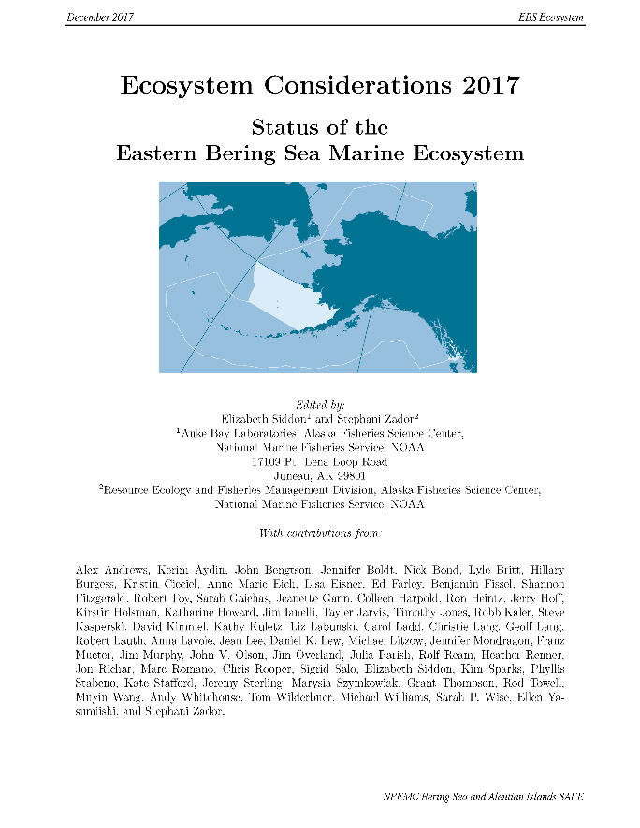
Hindcasts/Forecasts of the Bering Sea cold pool are reported each October
Zador et al., 2016

Slide 31
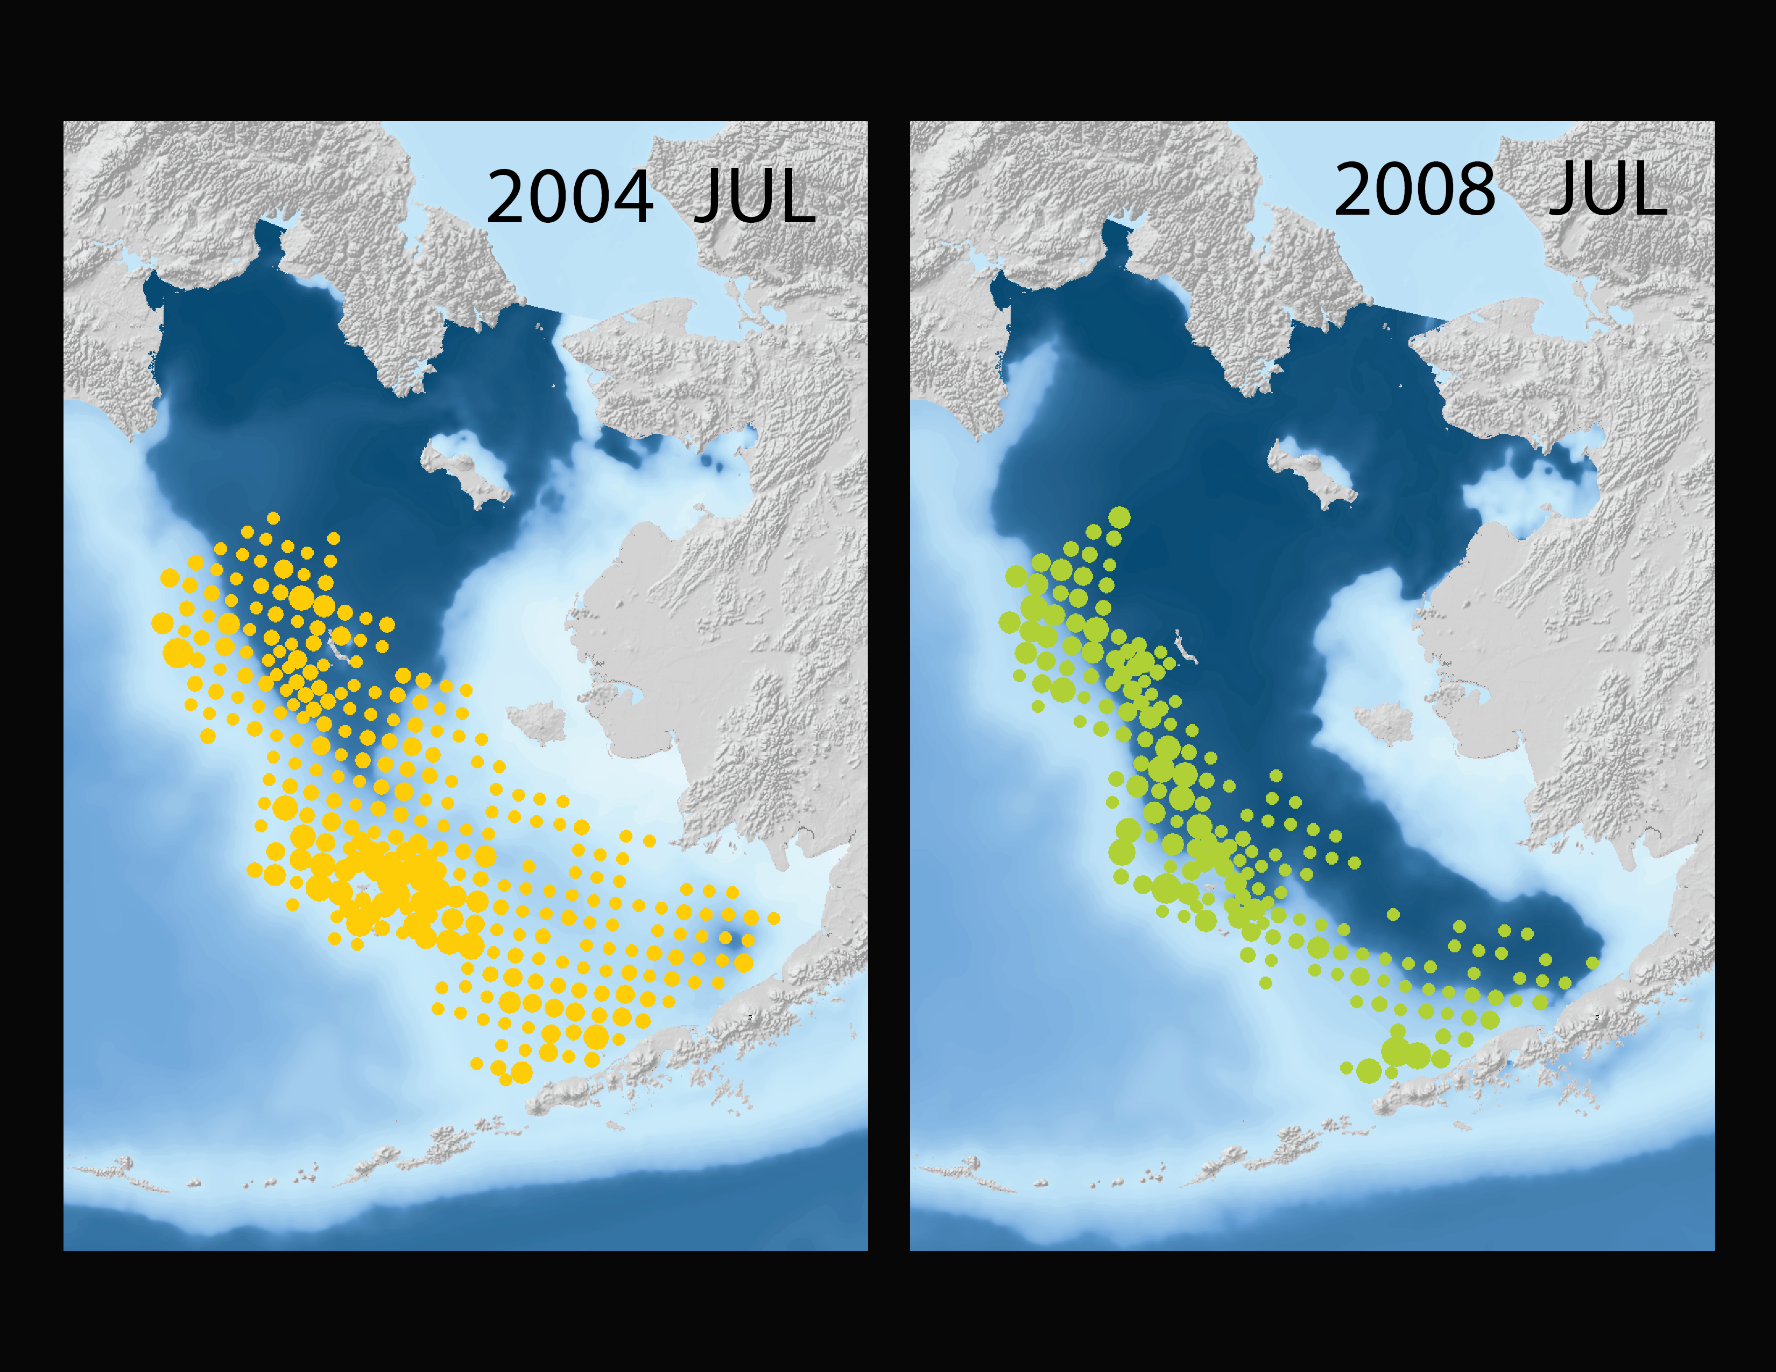
OBSERVED POLLOCK DISTRIBUTIONS
Notes:
BTS Survey Biomass for Pollock (data) with FEAST output bottom temperature. Change in distribution and abundance. Same scale used in both images scale goes from 7-14,000 kg. Stations with <7kg are not shown.

Slide 32
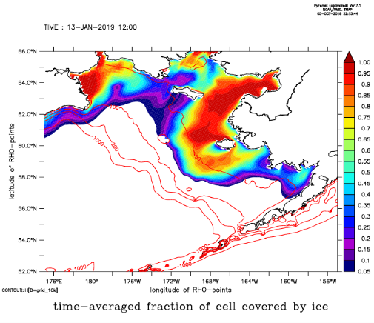
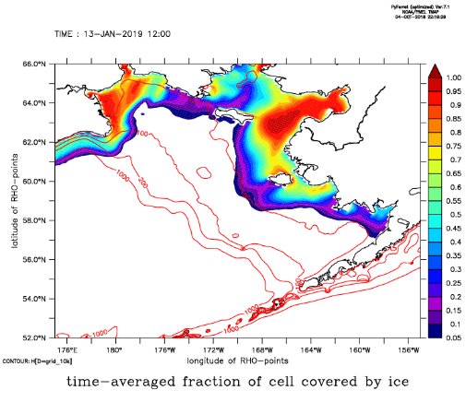
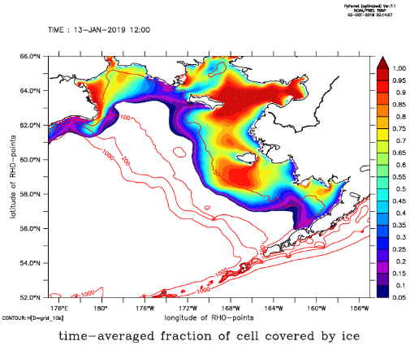
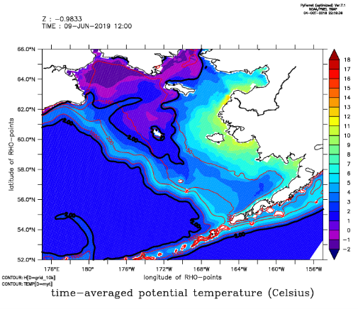
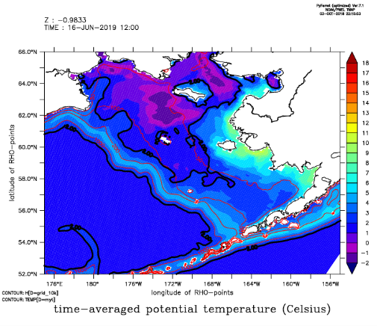
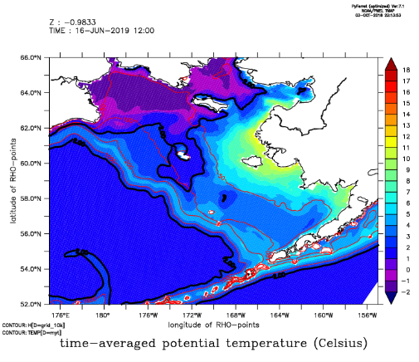
Recent forecasts from three start dates using Migo version of model
(we will also be trying start dates in April)
14 Sep 2018
24 Sep 2018
02 Oct 2018
Ice Cover
Jan 2019
Bottom T
Jul 2019

Slide 33
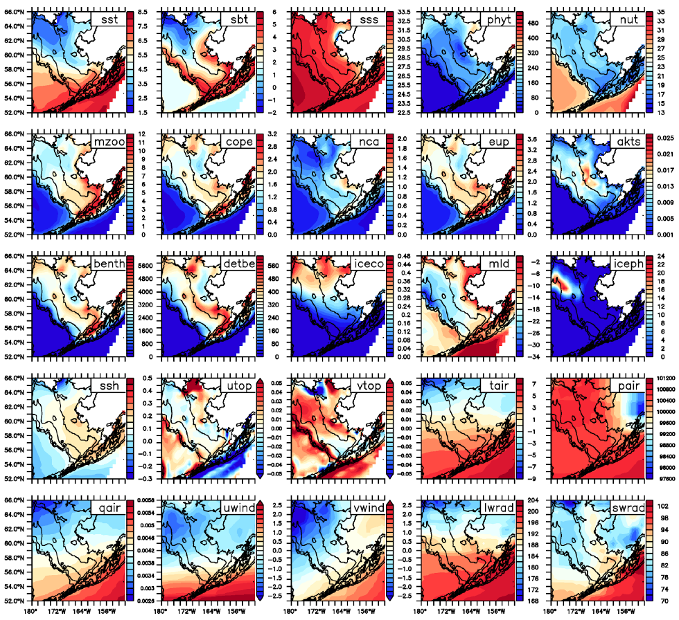
10-year climatology of Bumble version
(Hermann et al. ICES J. Mar. Sci, in review)
Southeasterly, mid-shelf maxima of euphausiids and copepods resemble acoustical and net data (Ressler et al. 2014; Coyle et al. 2008, Hunt et al. 2011, D. Kimmel, pers. comm.).

