Slide 1

IFQ Access opportunities
Expanded Discussion Paper
Anna henry
IFQ Committee March 25, 2021

Slide 2

Background
June 2018- Council requested first discussion paper
  Response to community access and entry opportunity challenges identified in the 20-year review of IFQ program and related public testimony
  Review existing programs that facilitate access opportunities for rural communities and new entrants within limited access fisheries
  Evaluate Norway’s Recruitment Quota and similar global examples

Slide 3
Background
June 2019- IFQ Access Opportunities, Global Examples discussion paper
  Balancing the benefits and consequences of limiting access
  IFQ access challenges and existing programs to address access concerns
  Global examples of access programs
    Target populations
      young people, small-scale fishermen, indigenous populations, rural communities, low income, disenfranchised populations
    Mechanisms for access
      separate allocation, different criteria/rules, opportunity to buy in, permit bank, open access, technical assistance, educational support, financial support, direct marketing
  Challenges/Benefits in NPFMC region
    Legal considerations
    Distributional impacts on other IFQ users
    Benefits in the North Pacific region

Slide 4
Background
June 2019- Council requested expanded discussion paper
Identifying considerations related to the creation of an Access Pool of halibut and sablefish QS that facilitates entry level opportunities
Target Population
  Entry level fishermen (crew and owner-operators) in fishing communities seeking to enter the halibut/sablefish fisheries.
  Entry level is defined as owning less than 5,000 pounds of combined QS in all areas based on 2019 quota holdings.
Mechanisms
  The Access Pool could be funded using newly created QS units based on a one-time 1% of 2019 QS Access Pool for halibut and sablefish in all areas
  The Access Pool could be funded by a tax of .5% or 1% of QS transferred, halibut and sablefish in all areas
Entity
  RFA or newly formed regional organization would receive the allocation and determine the distribution to applicants based on criteria established by the entity and approved by the Council.
Originally scheduled for review at April 2020 meeting
(cancelled due to Covid-19)

Slide 5
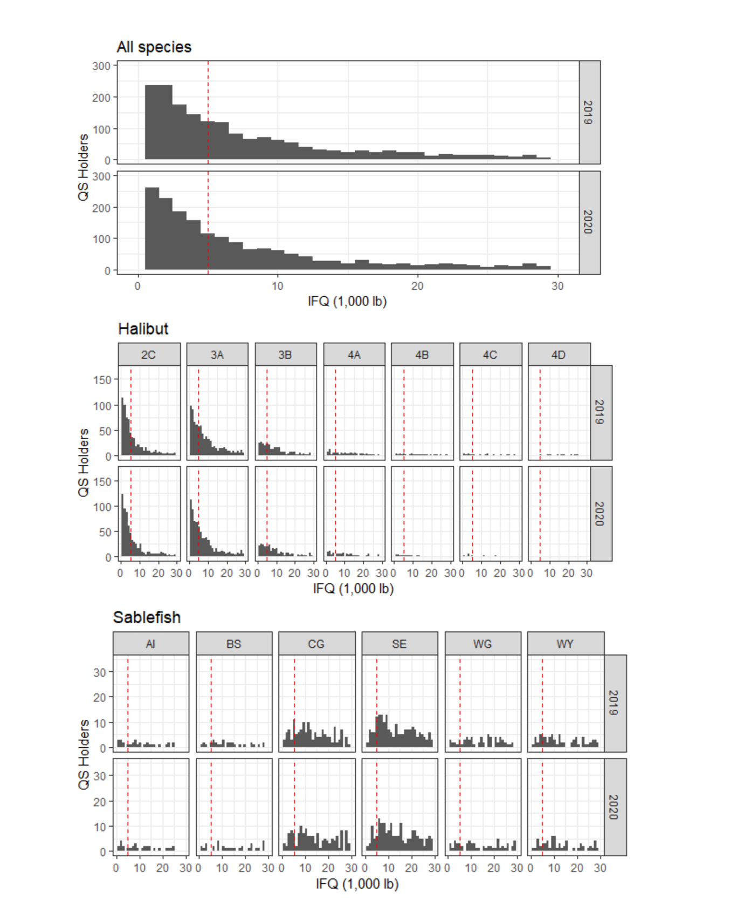
Distribution of QS holdings
The distribution of overall QS holdings is skewed such that there are numerous holders of QS representing small amounts of IFQ pounds and fewer holders of larger amounts of IFQ.
Figure 1 p. 3- Distribution of QS holders’ total holdings in pounds of IFQ in 2019 and 2020 for all species combined. The red dashed line represents the Council’s proposed 5,000 pound threshold.

Slide 6
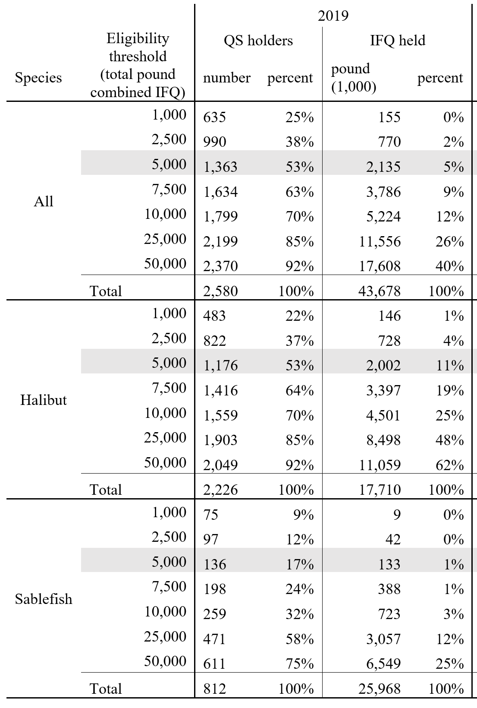
  Defining entry level participation
Council motion identifies entry level crew and owner-operators as the target population for the access pool
Entry level defined as IFQ participants owning less than 5,000 pound of combined halibut and sablefish IFQ in all areas based on 2019 quota share holdings
This definition includes 53% of current QS holders
Crewmembers
  In 2020: 2,835 TEC holders who do not hold QS
Table 2, p.5-Potential eligible access pool recipients under different eligibility thresholds

Slide 7
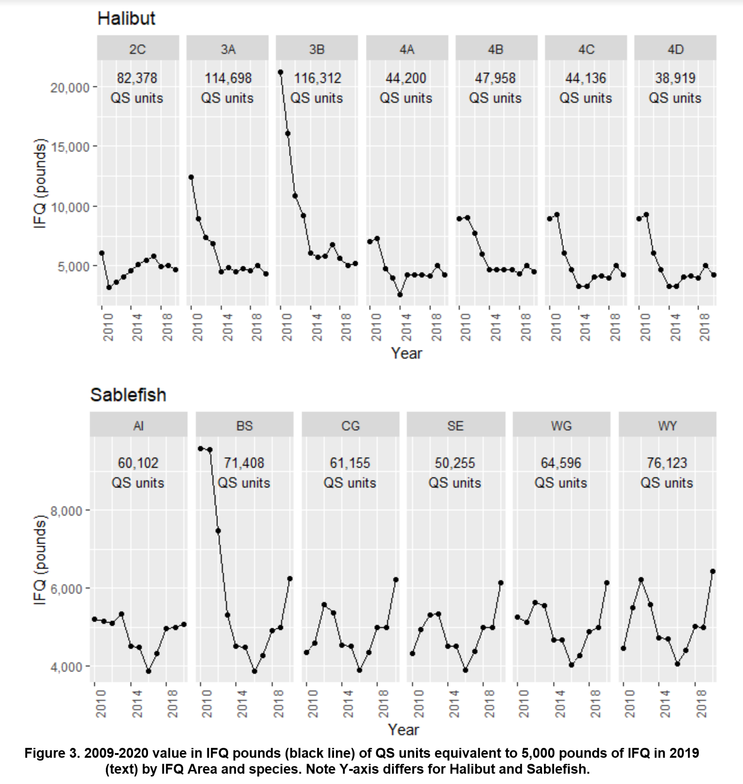
  Defining entry level participation
The amount of QS equivalent to 5,000 pound of IFQ in 2019 varies by IFQ area and is equivalent to different quantities of IFQ pounds each year as halibut and sablefish TACs and thus the annual amount of IFQ issued fluctuates

Slide 8
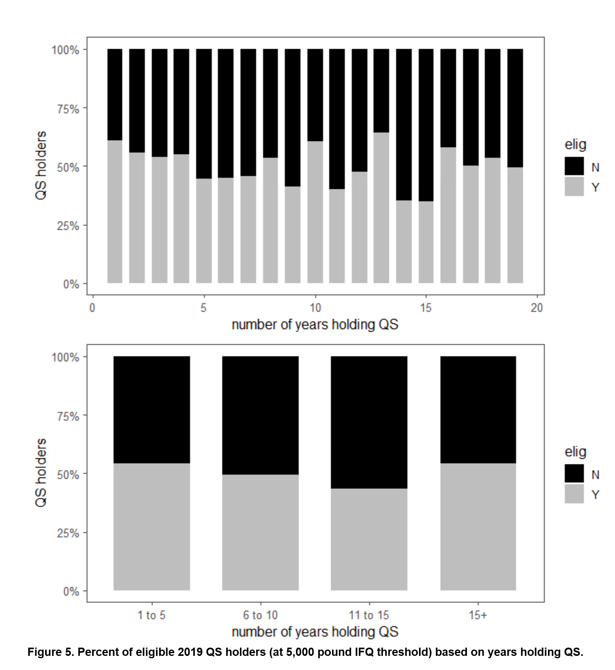
  Defining entry level participation
Entry level connotes a relative lack of experience in the fishery.
The total amount of QS held and the rate of accumulation of QS varies by individual and operation and does not always correlate with the length of time an individual has held QS.
The percentage of participants who are eligible for the access pool is not related to the length of time they have held QS

Slide 9
Access pool quantity and distribution
Halibut
Sablefish
 | 2019 | 2020
IFQ Area | 1% IFQ | 1% IFQ
 | (pounds) | (pounds)
2C | 36,100 | 34,100
3A | 80,600 | 70,500
3B | 23,300 | 24,100
4A | 16,500 | 14,100
4B | 9,680 | 8,800
4C | 4,550 | 3,830
4D | 6,370 | 5,362
4E | - | -
All | 177,100 | 160,792
 | 2019 | 2020
IFQ Area | 1% IFQ | 1% IFQ
 | (pounds) | (pounds)
AI | 26,565 | 26,962
BS | 13,139 | 16,402
CG | 91,315 | 113,669
SE | 65,785 | 80,755
WG | 27,888 | 34,259
WY | 34,987 | 45,040
All | 259,680 | 317,088
Tables 3 and 4 on page 13-14 display by vessel category as well

Slide 10
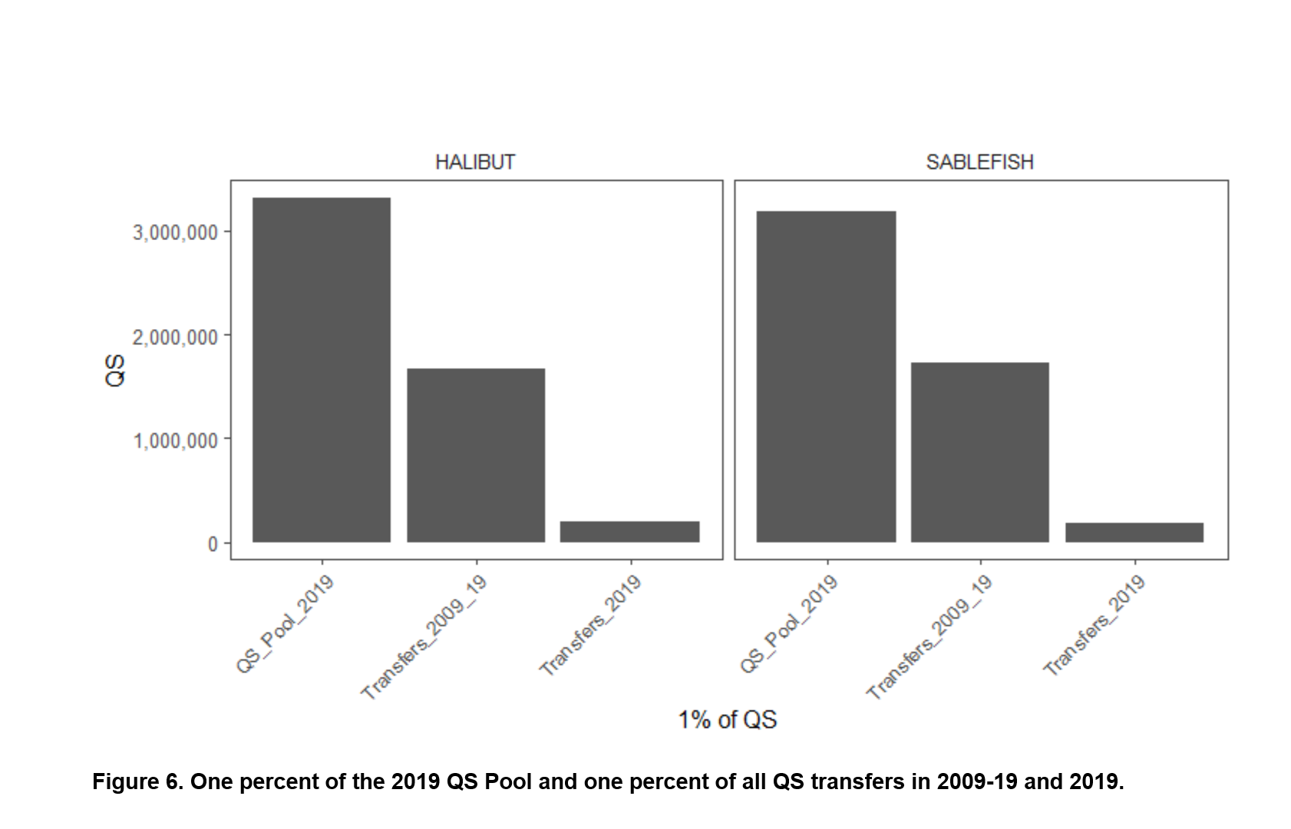
QS source mechanism
Transfer deduction
Issues to consider
1% or 0.5% from each QS transfer deposited in the access pool until 1% of the total 2019 QS is accumulated
Time to full accumulation
Transfer rates, accumulation by IFQ Area, vessel category
Transfer types included
Impacts to QS market
  Cost imposed on transfers
  Delay transfers
Management and implementation challenges

Slide 11
QS source mechanism
Newly created QS units
Issues to consider
New QS units equaling 1% of the total 2019 QS pool
A new share type subject to the restrictions of the access pool
Dilute existing QS
  With a stable TAC each unit of QS would correspond to a smaller amount of IFQ pounds
Short term adverse impact to current QS holders
Long term value change depends on specific market dynamics
Utilization rates by IFQ Area
Simpler implementation than transfer deduction

Slide 12
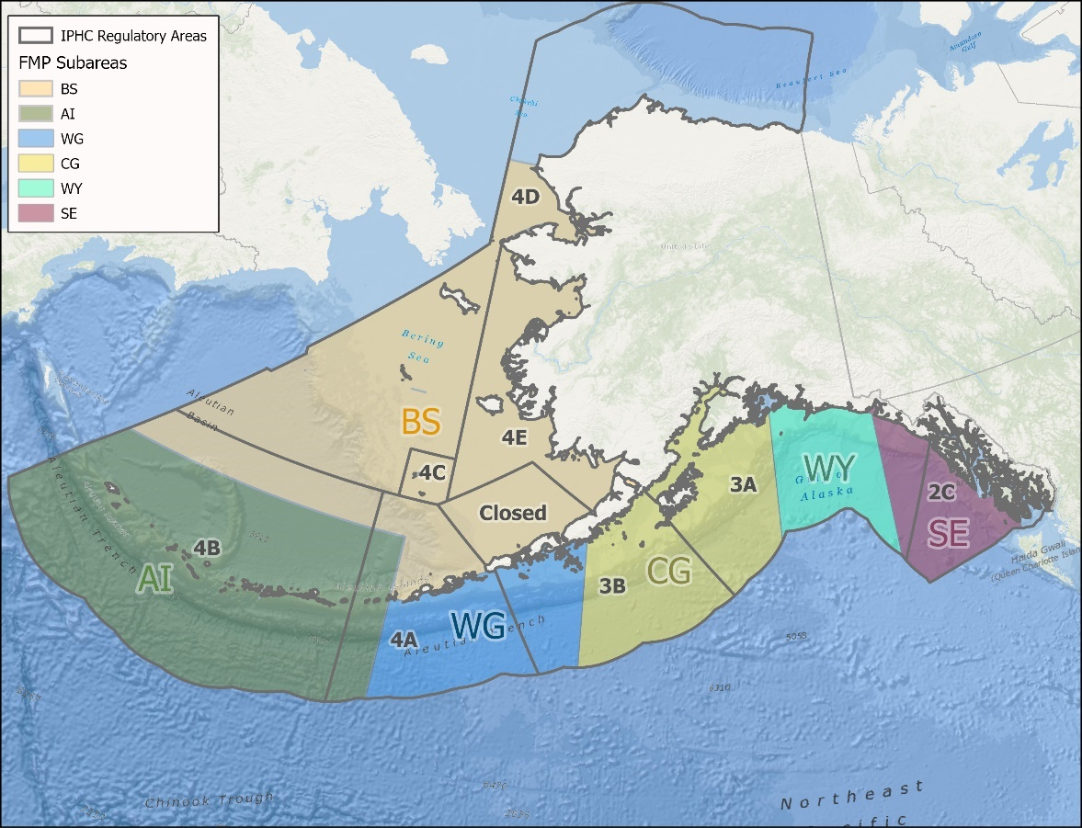
MANAGEMENT ENTITY
Regional Fishery Association
  Prohibited from receiving an initial allocation
Other Entity
  CQE or RQE as blueprint
Number and geographic distribution
Selection criteria for IFQ recipients
Regulatory and administrative costs and considerations

Slide 13
Outstanding questions
Eligibility threshold
  Over half (53%) of current QS holders would qualify for an access pool under an eligibility threshold of 5,000 pounds of combined QS in 2019 values
  How would eligibility apply to crewmembers (current, future TEC holders)?
  Quantity of QS held does not correlate with length of time holding QS, therefore defining eligibility based solely on a threshold of QS holdings may not sufficiently target entry level participants
QS source mechanisms
  Under a transfer deduction of 1% or 0.5% of permanent QS transfers, it would take numerous years to accrue the full one percent of the 2019 QS into the access pool

Slide 14
Outstanding questions
Access pool QS
  How would access pool QS source and distribution relate to current breakdowns by IFQ regulatory areas and/or QS vessel categories?
  Would this action apply to A shares?
  Would the access pool quantity and eligibility thresholds remain static in terms of 2019 QS values and IFQ TACs or would it fluctuate annually?
    If static, clarify why 2019 was selected as the index year.
Access pool management entity
  What is the optimal structure and number of access pool management entities to represent regional differences and maintain administrative efficiencies?
Access pool quota disbursement
  Develop guidance regarding criteria to select access pool IFQ recipients.

Slide 15
Questions?
Thank you to contributors: Sarah Marrinan (NPFMC), Sam Cunningham (NPFMC); Doug Duncan (NMFS), Alicia Miller (NMFS), Tom Meyer (NOAA GC)

