Slide 1
Assessment of BSAI Kamchatka flounder
Meaghan D. Bryan, Kalei Shotwell,
Elizabeth Siddon, Stephani Zador,
James Ianelli, Emily Markowitz
November, 2022

Slide 2
Data
Data Source | Years
Fishery catch | 1991 - 2022
Fishery lengths | 2008-2011, 2018-2022
Survey biomass
EBS shelf | 1991-2019, 2021-2022
EBS slope | 2002, 2004, 2008, 2010, 2012, 2016
Aleutian Islands | 1991, 1994, 1997, 2000-2018 (biennial), 2022
Survey length composition
EBS shelf | 1991-2019, 2021-2022
EBS slope | 2004, 2008, 2010, 2016
Aleutian Islands | Same as biomass without 2010
Survey age composition
EBS slope | 2002, 2012
Aleutian Islands | 2010, 2016, 2018

Slide 3
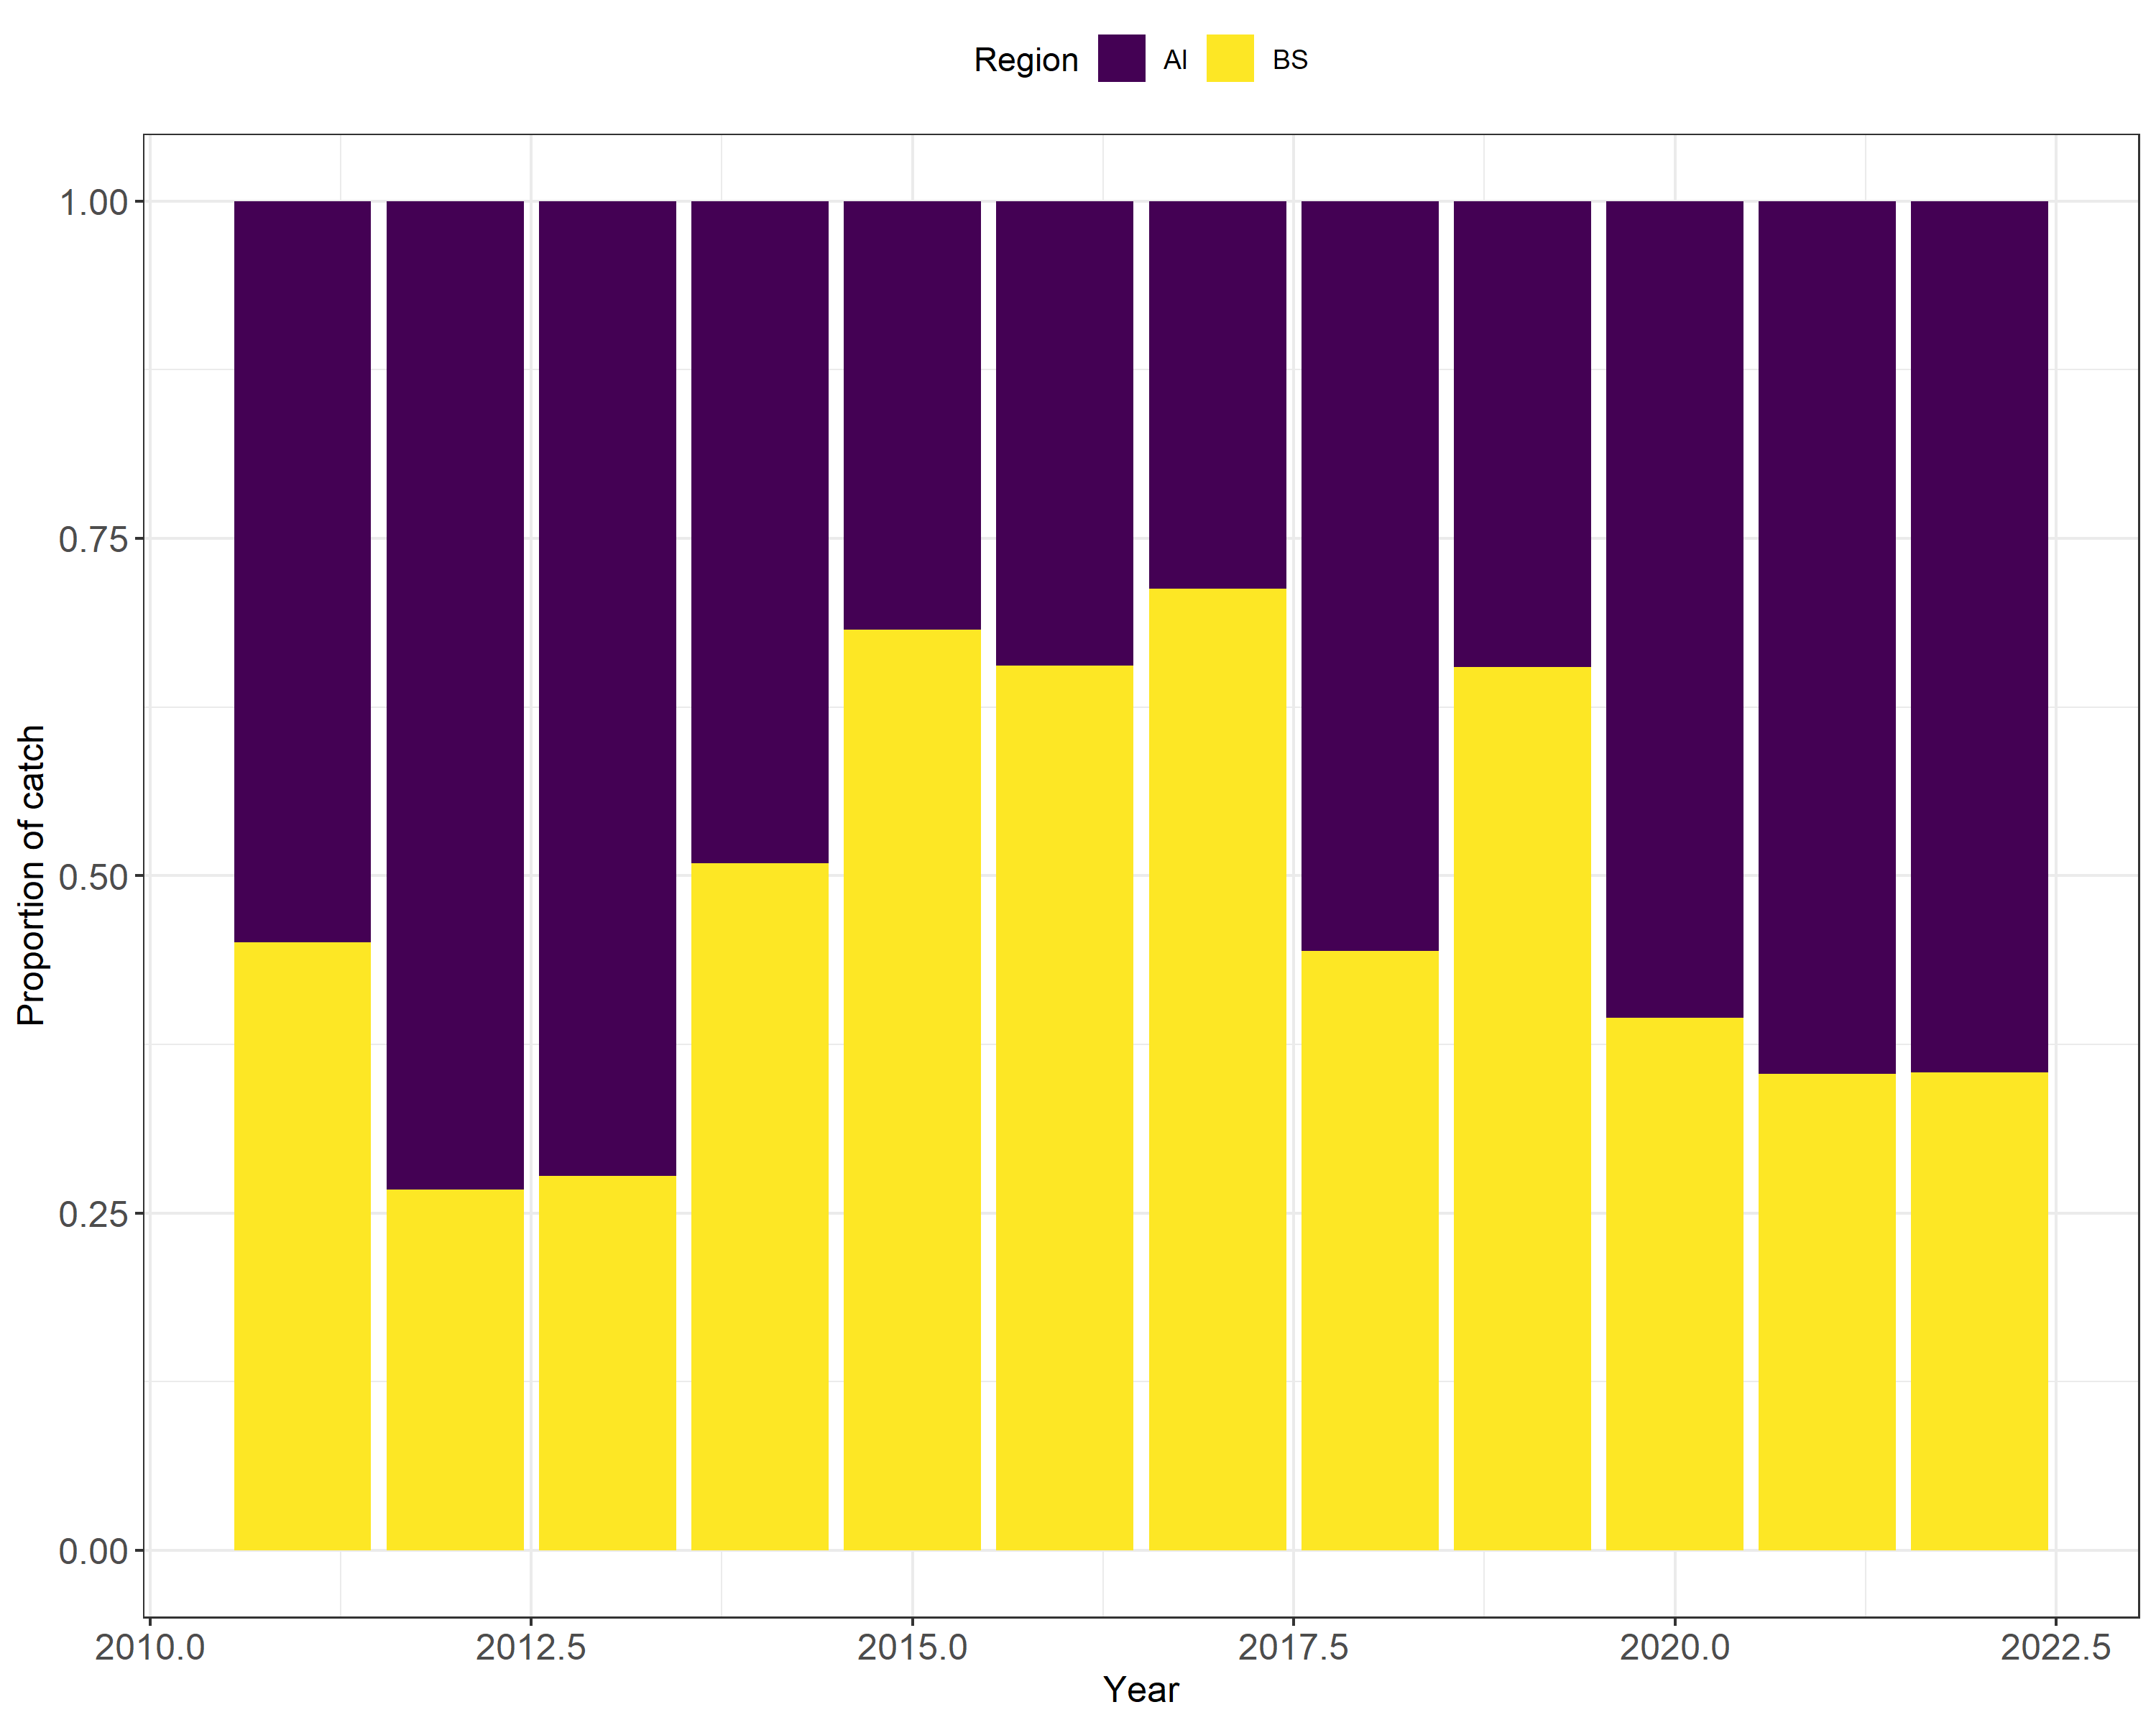
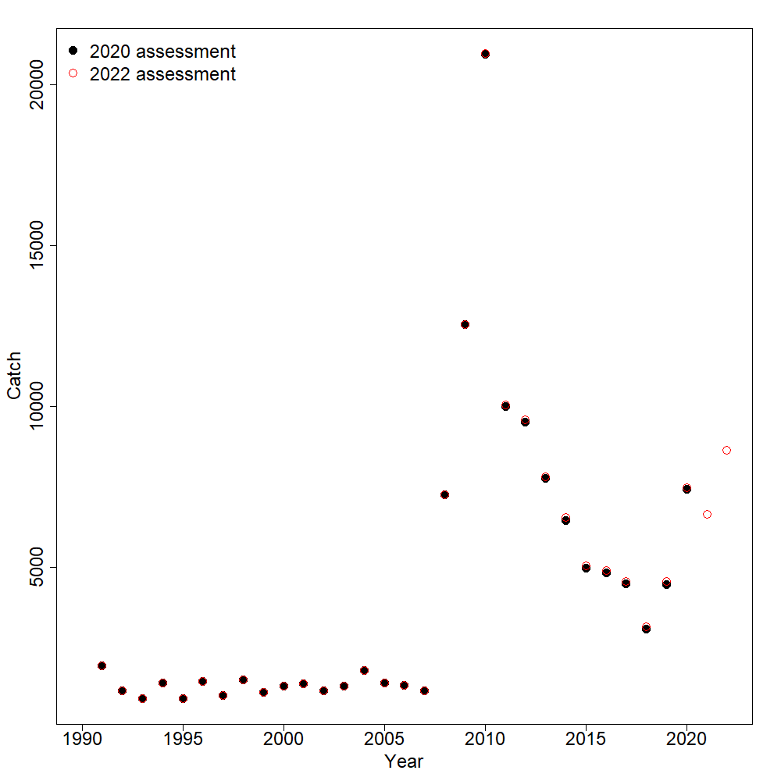
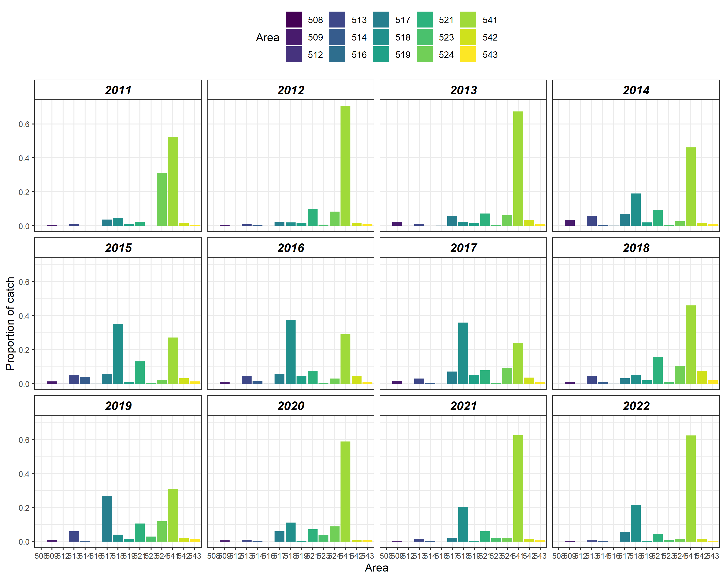
Catch
2008: 34% from 31%
2009: 42% from 45%
2010: 54% from 55%
1997 – 2007: 10%
Catch has been increasing since 2018
As of November 12, 2022 catch was 8,286t < 9,214 t ABC
On average since 2011, 80% of TAC has been caught
Notes:
Catch has been increasing since 2018 and in 2020 TAC exceeded.

Slide 4
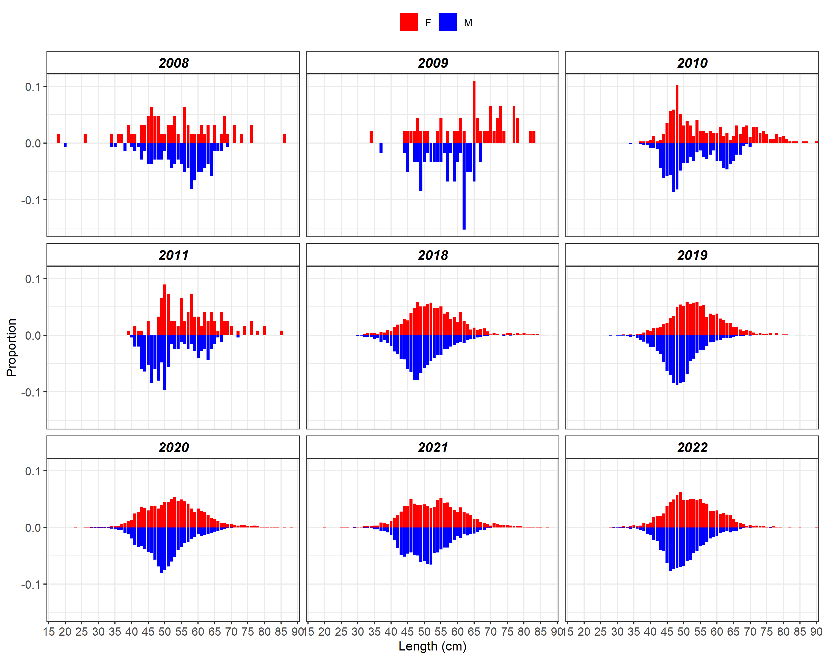
Fishery length composition
Notes:
Observer Program started collecting more Kam length data in 2018.
Last five years, size distributions fairly similar among years

Slide 5
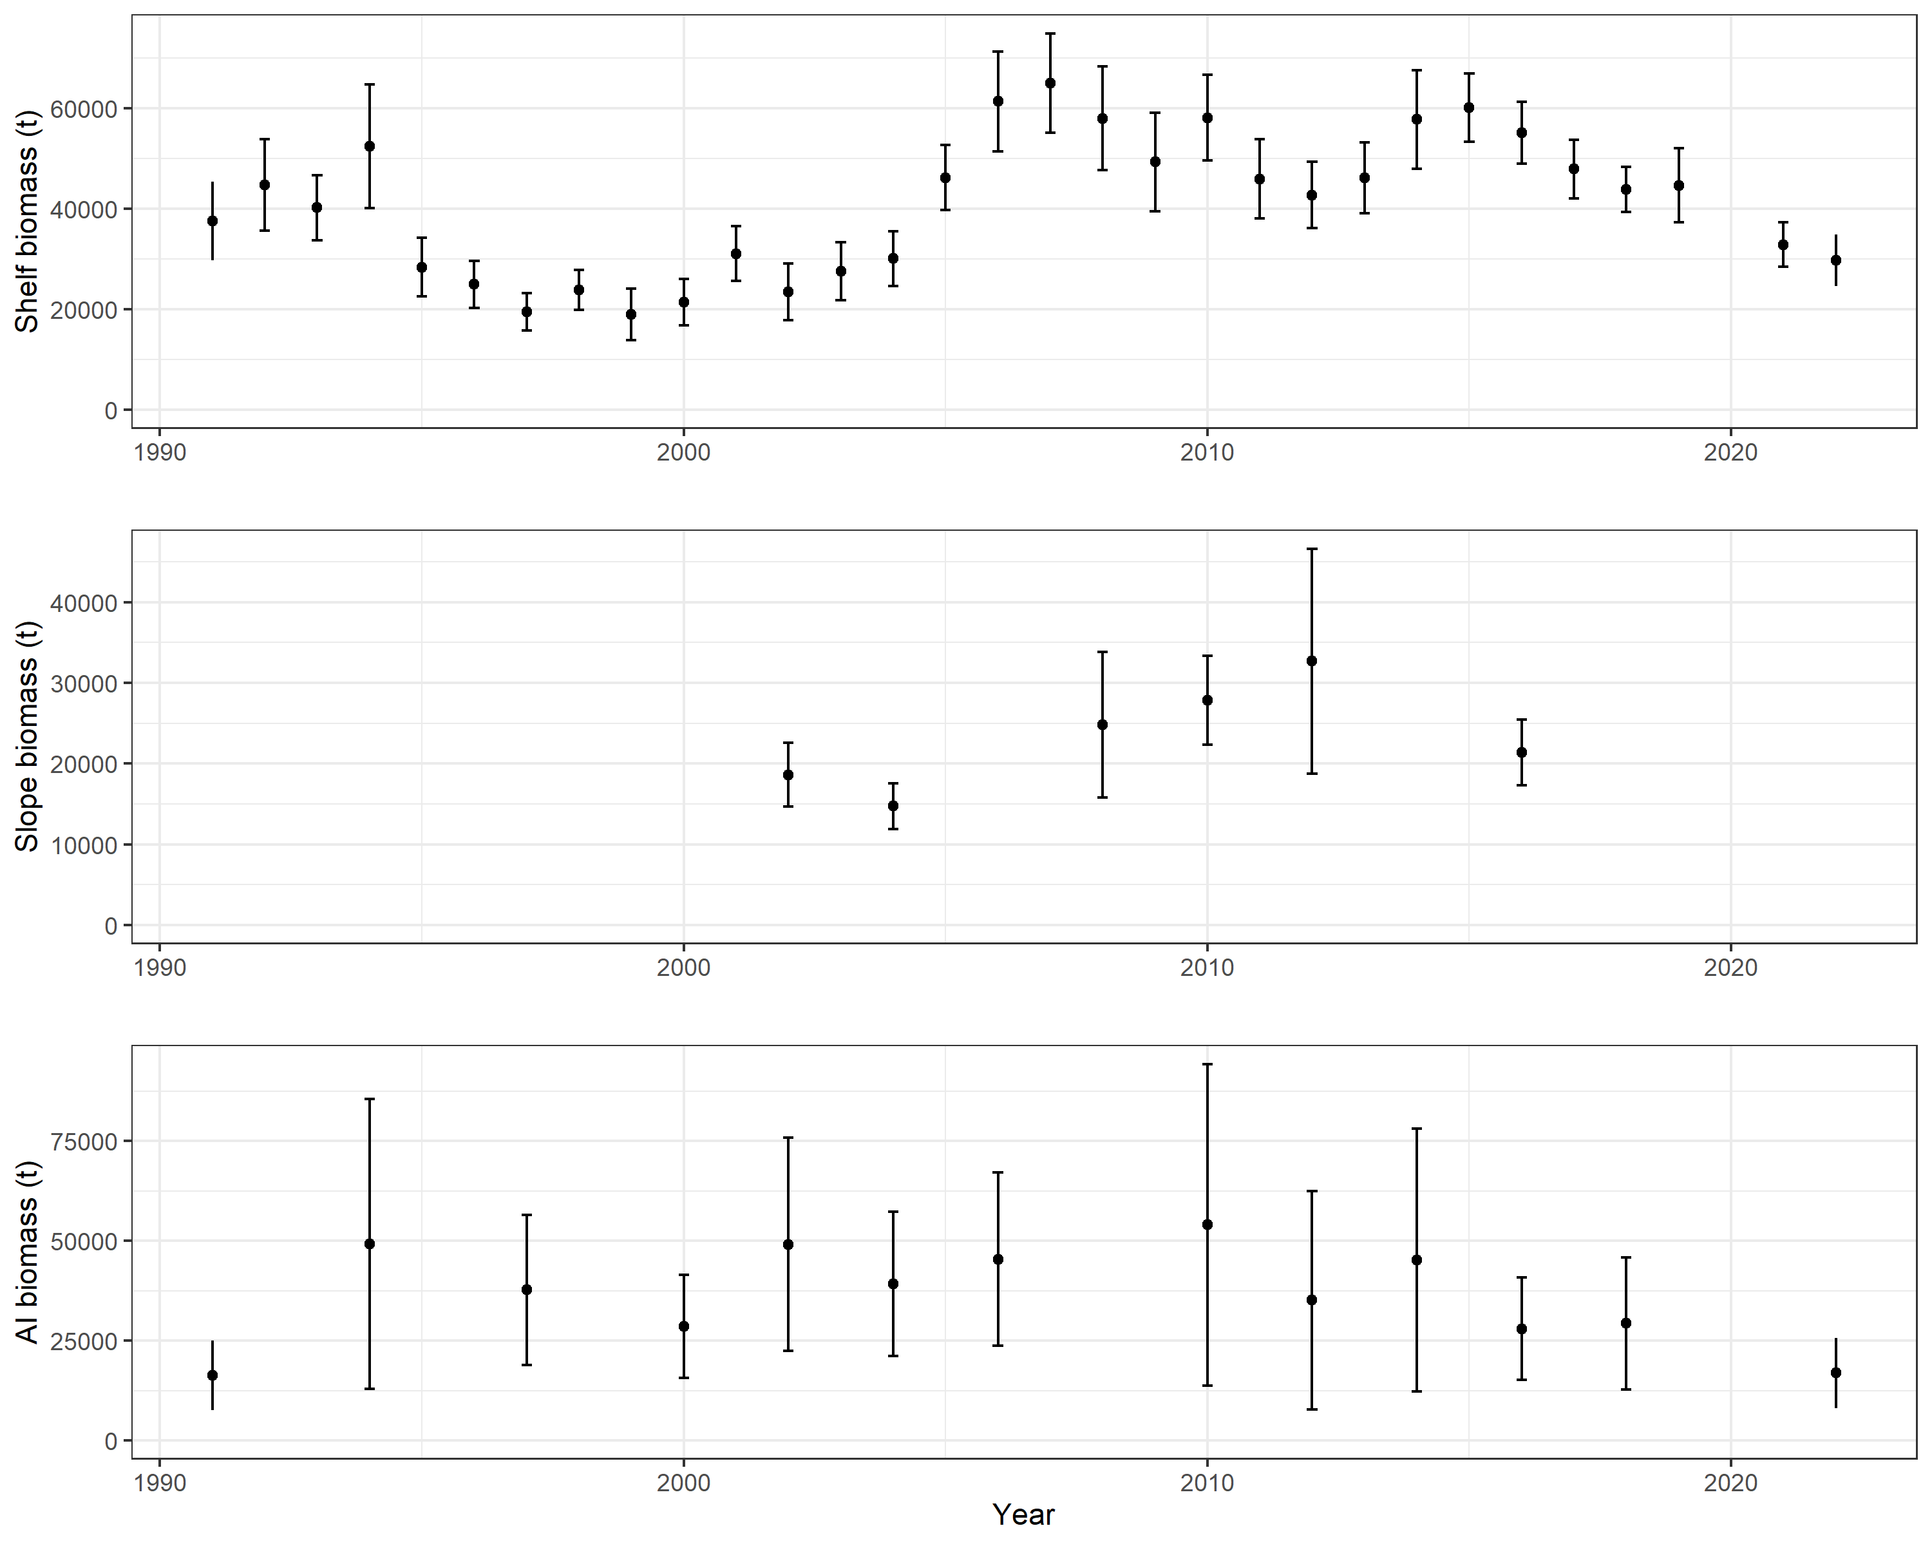
Survey biomass
2021: - 26%
2022: - 10%
2022: - 42%
Notes:
Fairly consistent evidence of recruitment since 2007

Slide 6
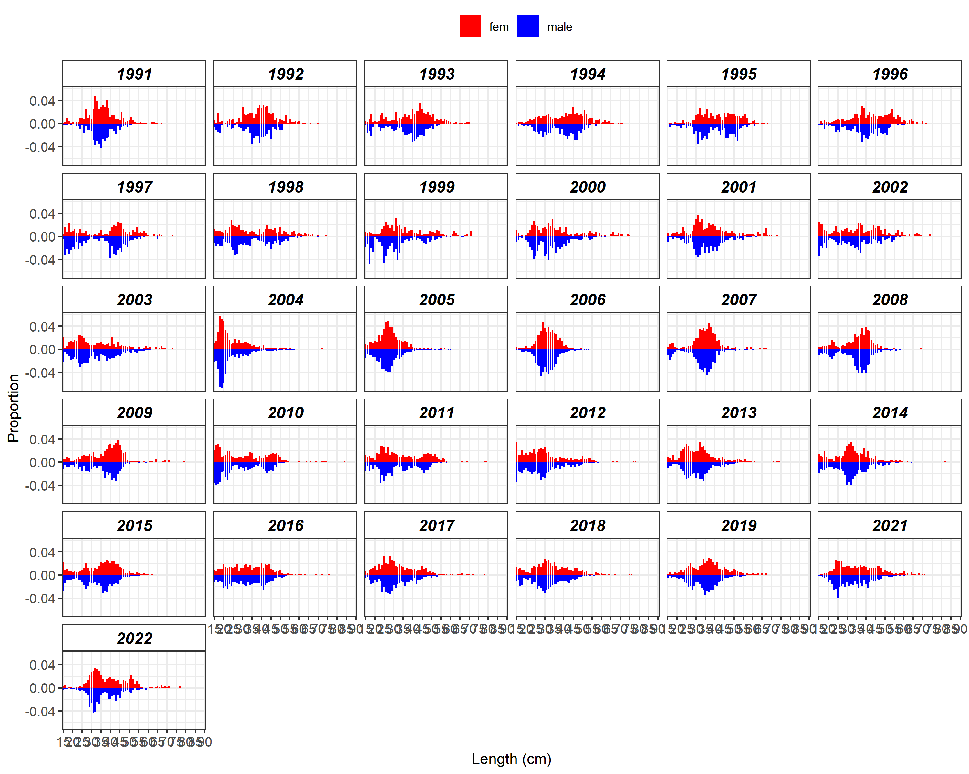
Shelf survey length composition
Notes:
Data suggests large age-2 rec in 2004, moderate in 2010, fairly consistent low level rec since

Slide 7
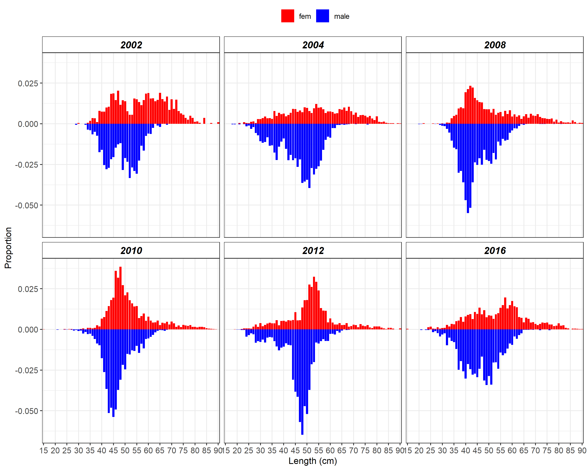
Slope survey length composition
Notes:
2004, 2008, 2012, and 2016 used in assessment
See 2004 cohort in 2008 and move through the timeseries

Slide 8
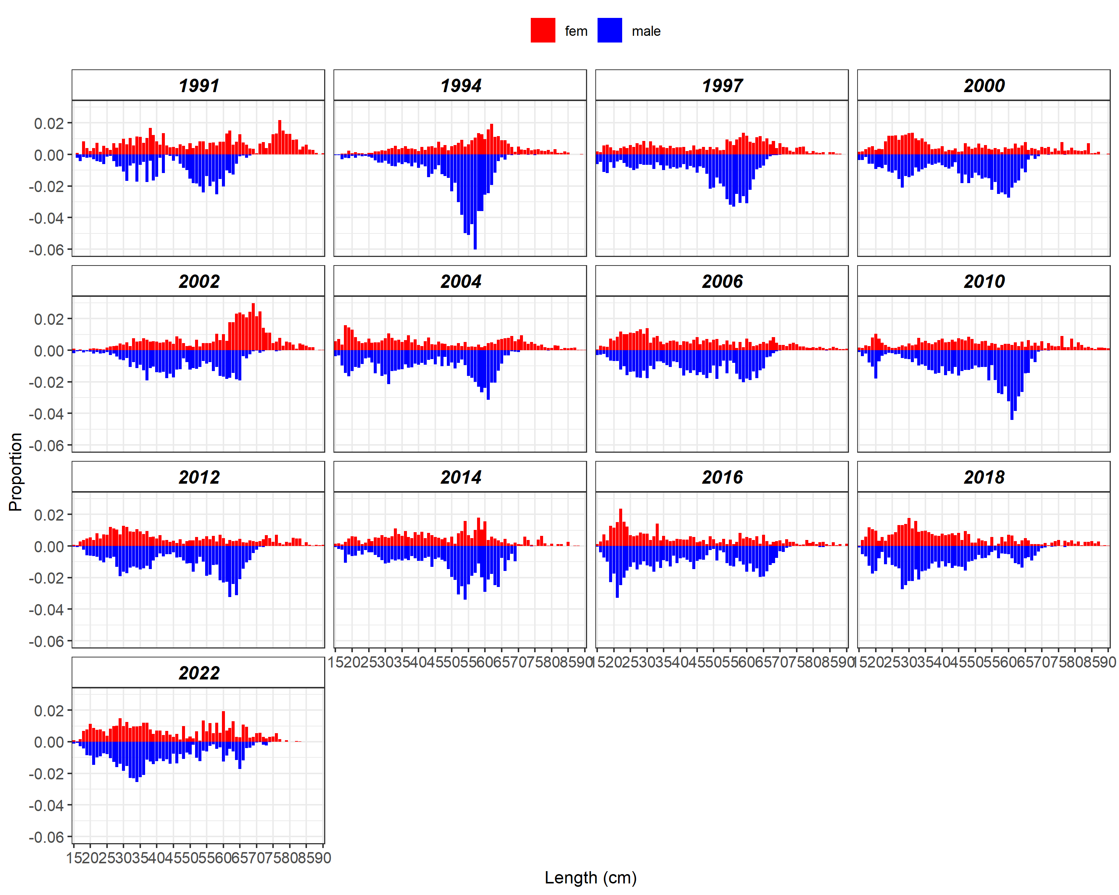
Aleutian Islands survey length composition

Slide 9
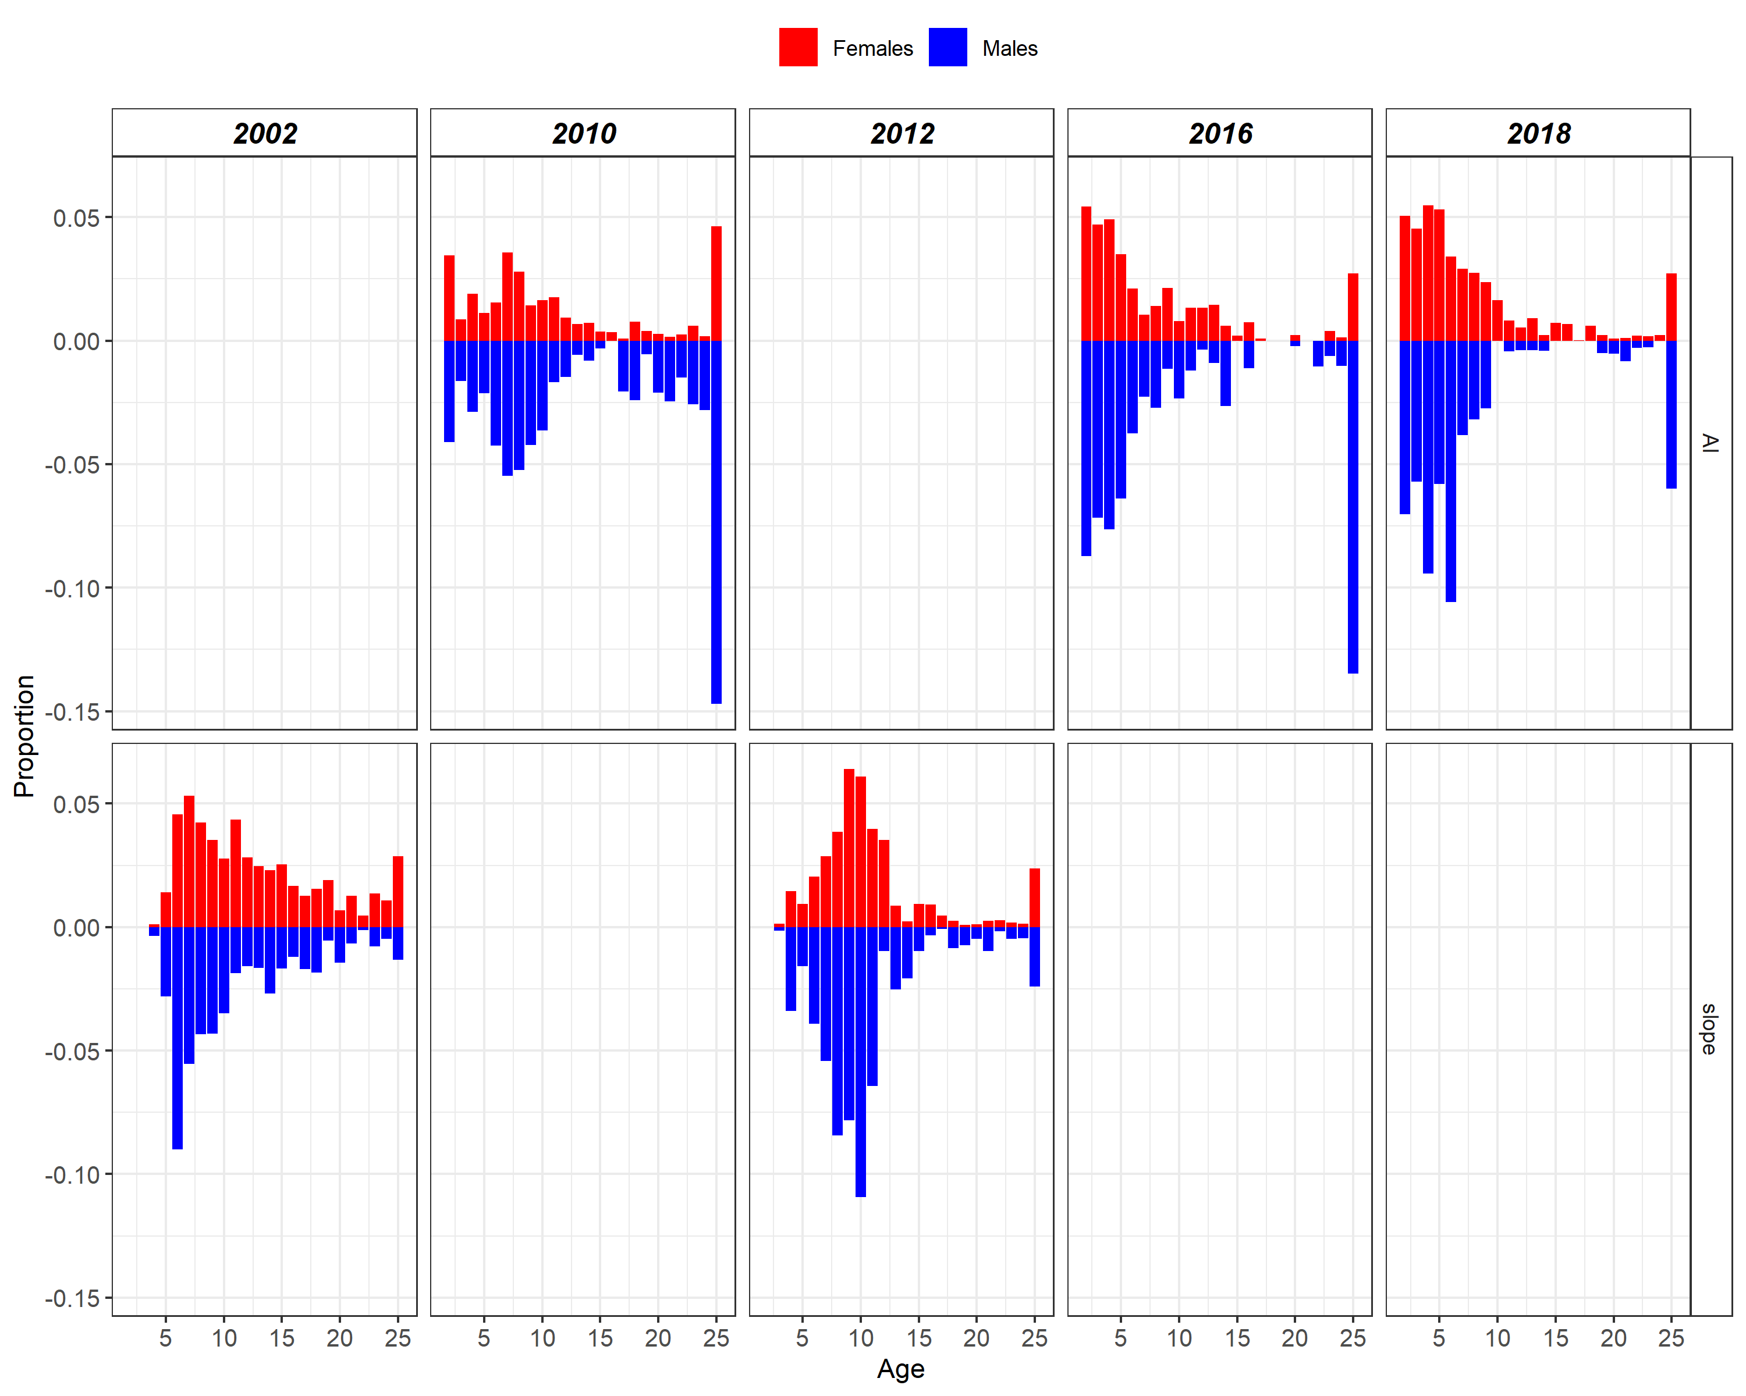
Age composition

Slide 10
Model structure
Age structured model (age 2+)
  Estimated outside of the model:
    Growth (sex-specific)
      Age-length transition matrices
    Length-weight relationship
    Maturity (Stark 2011)
  Natural mortality is fixed (0.11), same for females and males
  Age-based, sex-specific selectivity estimated
    Fishery - Logistic
    EBS shelf survey – Double logistic
    EBS slope survey - Logistic
    AI survey – Logistic
  Catchability estimated (EBS shelf survey and AI survey)
  Log mean recruitment and annual deviations estimated

Slide 11
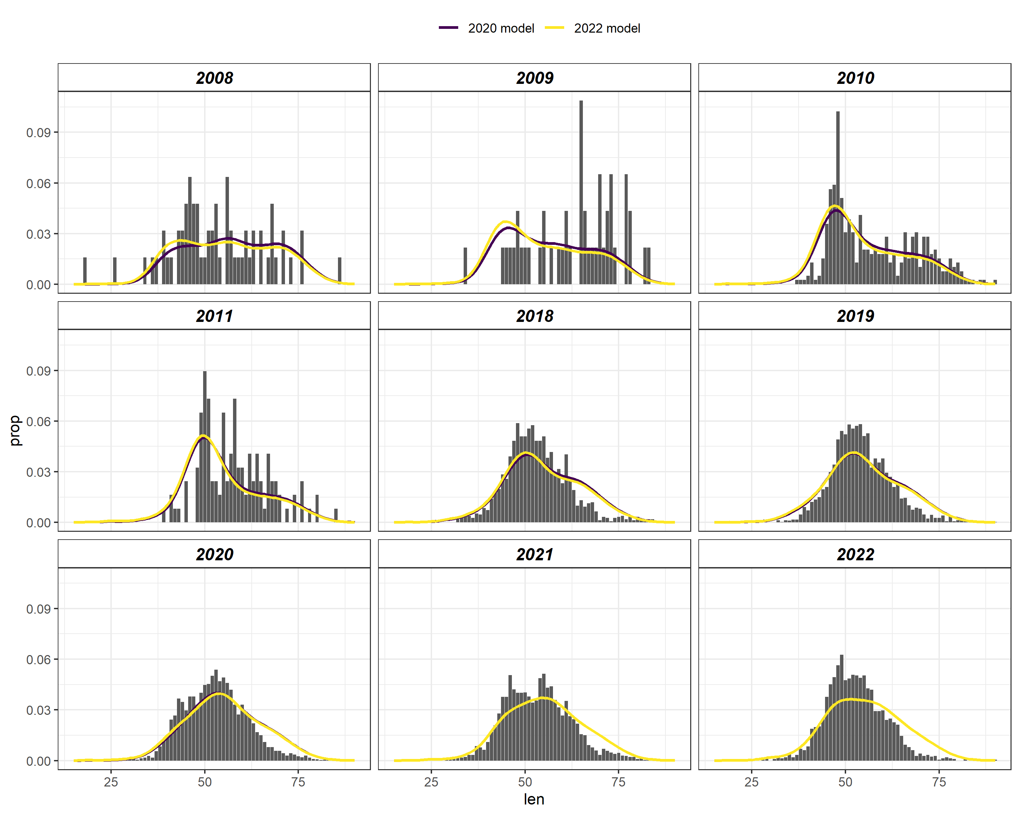
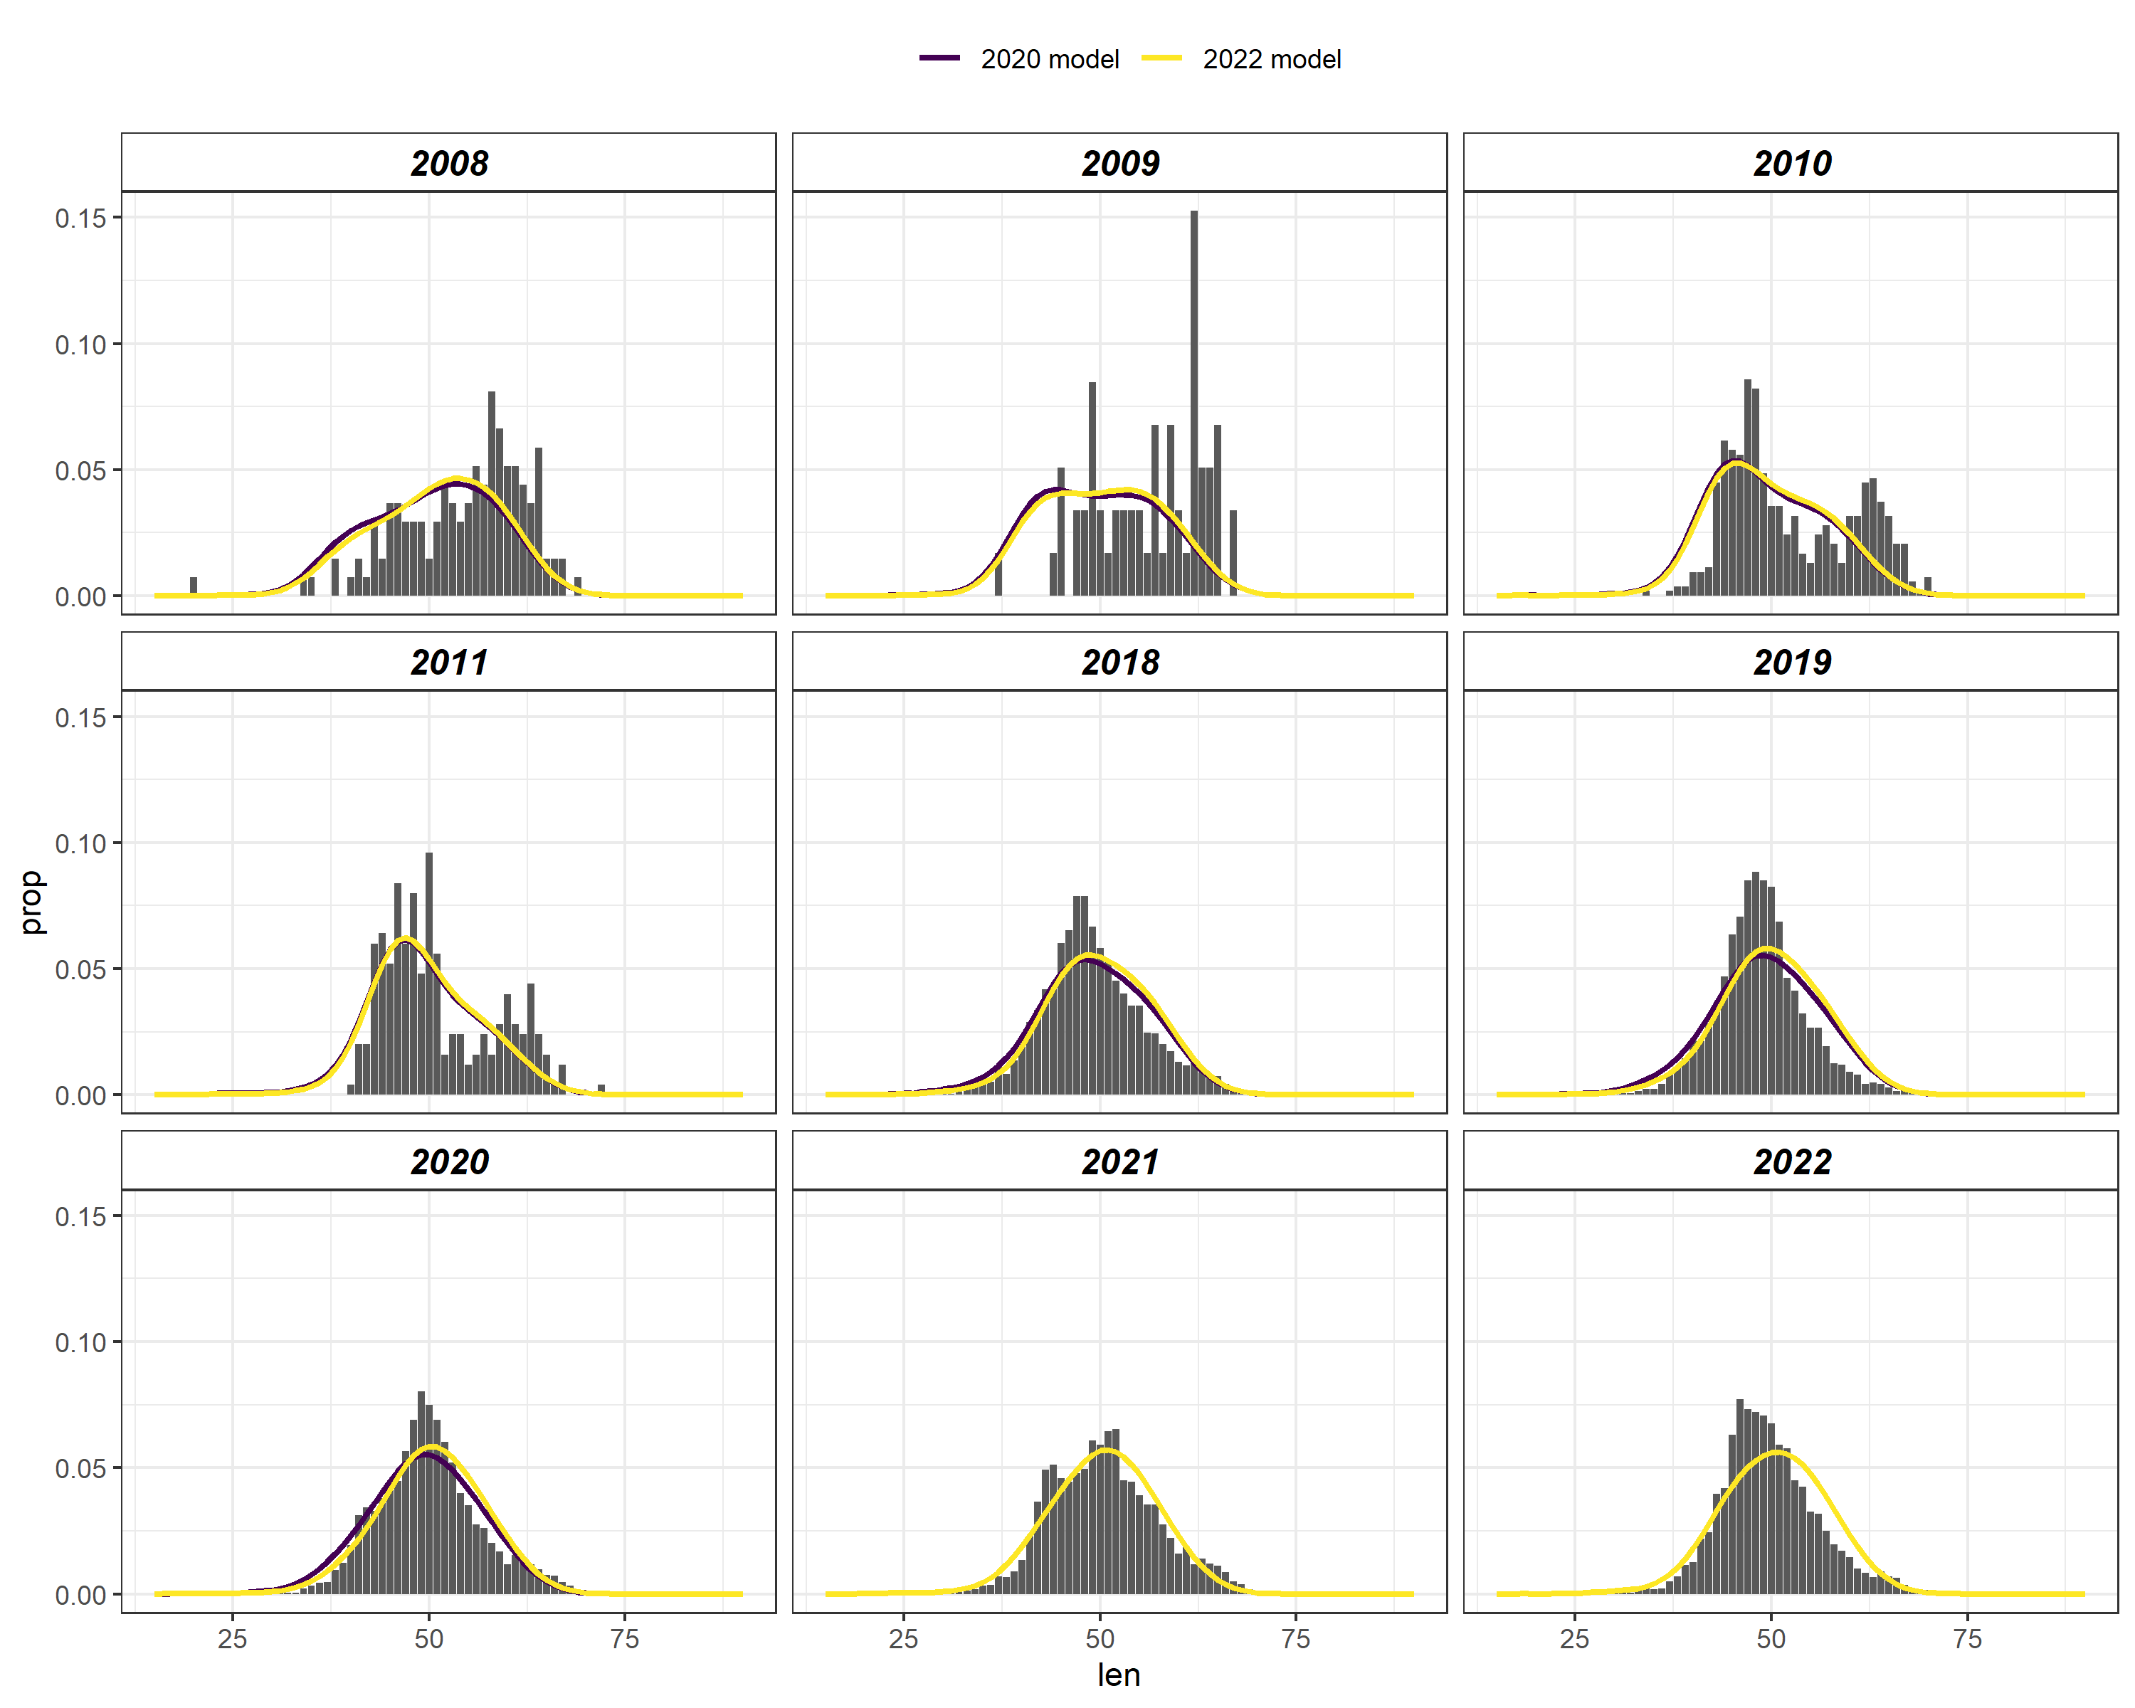
Fishery length
Females
Males
2020 model
2022 model

Slide 12
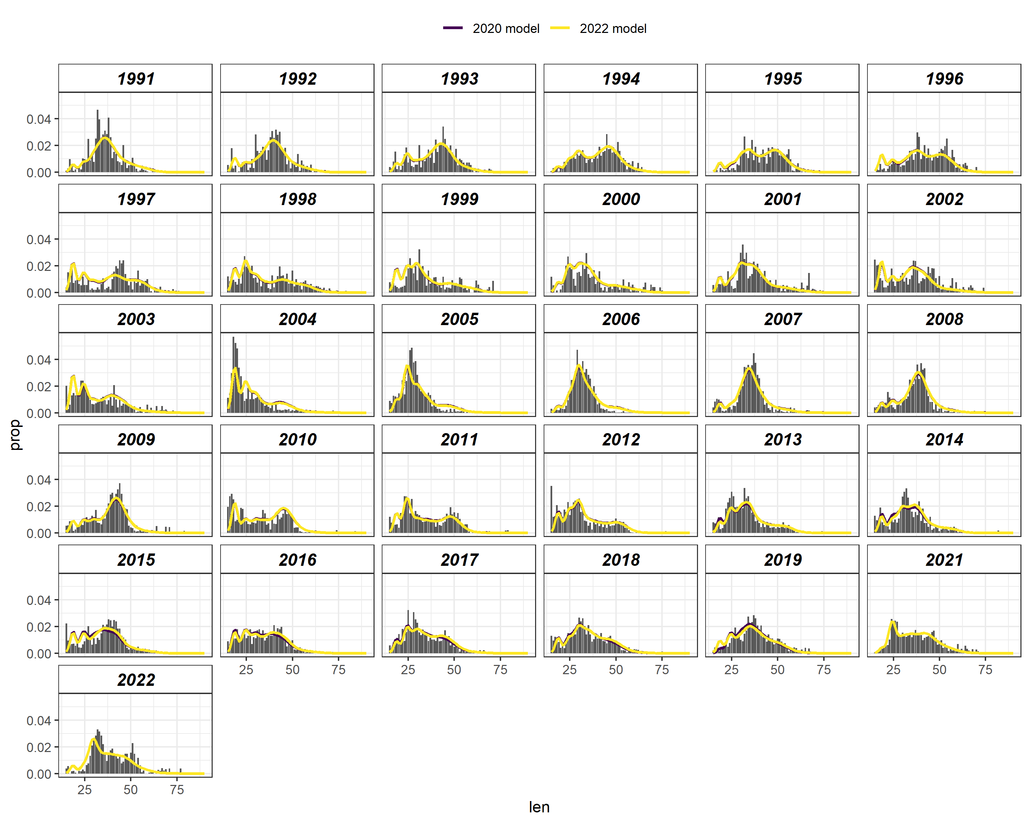
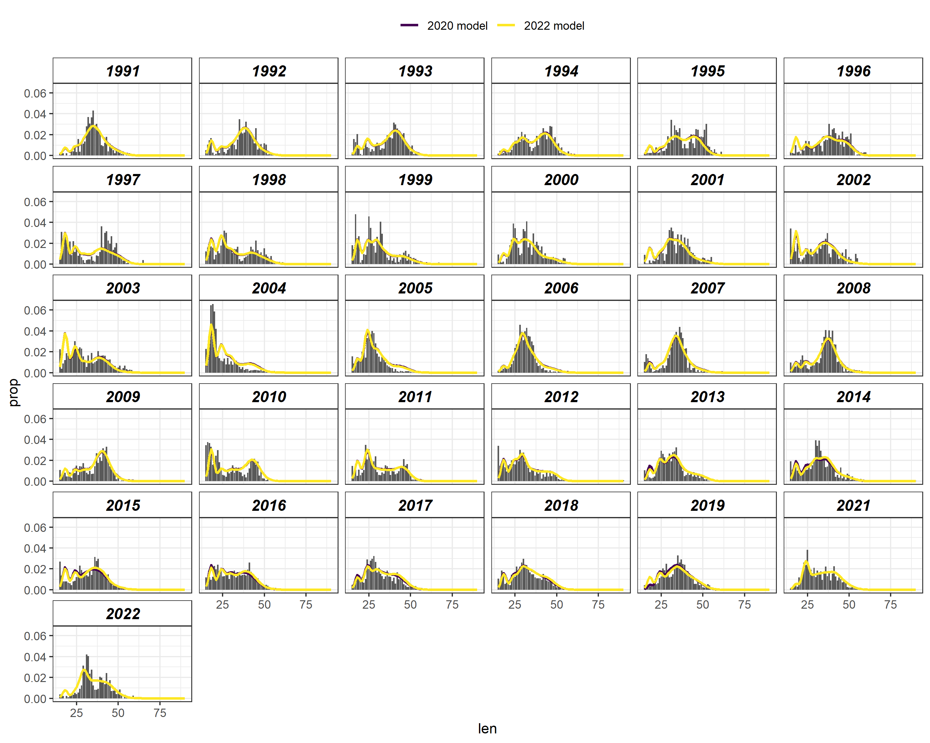
EBS shelf survey length estimates
Females
Males
2020 model
2022 model

Slide 13
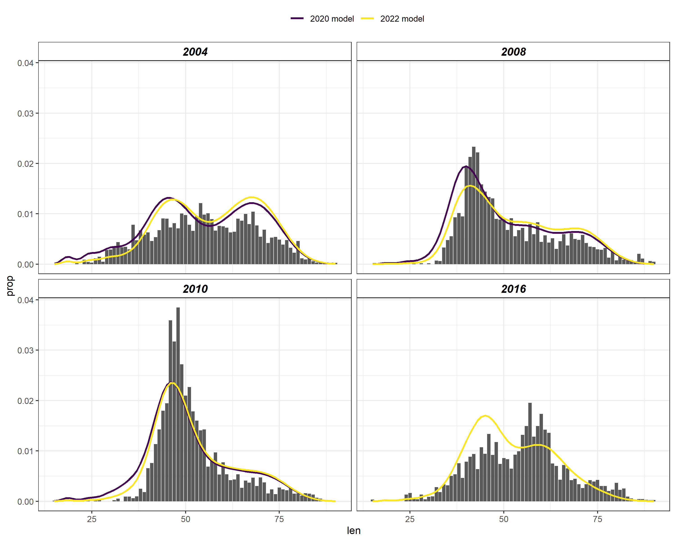
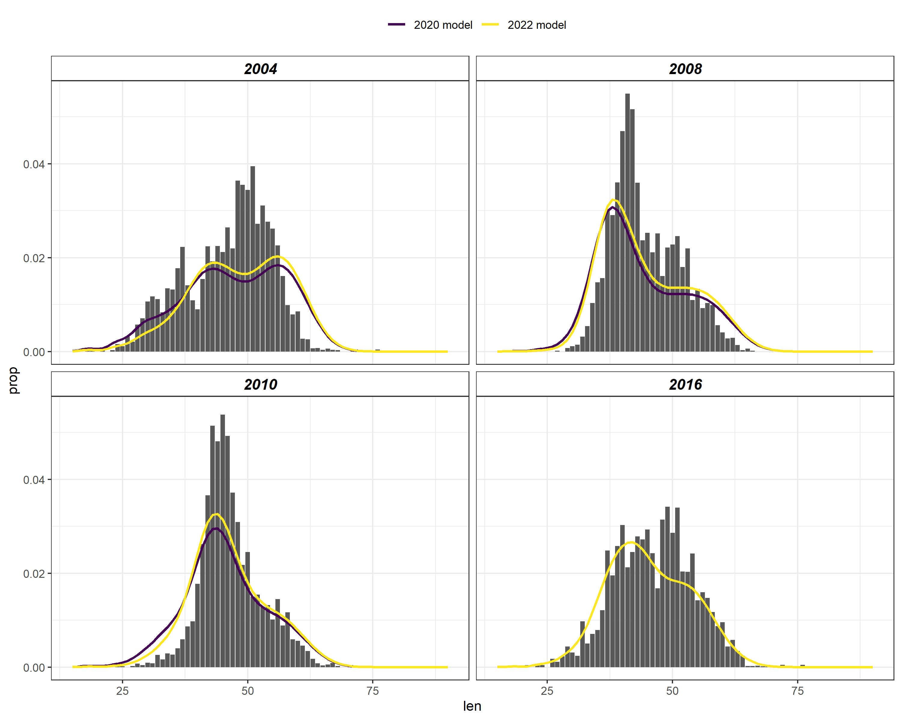
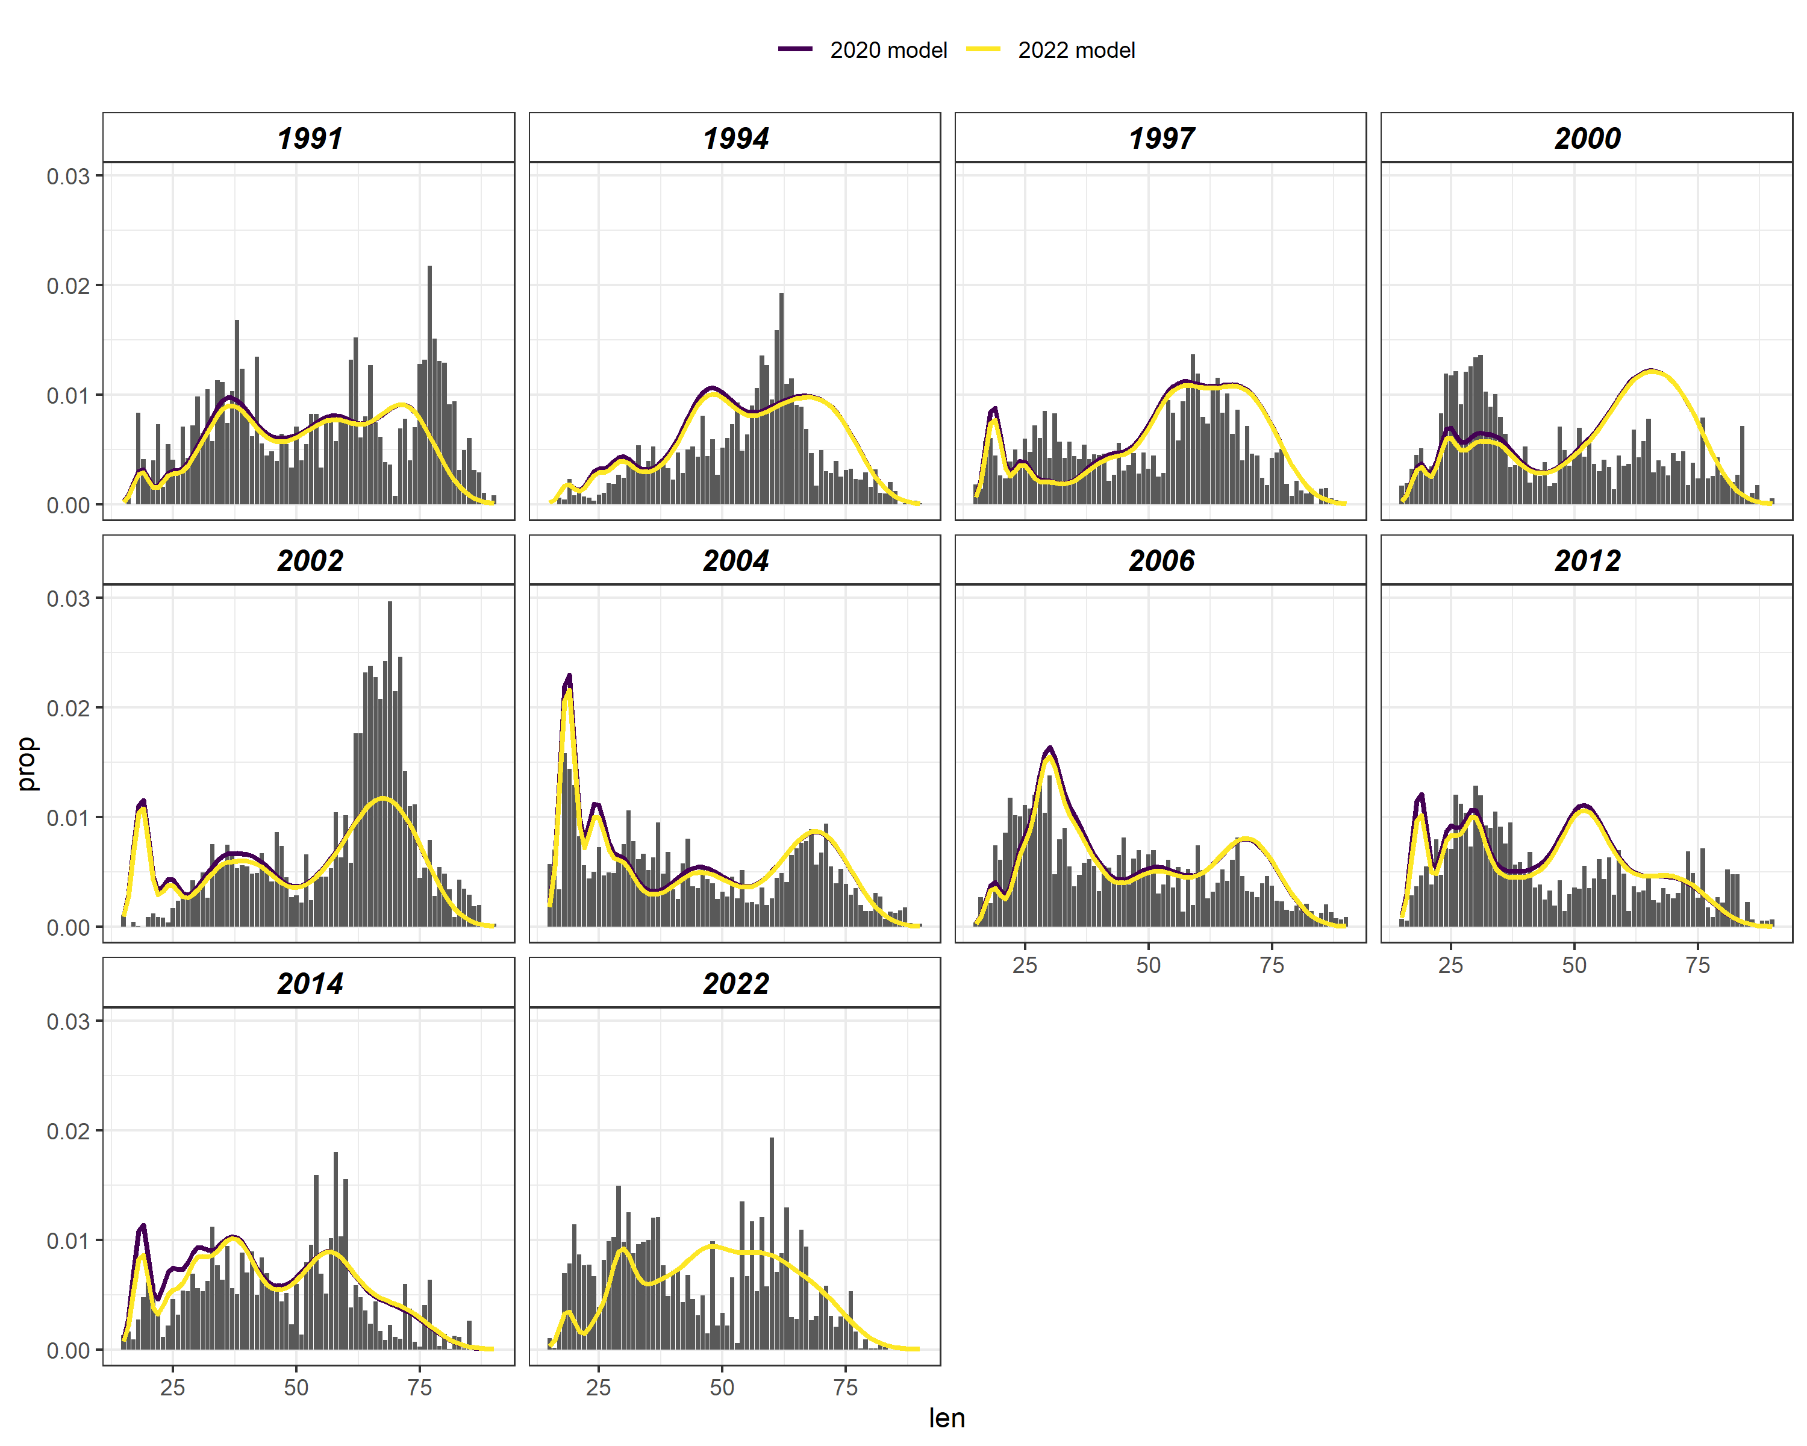
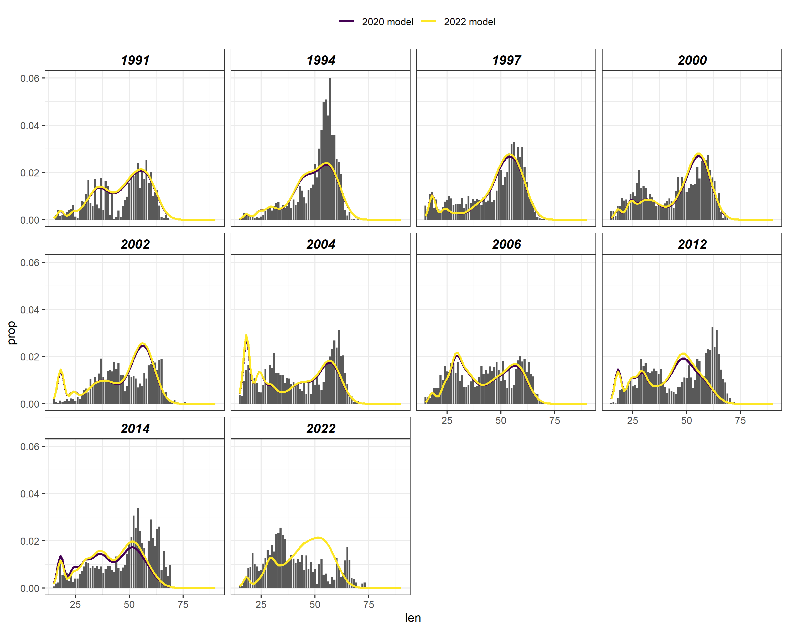
EBS slope and AI survey length estimates
Females
Males
2020 model
2022 model

Slide 14
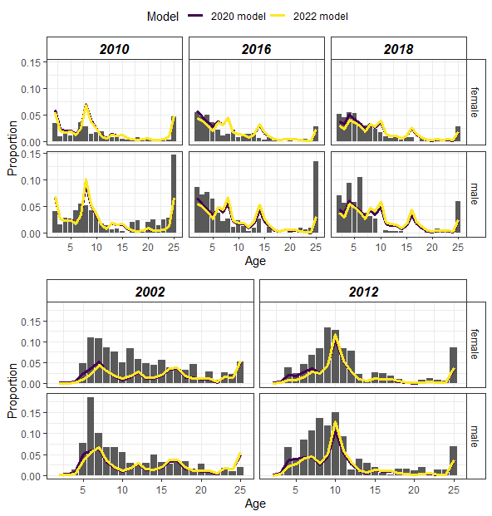
Model fit to age composition
2020 model
2022 model)
Aleutian Islands
EBS slope

Slide 15
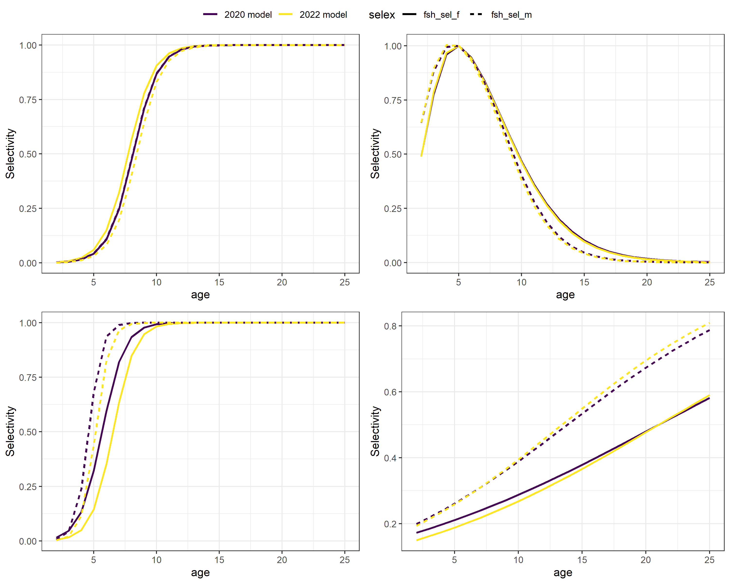
Selectivity
Females
Males
2020 model
2022 model
Fishery
EBS shelf survey
EBS slope survey
AI survey
Notes:
Dashed lines are males

Slide 16
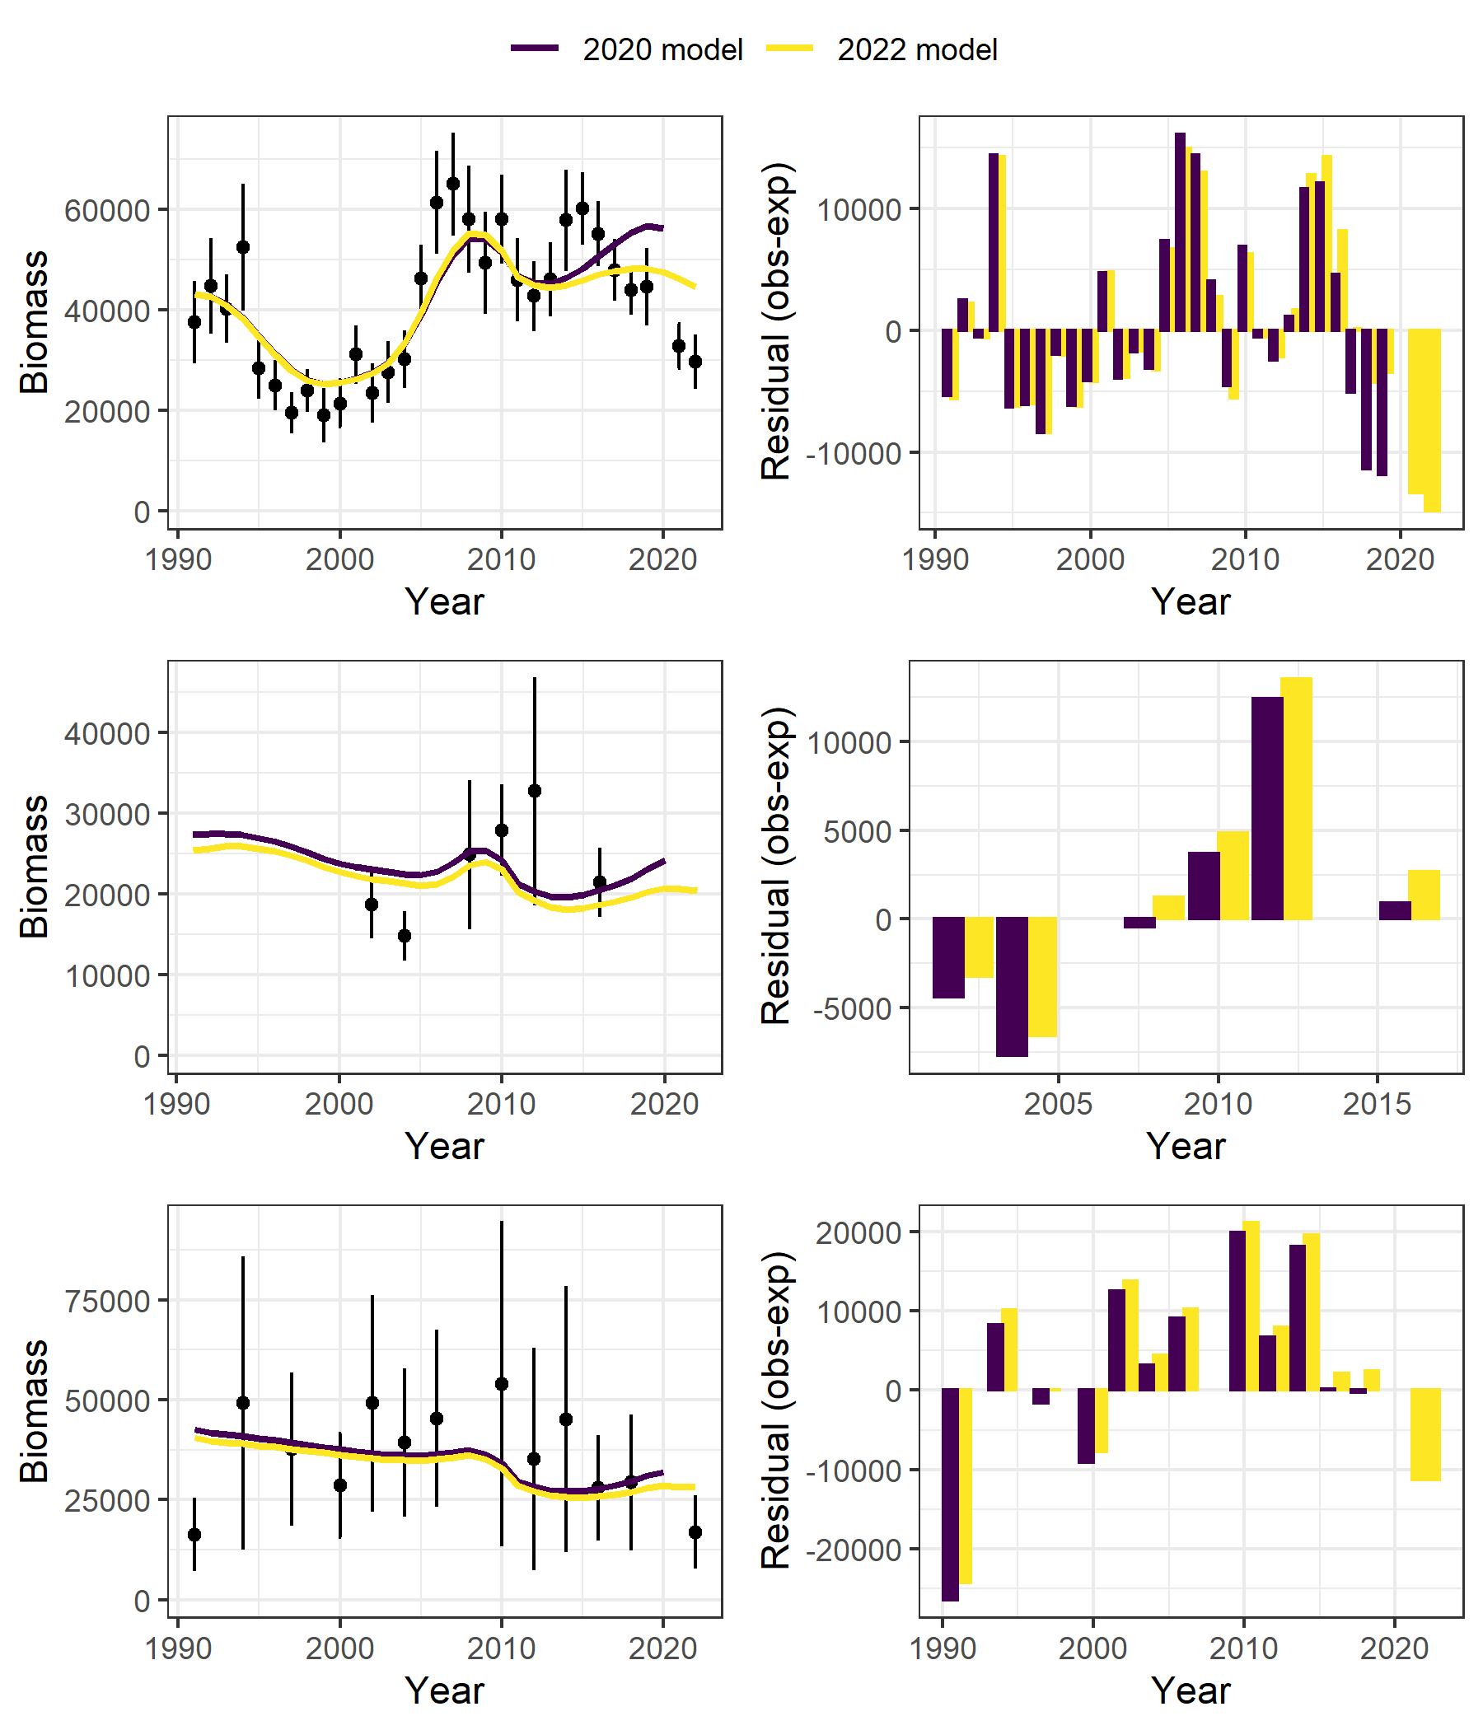
Model fit to survey biomass indices
EBS shelf
EBS slope
AI

Slide 17
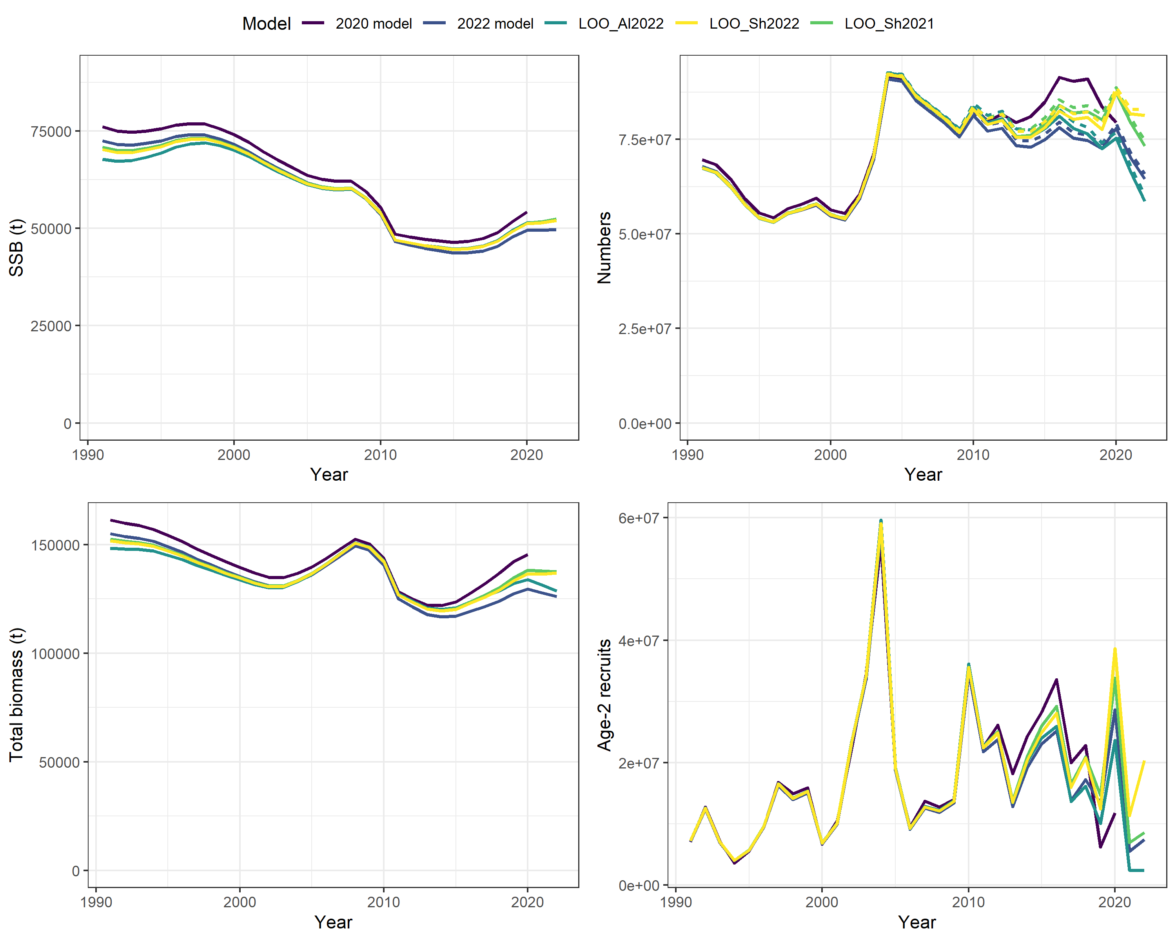
Impact of new survey data
Notes:
Impact of 2021 and 2022 EBS shelf and AI biomass and length data.

Slide 18
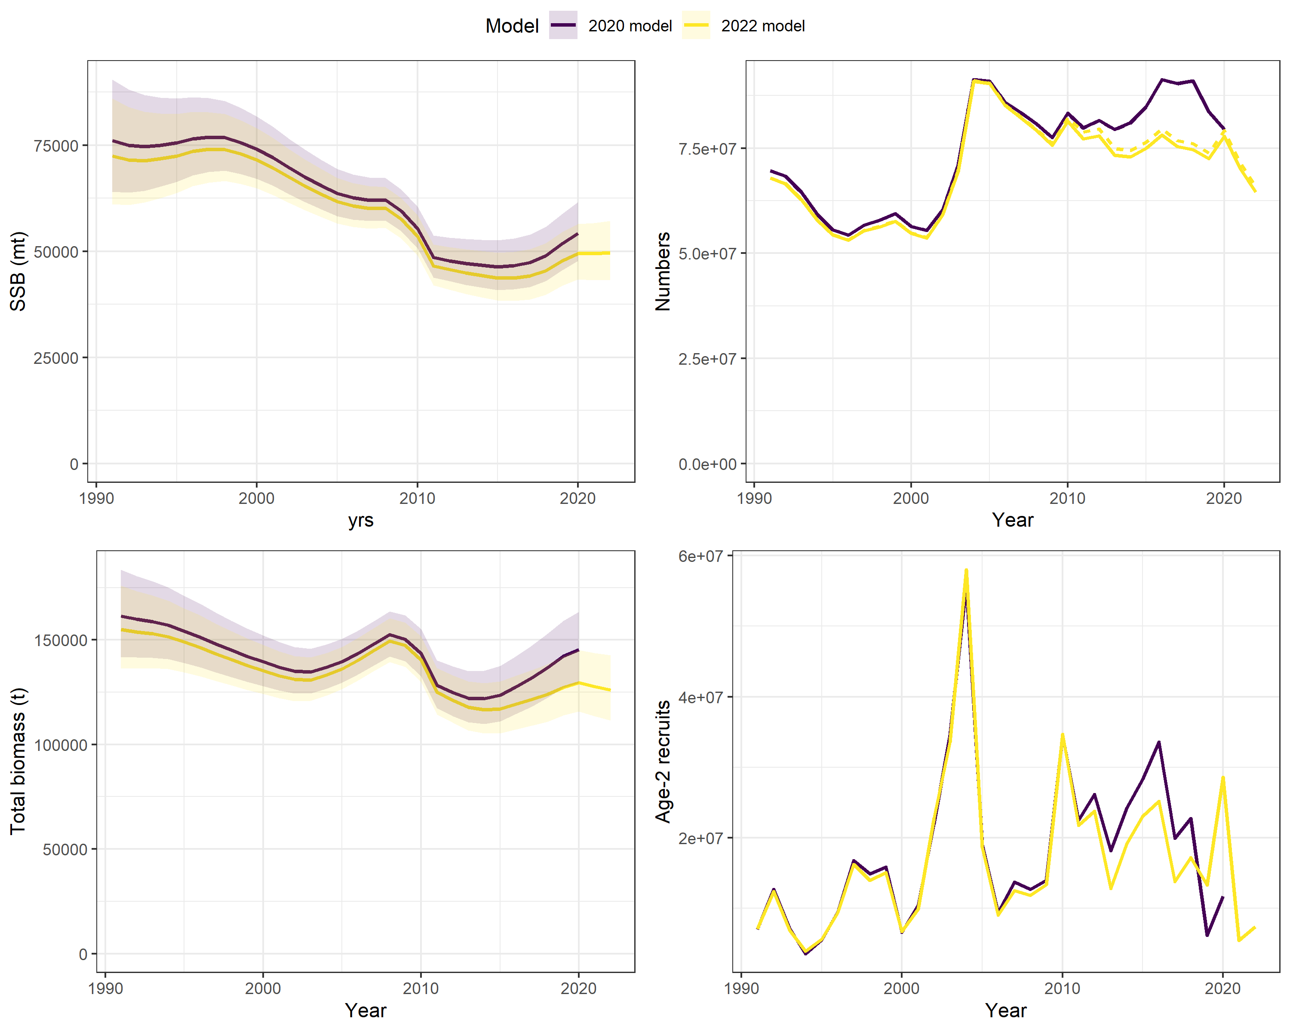
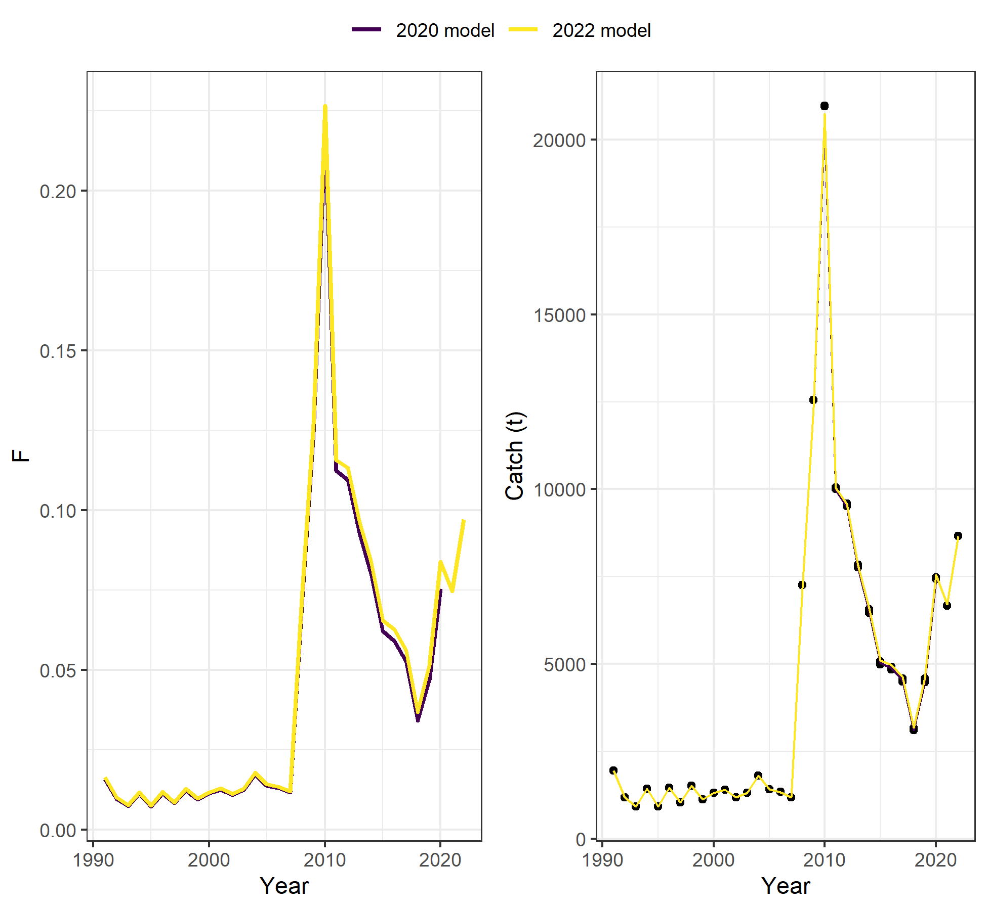
Time series results
Biomass scaled lower than 2020 assessment
  Differences correspond to years where fit to survey biomass is scaled lower
Notes:
2016 model A50 = 2 years
16.0a and 16.0b A50 = 7 and 9 years old,

Slide 19
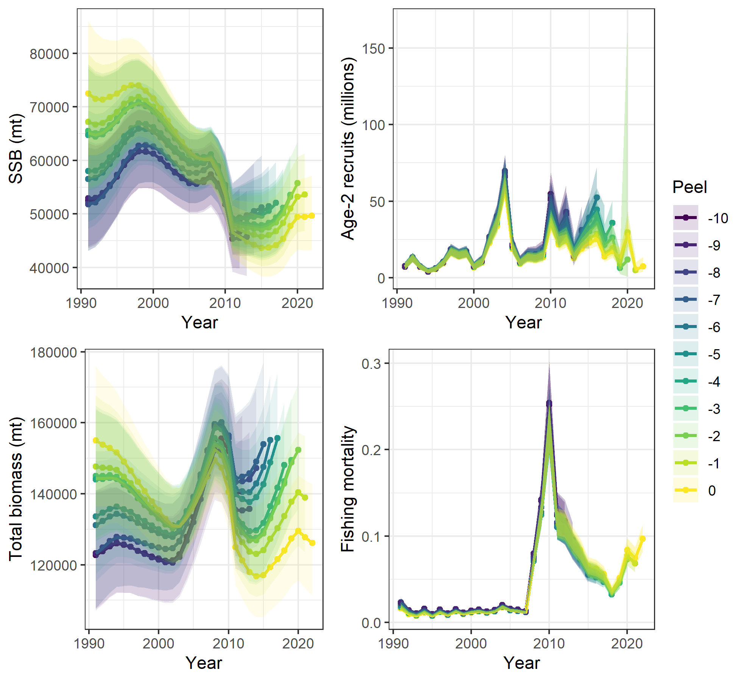
Retrospective analysis
Mohn's rho
SSB | Total biomass | Recruitment | F
0.116 | 0.210 | 0.383 | -0.102
Notes:
Greater retrospective pattern this year nit unexpected given the declines ins survey biomass

Slide 20
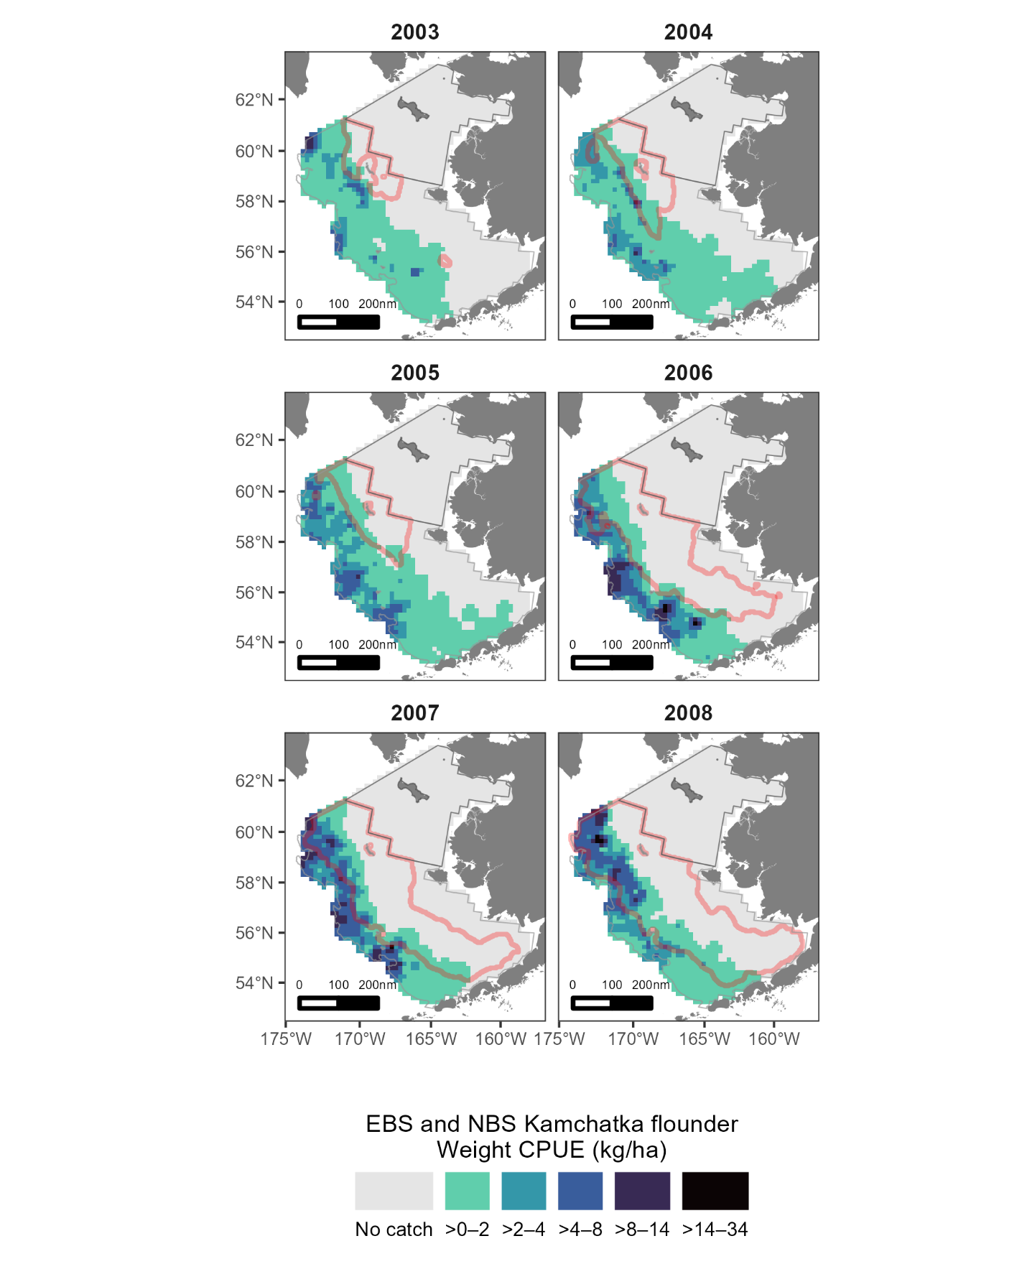
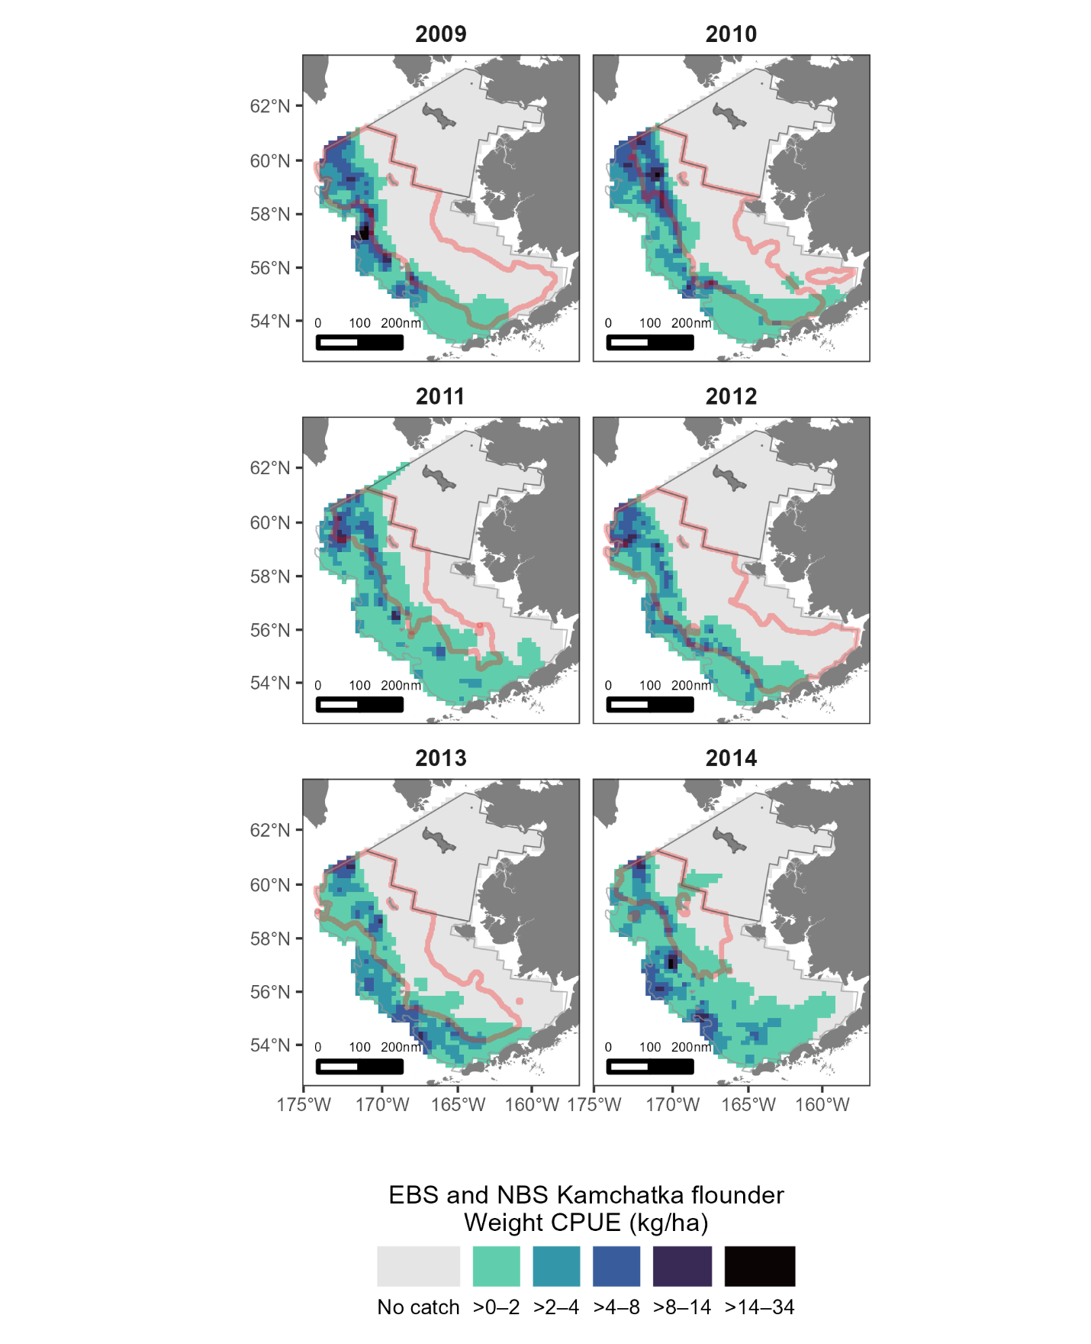
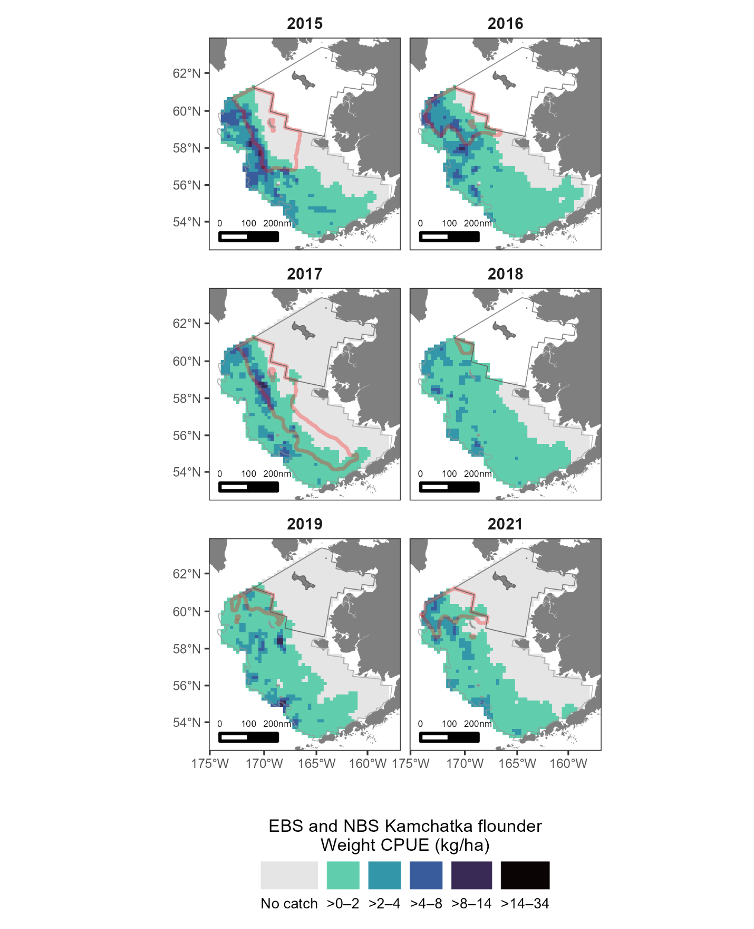
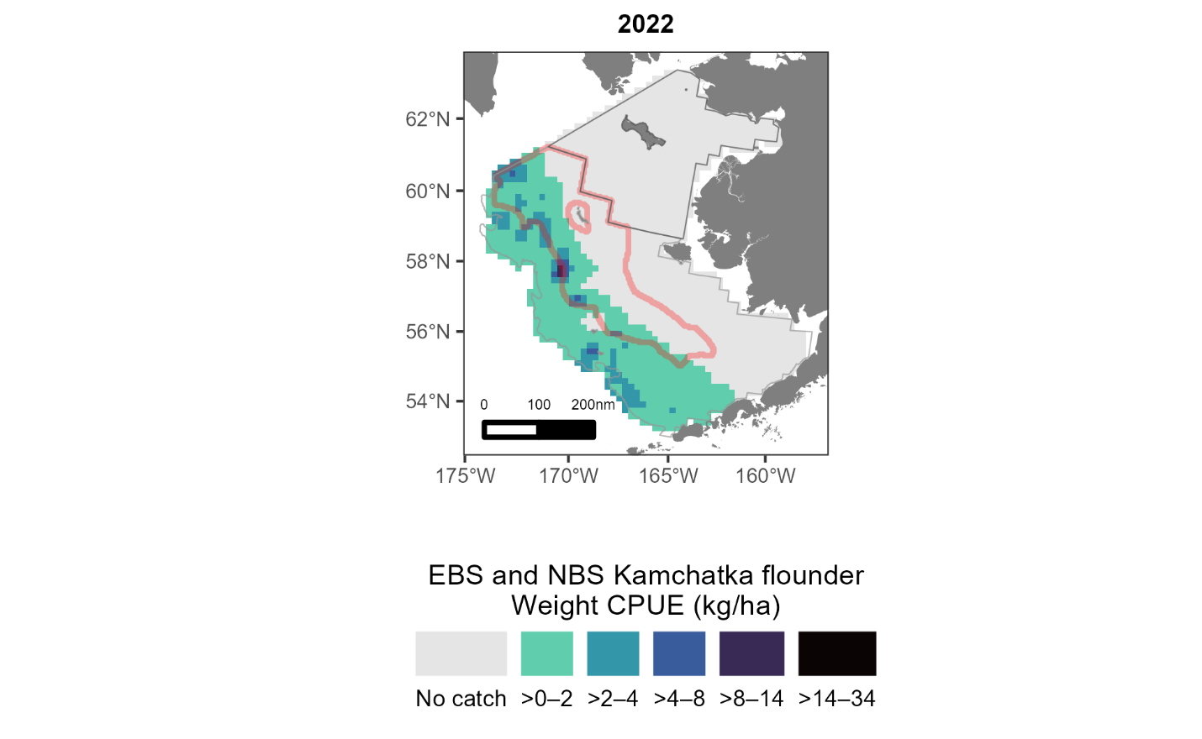
Risk table
Assessment related concerns
  Degraded fit to the EBS shelf survey biomass
  Increased retrospective pattern: time-varying catchability?

Slide 21
Harvest recommendations

Slide 22
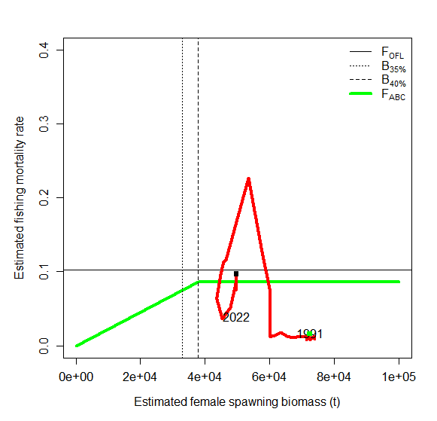
Phase plane plot

Slide 23
Data gaps and future directions
Evaluate models accounting for a relationship between catchability and cold-pool extent
The RACE bottom trawl surveys (2010 – present) age and length data were aggregated given that there were no obvious differences between regions (Bering Sea and Aleutian Islands). Re-examine data to ensure that regional differences in growth are not being obscured.
  Backlog of survey age data – A request will be submitted for these to be aged
Re-evaluate natural mortality estimate and whether sex-specific natural mortality should be used
Model may be overfitting the EBS shelf bottom trawl length composition data and creating patterns in the survey biomass residuals and other composition data. A formal data weighting method (e.g., Francis or McAllister-Ianelli) should be evaluated.
Ageing error is not accounted for in this assessment and should be considered during the next assessment and may help to resolve conflicts between the length and age data.

Slide 24
Divider Title
Additional Divider Information

