Slide 1
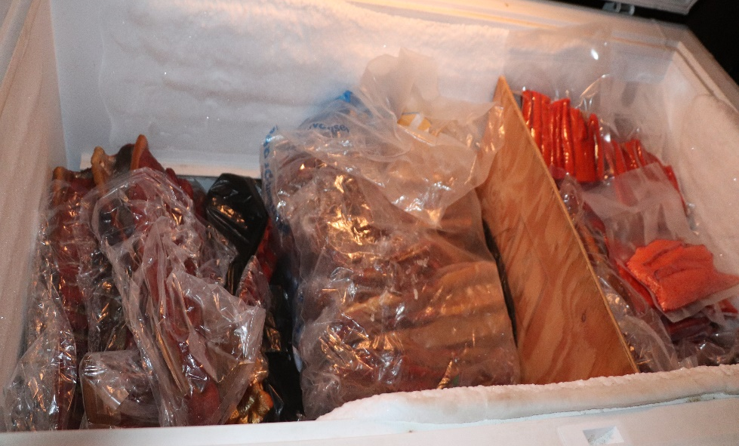
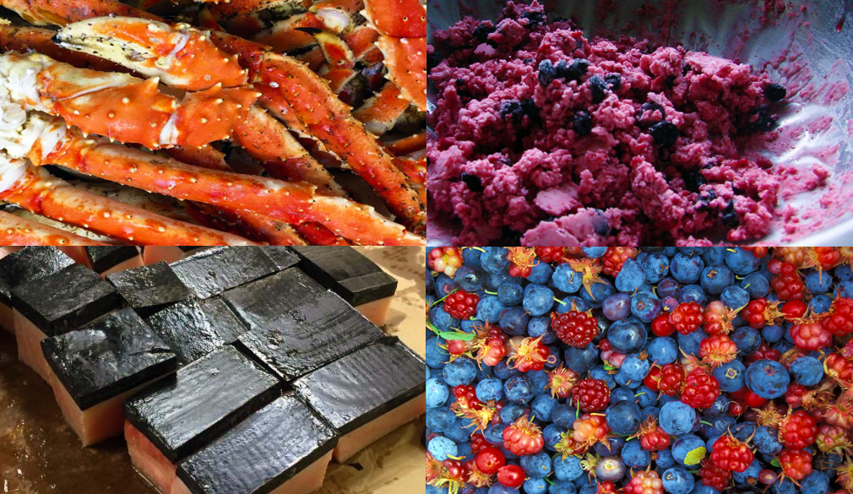
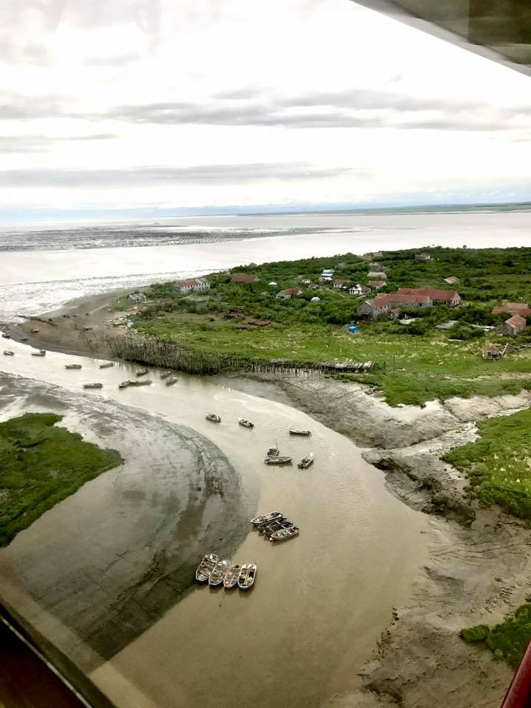
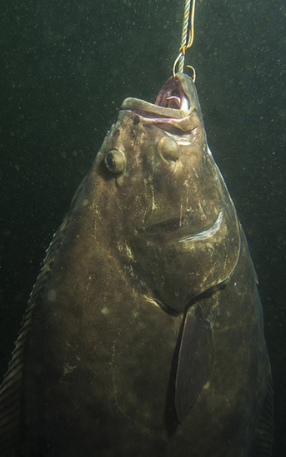
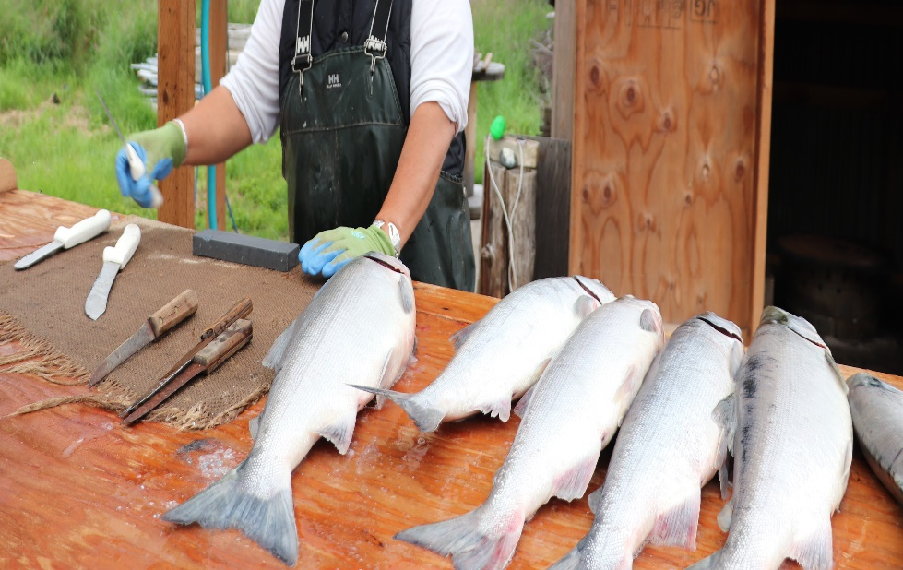

Local Knowledge, Traditional Knowledge, and Subsistence Task Force (Meeting 1)
Fishcamp - Graveyard, AK
Task Force Meeting 1
January 16-17 2020
Co-chairs: Sarah Wise and Kate Haapala
sarah.wise@noaa.gov and
kate.haapala@noaa.gov
Photo: Judy Jo Matsun

Slide 2
So much more than food…
Health
Identity
Social capital
Family/
community
Food security
Cultural cohesion
Fishing
(re)produces
social Networks
Spirituality

Slide 3
Beginning with shared understanding
Local Knowledge
Includes observations and experiences of local people in a region. LK is the product of knowledge formation and dissemination based on personal, shared and inherited experience (Martin et al. 2007).
Connected to a specific place.
May or may not be Indigenous to the area or base their understandings on knowledge that evolves over many generations (PFRCC 2011)
Can be acquired over generations; however differs from TK which is deeply embedded in cultures who have dwelled in a landscape since time immemorial (Berkes 1999:8, Ingold 2000:43).
Notes:
Throughout the Core FEP document, terms and ideas are described both in terms of federal or state agency definitions as well as Bering Sea regionally appropriate definitions provided to the FEP Team by regional stakeholders. Some of these big ideas, like EBFM, have come across the Council’s desk many times before, while other ideas, like Local Knowledge (LK) or Traditional Knowledge (TK), are newer. This table from page 15 highlights key characteristics of LK and TK.
For this Bering Sea FEP, Traditional Knowledge is defined as held by indigenous people. As such, Traditional Knowledge is closely related to Indigenous worldviews that are shaped by knowledge passed down from generation to generation over long time periods (hundreds or thousands of year). [An example of Traditional Knowledge recently heard by the Council are comments from the Bering Sea Elders Group, who share not only their personal knowledge, but compose comments based on the knowledge passed down to them over generations and relating to broad swaths of land and water areas.]
Local knowledge is more generally used to refer to knowledge held by anyone who has lived or worked in the Bering Sea region. Local Knowledge is closely linked with a specific place or activity. [A common example of Local Knowledge is how the Council often hears accounts from individual fishermen about their personal observations.]
Both LK and TK might be based on small-scale or large scale observation and knowledge, depending on context. The Core FEP aims to define these and other ideas clearly, while the Action Modules aim to produce results from projects and research.

Slide 4
Beginning with shared understanding
Traditional Knowledge
A living body of knowledge which pertains to explaining and understanding the universe and living and acting within it.
Is acquired and utilized by Indigenous peoples through long-term sociocultural, spiritual and environmental engagement.
Is an integral part of the broader knowledge system of Indigenous communities, is transmitted intergenerationally, is practically and widely applicable, and integrates personal experience with oral traditions.
It provides perspectives applicable to an array of human and nonhuman phenomena, is deeply rooted in history, time, and place, while also being rich, adaptable, and dynamic, all of which keep it relevant and useful in contemporary life.
This knowledge is part of, and used in, everyday life, and is inextricably intertwined with peoples' identity, cosmology, values, and way of life. TK does not preclude change, nor does it equal only 'the past'; in fact, it inherently entails change. Raymond-Yakoubian et al., 2017
Notes:
Throughout the Core FEP document, terms and ideas are described both in terms of federal or state agency definitions as well as Bering Sea regionally appropriate definitions provided to the FEP Team by regional stakeholders. Some of these big ideas, like EBFM, have come across the Council’s desk many times before, while other ideas, like Local Knowledge (LK) or Traditional Knowledge (TK), are newer. This table from page 15 highlights key characteristics of LK and TK.
For this Bering Sea FEP, Traditional Knowledge is defined as held by indigenous people. As such, Traditional Knowledge is closely related to Indigenous worldviews that are shaped by knowledge passed down from generation to generation over long time periods (hundreds or thousands of year). [An example of Traditional Knowledge recently heard by the Council are comments from the Bering Sea Elders Group, who share not only their personal knowledge, but compose comments based on the knowledge passed down to them over generations and relating to broad swaths of land and water areas.]
Local knowledge is more generally used to refer to knowledge held by anyone who has lived or worked in the Bering Sea region. Local Knowledge is closely linked with a specific place or activity. [A common example of Local Knowledge is how the Council often hears accounts from individual fishermen about their personal observations.]
Both LK and TK might be based on small-scale or large scale observation and knowledge, depending on context. The Core FEP aims to define these and other ideas clearly, while the Action Modules aim to produce results from projects and research.

Slide 5
Beginning with shared understanding
Subsistence
…
Notes:
Throughout the Core FEP document, terms and ideas are described both in terms of federal or state agency definitions as well as Bering Sea regionally appropriate definitions provided to the FEP Team by regional stakeholders. Some of these big ideas, like EBFM, have come across the Council’s desk many times before, while other ideas, like Local Knowledge (LK) or Traditional Knowledge (TK), are newer. This table from page 15 highlights key characteristics of LK and TK.
For this Bering Sea FEP, Traditional Knowledge is defined as held by indigenous people. As such, Traditional Knowledge is closely related to Indigenous worldviews that are shaped by knowledge passed down from generation to generation over long time periods (hundreds or thousands of year). [An example of Traditional Knowledge recently heard by the Council are comments from the Bering Sea Elders Group, who share not only their personal knowledge, but compose comments based on the knowledge passed down to them over generations and relating to broad swaths of land and water areas.]
Local knowledge is more generally used to refer to knowledge held by anyone who has lived or worked in the Bering Sea region. Local Knowledge is closely linked with a specific place or activity. [A common example of Local Knowledge is how the Council often hears accounts from individual fishermen about their personal observations.]
Both LK and TK might be based on small-scale or large scale observation and knowledge, depending on context. The Core FEP aims to define these and other ideas clearly, while the Action Modules aim to produce results from projects and research.

Slide 6
Draft Goals and Objectives
Goal 1: Local Knowledge and Traditional Knowledge
Modified Objectives
The TF will identify and define sources of LK and TK, and social science of LK and TK, to support the use of best scientific information available in Council decision-making.
To create processes and protocols whereby the Council identifies, analyzes, and consistently incorporates TK and LK, and the social science of TK and LK, into Council decision-making processes to support the use of best available scientific information in Ecosystem-based Fishery Management.
The TF will provide guidance and analytical protocols to council staff on how to evaluate and analyze LK and TK, and the social science of LK and TK.
The TF will provide guidance on how LK and TK, and the social science of LK and TK, should be incorporated into Council decision-making processes.
Steps
Identify
Analyze
Incorporate

Slide 7
Draft Goals and Objectives
Goal 2: Subsistence
Modified Objectives
To create clear direction(s) for the Council regarding how impacts to subsistence are defined and incorporated into analyses as well as mitigation strategies for potential impacts to subsistence resources or uses of those resources.
The Taskforce will provide guidance on how subsistence information can be incorporated into Council decision-making processes.
Identify existing measures and potential opportunities to mitigate impacts to subsistence resources and subsistence resources users
The Taskforce will identify sources for subsistence information.
Steps
Identify
Analyze
Incorporate

Slide 8
Opportunities for cross pollination
3 meetings/year (2 in person; 1 virtual)
Public engagement is welcome and encouraged. Public testimony will be solicited by phone, written, or in person.
- Outreach efforts are important and will be considered a priority.
Importance to document examples of how climate change is affecting knowledge and subsistence activities.
  Examples included cod fishing and potential conflicts with subsistence hunters
  Halibut fishing and bycatch
  Changes in abundance and condition of subsistence catch
  Adaptations to changes and addressing the issue of scale
TF requested a joint meeting with CCTF

