Slide 1
Re-evaluation of stock structure for Bering Sea/Aleutian Islands northern rockfish*
Paul Spencer
Alaska Fisheries Science Center
*(and also comment on ageing error)

Slide 2
Outline
Background (this is now the 3rd stock structure evaluation for this stock)
Harvest and population trends
Barriers and phenotypic characters (including growth and age/size structure)
Behavior and movement
Genetics

Slide 3
2012 Stock Structure report
Original stock structure template applied in 2012
  Spatial genetic structure (dispersal distances on order of 100 - 200 km; Gharrett et al. 2012)
  Growth differences between areas
  Spatial differences in exploitation rates
  Spatial differences in bycatch rates in the Atka mackerel fishery
BSAI Plan Team interpretation (September, 2012 minutes):
  Evidence of stock structure
  Splitting the ABC would not decrease mortality
  Economic losses, increased regulatory discards, and management difficulty were considered
  “Stepping back” from default advice (JPT, Sept 2010) of adopting subarea ABCs
  Spatial management of harvest is a policy decision that needs to be considered in a larger forum

Slide 4
2015 Stock Assessment
Information on high exploitation rates (particularly in the eastern and western AI) and targeted fishing was presented to the BSAI Plan Team in September, 2015
The Plan Team requested that if the eastern AI catch looked high in August, 2016, an updated stock structure template be presented in September, 2016

Slide 5
2016 Stock Structure report
Catches in 2016 were not estimated to exceed hypothetical subarea ABCs
The nature of directed fishing for BSAI northern rockfish was further quantified.
The BSAI Plan Team recommended that subarea catches and comparisons to reference levels (i.e., exploitation rates) be provided in on-year assessments. Further stock structure reports are not necessary unless new information becomes available.

Slide 6
SSC request for stock structure update (December, 2021)
A final concern that the SSC wishes to elevate is the potential for a mismatch in the spatial structure of this stock, as noted by the assessment author. A stock structure evaluation was completed as an appendix to the 2012 assessment. This included information on an area-specific evaluation of growth using AI survey data that indicated differences in growth among AI subareas, EBS and the GOA. Genetic data also supported stock structure at a smaller spatial scale than currently used for management. Given the concerns described by the assessment author and the recent interest in directed targeting of northern rockfish, the SSC suggests updating the information presented in the stock structure appendix for the next full assessment in 2023, given that it will be more than 10 years old at that time and there may be new survey information available.

Slide 7
Trends in survey biomass estimates

Slide 8
Harvest and population trends
Catches have been increasing ( > 4x increase from 2013)
2023 catch (~9500 t to date) is close to TAC, but below ABC

Slide 9
Spatial concentration of harvest
U_{F40%} – the exploitation rate associated with fishing at F40% (affected by selectivity, numbers at age, maturity, and size at age)

Slide 10
Dates of fishery openings, BSAI northern rockfish
(Sources: https://alaskafisheries.noaa.gov/status-of-fisheries/ https://www.fisheries.noaa.gov/news-and-announcements/bulletins)
 | Date of opening | Date of closing
Year | of directed fishing | of directed fishing
2009 | 11-Oct
2010 | 7-Sep
2011 | 1-Jul
2012 | 25-May
2013 | 7-Jun
2014 | 22-Jun
2015 | 2-Apr
2016 | 30-Mar
2017 | 16-Mar
2018 | 23-Mar | 17-Sep
2019 | 12-Apr
2020 | 2-Apr
2021
2022 | 2-Mar
2023 | 1-Jan

Slide 11
Rockfish hauls identified as targeting northern rockfish
From Observer data, with rockfish hauls determined by the Alaska Regional Office. Northern rockfish hauls are rockfish hauls in which northern rockfish in the dominant rockfish species in the catch
Number of tows that in which northern rockfish is the target species has increased since 2007
BSAI Hauls in which northern rockfish were caught, by fishery

Slide 12
Proportion of catch by target fishery
(for observed hauls)
Hauls targeting northern rockfish account for a large portion of the observed catch

Slide 13
Percent of northern rockfish in haul catch, by target
Within hauls targeting northern rockfish, >= 50% of the catch is northern rockfish

Slide 14
Distribution of the percent of northern rockfish in haul catch, for northern rockfish target hauls
In many of the northern rockfish “target” tows, northern rockfish is the most dominant species in the catch

Slide 15
Summary of previous information
Physical limitations to connectivity
Deep passes in the Aleutian Islands may limit movement of northern rockfish
Genetics
An isolation by distance pattern of spatial structure has been observed. Estimates of lifetime dispersal distance are ~ 100 - 200 km (Gharrett et al. 2012).

Slide 16
Research Study on how to manage stocks with isolation-by-distance (Spies et al. 2015, CJFAS)
BSAI northern rockfish used as an example
Three options:
  Several completely “separate” stocks (i.e., separate assessments, OFLs, etc)
  “catch-cascading” – spatially allocate catch in proportion to survey biomass (essentially, default practice in GOA)
  “Combined” – manage the area as a single unit
“Catch-cascading” showed highest equilibrium yield

Slide 17
Computation of fishery and survey size at age
Spatial gradient of size at age, for both fishery and survey
Within an area, fishery size at age is larger than survey size at age
The model averages over the spatial areas. However, the spatial distribution of catch is different from the spatial distribution of survey biomass

Slide 18
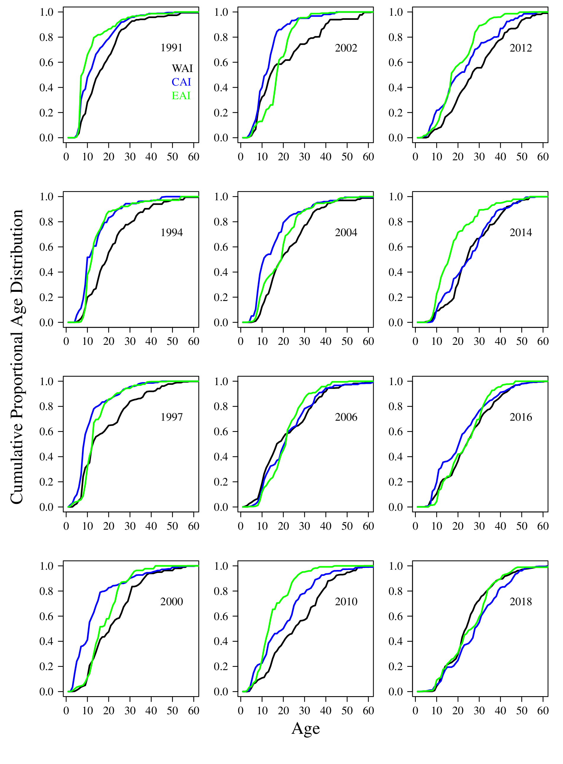
Age structure
Older fish in the western Aleutian Islands (in most years)

Slide 19
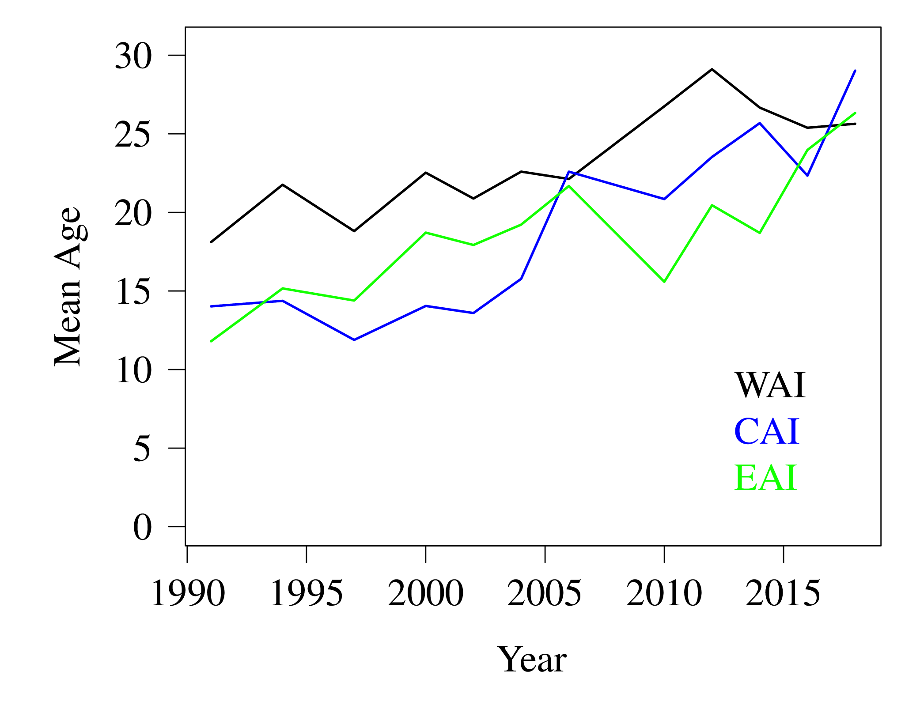
Age structure
Older fish in the western Aleutian Islands (in most years)

Slide 20
Conclusions
Evidence for spatial stock structure remains (genetics, spatial differences in growth and age structure)
Spatially allocating harvest is an effective approach for stocks with isolation-by-distance genetic structure (Spies at al. 2015)
The mismatch in spatial structure between the stock and its management unit increases the risk of localized depletion and loss of yield.

Slide 21
Just one more thing . . .
SSC (December, 2019). The SSC also notes that the aging error matrix is currently based on GOA northern rockfish information and requests that it be updated using BSAI information, if possible.
I was not able to complete this for the 2021 assessment, but plan on working on this for the 2023 assessment. Sensitivity runs conducted in 2021 suggest that it may not have a large effect on the model
3 different options for aging error
2019 model

