Slide 1
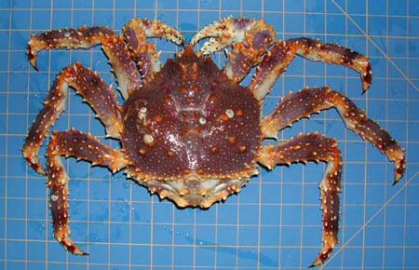
2024 Pribilof Islands Blue King Crab
Stock Assessment and Fishery Evaluation:
Overfishing Determination
William Stockhausen
AFSC/NMFS
September 2024

Slide 2
PIBKC Overfishing Determination
Biennial assessment schedule
  “off” year: overfishing status update only
  last full assessment: 2023
2023/24 crab fisheries
  directed fishery closed
  crab fisheries: no observed bycatch (snow crab, Tanner crab fisheries)
2023/24 groundfish fisheries
  0.139 t bycatch
  0.102 t bycatch mortality
Overfishing determination
  total catch mortality = 0.102 t < 1.16 t = OFL
  overfishing is not occurring
Notes:
update values in red

