Slide 1
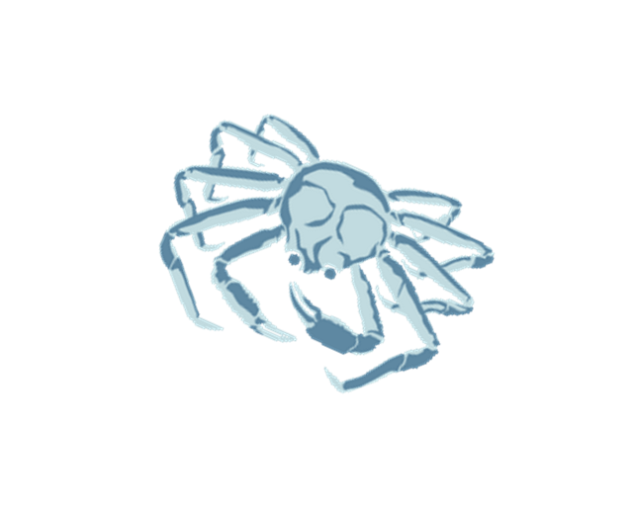


C3 Bering Sea Snow Crab Rebuilding Plan
Progress Report
February 2022
Jon McCracken and Diana Stram
Notes:
MARRINAN
Intros
Analysis, 4 appendices, the action memo includes an excerpt from the CPT meeting that highlights some questions (which we’ll touch on in this presentation)
Proposed action would set crab PSC limits to their lowest limit in the BSAI trawl Community Development Quota (CDQ) and non-CDQ groundfish fisheries when the corresponding crab directed fishery is closed
3 parts of this presentation (we don’t follow the order of the paper)
Introduction: includes history of action, purpose and need, alts, and a reminder of the current PSC limits for crab
More thorough description of alt 1, no action
Shorter description of alt 2, the one action alt

Slide 2

Introduction
Oct 19, 2021, NMFS notified Council that BS snow crab status has been changed to overfished
MSA section 304 requires that a rebuilding plan be developed and implemented within two years of stock being declared overfished
Council was scheduled to select alternatives for analysis
As noted in the January CPT minutes, the stock assessment model has not yet been accepted for use in management by the SSC
  As a result, the Council lacks the necessary information to select alternatives for analysis at this meeting, so the selection of alternatives for analysis will be scheduled for June
  For this meeting, the Council will receive a progress report
Notes:
The GMACS model was recommended for approval by the CPT in 2020 but rejected by SSC at that time.
CPT is scheduled to review the model during May meeting and the SSC will then review it in June
As a result, many of the model outputs presented at the Jan CPT meeting may change, given the range of considerations the CPT asked to author to address

Slide 3
Overfishing and Rebuilding Plans
Section 2.1 provides MSA section 304 and the NS 1 guidelines for rebuilding overfished stocks
Overfished if MMB < MSST
  MMB is 50,600 mt, which is less than the MSST threshold of 76,700 mt
This triggers MSA and NS1 guidelines to rebuild stock within an appropriate timeframe
Council must specify a time period for rebuilding the stock (T_{target}) based on being as short as possible taking into account:
  Status and biology of the stock
  Needs of fishing communities
  Recommendation by international organizations in which the U.S. participates, and
  Interaction of the overfished stock within the marine ecosystem
Time period shall not exceed 10 year, except where biology of the stock, other environmental conditions, or management measures under an international agreement dictate otherwise.

Slide 4
Overfishing and Rebuilding Plans
The shortest rebuilding time (T_{min}) is calculated based on time frame to rebuild the stock to its MSY biomass (B_{MSY}) in the absence of no fishing mortality (F=0)
  If T_{min} is ≤ 10 years, then the maximum rebuilding time (T_{max}) is 10 years for rebuilding a stock to its B_{msy}
    In other words, T_{target} cannot exceed 10 years
  If T_{min} for the stock exceeds 10 years, then one of the following methods can be used to determine T_{max}:
    T_{min} plus the length of time associated with one generation time for the stock
    Amount of time the stock is expected to take to rebuild to B_{msy} if fished at 75% of maximum fishing mortality threshold, or
    T_{min} multiplied by 2
Notes:
Generation time is the average length of time between when an individual is born and the birth of its offspring.
If Tmin exceeds 10 years
When selecting a method for determining T_{max} the Council in consultation with the SSC, should consider the relevant biological data and scientific uncertainty of that data, and must provide a rationale for its decision based on the best scientific information available.

Slide 5
Overfishing and Rebuilding Plans
Section 2.1 also includes information on the process for determining status of BSAI crab stocks
  Status determination for crab stocks are calculated using a five-tier system that accommodate varying levels of uncertainty of information (provided in Table 1 on page 9)
  It incorporates new scientific information and provides a mechanism to continually improve the status determination criteria as new information becomes available
    BS snow crab is a Tier 3 stock
  Under the five-tier system, overfishing and overfished criteria and ABC levels for most stocks are annually formulated
Notes:
The ACL for each stock equals the ABC for that stock. For crab stocks, the Overfishing Level (OFL) equals the maximum sustainable yield (MSY) and overfishing is determined by comparing the OFL with the catch estimates for that crab fishing year. Catch includes all fishery removals, including retained catch and discard mortality. Discard mortality is determined by multiplying the appropriate handling mortality rate by observer-based estimates of

Slide 6
Stock Status for Snow Crab
Section 2.2 provides an overview of the stock status of BS snow crab
Survey data show spatial gradients by maturity and size for both sexes of snow crab
  Larger males have been more prevalent on the southwest portion of the shelf while smaller males have been more prevalent on the northwest portion of the shelf
  Females show a similar pattern
  The distributions of crab by size and maturity have also change over time
  Figure 1 on page 12 show the biomass of mature male and female snow crab from 1982 to 2020
  In recent years, MMB was increasing as a large recruitment moved through the size classes, but that recruitment has since disappeared with MMB of 50.6 kt in 2021 survey

Slide 7
Natural Mortality
Section 2.3 starting on page 12 provides an overview of different sources of mortality
Section 2.3.1 provides brief description of natural mortality
  Currently, analyses are underway to understand the feasibility of estimating both time-varying mortality and catchability within a population dynamics model
  The goal of these analyses are to provide evidence to support or refute the assumptions about variation in mortality made in the stock assessment about elevated natural mortality in recent years
    Hypotheses related to temperature, disease, bycatch, discards, cannibalism, and predation are being explored

Slide 8
Directed Fishing Mortality
Section 2.3.2 starting on page 12 provides information on the directed fishery
Typically, the snow crab season starts Oct 15 and ends on May 15 for Eastern subdistrict and May 31 for Western subdistrict
Only male crab may be harvested
Fishing is not allowed during mating and molting periods (spring)
Size limit is greater than or equal than 3.1 inches or 78mm carapace width
Notes:
OFL and ACL (under the crab FMP, ACL is equal to annually recommended ABC level) for the Federal crab stocks are recommended to the Council by the SSC
Annual harvest levels and other management actions are determined by ADF&G

Slide 9
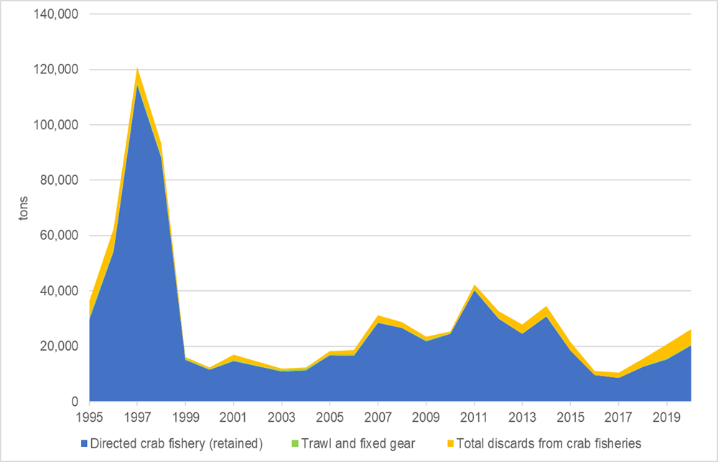
Directed Fishing Mortality
  Figure 4 (page 18) shows directed snow crab catch, discards from other crab fisheries, and trawl and fixed gear PSC in the groundfish fisheries

Slide 10
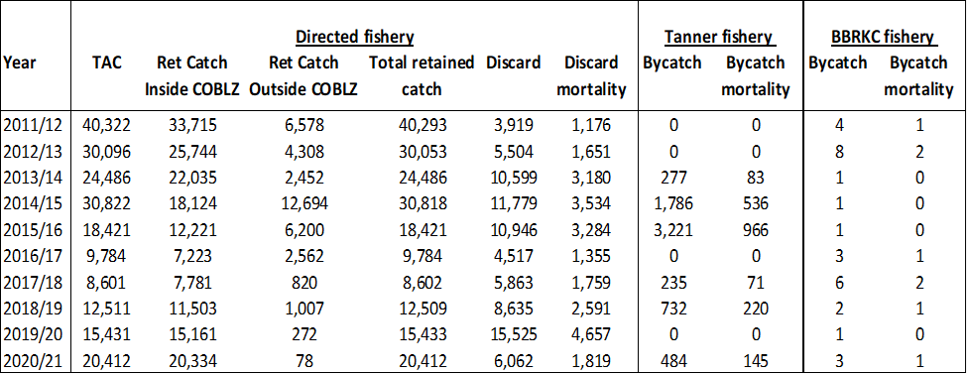
Directed Fishing
  Table 3 (also on page 18) provides TAC, retain catch inside/outside the COBLZ, discards and discard mortality and bycatch and bycatch morality in the directed Tanner and BBRKC fisheries from 2011/2012 season through the 2020/2021 season

Slide 11
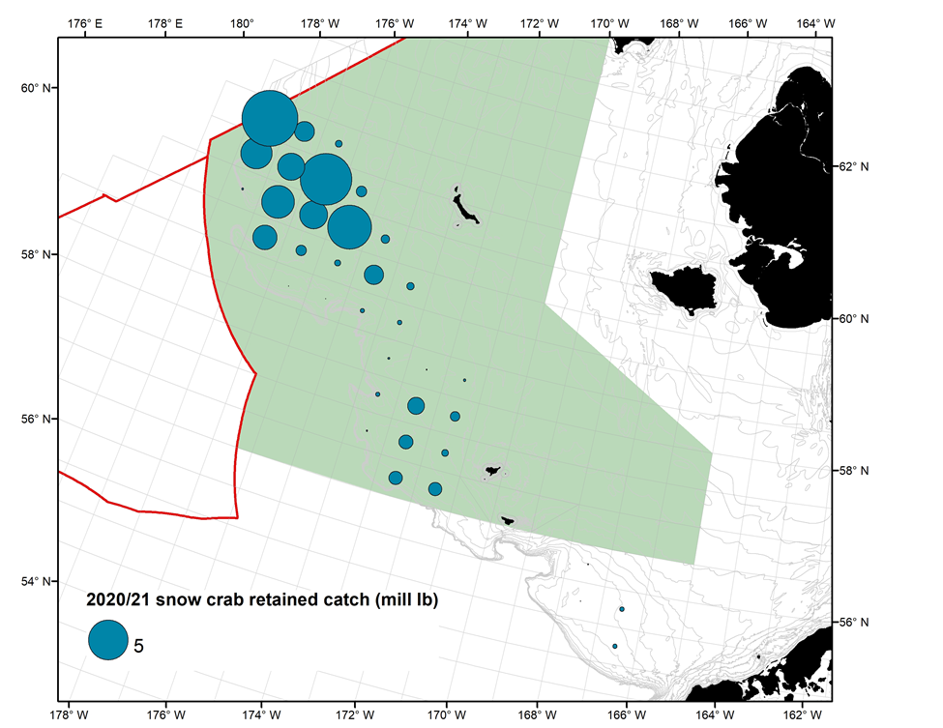
Directed Fishing
  Figure 5 (page 19) shows retained catch of snow crab in the 2020/2021 directed fishery, where size of the blue dot correspond to the magnitude of catch in each ADF&G statistical areas. The shaded green is the COBLZ.

Slide 12
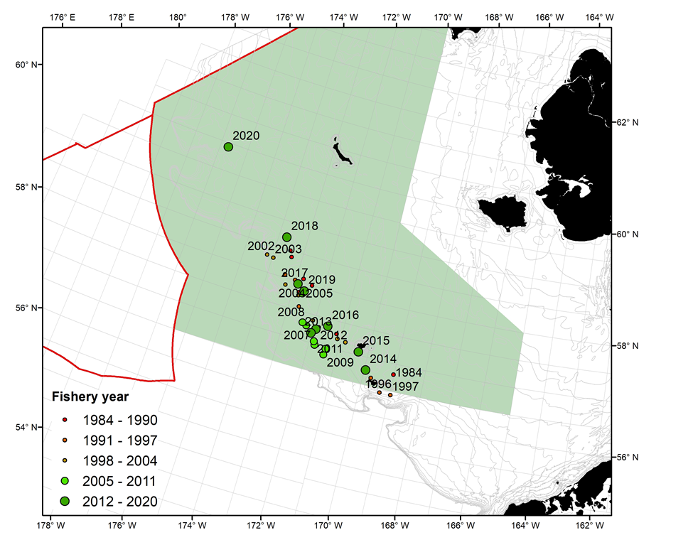
Directed Fishing
  Figure 6 (page 20) is the weighted center of the snow crab catch in the directed fishery from 1984 through 2020. The 2020/2021 fishery occurred much further north than in historic years.

Slide 13
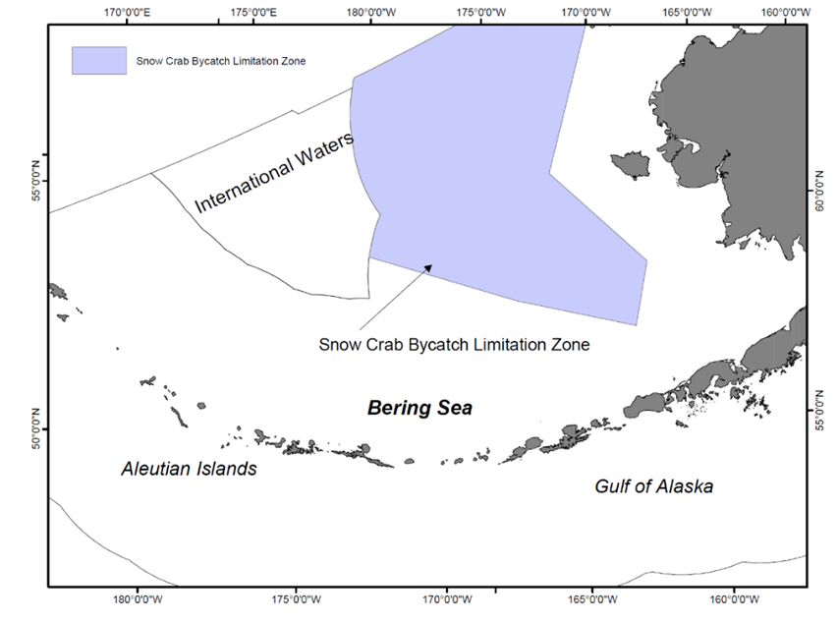
PSC Mortality
  Section 2.3.2 (starting on page 20) provides information on snow crab bycatch in the groundfish fisheries
  Figure 7 represents the snow crab bycatch limitation zone
  Trawl PSC accrues within the COBLZ and this area is closed to nonpelagic trawl directed fishing in the fishery/sector that reaches the specified PSC limit
  PSC limits are based on calendar year and not crab year (July 1- June 30)
  No bycatch measures are currently in place for any non-trawl gear fisheries inside or outside of the COBLZ

Slide 14
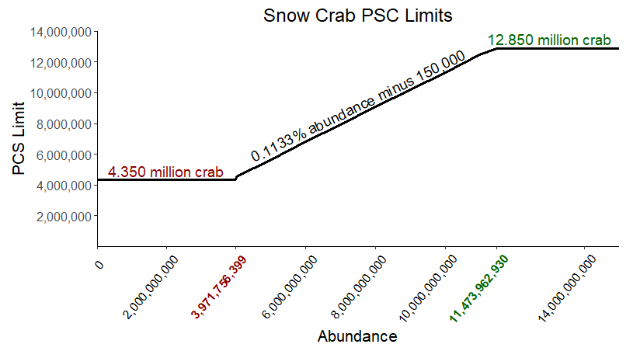
COBLZ Snow Crab PSC Limits
Set annually at 0.1133% of the snow crab abundance estimates with a minimum and maximum abundance threshold minus an additional 150,000 crab
  If 0.1133% multiplied by the total abundance is less than 4.5 million crab, then the minimum PSC limit will be 4.350 million crab
  If 0.1133% multiplied by the total abundance is greater than 13 million crab, then the maximum PSC limit will be 12.850 million animals.
  Table 4 (page 22) provides snow crab abundance and the PSC limit from 2012-2021
Notes:
Here are the snow crab PSC limits – they are set as a proportion of total abundance minus 150,000 crab. But with a floor and a ceiling.
These limits were established under Amend 40 and were based off of industry negotiated numbers that were then recommended to the Council. The industry group consider historical crab bycatch at different abundance levels.

Slide 15
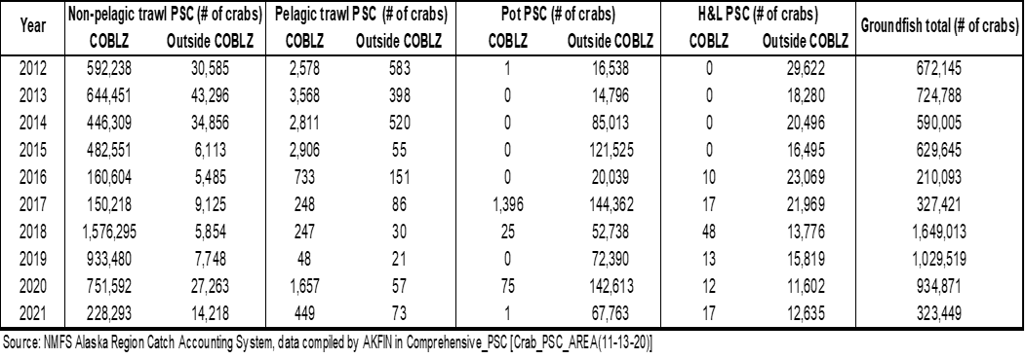
Table 5 Snow Crab PSC (page 23)

Slide 16
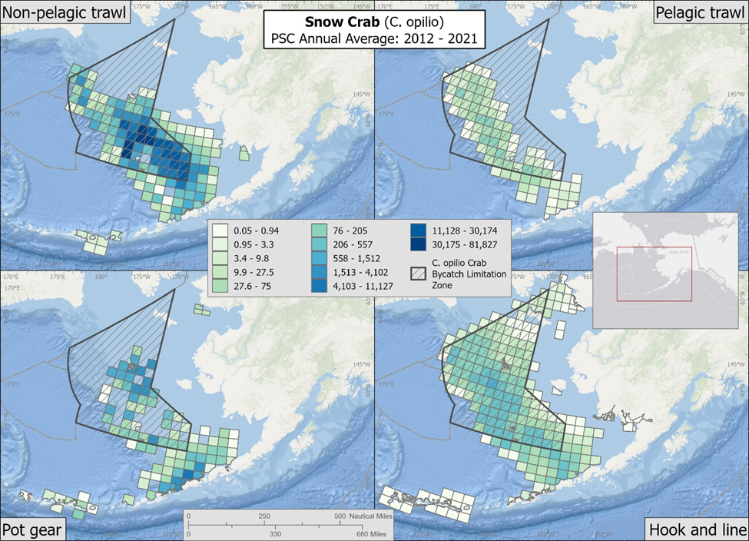
Figure 9 Snow Crab PSC (page 24)

Slide 17
Other PSC Data
Also included in this section are Figures 10 and 11 on page 25 which provide the number of male and female snow crab by carapace width and year for trawl, pot, and HAL gear from 2012-2021
Table 6 (page 26) provides snow crab PSC in COBLZ by gear type and target species from 2012-2021

Slide 18
Unobserved Crab Mortality
Section 2.3.4 (page 27) includes information on unobserved crab mortality
Includes both post-release mortality of discarded crab and crab never captured but die due to gear interactions or sustained damage
  Post-release mortality is sub-legal crab, females, non-target crab species caught in directed crab fisheries and PSC caught in groundfish fisheries required to be discarded
    Discard mortality has been studied with rates of 20-32% mortality for crab discarded in crab fisheries, 50% for fixed gear (pot and HAL), and 80% for trawl gear
    Discard mortality is accounted for in crab stock assessments
Notes:
In May 2020, the CPT discussed this proposed action on PSC limits, including potential stock impacts from unobserved trawl mortality. In order to understand the potential impacts on theoretical unobserved mortality, the CPT recommended that assessment authors rerun the assessments for BBRKC, Tanner crab, and snow crab with higher assumed levels of bycatch abundance (increases of 50% and 100%) as a sensitivity analysis to inform this analysis.
All three reports included results from simulation models that held certain biological parameters constant (identical to those determined in the 2019 assessment) while estimating changes in fishing mortality associated with increase in bycatch. The intent was to model theoretical unobserved bycatch mortality by responding to the question, “what effect would different levels of PSC have on the stock?”. Authors noted this is different than the question “how sensitive are the model results to mis-estimating the level of bycatch?” which would be conducted by allowing the biological parameters to vary (as was also demonstrated for one run in the BBRKC report). For instance, rerunning the models and allowing biological parameters to respond to the change in bycatch levels means the model would compensate by showing higher recruitment (i.e., the model would “make more fish”).
The results from model runs that held biological parameters to their 2019 status demonstrated some commonalities across reports. Based on the simulations, if bycatch mortality is anything less than doubled, there appears to be little change in stock dynamics and biomass trajectories across all species. The simulations all demonstrated a general scaling down of estimated mature male biomass (MMB) at very high percentage increases of bycatch, but little variation in female biomass and immature male biomass likely due in part to the selectivity of the groundfish gear. Unsurprisingly, if some level of bycatch mortality has been unobserved and unaccounted for in the assessments, these reports demonstrate the biggest impact would occur during the period when bycatch was largest.
Because Assessment authors determined an increase of 50% and 100% of bycatch in these simulations were not sufficient to demonstrate significant variation in output. Thus, authors agreed to run the simulations with historical bycatch at 100%, 200%, 500% and 1000%.
For BBRKC, when bycatch biomass increases by 500% or more in the models, estimated MMB values in the terminal years could decrease about 14% or more; the decreases might be much larger for some years.
For Tanner crab, based on previous catch rates, increasing the bycatch by 1000% would have lowered the MMB in the 1970s by an estimated ~100,000 t, while in recent years it would have been estimated to be ~6,000 t less.
For snow crab, bycatch has been small enough that increasing the bycatch input by 1000% resulted in only a ~2% change in the terminal year of MMB (with largest changes in the mid-1990s through mid-2010).
The full results are included in Appendix 4 and additional CPT discussion is captured in the CPT report from October 2020.
Given the expectation that crab PSC limits at their lowest threshold may have a modest impact on the BBRKC stock’s ability to rebuild
Additional info RE unobserved:
The raised sweeps reduce mortality rate for red king crab to 6%. Such sweep modifications were required by the Council for Bering Sea flatfish trawlers beginning in January 2011.
(Rose et al. 2013) provided estimates of mortality rates for crabs that encounter, but escape, trawls and showed how these mortalities could be greatly reduced by slightly raising the trawl components (sweeps) that affect most such crabs. Estimates of the rates of mortality due to contact with the trawl gear, adjusted for capture and handling, were below 16% , with the exception of red king crab that encountered the wing section of the footrope, for which mortality was estimated at 31%. Overall, estimated mortality rates for all 3 species were significantly lower for crabs that encountered the sweeps than for those crabs that encountered the footrope and were higher for those crabs that encountered the wingportion of the footrope as opposed to the center footrope.
All research that craig has done – saw very few softshell crab- might have been time of year they’ve been out there. Holes in info to assess this. Need to know when and where crab molt, how frequently which is a function of age, and how long until crabs reach the softest level they are encountering. How long are they this way?

Slide 19
Unobserved Crab Mortality
The second source of unobserved mortality is associated with fishing gear interaction, but the crab escape capture
  This type of unobserved mortality is more difficult to study and understand
  Morality rates of crab do not take into account unobserved morality associated with crab that escape capture and the extent to which crab populations are affected is currently unknown – this source of unobserved mortality is not accounted for in crab stock assessment
    Research results of unobserved morality rates of crab swept over by trawl gear shows that morality rates varied by crab species but depended mostly on the part of the trawl system encounter
      Altering specific gear designs showed that gear modification such as sweeps can mitigate unobserved mortality, but more research is needed
    Sensitivity analysis shows that bycatch has been small enough that increasing the bycatch input by 1000% resulted in only a ~2% change in the terminal year of MMB (with largest changes in the mid-1990s through mid-2010).
Notes:
In May 2020, the CPT discussed this proposed action on PSC limits, including potential stock impacts from unobserved trawl mortality. In order to understand the potential impacts on theoretical unobserved mortality, the CPT recommended that assessment authors rerun the assessments for BBRKC, Tanner crab, and snow crab with higher assumed levels of bycatch abundance (increases of 50% and 100%) as a sensitivity analysis to inform this analysis.
All three reports included results from simulation models that held certain biological parameters constant (identical to those determined in the 2019 assessment) while estimating changes in fishing mortality associated with increase in bycatch. The intent was to model theoretical unobserved bycatch mortality by responding to the question, “what effect would different levels of PSC have on the stock?”. Authors noted this is different than the question “how sensitive are the model results to mis-estimating the level of bycatch?” which would be conducted by allowing the biological parameters to vary (as was also demonstrated for one run in the BBRKC report). For instance, rerunning the models and allowing biological parameters to respond to the change in bycatch levels means the model would compensate by showing higher recruitment (i.e., the model would “make more fish”).
The results from model runs that held biological parameters to their 2019 status demonstrated some commonalities across reports. Based on the simulations, if bycatch mortality is anything less than doubled, there appears to be little change in stock dynamics and biomass trajectories across all species. The simulations all demonstrated a general scaling down of estimated mature male biomass (MMB) at very high percentage increases of bycatch, but little variation in female biomass and immature male biomass likely due in part to the selectivity of the groundfish gear. Unsurprisingly, if some level of bycatch mortality has been unobserved and unaccounted for in the assessments, these reports demonstrate the biggest impact would occur during the period when bycatch was largest.
Because Assessment authors determined an increase of 50% and 100% of bycatch in these simulations were not sufficient to demonstrate significant variation in output. Thus, authors agreed to run the simulations with historical bycatch at 100%, 200%, 500% and 1000%.
For BBRKC, when bycatch biomass increases by 500% or more in the models, estimated MMB values in the terminal years could decrease about 14% or more; the decreases might be much larger for some years.
For Tanner crab, based on previous catch rates, increasing the bycatch by 1000% would have lowered the MMB in the 1970s by an estimated ~100,000 t, while in recent years it would have been estimated to be ~6,000 t less.
For snow crab, bycatch has been small enough that increasing the bycatch input by 1000% resulted in only a ~2% change in the terminal year of MMB (with largest changes in the mid-1990s through mid-2010).
The full results are included in Appendix 4 and additional CPT discussion is captured in the CPT report from October 2020.
Given the expectation that crab PSC limits at their lowest threshold may have a modest impact on the BBRKC stock’s ability to rebuild
Additional info RE unobserved:
The raised sweeps reduce mortality rate for red king crab to 6%. Such sweep modifications were required by the Council for Bering Sea flatfish trawlers beginning in January 2011.
(Rose et al. 2013) provided estimates of mortality rates for crabs that encounter, but escape, trawls and showed how these mortalities could be greatly reduced by slightly raising the trawl components (sweeps) that affect most such crabs. Estimates of the rates of mortality due to contact with the trawl gear, adjusted for capture and handling, were below 16% , with the exception of red king crab that encountered the wing section of the footrope, for which mortality was estimated at 31%. Overall, estimated mortality rates for all 3 species were significantly lower for crabs that encountered the sweeps than for those crabs that encountered the footrope and were higher for those crabs that encountered the wingportion of the footrope as opposed to the center footrope.
All research that craig has done – saw very few softshell crab- might have been time of year they’ve been out there. Holes in info to assess this. Need to know when and where crab molt, how frequently which is a function of age, and how long until crabs reach the softest level they are encountering. How long are they this way?

Slide 20
Next Step
Section 2.4 (pages 28-29) addresses next steps
Without model projections, Council lacks the necessary info to select alternatives for analysis
  Selection of alternatives for analysis scheduled for June and initial review will likely be postponed to Oct 2022
  Alternatives for analysis will include no action alternative and action alternative(s) for rebuilding snow crab consistent with MSA and NS1 Guidelines
    Including a no action alternative is required, but selecting no action is a violation of MSA
    The rebuilding plan alternatives must be as short as possible, taking into account the status and biology of BS snow crab, the needs of the fishing communities, recommendations by international organizations the U.S. participates, and the interaction of BS snow crab with the marine ecosystems

Slide 21
Next Step
In June, there is the potential the Council may have a limited choice for selection of rebuilding alternatives to allow for some level of snow crab fishing mortality
  In the extreme case, if T_{min} with no fishing mortality is equal to 10 years, then T_{max} is 10 years and therefore the Council would have to select a rebuilding alternative without a directed fishery
  Depending on the sensitivity of bycatch of snow crab on T_{min} there is the potential the Council may have some discretion to allow bycatch of BS snow crab in directed crab and groundfish fisheries in the rebuilding alternative
In cases where the difference between T_{min} and T_{max} is sufficient to accommodate a level of fishing morality above 0 and not exceed T_{max} the Council could include directed BS snow crab fishing in their rebuilding alternative
  The directed fishery would continue to be governed by State harvest strategy
Notes:
Rebuilding plan and amendment FMP language could either 1) identify a specific formula for opening the fishery that would be incorporated into the State harvest strategy or 2) state that no change to current State harvest strategy may occur which would result in departure from the Council’s intended rebuilding timeline

Slide 22
Next Step
In June, with respect to potential options affecting bycatch in the groundfish fishery, the Council could include any of the following:
  Changes to the existing trawl snow crab PSC limit in the groundfish fisheries
  Changes to the COBLZ boundary
  Whether to accrue PSC outside the COBLZ towards the trawl PSC limit
  Establish a PSC limit for fixed gear fisheries
All this options would require an amendment to the groundfish FMP and need to be implemented in regulation
Including this options would add to the complexity of the rebuilding plan and will necessitate additional analysis and more implementation time

Slide 23
Thank You
Questions?

