Slide 1

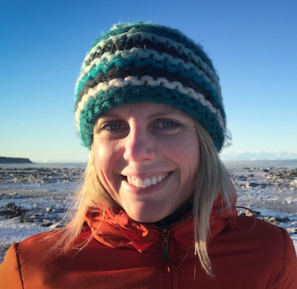
CLIMATE CHANGE TASK FORCE Climate Readiness Synthesis
October 2022
CCTF Members:
Co-chair: Diana Stram (NPMFC): diana.stram@noaa.gov
Co-chair: Kirstin Holsman (NMFS- AFSC) : kirstin.holsman@noaa.gov
Lauren Divine (Aleut Community of Saint Paul Island)
Scott Goodman (Natural Resources Consultants/BS Fisheries Res. Foundation)
Jason Gasper (NMFS-Regional Office)
Mike LeVine (Ocean Conservancy)
Steve Martell (SeaState)
Brenden Raymond-Yakoubian (Sandhill Culture Craft)
Jeremy Sterling (AFSC Marine Mammal Lab)
Todd Loomis (Ocean Peace, Inc.)

Slide 2
  The goal of the Climate Change Module is to facilitate the Council’s work towards climate-ready fisheries management that helps ensure both short- and long-term resilience for the Bering Sea.
Notes:
The goal of the climate change module is to facilitate and support equitable climate change adaptation pathways and long-term resilience for the coupled social-ecological system of the Eastern Bering Sea (see geographic description in the FEP [ add link] ) . This module will support the capacity to i) evaluate management tools to develop incremental (normative) adaptation measures to preserve livelihoods, health and wellbeing across fisheries and dependent coastal communities, and, ii) enable transformative adaptation needed to ensure the productivity and sustainability of the coupled social-ecological Bering Sea system. To achieve this, the climate change module will be used to synthesize current knowledge regarding climate change effects on the EBS system, identify potential climate-resilient management measures that can improve adaptive capacity and avoid maladaptation (Figure 1), evaluate the risks, timescales, and probability of success of various climate-resilient management policies under future scenarios of change; and provide prioritized recommendations for actions that could be taken to advance the goals and minimize the risks identified.

Slide 3
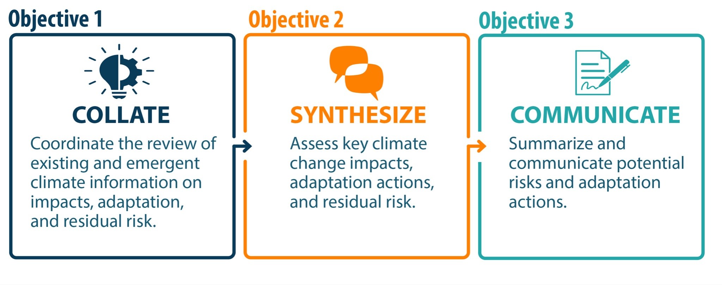
Overall CCTF objectives
Objective 1. Collate:
Evaluate the mechanisms and processes through which climate change information is currently included in the fishery management process, identify gaps, and help create opportunities to increase the inclusion of available information
Objective 2. Synthesize:
Synthesize information about long-term climate change impacts and scenarios and help create pathways for inclusion of that information in the fishery management process.
Objective 3. Communicate:
Identify potential management tools and actions for consideration by the Council that could help increase resilience and adaptation to climate change impacts

Slide 4
Overall CCTF objectives
Objective 1. Collate:
Evaluate the mechanisms and processes through which climate change information is currently included in the fishery management process, identify gaps, and help create opportunities to increase the inclusion of available information
Objective 2. Synthesize:
Synthesize information about long-term climate change impacts and scenarios and help create pathways for inclusion of that information in the fishery management process.
Objective 3. Communicate:
Identify potential management tools and actions for consideration by the Council that could help increase resilience and adaptation to climate change impacts

Slide 5
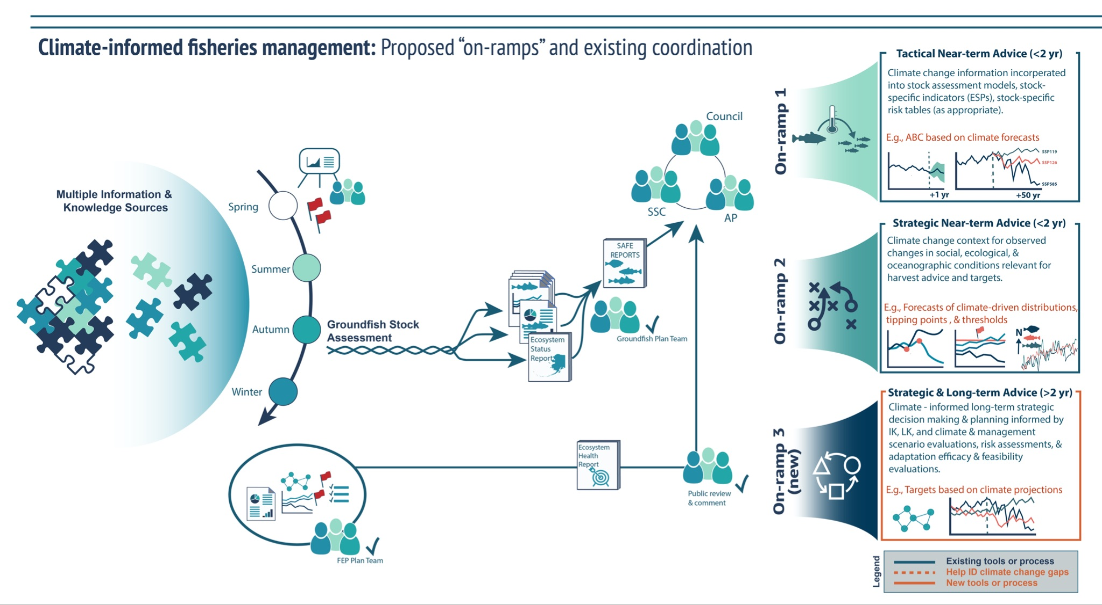

Slide 6
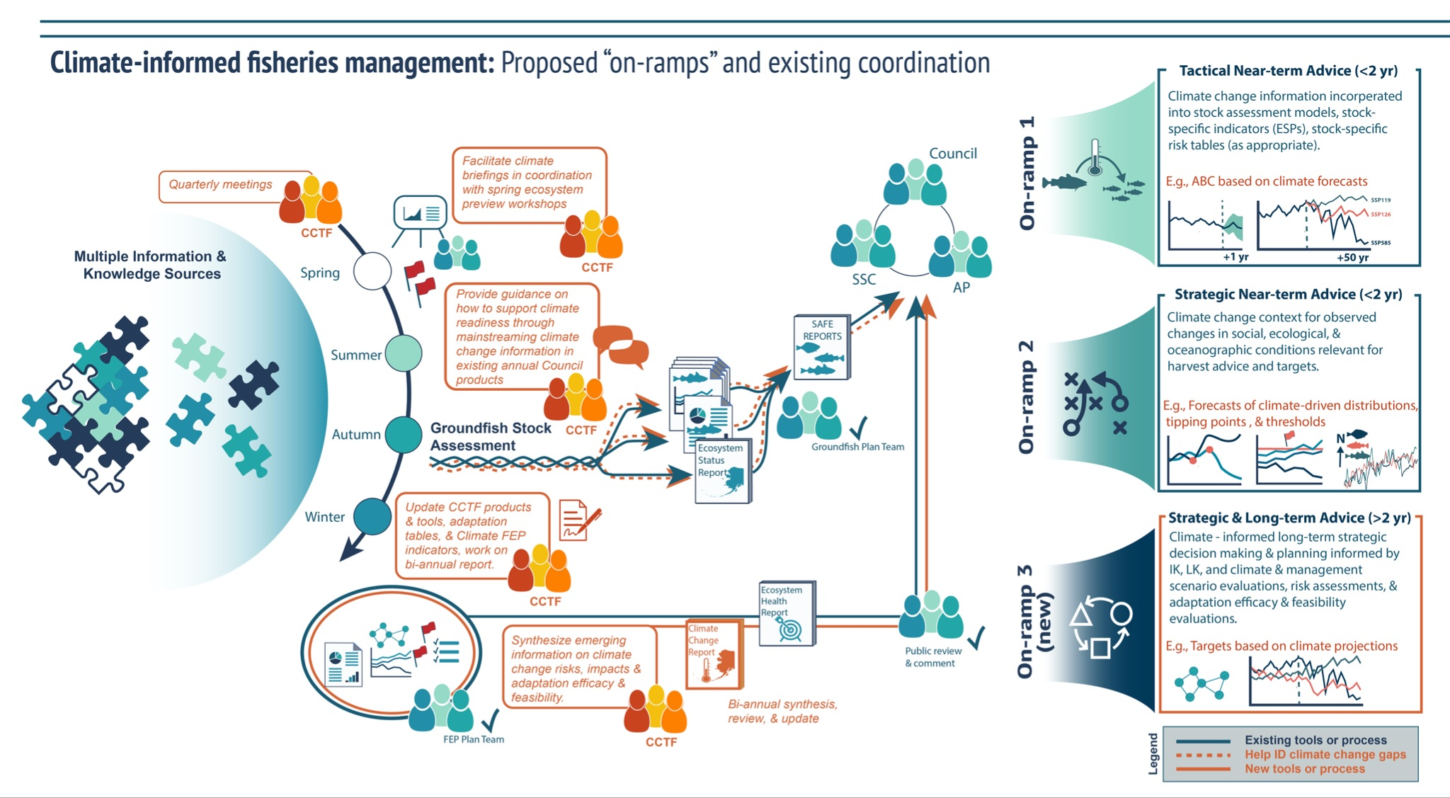

Slide 7
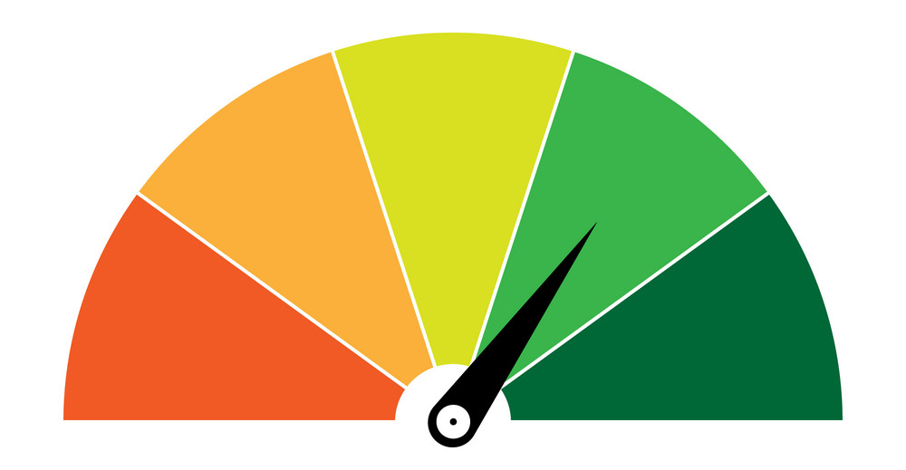
Climate Readiness Synthesis (2022)
Assessment of climate change readiness
& near term actions to increase readiness
Climate Readiness
Synthesis
2022
Climate Change Report

Slide 8
Climate Readiness Synthesis (2022)
Assessment of climate change readiness
& near term actions to increase readiness
Section 3: Knowledge & Information
Climate Readiness
Synthesis
2022
Section 2: SAFE reports & PT mins
Section 1: Management Process

Slide 9
Climate Readiness Synthesis

Slide 10
Management Overview ranking

Slide 11
Management Overview ranking

Slide 12
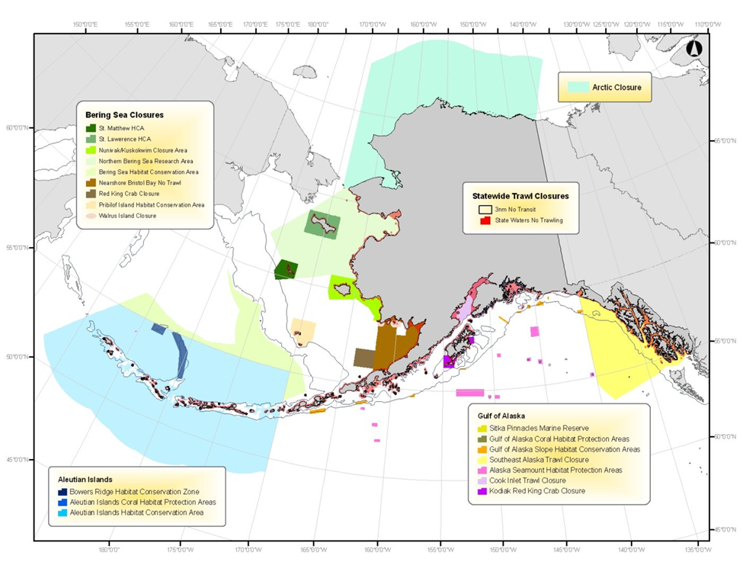
Case Studies (Management)
Table 1.2 more examples
Herring Savings Area
Red king crab savings area
Northern Bering Sea Research Area

Slide 13
1.6.1 Near-term considerations
Evaluate the effectiveness of feasibility of measures that increase flexibility in current and future Council- defined management actions and which may allow for rapid responses to change
  Seasonal flexibility in allocations, quota programs
  Transferability amongst sectors and seasons
Explore measures that support appropriate and timely response mechanisms in management
  More rapid response in some circumstances while others may exhibit longer-term stability and/or flexibility in response timing
Development of metrics to evaluate climate resilience in management measures
  Improved integration of fishery dependent information with fishery independent information (e.g., habitat, oceanographic, survey, climate model outputs, stock dynamics) and coordination amongst data providers
Explore the performance of, and feasibility to implement, spatial and temporal dynamic management measures through case studies (like those identified in this section)
Evaluate / re-evaluate OY cap performance under climate change and alternative sub-designs (e.g, proportional caps, dynamic as function of climate indices) below the 2MT to ensure this measure continues to impart stability and productivity benefits under future change.
Identify enabling factors to support industry led measures to increase rapid adaptation, reduce impacts, and respond to climate driven changes (e.g., communication and near-real time information sharing).

Slide 14
SAFE Report Ranking

Slide 15
SAFE Report Ranking

Slide 16
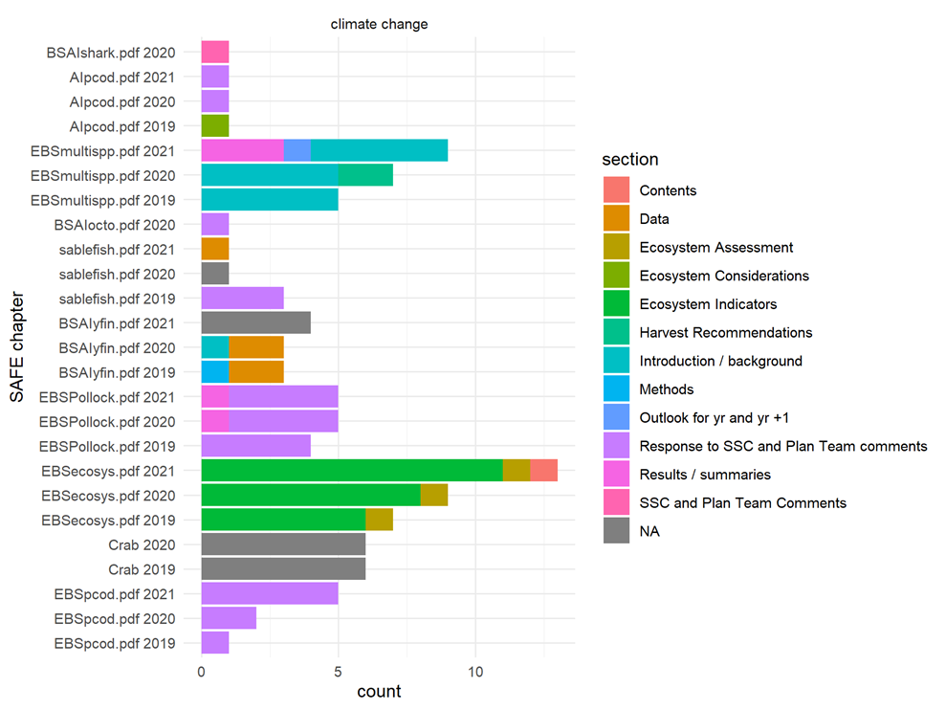
Figure 2-1

Slide 17
Near term on ramps:

Slide 18
Knowledge base Ranking

Slide 19
Knowledge base Ranking

Slide 20
Table 3-2 subsection ranking

Slide 21
Near term steps:
Provide input into the Research Priority setting process foregrounding the importance of diverse sources of climate information and their relationship to climate-ready fisheries science and management
Test mechanisms within the CCTF (e.g., Climate Briefings, Ecosystem Matrix tool, etc.) for bringing diverse knowledge sources related to climate change into the Council process
Finalize and implement LKTKS Taskforce protocol regarding incorporation of LK, TK, and subsistence information into the Council process
Track and consider climate change information and implications in light of recommended evaluations (as suggested by the Ecosystem Committee in March 2022) of the Programmatic EIS
Scope development of Fishery Ecosystem Plans in other regions for connectivity issues (e.g., Gulf of Alaska, Arctic), as discussed at the March 2022 meeting of the Ecosystem Committee
Increased development and implementation of EBFM tools across Council processes
Work on marine planning and protections that are equitable and inclusive of a diverse set of communities, people, knowledges, methodologies, and values
Implement a number of the CEC Final Report (NPFMC 2021) recommendations which could increase the flow of diverse sources of climate change information (including resilience tools) into the Council process. This includes:
  Co-presentation from Tribal representatives on all agenda items
  Standing Community Engagement or Tribal Advisory Committee
  Increase the input of Tribal Consultation activities into the Council process
  Council travel to rural communities for Council meetings and visits
  Continuation and ongoing improvement of current outreach practices to foster two-way engagement
  Taking steps towards Co-Production of Knowledge
  Increased capacity at AFSC in the non-economic social sciences, particularly as regards expertise working with Alaska Native communities and their knowledge
  Increased Indigenous inclusion on Council advisory and working bodies
Increased uptake of broader climate change knowledge base not, or not fully, integrated into the Council process through additional steps not indicated above in other bullets, e.g., through exploring collaborations, partnerships and co-production (also see Section 2 for near-term steps to advance climate integrated advice)
Conduct an analysis of Council documents as outlined above to explore whether and how the climate-relevant information from a variety of ‘other’ knowledge bases are currently making their way into the Council process in order to facilitate a gap analysis and recommendations for improvement, as necessary

Slide 22
Work Plan 2022-2023[priorities]
Address Council comments on CRS [Oct -Nov]
  finalize and post to Council website (glossy version for posting and cross-referencing)[Dec 2022]
Consider means to incorporate additional knowledge sources into Council research priorities [Feb]
Case study development (based on those explored in the CRS, e.g., herring closure area, 2 million MT cap, etc)
  Use these to populate and build out the climate readiness toolbox (online database of climate informed measures)
Scope resources to support post-doc/contractor(s) to advance CCTF and Council (climate) products (funding, fellowships, NOAA LANTERN, etc).

Slide 23
Work Plan (cont)
Use scenario planning workshops to help build out climate readiness measures
  Present case studies at scenario workshop
  Develop metrics for effectiveness at addressing climate change risk / adaptation
  Develop recommendations to address knowledge gaps and inform research ideas [Feb]
Potential management tools and measures that could be used to address climate change (using case studies to further develop these)
Using the rapid climate change search term methods from section 2 to conduct an analysis of Council documents to explore whether and how the climate-relevant information from a variety of ‘other’ knowledge bases are currently making their way into the Council process in order to facilitate a gap analysis and recommendations for improvement, as necessary.
Repeat rapid climate change search term review for 2022 SAFE reports (presently completed 2019-2021)
Assess whether CCTF proposed Climate Briefings as originally conceived still has merit or is duplicative of other activities and/or needs refinement [Jan-Mar 2023]
Scope information needs for the climate change report (see next bullet)
  Use case studies from bullet 2 to scope tools and information needs for the report[Diana, Kirstin]
  From Section 2 - optional author self-evaluation/review form of what information is needed to move individual safe chapters forward in readiness (and help scope information needs for the climate change report)[Jan-Mar 2023]
Outline Climate Readiness Report for input by FEP Team review, Ecosystem Committee, Council bodies [TBD 2023]

Slide 24
Summary and next steps
The CCTF has made considerable progress and the CCTF workplan is often referenced and cited at national meetings and workshops as an example of how to build a process to incorporate climate change information into management.
The Climate Readiness Synthesis Report represents a major milestone and is the first of its kind for fisheries management/Councils.
Lessons learned from the CRS and workplan activities is that the CRS, multiple tasks listed, as well as future steps 2 and 3 including the full Climate Change report, would advance faster with 1-2 people (post-doc or contractor) to help build out, finalize, and support workshops and work sessions to move products forward in an accelerated time frame
Going forward: workshops and worksessions to implement "near-term" options outlined in the CRS report; possibly update CRS next year at this time.
Drafting begins for the longer Climate Change Report
Virtual check-in by email quarterly; virtual review and feedback process
Meet bi-annually in work sessions to finalize and review the work from the contractors/post-doc
Present products to the Council annually

Slide 25
Thank you!!!

