Slide 1
2025 GOA Restratification: SSC Meeting
Zack Oyafuso, Lewis Barnett, Margaret Siple, Ned Laman, Stan Kotwicki
NOAA-AFSC-GAP
February 6, 2023

Slide 2
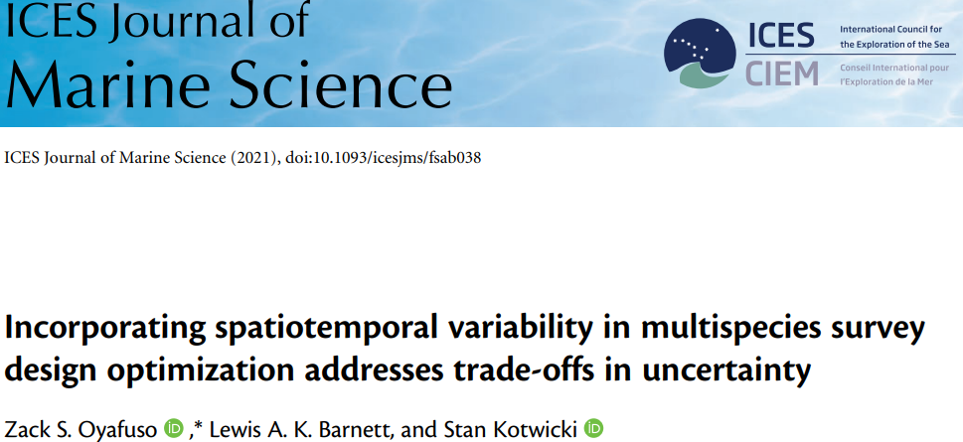
Timeline
December 2019: research on alternative survey designs in the GOA
2021: ICES JMS paper on the methods used to optimize a STRS design for GOA BTS
September 2021: presentation to the GOA Plan Team on methodology, ICES paper
2022: Tech Memo published on the comparison of the proposed STRS designs versus the historical STRS design
December 2022: communication of the effects of restratification on Oracle data tables to stock assessment

Slide 3
Timeline
December 2019: research on alternative survey designs in the GOA
2021: ICES JMS paper on the methods used to optimize a STRS design for GOA BTS
September 2020/2021: presentation to the GOA Plan Team on methodology, ICES paper
2022: Tech Memo published on the comparison of the proposed STRS designs versus the historical STRS design
December 2022: communication of the effects of restratification on Oracle data tables to stock assessment

Slide 4
Timeline (cont.)
December 2022: communication of the effects of restratification on Oracle data tables to stock assessment
Spring 2023: stock assessment will test out changes to the Oracle data tables given a “new” year of data under the 2025 restratification
Summer 2023: final year of the GOA BTS conducted under the historical STRS design
Summer 2025: GOA BTS conducted under re-STRS design

Slide 5
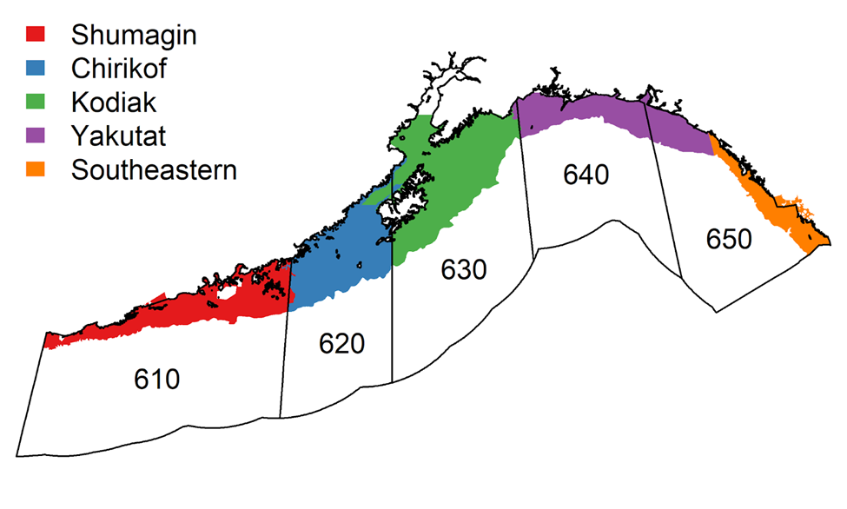
Summary of Restratification
 | Historical Strata (1984-2023) | 2025 Restratification (2025-on)
Stratum variables | INPFC areas Depth Terrain (shelf, gully, slope) | NMFS Statistical Areas Depth *Depth bins are allowed to differ among NMFS areas.
Total strata | 59 strata (54 strata when survey extends to 700 m) | 30 strata (25 strata when survey extends to 700 m)
INPFC areas (colors) with NMFS areas superimposed

Slide 6
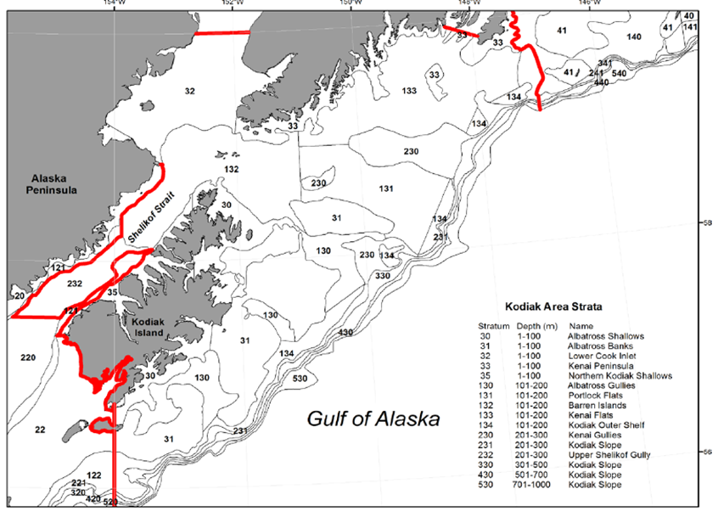
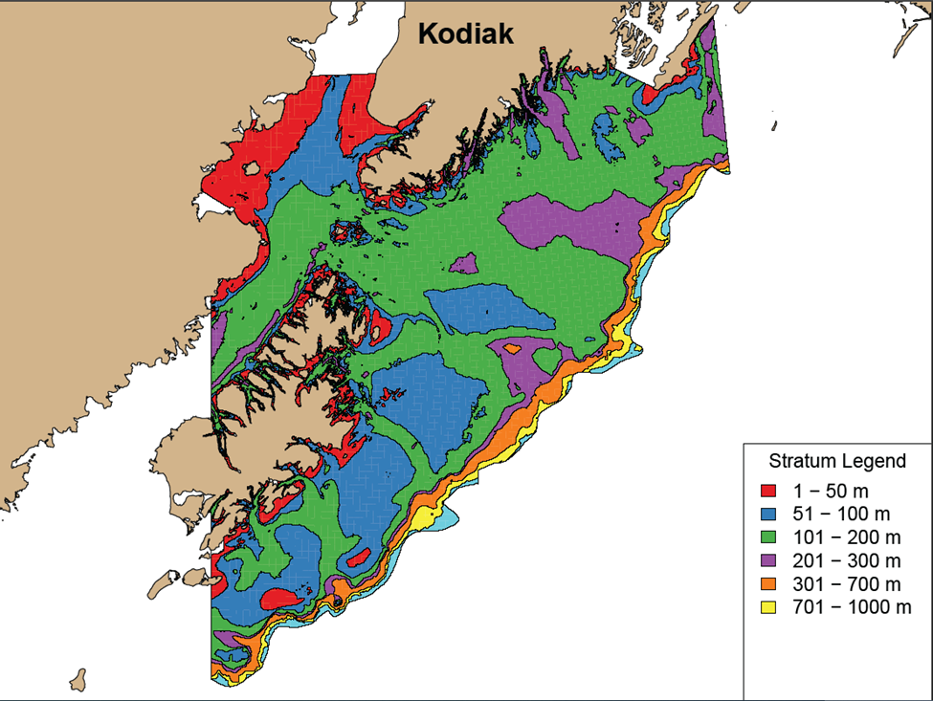
Example: Kodiak Management Area
Historical Stratification (1984-2023)
2025 Restratification

Slide 7
Summary of Restratification
 | Historical Strata (1984-2023) | 2025 Restratification (2025-on)
Stratum variables | INPFC areas (Figure 1); Depth bins (e.g., 1-100 m, 101-200 m); terrain (shelf/gully/slope) | NMFS areas (Figure 2); Depth Depth bins are allowed to differ among NMFS areas.
Total strata | 59 strata (54 strata when survey only extends to 700 m) | 30 strata (25 strata when survey only extends to 700 m)
Allocation criteria | Neyman allocation: stratum area, stratum variance, tow cost Species weighting: biomass and ex-vessel value | Bethel algorithm: stratum area, stratum variance Minimizes CV across species set for a given total sample size

Slide 8
Requested Feedback
Are the NMFS statistical areas (610, 620, 630, 640, 650) the relevant areas to use when implementing the new stratification?
Comments on the GOA restratification process?

