Slide 1
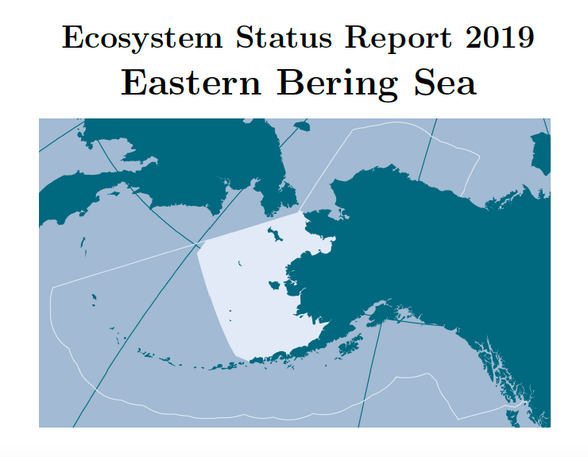





Distinguishing ESR, ESP, SEE
Ecosystem Health
Report Card
 | ESR | ESP | Strategic Ecosystem Evaluation
Purpose | Tactical - harvest specs | Tactical - harvest specs | Strategic
When issued | Oct-Dec | Oct-Dec | April every 3 yrs
Scope | Aggregated - Indicators that pertain to many stocks at once | Species/Stock-specific - we believe these have an impact on this specific stock | Aggregated - Synthesizing across ecosystem area /activities
Spatial | Large Marine Ecosystem (EBS, GOA, AI) | Large Marine Ecosystem/ FMP (EBS, GOA, AI) | LME -- Basin-scale
Temporal scope | Annual | Mixed | Bi or Triennial / longer term

Slide 2
Fisheries effects on the ecosystem??
Cumulative, multi-species effects (synthesis needed)
Informs management strategy, not tactical management decisions
Diversity of audiences
Monitors success of EBFM management actions (progress towards goals and objectives)
Without overwhelming

Slide 3
So where is our report starting point?
Focus of FEP is strategic
  Strategic versus Tactical advice led to development of this new product to deliver longer-term strategic advice rather than the near-term tactical advice contained in the ESRs.
  Purpose in FEP: to allow fishery management to more explicitly take into account and be responsive to changes in the ecosystem
Six ecosystem goals are overarching; FEP associates them with one or more strategic Ecosystem Objectives
May 3 2021 workshop recommendation: Organize report by six goals, and objectives under those goals. Subteams at workshop brainstormed initial data sources/resources.

Slide 4
Progress by Objective
Ecosystem Goal 1: Maintain, rebuild, and restore fish stocks at levels sufficient to protect, maintain, and restore food web structure and function
Ecosystem Goal 2: Protect, restore, and maintain the ecological processes, trophic levels, diversity, and overall productive capacity of the system
Objectives measurable by "more familiar" fisheries and ecological data.
Much of the raw data already gathered/reported by stock assessments, ESRs, and ESPs.
Desired indicators conducive to time series format (similar to ESRs).
May have different formats/analysis for "tactical" (SAs, ESRs, ESPs) versus "strategic" (SEE).
Many indicators already gathered/data assembled by team.
Categorizing of data sources including time and space scales began at March meeting.
Data shortlist by ~May 2022 to produce draft report by Sept 2022.

Slide 5
Progress by Objective
Ecosystem Goal 3: Conserve habitats for fish and other wildlife
Ecosystem Goal 4: Provide for subsistence, commercial, recreational, and non-consumptive uses of the marine environment
Requires more data discussion/availability.
Requires more consultation with data providers not at the Plan Team table.
More spatial considerations outside time series format.
Using Goal 1-2 work as an example, reach out to providers/determine. candidate indicators and needed expertise by Sept 2022 (data gathering and reporting to proceed after that).

Slide 6
Progress by Objective
Ecosystem Goal 5: Avoid irreversible or long-term adverse effects on fishery resources and the marine environment
Ecosystem Goal 6: Provide a legacy of healthy ecosystems for future generations
Active collaboration with CCTF.
May affect interpretation of Goal 1-4 indicators as well as suggesting goal-specific indicators.
Similar timeline to Goal 3-4 report sections.

Slide 7
Goal 1-2 working plan
Steps by May 2022
  List potential indicators for each goal (expansive shortlist)
  Get current or recent data/check data availability
  Summarize individual indicators and reason for inclusion
Steps after May 2022 check-in
  Review shortlist - anything missing (including Council body/stakeholder)
  Graphical/statistical synthesis (time range, etc.)
  Final indicator recommendations from Plan teams for broader review ~Sept 2022
  Final report draft goals 1-2 section ~Sept 2022

