Slide 1



IFQ Sablefish release Allowance
Enforcement Committee
Jan 28, 2021
Jim Armstrong, Council Staff
Joe Krieger, PhD, NMFS-AKRO

Slide 2
Alternatives
Alternative 1, No Action
Alternative 2, Voluntary Release by IFQ Fishery
  Element 1: DMRs:
    5%, 12%, 16%, 20%
    Sub-option: Different DMRs for pot, hook and line gear
  Element 2: Catch Accounting
    Option 1: Observer/EM
    Option 2: Longline survey catches of sub-three pound sablefish
  Element 3: Discard Mortality Accounting - Discard mortality accounted for in the stock assessment.
  Element 4: Monitoring and Enforcement - Provisions that could improve discard estimates

Slide 3
Affected Regulations
…, it is unlawful for any person to do any of the following:
50 CFR 679.7(d)(4)(ii)
  (ii) Fixed gear sablefish. For any person on a vessel using fixed gear that is fishing for a CDQ group with an allocation of fixed gear sablefish CDQ, to discard sablefish harvested with fixed gear unless retention of sablefish is not authorized under § 679.23(e)(4)(ii) or, in waters within the State of Alaska, discard is required by laws of the State of Alaska.
50 CFR 679.7(f)(11)
  (11) Discard halibut or sablefish caught with fixed gear from any catcher vessel when any IFQ permit holder aboard holds unused halibut or sablefish IFQ for that vessel category and the IFQ regulatory area in which the vessel is operating, unless:
    (i) Discard of halibut is required as prescribed in the annual management measures published in the Federal Register pursuant to § 300.62 of chapter III of this title;
    (ii) Discard of sablefish is required under § 679.20 or, in waters within the State of Alaska, discard of sablefish is required under laws of the State of Alaska; or
    (iii) Discard of halibut or sablefish is required under other provisions.

Slide 4
Affected Regulations
50 CFR 679.21(a)(2)(ii)
  …, return all prohibited species, or parts thereof, to the sea immediately, with a minimum of injury, regardless of its condition.
Enforcement of careful release expected to be simpler than enforcement of a minimum size limit

Slide 5
Existing Enforcement Actions
Enforce NMFS regulations
Observer issues
Random dock side inspections
  Logbook review
  Random spot checks of the gear
  Limited at-sea boarding
    Coordination with USCG, Troopers

Slide 6
Existing Enforcement Actions
Enforce NMFS regulations
Observer issues
Random dock side inspections
  Logbook review
  Random spot checks of the gear
  Limited at-sea boarding
    Coordination with USCG, Troopers

Slide 7
NMFS
Management and Enforcement
Management Considerations
  NMFS has concerns about inability to accurately estimate discards.
  NMFS is developing techniques that could help but work is still on-going.
Enforcement Considerations
  Extension of careful release requirements.
  No substantive enforcement concerns related to this action.
Notes:
Looking at management considerations under Alternative two.
As outlined in Section 2 of the document, the chief concerns of this action from a management perspective involve the inability to accurately estimate annual variability in number, size, and composition of discarded sablefish and the resulting impact on the sablefish stock assessment. In that section of the document which begins on page 146, we provide some high level summaries of these concerns.
After conversations with NMFS leadership both at the Alaska Region and the Alaska Fisheries Science Center, there was general concern about any resulting action that would allow vessels to discard sablefish if appropriate estimates of the size, number, and composition of the discarded catch cannot be obtained. This analysis describes in detail that the agency is not currently equipped to collect the necessary information to accurately estimate sablefish discards in the sablefish IFQ fishery. Furthermore, this analysis also explicitly describes possible negative consequences that poorly informed discard estimates could have on the sablefish stock and the resulting fishery.
While the agency is in the process of developing techniques and methodologies that might help to address some of these concerns, this work is still in progress and is still some years away.
Looking at enforcement considerations under Alternative two.
This action item was presented to the enforcement committee ahead of this Council meeting. The enforcement committee did not raise any substantive enforcement concerns,
Would require modifying regulations around the careful release of discarded sablefish . This resulting in changes to at-sea enforcement operations which would only involve observing fishery operations and ensuring that discarded sablefish are returned to the sea immediately, with a minimum of injury.

Slide 8
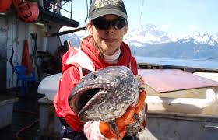
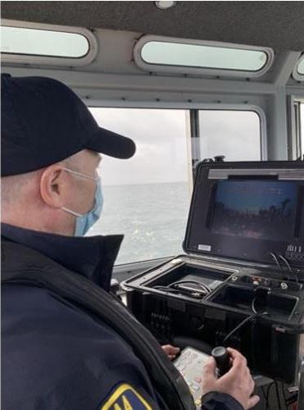
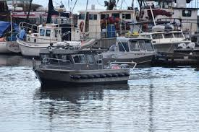
Questions?

