Slide 1
Research priorities:
Plan team information
What is the Plan Team role & reference information
Nicole Watson, Ph.D. | NPFMC Staff
nicole.watson@noaa.gov

Slide 2
Plan Team Role
Research Priorities
Plan Teams will review the submitted research priorities, listen to public comment, and then rank their top research priorities.
The SSC is asking for a top 3-5 research priority list from each Plan Team
Each PT can provide an additional list of what they see as “other important research priorities” that did not make the top 3-5 list but still see as priorities

Slide 3
Plan team member preparation to do before PT research priority meeting
Review the Excel sheet of the existing research priorities related to your associated Plan Team (it will be provided to you).
Review the Excel sheet of new submission research priorities related to your associated Plan Team.
  This will be provided to you either separately or included in the existing research priority Excel sheet described in the first bullet.
Use the Google Form if you wish to submit a new research priority idea of your own.
  The deadline to submit your own idea will be provided by your Plan Team leadership.
Each team member should consider the list of existing priorities, any new submissions from the public, and any submissions from themselves and identify their top 3-5 research priorities.
  Write down (or highlight) the ResearchID # for new and existing research priorities as this will be used in the voting process.
  These may change during the meeting, but it will be an important starting place for discussion.

Slide 4
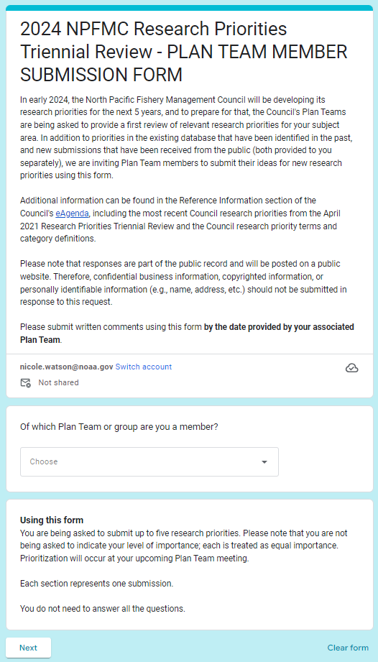
Submitting a PT member new priority idea using the Google Form
Be sure to select which PT you are submitting using this drop-down.
  This will ensure your submission is filtered to the correct Plan Team for review.
You are not being asked to indicate your level of importance at this time; each will be treated as equal importance.
  Prioritization will occur at your Research Priority plan team meeting.

Slide 5
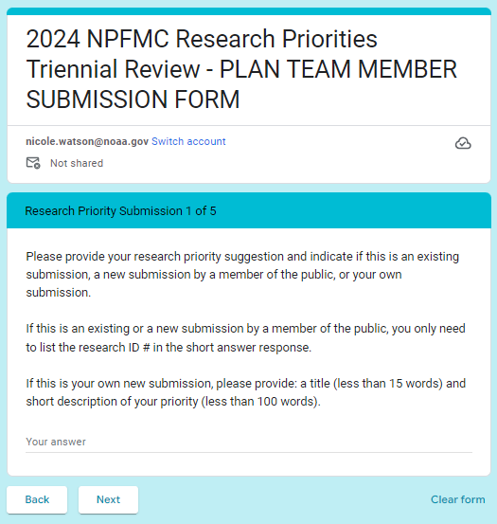
This section will appear five times (one for each potential choice of your top 3-5 priorities). You do not need to fill in each section and can skip ahead.
When you have proceeded to the section “Research Priority Submission 5 of 5” the “Next” button will change to “Submit”.
  Click “Submit” to finish your submission

Slide 6
At the research priorities
Plan Team meeting
Part 1: Discussion
Discuss adding any of the new submissions to the database of research priorities.
Any discussion of existing priorities (e.g., categories, description, etc.).
Discuss and review your choice for the top 3-5.
Public testimony: hoping to focus the public to help us prioritize (rather than adding new ideas at this point)
Take a break: members submit their final top 3-5 to staff for rank-choice voting
Part 2: Voting
Rounds of rank choice voting to get to our top 3-5 to submit to the SSC
  10-12 can be specified as priorities seen as important to the Plan Team, but need to identify the top 3-5 for SSC review.

Slide 7
Background information and additional resources
NPFMC Research Priorities webpage
Research Priorities eAgenda
2024 Research Priorities Triennial Review background document
The SSC proposed process for the 2024 research priorities review
The 2021 NPFMC list of top research priorities
The NPFMC research priority category terms and definitions
Link to the NPFMC research priorities database.
Link to the Google submission form

Slide 8
Background:
Purpose of RESEARCH PRIORITIES
Magnuson-Stevens Act requires Councils to identify 5-year research priorities for fisheries, fisheries interactions, habitat and other areas of research that are necessary for management purposes
Research priorities are selected based on how well they align with or inform management for the federal fisheries the Council manages
Final SSC and Council review will occur at the April 2024 meeting

Slide 9
Background:
Purpose of RESEARCH PRIORITIES
After final review, the updated research priorities are provided to:
  Secretary of Commerce
  Alaska Fishery Science Center
  Research and funding entities such as North Pacific Research Board, University of Alaska, University of Washington, Oregon State University, Alaska Department of Fish and Game, Alaska Ocean Observing System
Council has moved to a system of identifying 5-year priorities on a triennial basis
  Last review was in 2021

Slide 10
Background:
NPFMC Research PRIORITY Categories
Critical ongoing monitoring
  Information provided by monitoring activities in this category (1) provide an essential management function; (2) cannot likely be acquired through other means; or (3) are required by regulation. (e.g., agency fish surveys, socioeconomic data collections)
Urgent
  Research that is essential for compliance with federal requirements, including National Standards, or that has been identified by management as necessary to aid decision-making. It is expected that a one or two year project would meet the information need. Postponement would have a significant impact on management. (e.g., genetic analyses to resolve stock delineation questions for harvest specifications, fishery interaction studies to provide important input for Biological Opinions or NEPA analyses)
Important (near term)
  Obtaining a new set of data or research result that is likely to aid in the evaluation of a near term or ongoing management goal. The research might involve a time-limited program or work that could continue indefinitely. Postponement will not have an immediate impact on fishery management; however, the information generated will likely inform near term (e.g., <5 year) Council actions. (e.g., studies to improve stock assessment parameters, gear research to reduce bycatch, MSEs, social science surveys to inform new rationalization programs)
Strategic (future needs)
  Research that is valuable but is not associated with an immediate need or near-term (e.g., <5years) Council action. (e.g. long-term climate change studies, ichthyoplankton surveys that have not yet been linked to a stock assessment, monitoring contaminant levels in living marine resources)

Slide 11
Background:
SSC Plan for RESEARCH PRIORITIES 2024
Builds on existing process:
  Plan Teams as initial filter of research priorities – both of comprehensive list (database) plus top immediate priorities
  SSC amalgamates all inputs and identifies top 8-12 priorities
  Council considers and adopts final SSC recommendation
Adds new defined pathway for public input
    Opportunity to suggest new research priorities through online public solicitation period, open July to October 31, 2023
    Opportunity to comment on which projects are prioritized at Plan Team review meetings scheduled Nov-Jan, and SSC in February

Slide 12
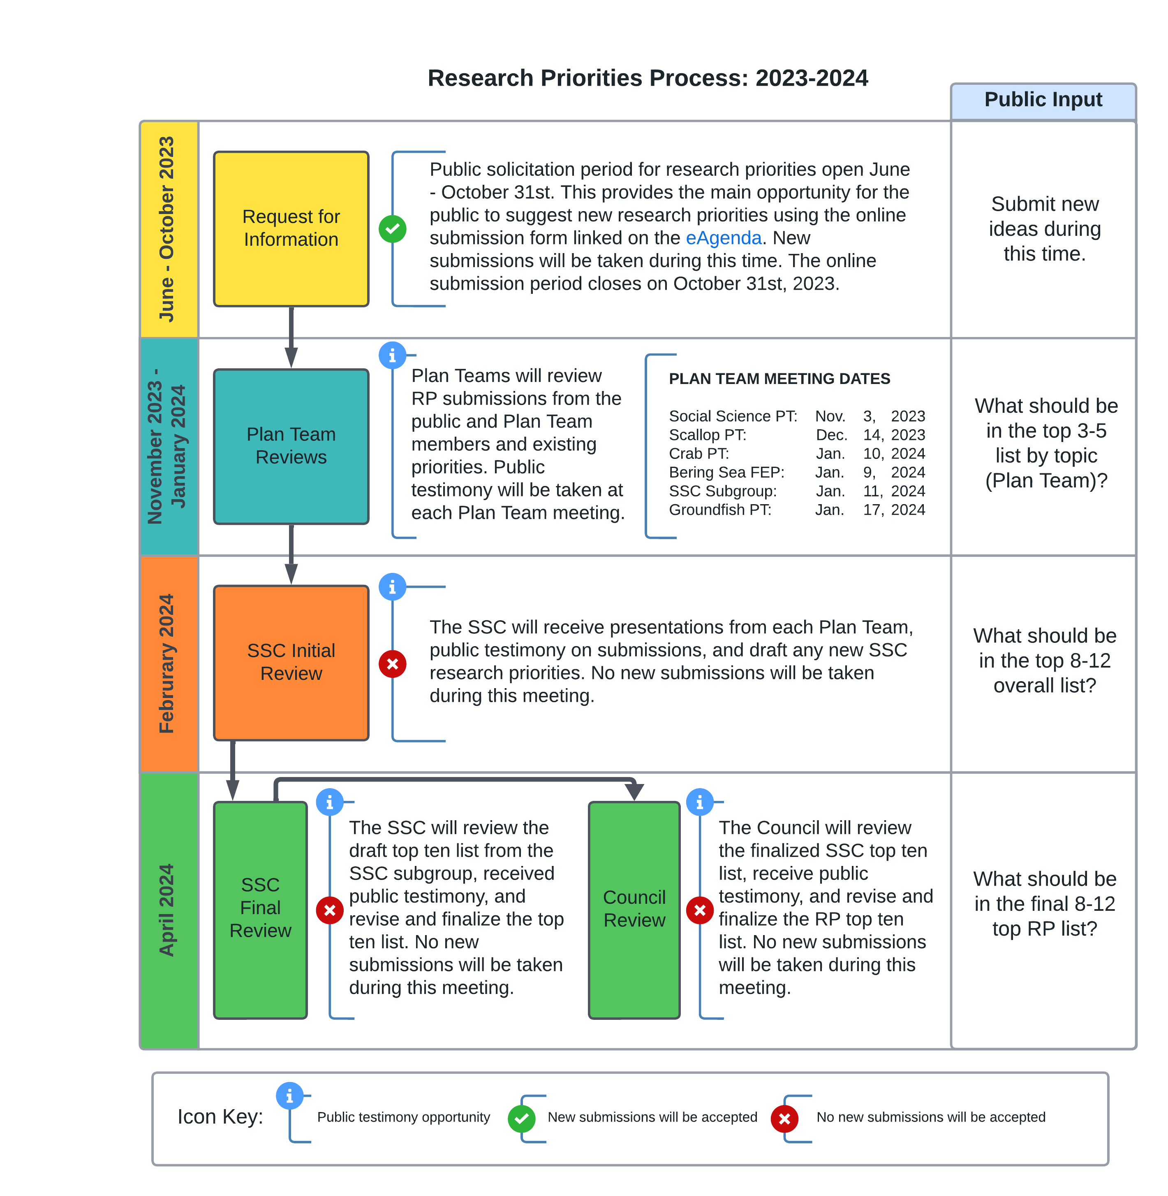

Slide 13
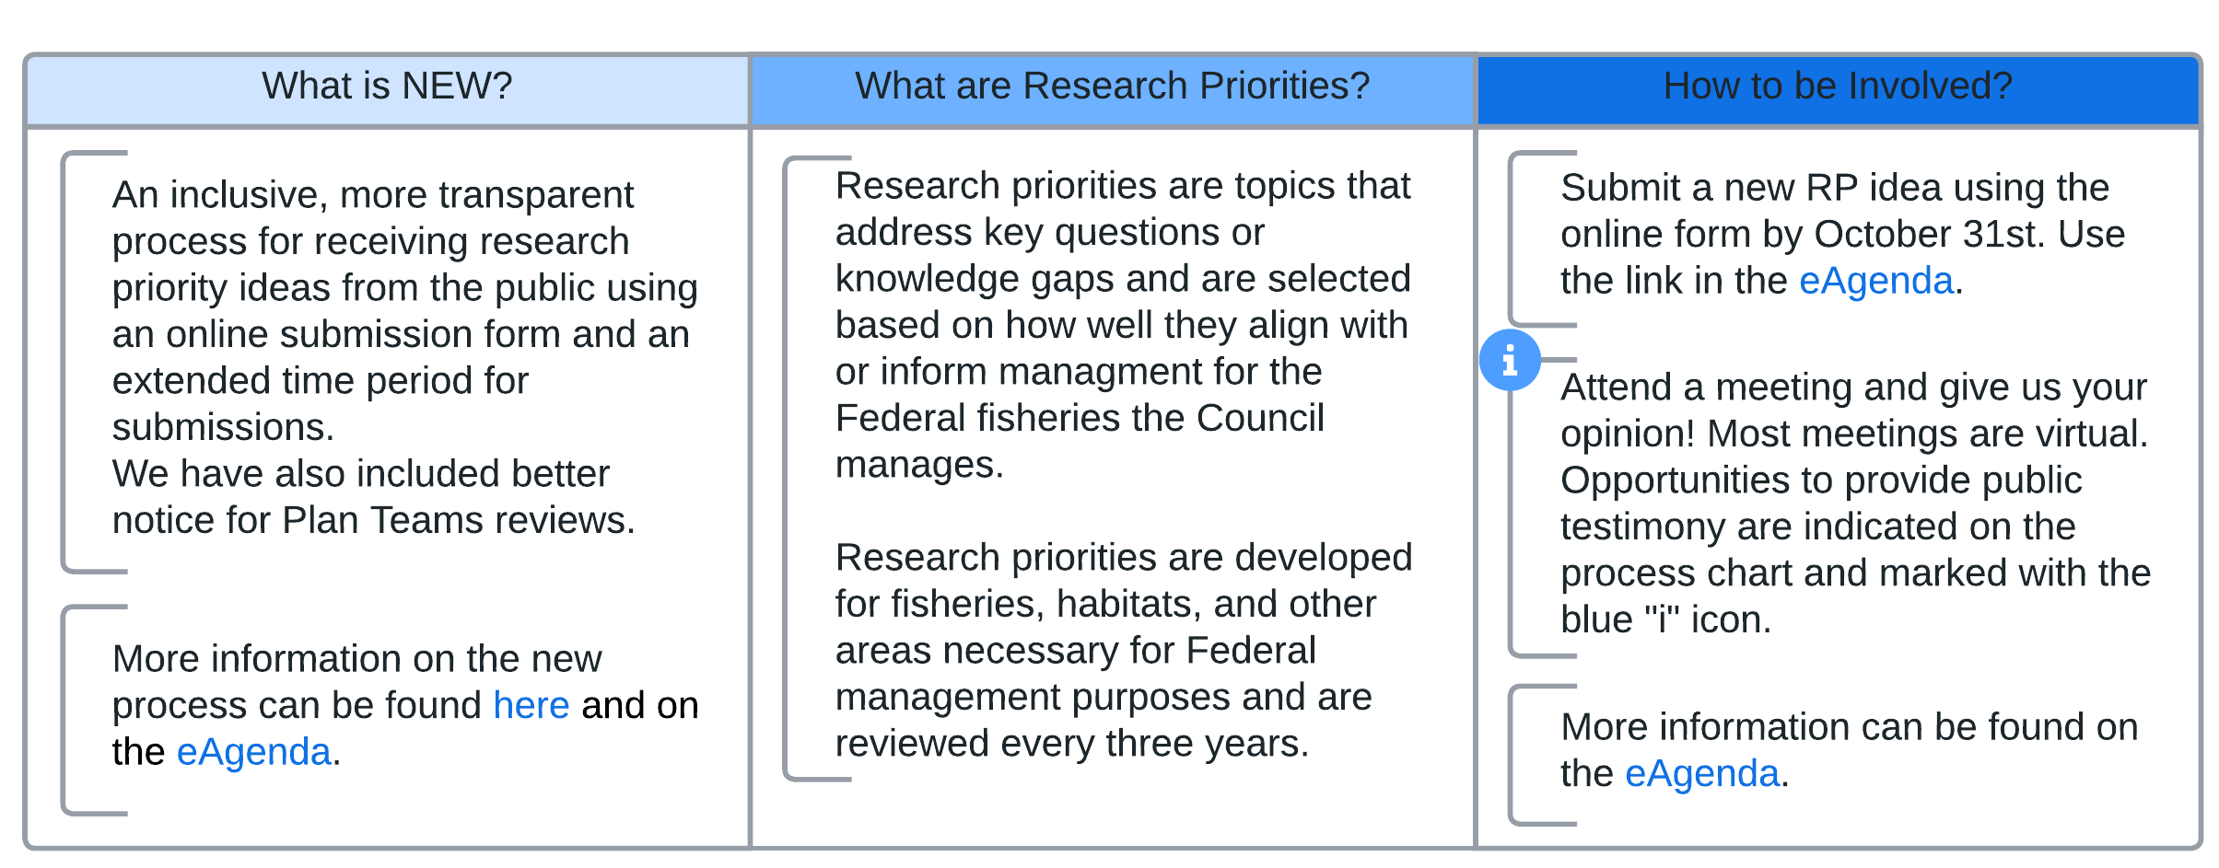
2023-2024 RP Process: Additional background
Public Input

